Slide 1
XIXth Workshop on High Energy Spin Physics
NIСA facilities (Collider+Nuclotron) for the search for EDM light nuclei
Ю.В. СЕНИЧЕВ^{1,5}, А.Е.АКСЕНТЬЕВ^{1,4,5}, С.Д. КОЛОКОЛЬЧИКОВ^{1,5}, В.П.ЛАДЫГИН²,
А.А.МЕЛЬНИКОВ^{1,3}, Н.Н. НИКОЛАЕВ^{3,5}, Е.М. СЫРЕСИН²
¹Институт Ядерных Исследований РАН, Москва
²Объединенный Институт Ядерных Исследований, Дубна
³Институт теоретической физики Ландау, Черноголовка
⁴МИФИ НИЯУ, Москва,
⁵МФТИ, Долгопрудный
Notes:
ЛаПлаз 2023

Slide 2
First message to search for Electric Dipole Moments(EDM) of fundamental particles: it came to understand the CP violation
Second message for Electric Dipole Moments of fundamental particles: the baryon asymmetry of the Universe that represents the fact of the prevalence of matter over antimatter
In 1967 A.Sakharov has shown three necessary conditions for baryogenesis (initial creation of baryons)
Baryon number violation;
CP-symmetry violation;
Interactions out of thermal equilibrium
The analysis done by the AD Sakharov, showed that this CP-violation is absolutely necessary to explain why on earth and in the visible universe there is a MATTER, but there is practically no ANTIMATTER.

Slide 3
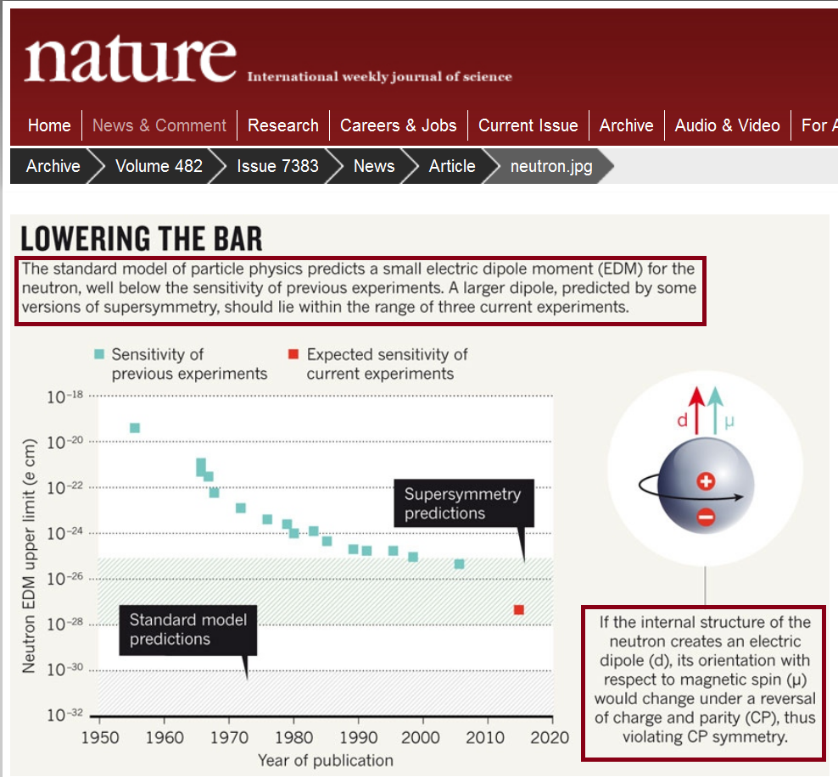
Current results for neutron:

Slide 4
How are we going to measure for EDM searching for EDM
In accordance of the Ehrenfest theorem, which states “in quantum mechanics, the average values of the coordinates and momenta of a particle, as well as the forces acting on it, are interconnected by equations similar to the corresponding equations of classical mechanics ".
In particular, “spin” means the average value of the quantum mechanical spin operator.

Slide 5
Basic principle of EDM measurement in ring comes from “Tomas-Bargmann, Michel, Telegdi” equation with EDM term
The spin is a quantum value, but in the classical physics representation the “spin” means an expectation value of a quantum mechanical spin operator:
EDM

Slide 6

Frozen spin method for purely electrostatic proton ring at “magic” energy
In the method the beam is injected in the electrostatic ring with the spin directed along momentum S║p and S┴E; S={0,0,S_{z}} and E={E_{x},0,0}
at “magic” energy :
$$\frac{d\overset{→}{S}}{dt}=\overset{→}{Ω}×\overset{→}{S} \\ \vec{Ω}=−\frac{e}{m}\left\{G\overset{→}{B}+\left(\frac{1}{γ^{2}−1}−G\right)\left(\overset{→}{β}×\overset{→}{E}\right)+\frac{η}{2}\left(\vec{E}+\vec{β}×\vec{B}\right)\right\} \\ G=\frac{g−2}{2},$$
MDM spin frequency
EDM spin frequency

Slide 7
Frozen spin method for purely electrostatic proton ring at “magic” energy
In the method the beam is injected in the electrostatic ring with the spin directed along momentum S║p and S┴E; S={0,0,S_{z}} and E={E_{x},0,0}
at “magic” energy :
MDM spin frequency
EDM spin frequency

Slide 8
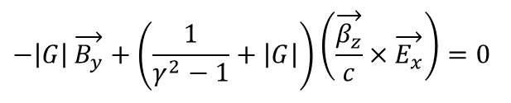
Frozen spin method for deuteron:
Frozen spin lattice for deuteron based on the «B+E» elements:
the spin of the reference particle is always oriented along the momentum
$$−\left|G\right|\overset{→}{B_{y}}+\left(\frac{1}{γ^{2}−1}+\left|G\right|\right)\left(\frac{\overset{→}{β_{z}}}{c}×\overset{→}{E_{x}}\right)=0$$

Slide 9
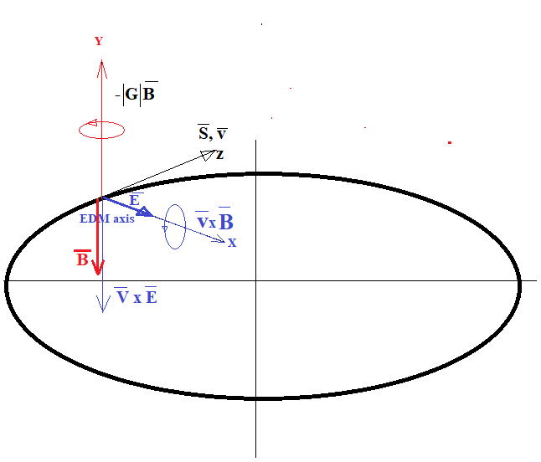
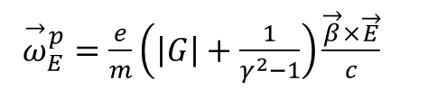
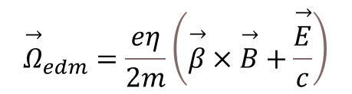
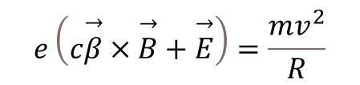


Vector diagram B and E fields
${\overset{→}{ω}}_{E}^{p}=\frac{e}{m}\left(\left|G\right|+\frac{1}{γ^{2}−1}\right)\frac{\overset{→}{β}×\overset{→}{E}}{c}$
Lorentz force: MDM and EDM frequencies:
$$e\left(c\overset{→}{β}×\overset{→}{B}+\overset{→}{E}\right)=\frac{mv^{2}}{R}$$
$${\overset{→}{ω}}_{B}^{p}=−\frac{e}{m}\left|G\right|·B_{⊥}$$
$${\overset{→}{Ω}}_{mdm}^{p}={\overset{→}{ω}}_{E}^{p}+{\overset{→}{ω}}_{B}^{p}$$
$${\overset{→}{Ω}}_{edm}=\frac{eη}{2m}\left(\overset{→}{β}×\overset{→}{B}+\frac{\overset{→}{E}}{c}\right)$$

Slide 10
Proton and deuteron rings for EDM search: main problems
accumulation of EDM signal
polarization conservation
systematic errors, separation of EDM and MDM:

Slide 11
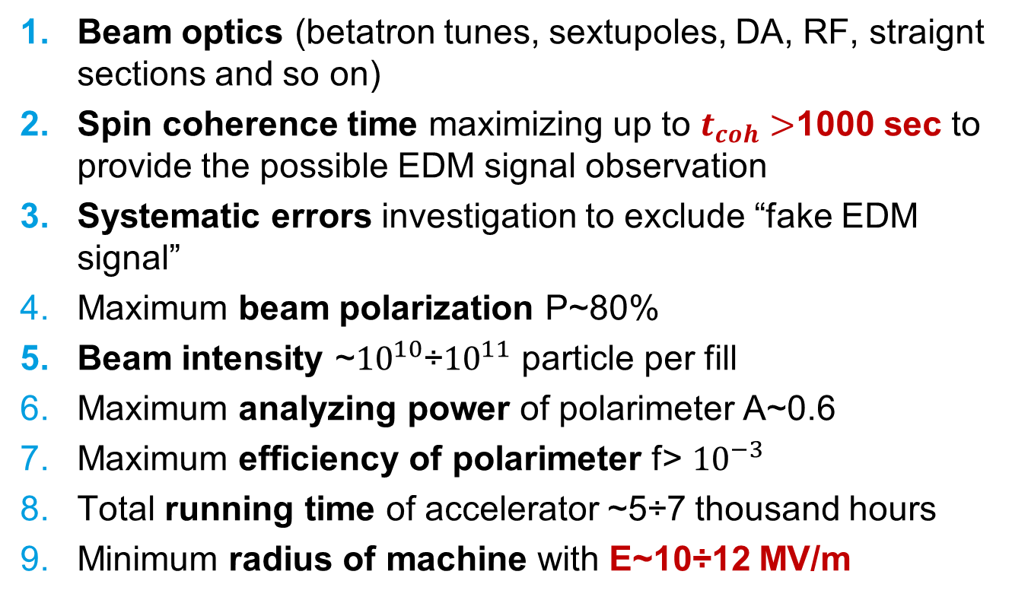
Main requirements to the experiment for search for EDM in the ring:
+

Slide 12
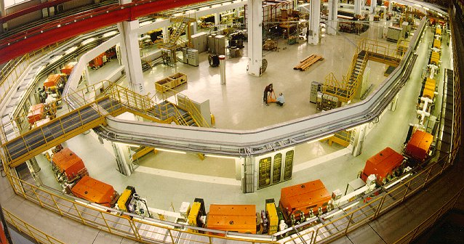
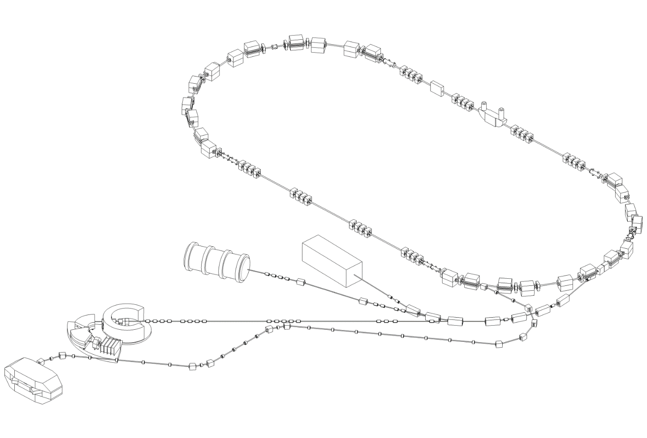
Cooler Synchrotron COSY
in Jülich
RF Devices for
Spin Manipulations
Sextupole magnets
Electron Cooler
EDDA Polarimeter
Momentum up to 3.5 GeV/c
Polarized Protons / Deuterons
Circumference 184 m

Slide 13
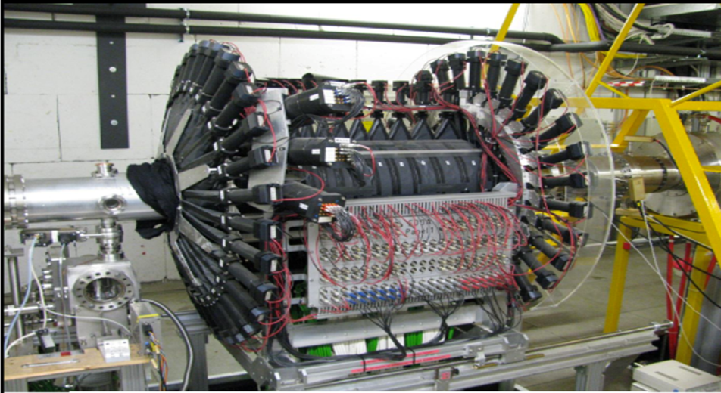
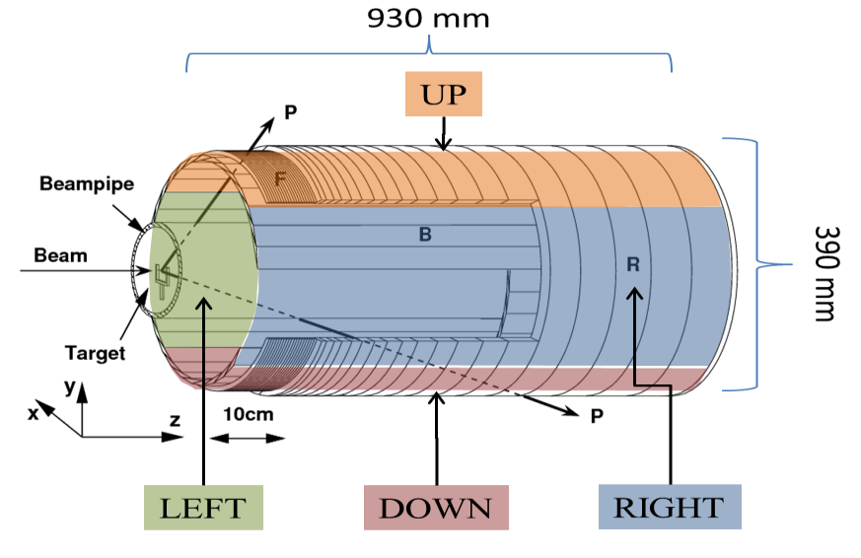
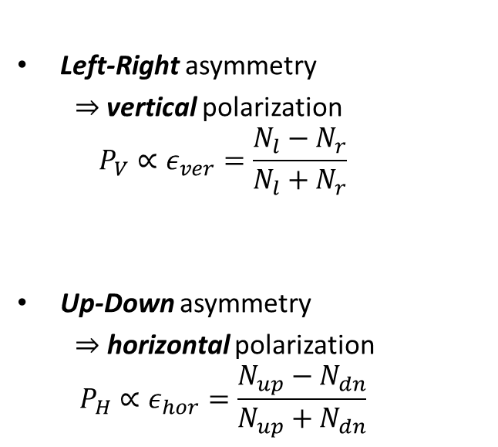
EDDA Polarimeter
Left-Right asymmetry
  $⇒$vertical polarization
  $$P_{V}∝ε_{ver}=\frac{N_{l}−N_{r}}{N_{l}+N_{r}}$$
Up-Down asymmetry
  $⇒$ horizontal polarization
  $$P_{H}∝ε_{hor}=\frac{N_{up}−N_{dn}}{N_{up}+N_{dn}}$$

Slide 14
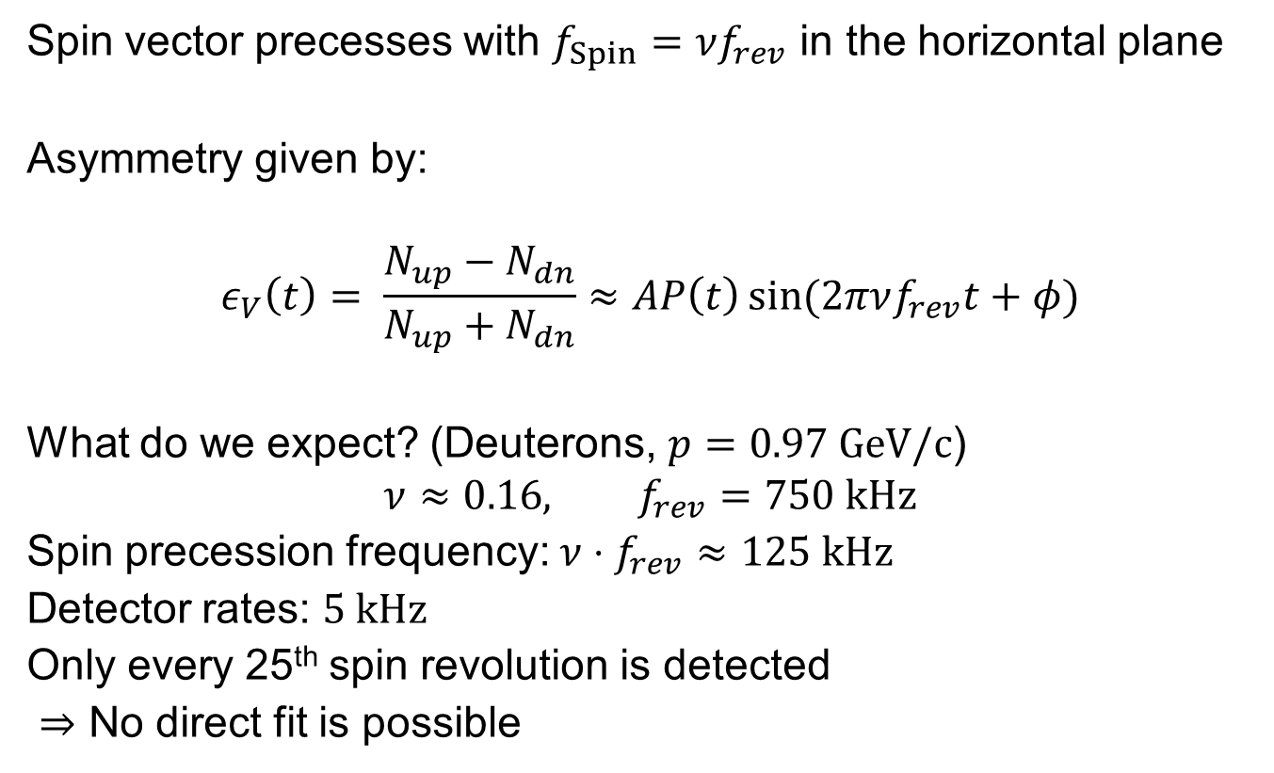
Spin Tune Measurement
Spin vector precesses with $f_{Spin}=νf_{rev}$ in the horizontal plane
Asymmetry given by:
$$ε_{V}\left(t\right)= \frac{N_{up}−N_{dn}}{N_{up}+N_{dn}}≈AP\left(t\right)\sin{(2πνf_{rev}t+φ)}$$
What do we expect? (Deuterons, $p=0.97 \text{GeV}\text{/}\text{c}$)
$$ν≈0.16, f_{rev}=750 kHz$$
Spin precession frequency: $ν⋅f_{rev}≈125 \text{kHz}$
Detector rates: $5 \text{kHz}$
Only every 25th spin revolution is detected
$⇒$ No direct fit is possible

Slide 15
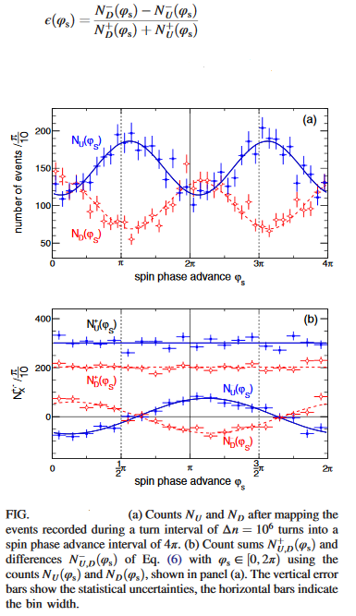
Measurement of polarization asymmetry
An rf solenoid-induced spin resonance was employed to rotate the spin by 90° from the initial vertical direction into the transverse horizontal direction. Subsequently, the beam was slowly extracted onto an internal carbon target using a white noise electric field applied to a stripline unit. Scattered deuterons were detected in scintillation detectors, consisting of rings and bars around the beam pipe, and their energy deposit was measured by stopping them in the outer scintillator rings. The event arrival times, with respect to the beginning of each cycle and the frequency of the COSY rf cavity, were recorded in one long-range time-to digital converter; i.e.,the same reference clock was used for all signals.

Slide 16
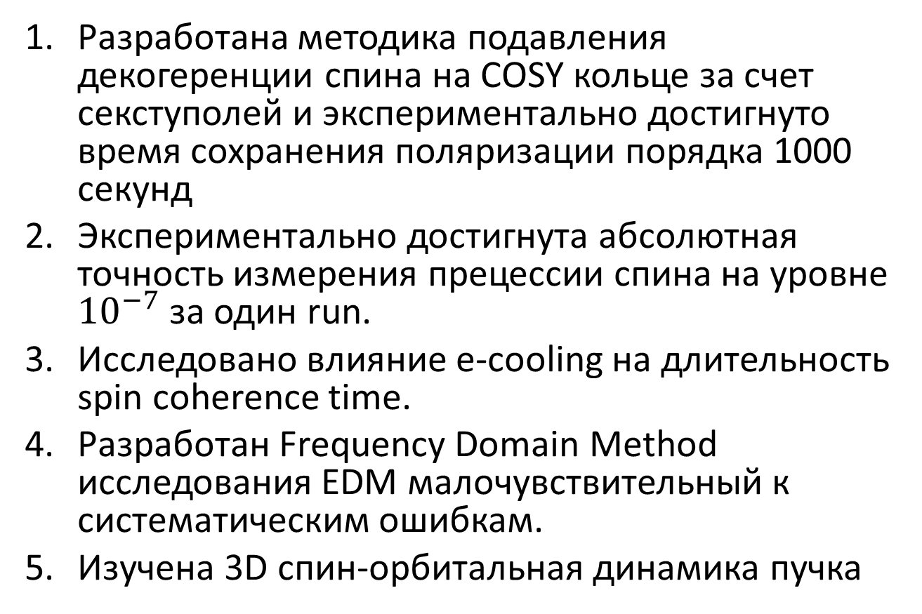
Что уже сделано на данный момент?
Разработана методика подавления декогеренции спина на COSY кольце за счет секступолей и экспериментально достигнуто время сохранения поляризации порядка 1000 секунд
Экспериментально достигнута абсолютная точность измерения прецессии спина на уровне ${10}^{−7}$ за один run.
Исследовано влияние e-cooling на длительность spin coherence time.
Разработан Frequency Domain Method исследования EDM малочувствительный к систематическим ошибкам.
Изучена 3D спин-орбитальная динамика пучка

Slide 17
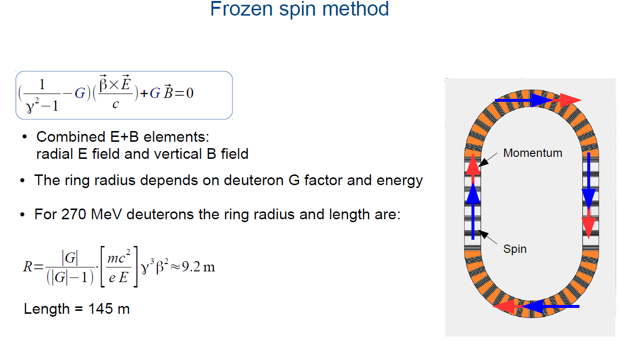

Slide 18
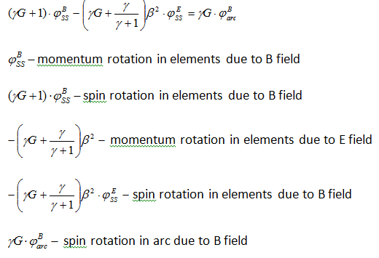

Basic relations in QFS structure with the magnetic arcs and the magneto-electrostatic spin recovery elements

Slide 19
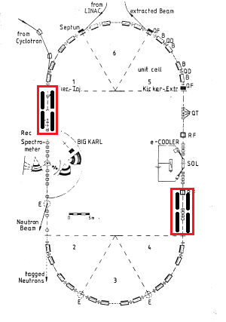
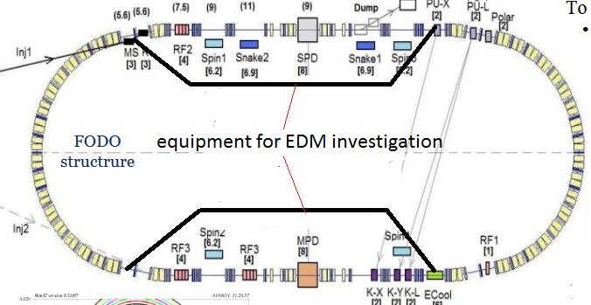
QFS option in COSY and NICA accelerators

Slide 20
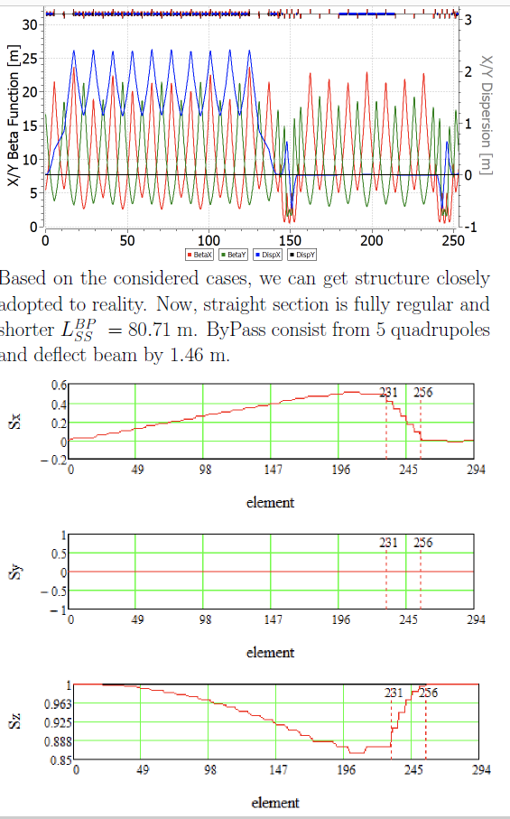
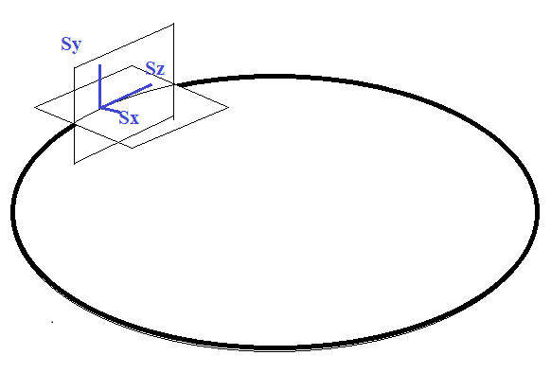
Bypass, NICA

Slide 21
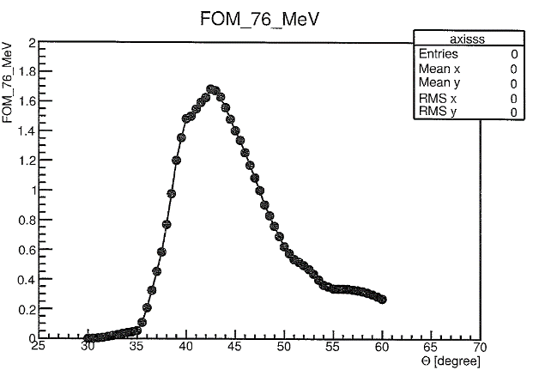
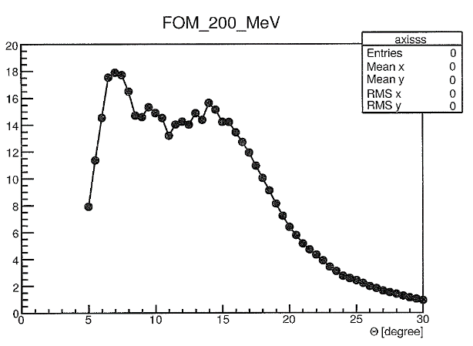
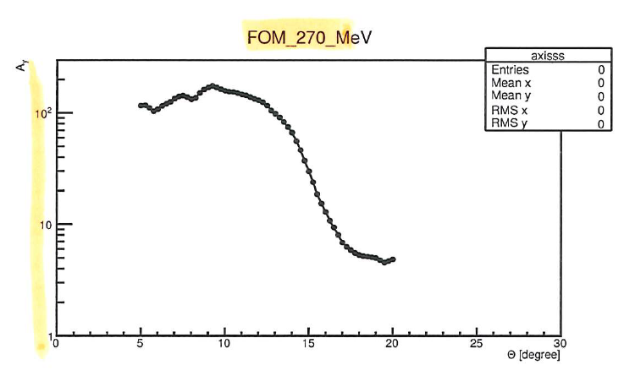
Figure Of Merit vs Energy: choice of energy
76 MeV 200 MeV 270 Mev

Slide 22
Search for AXION dark matter at NICA (K.Nikolaev ITP Landau)
Peccei-Quinn (pseudogoldstone) axions solve the strong-CP problem
Relic very light axions as a credible candidate for dark matter
Extensive serch for axions in dozen expts worlwide
Galactic axion field generates oscillating EDM and pseudomagnetic oscillating solenoidal field in the storage ring (Silenko 2021)
Axion oscillation frequency ω_{a}=m_{a}c²
Scan spin precession frequency ramping magnetic field in the ring until hitting the axion frequency (with good luck!): the axion signal is a sudden resonance (Froissart-Stora) rotation of vertical polarization towards horizontal one
Detect the buildup of precessing horizontal polarization at SPD by the JEDI time stamp technique via azimuthal asymmetry of elastic scattering in the internal carbon target in SPD
The beam halo is brought into interaction with the target heating the beam
Detuned quasi-frozen spin regime gives access to very small axion masses
No demand for any extra equipment beyond the internal target in SPD and heating the beam: just keep ramping the beam energy as much as possible

Slide 23
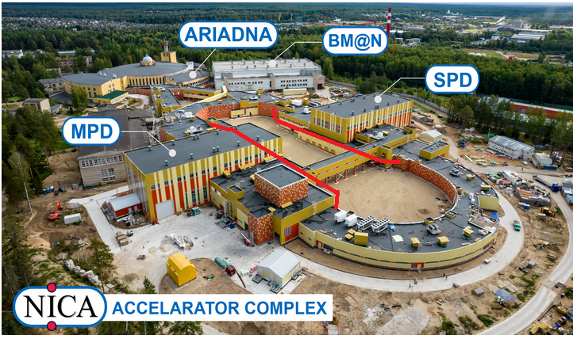

Slide 24
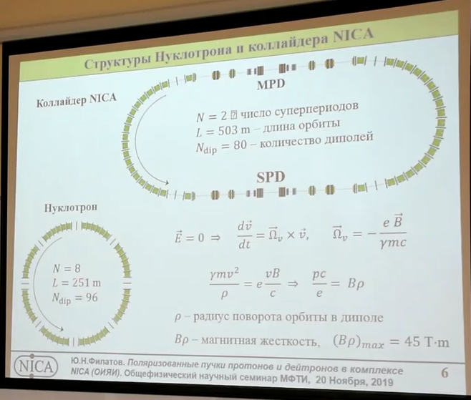
Nuclotron and NICA-Collider
Bypass

Slide 25
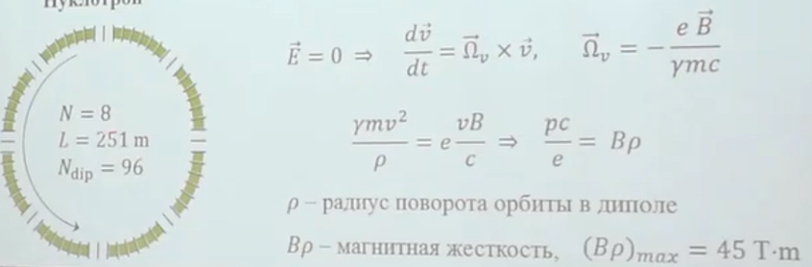
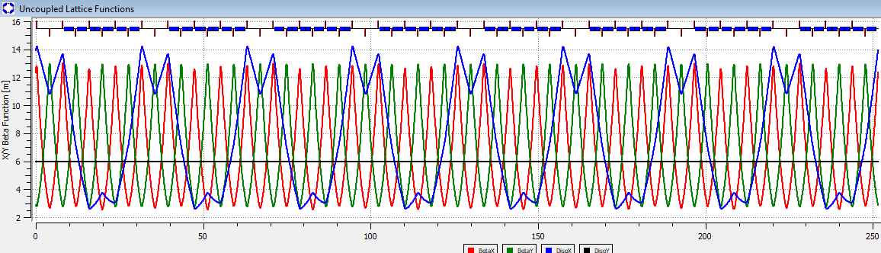
Twiss functions in Nuclotron

Slide 26
Адаптации магнитооптической структуры Нуклотрона для поиска электрического дипольного момента дейтрона (dEDM).
При решении этой задачи необходимо было решить четыре проблемы:
реализовать концепцию «квази-замороженного спина в предлагаемой оптике,
увеличение длин прямых промежутков между арками,
обеспечение нулевой дисперсии на прямых участках,
сохранение длины кольца ускорителя с учетом размещения требуемого оборудования.

Slide 27
Для реализации этих задач:
первая проблема, увеличение прямых участков до требуемой длины, решается за счет увеличения максимального магнитного поля в поворотных магнитах до величины 1.8 Тесла,
Подавление дисперсии решается выбором набега фазы радиальных колебаний на арках,
в структуру вводятся дополнительные электростатические дефлекторы с отрицательной кривизной, что позволяет сохранять среднее направление спина вдоль импульса во всем кольце в рамках концепции «квази-замороженного спина» в ускорителе.

Slide 28
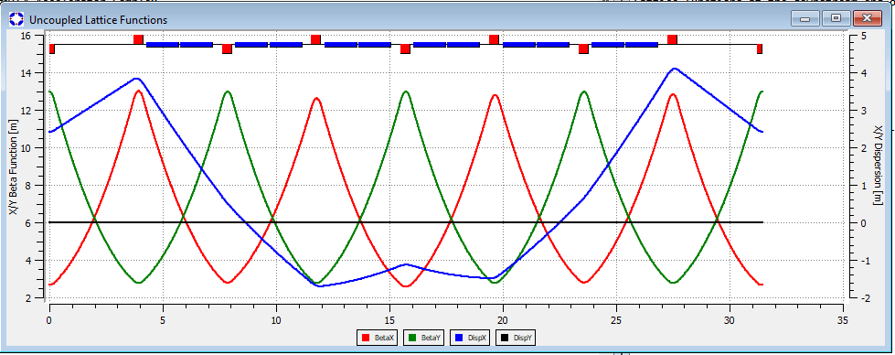
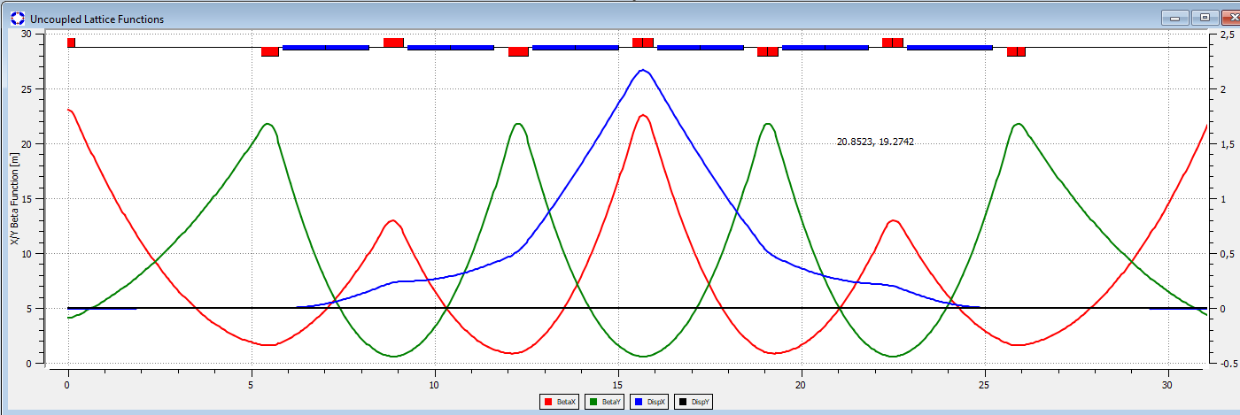
Модернизация одного суперпериода Нуклотрона

Slide 29
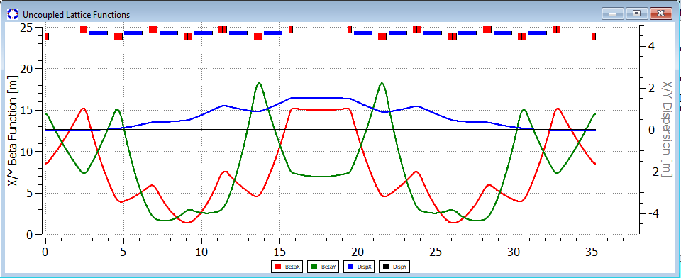
Nuclotron with
16-th superperiodical lattice

Slide 30
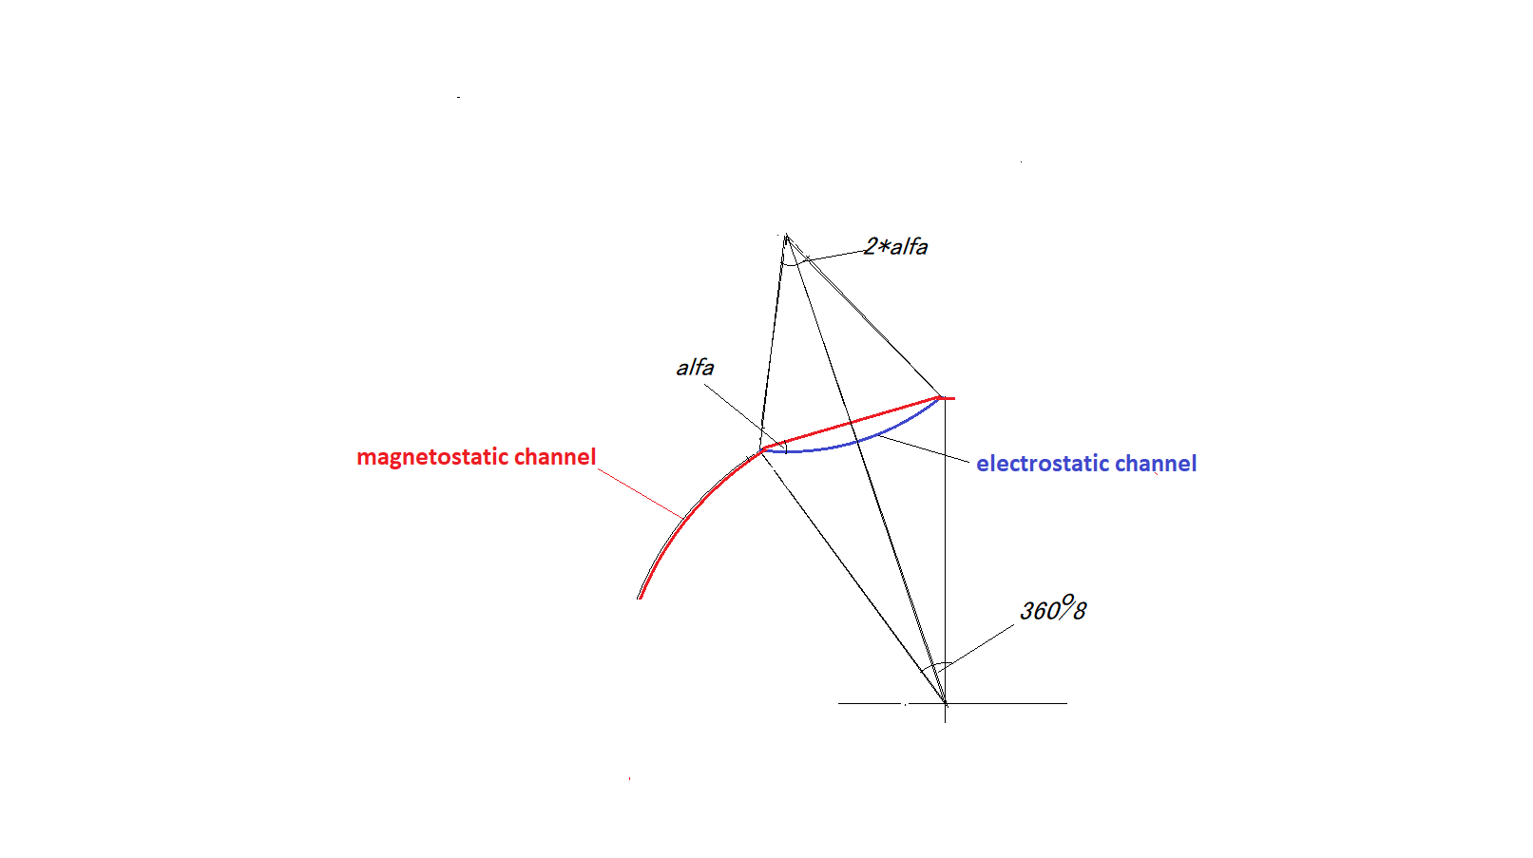

Electrostatic insertion in Nuclotron
Before/after modernization: 24.2 m / 21 m
after/before modernization: 10.5 m / 7.3 m
S
p
p
alfa
alfa
S

Slide 31
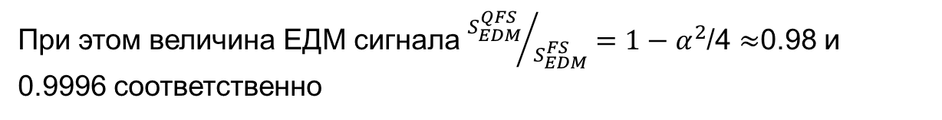

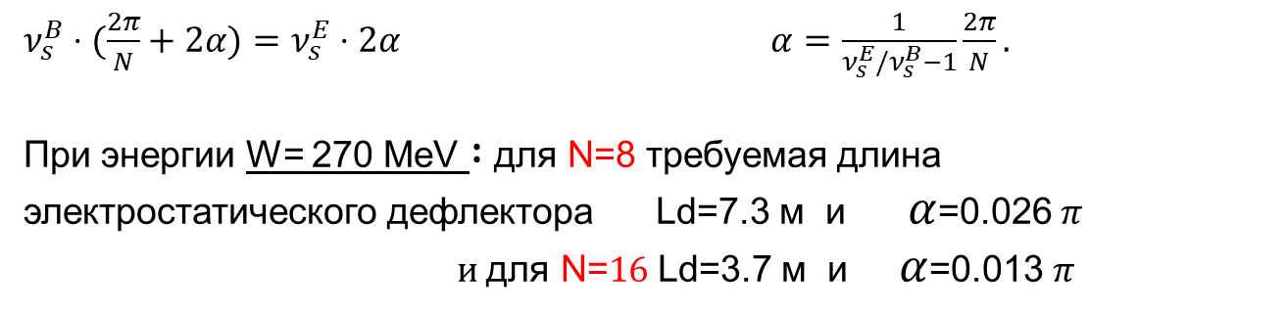
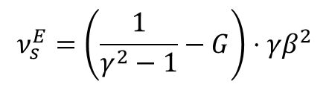
Основные соотношения
Нормализованная частота прецессии спина в горизонтальной плоскости
в электрическом дефлекторе относительно направления движения:
$$ν_{s}^{E}=\left(\frac{1}{γ^{2}−1}−G\right)⋅γβ^{2}$$
Нормализованная частота прецессии спина в горизонтальной плоскости
в магнитном дефлекторе относительно направления движения:
$ν_{s}^{B}=γG$.
$ν_{s}^{B}⋅(\frac{2π}{N}+2α)=ν_{s}^{E}⋅2α$ $α=\frac{1}{ν_{s}^{E}/ν_{s}^{B}−1}\frac{2π}{N}.$
При энергии W= 270 MeV $:$ для N=8 требуемая длина электростатического дефлектора Ld=7.3 м и $α$=0.026 $π$
$и \text{для }\text{N}\text{=}16$ Ld=3.7 м и $α$=0.013 $π$
При этом величина ЕДМ сигнала ${S_{EDM}^{QFS}}/{S_{EDM}^{FS}}=1−α^{2}$/4 $≈$0.98 и 0.9996 соответственно

Slide 32
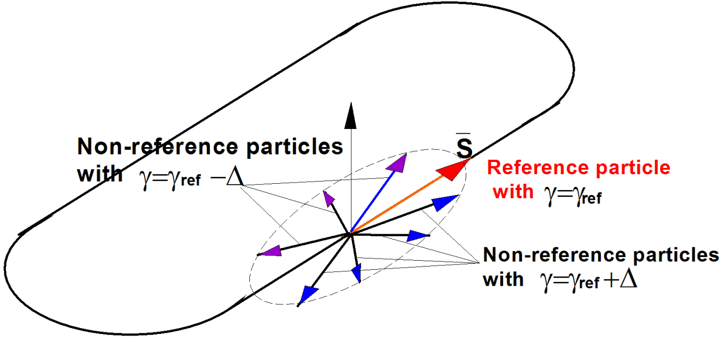
Spin tune decoherence
In magnetic field
In electric field

Slide 33
Frequency Domain Method: systematic errors
Let us to consider the case when in
We can not realize relation ,
but we can
we have so called 2D frozen spin option:

Slide 34
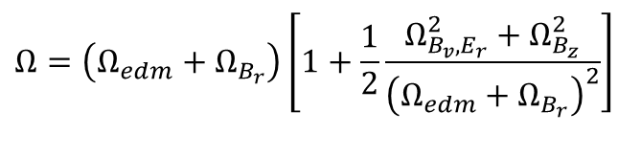


Frequency Domain Method: basic relationships
finally
Main idea:
to make the contribution from EDM frequency into the total frequency $Ω_{edm}+Ω_{B_{r}}$ bigger than from MDM additions
$$Ω=\left(Ω_{edm}+Ω_{B_{r}}\right)\left[1+\frac{1}{2}\frac{Ω_{B_{v},E_{r}}^{2}+Ω_{B_{z}}^{2}}{{\left(Ω_{edm}+Ω_{B_{r}}\right)}^{2}}\right]$$
$$Ω_{edm}>\frac{1}{2}\frac{Ω_{B_{v},E_{r}}^{2}+Ω_{B_{z}}^{2}}{Ω_{edm}+Ω_{B_{r}}}$$

Slide 35

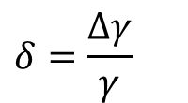
Effective gamma
Equation of Longitudinal motion:
$$\frac{dφ}{dt}=−ω_{rf}\left[\left(α_{0}−\frac{1}{γ^{2}}\right)⋅δ+\left(α_{1}−\frac{α_{0}}{γ^{2}}+\frac{1}{γ^{4}}\right)⋅δ^{2}+{\left(\frac{ΔL}{L}\right)}_{β}\right] \\ \frac{dδ}{dt}=\frac{eV_{rf}ω_{rf}}{2πhβ^{2}E}φ$$
$$δ=\frac{Δγ}{γ}$$
Nonlinear
Z motion
Betatron
motion

Slide 36
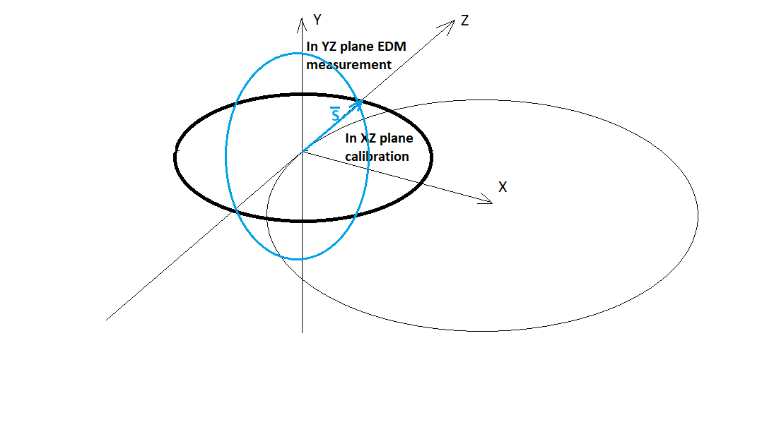
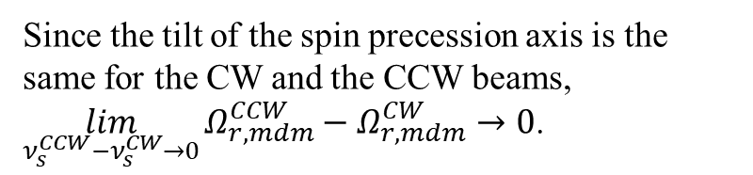
Frequency Domain method: calibration of effective gamma
The second part of FDM strategy is when we calibrate the effective gamma by measuring the spin precession frequency in the horizontal plane, where there is no EDM, and we have the precession frequency of the spin in the horizontal plane much larger than the frequencies in other planes, that is the invariant spin axis coincides with the vertical axis, and we exclude the influence of frequencies in other planes on the calibration in the horizontal plane
Since the tilt of the spin precession axis is the same for the CW and the CCW beams, $\lim_{ν_{s}^{CCW}−ν_{s}^{CW}→0}{Ω_{r,mdm}^{CCW}−Ω_{r,mdm}^{CW}}→0$.

Slide 37
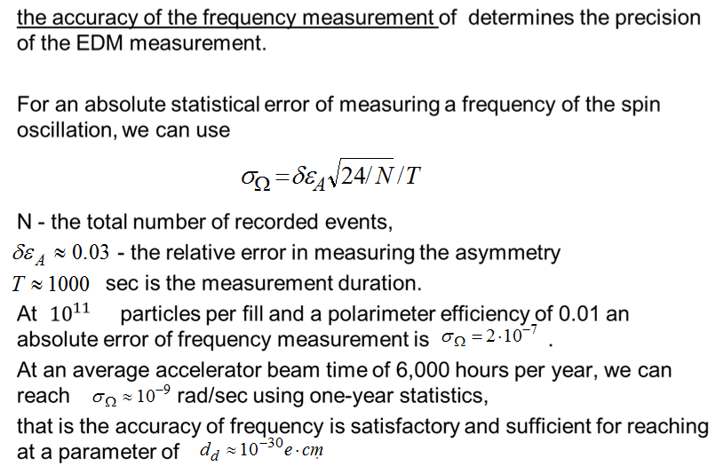
EDM measurement precision

Slide 38
Заключение
В итоге мы можем потенциально рассматривать возможность исследования электрического дипольного момента дейтрона в НИКЕ и Нуклотроне.

Slide 39


