Slide 1
The XIXth Workshop
on High Energy Spin Physics
dedicated to 90th anniversary of A.V. Efremov birth
September 4 - 8, 2023
Dubna, JINR, Russia
GPDs and gravitational form factors of nucleons
(quark and gluon contributions)
O.V. Selyugin, O.V. Teryaev
BLTPh, JINR

Slide 2
Contents
* Introduction
* GPDs and hadrons form-factors
* GPDs fitting of the electromagnetic nucleon form factors
* Electromagnetic and gravitomagnetic nucleons form-factors
* PDFs and GPDs of gluons
* Tomography of hadrons
* Gravitation Radiuses of nucleons

Slide 3
Standard definitions

Slide 4
Form factors
Mittenen (1973) – “matter distribution”
Bourrely-Soffer-Wu (1978) -
G(t) –”stands for the proton “nuclear form factor” parameterized like the e-m form factor, as a two poles, the slowly varying function reflect the approximate proportionality between the charge density and hadronic matter distribution inside a proton.”
Broniowski – Arriola (2008)
"..The gravitation form factors, related to the matrix
elements of the energy-momentum tensor [1] in a hadronic
state and thus providing the distribution of matter within
the hadron..."

Slide 5
General Parton Distributions (GPDs)
Sanielevici-Valin (1984) –Valon model – Phys.Rev.D29 (1984).
“matter form factor” (MFF) measures the interaction of a gluonic probe with the excited matter of the overlapping hadrons and should incorporate the static matter distributions of the participating hadrons…”

Slide 6
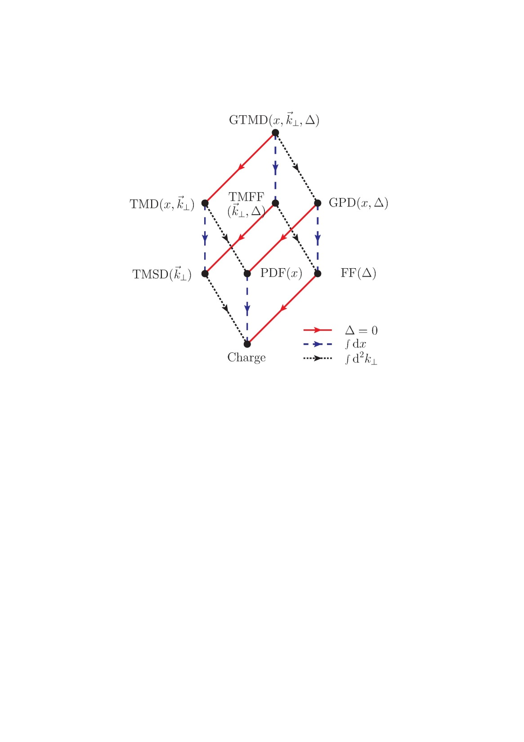
M. Burkhardt, B. Pasquini, EPJ (2015)

Slide 7
General Parton Distributions (GPDs)
GPDs
X.Ji Sum Rules (1997)
F_{x=0} (x;t) = F (x;t)
H^{q}(x;t) = H ^{q}(x,0,t) + H ^{q}(-x,0,t)
E^{q}(x;t) = E ^{q}(x,0,t) + E ^{q}(-x,0,t)
8

Slide 8
Why it is need know the t-dependence of GPDs in the wide region of the momentum transfer?
Form factors in the wide region of t (x^{n-1})
(Compton - zero momentum - x⁻¹
electromagnetic, - first momentum - x⁰
gravitomagnetic - second momentum – x¹
* Tomography of the nucleons
(impact parameter representation)
require the integration on the whole region of t

Slide 9
Gravimagnetic form factor
“Future studies using higher-statistics data will be crucial to justify or falsify model assumptions about the kinematic dependence of the GPDs.

Slide 10
Nucleon GPDs
O.S., O. Teryaev, Phys.Rev.D79:033003,2009
Found.Phys.40:1042,2010
Our ansatz
1. Simplest;
2. Not fare from Gaussian representation
3. Satisfy the (1-x)^{n} (n>= 2)
4. Valid for large t
q(x) is based on the MRST2002

Slide 11
The proton and neutron Dirac form factors follow from
By construction

Slide 12
muG_{ep}/G _{Mp}

Slide 13
General Parton Distributions -GPDs
Electromagnetic form factors (charge distribution)
Gravitation form factors
(matter distribution)

Slide 14
Martin – 2002 // H. KHANPOUR..-2012 (1205.5194)
Pumplin et al. 2002 (CTEQ6M)
Martin et al. 2002 (MRST02) .– Martin -2009 (LO, NLO, NNLO)
Gluck-Pisano 2008
Alekhin et al. 2012 (ABM12)
14

Slide 15
The differential cross section for the unpolarized cross section
that reaction can be written as

Slide 17
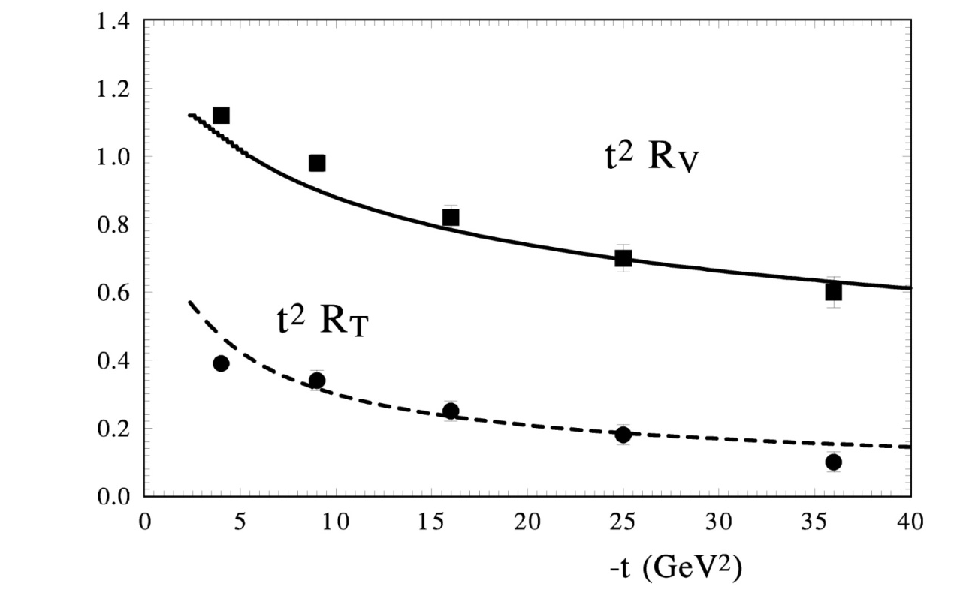
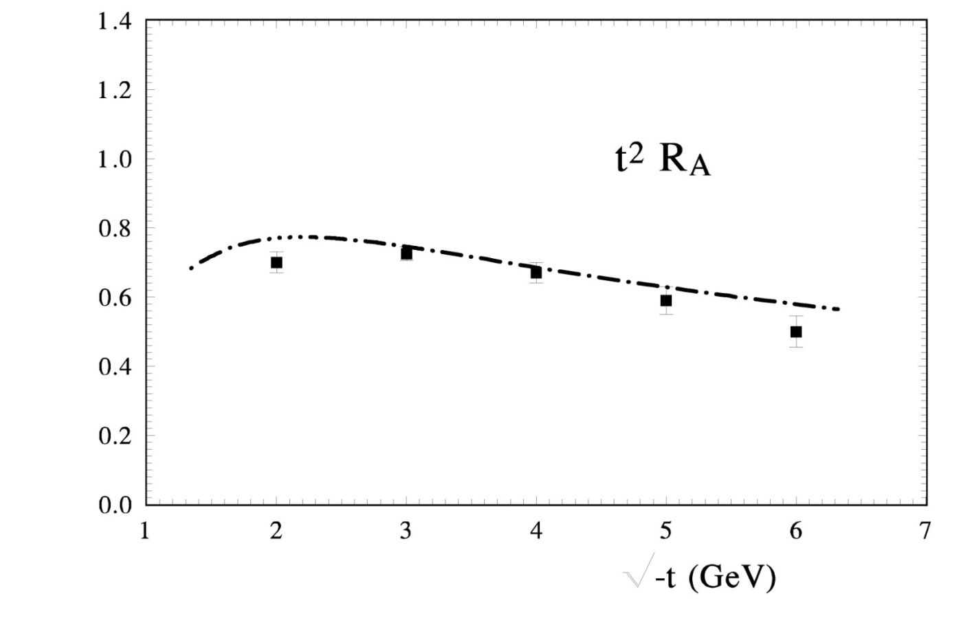

Slide 18
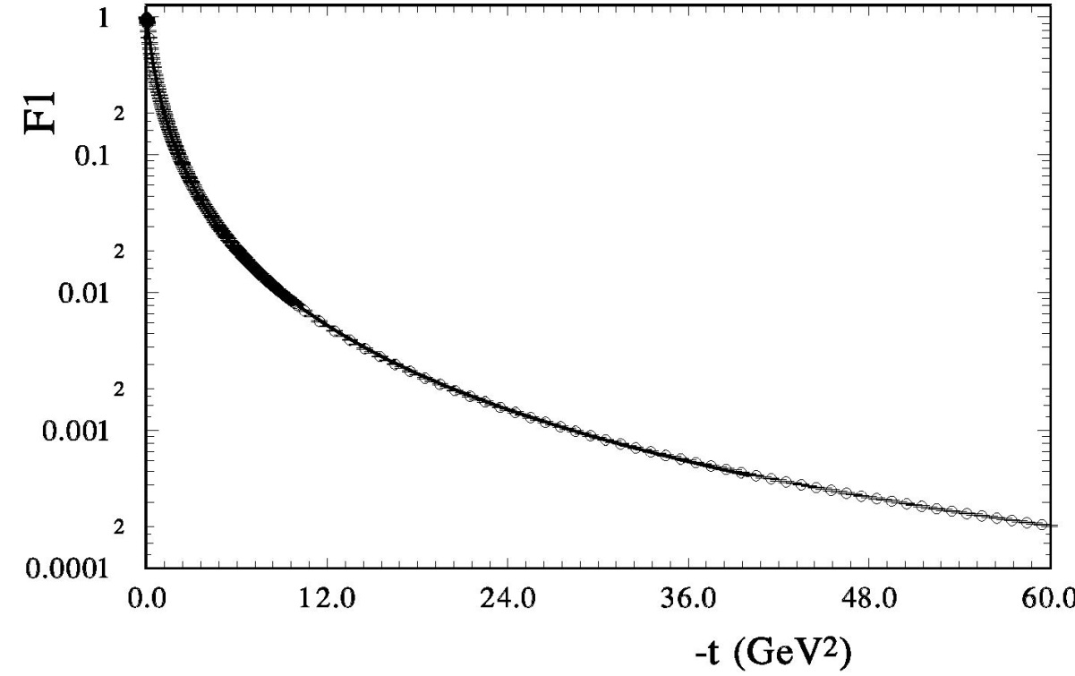

Slide 19
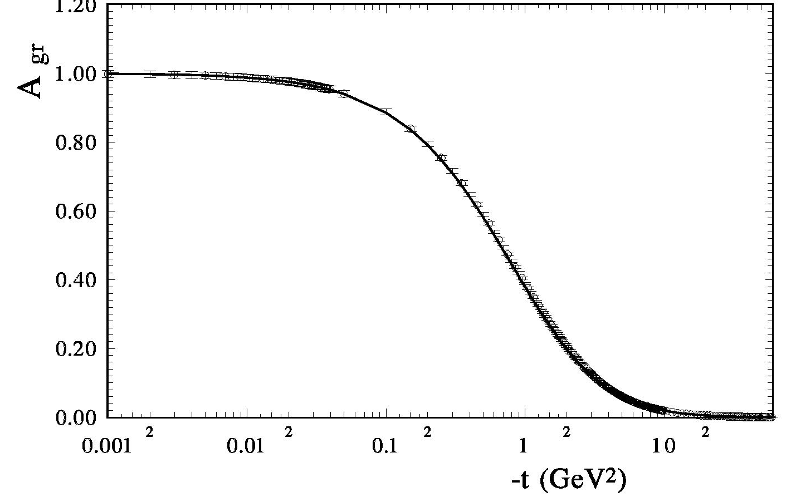
25

Slide 20
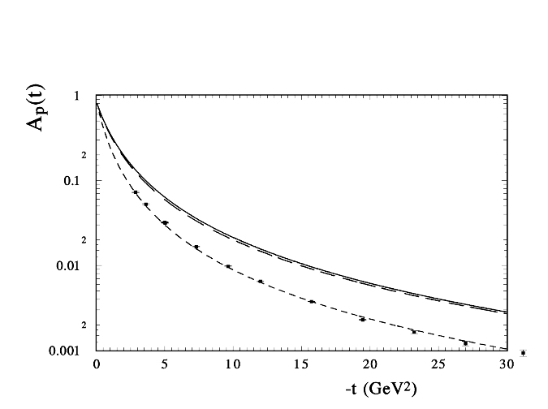
A(t) Gravitational form factor A and proton Dirac F_1

Slide 21
22

Slide 22
“TOMOGRAPHY” of NUCLEONS
M.Burkardt Phys.Rev, D74(2004)
C.Carlson, M. Vanderhaeghen
Phys.Rev.Lett., 100,(2008)

Slide 23
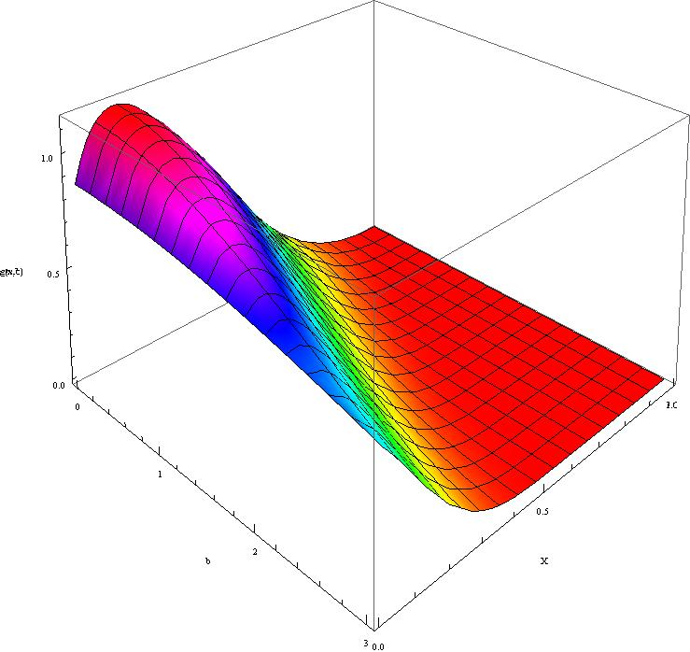
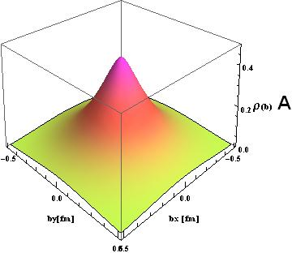
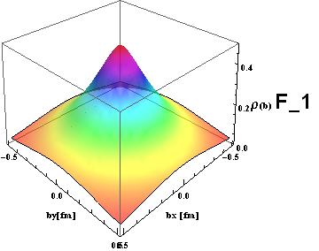
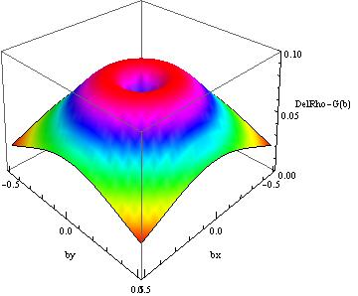
Proton - Del = (F1_em – A_gr)

Slide 24
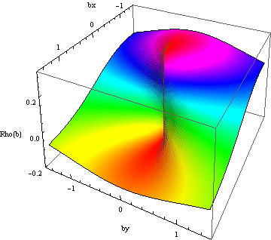
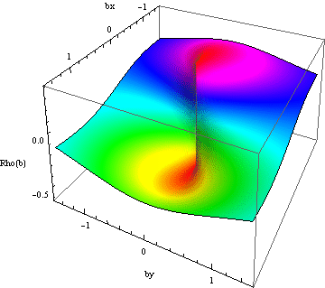
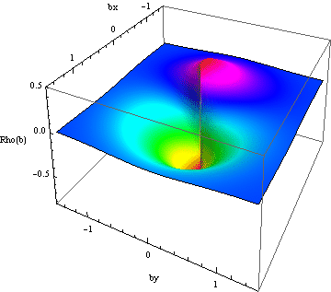
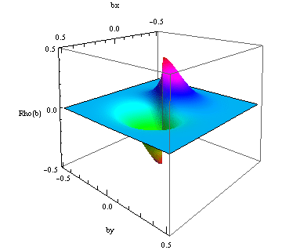
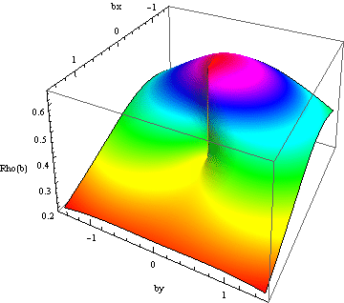
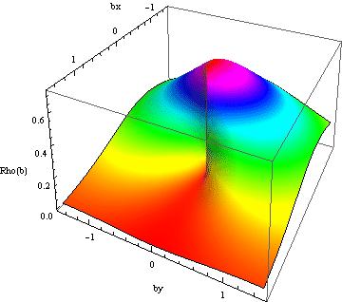
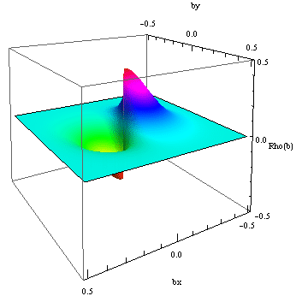
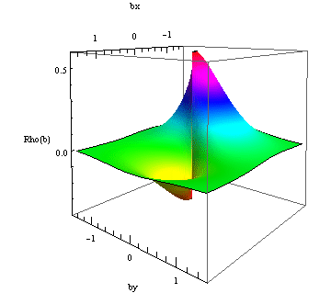
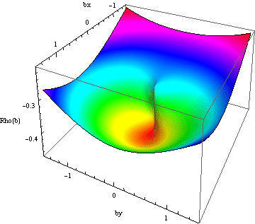
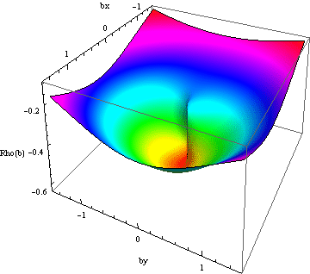
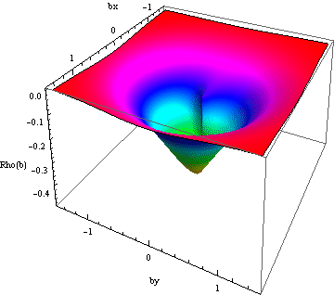
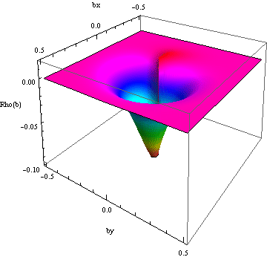
Neutron r_{T} (b_{x},b_{y;} ;x_{fix} )
u+d
d
u
X = 0.1 0.3 0.6 0.9

Slide 25
charge radius of proton
 | Basic variant | basic + 4 parameters
 | -t₁=10⁻⁵ | -t₂=10⁻³ | -t₃=4 10⁻² | -t₁=10⁻⁵ | -t₂=10⁻³ | -t₃=4 10⁻² | Order (Q)
model | Dt=10⁻⁵ GeV² | Dt=10⁻³ GeV² | Dt=10⁻³ GeV² | Dt=10⁻⁵ GeV² | Dt=10⁻³ GeV² | Dt=10⁻³ GeV²
ABKM09 | 0.525 | 0.525 | 0.505 | 0.536 | 0.535 | 0.522 | NNLO (3.)
JR08a | 0.546 | 0.545 | 0.547 | 0.566 | 0.565 | 0.543 | NNLO (0.55)
JR08b | 0.526 | 0.525 | 0.507 | 0.547 | 0.547 | 0.527 | NNLO (2.)
ABM12 | 0.524 | 0.524 | 0.505 | 0.543 | 0.543 | 0.523 | NNLO (0.9)
KKT12a | 0.525 | 0.524 | 0.504 | 0.525 | 0.525 | 0.507 | NLO (4.)
KKT12b | 0.519 | 0.519 | 0.521 | 0.518 | 0.518 | 0.501 | NLO (4.)
GJR07d | 0.523 | 0.523 | 0.505 | 0.531 | 0.531 | 0.515 | LO (0.3)
GJR07b | 0.532 | 0.531 | 0.512 | 0.546 | 0.544 | 0.526 | NLO (4.)
GJR07a | 0.506 | 0.506 | 0.498 | 0.521 | 0.520 | 0.503 | LO (0.3)
GJR07c | 0.510 | 0.510 | 0.501 | 0.519 | 0.519 | 0.502 | NLO (0.3)

Slide 26
26

Slide 27
GPD gluons
G..F. de Teramond, T. Liu, R.S. Sufian (2018)
Gluon f(t) -unknown
C.Tan, Z.Lu(2023) – wave function and integration over k_t . As aresult they obtained t-dependence only by numerical Integral and
H_g(x,0,t) is negative in the small x-region

Slide 28
gluons GFFs
The (00) component of the EMT defines the form factor
In the Brain frame, which can be expressed as
The mass distribution, the angular momentum distribution, the mechanical properties
Dipole form parametrization: 1)P.E. Shanahanand W. Detmond (2019);
2)K.A. Mano, I. Zahed (2020); 3)X-Y Wang, F. Zeng, Q. Wang (2022)
4) 3)X-Y Wang, F. Zeng, (2023)

Slide 29
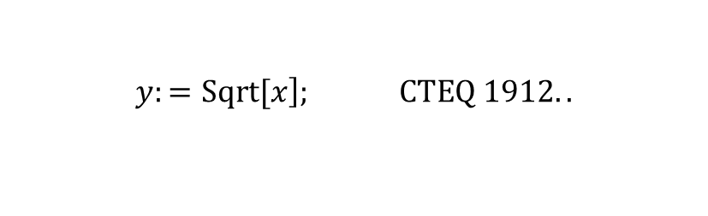
$$y:=\left.Sqrt[x\right]; CTEQ 1912..$$
$$\left(\begin{aligned}f1=\left.Sinh[3.032\right]∗\left(1.−y\right)^\left(3\right)+1.∗\left.Sinh[−1.705\right]∗3.∗y∗\left(1.−y\right)^2 \\ +1.∗{\left(3.+2.∗0.531\right)}/{3.}∗3.∗y^2∗\left(1.−y\right)+y^3\end{aligned}\right);$$
unu3=2.69*X**(0.531 - 0.)*(1 - X)**(3.148)*F1
Bour-Sof-L. Bellantuonno.. 2201.07640
Unu2=15.853*X**0.792/(Exp(X/0.099)-1.)
3 (f5) * green short dash * 4.21 ∗ x ∗ ∗0.021 ∗ (1. − x) ∗ ∗9.427;
1709.. Vafaee last red *)
unu5=5.25*x**(-0.11)*(1. - x)**12.5 -2.9*x**(-0.179)*(1. - x)**25
main 1902.. Bonvini dotted phiolet*)
unu6=1.3*x**(-0.55)*(1. - x)**(4.5)*(1.+0.229*Log(x)+0.01312*( Log(x))**2)
Local 1902.. Bonvini shrt-dash braun *)
unu7=35.*x**(0.34)*(1.-x)**(8.8)*(1.+0.76*Log(x)+0.22*(Log(x))**2
. +0.017*( Log(x))**3)
(* 1602.00254v2 Ariola- [Pi-mezon] *) short dash blue *)
unu9=X**(0.48 - 0.)*(1 - X)**(0.39)*(0.68+0.34*sqrt(x))

Slide 30
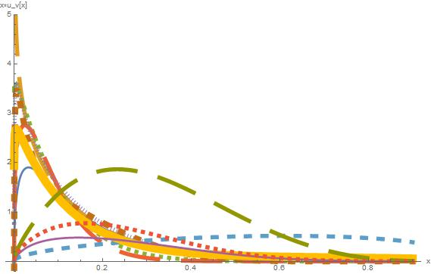
1 (f3) * CTEQ 1912.. xg(x) 0 ∗ P g blue solid*)
2 (f4) B-S-B long dash
3 (f5) * green short dash * 4.21 ∗ x ∗ ∗0.021 ∗ (1. − x) ∗ ∗9.427;
4 (f6) * 1709.. Vafaee last red * 5.25 ∗ x ∗ ∗(−0.11)*
5 (f7) (* main 1902.. Bonvini last red *)
6 =[5] (f8) (* Local 1902.. Bonvini last red *)
[p] (f9) (* 1602.00254v2 Ariola- *)

Slide 31
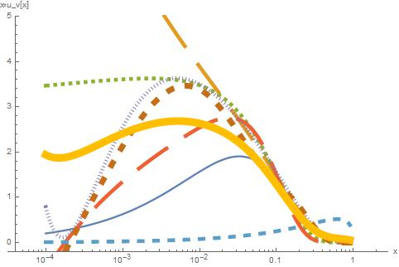
1 (f3) * CTEQ 1912.. xg(x) 0 ∗ P g blue solid*)
2 (f4) B-S-B long dash
3 (f5) * green short dash * 4.21 ∗ x ∗ ∗0.021 ∗ (1. − x) ∗ ∗9.427;
4 (f6) * 1709.. Vafaee last red * 5.25 ∗ x ∗ ∗(−0.11)*
5 (f7) (* main 1902.. Bonvini *)
6 =[5] (f8) (* Local 1902.. Bonvini last red *)
[p] (f9) (* 1602.00254v2 Ariola- *)

Slide 32
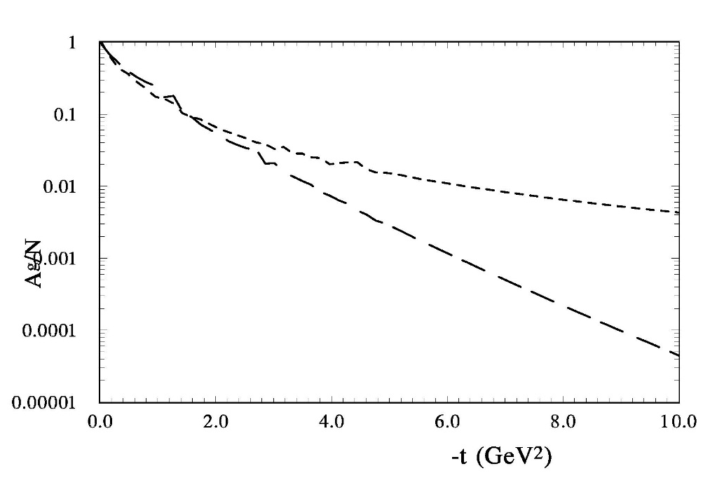
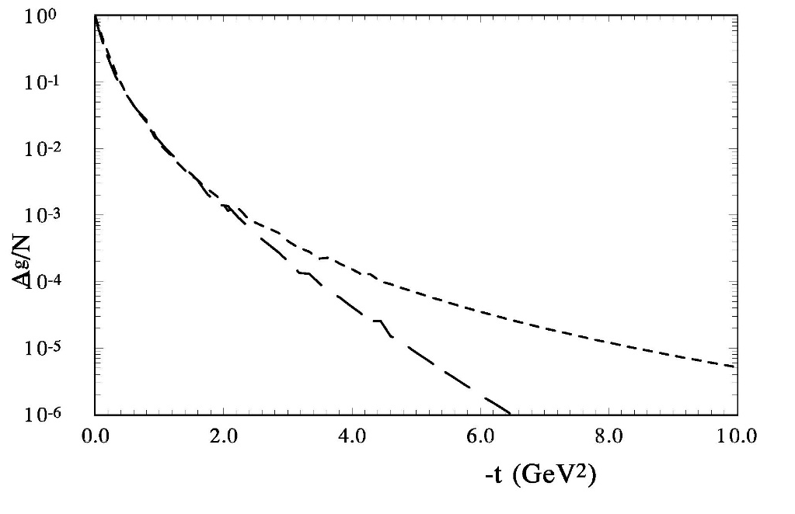

Slide 33
N | \chi2 | L2 (GeV2) | n | A(0) | <r2>1/2(fm)
u1 | 20110 | 0.35 | 3.(4.9) | 0.38 | 1.43(1.18)
u2 | 183 | 0.94 | 3. | 0.45 | 1.3
u3 | 40 | 0.43 | 2.04 | 0.38 | 1.05
u4 | 51000 | 0.29 | 3 | 0.33 | 1.5
U5 | 129 | 0.56 | 2.98 | 0.46 | 1.13
u6 | 3042 | 0.52 | 3 | 0.4 | 1.18
Pi | 44 | 0.89 | 1. | 0.4 | 0.52
D.C. Hackett et all. Arxiv: 2307.11707

Slide 34
N | \chi2 | L2 (GeV2) | n | A(0) | <r2>1/2(fm)
u1 | 2330 | 0.82 | 3. | 0.38 | 0.94
u2 | 10 | 0.92 | 2.7 | 0.44 | 0.84
u3 | 122 | 1.07 | 2.6 | 0.38 | 0.76
u4 | 8192 | 0.75 | 3 | 0.33 | 0.98
U5 | 78 | 1. | 2.77 | 0.46 | 0.81
u6 | 84 | 1.1 | 3 | 0.41 | 0.81
Pi | 226 | 4. | 1. | 0.40 | 0.39

Slide 35
N | \chi2 | L2 (GeV2) | n | A(0) | <r2>1/2(fm)
u1 | 10 | 0.92 | 2.7 | 0.38 | 0.84
u2 | 183 | 0.93 | 3 | 0.40 | 0.88
u3 | 122 | 1.07 | 2.6 | 0.38 | 0.76
u4 | 155300 | 0.65 | 3 | 0.33 | 1.05
U5 | 370 | 0.98 | 3 | 0.46 | 0.86
u6 | 1380 | 0.96 | 3 | 0.40 | 0.87
Pi | 0.26 | 1.44 | 1.07 | 0.40 | 0.67

Slide 36
CT18 global QCD analysis (2021)
Lattice QCD calculations
P.A. Zula(PDG) (2020); E. Kharzeev (2021)
Lattice calculations (D.Pefkou, D.C. Hackett, Ph.E. Shanahan
(Phys. Rev. D 105, 054509 (2022) )
0< -t < 2 GeV²

Slide 37
X.Cao, Yang Li, J.P. Vary arXiv:2308.06812
For the pion, the LFWF is approximately symmetric with respect to X. This shows its charge radius is large than its matter radius,
For our pion-dressed proton the LFWF concentrates on the x_p~1 side and its matter radius becomes large than its charge radius.
39

Slide 39
Summary
* The GPDs reflect the basic properties of the hadron structure and gave
some bridge between the many different reactions.
The new form of the t-dependence of GPDs allows to obtain
the different form factors, including
Compton form factors, electromagnetic form factors,
transition form factor, gravitomagnetic form factors.
The chosen form of t-dependence of GPDs pion
(the same as t-dependence of nucleon) allow us to describe the electromagnetic form factor of pions and pion-nucleon scattering
The investigation of the nucleon structure show that the density of the matter more concentrated into hadron than the charge density.

Slide 40
Summary
The quarks gravitation form factor A_{q} represented by dipole form
With L² = 1.6 GeV²
Using the different gluon PDFs we obtain the gravitation form factor A _{g}
It can be represented by multipole form with n=3 and L² around 0.9
The gluons gravitation radius is obtained approximately
equal the electromagnetic radius.

Slide 41
THANKS
For your attention

Slide 42
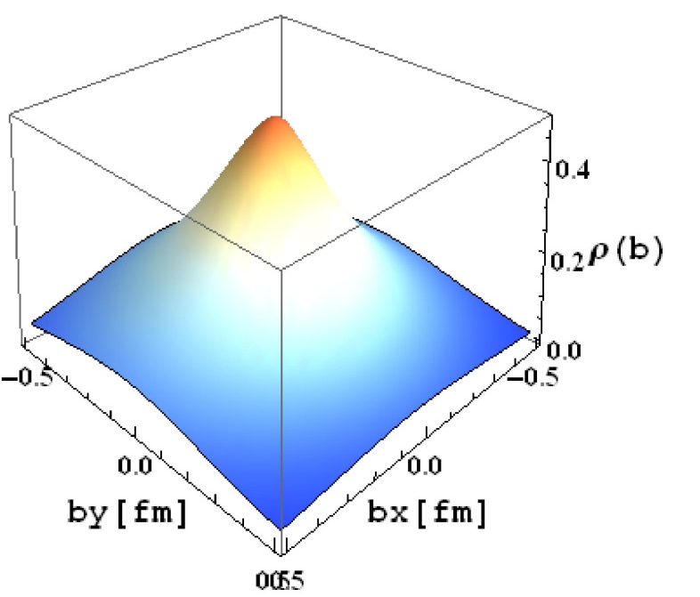
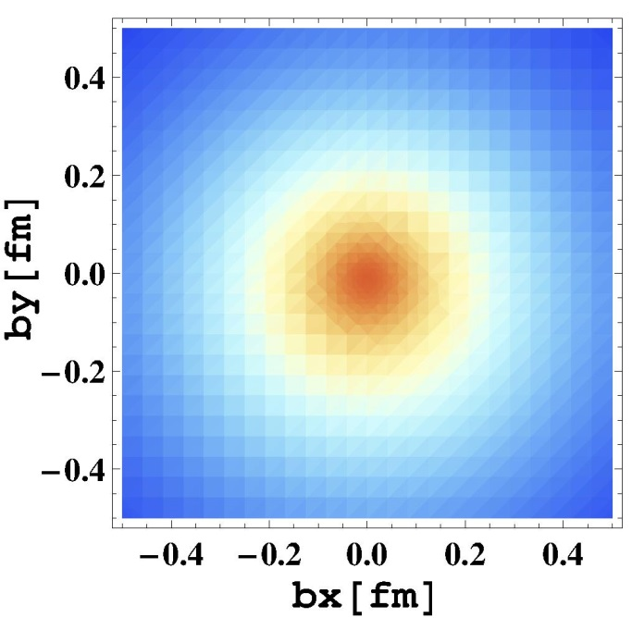
Quark transverse charge density of the proton
$$ρ_{T}^{N}\left(\vec{b}\right)=ρ_{0}^{N}\left(\vec{b}\right)+Sin(φ)\frac{1}{2π}\int_{0}^{∞}{\left.dq\frac{q^{2}}{2M_{N}}J_{1}\left(qb\right) F_{2}(q^{2 })\right)}$$

Slide 43
A.Z. Dubnickova and S. Dubnicka
Hep-ph/0708.0162
“One doesn’t know explicit form of the nucleon matrix element of the EM current”

Slide 45
Mean Radius of Nucleons

Slide 49
Nucleon GPDs
O.V.S. Phys.Rev. D89 (2014); Phys.Rev. D91 (2015)

Slide 50
Summary
* The GPDs reflect the basic properties of the hadron structure and gave
some bridge between the many different reactions.
The new form of the t-dependence of GPDs allows to obtain
the different form factors, including
Compton form factors, electromagnetic form factors,
transition form factor, gravitomagnetic form factor.
The our model of GPDs leads to the well description
of the proton and neutron
electromagnetic form factors simultaneously.
The chosen form of t-dependence of GPDs pion
(the same as t-dependence of nucleon) allow us to describe the electromagnetic form factor of pions
and obtain the gavitomagnrtic form factor of pion.
The obtained parameters of form factors of pion and nucleon
satisfied the quarks account.

Slide 51
Summary
In result, the description of the different reaction based on
the same representation of the hadron structure.
Especially it is concern the high energy elastic hadron scattering
The mHEGS model well describe the pion - nucleon elastic scattering
in wide energy and momentum transfer regions.
The investigation of the nucleon structure show that the density of the matter
more concentrated into hadron than the charge density.
The ratio of the radius of electromagnetic density to gravitomagnetic density
approximately the same for nucleon and pion
* The model open the new way to determine the true form of the GPDs and
hadrons structure

Slide 52
THANKS
For your attention

