Slide 1
Study of Spin Effects in SPASCHARM Experiment at U-70 facility
V. Mochalov
(on behalf of the SPASCHARM collaboration)

Slide 2
Outline
SPASCHARM Project
Physics Program
Polarized proton and antiproton beams
SPASCHARM real (at beamline 14)
Physics
Current experimental Setup
SPASCHARM at DSPIN 2019
SPASCHARM after DSPIN 2019
SPASCHARM in 2023-2024

Slide 3
Motivation
The project is aimed at studying the spin structure of the nucleon and the spin dependence of the strong interaction at energies up to 50 GeV. The fixed target SPASCHARM experiment will systematically study polarization phenomena in exclusive and inclusive hadronic reactions.
The universal setup will detect dozens of particles, produced on a polarized proton and nuclear targets. In parallel with single-spin asymmetries, the polarization of hyperons and the elements of the density spin matrix of vector mesons will be measured.
The ultimate goal of the experiment is to study spin structure of the proton, primarily the determination of the contribution of gluons to the spin of the proton through the investigation of spin effects in the formation of various charmonium states

Slide 4
Motivation 2
The presence of polarized both protons and antiprotons in the CP neutral -system potentially opens up opportunities for studying and comparing CP conjugate reactions with one another. This allows us to look at CP invariance in a new perspective, inaccessible to collisions of unpolarized particles.
Finally, the presence of eight types of unpolarized beams (π±, K±, p, p͂, d, C), in combination with a polarized and nuclear targets, extends the range of studies of polarization phenomena by an order of magnitude and enhances the uniqueness of the project. The study of energy dependence of spin effects reveals the dynamics of interaction. The measurements might be conducted at several energies in order to estimate the model parameters.

Slide 5
Single-spin asymmetry measurements (motivation)
Single–spin asymmetries and hyperon polarization almost do not depend on beam energy – accuracy is more important:
inclusive and exclusive reactions, including elastic, of the light (u, d, s – quarks) hadrons in the beam fragmentation region with polarized beam or target. The hyperon and vector mesons polarization (elements of the density spin matrix)

Slide 6
Elastic scattering
Elastic scattering is required for absolute polarimetry at channel 24
Special elastic scattering measurements with own physical program (See talk by Marina Nurusheva next)

Slide 7
Conceptual Design Report

Slide 8
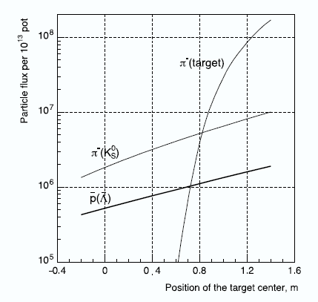
Beam intensity
V.Abramov et al, The polarized proton and antiproton beam project at U-70 accelerator Nuclear Inst. and Methods in Physics Research, A 901 (2018) 62–68

Slide 9
SPASCHARM at beamline 14
Energy 26,5 GeV, Particles pi/K/pbar=98%, 1.75%,0.15%, Intensity: up to 10⁶
Charged: Δθ_{x} > ±180 mrad, Δθ_{y} ≈ ±120 mrad, 0 < x_{F} < 1, p_{T} < ~2.5 GeV/c
γ and π⁰: Δθ_{x} ≈ ±50 mrad, Δθ_{y} ≈ ±40 mrad, 0 < x_{F} < 1, p_{T} < ~1 GeV/c
Field in spectrometer magnet 0,7 T (BxL)

Slide 10
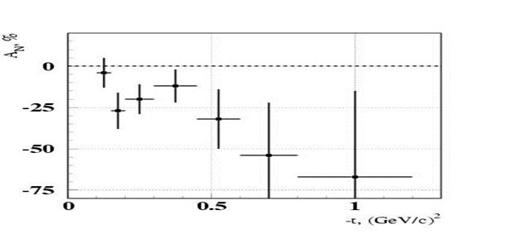
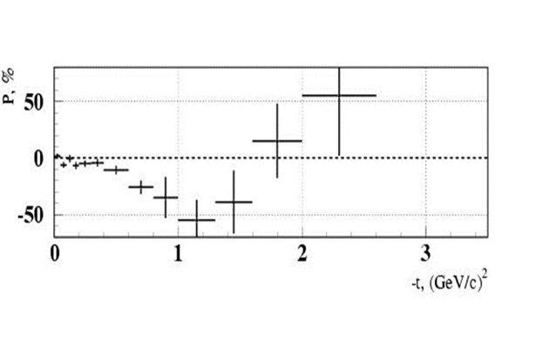
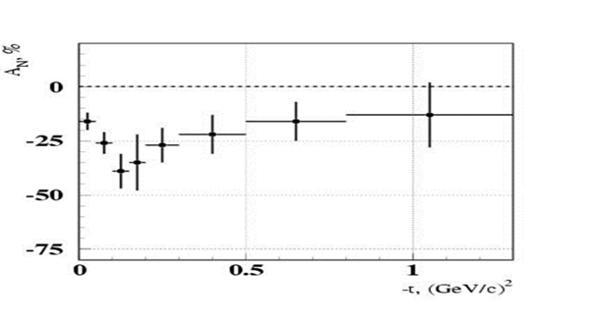
Beamline 14 motivation (exclusive)

Slide 11
SPASCHARM at Beam-line 14 (motivation inclusive)
pp↑→π⁰X at x_{F}=0
pd↑→π⁰X at x_{F}>0.7
Phys.Lett. B243 (1990) 461-464, Sov.J.Nucl.Phys. 50 (1989) 432-437, Yad.Fiz. 50 (1989) 695-704
Phys.Atom.Nucl. 73 (2010) 2017-2021, Yad.Fiz. 73 (2010) 2072-2076
A_{N} = (16±5)% at p_{T} =(0.7-1.8) GeV/c and at x_{F} > 0.7.
A quite sizeable asymmetry showed up at p_{T} ~ 1 GeV/с and above even in the unpolarized beam fragmentation region.

Slide 12
Finally !!! (Slide From 2019)
The pilot version of the SPASCHARM setup was commissioned in 2018:
Work with beam: 124 shifts (6 hour each) March 12 – April 12
March 12-23: 46 shifts Commissioning itself
March 23 –April 6 56 shifts with polarized target (partially commissioning)
April 06-12 22 Shifts Carbon and empty target
Finally on “tapes” events with min.bias trigger:
~800 Mevents with polarized target (300 Mevents of them during commissioning phase)
~300 Mevents on Carbon and empty target
Totally: about 10^9 events for analysis

Slide 13
SPASCHARM 14: current activities (2019)
Analyzing first experimental data
Analysis of the hardware performance
Development software and data reconstruction for reactions: π⁻ + p↑ → π⁻ X, π⁻ + p↑ → π⁺ X, π⁻ + p↑ → π⁰ X, π⁻ + p↑ → ω(π⁻ π⁺ π⁰) X
Systematic error estimation (also simulation)
Simulation
Reconstruction algorithm performance
Investigation possibility to study asymmetry in K^0 and ω inclusive production
Hardware
Tracking system optimization, including new station
DAQ (mainly TDC) optimization

Slide 14
Expected statistical accuracy 2018
J.Phys.Conf.Ser. 1690 (2020) 1, 012164 – ICPPA-2020
But what about systematics???

Slide 15
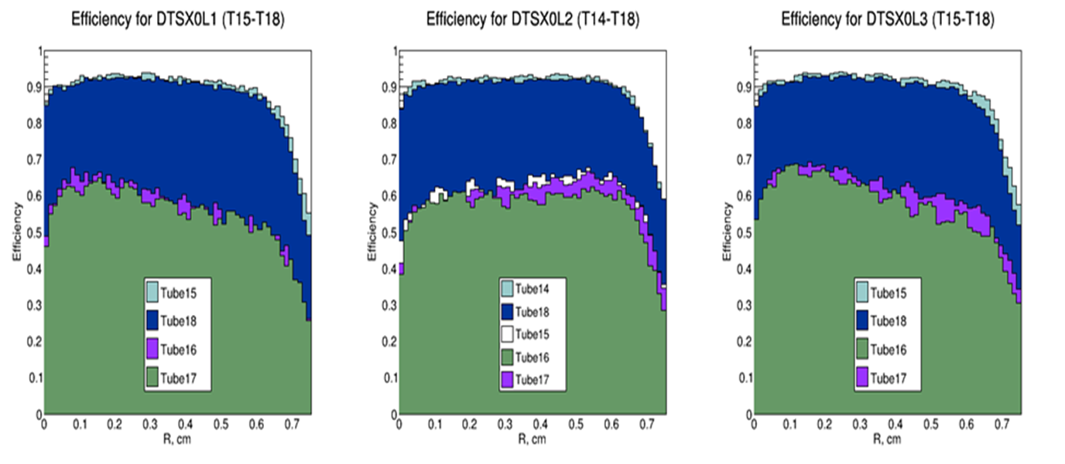
Run 2018 efficiency results
Efficiency strongly varied in time

Slide 16
2019-2021 activity
Experimental setup:
Increase efficiency and stability of track detectors
Add new drift chamber
Measure field of spectrometer magnet
Calorimeter calibration
Softare:
Develop software
Simulation of reality

Slide 17
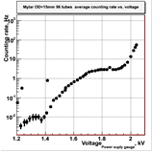
New 15 mm drift chamber
4 planes (X,Y, U,V).
Placed together with prop. chambers
Additional chamber is required for vertex reconstruction (K0, Λ)
Increase efficiency and accuracy of track reconstruction

Slide 18
Track system
New gas system
Study of dependence of efficiency and stability on gas mixture on cosmics and beam.
It was found at least 1 (better 1.5) volume blowing through the chamber
TDC was reconfigured to decrease redout time twice

Slide 19
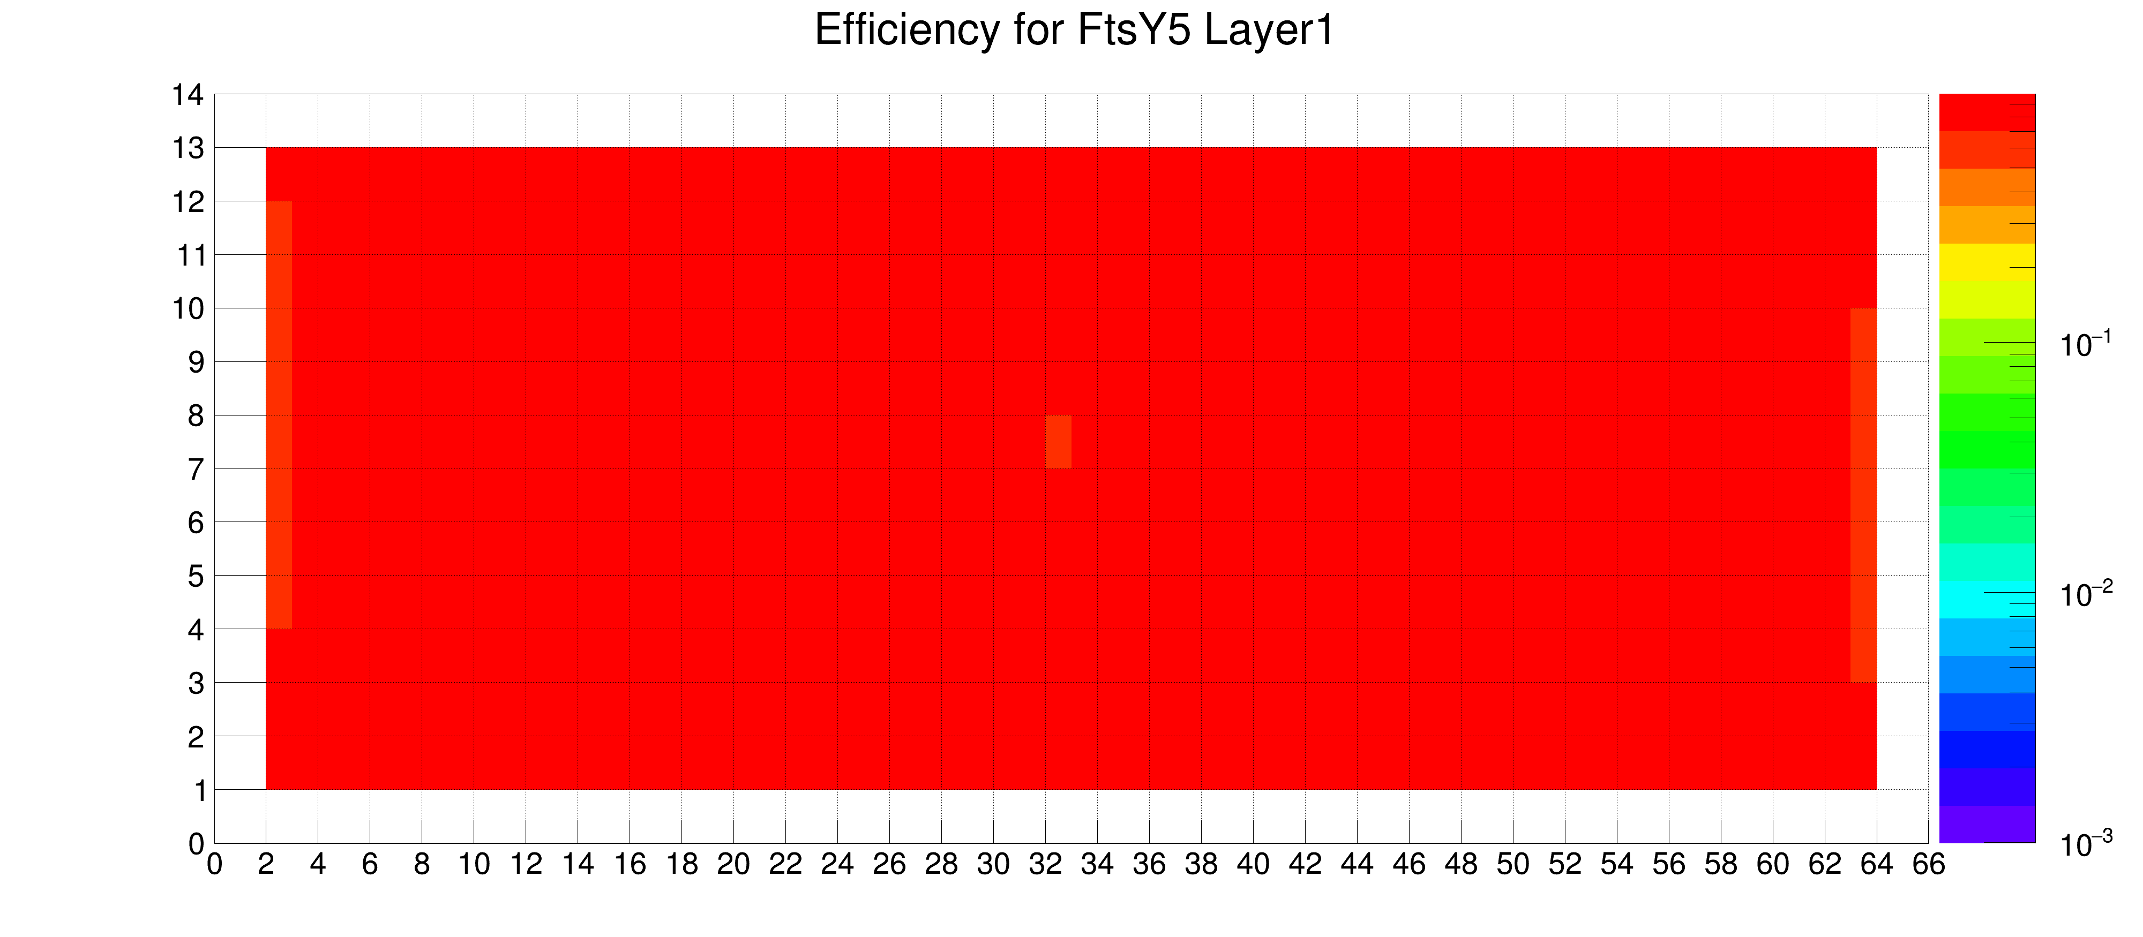
Tracking system efficiency 2021
Efficiency in 2022 is even higher for all planes (96-98% foe “small” tubes and 94-97% for “large” ones (received from reconstructed tracks)

Slide 20
Achieved stability in 2021

Slide 21
Proportional chambers efficiency

Slide 22
Field of spectrometer magnet was measured

Slide 23
Measurement accuracy

Slide 24
Magnet correction
RMS=(4.28±0.08)×10⁻⁴ | RMS=(1.86±0.07)×10⁻⁴ | RMS=(1.28±0.07)×10⁻⁴
(ΔB/B)_{MAX} = 2.5×10⁻³ | (ΔB/B)_{MAX} = 8.4×10⁻⁴ | (ΔB/B)_{MAX} = 7.8×10⁻⁴
Pol – N/A | POL=69% | POL > 70%

Slide 25
EMC-calibration
New calibration with 19 GeV electron beam was carried out.
All channels are alive
5,3 MeV/ADC channel, 10% spread between channels

Slide 26
Beam adjustment

Slide 27
New profilometer to prove beam position

Slide 28
Simulation physics

Slide 29
Expected (simulated) accuracy for $K_{S}^{0}$and $ω\left(782\right)$ mesons
JPS Conf.Proc. 37 (2022) 020504 SPIN-2021
GeV/с | 0 < p_{Z} ≤ 4.0 | 4.0 < p_{Z} ≤ 8.0 | 8.0 < p_{Z} ≤ 12.0 | 12.0 < p_{Z} ≤ 16.0 | p_{Z} > 16.0
0 < p_{T} ≤ 0.25 | 0.016 | 0.01 | 0.018 | 0.043 | 0.073
0.25 < p_{T} ≤ 0.5 | 0.024 | 0.008 | 0.012 | 0.024 | 0.039
0.5 < p_{T} ≤ 1.0 | 0.237 | 0.013 | 0.011 | 0.019 | 0.033
p_{T} > 1.0 | - | 0.186 | 0.039 | 0.039 | 0.058
 | p_{Z} ≤ 12.0 | p_{Z} > 12.0
p_{T} ≤ 0.5 | 0.052 | 0.022
p_{T} > 0.5 | 0.050 | 0.024

Slide 30
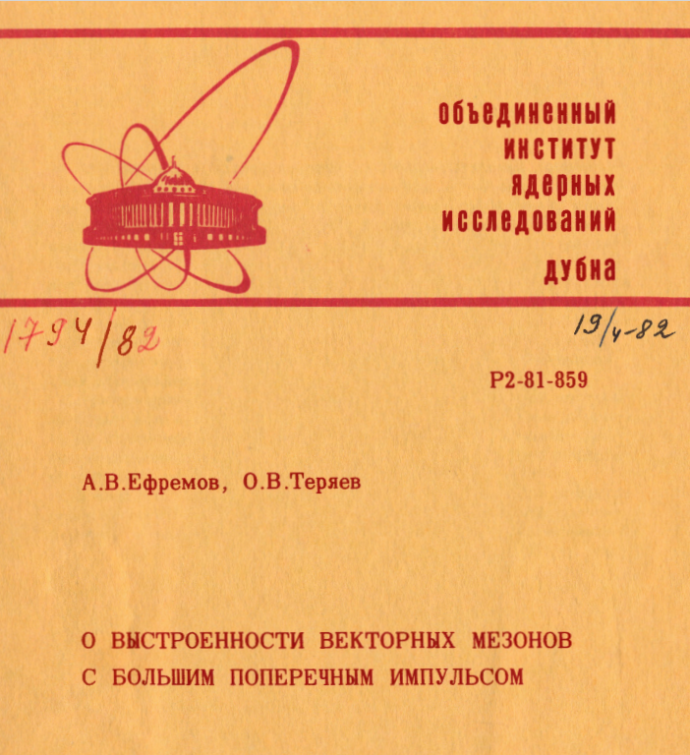
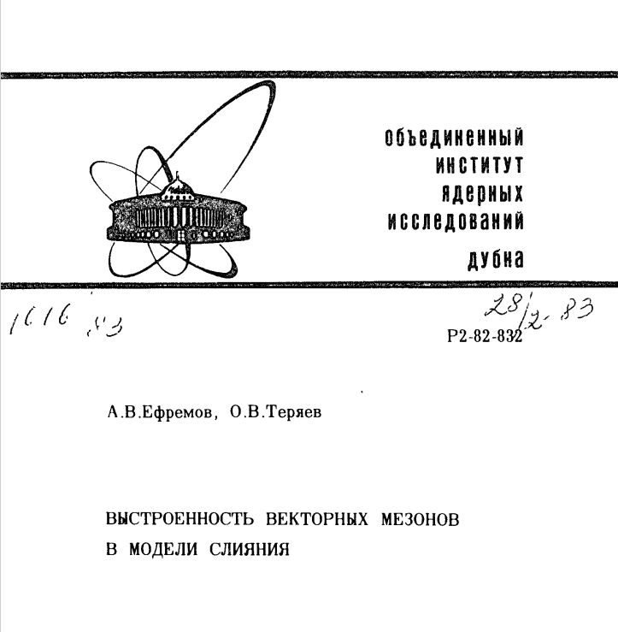
Run 2021 preliminary plan
A_{N} measurements in charged pion, K⁰ and ω(782) production with polarized target
were destroyed due to COVID-19 limitations in Moscow region and JINR
New program:
Spin density matrix of vector mesons (?)
Λ-hyperon polarization (?)

Slide 31
Run 2022 preliminary plan
A_{N} measurements in charged pion, K⁰ and ω(782) production with polarized target
were destroyed due to Target leakage (first superfluid) in 1K bath.
Tried to recover at least one half of beam time
New run 2022 program:
Trigger for K beam
Spin density matrix of vector mesons (?) and Λ-hyperon polarization (?) with K beam

Slide 32
See V. Abramov Talk on Tuesday

Slide 33
Data analysis of 2021
We reconstructed about 100 thousand K_{s} (σ about 12 MeV/c²) and about 20 thousand Λ (σ about 4 MeV/c²)

Slide 34
A-dependence

Slide 35
A-dependence
Preliminary
Paper is under preparation, supposed to be submitted this month

Slide 36
Λ Polarization and spin alignment
Data analysis on Λ polarization and spin alignment of vector mesons (ρ and K*) is under study.
First indication on significant Λ polarization on K⁻ beam (zero on π⁻)
Simulation of reconstruction efficiency on decay angle is required and under study.

Slide 37
Asymmetry of pions in 2018
Detector characteristics are reconstructed including alignment
Full real simulation (taking into account 2D chamber efficiency for each sub-plane of track detectors) is prepared and almost finished for time slots– it is required to obtain asymmetry we expecting first result this year.

Slide 38
Experiment strategy
Try to find finance for polarized particle beamline
New polarized target (Contract with JINR – hope new target to be ready in middle 2026)
Data taking to measure spin alignment and hyperon polarization with p, K⁻ and π⁻ beams with different nuclei
New detectors: fiber hodoscope and PNPI drift chambers
Analysis:
Charged pion asymmetry (data 2018)
Λ – polarization (2021 and 2022 runs)
ρ and K* spin alignment (2021 and 2022 runs)

Slide 39
Conclusion
SPASCHARM physics program is rich and complementary to SPD program.
Pilot version of the SPASCHARM experiment was commissioned and first data were accumulated.
Unfortunately polarized target is out of service – we had to reconsider physics program
Collaboration of IHEP, JINR, PNPI, KI (TEP) and MEPHI and Experimental Setup are fully ready to take new data and study spin effects on p, K⁻ and π⁻ beams with different nuclei
First results are on the way (first will be reported in a month on Nuclei-2023 conference)
We hope to obtain first spin results this Fall.
The Talk was supported by RSF grant 222-12-00164

Slide 40
Backup slides

Slide 41
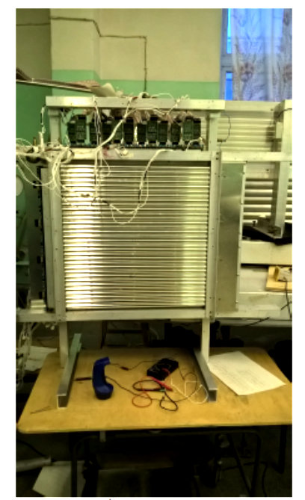
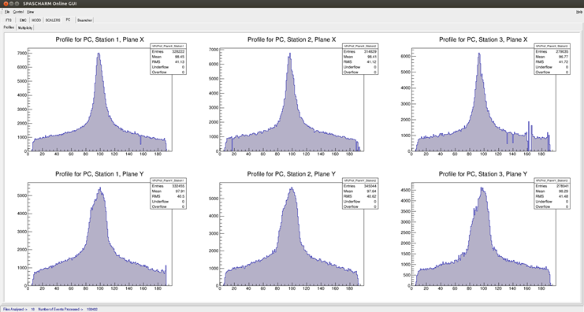
New detectors

