Slide 1
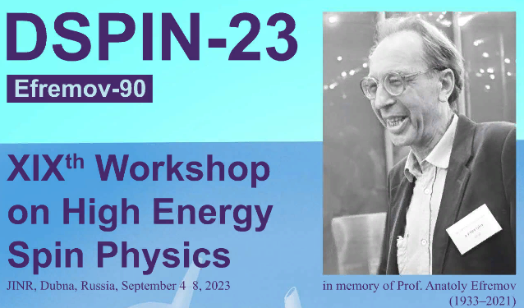
Polarized Ion Sources for high-energy accelerators and colliders
A. Zelenski, MIPT
High-intensity polarized proton and deuteron ion sources.
Optically-pumped polarized 3He++ ion source development for EIC.
DSPIN 2023, September 2023

Slide 2
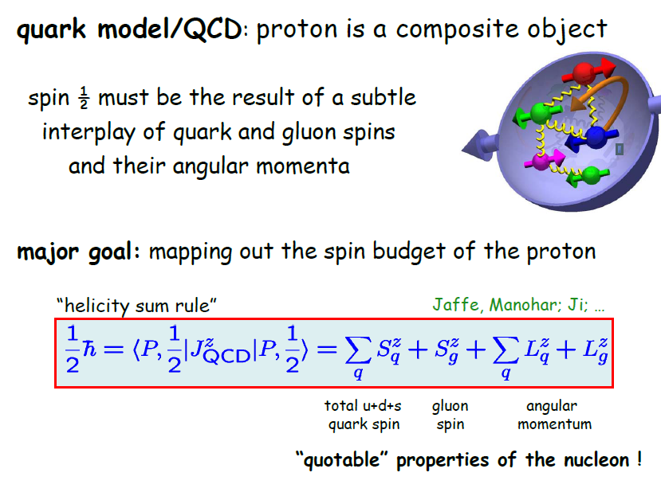
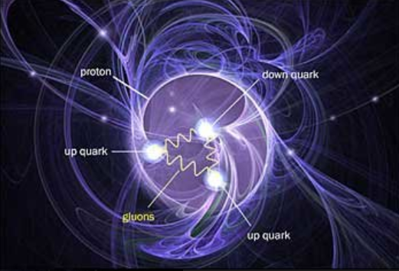
Magnetic moment -2.79 µ _{N}

Slide 3
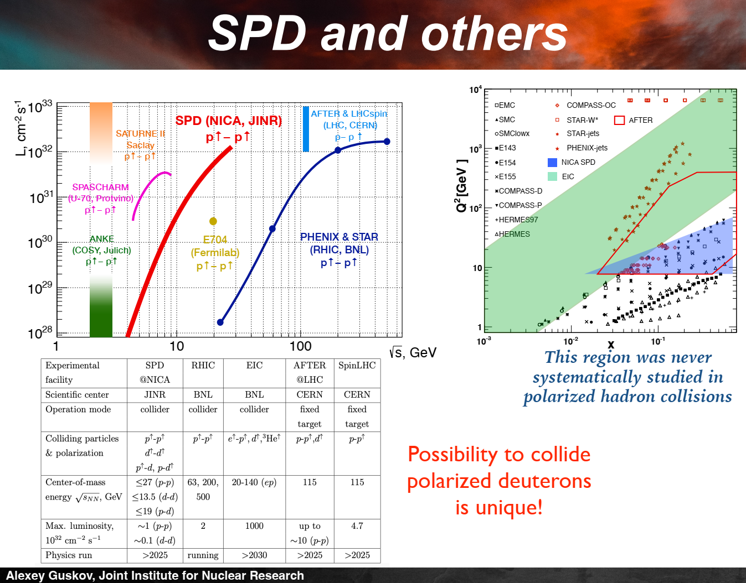
Transition from hadronic
to quark-gluonic constituents
Energy, luminosity, polarization
e,P,D, 3He

Slide 4

Workshop on high–energy spin physics, Protvino, 1983
G.Budker, G.Dimov,…- polarized H⁻ ion beam strip injection to circular accelerators, 1977, Pol. H⁻ ion beam intensity was ~5 µA.
A.V. Efremov
Yaroslav Derbenev
“Siberian snake” proposal, 1974
Anatoli Zelenski
A new polarized source technique.
Equal intensity for polarized and
un-polarized proton beams.
Notes:
4

Slide 5
High intensity polarized H⁻ ion source and “Siberian Snakes” made possible the high luminosity RHIC operation with colliding polarized protons beams to study:
proton spin structure,
fundamental tests of QCD and electro-weak interaction.
Polarimetry

Slide 6
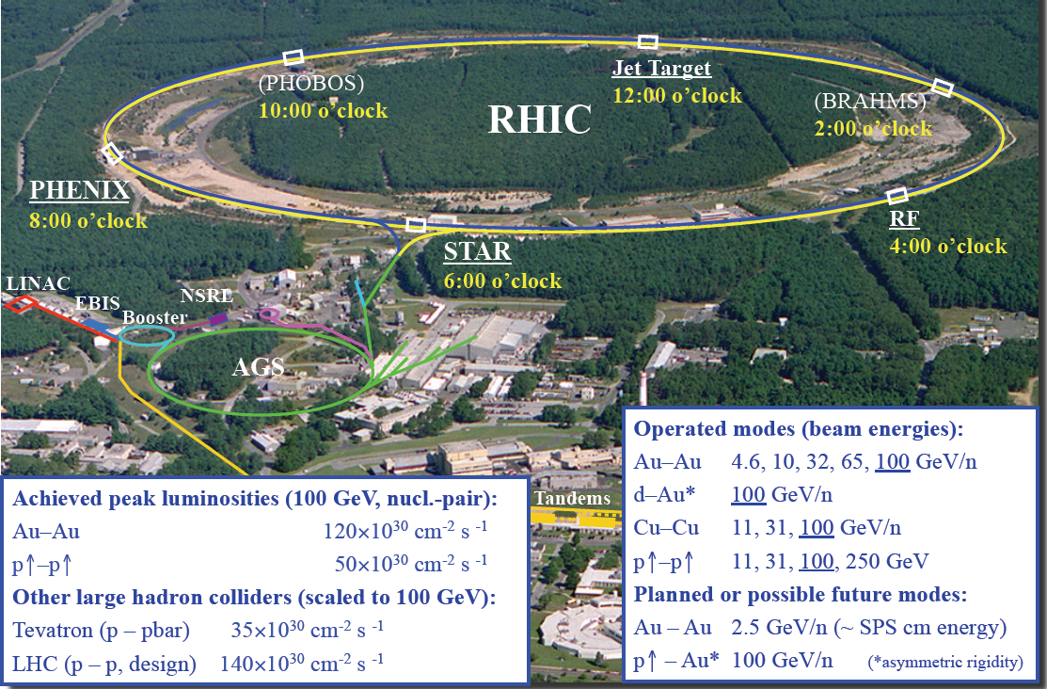
RHIC High-Luminosity Relativistic Heavy Ion (Polarized protons) Collider
3834 м
2010-100 ,31, 19.5,3.9, 5.5 GeV
Notes:
6

Slide 7

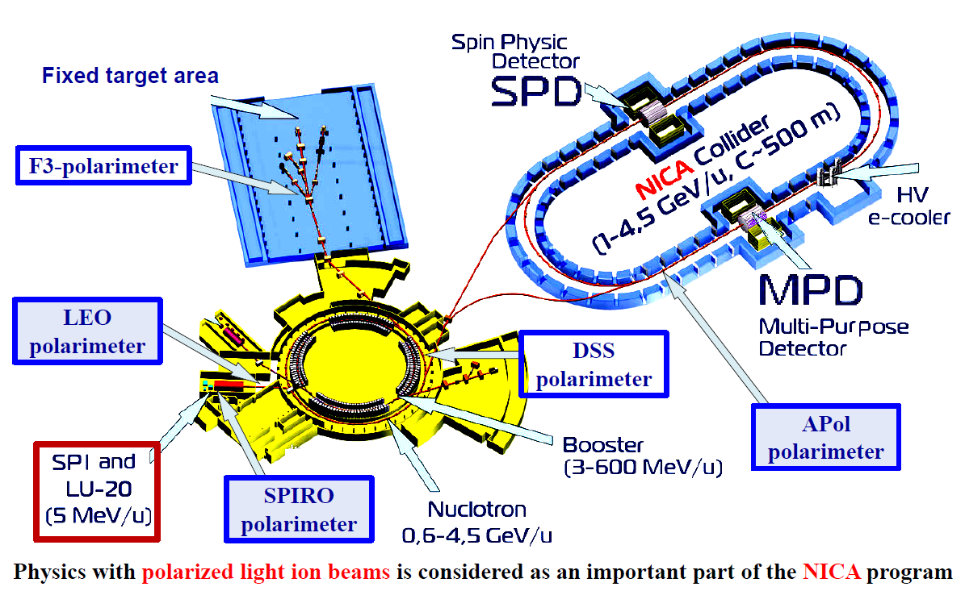
Polarized proton(deuteron) beams in NICA collider, √s up to 27 GeV-for protons
В.В. Фимушкин

Slide 8
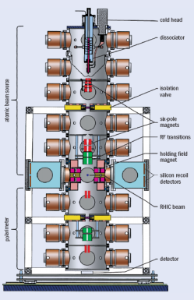
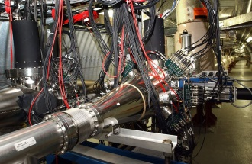
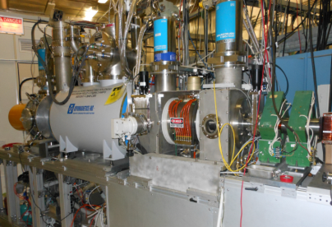
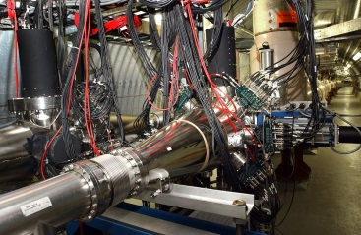
Polarization facilities at RHIC
L _{max} = 1.6 × 10³² s⁻¹cm⁻² 50 < √s < 510 GeV
Absolute H-jet
polarimeter
RHIC pC “CNI” polarimeters
RHIC
PHENIX
STAR
Siberian Snakes
Spin Rotators
Pol. H⁻ ion source
EBIS
LINAC
AGS, 24GeV
AGS pC “CNI” polarimeter
200 MeV polarimeter
BOOSTER, 2.5 GeV
Notes:
8

Slide 9
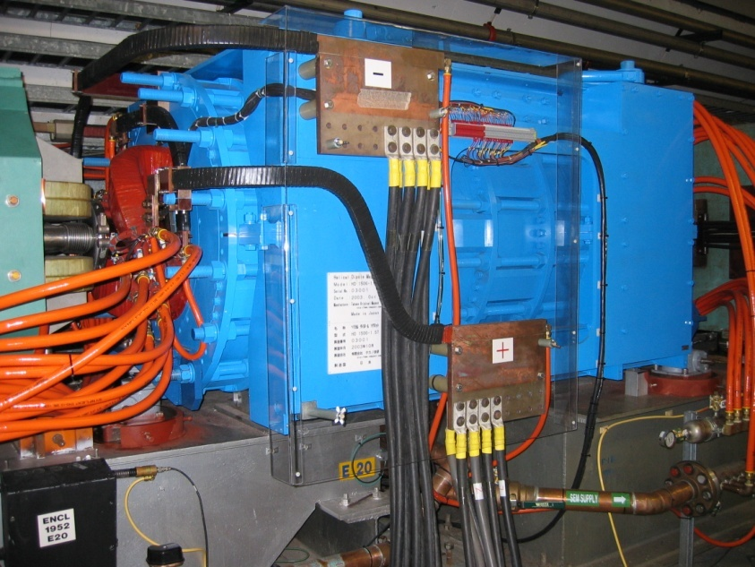
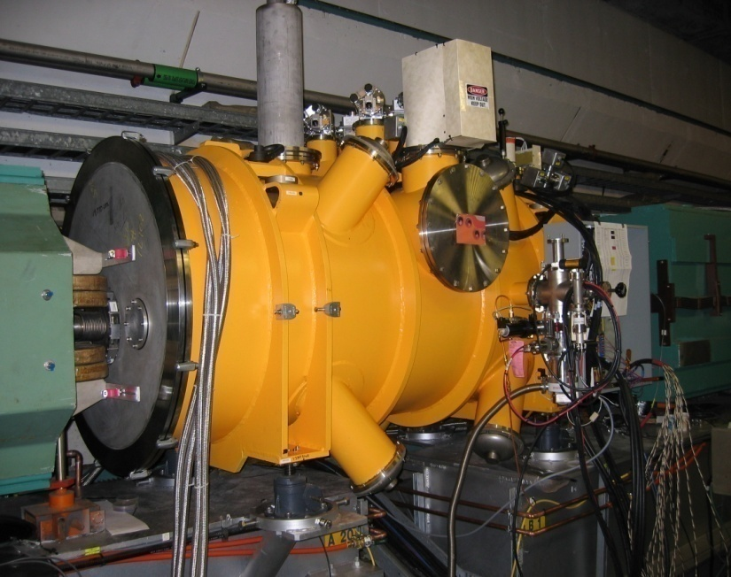
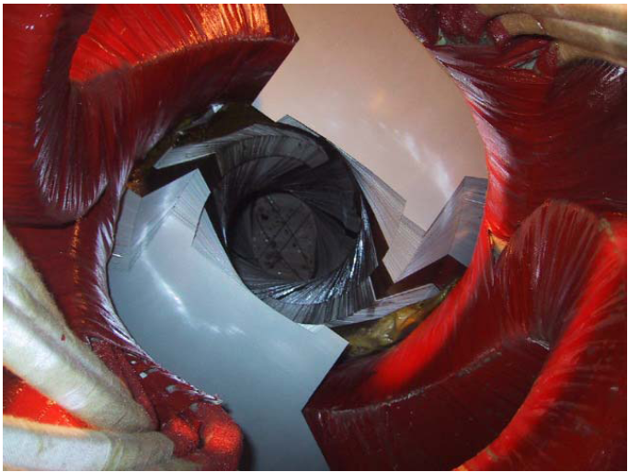
AGS Cold Snake installed.
The two-snake solution provides better spin matching at injection and extraction.
Notes:
9

Slide 10
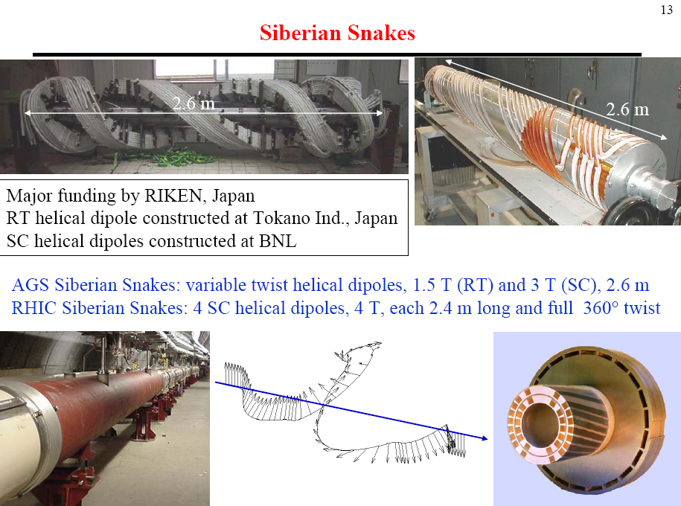
Notes:
10

Slide 11
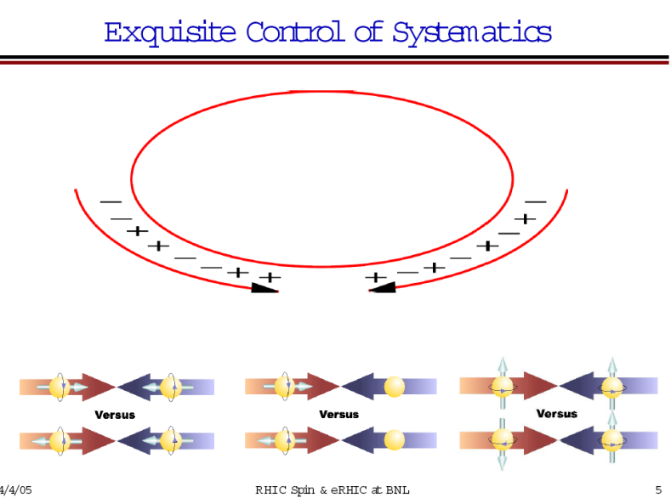
RHIC Polarized beam in Run 2013-22
OPPIS
1.0 mA x 300us→18∙10¹¹ polarized H⁻ /pulse
9.0 ∙10¹¹ polarized H⁻ /pulse at 200 MeV
routinely in Run-17, Polarization-85%
LINAC
Booster
(2.5-3.0) ∙10¹¹ protons /pulse at 2.3 GeV
AGS
(2.0-2.5) ∙10¹¹ p/bunch, P-70%
~2.0∙10¹¹ p/bunch, P~65-75% at 100 GeV
P ~ 60-65% at 255 GeV
RHIC
Notes:
11
11

Slide 12
Proton polarization techniques
AB velocity-2x10^5 cm/s
Ionization
ABS
Dissociator
Separating
6-pole magnet
RF
transition
ECR ionizer
→ H⁺
LDS
Cs cell
→ H⁻
Optically-
Pumped cell
Cs beam
→ H⁻
Plasma ionizer
AB velocity-10^8 cm/s
→ H⁻
Optical pumping
OPPIS
Proton
source
Optically-
Pumped cell
Sona
transition
Na cell,8%
→ H⁻
H⁰
Source
Optically-
Pumped cell
He cell,70%
→H⁺
Polarization
Transfer to
protons
Polarization by electron spin

Slide 13
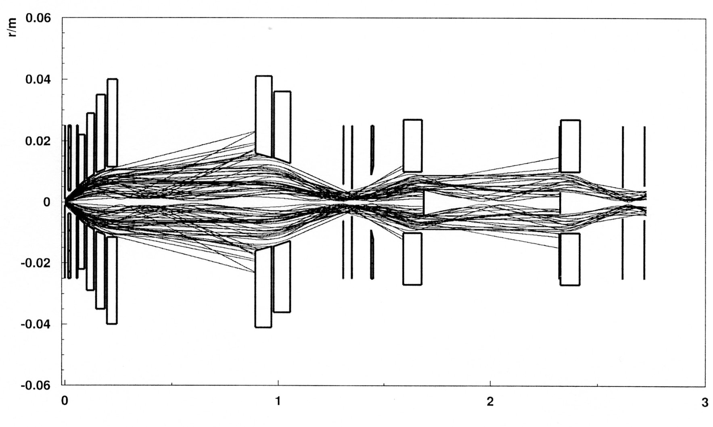
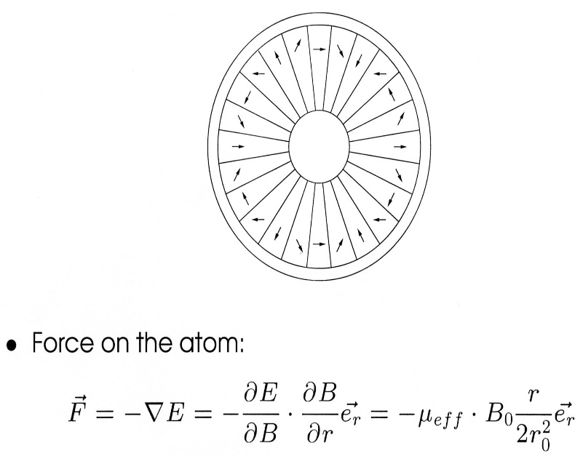
Spin filtering technique. Atomic beam sources
Hydrogen atoms with electron polarization: m_{J}=+1/2 trajectories
Breit-Rabi polarimeter
RHIC beam crossing
RF transition, polarization transfer
from electrons to protons
Magnet system design, NIM A256, (2006)
T.Wise, W.Haeberli, H.Kolster et al.
Ne-Fe-B permanent magnet
sextupole - 1.7 T
gradient 5.7 T/cm
Notes:
13

Slide 14
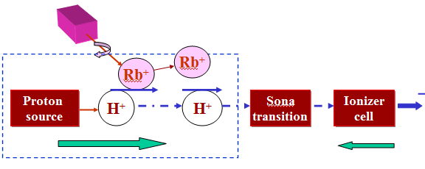
OPPIS with atomic H⁰ injector
High-brightness proton beam inside strong 2.5 T solenoid field
produced by atomic H beam ionization in the He-gas ionizer cell
H⁻
H0
Atomic H
injector
He-cell
25 kG
1.5 kG
The primary proton beam and
Equivalent atomic H intensity
current is 2.5 A at 6.5 keV beam energy !

Slide 15
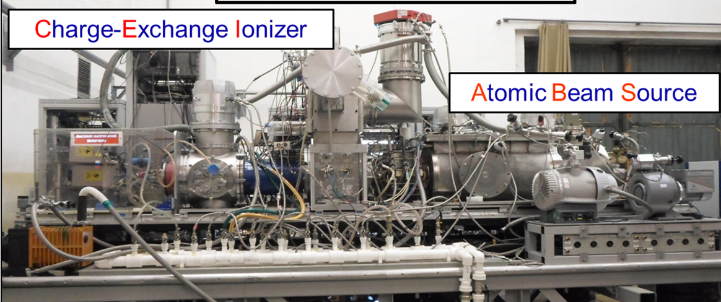
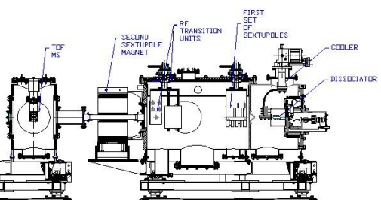
SPI-Source of Polarized Ions, NICA
Polarized proton/deuteron
current-6-10 мА
Pulse duration-200 us
0.2-1.0 Hz
The high intensity pulsed source of polarized ions (SPI) has been developed at JINR to inject polarized deuterons and protons into the NUCLOTRON and future collider of heavy and light ions NICA [1]. The SPI is an atomic beam-type polarized ion source with a charge-exchange plasma ionizer and a storage cell in the ionization region [2-4].
To measure the SPI beam polarization, the following low energy polarimeters will be used: SPI low energy polarimeter (SPIRO) and a linac output low energy polarimeter (LEO).

Slide 16
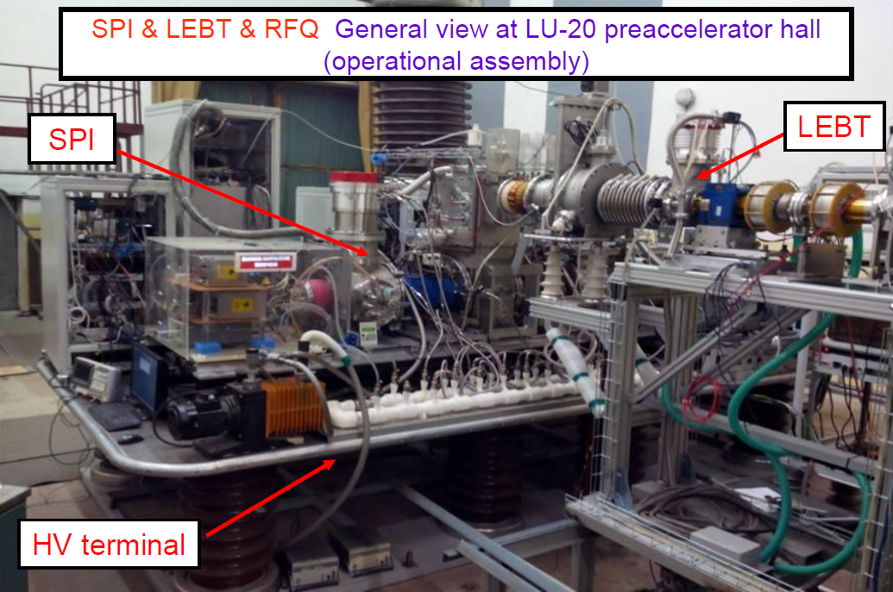


Slide 17
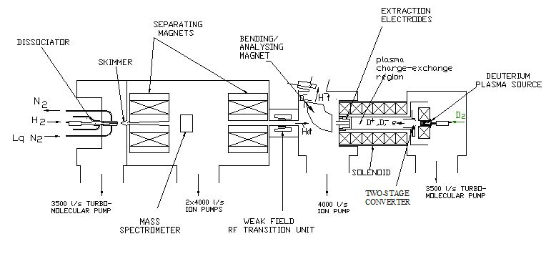
INR RAS source of polarized H⁻ ions, A.S.Belov
H⁰↑ + D⁻ ⇒ H⁻↑ + D ⁰
Peak H⁻ ion current - 4 mA
Polarization ~ 0.9
Unpolarized D⁻ ion current 60 mA (~20 mA/cm²)
Pulse duration (FWHM) –
170 μs
Rep. Rate 5 Hz
(Belov et. al, 2007)
17
Belov, SPIN2012, Dubna

Slide 18
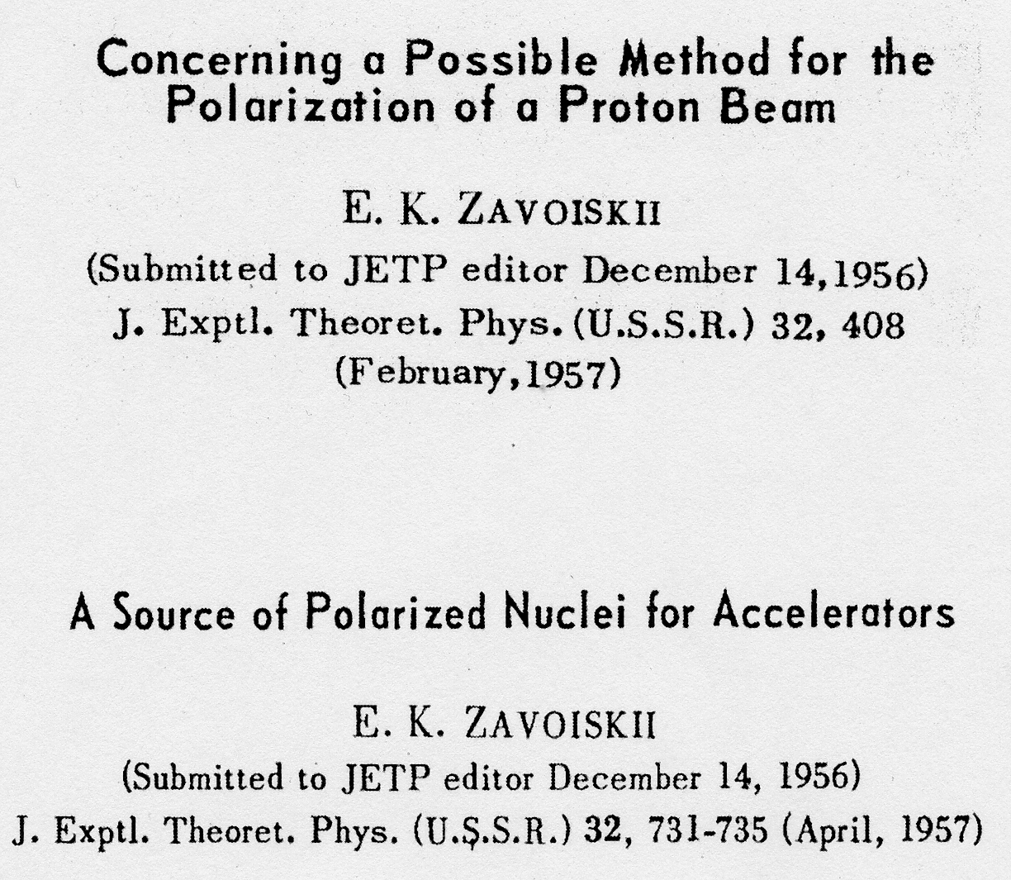
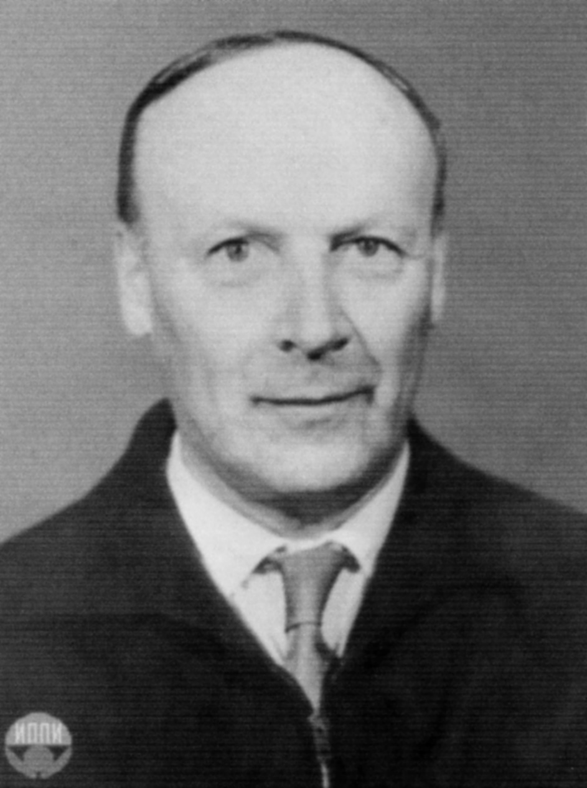
Методы поляризации предложенные Е.К. Завойским.

Slide 19
OPPIS with atomic H⁰ injector
High-brightness proton beam inside strong 2.5 T solenoid field
produced by atomic H beam ionization in the He-gas ionizer cell
H⁻
H0
Atomic H
injector
He-cell
25 kG
1.5 kG
The primary proton beam and
Equivalent atomic H intensity
current is 2.5 A at 6.5 keV beam energy !

Slide 20
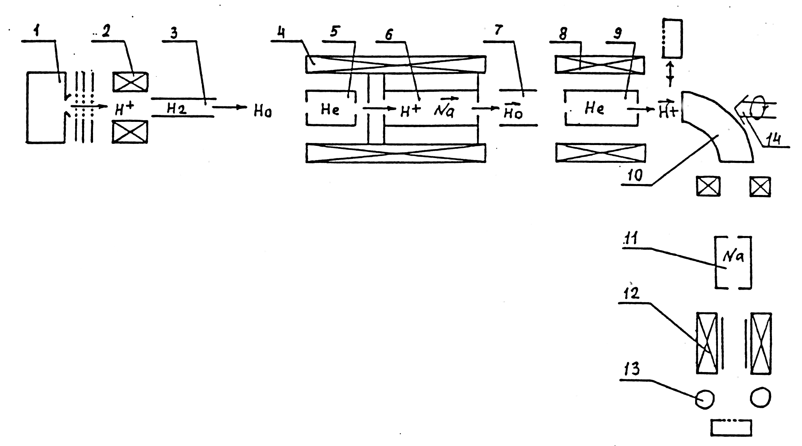
Pulsed OPPIS with the atomic hydrogen injector at
INR, Moscow, 1982-1990. First generation
Atomic H⁰ injector
Helium ionizer cell
Lamb-shift polarimeter
H⁻ current- 0.4mA
H⁺ current- 4.0 mA, P=65%, 1986

Slide 21
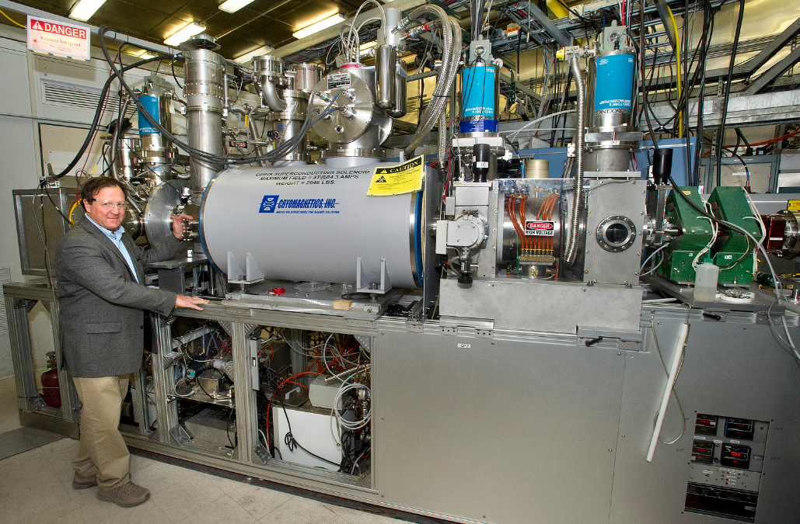
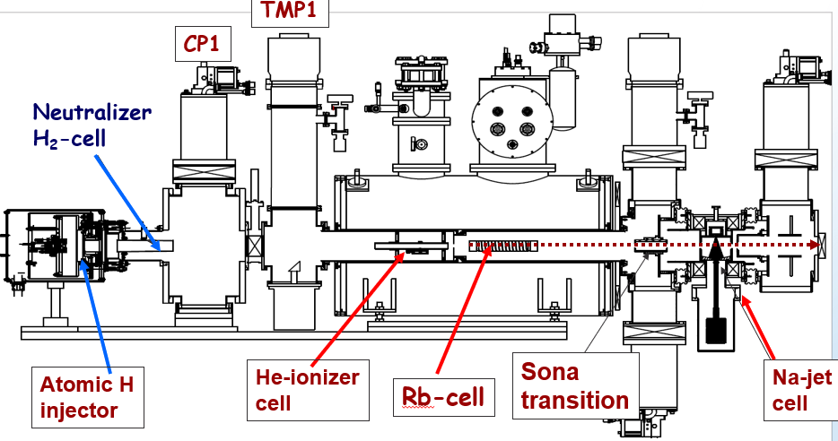
The RHIC OPPIS with atomic hydrogen injector, 2013-22
Polarized Н⁻ ion current
1.0-3.0 мА, Р-85%

Slide 22
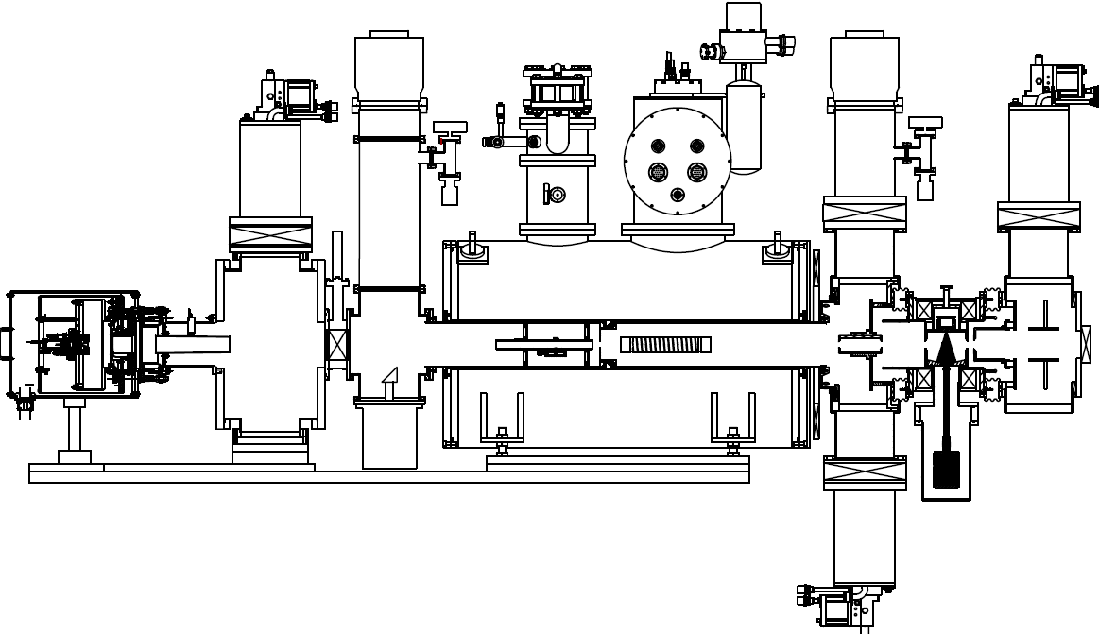
OPPIS with atomic H⁰ injector and He-ionizer cell at RHIC, 2012-19
TMP1
CP1
Neutralizer
H₂-cell
He-ionizer
cell
Sona
transition
Na-jet
cell
Atomic H
injector
Rb-cell
H⁰
H⁺
H⁰
H⁻
H⁺
H2
He
Rb
Na

Slide 23
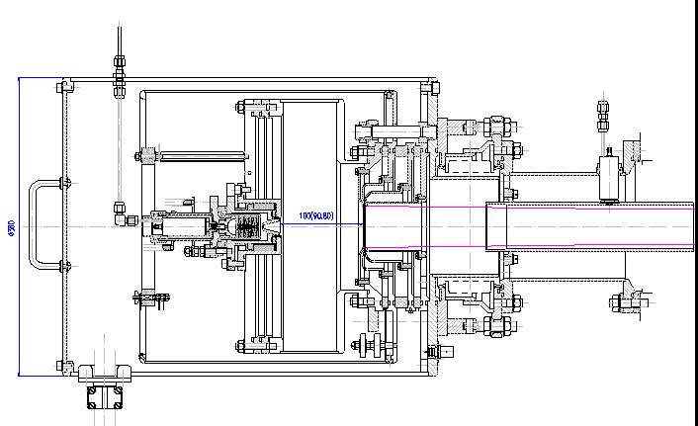
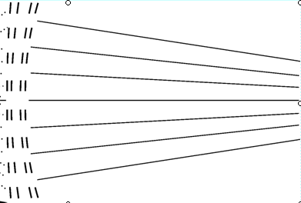
“Fast Atomic Beam Source”, FABS, BINP, Novosibirsk,2011
Plasmatron
4-grid proton
extraction system
~ 2.5 A
equivalent
H⁰ beam
H2 Neutralization cell
FABS produces 100-150 mA equivalent H0 beam intensity
Within the Na-jet ionizer acceptance.

Slide 24
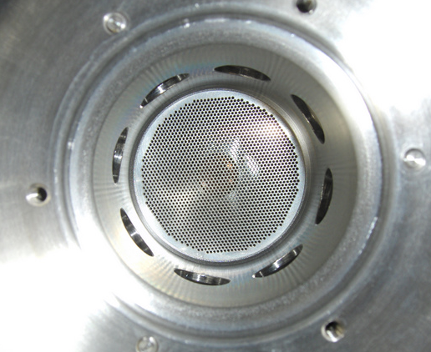
FABS 4-grid (spherical) Ion Optical System
with “geometrical focusing
2.5-5.0 A of
proton beam
At 6-10 keV
energy
1820 holes ,
1.0 mm in diameter
R1, grid1-180 cm
R2, grid2-150 cm
R3, grid3-120 cm
R4, grid4-120cm
5.0 cm

Slide 25
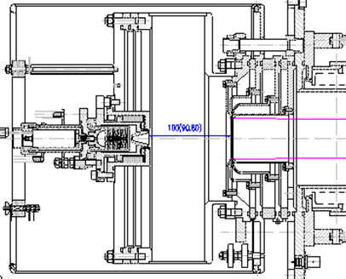

Atomic beam profile measurements
High-brightness
Proton source
Bending
magnet
Deflecting
magnet
FC
H⁻
SEM
200 cm
H⁺
H2-neutralizer
cell

Slide 26
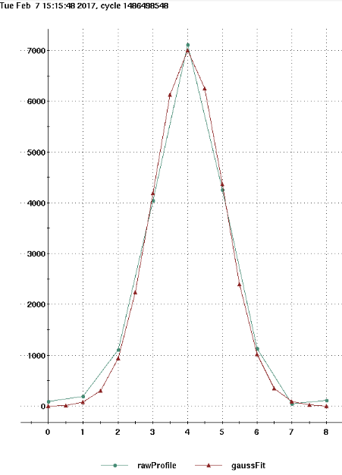
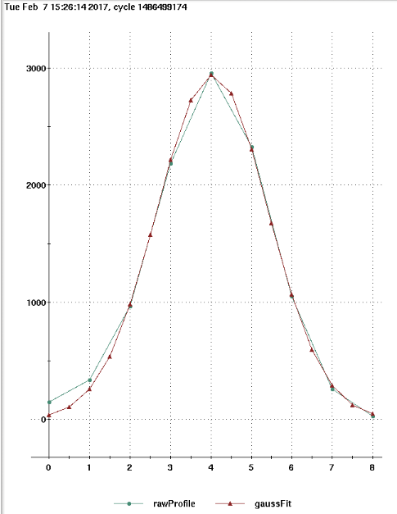
Atomic beam intensity profile vs. distance from the source.
Re-1.40 cm at the distance:
L=100 cm-from the source
Re-1.98 cm at the distance:
L=200 cm-from the source
FWHM-3.25 cm
FWHM-2.3 cm

Slide 27
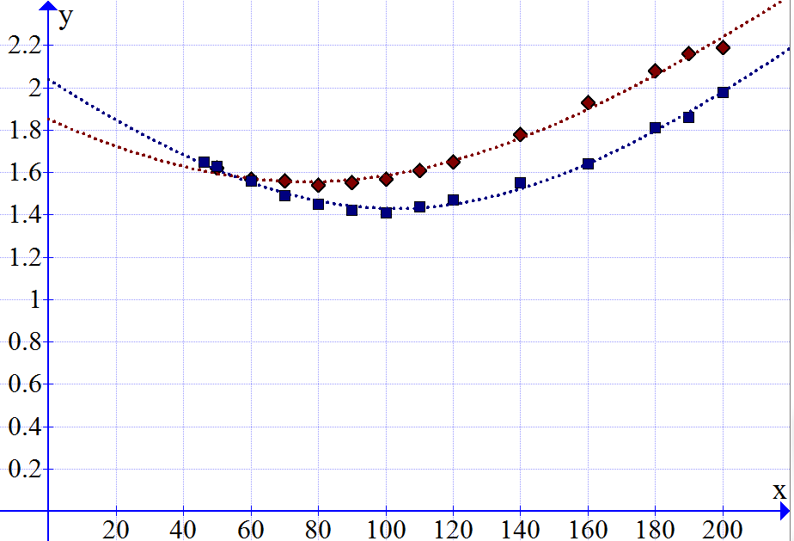
Atomic beam intensity profile vs. distance from the source measured with the movable secondary emission monitor.
Total equivalent H beam intensity 2.5A
Re
IOS#1
New IOS#2
F ~200 cm, δα -10 mrad
Distance from the source: L-cm
Re- half-width of beam intensity profile at -1/e level.
Beam profile FWHM = 1.67 Re

Slide 28
Residual un-polarized H0 beam component suppression
by energy separation
H⁰ + He → H⁺ + He + e
Deceleration
H⁰(6.5 keV)
Rb -cell
He-ionizer cell
H⁺(70%)
H⁰(2.5 keV)
H⁰(30%)
H⁰(6.5keV)
-4.1 kV
-4.0 kV
-4.1 kV
-2-3 kV
+0.1kV

Slide 29
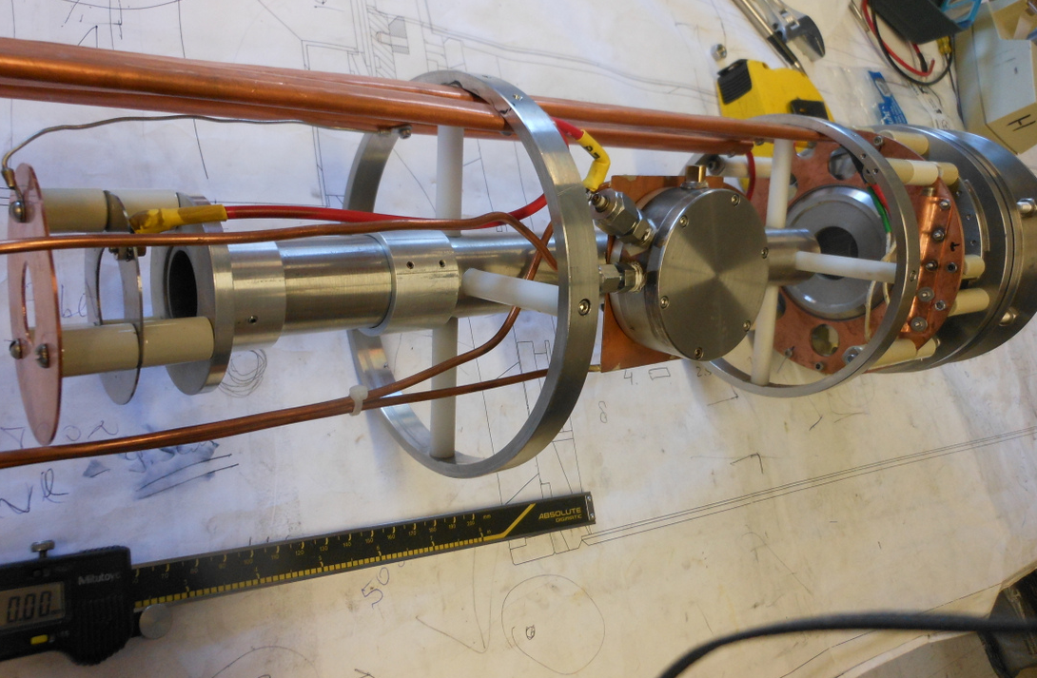
He-ionizer cell and 3-grid energy separation system
He-pulsed
valve
3-grid beam
deceleration
system

Slide 30
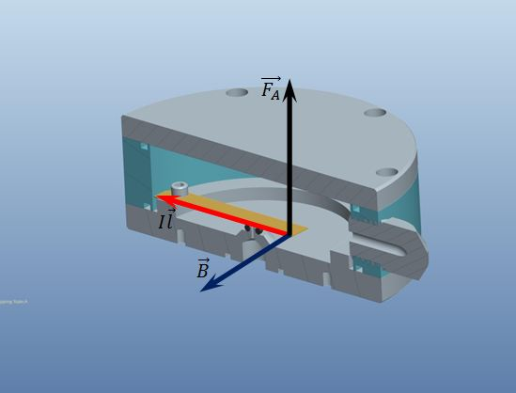
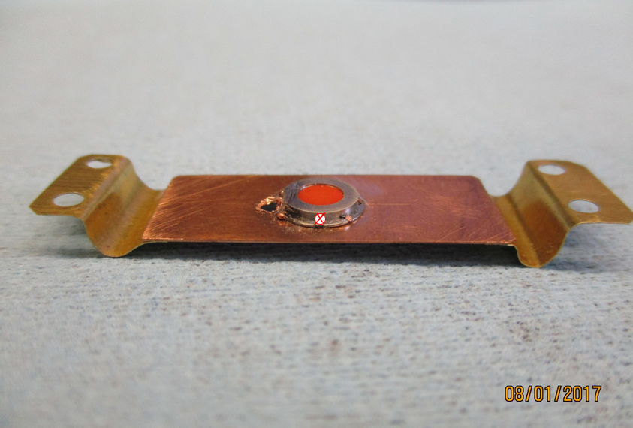
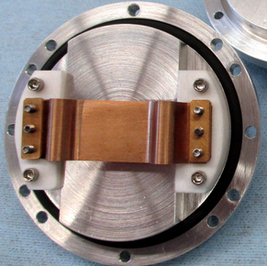
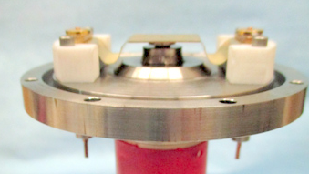
IxB-pulsed valve operation principle
Lorentz (Laplace) force moves the flexible conducting plate in the high (~ 3-5 T) magnetic field.
For I=10 A, L=5 cm, F=2.5 N. Current pulse duration ~100-500 us
F
I
B
I
B

Slide 31
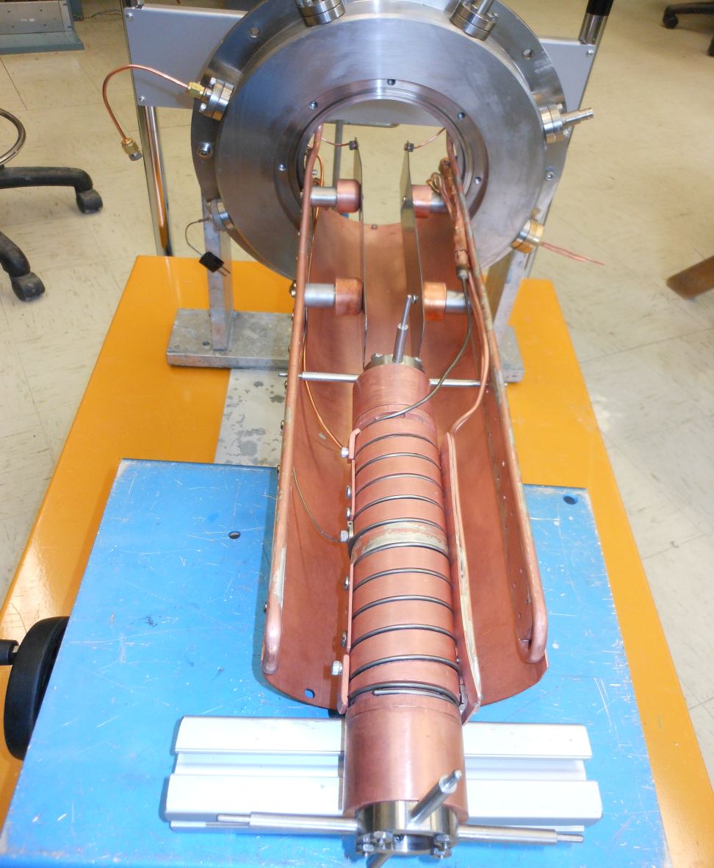
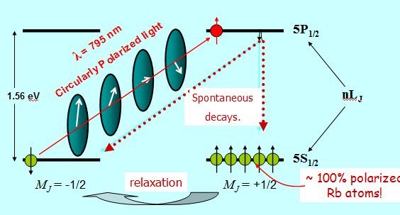
Optically-pumped , electron spin polarized Rb vapor cell
Rb –cell preparation for the Run-2017,
higher 6.0 kV deflecting plate voltage.

Slide 32
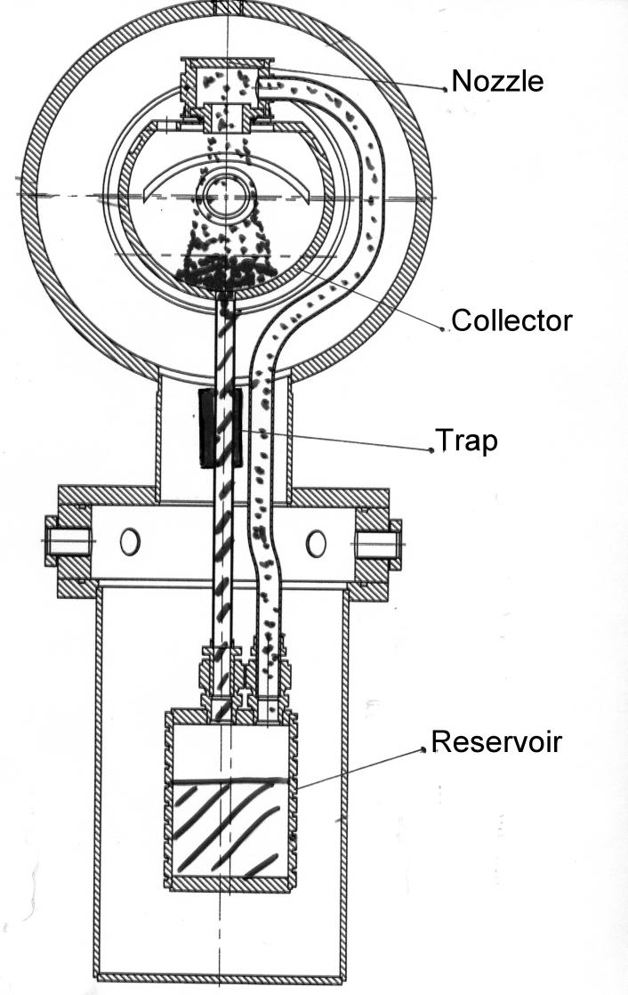
Sodium-jet ionizer cell
Transversal vapor flow in the Na-jet cell.
Reduces sodium vapor losses for 3-4 orders
of magnitude, which allow the cell aperture
increase up to 3.0 cm .
Nozzle
500deg.C
NL ~2·10¹⁵ at/cm²
L ~ 2-3 cm
Collector
~150 deg.C
Return
line
Boiler
~500 deg.C
Notes:
32

Slide 33
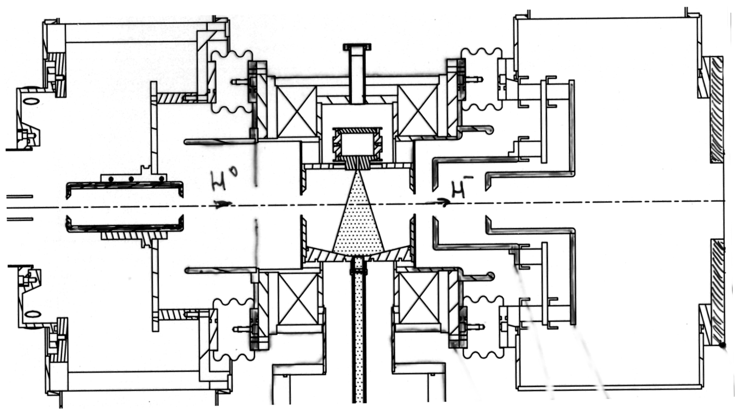
H⁻ beam acceleration to 35 keV at the exit
of Na-jet ionizer cell
H⁻
35 keV
39 keV
H⁰
3 keV
7 kev
-32 kV
-28 keV
-15 keV
Na-jet cell is isolated and biased to – 32 keV. The H⁻ beam is accelerated in a two-stage acceleration system

Slide 34
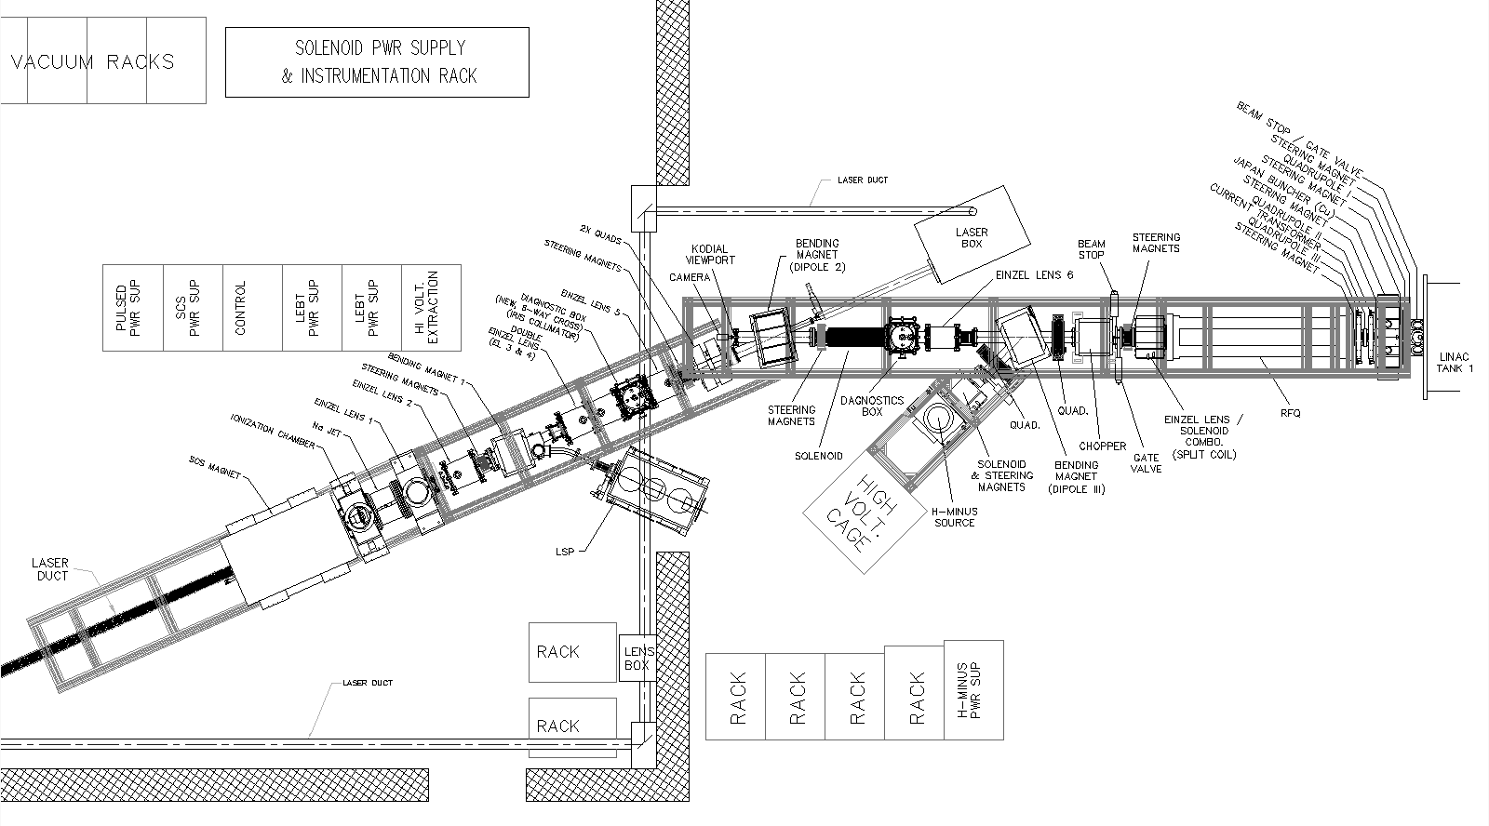
Low Energy Beam Transport line
Variable collimator
In DB2 to improve
Energy resolution.
23.7 deg bender
RFQ
OPPIS
FC4
35.0 keV
FC-Tk1,
750keV
Lamb Shift
Polarimeter
Notes:
34

Slide 35
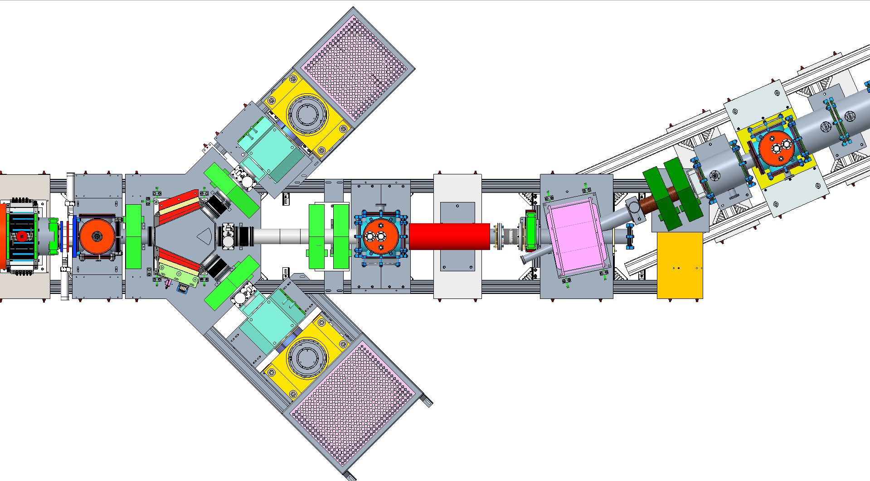
35 keV LEBT layout upgrade with three sources for Run-2020
Magnetron- S1
OPPIS
To RFQ
Laser beam
23.7 deg. dc bending magnet
Pulsed bending magnet, 45 deg.
Magnetron -S2

Slide 36
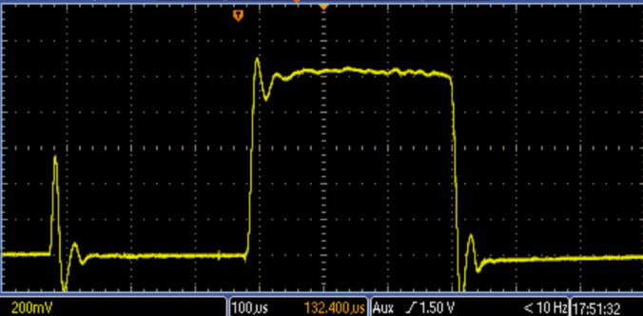
H⁻ ion beam current accelerated to 200 MeV, June-2017
1.05 mA
Rb-cell
Temp.-105 deg.
300 us

Slide 37
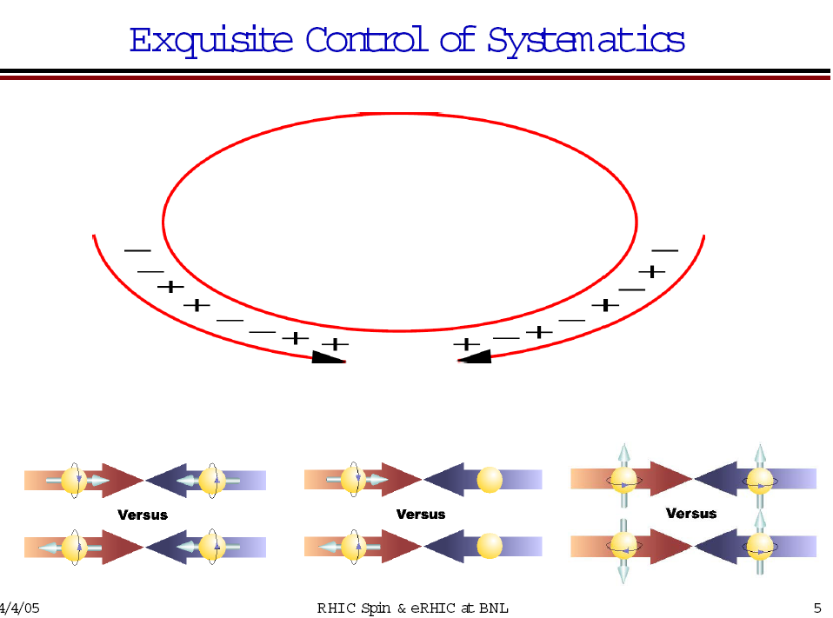
Notes:
37

Slide 38
Polarized injector, 200 MeV linac and injection lines. 200 MeV p-Carbon polarimeter.
Polarization direction is adjusted vertically in the 750 keV beamline by the solenoidal spin -rotator.
200 MeV polarimeter
OPPIS

Slide 39

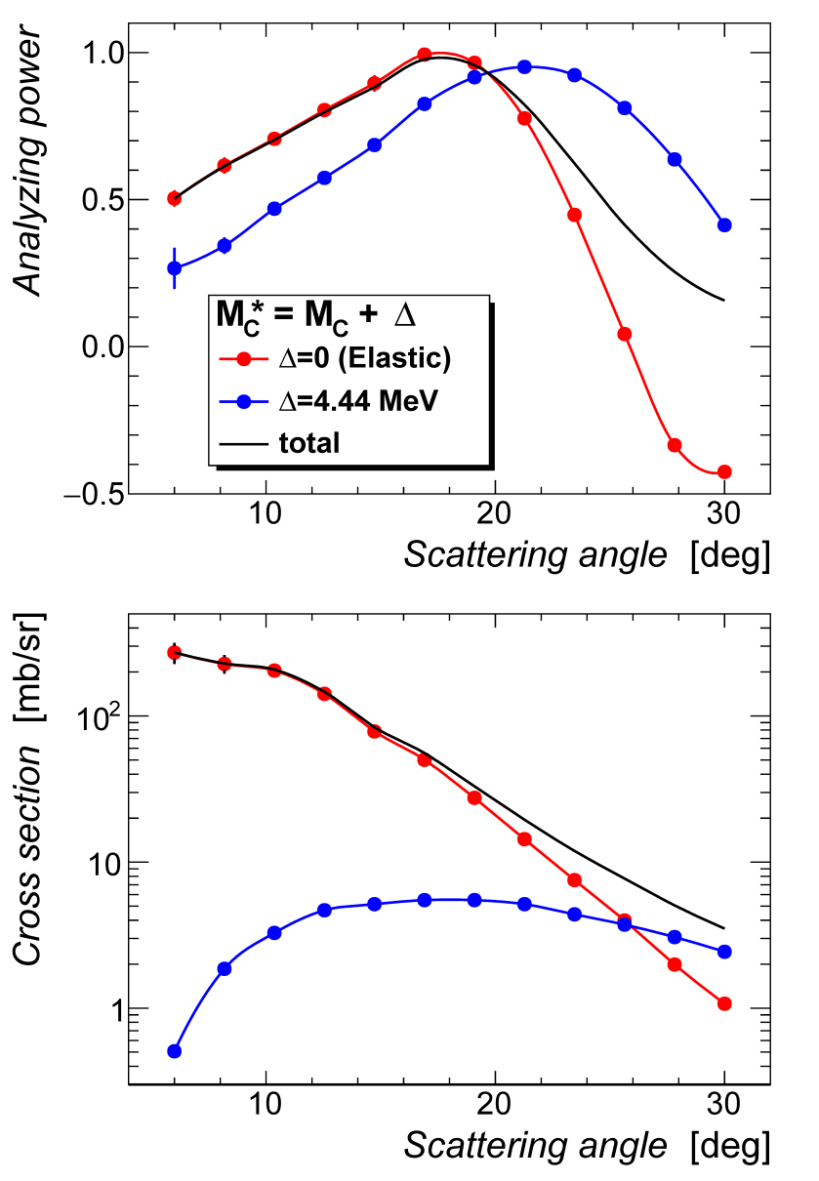
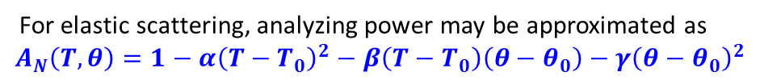



Analyzing Power
In 1980’s at Indiana University Cyclotron Facility there was a scrupulous study of the low energy polarized proton scattering on Carbon target .

Slide 40



200 MeV Polarimeter

Slide 41
Beam intensity and polarization at 200 MeV
Reliable long-term ∙operation of the source was demonstrated.
Very high suppression of un-polarized beam component was demonstrated.
Small beam emittance (after collimation for energy separation) and high transmission to 200 MeV.
Rb-cell thickness-NL | 4.5 | 5.5 | 7.5 | 10.4
Linac Current, μA | 440 | 520 | 740 | 950
Booster Input ×10¹¹ | 10.0 | 12.0 | 14.0 | 17.1
Pol. %, at 200 MeV | 86 | 86 | 84.5 | 83
Rb-cell thickness ,NL ×10¹³ atoms/cm²

Slide 42




H-jet polarimeter
17 October 2017
PSTP 2017. HJET in RHIC Run17.
42
Notes:
42

Slide 43
H-jet is the absolute high precision polarimeter !
High (~4.5%) analyzing power in a wide energy range (23-255 GeV).
High event rate due to high intensity (~300 mA) circulated beam current in the storage ring and high polarized H-jet thickness in the collision point.
Non-destructive.
No scattering for recoil protons.- windowless.
“Point” like target. Clean elastic scattering event identification.
Straightforward calibration with Breit-Rabi polarimeter.
Most of the false asymmetries are cancelled out in the ratio:
P _{beam} =( 1/A)Beam _{asym} / Target _{asym}
A typical result for 8-hrs store: ‹ P › = (~ 56 ± 2.0 stat ± 0.3syst) %
Notes:
43

Slide 44



Absolute Beam Polarization measurement in Run 2017, 255 GeV
Statistical error summary:
PSTP 2017. HJET in RHIC Run17.
44
Notes:
44

Slide 45

Polarization Profiles
Polarization loss from intrinsic resonances: polarization lost at edge of beam → polarization profile.
Impact of polarization profile on beam polarization at collisions:
<P>=Pjet-average polarization measured by H-jet or p-Carbon polarimeter
in a sweep mode. P₀-maximum polarization in the beam center.
For R_{H} ≈ R_{V} = R and small: P₀ = Pjet (1+R)² ;
P_{coll.} = Pjet (1+ ½R)
Bazilevskiy, Roser, Fisher

Slide 46

Upper limit for polarization in collisions (single spin asymmetry) vs. H-jet polarization.
P₀=80% - Red line
P₀=70% - Blue line
P_{jet}- black line
low limit on P_{coll}
For P₀=55 %, maximum
Pcoll~ 60%
R=0.1, P_{coll.pC}~ 58%

Slide 47
Источник поляризованных ядер 3Не++

Slide 48

Why polarized 3He⁺⁺ ion source and beams?

Slide 49
Production of polarized ³He⁺⁺ beam in EBIS. A.Zelenski, J.Alessi, ICFA Beam Dynamics
Newsletter 30, p.39, (2003)
Existed 3He++ sources intensity- 50nA, Birmingham
³He polarization inside the EBIS in high (5.0T) magnetic field. No polarization losses during beam transport through gradient magnetic field.
EBIS is used for efficient ionization and accumulation of polarized 3He⁺⁺ ions to the full capacity 10¹² total charge (5∙10¹¹ , 3He⁺⁺ ions).
Notes:
49

Slide 50
Principle of EBIS Operation
10A, 10-20 keV
Radial trapping of ions by the space charge of the electron beam.
Axial trapping by applied electrostatic potentials at ends of trap.
The total charge of ions extracted per pulse is ~ (0.5 – 0.8) x ( number electrons in the trap ~1.0∙10¹² )
Ion output per pulse is proportional to the trap length and electron current.
Ion charge state increases with increasing confinement time.
Output current pulse is independent of species or charge state!
Notes:
50

Slide 51

EBIS Beams Run to Date
Zr, Ru
Au³²⁺ -2.3e⁹/pulse, U³⁹⁺-1.5e⁹, 3He⁺⁺-7.3e¹⁰/pulse
Au³²⁺ in BTA to Au⁷⁷⁺ in ATR to Au⁺⁷⁹⁺ - 2e⁹- 8 EBIS pulses merge

Slide 52
“Extended” EBIS upgrade with new “injector” solenoid for polarized 3He⁺⁺ ion production
Polarization and ionization in high magnetic field
will produce 3He⁺⁺ ion beam with P ≥ 80%
Optically-pumped 3He cell
Ionization to 3He⁺⁺
Up to 2×10¹¹ 3He⁺⁺ ions/pulse
3He⁺

Slide 53

Circular polarized
Laser light at 1083 nm

Slide 54

3He optical pumping in high magnetic field
Can be used for polarized 3He gas production
inside solenoid for lungs MRI

Slide 55

Jan,2016, Sealed cell, OD-30 mm-Pol.- 88%, Field-2.0 T
Probe laser
absorption polarimeter

Slide 56


3He-gas purification and filling system
Modified Cryo-pump for 3He
purification and storage

Slide 57



3He-gas cryogenic purification and filling system
Pumping
Cryo-panel array
Cryo-pump cold head
Second stage-10 deg.K
Cryo-pump cold head
First stage- 55 deg.K

Slide 58

After 2 days closed cell, a lot of hydrogen
656 nm-L alpha

Slide 59


March 3, 2017

Slide 60



“Open” cell with inductive RF power input and new pneumatic filling “isolation” valve.
3He- (1-3) Torr
3He –purification
system
Vacuum pump

Slide 61

3He polarization setup using OPPIS 3.0 T solenoid
Septemer, 2017

Slide 62


Polarization measurements by the probe laser
absorption technique
a₂
a₁

Slide 63
Optical pumping and probe “compact” lasers layout
WS6-200
wavemeter
Probe laser
Scanning mode
Pumping laser, 1083 nm, 5 W
3.0 T field
Mirror
RF-power
modulation
Photo
Detector
Lock-in
amplifier
DAQ
200 mm

Slide 64


3He optical pumping in 3.0T magnetic field
Sealed cell
“Open” cell
79%
85%

Slide 65
3He –optically-pumped cell in the high magnetic field
3He-cell
Drift tube -40 kV
Insulator
Pulsed valve
Long, small diameter drift tube works like a 3He storage cell, which reduces gas load to the EBIS vacuum system and increases polarization due to ionization localization in the high magnetic field region.

Slide 66




“Electro-magnetic”, [IxB] valve operation principle
Lorentz (Laplace) force moves the flexible conducting plate in the high (~ 3-5 T) magnetic field.
For I=10 A, L=5 cm, F=2.5 N. Current pulse duration ~100-500 us
F
I
B

Slide 67
“Extended” EBIS upgrade with new “injector” solenoid for polarized 3He⁺⁺ ion production
Polarization and ionization in high magnetic field
will produce 3He⁺⁺ ion beam with P ≥ 80%
Optically-pumped 3He cell
Ionization to 3He⁺⁺
Up to 2×10¹¹ 3He⁺⁺ ions/pulse
3He⁺

Slide 68

Extended EBIS , December 2022

Slide 69
3He⁺⁺ Spin-rotator and polarimeter in the EBIS HEBT line at 6.0 MeV beam energy
Solenoid
Spin-rotator
3He-4He-scattering
6.0 MeV 3He++ beam
Beam back to the HEBT
The development of the 3He polarizing apparatuses, the spin-rotator,
and the nuclear polarimeter at the 3He++ ion beam energy 6.0 MeV
(in the high-energy beam transport line after the EBIS drift-tube Linac)
is funded by the DOE Research and Development Funds for
the Next Generation Nuclear Physics Accelerators Facilities.

Slide 70

Analyzing power for 3He-4He scattering

Slide 71

A layout of the ${}_{}^{3}{He−4He}$ polarimeter. The effective target is a part of the ${}_{}^{4}{He}$ gas filled scattering chamber. After scattering ³He and recoil ⁴He particles angles, energies and time -of-flight will be measured by the Si-strip detectors.
Polarized 3He++ beam enters the scattering chamber through
a thin (~2.0 um Al-foil) window. The scattering chamber is filled
with 5.0 Torr 4He gas. The effective target size is constrained
By the movable collimators.

Slide 72

Summary
Polarized 3He++ production is an important part of the ongoing extended EBIS “upgrade" project.
High polarization (of ~80%) of 3He was achieved in the “open” cell in the high
3.0-5.0 T magnetic field.
A new technique of 3He purification system (based on cryo-pumping) was developed to meet the strict requirements for high polarization production.
A new type of the pulsed electromagnetic valve was developed for 3He injection into the drift tube.
The 3He++ source, spin-rotator and polarimeter development is in progress.
It was funded by DOE grant: F2018-19 Research and Development for Next Generation Nuclear Physics Accelerator Facilities.
Notes:
72

Slide 73
3He++ ion source for the NICA collider
A new EBIS development for the polarized 3 He++ ion beam production by MEOP (metastability exchange optical pumping) в EBIS (2·10¹¹ 3He⁺⁺/ EBIS pulse).
A large variety of high-charged ion species from ³He⁺⁺ to Au ³²⁺ ,
U ³⁹⁺ can be produced in this source, when using external ion source injection with beam intensity >100 nC total charge /pulse.

