Slide 1

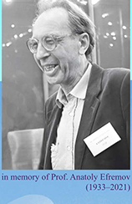

JINR
“Active Role of Gluons in Multiparticle Production”
E.Kokoulina, А. Kutov, V. Nikitin et al.
(JINR, RF и GSTU, Gomel, RB)
Елена Кокоулина (kokoulina@jinr.ru)
"XIXth Workshop on High Energy Spin Physics”. Dubna, September 4-8, 2023

Slide 2
Multiparticle processes studying in HEP
Electron-positron annihilation (е⁺е⁻).
Proton & proton-antiproton interactions. Bottomonium decay.
“Thermalization” project (high multiplicity). Collective phenomena.
Relativistic nuclear physics (АА).
"XIXth Workshop on High Energy Spin Physics”. Dubna, September 4-8, 2023

Slide 3
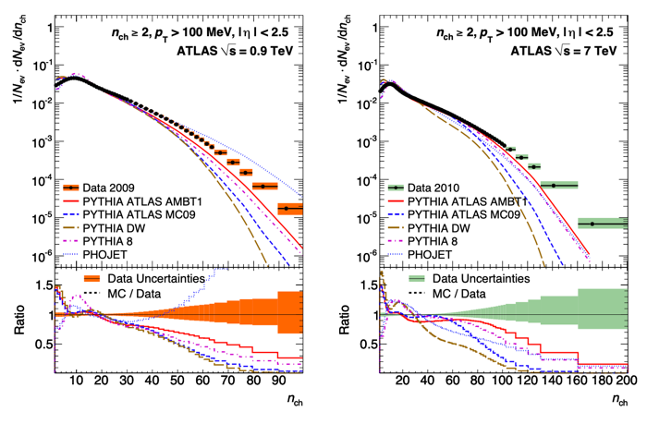
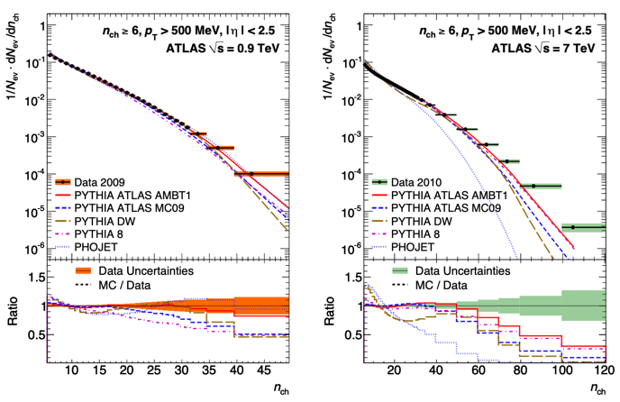
Experiments at LHC (ATLAS)
АTLAS’s data [2010] for MD in pp interactions at 0.9 and 7 TeV
Comparisons with Monte Carlo generators (PYTHIA, PHOJET).
"XIXth Workshop on High Energy Spin Physics”. Dubna, September 4-8, 2023

Slide 4
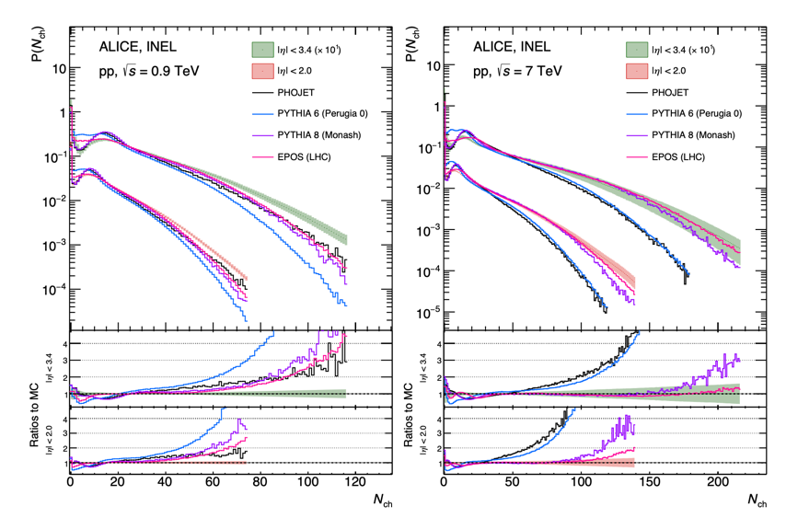
Experiments at LHC (ALICE)
[arXiv:1708.01435, ALICE Coll.]: МD of charged particles in high pseudo-rapidity region (рр сcollisions at 0.9 и 7 TэВ).
"XIXth Workshop on High Energy Spin Physics”. Dubna, September 4-8, 2023

Slide 5
e⁺e⁻ anihilation. I stage
Konishi et al. & Giovannini [NP, 1979] describe quark-gluon cascade in pQCD in view of elementary processes
Quark emission of gluon – , (A)
Gluon fission – , (A)
Quark-antiquark pair creation from gluon – .
~
System of diff. eq. describing branching processes, leads to Polia (NBD) for q-jet and Farry MD for g-jet:
~
~
А и А – вероятности процессов 1) и 2), k_{p} = A/A.
"XIXth Workshop on High Energy Spin Physics”. Dubna, September 4-8, 2023

Slide 6
e⁺e⁻ - annihilation
O.Biebel.
Phys.Rep. 2001
Multiplicity Distribution (MD)
Generation function (GF):
I stage
qg-cascade
GF ←> MD
Correlative moments, F_{k}:
II stage
(hadronization)
"XIXth Workshop on High Energy Spin Physics”. Dubna, September 4-8, 2023

Slide 7
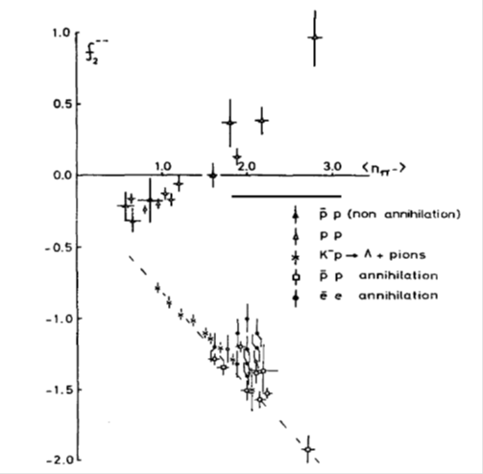
e⁺e⁻ annihilation - II stage
pQCD is unable to describe hadronization. The choice of MD at this stage is based on experimental behavior of the second correlative moment f₂ =<n(n-1)>-<n>² =D₂ - <n> (D₂ - variance).
The independent formation of particles is described by the Poisson distribution with f₂ = 0. Polya MD at the first stage corresponds to negative binomial distribution (NBD):
We chose binomial MD (Bernoulli) for II-stage:
"XIXth Workshop on High Energy Spin Physics”. Dubna, September 4-8, 2023

Slide 8
Convolution of two stages
(soft decoloration).
p = q, g,
Model parameters: N_{q}=N, α =N_{g}/N, .
"XIXth Workshop on High Energy Spin Physics”. Dubna, September 4-8, 2023

Slide 9
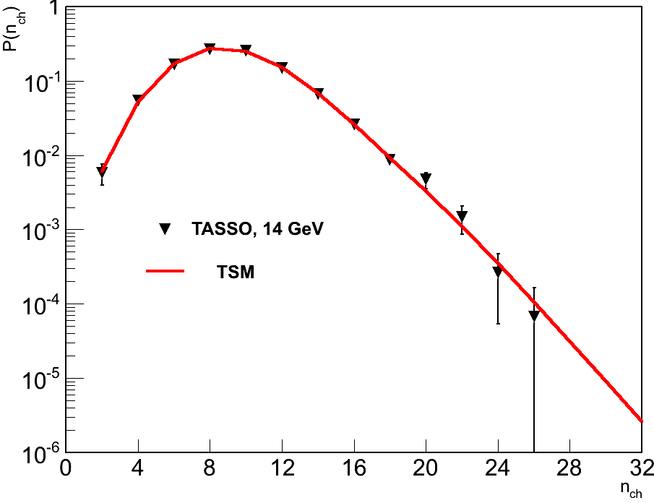
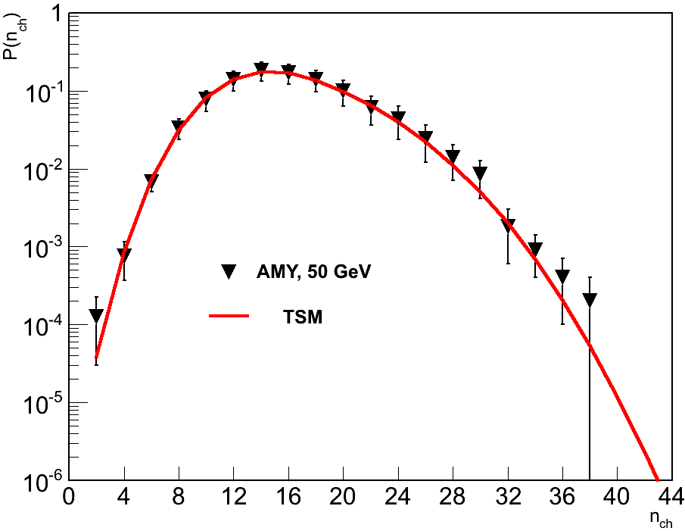
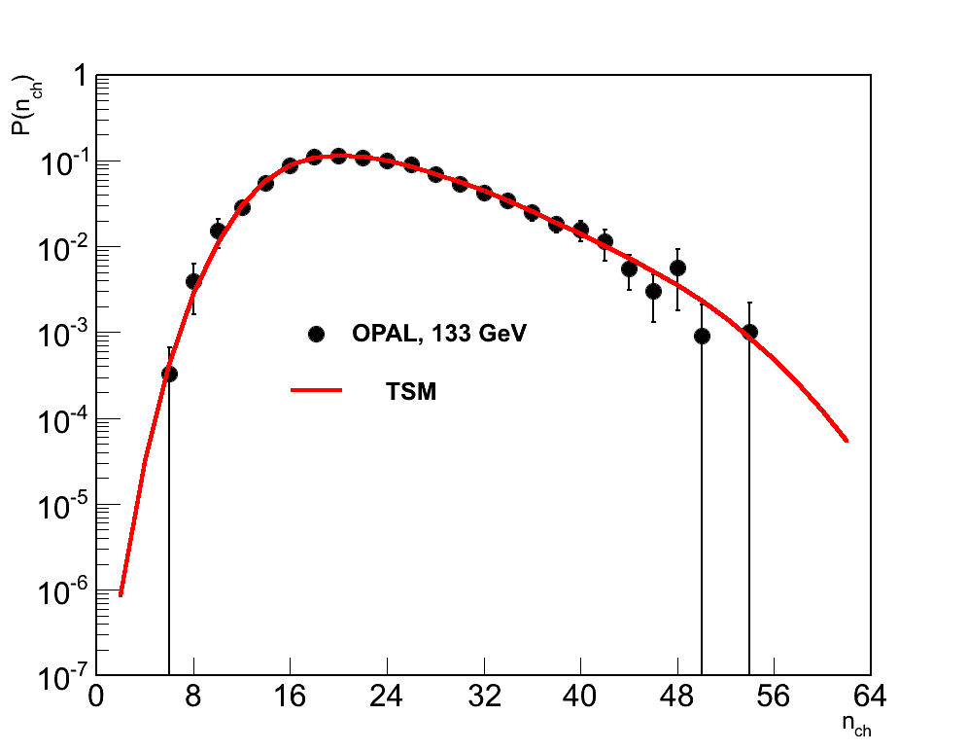
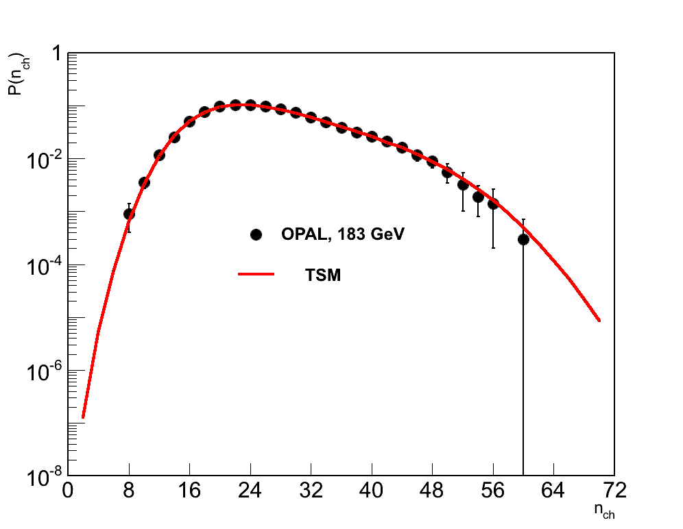
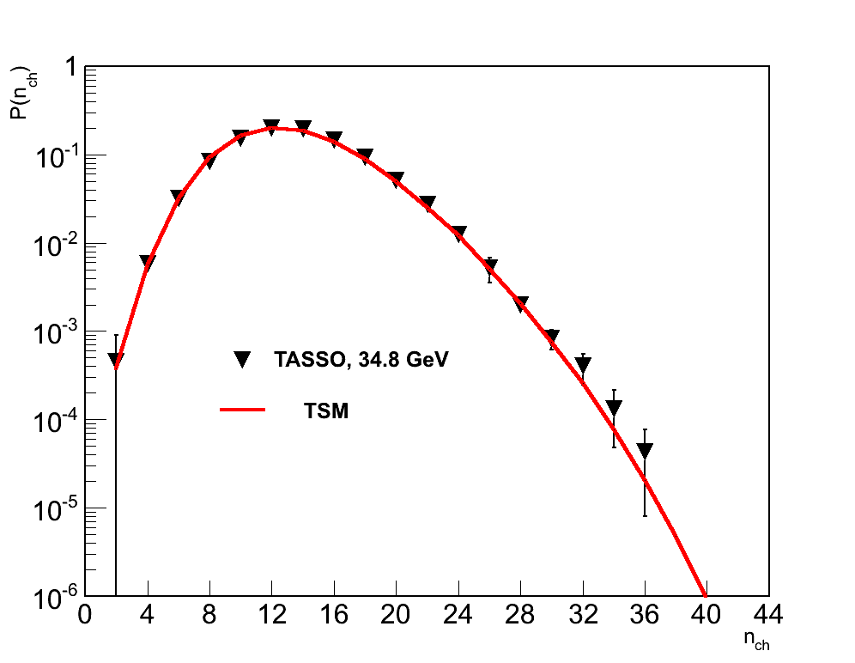
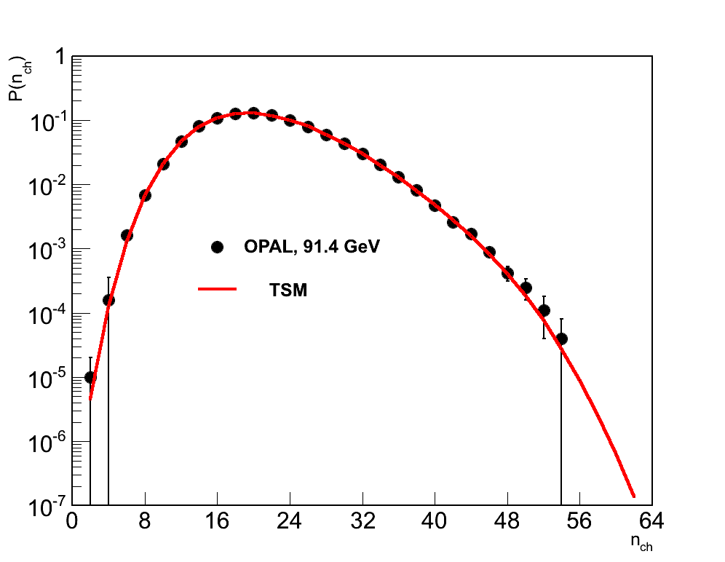
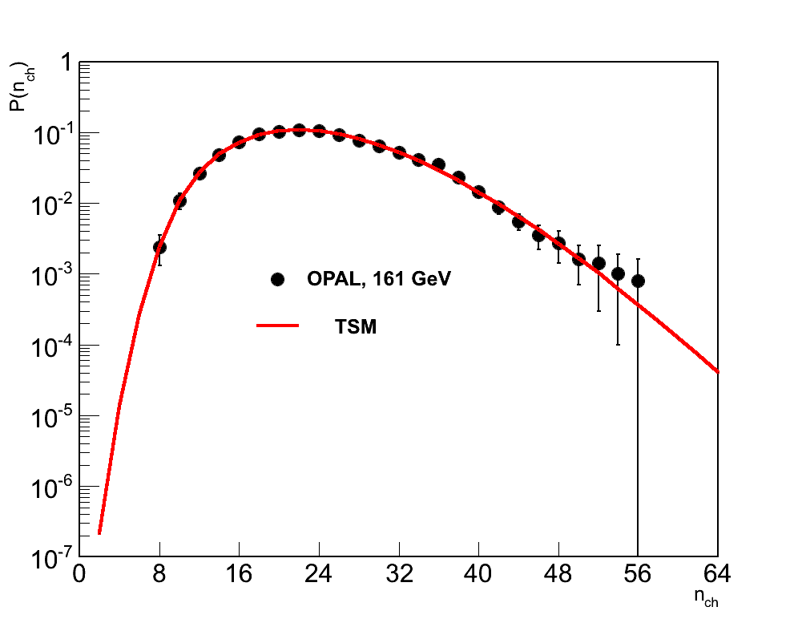
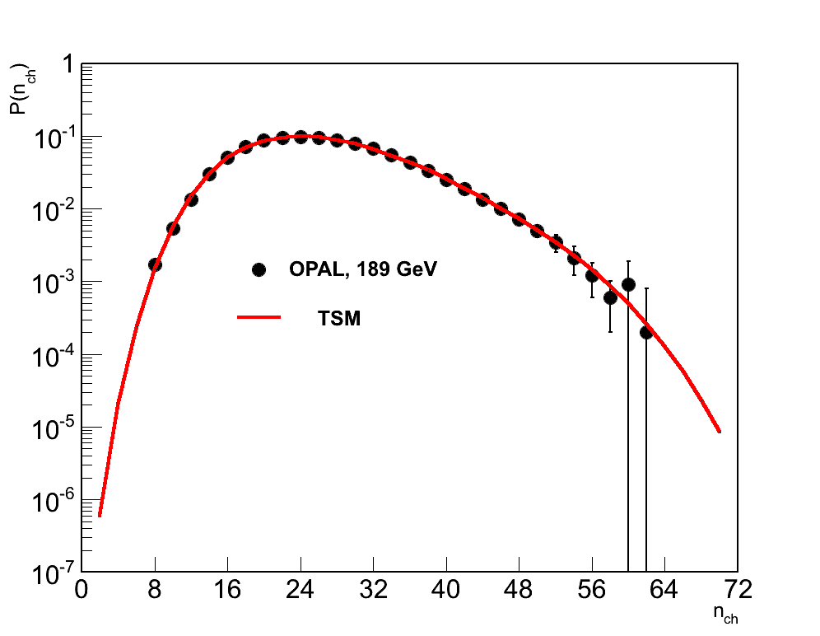
MD in е+е- annihilation (14 -189 ГэВ)
"XIXth Workshop on High Energy Spin Physics”. Dubna, September 4-8, 2023

Slide 10

Parameters of Model
Average number of hadrons, , formed from gluon, is close to 1, which testifies the fragmentation mechanism of hadronization.
~ log s .
Hypothesis of parton-hadronic duality (LoPHD)
<m> ∼ < n>
Recombination mechanism
Fragmentation mechanism
[ B. Muller. 2004]
"XIXth Workshop on High Energy Spin Physics”. Dubna, September 4-8, 2023

Slide 11
Parameter of model k_{p}
k_{p} is determined by the ratio of the bremsstrahlung contributions of active gluons (q -> q + g) to their division (g -> g + g), A/A, at the cascade stage. It takes on values ​​more than 1, which indicates the predominance of bremsstrahlung over fission. It tends to decrease with increasing energy. Withing the statistical bootstrap model, it was shown, k_{p}⁻¹ can be interpreted as the “temperature” at that stage
it rises with energy.
~
"XIXth Workshop on High Energy Spin Physics”. Dubna, September 4-8, 2023

Slide 12
f₂ Sign changing with energy growth from “-” to “+”
Parameters: α ∼ 1, N ∼ 6. At √s < 5 << 1 and f₂ < 0. At √s > ≿ 10, > 10 and the sign of the second correlative moment is changed : f₂ > 0.
"XIXth Workshop on High Energy Spin Physics”. Dubna, September 4-8, 2023

Slide 13
Three-gluon decay of quarkoniums ϒ(9.46), ϒ (10.02)
Z
"XIXth Workshop on High Energy Spin Physics”. Dubna, September 4-8, 2023

Slide 14
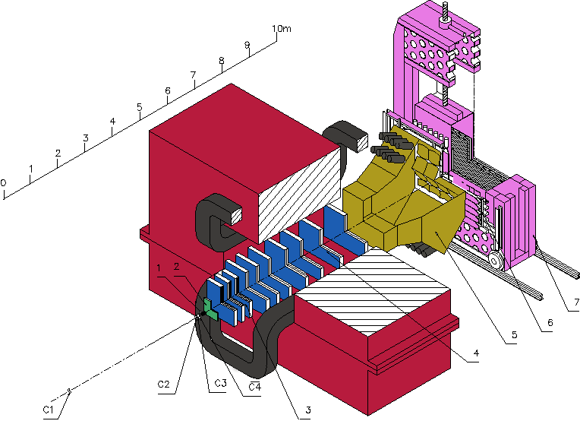
Hadron Interactions with High Multiplicity (HM). “Thermalization” project (IHEP+SINP MSU+JINR)
Project started in 2005, SVD-2 setup at U-70 accelerator, 50-GeV р-beam, Н₂ target, high multiplicity trigger. Kinematical limit (total energy spent on secondary particle production at rest) is close to 59 pions.
Spectrometer with Vertex Detector (SVD-2)
"XIXth Workshop on High Energy Spin Physics”. Dubna, September 4-8, 2023

Slide 15
Gluon Dominance Model (GDM)
Modification of the two stage model has been carried out: at the initial stage valence quarks and nascent gluons in accordance with pQCD branch due elementary fission processes (1-3). Then they fragment into real hadrons in accordance with the binomial distribution confirmed in e⁺e⁻ annihilation. The scheme of convolution combines both stages.
A comparison of this model with data (Mirabelle, U-70) showed that the hadronization parameters differ considerably from the values obtained in e+e- annihilation, they were much less than 1. It meant that the number of valence quarks involved in branching should be reduced. Participation of all three pairs of quarks is unlikely.
"XIXth Workshop on High Energy Spin Physics”. Dubna, September 4-8, 2023

Slide 16
Gluon Dominance Model (GDM)
Our study showed: hadronization parameters grow with decreasing of valence quark pairs. Only their complete exclusion improved considerably χ² for MD description, but hadronization parameter, the average number of hadrons produced from gluon at the second stage increases with energy, exceeding 1.
Valence quarks are staying in leading particles, secondaries are created by active gluons, which decay into quark-antiquark pairs, and form colorless hadrons.
Soft gluons (~50%) remain in the qg-system and partly re-emit soft photons leading to their excess yield.
"XIXth Workshop on High Energy Spin Physics”. Dubna, September 4-8, 2023

Slide 17
GDM, g-fission:
appearance of active gluons
gluon fission
hadronization
Almost a half of gluons (~ 47 %) remain in qg-system, without being fragmented into hadrons.
"XIXth Workshop on High Energy Spin Physics”. Dubna, September 4-8, 2023

Slide 18
GDM, scheme without gluon fission
Parameters:
р ГэВ/с |  | M_{g} | N |  | Ω | χ²/ndf
102 | 2.75±0.08 | 8 | 3.13±0.56 | 1.64±0.04 | 1.92±0.08 | 2.2/5
205 | 2.82±0.20 | 8 | 4.50±0.10 | 2.02±0.12 | 2.00±0.07 | 2.0/8
300 | 2.94±0.34 | 10 | 4.07±0.86 | 2.22±0.23 | 1.97±0.05 | 9.8/9
405 | 2.70±0.30 | 9 | 4.60±0.24 | 2.66±0.22 | 1.98±0.07 | 16.4/12
800 | 3.41±2.55 | 10 | 20.30±10.40 | 2.41±1.69 | 2.01±0.08 | 10.8/12
Observed growth of evidences a change of mechanism from fragmentation to recombination
ISR energy 60 GeV:
"XIXth Workshop on High Energy Spin Physics”. Dubna, September 4-8, 2023

Slide 19
GDM describes MD in pp at 100-800 GeV/c
102 GeV/c
300 GeV/c
205 GeV/c
405 GeV/c
GDM
NBD
GDM
КNО-IHEP
800 GeV/c
800 GeV/c
"XIXth Workshop on High Energy Spin Physics”. Dubna, September 4-8, 2023

Slide 20
GDM with gluon fission
Data [Mirabelle & SVD-2] for рр at 50 GeV/с stitching along topological cross sections, σ_{n} . At calculation MD, GDM takes into account two types contributions: gluon hadronization without their fission (green line) and with fission (blue line). Superposition of their contributions presents red line. High multiplicity stipulates namely by gluon fission.
"XIXth Workshop on High Energy Spin Physics”. Dubna, September 4-8, 2023

Slide 21
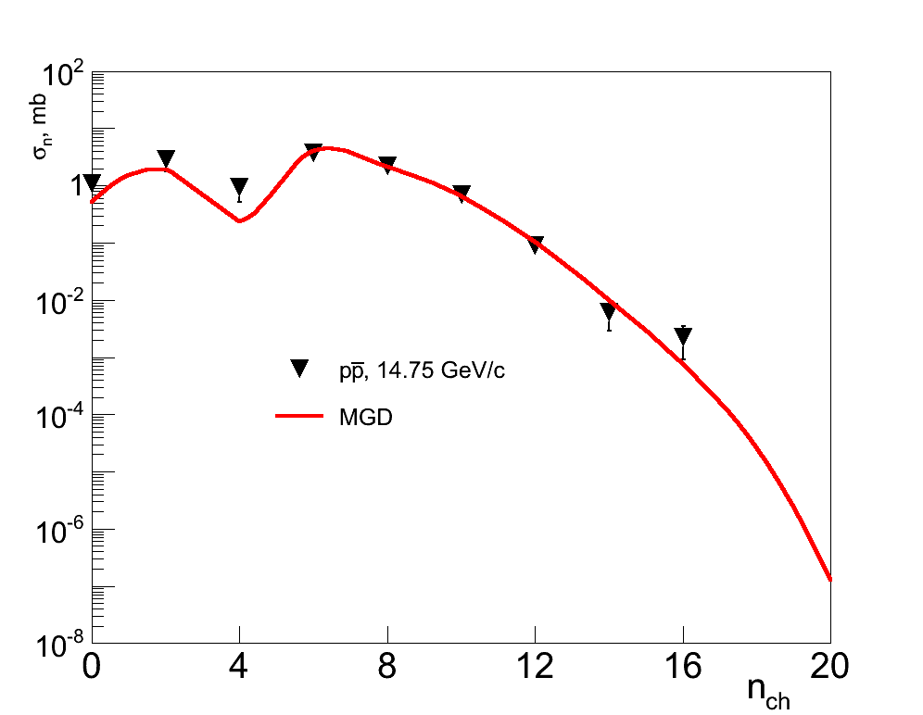
Proton-antiproton annihilation in GDM
<n₋>
J.G. Rushbrooke, B.R. Webber. Phys.Rep. 44 (1978) 1
"XIXth Workshop on High Energy Spin Physics”. Dubna, September 4-8, 2023

Slide 22
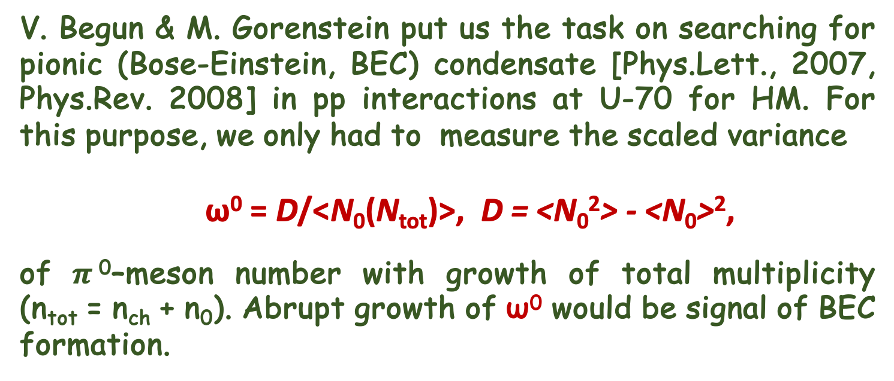
Neutral pion fluctuations at high total multiplicity
V. Begun & M. Gorenstein put us the task on searching for pionic (Bose-Einstein, BEC) condensate [Phys.Lett., 2007, Phys.Rev. 2008] in рр interactions at U-70 for HM. For this purpose, we only had to measure the scaled variance
ω⁰ = D/<N₀(N_{tot})>, D = <N₀²> - <N₀>²,
of $π$⁰–meson number with growth of total multiplicity (n_{tot} = n_{ch} + n₀). Abrupt growth of ω⁰ would be signal of BEC formation.
"XIXth Workshop on High Energy Spin Physics”. Dubna, September 4-8, 2023

Slide 23
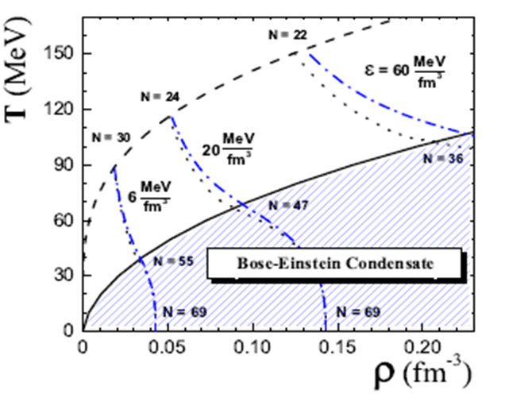
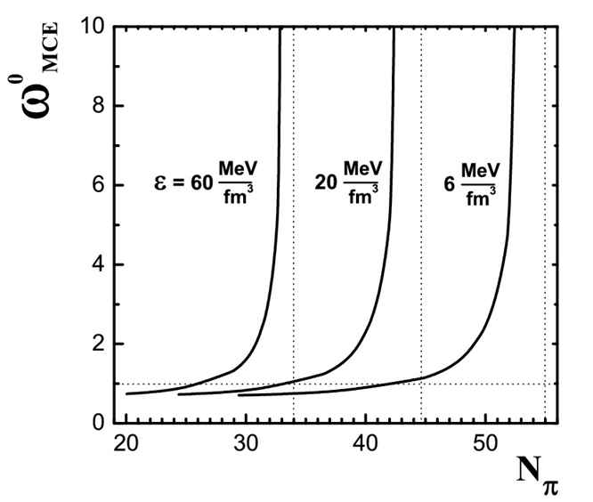
Fluctuiations of $π$⁰–mesons at High multiplicity
Phase diagram of pionic gas at μ_{Q} = 0. Dash line corresponds to ρ_{π}(T, μ_{π} = 0), solid – BEC. Energy densities 6, 20 и 60 Мev/fm³.
→ T_{C}(π) >> T_{C}(A).
"XIXth Workshop on High Energy Spin Physics”. Dubna, September 4-8, 2023

Slide 24
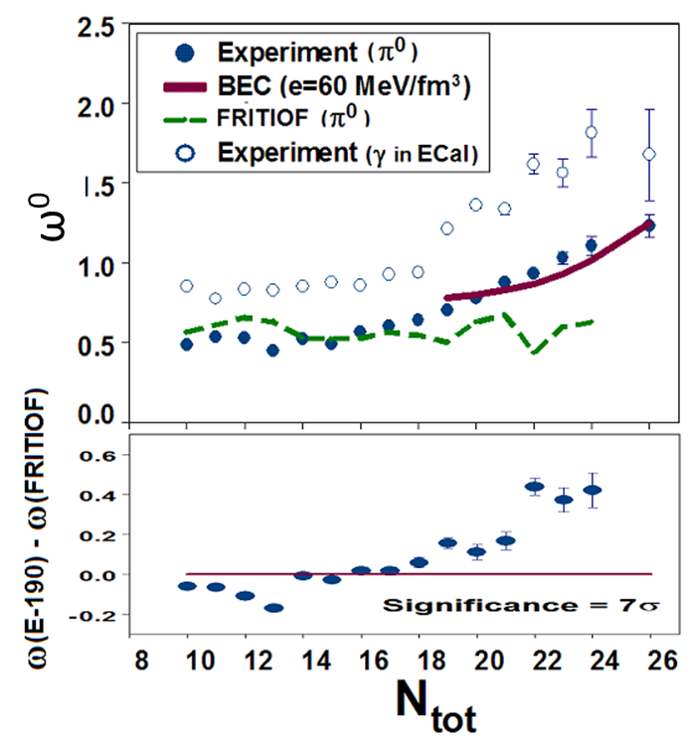
Fluctuiations of $π$⁰–mesons at High multiplicity
The deviation of the scaled variance, ω⁰ measured on the SVD-2 from the Monte Carlo predictions in the HM region is 7𝜎 at N_{tot} ∼ 25 [EPJ, 2012, ICHEP 2012].
"XIXth Workshop on High Energy Spin Physics”. Dubna, September 4-8, 2023

Slide 25
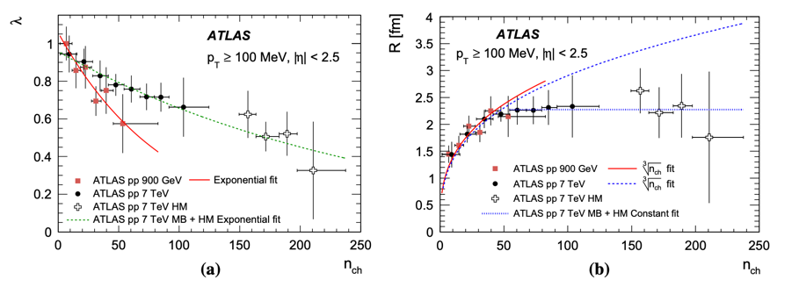
Bose-Einstein correlations in pp at HM (ATLAS)
Two-particle Bose-Einstein correlations in pp at 0.9 и 7 ТeV. ATLAS Collab. EPJ, 75 (2015). C₂(Q) = ρ(Q)/ρ₀(Q) = C₀ [1 + Ω (λ, QR)](1 + εQ), Q² = (p₁-p₂)² .
𝜆 close to 1 characterizes chaotic emission of particles, 𝜆 close to 0 – coherent emission (is characteristic for BEC), R defines the size of emission region, for BEC it’s hard time [hep-ph 1501.04530 ]. Their wave functions entangle . LHCb confirms 1709.01769 [hep-ex].
"XIXth Workshop on High Energy Spin Physics”. Dubna, September 4-8, 2023

Slide 26
Polar angle (𝛳) distributions. All and HM.
Angle distributions on the polar angle Θ. In HM region we observe two-humped structure, which it’s interpreted as Cherenkov radiation gluon by quark. Θ_{Cher} = 0.05377 ± 0.00273 rad with CL3.1 𝜎. For gluon rings cos Θ = 1/𝛽n_{r}, where n_{r} refraction coefficient n_{r} = 1.0016 ± 0.0001(4), close to 1. It testifies about rarity of qg-medium.
"XIXth Workshop on High Energy Spin Physics”. Dubna, September 4-8, 2023

Slide 27
Продольная и поперечная компонента при БМ
Средние значения поперечной и продольной компонент импульса заряженных частиц. Слева: M.K.-моделирование, справа: экспериментальные данные.
В области n_{ch} ∼ 16 наблюдается образование БЭК. При n_{tot} > 18 растет ω⁰ и исчезают лидирующие частицы, система становится изотропной по всем направлениям.
"XIXth Workshop on High Energy Spin Physics”. Dubna, September 4-8, 2023

Slide 28
KNO scaling
The world KNO distribution with addition of the SVD-2 points (√s = 9.8 GeV).
"XIXth Workshop on High Energy Spin Physics”. Dubna, September 4-8, 2023

Slide 29
RESULTS
The study of events with HM allow us to develop and supplement the mechanism of multiple production with a description of the hadronization stage by the Bernoulli distribution for various processes: e+e- annihilation, bottomonium decays, pp interactions, and proton and antiproton annihilation.
In the HM region, the collective behaviour of secondary particles has been discovered and confirmed, which gives us new ideas about the mechanism of multiple production, in particular, the active role of the gluon component in this process.
"XIXth Workshop on High Energy Spin Physics”. Dubna, September 4-8, 2023

Slide 30
Afterwords
“Perhaps there are no discoveries in elementary or higher mathematics, or even, perhaps, in any other field that could be made ... without analogy.” George Poiya.
"XIXth Workshop on High Energy Spin Physics”. Dubna, September 4-8, 2023

Slide 31
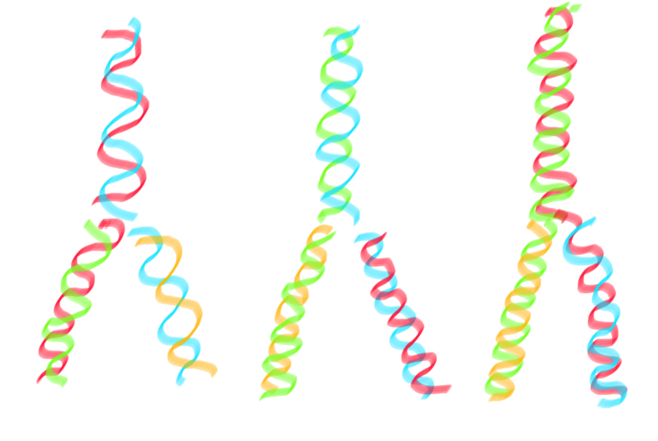
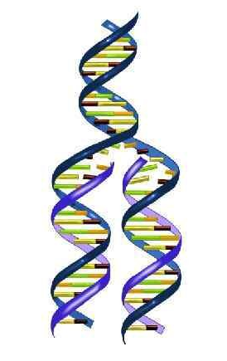
DNA Replication ~ gluons -> hadrons
"XIXth Workshop on High Energy Spin Physics”. Dubna, September 4-8, 2023

