Slide 1
Off-line measurements in 2021
Viacheslav Belov

Slide 2

In pursuit of results

Slide 3
Experimental setup
target
The idea of measurements is to save the beam time while proceeding with measurement of studied target out of muon beam.
For this purpose the germanium detector inside the lead shield is used. During expositions in 2019 the detector signal was digitized via ADC, only energy spectra were written on disc. For possible improvements of off-line measurements precision in 2021 DAQ using time signal with possibility of waveform writing was added. The digitizer CAEN DT5730 and ComPASS software was used for this purpose.
Ge
Energy signal
Time signal
Canberra
amplifier
CAEN DT5730
14bit 500MHz
Canberra
ADC
CAEN CoMPASS
software
Canberra
Genui software
Energy spectrum after trapezoidal filter
one per hour
Event by event
raw data
Energy spectrum
one per hour

Slide 4
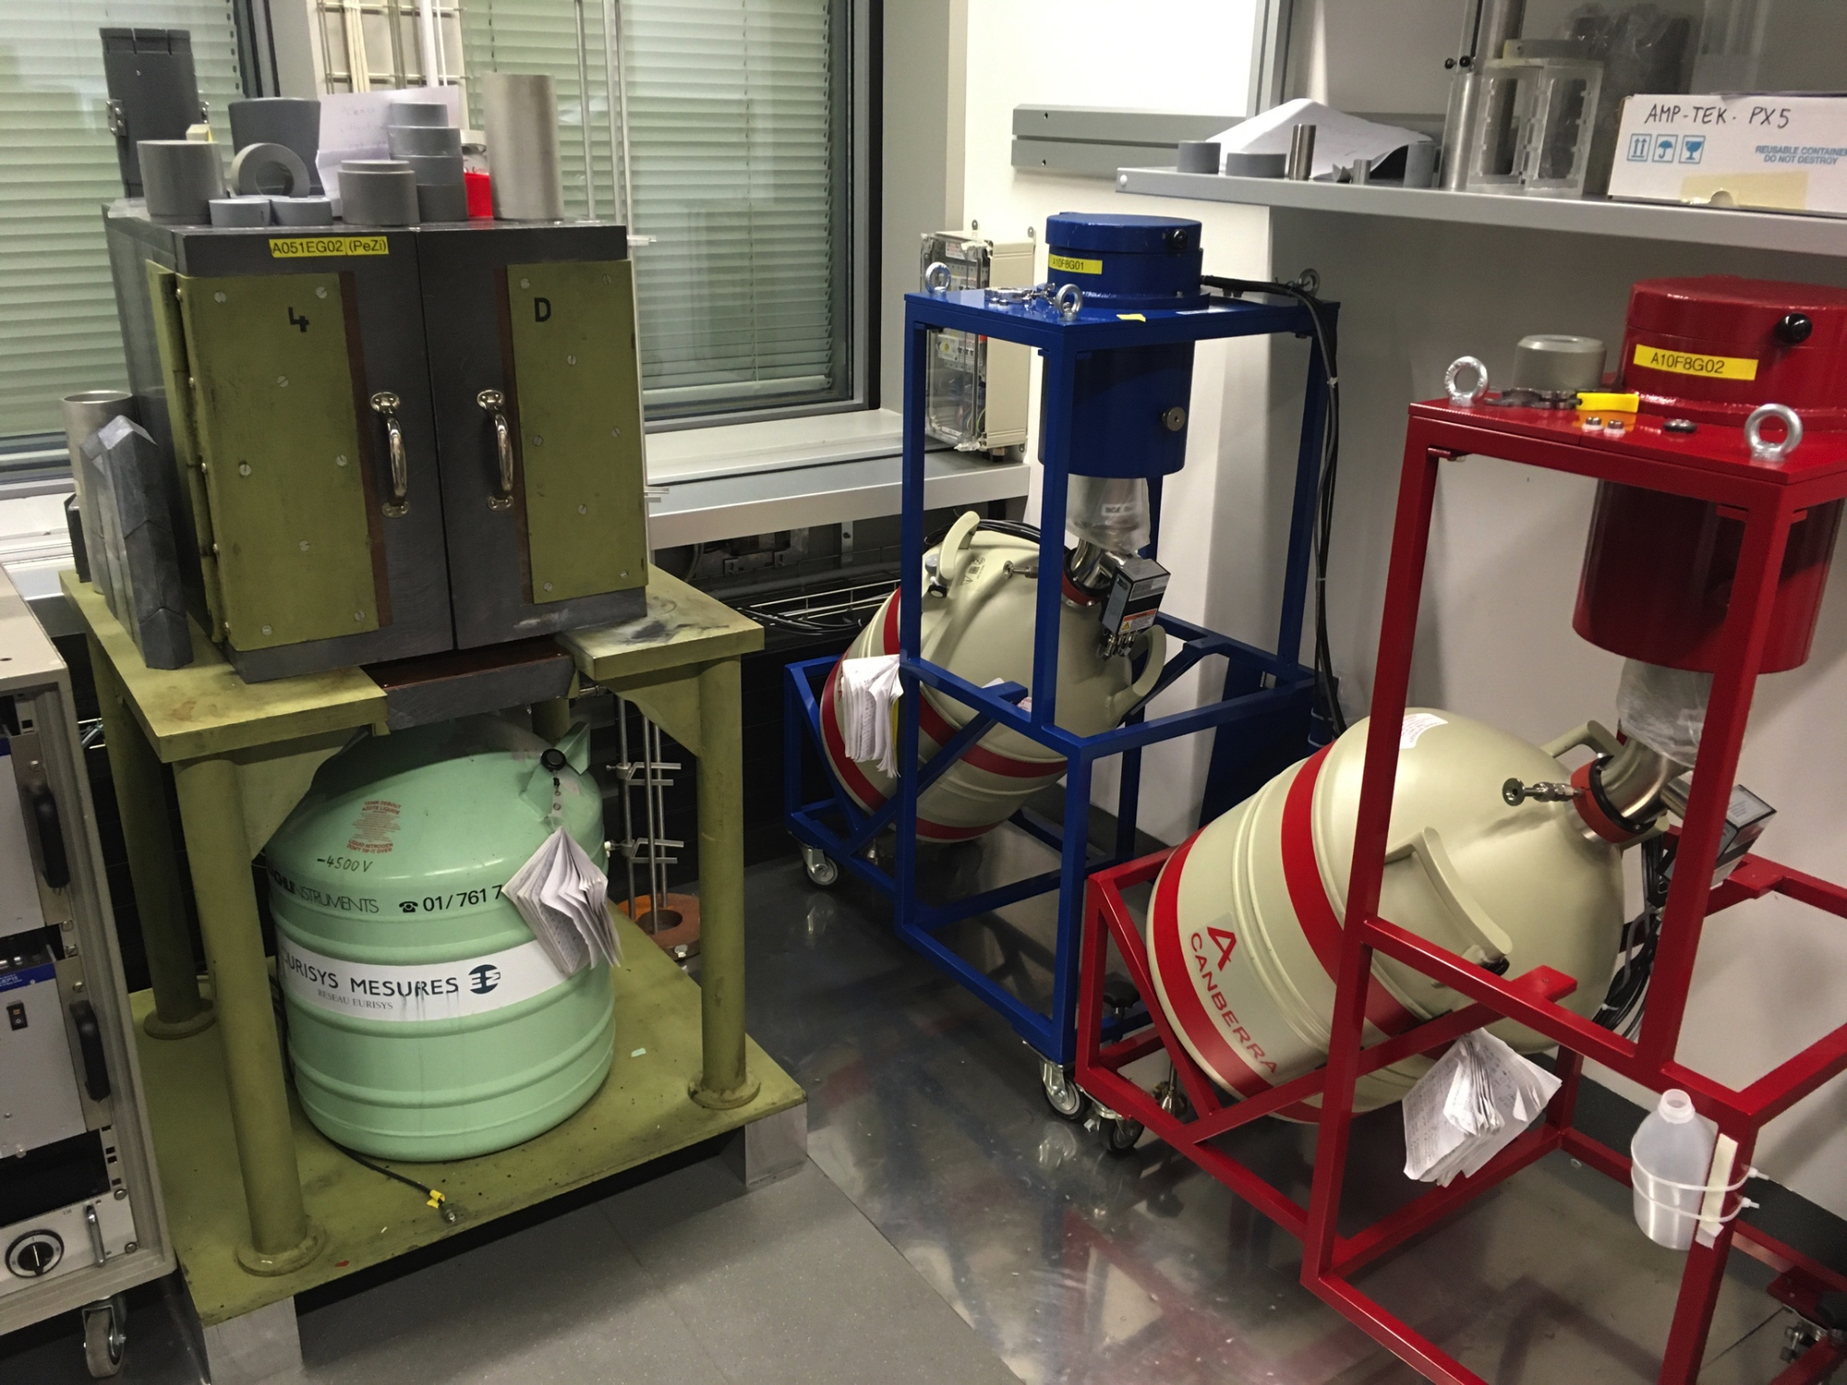
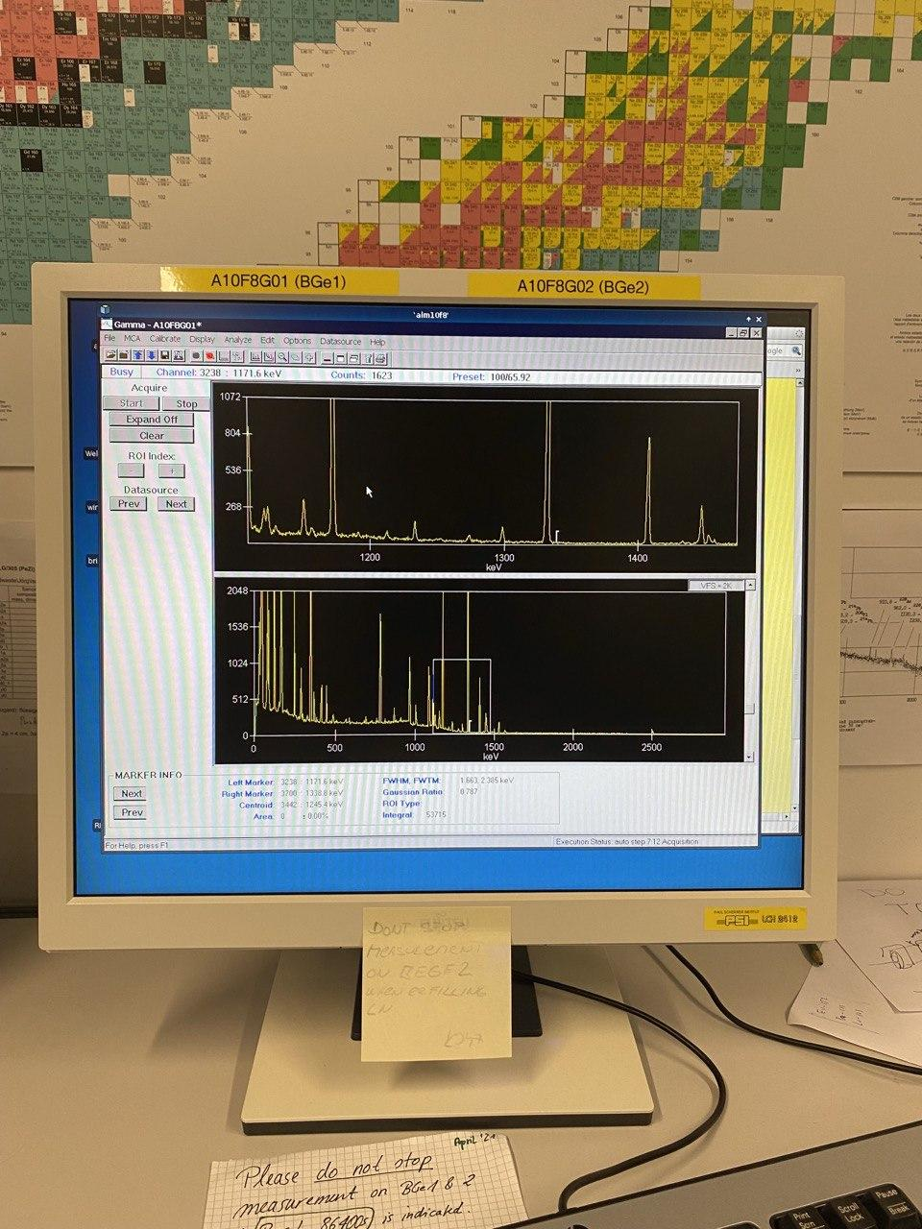
Experimental setup
Ge detector
Local DAQ Interface

Slide 5
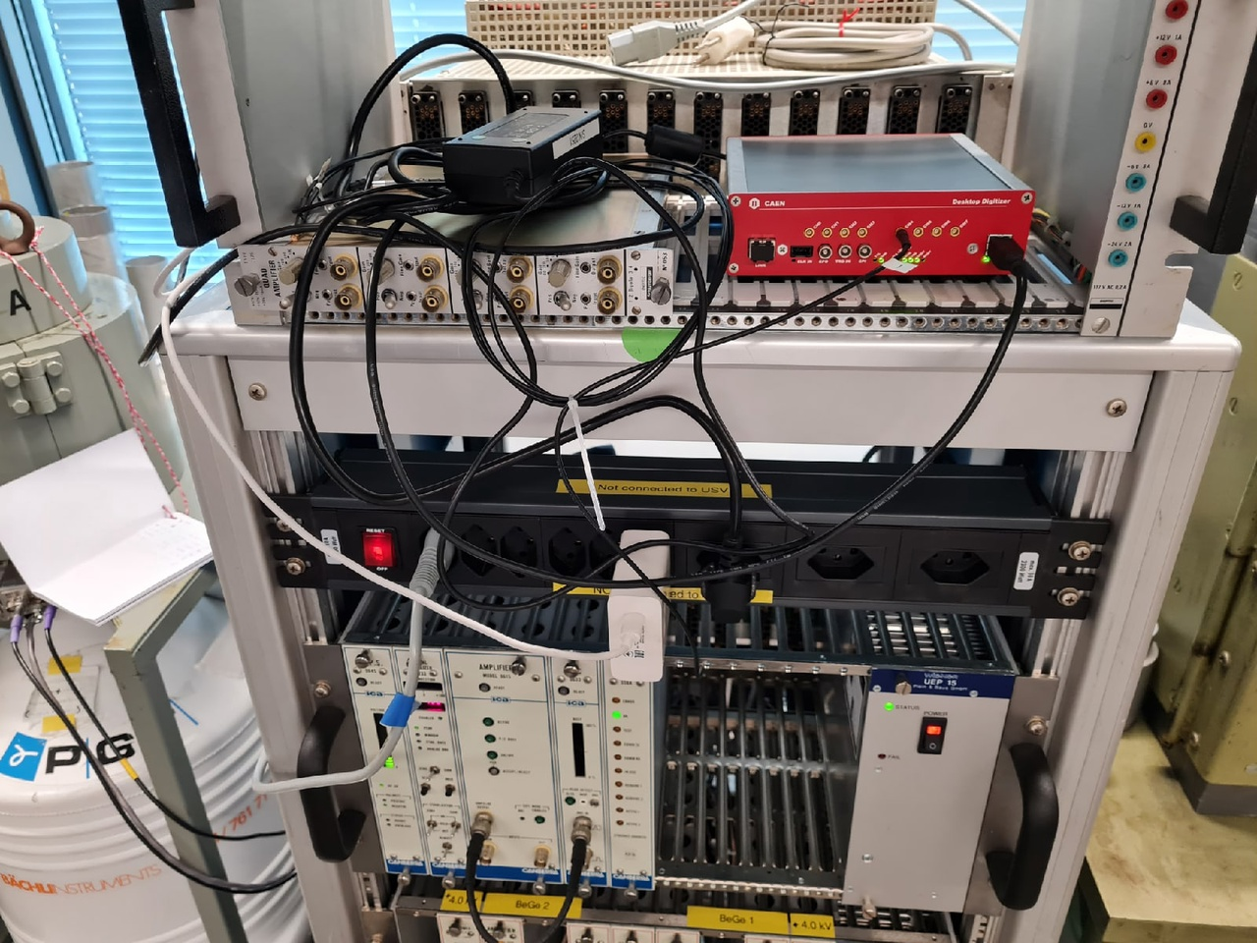
Experimental setup
CAEN digitizer
CANBERRA digitizer

Slide 6
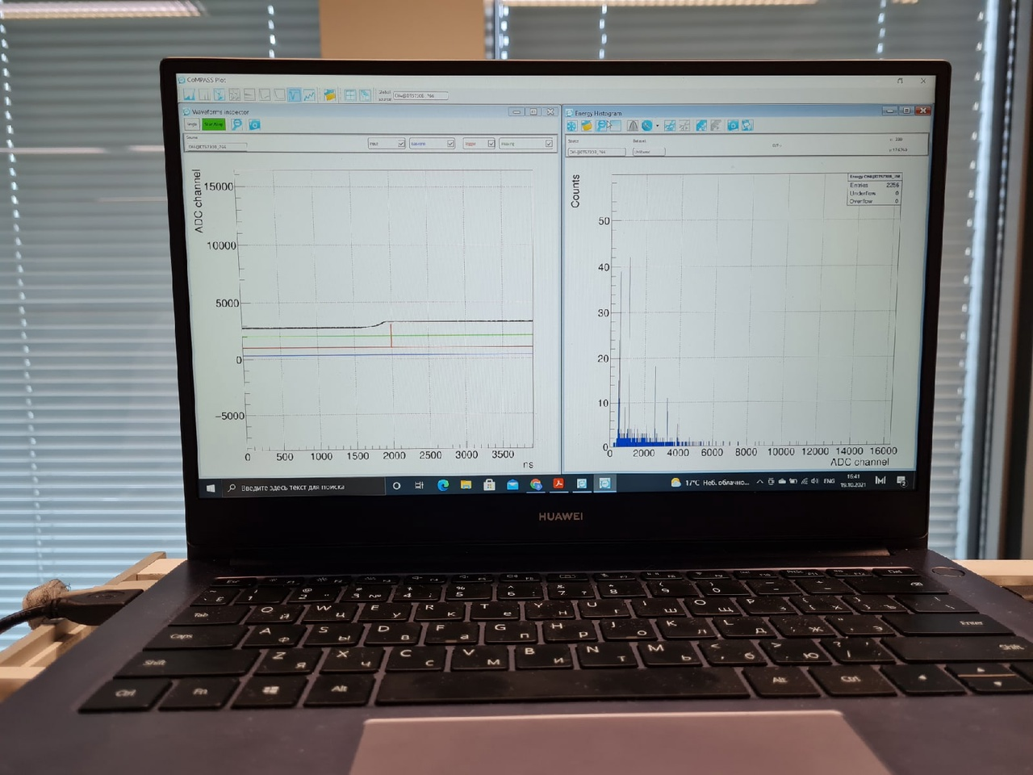
Experimental setup
Test DAQ Interface

Slide 7
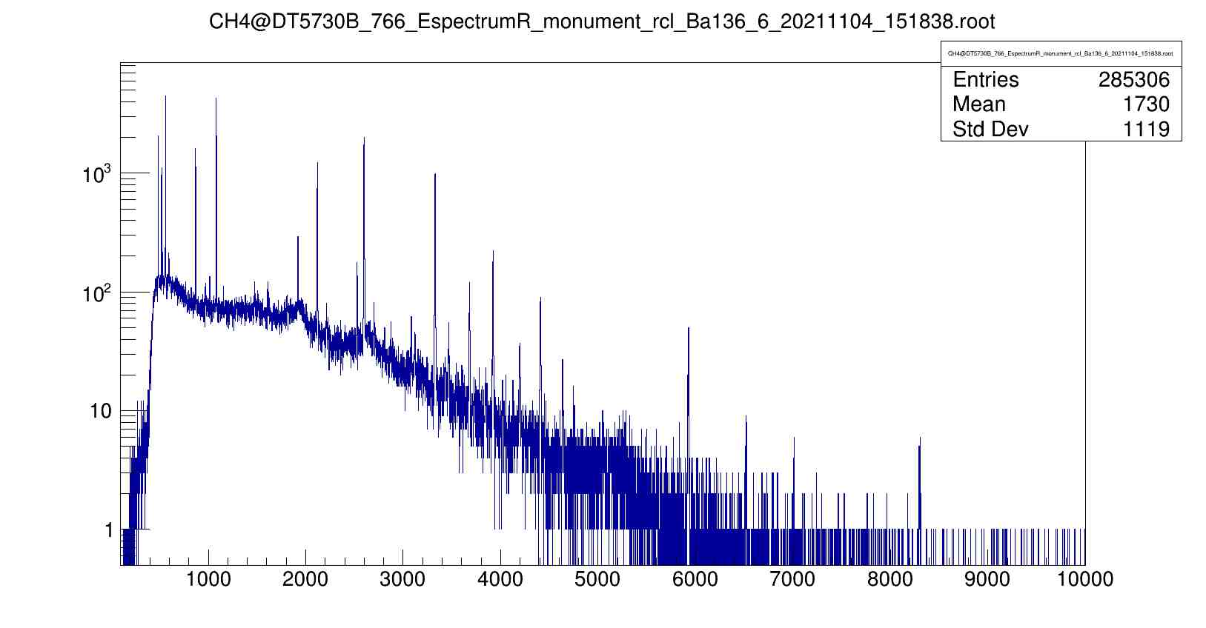
An example of the Ba136 energy spectrum
The presented spectrum was obtained using a СAEN digitizer using a trapezoidal filter. Spectrum not calibrated.

Slide 8
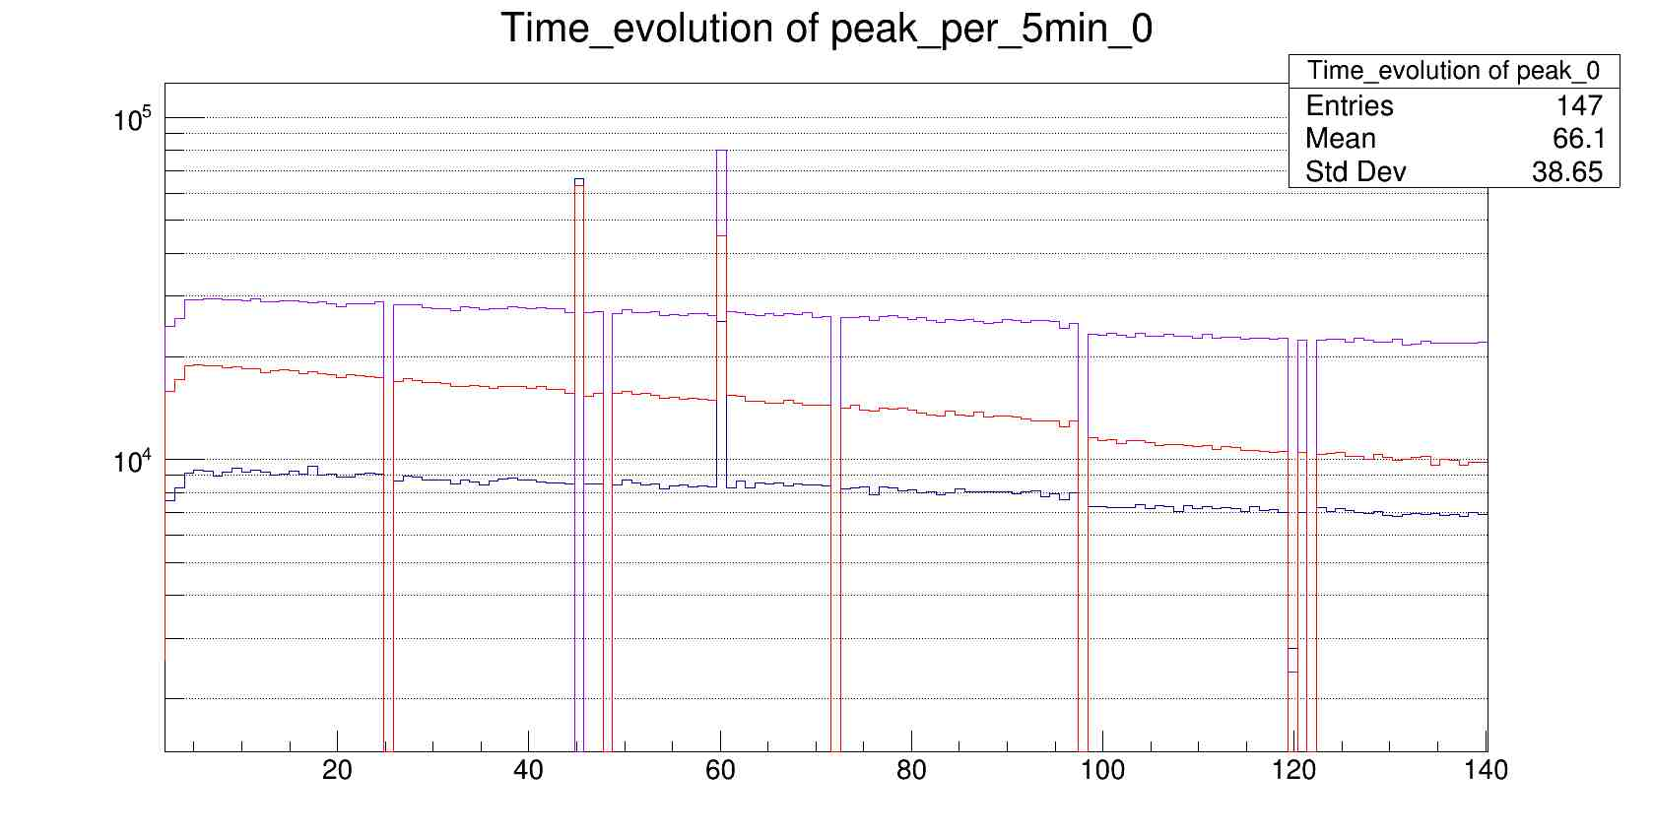
Time evolution of several different peaks
Time evolution of three peaks randomly taken over the entire energy range.

Slide 9
The end

