Slide 1
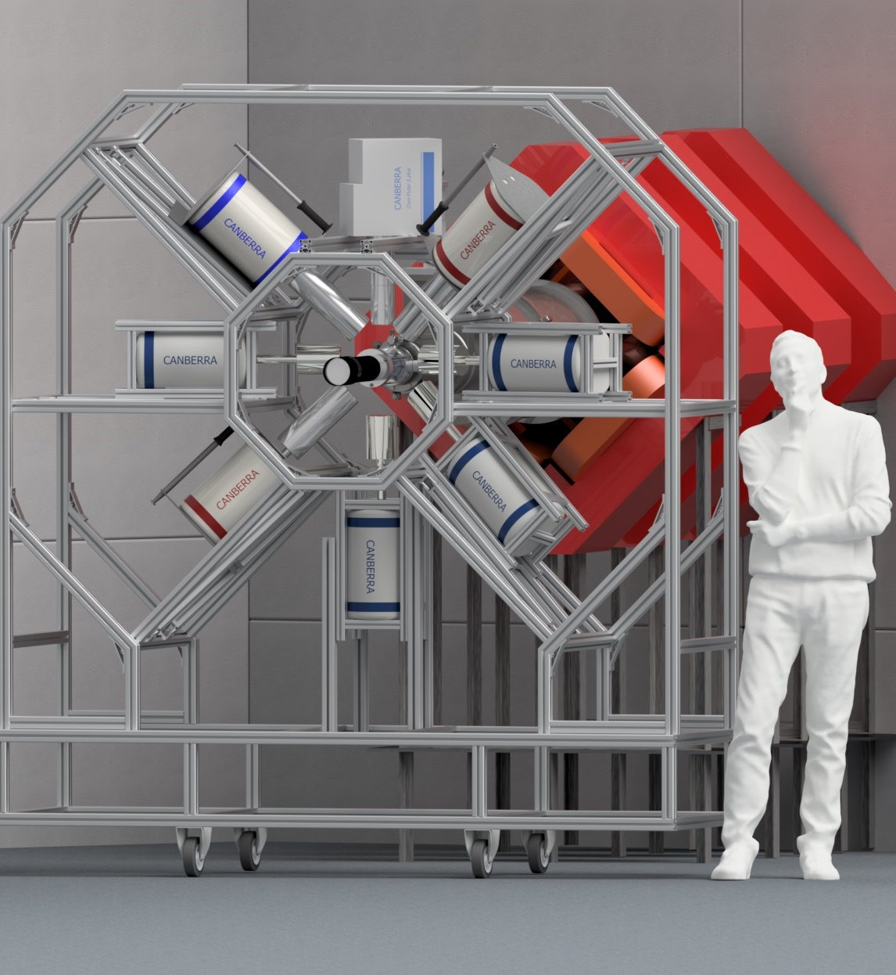
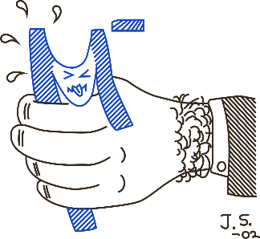
Measurements at PSI in 2022
OMC4DBD General Collaboration Meeting,
22-24 May 2023
Egor Shevchik 22/05/2023

Slide 2
2022 PSI measurements
We used the same target unit as for 2021 with minor changes.
The only enriched target for 2022 campaign – ¹⁰⁰Mo.
The Ge-detecors installed on the same frame.
Offline measurements at RHL of Mo-nat & Mo-100 for 21 days.
We made few changes in our DAQ scheme.

Slide 3
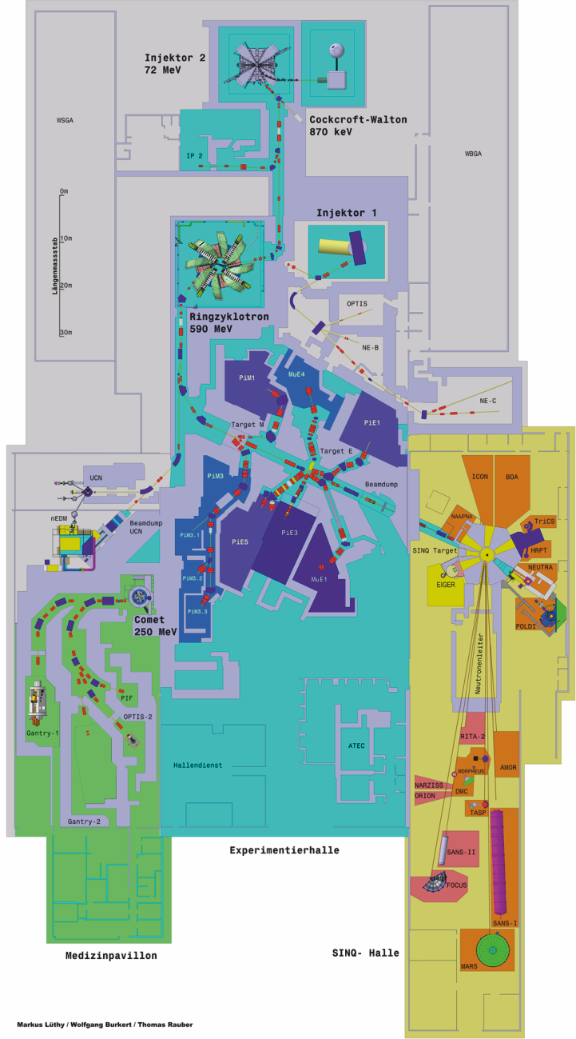
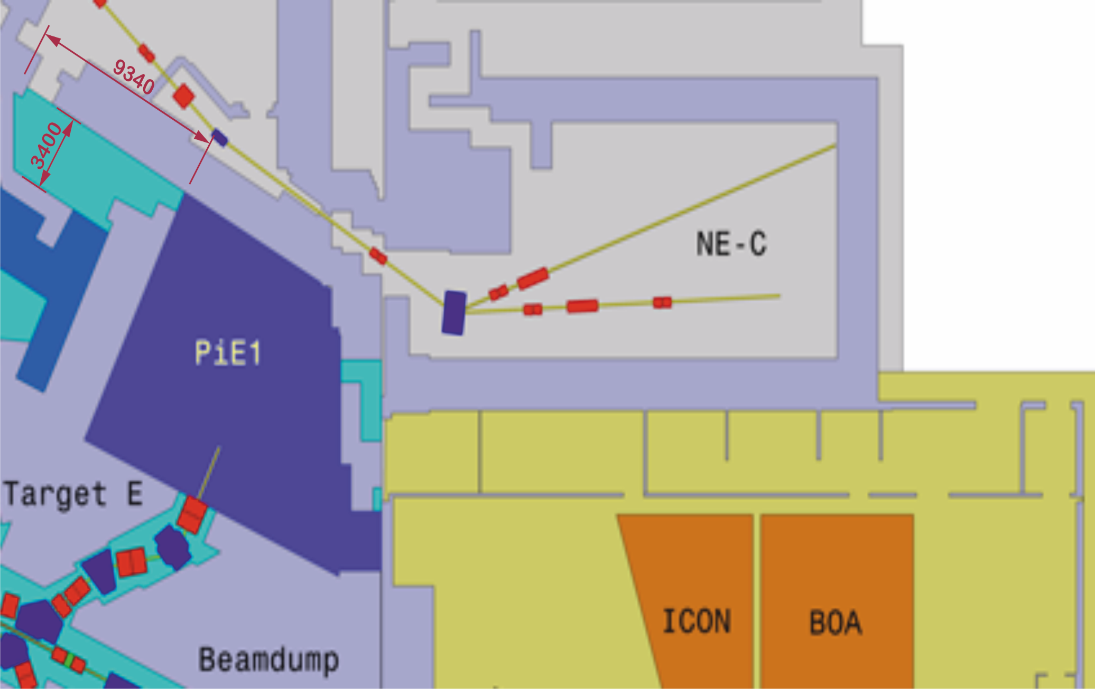
Experimental hall
OMC4DBD setup
Control rooms

Slide 4
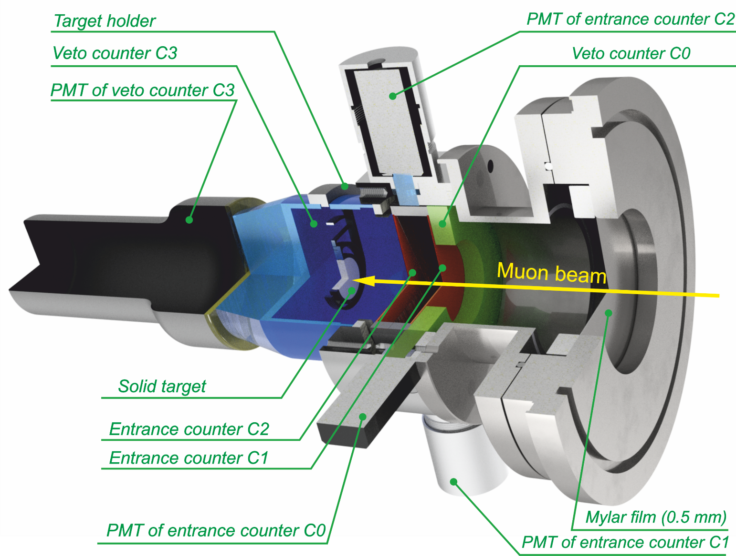
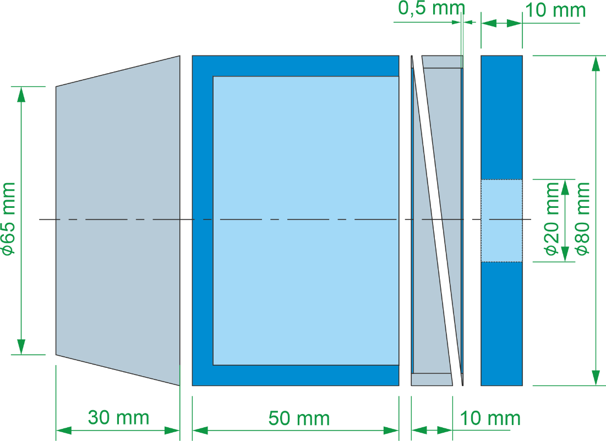
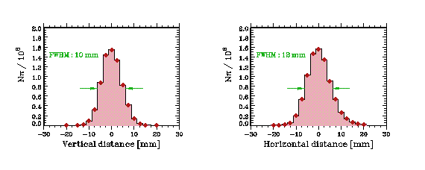

Target setup
$\overline{C0}$& C1 & C2 & $\overline{C3}$ $→EVENT$

Slide 5
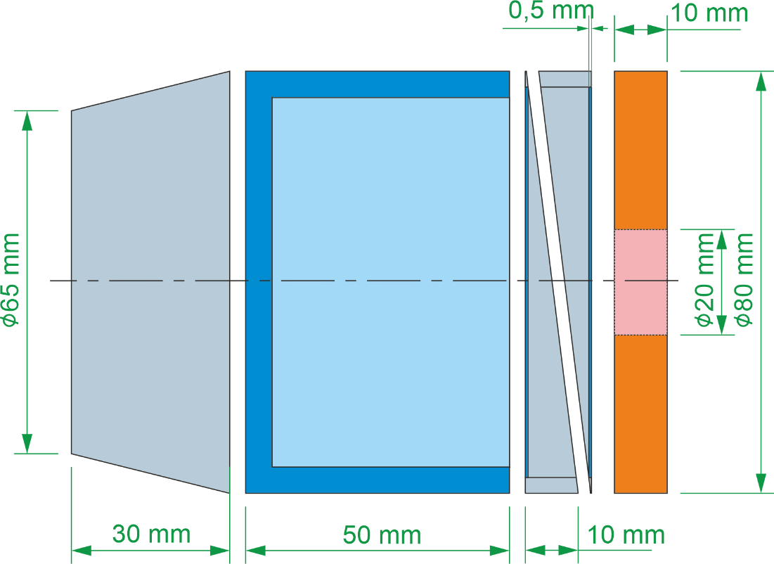
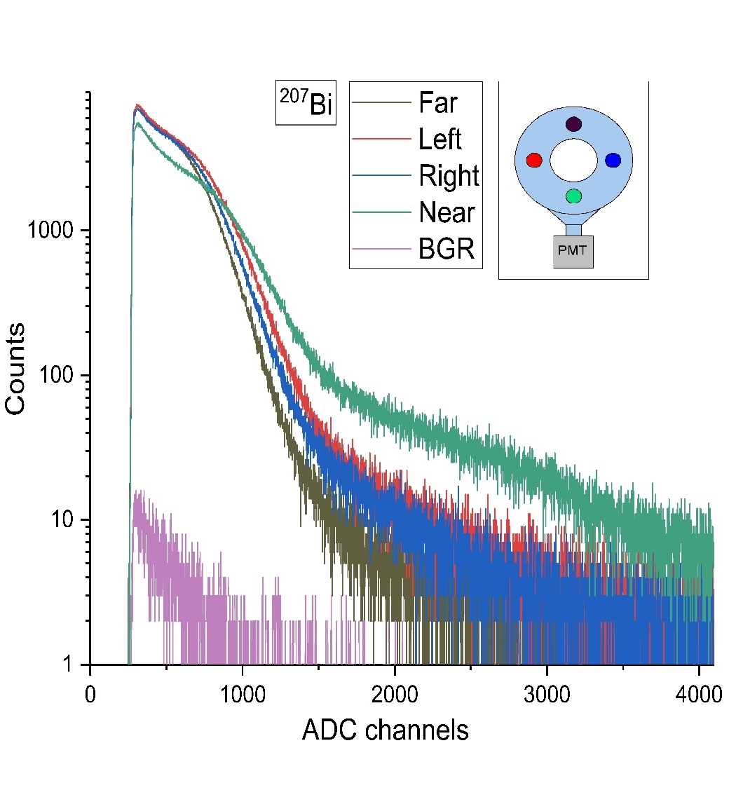
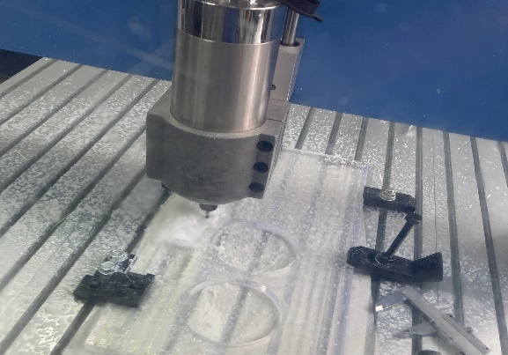
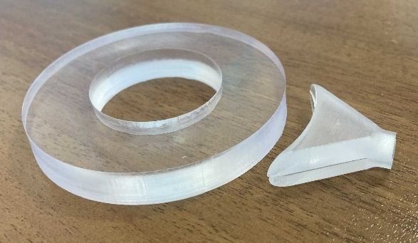
Target setup (C0)
Bi source at different positions @C0
C0
D = 80 mm
Dhole=25 mm
HScint = 10 mm
1 cm ring made of plastic scintillator and wrapped into 5 um mylar film.
The counter is attached to modular PMT by “fishtail” lightguide.
Ligthcollection inhomogeneity doesn’t exceed ~30% from the Bi source measurements in different positions.

Slide 6
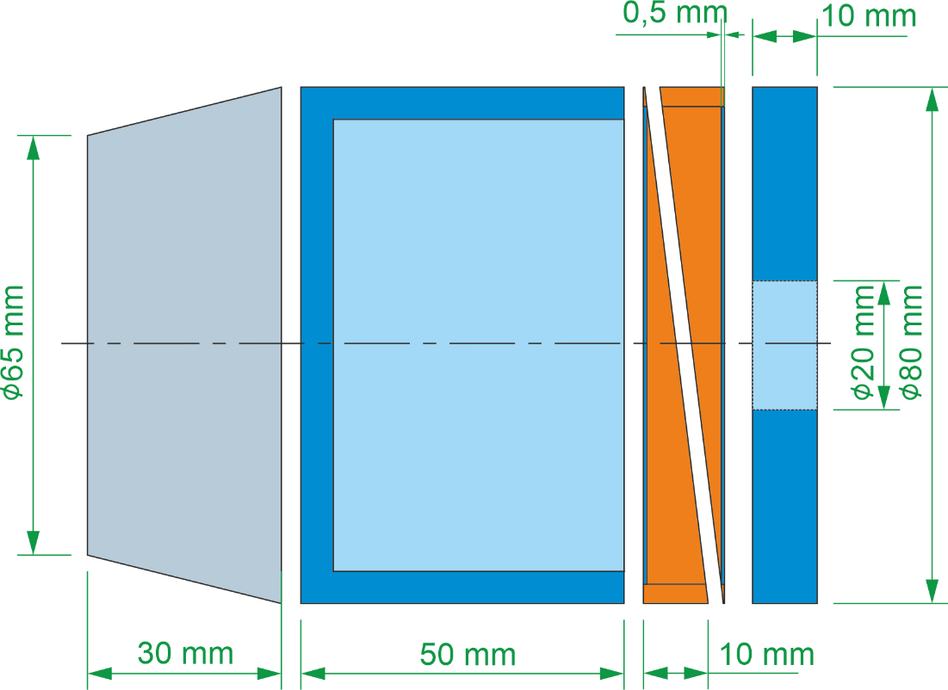
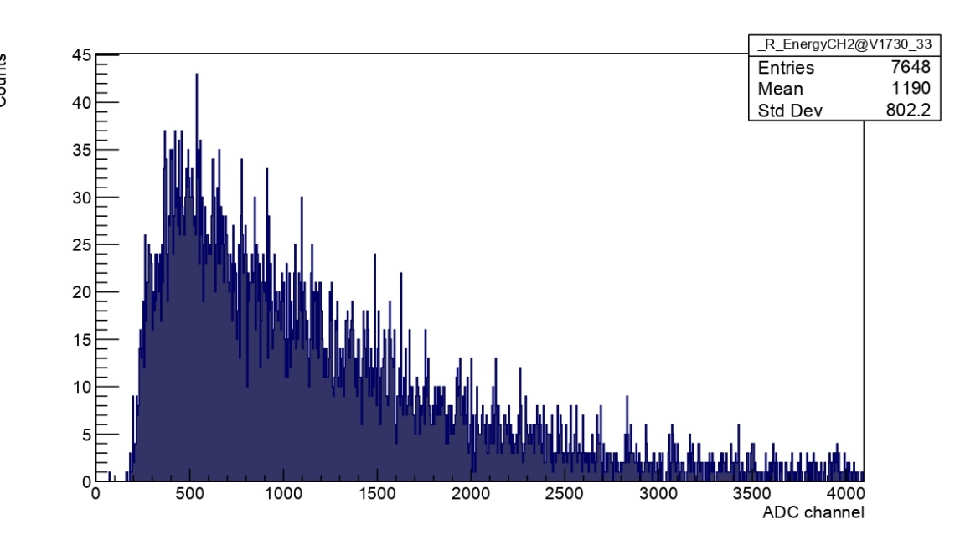
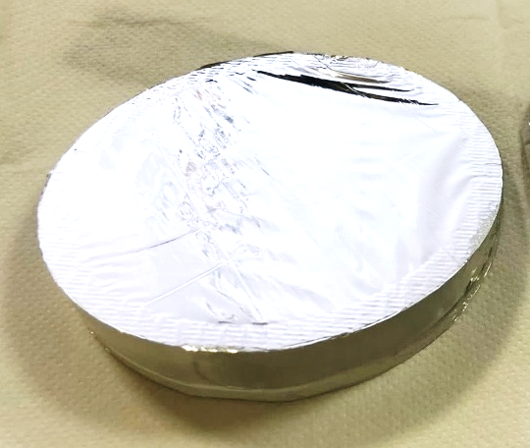
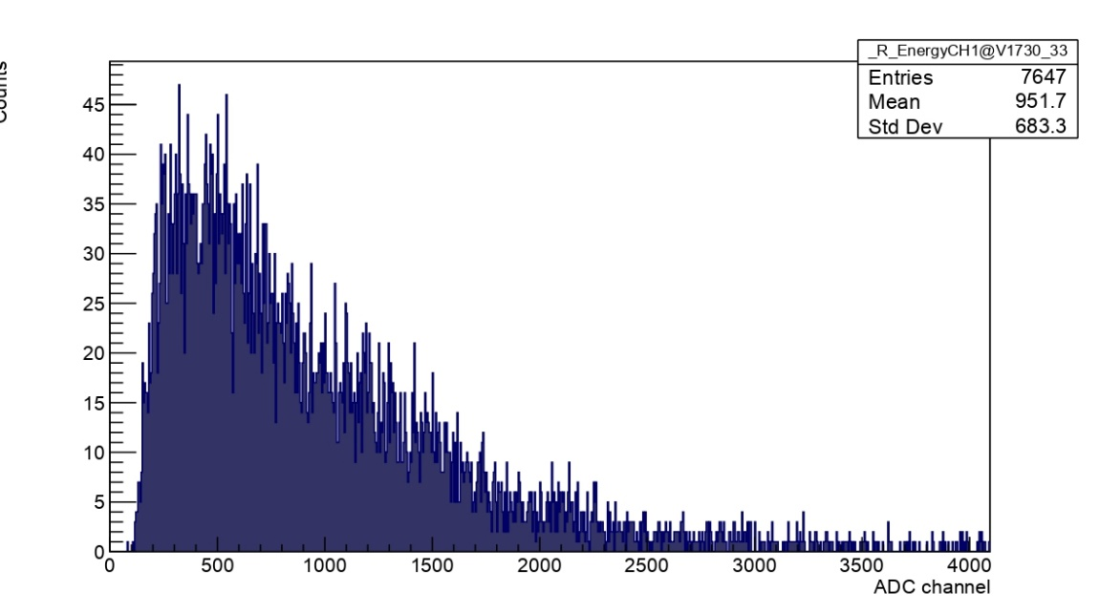
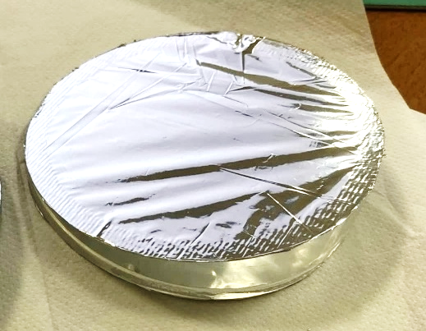
Target setup (C1 &C2)
Cosmic muons @C1
С1 & С2
D = 80 mm
HScint = 0.5 mm
Cosmic muons @C2
Thin 0.5 mm plastic scintillator circle glued into acrylic lightguide.
The lightguide has ring shape with wedge profile.
The counters are covered with 5 um mylar films and separated by the same thickness from each other.
The counters are readout by modular PMTs individually.
We saw different light collection for the counters, especially with beam muons (pictures in Igor’s or Elisabetta’s talks?). One has to fix it for the next beam time

Slide 7
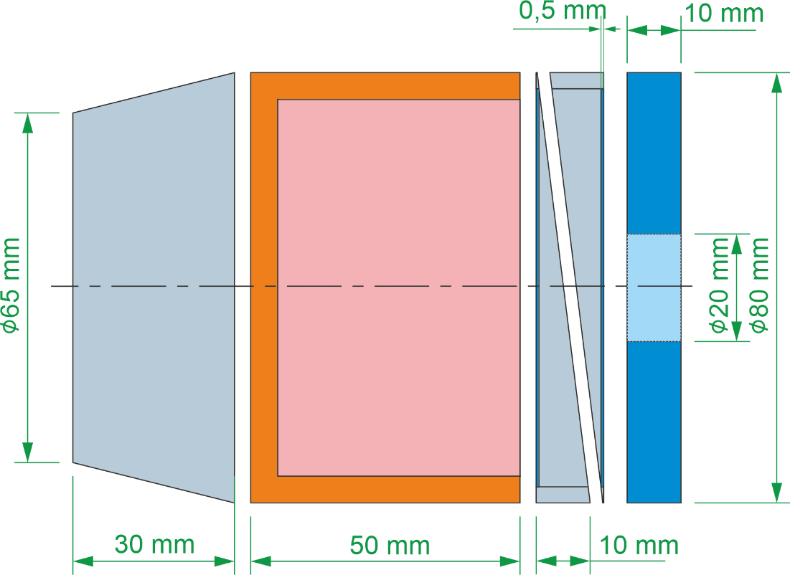
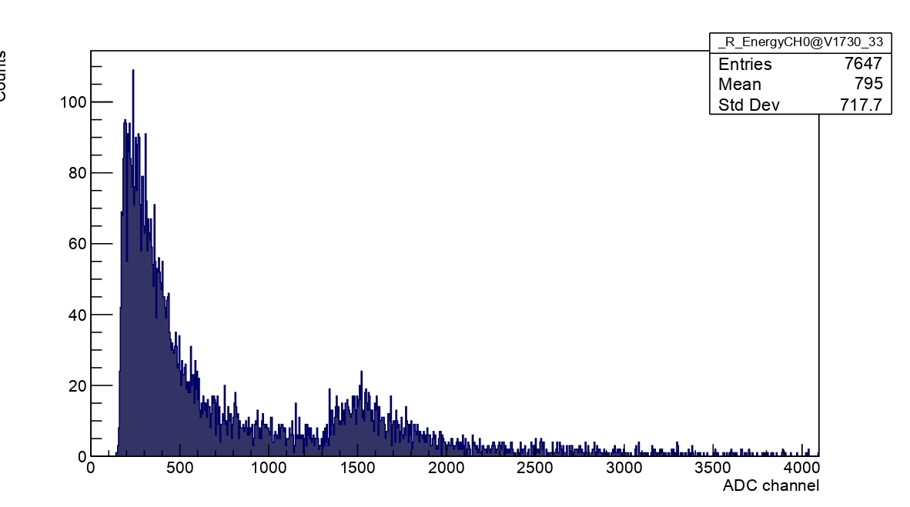
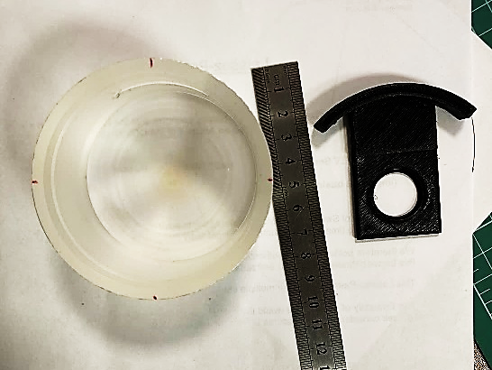
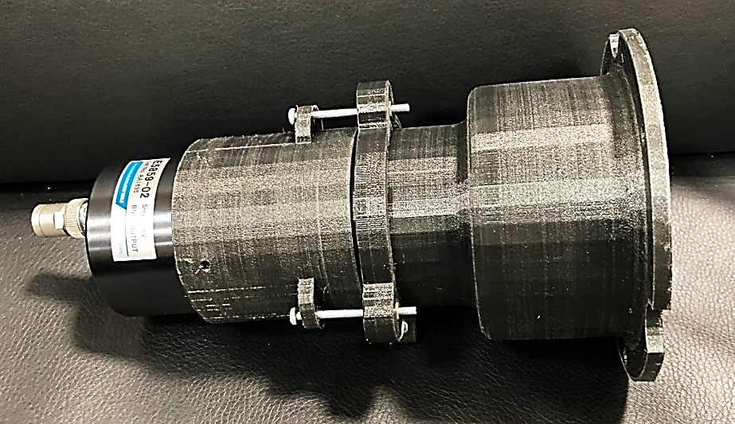
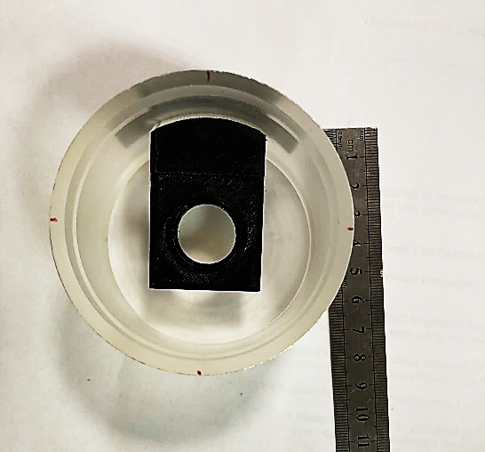
Target setup (C3)
Cosmic muons @C3
С3
D = 80 mm
HScint = 5 mm
Cup-like scintillator surrounding a target holder
Thickness of the C3 counter walls is 5 mm.
A target holder can be inserted through the cut in the wall of С3. The same way for calibration sources.
The counter is attached to R6091 PMT through a light guide made of polystyrene. For 2021 campaign we used plastic scintillator.

Slide 8
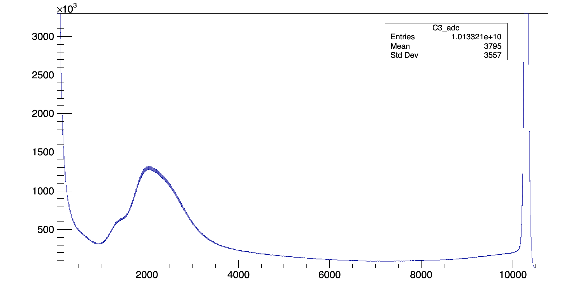
Target setup (C3)
Beam @C3
Some bumps and quite high rate at saturation region. This time we reduced amplitude to avoid saturation, but didn’t understand the bumps origin (Daniya’s talk)

Slide 9
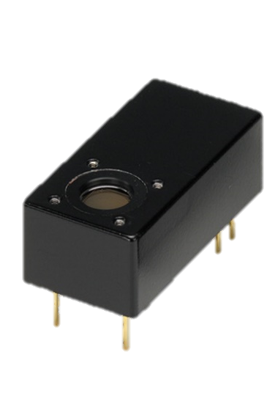
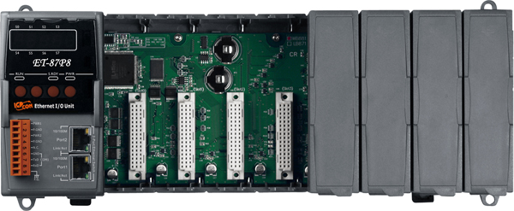

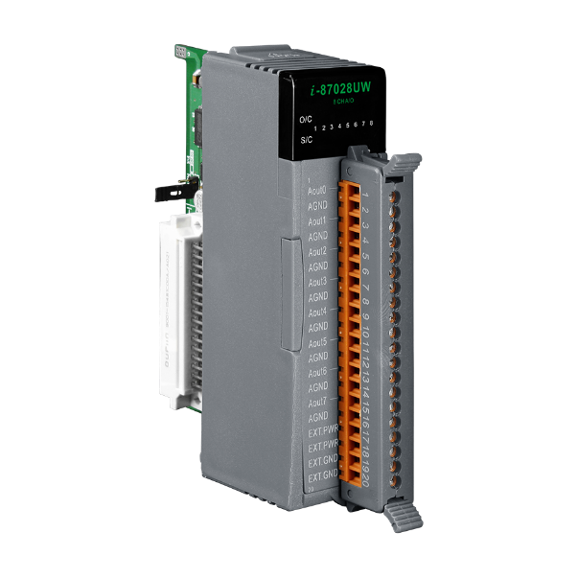
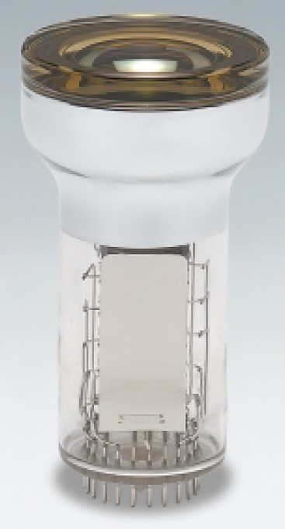
Target setup equipment
Remote control with
ICPDAS ET-878P
C0 counter
H10720 x2
Built-in HV power supply
0.5 – 1.1 VDC adjustable
C1, C2 counters
H6780
Built-in HV power supply
0.5 – 1.1 VDC adjustable
ICPDAS DAC I-87028UW-G
C3 Counter
3” PMT R6091
With Traco DC-DC for HV
0-4 VDC adjustable

Slide 10
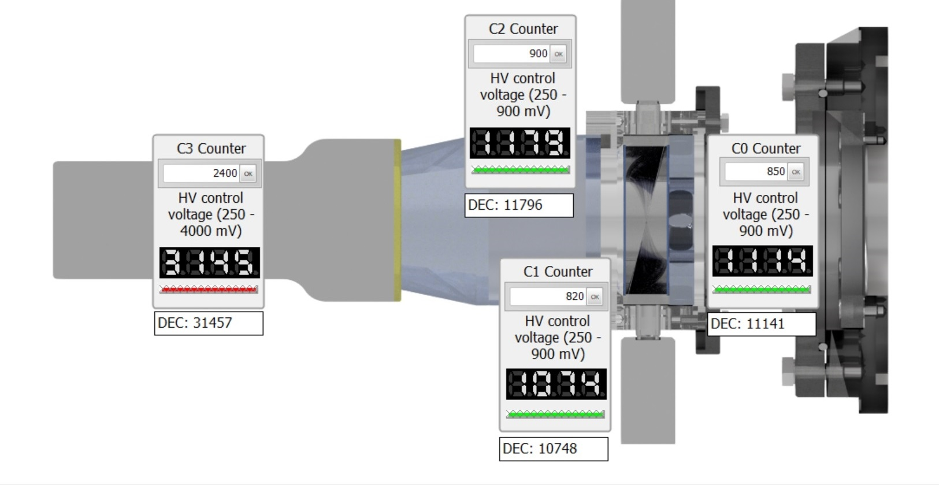
Target setup equipment
C2 Counter
Lightguide
C3 CUP
C1 Counter
C1 Counter

Slide 11
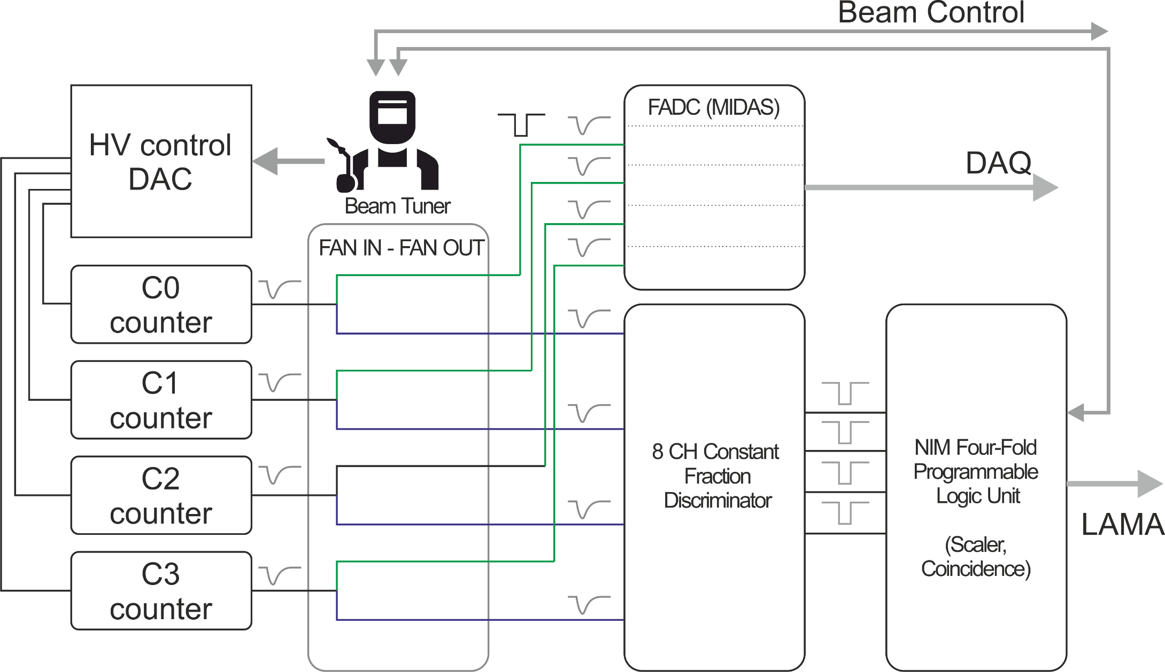


Beam tuning
$$\overline{C0}\&C1\&C2\&\overline{C3}$$
Optimal conditions:
Minimize C0 and C3
Maximize C1 and C2
Minimize muonic X-rays
from oxygen and carbon

Slide 12
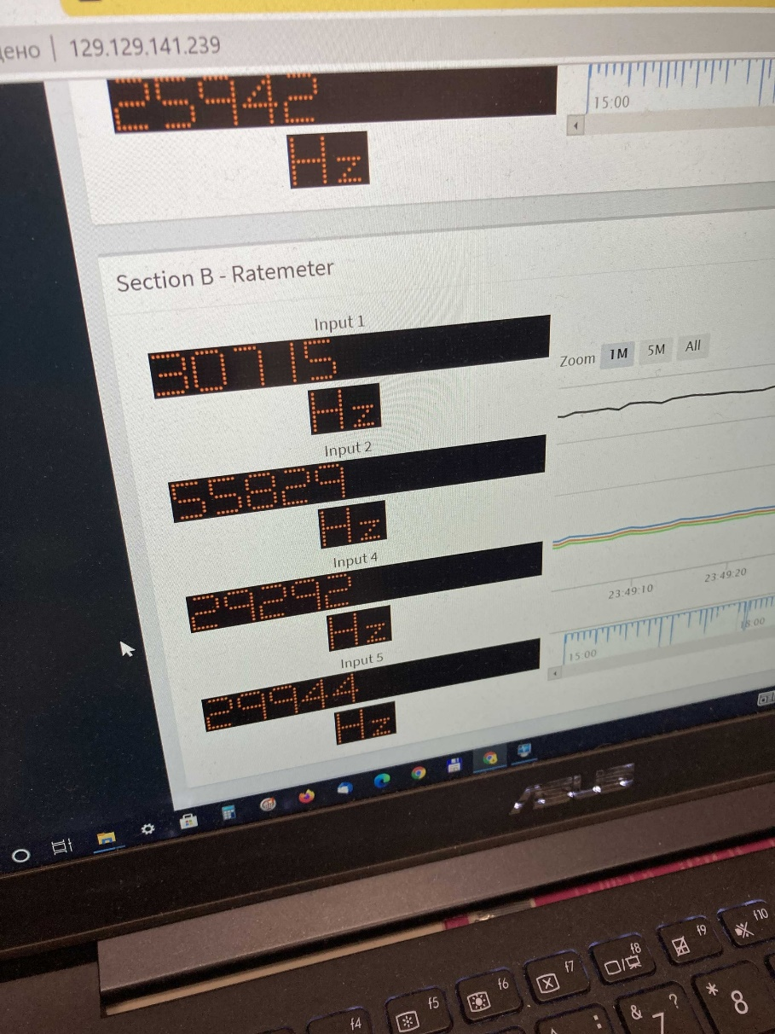
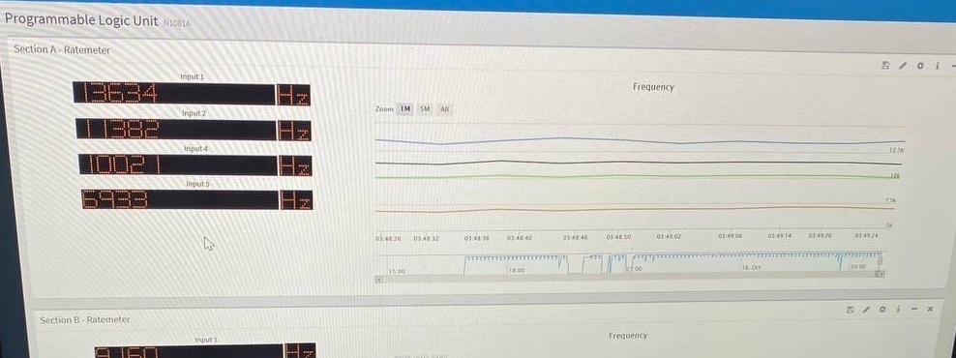
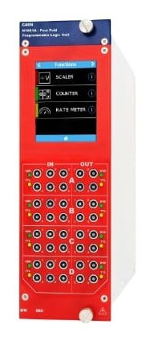
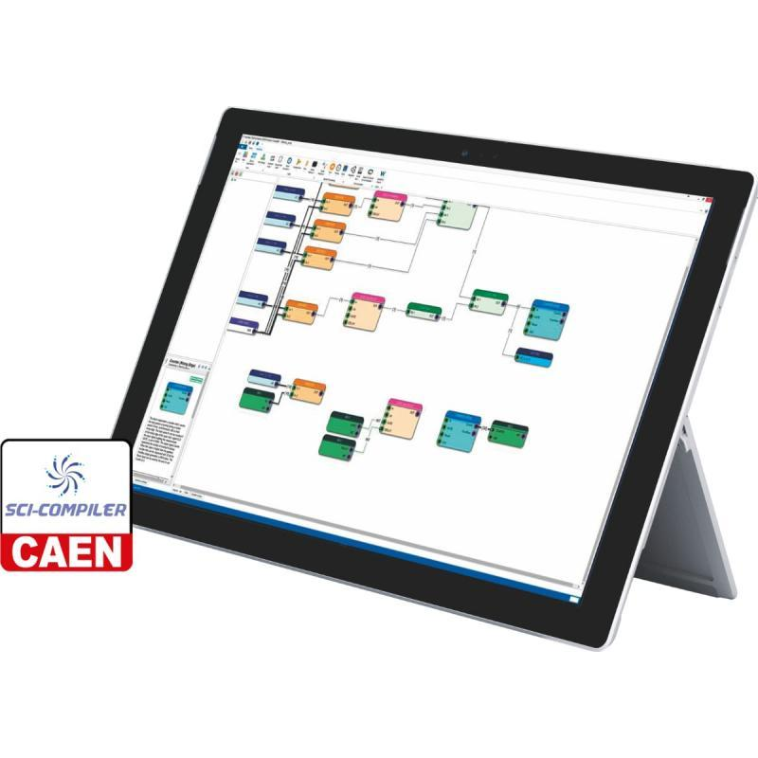
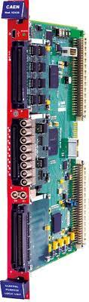
Beam tuning

Slide 13
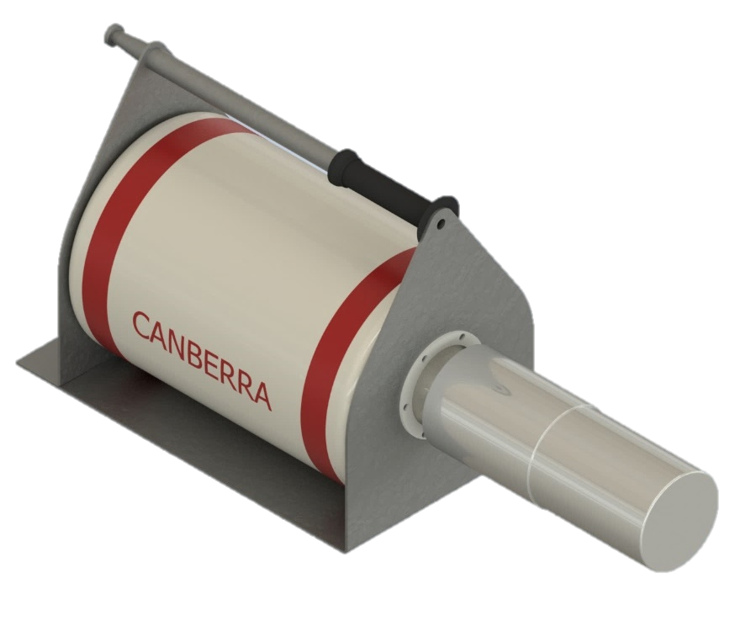
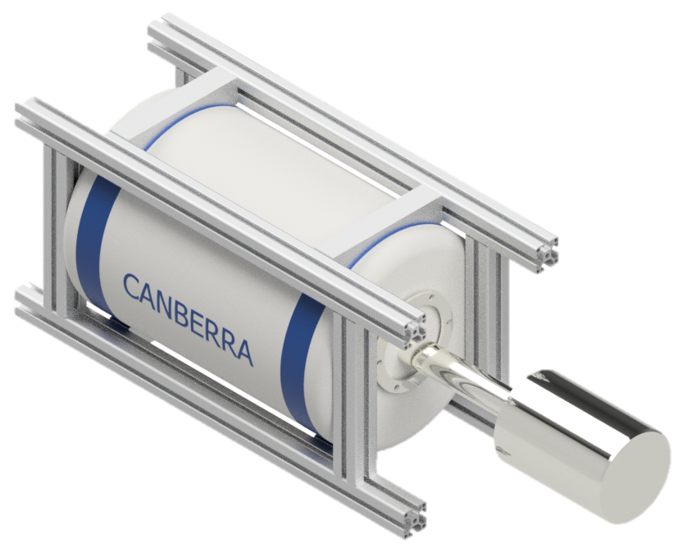
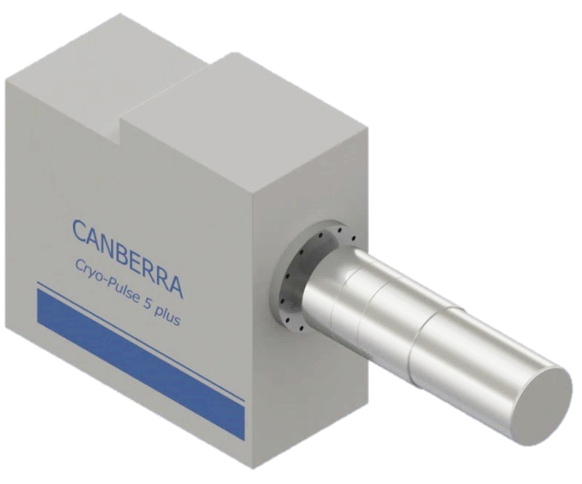
Ge-detectors set (actual)
x2
x1
x5
BigMac cryostat
with sheet steel frame
CryoPulse 5
(Electrically Refrigerated Cryostat)
BigMac cryostat
with ITEM frame
Konstantin Gusev & Nadezda Rumyantseva talks

Slide 14
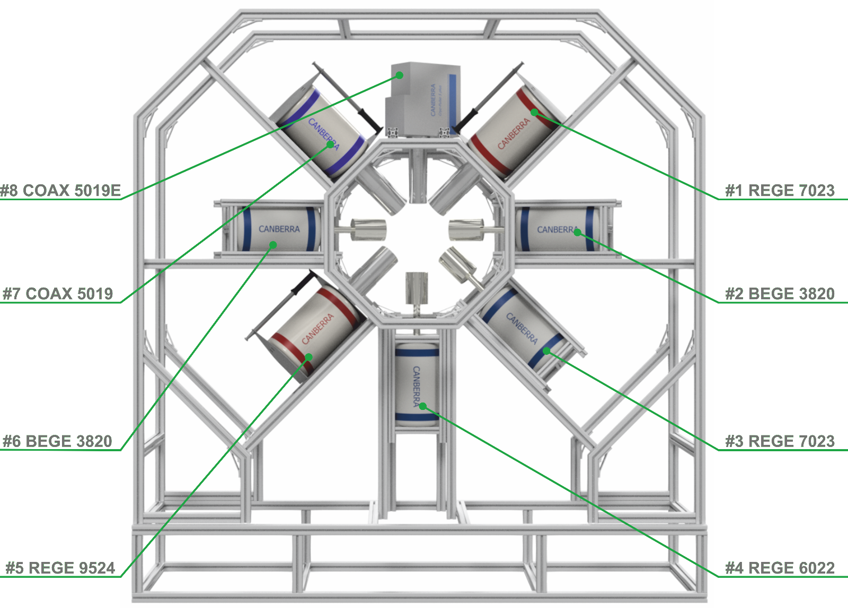
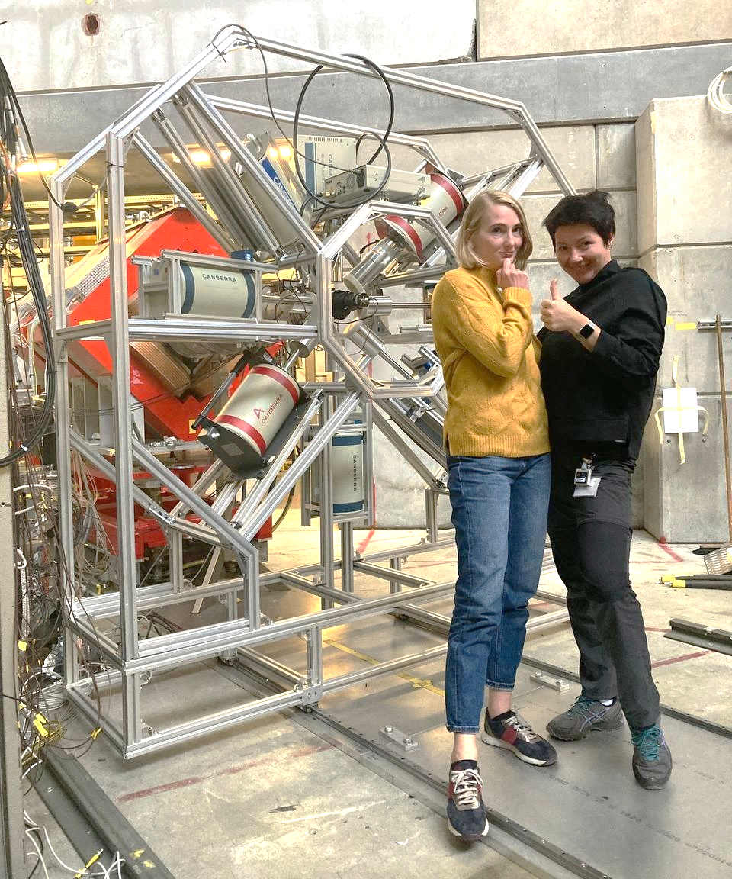
Ge-detectors setup assembly
BEGE 3830
The final configuration

Slide 15
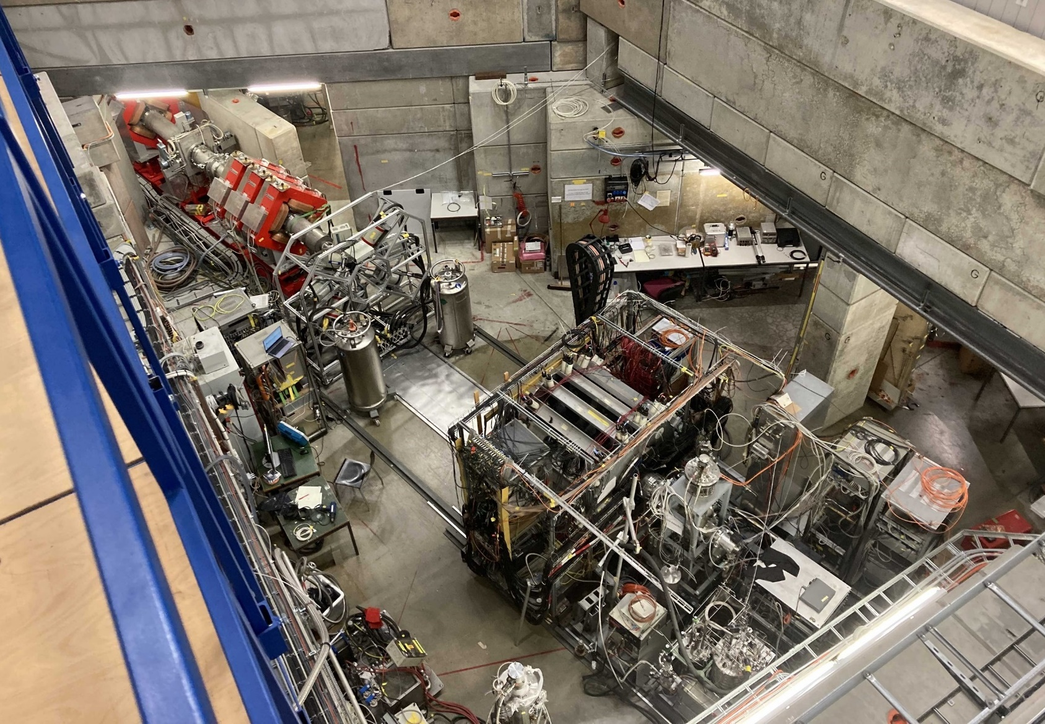
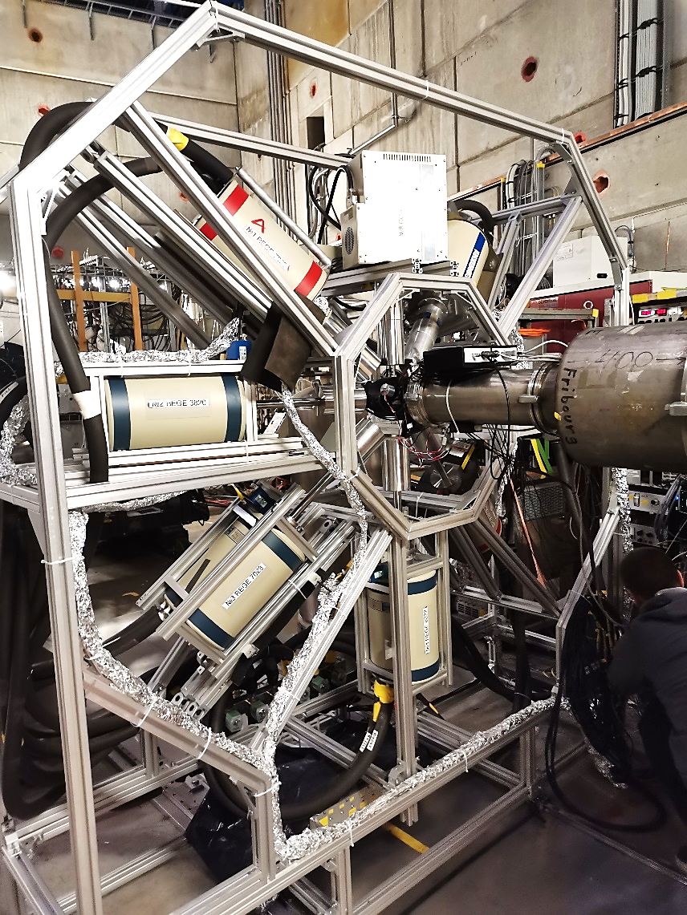
Experimental hall
Beam line
Trolley with Ge-detectors
LN Dewars
Racks with electronics

Slide 16
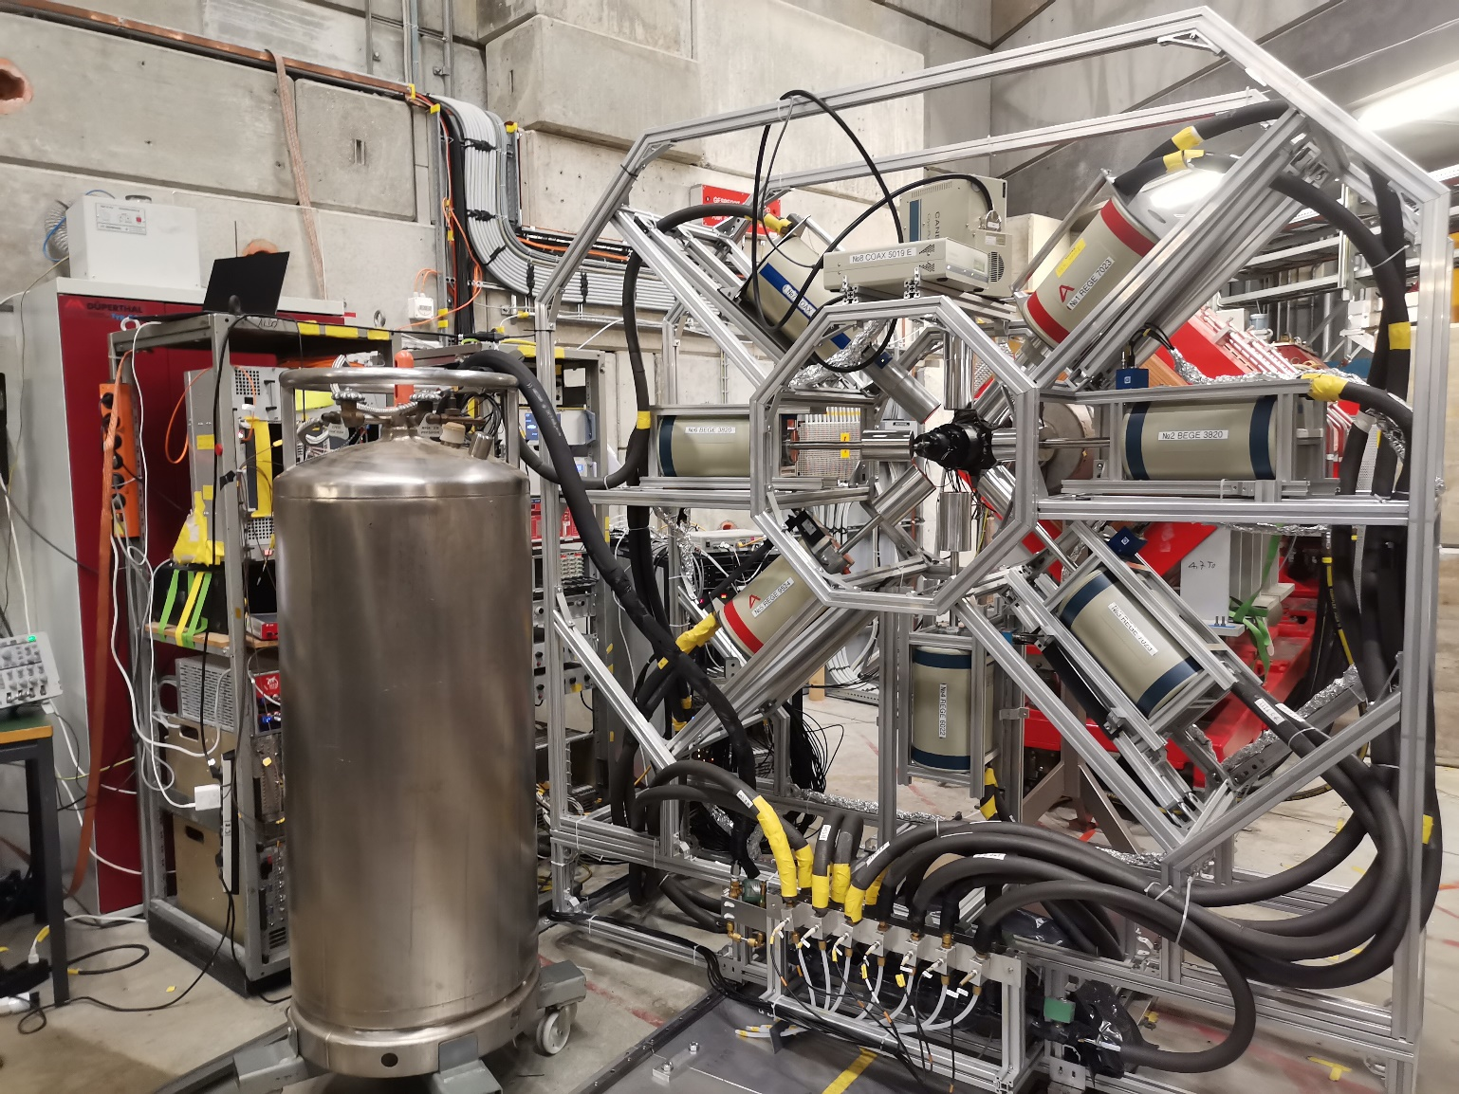
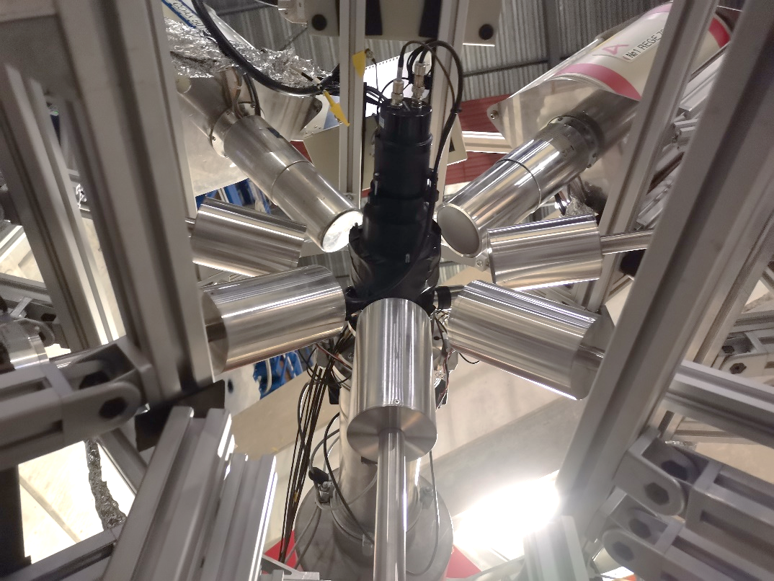
Ge-detectors setup
8 Ge-detectors mounted on the frame with 15 cm distance from the beam axis.
6 detectors with LN auto filling system
Neutron detector
The final configuration

Slide 17
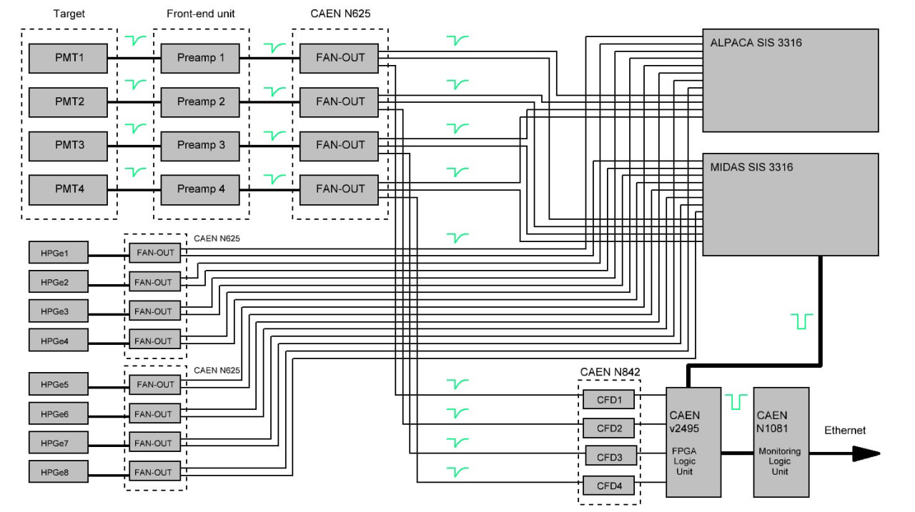
DAQ scheme

Slide 18
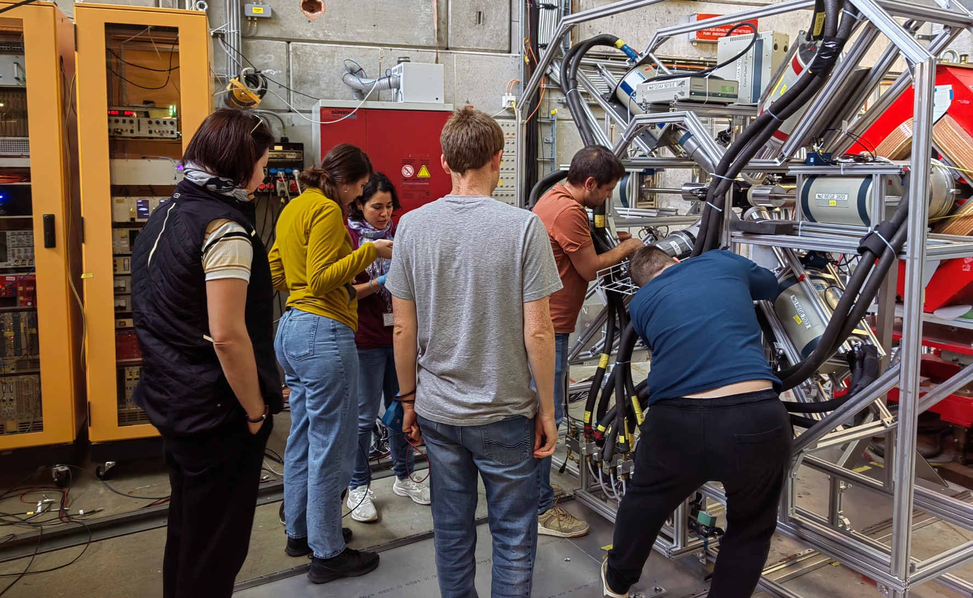
Beamtime schedule
Step | Time
Assembling and tuning of the setup | 22.09.2022-24.09.2022
Calibration runs | 25.09.2022-26.09.2022
^{nat}Mo measurements (together with beam tunning) | 26.09.2022-29.09.2022
Calibration runs | 30.09.2022
¹⁰⁰Mo | 01.10.2022-08.10.2022
Calibration runs | 08.10.2022
Deconstruction | 08.10.2022-10.10.2022

Slide 19
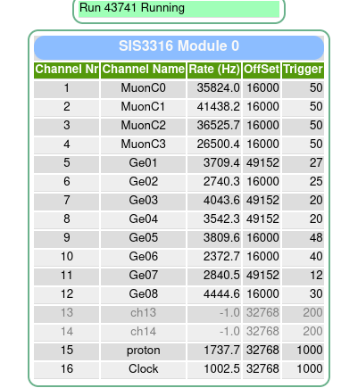
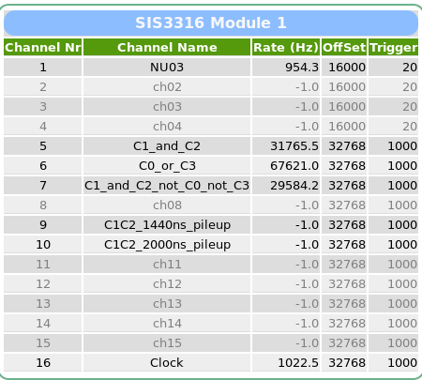
Count rates for Mo-100

Slide 20
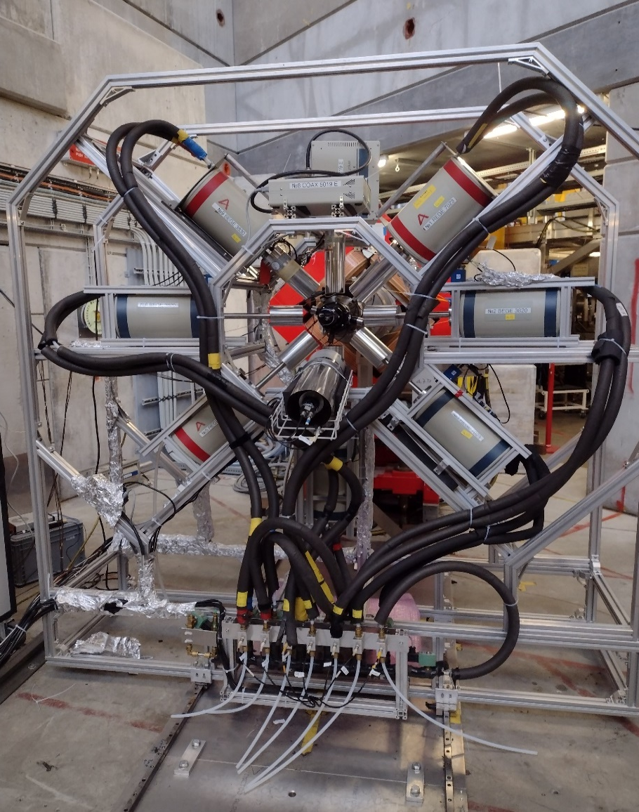
Main issues during 2022 campaign
Bad/old LEMO cables are the main reason of the lost time. During the setup tunning we saw different impacts:
  Double peaks from germanium detectors;
  Terrible energy resolution;
  Interruption of FADCs channels operation.
Correlation between energy resolution and pulser plugging. Possibly, caused by some cables, but the problem wasn’t solved during the campaign.
Some detectors showed high LN consumption. One should think about pumping the cryostats before the next beamtime.
We had power outage on 26/09/2022 during dewars refilling. Most likely, it was caused by the penetration of condensed water into the power strip
Detector 7 (75%) tripped on 29/09/2022 due to heating. Possible reasons are problems with refilling or low vacuum in the cryostat . We replaced it with 3B (BEGE 3830).

Slide 21
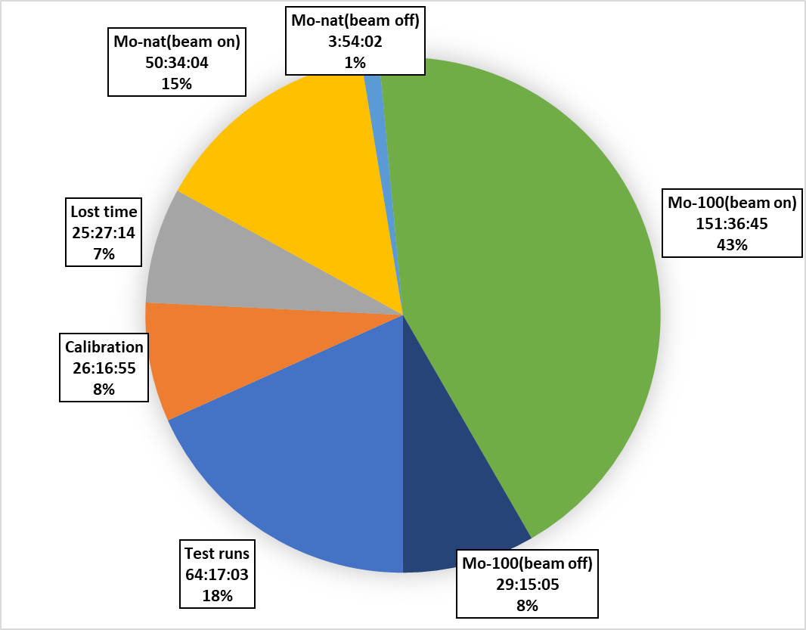
Beam time distribution
Prleminary, we have more then 70% of time with usefull data. BUT:
18% of test runs is too much for a future campaign. If we start with an already well-configured installation, it will significantly reduce the testing time. However, we were on schedule…
Lost time began with detector 7 tripping (more than 1 day). However, during the replacement, we fixed some problems with the cable connection and recognized its significant impact on data acquisition.
We have more than a half time of Mo-100 data.
During 2022 campaign we had very stable beam with minor interruptions.

Slide 22
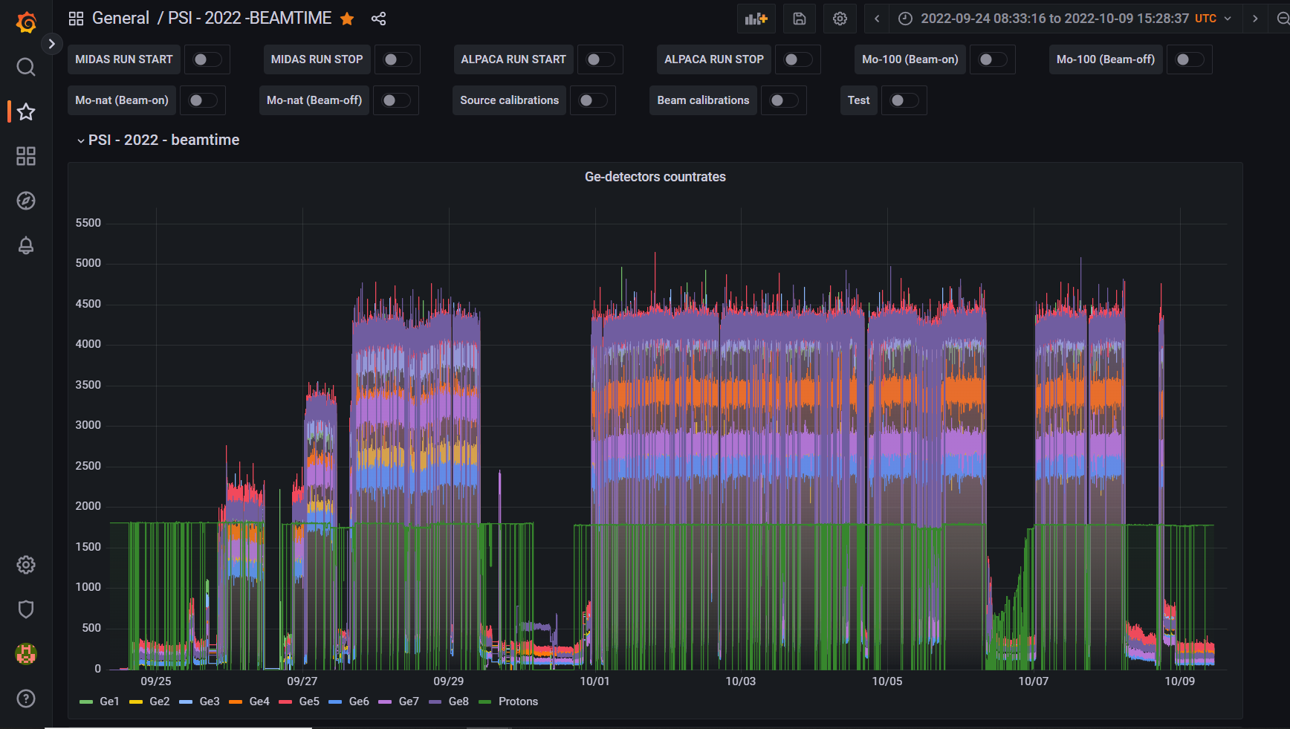
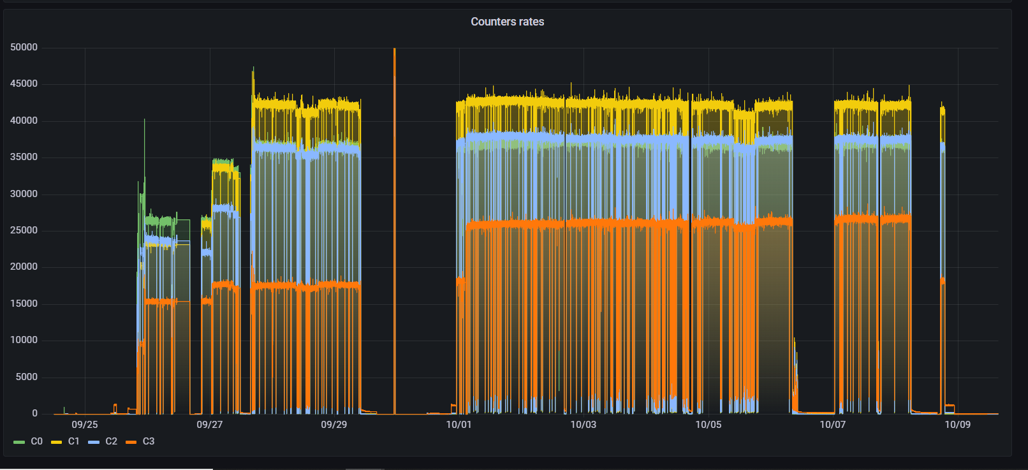
Beamtime data taking navigation
We export MIDAS database to Grafana dashboard to simplify navigation in campaign data taking:
Countrates for the Ge-detecors and the counters are available;
Time stamps for both MIDAS and ALPACA daq systems can be displayed;
Annotations for different measurements;
Usefull for transition runs (during shutter closing or opening);
Unexpected behavior of the setup can be explained together with the data the taking tables.

Slide 23

Beamtime data taking navigation

Slide 24

Beamtime data taking navigation

Slide 25

Beamtime data taking navigation

Slide 26

Beamtime data taking navigation

Slide 27

Beamtime data taking navigation
Access:
remotely at http://159.93.76.145:821
install MySQL server and Grafana dashboard, then download database and dashboard json files from https://wiki.tum.de/display/gainmomentum4dbd/Beamtime+2022

Slide 28
Beamtime data taking navigation
Both ALPACA and MIDAS data taking tables are avaliable at wiki.tum.de
The runs timestamps are synchronized with elog and logbook (2 minutes uncertainty)

Slide 29

Beamtime data taking navigation
Both ALPACA and MIDAS data taking tables are avaliable at wiki.tum.de
The runs timestamps are synchronized with elog and logbook (2 minutes uncertainty)

Slide 30


Outlooks
The target device allows tune the beam with enough accuracy, but has several drawbacks:
    Different light yields for C1 & C2 counters assume nonuniform settings (thresholds, ranges, etc.) for the DAQs and require individual tunning approach.
    Hard to distinguish events from muons, electrons and gammas in C3. Replacement of the lightguide didn’t change the spectra shapes. To be investigated…
Proper cabling with “fresh” cables is absolutely necessary. This helps to save time.
We saw vacuum degradation and LN consumption increasing for the cryostats. One should take care about pumping in advance.
Pulser problem hasn’t been solved until now. We don’t understand why the test channel connection drasticaly affects on energy resolution.
Most likely, we will not use our frame for 2023 beamtime.
We need time synchronization for ALPACA and MIDAS server. This will simplify parallel analysis.
Use insect repellents while walking at PSI forests!

Slide 31
Thank you for your attention!

Slide 32

C3 spectra 2021 vs 2022 (beam on)

Slide 33
NIM electronics

Slide 34

NIM electronics

