Slide 1
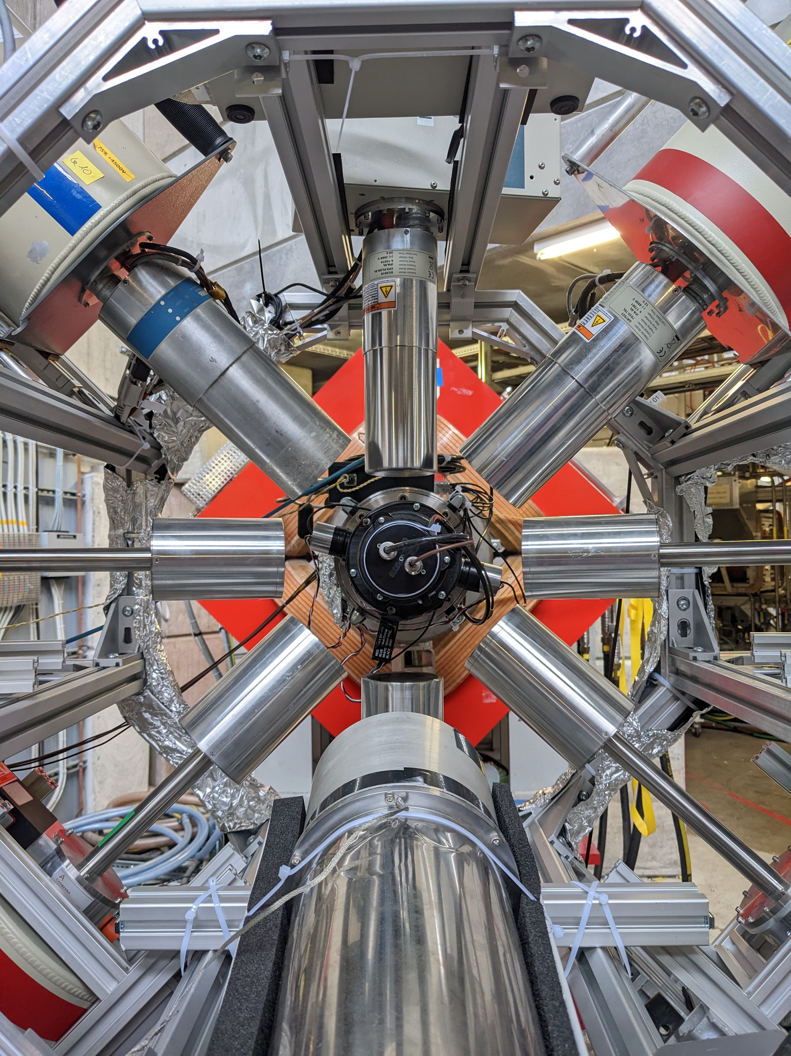

Stability of ¹³⁶Ba peaks and FWHM from Oct and Nov 2021 data sets
-Dhanurdhar bajpai

Slide 2
Outline
Review of procedure for time stability analysis and calibration correction
Variation of Peaks between Oct & nov data
  REGE detectors
  BEGE detectors
  COAX detectors
Variation of FWHM between Oct & nov data
  REGE detectors
  BEGE detectors
  COAX detectors
Summary

Slide 3
Procedure for time stability analysis
Time stability analysis is needed to understand the detector performance during the beamtime
This includes shift in muonic X-ray peak positions and the peak FWHMs
¹³⁶Ba data was divided into sets of 6 hours and all files within the 6 hour period were combined
4 peaks (1227.0 and 1283.7 KeV in low energy and 3922.9 and 2988.8 keV in high energy region) were selected and the mean/ sigma/ residuals were found using the GERDA fit function
1460.83 keV ⁴⁰K peak was used as a cross check of our detector stability over the entire (¹³⁶Ba⁺⁷⁶Se) measurement
This talk only focusses on ¹³⁶Ba time stability

Slide 4
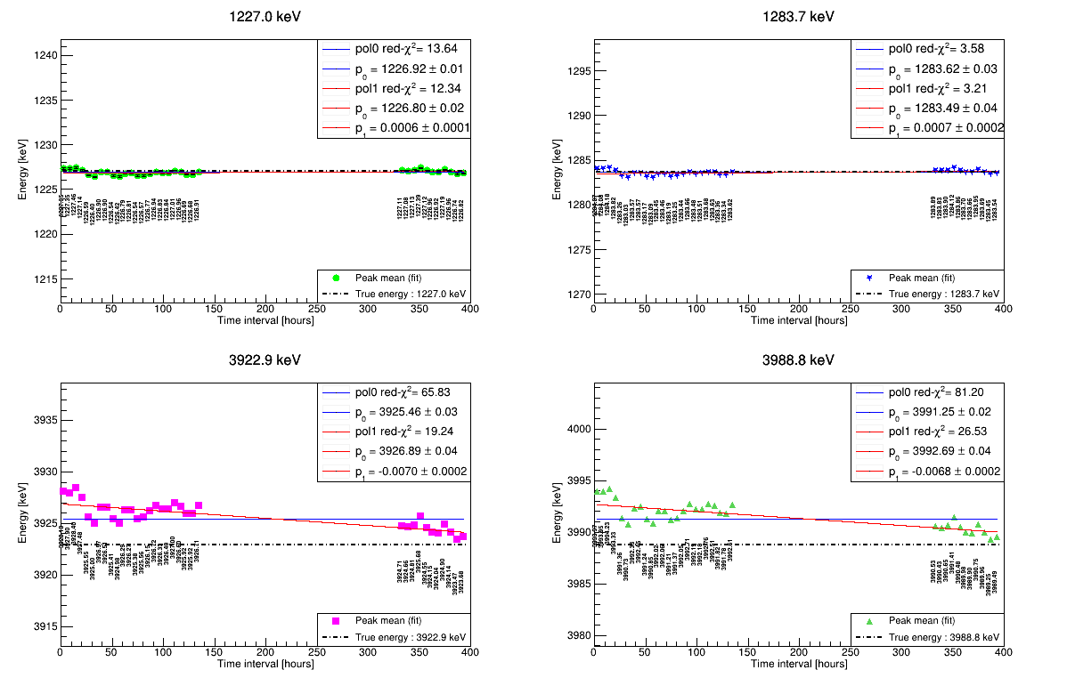
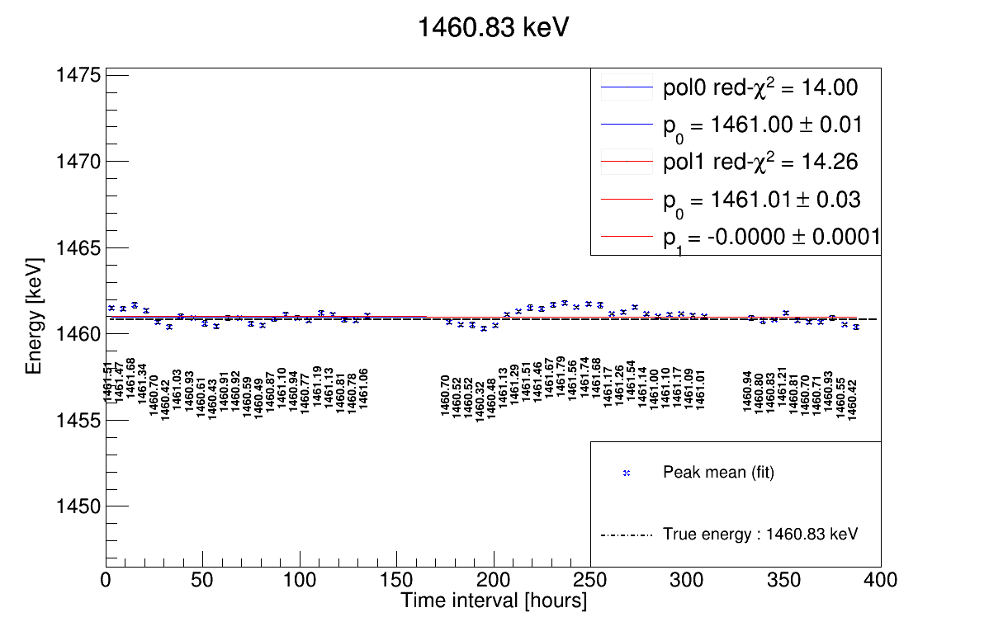
Example of Ba and K peak stability over time

Slide 5
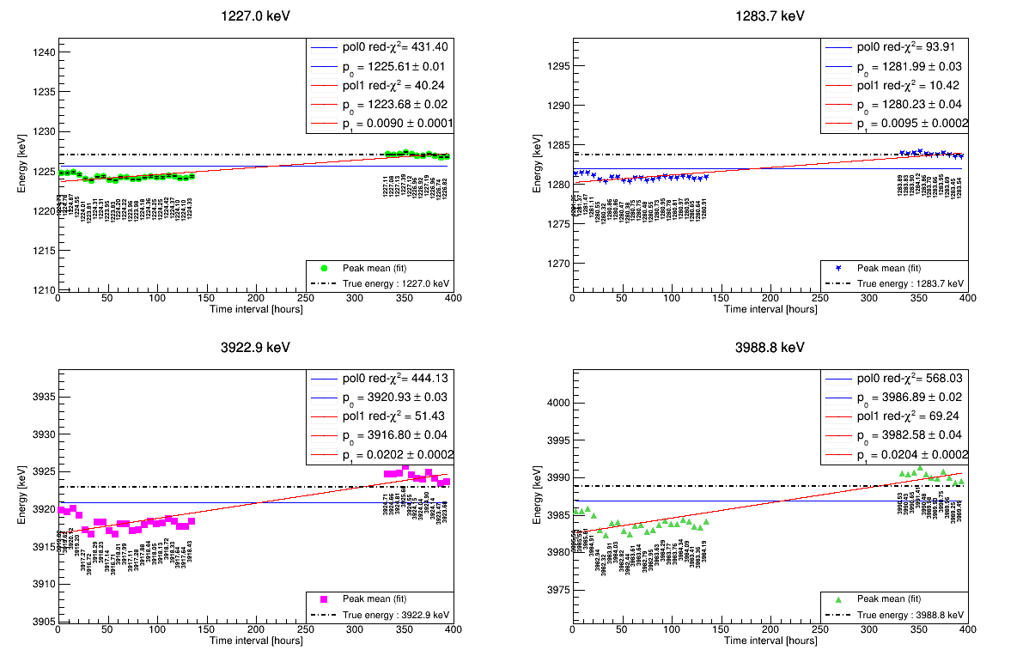
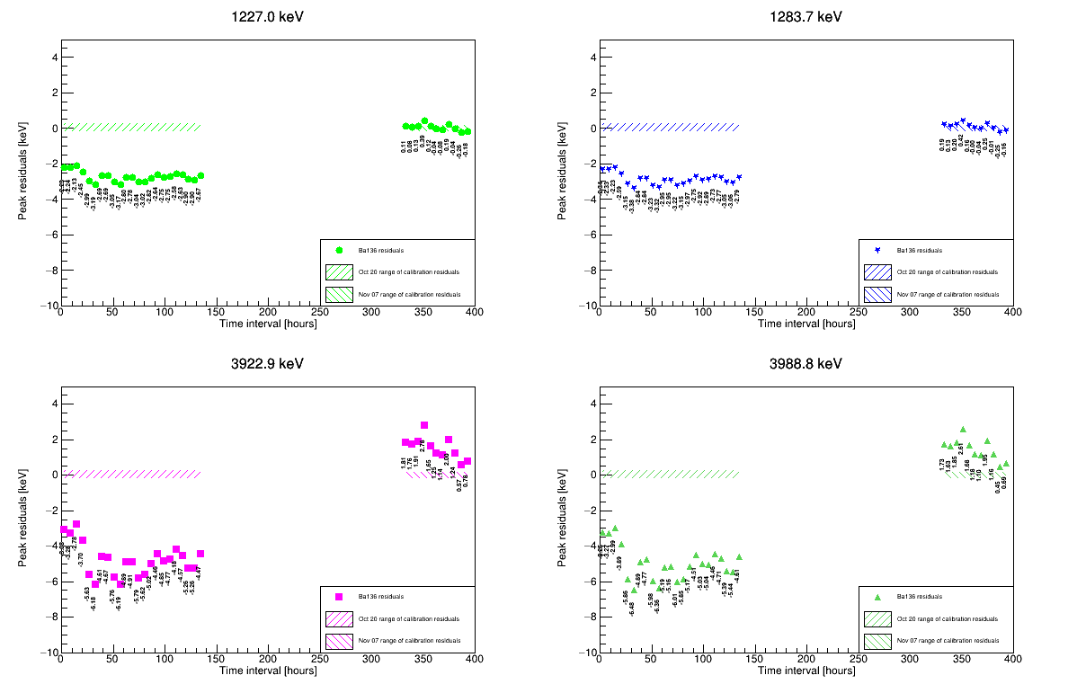
Procedure for calibration correction
¹³⁶Ba had two sets of data, Oct & Nov using calibrations from Oct 20 and Nov 7 respectively
Oct data with Oct 20 calibrations had worse peak mean positions and poor residuals

Slide 6
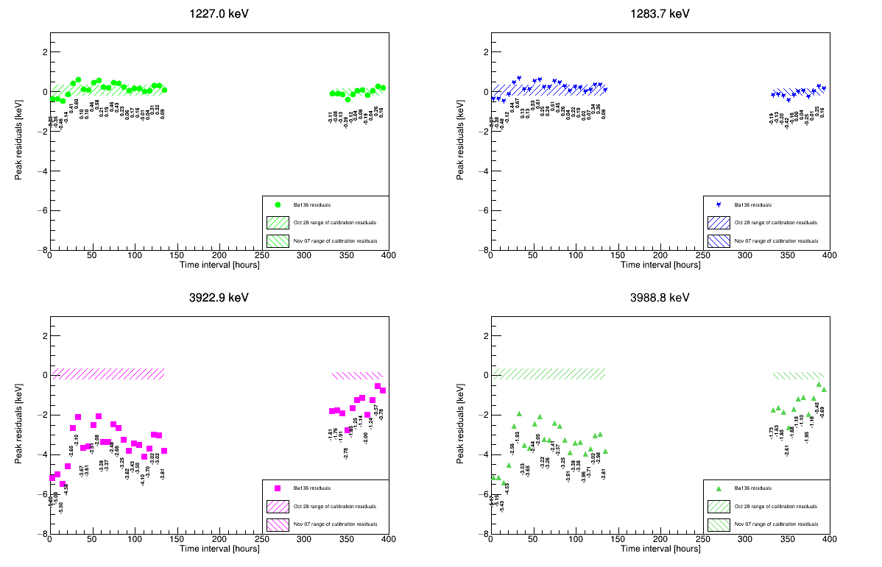

Procedure for calibration correction
So, we calculated the peak positions again by multiplying it with a correction factor for each detector as follows:
  Factor = $\frac{slope of Oct 28 calibration}{slope of Oct 20 calibration}$
This gave approximate peak positions without generating new tier3 files

Slide 7
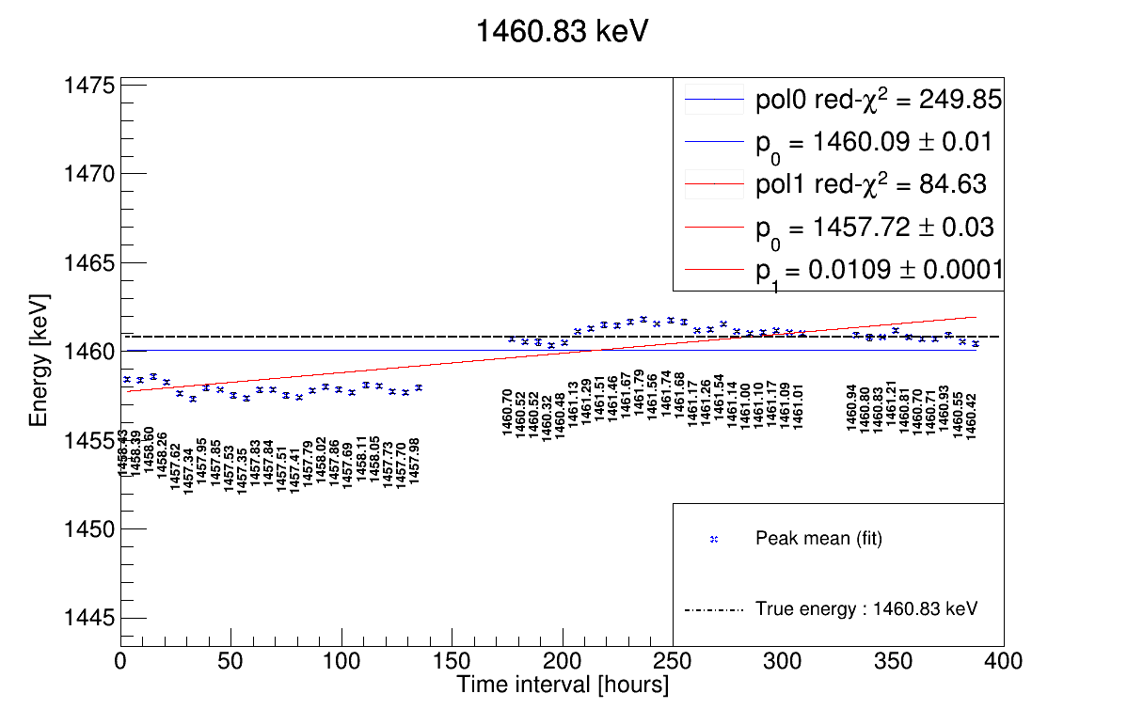
Cross-check calibration correction with ⁴⁰K

Slide 8
Variation of Peaks between Oct & nov data

Slide 9
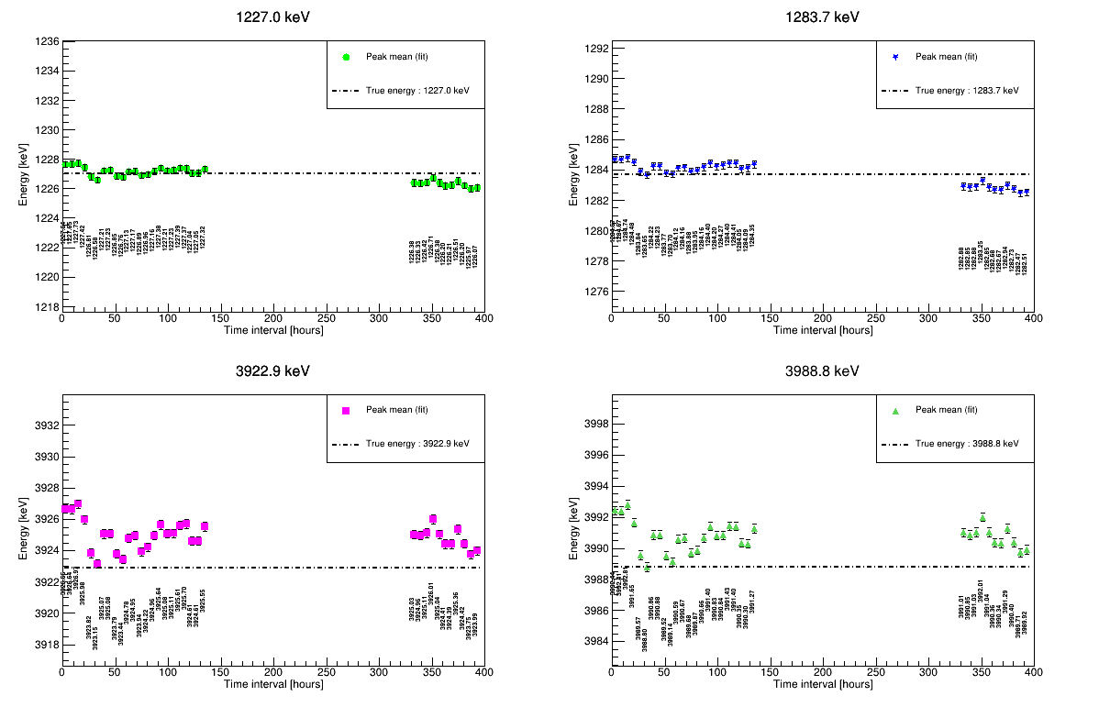
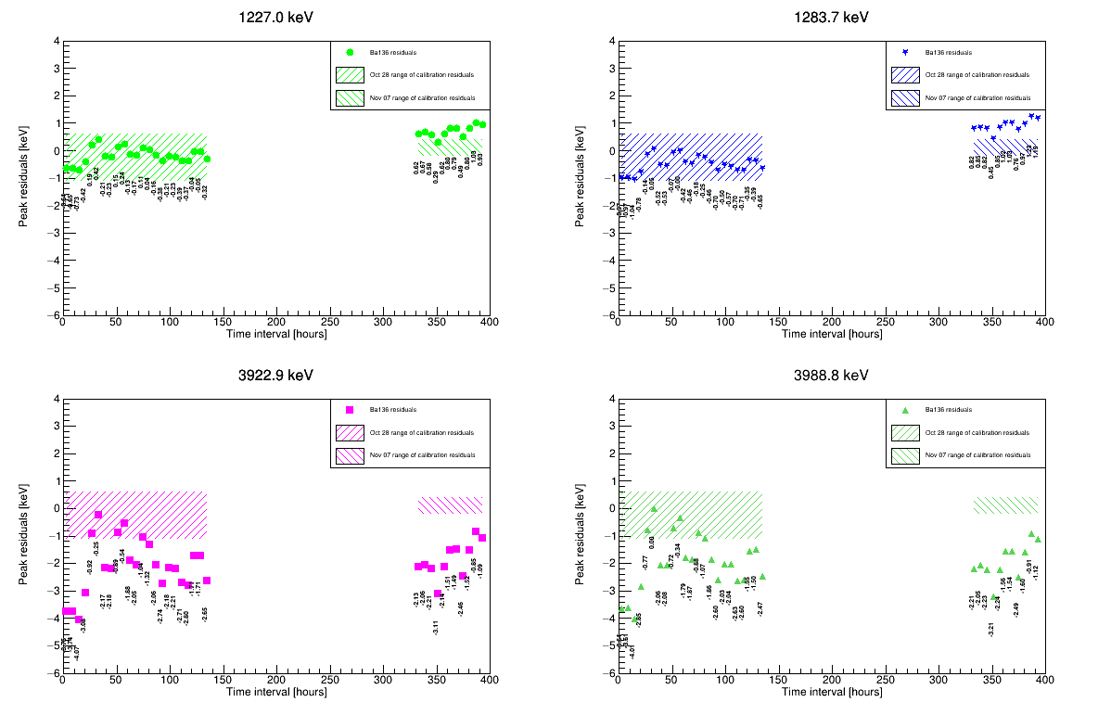
Channel 0 (REge) peaks and residuals
Shift
Stable
Poor residuals

Slide 10
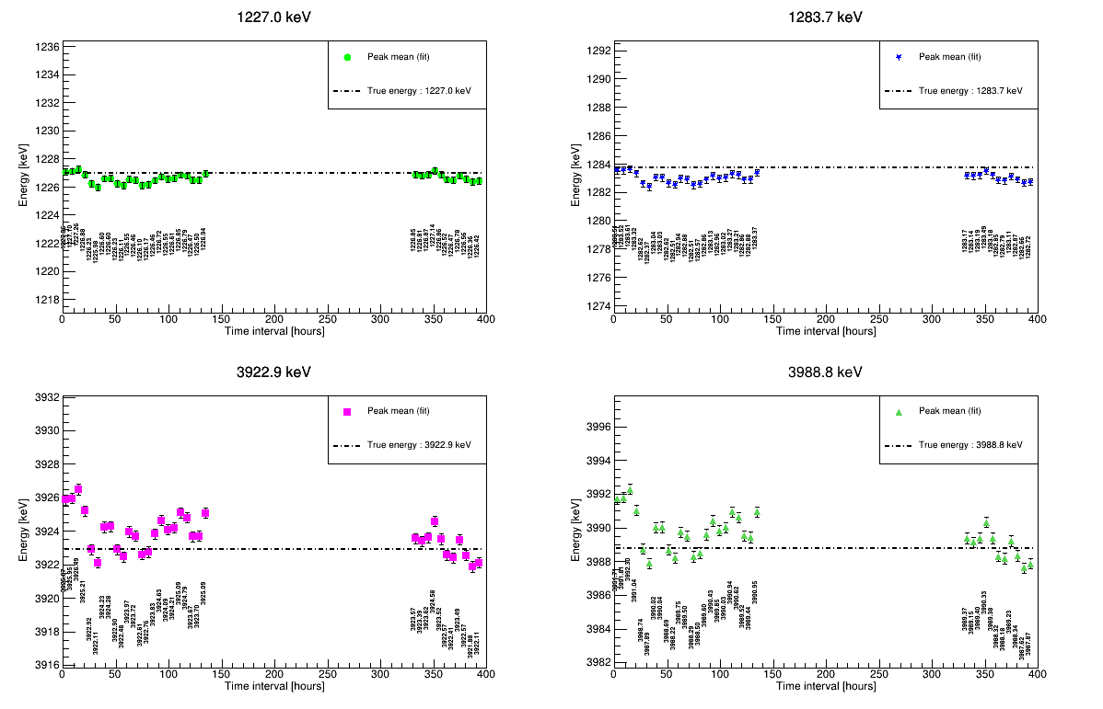
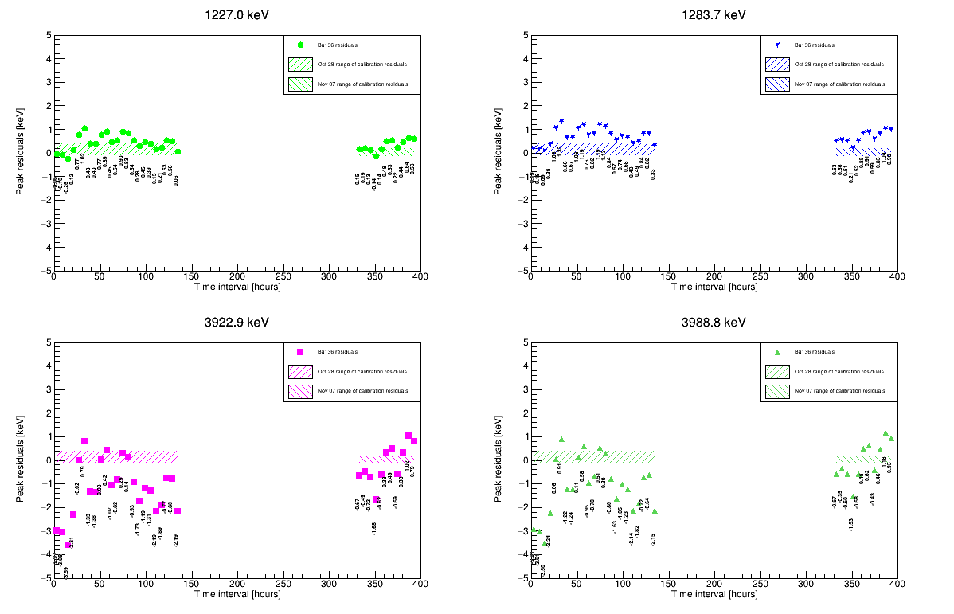
Channel 4 (REge) peaks and residuals
Stable
Stable
Poor residuals

Slide 11
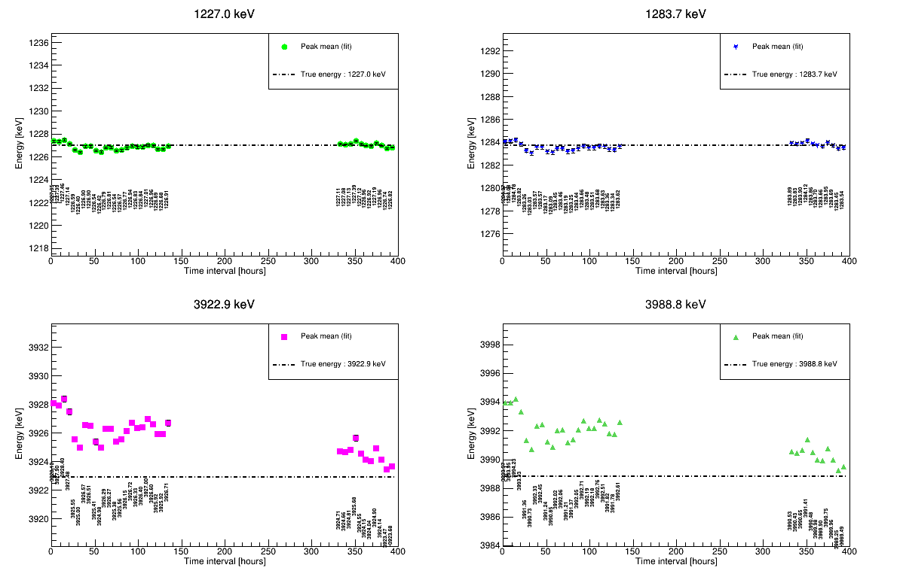
Channel 1 (bege) peaks and residuals
Stable
Shift
Poor residuals

Slide 12
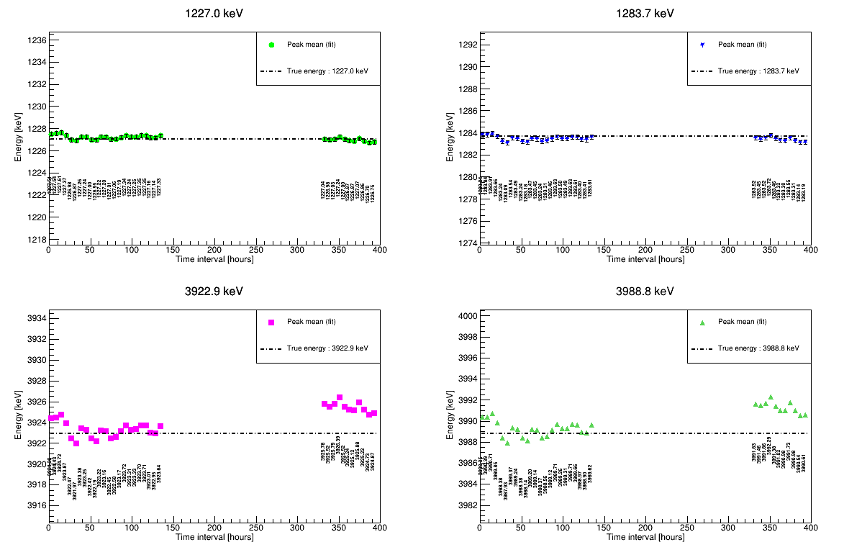
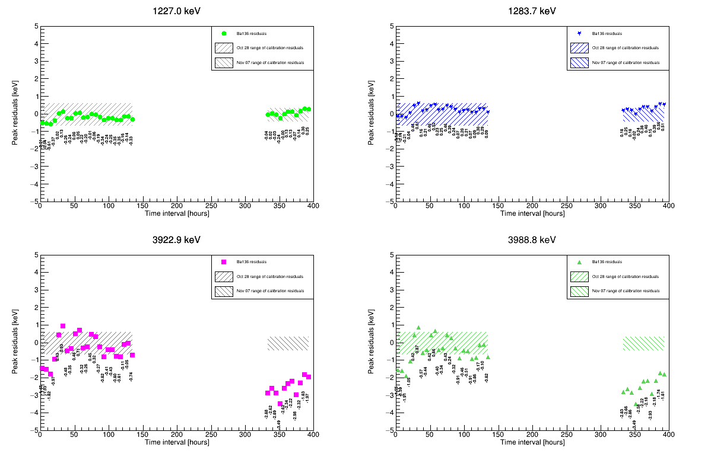
Channel 7 (Coax) peaks and residuals
Stable
Shift
Poor residuals

Slide 13

Shift/RMS for all detectors
|Shift|= Difference in means
FWHM is calculated from fit parameters of $\sqrt{(a+b∗E)}$ at that energy from calibration data
Excluded first 1.5 days of data

Slide 14
Shift/RMS for all detectors
Crude estimates of shift and RMS variation between Oct and Nov data
“Shift” is subject to threshold we set for the analysis (say 1.5 keV ?)
Peaks are “stable/unstable” if shifts are smaller/greater than this threshold
We also look at the FWHM of the peak to decide if we combine those data sets*
RMS can be a good estimate of peak stability within individual periods
*The FWHM from physics data is larger than calculated one (later slides)

Slide 15
Observation by looking at the peaks
Summary of peak stability of all detectors separately in low/high energy region
Magnitude of shift in peaks between end of Oct and beginning of Nov

Slide 16
Variation of FWHM between Oct & nov data

Slide 17
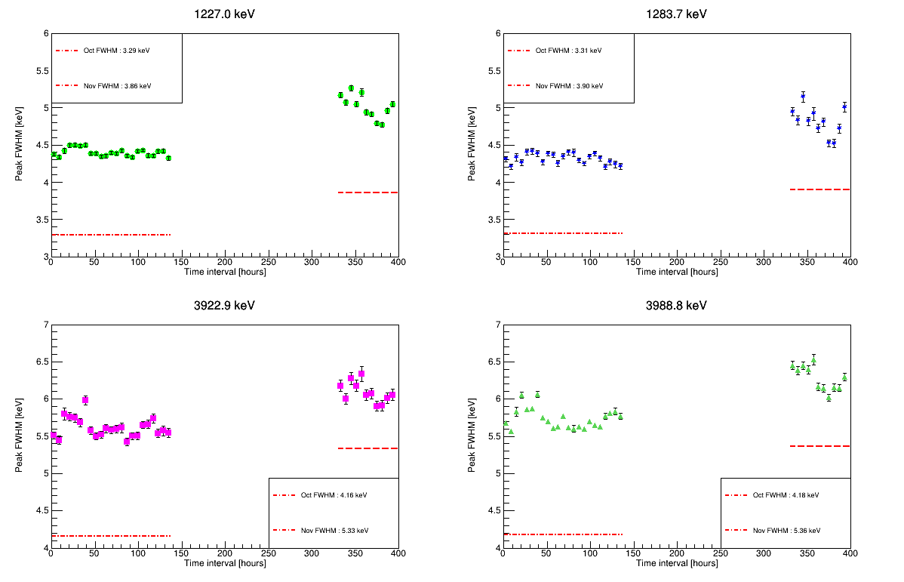
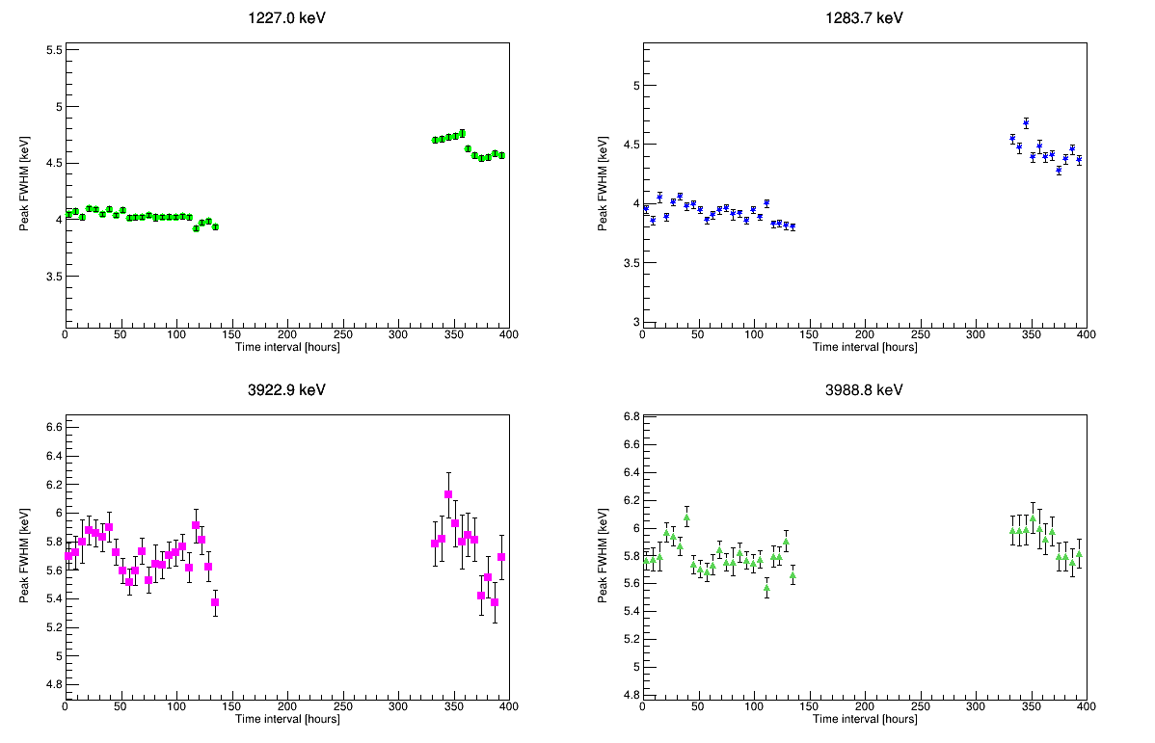
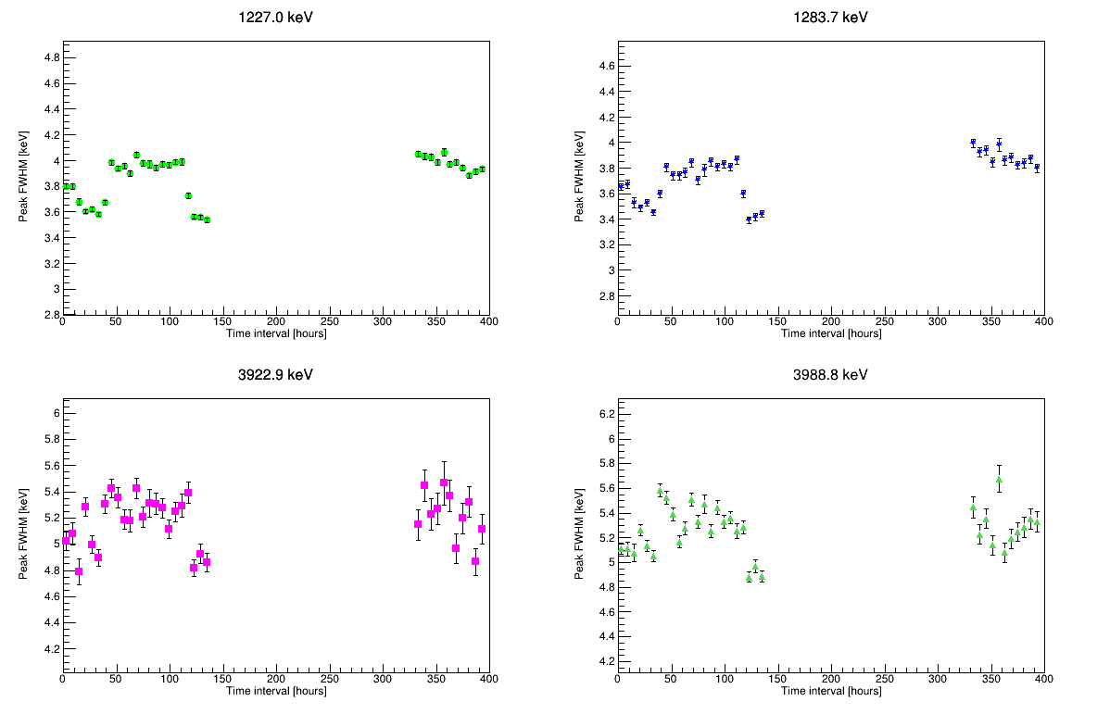
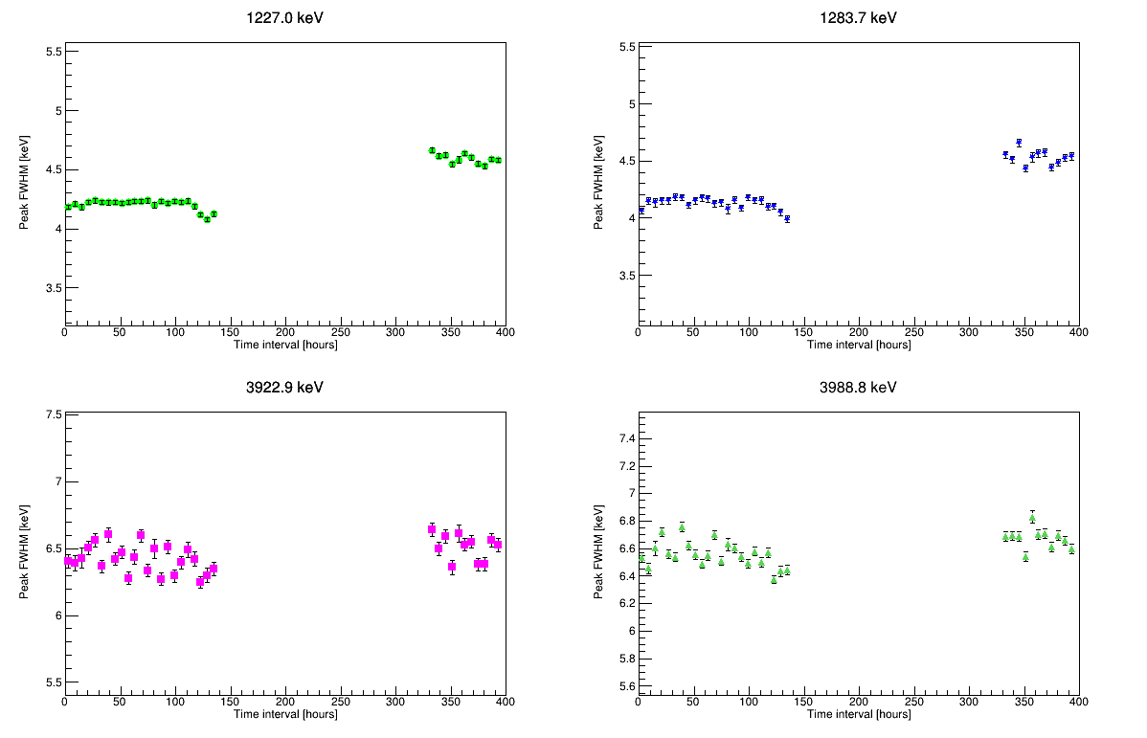
REGE DETECTORS FWHM
Channel 0
Channel 2
Eyeball observation: Behavior of FWHM is similar in given energy range/ detector type
Channel 3
Channel 4

Slide 18
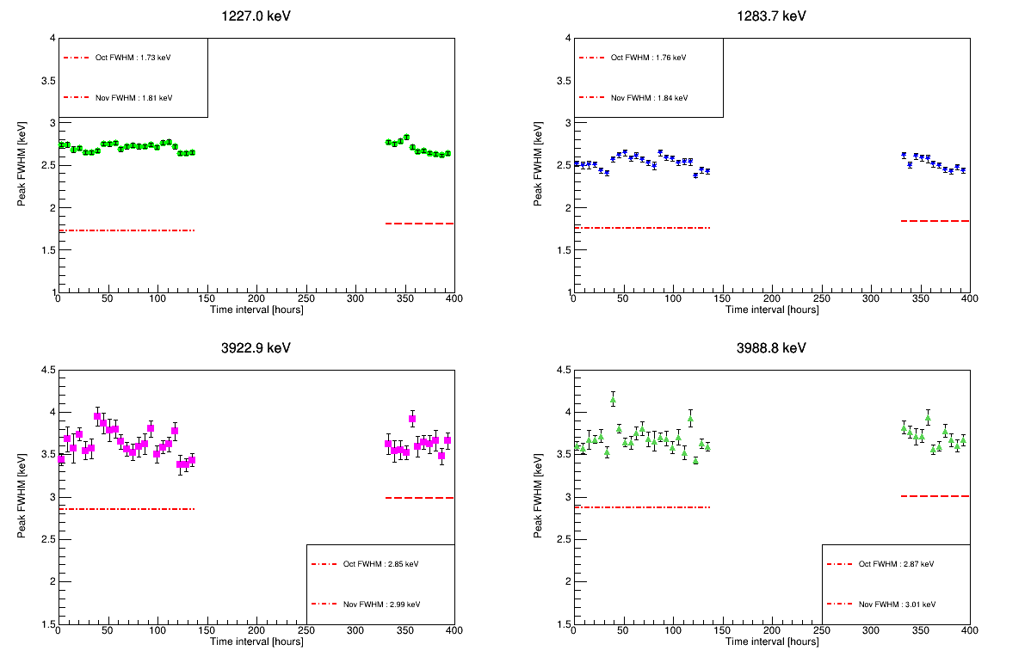
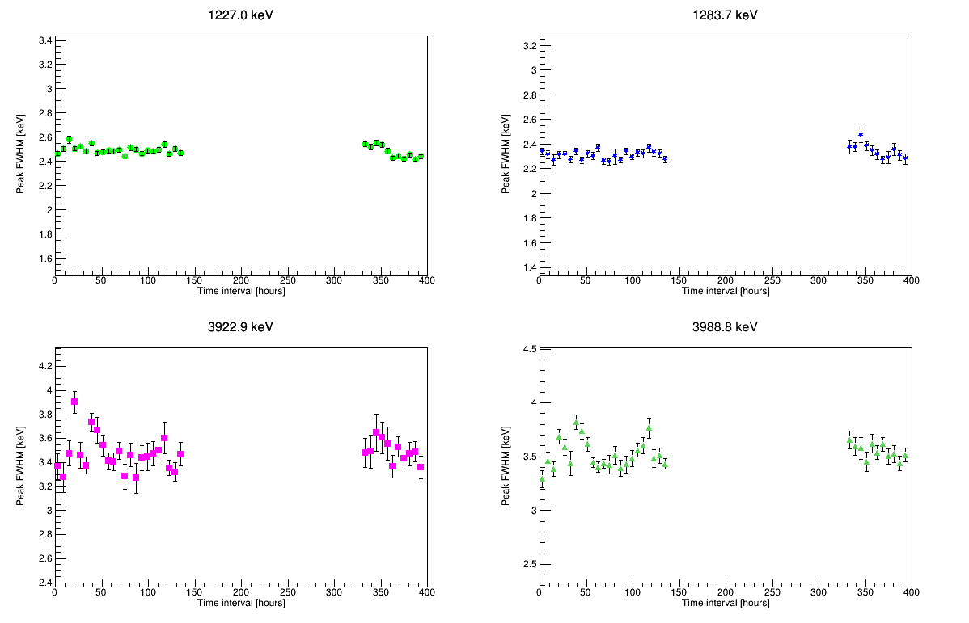
BEGE DETECTORS FWHM
Channel 1
Channel 5

Slide 19
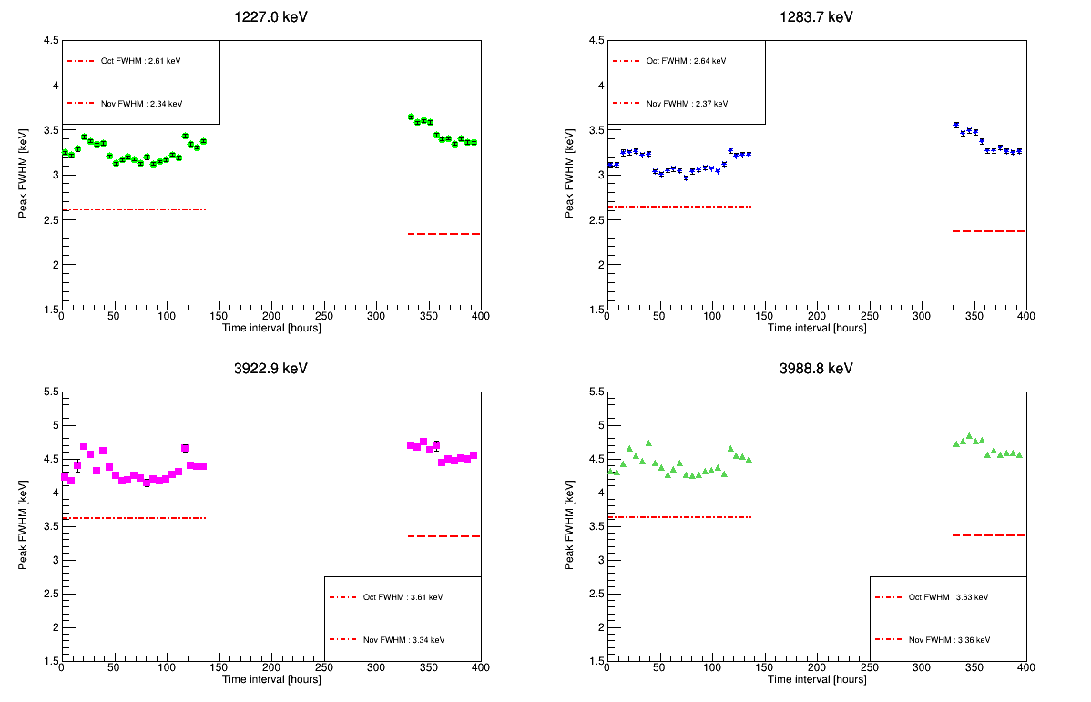
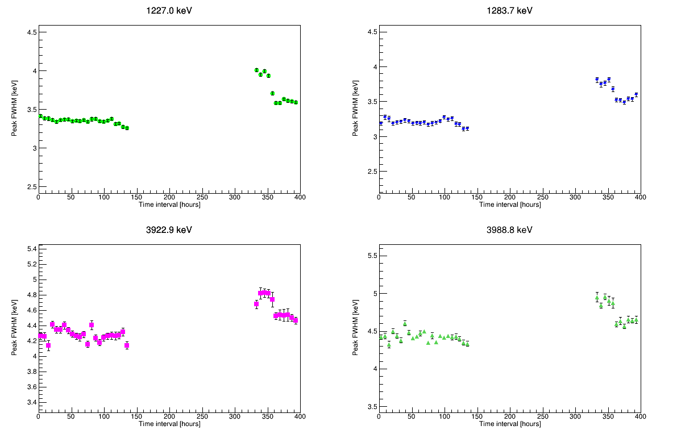
COAX DETECTORS FWHM
Channel 6
Channel 7
A jump in FWHM is seen from late Oct to initial Nov data but it lowers after the first few hours (~1-1.5 days)

Slide 20
Change in FWHM is within 5-15% for REGE detectors
Channels 2,3 and 4 have 0-2% change in FWHM from Oct to Nov at higher energies
Not true for Channel 0; has substantially high FWHM change at higher energy
Could be since this channel is the worst resolution detector compared to other channels (result from ¹⁵²Eu FWHM vs Energy curve and 1.3 MeV ⁶⁰Co peak)
< 2% change in FWHM for BEGE detectors
5-15% change in FWHM for COAX detectors
Study the % change in FWHM of detectors by their type
% change from the calculated mean of FWHM from Oct & Nov data sets

Slide 21
REGE DETECTORS FWHM
Higher energies have higher FWHM of the peaks in both data sets
Change in FWHM is within 5-15% for REGE detectors
Channels 2,3 and 4 have 0-2% change in FWHM from Oct to Nov at higher energies
Not true for Channel 0; has substantially high FWHM change at higher energy
Could be since this channel is the worst resolution detector compared to other channels (result from ¹⁵²Eu FWHM vs Energy curve and 1.3 MeV ⁶⁰Co peak)

Slide 22
Summary
We need to generate new tier3 files applying October 28 calibrations to first set of ¹³⁶Ba data and all the plots shown have the Oct 28 calibrations
The residuals are bad for higher energies as our calibration is only up to 1.4 MeV
We need to set a threshold for shift to call them stable/unstable, additionally look at the FWHM to decide if we combine the data sets or not
If there is a shift between the Oct and Nov data sets, for analysis, we will not combine the two periods, rather only runs within the same stable period since we cannot apply any time correction
The worse FHWM in Nov data set is mainly because of the change in dynamic range
There is a change in FWHM of peaks, mostly depending on detector type, bad for REGE and COAX detectors, quite stable for BEGE ones
Another separate report on time stability is in progress which documents all the plots and information and will be soon shared

Slide 23
Backup slides

Slide 24
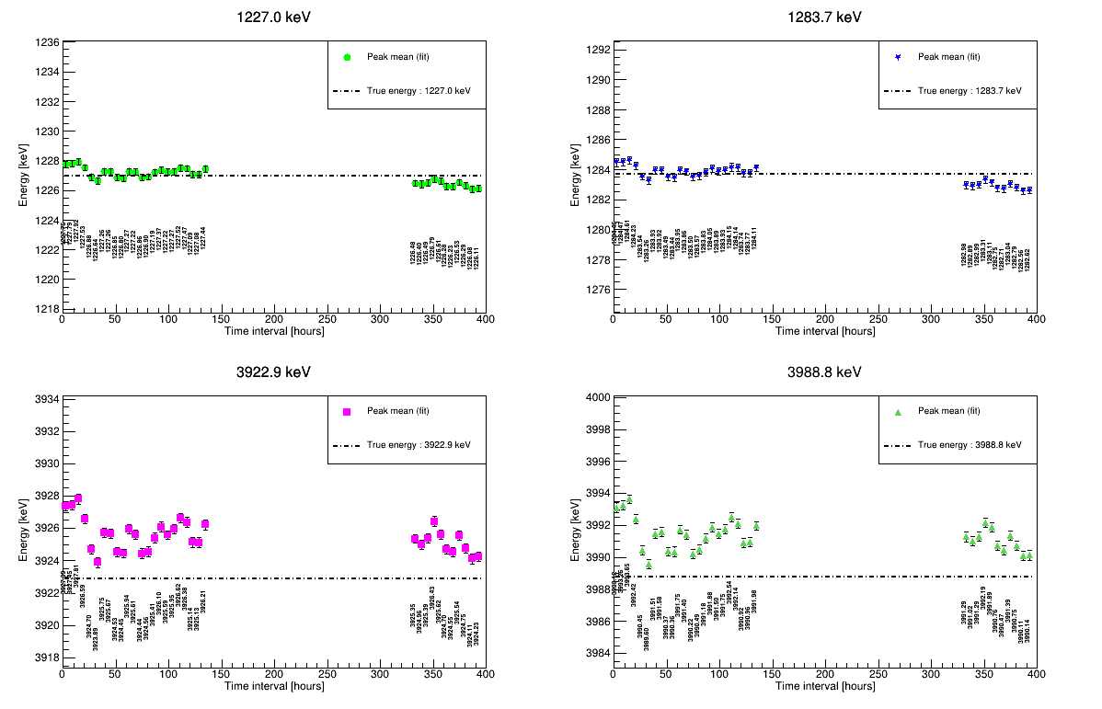
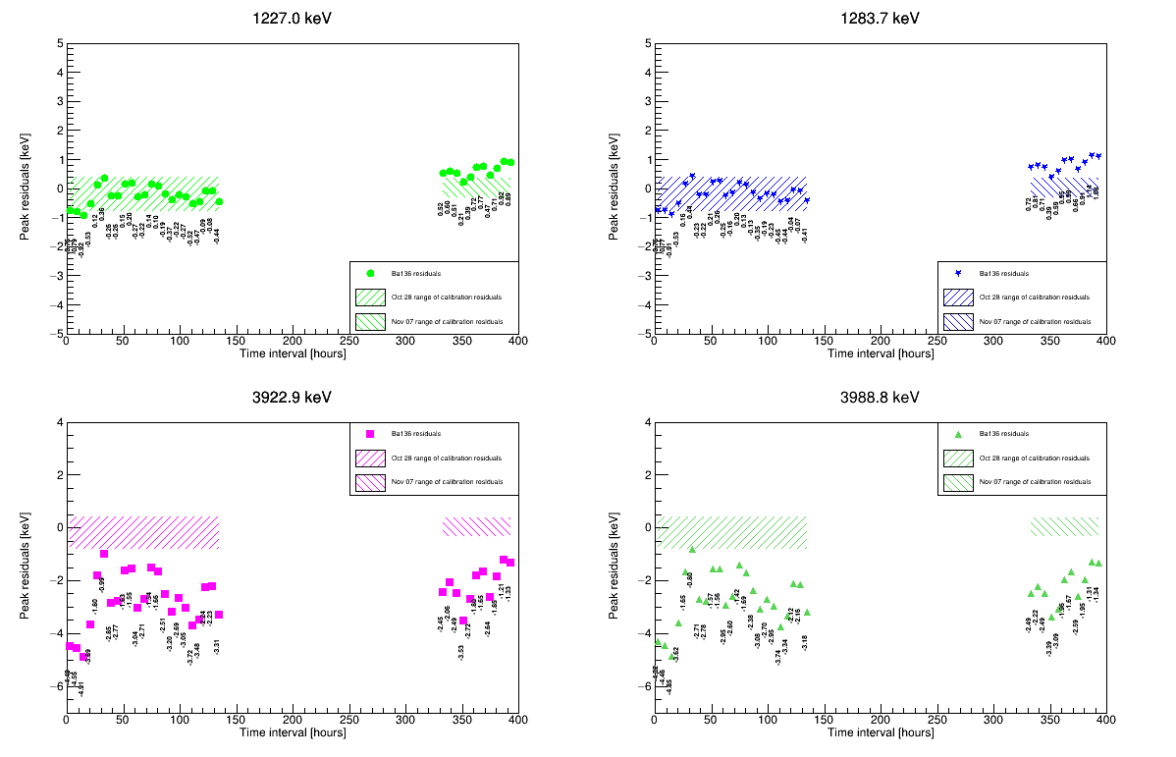
Channel 2 (REge) peaks and residuals

Slide 25
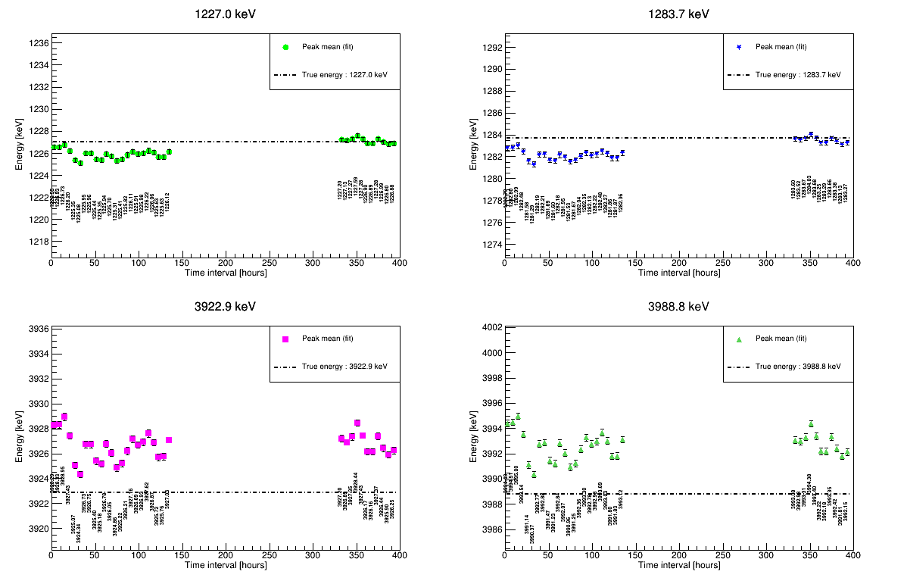
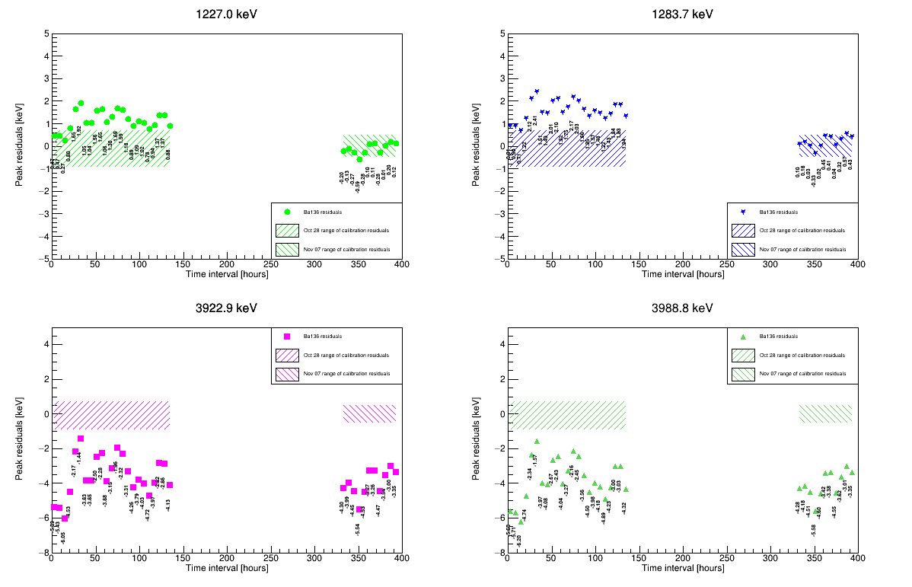
Channel 3 (REge) peaks and residuals

Slide 26
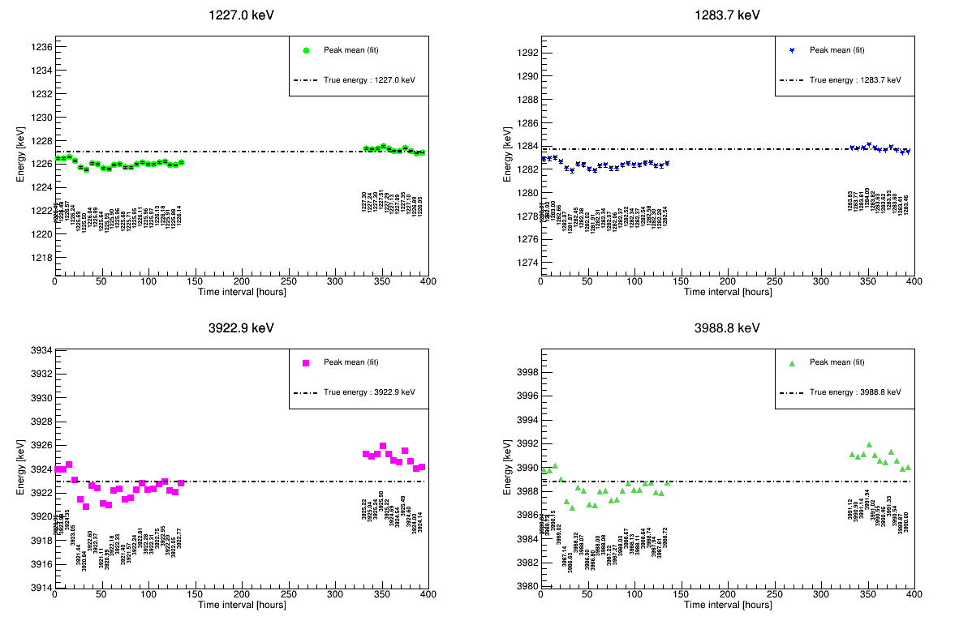
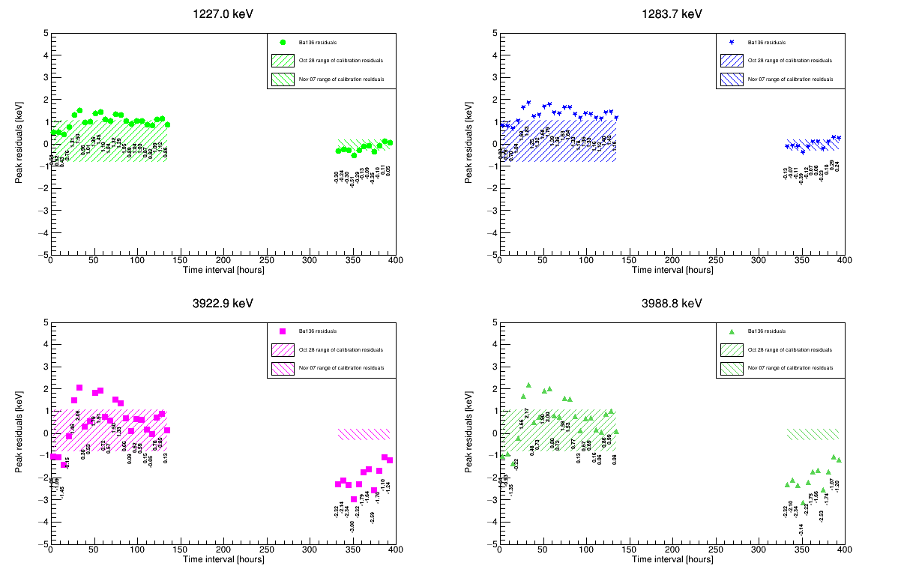
Channel 5 (bege) peaks and residuals

Slide 27
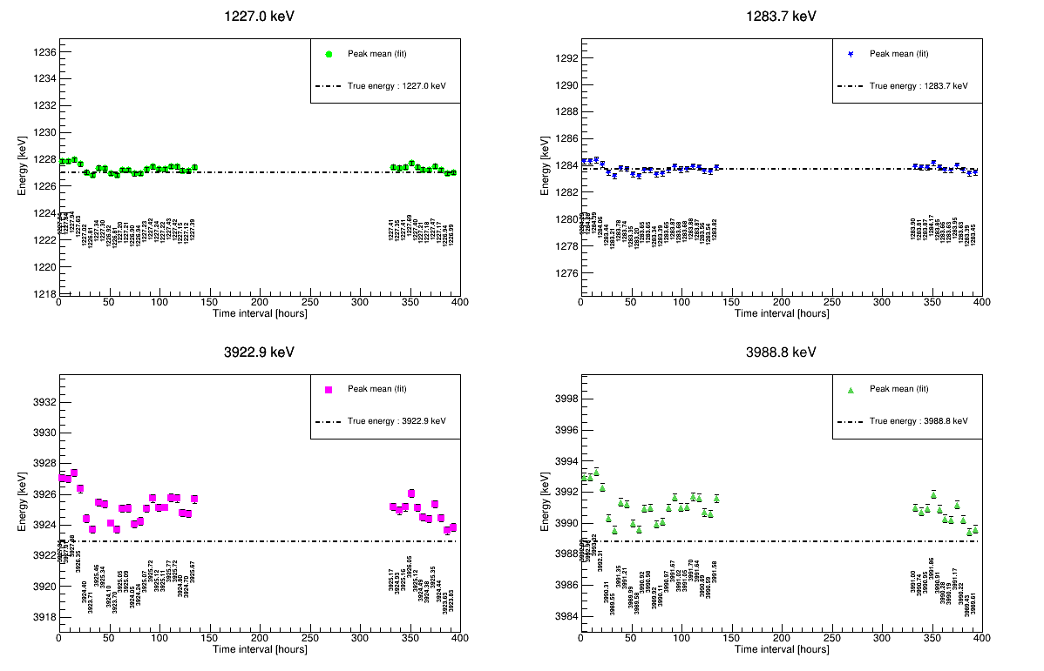
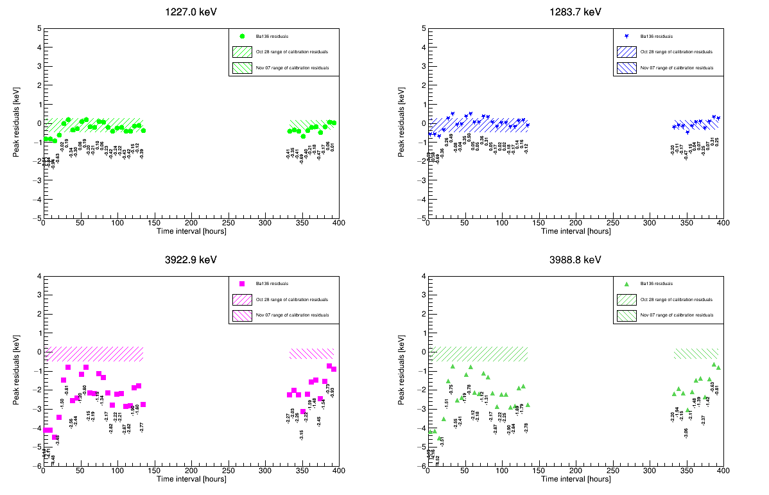
Channel 6 (Coax) peaks and residuals

