Slide 1
Investigation of the bb-decay processes Se-82 with the SuperNEMO detector
(SuperNEMO Demonstrator)
Oleg Kochetov (DLNP, JINR)
1

Slide 2
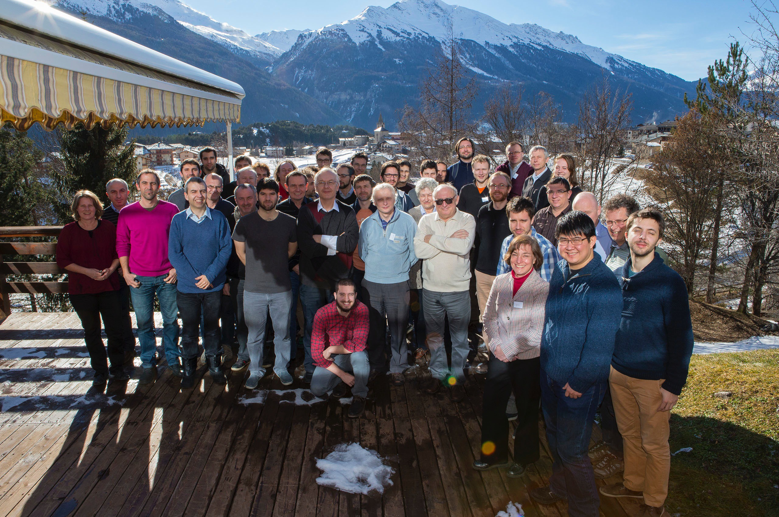
SuperNEMO Collaboration
2

Slide 3
SuperNEMO Collaboration
LIST OF AUTHORS DLNP: V.B. Brudanin, V.G. Egorov, D.V. Filosofov, I.I. Kamnev, D.V. Karaivanov, A.A. Klimenko, O.I. Kochetov, N.A. Mirzaev, I.B. Nemchenok, A.V Rahimov, A.V. Salamatin, Yu.A. Shitov, A.A. Smolnikov, V.V. Timkin, V.I. Tretyak, Yu.V. Yushkevich
LIST OF SuperNEMO COLLABORATION
R. Arnold¹, C. Augier², J.D. Baker³, A.S. Barabash⁴, A. Basharina-Freshville⁵, S. Blondel², S. Blot⁶, M. Bongrand², V. Brudanin^{7,8}, J. Busto⁹, A.J. Caffrey³, S Calvez², C. Cerna¹⁰, J.P. Cesar¹¹, A. Chapon¹², E. Chauveau⁶, D. Duchesneau¹³, D. Durand¹², V. Egorov⁷, G. Eurin^{2,5}, J.J. Evans⁶, L. Fajt¹⁴, D. Filosofov⁷, R. Flack⁵, X. Carrido², H. Gomez², B. Guillon¹², P. Guzowski⁶, R. Hodak¹⁴, A. Hubert¹⁰, P. Hubert¹⁰, C. Hugon¹⁰, S. Jullian², I. Kamnev⁷, D. Karaivanov⁷, A. Klimenko⁷, O. Kochetov⁷, S.I. Konovalov⁴, D. Lalanne², K. Lang¹¹, Y. Lemiere¹², T.Le Noblet¹³, Z. Liptak¹¹, P. Loaiza², G. Lutter¹⁰, F. Mamedov¹⁴,N. Mirzaev⁷, C. Marquet¹⁰, F. Mauger¹², B. Morgan¹⁵, J. Mott⁵, I. Nemchenok⁷, M. Nomashi¹⁶, F. Nova¹¹, F. Nowacki¹, H. Ohsumi¹⁷, R.B. Pahlka¹¹, F. Perrot¹⁰, F. Piquemal^{10,18}, P. Povinec¹⁹, P. Pridal¹⁴, A. Rahimov⁷, Y.A. Ramachers¹⁵, A. Remoto¹³, J.L.Reyss²⁰, B. Richards⁵, C.L. Riddle³, E. Rukhadze¹⁴, R. Saakyan⁵, A. Salamatin⁷, X. Sarazin², Yu. Shitov^{7,21}, L. Simard^{2,22}, F. Simkovic¹⁹, A. Smetana¹⁴, K. Smolek¹⁴, A. Smolnikov⁷, S. Soldner-Rembold⁶, B.Soule¹⁰, I. Stekl¹⁴, C.S. Sutton²³, G. Szklarz², J. Thomas⁵, V. Timkin⁷, S. Torre⁵, Vl.I. Tretyak²⁴, V.I. Tretyak⁷, V.I. Umatov^{4,} I. Vanushin⁴, C. Vilela⁵, V. Vorobel²⁵, D. Waters⁵, A. Zukauskas²⁵.
1-IPHC, ULP, CNRS/IN2P3, F-67037 Strasbourg, France
2-LAL, Univ Paris-Sud, CNRS/IN2P3, f-91405 Orsay, France
3-Idaho National Laboratory, Idaho Falla, ID 83415, U.S.A.
4-NRS “Kurchatov Institute” ITEP, 117218 Moscow, Russia
5-UCL, London WC1E 6BT, United Kingdom
6-University of Manchester, ManchesterM13 9PL, United Kingdom
7-JINR, 141980 Dubna, Russia
8-National Research Nuclear University MEPhI, 115409 Moscow, Russia
9-CPPM, Universite de Marseille, CNRS/IN2P3, F-13288 Marsielle, France
10-CENBG, Universite de Bordeaux, CNRS/IN2P3, F-33175, France
11-University of Texas at Austin, Austin TX 78712, U.S.A.
12-LPC Caen, ENSICAEN, Universite de Caen, CNRS/IN2P3,F-14050 Caen, France
13-LAPP, Universite de Savoie, CNRS/IN2P3, F-74941 Annecy-le-Vieux, France
14-Czech Technical University in Prague, CZ-12800 Prague, Czech Republic
15-University of Warwick, Coventry Cv4 7AL, United Kingdom
16-Osaka University, 1-1 Machikaney arnaToyonaka, Osaka, 560-043, Japan
17-Saga University, Saga 840-80502, Japan
18-Laboratoire Souterrain de Modane, F-75700 Modane, France
19-FMFI, Comenius Univ, SK842 48 Bratislava, Slovakia
20-LSCE, CNRS, F-91190 Gif-sur-Yvette, France
21-Imperial College London, London SW7 2AZ, United Kingdom
22-Institut Universitaire de France, F-75005 Paris, France
23-MHC, South Hadley, Massachusetts 01075, U.S.A.
24-Institutefor Nuclear Research, MSP 03680, Kiev, Ukraine
25-Charles University in Prague, CZ-12116 Prague, Czech Republic
3

Slide 4
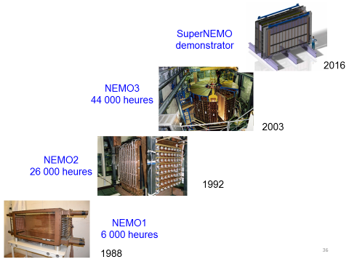
History of the NEMO collaboration in LSM
4

Slide 5
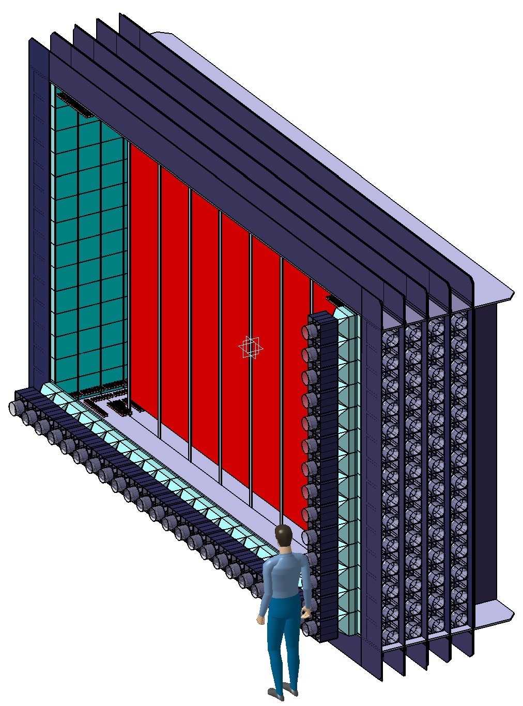

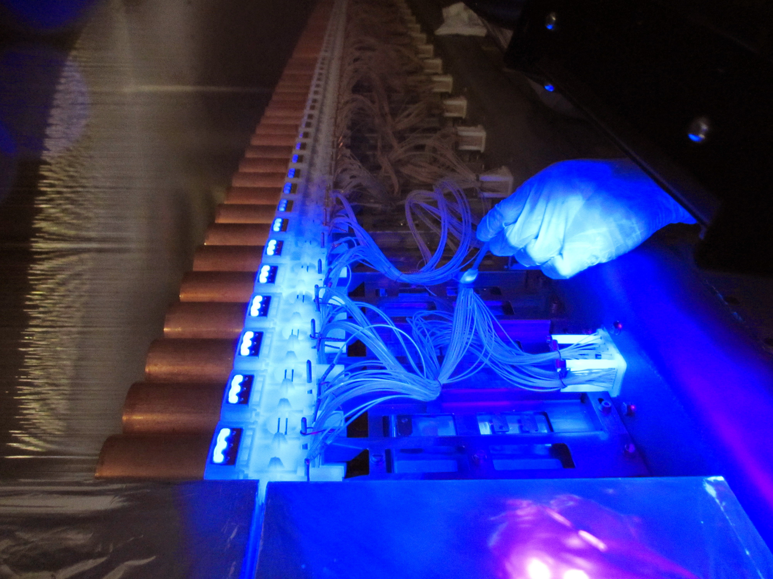
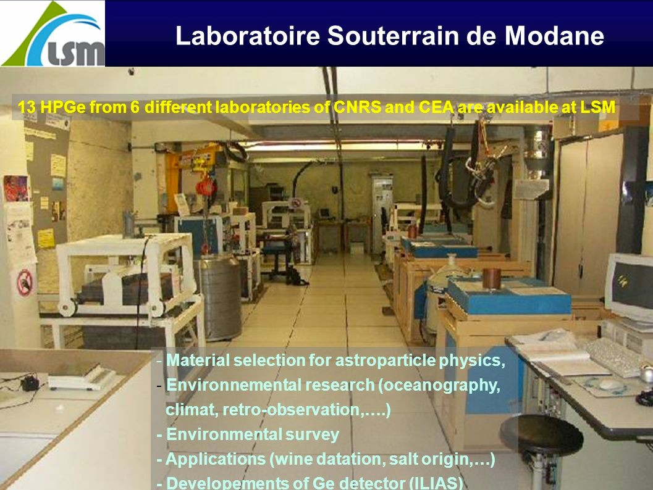
Background reduction and rejection
1kg of banana
Demonstrator Module
35 tons
=
=
100 Bq (decays/sec)

Slide 6
The main candidates to search for 0νββ-decay with Q_{2β} > 2 MeV
______________________________________________________________________
№ Nuclei Q_{2β}, keV Abundance, %
______________________________________________________________________
1. Ca-48 4272 0.187
2. Nd-150 3371.4 5.6
3. Zr-96 3350 2.8
4. Mo-100 3034.4 9.63
5. Se-82 2996 8.73
6. Cd-116 2805 7.49
7. Te-130 2527.5 34.08
8. Xe-136 2458.7 8.87
9. Sn-124 2287 5.79
10. Ge-76 2039.0 7.61
11. Pd-110 2000 11.72
Natural γ – rays background – E < 2.615 MeV
6

Slide 7
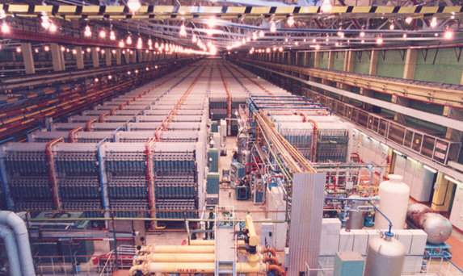
ββ sources enrichment
ECP (Electro-Chemical Plant, Svetlana)
Zelenogorsk
SuperNEMO collaboration has 7 kg of enriched Se-82 ... (Nd-150?)
7

Slide 8
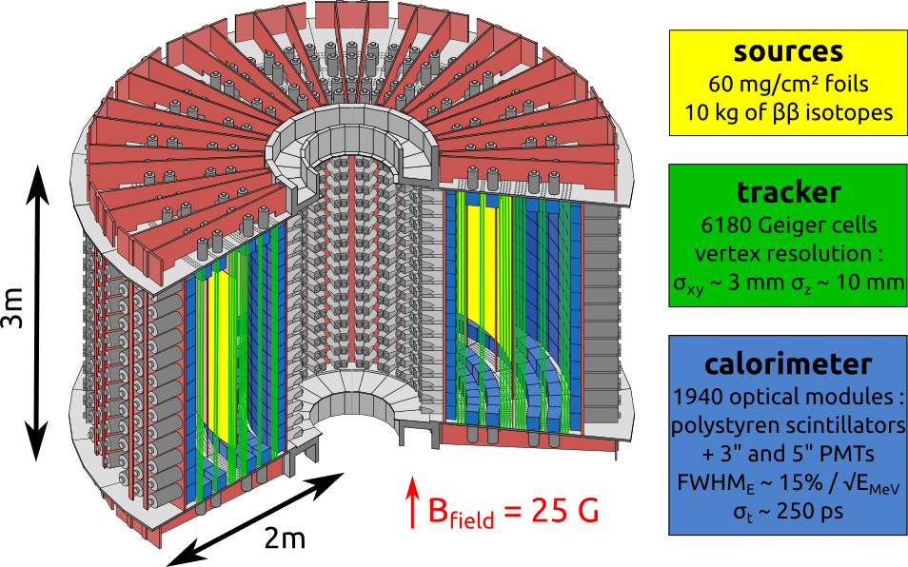
From NEMO-3 to SuperNEMO
NEM0-3 "camembert"
(source top view)
48_{Cа}
150_{Nd}
96_{Zr}
45
6
100Мо 6,9 kg
100_{Мо}
3
7
82_{Se}
100_{Мо}
2
82Se 0,93 kg
82_{Se}
100_{Мо}
8
nаt_{Тe}
100_{Мо}
1
130Тe 0,45 kg
9
130_{Тe}
Cu
0
116Cd 0,40 kg
10
100_{Мо}
nаt_{Тe}
19
100_{Мо}
116_{Cd}
150Nd 36,5 g
11
100_{Мо}
130_{Тe}
18
96Zr 9,43 g
12
100_{Мо}
100_{Мо}
100_{Мо}
100_{Мо}
16
17
13
48Cа 6,99 g
14
15
Tracker + calorimetric experiment searching for 0νββ decay
Located at Modane underground laboratory from Feb. 2003 to Jan. 2011
5 years of effective data taking
10 kg total of different ββ isotopes

Slide 9
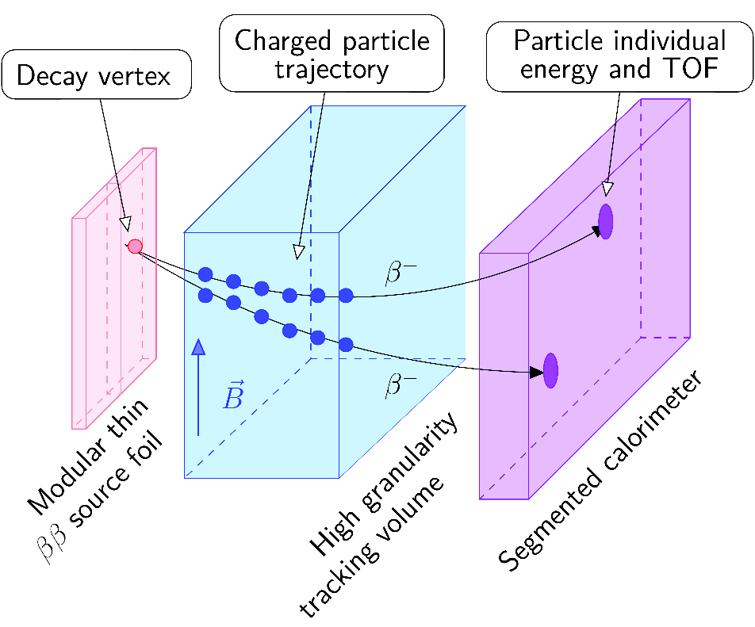
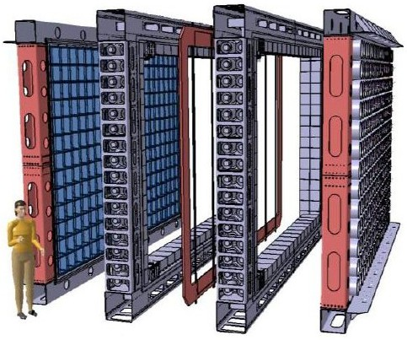
SuperNEMO technique
NEMO-3/SuperNEMO unique features
Full topological event reconstruction
Source separated from detector (can host any isotope)
Strong background suppression by particle identification, event characterisation and timing
Calorimeter
Tracker Calorimeter
Tracker + calorimetric experiment searching for 0νββ decay at Modane underground lab. (France)
Modular design (20 modules) with total mass of 100 kg
Demonstrator module currently being installed at Modane
Bfield
Demonstrator: 7 kg of ⁸²Se running for 2.5 yr
ββ source
9

Slide 10
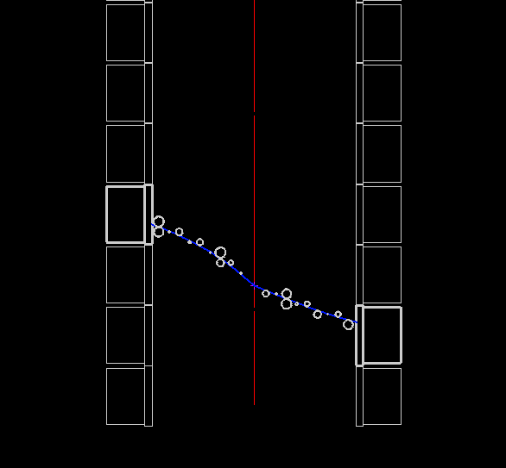

0νββ event topology
Unique double beta decay experiment with the direct reconstruction of the two electrons
Full signature of 0νββ events and
powerful background rejection
Basic selection criteria:
•
2 tracks with negative curvature
E=0.710 MeV
✘
•
common vertex
✘
E=2.285 MeV
✘
•
2 PMT hits with sum E > 200 keV
•
PMT-track association
10

Slide 11
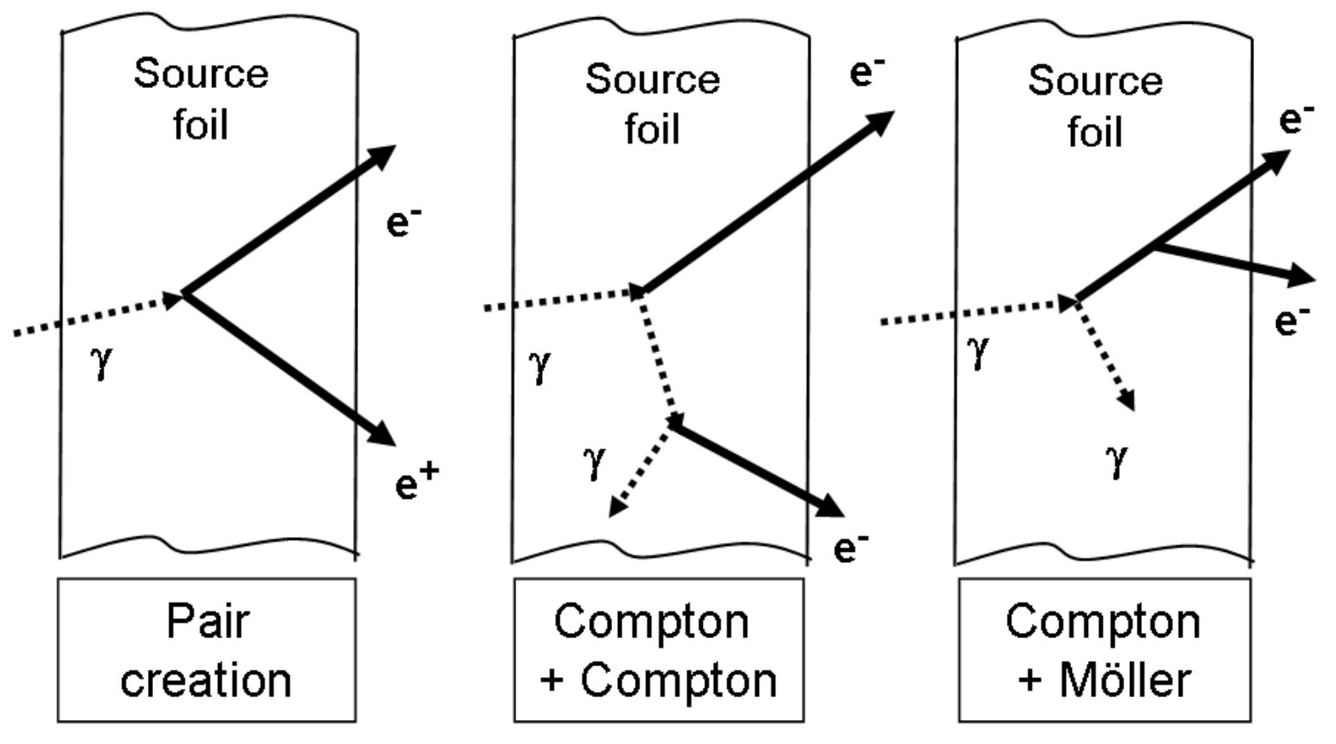
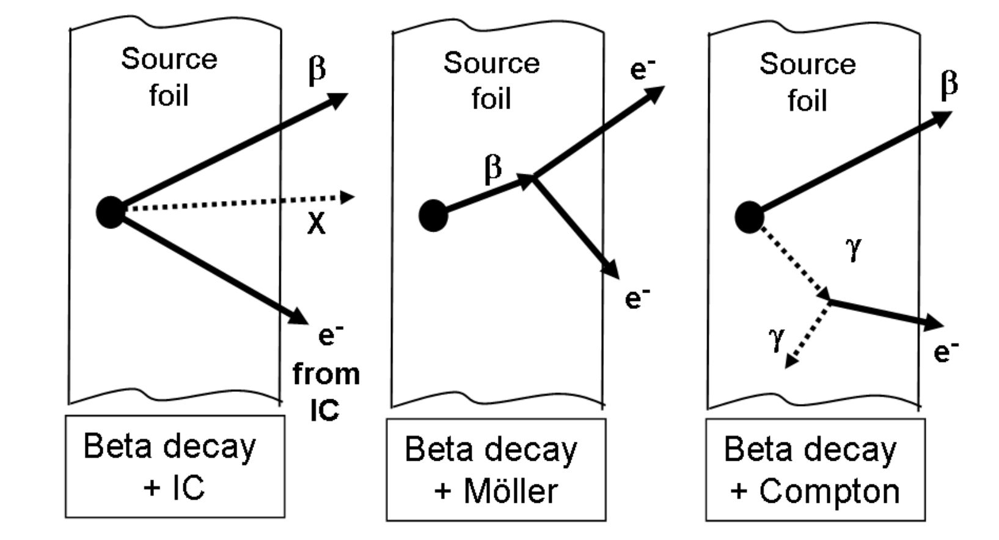
SuperNEMO background
Measure
External background
t₁ < t₂
Natural radioactivity (γ,n) from the detector components or its surroundings
Cosmic rays
Neutrons
Internal background
0vbb:
²⁰⁸Tl , 2.6 MeV
(n,γ) up to 10 MeV
t₁ t₂
Radioactive contaminations
in the source foil or Radon
daughters depositions on the foil or tracking wires
208_{Tl Q{3}
214_{Bi Q{3}
0vbb:
= 5.0 MeV
= 3.27 MeV
11

Slide 12
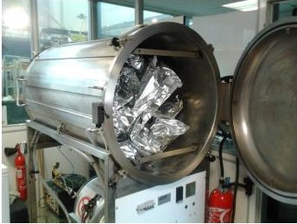
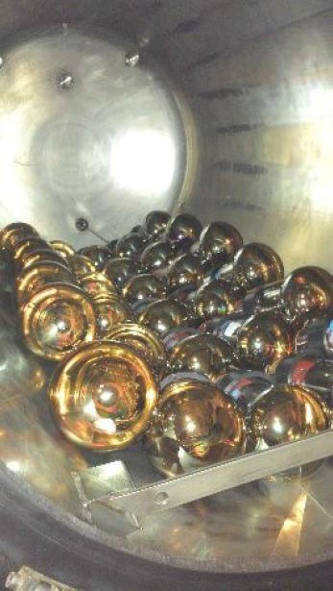
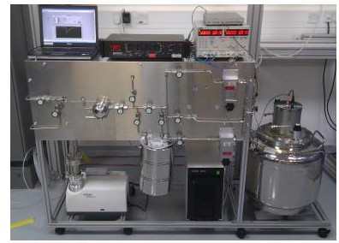
SuperNEMO background
²¹⁴Bi important background with Q𝛽=3.27 MeV
Can originate from internal
²³⁸U-chain contamination or from
²²²Rn emanation/diffusion
Ultra-pure material selection
Radon tent
alpha tagging: 1e1𝛼 channel
Bordeaux emanation setup
_{e}-
α
214_{Bi} 214_{Po} 210_{Pb}
Q_{β} =3.27MeV
(164us)
Q_{α} =7.8MeV
𝒜(²²²Rn) = 0.15 mBq/m³
Nucl.Instrum.Meth. A845 (2017)
London concentration line
12

Slide 13
Antiradon factory
14

Slide 14
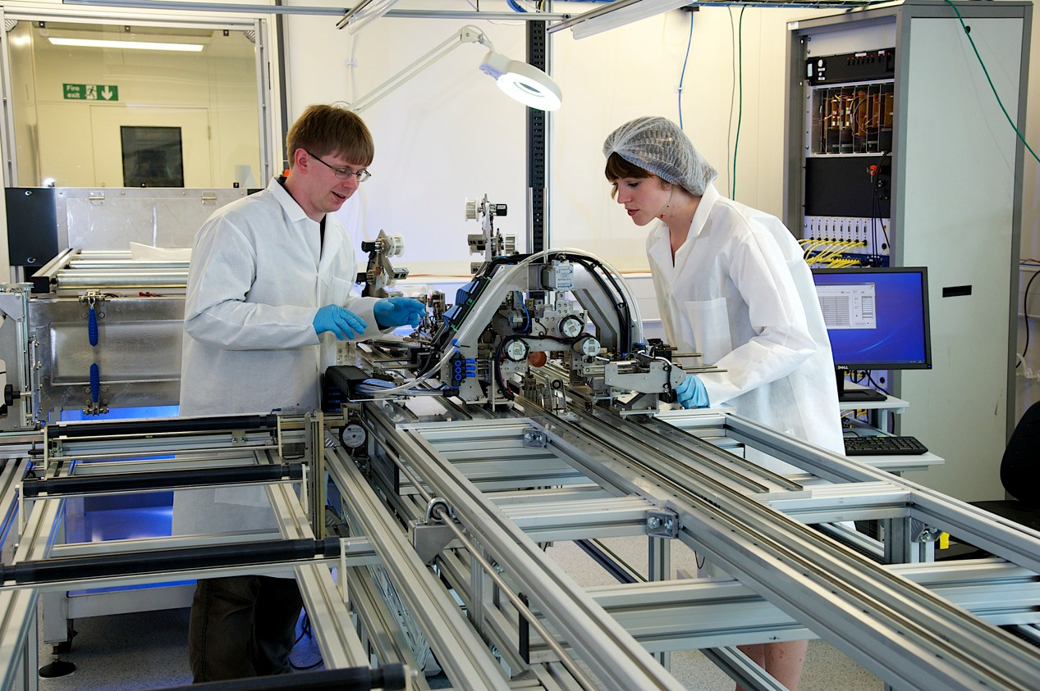
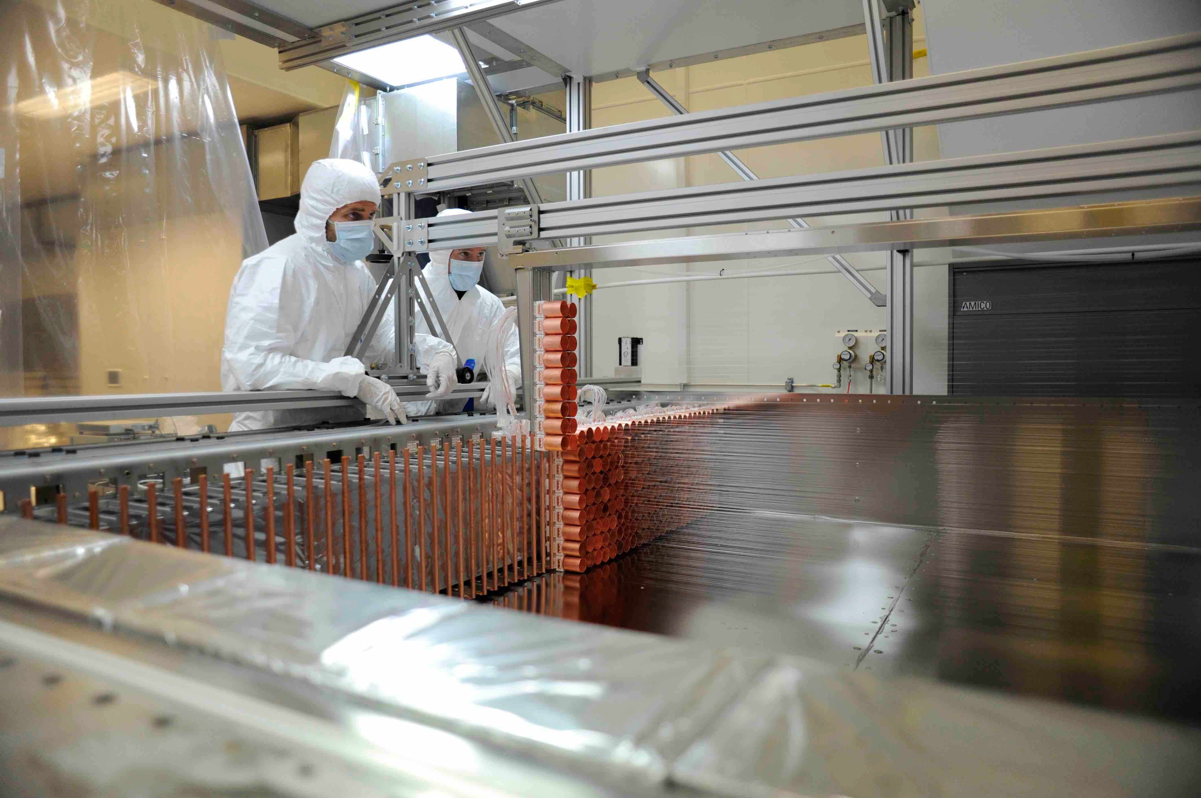

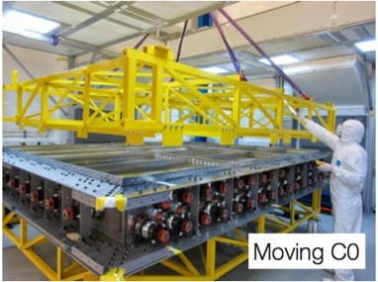
SuperNEMO tracker
Nucl.Instrum.Meth. A824 (2016)
Multi-wire drift chamber in Geiger mode
Ultrapure materials: copper, steel, duracon
Robotic production of 2034 drift cells
Radiopure gas flow, anti-radon sealing
<1% dead channels
.
15

Slide 15
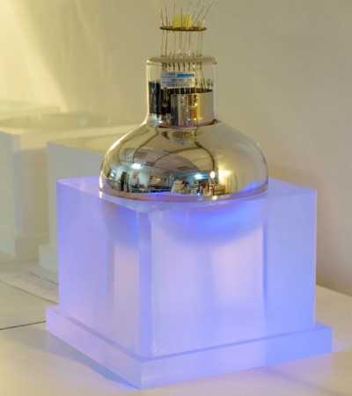



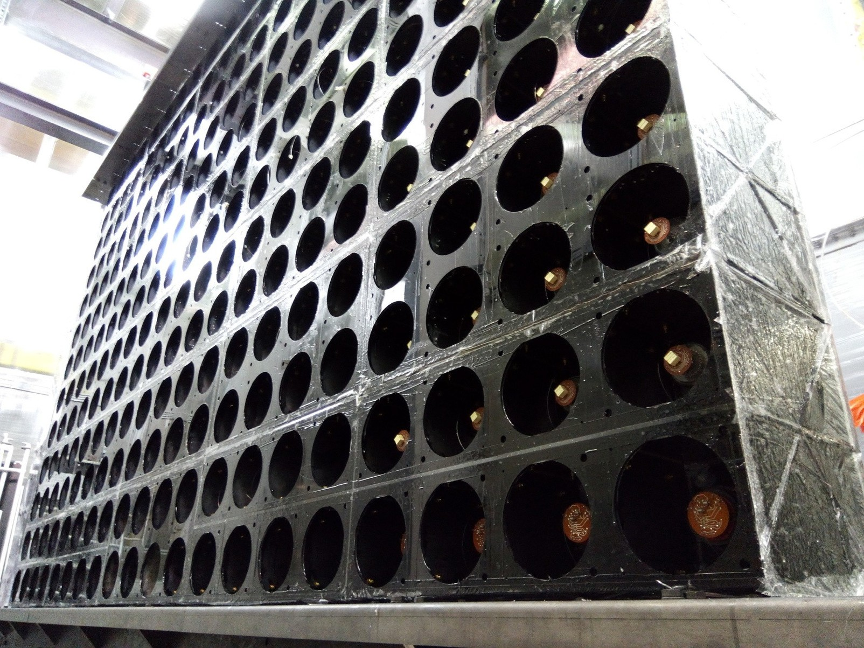
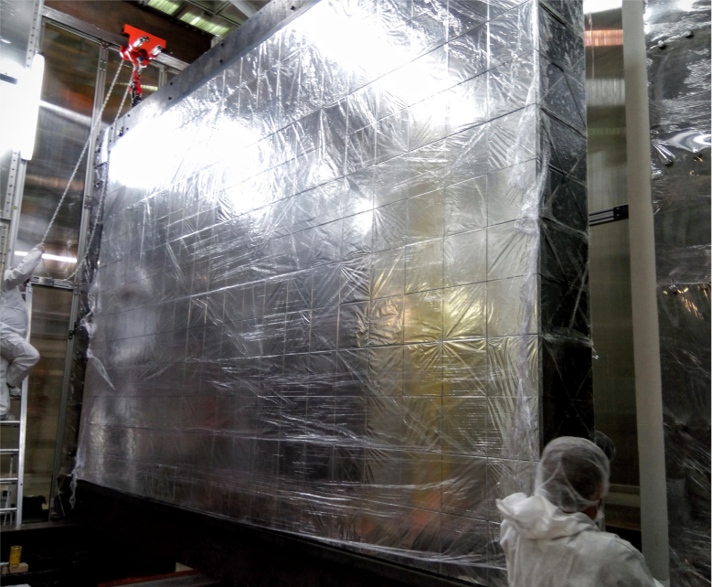
SuperNEMO calorimeter
520 main optical modules
8’’ high QE radiopure PMTs
𝜎t = 400 ps at 1 MeV
Number of optical modules
Nucl.Instrum.Meth. under publication (2017)
25
PS: Mean 8.33, RMS 0.33
PS Enhanced: Mean 7.97, RMS 0.30
20
15
Energy resolution 7.2%/√E(MeV)
10
5
Calibration system allows stability to < 1%
0
7
7.5 8 8.5 9 9.5 10
Energy resolution, FWHM at 1 MeV (%)

Slide 16
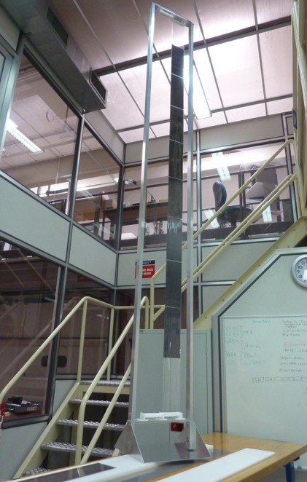
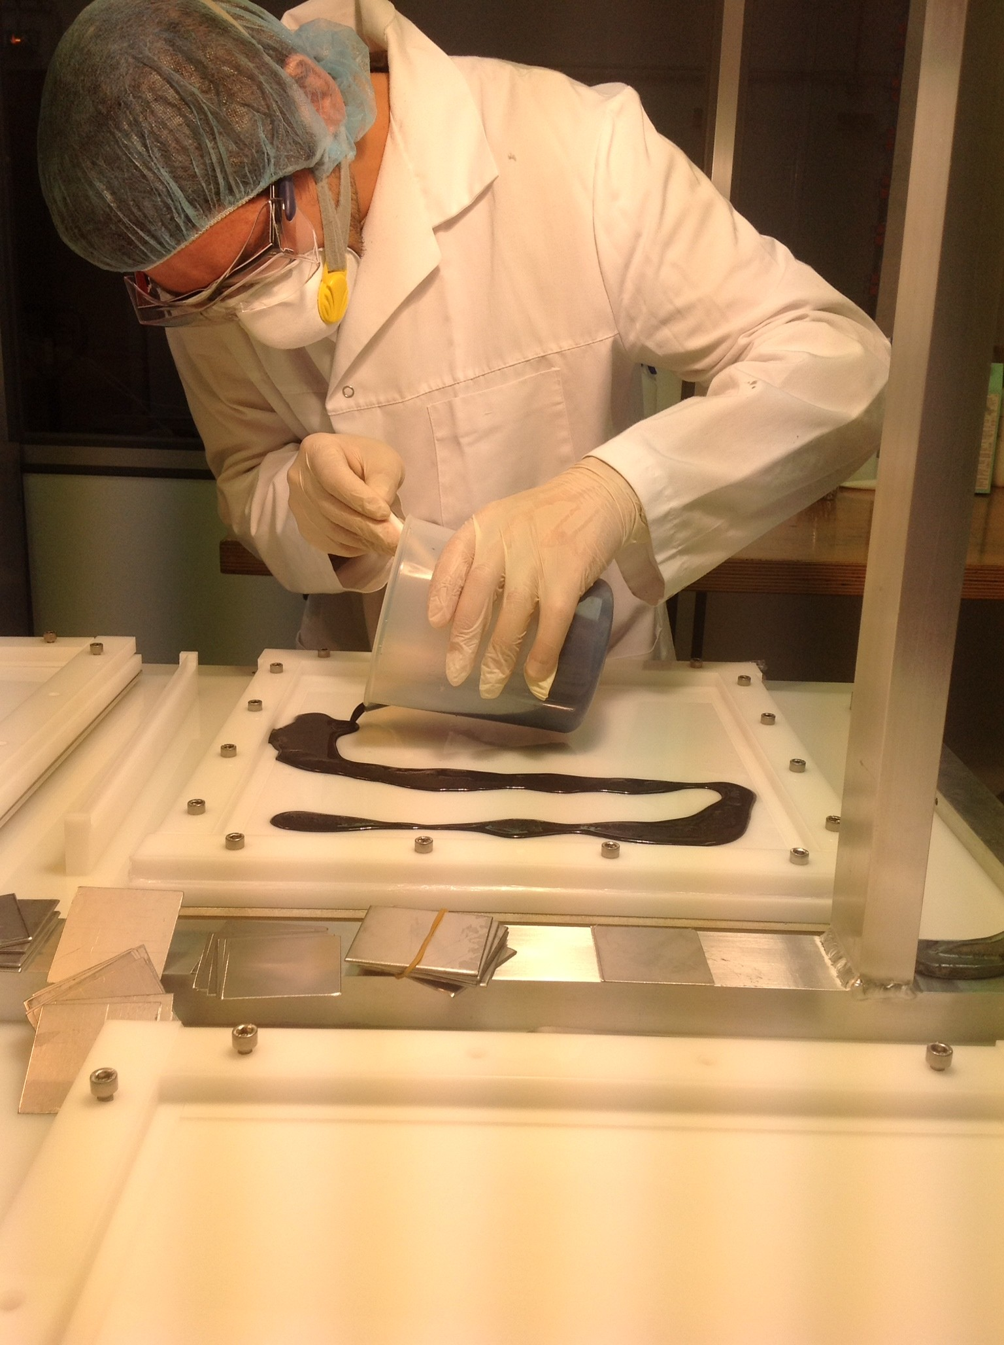
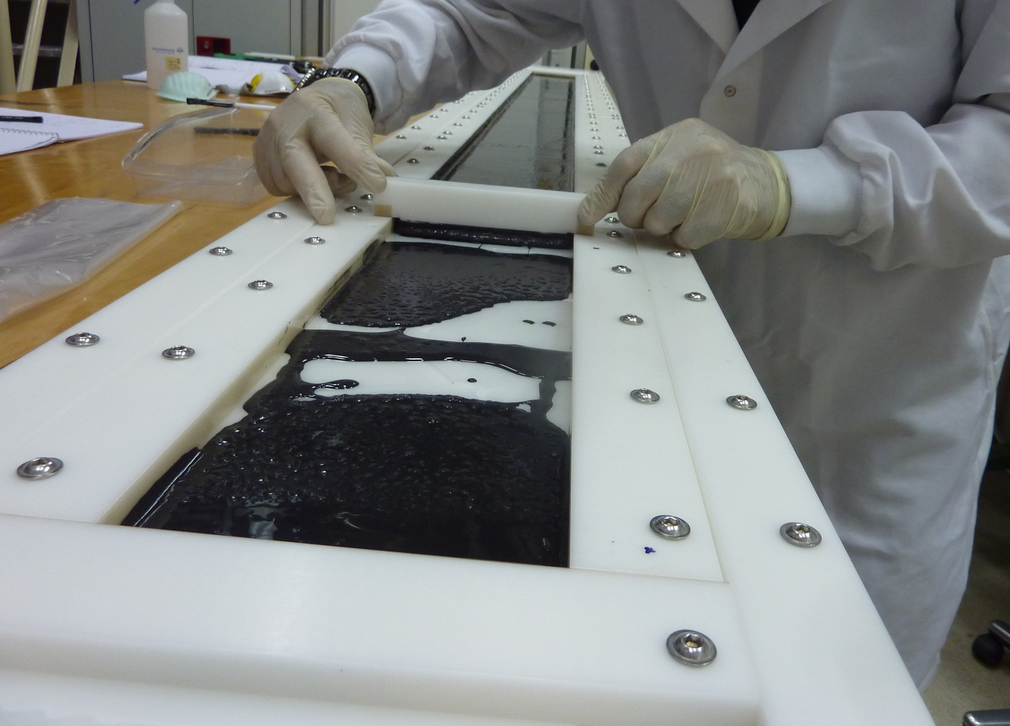
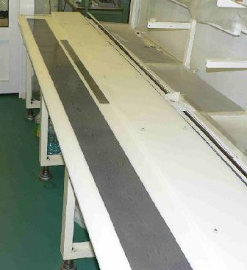
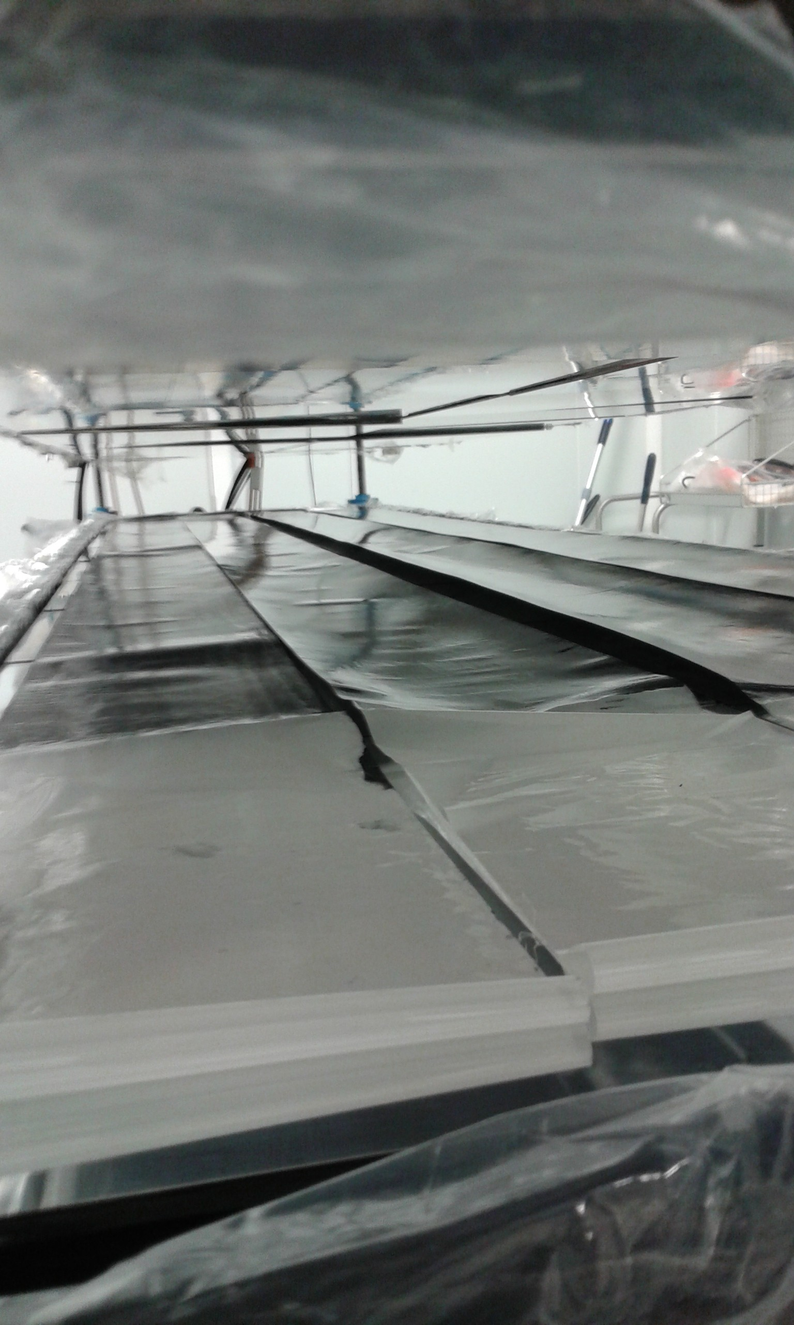
SuperNEMO source foils
36 foils made of ⁸²Se powder mixed with PVA glue + mylar mechanical support (200 um thick)
7 kg of ⁸²Se (Q𝛽𝛽=2.996 MeV)
Target limits (challenging) on foil contamination:
²⁰⁸Tl ≤ 2 μBq/kg
²¹⁴Bi ≤ 10 μBq/kg
BiPo detector in Canfranc laboratory to measure source foil contamination: preliminary results indicate levels of ²⁰⁸Tl [10-30] uBq/kg (90% C.L.)
JINST 12 (2017) no.06
Bi-Po 3
Training foil production technique
⁸²Se foils radio-purity measurements
17

Slide 17
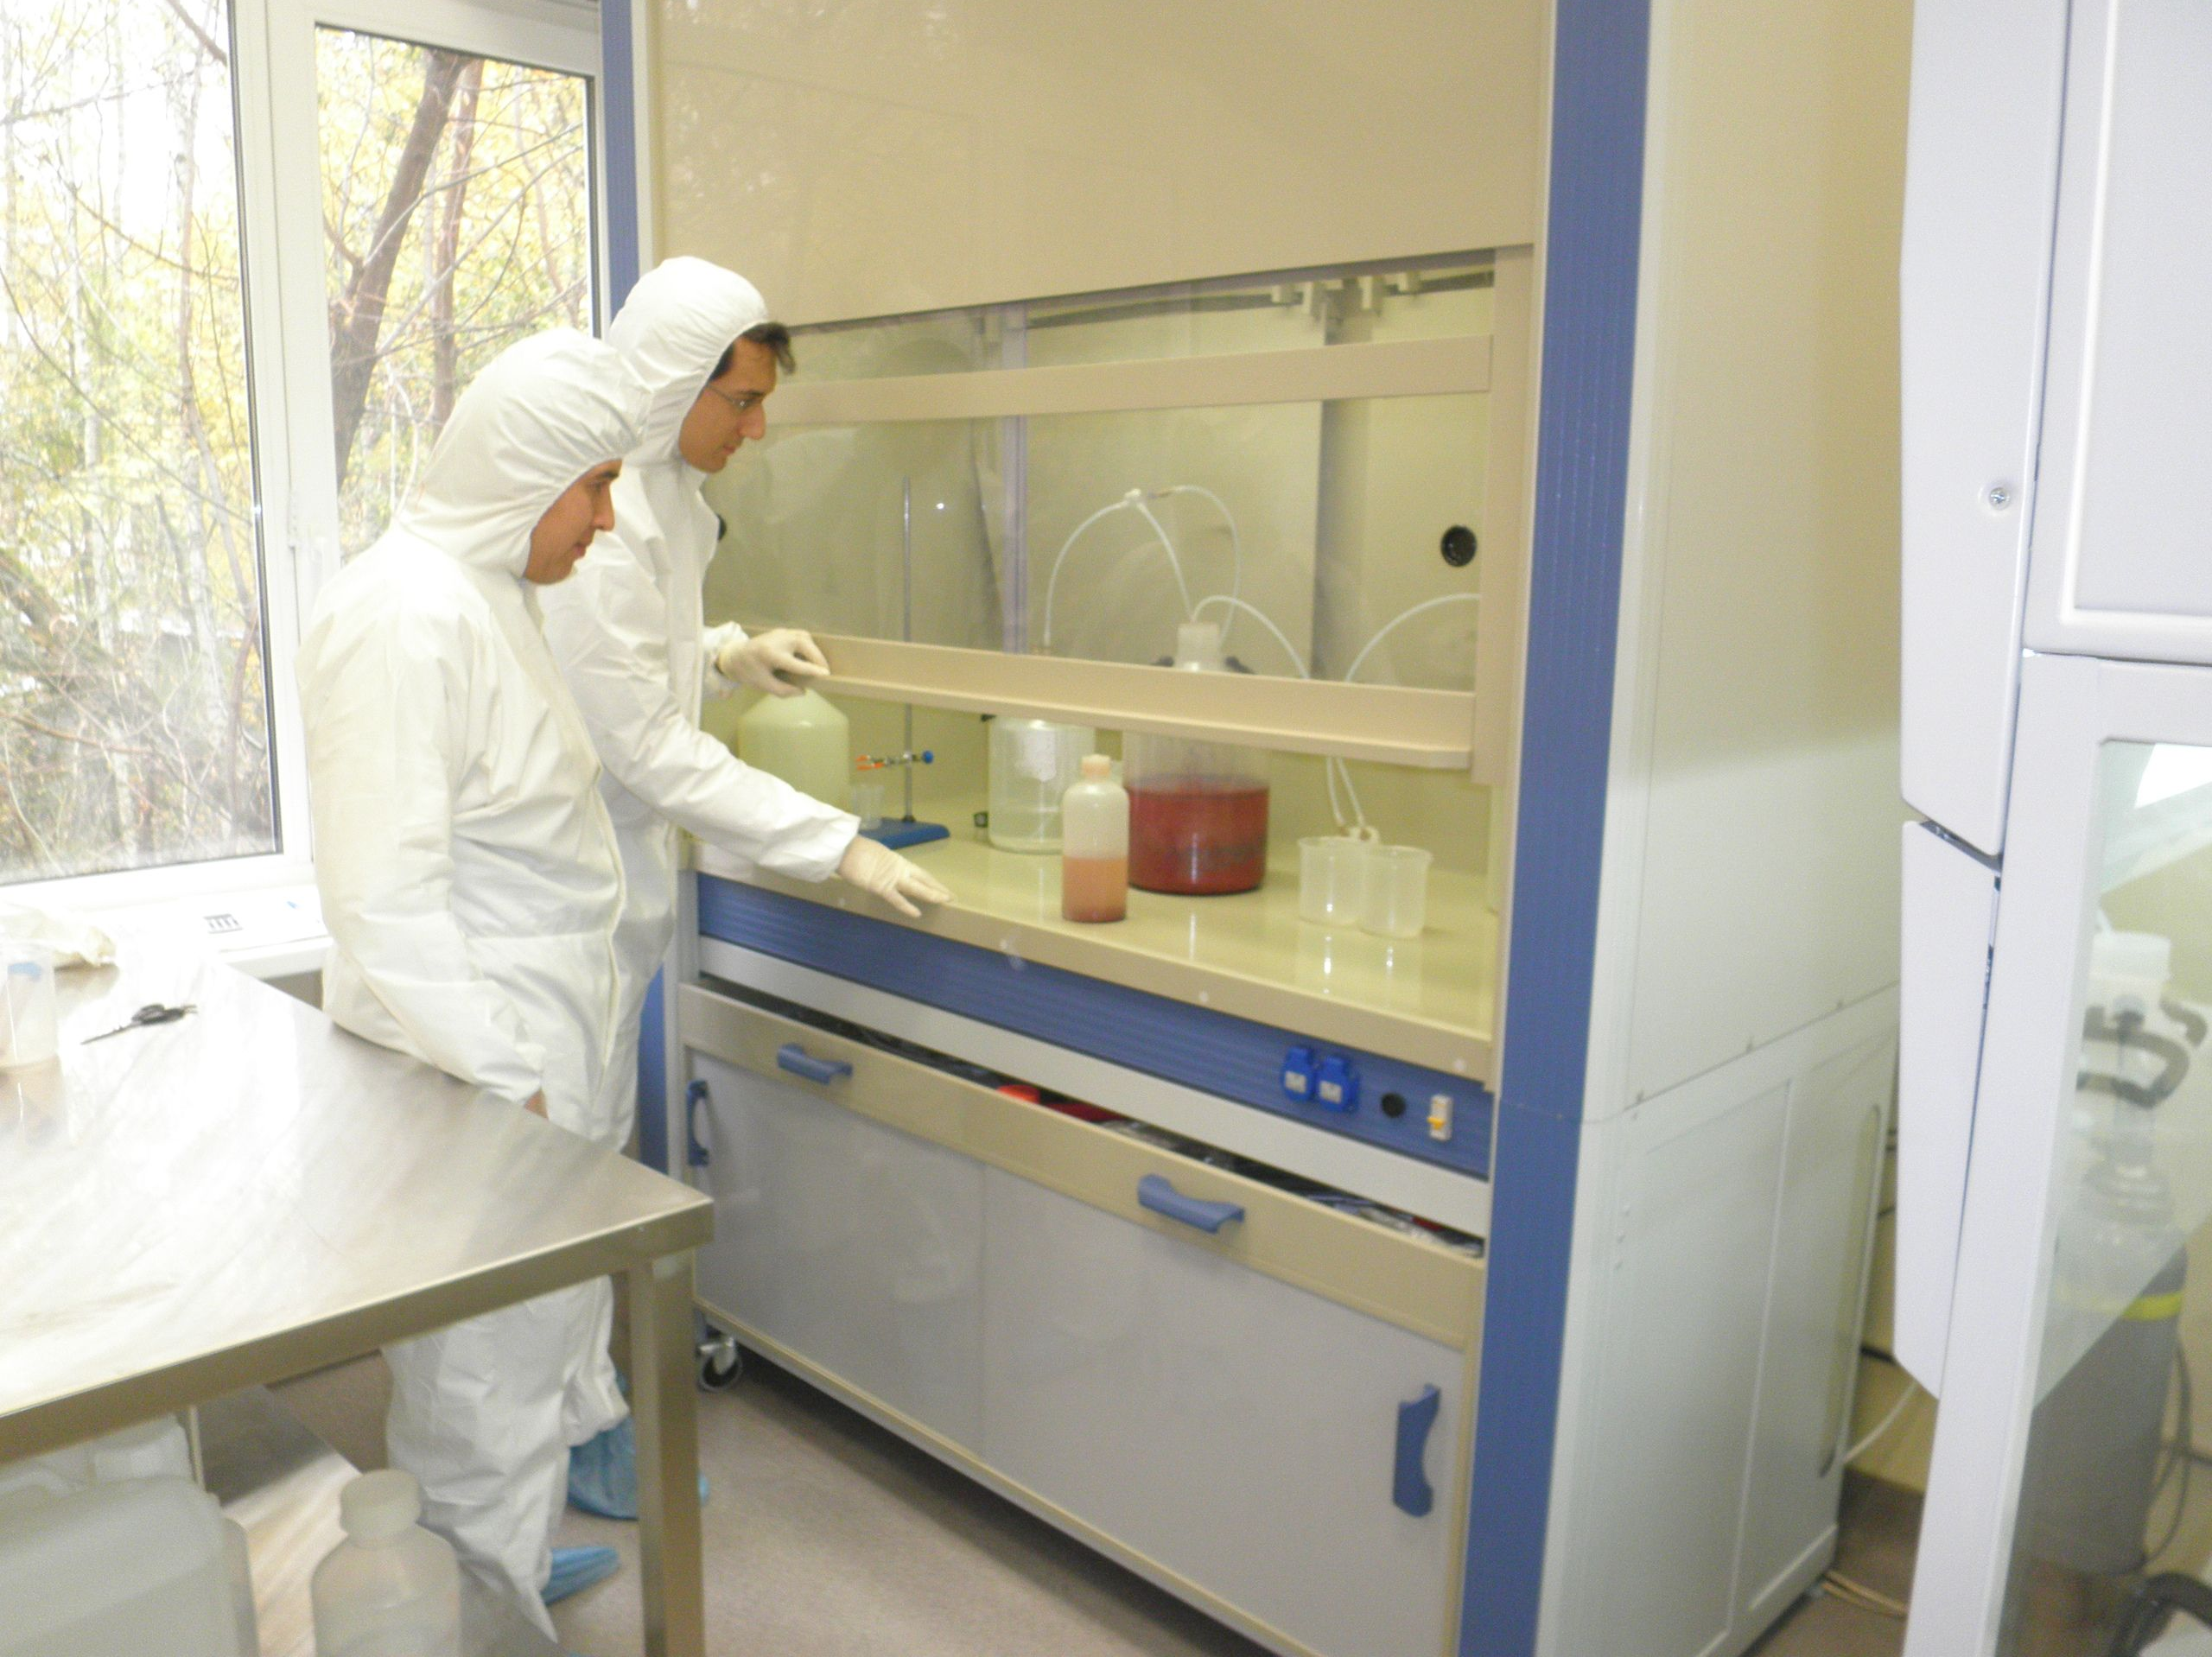
Clean room for radiochemistry purification of Se-82, DLNP, JINR
18

Slide 18
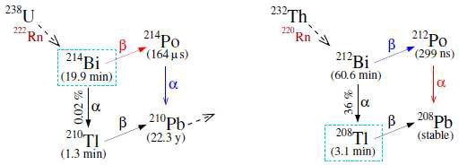
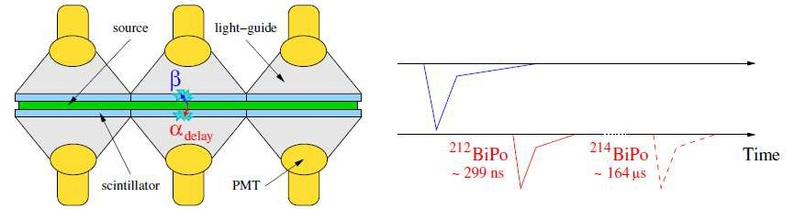
The Bi-Po 3 detector
•
HPGe spectroscopy not sensitive enough to reach few μBq/Kg: BiPo-3 dedicated setup at Canfranc underground lab
•
2 modules of 3.0x0.6 m² can measure up to 1.4 kg of ⁸²Se foil with thickness of 40 mg/cm²
•
²¹⁴Bi and ²⁰⁸Tl measured trough process from natural radioactivity chain
•
Thin radiopure plastic scintillators coupled to lightguides and low radioactivity PTMs
²⁰⁸Tl Sensitivity [μBq/kg source]
20
BiPo3: 3.6 m² - ⁸²Se: 40 mg/cm²
18
²⁰⁸Tl bkg: 0.16 μBq/m² scint
²⁰⁸Tl bkg: [0.04 - 0.50] μBq/m² scint SuperNEMO ²⁰⁸Tl target: 2 μBq/kg source
source
light−guide
16
14
BiPo ²⁰⁸Tl sensitivity
β
12
10
αdelay
8
6
4
scintillator
PMT
2
0
0
2
4
6
8
10 12
Measurement Time [month]
19

Slide 19
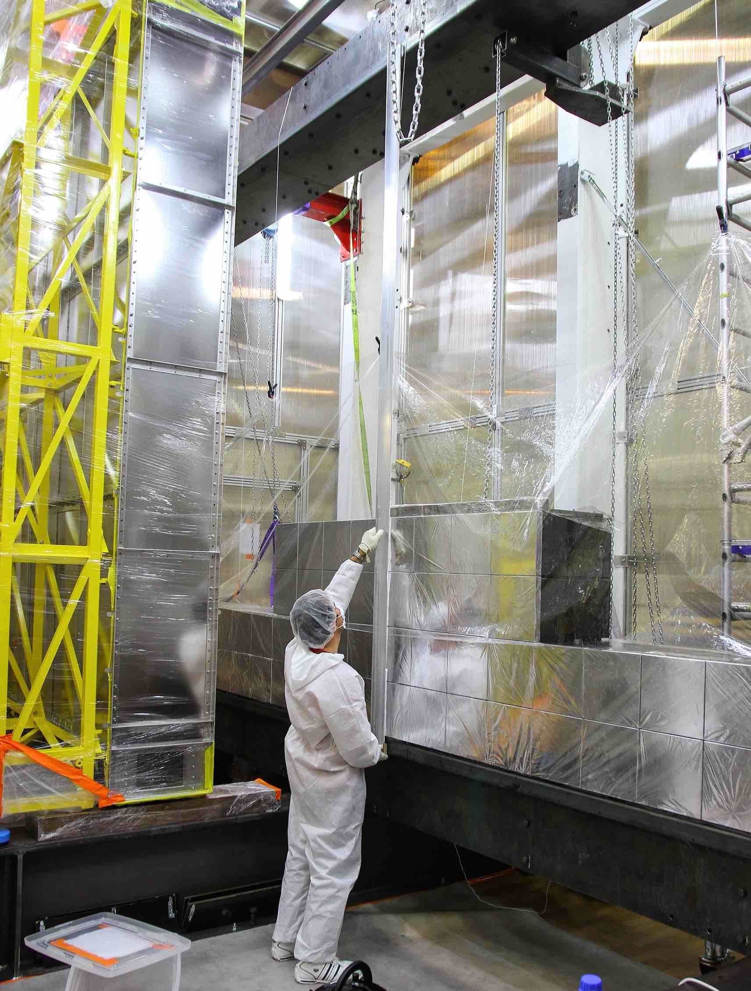
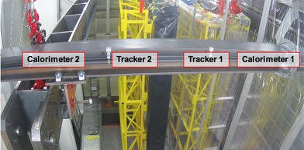
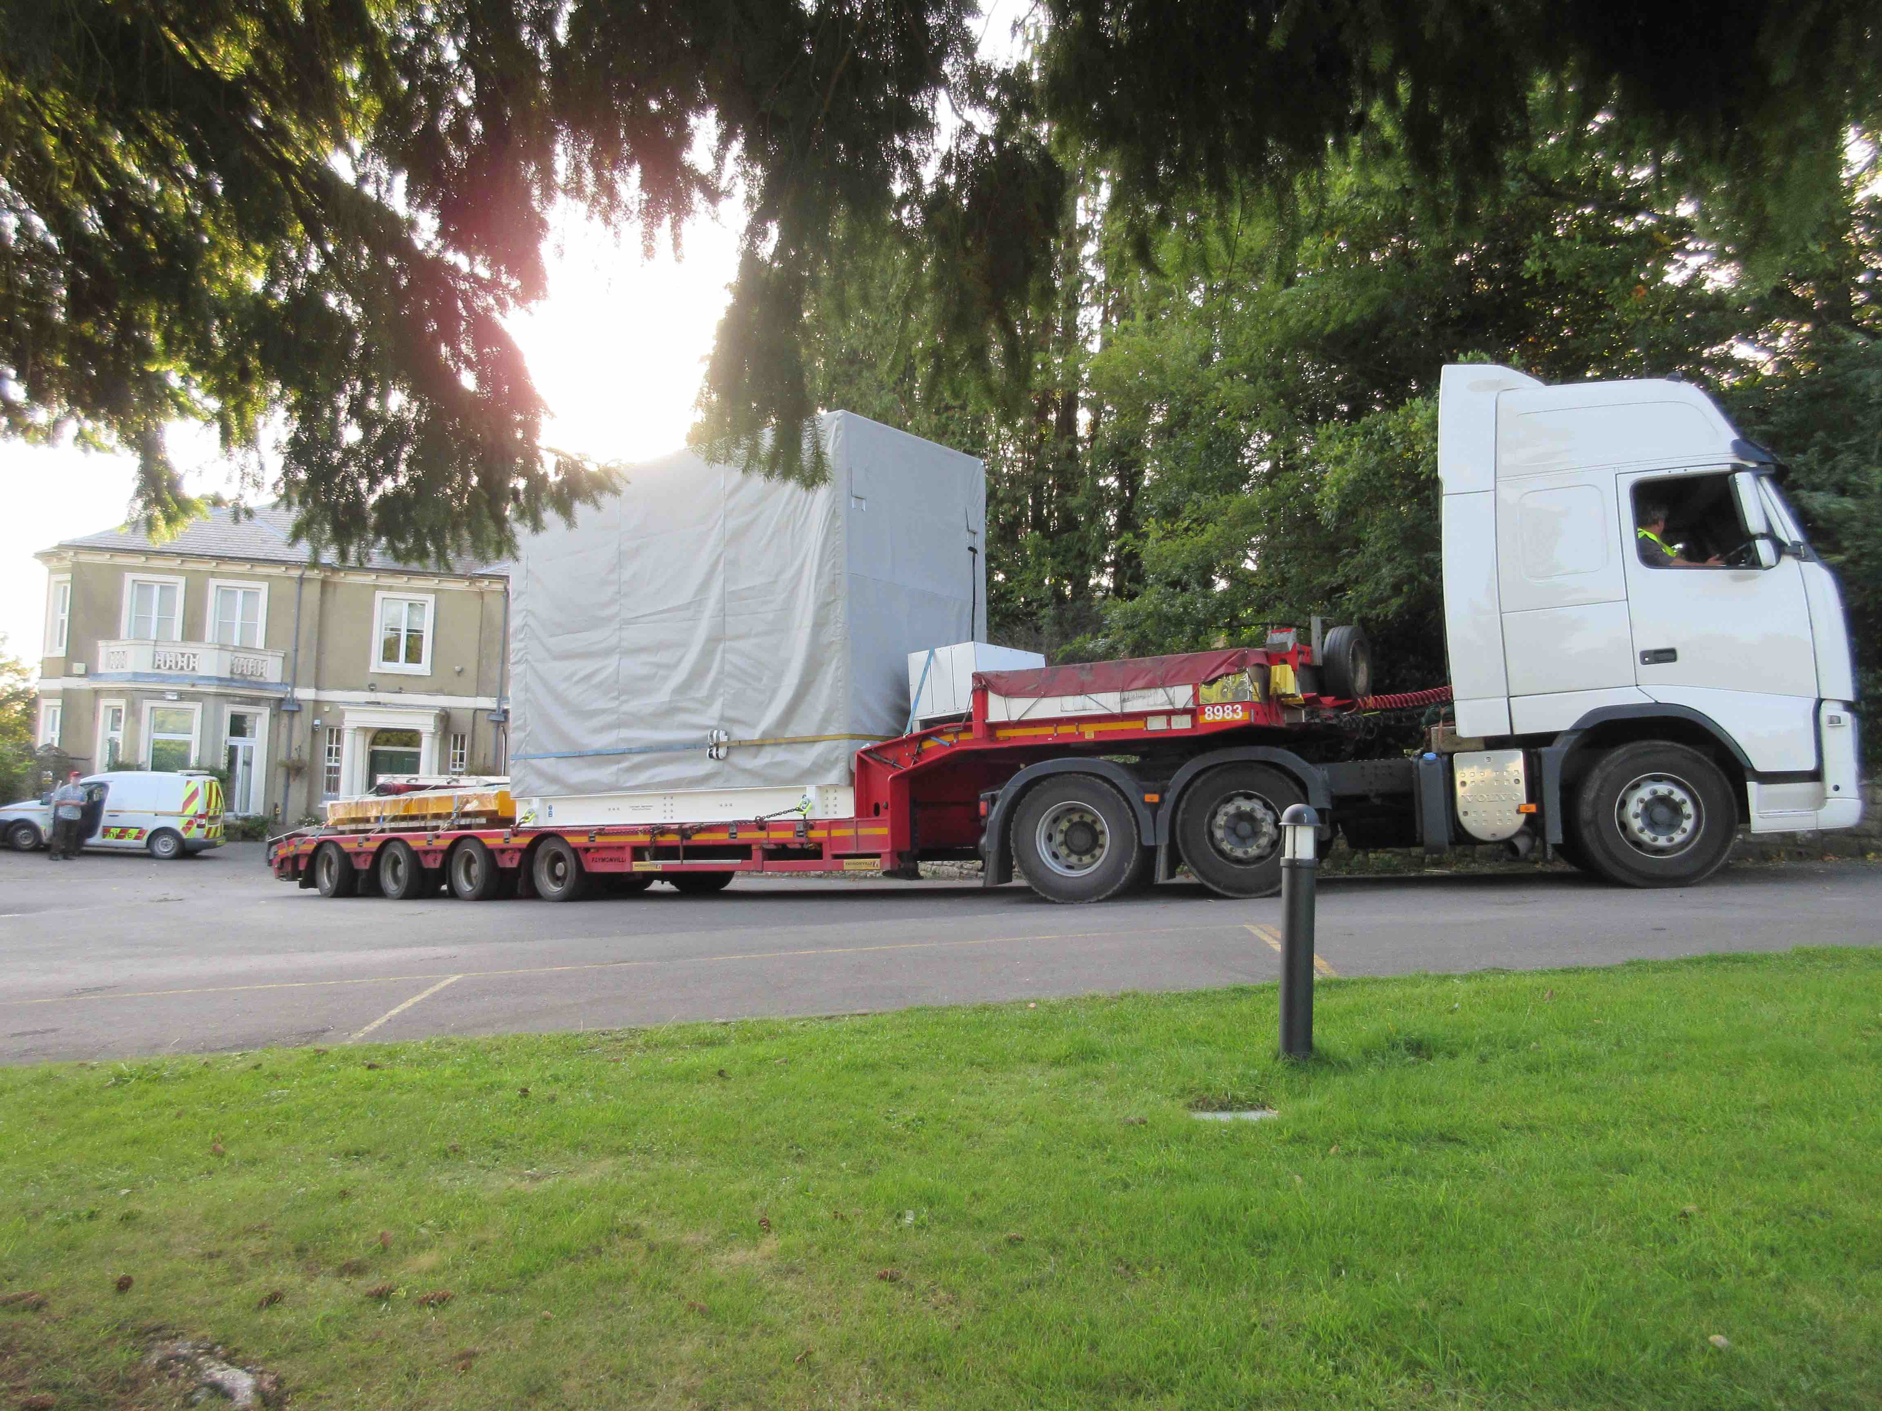
Installation status
SuperNEMO Demonsrator detector already installed at LSM
Source foils under measurement with BiPo at Canfranc
Demonstrator running by the summer of 2018
19

Slide 20


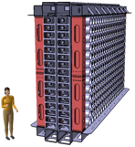
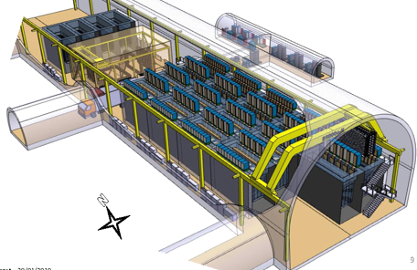
SuperNEMO sensitivity
SuperNEMO
Status
Half-life limit [10²⁴ years]
6
5.5
5
4.5 4
3.5
Half-life limit [10²⁴ years]
6
5
4
3
2
208
Tl
NEMO3
R
isotope
82
Se (or other, e.g. Nd)
ad
150
82Se
7kg
in progress
SuperNEMO
SuperNEMO
on
NEMO3
isotope mass
7 -+ 100 kg
radon
0.15 mBq/m³
Standard
Standard
./
BDT
BDT
internal contamination
²⁰⁸Tl ≤ 2 μBq/kg
²¹⁴Bi ≤ 10 μBq/kg
in progress
¹⁰ Contamination ¹⁰⁰
[µBq/kg]
1
1000 10000
Contamination [µBq/m³]
FWHM
8% @ 1 MeV
./
In [2.8-3.2] MeV:
Efficiency: 27.5%
Total number of bkg events: 0.21
Background index: 3 x 10⁻⁵ cts/(keV kg yr)
1 module
20 modules
Demonstrator Module 17.5 kg.yr :
Full SuperNEMO 500 kg.yr :
_{T} 0
24
> 5.9 x 10 yr
_{T} 0
1/2
24
6.5 ⇥ 10 yr
0.20 - 0.40 eV
1/2
> 10²⁶ yr
mi <
0.20 - 0.55 eV
m < 40 - 110 meV
50 - 100 meV
20

Slide 21
Summary
Tracker + calorimetric experiment searching for 0νββ decay
Demonstrator module under installation at Laboratoire Souterrain de Modane, France
Demonstrator:
✴7 kg of ⁸²Se running for 2.5 yr
✴Sensitivity on effective mass 0.20 - 0.55 eV
Challenges: low radioactivity source foil, extremely low levels of Radon
Practically all demonstrator module already installed. Data taking expected at the end of the summer 2018
Modular design SuperNEMO (20 modules) with total mass of 100 kg - Ultimate sensitivity 50-100 meV
21

Slide 24
Backup
Backup slides
24

Slide 25
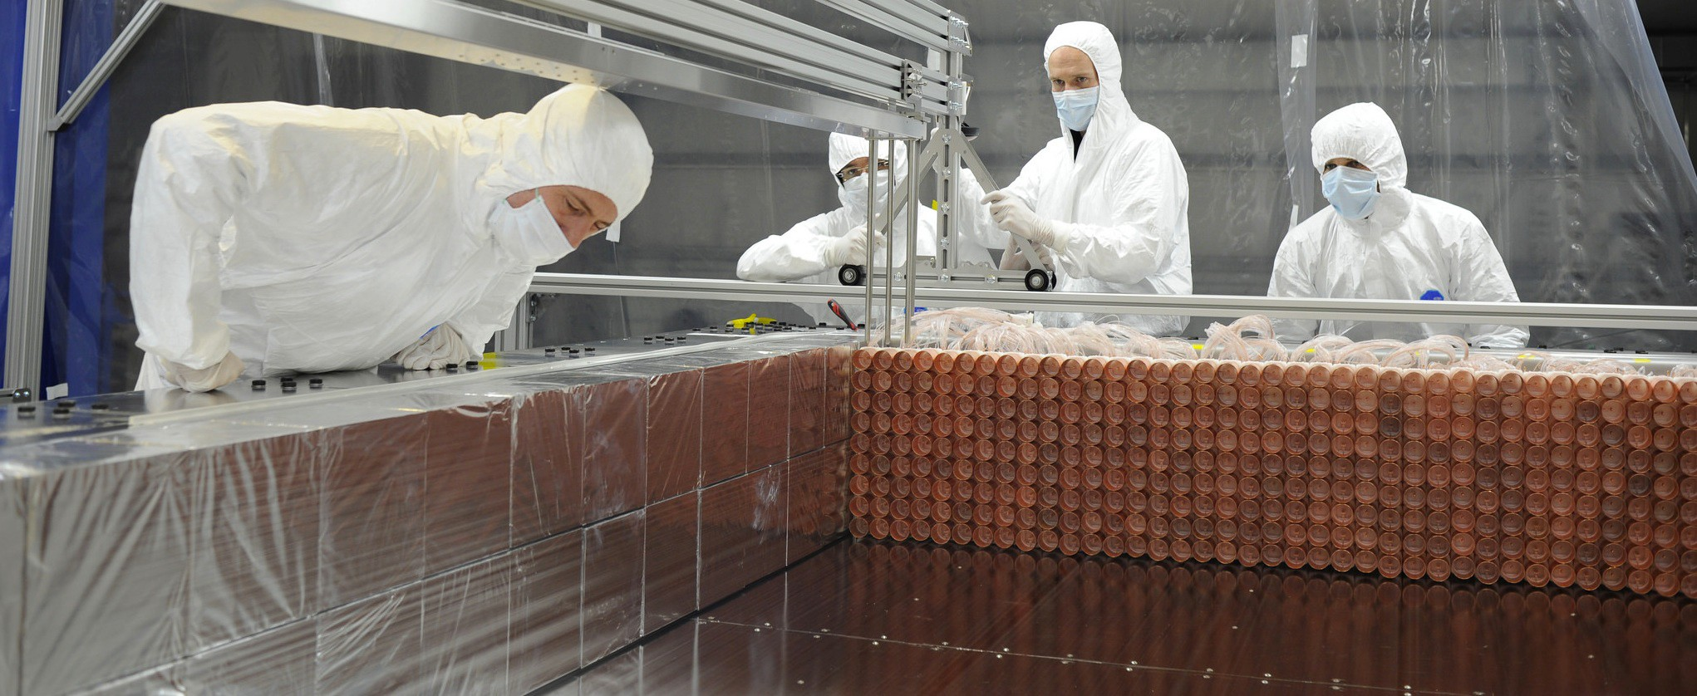
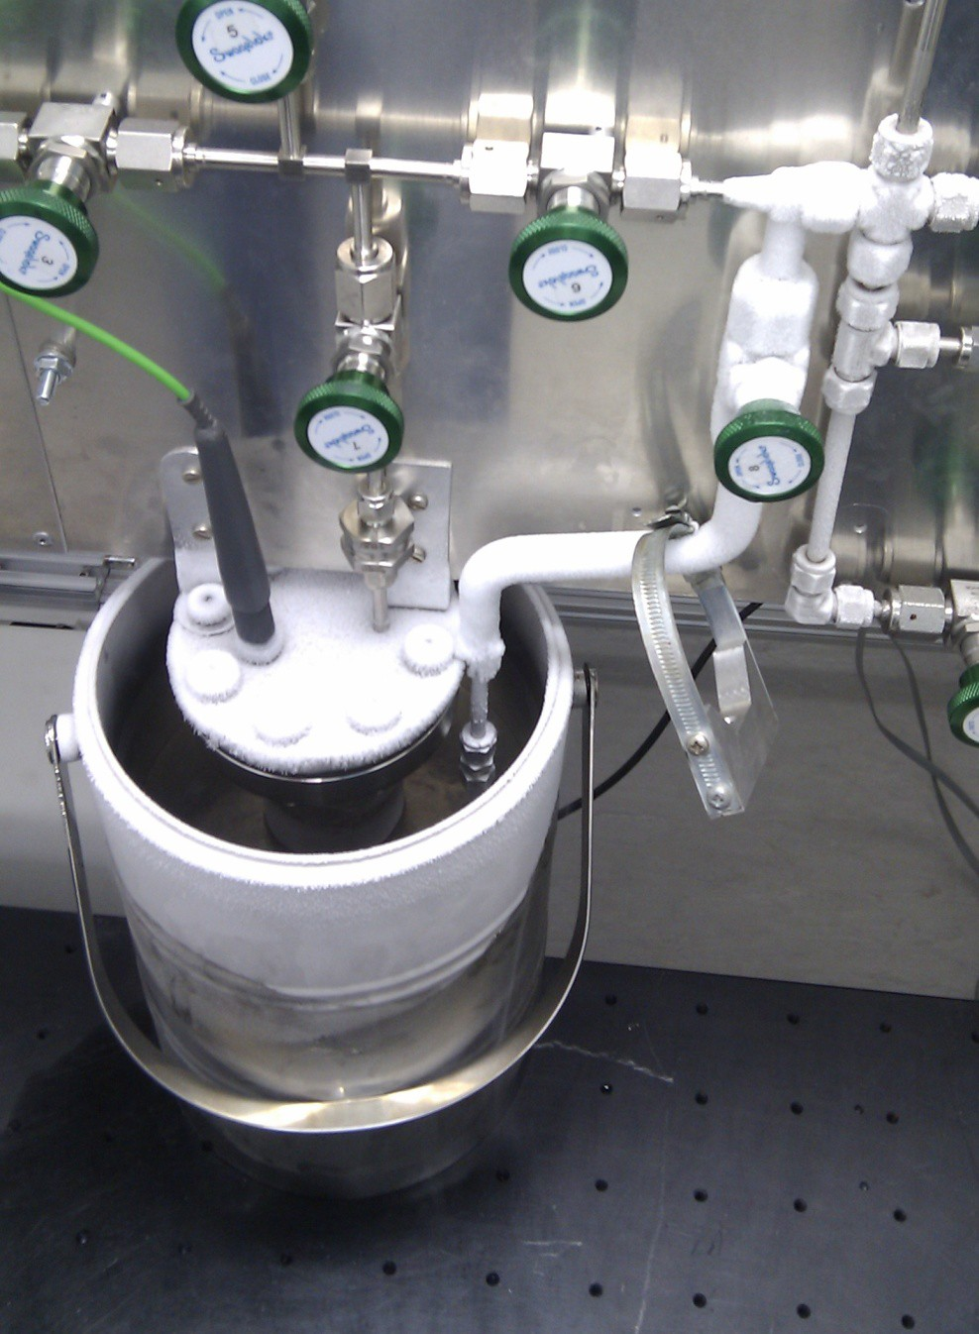


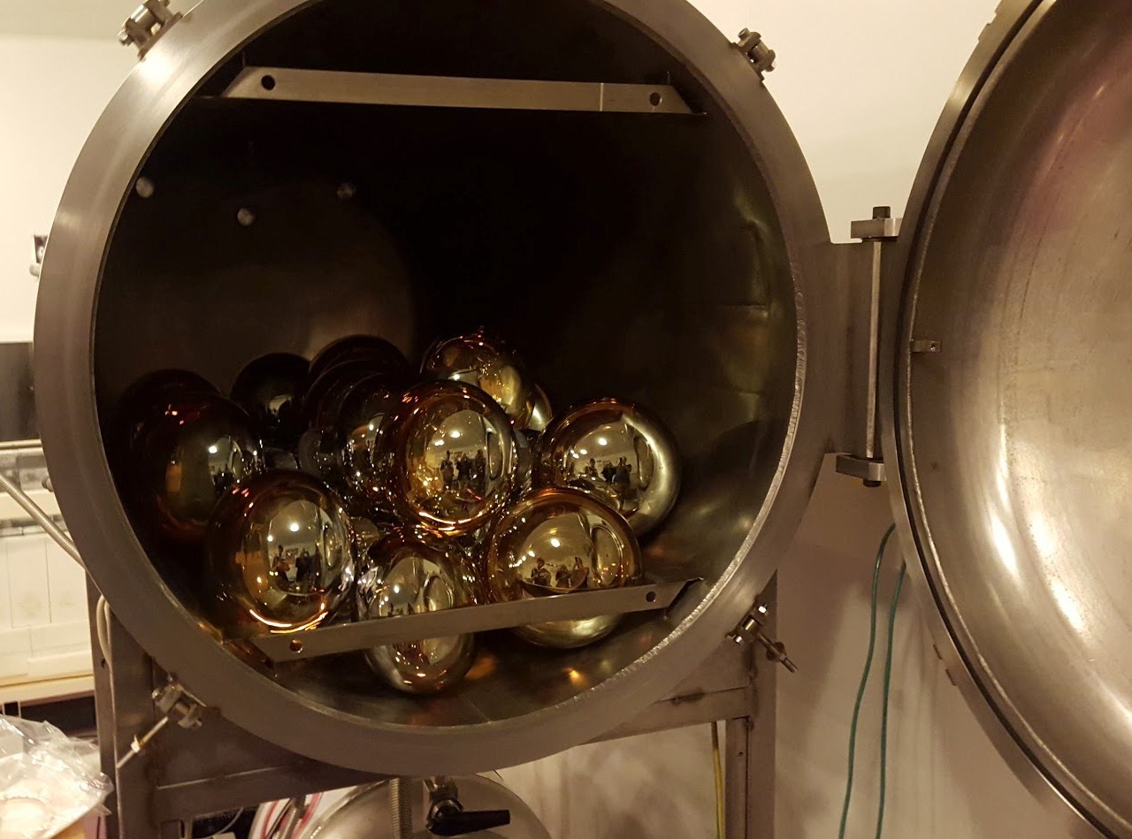
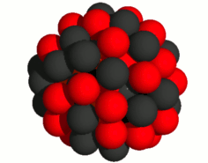
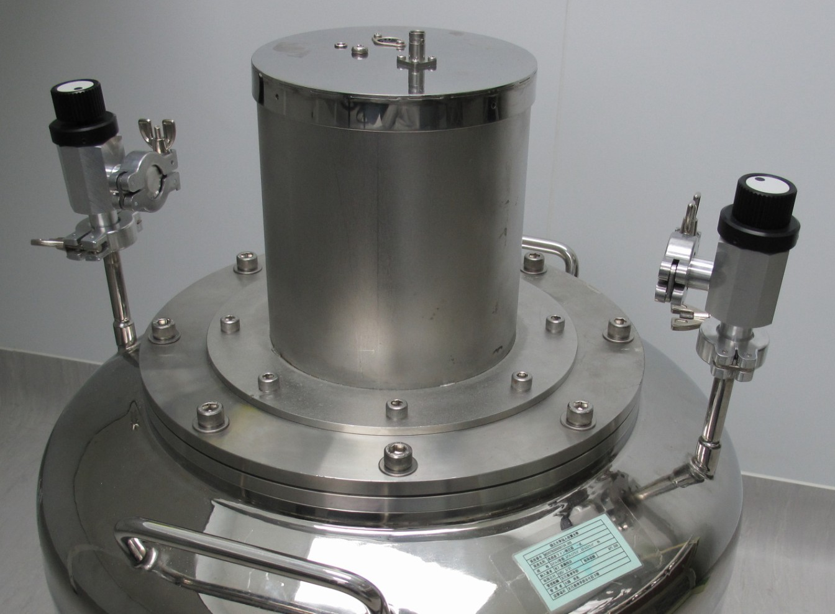
Radon
2. Flow through cooled carbon trap.
1. Purge for several T_{½} (²²²Rn)
P1.075
Emanation Facilities
70 atoms per m³
30 times better than NEMO-3
3. Release into electrostatic detector.
4. For reasonable gas, flow rates :
A(²²²Rn) = 150 µBq/m³
13

Slide 26
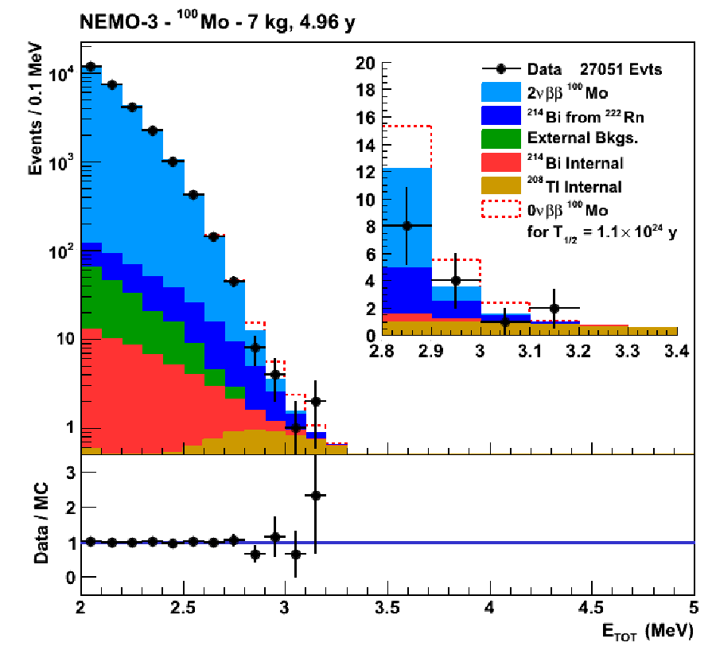
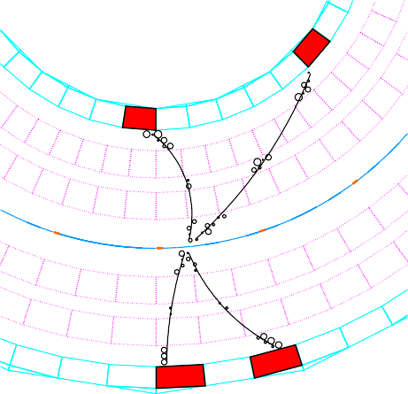
NEMO-3 results
PRD 92, 072011 (2015)
Many results with different isotopes and on different mechanisms 2b-decay
processes for: Ca-48, Se-82, Zr-96, Mo-100, Cd-116, Te-130, Nd-150
0νββ of
100_{Mo}
0ν4 β of ¹⁵⁰Nd
Possible with Dirac Neutrinos
Best candidate
2.079 MeV
¹⁵⁰Nd-------¹⁵⁰Gd + 4e⁻
T
0νββ
24
First measurement ever
Phys.Rev.Lett. 119. 041801
1/2
> 1.1 ×10 yr (90% C.L.)
m < 0.3 - 0.6 eV
0.1
NEMO-3 ¹⁵⁰Nd: 36.6 g, 5.25 y [4 electron channel]
Counts / 150 keV
0.09
0.08
0.07
0.06
0.05
0.04
0.03
0.02
(a)
Data (0)
NEMO-3
2006-06-08 13:35:02.673
150
Nd 0ν4β 90% CL (×0.1):
307 keV
Symmetric
Uniform
351 keV
Semi-symmetric
Anti-symmetric
150
Nd 2ν2β
Other backgrounds
532 keV
305 keV
0.01
0
0.5 1 1.5 2
2.5
3
_{T}
Electron energy sum (MeV)
1/2
21
3.2 x 10 yr (90% C.L.)
>11.1

Slide 27

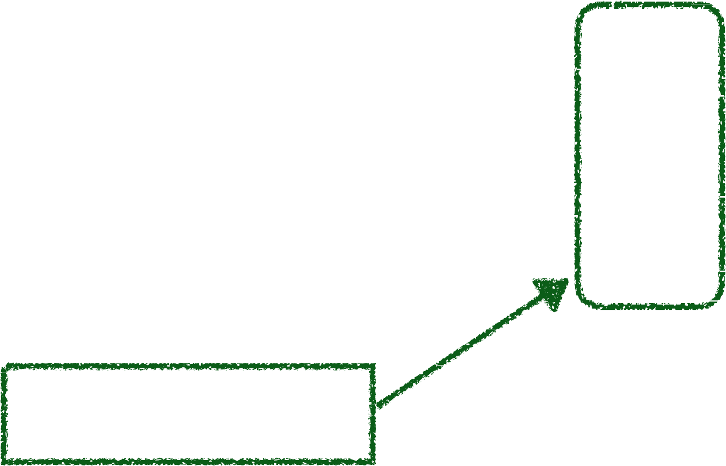
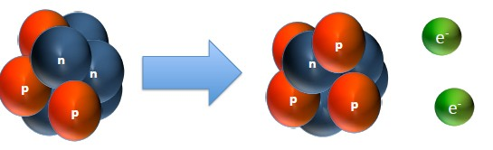
Most of ordinary matter is made of protons, neutrons and electrons
The matter-antimatter “disbalance” is likely to be linked to these processes:
Proton Decay: “Disappearance” of nucleons
Neutrinoless Double Beta Decay “Creation” of electrons
SuperNEMO
27

Slide 28
Radon
2. Flow through cooled carbon trap.
1. Purge for several T_{½} (²²²Rn)
P1.075
Emanation Facilities
70 atoms per m³
30 times better than NEMO,3
3. Release into electrostatic detector.
4. For reasonable gas,flow rates :
A(²²²Rn) = 150 µBq/m³
28

Slide 29
The Bi-Po 3 detector
•
HPGe spectroscopy not sensitive enough to reach few μBq/Kg: BiPo-3 dedicated setup at Canfranc underground lab
•
2 modules of 3.0x0.6 m² can measure up to 1.4 kg of ⁸²Se foil with thickness of 40 mg/cm²
•
²¹⁴Bi and ²⁰⁸Tl measured trough process from natural radioactivity chain
•
Thin radiopure plastic scintillators coupled to lightguides and low radioactivity PTMs
²⁰⁸Tl Sensitivity [μBq/kg source]
20
BiPo3: 3.6 m² - ⁸²Se: 40 mg/cm²
18
²⁰⁸Tl bkg: 0.16 μBq/m² scint
²⁰⁸Tl bkg: [0.04 - 0.50] μBq/m² scint SuperNEMO ²⁰⁸Tl target: 2 μBq/kg source
source
light−guide
16
14
BiPo ²⁰⁸Tl sensitivity
β
12
10
αdelay
8
6
4
scintillator
PMT
2
0
0
2
4
6
8
10 12
Measurement Time [month]
16

