Slide 1
Determination of Elemental Profile of Tobacco Plant and Soil using Neutron Activation Analysis
K. Lalrammawia
MIZORAM UNIVERSITY
Co-authors : Inga Zinicovscaia (FLNP JINR, Dubna), Omari Chaligava (Georgian Technical University),
Rajendra B Muthukumaran (Mizoram University)
India-JINR workshop 2023

Slide 2
Tobacco : Elemental profile
The propensity of tobacco plant to readily absorb heavy elements from the soil and sequestering them in their leaves has been well documented⁽¹⁻⁴⁾.
Various factors, such as soil pH, soil type, plant genotype, stalk position, soil composition, residues, and the use of pesticides/fungicides, can influence the elemental profile of tobacco leaves^{(2, 4-7)}.
Heavy elements are natural constituents of the Earth’s crust and soil conditions like acidity can affect the mobility of heavy elements in soil^{(3, 4, 8, 9)}
Angelova V, Ivanov K, Ivanova R (2004) Effect of chemical forms of lead, cadmium, and zinc in polluted soils on their uptake by tobacco. J Plant Nutr 27:757–773. https:// doi. org/ 10. 1081/ PLN-12003 0609
da Silva CP, de Almeida TE, Zittel R et al (2016) Translocation of metal ions from soil to tobacco roots and their concentration in the plant parts. Environ Monit Assess 188:663. https:// doi. org/10. 1007/ s10661- 016- 5679-3
Edelstein M, Ben-Hur M (2018) Heavy metals and metalloids:sources, risks and strategies to reduce their accumulation in horticultural crops. Sci Hortic 234:431–444
Aprile A, De Bellis L (2020) Heavy metals accumulation, toxicity, and detoxification in plant. Int J Mol Sci Basel, Switzerland, 21(11):364. https:// doi. org/ 10. 3390/ books 978-3- 03943- 478-7
Fassler E, Robinson BH, Stauffer W et al (2010) Phytomanagement of metal-contaminated agricultural land using sunflower, maize and tobacco. Agric Ecosyst Environ 136:49–58
Michalkova Z, Martinez-Fernandez D, Komarek M (2017) Interactions of two novel stabilizing amendments with sunflower plants grown in a contaminated soil. Chemosphere 186:374–380. https://doi. org/ 10. 1016/j. chemo sphere. 2017. 08. 009
Kumar V, Sharma A, Kaur P et al (2019) Pollution assessment of heavy metals in soils of India and ecological risk assessment: a state-of-the-art. Chemosphere 216:449–462. https:// doi. org/10. 1016/j. chemo sphere. 2018. 10. 066
Golia EE, Dimirkou A, Mitsios IK (2007) Accumulation of metals on tobacco leaves (primings) grown in an agricultural area in relation to soil. Bull Environ Contam Toxicol 79:158–162.https:// doi. org/ 10. 1007/ s00128- 007- 9111-0
Gondola I, Kadar I (1995) Heavy metal content of flue-cured tobacco leaf in different growing regions of Hungary. Acta Agronomica Hung 43:243–252
India-JINR workshop 2023

Slide 3
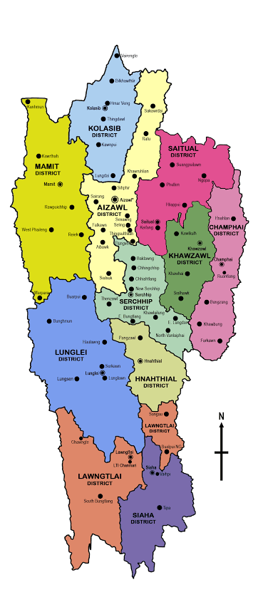
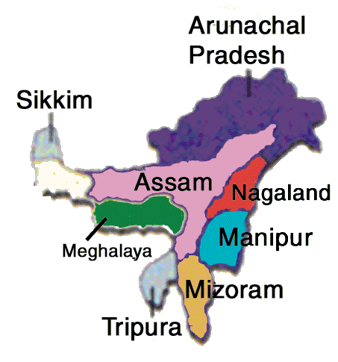
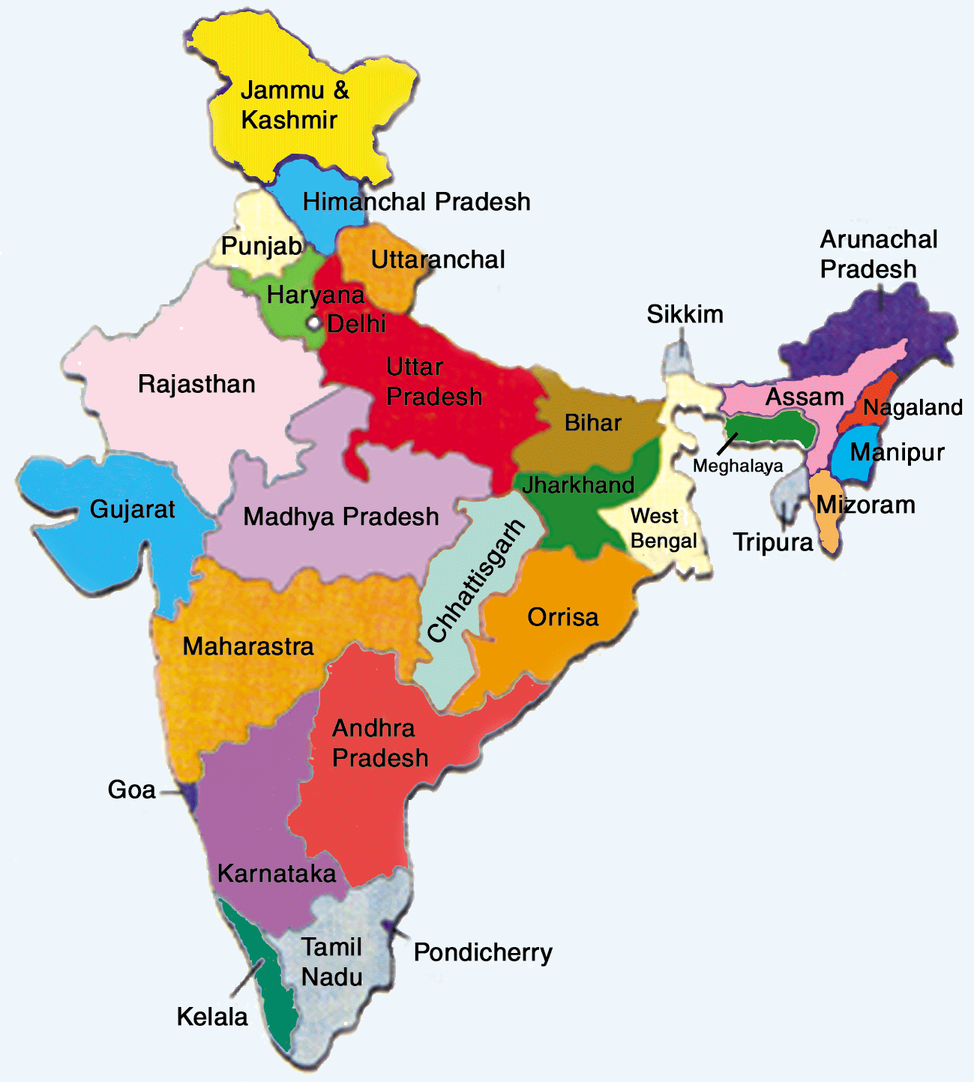
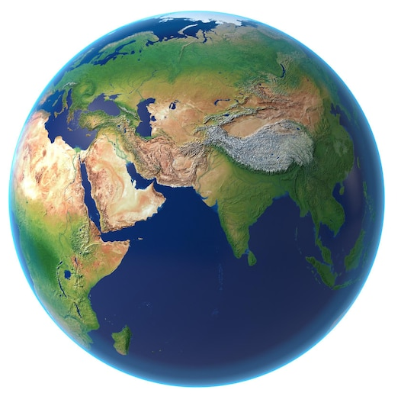
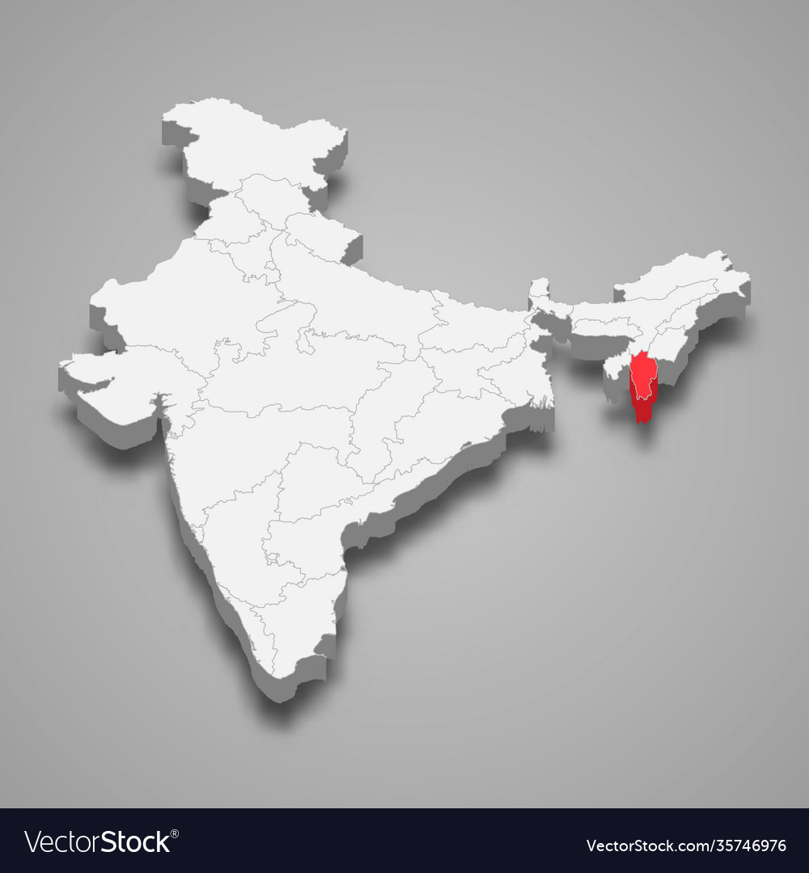
STUDY AREA
NORTH-EAST
INDIA
(NEI)
INDIA
MIZORAM
India-JINR workshop 2023

Slide 4
Tobacco : consumption
High consumption rate in India, particularly in Northeast India (NEI) (GATS2)⁽¹⁰⁾.
NEI - considerably higher incidence of cancer compared to the Indian national average, largely due to high tobacco consumption. (ICMR)⁽¹¹⁾.
In Mizoram (NEI), tobacco is organically cultivated for "zozial," an indigenous hand-rolled nonfilter cigarette available in NEI market.
This study aims to analyze trace elements' distributions and mass fractions in tobacco plants and their corresponding soil in the Mizoram state of NEI, where tobacco is cultivated, representing the first scientific investigation of tobacco grown under "shifting" cultivation conditions in Mizoram, NEI.
GATS2 (2017) Fact Sheet, India, 2016–17. Global Adult Tobacco Survey 4.
ICMR (2021) Profile of cancer and related health indicators in the North East Region of India, ICMR – National Centre for Disease Informatics and Research, Bengaluru, India
India-JINR workshop 2023

Slide 5
Experimental procedure
Samples were collected during December 2019 – February 2020 from 8 different cultivation sites from North and East parts of Mizoram.
Two to three sets each of 5–10 matured tobacco leaves of lower priming (lug leaves) along with the roots and stems from each tobacco plant were collected from each sampling site.
The surface soil near the roots (15–30 cm in depth) was also collected from each sampling site, sieved and packed.
India-JINR workshop 2023

Slide 6
Soil parameters
Nitrogen - Alkaline permanganate method was used to determine the available nitrogen in soil samples⁽¹²⁾
Phosphorus - The Bray and Kurtz method was used to determine available phosphorus in soil sample⁽¹³⁾
Potassium - Neutral ammonium acetate method was used to analyze available potassium in soil sample⁽¹⁴⁾
SOM - SOM in soil was analyzed using rapid titration method⁽¹⁵⁾
Soil pH - pH meter (Eutech-510).
Subbiah BV, Asija GL (1956) A rapid procedure for the determination of available nitrogen in soil. Curr Sci 25:259–260
Bray RH, Kurtz LT (1945) Determination of total organic and available forms of phosphorus in soils. Soil Sci 59:39–45. https://doi. org/ 10. 1097/ 00010 694- 19450 1000- 00006
Hanway JJ, Heidal H (1952) Soil analysis methods as used in Iowa State College Soil Testing Laboratory. Iowa State College of Agriculture Bulletin 57:1–31
Walkley A, Black IA (1934) An examination of the degtjareff method for determining soil organic matter and a proposed modification of the chromic acid titration method. Soil Sci 37(1):29–38.
India-JINR workshop 2023

Slide 7
Elemental analysis
Instrumental Neutron Activation Analysis (INAA) - determined using NAA at the installation REGATA of the pulsed fast reactor IBR-2 of the Frank Laboratory of Neutron Physics (JINR, Dubna, Russia).
Elements with short-lived radionuclides - samples were irradiated at a thermal neutron flux of 1.6 × 10¹² ncm⁻² s⁻¹ (soils for 1 min and plant samples for 3 min) and measured for 15 min.
Elements with long-lived radionuclides - samples were irradiated for 4 days at a neutron flux 3.31 × 10¹¹ ncm⁻ ² s⁻¹
Measured twice using HP germanium detectors after 4 and 20 days of decay, respectively.
The NAA data processing and determination of element mass fractions were performed using Genie2000 and software developed in JINR.
The quality control of NAA results was ensured by simultaneous analysis of the examined samples and standard reference materials: NIST 1633b (Constituent Elements in Coal Fly Ash), NIST 2709 (San Joaquin Soil), NIST 1547 (Peach Leaves), NIST 1575a (Trace Elements in Pine Needles), and NIST 1632c (Trace Elements in Coal).
India-JINR workshop 2023

Slide 8
Statistical analysis
Pearson’s correlation coefficients - SPSS (V16.0) [CLs p < 0.05 and p < 0.01]
Principal component analysis (PCA) - “factoextra” package in the R version 4.0.3.
India-JINR workshop 2023

Slide 9
RESULTS -
India-JINR workshop 2023

Slide 10
Range and mean of element concentrations (mass fractions) in soils (n=8)
Elements | Range (mg/kg) | Mean ± SD | Elements | Range (mg/kg) | Mean ± SD
Na | 2730–5680 | 3911 ± 1283 | Zr | 160–170 | 225 ± 41
Mg | 17,000–30,200 | 21,900 ± 4900 | Sb | 0.4–0.7 | 0.6 ± 0.1
Al | 59,000–103,000 | 72,175 ± 15,108 | Cs | 4–9 | 7 ± 2
Si | 40,400–395,000 | 339,500 ± 68,197 | Ba | 338–520 | 446 ± 73
Cl | 43–275 | 98 ± 76 | La | 32–44 | 41 ± 4
K | 11,800–25,500 | 18,600 ± 4530 | Ce | 64–91 | 84 ± 9
Ca | 633–2870 | 1885 ± 1052 | Nd | 23–42 | 34 ± 6
Sc | 10–16 | 14 ± 2 | Sm | 5–8 | 7 ± 1
Ti | 3670–5620 | 4864 ± 623 | Eu | 0.7–1.4 | 1 ± 0.2
V | 80–149 | 104 ± 24 | Tb | 0.6–1 | 1 ± 0.2
Cr | 75–142 | 105 ± 20 | Dy | 3–7 | 5 ± 1
Mn | 503–1700 | 1047 ± 387 | Yb | 2–4 | 3 ± 0.4
Fe | 31,500–54,400 | 41,788 ± 7463 | Hf | 6–9 | 8 ± 1
Co | 15–23 | 20 ± 7 | Ta | 1–1.3 | 1 ± 0.1
Ni | 36–62 | 49 ± 8 | W | 1.8–2.3 | 2 ± 0.2
Zn | 58–124 | 88 ± 25 | Th | 15–18 | 16 ± 1
As | 6–12 | 9 ± 2 | U | 2.7–3.2 | 3 ± 0.2
Br | 2–15 | 8 ± 4 | Cu | 8–22 | 14 ± 5
Rb | 89–171 | 134 ± 29 | Cd | 0.02–0.08 | 0.05 ± 0.03
Sr | 45–90 | 69 ± 14 | Pb | 9–13 | 11 ± 2
ESSENTIAL ELEMENTS
NON-ESSENTIAL ELEMENTS
RARE EARTH ELEMENTS
Si > Al > Fe > Mg > K > Ti > Na > Ca > Mn > Ba > Zr > Rb > Cr > V > Cl > Zn > Ce > Sr > Ni > La > Nd > Co > Th > Cu > Sc > Pb > As > Hf > Br > Sm > Cs> Dy > Yb > U > W > Eu > Ta > Tb > Sb > Cd
India-JINR workshop 2023

Slide 11
Range and mean of element concentrations (mass fractions) in tobacco leaves (n=8)
Elements | Range (mg/kg) | Mean ± SD | Elements | Range (mg/kg) | Mean ± SD
Na | 129–753 | 411 ± 267 | Zr | 4–13 | 7 ± 3
Mg | 4900–11,600 | 8563 ± 2117 | Sb | 0.05–0.2 | 0.1 ± 0.06
Al | 599–3140 | 1446 ± 829 | Cs | 0.1–0.3 | 0.2 ± 0.1
Si | 15,900–64,600 | 37,500 ± 15,303 | Ba | 107–241 | 159 ± 45
Cl | 643–42,100 | 16,927 ± 15,475 | La | 2–5 | 3 ± 1
K | 33,400–64,000 | 49,050 ± 11,310 | Ce | 2–7 | 3 ± 2
Ca | 18,600–35,900 | 26,050 ± 7336 | Nd | 1–4 | 2 ± 1
Sc | 0.1–0.8 | 0.3 ± 0.2 | Sm | 0.3–0.8 | 0.4 ± 0.2
Ti | 61–172 | 114 ± 35 | Eu | 0.04–0.2 | 0.07 ± 0.04
V | 1–2 | 2 ± 1 | Tb | 0.02–0.1 | 0.04 ± 0.02
Cr | 2–8 | 4 ± 2 | Dy | 0.3–0.8 | 0.5 ± 0.2
Mn | 107–681 | 214 ± 190 | Yb | 0.3–0.8 | 0.1 ± 0.07
Fe | 442–3390 | 1184 ± 951 | Hf | 0.2–0.5 | 0.3 ± 0.1
Co | 1–4 | 1.3 ± 1 | Ta | 0.01–0.07 | 0.03 ± 0.02
Ni | 2–10 | 6 ± 2 | W | 0.2–0.4 | 0.3 ± 0.08
Zn | 42–265 | 150 ± 71 | Th | 0.2–1 | 0.4 ± 0.3
As | 0.2–1 | 0.4 ± 0.2 | U | 0.04–0.2 | 0.1 ± 0.06
Br | 25–129 | 62 ± 35 | Cu | 7–43 | 19 ± 16
Rb | 7–31 | 21 ± 10 | Cd | 0.04–0.1 | 0.07 ± 0.03
Sr | 130–221 | 173 ± 34 | Pb | 0.3–2 | 0.8 ± 0.5
India-JINR workshop 2023

Slide 12
Range and mean of element concentrations (mass fractions) in roots (n=8) and stems (n=8)
 | Roots (n = 8) |  | Stems (n = 8) |  |  | Roots (n = 8) |  | Stems (n = 8)
Elements | Range (mg/kg) | Mean ± SD | Range (mg/kg) | Mean ± SD | Elements | Range (mg/kg) | Mean ± SD | Range (mg/kg) | Mean ± SD
Na | 290–2500 | 846 ± 863 | 78–1890 | 560 ± 680 | Zr | 3–27 | 11 ± 8 | 7–17 | 7 ± 5
Mg | 990–4060 | 2524 ± 853 | 1180–6100 | 3054 ± 1732 | Sb | 0.003–0.2 | 0.07 ± 0.04 | 0.05–0.2 | 0.06 ± 0.07
Al | 944–2940 | 2681 ± 2016 | 421–3780 | 1379 ± 1104 | Cs | 0.2–1 | 0.4 ± 0.2 | 0.2–0.4 | 0.2 ± 0.1
Si | 4950–29,700 | 14,306 ± 7071 | 6100–20,100 | 11,907 ± 5015 | Ba | 54–126 | 78 ± 32 | 61–165 | 98 ± 44
Cl | 1360–14,000 | 6073 ± 4955 | 776–26,300 | 11,666 ± 10,132 | La | 1–5 | 2 ± 1 | 1–3 | 1 ± 0.8
K | 20,200–64,000 | 33,725 ± 14,866 | 25,600–117,000 | 49,900 ± 29,717 | Ce | 2–10 | 4 ± 3 | 2–6 | 2 ± 1.7
Ca | 6080–14,100 | 9248 ± 3228 | 3930–13,500 | 7517 ± 3604 | Nd | 1–4 | 2 ± 1 | 1–2 | 1 ± 0.2
Sc | 0.3–2 | 0.7 ± 0.5 | 0.1–1 | 0.3 ± 0.2 | Sm | 0.1–1 | 0.4 ± 0.3 | 0.3–0.5 | 0.2 ± 0.1
Ti | 49–259 | 186 ± 128 | 31–248 | 108 ± 66 | Eu | 0.03–0.2 | 0.07 ± 0.05 | 0.04–0.1 | 0.04 ± 0.03
V | 1–10 | 4 ± 3 | 0.6–6 | 2 ± 1.7 | Tb | 0.02–0.1 | 0.05 ± 0.04 | 0.03–0.06 | 0.03 ± 0.02
Cr | 3–12 | 7 ± 4 | 2–10 | 4 ± 3 | Dy | 0.2–0.7 | 0.4 ± 0.2 | 0.2–0.4 | 0.3 ± 0.1
Mn | 24–100 | 63 ± 28 | 17–91 | 46 ± 26 | Yb | 0.07–0.5 | 0.2 ± 0.1 | 0.1–0.3 | 0.1 ± 0.07
Fe | 713–4490 | 1798 ± 1235 | 870–3660 | 1051 ± 1091 | Hf | 0.09–1 | 0.4 ± 0.3 | 0.3–0.6 | 0.24 ± 0.19
Co | 1–2 | 1 ± 0.5 | 0.5–1 | 0.7 ± 0.3 | Ta | 0.02–0.1 | 0.06 ± 0.04 | 0.04–0.1 | 0.03 ± 0.03
Ni | 2–6 | 5 ± 2 | 3–8 | 4 ± 2 | W | 0.1–0.2 | 0.2 ± 0.06 | 0.2–0.4 | 0.2 ± 0.1
Zn | 17–115 | 43 ± 32 | 26–155 | 55 ± 44 | Th | 0.3–2 | 0.8 ± 0.6 | 0.5–1 | 0.4 ± 0.3
As | 0.2–1 | 0.4 ± 0.3 | 0.3–1 | 0.3 ± 0.2 | U | 0.05–0.4 | 0.2 ± 0.1 | 0.1–0.2 | 0.08 ± 0.06
Br | 5–40 | 21 ± 13 | 12–98 | 42 ± 33 | Cu | 5–12 | 8 ± 3 | 3–15 | 8 ± 5
Rb | 11–31 | 18 ± 8 | 8–56 | 20 ± 15 | Cd | 0.2–0.8 | 0.4 ± 0.2 | 0.03–0.2 | 0.09 ± 0.06
Sr | 54–146 | 91 ± 31 | 68–130 | 79 ± 26 | Pb | 0.6–2 | 1 ± 0.5 | 0.3–2 | 0.7 ± 0.6

Slide 13
Soil parameters of different sampling locations
Sample | Site | pH | kg/ha |  |  | SOM (%)
 | Puilo |  | N | P | K
IND-T1 | Chhawrtui | 6.93 | 281.49 | 79.11 | 146.72 | 4.33941
IND-T2 | Tualte | 5.28 | 325.14 | 28.84 | 135.52 | 3.30007
IND-T3 | Khuangleng | 5.25 | 379.34 | 9.11 | 161.28 | 4.324515
IND-T4 | Bungtlang | 5.54 | 379.34 | 21.93 | 86.24 | 4.95507
IND-T5 | Hmuntha | 5.0 | 454.6 | 169.52 | 84 | 3.162705
IND-T6 | Lungdai | 5.19 | 534.38 | 17.88 | 209.44 | 5.85208
IND-T7 | Model veng | 4.7 | 407.94 | 201.73 | 136.64 | 3.606245
IND-T8 | Site | 4.38 | 465.14 | 275.78 | 92.96 | 3.473845
soil pH values ranged from strongly acidic (pH = 4.4) to marginally acidic (pH = 6.9) with a mean soil pH = 5.3
Pearson’s correlation coefficients were calculated using SPSS (V16.0)
India-JINR workshop 2023

Slide 14
Correlation between elemental concentration and soil parameters
Elements | pH | N | P | K | SOM | Elements | pH | N | P | K | SOM
Na | -0.532 | 0.267 | 0.927** | -0.487 | -0.722* | Zr | 0.026 | -0.003 | 0.196 | -0.233 | -0.326
Mg | -0.362 | 0.357 | 0.294 | 0.155 | -0.254 | Sb | -0.505 | 0.239 | 0.806* | -0.473 | -0.669
Al | -0.351 | 0.182 | 0.714* | -0.61 | -0.762* | Cs | -0.457 | 0.176 | 0.836** | -0.596 | -0.818*
Si | -0.682 | 0.803* | 0.51 | -0.242 | -0.224 | Ba | -0.374 | 0.398 | -0.105 | 0.181 | 0.037
Cl | -0.507 | 0.849** | 0.388 | -0.085 | 0.033 | La | -0.2 | 0.247 | -0.134 | -0.391 | -0.102
K | 0.185 | -0.448 | 0.318 | -0.425 | -0.687 | Ce | -0.419 | 0.387 | 0.37 | -0.439 | -0.466
Ca | -0.511 | 0.804* | 0.639 | 0.084 | 0.059 | Nd | -0.292 | 0.158 | 0.199 | -0.646 | -0.518
Sc | -0.29 | 0.117 | 0.616 | -0.659 | -0.747* | Sm | -0.225 | 0.3 | 0.359 | -0.618 | -0.413
Ti | -0.041 | 0.285 | 0.507 | 0.002 | -0.296 | Eu | 0.063 | 0.016 | 0.098 | -0.508 | -0.375
V | -0.38 | 0.242 | 0.651 | -0.586 | -0.723* | Tb | -0.245 | 0.199 | 0.434 | -0.788* | -0.493
Cr | -0.524 | 0.724* | 0.33 | 0.043 | -0.163 | Dy | -0.503 | 0.738* | 0.435 | -0.177 | -0.183
Mn | -0.162 | 0.293 | 0.182 | -0.336 | -0.361 | Yb | -0.221 | 0.35 | 0.264 | -0.349 | -0.377
Fe | -0.312 | 0.241 | 0.574 | -0.588 | -0.646 | Hf | -0.19 | 0.042 | 0.366 | -0.355 | -0.536
Co | -0.182 | 0.415 | 0.145 | -0.248 | -0.255 | Ta | -0.235 | 0.094 | 0.561 | -0.536 | -0.715*
Ni | 0.029 | 0.279 | -0.005 | 0.303 | -0.118 | W | -0.458 | -0.187 | 0.14 | -0.239 | -0.764*
Zn | -0.475 | 0.014 | 0.475 | -0.06 | -0.714* | Th | -0.322 | 0.174 | 0.591 | -0.609 | -0.713*
As | -0.271 | 0.262 | 0.557 | -0.506 | -0.573 | U | -0.246 | 0.135 | 0.562 | -0.445 | -0.655
Br | -0.33 | -0.251 | -0.071 | -0.127 | -0.649 | Cd | -0.257 | -0.111 | 0.173 | -0.072 | -0.302
Rb | -0.299 | -0.224 | 0.236 | -0.235 | -0.694 | Cu | -0.107 | -0.354 | -0.398 | 0.356 | -0.228
Sr | -0.285 | 0.671 | 0.186 | 0.443 | 0.377 | Pb | -0.662 | 0.621 | 0.686 | -0.447 | -0.484
** Correlation is significant at p<0.01 level (2-tailed) ; *Correlation is significant (2-tailed at p<0.05 level).
India-JINR workshop 2023

Slide 15
Bioconcentration and translocation of ions in tobacco
Elements | BCF (L) | TF (L) | BCF (ST) | TF (ST) | BCF(R) | Elements | BCF (L) | TF (L) | BCF (ST) | TF (ST) | BCF(R)
Na | 0.105 | 0.49 | 0.14 | 0.67 | 0.22 | Sr | 2.53 | 1.89 | 1.16 | 0.87 | 1.334
Mg | 0.391 | 3.39 | 0.14 | 1.21 | 0.12 | Zr | 0.032 | 0.64 | 0.03 | 0.6 | 0.051
Al | 0.02 | 0.54 | 0.019 | 0.52 | 0.04 | Sb | 0.18 | 1.41 | 0.11 | 0.85 | 0.13
Si | 0.11 | 2.62 | 0.035 | 0.83 | 0.042 | Cs | 0.024 | 0.45 | 0.026 | 0.48 | 0.054
Cl | 171.95 | 2.79 | 118.51 | 1.92 | 61.69 | Ba | 0.36 | 2.05 | 0.22 | 1.26 | 0.17
K | 2.64 | 1.45 | 2.67 | 1.48 | 1.81 | La | 0.076 | 1.3 | 0.032 | 0.55 | 0.06
Ca | 13.82 | 2.82 | 3.99 | 0.81 | 4.91 | Ce | 0.041 | 0.79 | 0.028 | 0.53 | 0.052
Sc | 0.025 | 0.49 | 0.025 | 0.49 | 0.051 | Nd | 0.052 | 1.04 | 0.032 | 0.65 | 0.05
Ti | 0.023 | 0.61 | 0.022 | 0.58 | 0.04 | Sm | 0.056 | 0.95 | 0.033 | 0.55 | 0.06
V | 0.02 | 0.54 | 0.019 | 0.53 | 0.04 | Eu | 0.057 | 0.99 | 0.033 | 0.56 | 0.058
Cr | 0.041 | 0.64 | 0.036 | 0.56 | 0.064 | Tb | 0.045 | 0.77 | 0.034 | 0.58 | 0.058
Mn | 0.205 | 3.42 | 0.044 | 0.73 | 0.06 | Dy | 0.096 | 1.29 | 0.065 | 0.87 | 0.074
Fe | 0.028 | 0.66 | 0.025 | 0.59 | 0.043 | Yb | 0.032 | 0.51 | 0.035 | 0.56 | 0.062
Co | 0.065 | 1.1 | 0.034 | 0.58 | 0.06 | Hf | 0.037 | 0.67 | 0.031 | 0.55 | 0.056
Ni | 0.118 | 1.19 | 0.084 | 0.85 | 0.1 | Ta | 0.026 | 0.52 | 0.026 | 0.52 | 0.05
Cu | 1.45 | 2.52 | 0.63 | 1.09 | 0.57 | W | 0.137 | 1.91 | 0.1 | 1.38 | 0.072
Zn | 1.7 | 3.52 | 0.62 | 1.29 | 0.48 | Th | 0.027 | 0.53 | 0.027 | 0.53 | 0.05
As | 0.041 | 0.88 | 0.035 | 0.75 | 0.05 | U | 0.034 | 0.6 | 0.027 | 0.48 | 0.056
Br | 8.02 | 2.91 | 5.51 | 2 | 2.76 | Cd | 7.24 | 5.57 | 1.7 | 1.31 | 1.3
Rb | 0.156 | 1.17 | 0.15 | 1.14 | 0.131 | Pb | 0.103 | 1.53 | 0.058 | 0.87 | 0.067
BCF for tobacco leaf
Cl > > > Ca > Br > Cd > > K > Sr > Zn
Translocation
Cd > Zn > Mn > Mg > Br > Ca > Cl > Si > Cu > Ba > W > Sr > Pb > K > Sb > Ni > Co
India-JINR workshop 2023
BCF – Bioconcentration Factor ; TF – Translocation Factor ; L – Leaf ; ST – Stem ; R – Root

Slide 16
Comparison of heavy elements concentrations in soils of the study area with permissible limits for Indian soils
 | Cr | Mn | Fe | Co | Ni | Cu | Zn | Cd | Pb | Ref
Indian natural soil background | 114 | 209 | 32015 | 15.2 | 27.7 | 56.5 | 22.1 | - | 13.1 | (16)
Indian limit for soil | - | - | - | - | 75-150 | 135-270 | 300-600 | 3.0-6.0 | 250-500
Minima (Present Study) | 75 | 503 | 31500 | 15 | 36 | 7.99 | 58 | 0.018 | 9.14 | Present Study
Maxima (Present Study) | 142 | 1700 | 54400 | 23 | 62 | 21.98 | 124 | 0.079 | 13.19
Mean (Present Study) | 104.9 | 1047 | 41787.5 | 20.31 | 48.88 | 14.125 | 87.9 | 0.05 | 11.25
Mussalo-Rauhamaa H, Salmela SS, Leppanen A, Pyysalo H (1986) Cigarettes as a source of some trace and heavy metals and pesticides in man. Arch Environ Health 41:49–55. https:// doi. org/10. 1080/ 00039 896. 1986. 99357 65
India-JINR workshop 2023

Slide 17
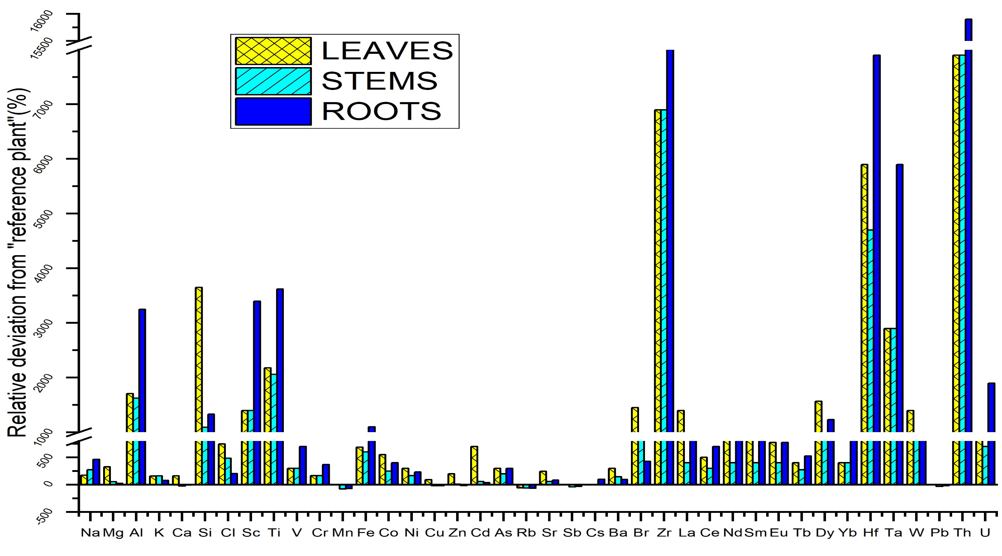
Fig. 1: Indicator “fingerprints” of element concentration (mass fraction) in tobacco plants expressed as the relative deviation from the “Reference Plant”
India-JINR workshop 2023

Slide 18
Fig.2 : PCA Analysis : Bi-plots of heavy element distributions in tobacco samples of different countries
India-JINR workshop 2023

Slide 19
CONCLUSIONS -
Neutron activation analysis (NAA) determine the presence of 9 essential, 20 non-essential and 8 rare earth elements in tobacco plants from Northeast India .
The heavy element mass fractions in tobacco were weakly correlated to different soil parameters .
The Bioconcentration factor values indicated that Cd was selectively absorbed and translocated in tobacco leaves compared to other elements like Zn, Cu, Ni, and Pb.
The roots of tobacco plants from Northeast India had significantly higher mass fractions of Al, Sc, Ti, Zr, Hf, Ta, Th, and U compared to "reference plant”.
By virtue of element compositions, PCA revealed that NEI tobacco is clearly differentiated from other varieties of tobaccos.
India-JINR workshop 2023

Slide 20
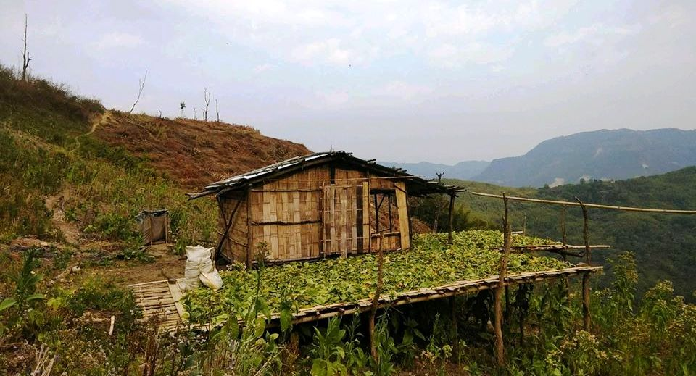
THANK YOU ALL
FOR YOUR KIND ATTENTION
India-JINR workshop 2023

