Slide 1

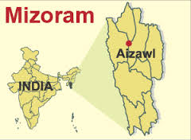
Characterization of Tobacco stalk Ash
Muthukumaran R.
Department of Chemistry
Mizoram University
Aizawl – 796 004
INDIA

Slide 2
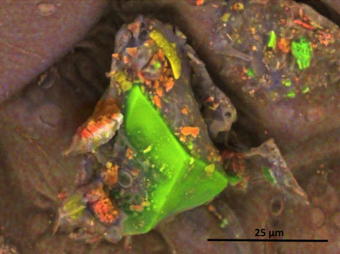
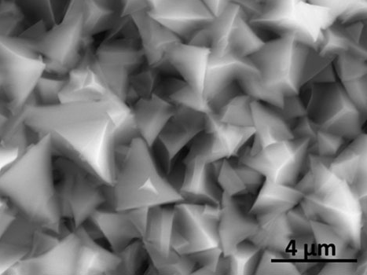
Inorganic Particles of Tobacco Filler
(phytolithic)
Calcium, carbon, and oxygen (orange), Silica (green) and aluminum and oxygen-containing
particles (yellow) [filler]
Halstead MM, Watson CH, Pappas RS (2015) J Anal Toxicol 39: 698-701

Slide 3
Inorganic Particles of Cigarette Ash
Baliga VL, Miser DE, Sharma RK et al. (2003) Physical Characterization of the Cigarette Coal: part 1—Smolder Burn, J Analy Appl Pyroly. 68: 443-65

Slide 4
Inorganic Particles of Cigarette Ash
Baliga VL, Miser DE, Sharma RK et al. (2003) J Analy Appl Pyroly. 68: 443-65

Slide 5
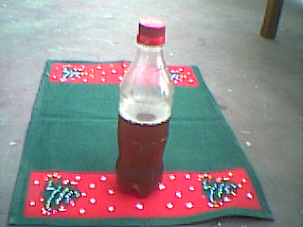
Manufacturing tuibur
Water Stream
③
Production Unit
Aspirator Unit
Pipes connected to upstream
Filtration Unit
Smoke Generator Unit
Water hole
①
②
Ash + Raw Tuibur
Smoldering Tobacco
Stalk
Feedstock Generation
1” dia pipe
Water flow
Upper Steel Container
18” dia x 18” height
1’ dia x 3’ height
Filtered Tuibur, pH 9-10.5 (20L)
Tobacco stalk Ash
9” dia x 18” height
Air flow
Bamboo Joint
3“ thick earth
Air flow
Tobacco stalk Ash
Connector
(15 cm iron pipe of 1” dia)
0.5” dia pipe
1” dia pipe
Water flow
Feed stock solution, pH 9-10.5 (20L)
Smoke
Mixing of ‘diluted’ smoke into downstream
18” dia x 18” height
24” dia x 18” height
Feed stock solution, pH 9 - 10.5 (20L)
Smoke
Lower Container
Notes:
The mean nicotine content of TSIW samples was 12.23 mg g⁻¹ and ranged from 10.04 mg g⁻¹ (Lunglei site 1) to 18.25 mg g⁻¹ (Aizawl site 1).

Slide 6
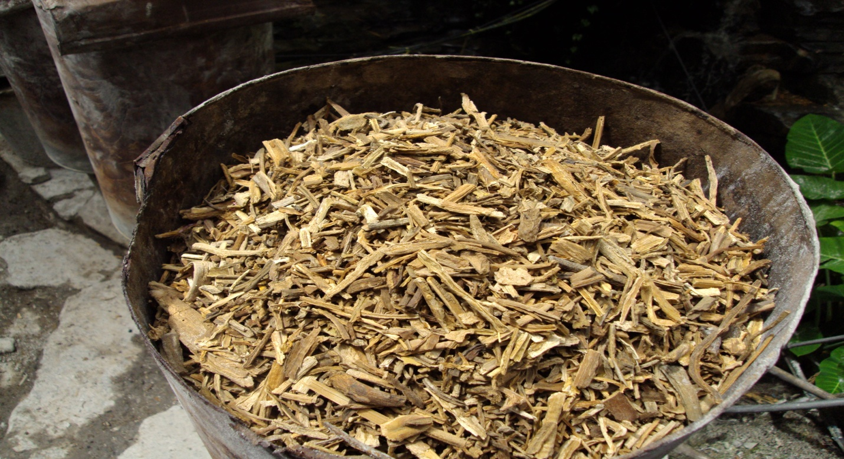
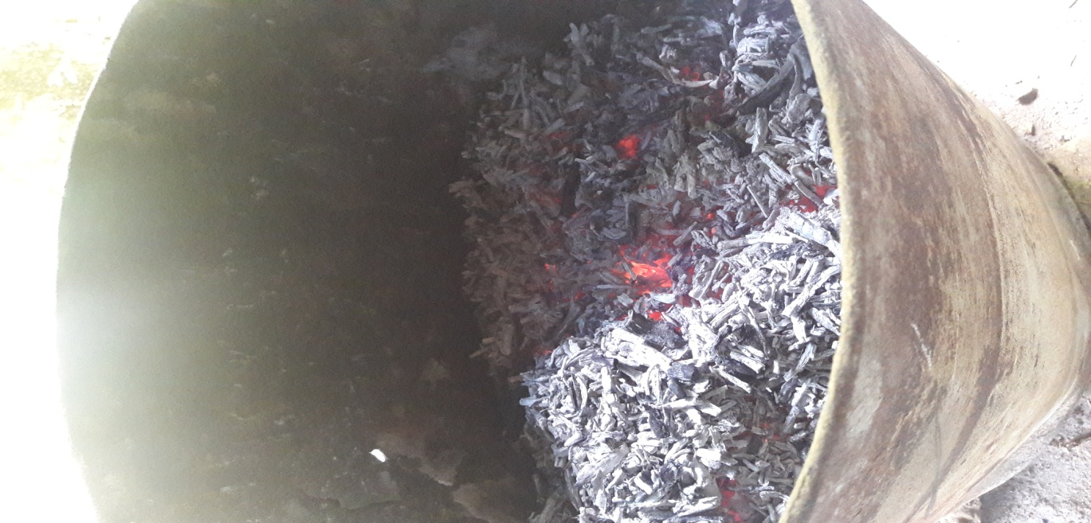
Combustion of tobacco stalk
Tobacco stalk: Tobacco stem, petiole, midrib
Smoldering Tobacco stalk under aerobic conditions

Slide 7
Key Questions
What is the nature and composition of inorganic particulate constituents on the surface & interior of the tobacco stalk (tuibur)?
What is the potential microstructural features of inorganic particulate matter present in tobacco ash generated from tobacco stalk?

Slide 8
Inorganic Particulate Matter – Tobacco Stalk

Slide 9
XR-PD of Tobacco stalk Ash

Slide 10
X-ray Photoelectron spectroscopy (XPS) of Tobacco stalk Ash
Ca 2P
C 1S
O 1S

Slide 11
XPS of Tobacco Ash
K 2P
Cl 2P

Slide 12
XPS of Tobacco Ash
Mg 1S
Si 2P

Slide 13
XPS of Tobacco Ash
S 2P
Al 2P

Slide 14
XPS of Tobacco Ash
Fe 2P
P 2P
Hg 4f

Slide 15
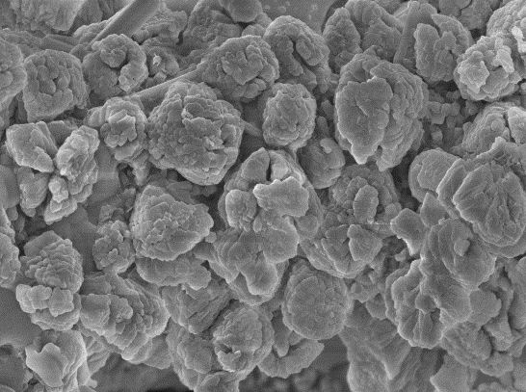
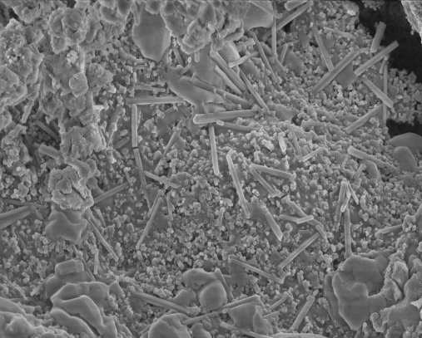
SEM of Tobacco Ash
2 µm
1 µm

Slide 16
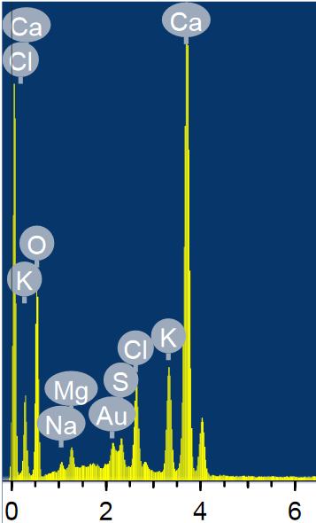
SEM of Tobacco Ash
300 nm

Slide 17
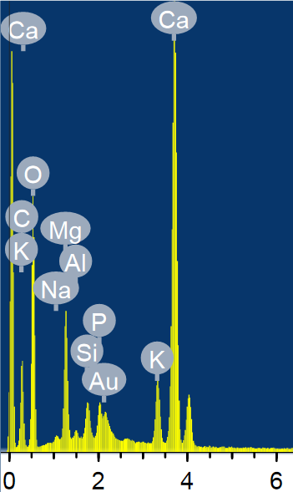
SEM of Tobacco Ash
200 nm

Slide 18
EDAX of Tobacco Ash

Slide 19
EDAX of Tobacco Ash

Slide 20
Raman Spec. Tobacco Ash ( 473 nm and 785 nm)

Slide 21
Raman Spec. Tobacco Ash ( 473 nm and 785 nm)

Slide 22
Frequencies ν, cm⁻¹ |  |  |  | Assignments
Mineral |  |  | Other compounds
Aragonite | Calcite | Calcite
135, 146 | 158 | 158 |  | T (Ca, Mg, CO₃) Ti-O vibration mode
197 |  |  |  | T (Ca, Mg, CO₃)
277 | 282 | 282 |  | T (Ca, Mg, CO₃)
 |  |  | 385 | Ca-O stretch lattice mode(ν₂(E)) of Si-O in anatase
 |  |  | 458 | ν₂(PO₄)³⁻ stretching mode
 |  |  | 510 | Al-O-Si bending mode
 |  |  | 630 | Si-O-Si stretching vibration E_{g} mode of anatase
702 | 716 |  |  | in-plane bending (ν₄) modes of the carbonate ion
854 |  |  |  | ν₂((CO₃)²⁻) out-of-plane bending in aragonite
 |  |  | 992 | ν₁((SO₄)²⁻) symmetric stretch
1082 | 1088 |  |  | symmetric stretching mode ν₁((CO₃)²⁻)
Raman Freq. Tobacco Ash ( 473 nm)

Slide 23
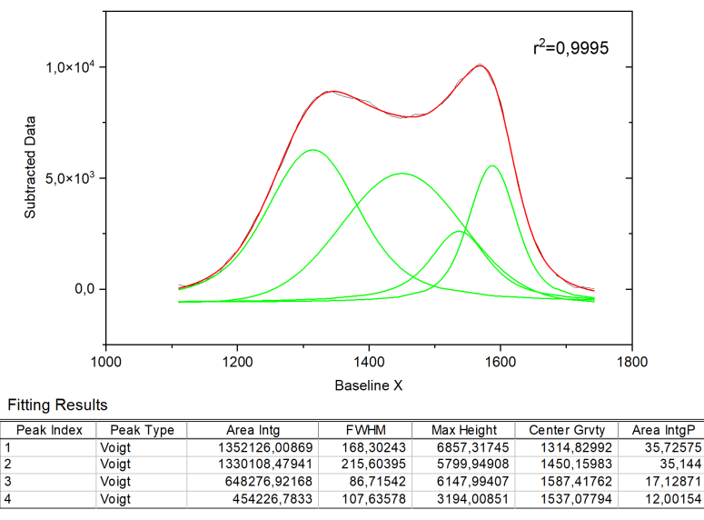
Raman Spec. Tobacco Ash ( 473 nm and 785 nm)
C 1S

Slide 24
Tobacco Stalk Ash
element | Conc. (μg/g) | S.D
Al | 6999.59 | ±65.004
Ba | 322.33 | ±2.42
Cd | 0.426 | ±0.005
Co | 2.469 | ±0.016
Cr | 10.141 | ±0.050
Cu | 45.78 | ±0.133
Fe | 3441.17 | ±15.92
Mn | 306.42 | ±1.91
Ni | 16.781 | ±0.842
Pb | 2.332 | ±0.125
S | 20304.72 | ±512.24
Sr | 1135.95 | ±12.496
V | 9.123 | ±0.11
Zn | 195.59 | ±1.357
ICP-AES Analysis of Tobacco Ash

Slide 25
Conclusion
a) Identification and classification of some of the ‘insoluble’ inorganic particulate phase on the surface of tobacco stalk and tobacco ash (biogenic or environmental)
b) Evaluation of the size distribution and micro-structural features of inorganic particulate matter
Phase identification (aragonite and Calcite) of insoluble inorganic particulate matter
XPS analysis of Ca, Fe, C, S, P, Al, Si and Hg species at different electronic environments on tobacco ash surface

Slide 26
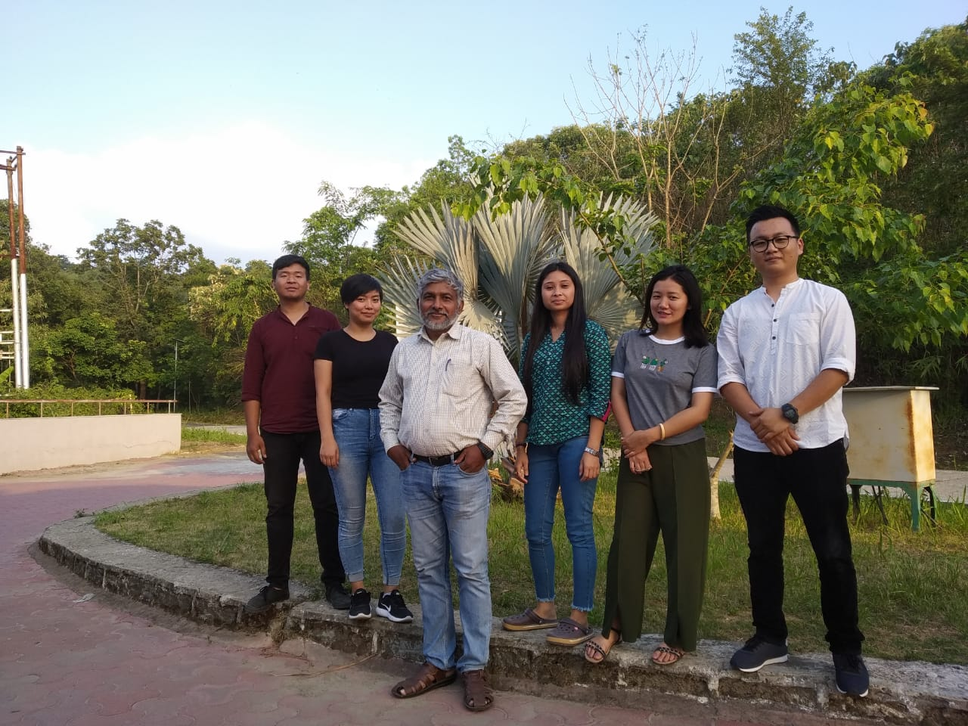
Dept Bio-Techonology, New Delhi, INDIA
UGC-DAE Kolkata Centre, Kolkata, INDIA
JINR, FLNP, Dubna, RUSSIA
Mizoram University, INDIA
NEIST, Jorhat, INDIA ; Tezpur University, INDIA
Dr. Inga Zinicovscaia, FLNP, JINR, Dubna
Prof. G. Arzumanyan, Raman Spec., JINR, Dubna
Prof. Vicoria Vartic, Raman Spec., JINR, DUBNA
Acknowledgement

Slide 27

Thank You!

