Slide 1
Assessment of the elemental composition of areca nut and soil samples collected in Northeast India
Inga Zinicovscaia
Joint Institute for Nuclear Research
inga@jinr.ru

Slide 2
Lalrinawma Zote,^{1◊}, Khawlhring Lalrammawia ^{1◊,}, Ananya Buragohain¹, Lalrinhlupuii,¹Bomngam Kakki¹, Rebecca Lalmuanpuii^{1†}, Zodinpuia Pachuau¹, John Vanlalhruaia¹, Rajendra Bose Muthukumaran^{1,}*, Nachimuthu Senthil Kumar², Lalrintluanga Jahau³, Mathummal Sudarshan⁴, Nikita Yushin⁵, Pavel Nekhoroshkov⁵, Dmitrii Grozdov⁵, Anastasiya Sergeeva⁵, Inga Zinicovscaia^{5,6,} *
1 – Department of Chemistry, Mizoram University, Aizawl, India
2 – Department of Biotechnology, Mizoram University, Aizawl, India
3 – Centre for Rural Development Research and Trinity Diagnostic Centre, Aizawl, Mizoram, India
4 – UGC-DAE Consortium for Scientific Research, Kolkata Centre, Kolkata-106, India
5 - Frank Laboratory of Neutron Physics, Joint Institute for Nuclear Research, 141980 Dubna, Russian Federation
6- Horia Hulubei National Institute for R&D in Physics and Nuclear Engineering, 30 Reactorului Str. MG-6, Bucharest - Magurele, Romania

Slide 3
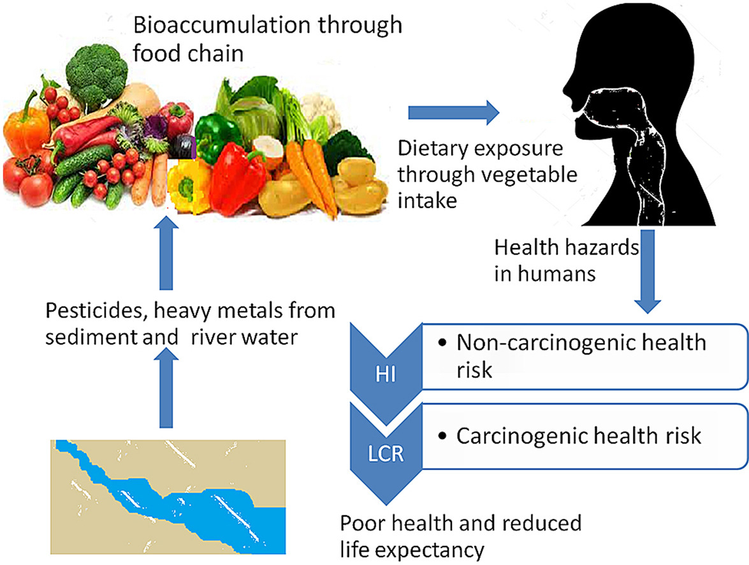
https://doi.org/10.1016/j.envres.2021.111780

Slide 4
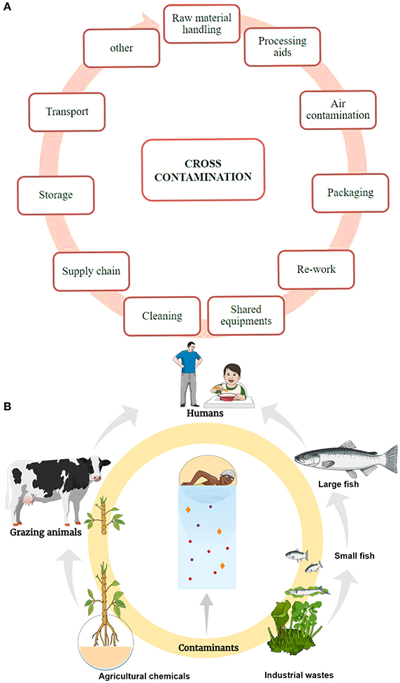
Contamination in the food production and processing
Contamination due to environmental influences
https://doi.org/10.3389/fphar.2017.00830

Slide 5
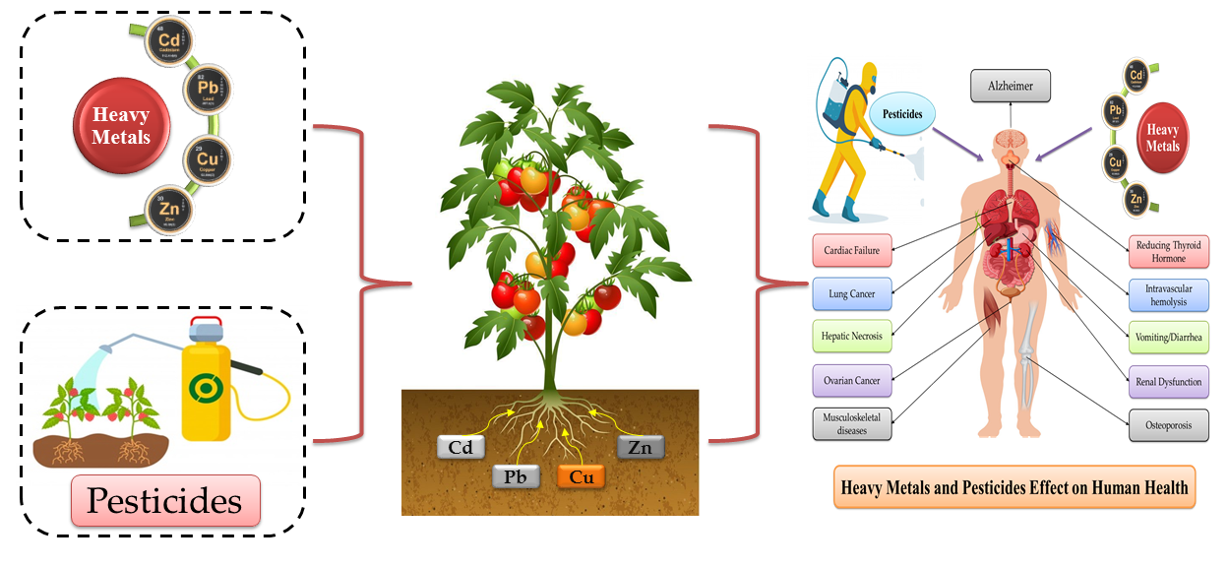
https://doi.org/10.3390/toxics9030042

Slide 6
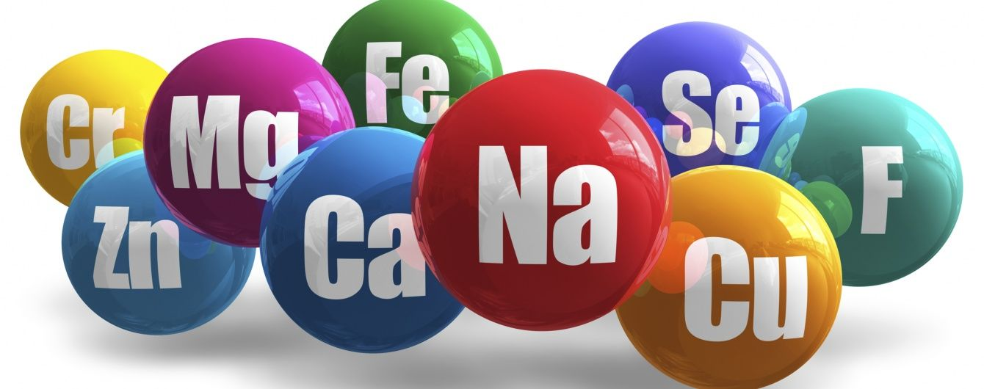

Slide 7
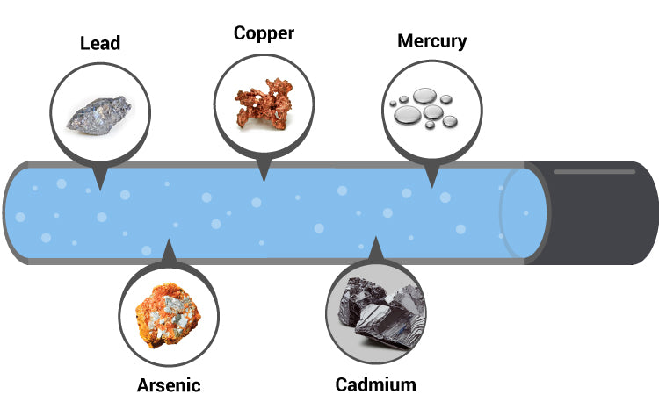

Slide 8
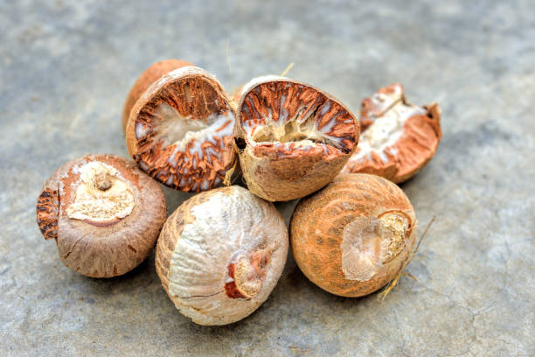
In Northeast India, virtually 60-65% of the population, on a daily basis, consume mature fresh areca nuts (2 areca nuts on average, whereas some ‘addicts’ consume 5-6 areca nuts on average).

Slide 9
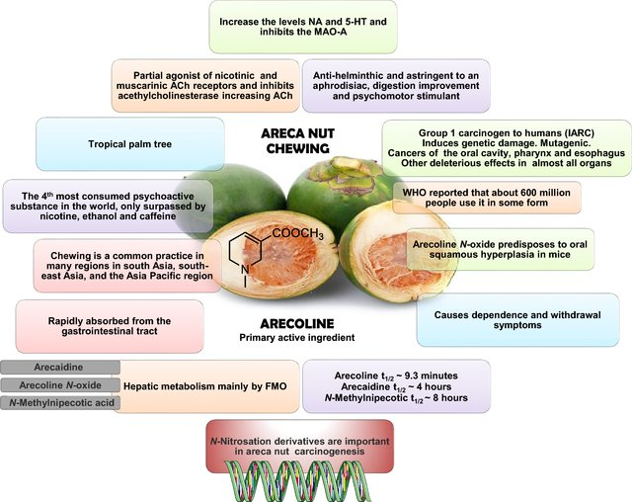

Slide 10
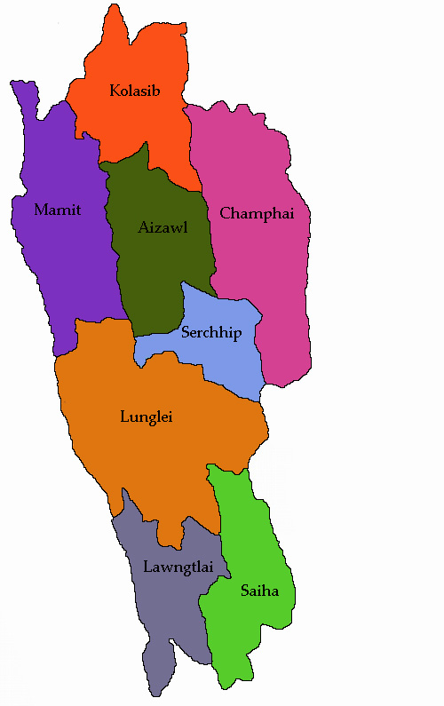
Samples were collected in very close proximity to the areca palm trees in Lengpui, Lengte, Zampui, Zamuang, Vairengte, Kolasib, Sibsagar, Golaghat.
Mizoram State

Slide 11
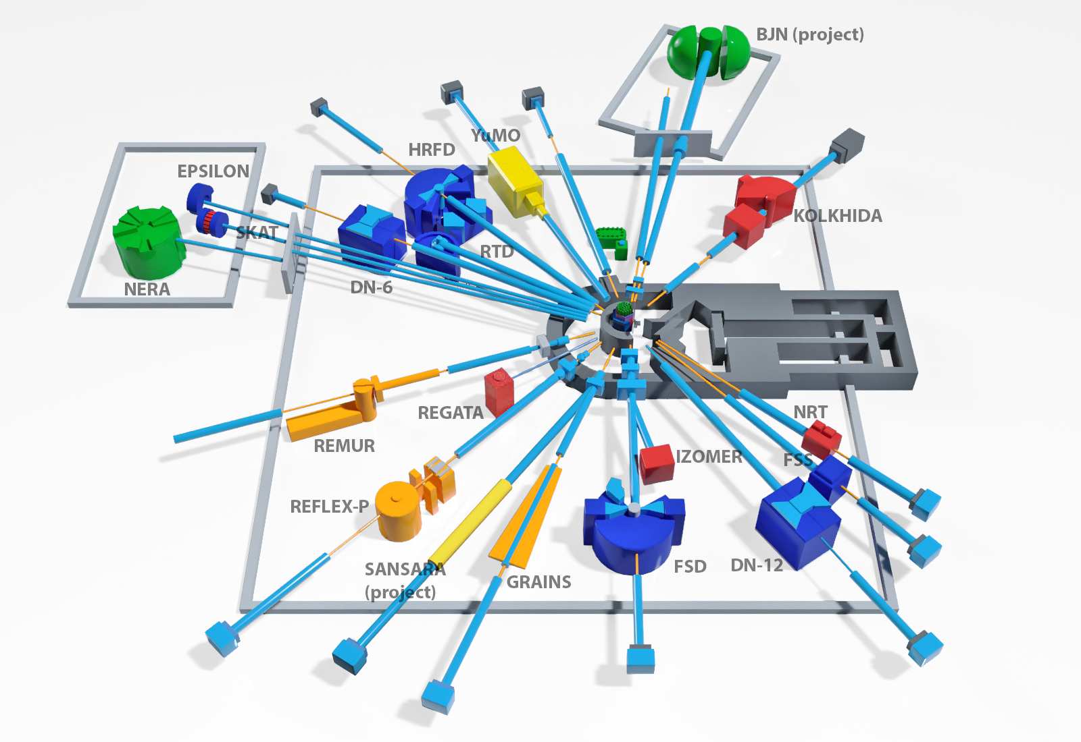
Reactor and Radioanalytical complex REGATA

Slide 12
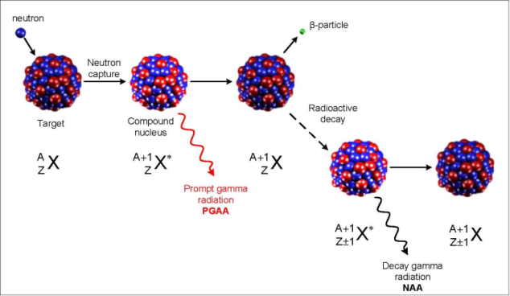
Diagram illustrating the process of neutron capture by a target nucleus followed by the emission of gamma rays.

Slide 13
NAA features the following advantages:
high sensitivity to a majority of elements;
good selectivity;
a possibility of simultaneously determining a large number of elements;
The method works for a very wide concentration range, from percent level down to the ppt and even sub-ppt level.
independence of the results on the form of chemical compounds;
NAA is in an unbeatable position in analysis of the rare earth elements (REE)
A nondestructive nature, which allows avoiding the risk of contamination of samples with reagents or their incomplete dissolution;
easy procedure for preparation of samples for analysis.
The disadvantages of NAA are:
necessity of using nuclear reactors;
problems arising from storage and disposal of nuclear waste;
time required for analysis.

Slide 14
Analysis of PT samples (short-lived isotopes)
Mg, Al, Si, Cl, Ti, V, Mn and Dy
Weight of soil, geological samples about 0.1 gram
Weight of plant samples and biological samples about 0.3 gram
Irradiation – 1 min(soil), 3 min (plant)
Irradiation channel - Ch 2 (full neutron spectrum).
up to 4 samples of the same type (in compliance with the quantity of detectors) are irradiated simultaneously in polyethylene capsule.

Slide 15
Analysis of PT samples (long-lived isotopes)
Na, K, Sc, Fe, Co, Zn, Ga, As, Rb, Sr, Zr, Sb, Cs, Ba, La, Ce, Sm, Tb, Hf, Ta, W, Th, and U
Weight of samples as in case of short-lived isotopes
Irradiation – 3-5 days
Irradiation channel - Ch 1 (Cd- screen, epithermal and fast neutrons)
Cooling -3.5 days/ Repacking
First measurement- 30 min.(live time), directly after repacking
Cooling time – 20 days after the end of irradiation/ Second measurement – 1.5 hours (live time)
12-15 samples and 3-4 standards are irradiated simultaneously in one container
Standards are located in the middle part of container.

Slide 16
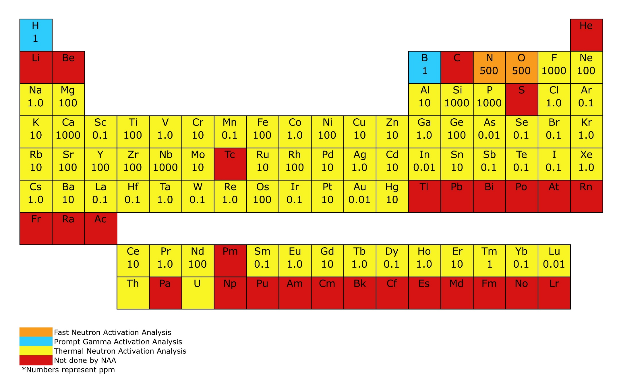
https://www.nist.gov/laboratories/tools-instruments/instrumental-neutron-activation-analysis-inaa

Slide 17
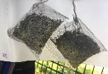
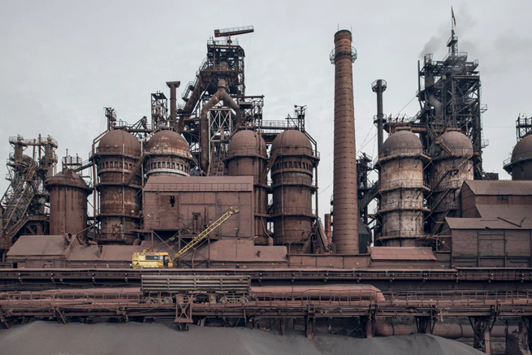
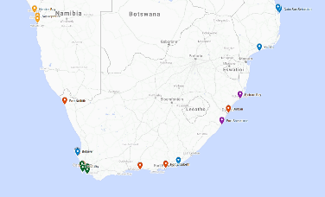
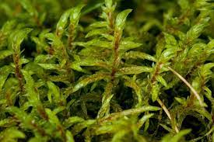
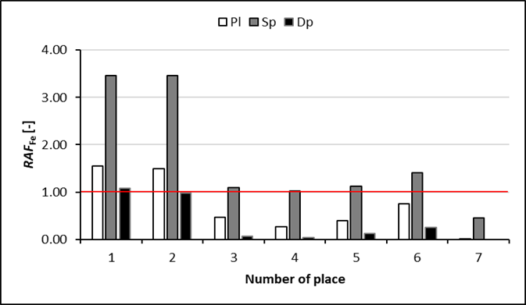
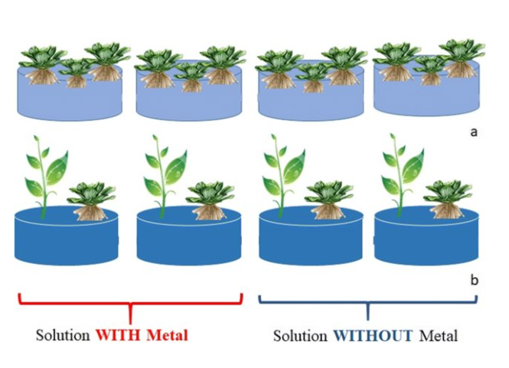
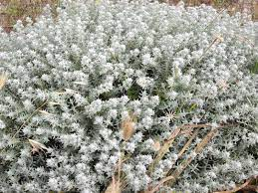
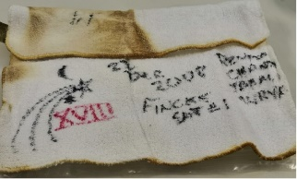
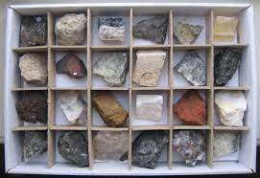
Water biomonitoring
Active and passive biomonitoring
Soil bioremediation
Wastewater treatment
Scientific directions
Nanotoxicology
Food quality assessment
Analysis of extraterrestrial materials
Geology and archeology

Slide 18
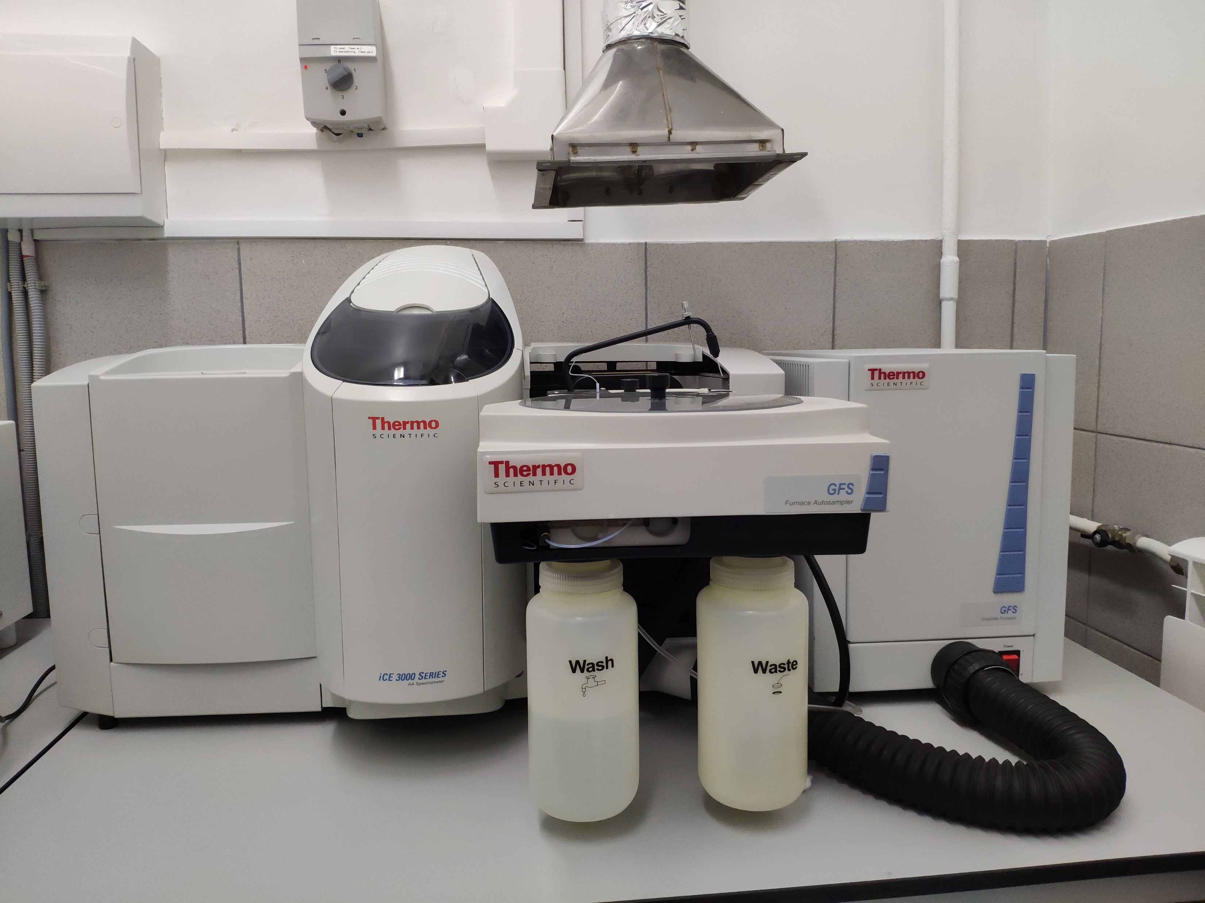
Thermo Scientific™ iCE™ 3000 Series AA spectrometers with electrothermal (graphite furnace) atomization.
Limits of detection
As- 0.4 µg/L
Cd – 0.007 µg/L
Cu- 0.19 µg/L
Cr- 0.1 µg/L
Pb -0.08 µg/L
Sb - 0.25 µg/L

Slide 19
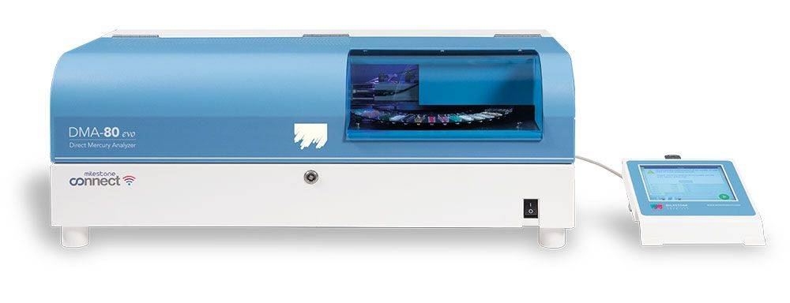
Milestone's DMA-80 Direct Mercury Analyzer

Slide 20
Elemental profile

Slide 21
Bioaccumulation index

Slide 22
Contamination factor

Slide 23
Conclusions
The concentration levels of 14 elements present in areca nut and husk of areca palm fruits besides concentrations of 34 elements present in the corresponding soil samples collected from NEI were determined, for the first time, using INAA and AAS.
The range of elemental concentration levels were at ppm to ppb levels in all areca palm fruit samples. No REEs were detected in areca nut samples.
Pb content was relatively higher than FAO/WHO’s permissible levels, while As, Cd, and Cu contents were within the permissible levels in edible areca nuts.
Based on the Indian standards for agricultural soils, NEI plantation soils may be classified as unpolluted soil which is consistent with the calculated pollution indices.
More detailed studies need to be carried out using more areca samples to further assess the preliminary finding of the current study.

Slide 24
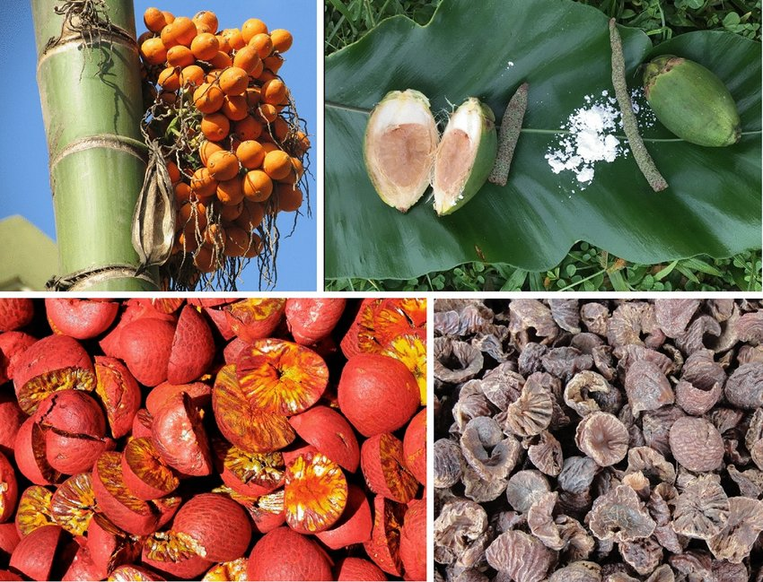
Thank you for your attention!

