Slide 1

“Biochemical and Biophysical Characterization of Synthetic anti-VEGF Antigen Binding Fragment for Treating Wet-AMD and Diabetic Retinopathy”
In Healthcare for All
Inclusive | Affordable
By
Dr. C.N. Ramchand
Director, Theragen Biologics & Theragen LifeSciences
CEO, MagGenome technologies Pvt. Ltd.
Advisor, SciGenom Labs and Medgenome
18th Oct 2023
India-JINR workshop on elementary particle and nuclear physics, and condensed matter research
Dubana, Moscow Region, Russia
Oct 16 - 19, 2023

Slide 2
Theragen at-a-Glance
Theragen Biologics Pvt Ltd is Chennai based biotechnology company, established in 2017.
Focused on the development of novel & bio-superior biologics and contractual bio-similar projects
Highly experienced, capable management and scientific team
Effective yet cost-efficient R&D team based in India, utilizing the strength and expertise in biologics development
Successful prior development of biologics and regulatory approvals
Two novel biologic molecules for wet-AMD and Diabetic Retinopathy (DR)

Slide 3




Expert board & management
Arumugam S
Chairman
C N Ramchand
President
Satish Chandran
Director-TBL Inc.
Jayakrishna Ambati
Director-TBL Inc.
Eminent Orthopedic Surgeon specializing in Arthroscopy Director of Centre for Sports Science, a state-of-the-art sports performance assessment lab in Chennai, India. Entrepreneur with interests in power plants, pharmaceuticals, and biotechnology |  | 30+ years of drug discovery and biologics experience Expert in drug discovery, development, commercialization and outlicensing of NCE, NBE Nutraceuticals and ANDA. Adjunct Faculty, Swinburne University, Australia |  | 40+ years of leadership experience in biotechnology Multiple biotech CEO roles Multiple C-Suite roles with big Pharama (Pfizer, Wyeth) Serial entrepreneur with multiple exits Advisor / Board member for several emerging and established biotech platforms |  | 25+ years ophthalmology experience and expertise Founder and Director of Inflammasome Therapeutics, (US disease therapy) Co-founder of iVeena Delivery Sytems (US biotech) Principal Investigator and Advisor to various US ophthalmology clinical trials

Slide 4
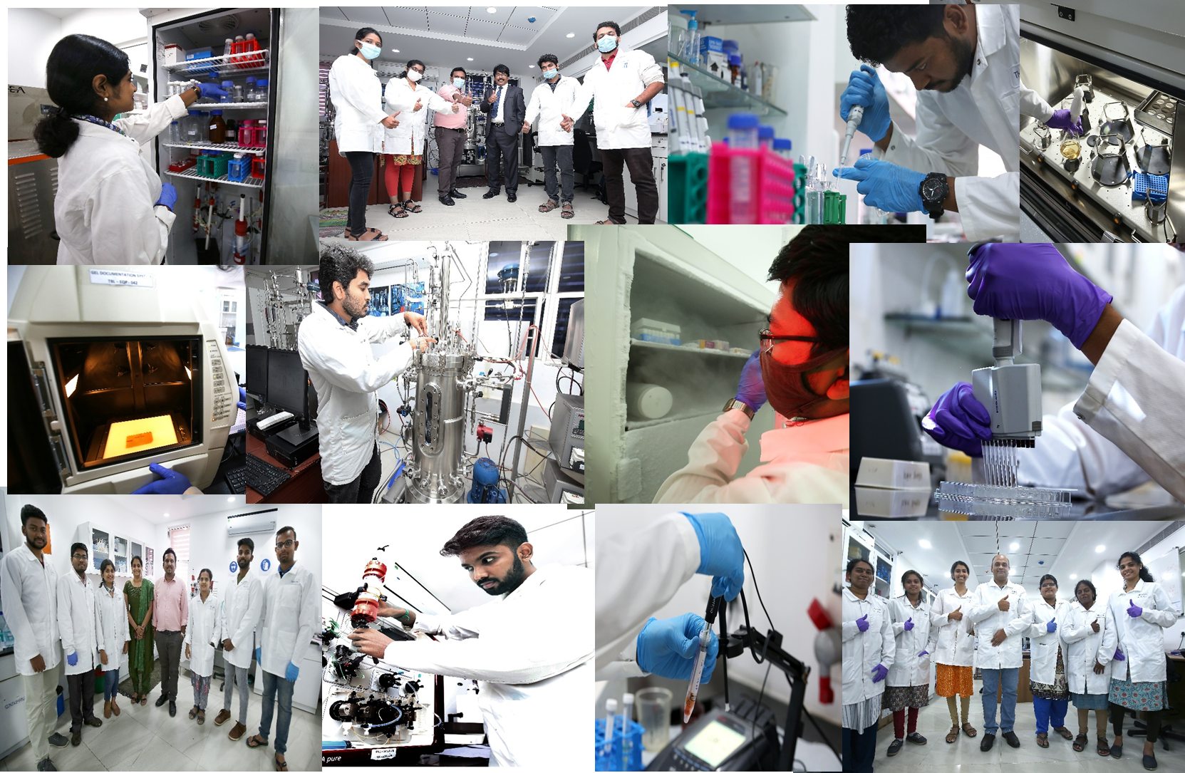
Our team and facility

Slide 5
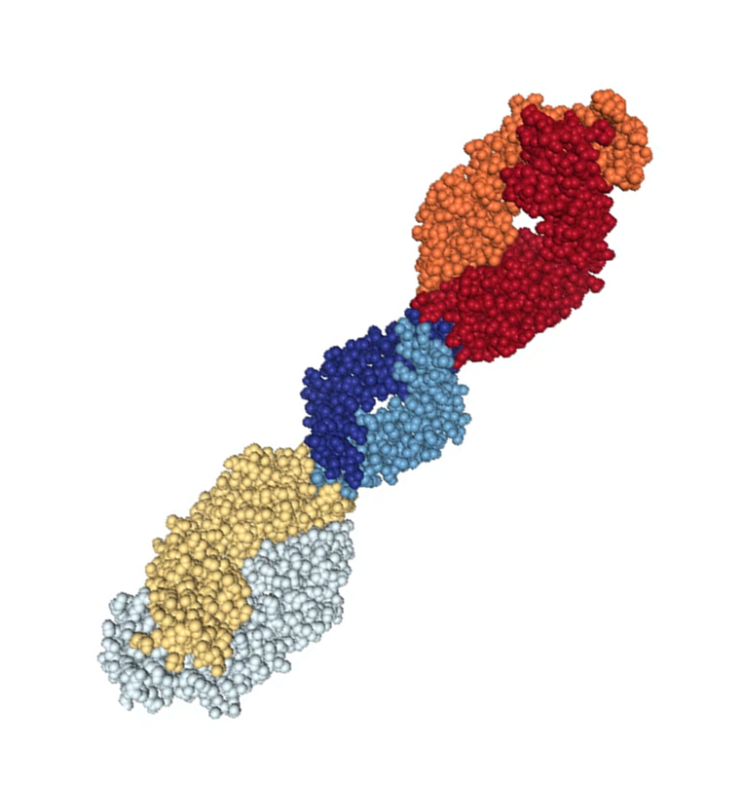
Discovery and development of novel biologics: what we have developed
Novel Biologics
Fab molecule
FAB201
FAB293
Antigen binding fragment for treatment of wet-AMD
Antigen binding fragment for treatment of Diabetic Retinopathy

Slide 6
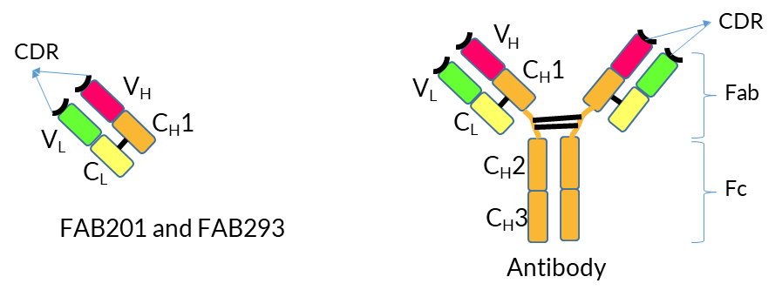
Structure of Anti-VEGF Fab and antibody
CDR regions of FAB201 and FAB293 binds all isoforms of VEGF-A

Slide 7
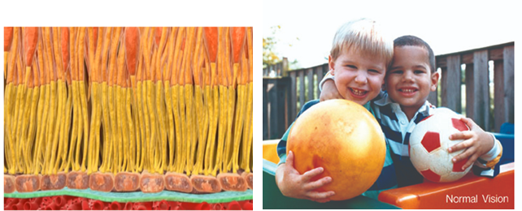
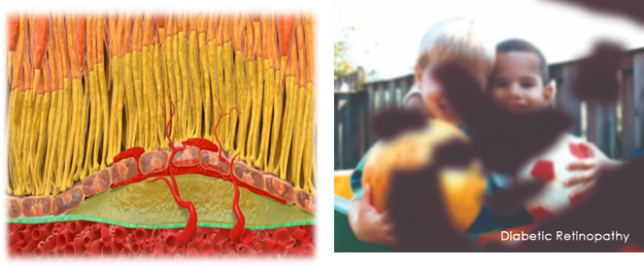
About disease- Diabetic retinopathy
Normal Retina
Diabetic Retinopathy Retina
Normal Vision
Diabetic Retinopathy Vision
~160 million DR patients worldwide by 2025

Slide 8
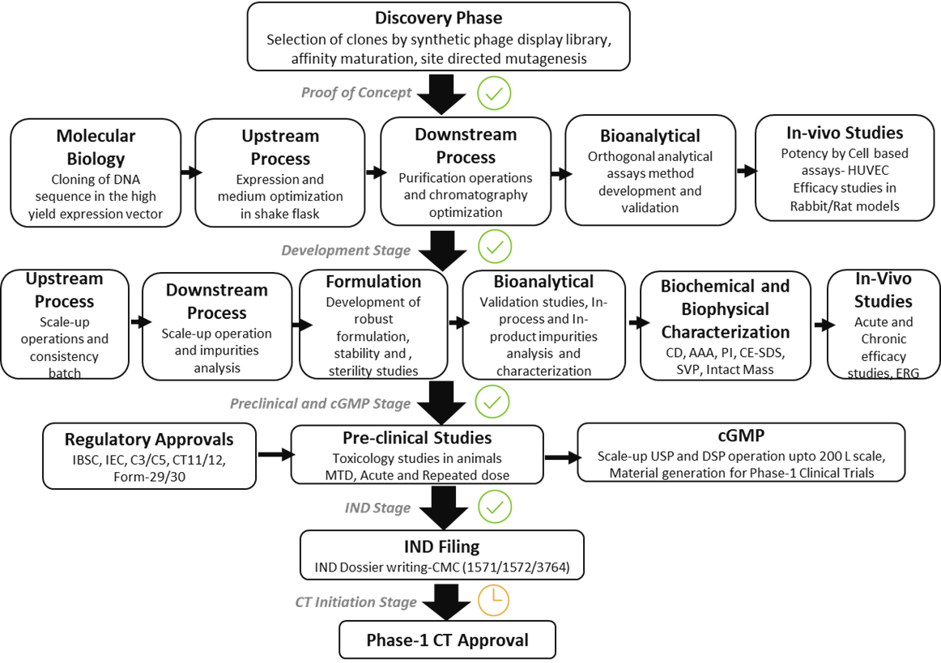
Product development path

Slide 9
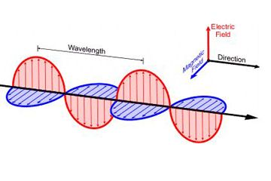
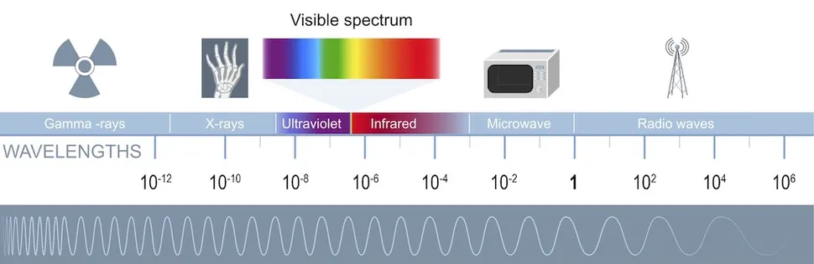
Biotechnological Applications of Electromagnetic Radiations
Electromagnetic radiation: synchronized oscillations of electric and magnetic fields.
Properties of electromagnetic radiations are exploited for
Colorimetry, Turbidimetric and UV readings for measurements of biomolecules
Luminescence (Fluorescence, Phosphorescence and chemiluminescence assays)
Changes in angle of reflection, resonance, scattering etc

Slide 10
Drug Discovery Workflow
Electromagnetic Radiations in Testing
Molecular Biology and Cloning
  Phage display Platform
  Transformation to E.coli BL21-293
  Validation
Colorimetry
UV spectrophotometry- A260 nm
Upstream Processing
Colorimetry
UV spectrophotometry- A260 nm
Turbidimetry
Detection based on IR
  Biomass generation-30 L Fermenter
  Validation
Downstream Processing and Formulation
  Cell lysis and Purification
  DS and DP generation
  Fill Finish to CCS and Stability study
ColorimetryTurbidimetry
Colorimetry
UV spectrophotometry- A260 nm
Turbidimetry
RFU
Changes in angle of reflected light
Bioanalytical Characterization
  Assay Development and Validation
  RP-HPLC/ SEC HPLC/A280/ Bradford/ ET/ ELISA/ HCP/HCDNA/ SVP/ Cell Based Assay/ SPR
Biochemical and Biophysical Characterization
Charge to mass ratio (ToF)
Far UV absorption
  Intact Mass/ PMF/ pI/ Disulphide bonds/ CD spectra/ SPR/

Slide 11
Biochemical and Biophysical techniques used for the characterization of FAB201 and FAB293 molecules
The Fab molecules were engineered and fully characterized using advanced Biochemical & Biophysical characterization techniques.
• Bioanalytical assay’s-
  ELISA (Synergy H1-M multimode plate reader from Biotek)
• In-vitro binding affinity-
  Surface Plasmon Resonance (SPR) by- Biacore 3000 (GE Healthcare); CM5 Chip

Slide 12
Biochemical and Biophysical techniques contd…
• Protein/product characterization-
  PI by Biorad Protean i12 IEF System
  Intact mass by ESI-Q-TOF instrument (Waters QTOF SYNAPT G2 Mass Spectrometer)
  Disulfide bond analysis by LC-MS/MS using a Waters QTOF SYNAPT G2 Mass Spectrometer
  Peptide mass fingerprinting (PMF) by LC-MS/MS using a Waters QTOF SYNAPT G2 Mass Spectrometer
  AAA sequencing by by LC-MS/MS using a Waters QTOF SYNAPT G2 Mass Spectrometer
  CD spectra by Jasco J-815 Spectropolarimeter
  CE-SDS Page by PA 800 Plus Protein Characterization System; Sciex with PDA detector
  Capillary Iso electric focusing (cIEF) by Rotein Simple Maurice C; GE Ettan IPGPhor3
  SVP analysis by Beckman HIAC 9703+ Liquid Particle Counter
  Epitope mapping by HDX-MS; LTQ-FTICR mass spectrometer (Thermo Fisher, Waltham, MA)
  Hydrodynamic size by DLS, Malvern Zetasizer

Slide 13
Biochemical and Biophysical techniques contd…
In-process related impurity analysis-
Host Cell Protein (HCP) by Micro plate reader Thermo Fisher, Model No.-51119300
Host Cell (Hc)-DNA by Quantitative PCR system Roche, Light Cycler 480 II
Endotoxin by Endotoxin Kit KTA2 Charles River Laboratories; Synergy H1-M multimode plate reader from Biotek
Product related impurities analysis-
SDS-PAGE by Gel electrophoresis system, BioRad
SEC-UPLC by Agilent 1260 Infinity II HPLC system
Column: TOSOH TSK gel UP-SW3000, 4.6 x 300 mm; 2 μm
Shimadzu LC-2010C HT
Column: Agilent, ZORBAX SB-300, C8, 2.1 x 100 mm, 3.5 μm
SVP by Beckman HIAC 9703+ Liquid Particle Counter

Slide 14
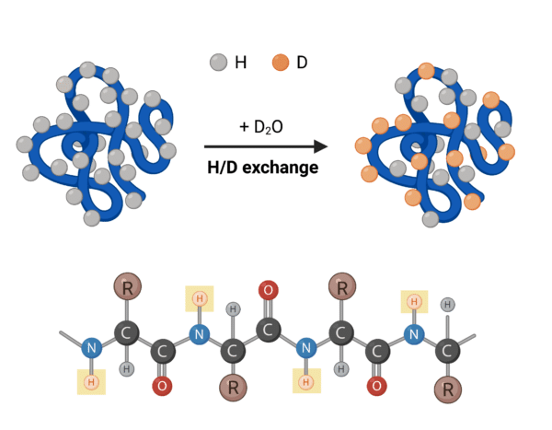
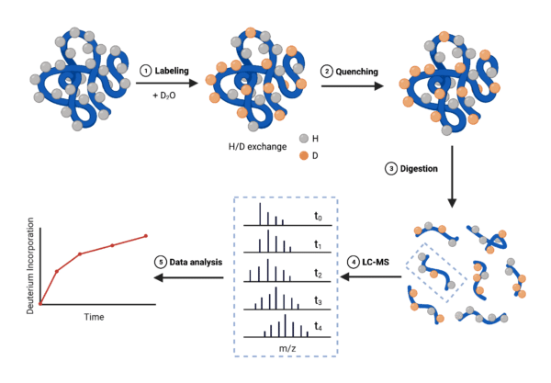
Epitope mapping by HDX-MS
Epitope mapping of FAB201 by HDX-MS:
Instrument- LTQ-FTICR mass spectrometer (Thermo Fisher, Waltham, MA)
Hydrogen-deuterium exchange (HDX) a method involving protein deuteration to distinguish amide hydrogens participating in secondary structures and investigate protein structure, conformational dynamics, and protein-ligand interaction.
HDX is commonly measured by nuclear magnetic resonance (NMR) spectroscopy or mass spectrometry (MS); the latter is referred to as HDX-MS.
Epitope mapping is a critical step in therapeutic antibody development, its a tool for probing information about the specific binding sites of therapeutic and diagnostic antibodies.

Slide 15
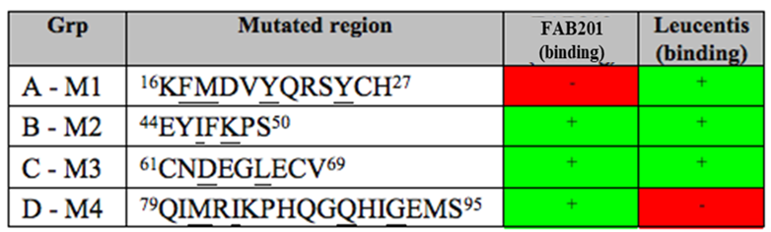
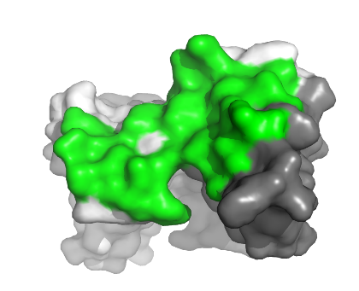
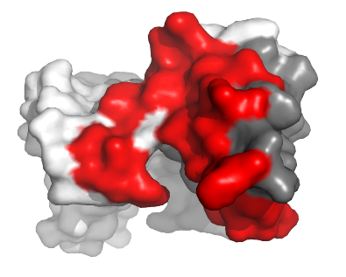
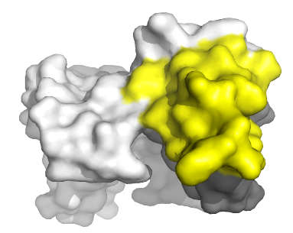
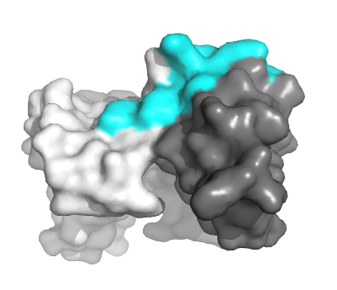
FAB201 binds to a distinct epitope when compared to Lucentis
FAB201 epitope
VEGFR1 epitope
VEGF (zoomed-in)
VEGF-R1 binding site
(1BJ1 structure)
VEGF-R2 binding site
(1FLT structure)
Lucentis potential epitope
(1BJ1 structure)
FAB201 potential epitope
(HDX-MS and mutagenesis data)

Slide 16
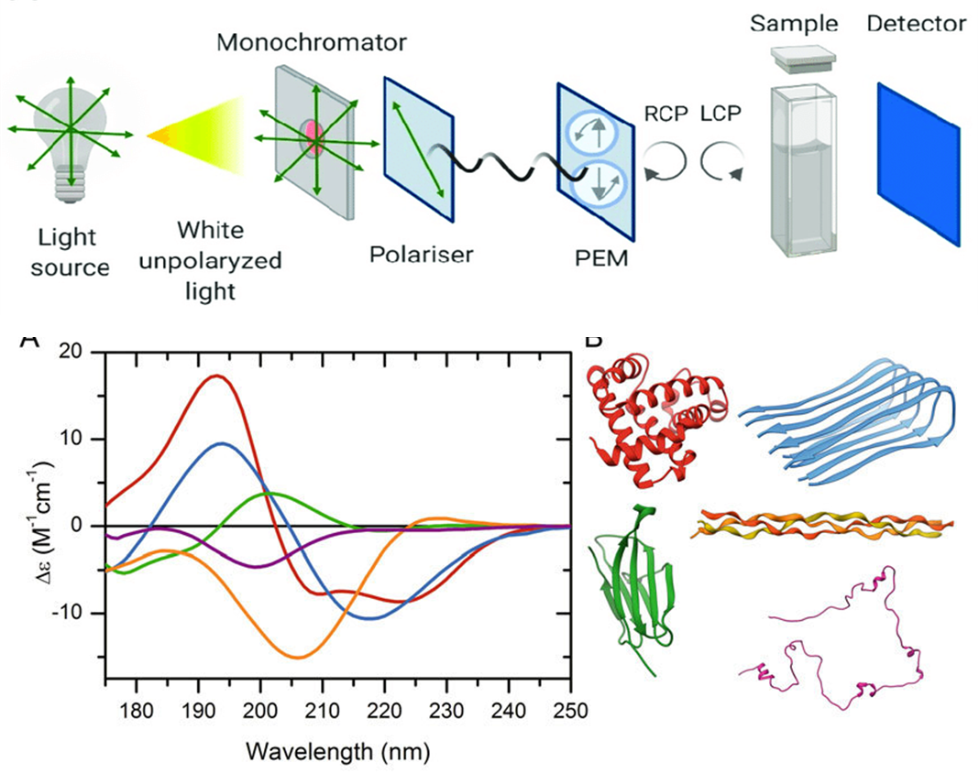
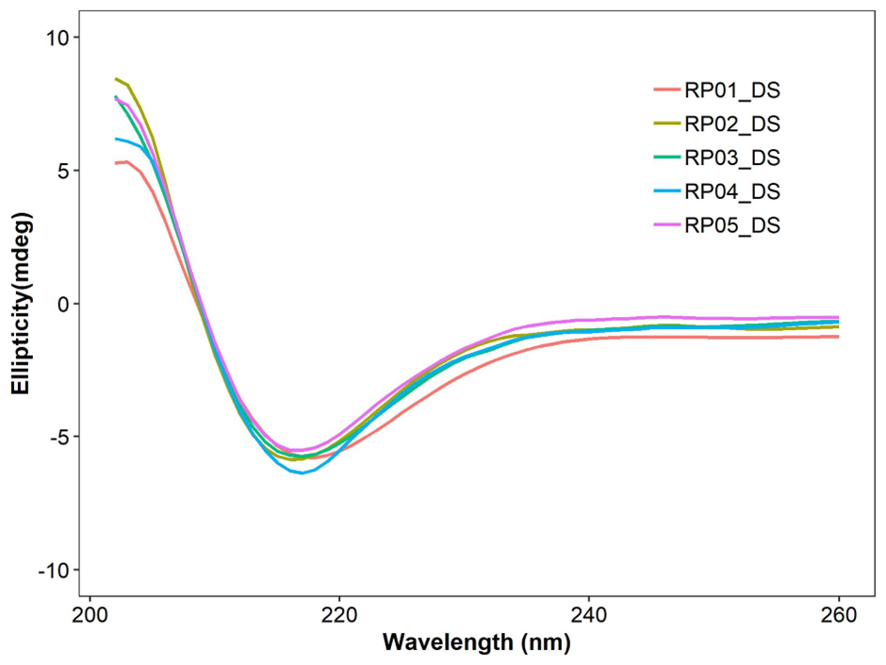
CD-Spectra
Analysis of secondary structure of FAB201 using far-UV CD spectra.
Circular Dichroism (CD) is the unequal absorption of left- and right-handed circularly polarized light by any substance, as a result of which the emitted light becomes elliptically polarized and the ellipticity is measured sensitively by a spectropolarimeter.
Different secondary structure elements in a protein such as α-helix or β-sheet have characteristic far UV CD spectral signature and it can be used as an important tool for its biophysical characterization.
CD spectra instrument- Jasco J-815 Spectropolarimeter

Slide 17
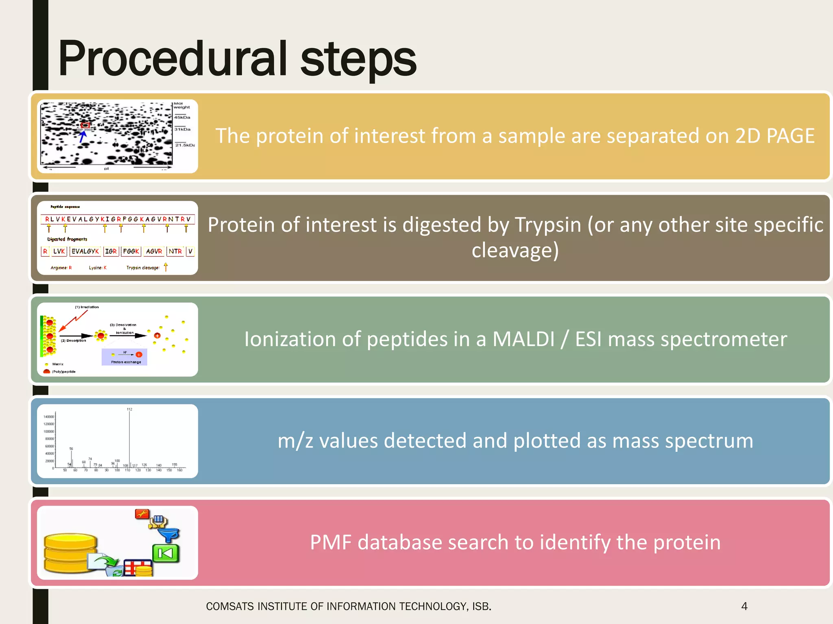
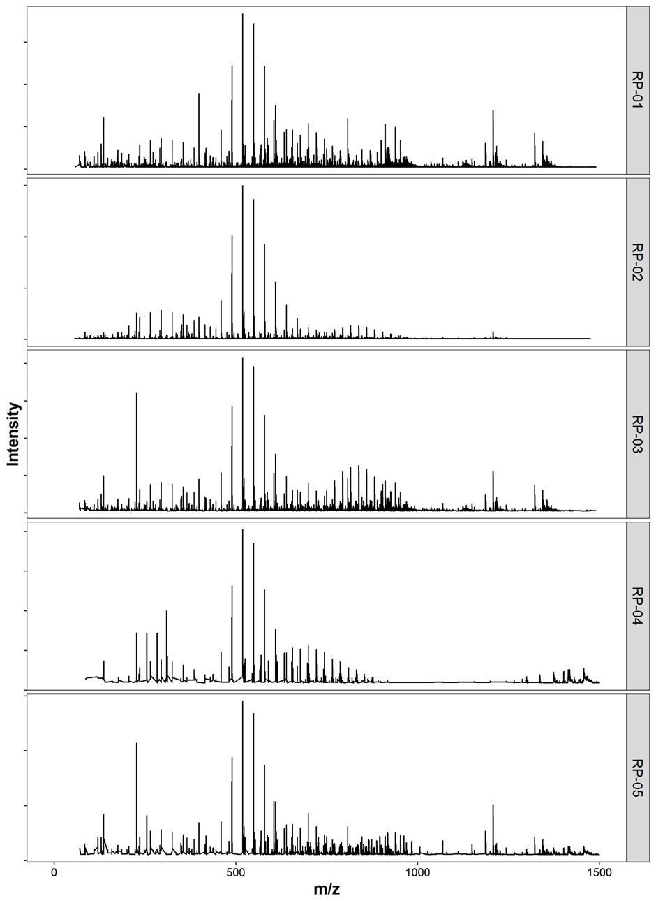
Peptide Mass Fingerprinting and Amino Acid Sequencing
Peptide mass fingerprinting and amino acid sequencing of FAB201.
A large protein molecule can be broken down to smaller peptide fragments by digestion with various enzymes. Recording of the peptide mass spectrum provides a unique fingerprint of the protein that can be compared with the theoretical sequence.
Further subjecting the peptide fragments to MS/MS analysis can construct their primary sequence.
Instrument used-
Peptide mass fingerprinting (PMF) by LC-MS/MS using a Waters QTOF SYNAPT G2 Mass Spectrometer.

Slide 18
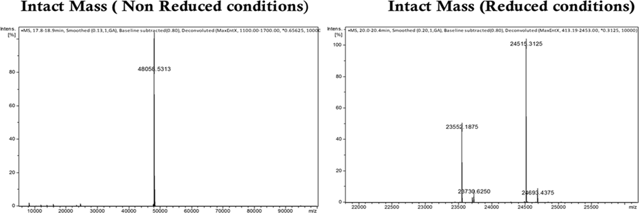
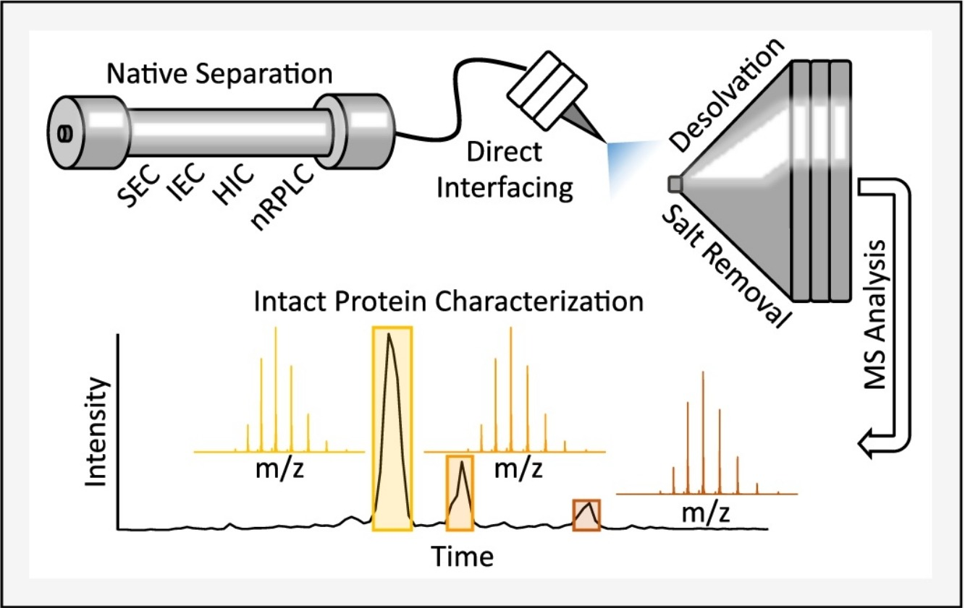
Intact Mass
Intact Mass of FAB201- by Mass Spectrometry
For a monoclonal antibody Fab fragment, intact mass measurement can be done in non-reduced state when the fragment is completely intact and in reduced state when the disulphide linkages are broken and the heavy and light chains get separated.
Intact mass measurement by Electrospray Ionization Mass Spectrometry (ESI-MS) uses the ability of protein molecules to form multiple-charge ions. As a result spectra for a pure protein display its multiple-charge species which can be de convoluted to get the intact mass of the molecule.
Instrument used-
Maxis Impact ESI-QTOF Mass Spectrometer from Bruker Daltonics fitted with Agilent 1100 Liquid Chromatography system.
Intact Mass | 442aa | 48.06kDa
Light Chain | 214aa | 23.55KDa
Heavy chain | 228aa | 24.52kDa

Slide 19
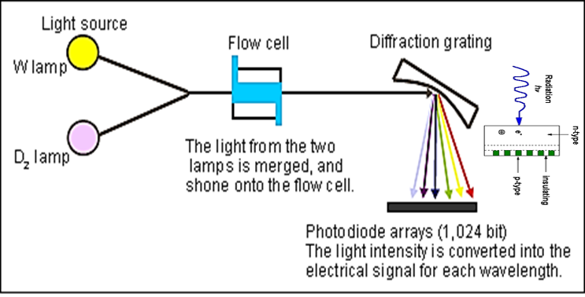
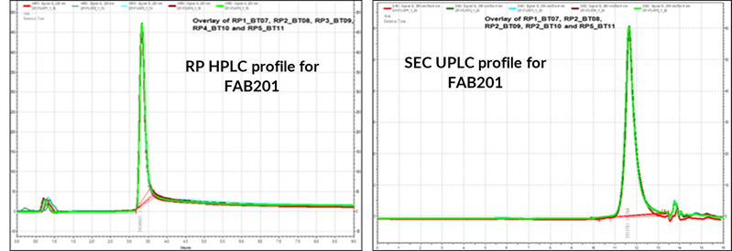
High Performance Liquid Chromatography (HPLC)
Instrument used for SEC and RP-HPLC-
SEC-UPLC by Agilent 1260 Infinity II HPLC system
  Column: TOSOH TSK gel UP-SW3000, 4.6 x 300 mm; 2 μm
Shimadzu LC-2010C HT
  Column: Agilent, ZORBAX SB-300, C8, 2.1 x 100 mm, 3.5 μm
Detectors- UV/Vis; Photodiode Array (PDA); Refractive Index; Fluorescence Detector; Mass Spectrometric Detectors

Slide 20
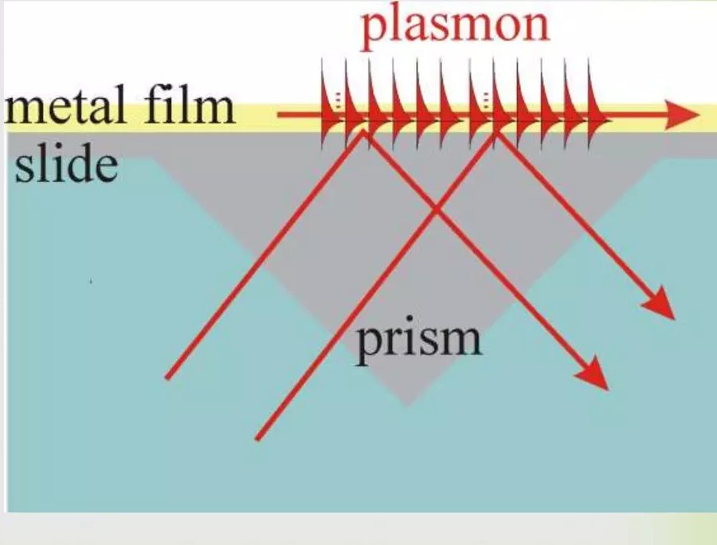
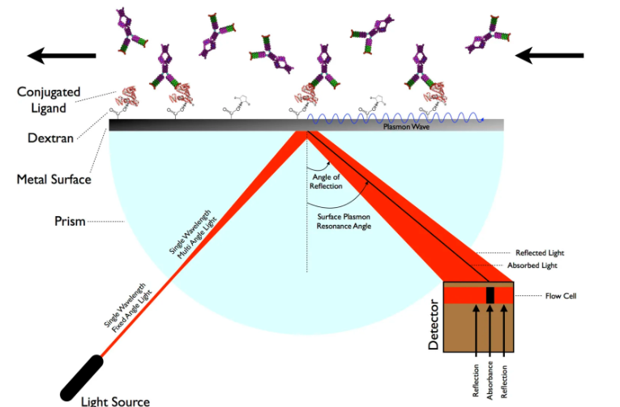
Surface Plasmon Resonance
Plasmons: Collective oscillations of “free electron gas” density, often at optical frequencies.
Surface Plasmons: Plasmons confined to surface (interface) and interact with light resulting in polarities.
P-Polarised light is directed through a prism to the under surface of the gold film where surface plasmons are generated at a critical angle of the incident light.
This absorption of light is seen as a decrease in intensity of the reflected light. Resonance or response units (RU) are used to describe the increase in the signal, where 1 RU is equal to a critical angle shift of 10⁻ ⁴ deg or 10⁻¹² g mm ⁻²

Slide 21
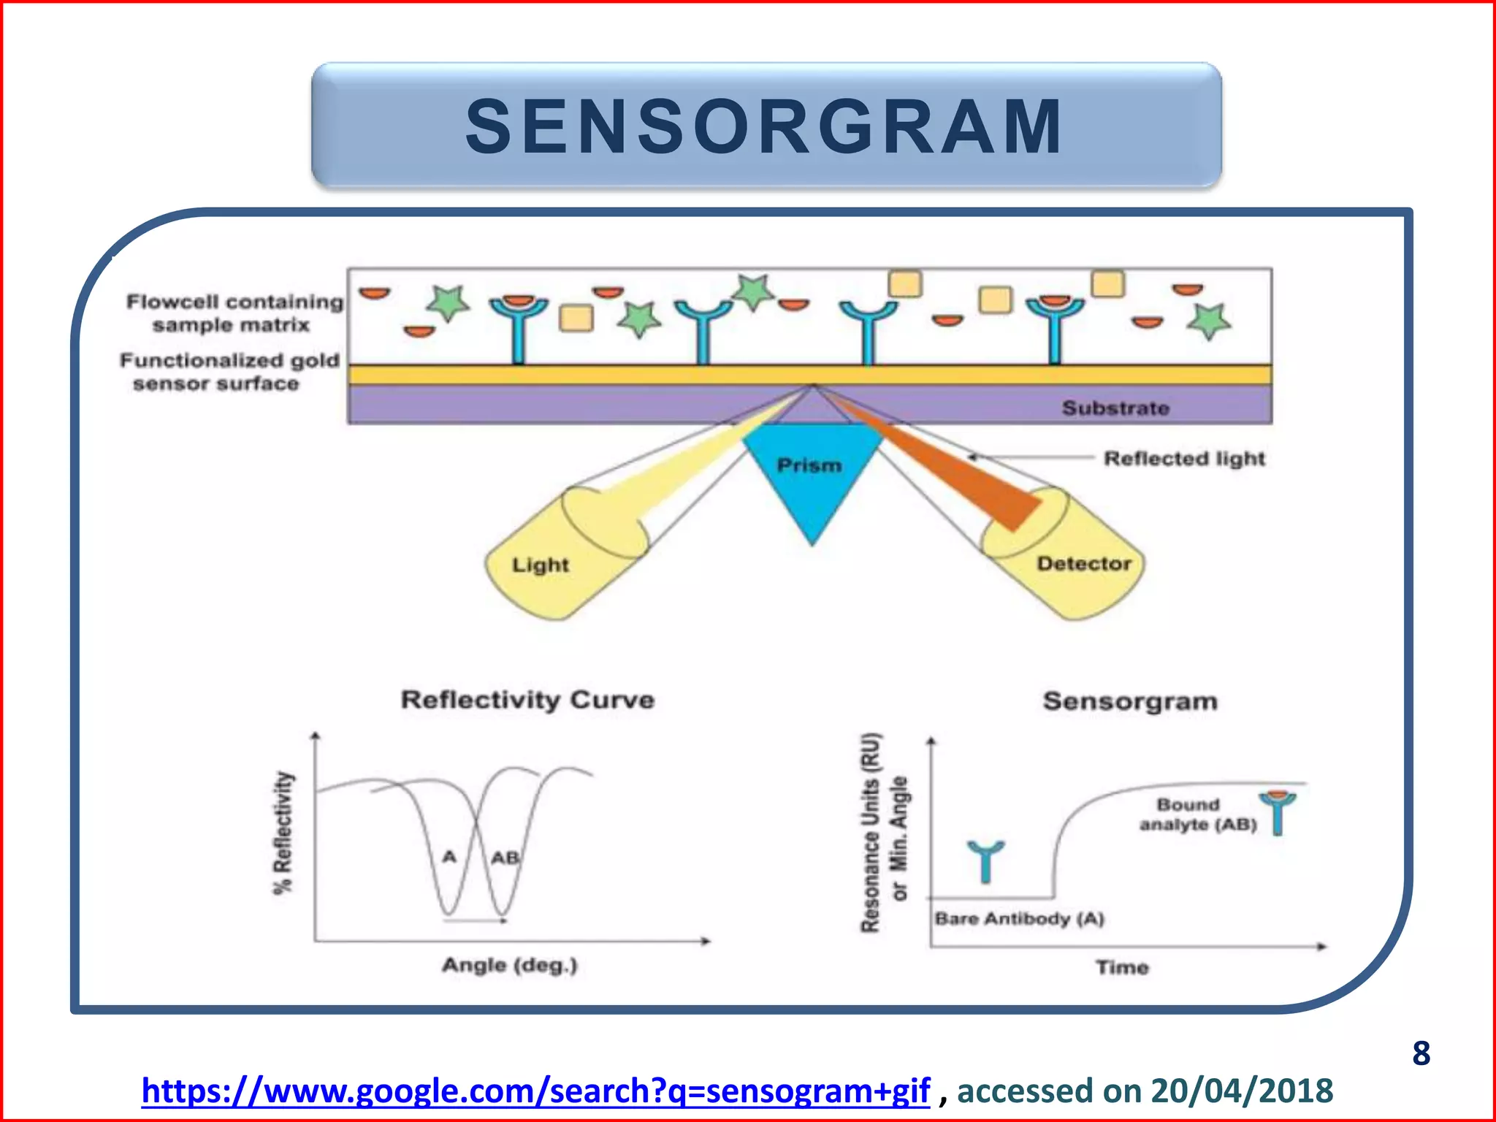
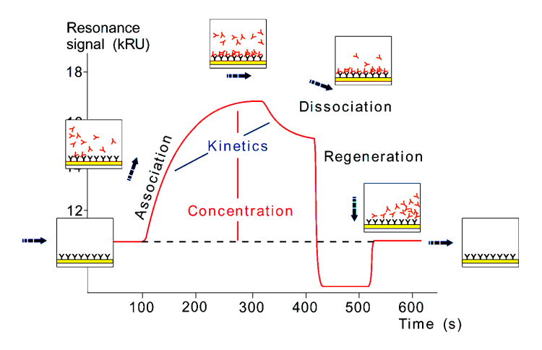
Spr continuation
SPR Sensogram
Evaluates the Affinity, Binding Kinetics, Concentration and Specificity
of biomolecular interactions

Slide 22
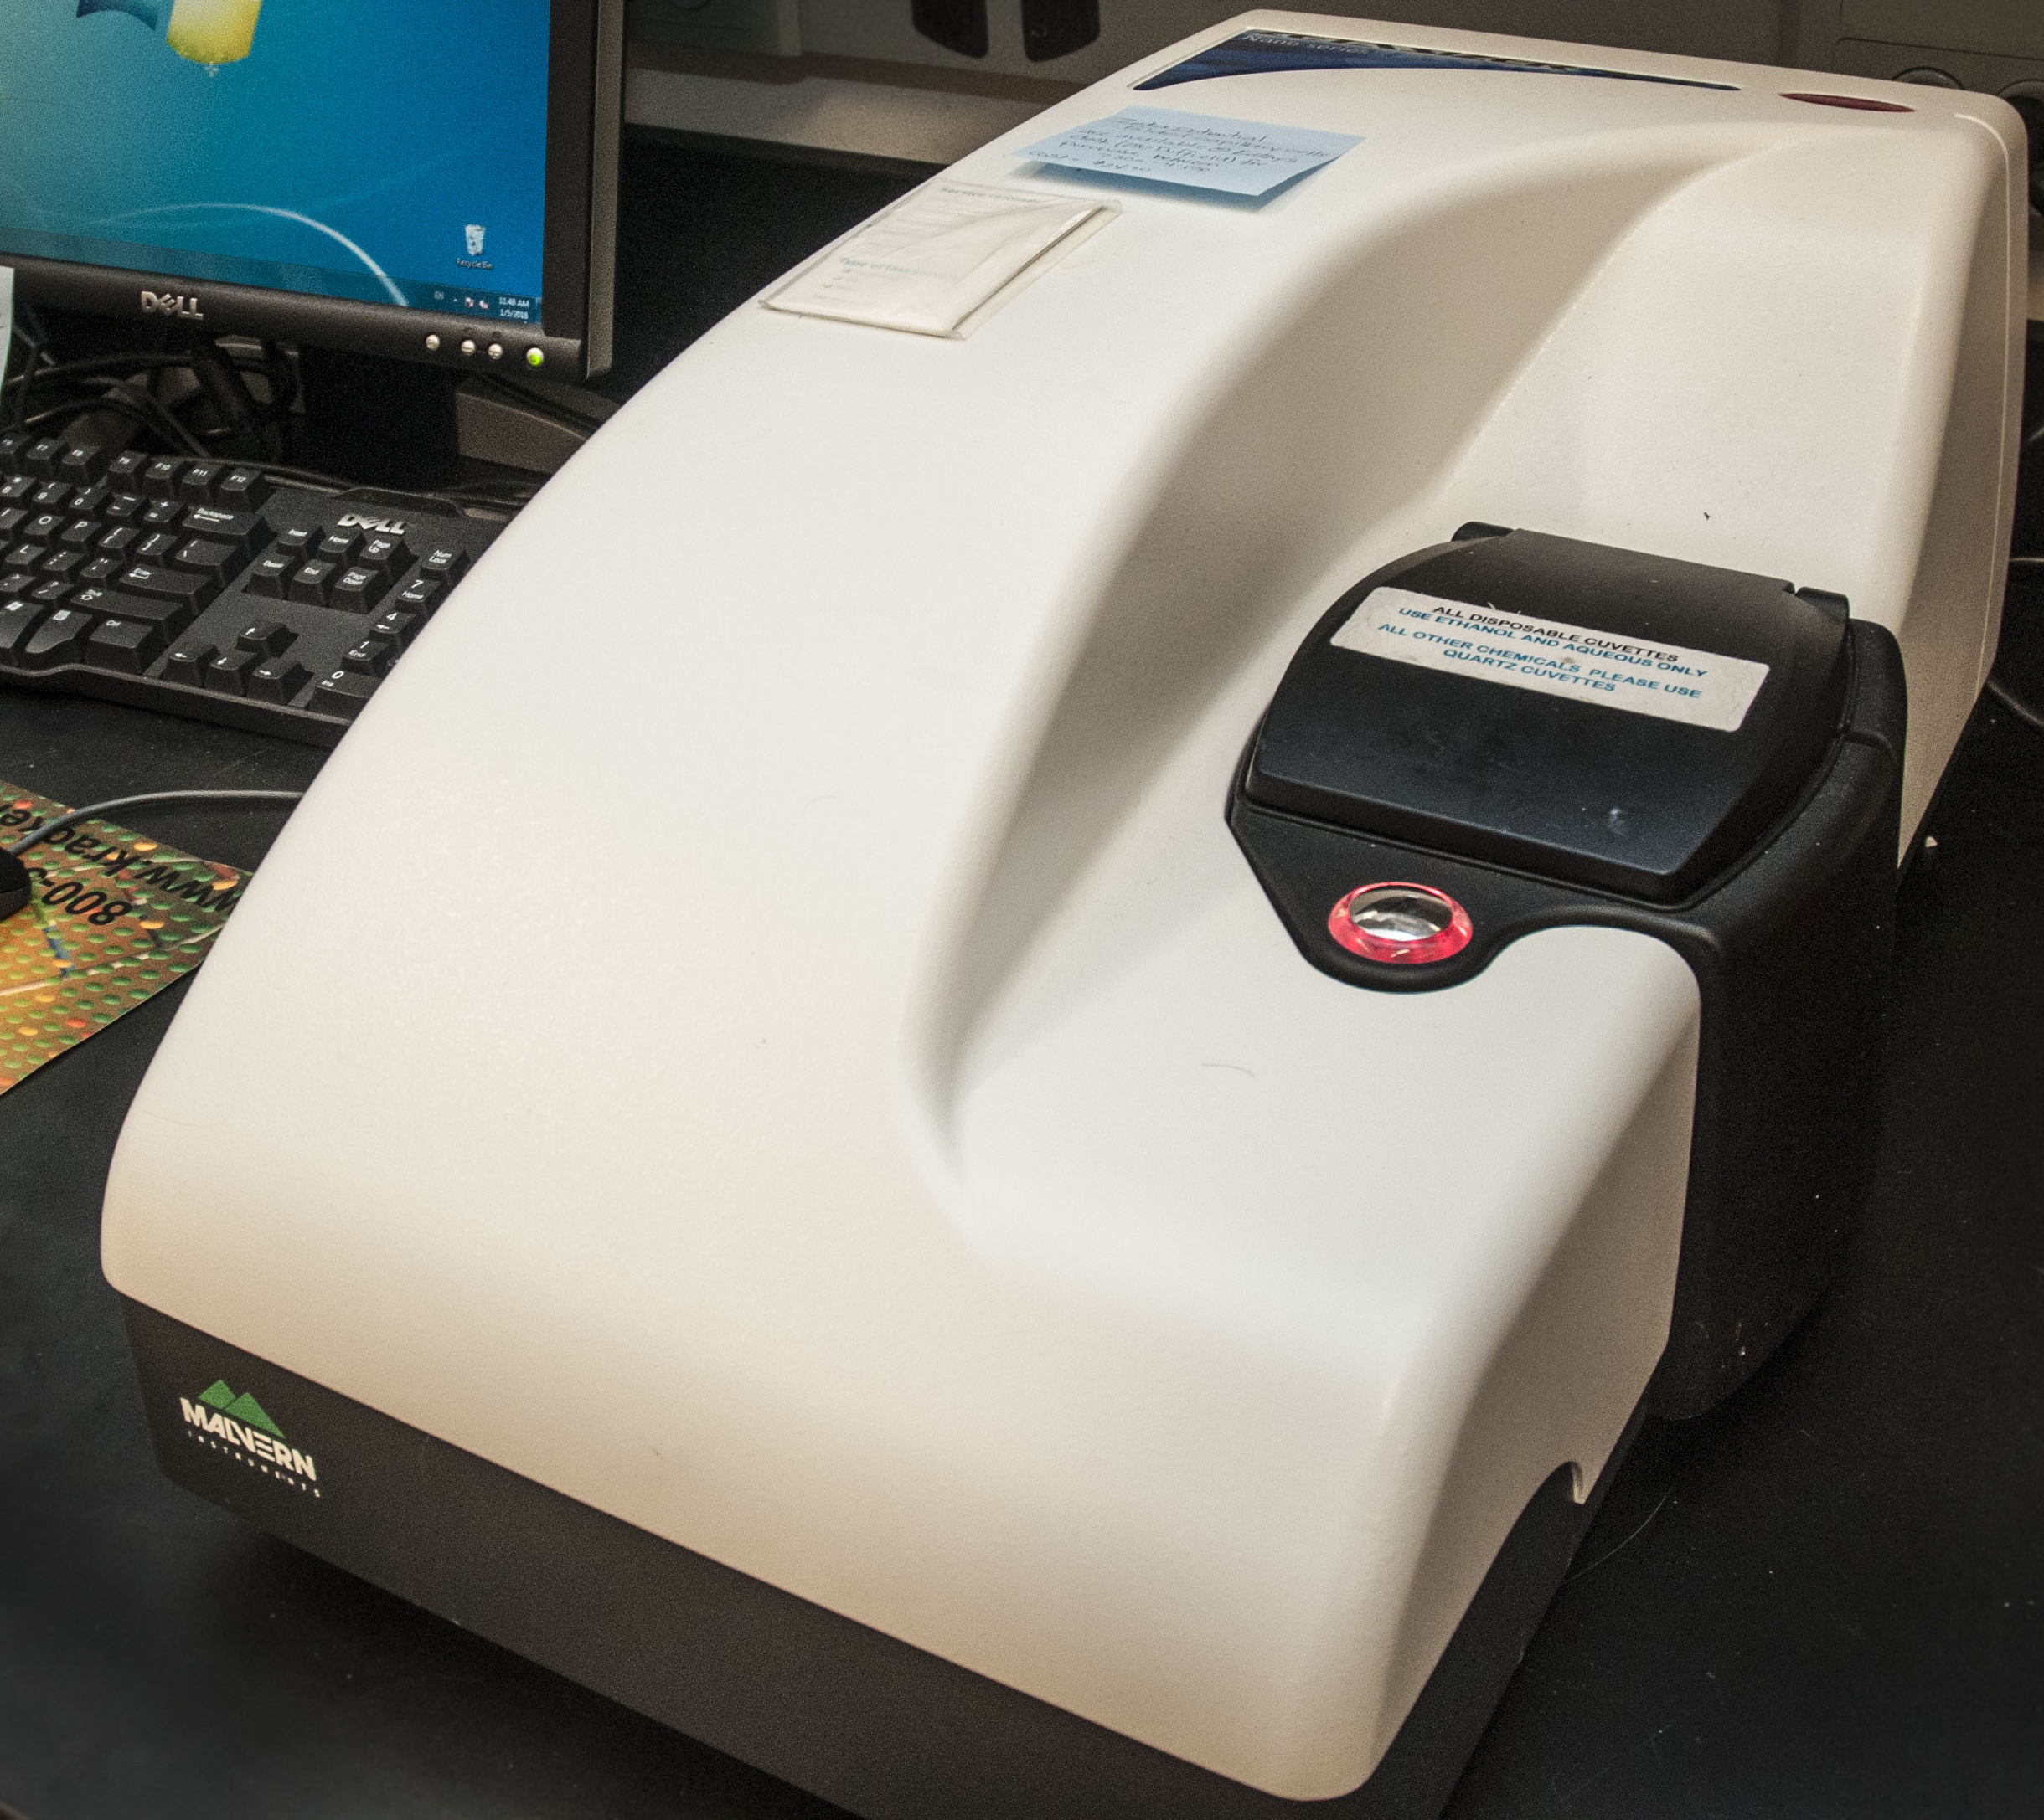
Dynamic Light Scattering (DLS)
Analytical tool for determining the diffusion coefficient, size distribution and hydrodynamic size of molecules/ particles
Based on the Brownian motion of the particle in solution.
Particle size determined by measuring the random change in intensity of light scattered from suspension
Coherent monochromatic light source is radiated upon a sample. The frequency spectrum of intensity of resulting scatter is recorded and the sizes of the particle are determined.
As a result of their higher average velocity, smaller particles cause bigger shift in light frequency than larger particles.
Hydrodynamic size derived by Stokes – Einstein Equation,
D=K_{B}T/6 ηπR, where D= Diffusion Constant, K_{B}= Boltzmann’s Constant, T= Absolute Temperature, η= dynamic viscosity, R= Radius of the sphere.
Laser of known wavelength passes through sample
Intensity of scattered light collected by a detector
Deconvoluted by algorithms and determine particle size and distribution.

Slide 23
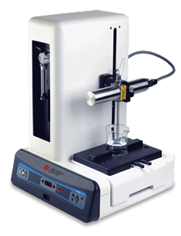
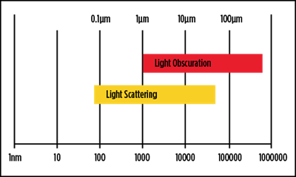
Light obscuration method (HIAC)
To determine the size Sub visible particles in a suspension.
Analytical technique in which the individual particles in a liquid suspension are placed in-between a laser light source and a detector.
The laser light source illuminates individual particles resulting in a shadow or a blockage of light (hence called “obscuration”).
Light obscuration or the reduction of light intensity is measured by the detector, which then process the measured signal and use it to display a comprehensive calibration curve. This curve is then read to quantify particles and determine their size.
Approaches for differently sized particles

Slide 24
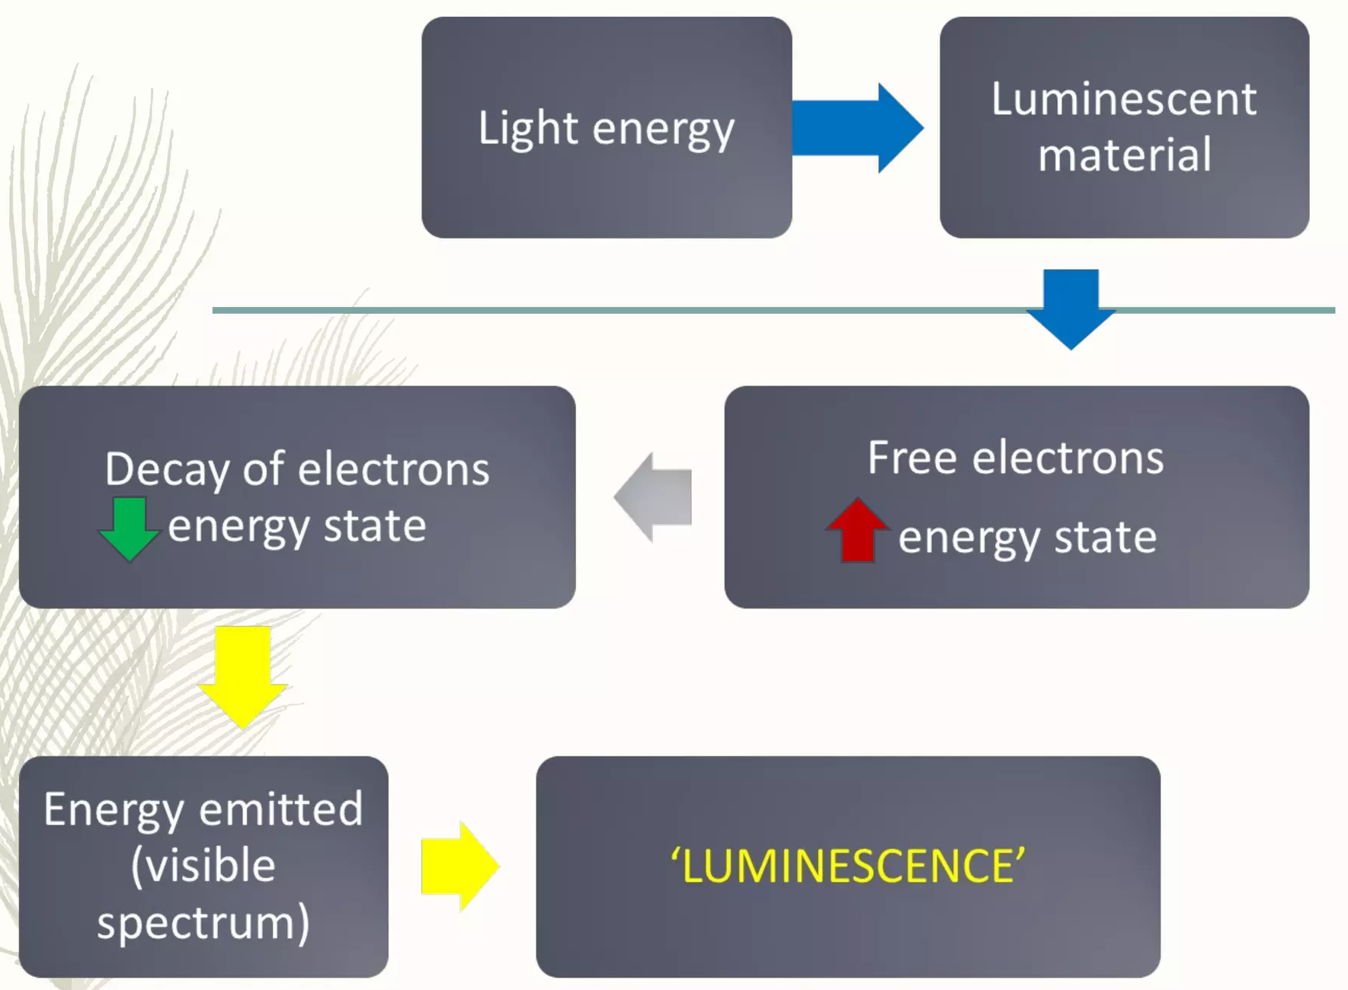
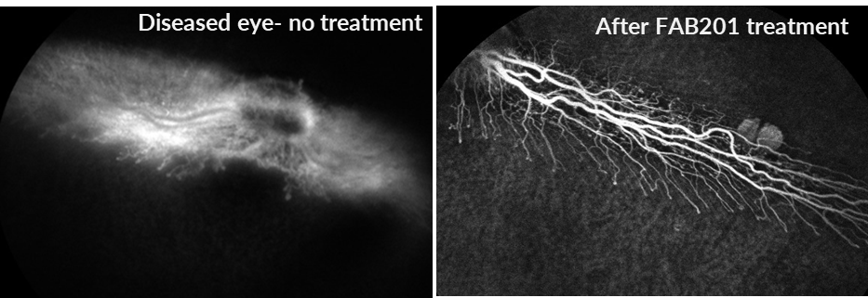
Efficacy of FAB201- fluorescein angiography
FAB201 efficacy in rabbit eye- by Fluorescein Angiography
Fluorescein angiography (FA) is a technique for examining the circulation of the retina and choroid using a fluorescent dye and a specialized camera. Sodium fluorescein is added into the systemic circulation, the retina is illuminated with blue light at a wavelength of 490 nm, and an angiogram is obtained by photographing the fluorescent green light that is emitted by the dye.
Instrument used-
Fundus camera, digital
Exciter filter: Allows only blue light to illuminate the retina. Depending on the specific filter, the excitation wavelength hitting the retina will be between 465 and 490 nm.

Slide 25
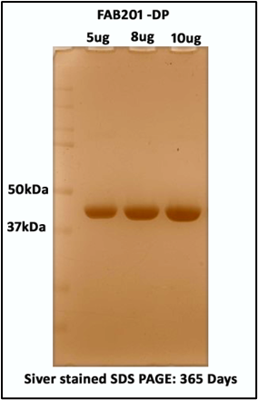
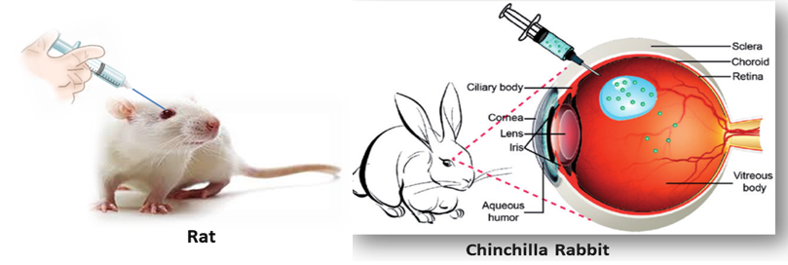
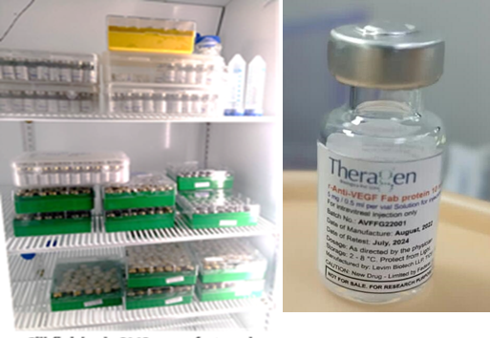
FAB 201 (Raamsizumab): Final product
Greater Efficacy
Greater Stability
2x+ efficacy vs. incumbent market leader)
3+ years shelf life when stored @ 4ºC ⁽¹⁾
30+ days shelf life when stored @ 25ºC – 37ºC ⁽¹⁾
Unlocks global supply chain and distribution flexibility
Upside from
FAB 201
Proven Safety in Preclinical Studies
FAB201 is Ready for Clinical Use
A: Control
Comparable shelf life data is not publicly available for incumbent solutions Lucentis, Eylea, Beovu and Avastin; Storage temperature is -20ºC.

Slide 26
THANK YOU

