Slide 1


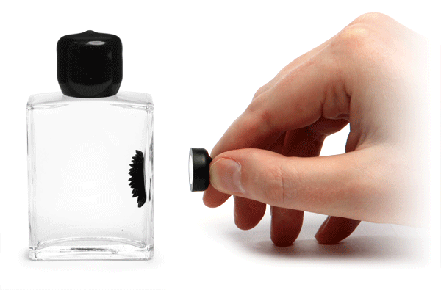

Complex molecular interactions involved in binding of fragmented nucleic acid molecules on magnetic nanoparticles for next generation sequencing applications
Aniruddha Bhati, PhD,
Senior Scientist and Head of Technical Operations,
MagGenome Technologies Pvt Ltd,
Chennai and San Francisco

Slide 2

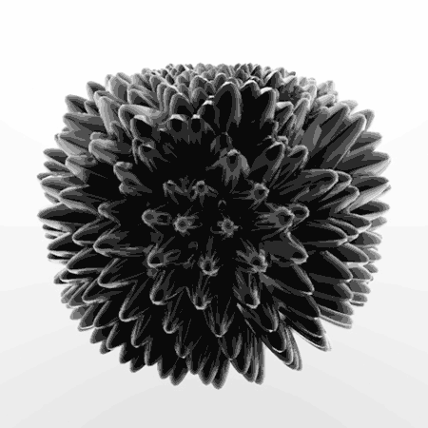
Magnetic Nanoparticles
Magnetic nanoparticles (MNP) can be manipulated by applying external magnetic field.
Iron oxide MNP: Biocompatible, FDA approved. Mainly used for biological and biomedical applications.
Average size 10-12 nanometres.
Superparamagnetic - particles gets magnetized on application of magnetic field, while on removal it behaves like non-magnetic particles.
High surface to volume ratio.

Slide 3
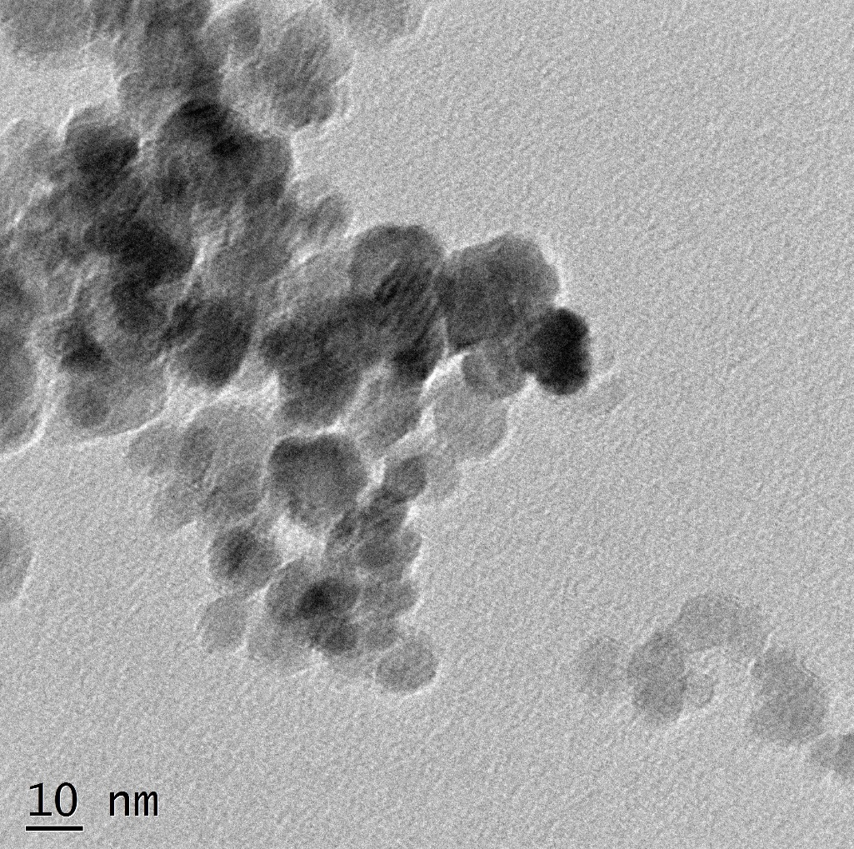
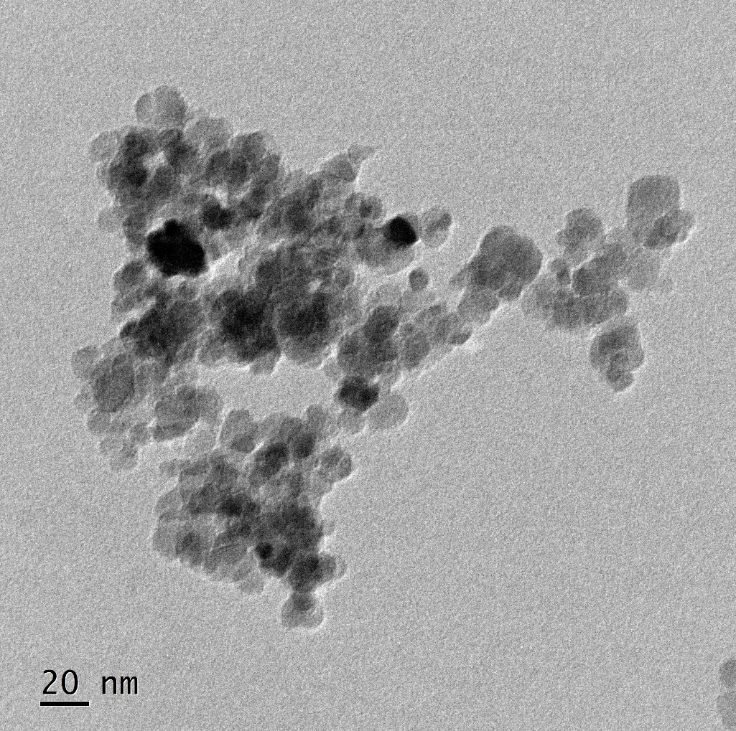
Magnetic Nanoparticles: HR TEM Image
High Resolution Transmission Electron Microscopy (HRTEM) (JEOL JEM 2100 200-kV transmission electron) microscope (TEM) with a point resolution of 50X to 1.5MX

Slide 4
Application of Magnetic nanoparticles in Next Generation sequencing

Slide 5
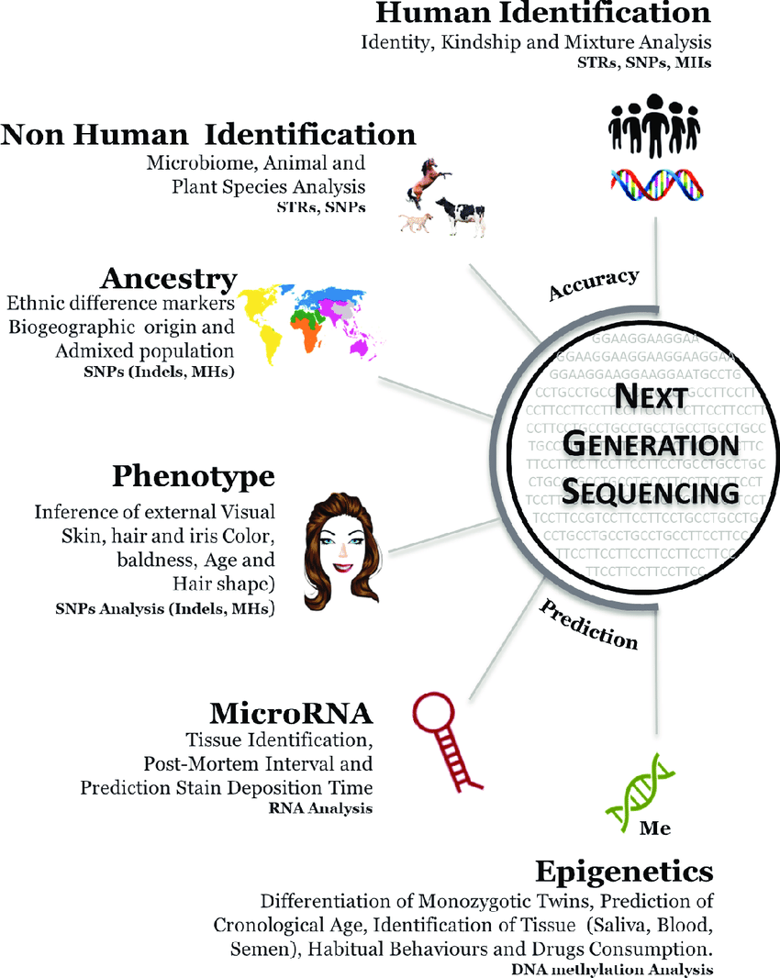
What is Next generation sequencing ?
Next-generation sequencing (NGS) is a massively parallel sequencing technology that offers ultra-high throughput, scalability, and speed.
The technology is used to determine the order of nucleotides in entire genomes or targeted regions of DNA or RNA.
NGS has revolutionized the biological sciences, allowing labs to perform a wide variety of applications and study biological systems at a level never before possible.

Slide 6
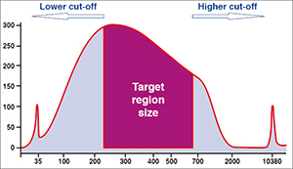
Next Generation Sequencing in a nutshell

Slide 7
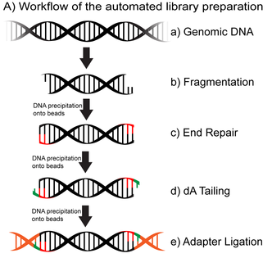
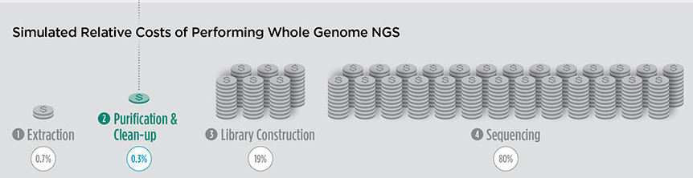
Next Generation Sequencing in a nutshell
Fragmentation through enzymatic or mechanical means.
End-repair and processing to homogenize the heterogeneous fragment ends.
Adapter ligation for cluster generation and in-cell clonal amplification.
Size selection to remove suboptimal fragment sizes and any adaptor dimers.
Enzymatic size selection
Magnetic beads-based size selection
Gel based size selection

Slide 8
Importance of beads in sequencing processes
NGS can offer rapidity, reliability, and cost-effectiveness. However, these benefits also depend on the quality of the DNA being sequenced.
Poor quality or inefficiency in the early stages of the sequencing process can mean additional costs of errors, rework, or waste
Cleanup/Size selection beads are a pivotal part of the sequencing processes. They have an immediate impact on efficiency and on quality, as well as key impacts downstream.
Thus, it is critical to evaluate any cleanup kit before selection.
It is also important to benchmark its overall performance with others before starting NGS operations or when considering changing to a different cleanup solution.

Slide 9

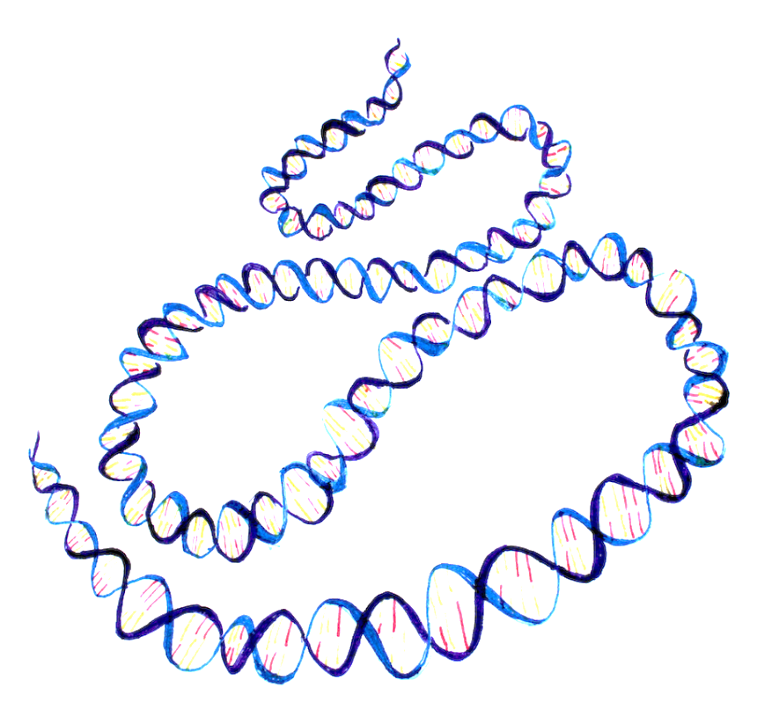
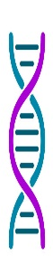

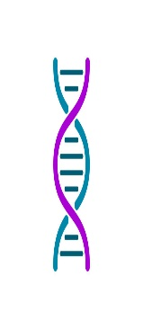






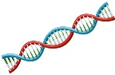
Double-sided size-selection using magnetic nanoparticles
Too big
Enzymatic
or
Mechanical fragmentation
Too small
Genomic DNA
Sheared genomic DNA fragments
Optimum size
(150-800bp)

Slide 10


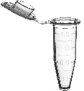

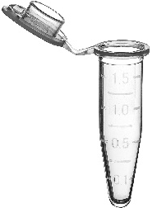



Selective precipitation principle:
First Round of Size Selection
DNA binding to solid-phase reversible immobilization (SPRI) can be controlled by PEG/NaCl concentration; selective precipitation allows size selection from a mixture of fragmented DNA
Beads bound to high mw DNA discarded
Supernatant collected
Processed for 2nd round of size selection
Low conc. of PEG/NaCl
Binding with higher mw DNA
Bare MNP
PEG/NaCl retained in solution
Selective precipitation principle:
Second Round of Size Selection
Supernatant Discarded
Beads bound to 150-800 bp DNA
High conc of PEG/NaCl
Eluted from beads

Slide 11
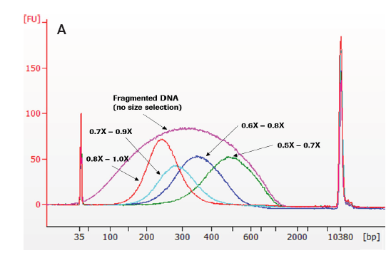
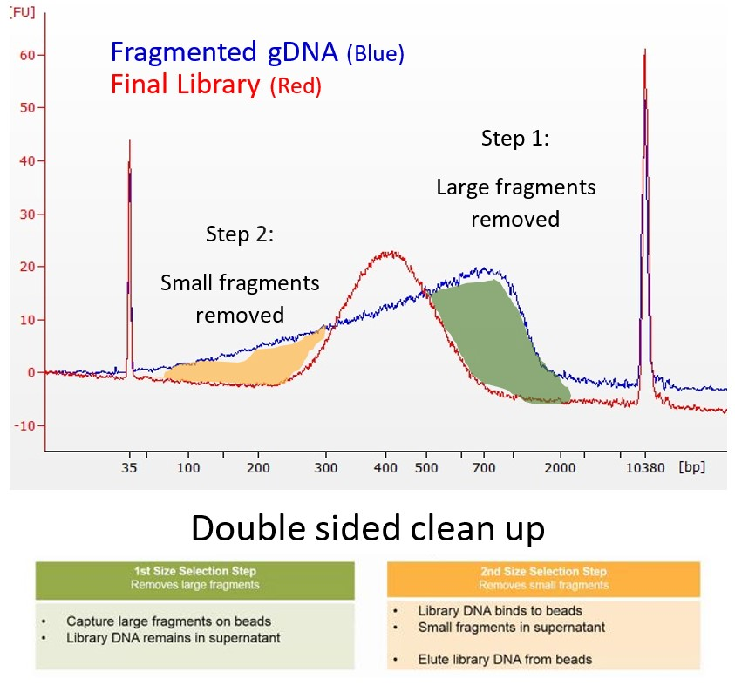
Double-sided size-selection using magnetic nanoparticles

Slide 12
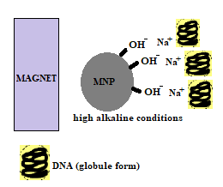
Mechanism
DNA molecules of differing molecular weight can be selectively precipitated using condensing agents like Polyethylene glycol (PEG) in the presence of a salt like NaCl.
The binding of DNA to the beads is dependent on the concentration of the PEG and hence the ratio of the beads to the DNA remains critical. Higher volume of the binding mix helps to capture lower base pair fragments while lower volume captures higher base pair fragments.
MagGenome’s size selection beads- uncoated iron oxide nanoparticles.
In order to increase the DNA recovery rate -pH of the binding system was maintained at high alkaline condition.
The beads in such alkaline conditions gains more negative charge on its surface and DNA being negatively charged, with the help of monovalent cation like Na+ serving as a bridge between the DNA and the beads while PEG enables in condensing the DNA from coil to globule shape.

Slide 13
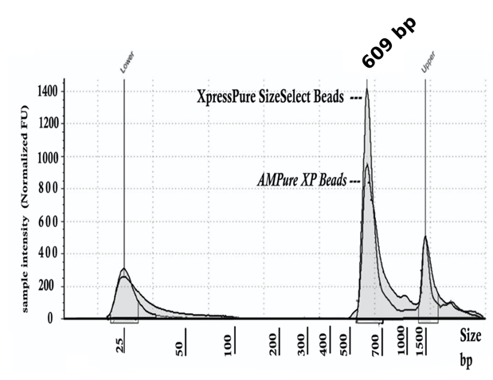
Comparative analysis in Illumina library preparation
  The library profiles of XpressPure SizeSelect beads and AMPure XP beads are identical when used in Illumina Truseq Nano DNA library preparation kit (Cat. No: 20015965) at the same bead to library ratio.

Slide 14
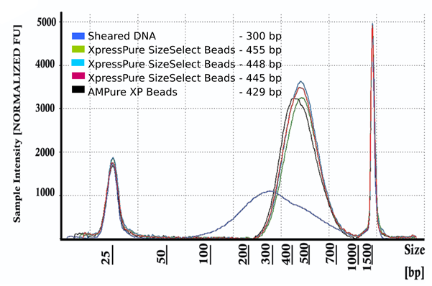
Comparative analysis in Illumina library preparation
  Agilent’s TapeStation profile showing the consistent performance of XpressPure SizeSelect beads along with AMPure XP using NEB NGS library Kit (cat#E7370L) following manufacturer’s instructions.

Slide 15
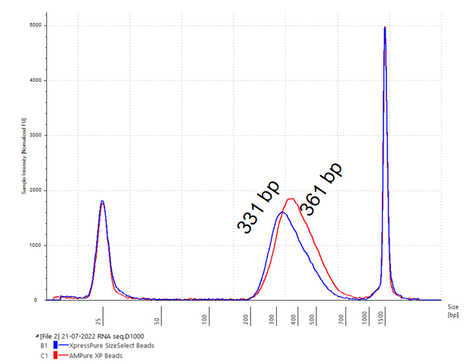
Comparative analysis in Illumina Library preparation
  Performance of XpressPure SizeSelect beads compared with AMPure XP using TruSeq RNA Library Prep Kit v2 (REF: 15027387)

Slide 16
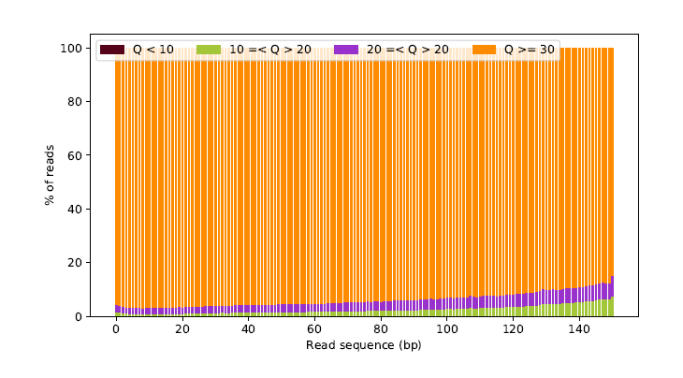
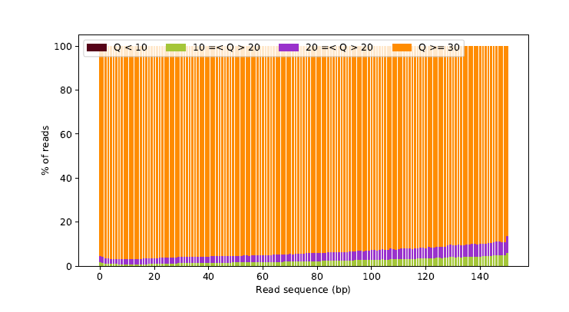
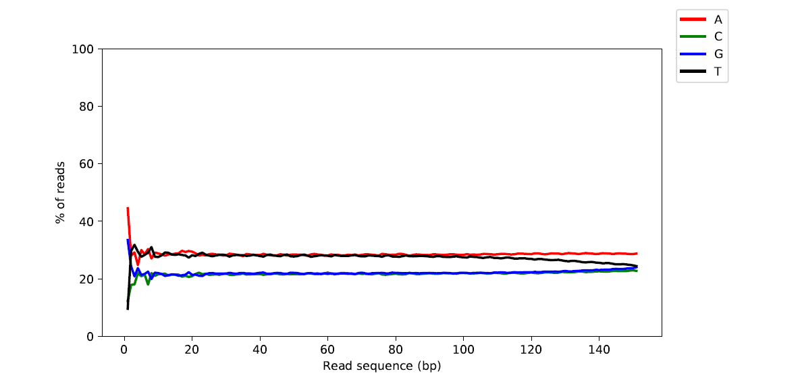
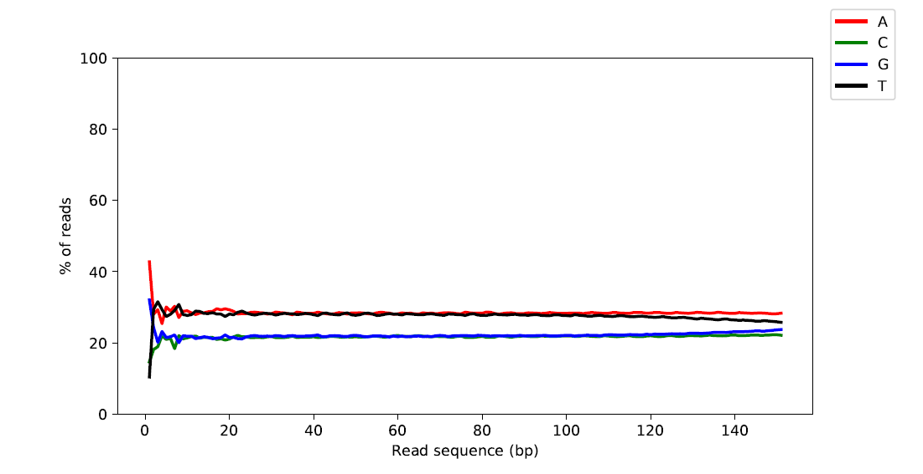
Quality and base distribution – NovaSeq 2x150
AMPure XP
XpressPure
Distribution of all four nucleotides (A T C G) across reads remain stable for both Ampure and XpressPure, denoting perfect run

Slide 17
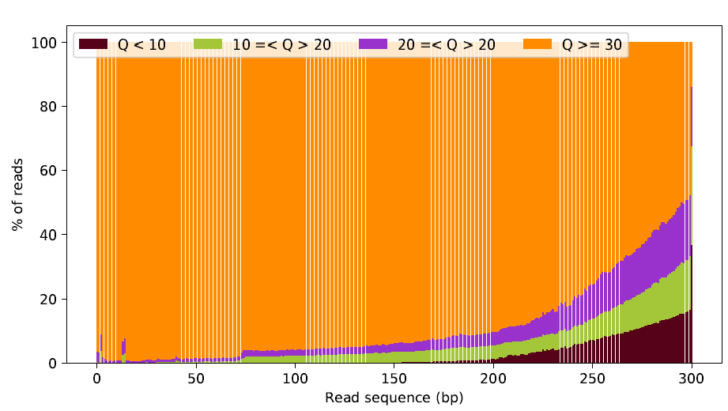
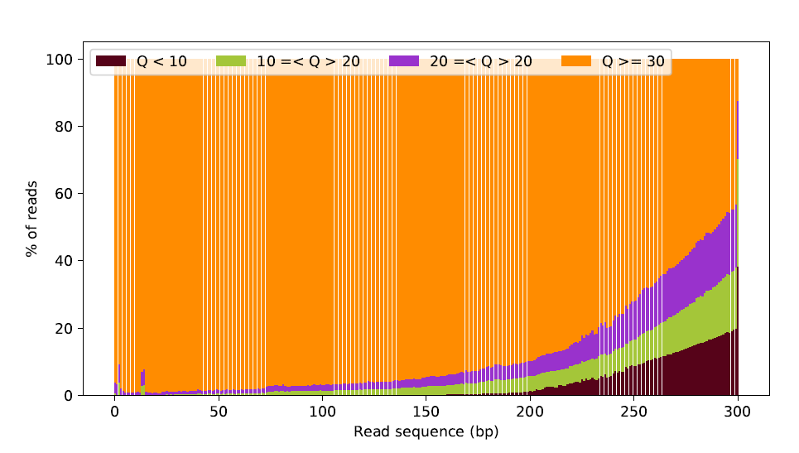
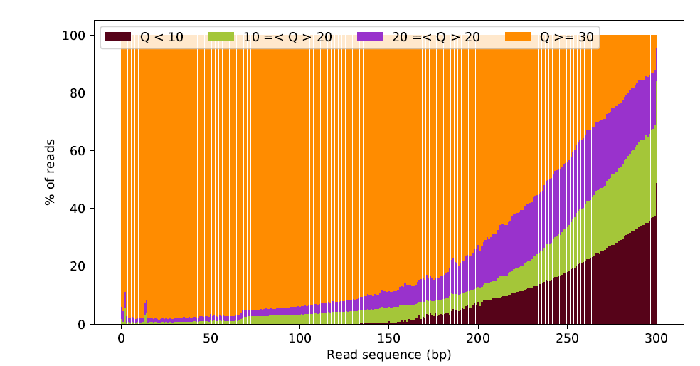

Quality distribution – MiSeq 2x300 – R1 (Forward & Reverse)
AMPure XP
XpressPure

Slide 18
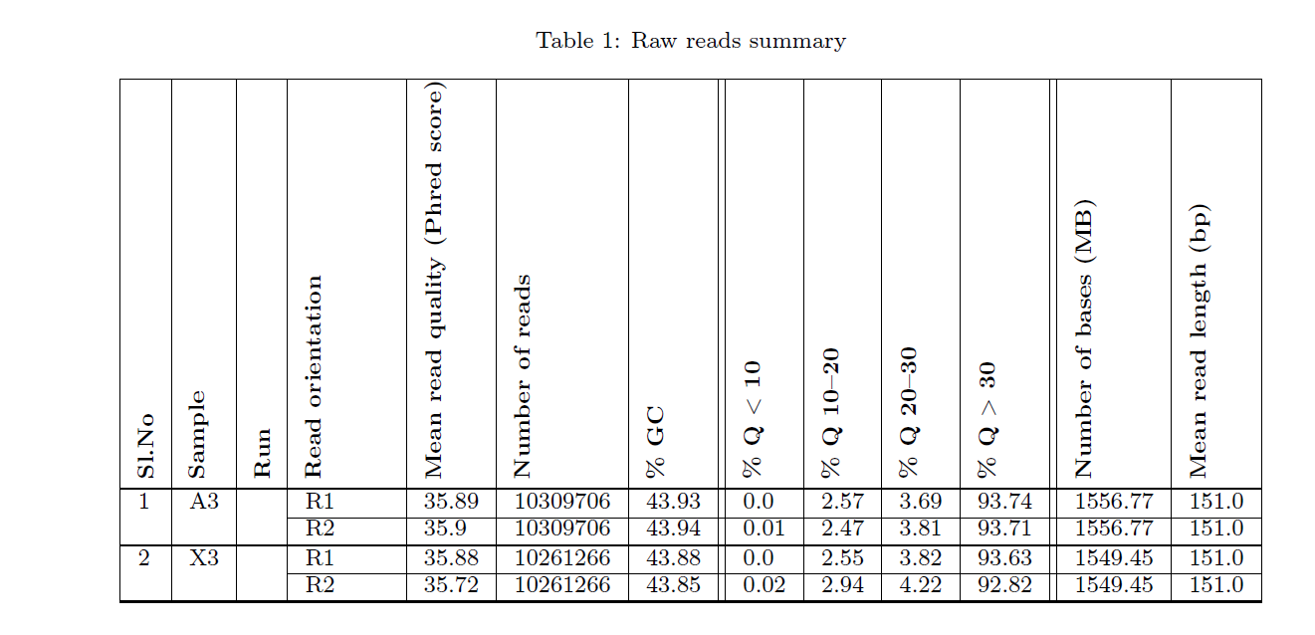
Comparative Raw reads summary – NovaSeq 2x150
A3 – AMPure XP
X3 - XpressPure
Phred score Q> 30 denotes probability of an incorrect base calling 1 in 1000 times
Base call accuracy 99.9%

Slide 19

Has the time come, for Magnetic Nanoparticles?
Notes:
Researchers are harnessing the power of high-throughput genomics to conduct large-scale, global genetic analyses.
This research often focuses on the multifactorial genetic discovery of disease risk markers and may involve looking for changes in genetic variants such as single nucleotide polymorphisms (SNPs), indels, splice variants, structural variants, and methylation markers.
High-throughput genomics studies with tens to hundreds of thousands of samples require fast, cost-effective tools.

Slide 20
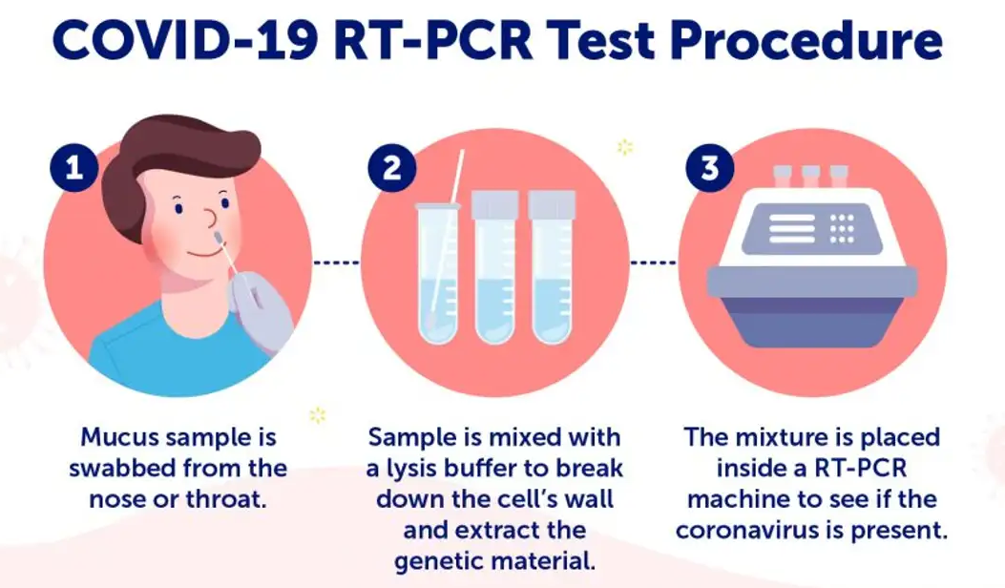
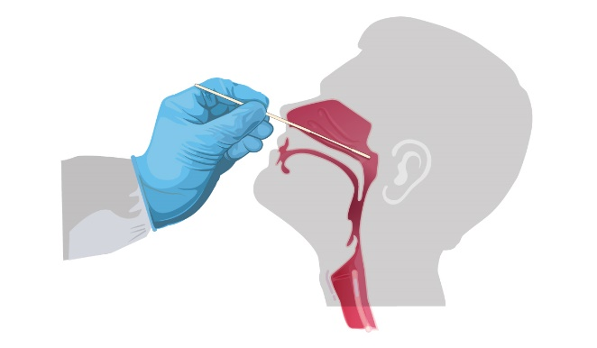
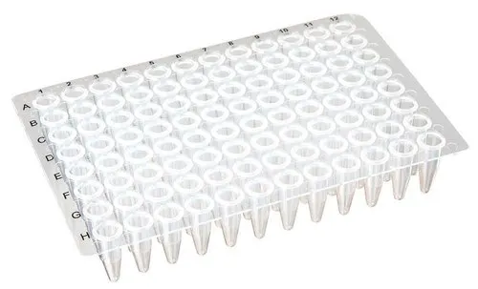

Why is automation important?

Slide 21
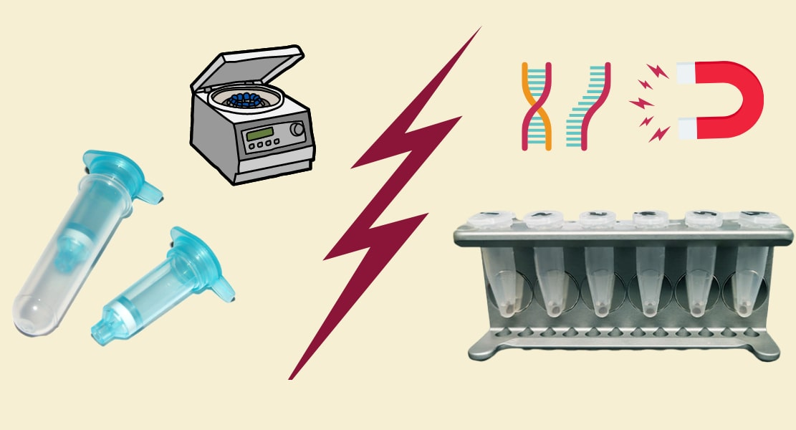
How is nucleic acid extracted ?

Slide 22
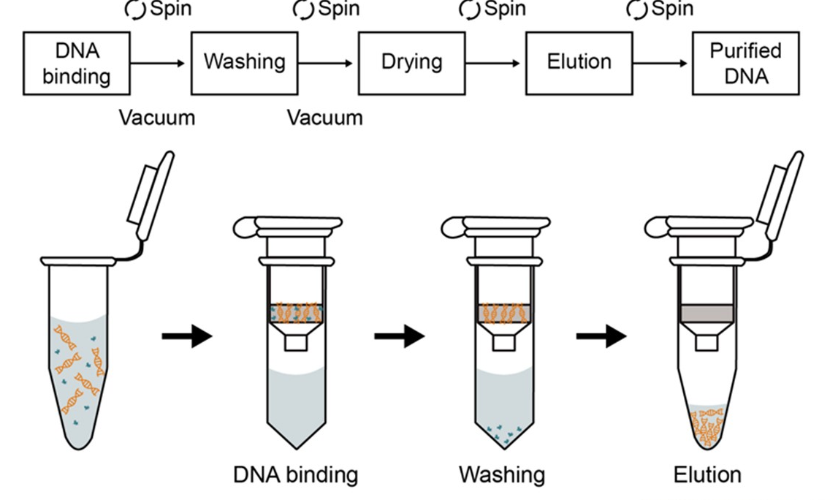
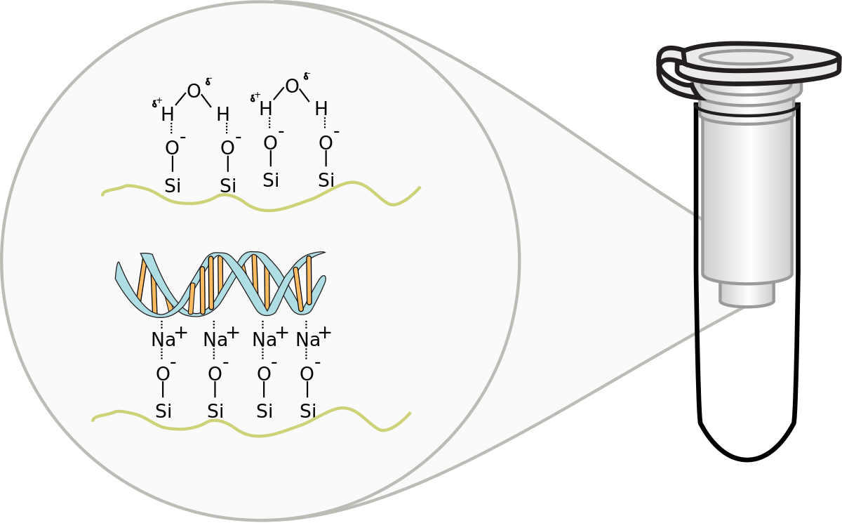
How is silica column used for nucleic acid extraction ?

Slide 23
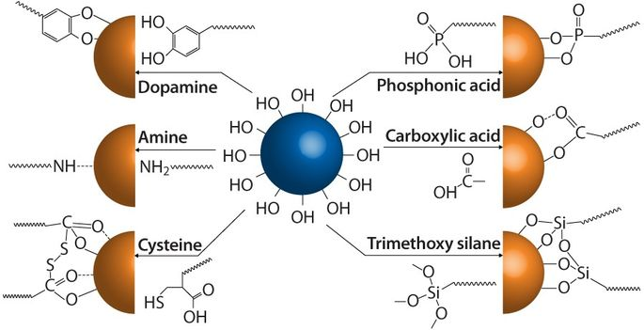

How bare magnetic nanoparticles work?
We have developed technologies to specifically bind different molecules to bare Magnetic Nanoparticle.
How charge works?
Acidic pH
OH₃⁺
OH ⁻
Basic pH
Bare magnetic nanoparticles
Binding due to:
1) Hydrophobic interactions
2) Charge

Slide 24
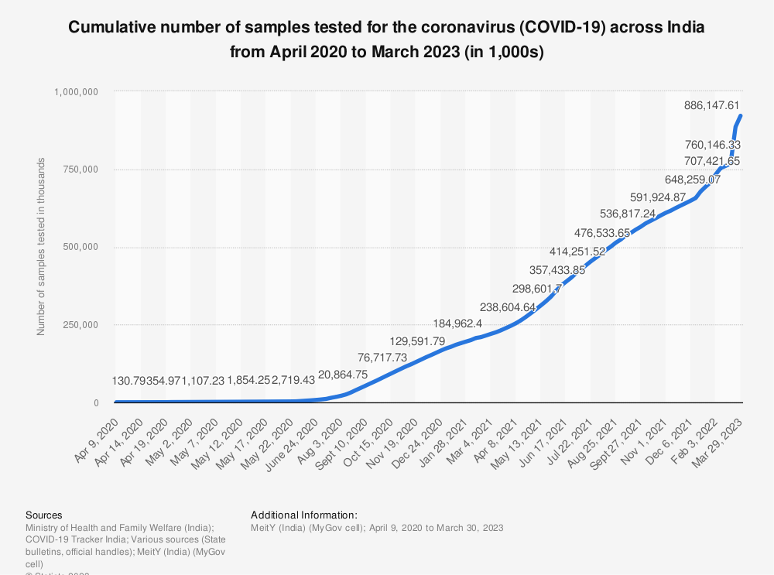
Why is automation important?
Notes:
Researchers are harnessing the power of high-throughput genomics to conduct large-scale, global genetic analyses.
This research often focuses on the multifactorial genetic discovery of disease risk markers and may involve looking for changes in genetic variants such as single nucleotide polymorphisms (SNPs), indels, splice variants, structural variants, and methylation markers.
High-throughput genomics studies with tens to hundreds of thousands of samples require fast, cost-effective tools.

Slide 25
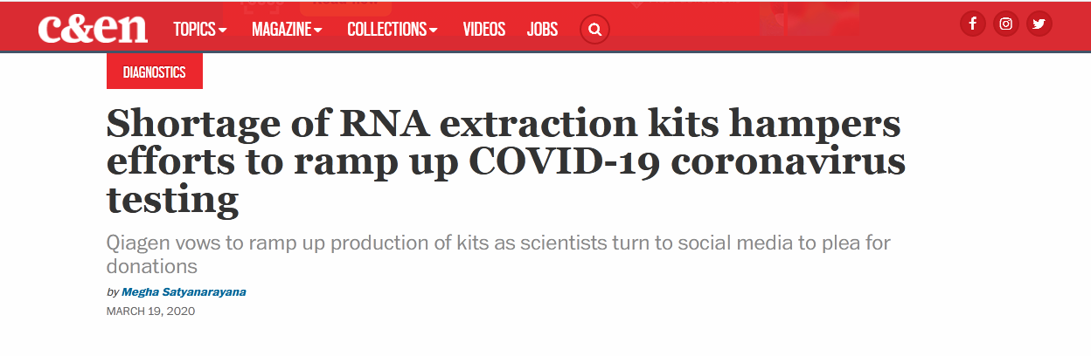
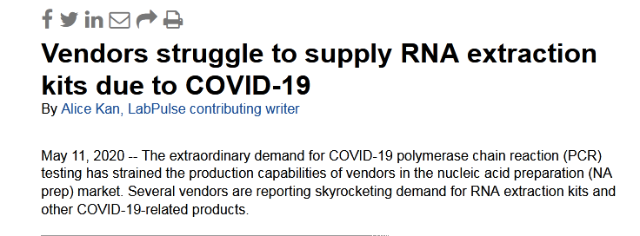
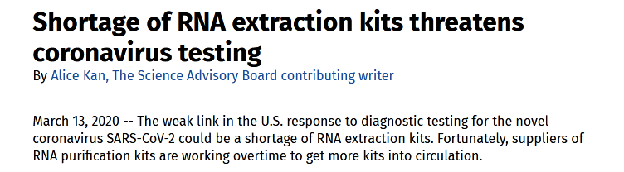
Scarcity of Viral RNA extraction kits March-April 2020

Slide 26
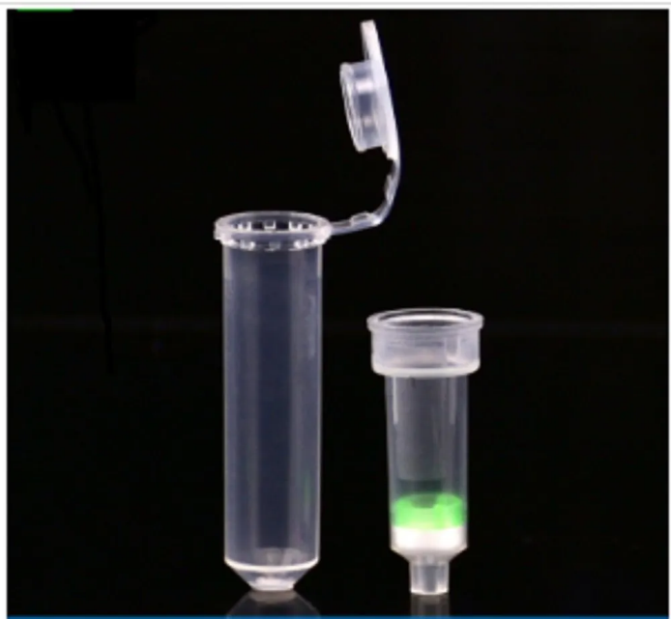
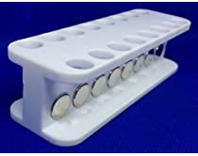
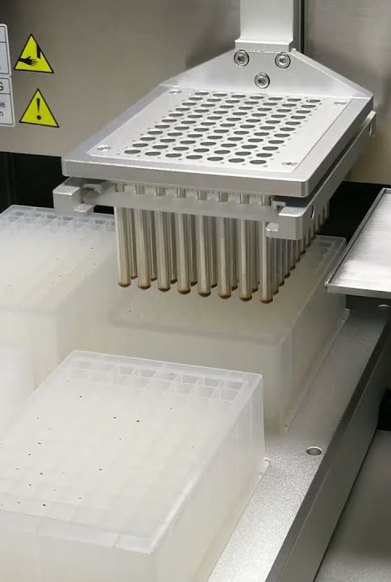
Nanotechnology and its impact?
How nanotechnology brought a Paradigm shift
in Molecular Diagnostics!
From 8-10 samples in 45 mins
To 96 samples in 15 mins and beyond…
Notes:
Researchers are harnessing the power of high-throughput genomics to conduct large-scale, global genetic analyses.
This research often focuses on the multifactorial genetic discovery of disease risk markers and may involve looking for changes in genetic variants such as single nucleotide polymorphisms (SNPs), indels, splice variants, structural variants, and methylation markers.
High-throughput genomics studies with tens to hundreds of thousands of samples require fast, cost-effective tools.

Slide 27
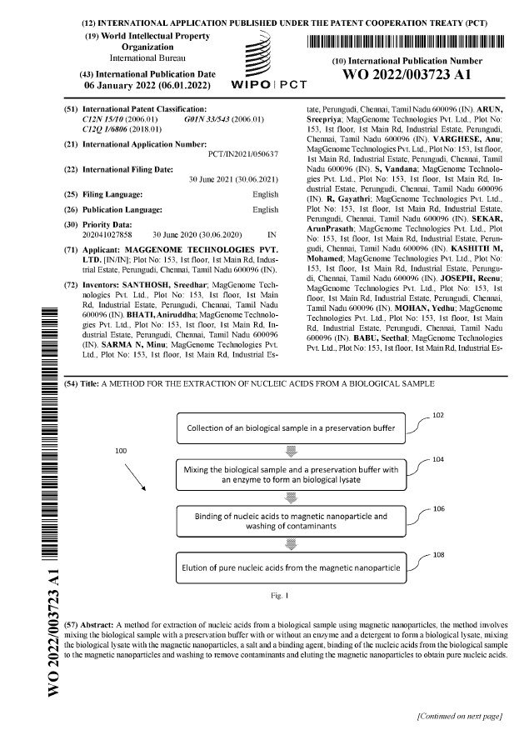
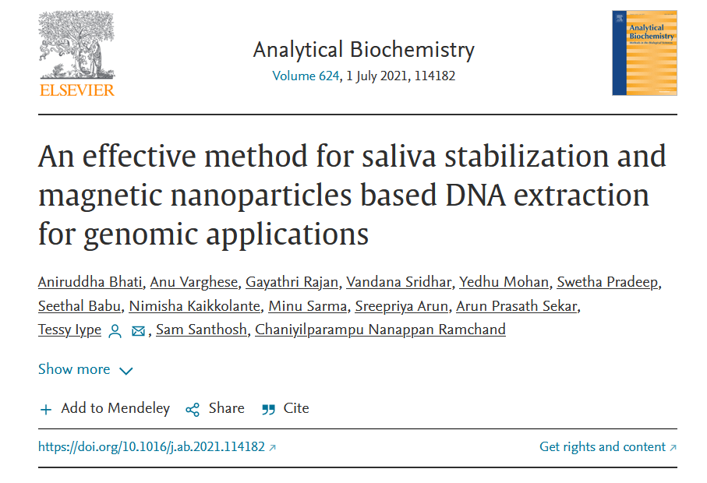
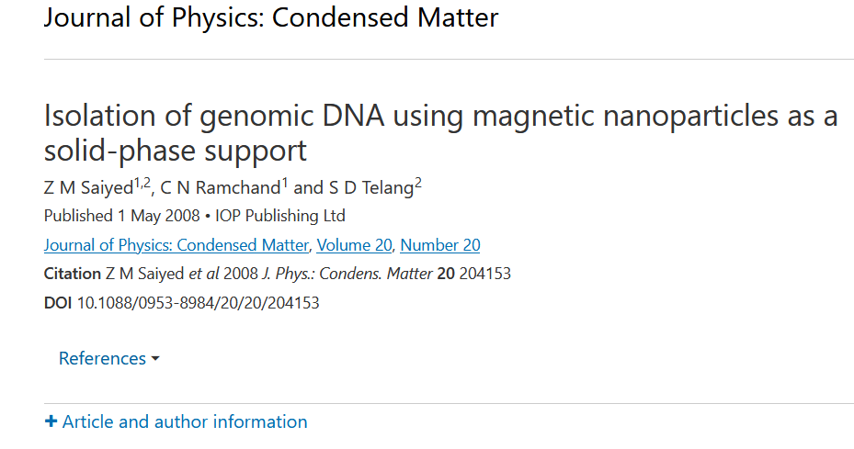
Our patents and papers on the binding of nucleic acid to Magnetic nanoparticles

Slide 28

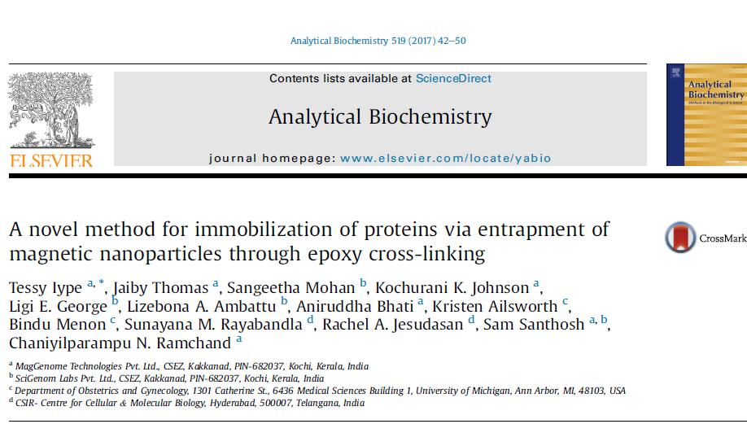
Granted patent and publication for protein immobilization on magnetic nanoparticles
Title: Entrapment of Magnetic Nanoparticles in a Cross-Linked Protein matrix without affecting the functional properties of the Protein

