Slide 1
Study of Uranium Toxicity due to Protracted Ingestion of Groundwater in Bathinda District of Punjab, India
India-JINR Workshop On Elementary Particle And Nuclear Physics, And Condensed Matter
Abhishek, Dr. Rohit Mehra
Radiation Monitoring and Assessment Lab
Department of Physics
Dr. B R Ambedkar NIT Jalandhar, Punjab-144008

Slide 2
OUTLINE
Introduction
Research objective and significance
Methodology
Instrumentation
Results
Conclusion

Slide 3
URANIUM IN GROUND WATER
Amount of Uranium in aquifer rocks
Ground water decline, Nitrate pollution
Water-Rock interactions
Interaction of Uranium with other compounds like bicarbonates
Anthropogenic
activities,
Nuclear waste
Impacts of uranium on health
Low level of radioactivity of Natural Uranium
Radiological toxicity due oral ingestion, inhalation
Uranyl compounds form stable complexes with proteins and nucleotides targeting skeleton, kidney and liver as primary sites
Nephritis, bone cancer, respiratory diseases etc.

Slide 4
RESEARCH OBJECTIVES
To estimate the concentration of Uranium in groundwater samples collected from Bathinda district of Punjab.
To calculate the health risks associated with uranium via drinking water pathway.
To compute the dose received by different body organs/tissues in human body using Hair Compartment Model.
SIGNIFICANCE OF STUDY
Baseline mapping and worldwide comparisons
Significance with respect to experimental techniques
Significance with respect to area and geology
Bathinda District

Slide 5
INSTRUMENTATION
LED-FLUORIMETER
Analytical Technique Fluorescence of uranium salt
Element Analysed Uranium in aqueous medium
Excitation Source Pulsed UV LED (Light Emitting Diodes)
Detector Photomultiplier tube
Cuvette Made from Ultra low fluorescence Fused Silica
Minimum Detection Limit 0.5 ppb.
Dynamic range 0.5 – 1000 ppb with deviation10%
Modes of operation
Standard Addition Mode (Spike Mode)
Calibrated Fluorescence Mode
Uncalibrated Fluorescence Mode (Count Mode)
Measurement time
1 second (averages the fluorescence for 256 pulses
and displays the average).

Slide 6
METHODOLOGY
Radiological toxicity
Risk coefficients for various Uranium isotopes
Isotope | Mortality (Bq⁻¹) | Morbidity(Bq⁻¹)
⁹²U₂₃₄ | 6.2 X10⁻¹¹ | 9.5 X 10⁻¹¹
⁹²U₂₃₅ | 6.32 X 10⁻¹¹ | 9.8 X 10⁻¹¹
⁹²U₂₃₈ | 7.5 X 10⁻¹¹ | 7.5 X 10⁻¹⁰

Slide 7
Chemical toxicity risk assessment
WHO (2011)

Slide 8
HAIR COMPARTMENT MODEL

Slide 9
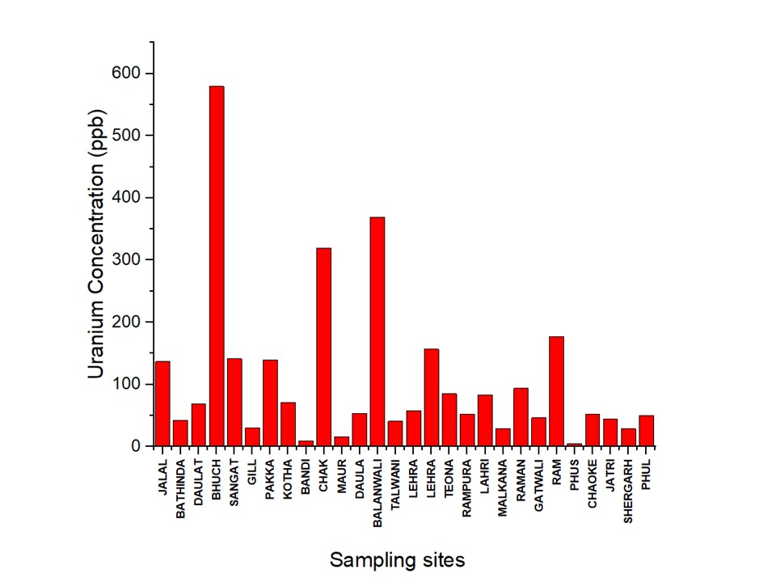
RESULTS
Graph showing concentration of Uranium

Slide 10
RADIOLOGICAL AND CHEMICAL TOXICITY
 |  | Minimum | Maximum | Mean
Uranium concentration (µg L⁻¹) |  | 5.19 | 579.28 | 106.41
Uranium Activity (Bq L⁻¹⁾ |  | 0.13 | 14.48 | 2.66
Excess Cancer Risk (Mortality) | U-234 | 1.39 × 10⁻¹¹ | 1.55 × 10⁻⁰⁹ | 2.86 ×10 ⁻¹⁰
 | U-235 | 2.04 × 10⁻⁰⁹ | 2.28 × 10 ⁻⁰⁷ | 4.18 × 10 ⁻⁰⁸
 | U-238 | 3.40 × 10 ⁻⁰⁷ | 3.80 × 10 ⁻⁰⁵ | 6.97 × 10 ⁻⁰⁶
Excess cancer risk (Morbidity) | U-234 | 2.17 × 10 ⁻¹¹ | 2.42 × 10⁻⁰⁹ | 4.45 × 10 ⁻¹⁰
 | U-235 | 3.22 × 10 ⁻⁰⁹ | 3.60× 10 ⁻⁰⁷ | 6.61× 10 ⁻⁰⁸
 | U-238 | 3.40 × 10 ⁻⁰⁷ | 3.80× 10 ⁻⁰⁵ | 6.97 × 10 ⁻⁰⁶
LADD (µg kg⁻¹ day⁻¹⁾ |  | 0.10 | 11.61 | 2.13
HQ |  | 0.09 | 9.68 | 1.78

Slide 11
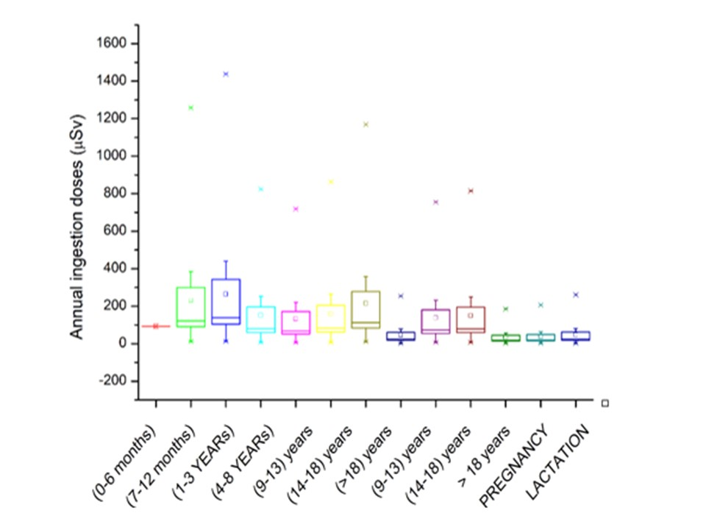
AGE DEPENDENT ANNUAL INGESTION DOSES (µS/year)

Slide 12
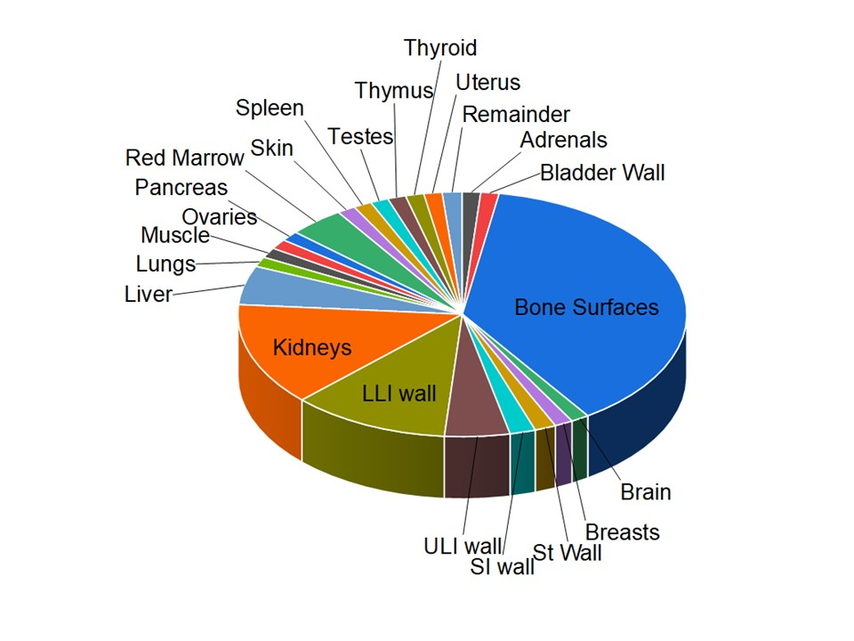
ORGAN SPECIFIC DOSES FOR DIFFERENT ORGANS

Slide 13
Conclusions
The high concentration of uranium in the study region may be due to geology of the region and presence of radioactive Tosham Hills nearby the study region, heavy use of fertilizers.
In region of high concentration, ingestion of groundwater poses significant radiological and chemical toxicity risk.
Study highlights that infants and children are more vulnerable towards exposure due to uranium ingestion.
Bone surface is the most stable repository for uranium in human body followed by LLI wall and Kidney

Slide 14
Thankyou
Email: abhishek.ph.22@nitj.ac.in

