Slide 1
India-JINR workshop on elementary particle and nuclear physics, and condensed matter research
October 16-19, 2023
Dubna, Russia
Bivash Behera
Department of Physics
Panjab University, Chandigarh, India
bivash@pu.ac.in
Binary fragmentation dynamics of few heavy systems

Slide 2
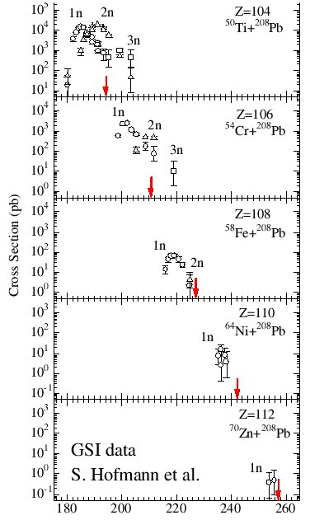
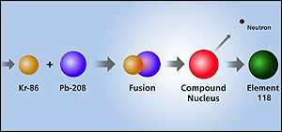
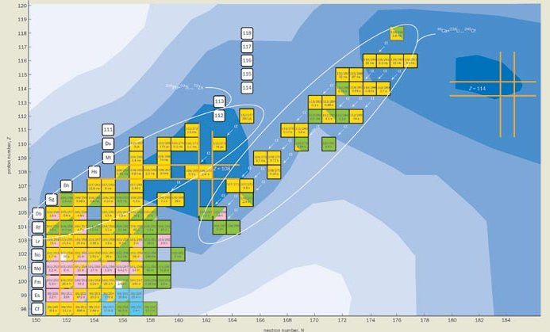
Production of Super-heavy
elements

Slide 3
DYNAMICS OF FUSION-FISSION REACTIONS AROUND
THE BARRIER
DYNAMICS OF FUSION-FISSION REACTIONS AROUND THE BARRIER
1. Formation of Super Heavy Nucleus:
2. Two step process: (a) Survive Quasi-fission and lead to a compact compound Nucleus (CN) (b) CN has to survive fission competition.
3. CN+NCN Process. NCN process: Fast fission, Quasi-fission, Pre-eq fission are all NCN process
4. Measurement of fission fragment angular distribution, mass distribution and mass energy correlation helps in distinguishing NCN processes. Pre-scission neutron multiplicity is another probe for the investigation of the NCN process.
5. To optimize Super-heavy production we have to take care of (a) entrance Channel (b) Shell effect (c) deformation of entrance channel and (d) Neutron rich projectile
6. The optimum selection of target and projectile is necessary to maximize the formation probability of Super-Heavy Nuclei.

Slide 4
M.G. Itkis systematics: NN-2006 Conference (RIO, BRAZIL)
M.G. Itkis et al., Nucl. Phys. A 734 (2004) 136-147;G.N.Knyazheva et al., Phys. Rev C 75. 064602 (2007) ;
India-JINR workshop on elementary particle and nuclear physics, and condensed matter research

Slide 5
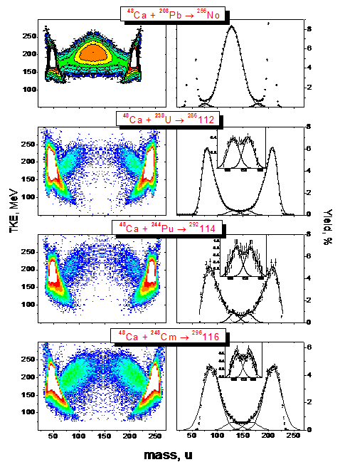
MED of Fission Fragment of ²⁵⁶102- ²⁹⁶116 nuclei produced in “hot” fusion reactions with ⁴⁸Ca-projectiles
Sharp change of the MED triangular shape for the reaction ⁴⁸Ca+²⁰⁸Pb, where the Fusion-Fission dominates, to the Quasi-Fission shape of MED for the ²⁸⁶112-²⁹⁶116 nuclei.
The wide two-humped mass distribution with high peak of heavy fragment near double magic Lead for the Quasi-Fission process.
In spite of the dominating role of the Quasi-Fission process for these reactions, it is assumed that in the symmetric region of the fragment masses (A/2 ± 20) FF process coexists with QF.
M.G. Itkis et al, Nucl. Phys. A 734 (2004) 136147;
G.N.Knyazheva et al., Phys. Rev C 75. 064602
(2007) ;
India-JINR workshop on elementary particle and nuclear physics, and condensed matter research

Slide 6
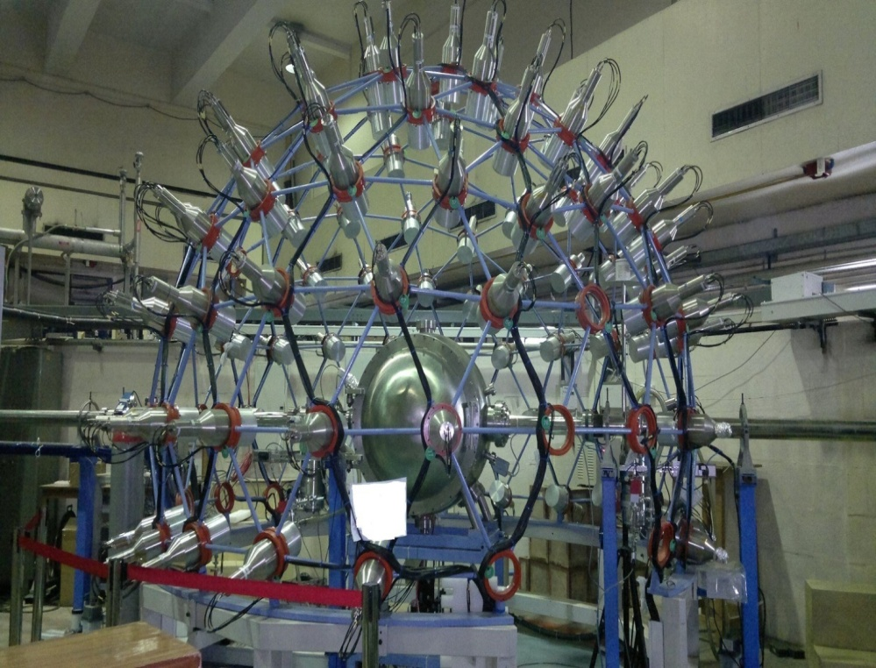
Mass distribution measurement for ⁴⁸Ti+²⁰⁸Pb & ⁴⁸Ti+²³²Th system
⁴⁸Ti+²⁰⁸Pb and ⁴⁸Ti +²³²Th leading to ²⁵⁶Rf₁₀₄ and ²⁸⁰Cn₁₁₂ composite system respectively
15 UD Pelletron + LINAC accelerator @ IUAC, New Delhi
Beam Energy = 275 and 280 MeV, Beam Current= 0.7 pnA
Target thickness = 250 μg/cm²
NAND:
Geodesic dome structure for detector mounting
Neutron flight path: 175 cm
Organic liquid scintillator (BC501A) for fast neutron detection
Diameter of reaction chamber: 100cm
National Array of Neutron Detectors (NAND) : Array of 100 BC501 A Neutron Detectors
Detail - K.S. Golda – This conference
P. Sugathan et al., Pramana: Vol 83, Issue 5 (2014), 807-815

Slide 7
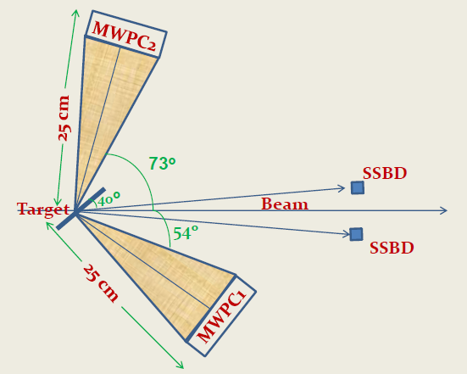
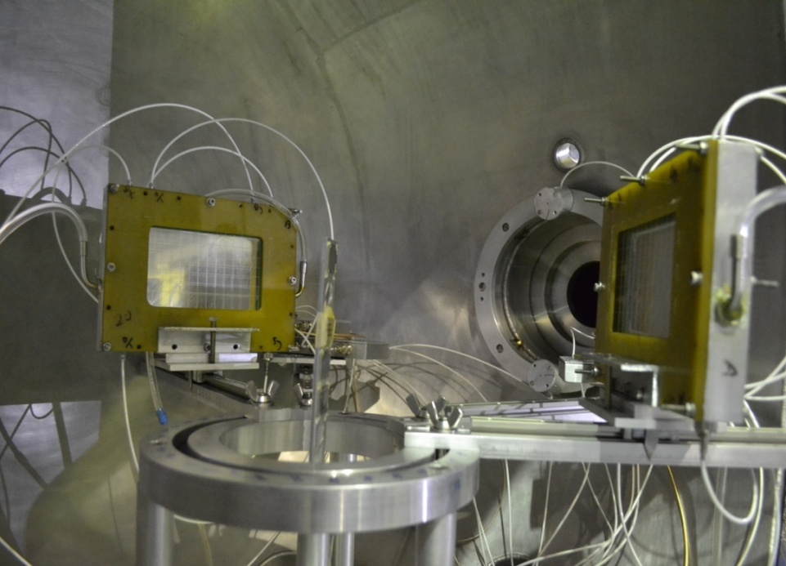
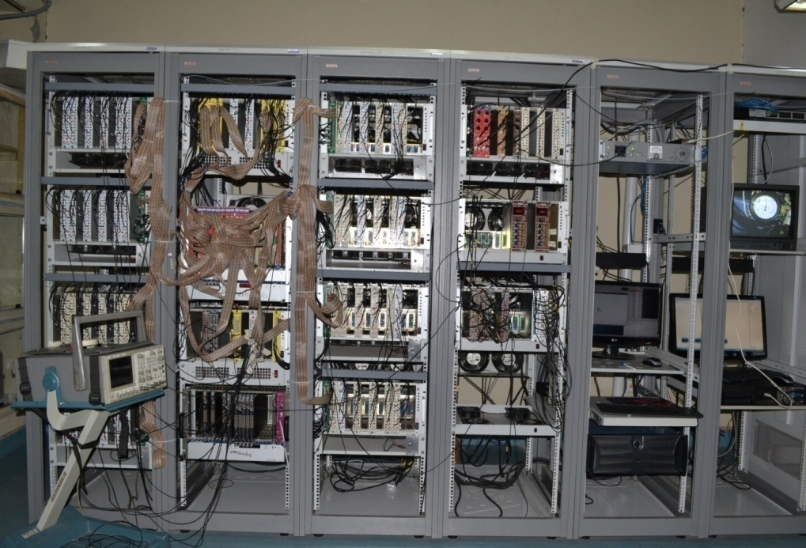
Experimental Setup
MWPCs are used for fission fragment detection
Detectors kept at respective folding angle
Distance 25 cm
SSBD for beam monitoring
Home made pre-amplifiers for processing signal
VME based DAQ with LAMPS for data collection
⁴⁸Ti+²³²Th

Slide 8
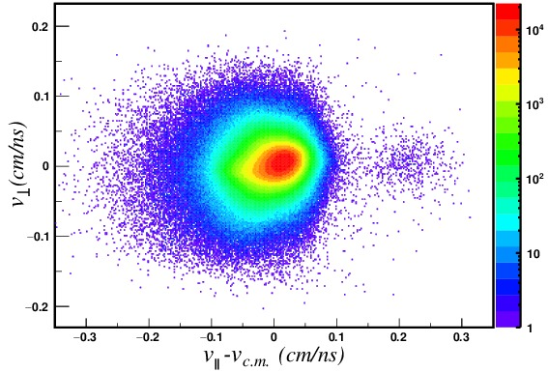
The binary events originated from full momentum transfer (FMT) are characterized by the intense region corresponding to velocity co-ordinate ( V║ – V_{c.m.} , V┴ ) = (0,0) , The FWHM at (0,0) is (0.12, 0.1). The spread is due to the evaporation of charged particles and neutrons either from the composite system before the session point or from the fission fragments,
(M. Thakur et al., Eur.Phys J A(2017)53-133)

Slide 9
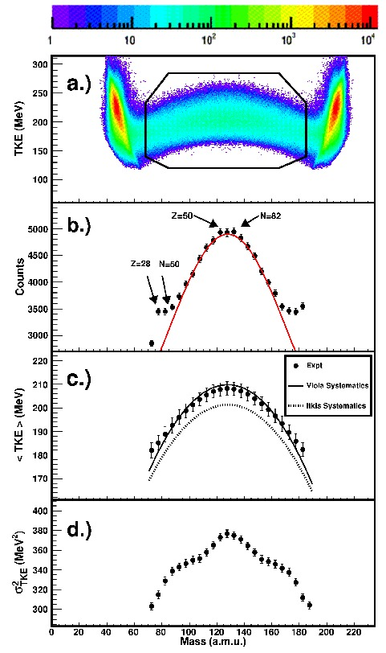
Mass energy Distribution (MED):
In spite of the symmetric fission components described by Gaussian there is also appearance of shoulders, which points towards asymmetric fission components.
According to the N/Z hypothesis, shoulders are peaking around fission fragment mass 69 a.m.u. and 84 a.m.u. corresponding to proton and neutron shell closures at Z= 28, 50 and N=50, 82 respectively.
The Shoulder peaking around the fission fragment masses 64 a.m.u corresponds to the proton and neutron numbers at Z=26 and and N=38, while the right shoulder appear around 192 a.m.u, which is the sum of Z=78 and N=114.
Neutron Numbers from DNS calculation
M. Thakur et al., Eur. Phys. J A (2017) 53-133

Slide 10
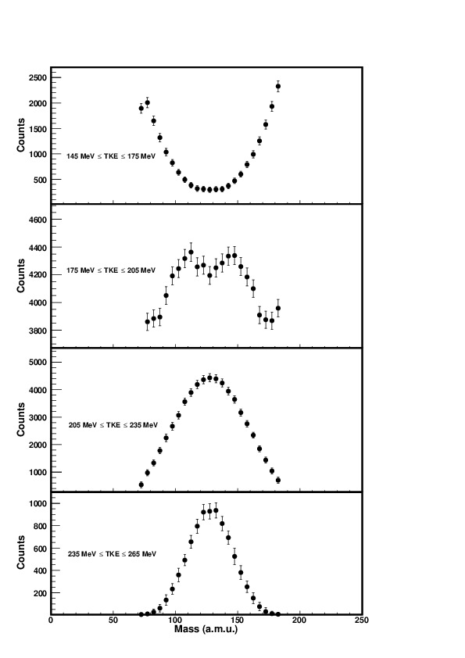
TKE cuts in the MED
(a). 145 MeV ≤ TKE ≤ 175 MeV
A Valley observed in symmetric mass region
(b). 175 MeV ≤ TKE ≤ 205 MeV
The Valley shifted upwards and has side
shoulders corresponding to shell closures at Z= 28, 50 and N=50, 82
(c). 205 MeV ≤ TKE ≤ 235 MeV
A broad mass distribution with FWHM=77 a.m.u
(d). 235 MeV ≤ TKE ≤ 265 MeV
The shape of the distribution is gaussian with
Narrow FWHM. of 42 a.m.u - Fusion-fission
M. Thakur et al., Eur. Phys. J A (2017) 53-133

Slide 11
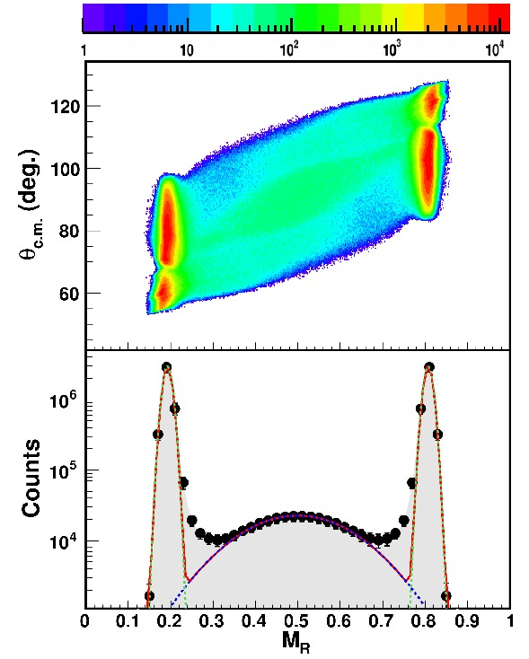
Mass Angle Distribution
A strong mass angle co-relation was observed. This observation indicates significant contribution from asymmetric fission in addition to true fusion-fission process
The lower panel illustrates the projection of MAD on MR axis
in θ_{c.m.} window 70 to 105 .
The distribution is fitted with three Gaussiaon.
M. Thakur et al., Eur. Phys. J A
(2017) 53-133

Slide 12
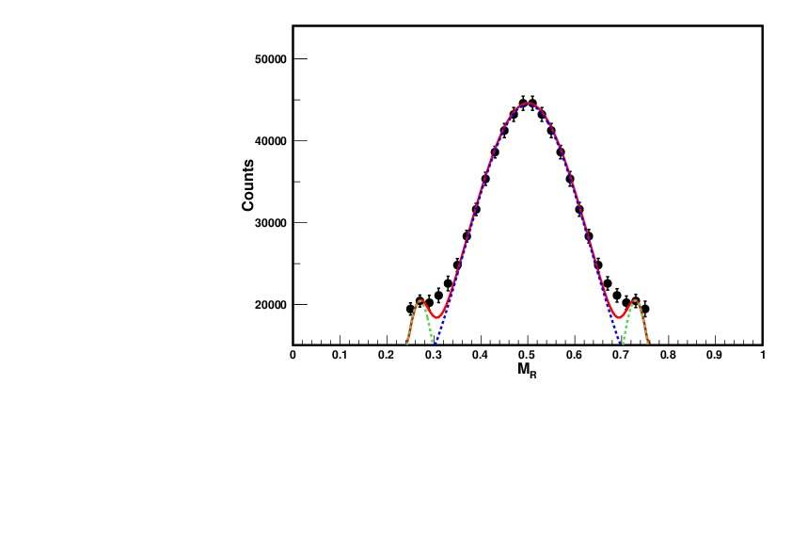
The MR distribution of fission
fragments in the region
0.23 < M_{R} < 0.76 and θ_{c.m}.
window 70º ≤ θ_{c.m.} ≤ 105º
Shoulders are asymmetric mass events
The extracted mass width (σ_{MR}) for ⁴⁸Ti+²⁰⁸Pb using Gaussian fitting is 0.134+0.0004, larger than that for ⁴⁸Ca+²⁰⁸Pb but less than that of ⁴⁸TI+²⁰⁰Hg, even though these experiments were performed around the Coulomb barrier. In ⁴⁸Ti+²⁰⁸Pb system, the number of shell closure of two, while it is four in the ⁴⁸Ca+²⁰⁸Pb system and absent in the ⁴⁸Ti+²⁰⁰Hg system. The observed variation could be attributed to an artifact of the interplay between the entrance channel magicity and charge product effects.
M. Thakur et al., Eur. Phys. J A (2017) 53-133

Slide 13
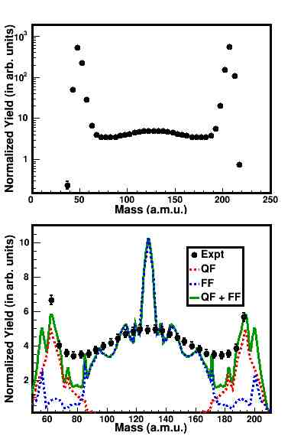
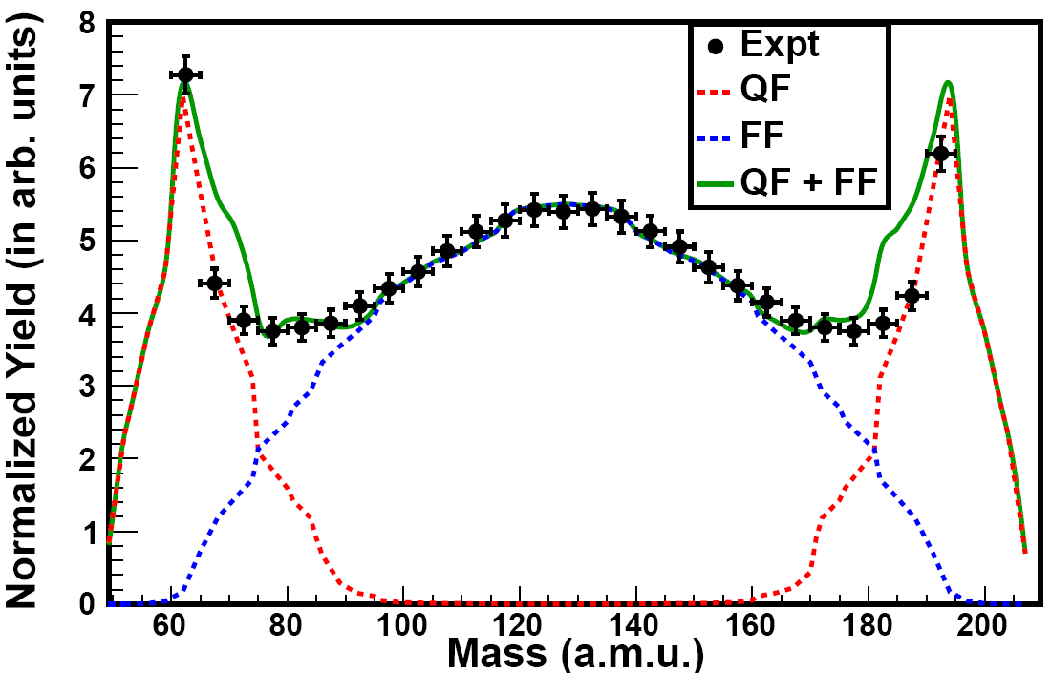
Calculations by DNS Model ..
Theoretical Yields of mass distribution by DNS model shows that there is a overlap of the mass distributions of the quasi-fission and fusion-fission products near mass number A=64. The peak A=64 is related with the formation of the isotopes Fe and Ni with the neutron number N=38 and N=40.
Upper Panel - Experimental Mass distribution.
Lower Panel – Theoretical Calculations
along with expt. mass distributions
Nasirov et al. NPA 759 342 (2005).
M. Thakur et al., Eur. Phys. J A (2017) 53-133

Slide 14
Summary of MD, MED and MAD for ⁴⁸Ti+²⁰⁸Pb->²⁵⁶Rf
1. Mass energy distribution (MED) analysis shows the simultaneous occurrence of quasi-fission and fusion-fission process in the decay of near super heavy nucleus ²⁵⁶Rf.
2. Mass symmetric region is contaminated by quasi-fission process.
3. The observed correlation in MAD and the broad mass distribution along with side shoulders at proton and neutron shell closure have been attributed to the presence of asymmetric fission in addition to fusion-fission process.
3. The observed mass yield distributions for the different TKE region confirmed the fact that the symmetric fragmentation dominated by fusion-fission process increases with increase in TKE.

Slide 15
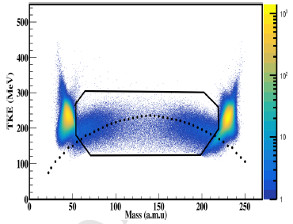
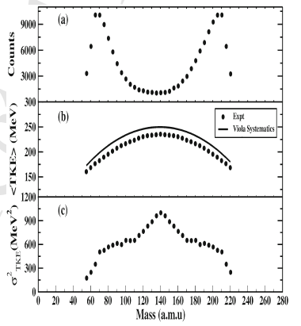
Case Study for MED, MAD for ⁴⁸Ti+²³²Th @ 280 MeV
E* = 63.5 MeV
Mass-TKE co-relation plot for ⁴⁸Ti+²³²Th. The dotted line shows viola systematics
The mass distribution is found to be wide double humped shape caused by dominance of quasi-fission (QF) process. A deviation of TKE from viola systematic is observed due to QF process
Mass distribution and TKE for the selected mass region for ⁴⁸Ti+²³²Th
Shruti et al. Accepted for Eur. Phys. J. A

Slide 16
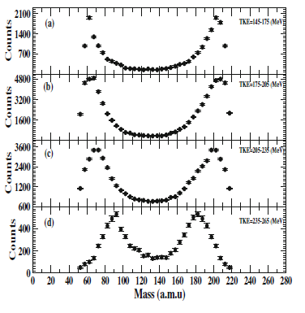
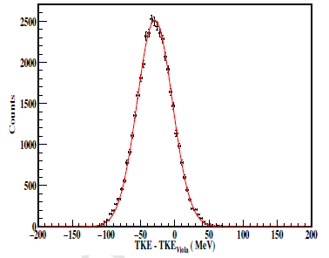
Fragment mass distribution for the polygon gated region corresponding to different TKE cuts starting from the lowest value of the TKE to the highest value of TKE.
TKE distribution of the fragments for the symmetric mass region A_{CN}/2 ±20 . Red lines show the fit to the data by a Gaussian fit.
Shruti et al. Accepted for Eur. Phys. J. A

Slide 17
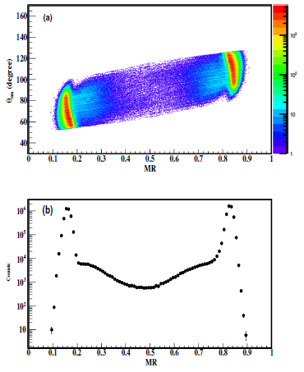
Two dimensional plot for the mass angle (MAD) distribution for ⁴⁸Ti+²³²Th system @63.5 Mev
Projection of MAD on MR axis.
A strong mass angle co-relation was observed
Shruti et al. Accepted for Eur. Phys. J. A

Slide 18
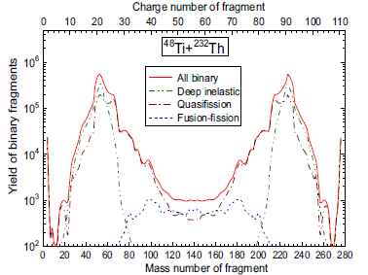
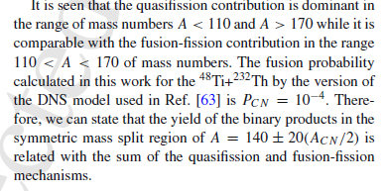
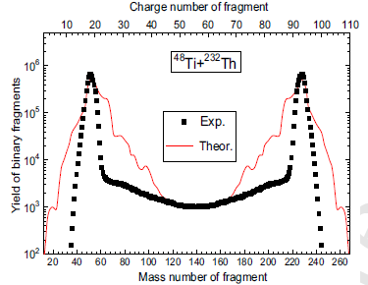
Theoretical Calculation by DNS Model
Nasirov et al. NPA 759, 342 (2005)
Shruti et al. Accepted for Eur. Phys. J. A

Slide 19
Summary of MD, MED and MAD for ⁴⁸Ti+²³²Th->²⁸⁰Cn₁₁₂
Mass-total kinetic energy distribution of the final fragments obtained in the reaction ⁴⁸Ti+²³²Th at an incident energy 280 MeV has a continuous spectrum in mass which is extending from the projectile-like to the target-like mass with a broad-ranging distribution of fission-like events centred at mass-symmetry of the fissioning system.
2. The mass distribution of the studied reaction has typical wide double hump shape with the maximum at the mass numbers A = 80 and A = 200 which is caused by the yield of the asymmetric quasi-fission fragments.
3. The QF presence is confirmed by the correlation in the experimental mass-angle distribution. The fission following the compound nucleus formation has nearly symmetric mass division and thus possess forward backward symmetric angular distributions relative to the 90◦ While the light quasi-fission products have distribution in the forward angles and the heavy quasi-fission products have distribution in the backward angles.
DNS Model calculation also predicted large QF events with a very small contribution from the symmetric fragments.
5. A deviation from the Viola systematic has been observed.

Slide 20
Collaborators:
1. Dr. Meenu Thakur , Ms. Shruti (Ph.D. Students Panjab University, India )
2. A.K. Nasirov - Bogoliubov Laboratory of Theoretical Physics, JINR, Dubna, Russia
Dr. P. Sugathan, Dr. Akhil Jhingan, K.S. Golda, N. Saneesh, Mohit Kumar – Inter University Accelerator Centre, New Delhi, India
4. S. Mandal, Kajol Chakraborty – University of Delhi, India
5. H. J. Wollersheim, J. Gerl – GSI, Darmstadt, Germany
6. Hardev Singh - Kurukshetra University, Kurukshetra , India

