Slide 1

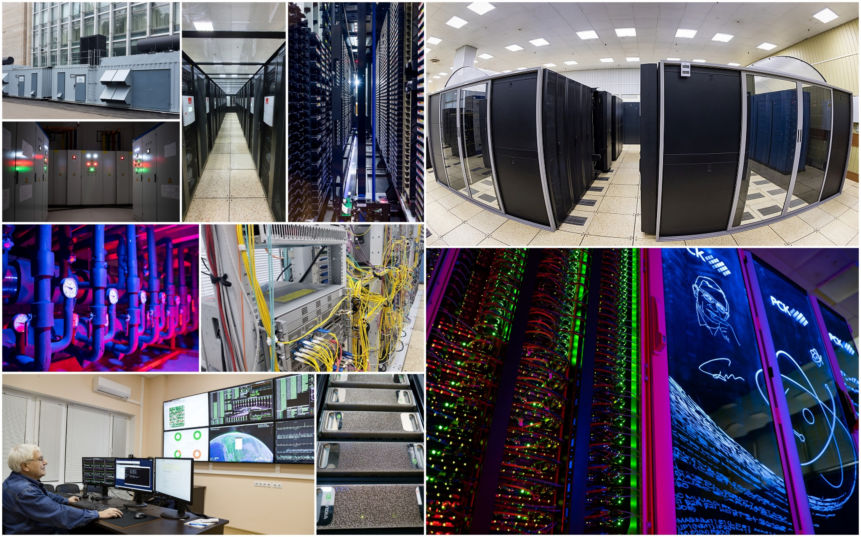

Processing and Storage of HEP Experimental Data @ JINR
Nikolay Voytishin
On behalf of
Meshcheryakov Laboratory of Information Technologies,
JINR
JINR-India workshop Dubna, Russia, October2023

Slide 2

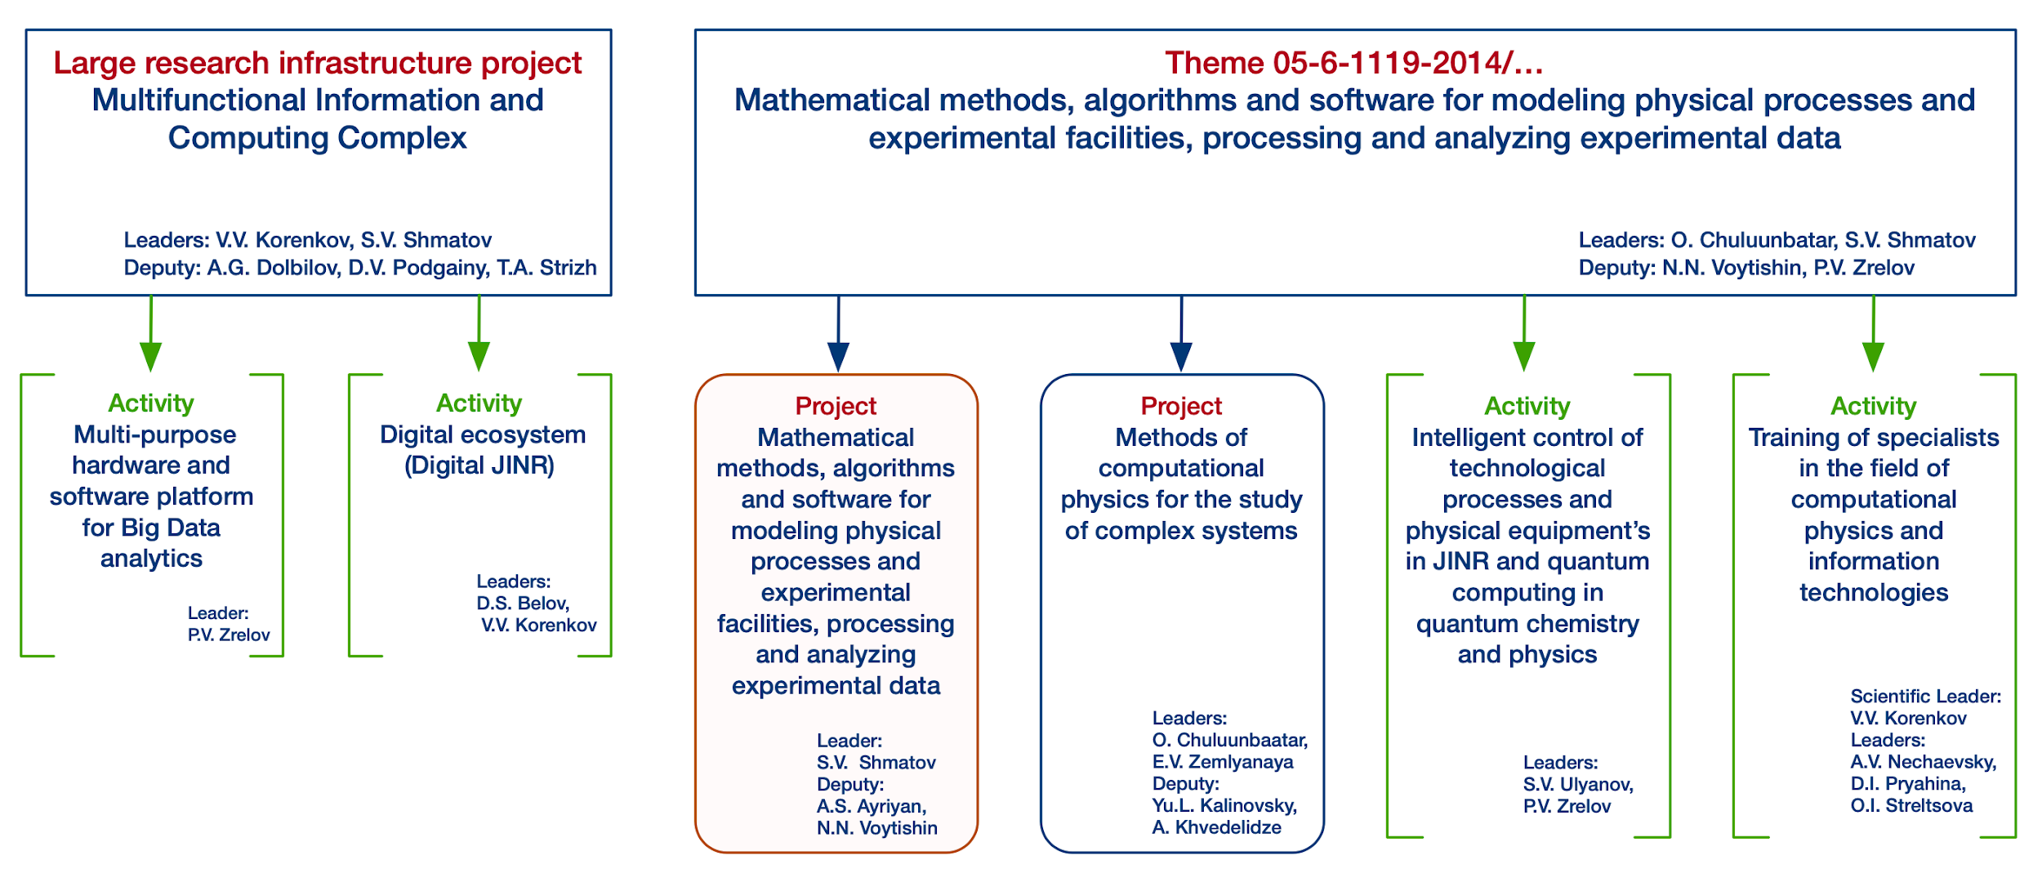
Information Technologies @ JINR
Leaders: Korenkov V.V. , Shmatov S.V.
Deputy Leaders: Dolbilov A.G., Podgainy D.V.,
Strizh T.A.
Activity
Multi-purpose hardware and software platform for Big Data analytics
Activity
Digital ecosystem (Digital JINR)
Leaders:
Korenkov V.V.,
Belov S.D.
Leader: Zrelov P.V .

Slide 3
Information Technologies @ JINR
Dedicated IT tasks and resources for HEP experiments
Leaders: Korenkov V.V. , Shmatov S.V.
Deputy Leaders: Dolbilov A.G., Podgainy D.V.,
Strizh T.A.
Activity
Multi-purpose hardware and software platform for Big Data analytics
Activity
Digital ecosystem (Digital JINR)
Leaders:
Korenkov V.V.,
Belov S.D.
Leader: Zrelov P.V .

Slide 4

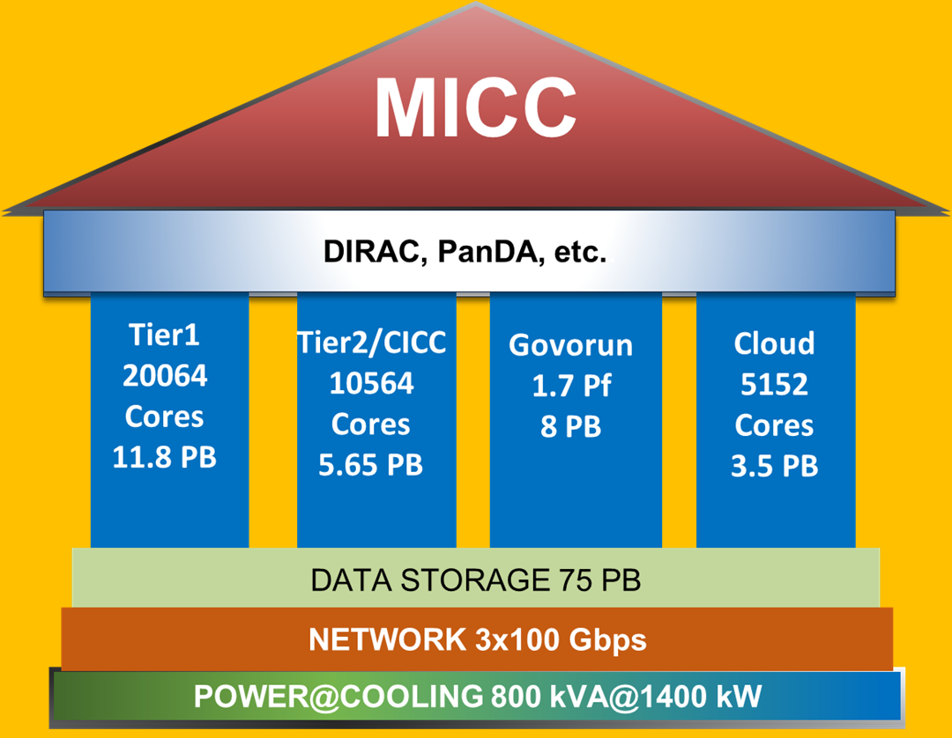
Multifunctional Information and Computing Complex (MICC)
4 advanced software and hardware components
Tier1 grid site
Tier2/CICC site
hyperconverged “Govorun” supercomputer
cloud infrastructure
Distributed multi-layer data storage system
Disks
Robotized tape library
Network
Wide Area Network
Local Area Network
Engineering infrastructure
Power
Cooling
The main objective of the project is to ensure multifunctionality, scalability, high performance, reliability and availability in 24x7x365 mode for different user groups that carry out scientific studies within the JINR Topical Plan.

Slide 5
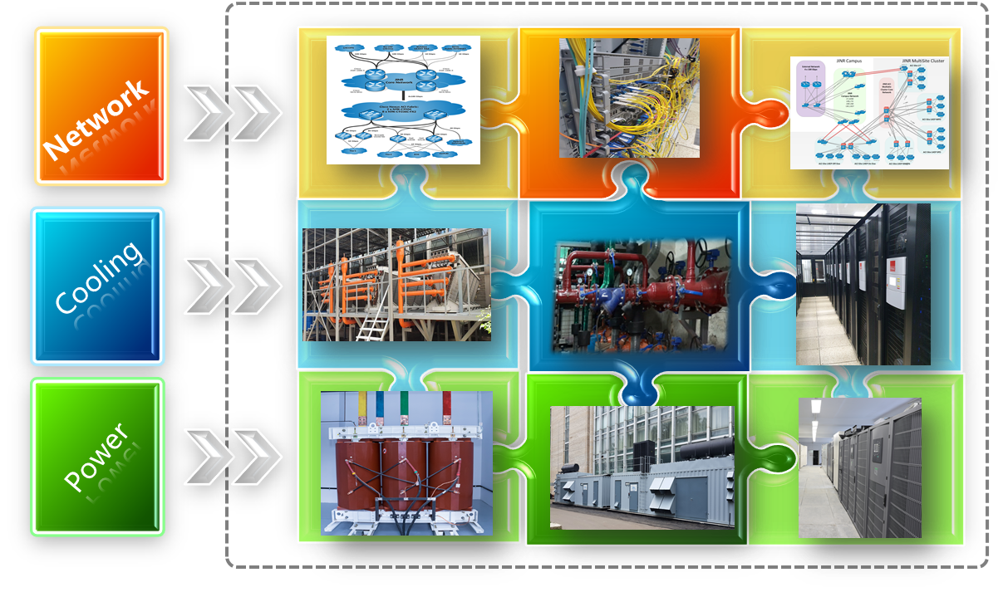
MICC Power @ Cooling @ Network
Wide Area Network 3x100 Gbps
Cluster Backbone 4x100 Gbps
Campus Backbone 2x100 Gbps
Dry chillers
In-Row systems
Total cooling 1400 kW
Uninterruptible power supplies (UPS) 8x300 kVA
Diesel-generator units (DGU) 2x1500 kVA
Transformers 2x2500 kVA
5

Slide 6
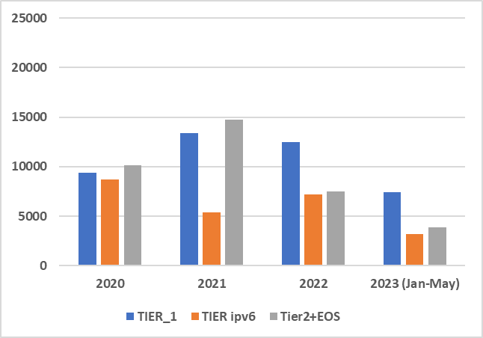
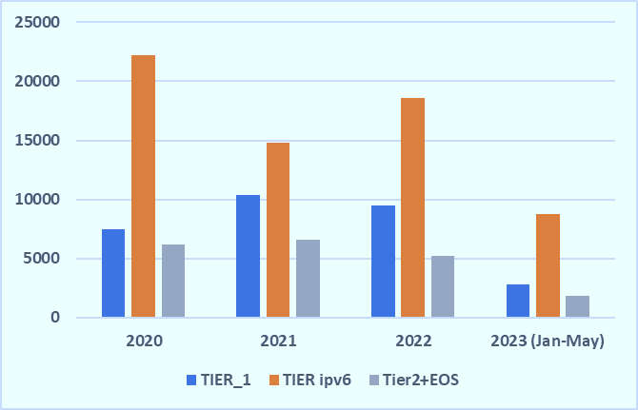
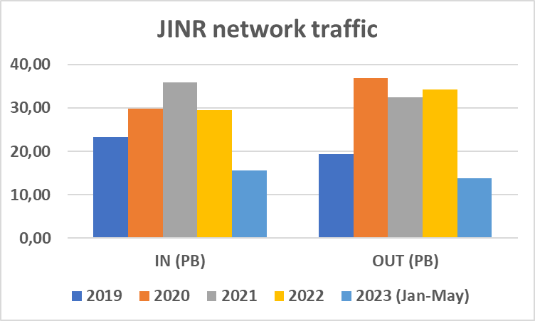
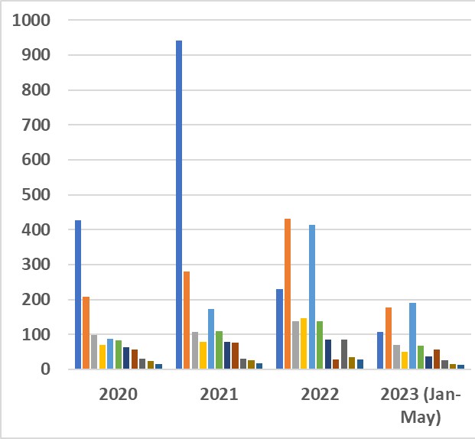
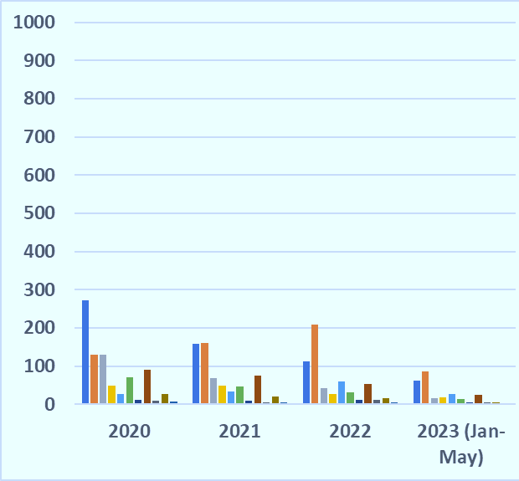
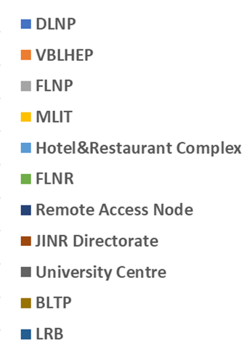
Networking @ Traffic
Distribution of the incoming and outgoing traffics by the JINR MICC in 2020-2023 (TB)
Wide Area Network 3x100 Gbps
Cluster Backbone 4x100 Gbps
Campus Backbone 2x100 Gbps
Incoming
Outgoing
JINR Traffic in PB
Distribution of the incoming and outgoing traffics by the JINR subdivisions in 2020-2023 (TB)
Incoming
Outgoing
Users - 6353
Network elements - 9327
IP addresses - 18163
Remote access - 911
E-library - 1464
VOIP - 121
EDUROAM - 116
Email @jinr.ru - 4579

Slide 7
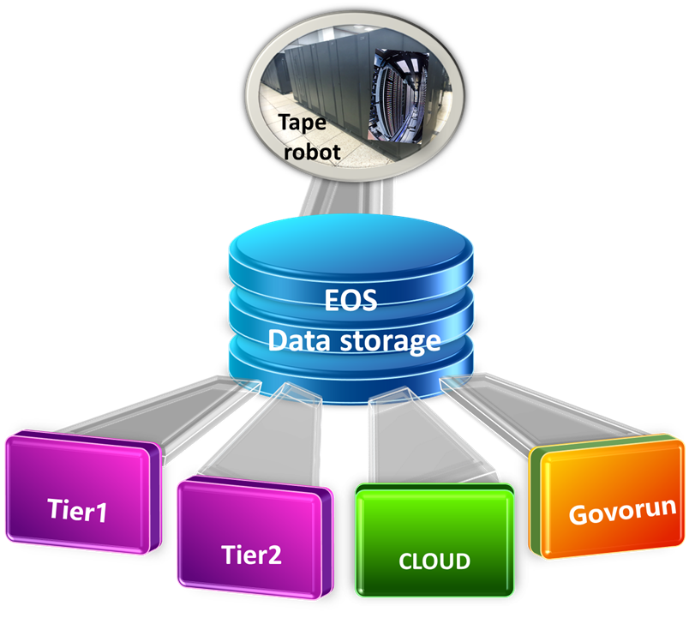
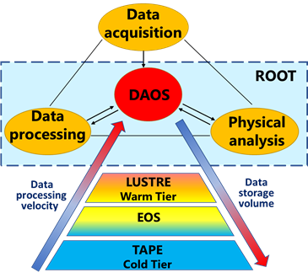
Distributed Multi-layer Data Storage System
Limited data and short-term storage – to store the OS itself, temporary user files
AFS distributed global system – to store user home directories and software
dCache is traditional for the MICC grid sites – to store large amounts of data (mainly LHC experiments) for the middle-term period
EOS is extended to all MICC resources – to store large amounts of data for the middle-term period. At present, EOS is used for storage by BM@N, MPD, SPD, BaikalGVD, etc.
Tape robotic systems – to store large amounts of data for the long-term period. At present, for CMS. BM@N, MPD, SPD, JUNO – in progress.
A special hierarchical data processing and storage system with a software-defined architecture was developed and implemented on the “Govorun” supercomputer.
According to the speed of accessing data, there are the following layers:
  very hot data (DAOS (Distributed Asynchronous Object Storage)),
  the most demanded data (fastest access),
  hot data,
  warm data (LUSTRE).

Slide 8
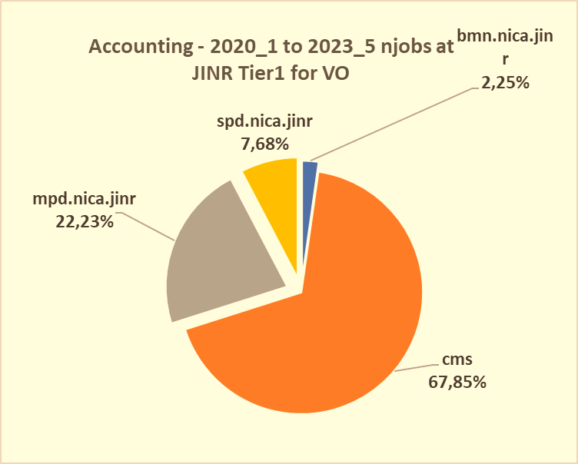
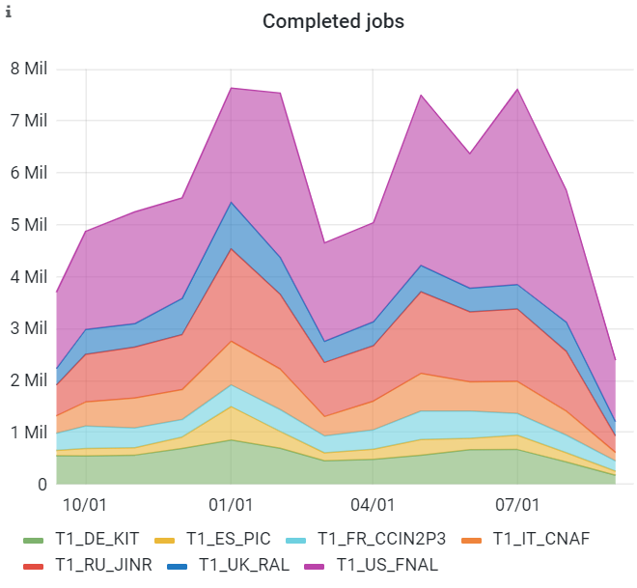
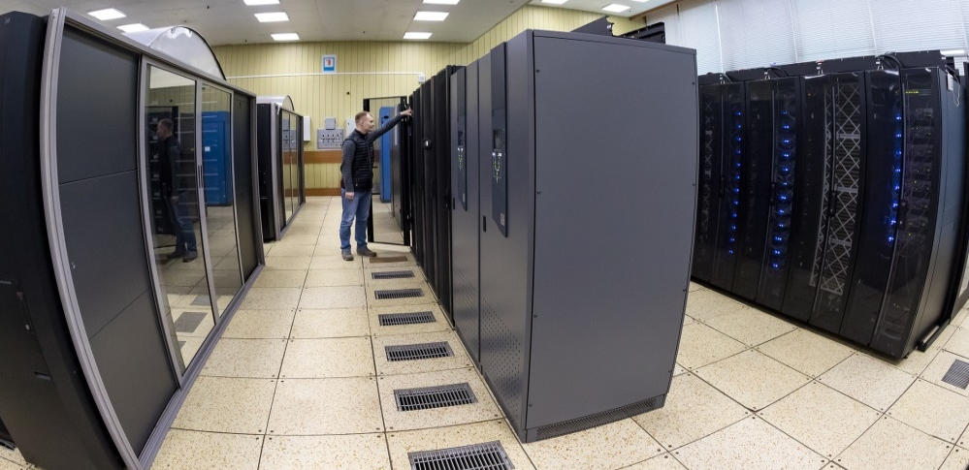
JINR Tier1 for CMS (LHC) and NICA
Last year
Since the beginning of 2015, a full-scale WLCG Tier1 site for the CMS experiment has been operating at MLIT JINR.
The importance of developing, modernizing and expanding the computing performance and data storage systems of this center is dictated by the research program of the CMS experiment, in which JINR physicists take an active part within the RDMS CMS collaboration.
JINR Tier1 is regularly ranked on top among world Tier1 sites that process data from the CMS experiment at the LHC.
.
Since 2021, the JINR Tier1 center has demonstrated stable operation not only for CMS (LHC), but also for the NICA experiments.
20060 CPU cores;
11,7 PB dCache based disk storage;
21,3 PB Tape storage
100% reliability and availability

Slide 9
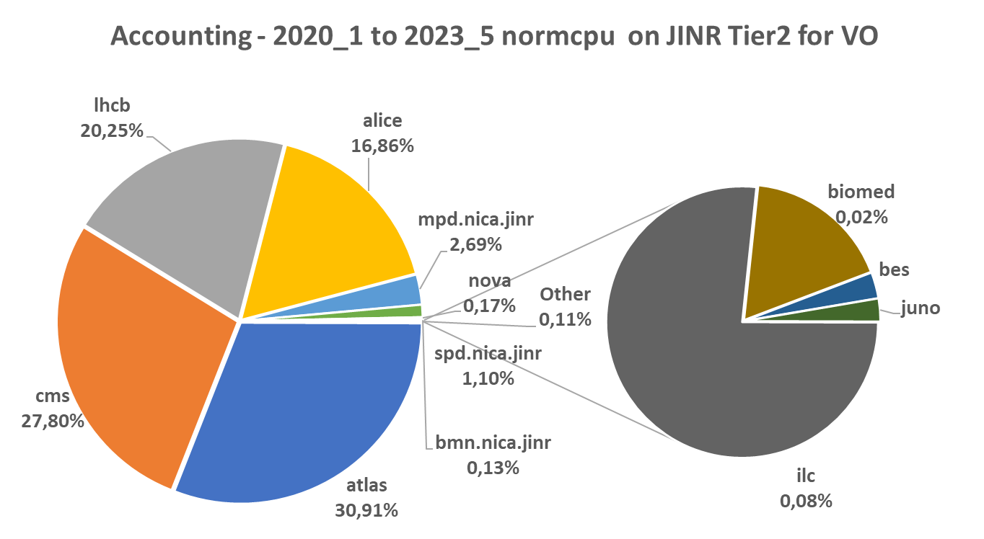
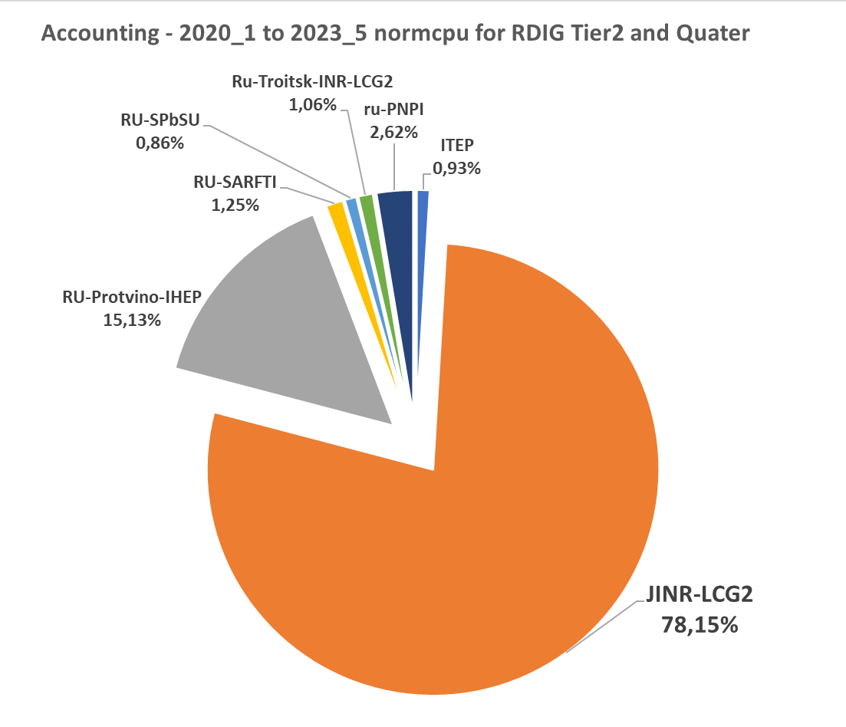
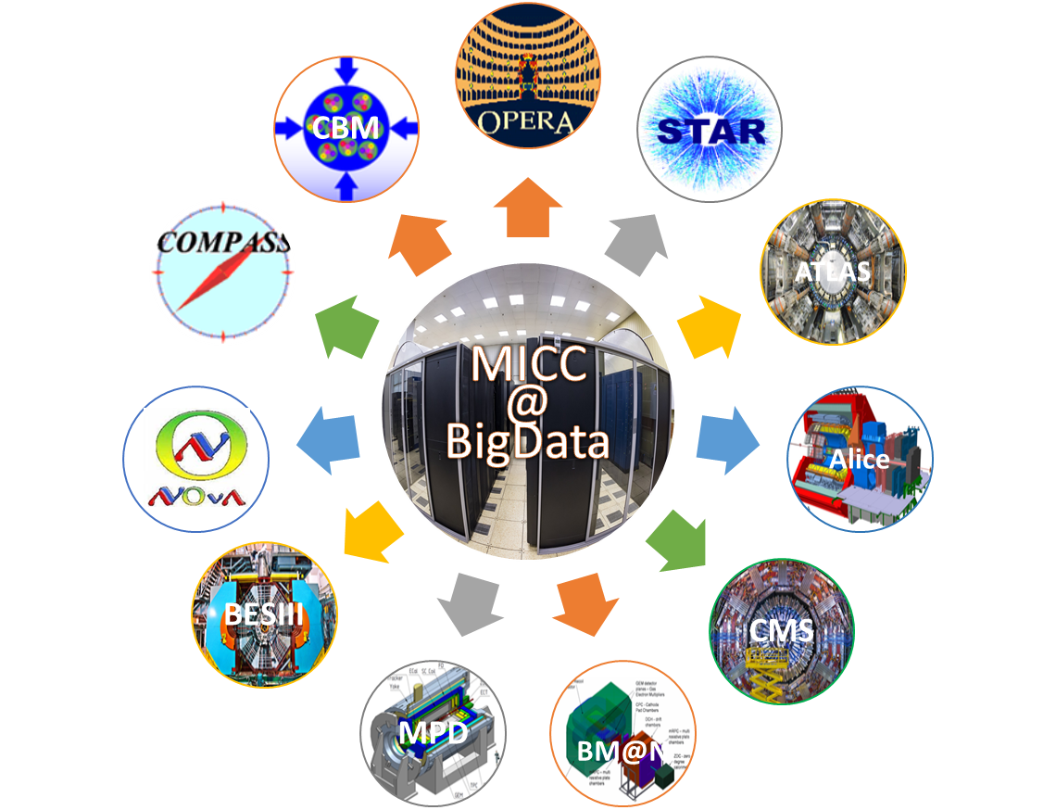
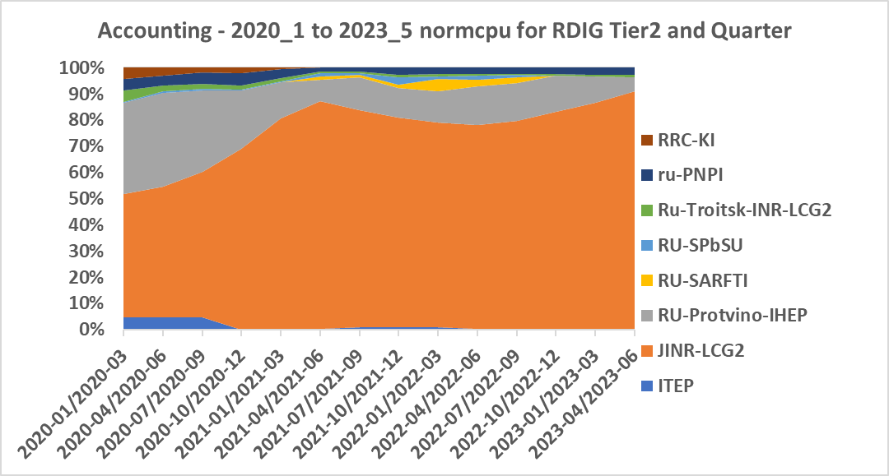
JINR Tier2 in WLCG & RDIG
Tier2 at JINR provides computing power and data storage and access systems for the majority of JINR users and user groups, as well as for users of virtual organizations (VOs) of the grid environment (LHC, NICA, etc.).
JINR Tier2 is the most productive in the Russian Data Intensive Grid (RDIG) Federation.
Almost 80% of the total CPU time in the RDIG is provided by JINR Tier2 site.

Slide 10
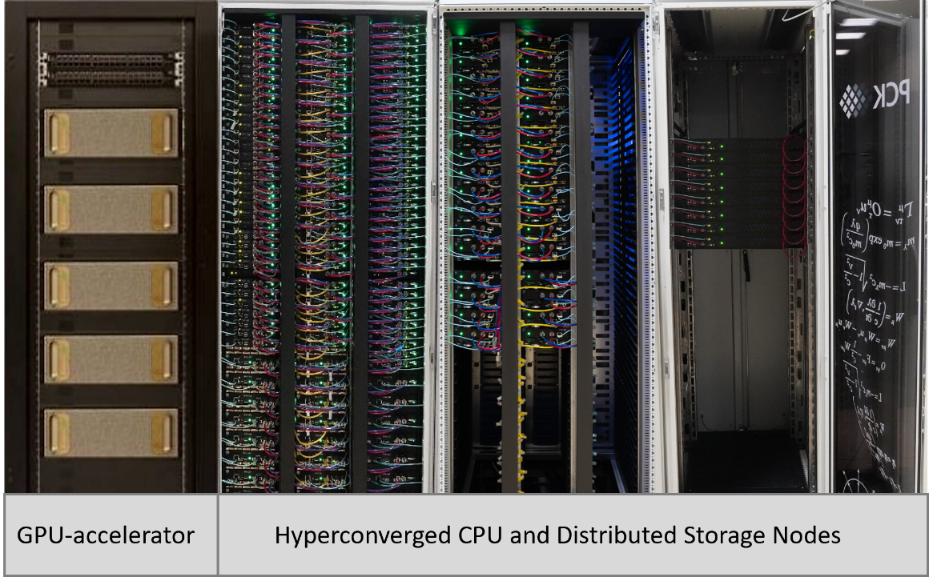
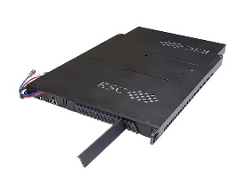
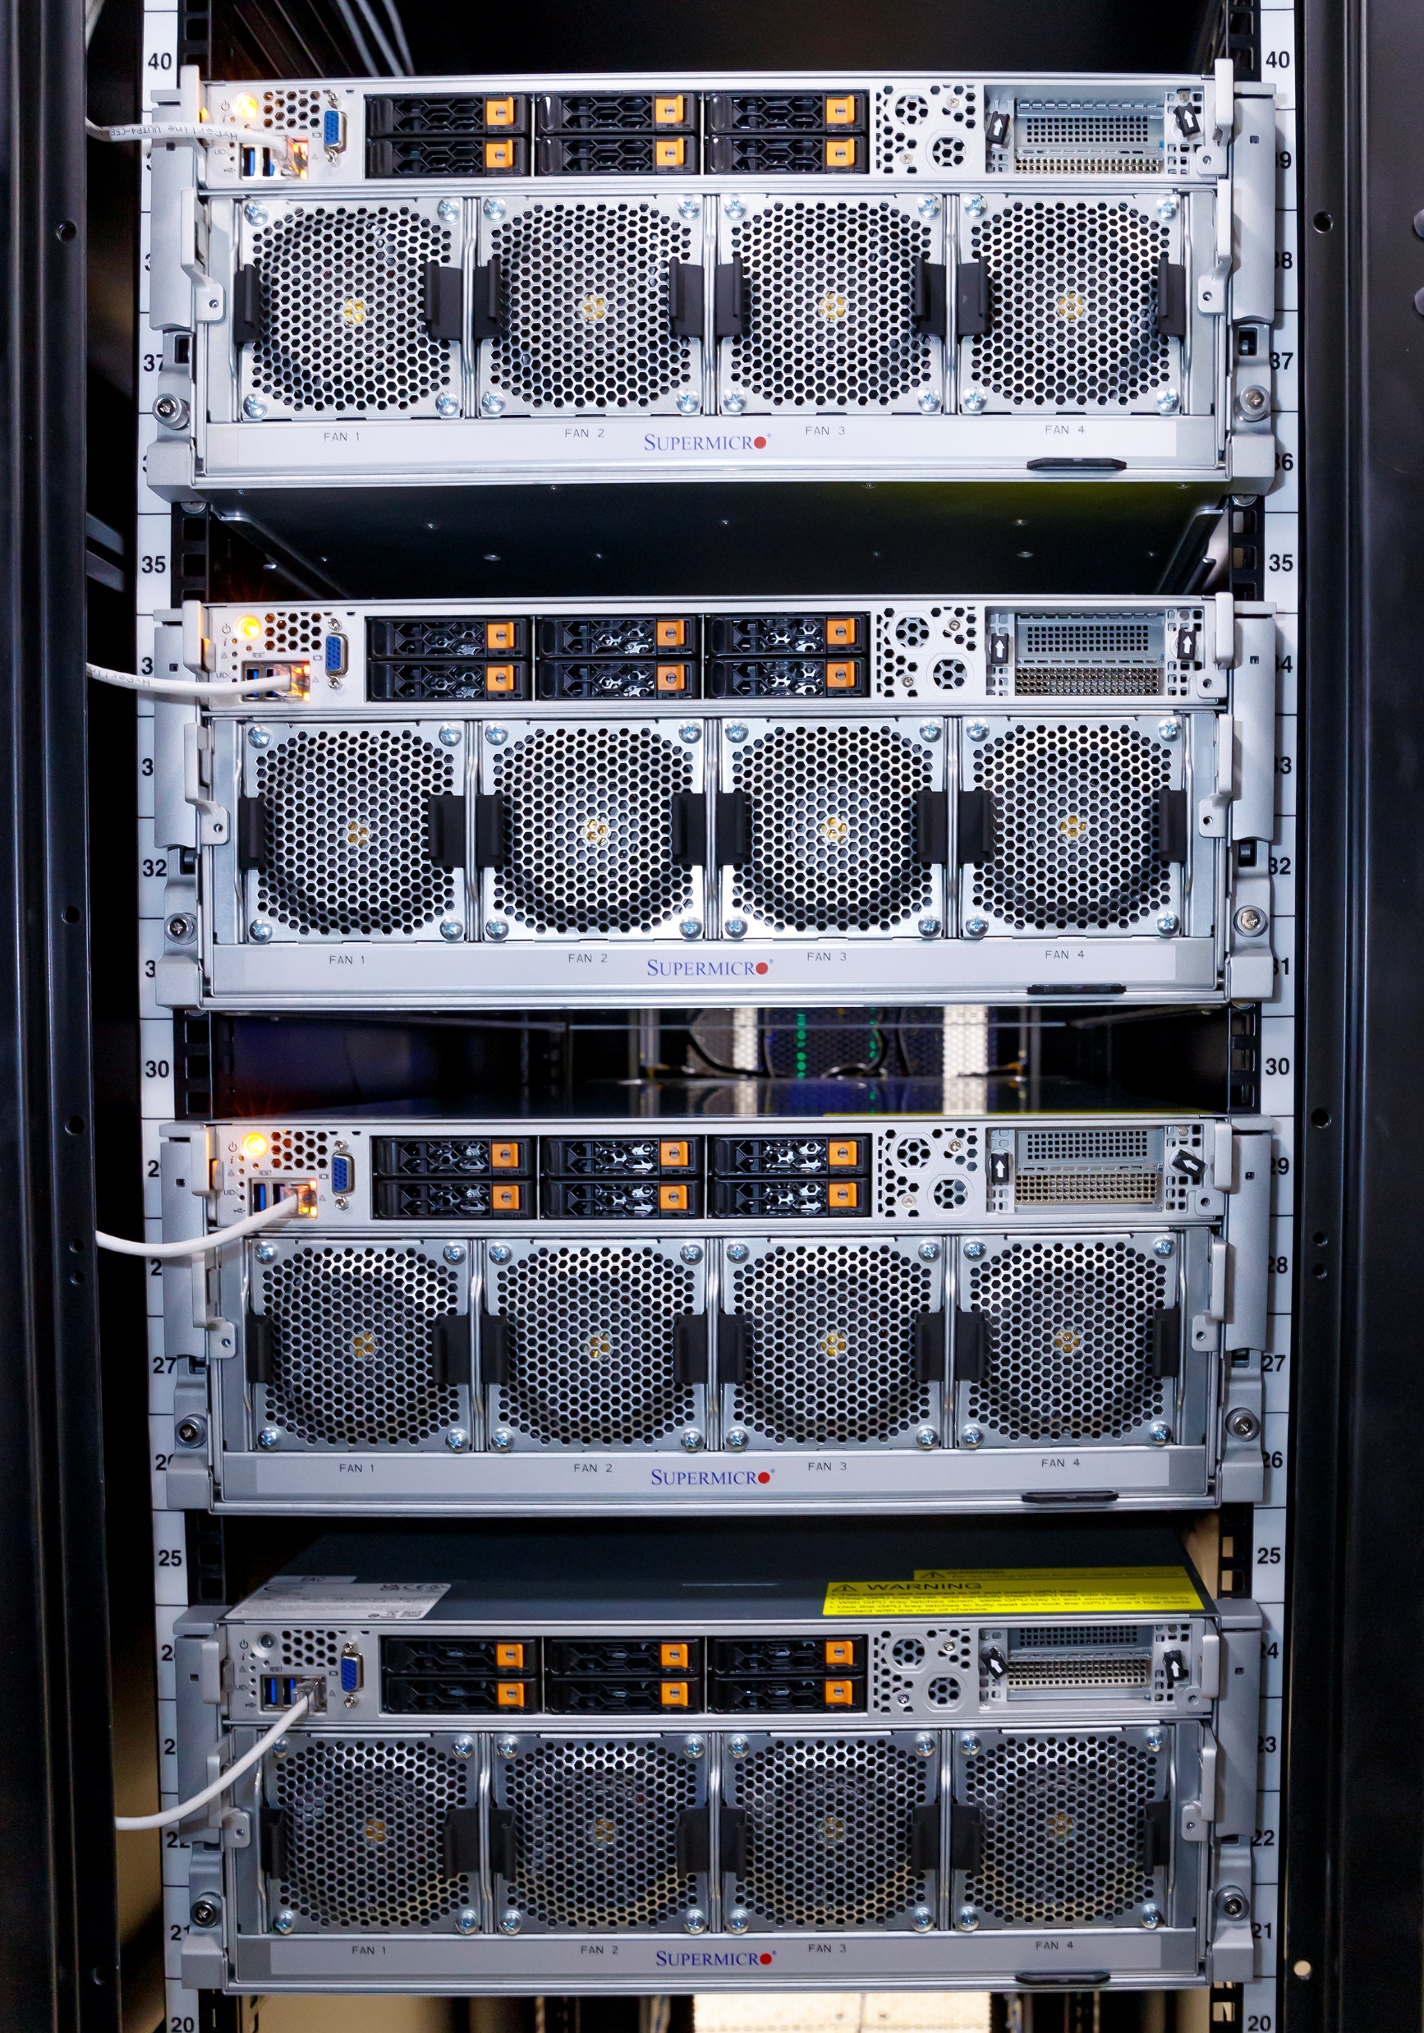
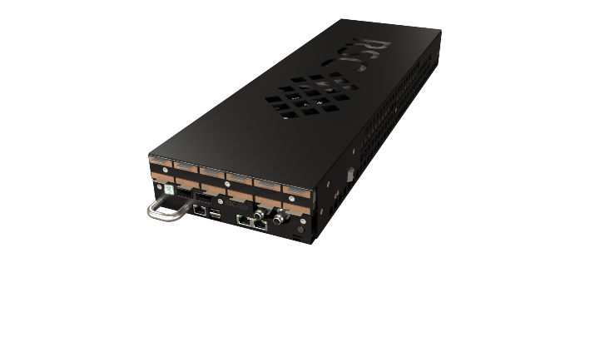

"Govorun" supercomputer modernization in 2022 - 2023
+ 40 NVIDIA А100 GPU accelerators
Performance: + 600 Tflops DP
+32 hyperconverged compute nodes
+2 432 new computational cores
Performance: +239 Tflops DP
“New cores”/”old cores” performance
increase by more than 1.5 times
+8 distributed storage nodes
Lustre, EOS increase: +8 PB
DAOS increase: +1.6 PB
+0.4 PB for MPD mass production storages integrated into the DIRAC File Catalog
+1 PB for the MPD EOS storage
+
+
+
Computation field:
+32 hyperconverged compute nodes
Hierarchical Storage:
+8 distributed
storage nodes
“Govorun” SC total peak performance: 1.7 PFlops DP
Total capacity of Hierarchical Storage: 8.6 PB
Data IO rate: 300 Gb/s
5 servers with 8 NVidia A100 GPUs in each
Notes:
В ноябре 2022 года был осуществлен очередной этап модернизации СК «Говорун», связанный с расширением CPU-компоненты и иерархической системы обработки и хранения данных. В итоге, производительность СК «Говорун» выросла на 23,5% и достигла уровня 1,1 ПФлопс, а общая емкость иерархического хранилища выросла до 8,6 ПБ. Гиперконвергентность новых вычислительных узлов уже позволила задействовать их для задач массовой генерации и реконструкции данных эксперимента MPD NICA: было сгенерировано более 50 миллионов событий. Следует отметить, что для ряда задач MPD возникла потребность в большом объеме оперативной памяти, которую удовлетворяют новые узлы.
In November 2022, the next stage of modernization of the “Govorun” supercomputer, which is associated with the expansion of the CPU component and the hierarchical data processing and storage system, took place. Consequently, the performance of the “Govorun” supercomputer enhanced by 23.5% and reached 1.1 PFlops, and the total capacity of the hierarchical storage increased to 8.6 PB. The hyperconvergence of the new compute nodes has already enabled their use for data mass generation and reconstruction tasks within the NICA MPD experiment: over 50 million events were generated. It is noteworthy that for a number of MPD tasks, there was a need for a large amount of RAM, which is satisfied by the new nodes.
10

Slide 11
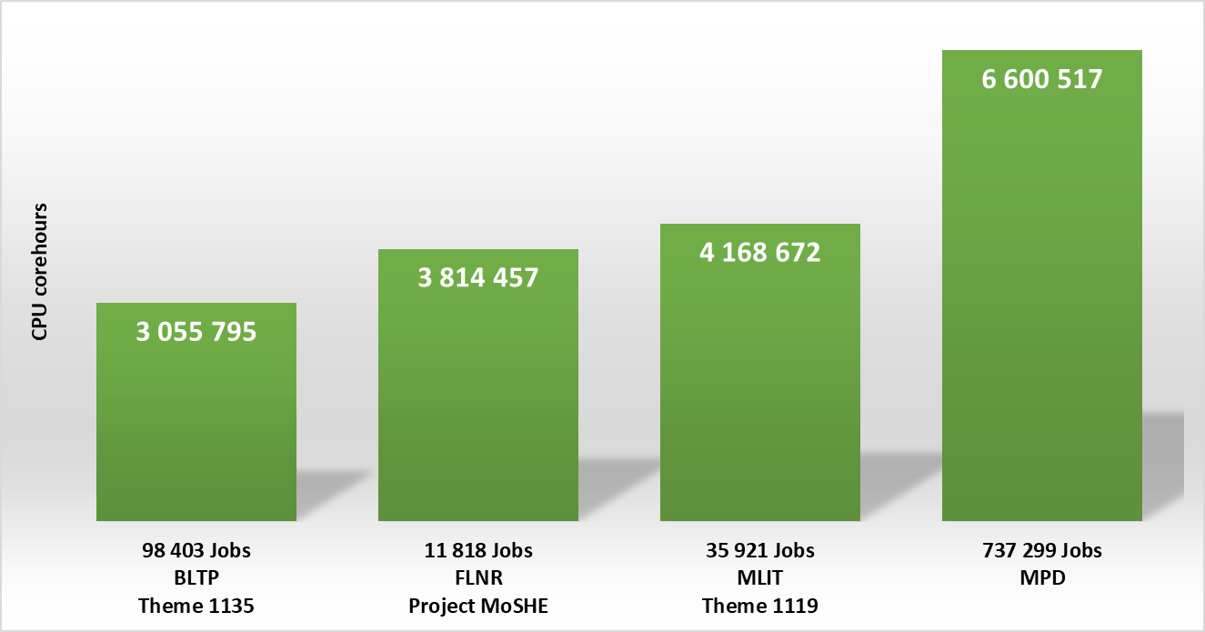
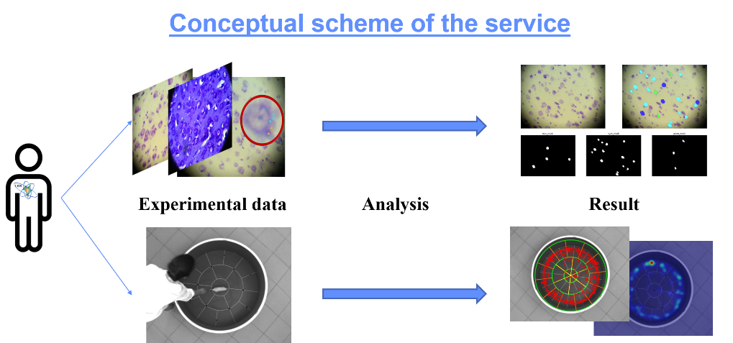
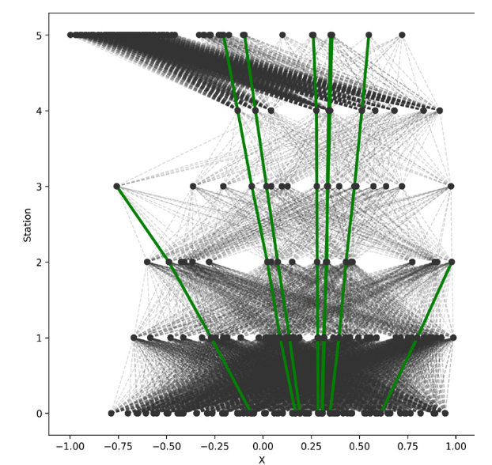
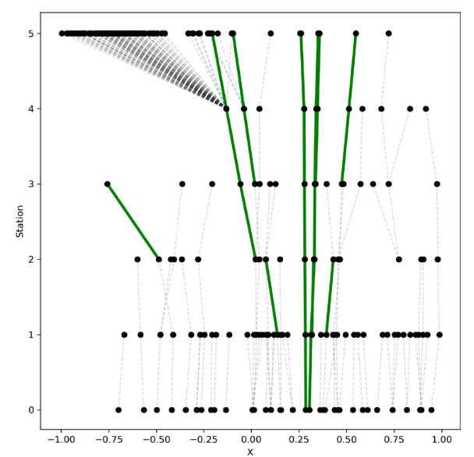
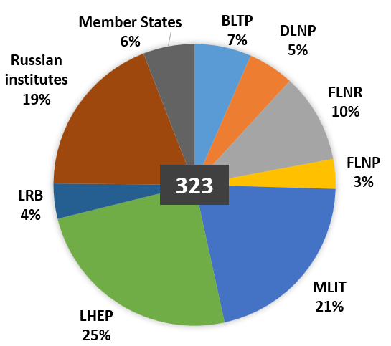
“Govorun” Supercomputer for JINR tasks in 2022
Projects that mostly intensively use the CPU resources of the “Govorun” supercomputer:
NICA megaproject,
simulation of complex physical systems,
computations of the properties of atoms of superheavy elements,
calculations of lattice quantum chromodynamics.
Selected statistics of the most
resource intensive projects
The GPU component is actively used for solving applied tasks by the neural network approach:
processing of data from experiments at LRB,
data processing and analysis at the NICA accelerator complex, etc.
During 2022, 890 911 jobs were performed on the CPU component of the “Govorun” supercomputer, which corresponds to 18 543 076 core hours.
The resources of the “Govorun” spercomputer are used by scientific groups from all the Laboratories of the Institute within 25 themes of the JINR Topical Plan.
Information system for
radiation biology tasks
Neural network for HEP data reconstruction and analysis

Slide 12
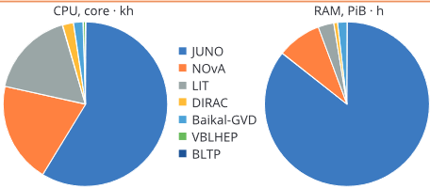
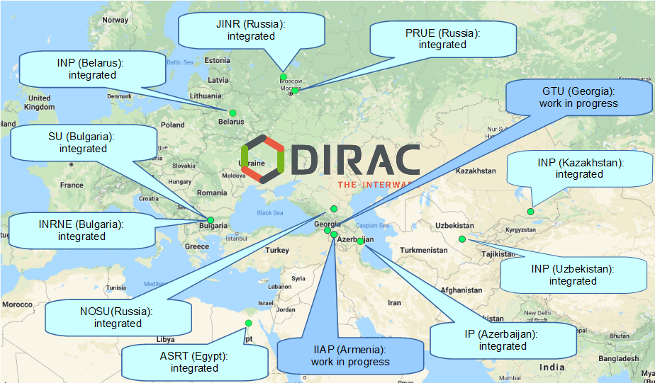
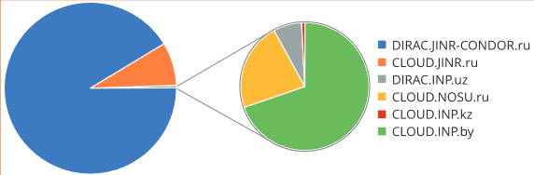
Cloud Infrastructure
Computational resources for neutrino experiments
VMs for JINR users
Testbeds for research and development in IT
COMPASS production system services
Data management system of the UNECE ICP Vegetation
Service for data visualization, Gitlab and some others
The Baikal-GVD, NOvA and JUNO experiments are the major users of the cloud infrastructure.
Usage of cloud computing by experiments and JINR subdivisions in 2022
DIRAC-based distributed information and computing environment (DICE) that integrates the JINR Member State organizations’ clouds
Most of the jobs in the JINR DICE in 2022 were performed on the neutrino computing platform (DIRAC.JINR-CONDOR.ru).
Distribution of the number of jobs completed in the JINR DICE by participants
The main consumer of the JINR DICE resources in 2022 was the Baikal-GVD experiment (96%).
17.10.2023
12
Notes:
A universal computing resource that supports individual scientists and provides a variety of common services, ranging from simple websites to complex multi-user computational systems.

Slide 13

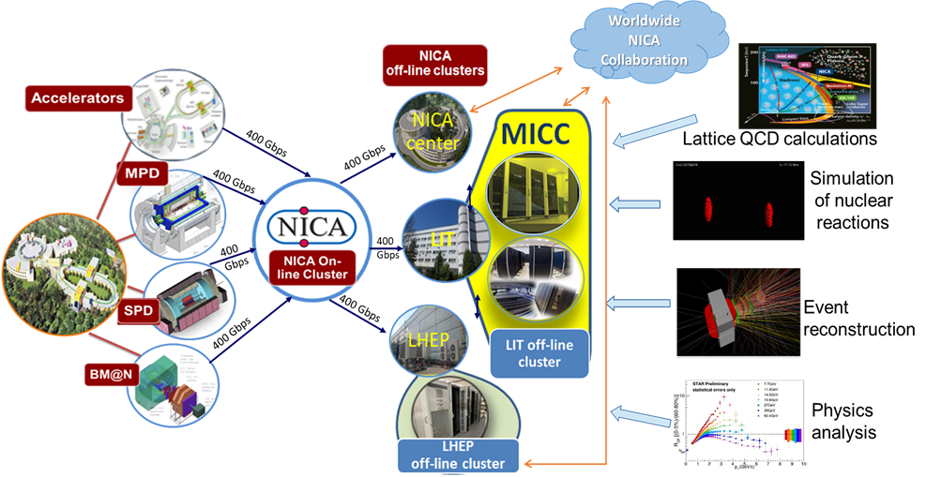
Development of the NICA Information and Computer Complex
The creation of a long-term data storage center on the MICC resources at MLIT (Tier0) is planed. The process of modeling, processing and analyzing experimental data obtained from the BM@N, MPD and SPD detectors will be implemented in a distributed computing environment based on the MICC and the computing centers of VBLHEP and collaboration member countries.
The information and computing unit of the NICA complex embraces:
1. online NICA cluster,
2. offline NICA cluster at VBLHEP,
3. all MICC components (Tier0, Tier1, Tier2, “Govorun” supercomputer, cloud computing),
4. multi-layer data storage system,
5. distributed computing network.
NICA Tier 0,1,2 | 2024 | 2025 | 2026 | 2027 | 2028 | 2029 | 2030
CPU (PFlops) | 2.2 | 2.6 | 8.6 | 8.6 | 15.6 | 15.6 | 15.6
DISK (PB) | 17 | 24 | 47 | 75 | 96 | 119 | 142
TAPE (PB) | 45 | 88 | 170 | 226 | 352 | 444 | 536
NETWORK (Gbps) | 400 | 400 | 800 | 800 | 800 | 1000 | 1000

Slide 14
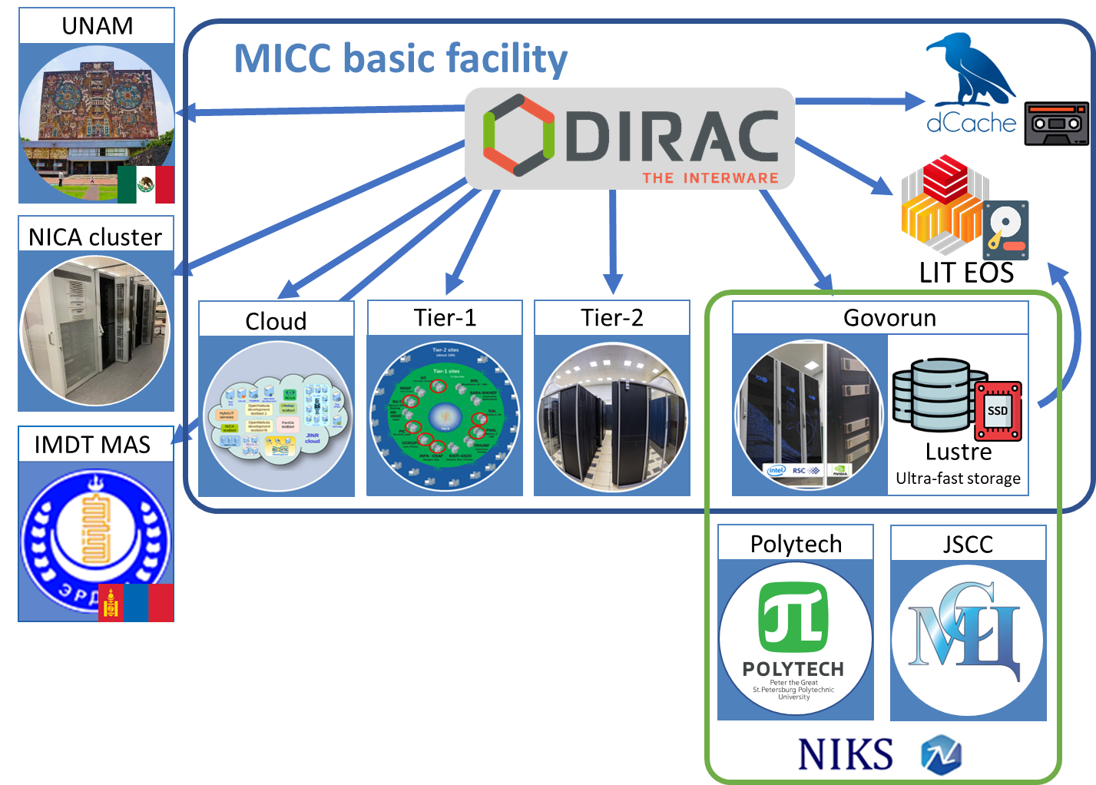
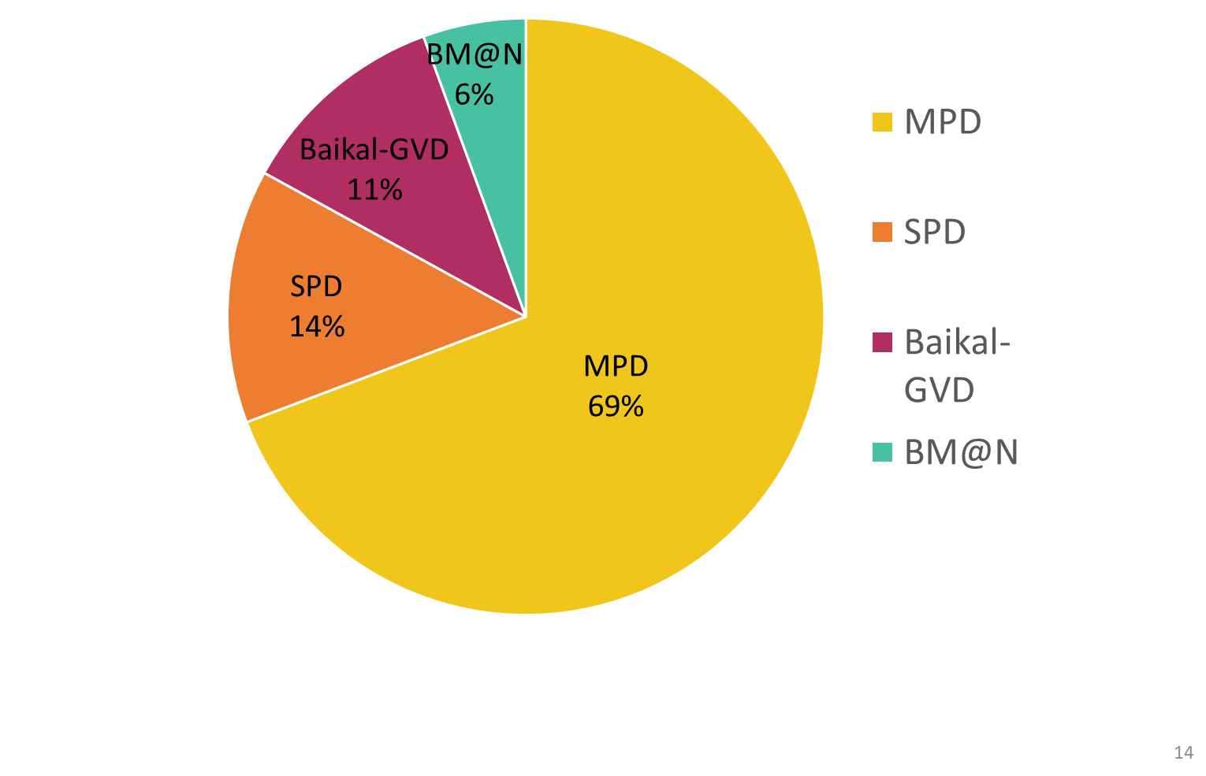
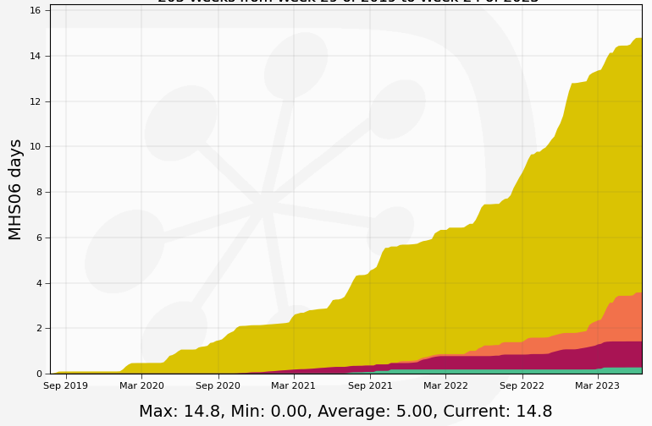
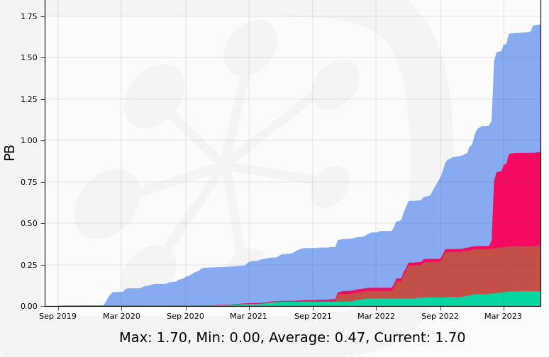
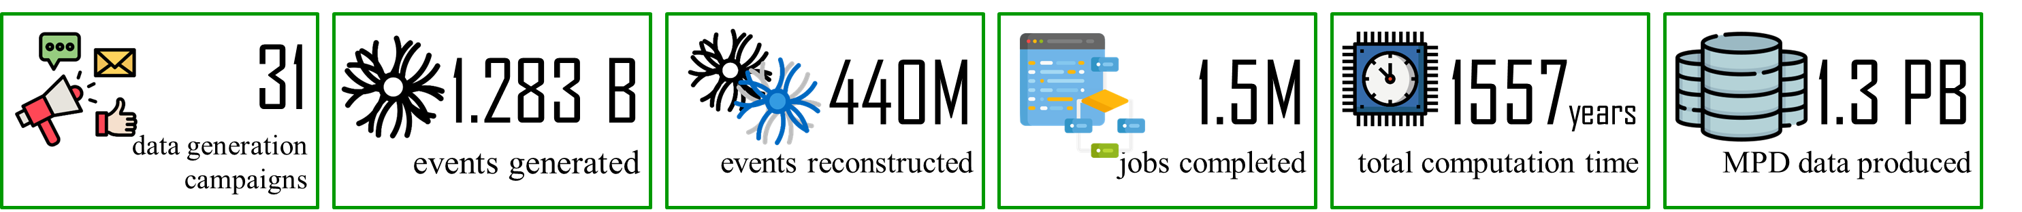
DIRAC-based distributed heterogeneous environment
Usage of the DIRAC platform by experiments in 2019-2022
Normalized CPU time
Total number of executed jobs
Data processed by experiments
EOS MPD
EOS BM@N
EOS SPD
EOS Baikal-GVD
The major user of the distributed platform is the MPD experiment.
The computing cluster of the Institute of Mathematics and Digital Technologies of the Mongolian Academy of Sciences (IMDT MAS) and NIKS (National Research Computer Network, Russia's largest research and education network) were integrated into the heterogeneous distributed environment based on the DIRAC platform.
Summary statistics of using the DIRAC platform for MPD tasks in 2019-2022
14
Notes:
Вычислительный кластер Института математики и цифровой технологии Монгольской Академии Наук (IMDT MAS) был интегрирован в гетерогенную распределенную среду на базе платформы DIRAС. Это дает возможность использовать свободные ресурсы кластера в вычислениях для мегасайенс проекта NICA. Также добавлена национальная научно-образовательная телекоммуникационная сеть России, позволяющая использовать свободные ресурсы, подключенные к сети НИКС. Ресурсы Гетерогенной платформы используются для массовой генерации и реконструкции данных эксперимента MPD. Практика использования различных вычислительных ресурсов ОИЯИ и других институтов коллаборации MPD показала, что на данный момент наиболее эффективным является использование ресурсов именно СК «Говорун». Диаграмма справа иллюстрирует увеличение доли вычислительных ресурсов МИВК в гетерогенной среде для задач MPD. Резкое увеличение доли СК «Говорун» связано с проведенной в 2022 году модернизацией, так на новых узлах было сгенерировано более 50 миллионов событий.
The computing cluster of the Institute of Mathematics and Digital Technologies of the Mongolian Academy of Sciences (IMDT MAS) was integrated into the heterogeneous distributed environment based on the DIRAC platform. This makes it possible to use available cluster resources in computing for the NICA megascience project. The National Research Computer Network (NIKS, the Russia's largest research and education network) was also added, allowing the use of available resources connected to the NIKS network. The resources of the heterogeneous platform are used for data mass generation and reconstruction within the MPD experiment. The experience of using different computing resources of JINR and other MPD collaboration institutes has shown that at present, the use of the “Govorun” supercomputer resources is the most efficient. The diagram on the right illustrates the increase in the share of the MICC computing resources in the heterogeneous environment for MPD tasks. The sharp increase in the share of the “Govorun” supercomputer is related to the modernization carried out in 2022; thus, more than 50 million events were generated on the new nodes.

Slide 15
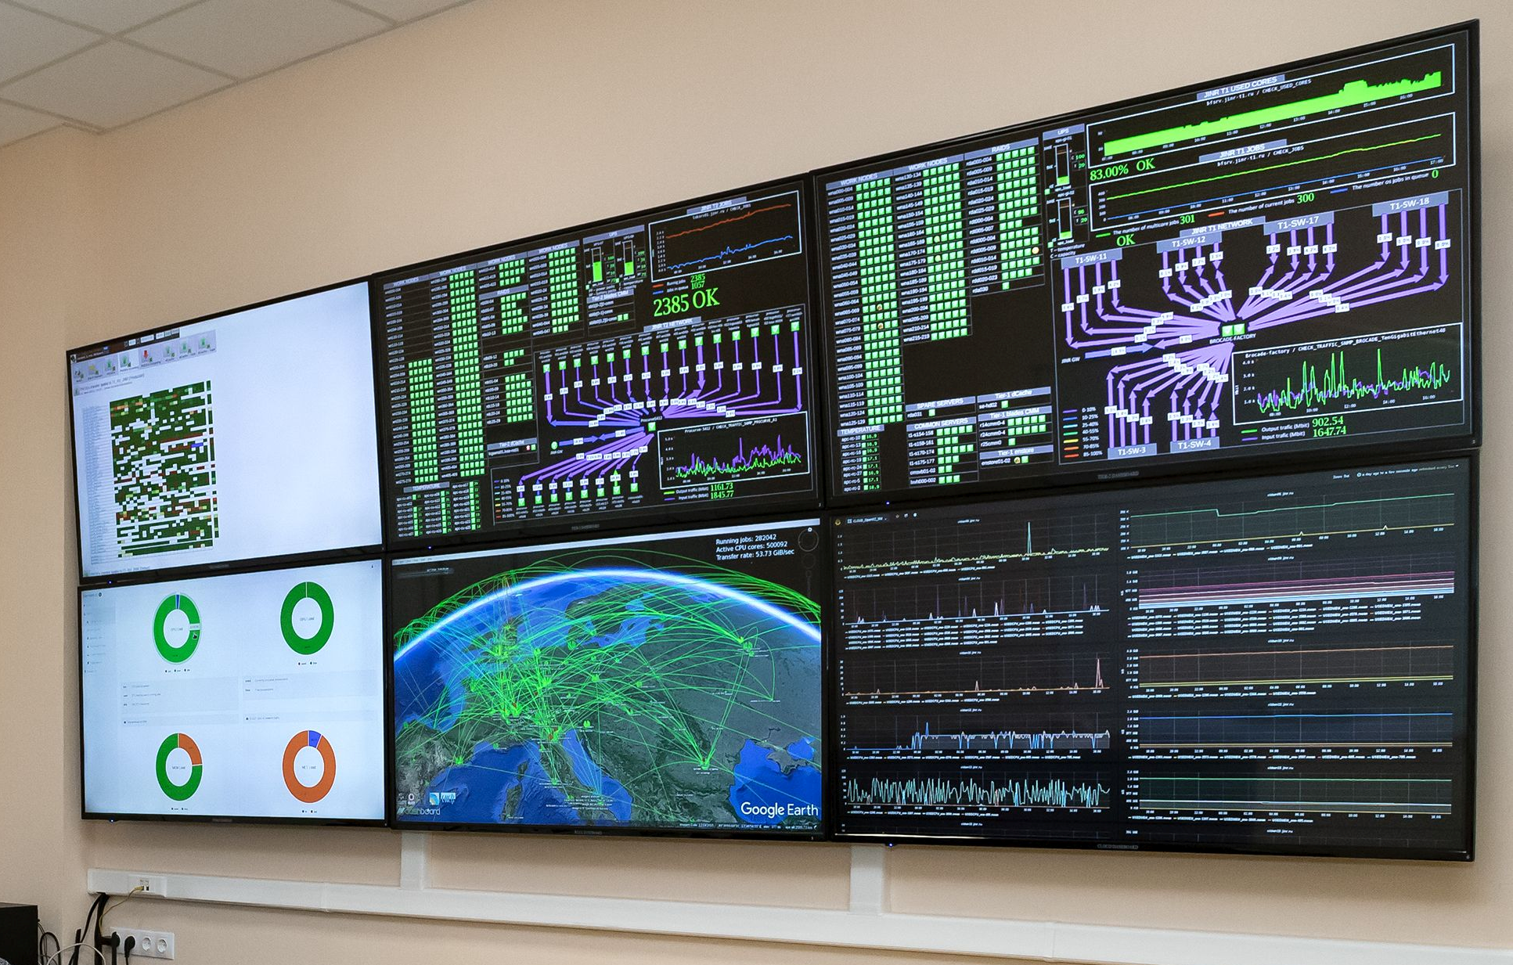
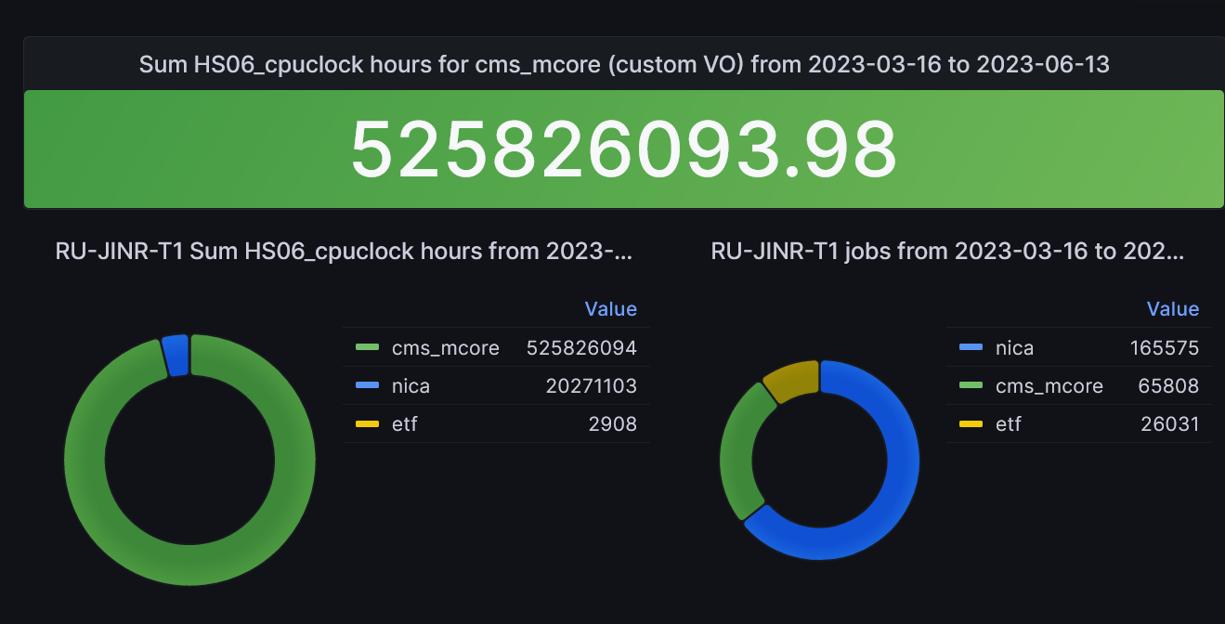
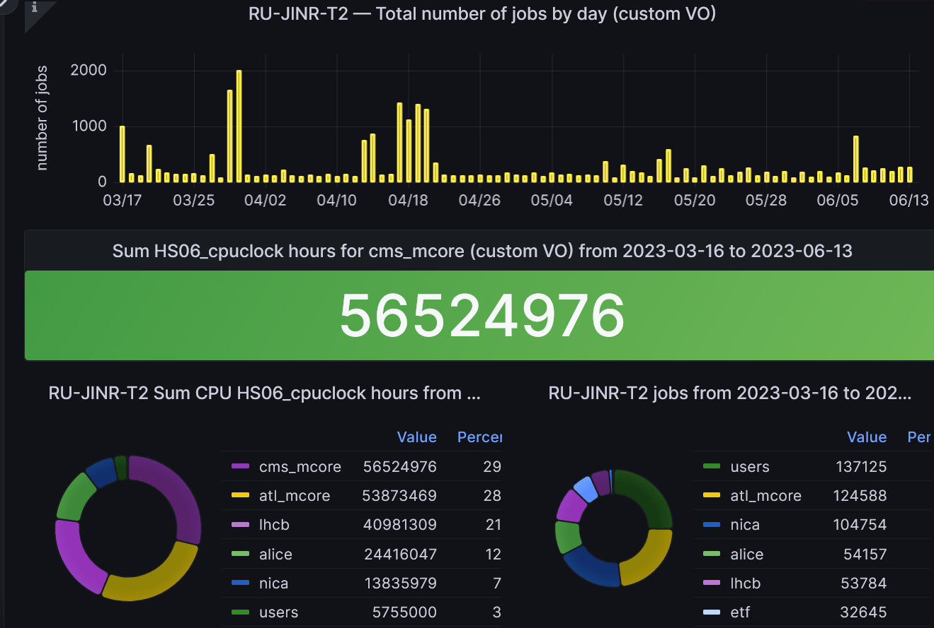
MICC Monitoring @Accounting
The successful functioning of the computing complex is ensured by the system that monitors all MICC components.
We must
expand the monitoring system by integrating local monitoring systems for power supply systems into it (diesel generators, power distribution units, transformers and uninterruptible power supplies);
organize the monitoring of the cooling system (cooling towers, pumps, hot and cold water circuits, heat exchangers, chillers);
create an engineering infrastructure control center (special information panels for visualizing all statuses of the MICC engineering infrastructure in a single access point);
account each user job on each MICC component.
It is required to develop intelligent systems that will enable to detect anomalies in time series on the basis of training samples, which will result in the need to create a special analytical system within the monitoring system to automate the process.
3 monitoring servers
About 16000 service checks
About 1800 nodes

Slide 16
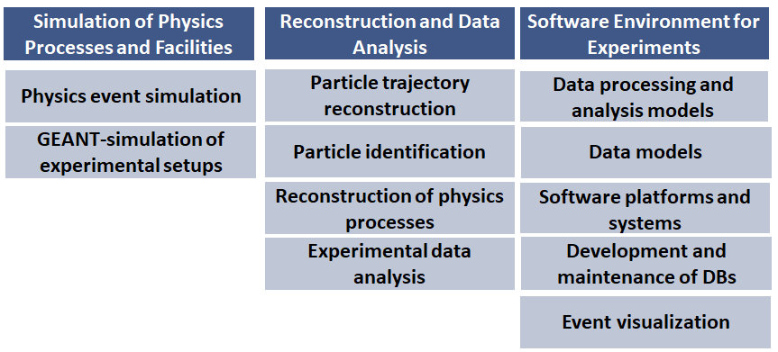
The Goals and Objectives of the Project
Mathematical methods, algorithms and software for modeling physical processes and experimental facilities, processing and analyzing experimental data
The Project Structure
The main strategy is to use common solutions and methods for different experiments
Notes:
The project is aimed at
the development of mathematical methods and software for modeling physical processes and experimental facilities, processing and analyzing experimental data in the field of elementary particle physics, nuclear physics, neutrino physics, condensed matter, radiobiology, etc.
development, support and operation of software complexes for the distributed processing and analysis of experimental data as well as information systems to support research at JINR and other world centers.

Slide 17
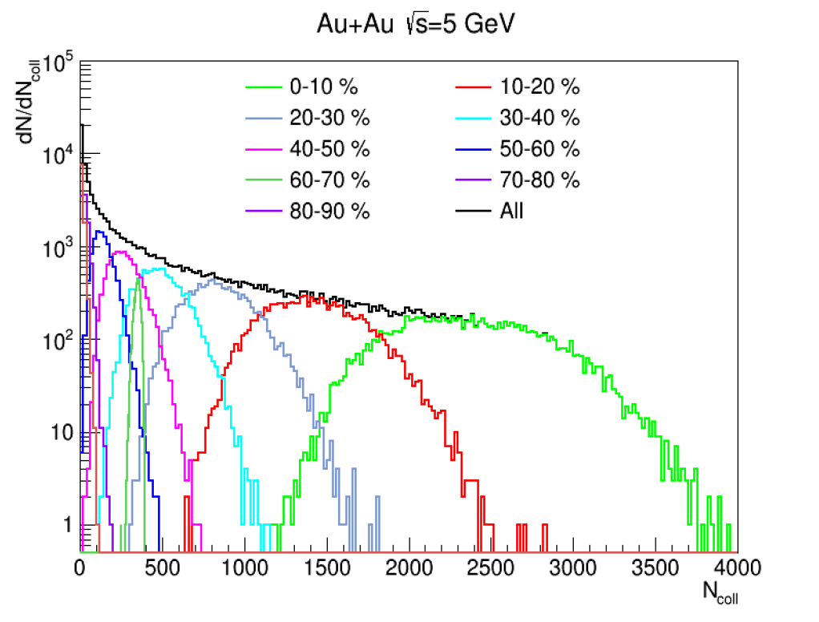
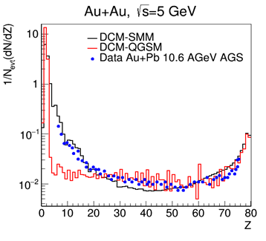
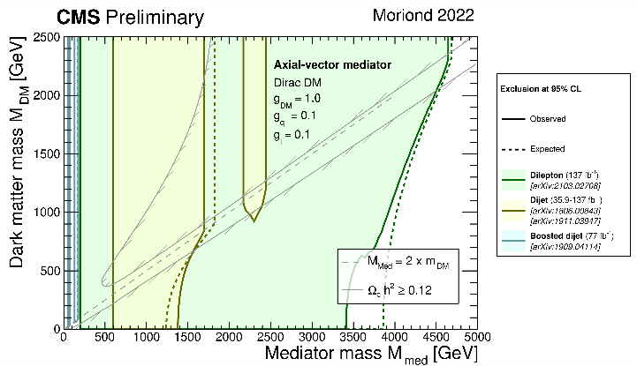
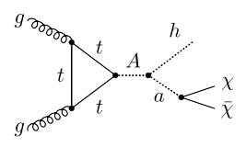
MC Generators for the NICA and LHC Experiments
Development of the heavy ion collision generators
  Dubna Cascade Model, Quark-Gluon-String Model, Statistical Multifragmentation Model for the NICA Experiments
  tuning the HIJING generator with data of NA49 and NA61/SHINE @ CERN, STAR@RHIC (can be used in MPD and SPD experiments)
Analytical and numerical methods for calculating neutron-proton systems under strong compression at the NICA
The priority tasks of the JINR Groups in LHC physics program (ATLAS and CMS) include searches for candidates for dark matter particles, tests of predictions of TeV-energy scenarios
h (→ bbar) + a (→ χχ) = bbar + MET
Fine tuning the generators for searches for new physics
  revision of model parameters for 2HDM+a, 2HDM+s, etc.
  simulation with Pythia8, QBH, MadGraph5_aMC@NLO + FeynRules (simplified DMM, HDM+a, 2HDM+s, etc.)
  mass production + Geant4 response
Ex., Dark Matter can be probed with two fermions/two fermions + MET/higgs + MET/Z + MET in the final states
MLIT + BLTP + VBLHEP

Slide 18

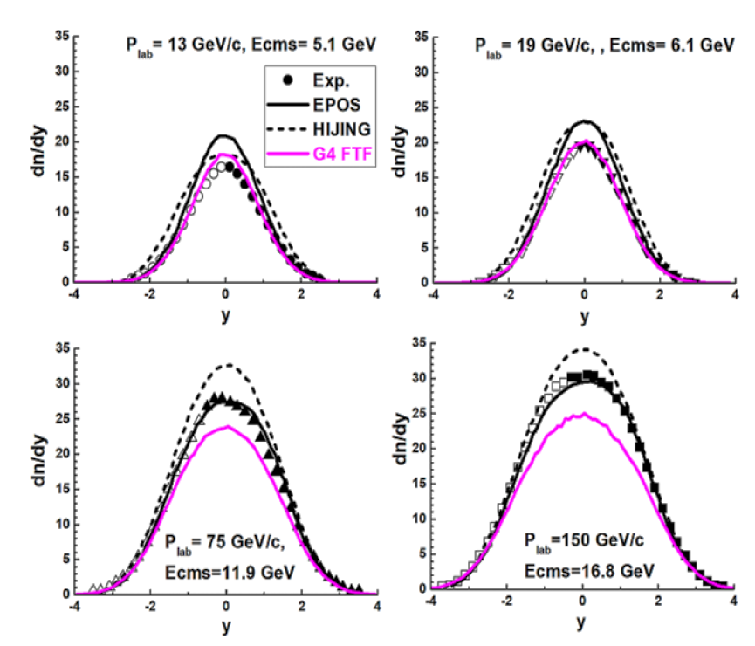
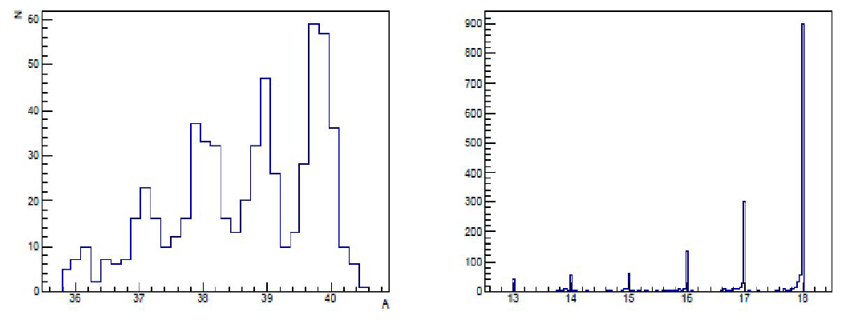
Modeling Experimental Facilities for the NICA, LHC, etc.
Development, verification, validation and application of FTF (Fritiof) and QGSM (Quark-Gluon-String-Model) hadronic models
Simulation and prototype testing for present and future orbital detectors: NUCLEON, NUCLEON-2, HERD
Rapidity distributions of π⁻ mesons in
⁴⁰Ar + ⁴⁵Sc interactions (EPJ , C82 (2022)
Prototypes tested @ Nuclotron JINR
isotopes
charges
Exp. conclusion: “There is no model (EPOS, UrQMD, HIJING …) able to describe the data!” from NA61/SHINE Collab. on PP, ⁴⁰Ar + ⁴⁵Sc and ⁷Be + ⁹Be

Slide 19
Reconstruction of physical objects and analysis of experimental data
development of algorithms, including those based on recurrent and convolutional neural networks for machine and deep learning tasks, and creation of corresponding software for the reconstruction of physical objects (tracks, particles, clusters, etc.) and physical processes;
development of methods and algorithms for data analysis, including statistical analysis;
adaptation of existing software for specific experiments, reconstruction and analysis of experimental data;
analysis of Open Data of experiments, in particular, experiments at the LHC;
conducting a global analysis of data from various experiments (in particular, a combined analysis of data from accelerator and astrophysical experiments in search for candidates for the role of dark matter).

Slide 20
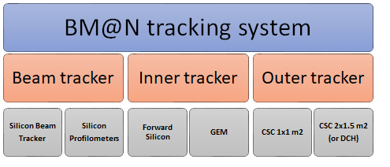
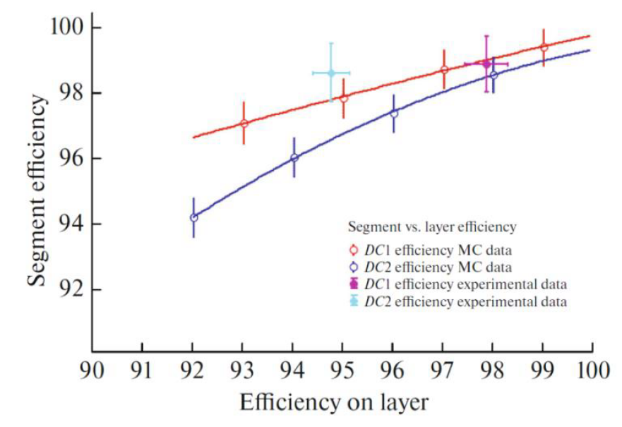
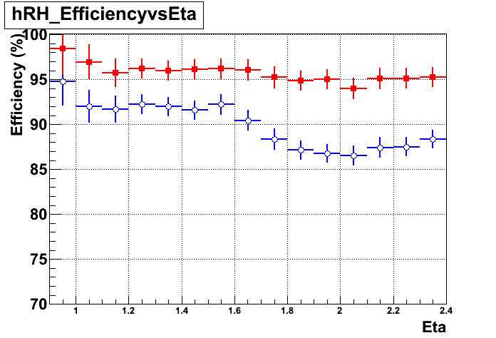



Tracking Algorithms for HEP Experiments
Mathematical methods and software for processing and analyzing data from the experiments @ NICA
  software for alignment and calibration of the BM@N STS (silicon chambers) and GEM (gas electron multipliers) track detectors
  development and application of methods and algorithms for processing and analyzing experimental data for the coordinate detectors
Mathematical methods and software for muon reconstruction and the estimation of operation parameters of CMS detectors @ LHC
  reconstruction of the cosmic muon trajectory in the setup for testing active elements of the CMS HGCal, as well as evaluation of the efficiency of HGCal modules;
  usage of discrete wavelet analysis to recognize the coordinates of close-flying particles from over-lapping signals in the Cathode Strip Chambers (CSC). Evaluation of the operation parameters of CSC detectors and of the rate of background particles for different types of experimental data.
Blue – old algorithm
Red – new algorithm

Slide 21




Machine Learning Methods for the Track Reconstruction and PID
particle identification based on the gradient boosting of decision trees with MPD Time-Projection Chamber (TPC) and Time-of-Flight (TOF)
new approaches to track recognition in SPD strip and pixel detectors based on a recurrent neural network and a graph network (already used for track recognition in the BM@N experiment at JINR and in the BESIII experiment in China)
MPD
BM@N
Efficiency and contamination of the identification of positively charged particles in the MPD model data, obtained by the method of decision trees with gradient boosting
Preliminary results: accuracy of about 99% for testing data (18% of true segments are lost)

Slide 22


Support and development of the software environment for JINR research
Development of the software environment for processing and analyzing data from the NICA experiments
Creation, implementation and development of an information and computing complex for processing, analyzing and storing data for the SPD experiment
Creation of specialized databases and information systems for the Collaborations @ NICA and LHC (ATLAS, BM@N, MPD)
Development and creation of an information and computing system for
  automating the processing of data from radiobiological studies
  intelligent determining the state of agricultural and decorative plants
  monitoring and predicting the state of the environment

Slide 23


Data Bases for HEP Computing
ATLAS EventPickingService
    the first version for automated event collection has been created.
    the service was used for the second stage oа the «γγ→WW» analysis (136 K events)
    further modernization of the service is ongoing according to the received results
ATLAS CREST (Condition DB)
    C++ API for CREST (implemented into Athena software package)
    COOL2CREST converter (developed, but not yet implemented)
    both parts require constant improvement for compatibility with the updated CREST server
Event metadata system for the experiments at NICA (BM@N, MPD and SPD)
    has been designed to index events of the NICA experiments and store their metadata
    quick search by required conditions and parameters used in various physics analyses for a set of physics events to use in further event data processing
Geometry DB
    The geometry database is the main element of the information system designed to store, process and manage information about the geometric models of detectors. It is implemented into BMNROOT software
Configuration DB (Configuration Information System, CIS)
    Configuration database for managing online applications for collecting and processing high energy physics events. It was created for process launching in BM@N environment.

Slide 24

Collaboration

Slide 25




Development of the system for training and retraining IT specialists

Slide 26









methods, software and program packages for data processing and analysis;
mathematical methods and tools for modeling complex physical and technical systems, computational biochemistry and bioinformatics;
methods of computer algebra, quantum computing and quantum information processing;
machine learning and big data analytics;
algorithms for parallel and hybrid calculations.
Distributed Computing Systems
HPC
Сloud Technologies
Distributed Storage Systems
Distributed Computing and HPC Applications in science, education, industry and business, open data.
Computing for MegaScience Projects
Quantum informatics and computing
Big Data, Machine Learning and Artificial Intelligence
Notes:
student schools are traditionally held on the basis of conferences

Slide 27
Using JINR computing resources for your research FAQ
What is the recipe of getting access and use JINR’s computing resources?
  Find a theme or project appropriate for your research in the JINR Topical Plan
  (available online at: http://www.jinr.ru/staff/science_ptp/)
  Start collaborating in the chosen theme or project with JINR researchers;
  Conclude a formal agreement with JINR about your institution/research center/university status;
  Receive one of the statuses of JINR personnel: staff, associated staff, visitor, user(under development);
  Get access to needed resources for your research.
Can JINR resources be used for personal or commercial purposes?
  NO

Slide 28
.
Thank you for your attention!

Slide 29
.
BackUp

Slide 30

Simulation of physical processes and experimental facilities
analytical and numerical calculations of physical processes, software optimization, including tuning and adaptation of physics event generators;
MC event production, development and support of information systems for event catalogues;
participation in the creation of computer models of experimental facilities and simulation of elementary particles passing through them based on GEANT4 (and others) and fast simulation of the response of the detectors.

Slide 31

Support for the JINR Neutrino Program
MLIT contribution: engineering infrastructure (electricity, UPS, cooling, network, racks, manpower)
DLNP contribution: computing and storage resources (CPUs/GPUs&disks)
Computational resources for the JINR neutrino program using the cloud infrastructure of the MICC.
The NOvA, Baikal-GVD and JUNO experiments are the major consumers of the cloud infrastructure.

