Slide 1
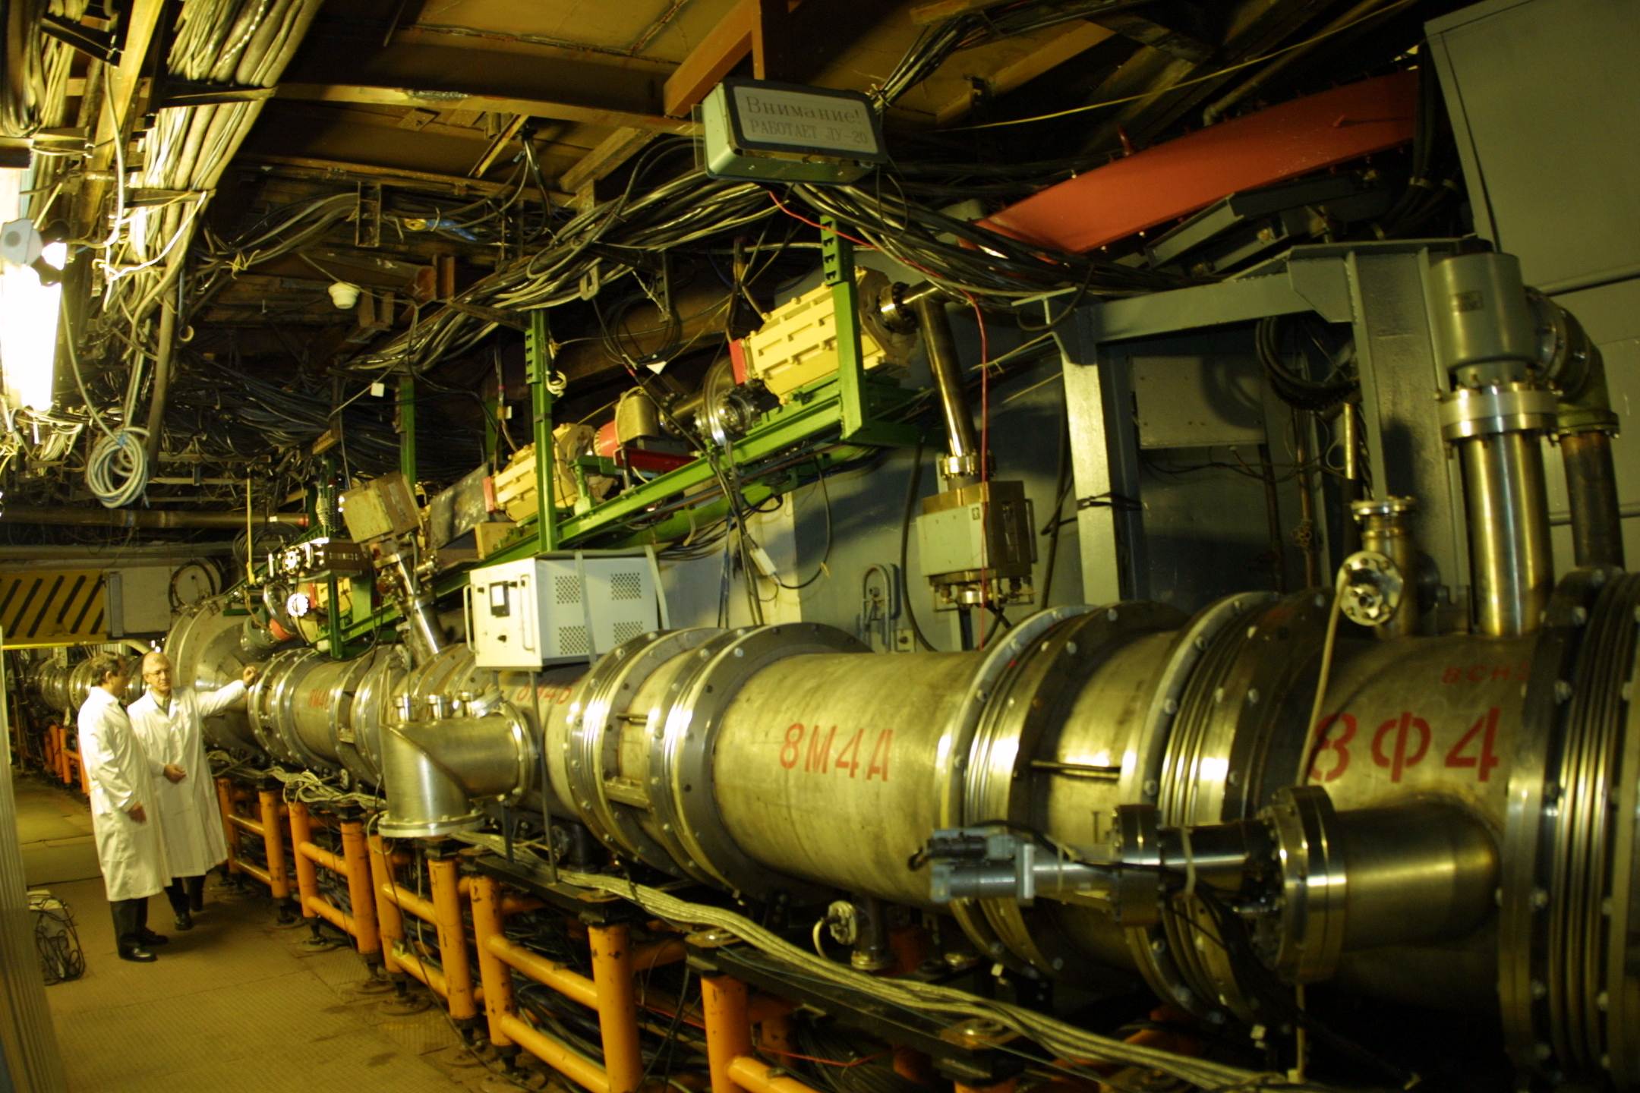
30 years of the Nuclotron
A.I. Malakhov
The XXVth International Baldin Seminar on High Energy Physics Problems "Relativistic Nuclear Physics and Quantum Chromodynamics, September 18 - 23, 2023, Dubna

Slide 2
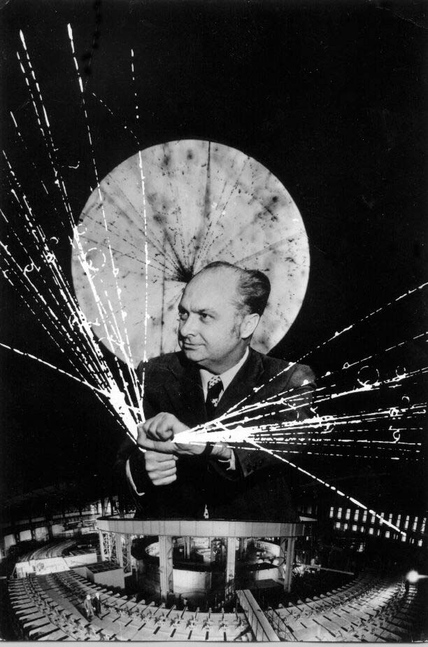
Relativistic Nuclear Physics

Slide 3
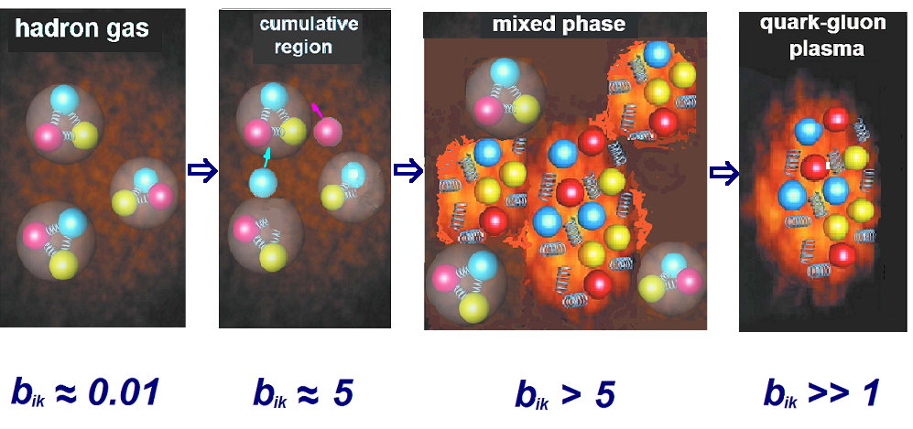
b_{ik} = -(u_{i} - u_{k})²

Slide 4
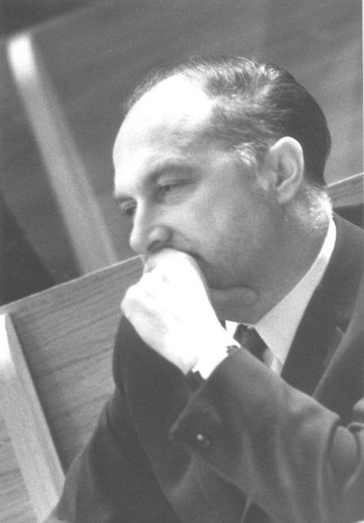
NUCLOTRON
A.M.BALDIN

Slide 5
1974 г.
А.М.Балдин, В.В.Василишин, Е.М.Дьячков, А.Г.Зельдович, Л.П.Зиновьев,И.Б.Иссинский, А.Д.Кириллов, Е.М.Кулакова, Л.Г.Макаров, И.Н.Семенюшкин, А.А.Смирнов, В.Л.Степанюк, В.А.Михайлов и др.
"Нуклотрон - ускорительный комплекс релятивистских ядер в ЛВЭ ОИЯИ".
Труды четвертого Всесоюзного совещания по ускорителям заряженных частиц, Москва, 1974 г. Том II, стр.4-8.
"Nuclotron - accelerator complex of relativistic nuclei at the JINR LНЕ“
Proceedings of the Fourth All-Union Meeting on Charged Particle Accelerators, Moscow, 1974 Volume II, pp.4-8.

Slide 6
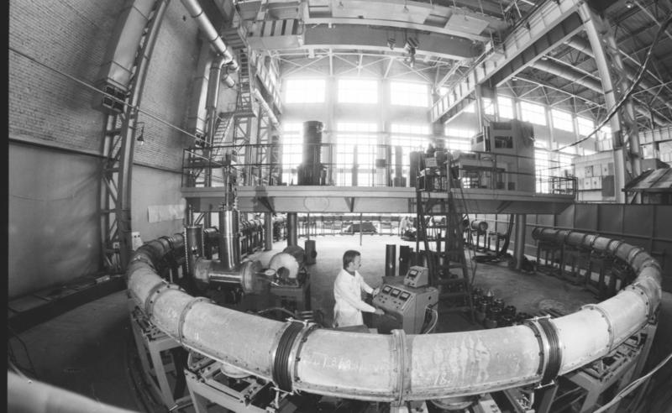
General view of the SPIN synchrotron (1986).

Slide 7
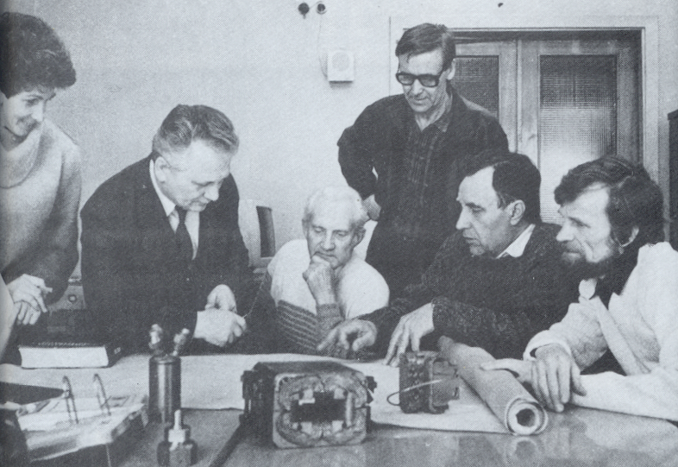
State Prize of the Russian Federation in the field of science and technology for the development and construction of economical superconducting magnets for high-energy accelerators (1992)
V.S.Alfeev, Z.V.Borisovskaya, B.K.Kuryatnikov, V.I.Lobanov, L.G.Makarov, E.A.Matyushevsky, I.A.Shelaev

Slide 8
1986
The project: «Reconstruction of the synchrophasotron magnetic system into a superconducting – Nuclotron» was approved

Slide 9
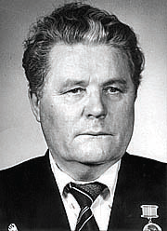
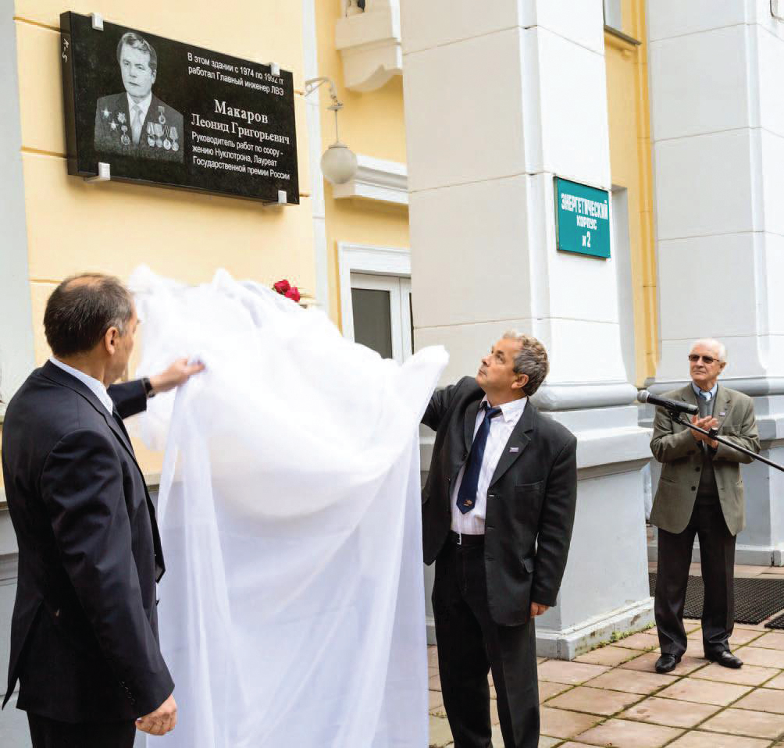
L.G. Makarov
Makarov L.G. turns 100 years old on September 30, 2023
The opening of a memorial plaque in honor of L.G. Makarov in 2013 on his 90th birthday. From left to right:
V.D. Kekelidze, A.I. Malakhov, A.D. Kovalenko.

Slide 10
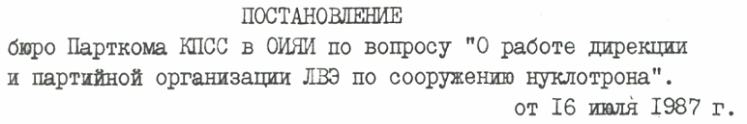
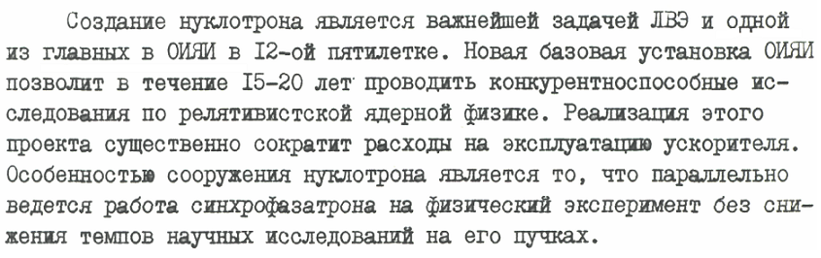
V.K. Lukyanov
RESOLUTION
of the CPSU Party Committee in JINR on the issue "On the work of the Directorate and the LHE party organization on the construction of the Nuclotron“, July 16, 1987.
The construction of the Nuclotron is the most important task of the LHE and one of the main goals at JINR in the 12th five-year plan.

Slide 11

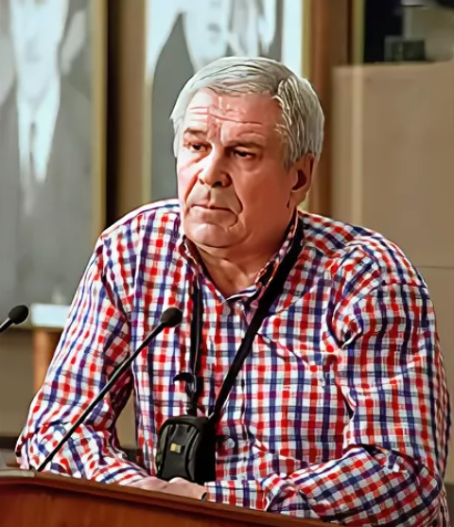
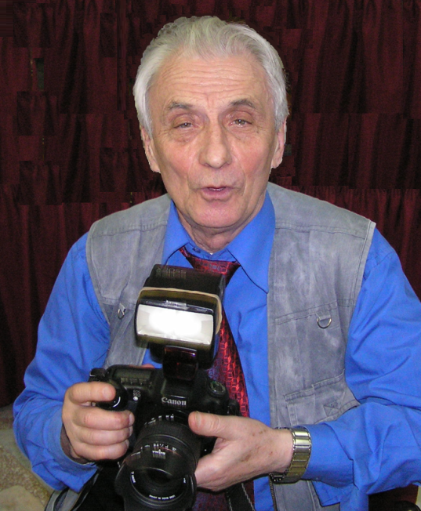
Newspaper «Dubna»
еditor E. Molchanov
Press Secretary
B.M. Starchenko
Рhotojournalist
Yu.A. Tumanov

Slide 12
1987-1992
The project was completed, as planned, in five years - from 1987 to 1992.

Slide 14
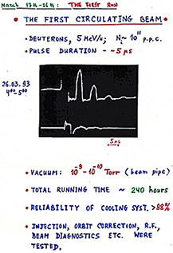
1993
The first cooling run of the Nuclotron ring to the operating temperature of 4.5 K, testing of all its systems, including adjustment with the beam, was carried out in March 1993 (March 26, the first circulating beam).

Slide 15
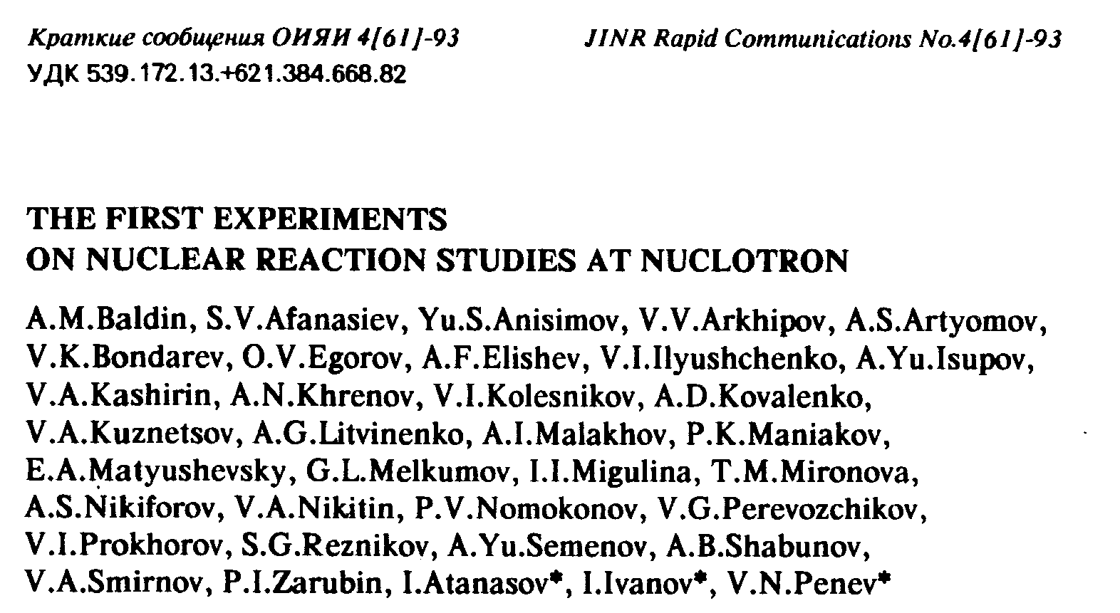

Slide 16
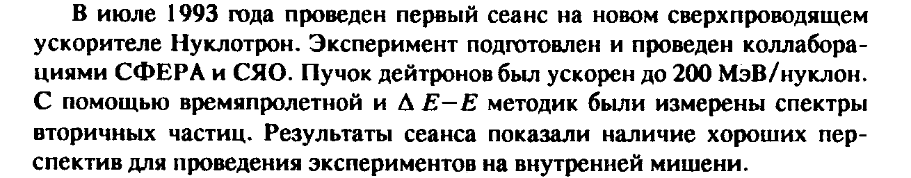
Abstract
In July 1993, the first run was performed at the new Nuclotron superconducting accelerator. The experiment was prepared and carried out by the SPHERE and RNS (SYaO) collaborations. The deuteron beam was accelerated to 200 MeV/nucleon. The spectra of secondary particles were measured using time-of-flight and ΔE-E techniques. The results of the run showed good prospects for experiments on the internal target.

Slide 17
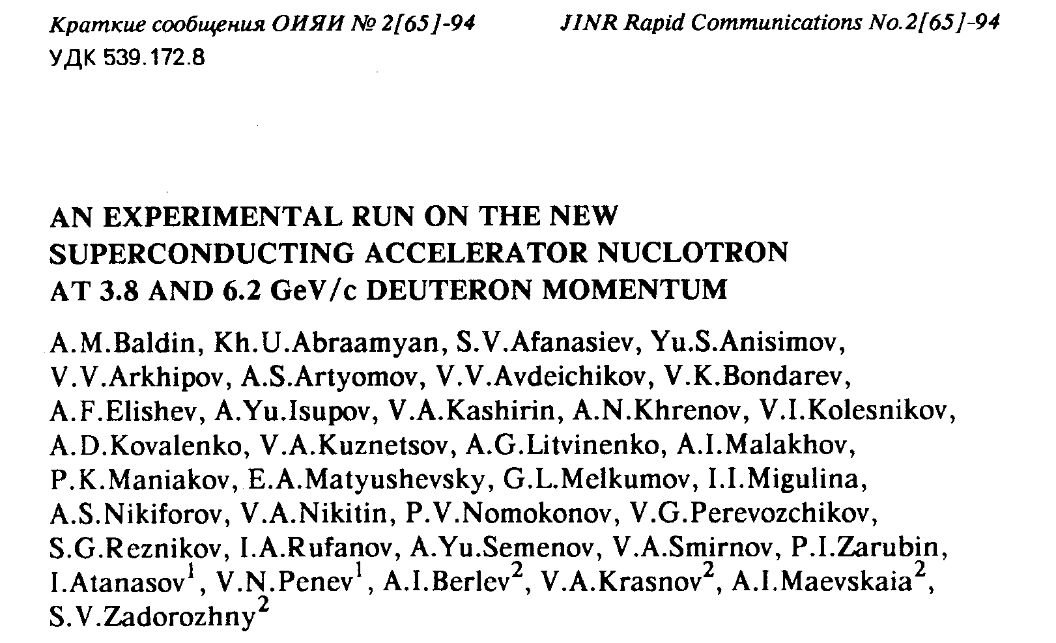

Slide 18
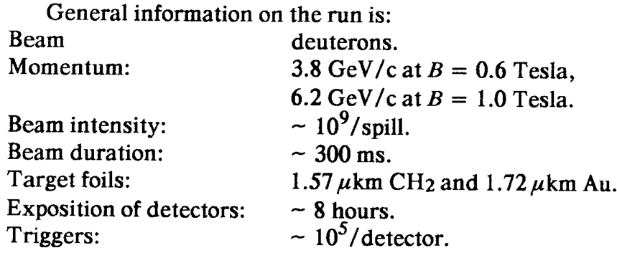

Slide 19
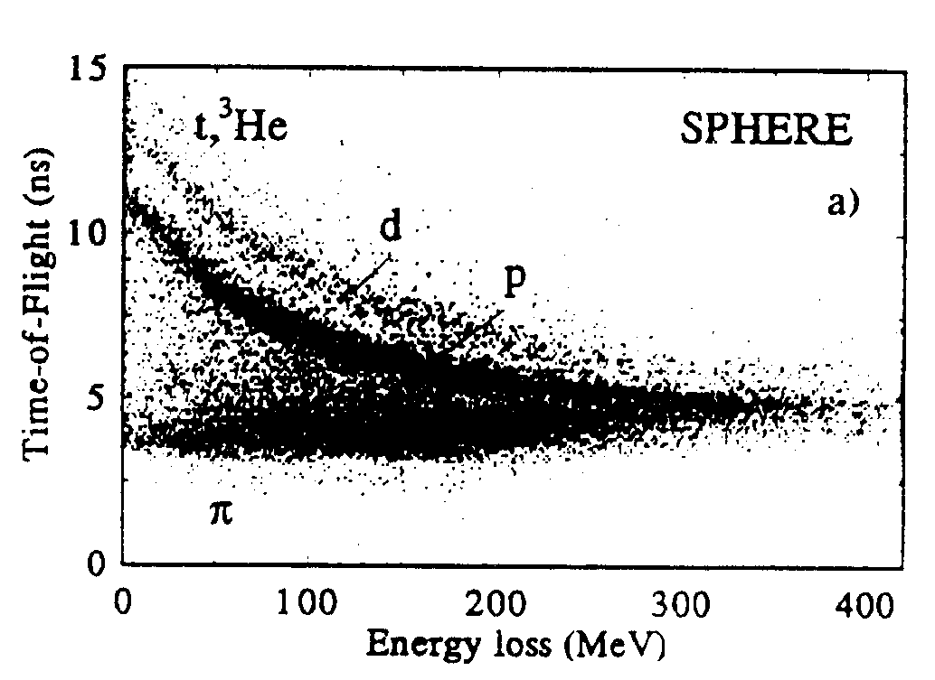

Slide 20
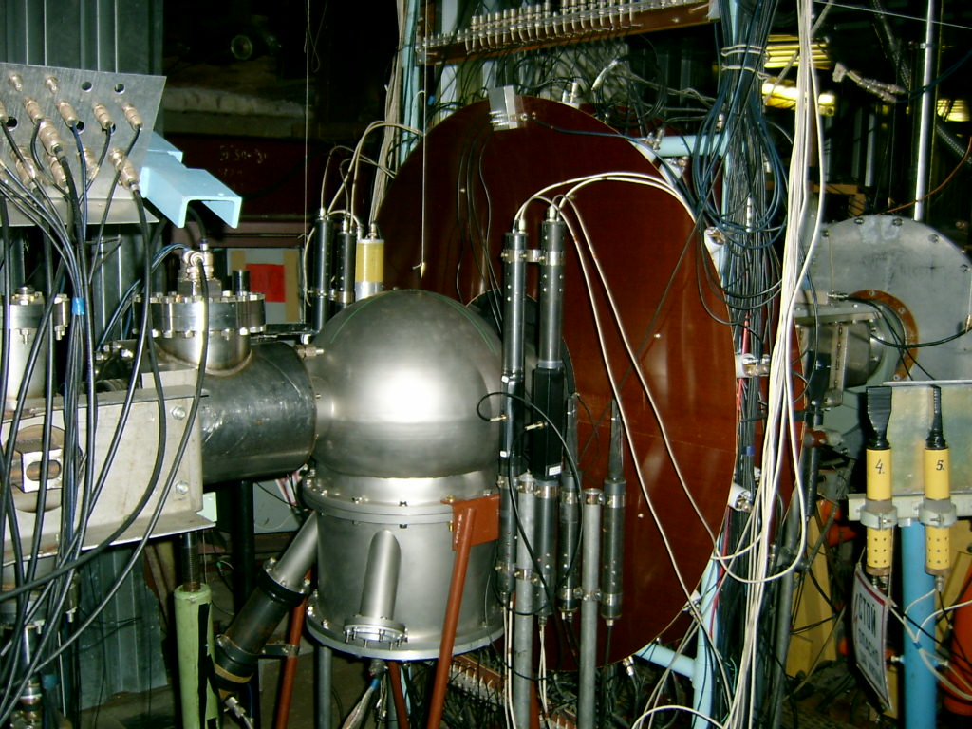
Internal Target Station
J.Kliman
S.Gmuca
Yu.S.Anisimov
JINR First Prize for 2000 “Station of internal targets for experiments on the Nuclotron”, authors: Yu.S.Anisimov, A.S.Artemov, V.A.Krasnov, A.I.Malakhov, V.M.Slepnev, A.Yu.Starikov, Ya.Kliman, V.Matoushek, M.Morkhach, I.Turzo.
10

Slide 21
Slow beam extraction system
E.A.Matyushevsky
A.D.Kovalenko
I.B.Issinsky
Yu.I.Tyatyushkin
JINR First Prize for 2002 "Slow extraction of the Nuclotron beam".
Authors: B.V.Vasilishin, V.I.Volkov, I.B.Issinsky, V.N.Karpinsky, A.D.Kovalenko, V.A.Mikhailov, V.A.Monchinsky, S.A.Novikov, V.V.Seleznev, G.G.Khodjibagiyan.
8

Slide 22
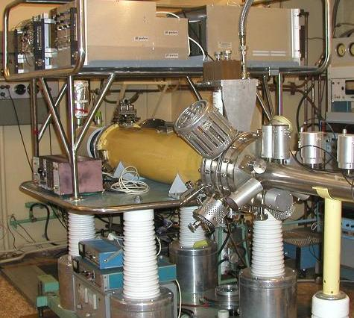
Heavy Ion Source KRION
11

Slide 23
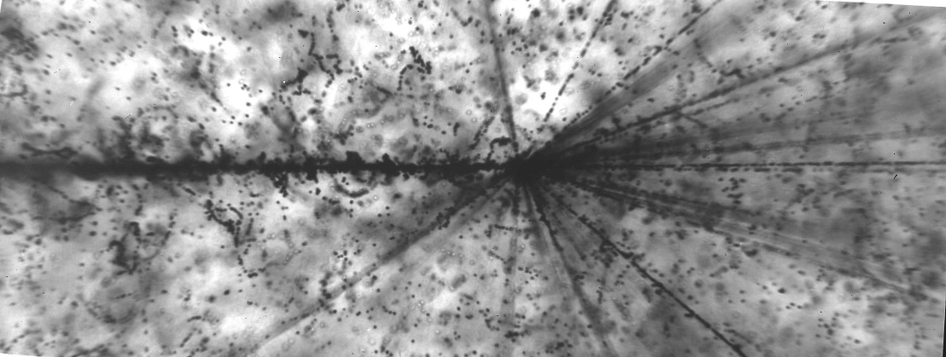
Brightness Award
E.D.Donets, E.E. Donets, V.V.Salnikov, D.E.Donets .
⁵⁶Fe
Interaction of ⁵⁶Fe ion with E_{kin} = 1 A∙GeV from Nuclotron with an emulsion nucleus
The prize was established by the international community of researchers involved in the physics and technology of ion production and ion sources, and it has been awarded once every two years on a competitive basis for the most outstanding achievement.

Slide 24
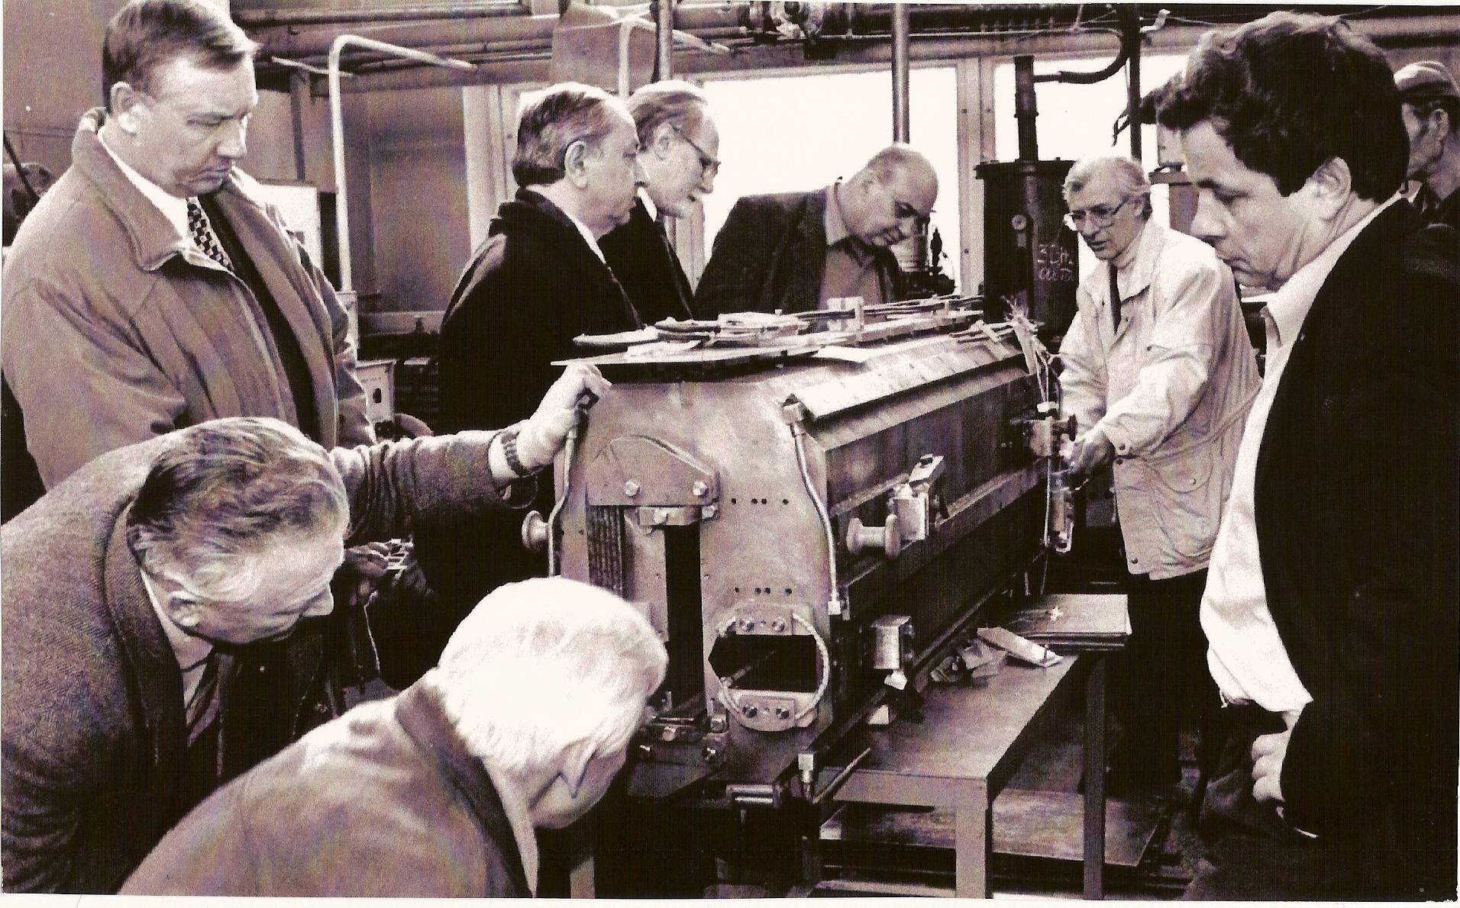
JINR Directorate visit
9

Slide 25
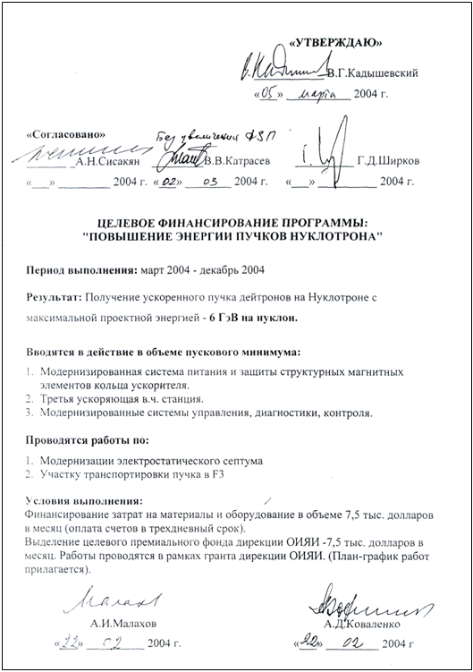
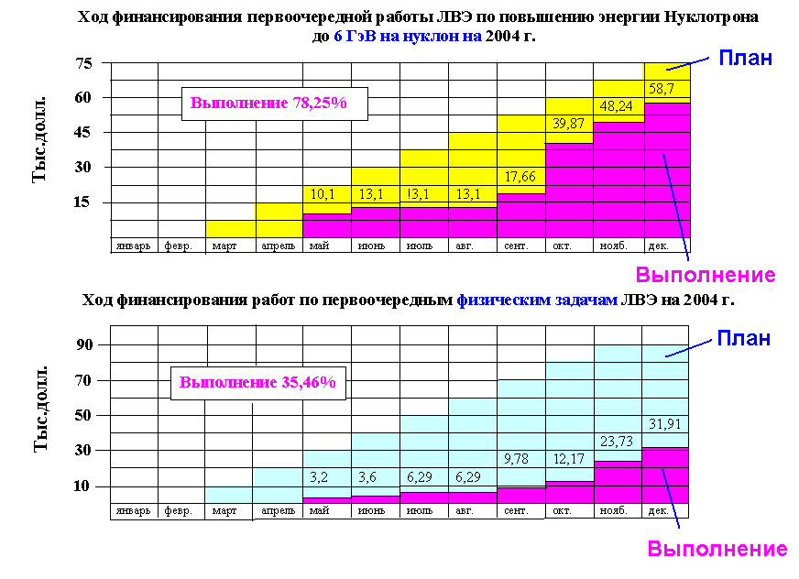

Slide 27

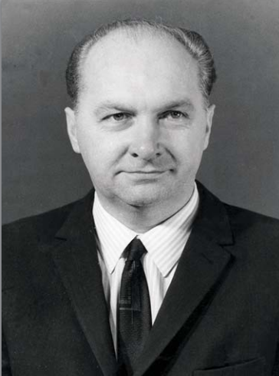
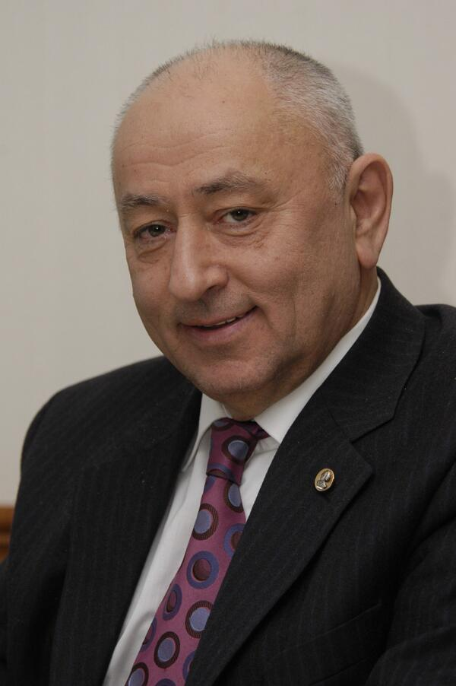
http://becquerel.jinr.ru/photos/baldin/Baldin90/books/rus/Malakhov_book_.pdf
«Посвящается моему учителю и другу академику РАН Александру Михайловичу Балдину и славному коллективу Лаборатории высоких энергий ОИЯИ, который не только выстоял в 1990-е гг., но и осуществил в это тяжелое время ввод в строй сверхпроводящего ускорителя (нуклотрон) и обеспечил проведение физических исследований на синхрофазотроне»
A.M. Baldin
V.G. Kadyshevsky
A.N. Sisakyan

Slide 28
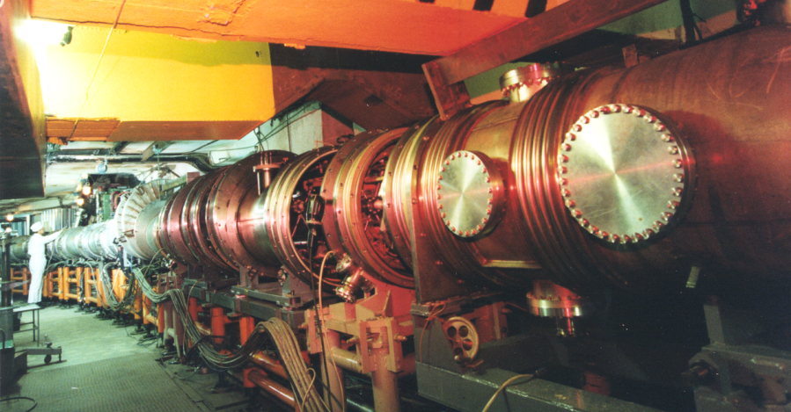
Experiments with
relativistic nuclei
Experiments with
polarized beams
Nuclotron
Applied research
Testing of
equipment

Slide 29
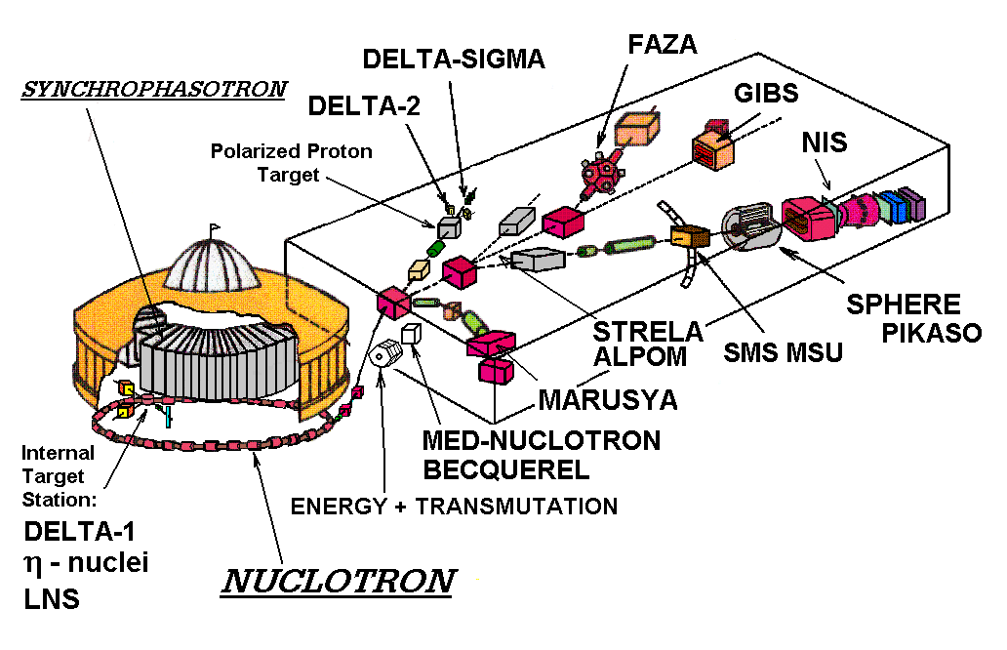
(1993-2007)

Slide 30

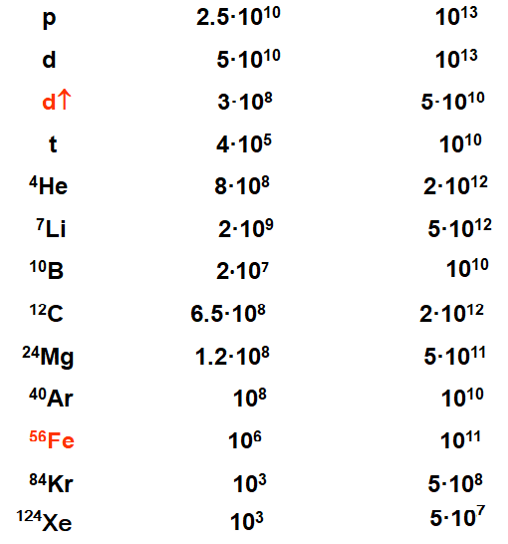
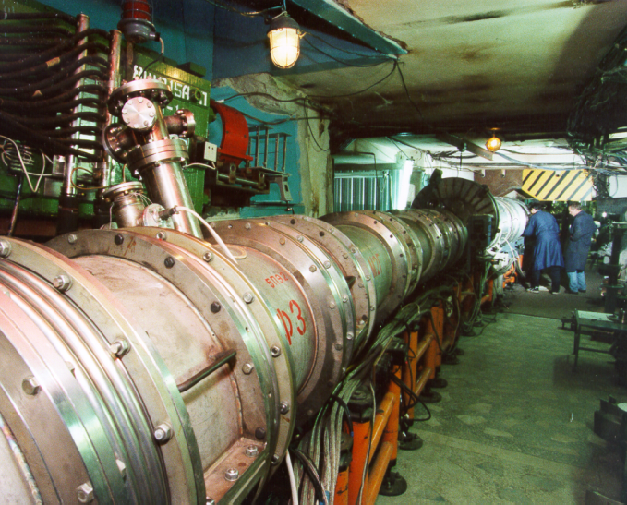
Nuclotron intensity
(particles per cycle)
Beam
have to be
(with booster)
available
JINR
Veksler & Baldin Laboratory of High Energies
Dubna
NUCLOTRON

Slide 31

Interaction of ⁵⁶Fe ions with E_{kin} = 1 A*GeV extracted from the NUCLOTRON with emulsion nuclei
⁵⁶Fe
13

Slide 32

Interaction of ¹²⁴Xe ions with E_{kin}=1 A*GeV extracted from the NUCLOTRON with emulsion nuclei
¹²⁴ Xe
13

Slide 33
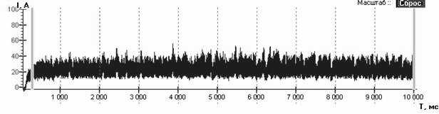
Beam spill up to 10 seconds
Beam intencity, arb.units
Time, msec.
15

Slide 34
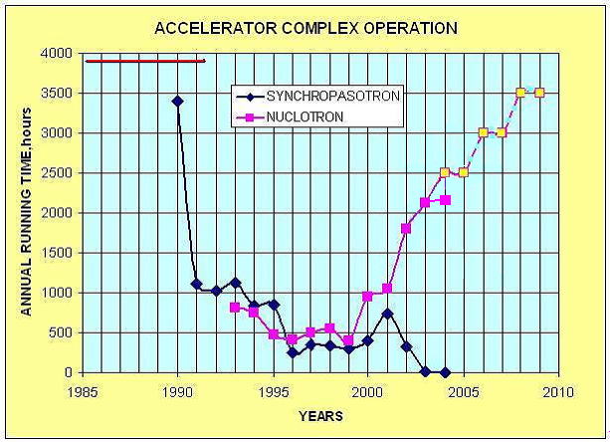
  NUCLOTRON: ANNUAL RUNNING TIME
  RUNNING TIME EXCEEDED 2100 hour/year

Slide 35
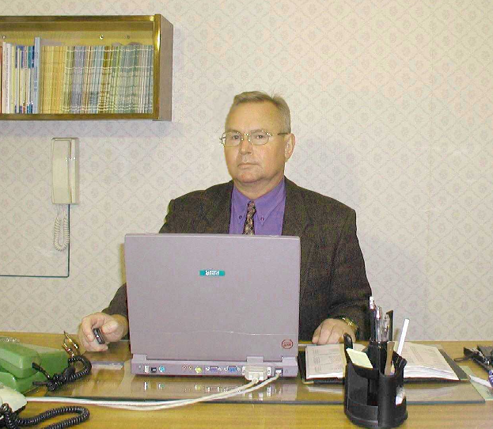
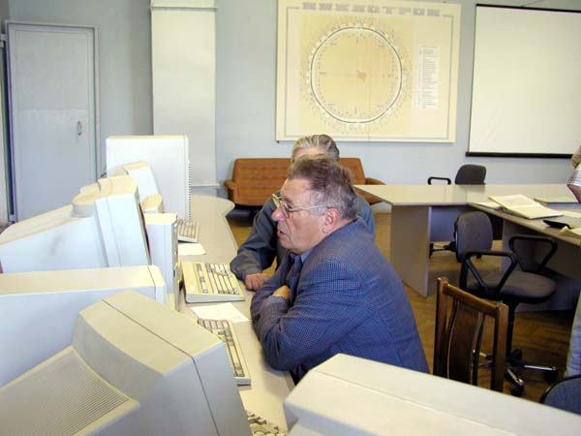
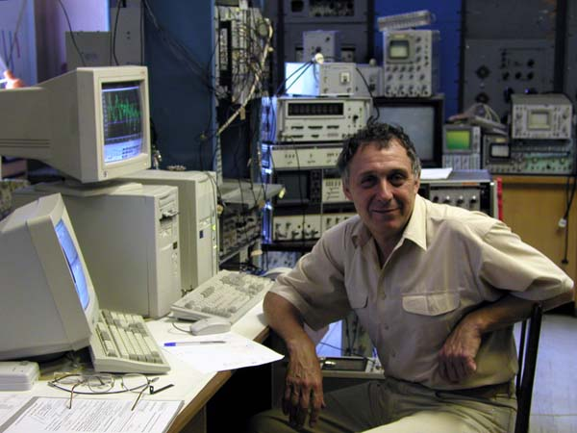
N.N.Agapov
A.D.Kovalenko
A.A.Smirnov
V.I.Volkov
O.I.Brovko
18
V.A.Monchinsky

Slide 36
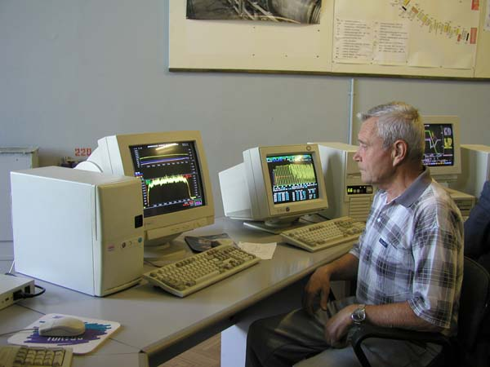
NUCLOTRON Dispatchers
A.S.Isaev
D.I.Sherstyanov
E.V.Rudnev
19

Slide 37
NUCLOTRON Users
Belarus: The Institute of Radiative Physical-Chemical Problems of NASB, The Academy of Scientific and Engineering Complex ‘SOSNY’, (Minsk) …
Bulgaria: Institute for Nuclear Research and Nuclear Energy of BAS, University of Chemical Technology and Metallurgy (UCTM) (Sofia) …
Czech Republic: Nuclear Physics Institute (Řež), Charles University, Czech Technical University (Prague) …
Greece:
Aristotle University of Thessaloniki (Thessaloniki)
Germany: Technishe Hochschule Darmstadt – Institut fűr Kernphysik (Darmstadt), Universität (Siegen, Karlsruhe), Philipps-Universität Marburg (Marburg), Forschungszentrum Jűlich GmbH (Jűlich) …
Italy: Istituto Nazionale di Fisica Nucleare. Sezione di Firenze (Florence) …
Mongolia: Institute of Physics and Technology of MAS, National University of Mongolia (Ulaanbaatar)
Slovak Republic: Institute of Experimental Physics, P.J. Šafárik University (Kosiče), Institute of Physics SAS, Comenius University (Bratislava) …
Poland: Niewodniczanski Institute of Nuclear Physics (Cracow), The Andrzej Soltan Institute for Nuclear Studies (Otwock, Warsaw) …
Russia: Institute for Nuclear Research of RAS (Troitsk), Lebedev Physical Institute of RAS (FIAN), Skobeltsyn Research Institute of Nuclear Physics at the Moscow State University, Russian Nuclear Research Institute of Experimental Physics (Sarov), Institute of Atomic Energy (Obninsk) …
And the Scientific Centers in Armenia, Georgia, Egypt, Kazakhstan, Romania, USA, Uzbekistan, Ukraine, France, Japan
Australia:
The University of Sidney

Slide 38

Some quotes from the Nuclotron
user mails
"... the work was very efficient with exciting results.
I would like to thank the co-workers of the accelerator departments for providing us with a vеry good beam and for their cordiality ...».
Professor P. Pikozzo (Italy) March 2001.
"... all of us from the West are deeply impressed by the excellent work of the Nuclotron ...«.
Professor R. Brandt (Germany) January 2002.

Slide 39
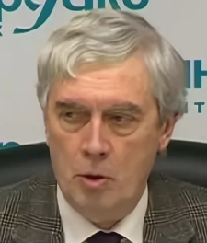
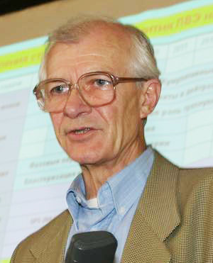
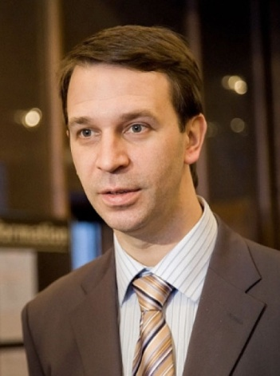
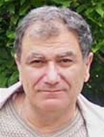
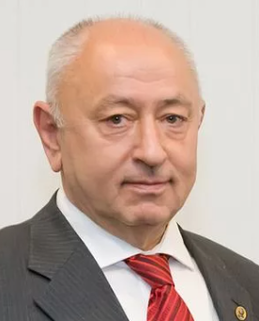

Decree of the Government of the Russian Federation of February 25, 2011 No. 285-r "On awarding prizes of the Government of the Russian Federation in 2010 in the field of science and technology"
To award the 2010 Government Prize of the Russian Federation in the field of science and technology and to award the title of "Laureate of the Government Prize of the Russian Federation in the field of science and technology":
Sharkov B.Yu., Alekseev N.N., Satov Yu.A., Shumshurov A.V., Shchegolev V.A., Kovalenko A.D., Trubnikov G.V., Khojibagian G.G., Sisakian A.N.
- for the construction of a new generation of heavy ion accelerators for relativistic nuclear physics and innovative nuclear energy technologies
Chairman of the Government
оf the Russian Federation V. Putin

Slide 40
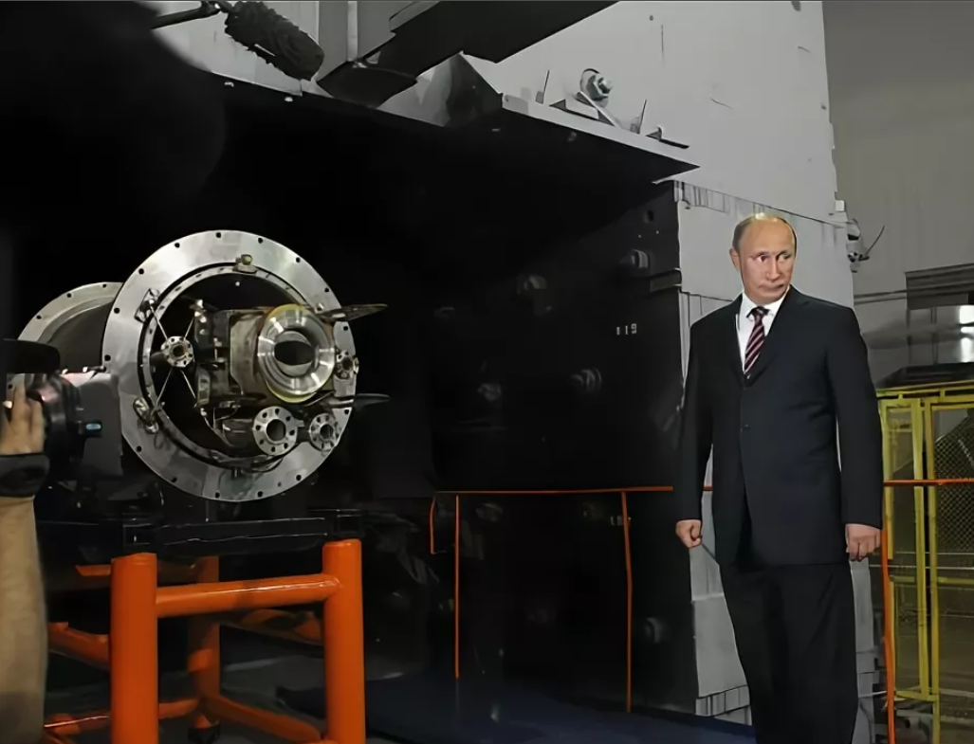
5 July 2011

Slide 41
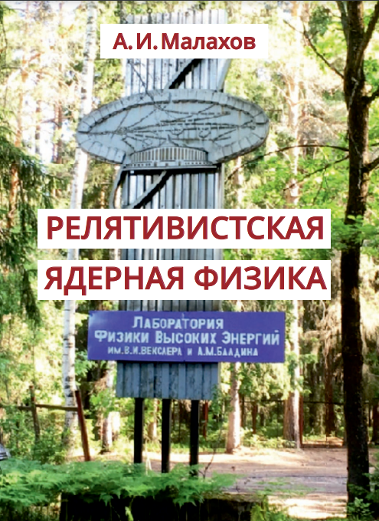
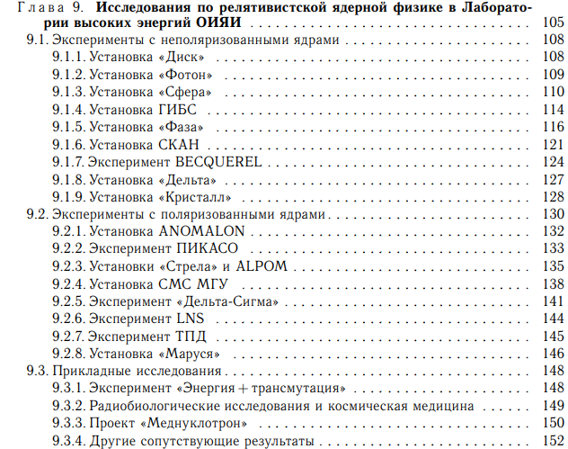
http://www1.jinr.ru/Books/Malakhov.pdf

Slide 42
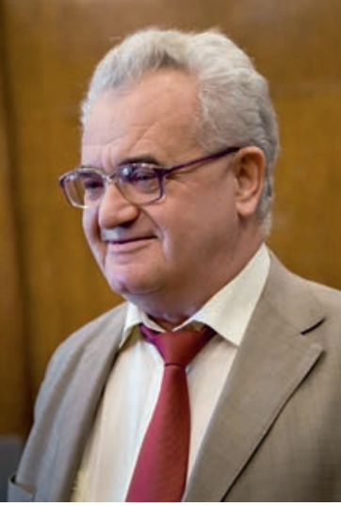

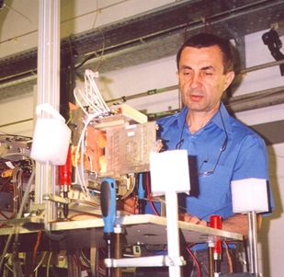
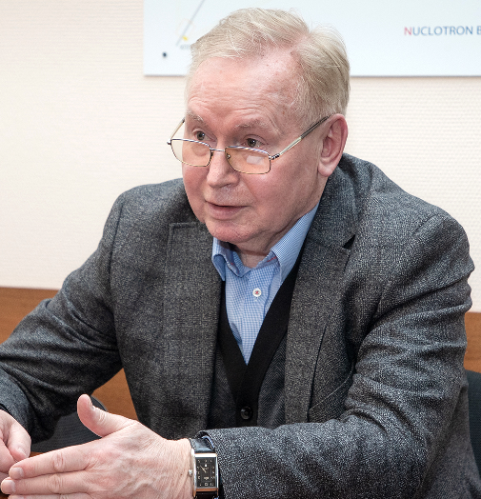
MED-NUCLOTRON
J. Ruzhichka
S. Dubnichka
V.V. Golovatyuk
N.N. Agapov

Slide 43
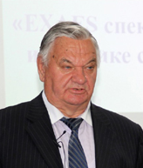
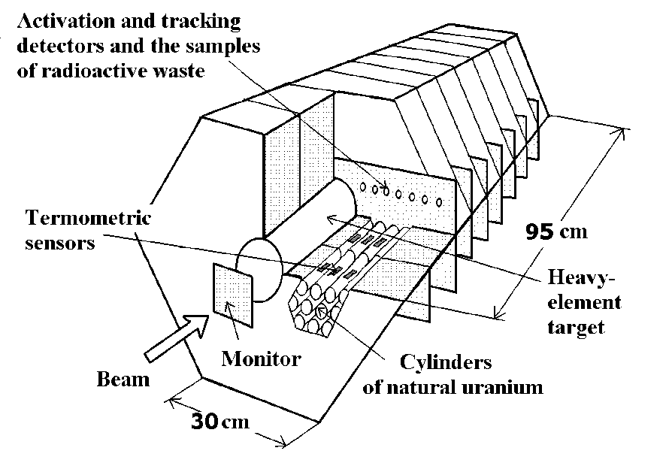
Energy+Transmutation
M.I. Krivopustov
S.I. Tyutyunikov
M. Bilevich
V. Vestmaier
S. Kilim
B. Slowinsky
M. Shuta
E. Strugalska-Gola
V. Vagner

Slide 44
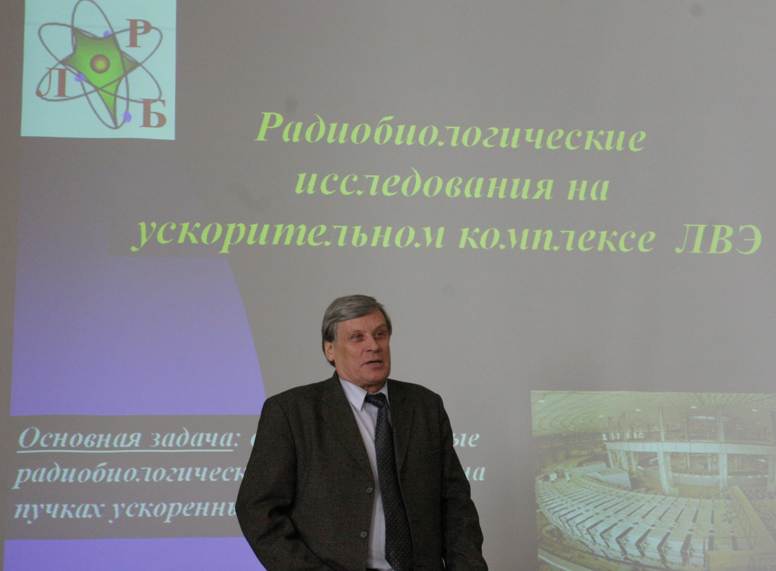
Radiobiology
E.A. Krasavin

Slide 45



In 2021, the construction of channels for the transportation of charged particle beams aimed at studying in the field of life science, radiation materials science and radiation resistance of electronics, the development of advanced technologies for nuclear energy tasks to be continued. For these purposes, the construction of three zones has been provided. This research infrastructure was named ARIADNA – Applied Research Infrastructure for Advance Development at NICA fAcility.
Chip Irradiation Station

Slide 46




BM@N experiment
V.D. Kekelidze
M.N. Kapishin
¹²C 10⁶/cycle
(2022)
¹²⁴Xe, 10⁷/cycle (2023) 3 and 3.9 AGeV, >550 million events, 3200 hours

Slide 47
The most exiting results
at the Nuclotron

Slide 48

A.D.Kovalenko
Observation of parametric X-rays produced by relativistic protons and carbon nuclei in Si crystals
(2005)
A.D. Kovalenko
С¹²
2.2 А∙ГэВ
Протоны 5 ГэВ
A.M.Taratin
Yu.N. Adischev, S.V. Afanasiev, V.V. Boiko, A.N. Efimov, Yu.V. Efremov, A.S. Gogolev, A.D. Kovalenko, Yu.L. Pivovarov, A.P. Potylitsyn, S.V. Romanov, Sh.Z. Saifulin, E.A. Silaev, A.M. Taratin, S.P. Timoshenkov, S.R. Uglov, V.I. Volkov, M.A. Voevodin, V.N. Zabaev. First observation of parametric X-rays produced by moderate relativistic protons and carbon nuclei in Si crystals. Nucl.Instrum.Meth.B 252 (2006) 111-117.

Slide 49



Discovery of tensor polarization of unpolarized
deuterons passing through matter
Tensor polarization of deuterons depending on the thickness of the target.
A.G. Litvinenko
L.S. Zolin
L. S. Azhgirei, T. A. Vasiliev, Yu. V. Gurchin, V. N. Zhmyrov, L. S. Zolin, A. Yu. Isupov, A. K. Kurilkin, P. K. Kurilkin, V. P. Ladygin, A. G. Litvinenko, V. F. Peresedov, S. M. Piyadin, S. G. Reznikov, A. A. Rovba, P. A. Rukoyatkin, A. V. Tarasov, A. N. Khrenov, M. Yanek. Measurement of tensor polarization of a deuteron beam passing through matter. Physics of Particles and Nuclei Letters, v. 7, p. 27–32 (2010).
V.G. Barishevsky

Slide 50


Indications on the existence of ɳ - nuclei
SKAN experiment
S.V.Afanasiev
S.V. Afanasiev, A.S. Artiomov, R.N. Bekmirzaev, D.K. Dryablov, Z.A. Igamkulov, V.I. Ivanov, A.Yu. Isupov, D.M. Jomurodov, A.I. Malakhov, A.I. Lebedev, A I. L’vov, L.N. Pavlyuchenko, E.B. Plekhanov, V.V. Polyansky, S.S. Sidorin, G.A. Sokol, and M.U. Sultanov. Search for η-Mesic Nuclei in the Reaction d + C at JINR. Physics of Particles and Nuclei Letters, 2011, Vol. 8, No. 10, pp. 1073–1077.
31

Slide 51




Unique beams of radioactive relativistic nuclei at the Nuclotron
These beams ensure a world-class fundamental study of the structure of the family of light nuclei.
P.A. Rukoyatkin
BECQUEREL experiment
V.A. Monchinsky
P.I. Zaruin
P. I. Zarubin. “Tomography" of the cluster structure of light nuclei via relativistic dissociation”. Lecture Notes in Physics, Vol. 875, Clusters in Nuclei, 3, pp 51-93, 2013, Springer International Publishing.

Slide 52




Discovery of the effect of the pion yield growth with increasing the mass of the target
A.B. Kurepin
DELTA experiment
V.A.Krasnov
A.N.Livanov, Yu.S.Anisimov, S.Gmuca, Yu.V.Gurchin, M.Janek, A.S.Kiselev, V.A.Kizka, V.A.Krasnov, S.N.Kuznetsov, V.P.Ladygin, A.I.Malakhov, J.Kliman, V.Matousek, M.Morkhach, E.B.Plekhanov, I.Turzo, A.B.Kurepin, T.A.Vasiliev. Search for resonant structure in the pion production reaction on the Nuclotron internal beam. Int.J.Mod.Physics, A22 (2007) 604-607.

Slide 53


Unique results with Nuclotron polarized deuterons
LNS experiment
Very important for understanding three-nucleon forces
V.P. Ladygin
H. Sakai (Japan)

Slide 54


Observation of the unexpected energy dependence of the differential cross section ratio on bound and free protons for np → pn reaction
(2005)
DELTA-SIGMA
R_{dp} (0⁰)= [dσ/dΩ(nd)]/[dσ/dΩ(np)]
experiment
L.N.Strunov
V.I.Sharov
Kinetic energy of neutrons, GeV
V.I. Sharov, A.A. Morozov, R.A. Shindin et al. Measurements of the ratio R(dp) of the quasi-elastic nd → p(nn) to the elastic np → pn charge-exchange process yields at zero proton emission angle over the 0.55-2.0-GeV neutron beam energy region. The European Physical Journal A39 (2009) 267–280.
F.Legar

Slide 55
«The end of an attractive fairy tale and unexpected results on the Nuclotron»
Yes, the physicists of the LHE JINR have closed one door in physics. As it usually happens, at the same time they opened other doors, more reliable ones, and raised new questions in their field of science. I am sure that these issues will be not less important than the previous ones, which have been solved during half a century.
Да, физики ЛВЭ ОИЯИ закрыли одну дверцу в физике. Как это бывает, одновременно раскрыли другие двери, более надежные и поставили в своей области науки новые вопросы. Я уверен, что эти вопросы будут не менее важны, чем предыдущие, которые решались в течение половины века.
Frantisek Legar (France)

Slide 56
Thank you for the attention!

