Slide 1
Investigation of Relativistic
Nuclear Collisions in
the Four-velocity Space
A.I. Malakhov *
The XXVth International Baldin Seminar on High Energy Physics Problems "Relativistic Nuclear Physics and Quantum Chromodynamics, September 18 - 23, 2023, Dubna
* Together with G.I. Lykasov and A.A. Zaitsev
_____________________________________________________________________________________________________________ A.Malakhov. The XXV International Baldin Seminar on High Energy Physics Problems, September 18 -23, 2023

Slide 2
A.M. Baldin, A.I. Malakhov. JINR Rapid Communications, 1 [87]-98 (1998) 5-12.
Ratio of antiparticle to particle yields
Similarity Parameter
Description of the spectra of secondary particles depending on P_{T} in a wide range of energies
Rapidity
П = N∙ChY
Energy dependence of the slope parameter on energy
Part of the transferred
four-momentum
The ratio of the strange kaon yield to the pion yield
Description of the particle yield depending on their rapidity
(The Baldin-Malakhov equation)
_____________________________________________________________________________________________________________ A.Malakhov. The XXV International Baldin Seminar on High Energy Physics Problems, September 18 -23, 2023

Slide 3
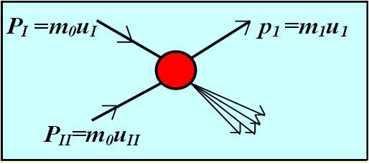
I + II→1 + …
(N_{I}P_{I} + N_{II}P_{II} – p₁)² = (N_{I}m₀ +N_{II}m₀ + M)²
N_{I} and N_{II} are the part of the transferred
four-momenta of nucleons participating in nuclei I and II.
M is the mass of the particle providing conservation of quantum numbers.
_____________________________________________________________________________________________________________ A.Malakhov. The XXV International Baldin Seminar on High Energy Physics Problems, September 18 -23, 2023

Slide 4
A.M. Baldin, A.A. Baldin. Phys. Particles and Nuclei, 29(3), 1998, 232
u_{I} and u_{II} are four velocities of the nuclei I and II.
Ed³σ/dp³ = C₁A_{I}^{α(NI)} · A_{II}^{α(NII)} · exp(−П/C₂)
_____________________________________________________________________________________________________________ A.Malakhov. The XXV International Baldin Seminar on High Energy Physics Problems, September 18 -23, 2023

Slide 5
In the mid-rapidity region (y=0, y is the rapidity of particle 1) the analytical form for П was found in A. M. Baldin, A. I. Malakhov. JINR Rapid Communications, 1 [87]-98 (1998) 5-12.
In this case N_{I} and N_{II} are equal to each other: N_{I} = N_{II} = N.
N = [1 + (1 +Ф_{М} /Ф²)^{1/2}]Ф,
where
Ф = 2m₀(m_{1t} chY +M)/sh²Y,
Ф_{м} = (M² − m²₁)/(4m²₀· sh²Y ).
m_{1t} = (m²₁+p_{t}²)^{1/2},
Y – rapidity of interacting nuclei.
П = N∙ChY
_____________________________________________________________________________________________________________ A.Malakhov. The XXV International Baldin Seminar on High Energy Physics Problems, September 18 -23, 2023

Slide 6
Ratio of antiparticle to particle yields
Description of the spectra of secondary particles depending on P_{T} in a wide range of energies
П = N∙ChY
Energy dependence of the slope parameter on energy
The ratio of the strange kaon yield to the pion yield
Description of the particle yield depending on their rapidity
_____________________________________________________________________________________________________________ A.Malakhov. The XXV International Baldin Seminar on High Energy Physics Problems, September 18 -23, 2023

Slide 7
For nuclei and nuclear fragments M = -m₁
For anti-nuclei and anti-nuclear fragments M = m₁
_____________________________________________________________________________________________________________ A.Malakhov. The XXV International Baldin Seminar on High Energy Physics Problems, September 18 -23, 2023

Slide 8
In case of symmetric nuclei (A_{I} = A_{II} = A) the above relation takes the following form:
If A_{I} = A, A_{II} = B, then
_____________________________________________________________________________________________________________ A.Malakhov. The XXV International Baldin Seminar on High Energy Physics Problems, September 18 -23, 2023

Slide 9
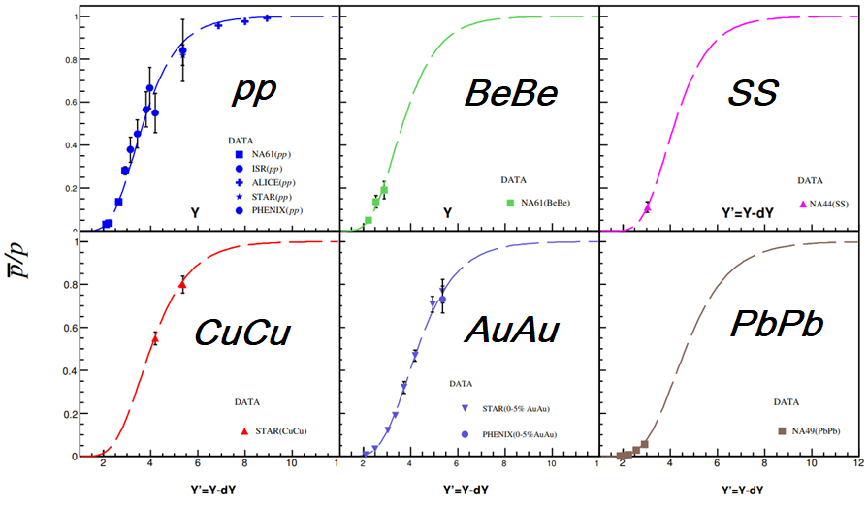
Description of the yield ratios of anti-p/p with one value of constant C₂=0.146 taking into account dY (Y) dependences.
_____________________________________________________________________________________________________________ A.Malakhov. The XXV International Baldin Seminar on High Energy Physics Problems, September 18 -23, 2023

Slide 10
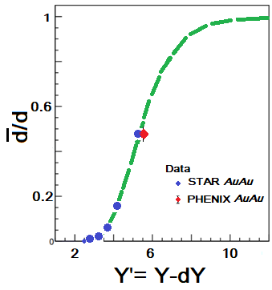
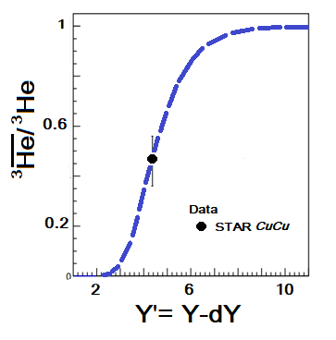
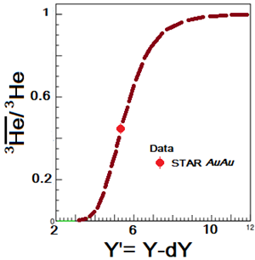
Description of the yield ratios of anti-d/d, anti-He³/He³ with one value of constant C₂=0.146.
A.I. Malakhov and A.A. Zaitsev. Journal of Experimental and Theoretical Physics, 2022, Vol. 135, No. 2, pp. 209–214.
_____________________________________________________________________________________________________________ A.Malakhov. The XXV International Baldin Seminar on High Energy Physics Problems, September 18 -23, 2023

Slide 11
Ratio of antiparticle to particle yields
Description of the spectra of secondary particles depending on P_{T} in a wide range of energies
П = N∙ChY
Energy dependence of the slope parameter on energy
The ratio of the strange kaon yield to the pion yield
Description of the particle yield depending on their rapidity
_____________________________________________________________________________________________________________ A.Malakhov. The XXV International Baldin Seminar on High Energy Physics Problems, September 18 -23, 2023

Slide 12
Using relativistic invariant variables s, p_{t} and ch(Y) = √s/2m₀ dependence we have obtained the following form for П:
δ = 1- 4m₀²/s, m_{t}² = p_{t}² + m₁²
Baldin-Malakhov-Lykasov equation
At large √s >>1 GeV:
G.I. Lykasov, A.I. Malakhov. Self-consistent analysis of hadron production in pp and AA collisions at mid-rapidity.Eur.Phys. J. A54, 187 (2018).
_____________________________________________________________________________________________________________ A.Malakhov. The XXV International Baldin Seminar on High Energy Physics Problems, September 18 -23, 2023

Slide 13
For π-mesons at p_{t}² >> m₁²:
_____________________________________________________________________________________________________________ A.Malakhov. The XXV International Baldin Seminar on High Energy Physics Problems, September 18 -23, 2023

Slide 14
E∙(d³σ/dp³) = (1/π) d³σ /(dm_{1t}²dy)=
= [φ_{q}(y,p_{t}) + φ_{g}(y,p_{t})∙(1- σ_{nd}/g(s/s₀)∆)]∙g(s/s₀)∆
σ_{n} – cross-section of hadron production
by the exchange of n-pomerons.
g – constant (~20 mbarn), S₀ ~ 1 GeV²,
∆ = [α_{p}(0)-1] ~ 0,08
G.I.Lykasov proposed to use functions depending on the similarity parameter П as functions φ(y,p_{t}) :
G. Lykasov → φ = φ(П)
_____________________________________________________________________________________________________________ A.Malakhov. The XXV International Baldin Seminar on High Energy Physics Problems, September 18 -23, 2023

Slide 15
The first part of inclusive spectrum (Soft QCD (quarks)) is related to the function ɸ_{q}(y=0, П), which is fitted by the following form [*]:
The function ɸ_{g}(y=0, П) related to the second part (Soft QCD (gluons)) of the spectrum is fitted by the following form [*]:
[*] V. A. Bednyakov, A. A. Grinyuk, G. I. Lykasov, M. Pogosyan. Int.J.Mod.Phys., A27 (2012) 1250042.
_____________________________________________________________________________________________________________ A.Malakhov. The XXV International Baldin Seminar on High Energy Physics Problems, September 18 -23, 2023

Slide 16
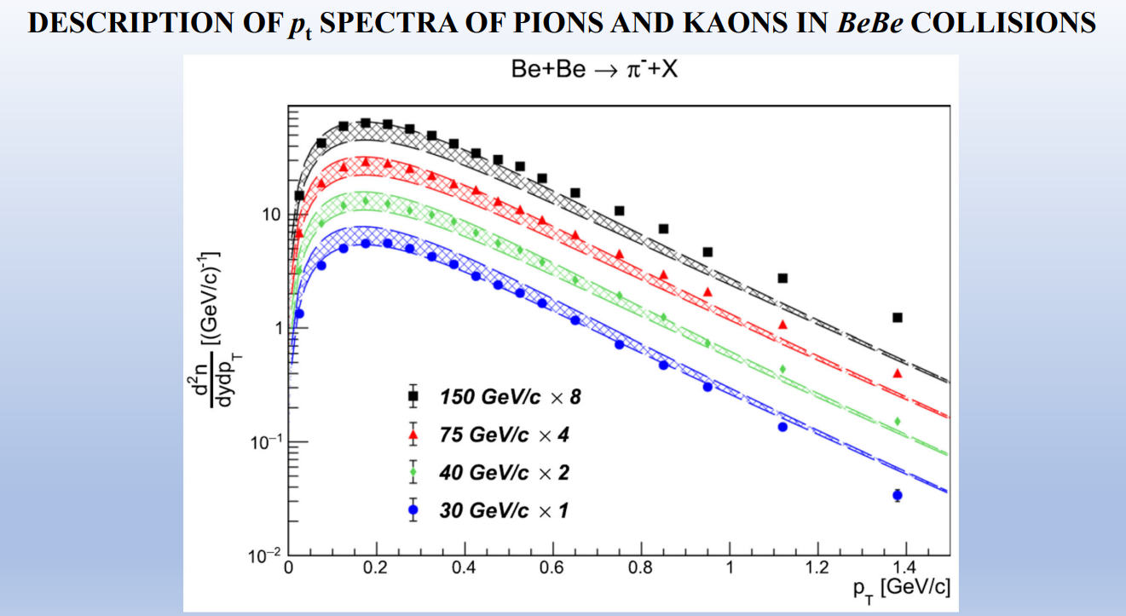
G. I. Lykasov, A. I. Malakhov, A. A. Zaitsev. Ratio of kaon-to-pion production cross-sections in BeBe collisions as a function of √s. Eur. Phys. J. A (2022) 58:112
_____________________________________________________________________________________________________________ A.Malakhov. The XXV International Baldin Seminar on High Energy Physics Problems, September 18 -23, 2023

Slide 17
Ratio of antiparticle to particle yields
Description of the spectra of secondary particles depending on P_{T} in a wide range of energies
П = N∙ChY
Energy dependence of the slope parameter on energy
The ratio of the strange kaon yield to the pion yield
Description of the particle yield depending on their rapidity
_____________________________________________________________________________________________________________ A.Malakhov. The XXV International Baldin Seminar on High Energy Physics Problems, September 18 -23, 2023

Slide 18
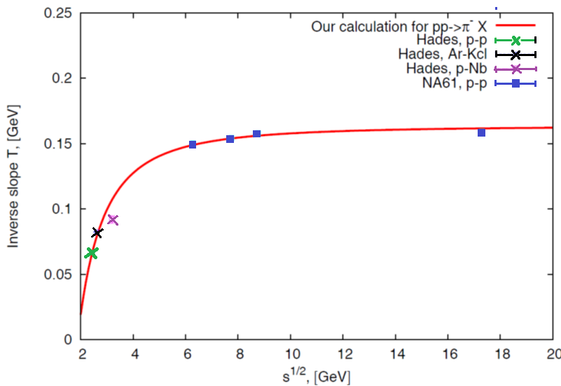
E(d³σ/dp³) ~ exp (-m_{t} /T) , T=Const
E(d³σ/dp³) ~ exp(- П/С₁) = exp(-m_{1t}/[m₀(1-4m₀²/s)]
T = m₀(1-4m₀²/s)
A. A. Abgrall et al. Eur.Phys.J., C74 (2014)
2794 (NA61).
G. Agakishiev et al. arXiv:1512.07070v1 [nucl-ex]
22 Dec 2015 (HADES).
G.I. Lykasov, A.I. Malakhov. Self-consistent analysis of hadron production in pp and AA collisions at mid-rapidity. Eur.Phys.J.A 54 (2018) 11, 187.
_____________________________________________________________________________________________________________ A.Malakhov. The XXV International Baldin Seminar on High Energy Physics Problems, September 18 -23, 2023

Slide 19
Ratio of antiparticle to particle yields
Description of the spectra of secondary particles depending on P_{T} in a wide range of energies
П = N∙ChY
Energy dependence of the slope parameter on energy
The ratio of the strange kaon yield to the pion yield
Description of the particle yield depending on their rapidity
_____________________________________________________________________________________________________________ A.Malakhov. The XXV International Baldin Seminar on High Energy Physics Problems, September 18 -23, 2023

Slide 20
BMLZ – Baldin-Malakhov-Lykasov-Zaitsev model.
G.I. Lykasov, A.I. Malakhov, A.A. Zaitsev. Ratio of cross-sections of kaons to pions produced in pp collisions as a function of √s. Eur.Phys.J.A 57 (2021) 3, 91.
_____________________________________________________________________________________________________________ A.Malakhov. The XXV International Baldin Seminar on High Energy Physics Problems, September 18 -23, 2023

Slide 21
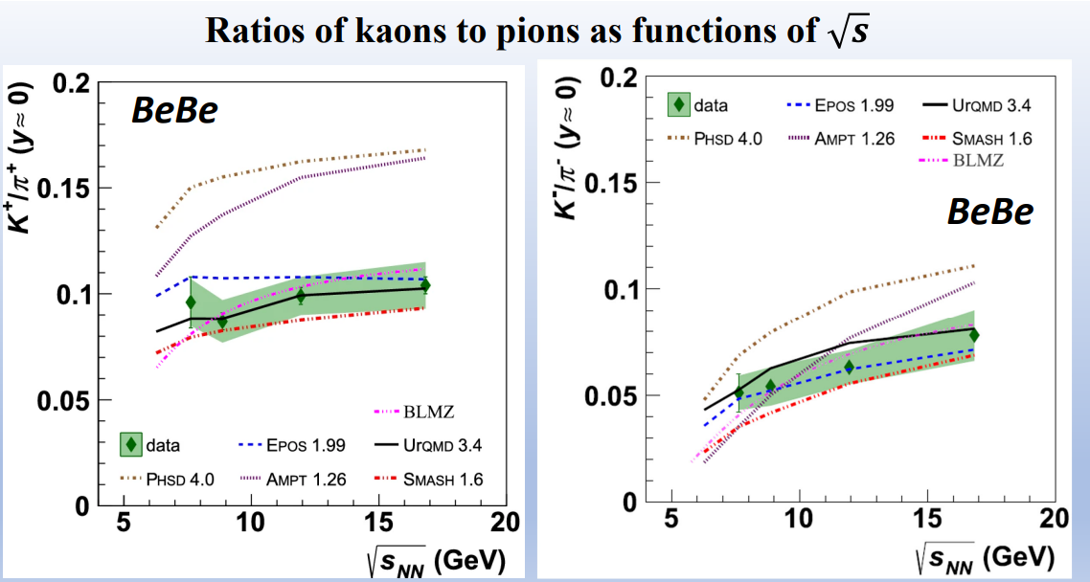
BLMZ model:
Lykasov, G.I., Malakhov, A.I. and Zaitsev, A.A. Ratio of kaon-to-pion production cross-sections in BeBe collisions as a function of √s. Eur. Phys. J. A 58, 112 (2022).
_____________________________________________________________________________________________________________ A.Malakhov. The XXV International Baldin Seminar on High Energy Physics Problems, September 18 -23, 2023

Slide 22
Ratio of antiparticle to particle yields
Description of the spectra of secondary particles depending on P_{T} in a wide range of energies
П = N∙ChY
Energy dependence of the slope parameter on energy
The ratio of the strange kaon yield to the pion yield
Description of the particle yield depending on their rapidity
_____________________________________________________________________________________________________________ A.Malakhov. The XXV International Baldin Seminar on High Energy Physics Problems, September 18 -23, 2023

Slide 23
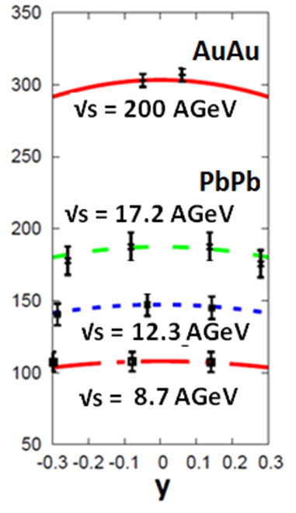
A.I. Malakhov, G.I. Lykasov. Mid-rapidity dependence of hadron production in p-p and A−A collisions. Eur.Phys.J.A56 (2020) 4, 114.
П = N∙chY
N = {1 + [1 + (Ф_{M}/ Ф²)]^{½}}Ф
Ф ≈ {(1/m₀)[m_{1t}chy∙chY +
+ M]}∙[1/(2sh²Y)]
Ф_{М} = (М² – m₁²)/(4m₀²sh²Y)
Pion y-spectra in AuAu (RHIC) and PbPb (SPS) collision.
J. Cleymans, et al., Phys.
Rev. C78, 017901 (2008).

Slide 24
Ratio of antiparticle to particle yields
Description of the spectra of secondary particles depending on P_{T} in a wide range of energies
П = N∙ChY
Energy dependence of the slope parameter on energy
The ratio of the strange kaon yield to the pion yield
N = [1 + (1 +Ф_{М} /Ф²)^{1/2}]Ф,
Ф = 2m₀(m_{1t} chY +M)/sh²Y,
Ф_{м} = (M² − m²₁)/(4m²₀· sh²Y ).
Description of the particle yield depending on their rapidity
In central rapidity region.
_____________________________________________________________________________________________________________ A.Malakhov. The XXV International Baldin Seminar on High Energy Physics Problems, September 18 -23, 2023

Slide 25
Thank you for the attention!

Slide 26
Back slides
_____________________________________________________________________________________________________________ A.Malakhov. The XXV International Baldin Seminar on High Energy Physics Problems, September 18 -23, 2023

Slide 27
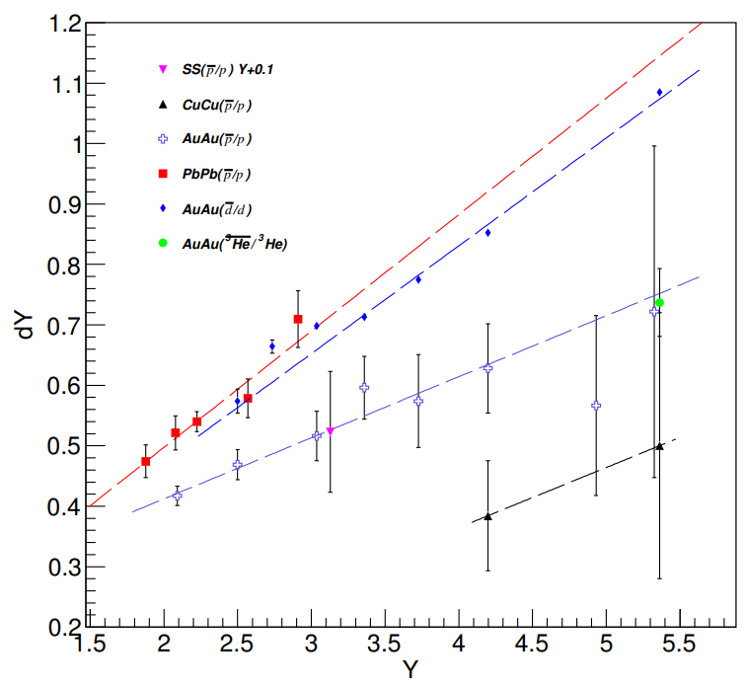
The dependence of the rapidity loss of dY on the rapidity of Y. The dotted lines - linear approximation of dY (Y )=p0+p1·Y .
_____________________________________________________________________________________________________________ A.Malakhov. The XXV International Baldin Seminar on High Energy Physics Problems, September 18 -23, 2023

Slide 28
I + II → 1 + …
(N_{I}P_{I} + N_{II}P_{II} – p₁)² = (N_{I}m₀ +N_{II}m₀ + M)²
N_{I} and N_{II} are nucleon effective numbers participating in interaction (cumulative numbers) for nuclei I and II.
M is the mass of the particle providing conservation of the baryon number, strangeness and other quantum numbers.
For antinuclei and K⁻ mesons M = m₁, for nuclear fragments M= -m₁. For K⁺ mesons M=m_{Λ} – m₀. For the particles produced without accompanying antiparticles (π mesons) M=0.
_____________________________________________________________________________________________________________ A.Malakhov. The XXV International Baldin Seminar on High Energy Physics Problems, September 18 -23, 2023

