Slide 1
EMISSION OF CUMULATIVE PROTONS , PIONS, KAONS AND ANTIPROTONS IN COLLISIONS OF HEAVY IONS INTERMEDIATE ENERGIES BASED ON NON-EQUILIBRIUM HYDRODYNAMIC APPROACH
A.T. D’yachenko^{1.2}
¹Emperor Alexander I Petersburg State Transport University;
²NRC “Kurchatov Institute” B.P. Konstantinov Petersburg Nuclear Physics Institute

Slide 2
In .
The prospects of the hydrodynamic approach to the description of collisions of heavy ions of intermediate energies and the importance of taking into account non-equilibrium processes are noted.
When describing these spectra, the correction for the microcanonical distribution was taken into account, and the contribution of the fragmentation process was also taken into account for the proton yields .
In the present work, we have an angle of 0⁰ for the collision
of carbon nuclei in tsuccessfully described the double
differential cross sections for the production of cumulative protons,
pions, kaons, and antiprotons emitted at he ¹²C + ¹²C reaction
at an energy of 19.6 GeV per nucleon on
a fixed target, obtained at the U-70 accelerator at IHEP (Serpukhohov).

Slide 3
The Schrödinger equation and Hydrodynamics
"… важно сконцентрировать имеющиеся ресурсы на основных прорывных направлениях..." В.В. Путин.
To take into account dissipation in the process of collisions of complex systems, in addition to equations (2)-(3), a dissipative function related to the temperature of the system should be introduced into these equations

Slide 4
СВЯЗЬ УРАВНЕНИЙ ГИДРОДИНАМИКИ С УРАВНЕНИЕМ КЛЕЙНА-ГОРДОНА

Slide 5
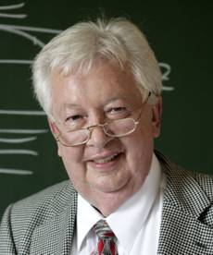
Fortov V.E,.Lomonosov I.V. // Phys. Usp. 2014. V. 57. no. 3. P.219
Fortov V.E., Sharkov B. Yu., Stöcker H.// Phys. Usp. 2012. V. 55. no. 6. P. 582.
Stöcker H., Greiner W. // Phys. Rept. 1986. V. 137. №. 5-6. P. 277.
D’yachenko A.T., Gridnev K.A., Greiner W. // J. Phys. 2013. V.G40.P. 085101
Korteweg D.J., Vries G.// Phil. Mag. 1895. V. 39. P. 422.
Scheid W, Muller H, Greiner W. 1974 // Phys. Rev. Lett. 1974, V. 32, P. 741
Baldin A.M. et al. Cumulative mesoproduction // Sov. J. Nucl. Phys. 1974. V. 18,no. 1. P. 41-44.
Bayukov Yu.D. et al. Scaling invariance effects in proton-nucleus backward scattering in few-GeV energy range // Sov. J. Nucl. Phys. 1974. V. 18, no. 6. P. 639-641.
GREINER Walter
1935-2016
L.D. Landau, Izv. Akad. Nauk Ser.Fiz. 17, 51(1953).
GRIDNEV Konstantin Alexandrovich
1938-2015

Slide 6
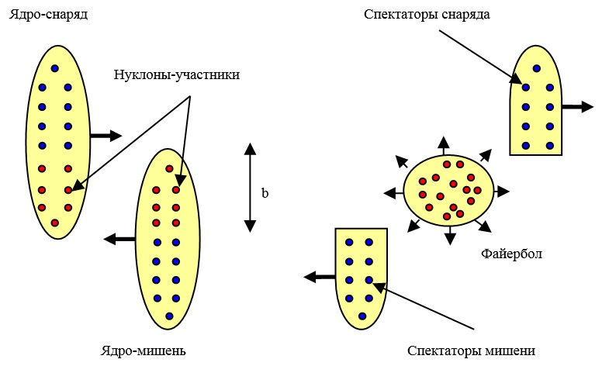

Slide 7
1.KORTEVEG-DE VRIES SOLITONS
м/с

Slide 8
Effect MONRO

Slide 9
2. FEATURES OF NON-EQUALIBRIUM HYDRODYNAMIC APPROACH
To describe the collisions of heavy ions we use the non-equilibrium hydrodynamic approach, in which the kinetic equation for the nucleon distribution function is solved jointly with the equations of hydrodynamics, which are essentially local laws of conservation of mass, momentum and energy.
, (1)
where is the locally equilibrium distribution function and
‘ is the relaxation time
(2)
The self-consistent potential appearing in the interaction term is specified in just the same way as this is done in the case of density-dependentive forces belonging to the Skyrme type

Slide 10
Quntum kinetic equation
Обобщение Больцмановского интеграла для получения уравнений
трехжидкостной гидродинамики

Slide 11
(3)
.
(4)

Slide 12
3.THE HYDRODYNAMIC STAGE
After selecting the region of the local heating, hot spot - the overlap region of the colliding nuclei, we analyze the stages of compression, expansion and freeze-out of matter during the collision of heavy ions. At the compression stage, a collisionless shock wave with a changing front is formed. At the expansion stage, when the shock wave reaches the boundaries of hot spot, the initially compressed system is expanded, we describe it in the relaxation approximation taking into account the nuclear viscosity. As the relaxation time we take , where is the mean free path, is the total nucleon-nucleon cross section, is the nucleon density, and is the average velocity of the thermal motion of the nucleons. At the freeze-out stage, when the system reaches a critical density also called the freeze-out density, the system does not "hold itself" and the secondary particles are formed.

Slide 13
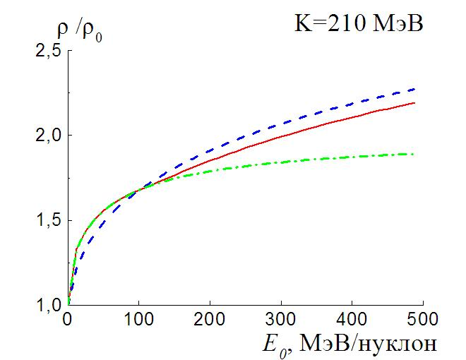
Dependence on the collision energy of the maximum compression ratio
achieved in the central collision of nuclei for the case of the relaxation factor
(solid line) calculated by us, for the case when the factor
(dashed line), and for the case when (a dashed-dot line)

Slide 14
4.STATISTICAL FRAGMENTATION MECHANISM
To describe the soft part of the spectrum of emitted protons, one can use the statistical model of fragmentation of colliding heavy ions proposed by Feshbach, Huang, and Goldhaber . According to this model, the probability of the escape of fragments from a compound nucleus is proportional to ,
where p is the momentum of the fragment in the rest frame of the nucleus, and the variance
1) 2)
As a result, we find the contribution we need to the cross section for protons during fragmentation (b is the impact parameter)

Slide 15
5. A COMPARISON WITH EXPERIMENTAL DATA
As a result, the double differential cross-section of proton emission has the form (where b is the impact parameter, is a Planck constant, is the radius vector):
(5)
where the distribution function of emitted protons
(6)
Here the spin factor , , and are respectively the total energy, the Lorentz factor and the proton momentum; is the velocity field, is the factor taking into account that the cross section of the hot spot formation is always greater than the geometric one, is the chemical potential, which is found from the conservation of the average number of particles for a grand canonical ensemble, is the temperature,
is correction for the microcanonical distribution, which for the kinetic energy is equal to ,

Slide 16
(7)
where , is the number of nucleons in the thermostat,
is the energy that is close to the energy of the thermostat, i.e. close to the kinematic limit for the energy of the system. We also chose the energy value , when the distribution function decreases by an order of magnitude compared to its maximum. When the amendment was supposed equal to zero. In the energy interval
it was a linear interpolation between zero and expression (7). Here the correction is found for the Boltzmann limit of an ideal gas, since deviations from a grand canonical distribution of the Fermi gas are manifested on the "tails" of the energy spectra when the Fermi distribution coincides with the Boltzmann limit.
The probability of a microcanonical distribution in the limit of the Boltzmann limit of an ideal gas is
,
(8)

Slide 17
where is the kinetic energy of the system, is the energy of the thermostat, is the normalization factor. As a result, in the limit of a large number of particles at , expression (8) becomes a grand canonical distribution
Thus, on the tails of the energy distributions, using formula (7), we find an amendment for the microcanonical distribution (6), which changes the usual Fermi-Dirac distribution, describing the system well away from the tails of the proton spectrum. Moreover, in formulas (5) - (6) it is taken into account that the energy of the system is recalculated in accordance with the Lorentz transformations. The energy in the distribution (6) is reckoned from the value of the self-consistent mean field with allowance for the surface energy, since the nucleons are "locked" by the mean field.
In addition to the contribution of (1) to the cross section for the emission of protons from the hot spot, we also took into account the contribution from the fusion of the non-overlapping parts of the colliding nuclei so called "spectators".

Slide 18
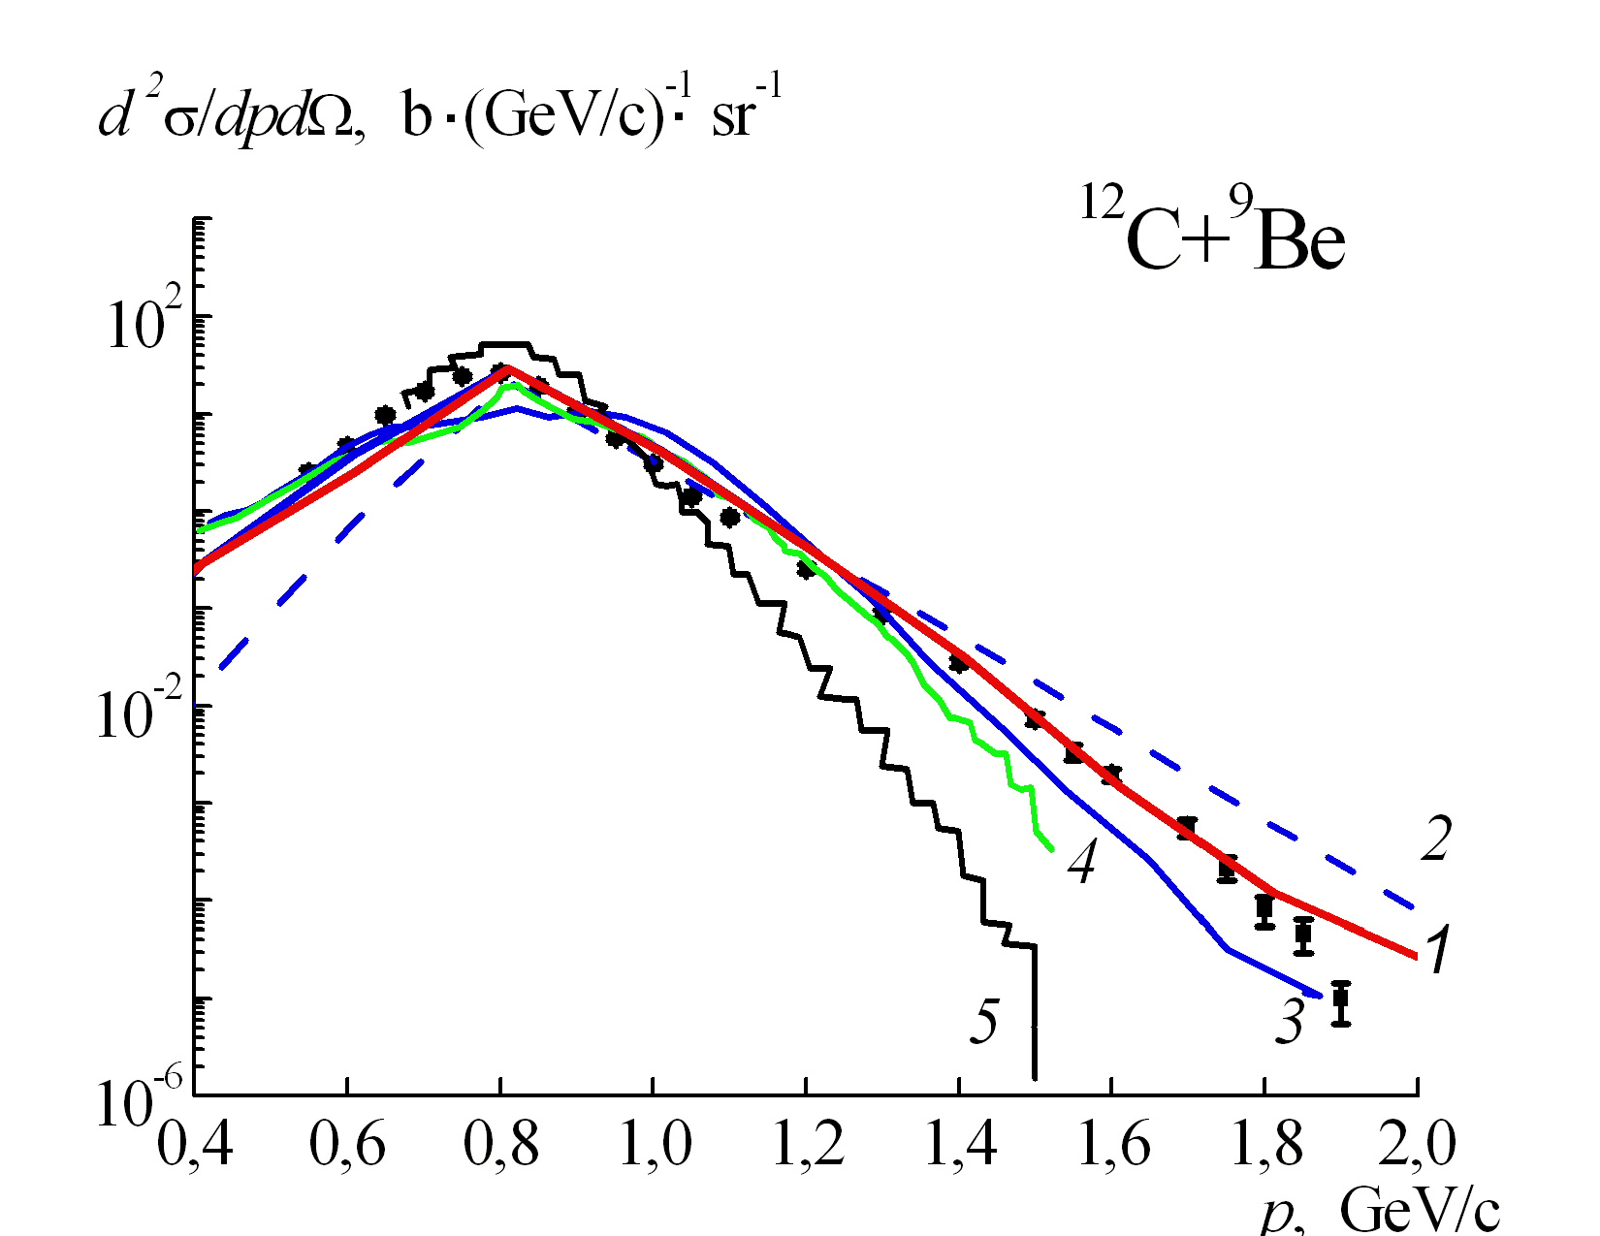
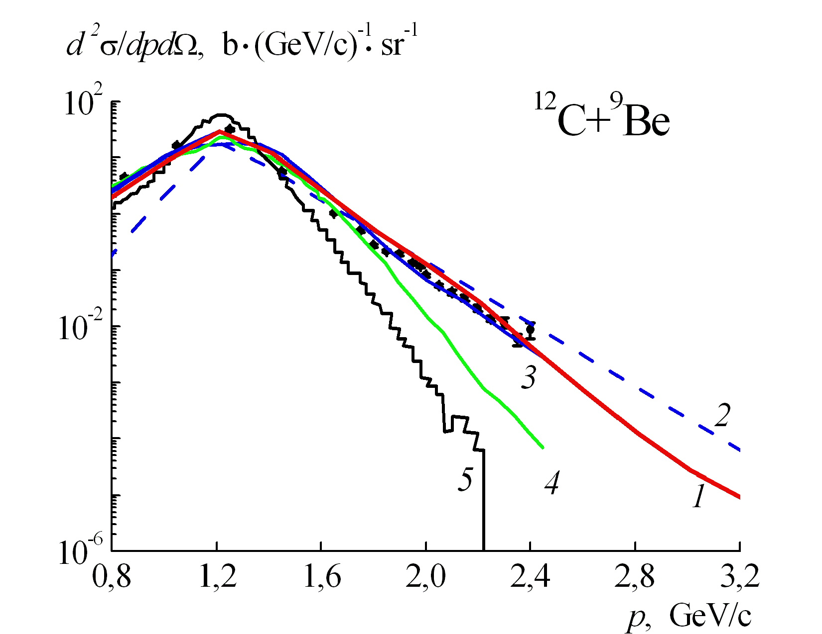
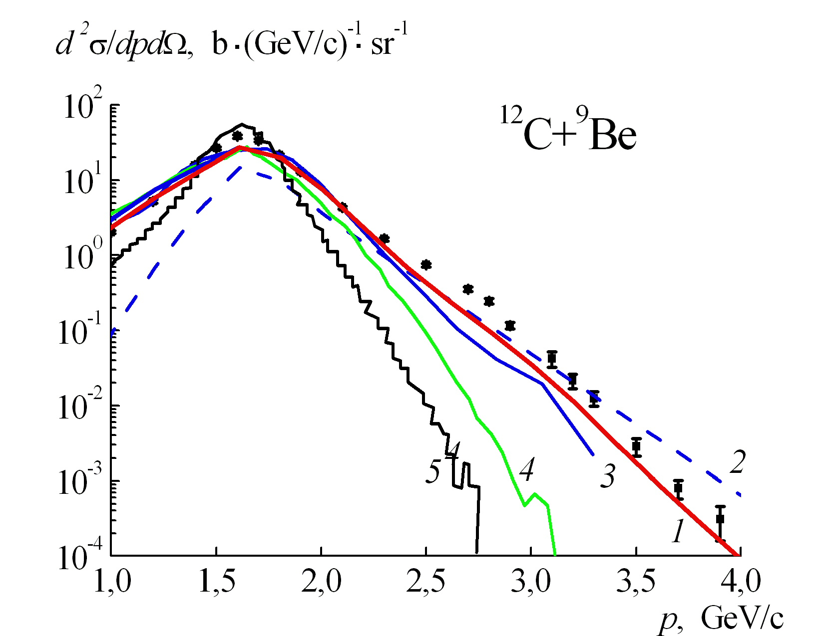
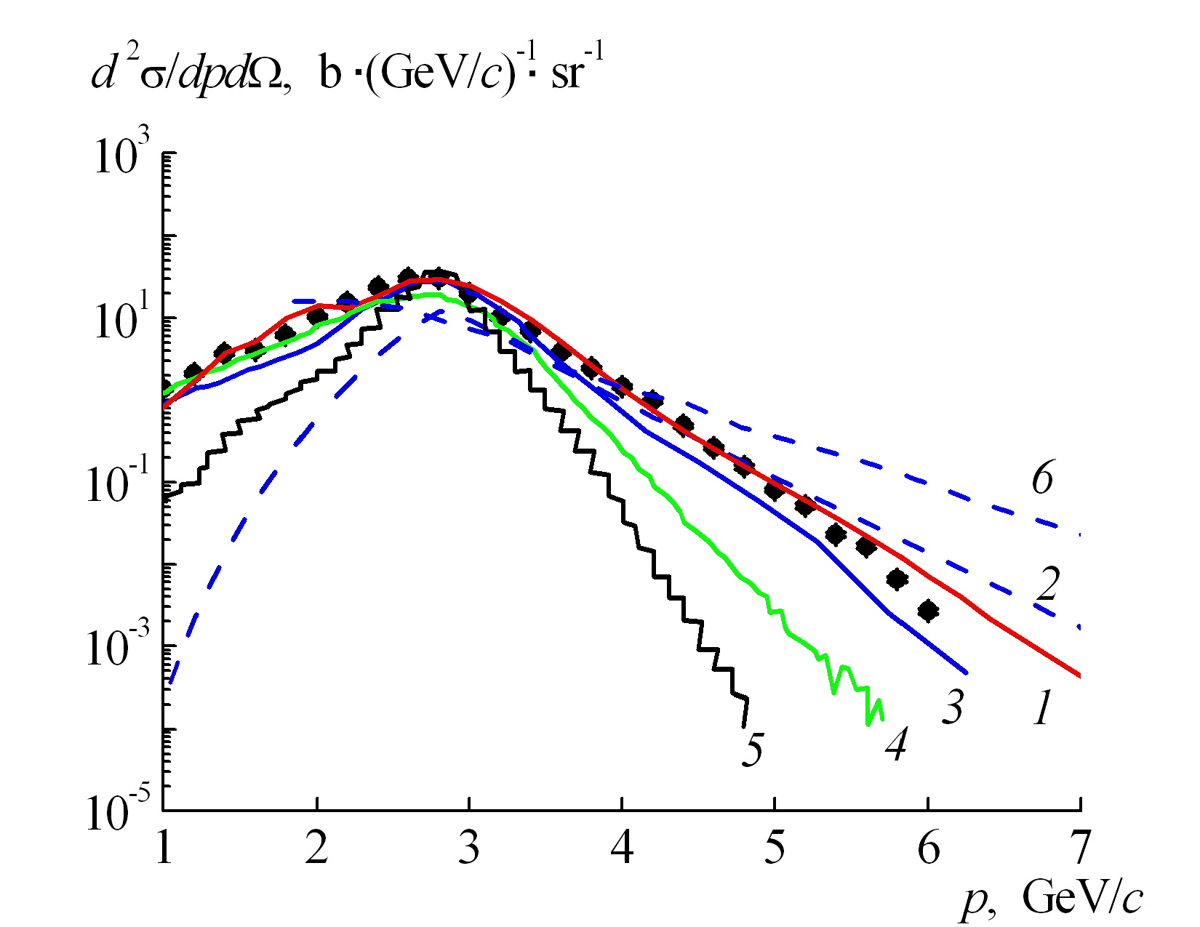
¹²C+⁹Be 300 MeV/nucl. (protons) 3,5⁰
¹²C+⁹Be 600 MeV/nucl. (protons) 3,5⁰
¹²C+⁹Be 950 MeV/nucl. (protons) 3,5⁰
¹²C+⁹Be 2000 MeV/nucl. (protons) 3,5⁰
Б. М. Абрамов и др., ЯФ 78, 403 (2015).
А.Т. Дьяченко, И.А. Митропольский, ЯФ 83, 317 (2020)
W. Cassing and E. Bratkovskaya, Phys. Rept. 308, 65 (1999). №6
S. G. Mashnik, J. S. Bull, H. G. Hughes, et al., Eur. Phys. J. Plus 126, 49 (2011).№4
A.V. Dementev and N.M. Sobolevsky, Nucl. Tracks Radiat. Meas. 30, 553 (1999).№3

Slide 19
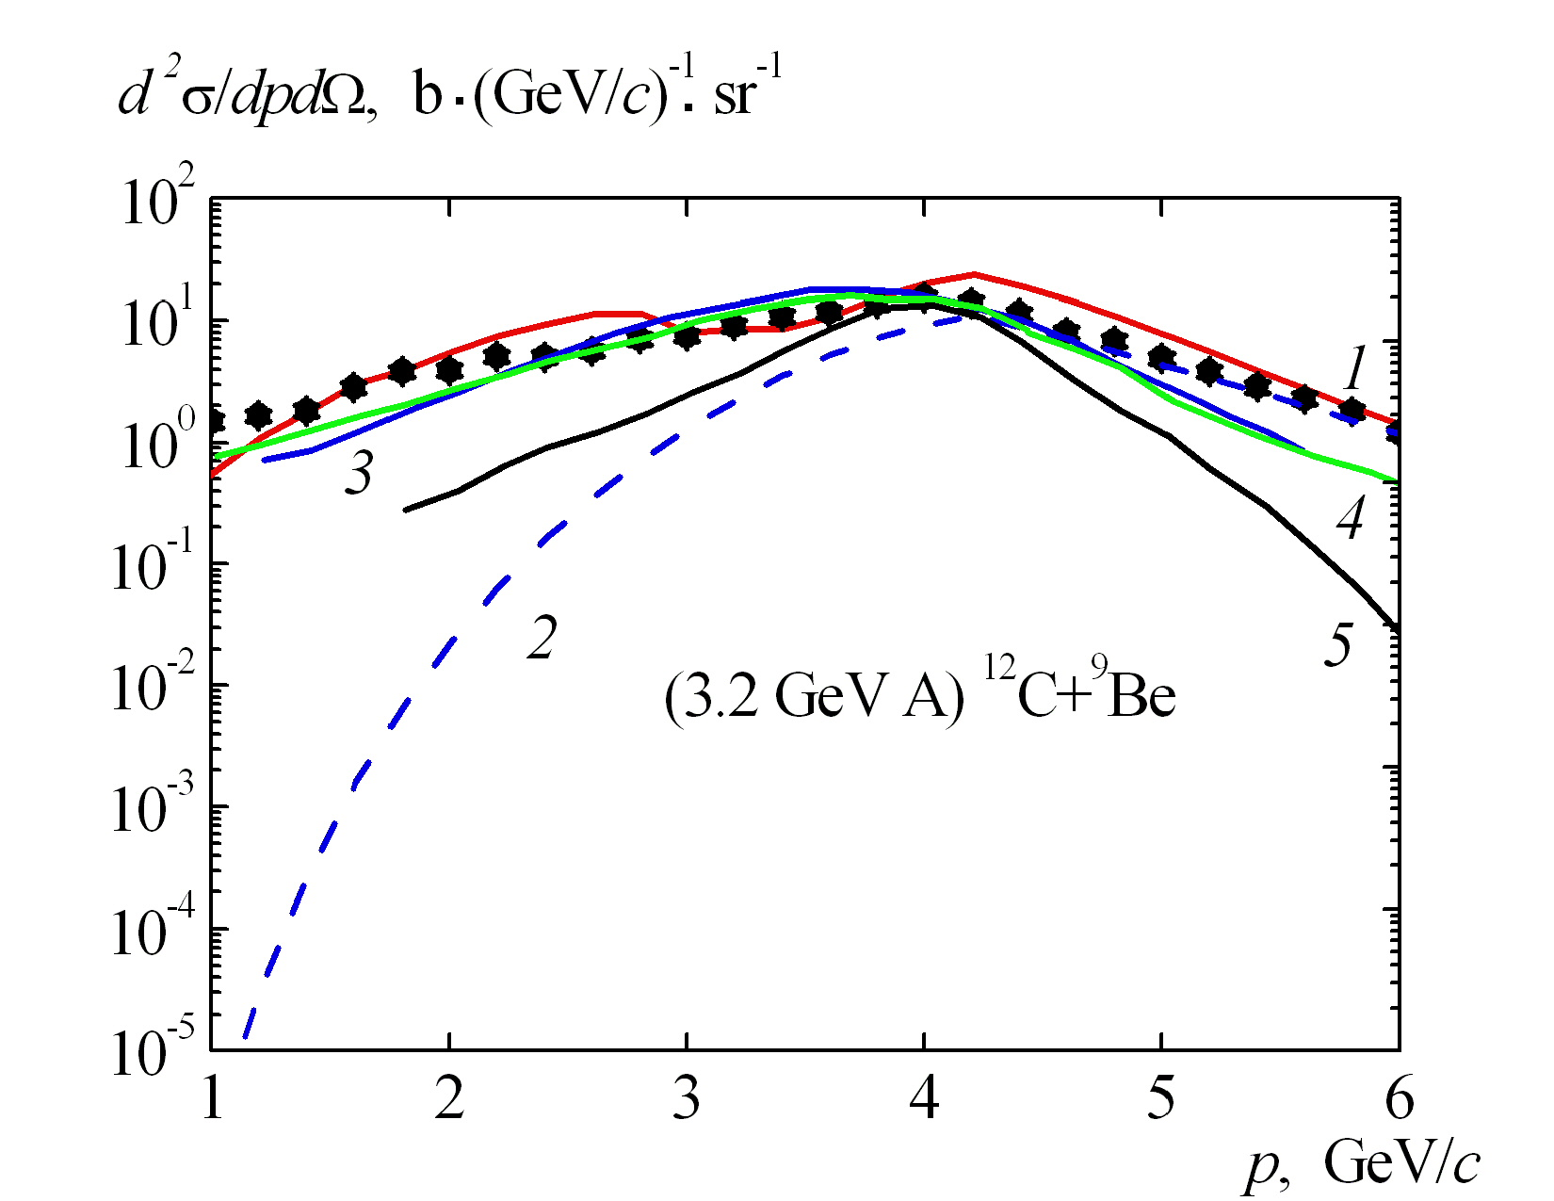
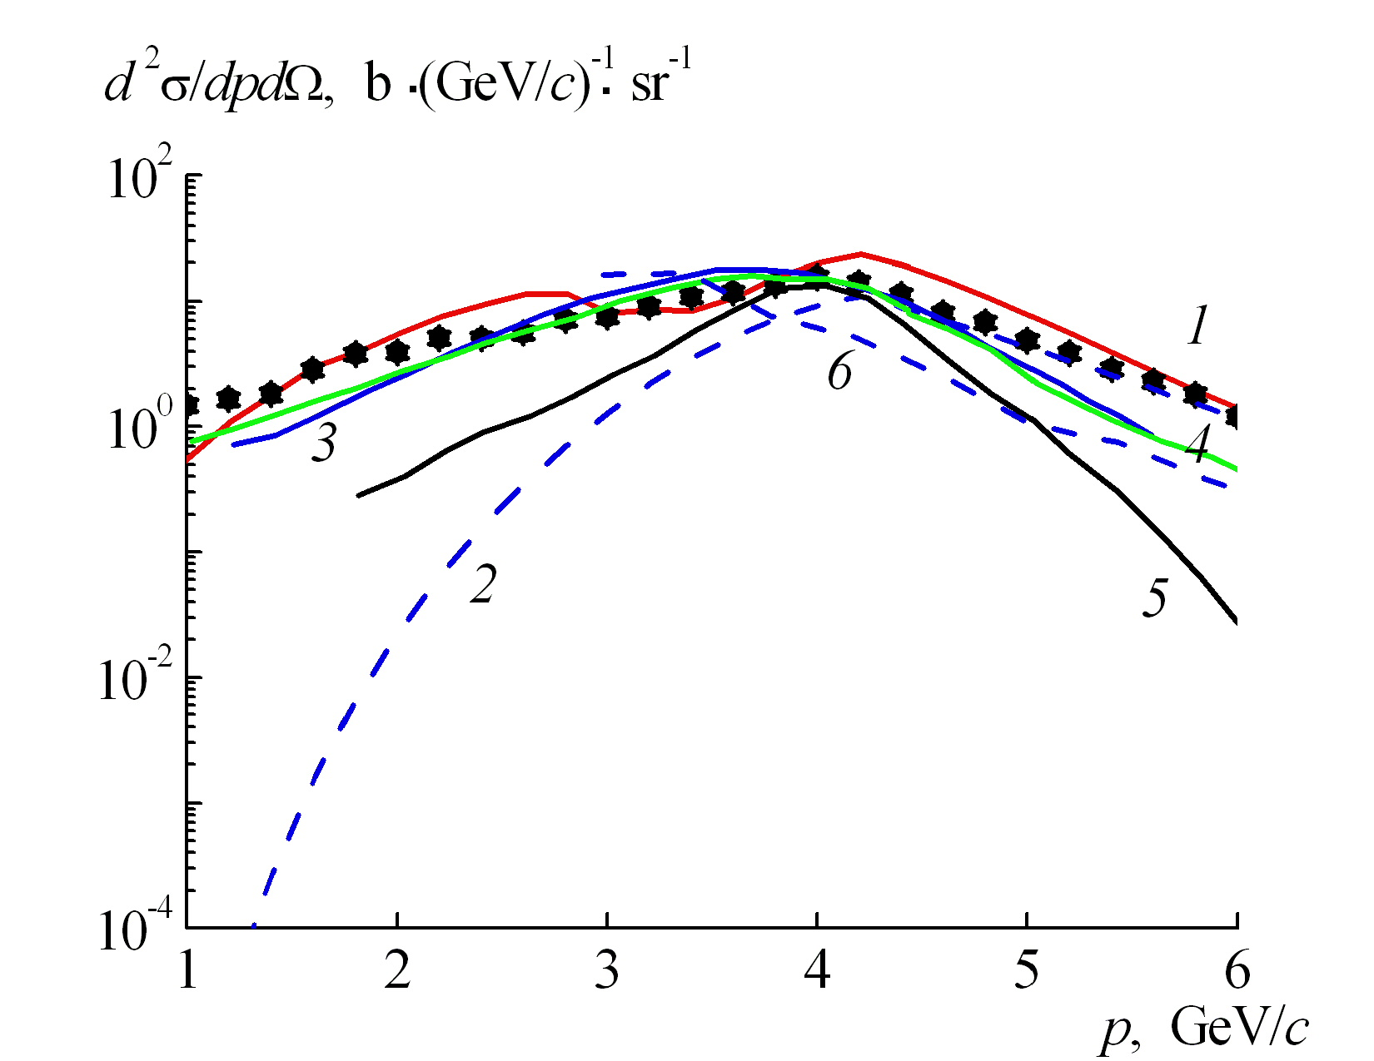
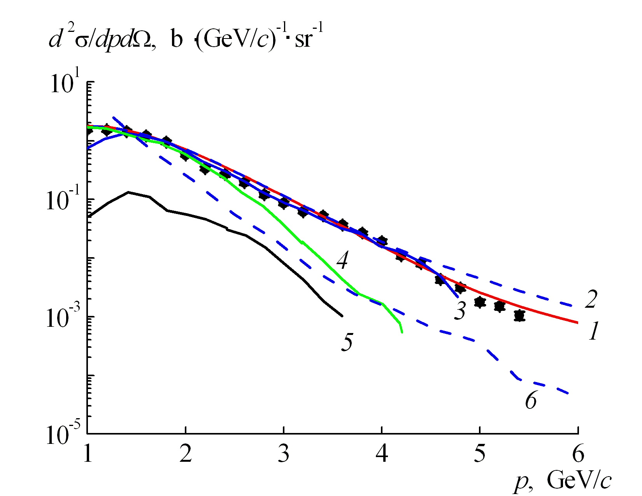
¹²C+⁹Be 3.2 GeV/nucl. (protons) 3,5⁰
¹²C+⁹Be 3.2 GeV/nucl. (negative pions) 3,5⁰
Б.М. Абрамов, М. Базнат, Ю.А. Бородин, …, В.В. Куликов, и др., ЯФ 84, 331 (2021)
1,2 Our approach
3 Sobolevsky
4 Mashnik
5 GEANT4
6 HSD

Slide 20
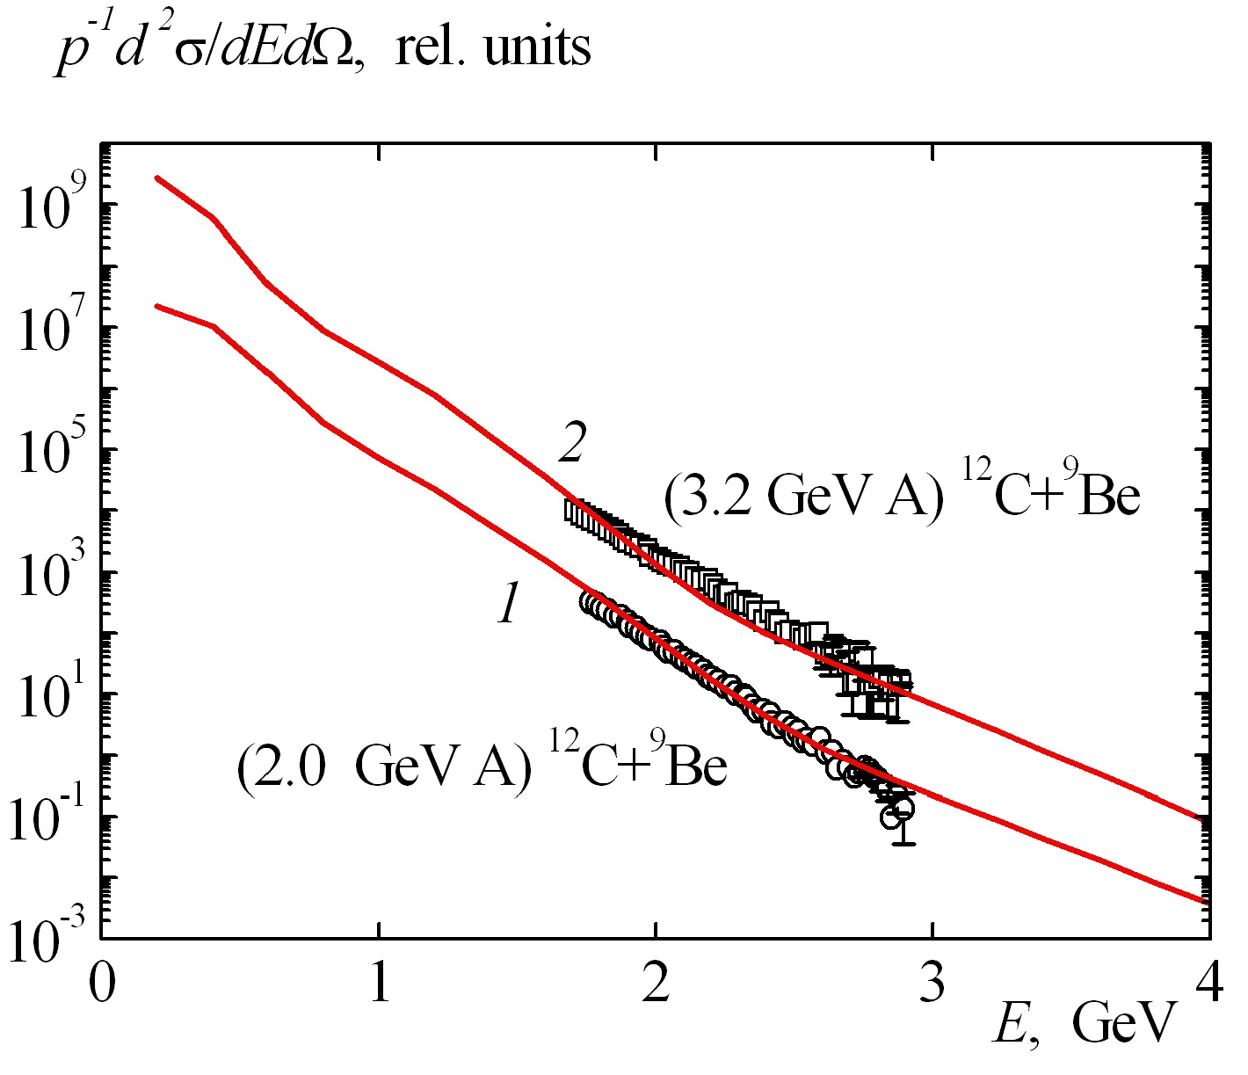
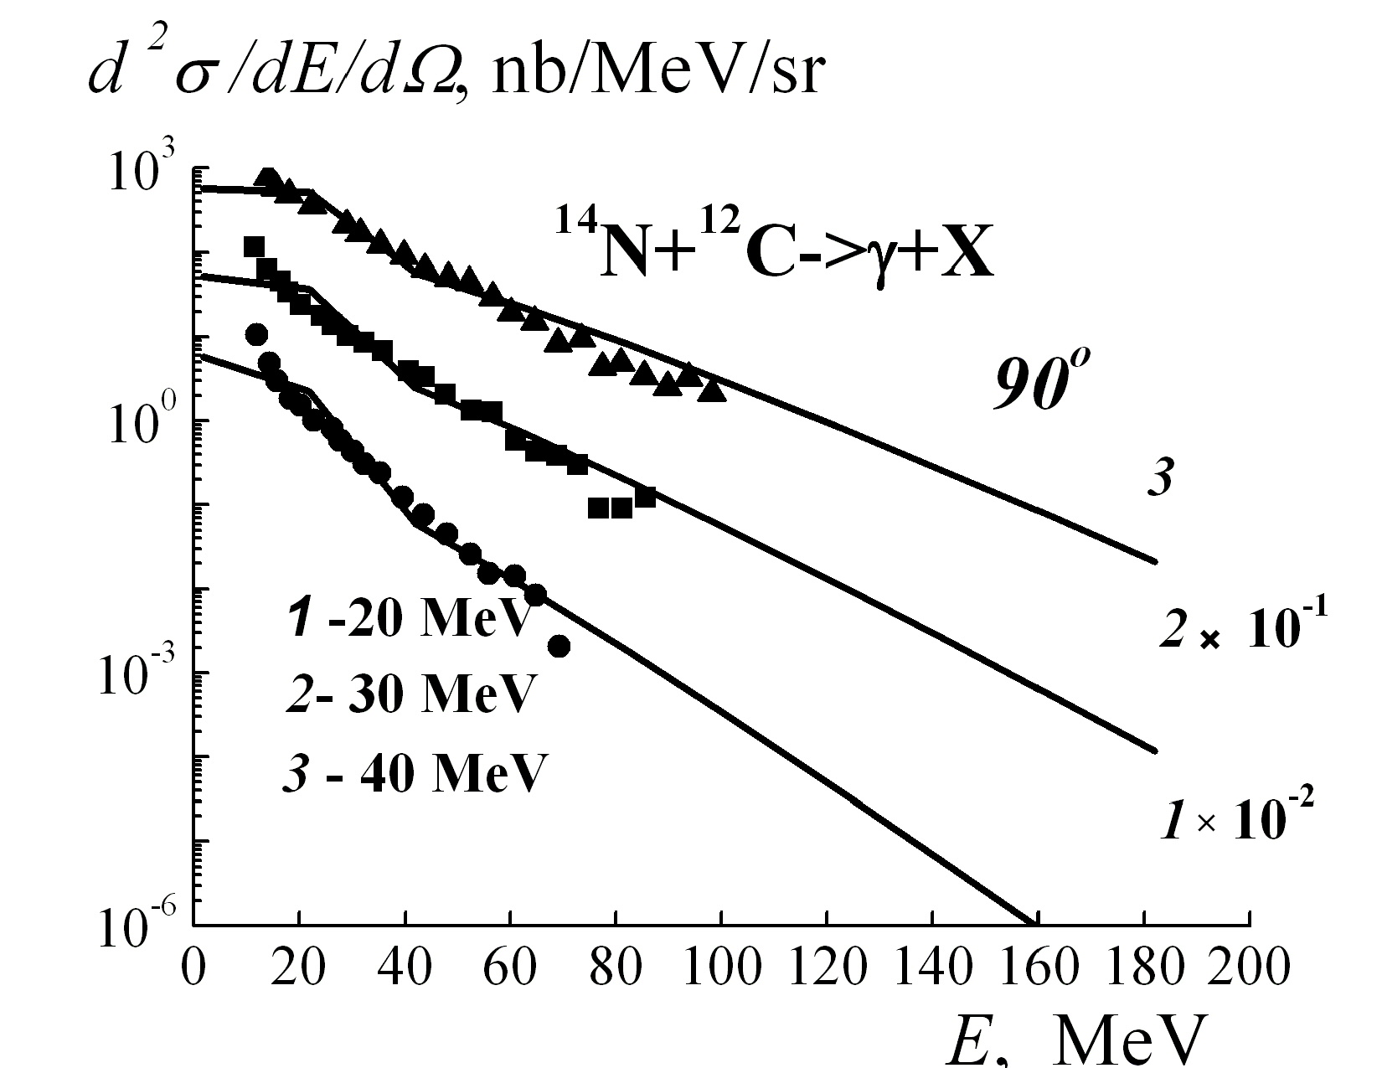
Hard photons
¹²C+⁹Be (photons) 38⁰ ¹⁴N+¹²C (photons) 90⁰
SRC W.-M. Guo, B.-A. Li, G.-C. Yong, Phys.Rev.C 104 (2021) 3
И. Г. Алексеев, А. А. Голубев, В. С. Горячев, и др., ЯФ 78, 995 (2015)

Slide 21
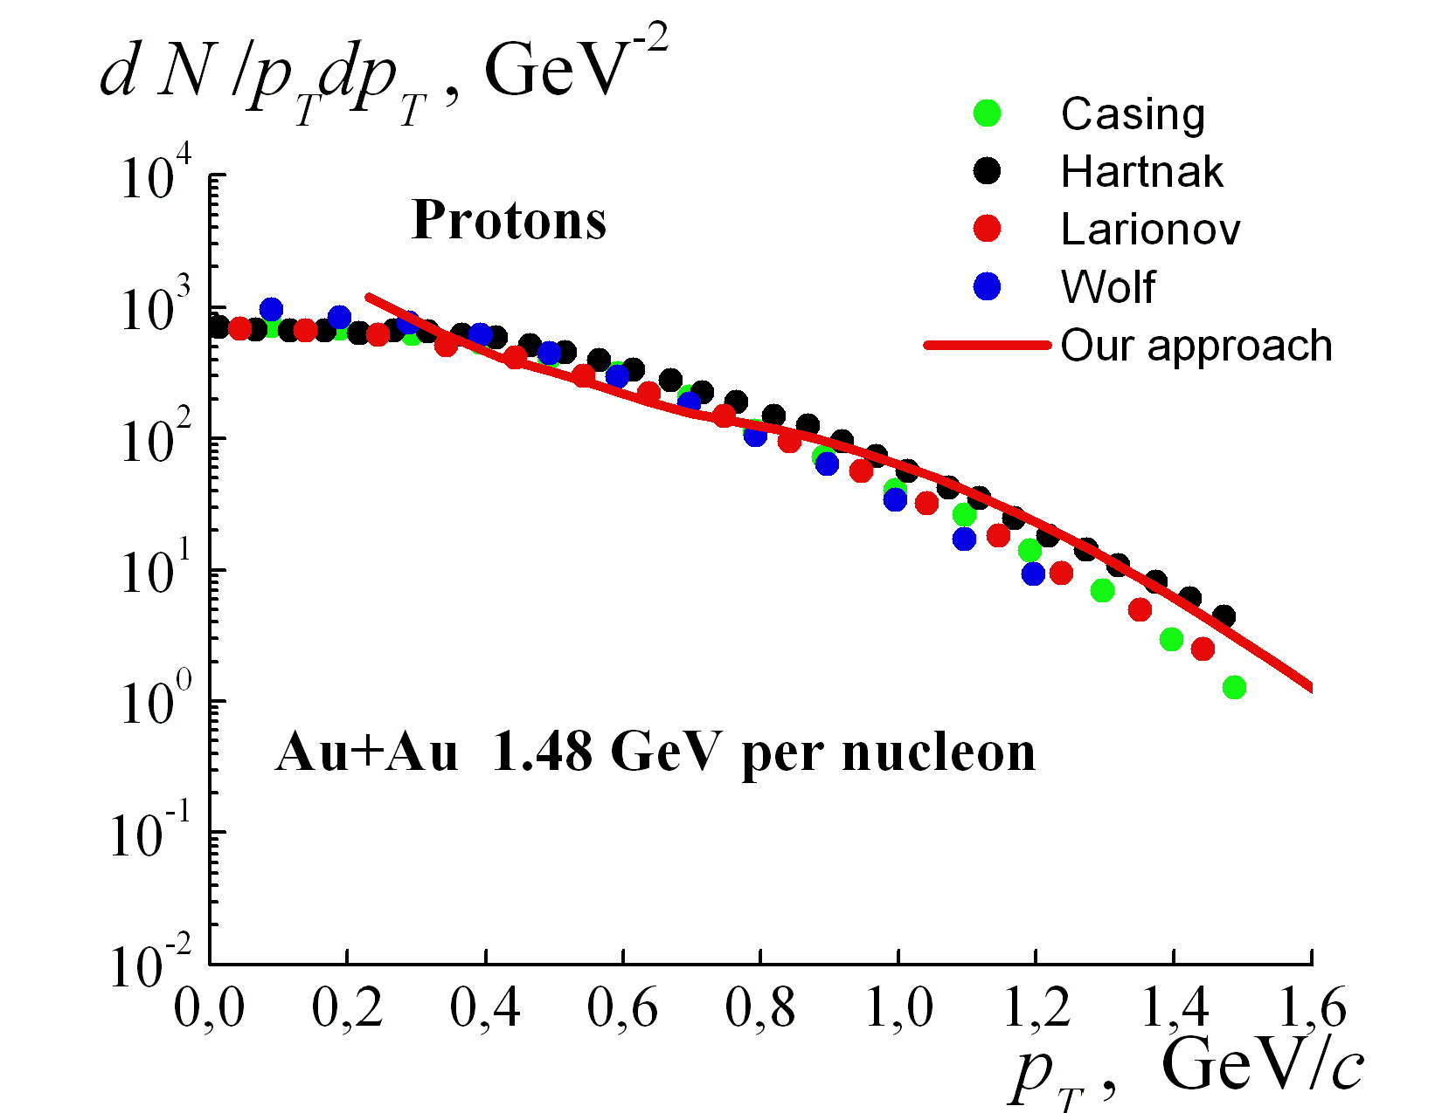
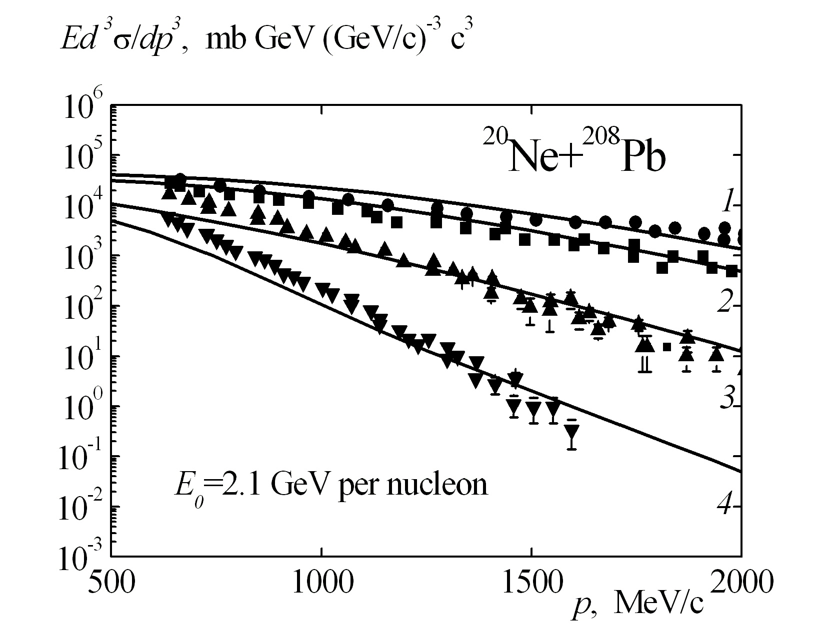
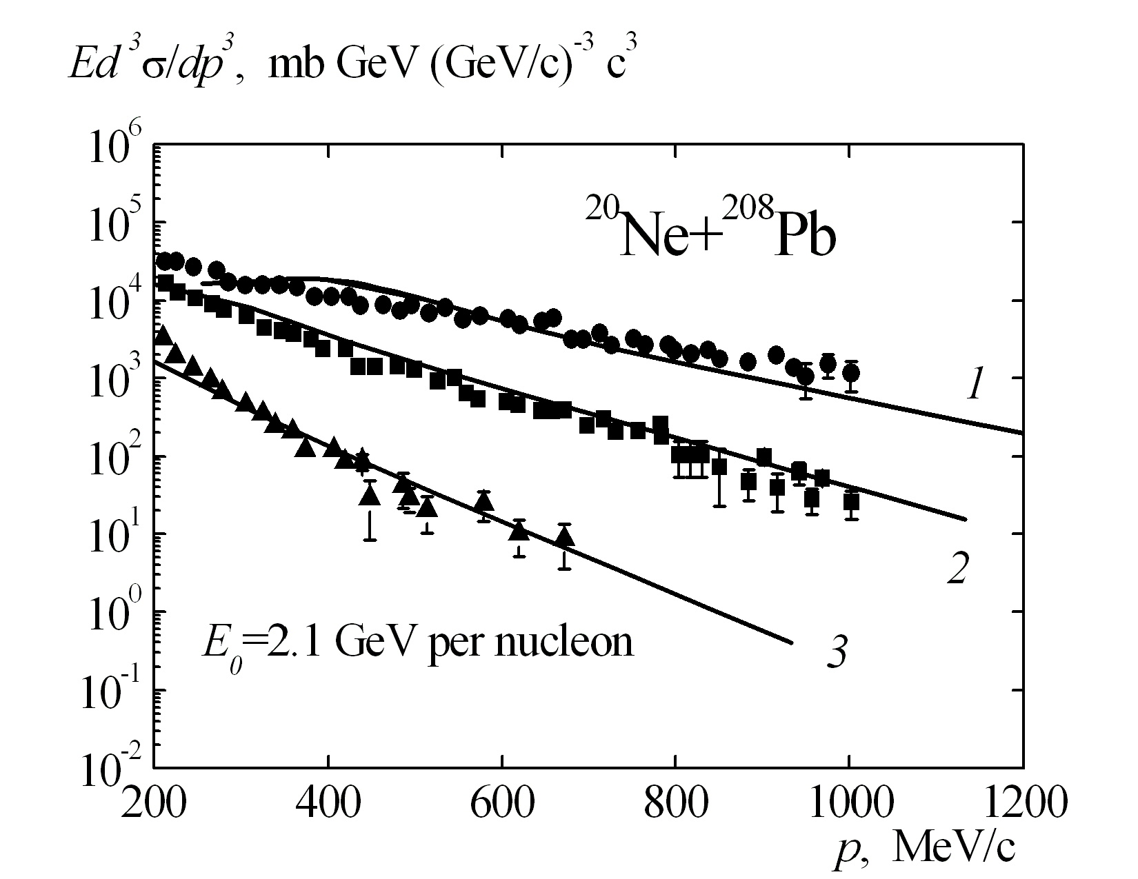
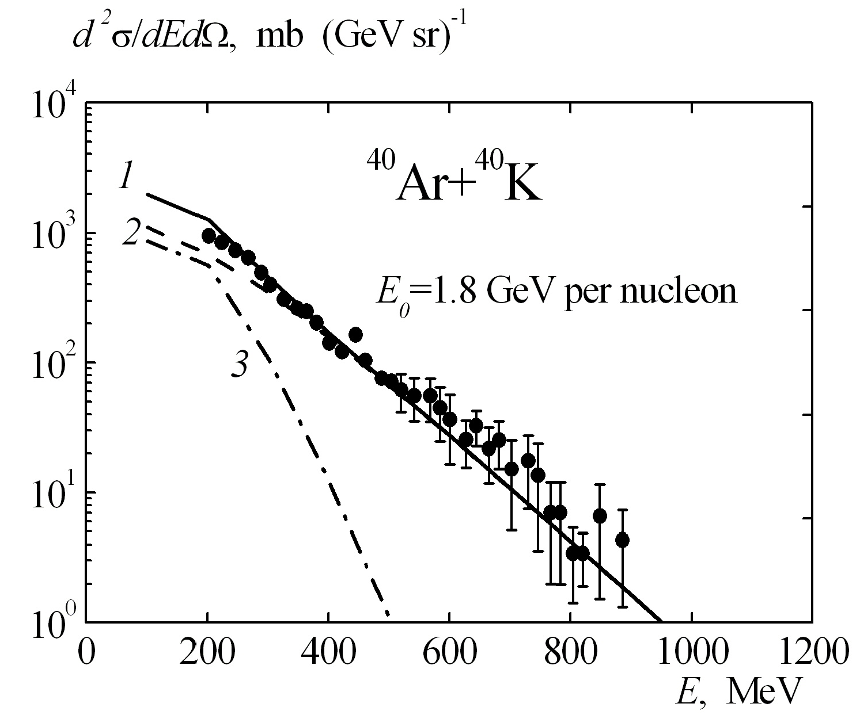
Protons
E.E. Kolomeitsev, C. Hartnack, H.W. Barz, et al., J. Phys. G: Nucl. Part. Phys. 31, 741 (2005); arXiv:2202.06672v1 [nucl-th].
Negative
pions

Slide 22
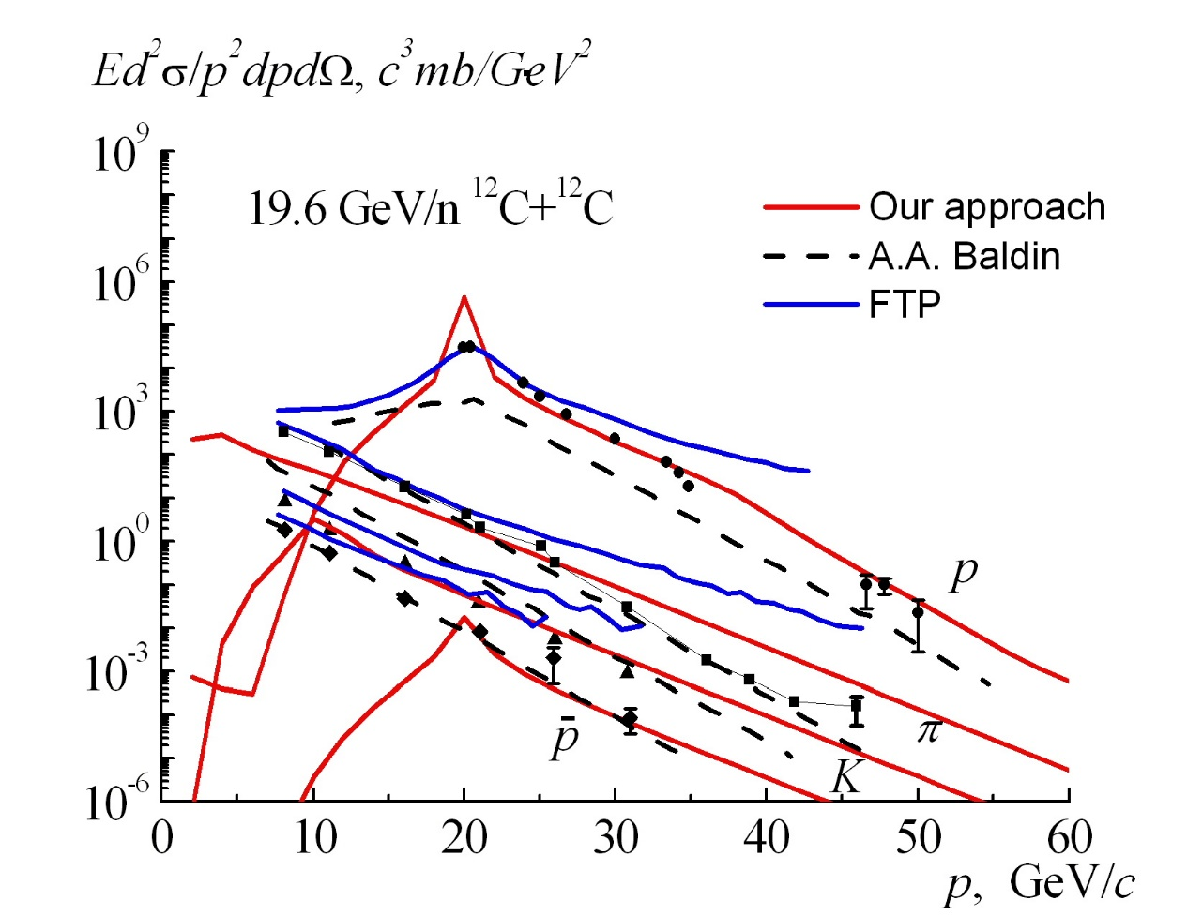
Cumulative protons, pions, kaons and antiprotons
Afonin A.G. et al. Phys. Atom.Nucl. 83, 228 (2020)

Slide 23
«…законы температурного равновесия и понятие энтропии можно вывести в рамках кинетической теории теплоты. Теперь, естественно возникает вопрос, действительно ли необходима кинетическая теория для вывода этого фундаментального положения термодинамики или же для этого, быть может, достаточно предположений более общего характера…» A. Einstein. Ann. Phys. 1903. V. 11. P. 170. (Собр. науч. трудов А. Эйншейна. 1966. Т. 3. С. 50).
где - лоренц –инвариантный пространственно-временной фазовый объем
В приближении безмассовых частиц

Slide 24
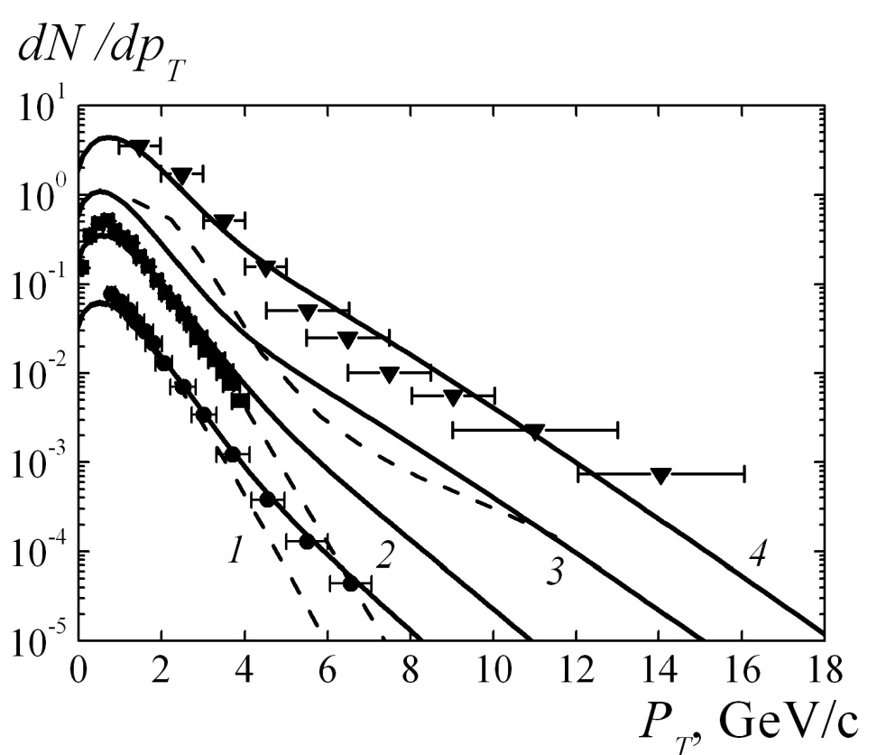
LHC

Slide 25
Conclusions
Thus, in this paper, the idea of using of a non-equilibrium equation of state in the hydrodynamic approach with hot spot to describe the high-momentum proton, pion and photon spectra emitted in heavy-ion collisions over a wide energy range has been further developed.
The experimental shoulder in the cross section for the production of protons in the cumulative region is reproduced by our calculations, and sometimes by cascade models. The cumulative pions , kaons, antiprotons and gamma-quanta are reproduced by ours too.

Slide 26
References
1. H. Stöcker and W. Greiner, Phys. Rep.137, 277 (1986).
2. A.S Khvorostukhin and V.D. Toneev, Phys. Atom. Nucl. 80, 285 (2017).
3. A.S Khvorostukhin and V.D. Toneev , Phys. Part. Nucl. Lett. 14, 9 (2017).
4. H Petersen , J. Steinheimer, G. Burau, M. Bleicher, and H. Stöcker, Phys. Rev. C78, 044901 (2008).
5. A.V. Merdeev, L.M. Satarov, and I.N. Mishustin, Phys. Rev. C84, 014907 (2011).
6. I.N. Mishustin, V.N. Russkikh, and L.M. Satarov, Sov. J. Nucl. Phys. 54, 260 (1991).
7. Yu.B. Ivanov, V.N. Russkikh, and V.D. Toneev, Phys. Rev. C73, 044904 (2006).
8. A.T. D’yachenko and I.A. Mitropolsky, Phys. Atom. Nucl. 83, 558 (2020).
9. A.T. D’yachenko and I.A. Mitropolsky, Bull. Russ. Acad. Sci. Phys. 84, 391 (2020).
10.A.T. D’yachenko and I.A. Mitropolsky, EPJ Web of Conf. 204 , 03018 (2019).
11.A.T. D’yachenko and I.A. Mitropolsky, Phys. Atom. Nucl. 82, 1641 (2019).
12.A.T. D’yachenko and I.A. Mitropolsky, Bull. Russ. Acad. Sci. Phys. 80, 916 (2016).
13.A.T. D’yachenko and I.A. Mitropolsky, Bull. Russ. Acad. Sci. Phys. 81, 1521 (2017).
14.A.T. D’yachenko, K.A Gridnev, W. Greiner, J. Phys. G40, 085101 (2013).
15.A.T. D’yachenko, Phys. Atom. Nucl. 57, 1930 (1994)..
16.P. Bonche, S. Koonin, J.W. Negele, Phys. Rev. C13, 1226 (1976).
17.G. D.Westfall et al., Phys. Rev. Lett. 37, 1202 (1976).
18.K.K. Gudima and V.D. Toneev, Sov. J. Nucl. Phys. 42, 409 (1985)..
20.B.M. Abramov et al., Phys. Atom. Nucl. 78, 373 (2015).
21.K. Urmossy, G.G. Barnafoldi, and T.S. Biro, Phys. Lett. B718, 125 (2012).
22.C. Bignamini, F. Becattini, and F. Piccelini, arXiv:1204.2300v1(2012).
23.C.Y. Wong and G. Wilk, Phys. Rev. D87, 114007 (2013).
24.A.S. Goldhaber, Phys. Lett. B53, 306 (1974).
25.H. Feshbah and K. Huang, Phys.Lett. B47, 300 (1973)..
26.G. Bertsch, Z. Phys., A289, 103 (1978).
27.V.M. Kolomietz and H.H.K. Tang, Physica Scripta. 24, 915 (1981).
28.С.Y. Wong and J.A. McDonald, Phys. Rev. C16, 1196 (1977).
29.K. Huang, Statistical Mechanics (Wiley, New York, 1987).
30.L. D. Landau and E. M. Lifshitz, Course of Theoretical Physics, Vol. 5: Statistical Physics (Pergamon, Oxford, 1980; Nauka,
Moscow, 1976).
31. A. I. Anselm, Fundamentals of Statistical Physics and Thermodynamics (Nauka, Moscow, 1973) [in Russian].
32.A.V. Dementev and N.M. Sobolevsky, Nucl. Tracks Radiat. Meas. 30, 553 (1999).
33.S.G. Mashnik et al., LA-UR-08-2931(Los Alamos 2008); arXiv.0805.0751[nucl-th].
34.T. Koi. et al., AIP Conf. Proc. 896, 21 (2007).
35. M.A. Braun and V.V. Vechernin, [Sov. J. Nucl. Phys. 43, 1016 (1986).

Slide 27
THANK YOU !

