Slide 1

Perspectives for the study of hyperon and hypernuclei production
in heavy-ion collisions at NICA/MPD
V.Kolesnikov, V.Vasendina, A.Zinchenko on behalf of MPD
VBLHEP, JINR
XXV Baldin Seminar “Relativistic Nuclear Physics & Quantum Chromodynamics”
Dubna, Russia, September 18 – 23, 2023

Slide 2
OUTLINE
Introduction:
- NICA/MPD physics cases : strangeness and hypernuclei
MPD detector performance studies:
Summary
Λ-hyperon reconstruction
Results for cascades
Hypertriton reconstruction

Slide 3
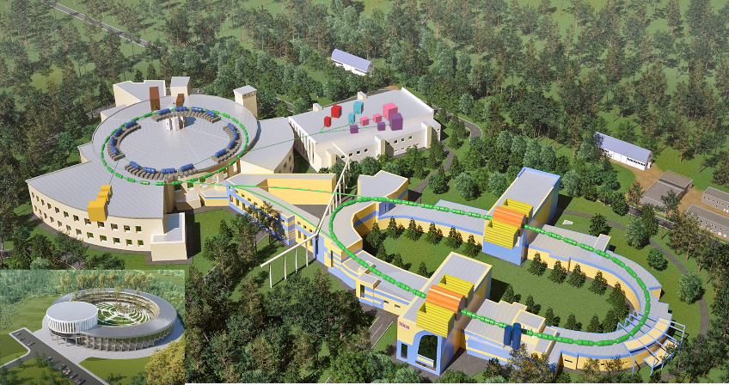
NICA – Nuclotron-based Ion Collider fAcility
Chain of accelerators providing ion beams (from p to Au) for fundamental physics studies & applied research
Modern detectors for study dense nuclear matter and spin phenomena (MPD, SPD, BM@N)
Experimental zone with beam lines for physics study and applied research
Cryogenic infrastructure for production, testing and supply superconducting elements
Beam energies: 0.5 - 5 AGeV
Intensity: up 10⁹ for ¹⁹⁷Au
Experimental zone (BM@N detector)
Booster
Nuclotron
SPD detector
Collider
MPD detector

Slide 4
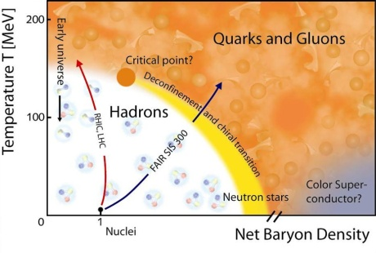
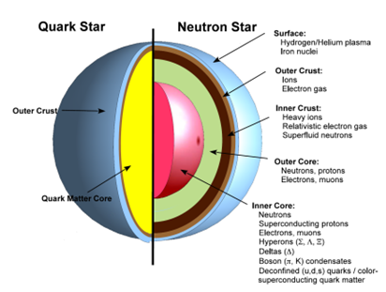
NICA/MPD physics. Tasks and Observables
Experimental strategy: energy and system size scan to measure a large variety of signals systematically changing collision parameters (energy, centrality, system size). Reference data (ip+p) will be taken in the same experimental conditions.
Bulk properties, EOS
particle yields & spectra, ratios, femtoscopy, flow
measure: γ, π, K, p, Λ, Ω, (anti)particles, light nuclei
In-Medium modification of hadron properties
onset of low-mass dilepton enhancement
measure: ρ, ω, φ → e+e-
Deconfinement (chiral) phase transition at high ρ_{B}
enhanced strangeness production
Chiral Magnetic (Vortical) effect
QCD Critical Point
event-by-event fluctuations and correlations
EOS @ NS densities, in-medium Λ-N and Λ-N interactions
hypernuclei

Slide 5
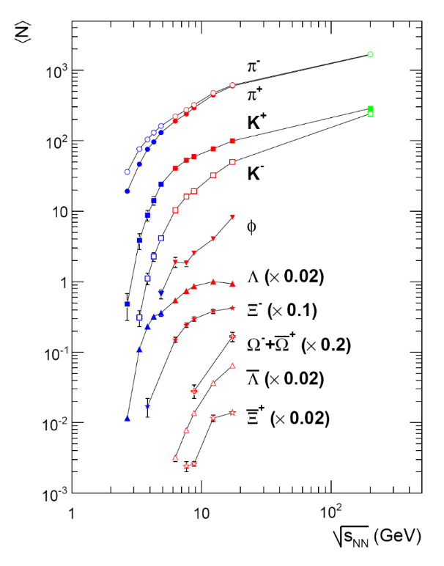
NICA physics cases: strange hadrons
Excitation function of hadrons, including strangeness (yields, spectra, and ratios)
Nuclear matter EOS, in-medium effects, and chemical equilibration can be probed
Hyperons sensitive to early stage and phase transformations in QCD medium
Non-monotonic strangeness-to-entropy ratio seen in heaviest systems (phase transformation?)
Lack of data on multistrangeness
in different collision systems
@ NICA energies!
System size of the energy dependence is not fully understood
PRC 94, 044912 (2016)
Theory predicts the largest effect
for the hadron ratios due to CSR
in dense matter at NICA
NICA

Slide 6
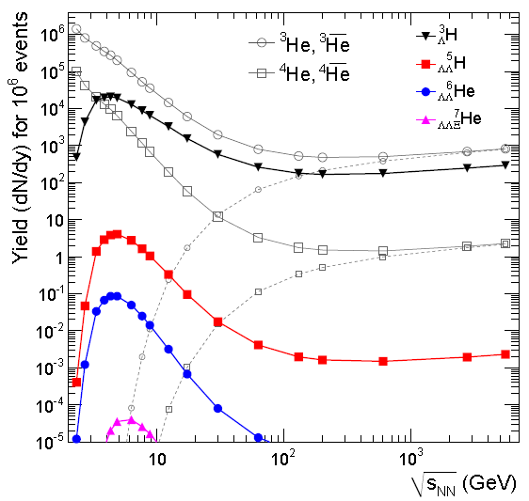

NICA physics cases: hypernuclei
Hypernuclei are nuclei containing
at least one hyperon
Nuclear matter EOS is of importance for QCD, nuclear physics and astrophysics
Only NN potential are very well determined from scattering experiments
But YN or YY potentials are rather uncertain since such experiments difficult to perform
High multiplicity heavy-ion collisions provide several methods to do the job: two-particle correlations and hypernuclei
QM’2022
A. Andronic et al, PLB 697 (2011) 203
Few data on the production of hypernuclei in HIC
Available data leave space for various model predictions (thermal, coalesce, hybrid)
Further and deeper investigations of the hypernuclear formation mechanisms require
additional measurements at different
energies and collision systems (NICA)
Thermal model predicts an enhanced
production of (hyper)nuclei within the
NICA energy range

Slide 7
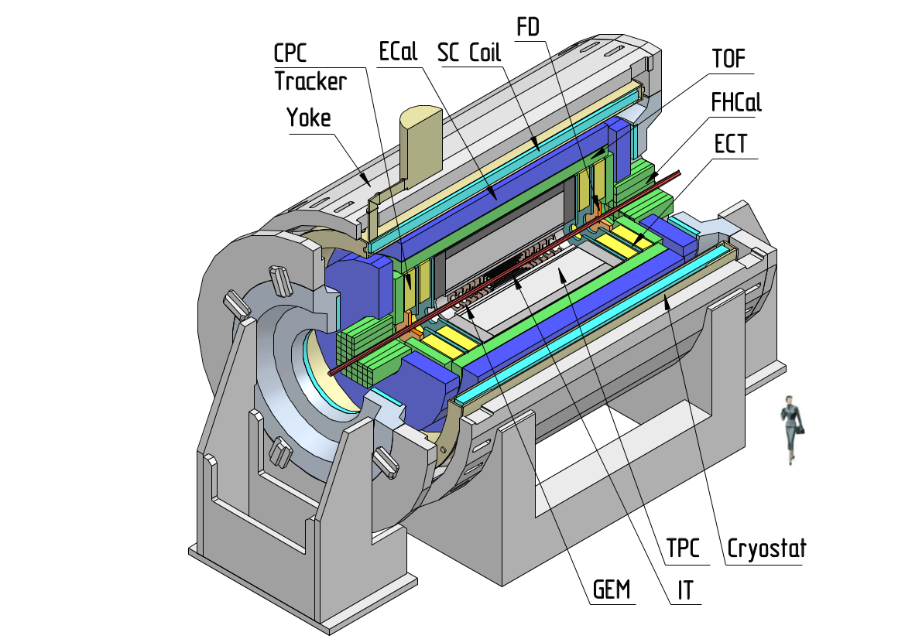
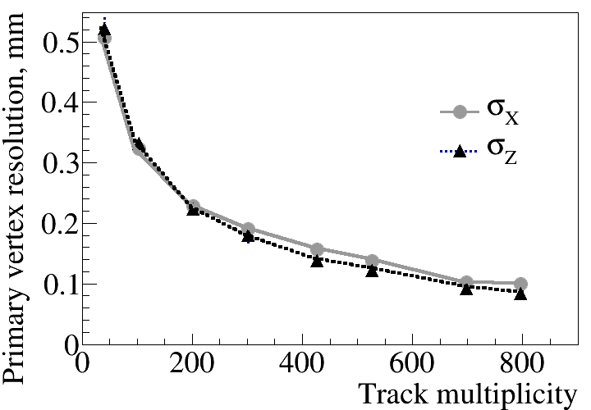
MultiPurpose Detector for A+A collisions @ NICA
3D tracking (TPC), uniform acceptance
Powerful PID (TPC, TOF, ECAL)
Precise event characterization (FHCAL)
Fast timing and triggering (FD)
7

Slide 8
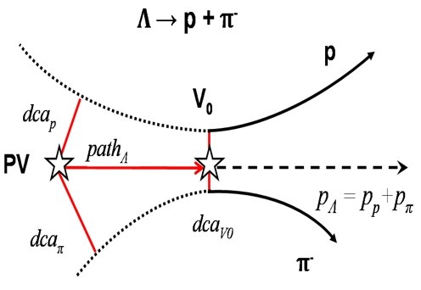
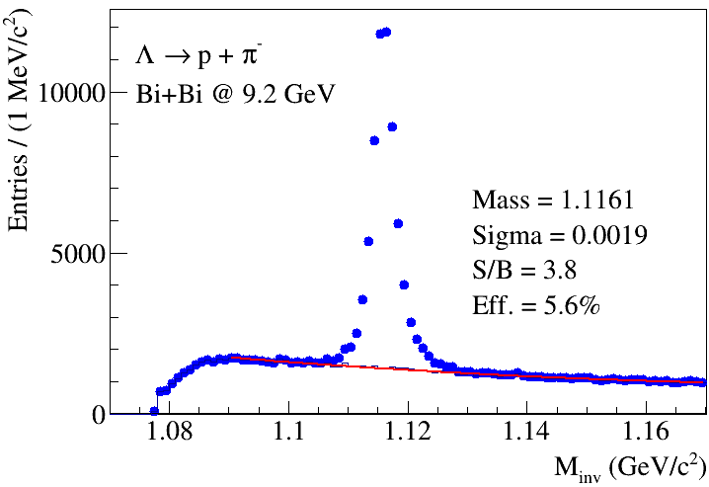
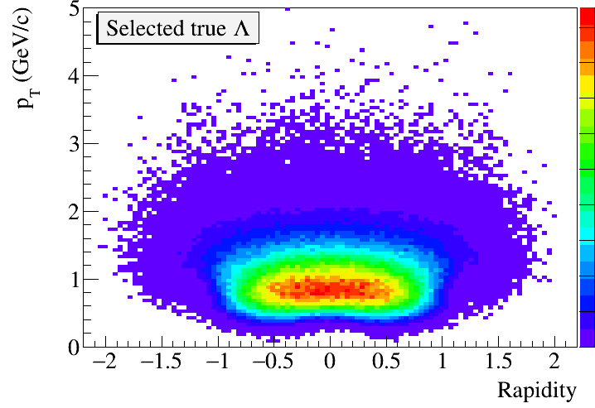
Λ-hyperon reconstruction in MPD
Data set: Bi+Bi @ 9.2 GeV, 50M Min bias (UrQMD)
PID: dE/dx+TOF
Selection: |y| < 0.5, Z_{PV} = ±130 cm
Centrality bins: TPC multiplicity 0-10%,10-20%,20-40%,40-60%, 60-80%
Hyperon reco: Secondary vertex finding technique with a set of topological cuts
PV - primary vertex
V0 - vertex of decay
dca- distance of closest approach
path – decay length
8

Slide 9
Λ-hyperon reconstruction in MPD: background estimate
Study of systematic uncertainties and
improvements in the analysis chain:
Background estimates (fit vs mixed background)
Varying PID modes for high-pT protons
Testing alternative Machine Learning technique
Consistency in bkg. estimates
More in talk of D.Suvarieva on Tuesday at 15:50

Slide 10
Λ-hyperon reconstruction at high pT: PID vs pairing of pos. and neg. hadrons
Larger pT-coverage
w/o PID for protons

Slide 11
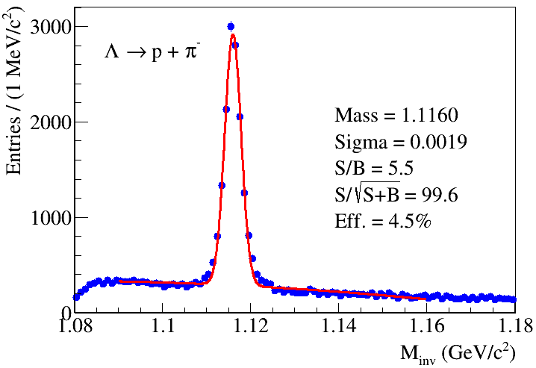
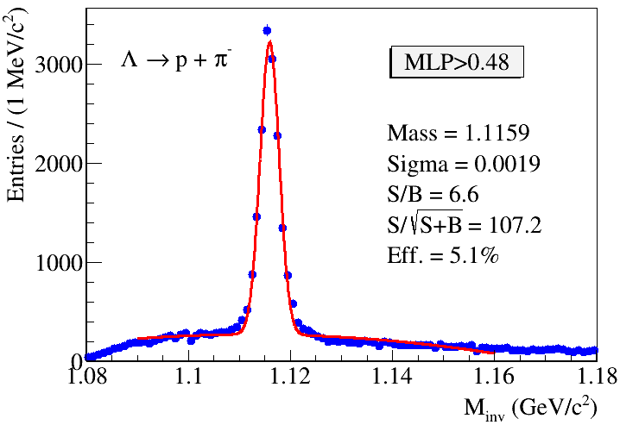
Λ reconstruction: standard method vs TMVA
ML approach within the Toolkit for Multivariate Data Analysis with ROOT (TMVA)
Standard method of Topological Cuts (6 cuts) TMVA method (8 cuts)
Better Lambda selectivity with TMVA (under tuning)
11

Slide 12
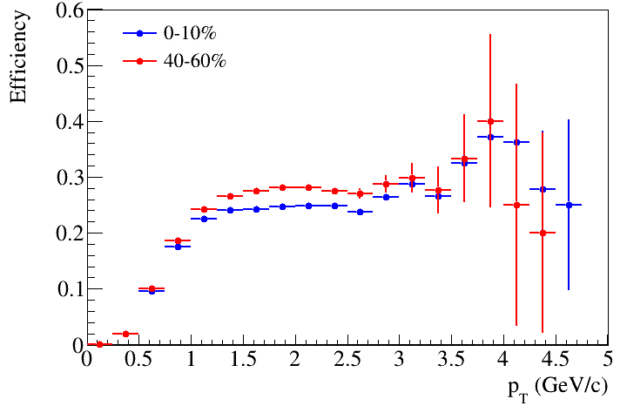
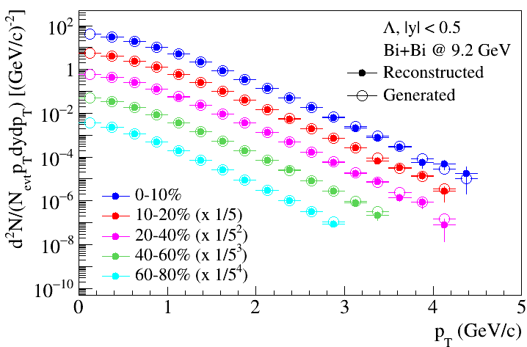
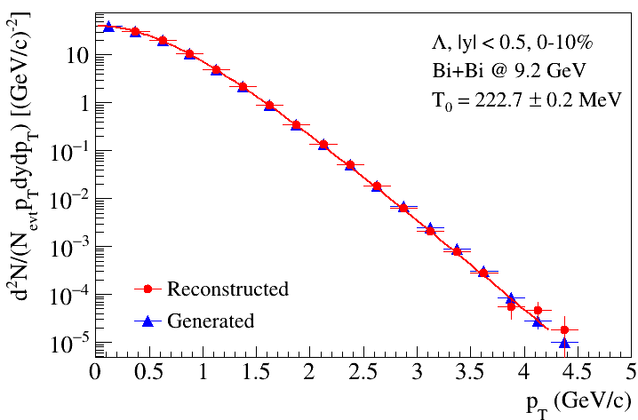
Λ analysis results: fully corrected invariant pT-spectra in centrality bins
Invariant pT-spectra of Lambda are reconstructed
in several centrality bins
Reconstructed distributions are consistent with data from model
Thermal fits applied to data
12

Slide 13
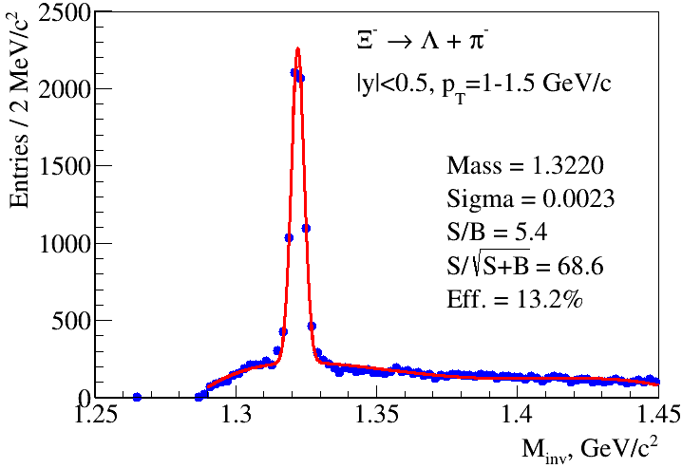
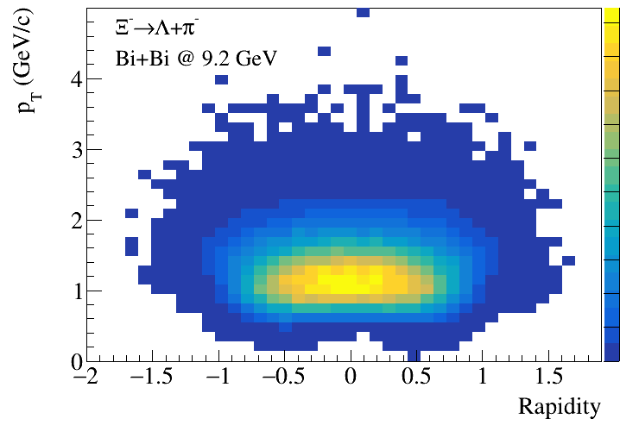
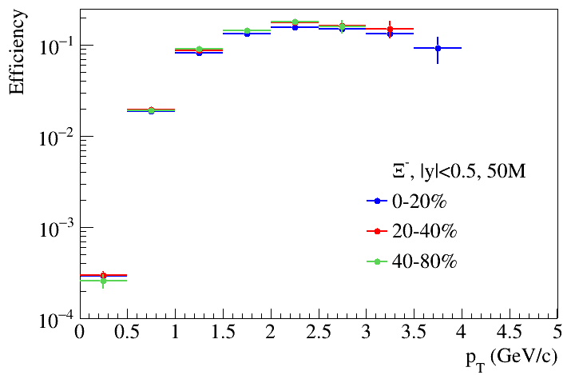
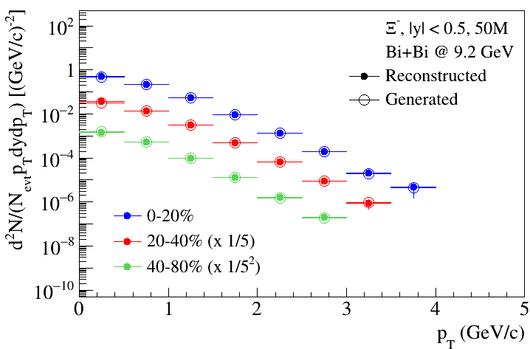
Ξ analysis: efficiency, phase-space and spectra in centrality bins
Good phase-space
coverage for Ξ in MPD
Analysis is ongoing

Slide 14
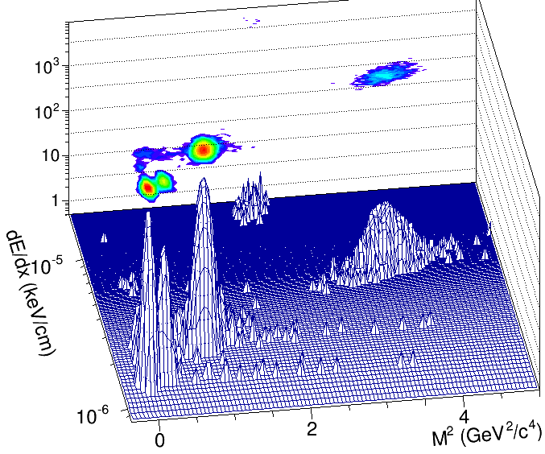
Reconstruction of hypertritons in MPD
40M Events Bi+Bi at 9.2 GeV, |y|<1 (PHQMD model)
Full event simulation and reconstruction
A set of topological cuts aimed at maximizing significance
Invariant spectrum of hypertritons is reconstructed up pT=4.5 GeV/c
With a larger data sets, pT-spectra and rapidity densities can be obtained in centrality selected Bi+Bi collisions over a large phase space shedding light
to the formation details and collective behavior of hypernuclei

Slide 15
Hypertriton lifetime study
Hypertritons are reconstructed in several \tau bins
2- and 3-prong decay modes were studied separately to estimate systematics
τ = ML/p (p – momentum,
M-hypertriton mass, L-track length)
Results for different decay
modes are consistent

Slide 16
Summary
Intensive preparations for the start of the MPD physics program at NICA is ongoing
Production of hyperons and hypernuclei is sensitive to the strange sector of the nuclear matter EOS and has implication for nuclear physics and astrophysics
The results of MPD feasibility studies indicate good hyperon and hypernuclei reconstruction performance of the detector
Future high statistics data from NICA/MPD can provide better constrains for hypernuclei production models in the high baryon density regime
Thank you for listening!

Slide 17
Spares

Slide 18
Strangeness in dense nuclear matter : puzzling behavior
Hyperons appear in the core of neutron stars (NS) at ~ (2-3)n₀ leading to softening EoS and reducing
the max. mass for NSs, but the latter is in contradiction with observations (NS hyperon puzzle)
Averaged lifetimes of hypernuclei from A+A are shorter than expected from theory (lifetime puzzle)
REVIEWS OF MODERN PHYSICS 88 (2016)
PRL 128, 202301 (2022)
Data
EoSs with
hyperon dofs
Many open questions on YN (YY, YNN) potentials in dense matter, new data on B_{Λ}, lifetimes, branching ratios are needed to provide tighter constrains
More data are required to reduce current uncertainty (NICA/MPD)
18

Slide 19
Results for heavier hypernuclei in MPD
40Mevents Bi+Bi at 9.2 GeV, b < 12 fm (PHQMD) enriched by signal particles
Good MPD performance for heavier hypernuclei in Bi+Bi at 9 GeV

