Slide 1
Studying the possibility of lambda hyperon reconstruction in the BM@N experiment at the NICA complex
Made by:
Barak R.
Supervised by:
Merts S.P.
The XXVth International Baldin Seminar on High Energy Physics Problems "Relativistic Nuclear Physics and Quantum Chromodynamics“, 18–23 Sep 2023

Slide 2
Introduction
Collisions of heavy relativistic ions allow us to study nuclear matter at extreme density and temperature.
At sufficiently high temperature and energy density, the so-called Quark-Gluon Plasma (QGP) is formed [1]:
  Hyperon formation.
Theoretical models offer different descriptions [2],[3]:
  New experimental data is needed for clarification.
[1] Kapishin.M, “Studies of baryonic matter at the BM@N experiment (JINR).” Nuclear Physics A 982 (2019) 967–970.
[2] J. A. et al Nucl. Phys., vol. A 757, pp. 102–183, 2005.
[3] K. A. et al Nucl. Phys., vol. A 757, pp. 184–283, 2005.

Slide 3
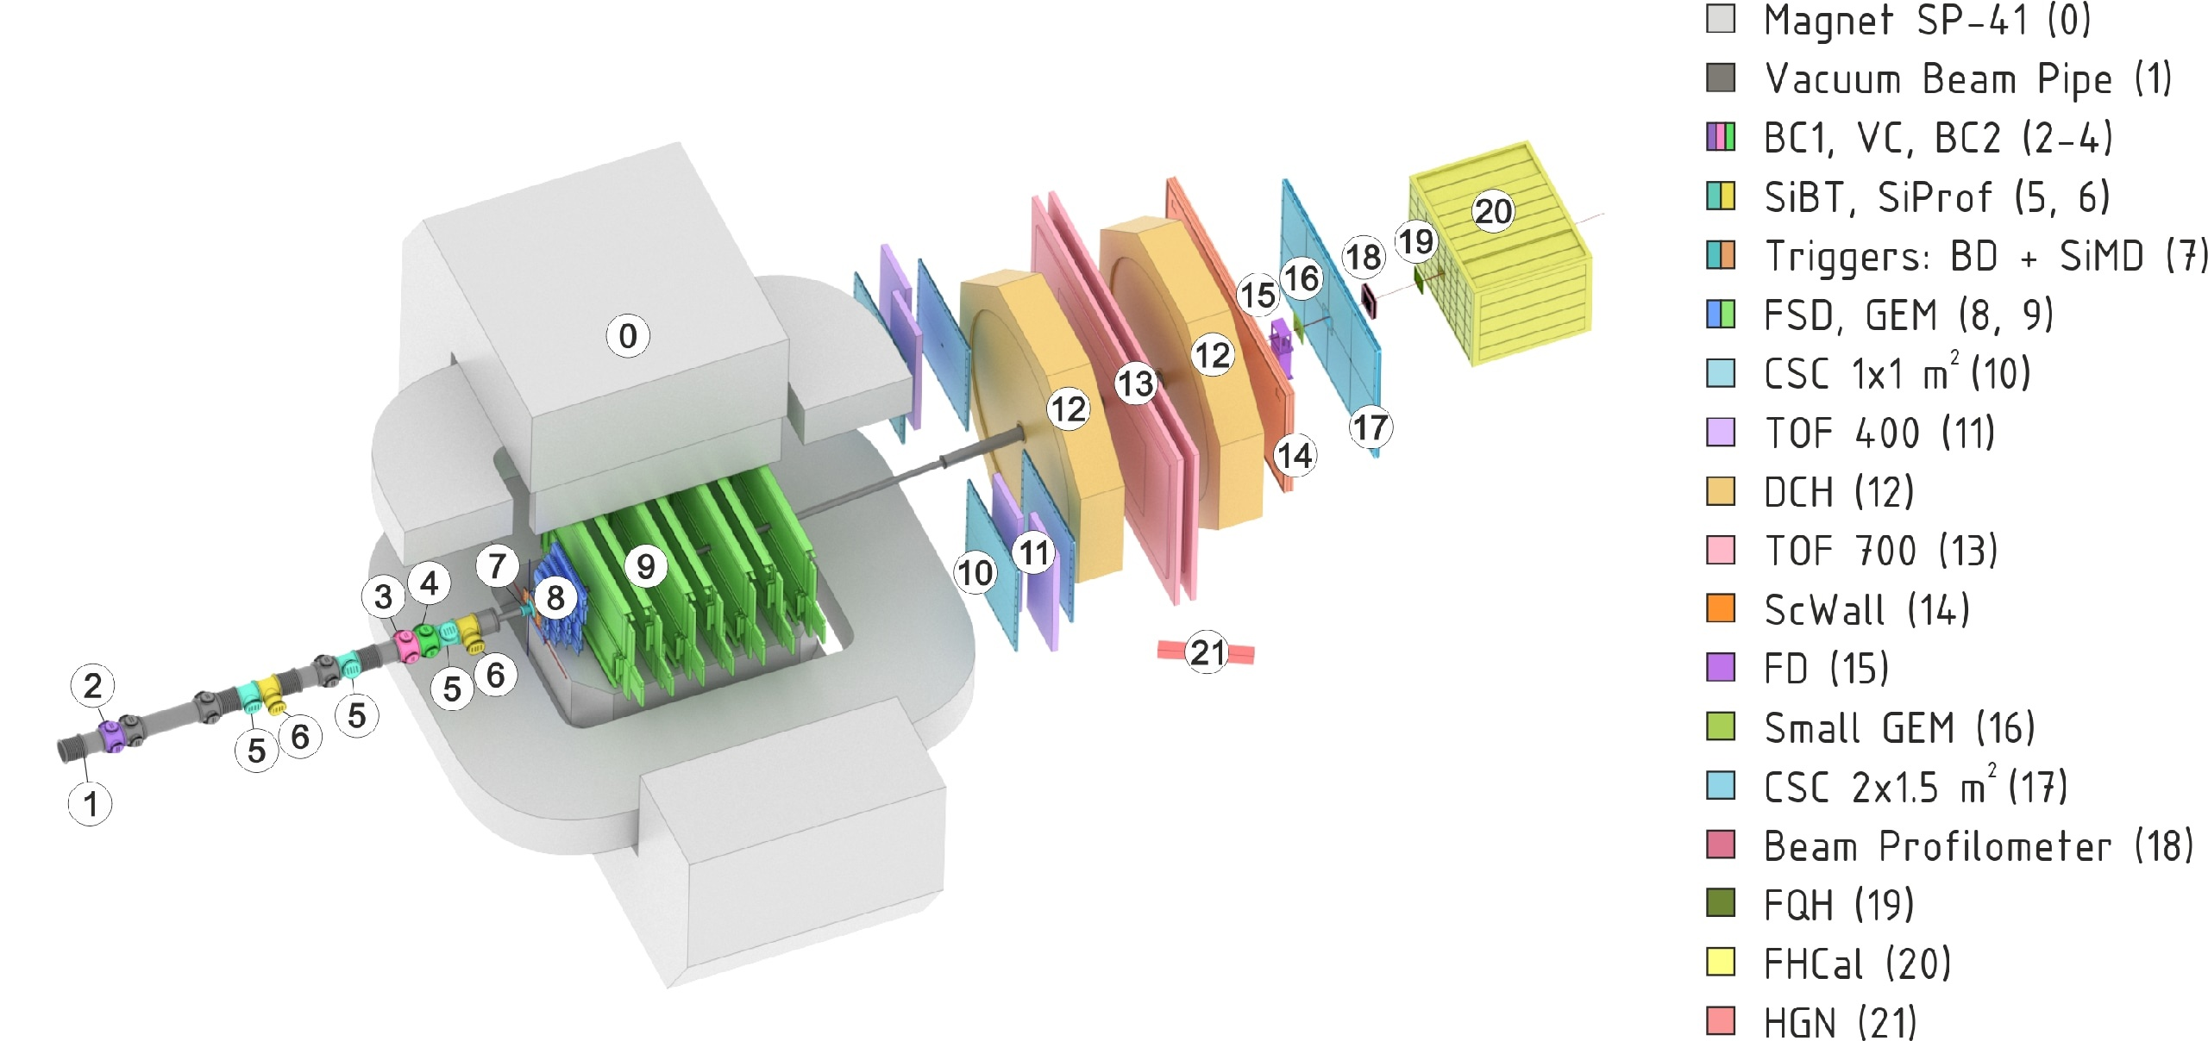
BM@N experiment at the NICA complex
Collisions of elementary particles and ions with a stationary target at energies up to 4 GeV per nucleon.
Experimental setup of BM@N
NICA accelerator complex

Slide 4
Goal of the work
Search for lambda hyperons in the data of the BM@N experiment.
Tasks
Modelling and reconstruction of data for analysis.
Development and implementation of lambda hyperon reconstruction algorithm in bmnroot.
Investigation of the influence of background sources on the quality of reconstruction.
Analysis of the reconstruction efficiency in phase space as a function of rapidity and transverse momentum.

Slide 5
Data
Data obtained from the Monte Carlo generator DCMSMM [4] was used for the analysis. 250,000 events were simulated and reconstructed.
[4] Baznat M., Botvina A., Musulmanbekov G., Toneev V., Zhezher V. Monte-Carlo Generator of Heavy Ion Collisions DCM-SMM, Physics of Particles and Nuclei Letters 17, 3, 303-324 (2020)

Slide 6
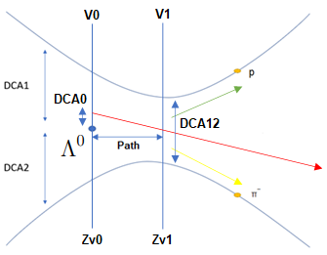
Data processing
Algorithms were developed and implemented to enable the search for the trajectories of lambda hyperons along the decay channel into a proton and negative pi-meson:
  Sorting of pairs of particles with different signs.
  Calculating the invariant mass.
  Imposing a number of geometric restrictions on the parameters of each pair.

Slide 7
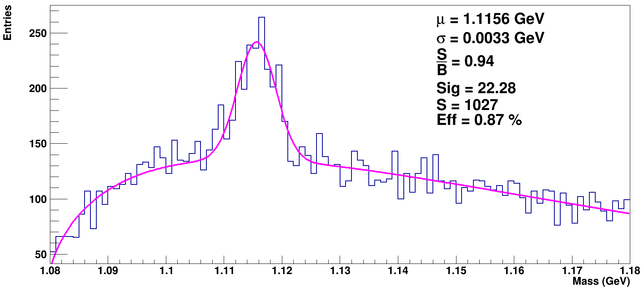
Results

Slide 8
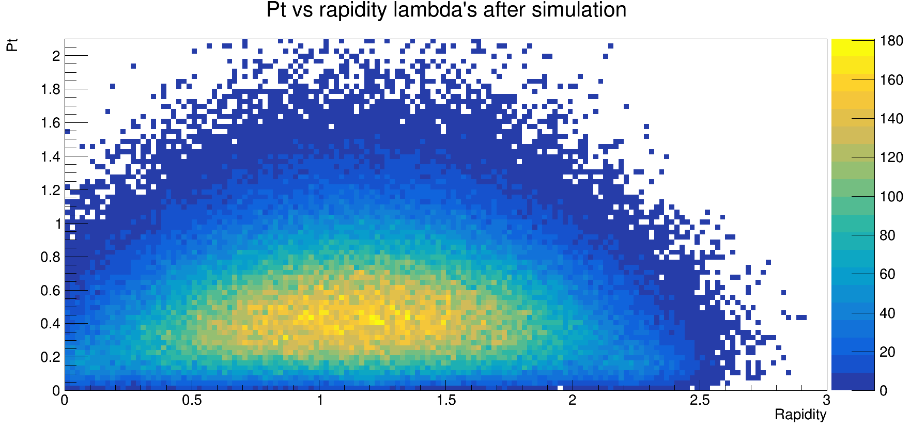
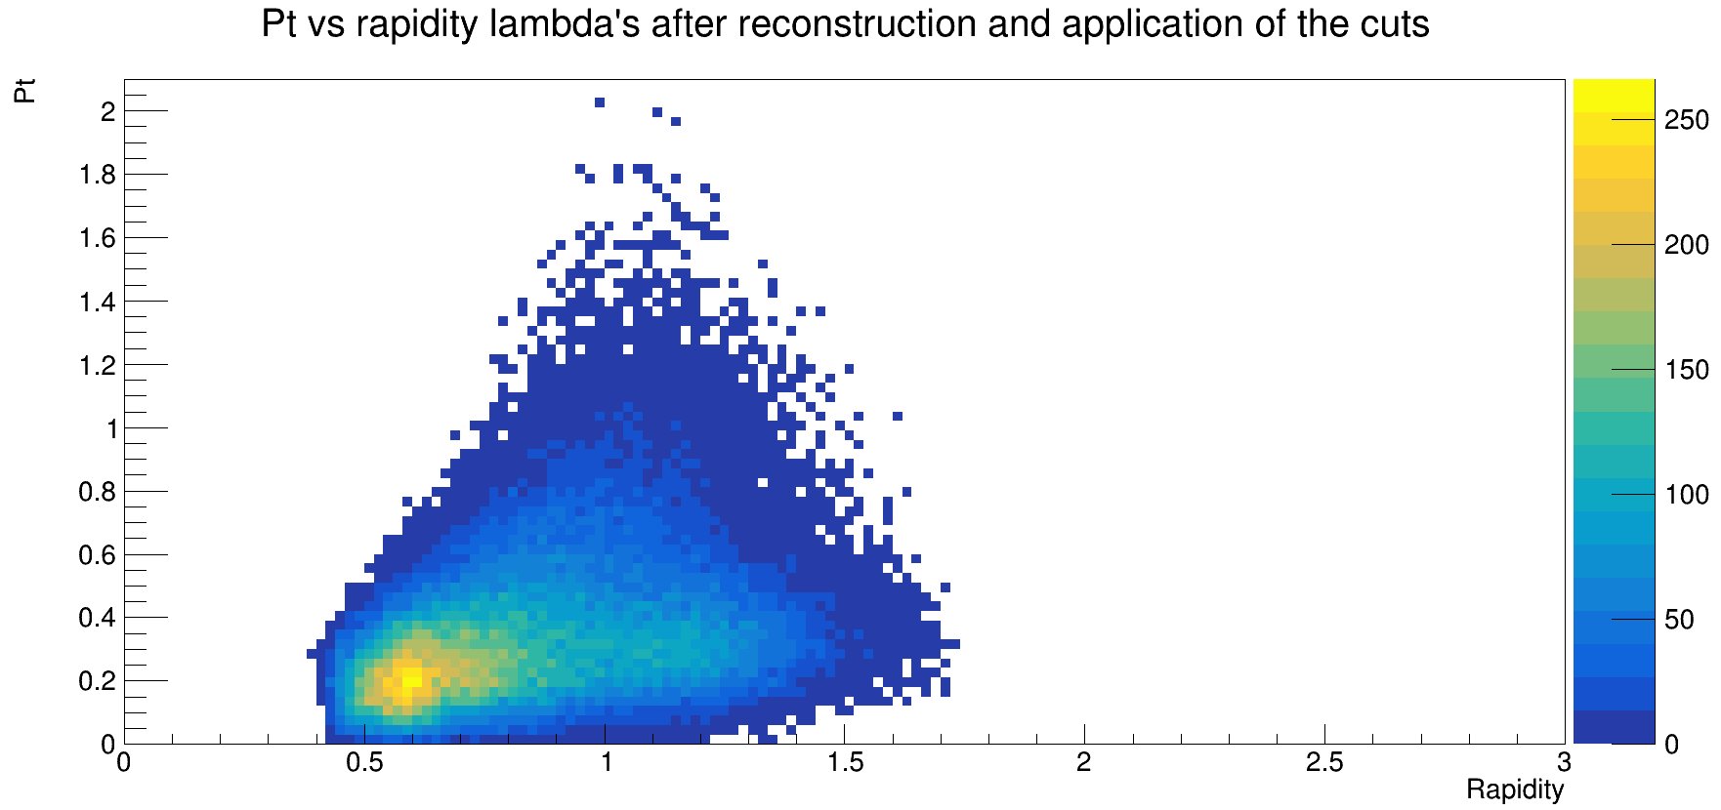
Results

Slide 9
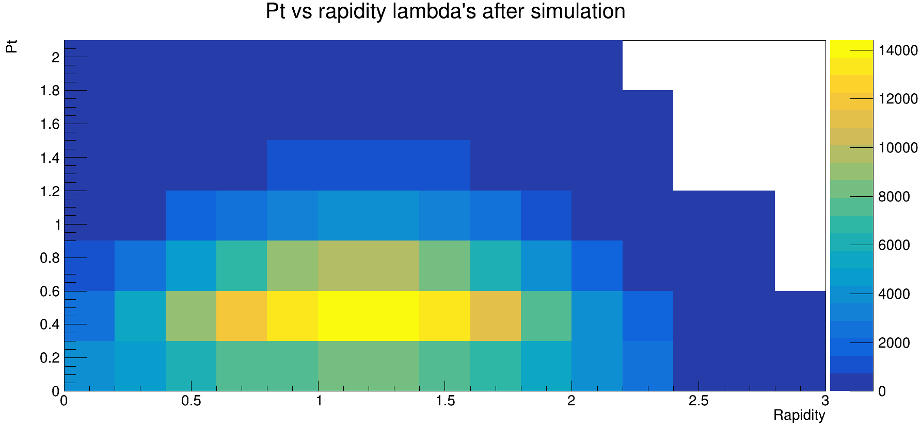
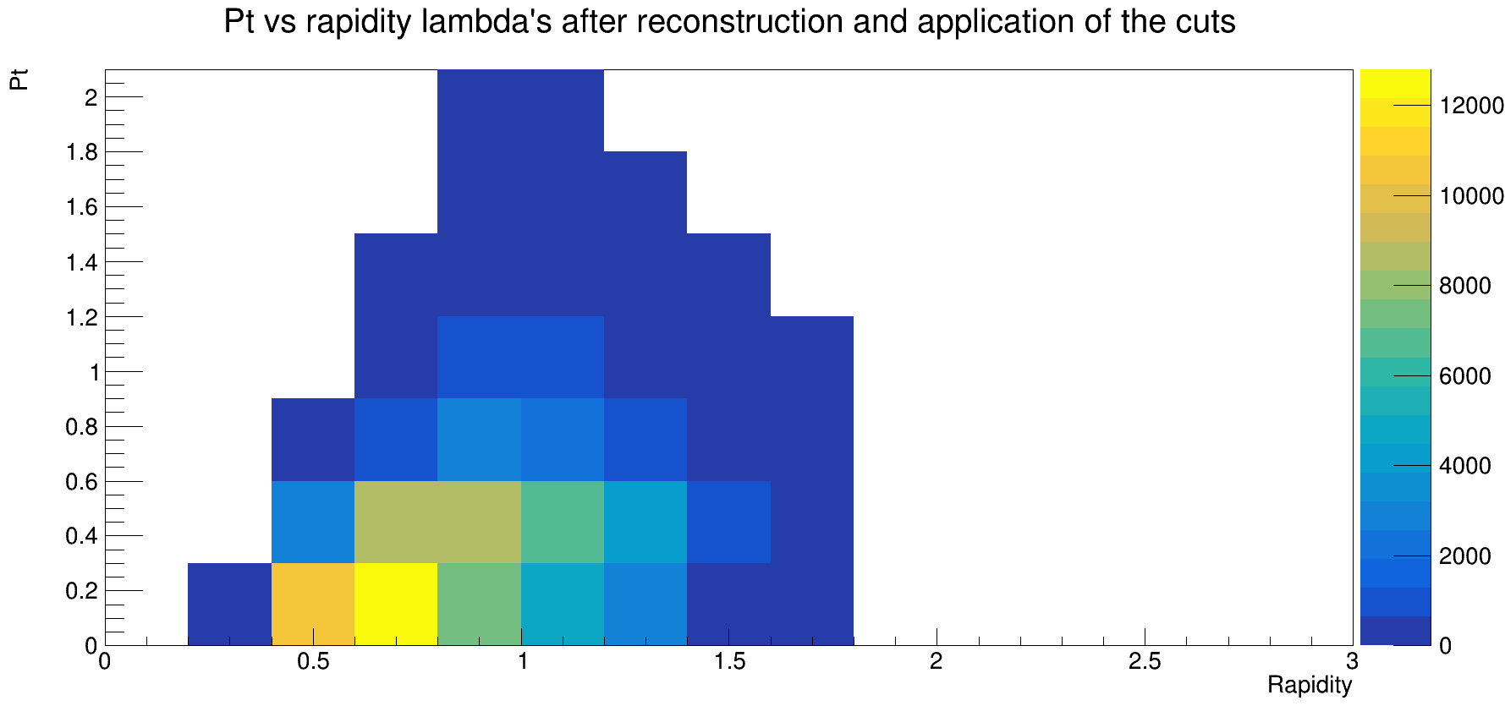
Results

Slide 10
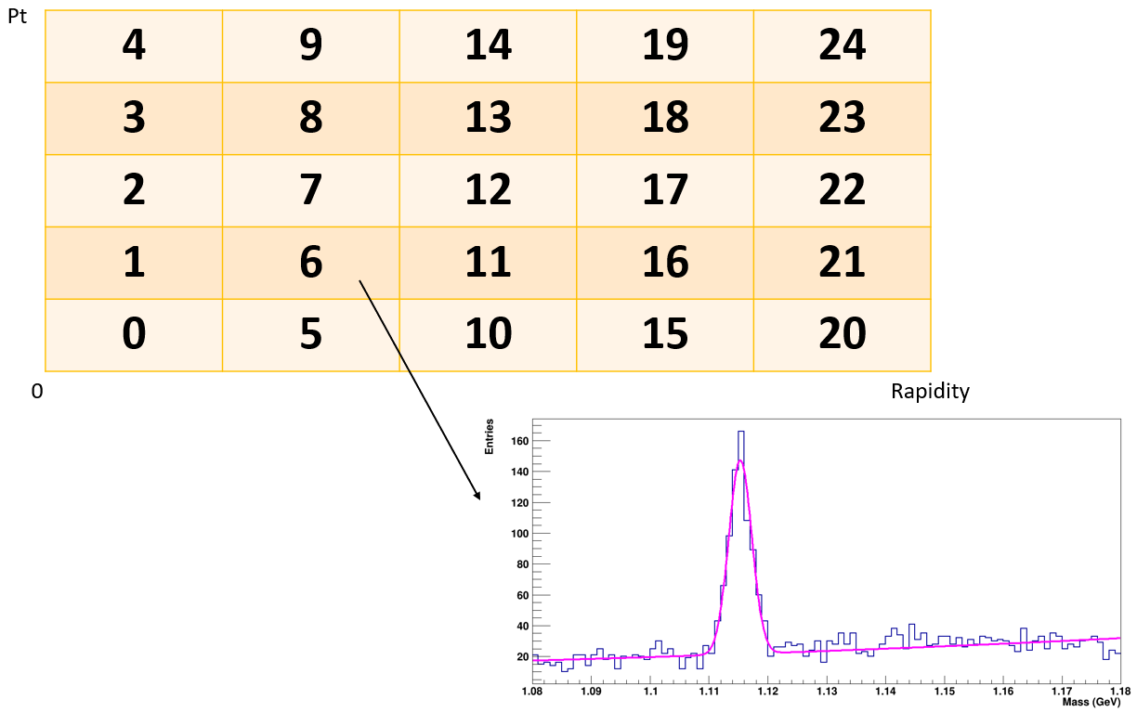
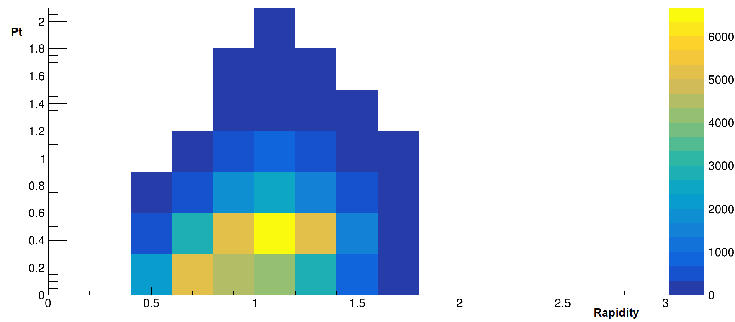
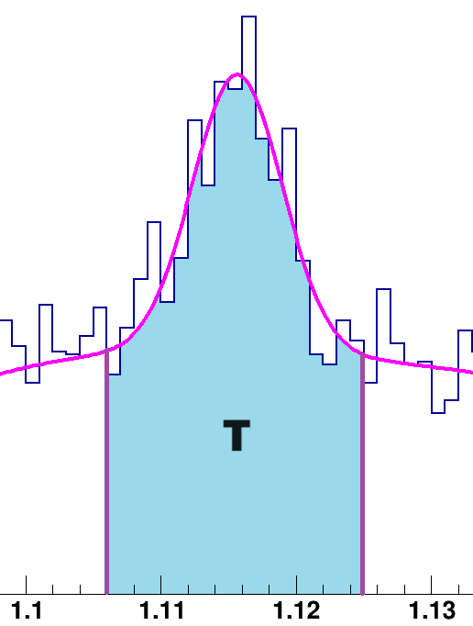
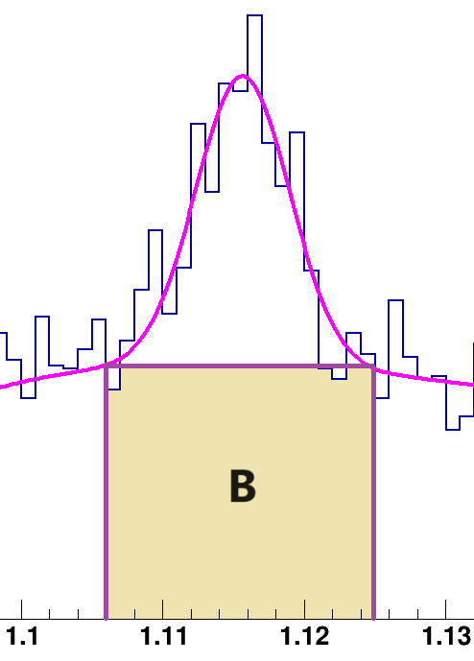
Results
S =
-

Slide 11
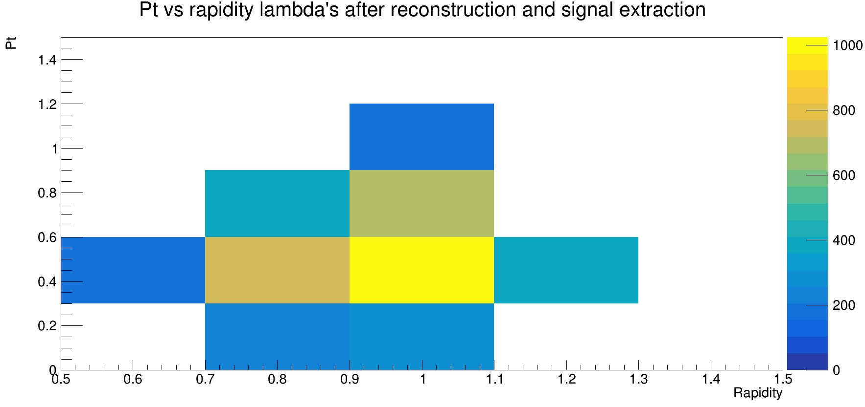
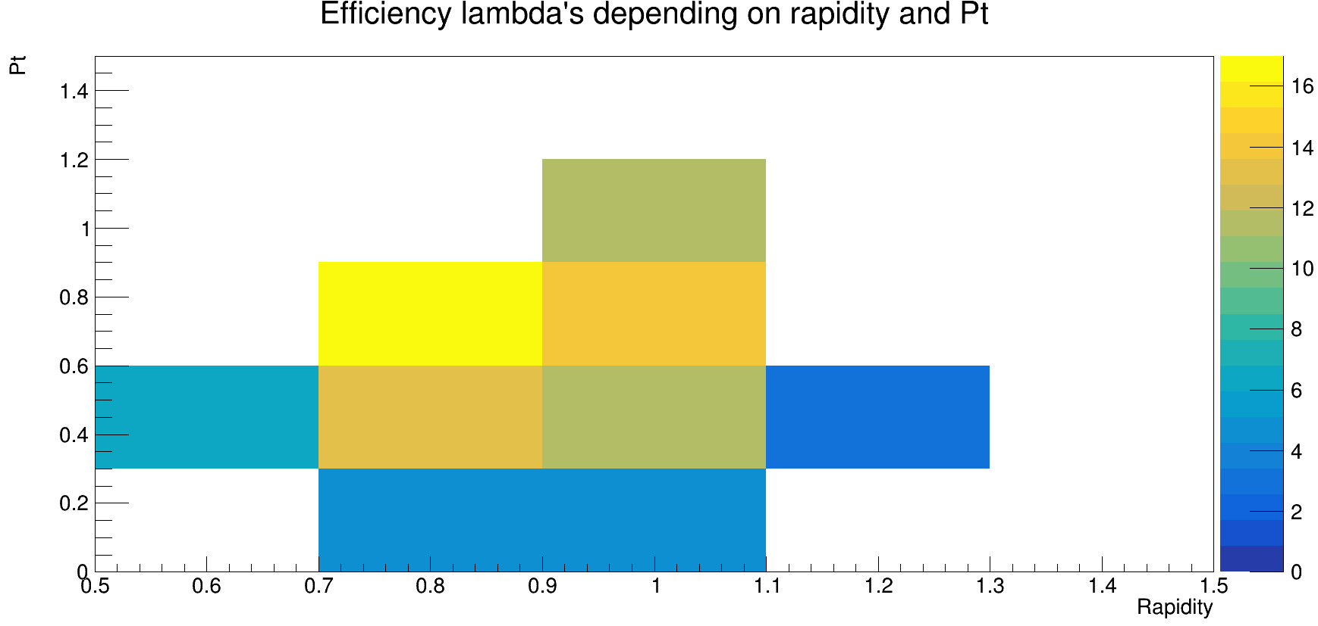
Results

Slide 12
Conclusion
Simulation and analysis of 250,000 events for the case with all possible sources of background increment were carried out.
Presence of lambda hyperons was confirmed.
Efficiency depending on rapidity and transverse momentum was derived.

Slide 13
Thank you for your attention!

Slide 14


Slide 15
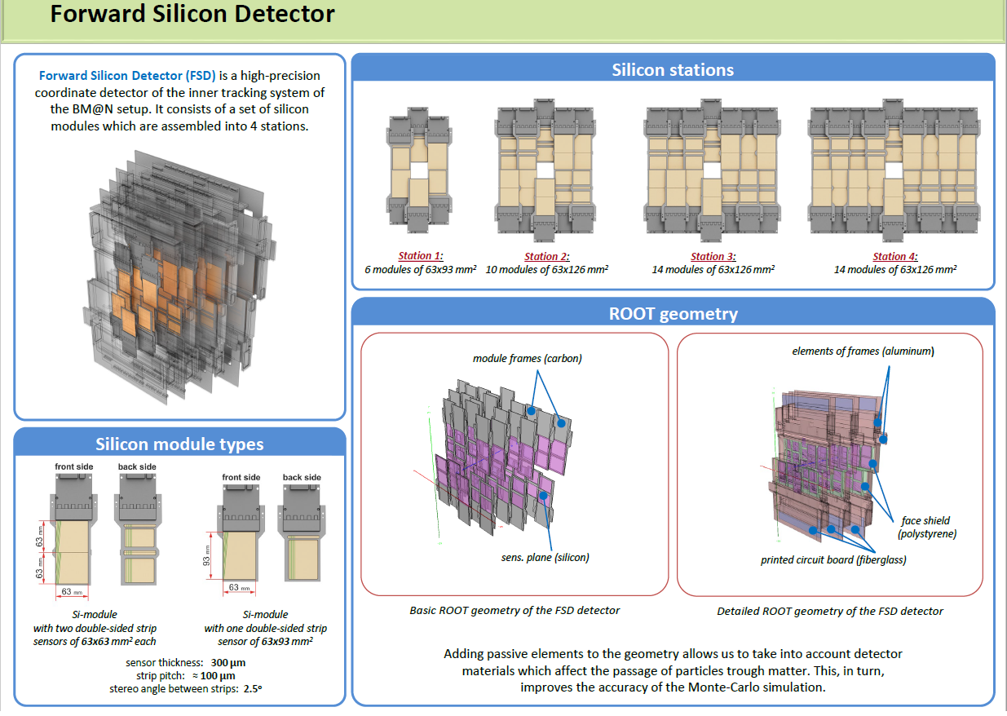

Slide 16
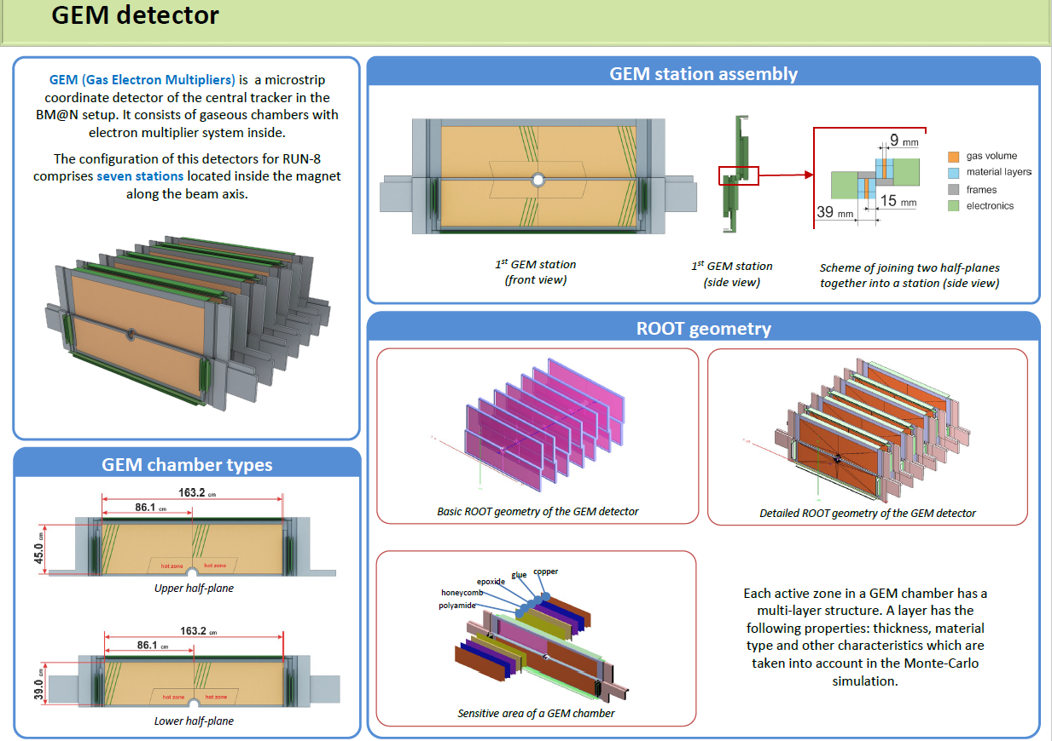

Slide 17
