Slide 1
Centrality determination method based on observables from TPC and FHCal at MPD/NICA
Volkov Vadim
Sultan Musin
INR RAS
XXVth International Baldin Seminar on High Energy Physics Problems "Relativistic Nuclear Physics and Quantum Chromodynamics“
21/09/2023

Slide 2
Overview
FHCal@MPD and the problem of ambiguity in energy deposition distribution
2D-fit of FHCal energy distributions method for centrality determination
Standard TPC multiplicity/Glauber approach
Comparison of two methods (FHCal vs TPC)
Short review & problems
A new method for centrality determination based on combined FHCal and TPC observables
Simulations are made for LAQGSM & DCM-SMM fragmentation models for Au-Au collisions with $\sqrt{SNN}=11 GeV$energy.
Notes:
To begin with, I want to review the structure of the talk.
First, I will briefly cover the design of the FHCal calorimeter and the problems that are associated with its construction.
Then I will tell you about the method of centrality determination with the observables from the calorimeter and about its results, we will see what resolution was obtained and under what conditions.
The next section will be devoted to the comparison of the methods of centrality determination by TPC multiplicity and by FHCal two-dimensional correlations. And there will be a little bit about the problems that follow from what was presented, in particular the relation of the methods to the Glauber model.
After that, the present state of the art of centrality determination will be briefly summarized. I will show what the resulting problems are and how I have tried to solve them with the new method.
This method and its results will be the last part of the report.

Slide 3
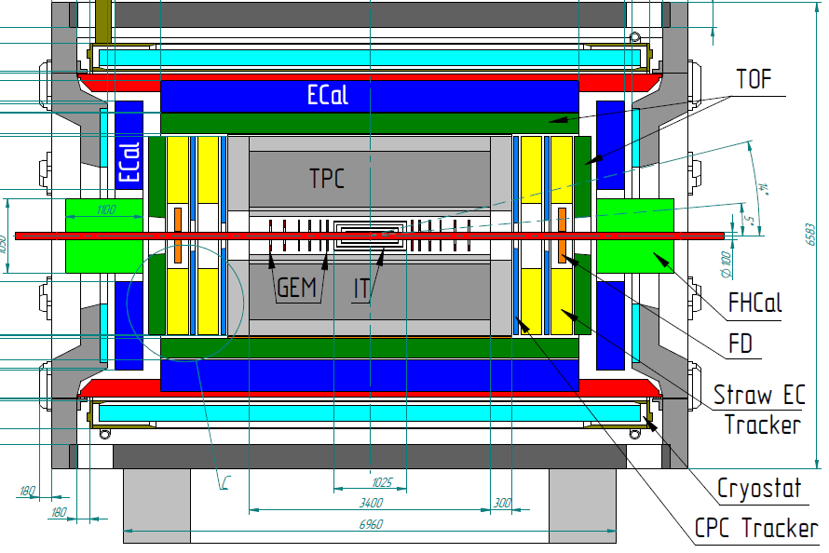
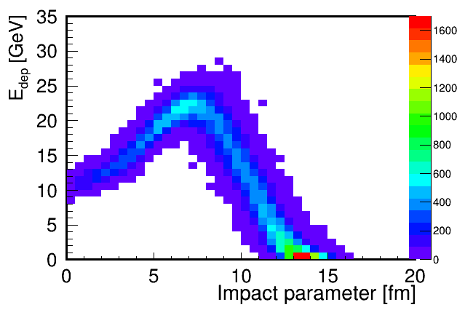
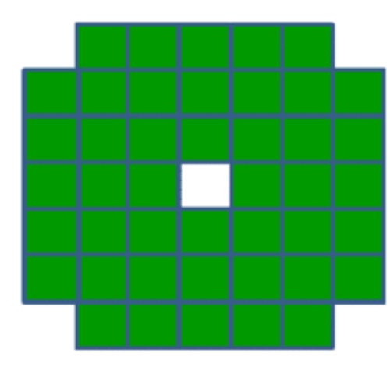
FHCal@MPD
The main purpose of the FHCal is to detect spectators and to provide an experimental measurement of a heavy-ion collision centrality and orientation of its reaction plane.
There is an ambiguity in FHCal energy deposition for central/peripheral events due to the fragments (bound spectators) leak into beam hole.
Two upstream/downstream parts
44 individual modules
ambiguity
Beam hole
Notes:
So, briefly I will remind about the structure of the forward hadron calorimeters FHCal.
In the mpd experiment 2 identical calorimeters will be placed symmetrically with respect to the collision point. They are designed to detect spectators and based on the energy deposition in the modules should determine the orientation of the reaction plane and the centrality of collisions. In addition, the calorimeters are also planned to be used as triggers.
The calorimeters have good transverse segmentation and consist of 44 x modules (each). In principle, this segmentation allows to distinguish the centrality of events by the spatial distribution of energy over the transverse surface of the calorimeter.
The main problem that relates to centrality is the presence of a beam hole into which a significant fraction of heavy fragments escape, which in turn leads to ambiguity in the determination of centrality. As can be seen from the lower right figure, a one energy can, for example, correspond to both central and semi-peripheral events.
To solve this problem, the method of two-dimensional linear approximation was developed, and we will now turn to it.

Slide 4
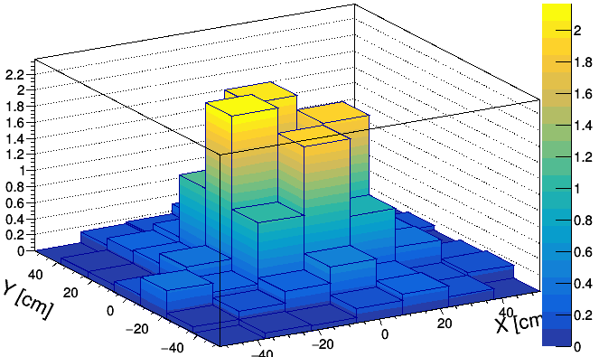
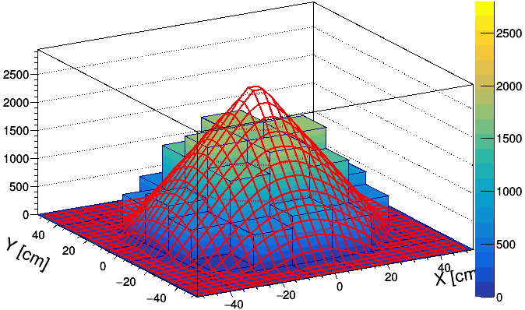
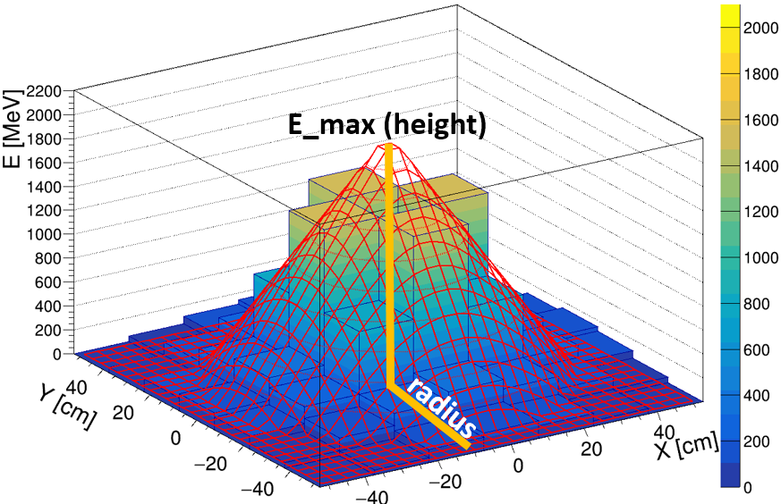
2D-linear fit method (linear approach)
Energy distribution in FHCal modules
Single event
Fitted event
E [GeV]
E [MeV]
In this method the spatial energy distribution in FHCal modules is used.
The energy in the histogram is uniformly distributed in FHCal modules according to the polar angle.
The histogram is fitted by a symmetrical cone (linear approximation).
Weight of each bin is proportional of the energy deposited in corresponding FHCal module.
This fit provides the new observables: radius, height of the cone. Volume of cone corresponds to the reconstructed energy (E_{rec}).
Notes:
In the upper left figure, you see the energy distribution over the surface of the calorimeter for the one single event.
The procedure for the two-dimensional fit is quite simple. Briefly, it consists of first uniformly spreading this energy distribution with respect to the hole in the centre of the calorimeter. The resulting distribution is then fit with a cone.
Such a fit gives us three new observables, which are essentially just parameters of the cone. These can be used to determine centrality.
I will not go into detail here, the point is that each event in the calorimeter, one of which is shown on this slide, is fitted with this 2D linear fit method and we get new values of observables for each event.

Slide 5
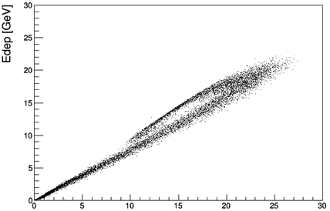
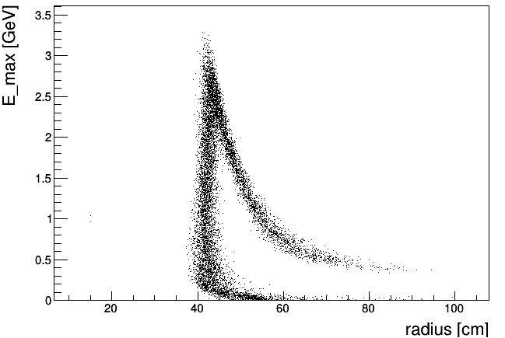
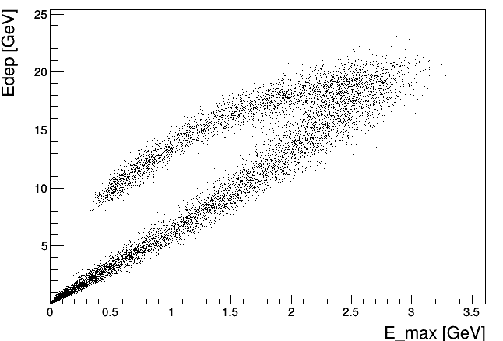
Correlation between obtained fit parameters. LAQGSM
Initially we have experimental energy deposition E_{dep} in FHCal.
Experimental energy deposition vs reconstructed energy from the fitted event
Maximum energy in central bin vs radius
central events
peripheral events
E_{rec} [GeV]
Experimental energy deposition vs maximum energy in central bin
After linear fit we have:
E_{rec} is reconstructed energy (volume of cone);
E_{max} – maximum energy in central bin (in FHCal hole);
Radius of spectator spot at FHCal is defined by the scattering spot of spectators.
central events
This correlation can be used for the centrality determination
peripheral events
In ideal case all fit parameters may be used for centrality determination.
Notes:
So, we got 3 new observables, which are geometric parameters of the cone. First, it is the height of the cone, it corresponds to the energy deposition in the centre of the calorimeter, i.e., in the hole. Secondly, it is the volume of the cone, which conditionally corresponds to the total energy deposition in the event. And the third observable is the radius of the cone. It can be assumed that it shows the size of the spectator spot on the surface of the calorimeter.
Using these three observables, one can construct various correlations with the total energy deposition in the calorimeter. Such correlations are presented here on the right. We are interested in the correlation between the energy deposition and the maximum energy (aka cone height) in the calorimeter hole, it is called Emax.
It is this correlation that was taken as the main correlation for determining the centrality further. Although I will briefly note that other correlations were also used, but the results were not so good, so I will not show them.

Slide 6
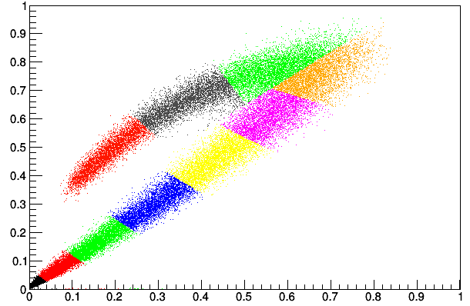
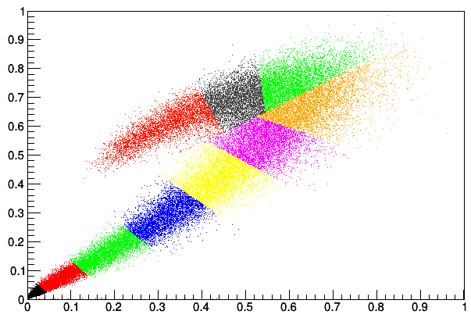
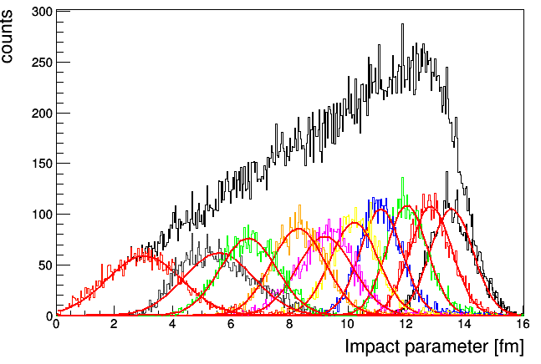
Centrality resolution for E_{dep} vs E_{max}
Edep [a.u]
LAQGSM
Each color bin is 10% fractions of the total number of events.
E_{max} [a.u]
Edep [a.u]
DCM-SMM
Dependence of resolution of impact parameter on centrality
DCM-SMM
The distribution of the impact parameters clearly shows how strongly the central collision classes are mixed.
The new method will show significant improvement for these classes.
E_{max} [a.u]
Notes:
This slide shows the results of the centrality determination from this correlation.
Very briefly, how exactly they were obtained. This correlation was fit with an ellipse, and then we traversed along the envelope of the ellipse for all events, accumulating a certain number of events in each class, in this case 10% of the total number of events. That is, for example, the correlation is traversed from the lower left corner, and the colour indicates the classes of events, each of which contains 10% of the total number of events. That is, by traversing the ellipse we accumulate events. Perpendiculars to the ellipse were used to separate classes from each other Accordingly, the most central events are located here. In the so-called upper branch of the correlation.
The results of the method are presented here for two models, we are more interested in the DCM-SMM model. The top right shows the resolution of the centrality classes, the resolution is obtained from the Gaussian fit of the impact parameter distributions. These distributions are shown bottom right for each class. Of course, the actual impact parameters are known because they are taken from the model.
Here I want to point out that the main problem here is the separation of the upper and lower branches, as we can see the classes are quite strongly mixed without this, but they are significantly mixed in the area where the branches intersect. And it seems that if you improve somehow the separation of these branches, you can improve the resolution for the central classes.

Slide 7
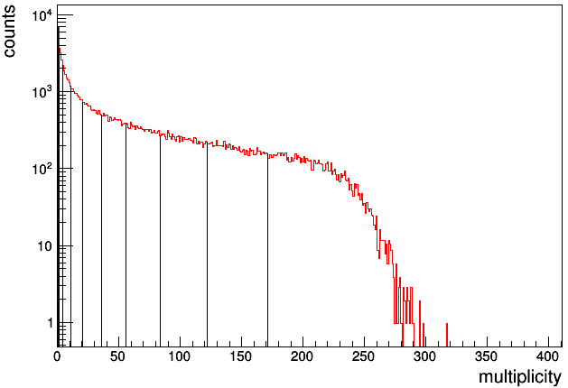
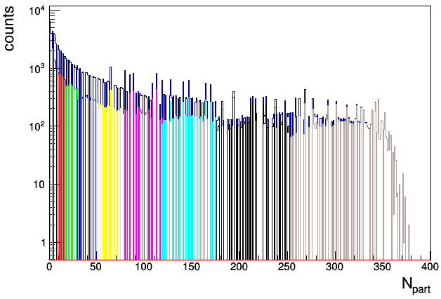
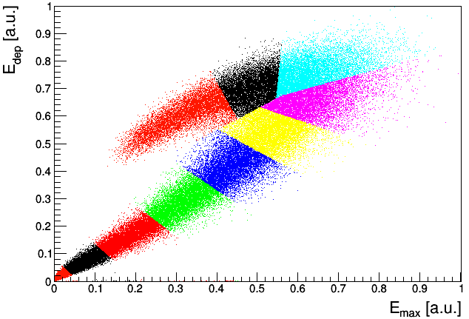
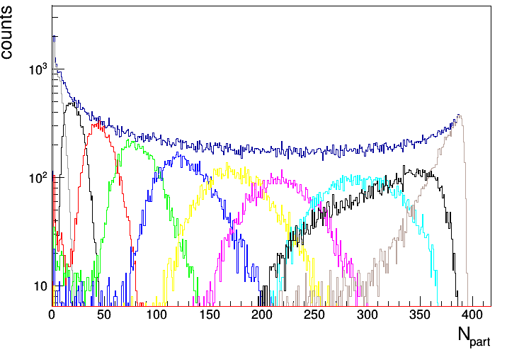
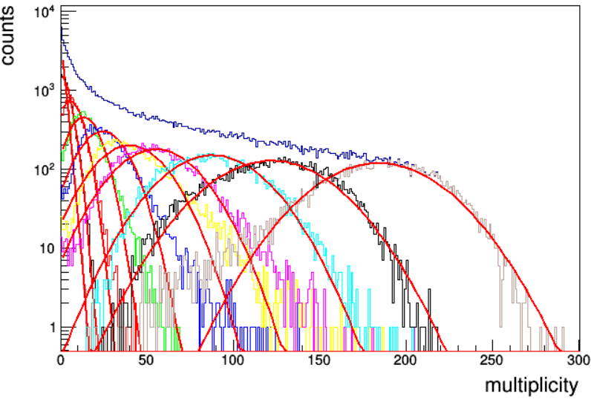
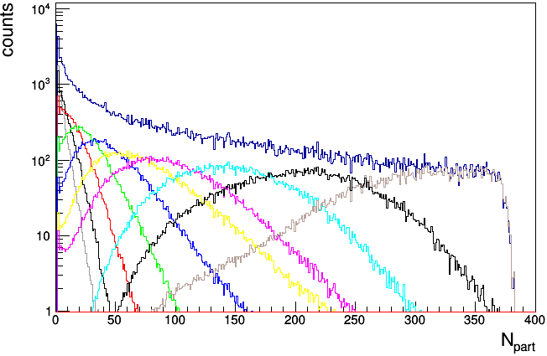
Number of participants comparison. DCM-SMM
Comparison of several methods of determining the number of participants
Participants from the DCM-SMM model
Participants obtained from TPC multiplicity (Glauber model)
Participants derived from FHCal classes
Obviously, deriving multiplicity from the E_{dep} E_{max} correlation and the subsequent employment of the Glauber model adversely affects resolution.
For this reason, a different approach that includes the multiplicity itself is required.
N_{part} Glauber DCM-SMM
intersection
Glauber
N_{part} FHCal DCM-SMM
DCM-SMM
Glauber
N_{part} FHCal Glauber DCM-SMM
Bad resolution for FHCal classes-> multiplicity->Glauber->N_{part} approach (grey triangles)
NBD
Notes:
And this slide shows the results of that comparison.
The top block shows the partitioning of TPC multiplicity into classes and the transition to the number of participants via Glauber and NBD.
The bottom block represents two possible ways of moving from Edep Emax correlation (energy deposition vs maximum energy) to the number of participants. The first is to simply obtain the number of participants from the DCM-SMM model. The second is to construct TPC multiplicity distributions for each colour centrality class. And the subsequent transition from these multiplicity distributions to the number of participants for the Glauber model.
Let us pay attention to the lower right picture, which convincingly shows that such a transition from the classes obtained by energy allocation in FHCal to multiplicity, and then transition to the number of participants from Glauber cost a lot. This path here corresponds to the grey triangles, and you can see that it is worse than taking the number of participants from the generator (orange squares), and worse than just using multiplicity without FHCal at all (black rhombuses).

Slide 8
Short summary of centrality determination using FHCal observables
A method for centrality determination is provided by the 2D linear fit approach, however the utilization of the Glauber model for N_{part} estimation presented a challenge in this case.
The attempt to enhance resolution by constructing new observables based on energy deposition in the calorimeter did not yield fruitful results, as the majority of other observables display high correlations.
An observable that holds promise is the TPC multiplicity, and it is feasible to establish the correlation between energy deposition (E_{dep}) and multiplicity.
Hence, an alternative approach that incorporates the multiplicity itself becomes necessary.
The correlation between (E_{dep}; E_{max}) has exhibited a satisfactory outcome.
Therefore, it seems logical to try to determine centrality using both the observables from TPC and FHCal.
Notes:
Thus, the state of affairs for today was as follows. There are two detectors that can be used to determine centrality. There is a standard method that relies on multiplicity, and there is a method that relies on Edep Emax correlations in the calorimeter.
The problem with the method, which relies only on the energy deposition in FHCal, in principle, is that it is difficult to move from it to the lossless Glauber model.
In addition, the task of improving the resolution for the central classes is still on its own.
Thus, it seems that these problems can be solved by combining approaches.
We have seen that the Edep Emax method itself showed good results, and we also know that multiplicity is a very good centrality estimator, for this reason we will consider this triple correlation.

Slide 9
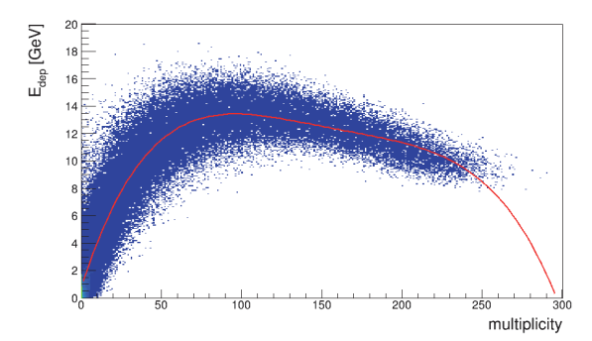
New method for centrality determination (preliminary)
Edep vs Multiplicity (TPC)
Fitted with pol4
E_{dep} vs E_{max} vs multiplicity
The correlation (E_{dep}; E_{max} ; multiplicity) was considered
We have approximations of both correlations: pol4 for (E_{dep}; multiplicity) and ellipse for (E_{dep}; E_{max}).
It remains to combine them to obtain a three-dimensional distribution, implying that it is necessary to traverse the ellipse and obtain values that correspond to the multiplicity value at each point of the ellipse.
Notes:
You can see the Edep Emax Mult correlation. In itself, the construction of such a correlation is not difficult. The main problem here is the division of such a correlation into classes.
For such a separation, again, as in the case of an ellipse, for Edep Emax we need to obtain some envelope, passing along which we will collect our centrality classes by 10% of the total number of events in each.
In short, obtaining such an envelope is done by combining two fits, one of them is a polynomial correlation fit (Edep; mult). The second is the already described elliptical fit. Previously, perpendiculars to the ellipse were used to separate classes from each other. In this case, their role is played by the plane perpendicular to the envelope.
In general, the procedure is really complicated and I see no reason to describe it here in detail, it could be another speech. I'll just say that the envelope of the three-dimensional correlation was obtained, it goes something like this, inside the thick of these points. and the classes were cut.

Slide 10
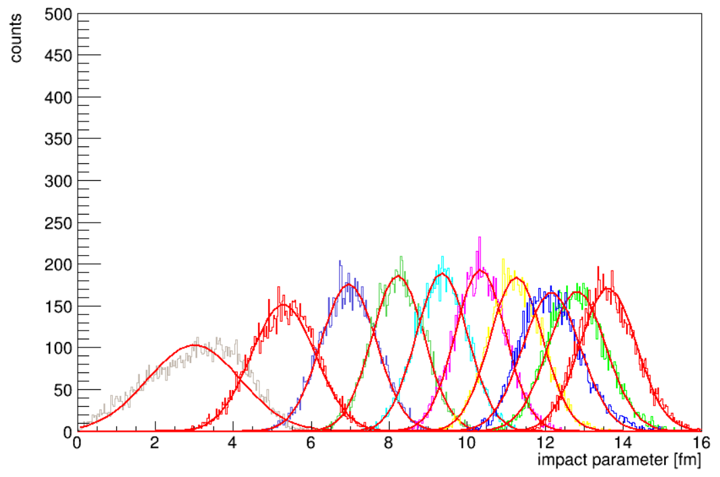
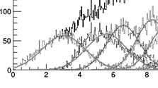
Centrality resolution for E_{dep} vs E_{max} vs multiplicity
It is clearly seen that the resolution of the 10-20% class has improved significantly (σ_{b}/b = 0.15 vs 0.21, 0.21) with a new method
The resolution of b for centrality class determination obtained from simulations with the DCM--SMM fragmentation model.
Compare with the width of the impact parameter distributions for E_{dep} E_{max}
Since the method uses TPC multiplicity, it is possible to use Glauber's model to estimate centrality by N_{part} in more direct way
Notes:
The results of the method are presented on this slide in two versions. By the impact parameter, and by the number of participants from the generator.
According to the impact parameter, orange dots refer to the new 3d method, grey triangles to the old cone fit method. and round ones are just mult. classes.
The most important thing here is that, it seems, the branches were able to move apart and the resolution in terms of the impact parameter improved by one and a half times for the 10% class, as well as for other central classes. You can also just visually compare how the distribution of impact parameters by class looked before (grey picture), and how it is now. It can be seen that there is an improvement, they are no longer so mixed up.
If we turn to comparing the determination of centrality by the number of participants, we see that pure multiplicity works worse for central events. But what worries me more is this sharp inflection for the 3D method. I can't explain it at the moment, so I would welcome comments on this.

Slide 11
Results
Two methods for centrality determination in the MPD experiment were considered
FHCal 2D fit method (E_{dep}; E_{max})
TPC multiplicity method
A comparison of their performance in terms of the mean number of participants N_{part} was done
A new method based on the energy deposition in the FHCal in conjunction with the TPC multiplicity was proposed
Preliminary results shows that the method potentially achieves a reduction in volume fluctuations for central and semi-central events
Validation of the method and its verification on up to date collaboration simulation data is required
As well as estimation of the N_{part} using the Glauber model
Notes:
Since there is little time, I will not fully read what is on the slide. The main thing can be summed up like this.
A method for determining centrality has been developed that exploit both the energy deposition capabilities of the calorimeter and the multiplicity of the TPC.
The resolution for the central classes has been improved with this method, for a class of 15% quite significantly.
As for Glauber's problems, I would like to suggest that the inclusion of multiplicity itself in the 3d correlation may improve past results, or at least facilitate the transition to Glauber's number of participants.
That's all, thank you for your attention, I will be glad to hear your comments and questions.

Slide 12
Thank you for your attention!

Slide 13
BACKUPS

Slide 14
From multiplicity to number of participants
As a method is needed to compare results across approaches, the number of participants is used in this regard.
There are two ways to go about considering participants.
The first is to converse to the number of participants by using the one-component Glauber model (MEPHI code is used).
The multiplicity distribution from the Monte Carlo simulations is fit with the distribution of the Glauber model data.
The approximation is performed using the NBD distribution.
The second is to use the participants directly from the model (this is only possible for the DCM-SMM model)
DCM-SMM
Multiplicity
NBD
N_{part}
Notes:
So, one of the problems with this method was initially the problem of comparing its results with other experiments or methods, etc.
In principle, there are two ways of such comparison. The first, and I think the most preferable, is the comparison through the Glauber model. The transition to the number of participants is possible from multiplicity through the Glauber model and the NBD distribution.
The second is to compare the number of participants from the model, in this case DCM-SMM.

Slide 15
New method for centrality determination (preliminary)
Resolution for the determination of centrality classes from the mean number of participants N_{part} obtained from the DCM-SMM generator.
Requires validation against generator data and a second approach using the Glauber model.
?

Slide 16
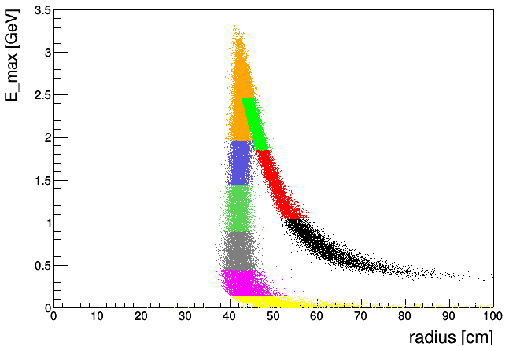
LAQGSM 11 GeV (v2)

Slide 17
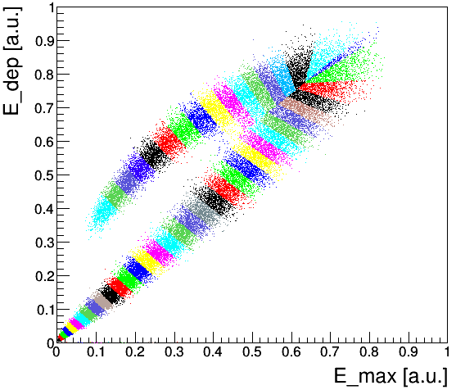
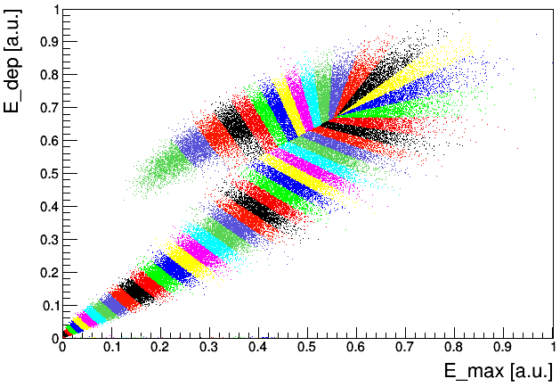
Centrality resolution for E_{dep} vs E_{max} 2% binning backup
Dependence of impact parameter on centrality
LAQGSM
LAQGSM
DCM-SMM
Each color bin is 2% fractions of the total number of events.
Dependence of resolution of impact parameter on centrality
LAQGSM
DCM-SMM
DCM-SMM

Slide 18
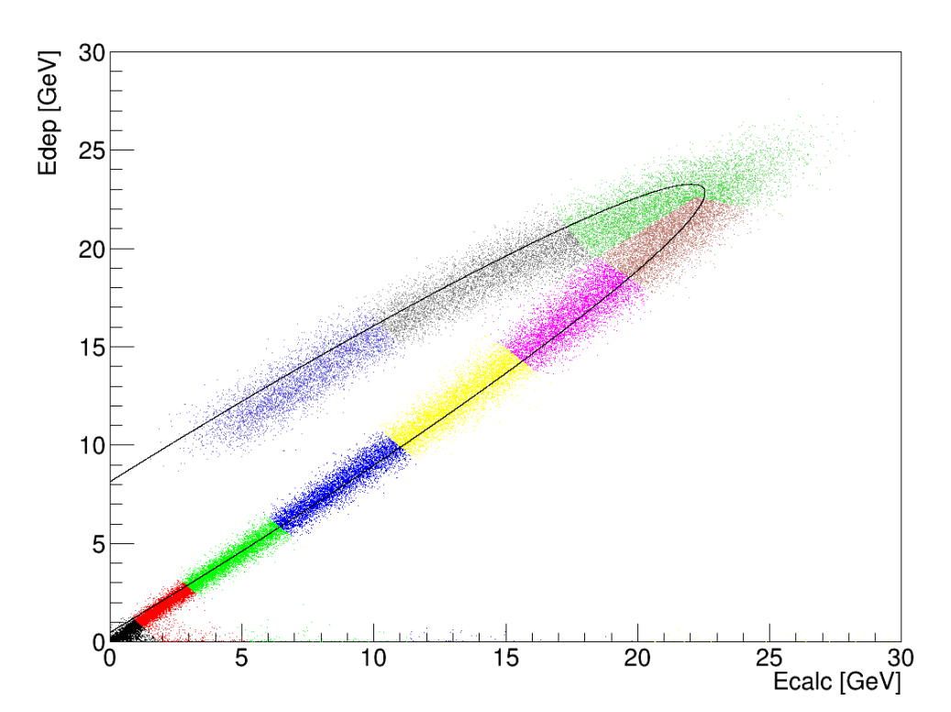
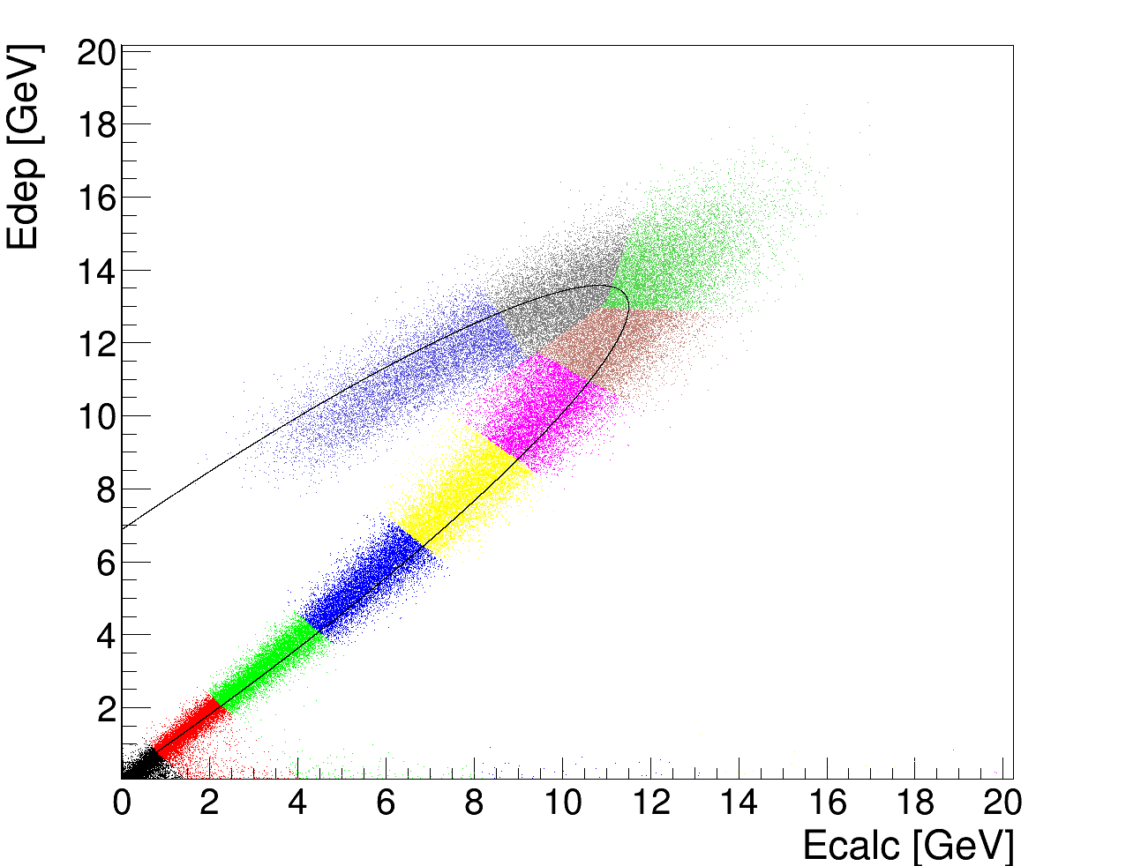
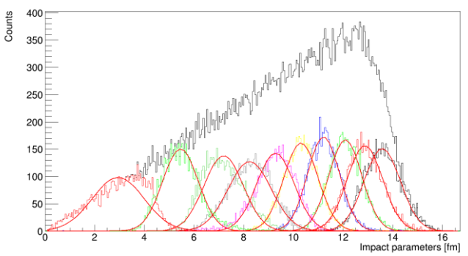
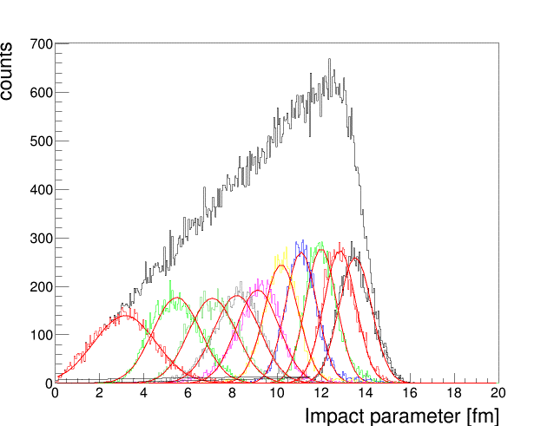
5 GeV example for LAQGSM and DCM-SMM models
LAQGSM
DCM-SMM
Each color bin is 10% fractions of the total number of events.
E_{rec}
E_{rec}

