Slide 1
Simulation of silicon detectors of the MiniSPD setup
N.Barlykov, V.Dudin(JINR)

Slide 2
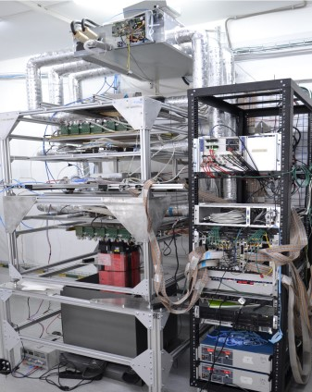
MiniSPD stand

Slide 3
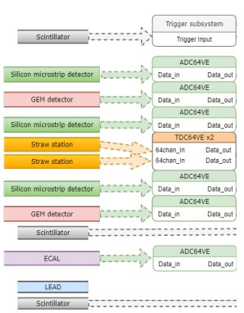
Structure of MiniSPD
Top scintillator
Si
Trigger subsystem consists of
two (top and bottom) scintillators. Top: ScintPos[2] = 3 mm.
Bottom: ScintPos[2] = 931,5 mm.
Si
Si
Bottom scintillator

Slide 4
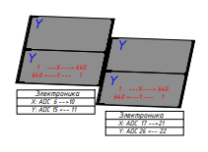
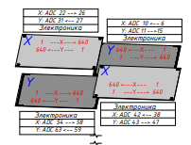
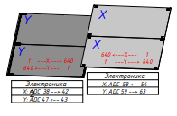
Two-sided Si-plates
1
TOP
2
Top module:
1st part - U/X (coordinates)
2nd part – U/X
Middle module:
3rd – X/U, 4th – Y/U
5th – U/X, 6th – X/U
Bottom module:
7th part - U/X
8th part – X/U
3
4
MIDDLE
5
6
7
8
BOTTOM

Slide 5
Geometry of Silicon plates
Thickness of every single Si-plate – 300 microns
Number of strips – 640
Strip’s size – 0,095 mm
Measured coordinates – X & U (2,5°)
Strip numeration:
Numeration of strips from left to right:
X1, X2, X4, X5, X7 and U1, U2, U3, U4, U5, U7
From right to left:
X3, X6, X8 and U6, U8.

Slide 6
Geometry of Silicon plates
 | X, mm | Y, mm | Z, mm | Size, mm
Sx1, Su1 | -28,55 | 0 | 35,0 | 63 x 126
Sx2, Su2 | 31,55 | 0 | 50,3 | 63 x 126
Sx3, Su3 | -32,55 | -27,55 | 387,8 | 63 x 63
Sx4, Su4 | 27,55 | -32.55 | 395,1 | 63 x 63
Sx5, Su5 | -27,55 | 32,55 | 395,1 | 63 x 63
Sx6, Su6 | 32,55 | 27,55 | 387,8 | 63 x 63
Sx7, Su7 | -28,55 | 0 | 893,5 | 63 x 126
Sx8, Su8 | 31,55 | 0 | 886,2 | 63 x 126
Table 1. Detector coordinates

Slide 7
Inclusion in basic packet of StripStepping.cc for simulation of triggering of strips
Add StripStepping.cc to SteppingAction.cc
In StripStepping for every module and part:
1. Connect the triggered strip number with X-coordinate, define U-coordinate for the same plane and the strip number on U-plate and its E_dep (energy deposition). The counter works.
2. Sorting of triggered strip number in increasing order for elimination of repeating numbers (X and U plates).
3. Border accounting. (Complicated programme)

Slide 8
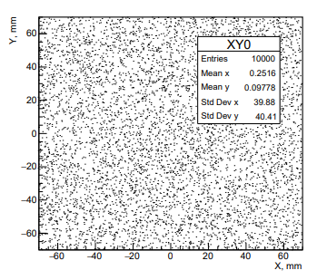
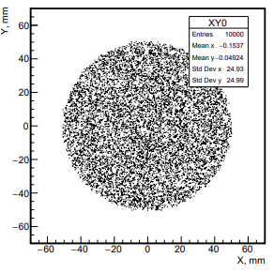
Direction and position of initial muons
Polar angle distribution by cosine
X(Y) – R(0, r) (uniform distribution)
-10° ≤ θ ≤ 10°, ρ (density) on θ -25° ≤ θ ≤ 25°
r = 100 mm r = 50 mm
Number of muons - 10000

Slide 9
Scheme of MiniSPD
Geant4. Theta = 50 degrees

Slide 10
-25° ≤ θ ≤ 25°

Slide 15
Energy deposition in a one strip at the X1-side for simulation events (left) and experimental data (right).

Slide 16
Possible combinations of Si-modules for tracks passing through MiniSPD setup

Slide 17
Alignment is minimization of residuals of functional:
Large number of parameters: track parameters (4 * number of tracks) and shifts (numbers of detectors), number of hits >> parameters.
$$u_{fit}→u_{j}\left(z_{i}\right)=\left(x_{0}+t_{x}z_{i}\right)cos\left(α_{i}\right)+\left(y_{0}+t_{y}z_{i}\right)sin\left(α_{i}\right)+Δu_{i}$$

Slide 18
χ2 and residual distributions of track passing through part 1,3 and 7 for X3(yellow) and U3(blue) before alignment

Slide 19
χ2 and residual distributions of track passing through part 1,3 and 7 for X3(yellow) and U3(blue) after alignment

Slide 20
Conclusion
Monte Carlo simulation of two-sided silicon plates of MiniSPD stand is carried out for two cases: with and without taking into account operation of the scintillator triggers. Comparison Monte Carlo simulation with experimental data allows to estimate the lower threshold on energy for a single strip operation. It is about 55 keV.
Work of all parts (1-8) and their sides (X and U) of MiniSPD Si-detectors was analyzed and compared with Monte Carlo simulation. Noisy and dead channels are seen directly from the distributions according to the numbers of triggered strips. The alignment task is solved for parts of the middle module. The distributions on residuals of its parts and χ2 on tracks are obtained.

