Slide 1

Bogoliubov Lab. Theor. Phys . JINR, Dubna
L. P. Kaptari, S.M. Dorkin

Slide 2

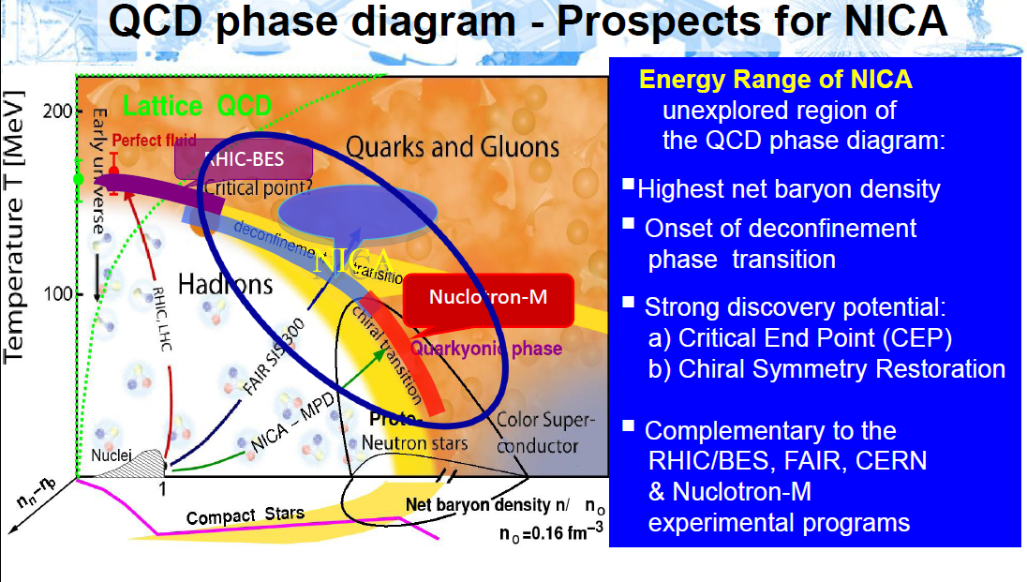
QGP signals (GSI (10-40 GeV/N), RHIC(S_{NN}> 20 GeV), NICA(S_{NN}> 4-11 GeV/N)...

Slide 3
NEEDS for a RELIABLE approach (theory, effective model …) to describe mesons and their properties at zero and finite temperature
AND not only mesons: glueballs are also relevant to QCD phenomena in vacuum and hot and dense environment
Also, glueballs as possible QCD bound states, present an independent interests in investigations of non perturbative phenomena in QCD

Slide 4
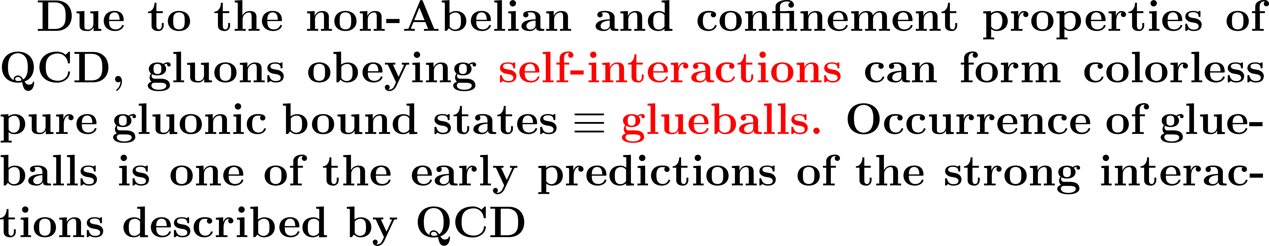
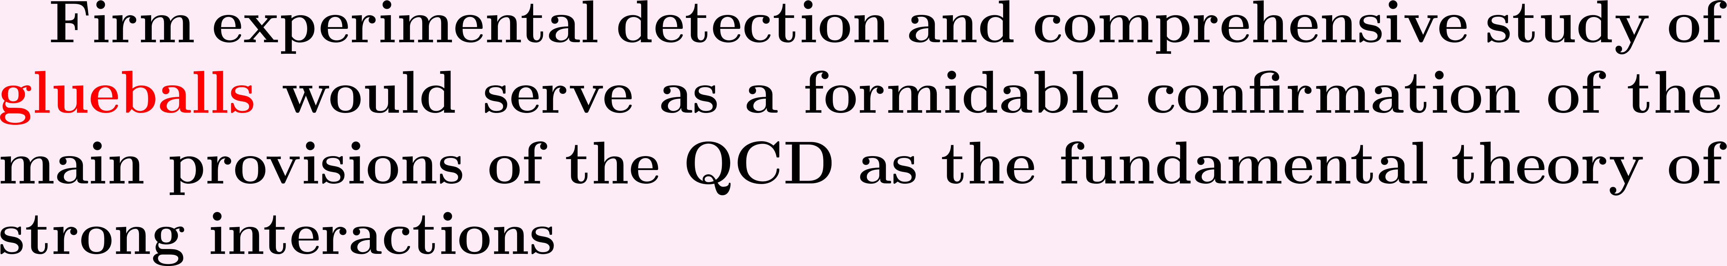
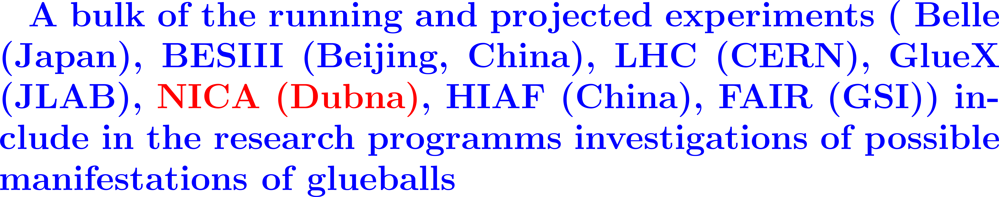
Why glueballs?

Slide 5
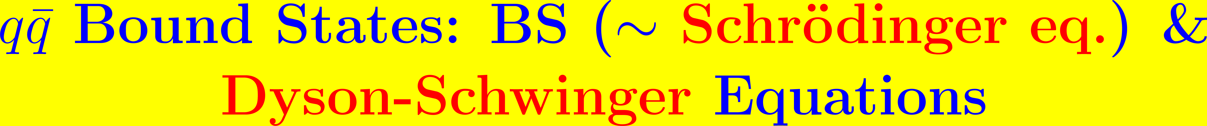
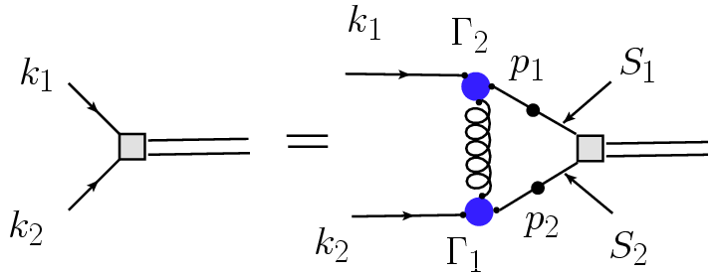
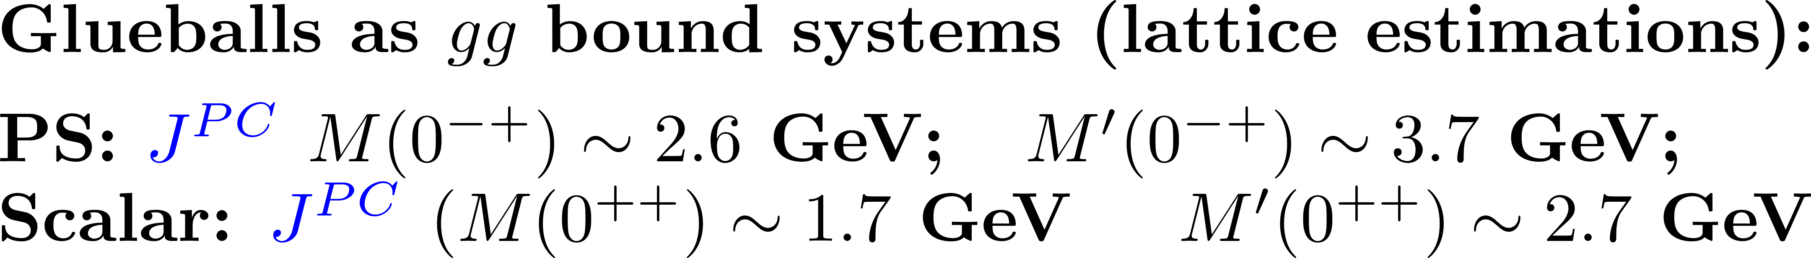
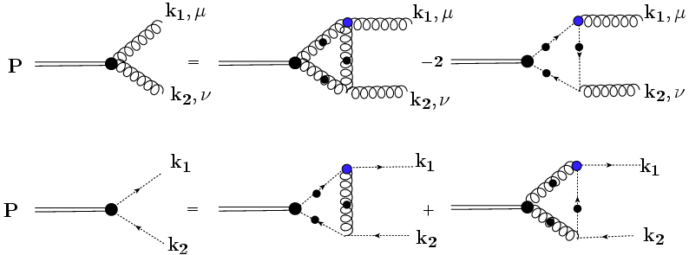

Slide 6





L. P. Kaptari

Slide 7
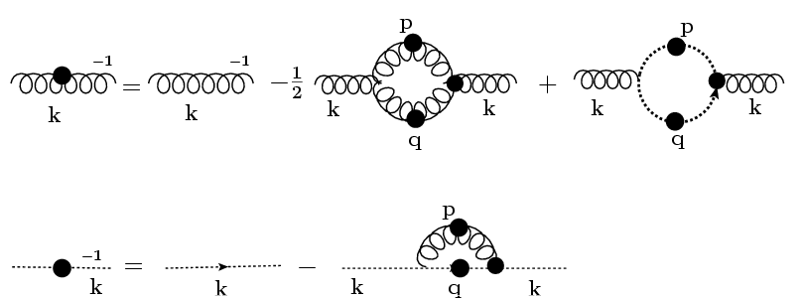
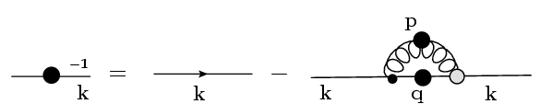
L.P. Kaptari
TRUNCATION:

Slide 8
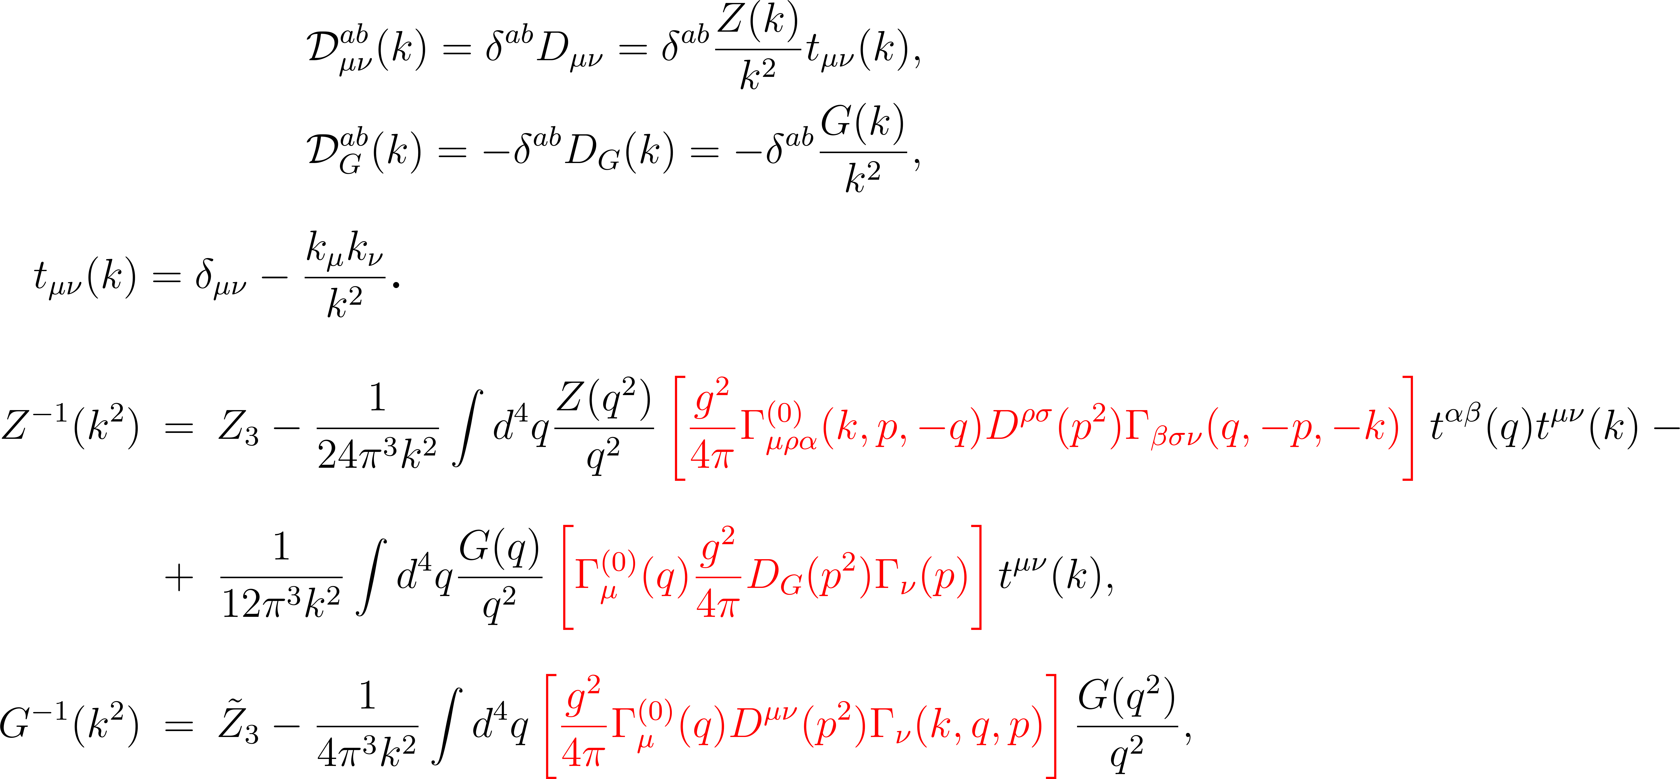
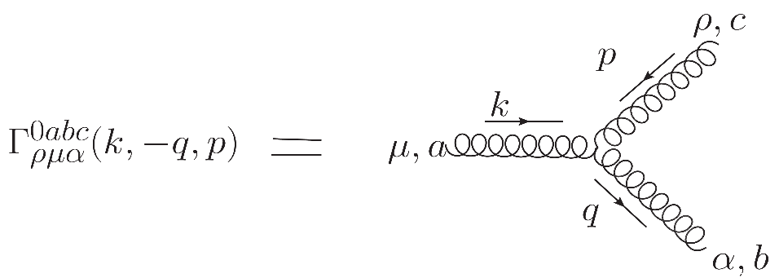
L.P. Kaptari
LANDAU gauge

Slide 9
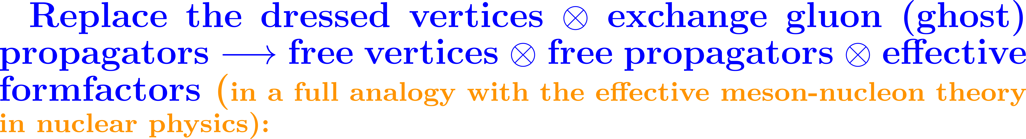
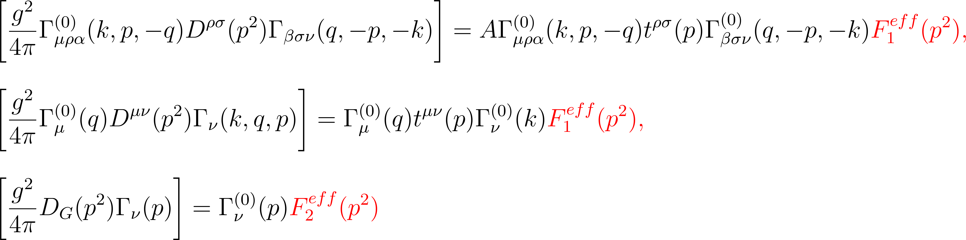
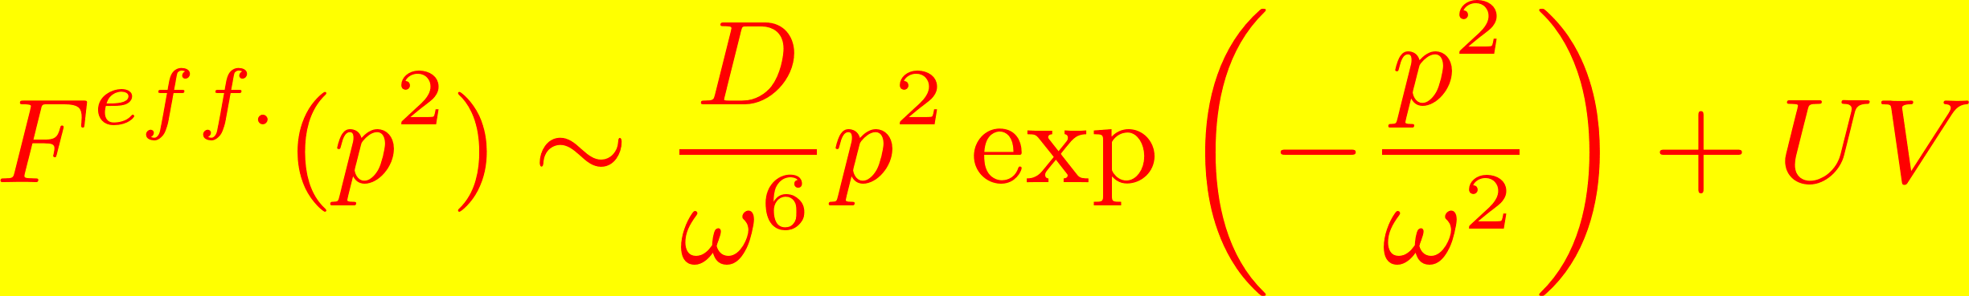
L.P. Kaptari
Effective interaction: rainbow approximation:

Slide 10
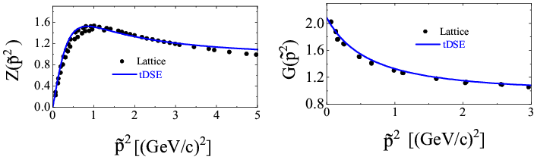
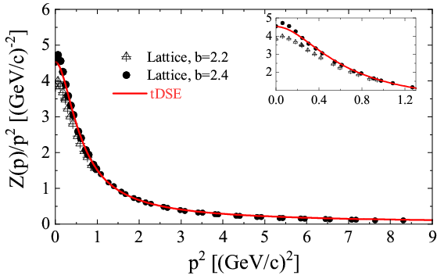

Slide 11
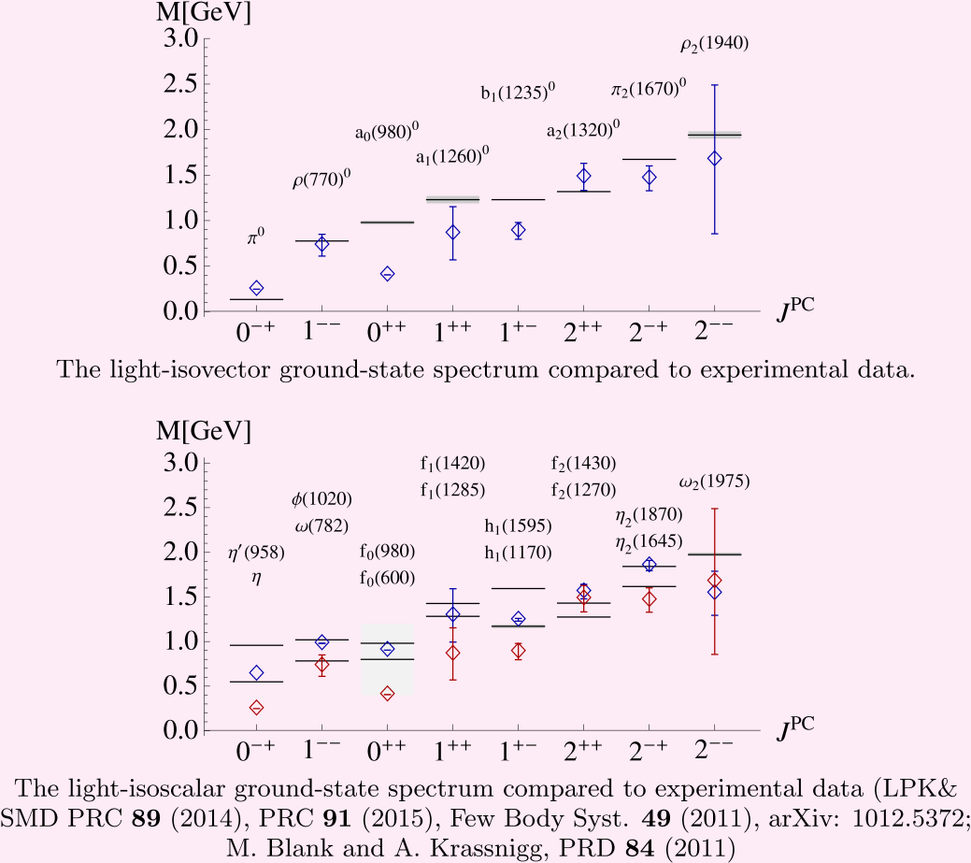
L.P. Kaptari

Slide 12


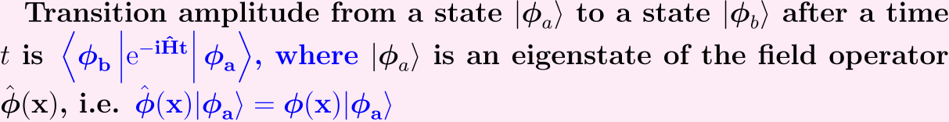
L. P. Kaptari
Finite Temperatures
The statistical density matrix:
Ansamble average of an operator :

Slide 13
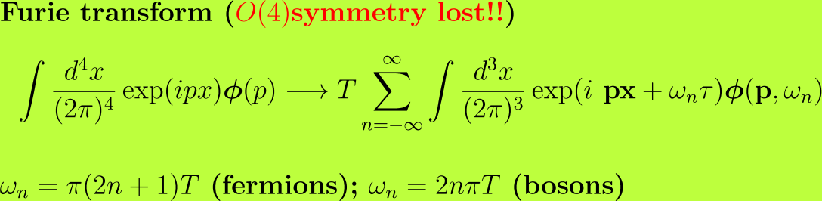
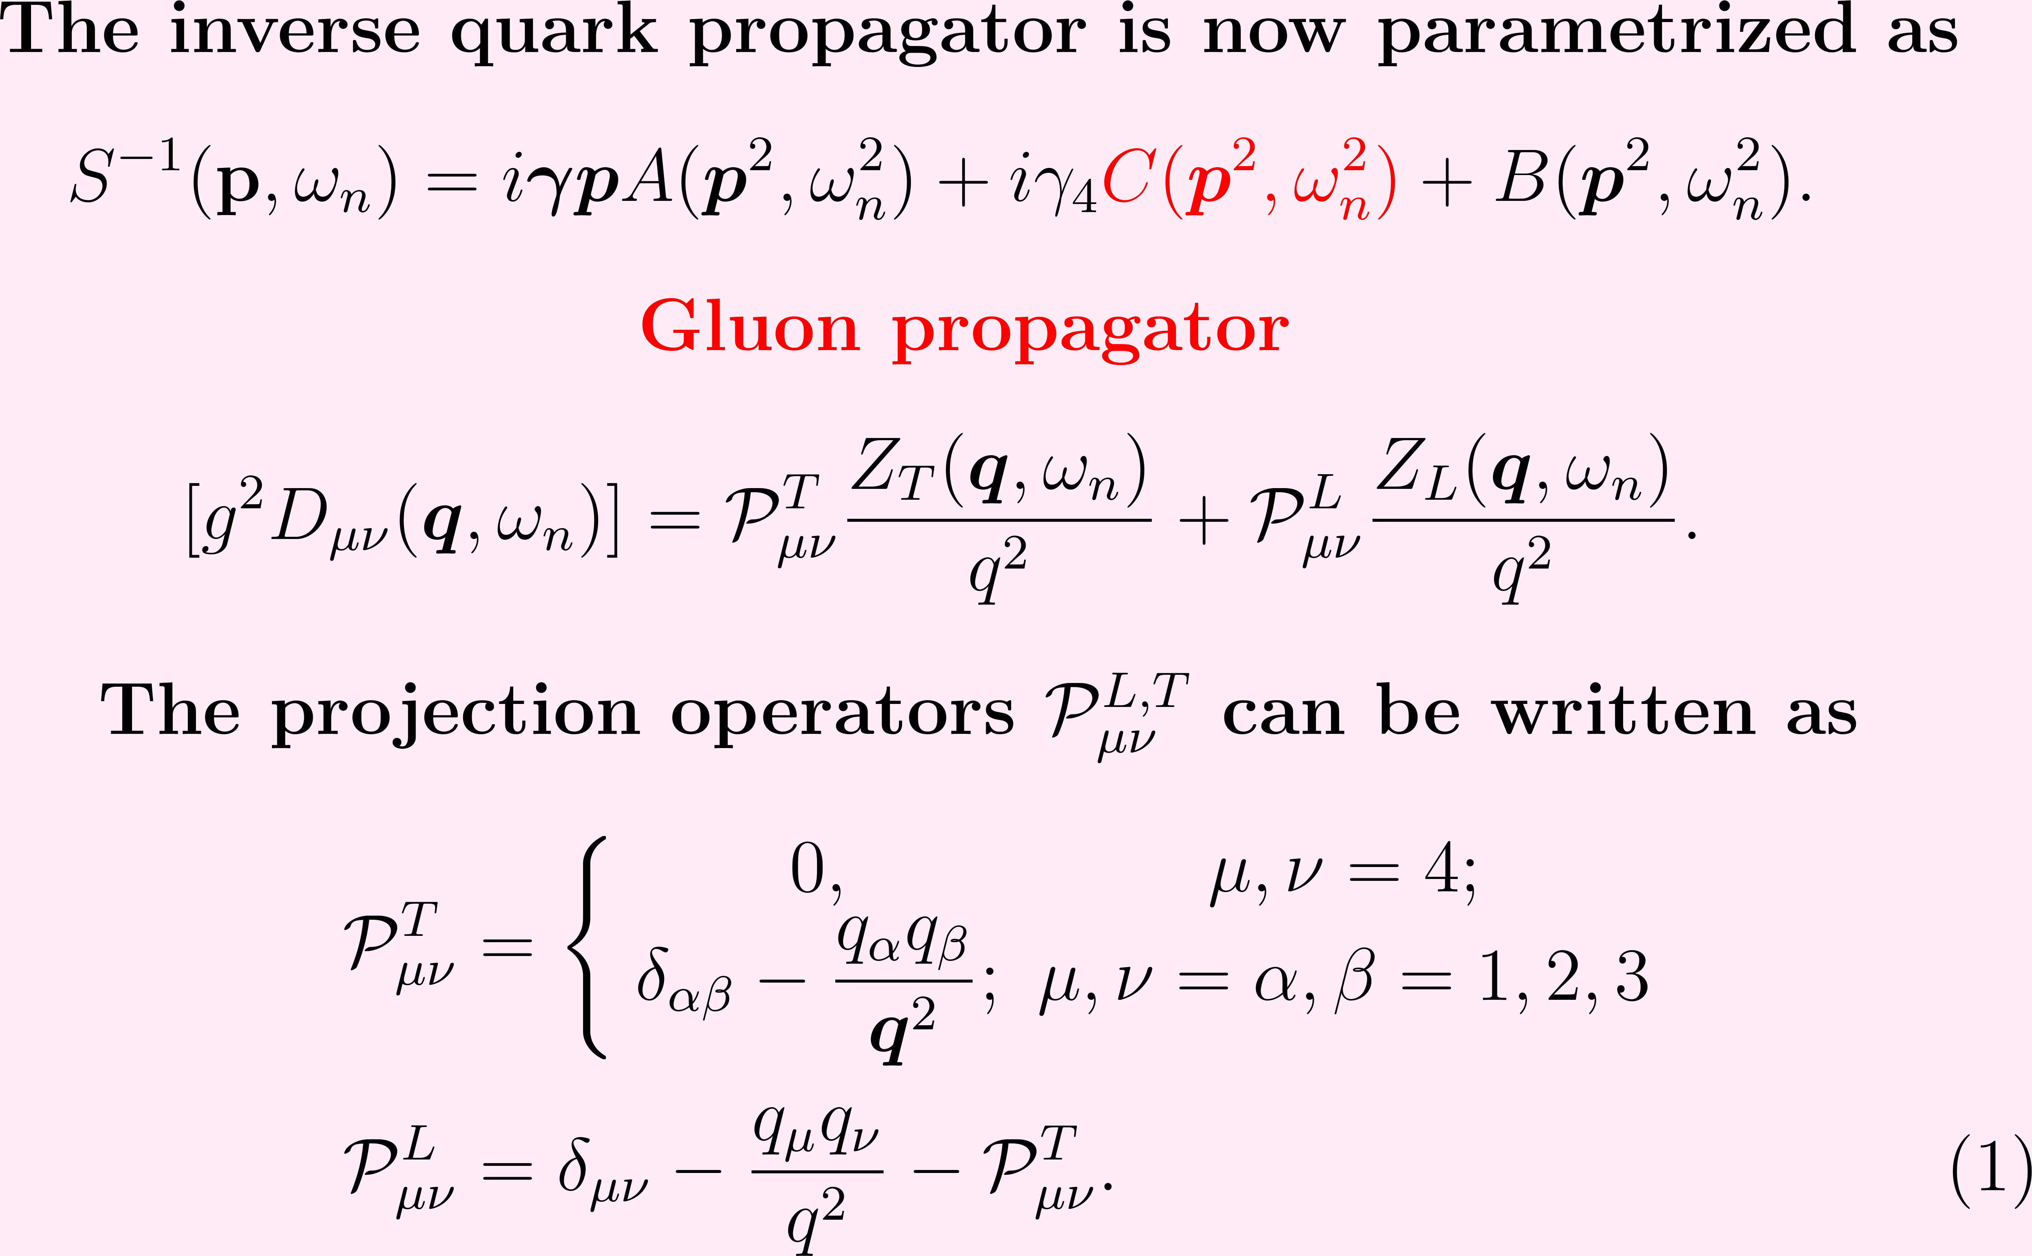
L. P. Kaptari

Slide 14
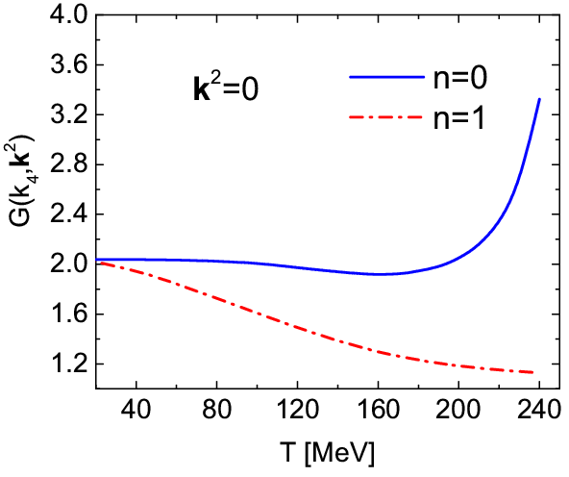
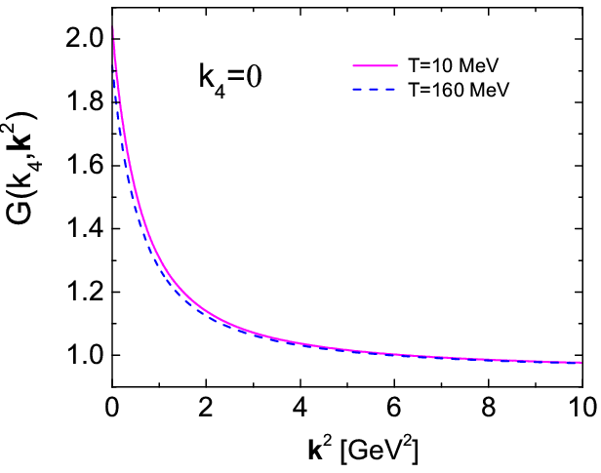
Results: Ghosts at finite T
G(k₄,k²)
E.-M. Ilgenfritz, Phys.Rev.D 85 (2012) 034501

Slide 15
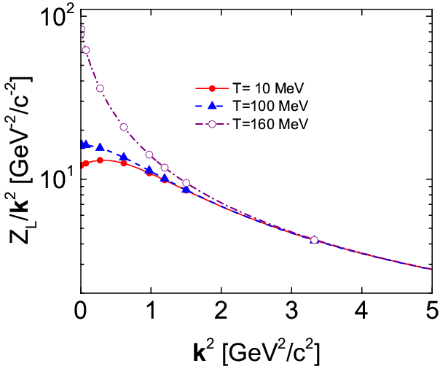
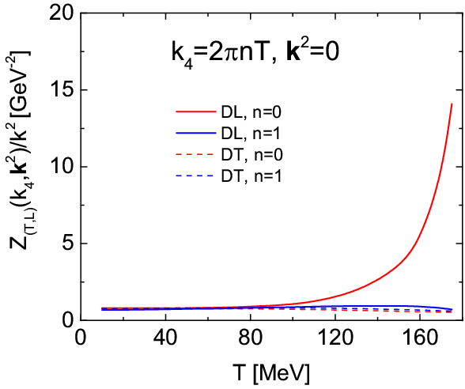

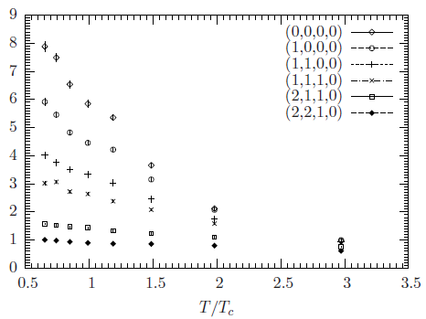
Results: Gluons at finite T
Lattice
A.Cucchieri, A. Maas, T. Mendes
Phys.Rev.D 75 (2007) 076003
(Lattice)

Slide 16
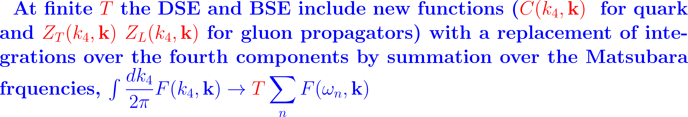
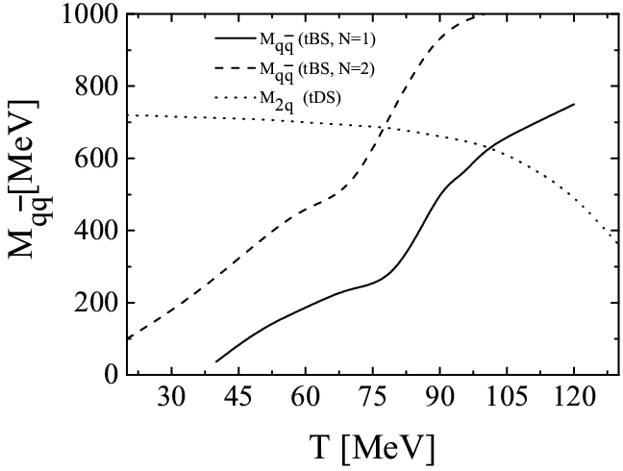
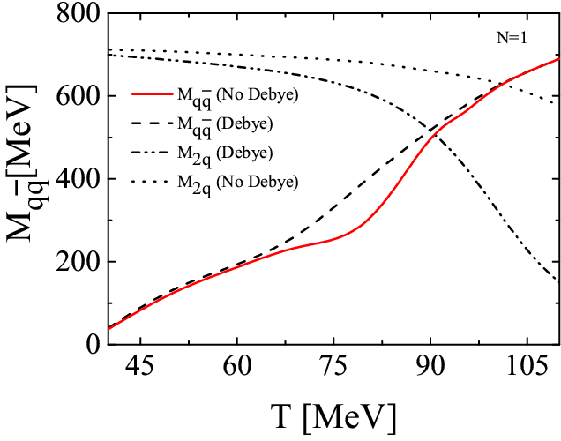
Pseudo-Scalar Mesons (pions)

Slide 17
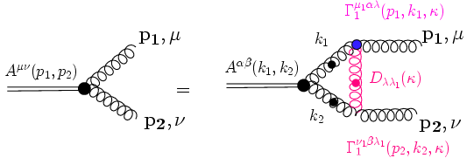
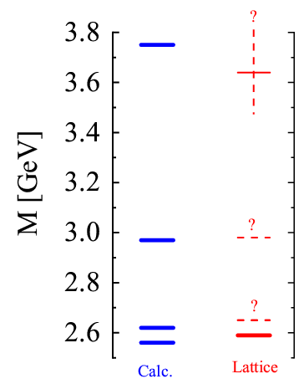
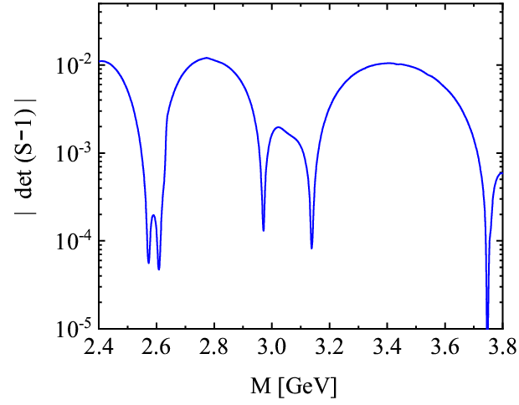
Pseudo-scalar glueballs

Slide 18
L.P. Kaptari
SUMMARY
The truncated Dyson-Schwinger and Bethe-Salpeter equations in Euclidean complex momentum domain have been analyzed within the ladder rainbow truncation. The method provides a surprisingly good description of the meson and glueball mass spectra and their decay constants in vacuum.
Our approach has been generalized to finite temperatures. Some critical phenomena in hot matter, such as behaviour of ghost and gluon propagators at high temperatures, relevant to possible signals of QGP, have been considered.
At finite temperature, our model results with vacuum parameters quantitatively agree with QCD lattice calculations. However, at high enough values of T (beyond some critical value, e.g. T_{c} ~ 150-170 MeV) the solution of DSE for the gluon dressings does not longer converge. Perhaps, this is an indication that the effective parameters of the model must acquire a more complicate T-dependendence, or that this is the temperature region where phase transition can be searched for.

Slide 19
THANK YOU !!!

Slide 20
Back up slides

Slide 21
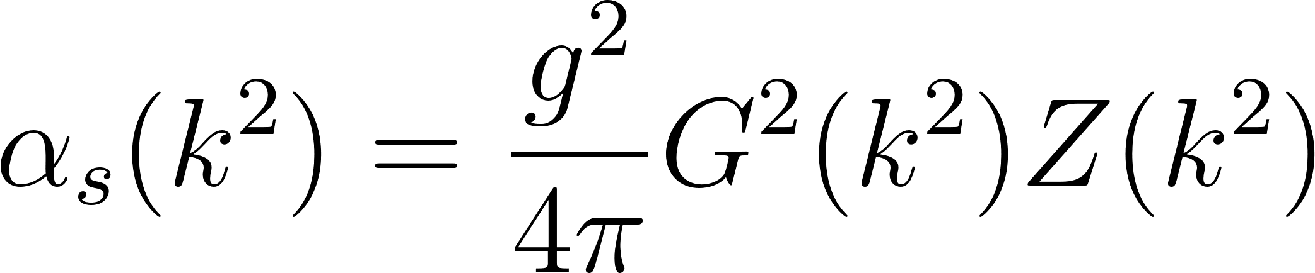
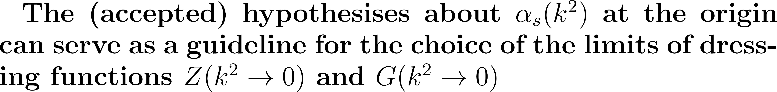
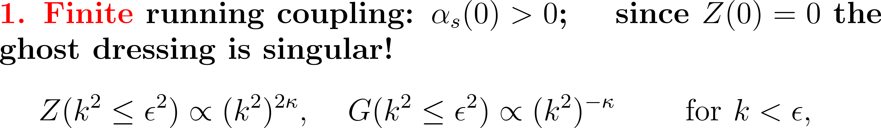
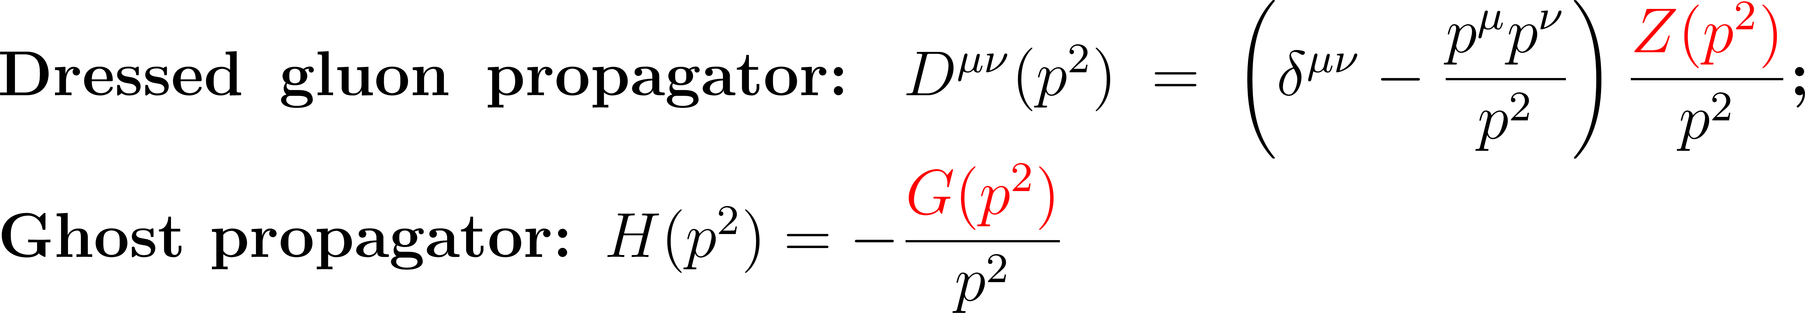
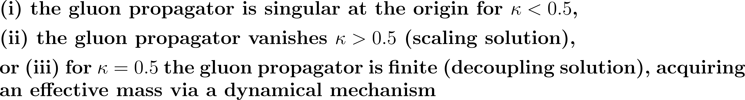
L.P. Kaptari
Solving the gluon-ghost DSE

Slide 22
L. P. Kaptari
The ladder-rainbow truncation of the Dyson–Schwinger-Bethe-Salpeter equations describes fairly well the vacuum (T=0) properties (masses, electroweak decay constants…) of the pseudoscalar glueballs, scalar, pseudoscalar, vector etc., mesons as bound states of two gluons or two quarks and allows for Poincarè covariant studies of processes with mesons.

Slide 23

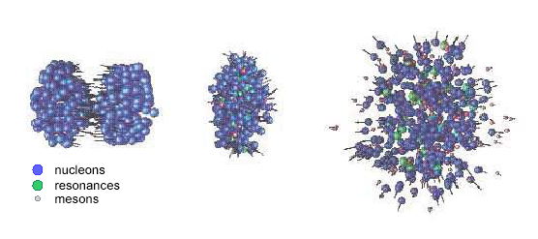
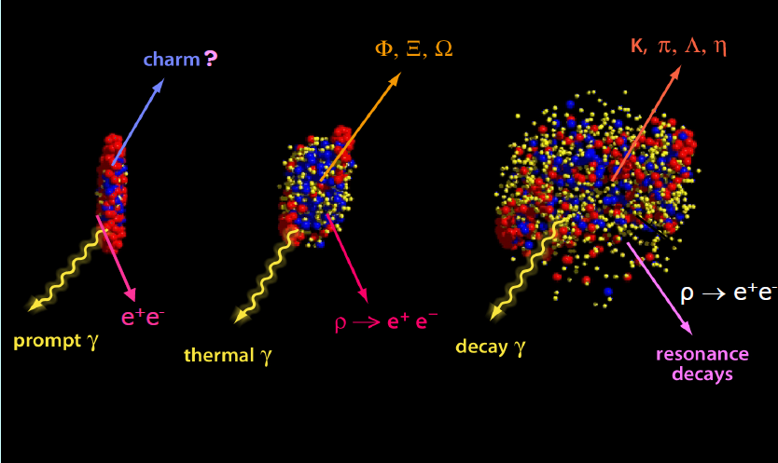
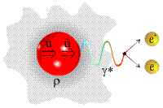
L. P. Kaptari
MOTIVATION
QGP signals (GSI, RHIC, NICA ..)
Heavy Ion
collisions
Dense matter
Freeze-out

Slide 24
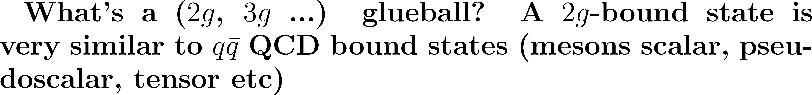
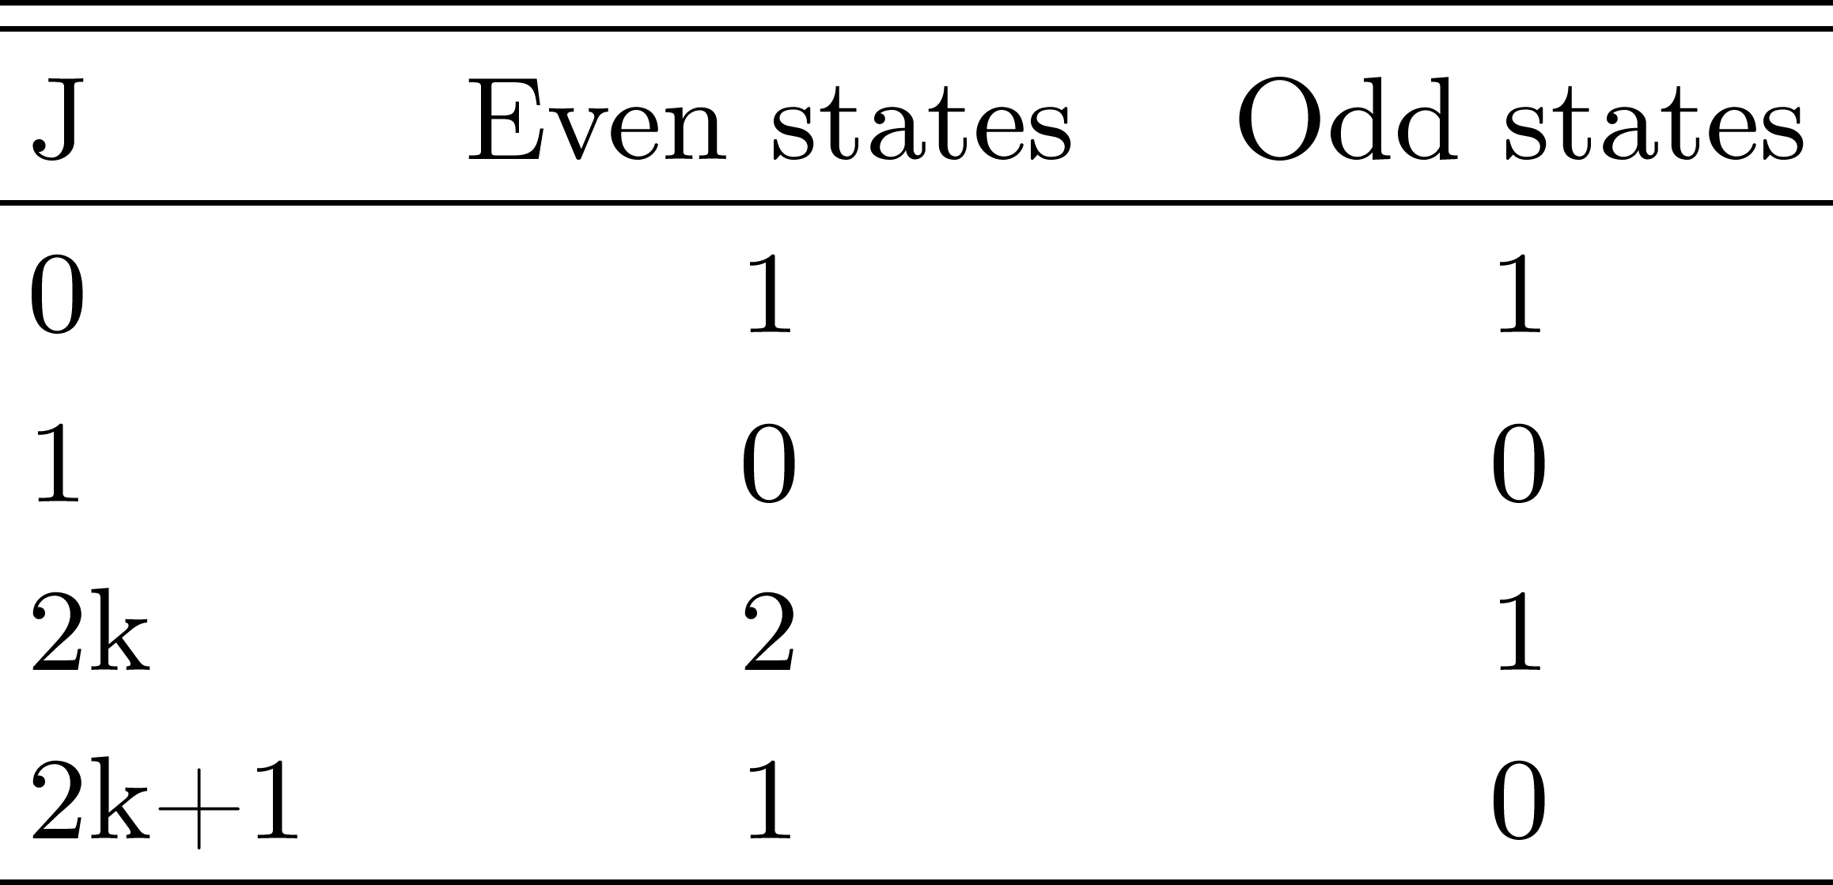
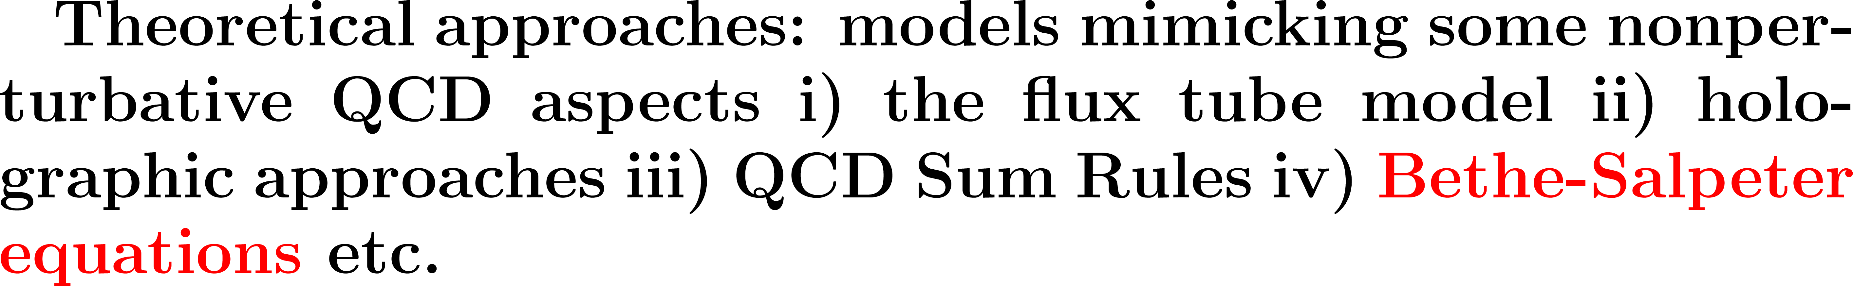
L.P. Kaptari

Slide 25
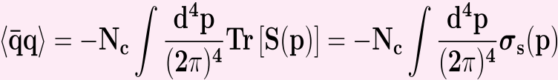
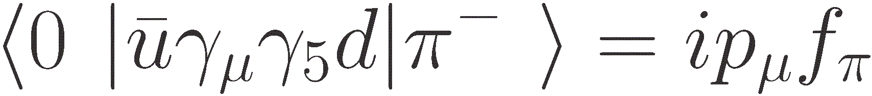
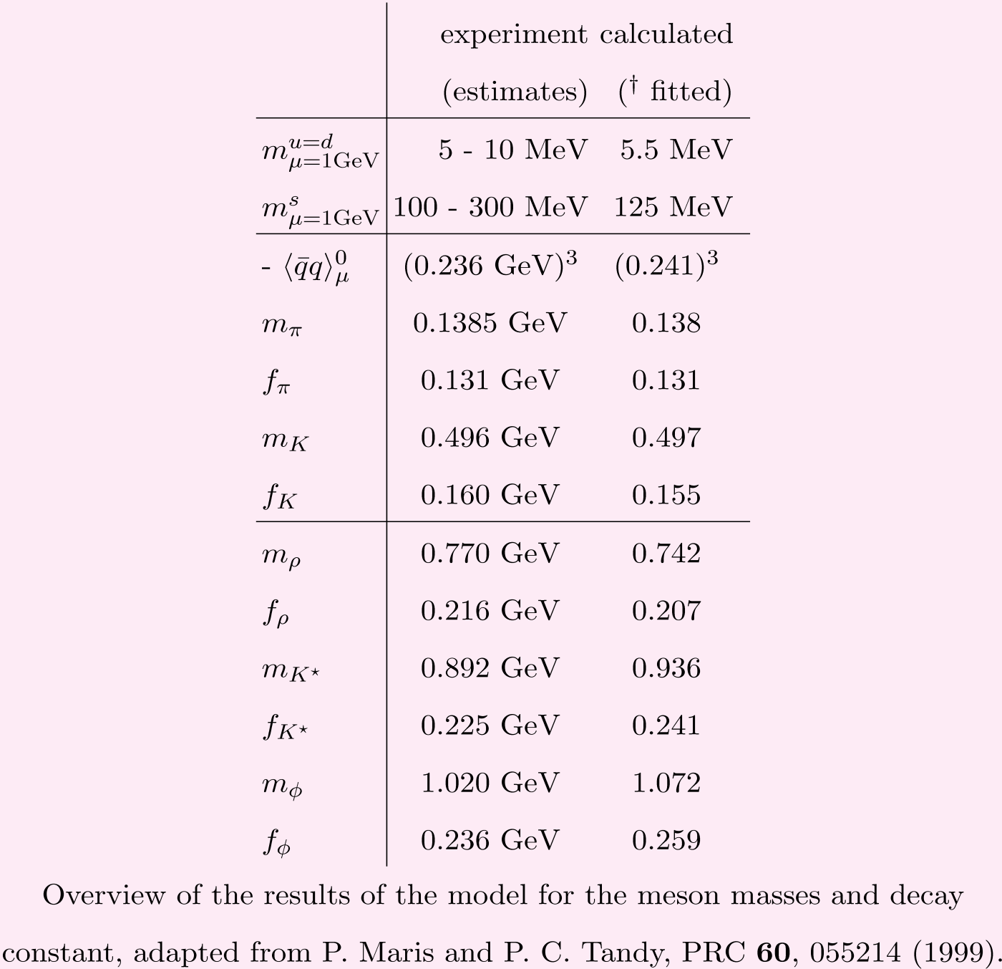
L.P. Kaptari

