Slide 1
Baldin ISHEPP XXV September 18 - 23, 2023
Radiobiological research on heavy ions in LRB JINR
Notes:
I would like to thank the organisers for the opportunity to speak for the seminar and presents the results of radiobiological research on heavy ions in Laboratory of radiation biology

Slide 2
Laboratory of Radiation Biology
Radiobiological research directions in areas of:
Molecular radiobiology
Radiation genetics
Radiation cytogenetics
Radiation physiology
Molecular and radiobiological aspects of cancer radiotherapy
Notes:
Laboratory of radiation biology incorporates two departments – department of radiation research and department of radiation biology and physiology.
There are quite a lot of research directions in the department, including ….. , and it is very difficult task to cover all of them.

Slide 3
Radiation biology in LRB
Two presentation options
Option 1: Little about everything
Option 2: Lot about few things
Notes:
So, having a choice to speak little about everything or a lot about few things,
I decided to take the second option.

Slide 4
Radiation biology in LRB
Two presentation options
Option 1: Little about everything
Option 2: Lot about few things
Notes:
which is to present you the most important and interesting, from my point of view, topics

Slide 5
Radiation biology in LRB
Option 2: Lot about few things
Two topics:
RBE problem
Clustered DNA damage
Notes:
And these topics are the so-called RBE problem and the concept of clustered DNA damage and its role in radiation biology

Slide 6
Radiation biology in LRB
Two topics:
RBE problem
Clustered DNA damage
Notes:
So, starting from RBE problem
I would like to mention, first, the difficulty of my job – to deliver biological content to the audience of physicist, therefore I will start with some basic knowledge and information, and would like to apologise if some of you are familiar with such knowledge and may consider it unnessesary

Slide 7
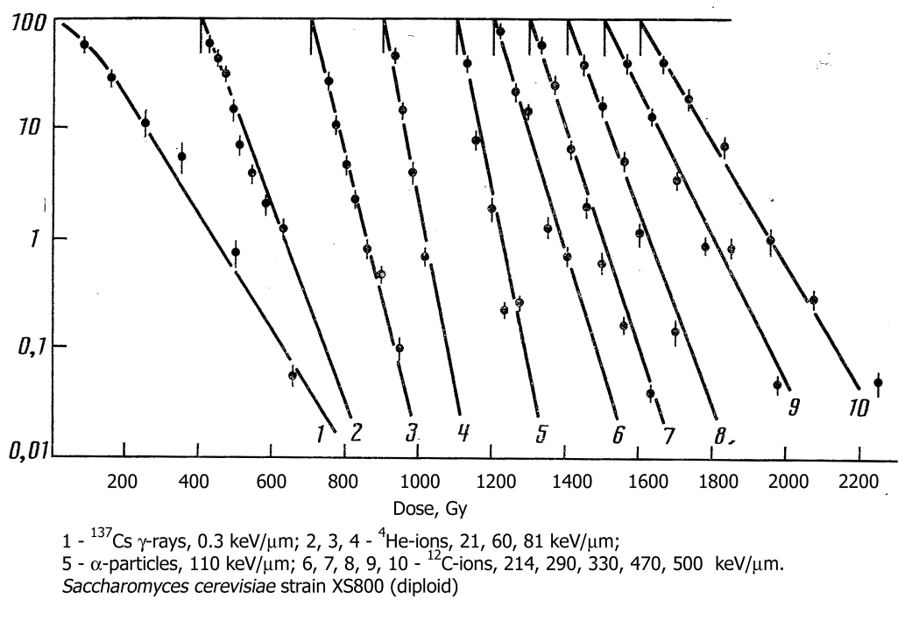
RBE problem
Cell survival and RBE – Relative Biological Effectiveness
Dose – effect curves are different for different types of radiation
The knowledge of absorbed dose is not sufficient to describe/predict biological response
How to predict biological response? Radiobiological efficiency of different types of radiation is not the same
Introduction of Relative Biological Effectiveness - RBE
Yeast cells, Data from Lobachevsky et al, 1988, LRB
RBE – the ratio of doses of the standard and tested radiation that result in the same level of biological effect
D_{X} – dose of the standard radiation (250 kVp X-rays)
D_{R} – dose of the tested radiation
Mammalian cells, Data from Barendsen, 1968
$$RBE=\frac{D_{x}}{D_{R}}$$
Notes:
In radiation biology, one of the important and informative end points or effects is cell survival. This effect is usually presented as survival curve, or dose response curve, for which the survival is plotted against the dose of ionising radiation.
Survival is plotted using log-scale, and one of the early observations in classical radiobiology was that the shape and the slope of survival curve depends on the type of ionising radiation.
Figures on this slide demonstrate survival curves for a range of different types of radiations and for mammalian and yeast cells.
It was assumed, that different types of radiations have different biological efficiency, and for the description and interpretation of such results, a concept of Relative Biological Effectiveness (RBE) was introduced/ RBE is defined as ….

Slide 8
RBE problem
RBE – LET Relationship
LET – Linear Energy Transfer (dE/dx)
LET as a parameter to characterize type of radiation
Building RBE-LET relationship
$$RBE=\frac{D_{x}}{D_{R}}$$
Yeast cells, Data from Lobachevsky et al, 1988
Why RBE-LET relationship is so complex?
What factors determine the RBE-LET relationship:
Physics of ionising radiation?
Geometry of biological target?
Biological response to radiation?
RBE-LET relationship is complex:
Increasing RBE in the range up to ~ 100 kEv/μm
Maximum at ~ 100 kEv/μm
Fast decrease at LET above ~ 100 kEv/μm
Notes:
To characterise different types of radiation, a quantitative variable was chosen – Linear Energy Transfer , or LET, and RBE was plotted as a function of LET, as illustrated in the diagram.
The RBE – LET relationship is quite complex, including…
and interpretation of this relationship was one of the main subjects in radiation biology for decades. That’s what we call the RBE problem
Questions to answer were what factors contribute to the shape of this relationship:
1
2
3

Slide 9
RBE problem – the role of physical factor
Why efficiency increases (RBE>1) with increasing LET for the same amount of absorbed energy?
Low LET High LET
Same absorbed energy (dose) to nucleus
Survived Killed
Target nucleus 200 μm³
Radiation sensitive target (nucleus) is structured – consists of multiple mini-targets (DNA)
Damage to one or a few mini-targets (DNA double strand breaks) is required to kill the cell
Different absorbed energy to mini-target (DNA)
No damage or DNA damage
Simple lesions Complex lesions
Mini-target (DNA) 1 μm³
Notes:
The role of physical factor and the geometry of target in RBE-LET relationship is obvious and illustrated on this slide…
The structure of the target plays an important role in this consideration…
Consideration of energy deposition in the target and the concept of the target damage are important steps in understanding the process…

Slide 10
RBE problem – the role of physical factor
Energy deposition in target volume
DNA damage
Chromosome aberrations, cell death, mutagenesis
Particle track
superimposed on DNA
Data source: LRB
Energy deposition in the target volume (DNA) results in formation of DNA lesions of various complexity
Spectrum of DNA lesions is determined by the type of radiation (LET)
Notes:
This slide illustrate in more details the relationship between energy deposition and the types of target damage, assuming that DNA is the critical target in cells for radiation.
It is important to note, that modern computational techniques allows to calculate energy deposition and to establish the relationship between spectrum of energy deposition and major types of DNA lesions, as shown in the diagram, namely
Isolated lesions such as,…
and clustered lesions such as

Slide 11
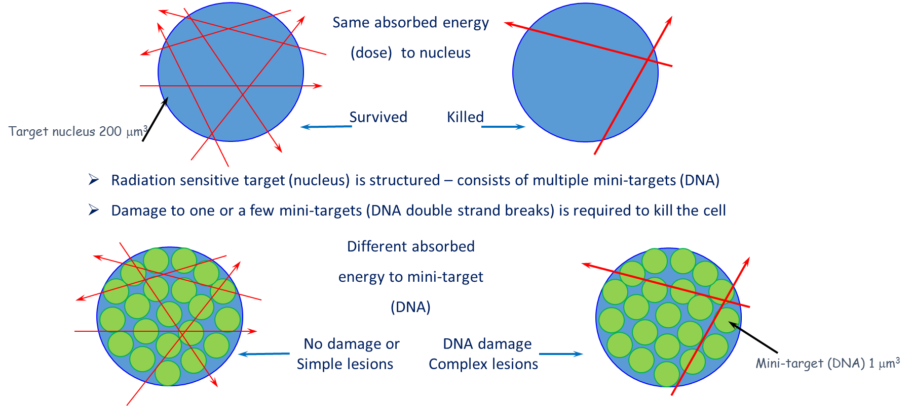
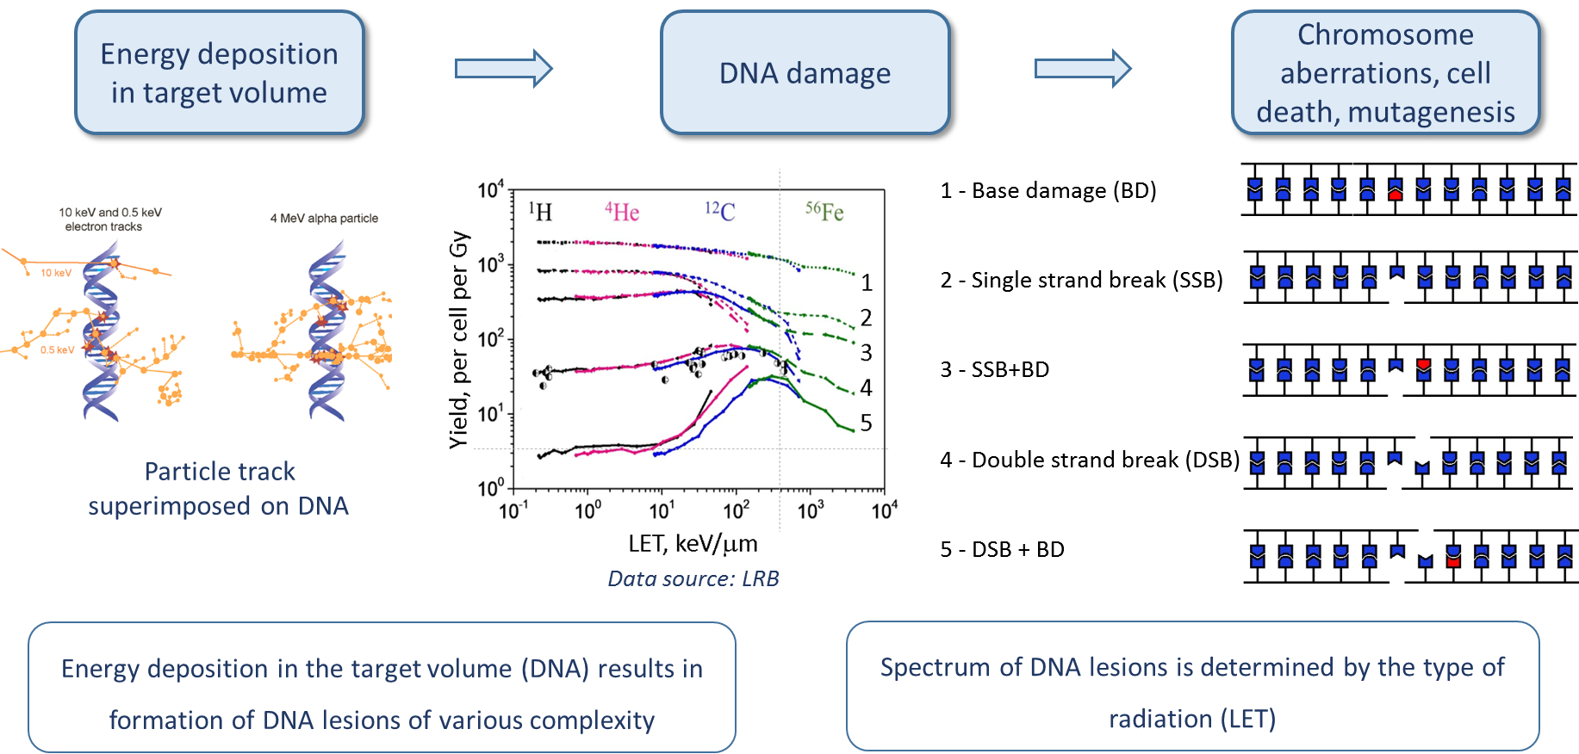
RBE problem – the role of physical factor
Attempts to provide interpretation of RBE-LET relationship based on physical factor only failed
Notes:
Although there is an obvious parallel between the yield of some types of lesions (DSB and complex DSB) as a function of LET and RBE-LET relationship, as can be seen from this slide, the consideration of physical and geometric factors is not able to provide a comprehensive interpretation of the RBE problem

Slide 12
RBE problem – the role of biological factor
Energy deposition in target volume
DNA damage
Chromosome aberrations, cell death, mutagenesis
Base excision repair
SSB repair
Mismatch repair
Non-homologous end joining
Homologous recombination etc.
Undamaged (repaired) DNA
DNA lesion complexity
DNA lesions are repaired by different pathways
Successful repair depends on the lesion complexity and cell status
Different lesions are responsible for different radiobiological effects (end points) i.e. lethal, mutagenic etc.
Notes:
Therefore, consideration of the role of biological factor is important/
DNA lesions are repaired…
The success of repair depends on lesion complexity…
Different lesions are responsible for different effects, such as….., and in biological systems of different organization, such as prokaryotes or eukaryotes

Slide 13
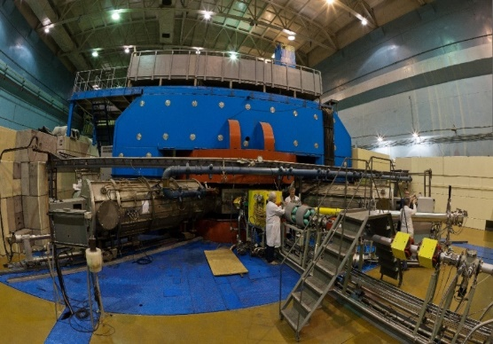
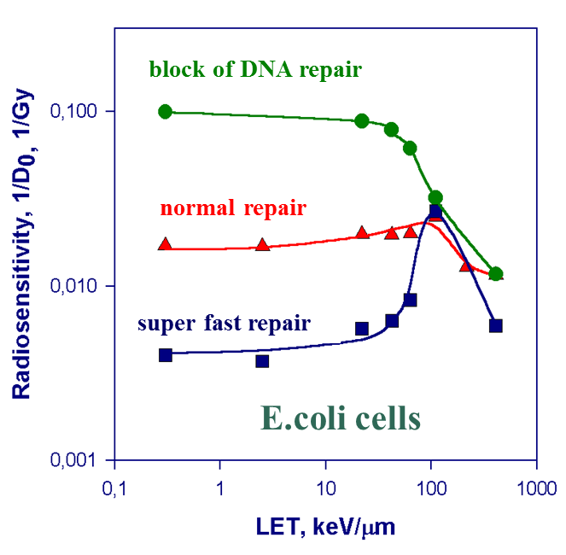
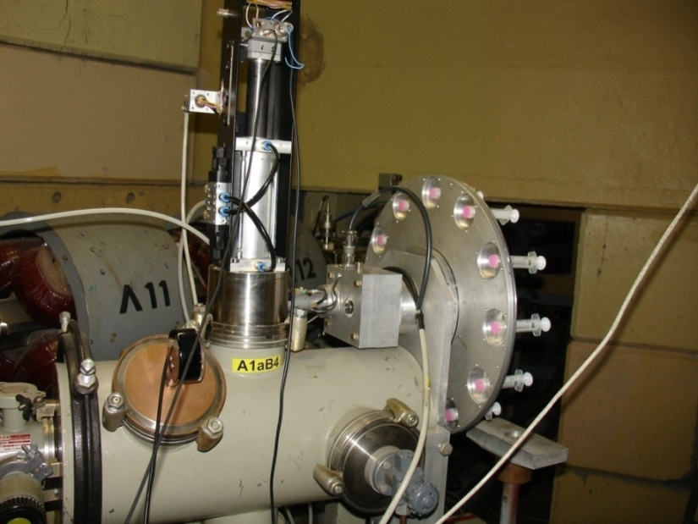
RBE-LET relationship – the role of DNA repair
Rec A mutant
Rec A mutant
Wild type
Wild type
U-400M cyclotron
Gam^{r} mutant
Gam^{r} mutant
E.coli cells
Yeast cells
E.coli cells
Prokaryotic Escherichia coli cells
Rec A – radiosensitive mutant, DNA SSB repair deficient
Increased yield of DSB (DSB – critical lesion)
Gam^{r} – radioresistant mutant
Eukaryotic Saccharomyces cerevisiae yeast cells (haploid)
Rad 6 – radiosensitive mutant, DNA repair deficient
Increased yield of DSB (DSB – critical lesion)
“Genome” station
$$RBE=\frac{D_{x}}{D_{R}}$$
Data source: LRB
Notes:
So, the status od DNA repair system, in combination with changes in the spectrum of DNA lesions becomes an important factor in the interpretation of RBE-LET relationship.
This is demonstrated in diagrams above for ….. and …..
I should note that on these diagrams it is not RBE but inverse Dr is plotted. This doesn’t change the shape of the curve and will be addressed later in my talk

Slide 14
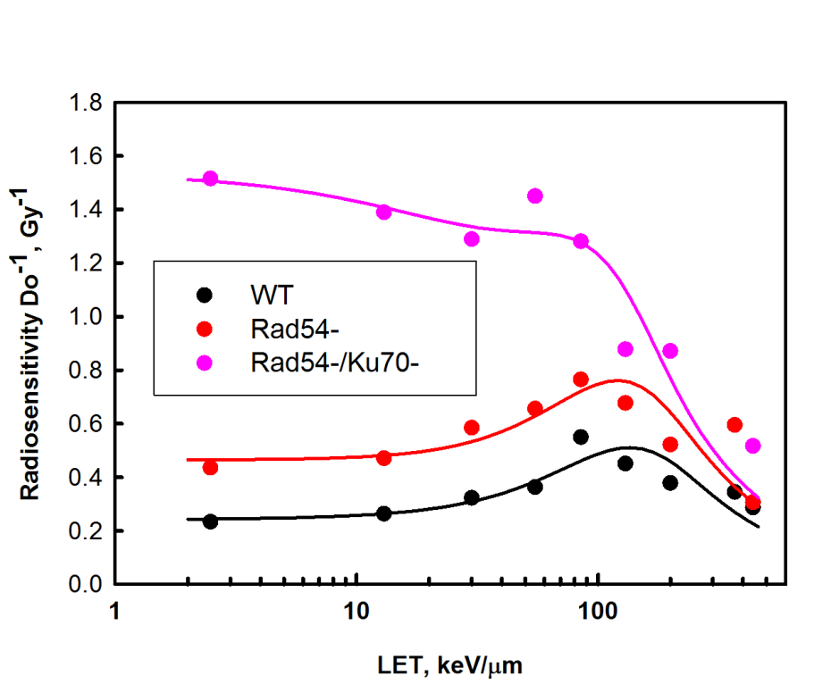
RBE-LET relationship – the role of DNA repair
Chinese hamster cells
B-lymphoma cells
DNA synthesis inhibitor
Control
Data source: LRB
Data source: Furusawa 2013
Eukaryotic mammalian Chinese hamster cells
Effect of addition of DNA synthesis (repair) inhibitor
Eukaryotic mammalian B-lymphoma cells
Rad54 and Ku70 mutants, encode proteins involved in DNA DSB repair
Notes:
Diagrams on this slide illustrate the role of the status of DNA repair system in RBE-LET relationship system in mammalian cells.
…
…

Slide 15
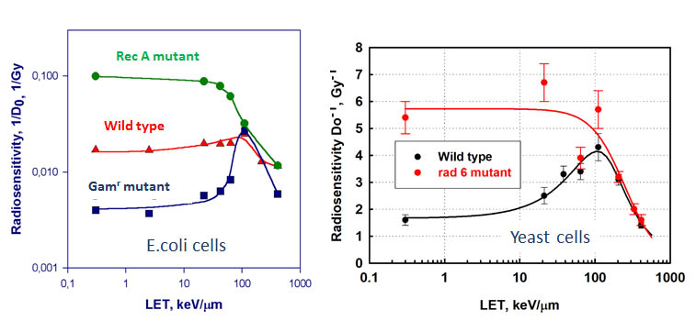
RBE problem– RBE-LET relationship
Major message:
Relative Biological Effectiveness (RBE) of ionizing radiation is determined by two factors – physical and biological
Physical: microdosimetric distribution of energy deposition that determines the spectrum of DNA lesions
Biological: the ability of cell to repair DNA damage that depends on LET reflecting changes in DNA lesions spectrum
Interpretation of RBE-LET relationship – problem solved
Overwhelming experimental and especially intellectual contribution of LRB in solving this problem
Availability of radiation sources provided by JINR facilities – a key factor in solving this problem
Notes:
Summarising the above, we state that Relative Biological Effectiveness (RBE) of ionizing radiation is determined by two factors – physical and biological. Physical factor is the microdosimetric distribution of energy deposition that determines the spectrum of DNA lesions and biological is the ability of cell to repair DNA damage. It is important to note that this ability depends on LET reflecting the change in DNA lesions spectrum. Consideration of these two factors allows the interpretation of RBE as a function of LET of radiation.
Interpretation of RBE-LET relationship in the context of the role of physical and biological factors provided a solution for so-called RBE-LET problem. And I would like to underline the overwhelming experimental and especially intellectual contribution of LRB scientists to the solution of this problem and the availability of heavy ion radiation sources provided by JINR facilities as a key factor in solving this problem.

Slide 16
RBE problem – problem of RBE
Does RBE reflect real effectiveness of high-LET radiation?
RBE of 100 keV/μm for WT ~2.6
RBE of 100 keV/μm for rad 6 ~0.9
What conclusion can be drawn?
High LET radiation is efficient in killing WT cells but not efficient in killing repair deficient cells ?
$$RBE=\frac{D_{x}}{D_{R}}$$
What is the reality?
High LET radiation is efficient in killing both WT and mutant cells
Low LET (standard) radiation is highly inefficient in killing WT cells
D_{X} – dose of the standard radiation (x-rays) - variable
D_{R} – dose of the tested radiation - invariant
Notes:
Problem of RBE

Slide 17
Radiation biology in LRB
Two topics:
RBE problem
Clustered DNA damage
Notes:
The second subject of my talk – clustered DNA damage
Consideration of clustered DNA damage – insight into the mechanism of contribution of biological factor to RBE-LET relationship
Clustered DNA damage – one of the biological factors contributing to the RBE-LET relationship

Slide 18
Clustered DNA damage
Modern molecular technology for DNA damage visualization (γH2AX assay)
H2AX
Histone (protein) – a component of chromatin
Phosphorylated H2AX, in response and at sites of DNA double-strand breaks (DSB), repair signal
Antibody to γH2AX labelled with fluorescent marker
P
γH2AX
P
P
H2AX
H2AX
γH2AX
γH2AX
H2AX
H2AX
γH2AX
γH2AX
H2AX
P
DNA DSB
P
1 focus = 1 DNA DSB
γH2AX focus, visualised by fluorescence microscopy
Notes:
Gamma-H2AX assay – a technology for visualisation and quantitation of DNA DSB

Slide 19
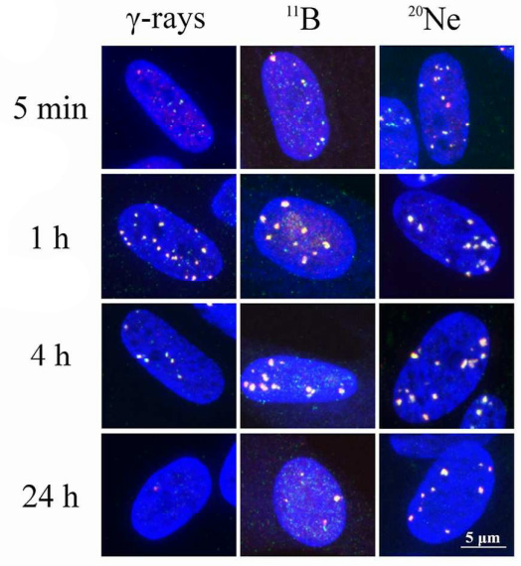
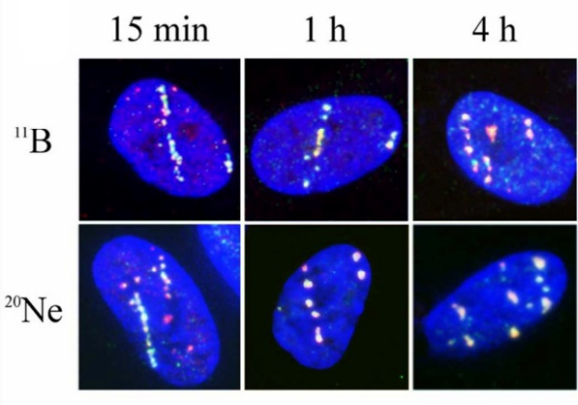
Clustered DNA damage
Kinetics of induction and disappearance of gH2AX/53PP1 foci following exposure to low- and high-LET radiations
Foci disappearance kinetics reflects the repair of DNA DSB breaks
Low repair efficiency for high LET radiation due to increased DSB complexity
²⁰Ne ions
(LET = 132 keV/µm, E = 46.6 MeV/n)
¹¹B ions
(LET = 138 keV/µm, E = 8.1 MeV/n)
Irradiation geometry:
top – 90º to cell monolayer
right – parallel to cell monolaer
4 – simple DSB
5 – complex DSB (DSB + base damage)
Notes:
Kinetics of foci in the diagram is a reflection of DNA DSB repair kinetics
DSB repair is less efficient following high LET irradiation, as illustrated in the diagram and image
The reason for low repair efficiency in different complexity of DNA lesions
DSB by itself is a clustered lesion – a cluster of two SSB
DSBs can be of various complexity, and more complex DSBs are more difficult to repair
Contribution of complex DSB increases with increasing LET – the repair is less efficient following exposure to high LET

Slide 20
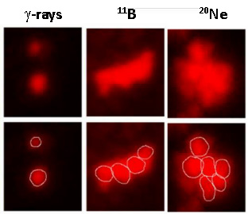
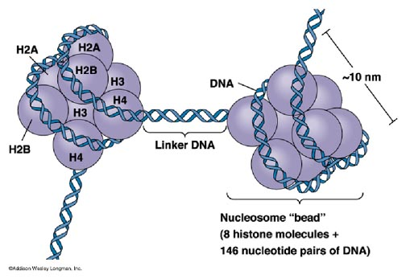
Clustered DNA damage – detection of DSB clusters
High resolution laser confocal scanning microscopy allows discrimination of individual foci in foci clusters
Foci clusters correspond to clusters of DNA DSB
⁷⁸Kr 2.76 GeV/n, 3 Gy
Chromatin structure of DNA
Origin of DSB clusters – one ion track crossing few adjacent DNA strands
Notes:
The second aspect of clustering – clusters of DSBs, as can be detected by high resolution laser confocal scanning microscopy
Groups or clusters of foci can be observed in nuclei following high LET irradiation
Clusters of foci/DSB emerge from a single ionising particle track crossing a few DNA molecules, due to higher order structuring of DNA – nucleosome and chromatin formation

Slide 21
Clustered DNA damage – two levels of clustering
Level 1 – clustered lesions Level 2 – clusters of lesions (DSB)
Isolated lesions
⁷⁸Kr 2.76 GeV/n, 3 Gy
Clustered lesions
DSBs of various level of complexity
Notes:
Two summarise – there are two levels of clustering
1 – DNA DSB itself as a clustered lesion of different complexity and
2 – clusters of DSB

Slide 22
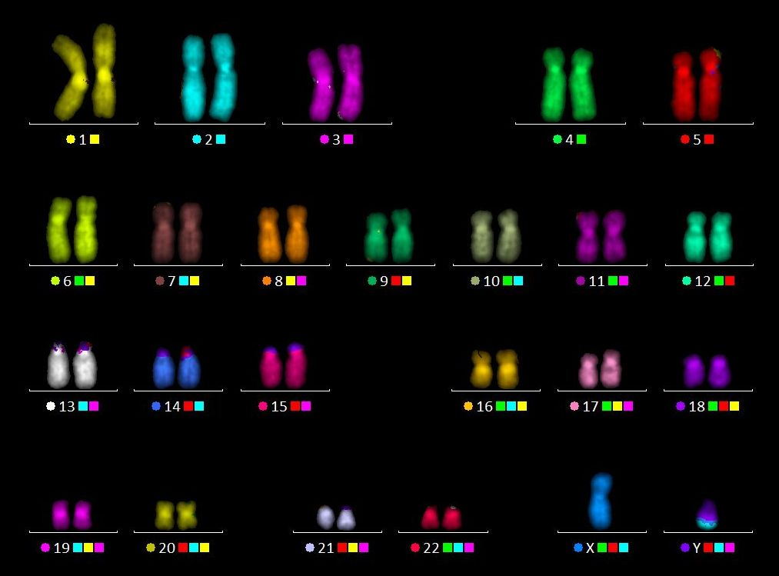
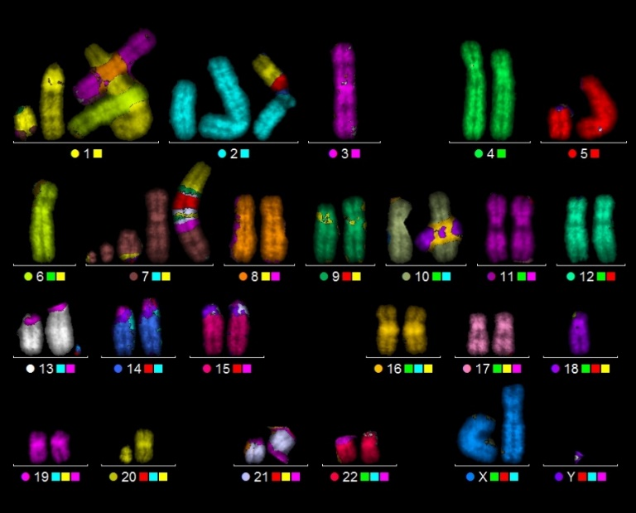
Clustered DNA damage and complex chromosome aberrations
Chromosome aberrations (CA) is a manifestation of structural alterations to the genetic machinery
CA emerge from radiation induced DNA lesions in the process of their repair
Advanced CA detection technique (mFISH) allows investigation of complex CA that involve interaction of two and more chromosomes containing three or more DNA breaks (DSB cluster)
Classic CA assay Multicolour mFISH assay – allows to identify each chromosome
Normal human karyogram Complex CA following high LET irradiation
Image source: LRB

Slide 23
Baldin ISHEPP XXV September 18 - 23, 2023
Thank you for your attention!

