Slide 1


New drift chambers for ALPOM-2 experiment.
The XXVth International Baldin Seminar on High Energy Physics Problems "Relativistic Nuclear Physics and Quantum Chromodynamics, September 18 - 23, 2023, Dubna
Anton Druzhinin, Roman Shindin, Nikolay Piskunov, Yuri Kiryushin,
Dmirty Kirillov, Natalia Kostiaeva, Evgeny Makoveev, Alexey Baskakov

Slide 2
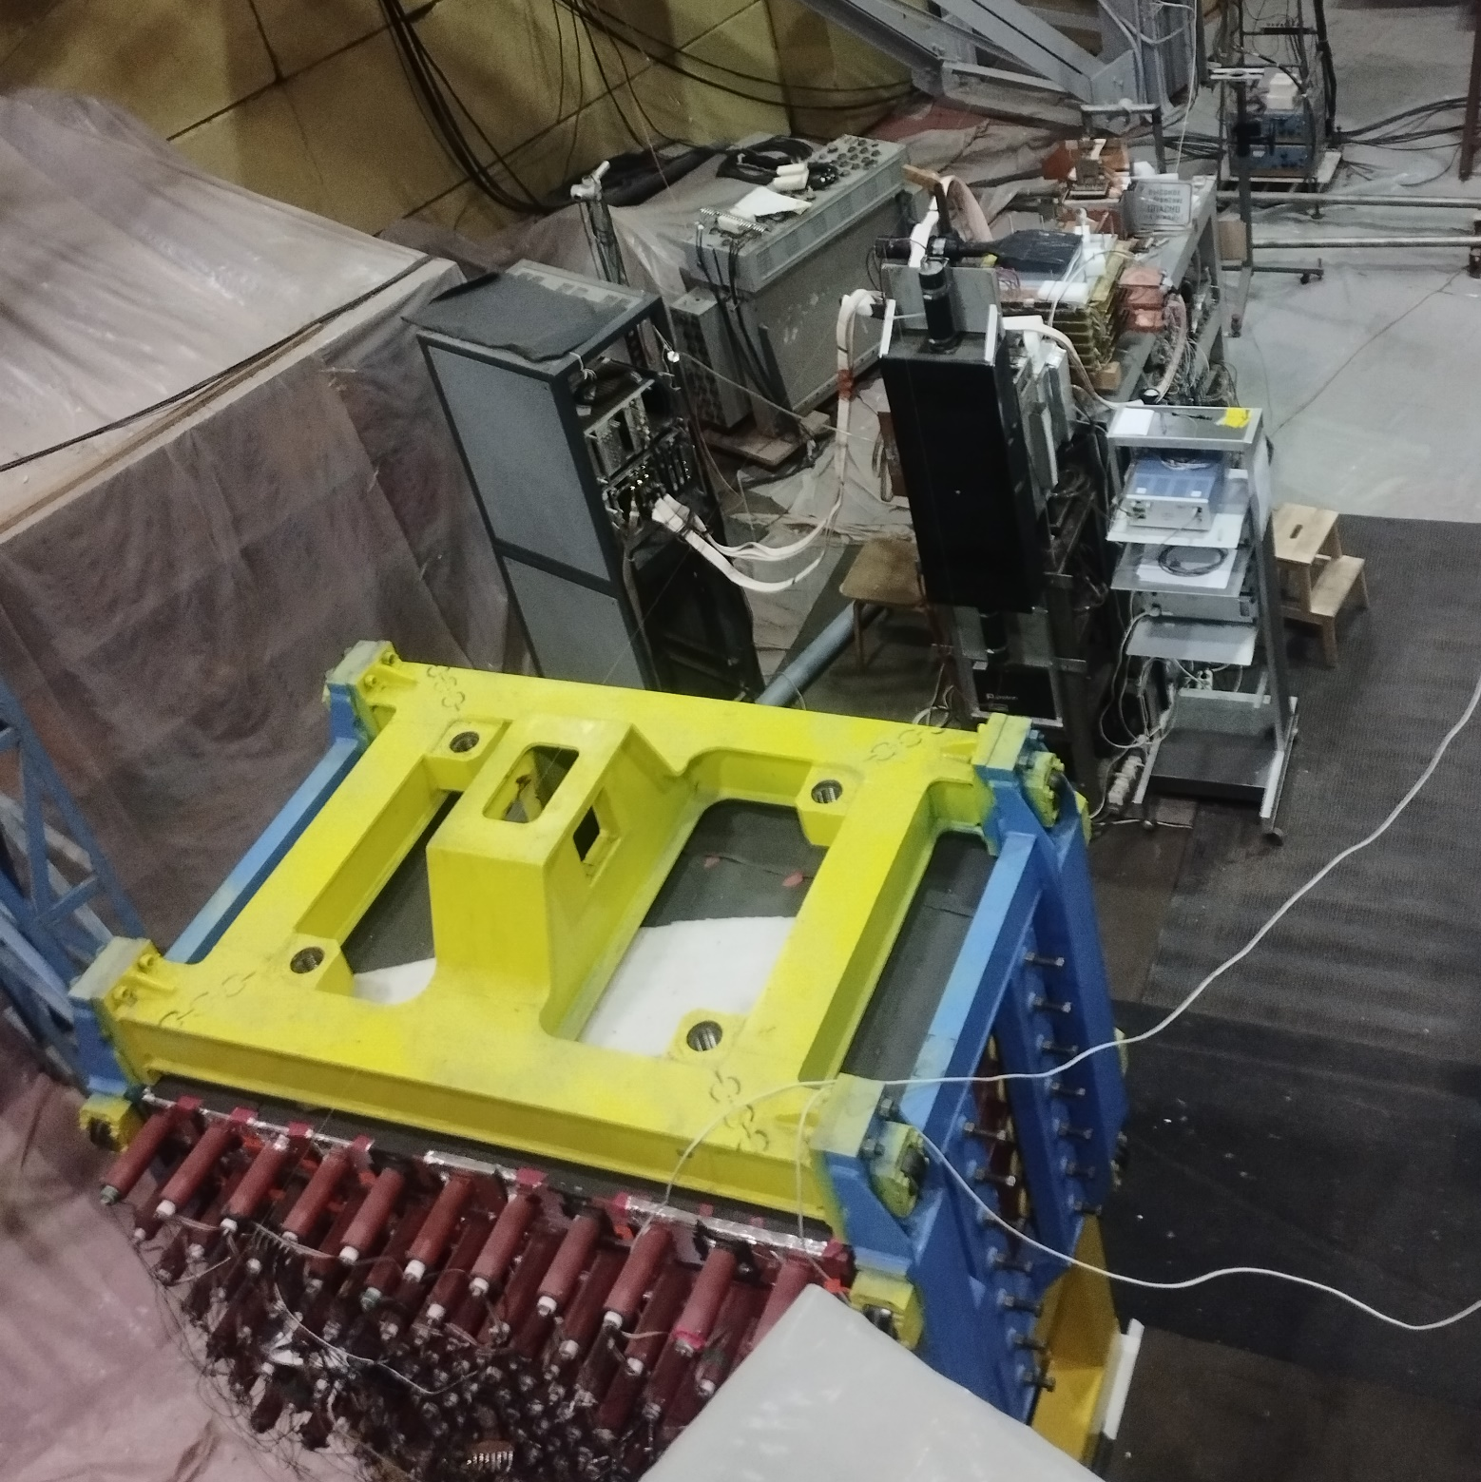
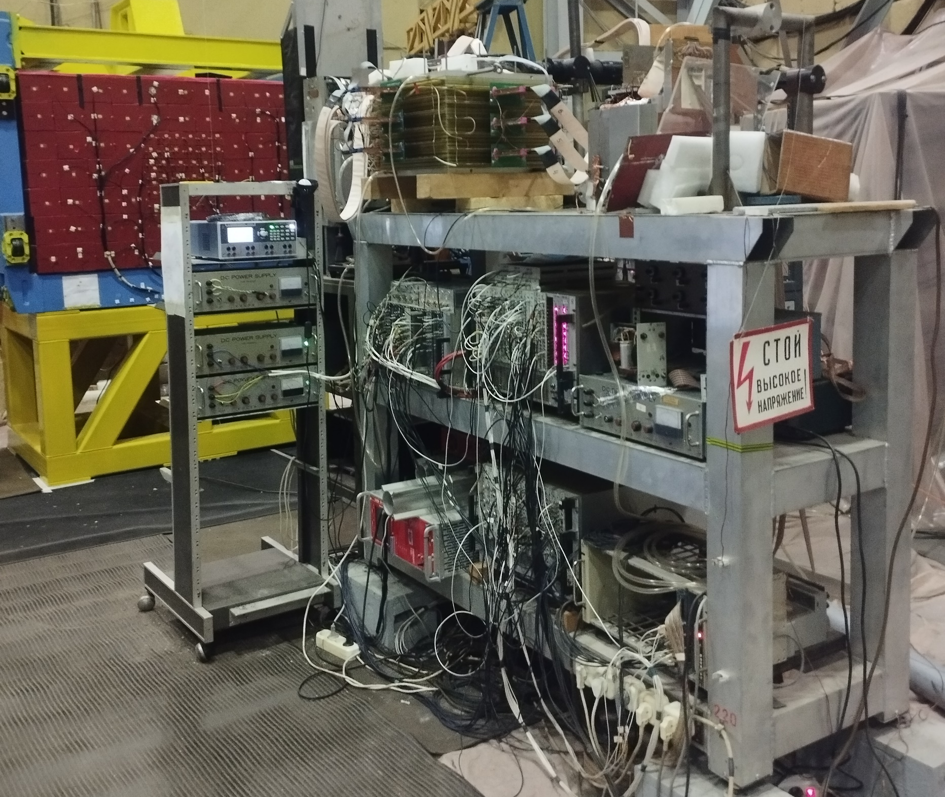
Alpom-2

Slide 3
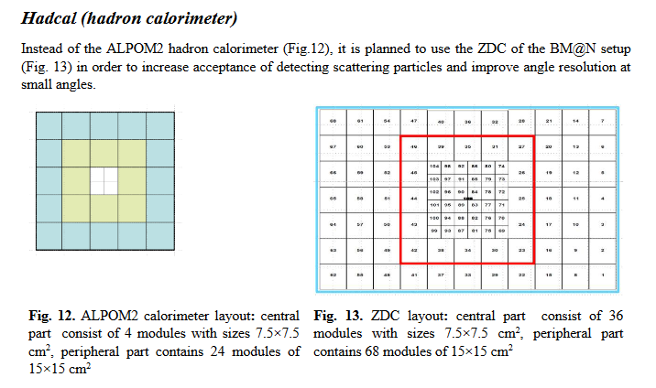
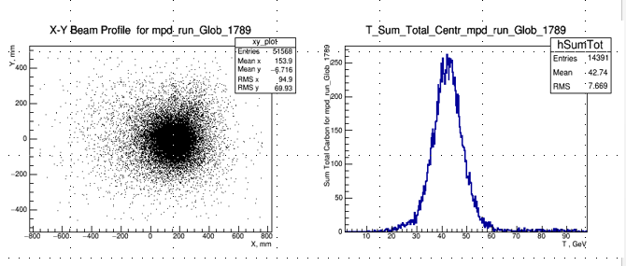
Upgrading the ALPOM2 setup
Drift chambers (plane configuration)
Now 8 planes (4X+4Y) Future 12 planes (6X+6Y)

Slide 4

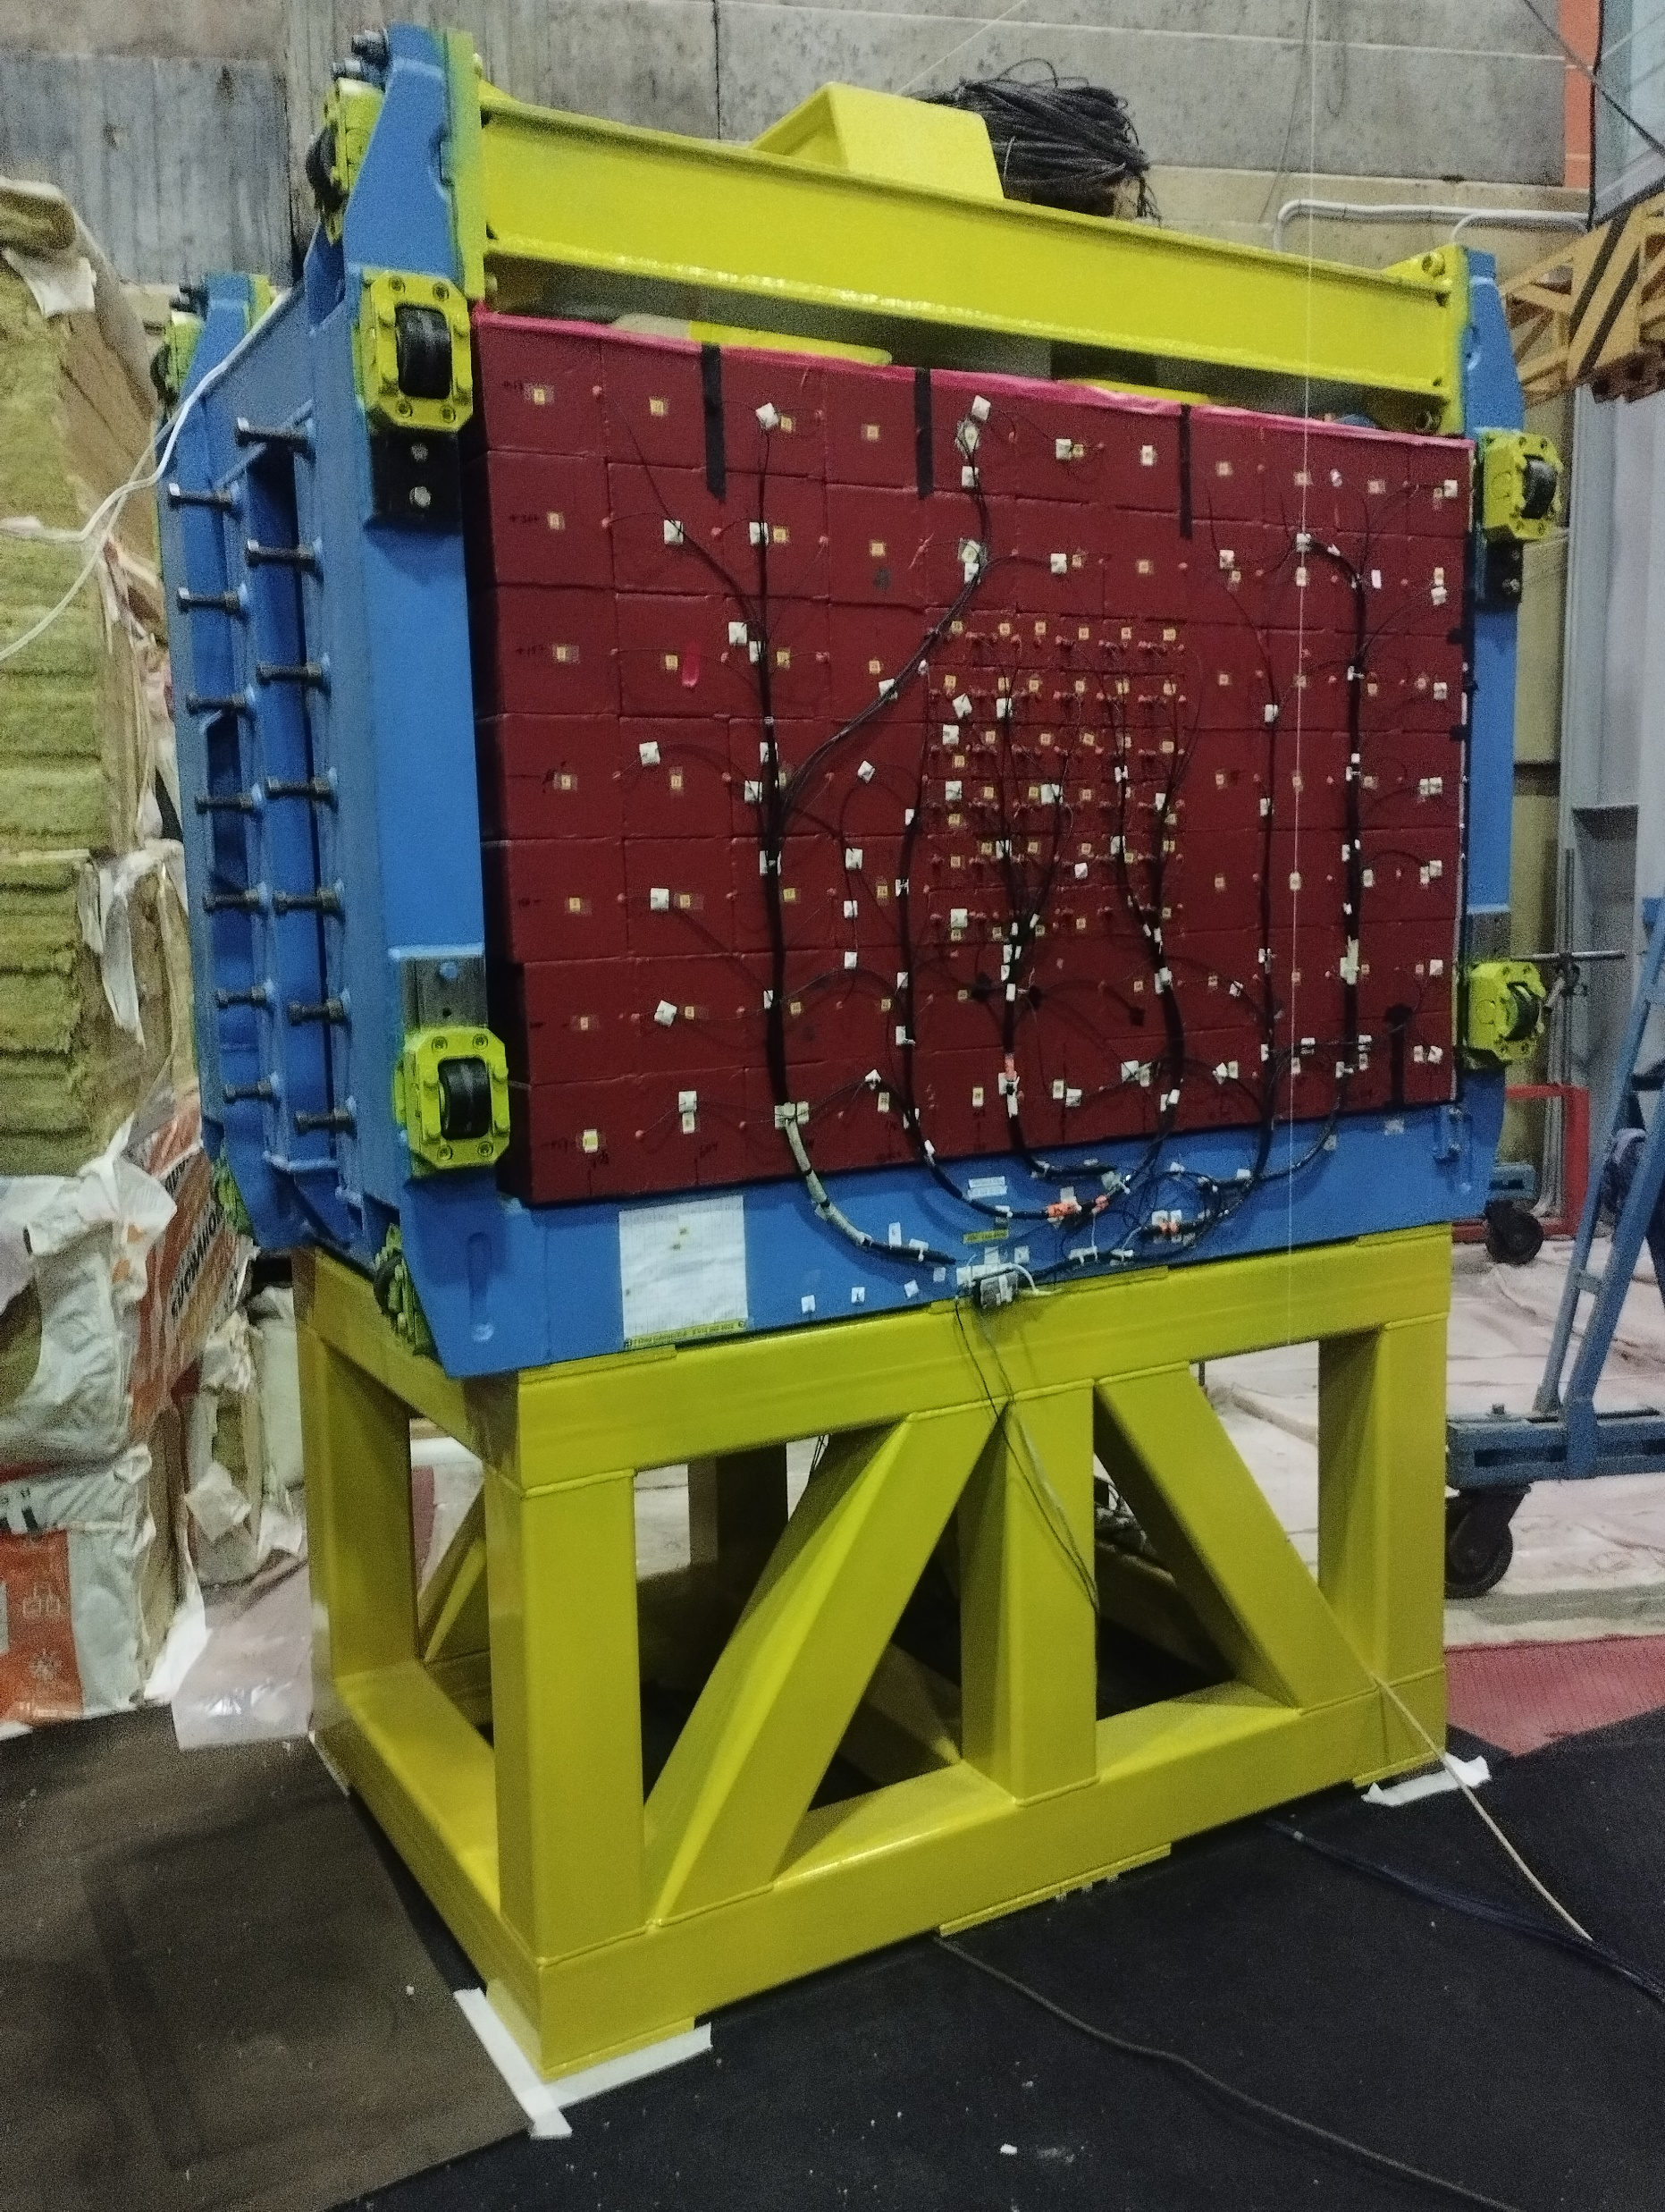
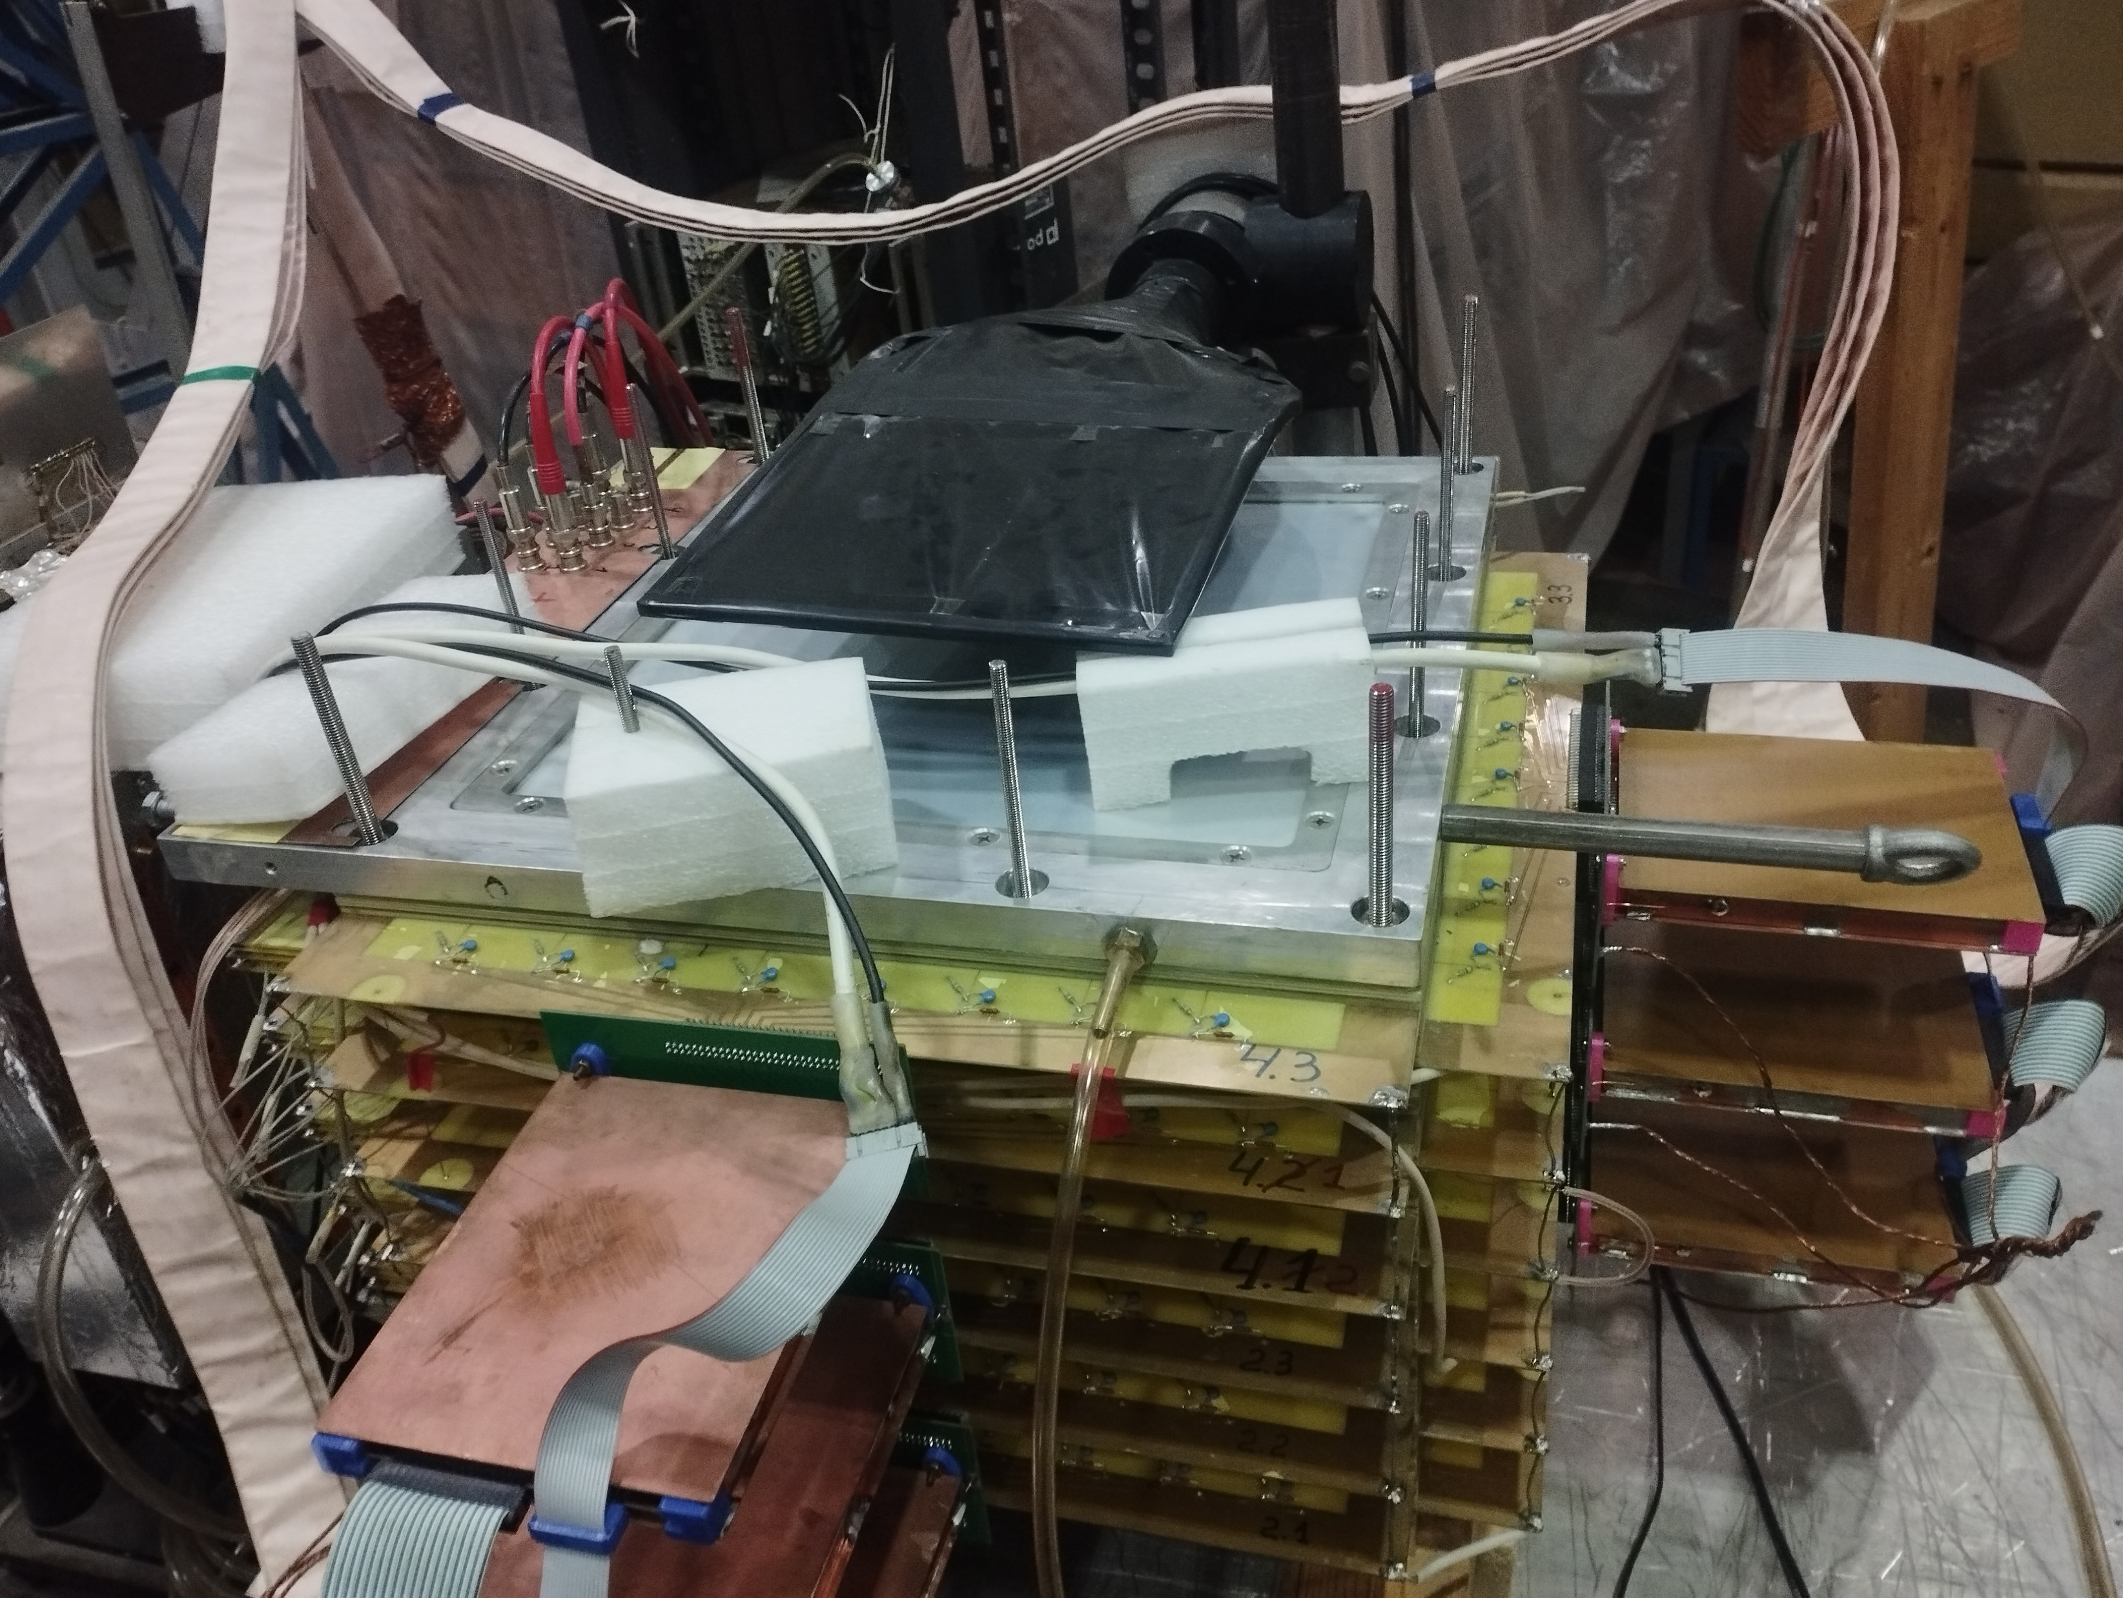
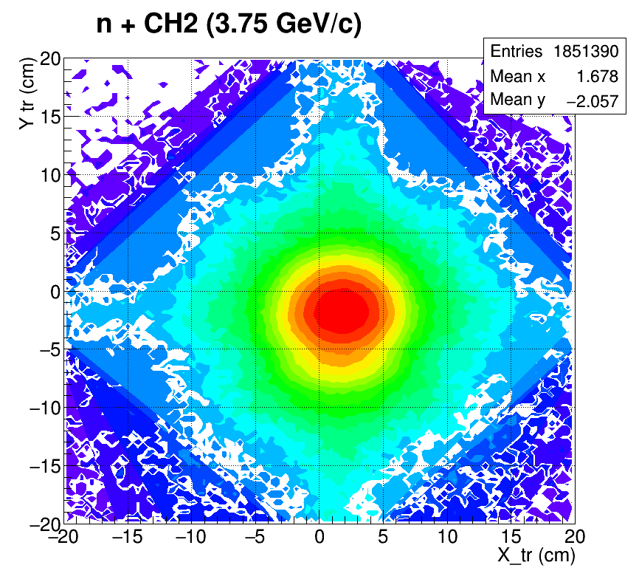
p(pol)+CH2 up to 7.5 GeV/c and n(pol)+A up to 6.0 GeV/c at the Nuclotron
Calorimeter
Drift chambers
Neutron or
proton beam
Hadron calorimeter
S1
S0
S4,S3
CH2, C, CH, Cu target
New hadron calorimeter
At the CH2 target
New drift chamber

Slide 5
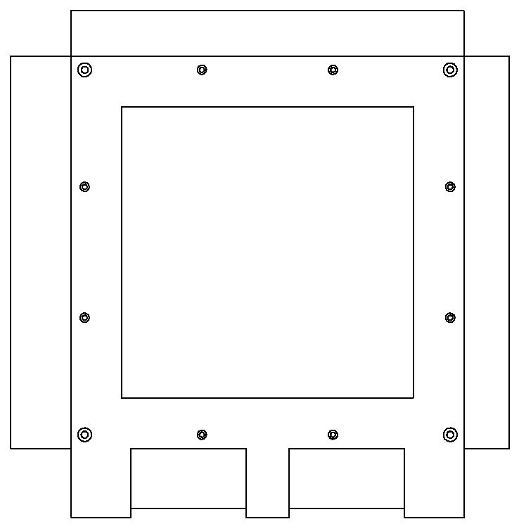
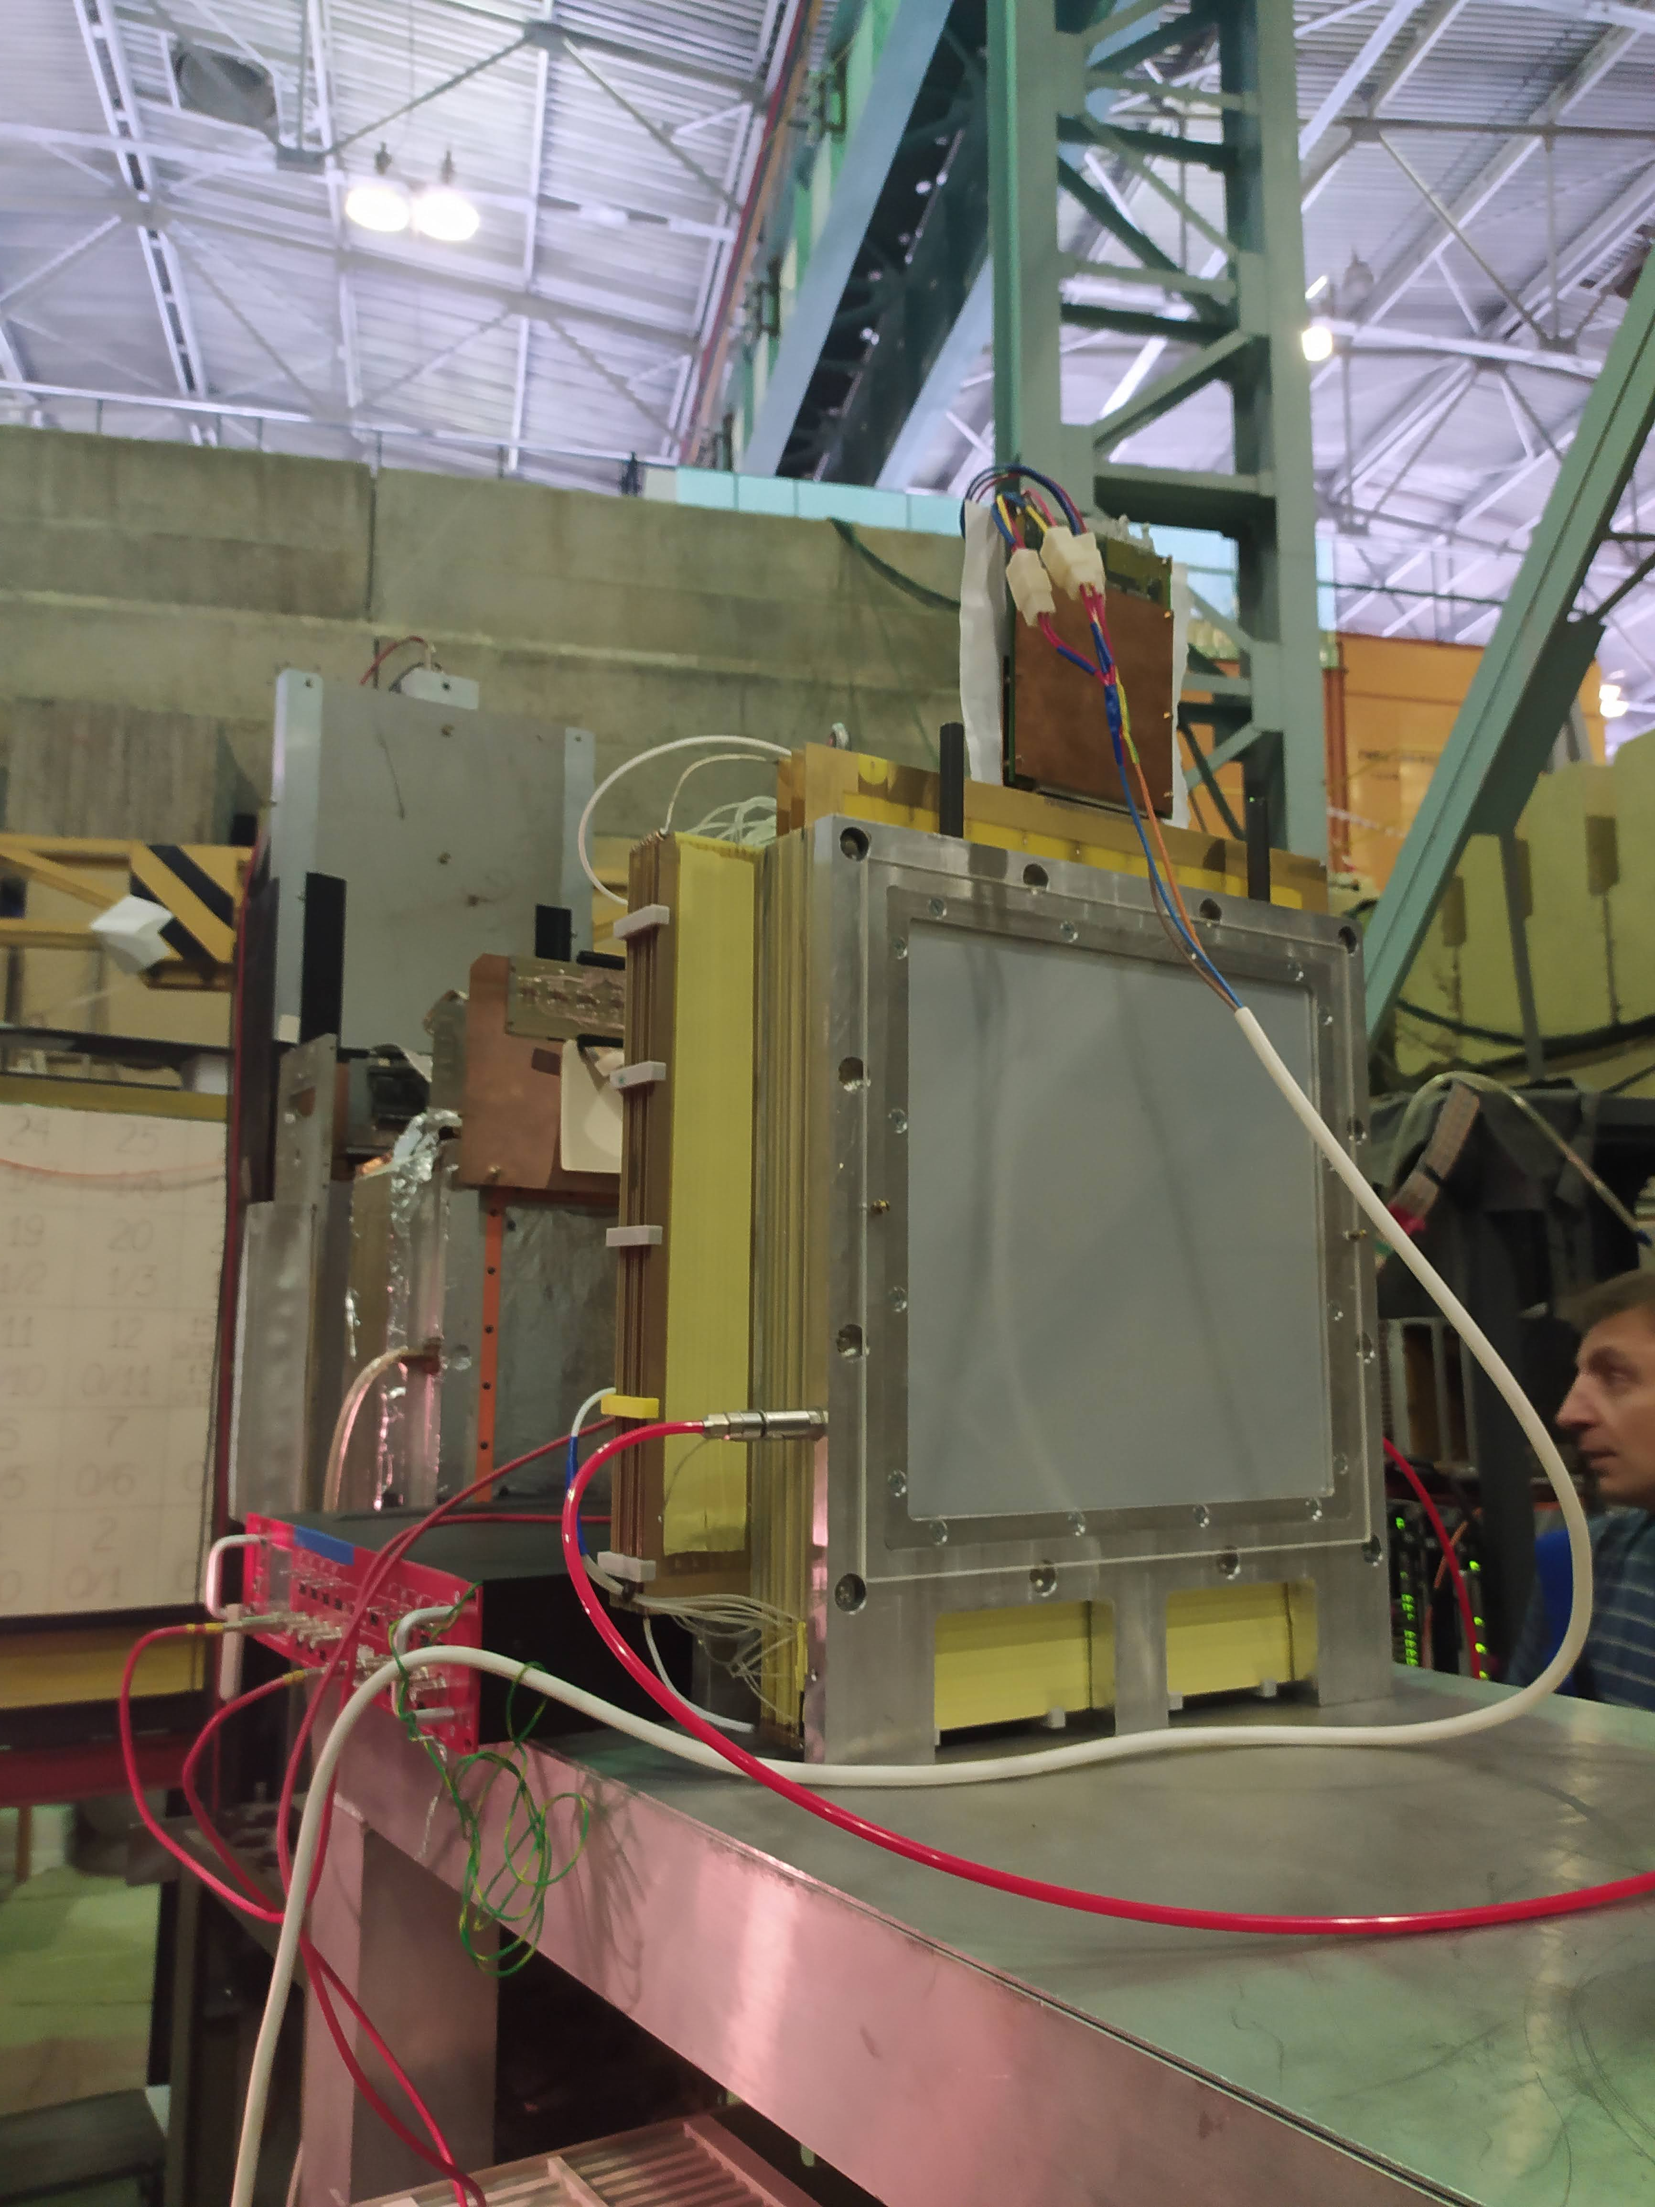
Chamber construction

Slide 6
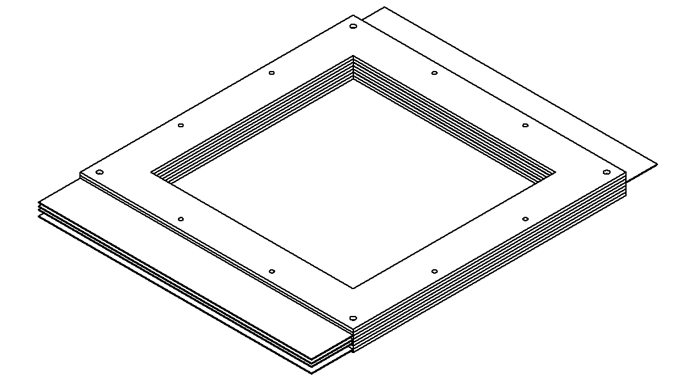

Module construction
Empty
Signal
Cathodes
Screen
Empty

Slide 7
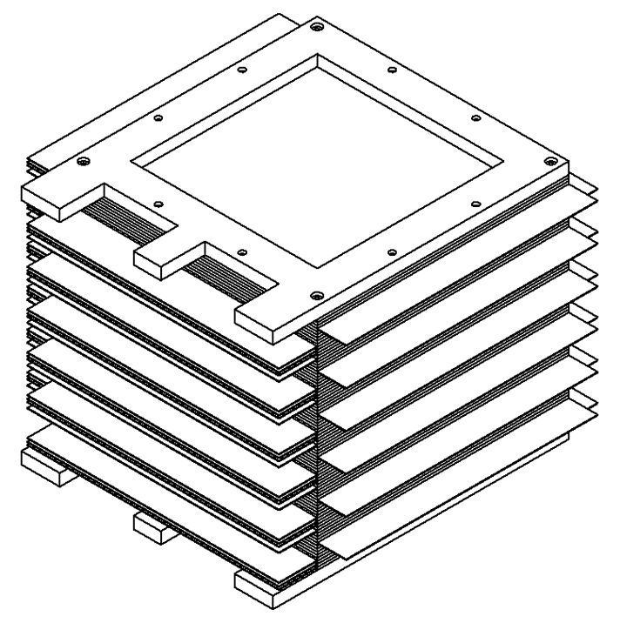
Chamber construction
Mailar window
Duralumin case
Signal planes
Cathode planes

Slide 8
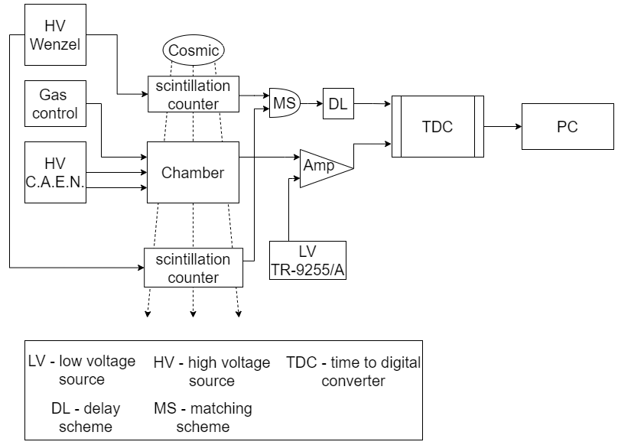
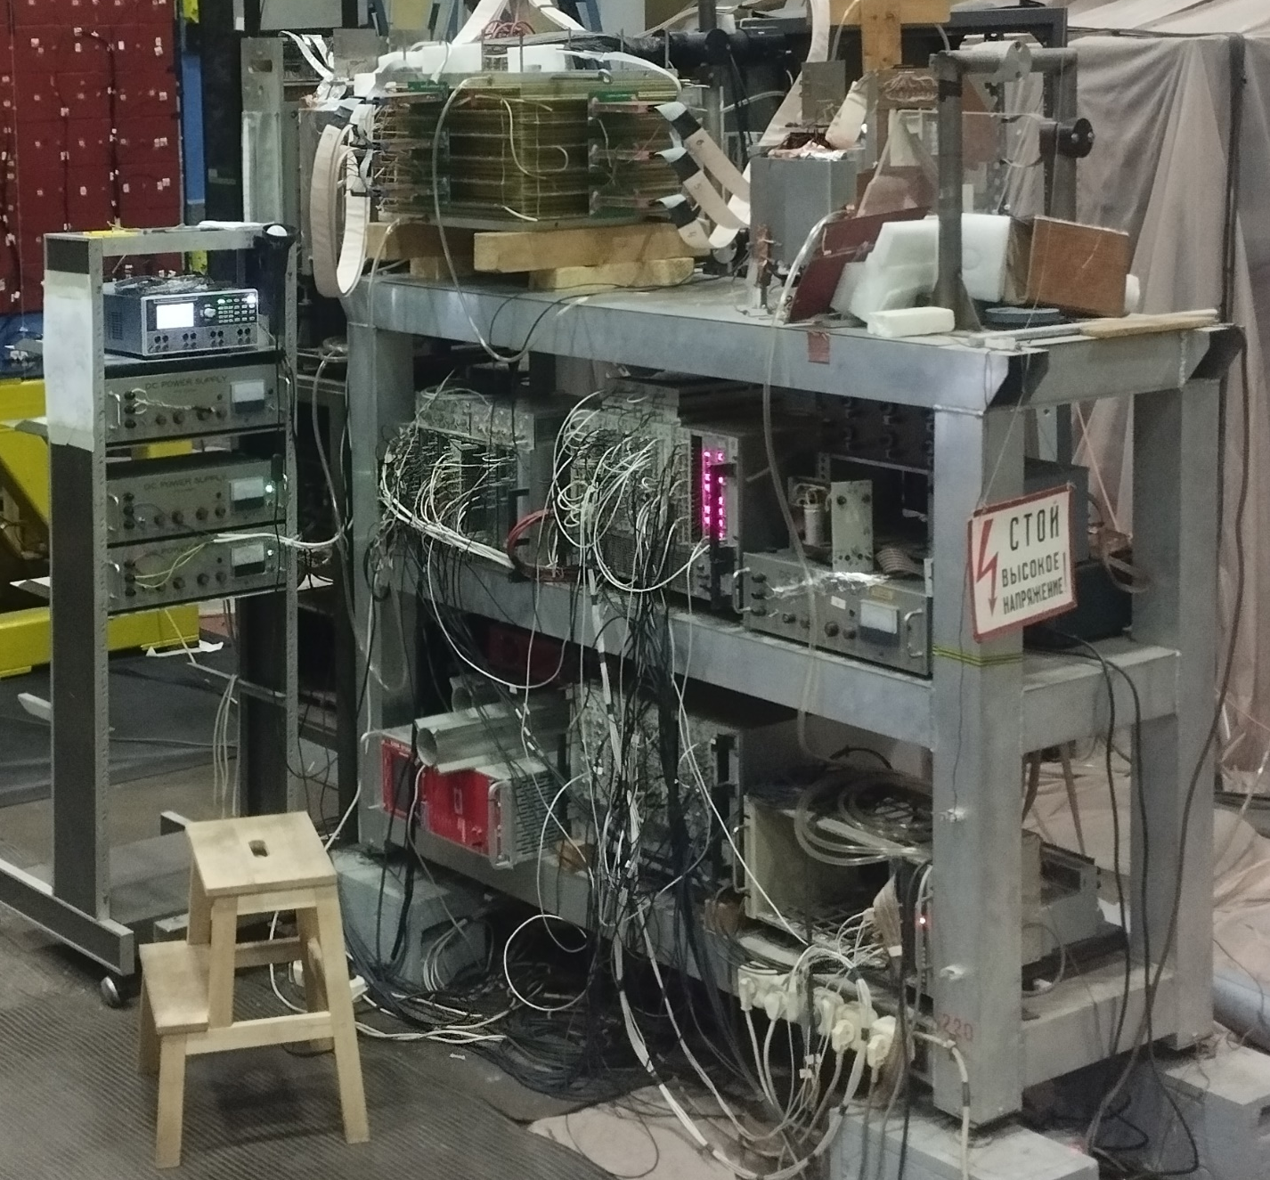
Stand construction

Slide 9
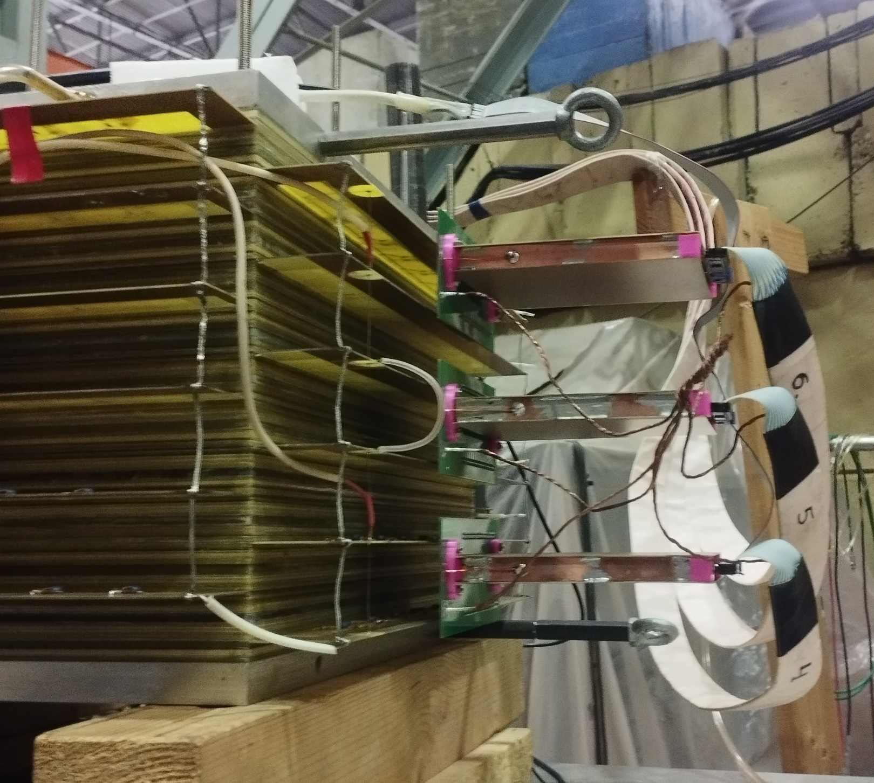
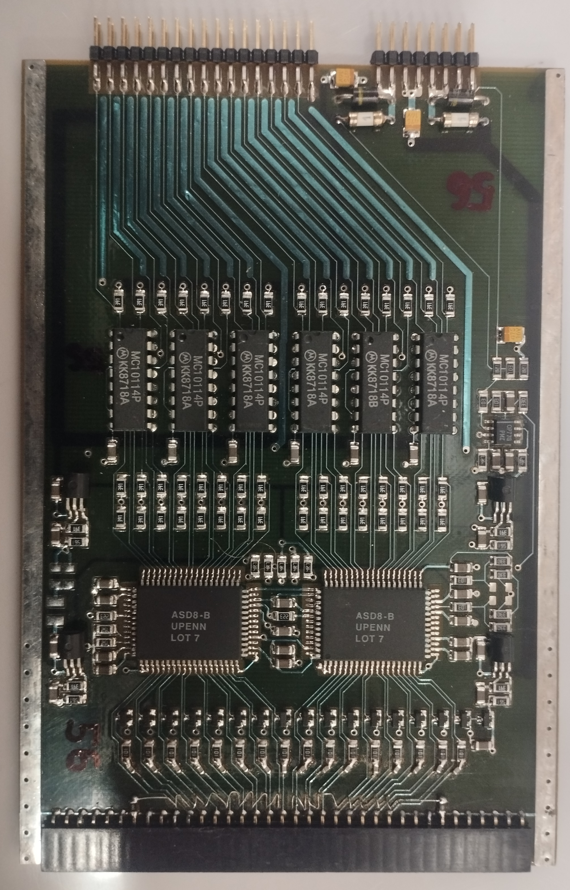
Amplifiers
amplifiers in grounded, protected cases
amplifier to crate cables

Slide 10
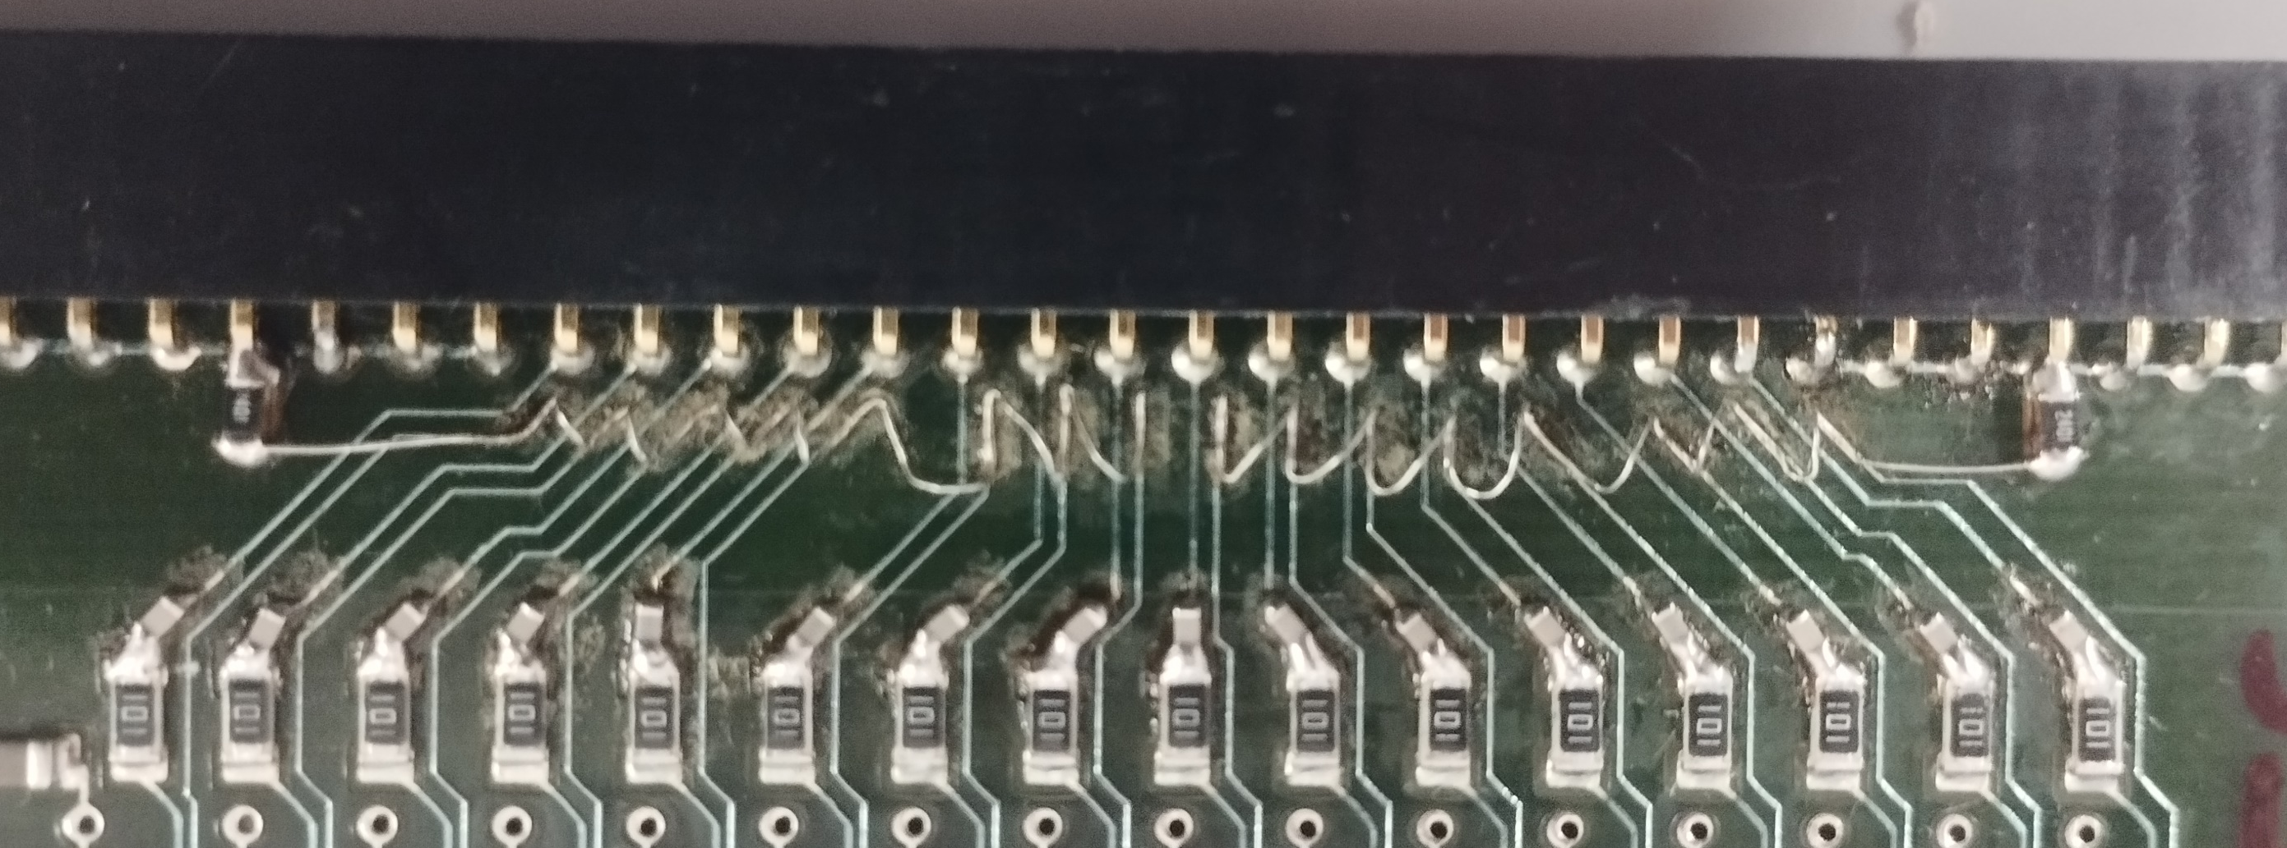
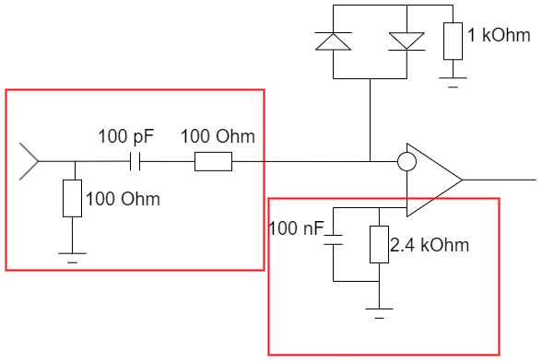
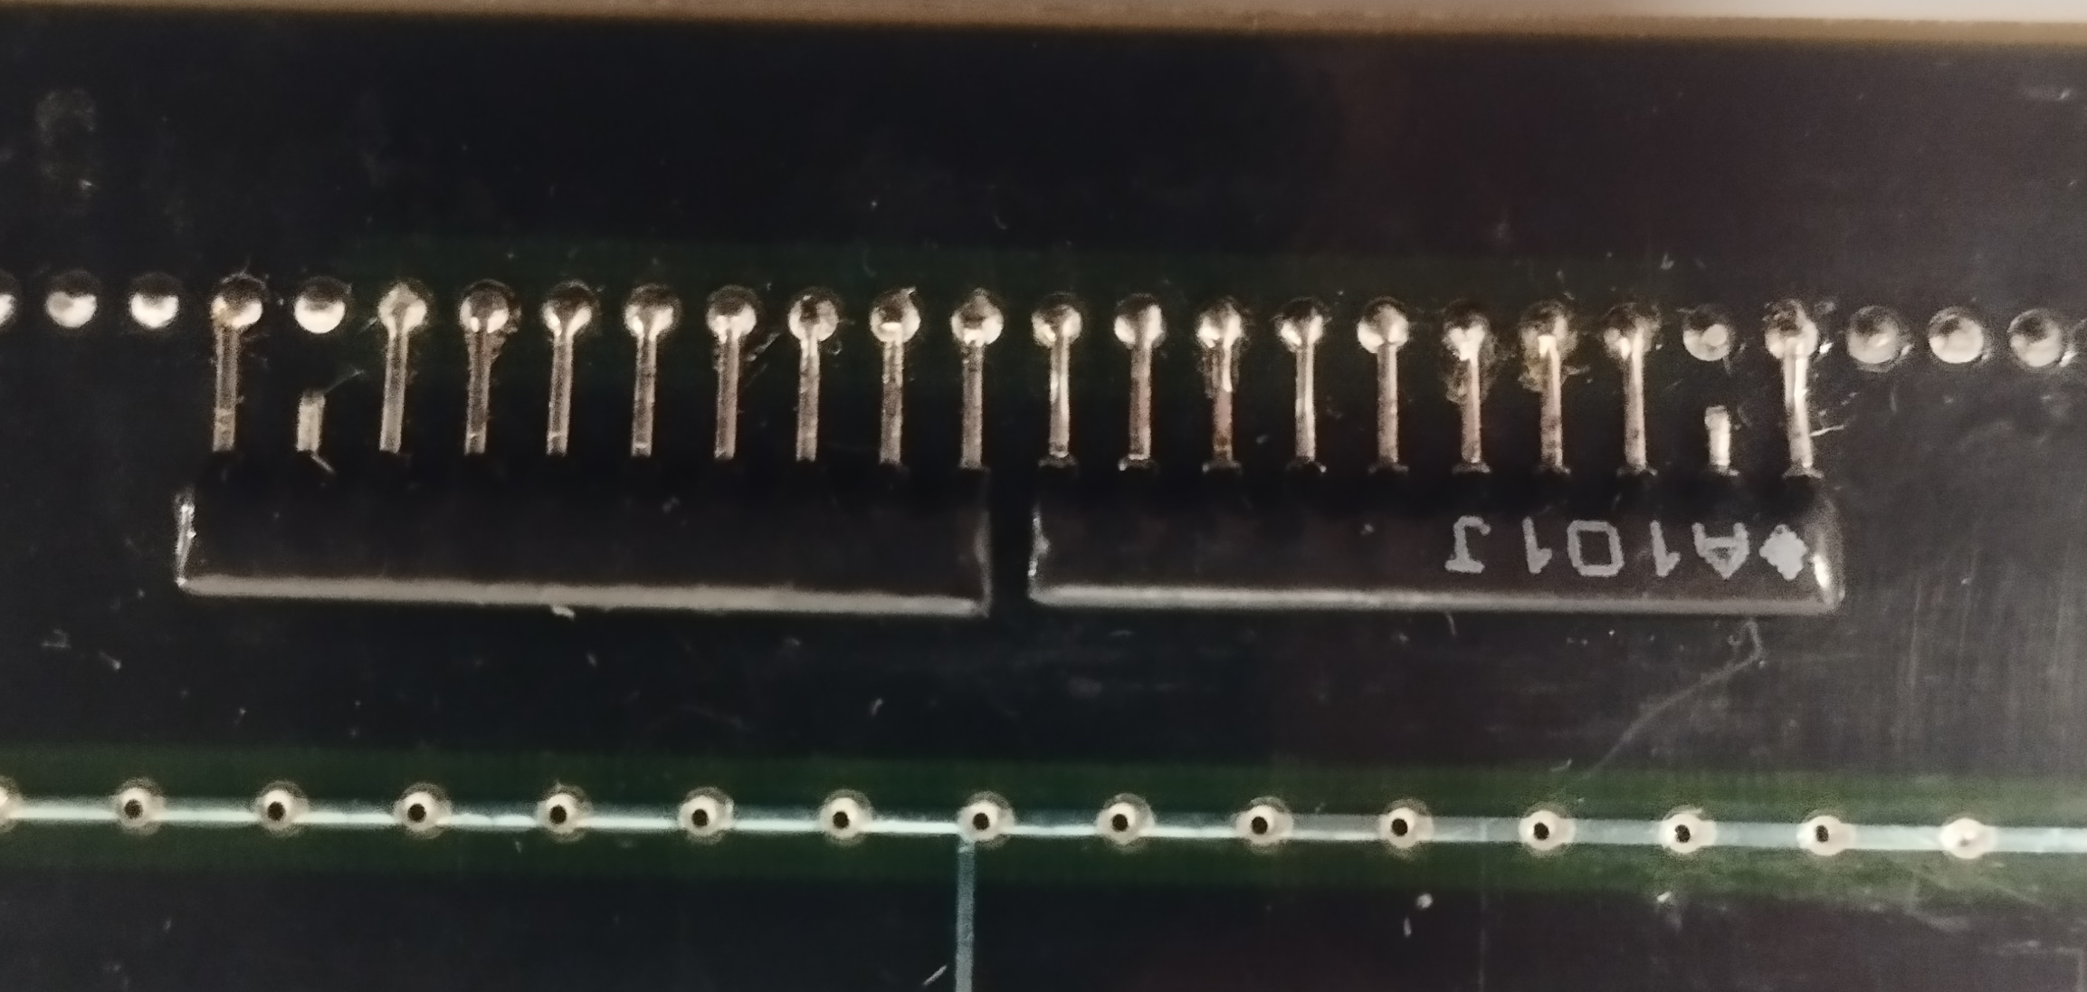
Amplifier upgrade

Slide 11
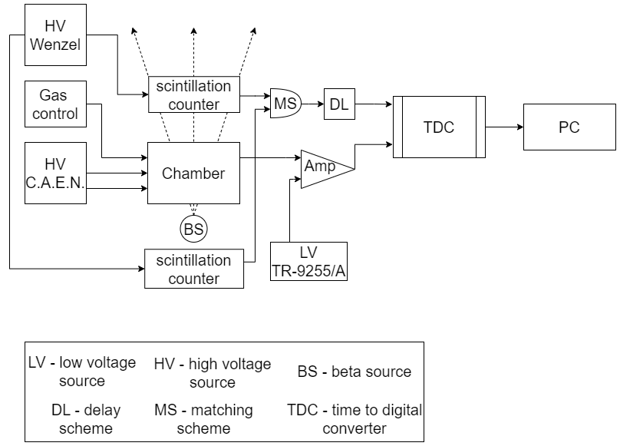
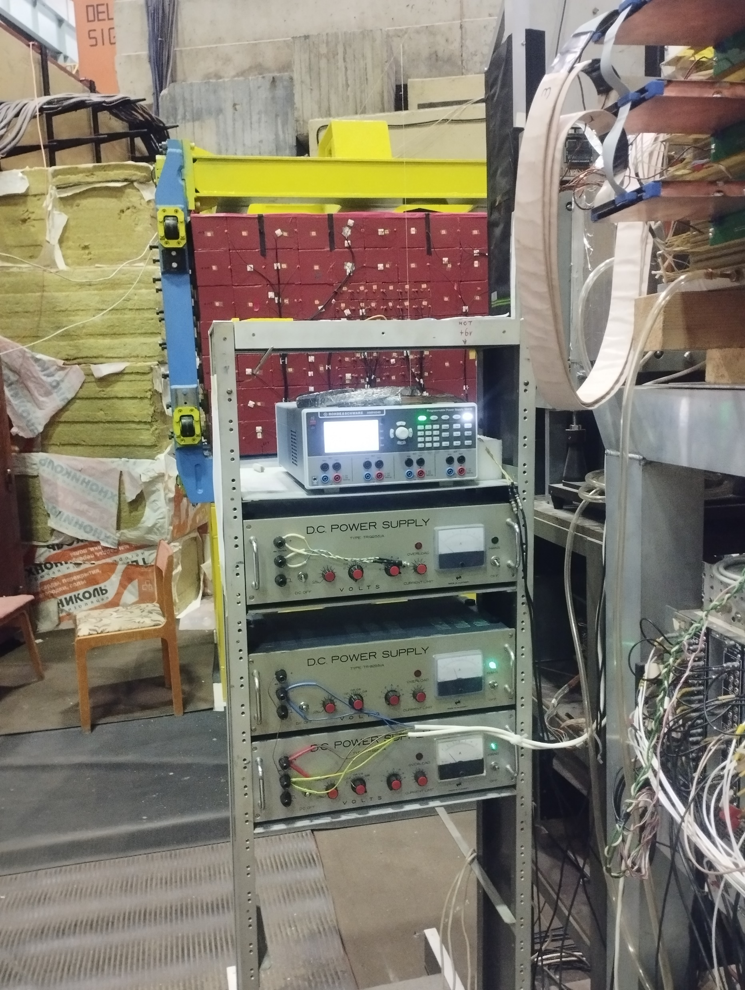
Stand construction

Slide 12
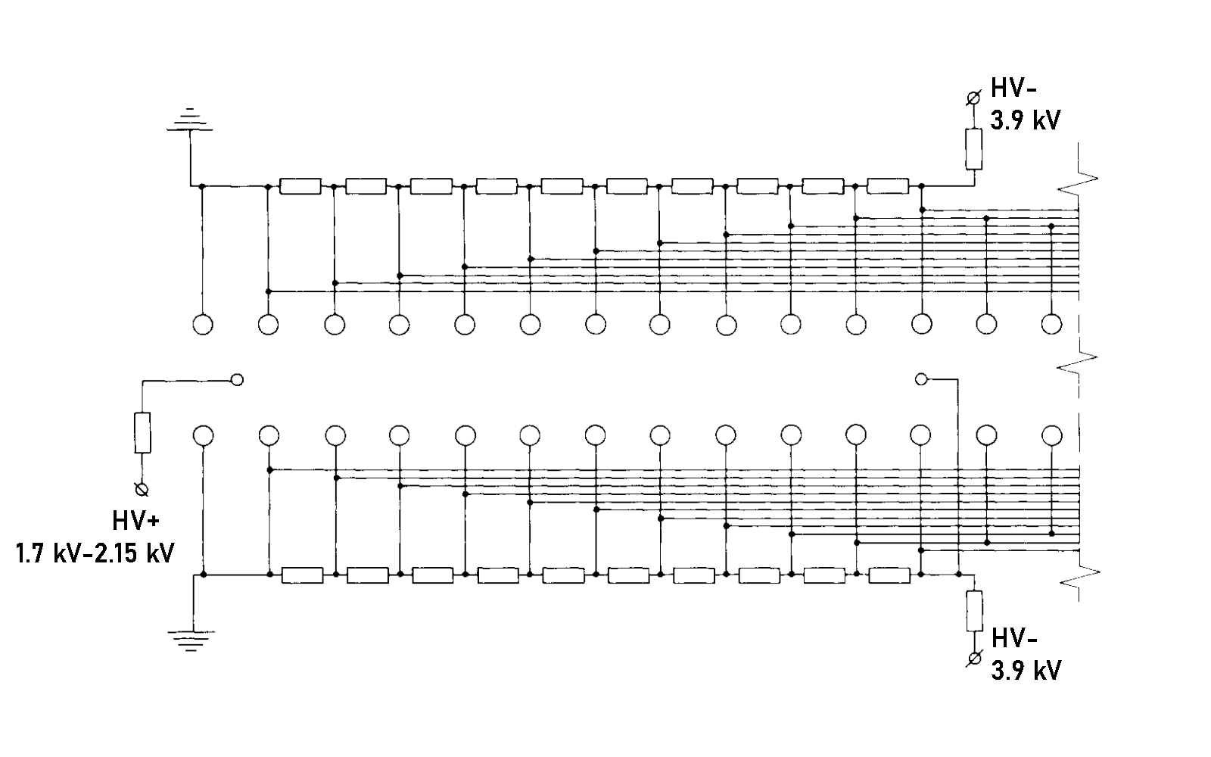
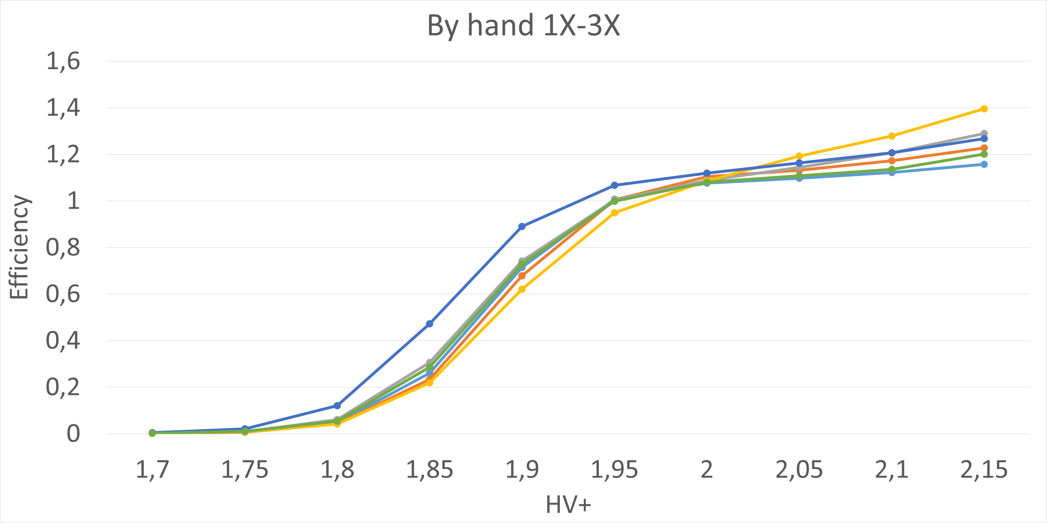
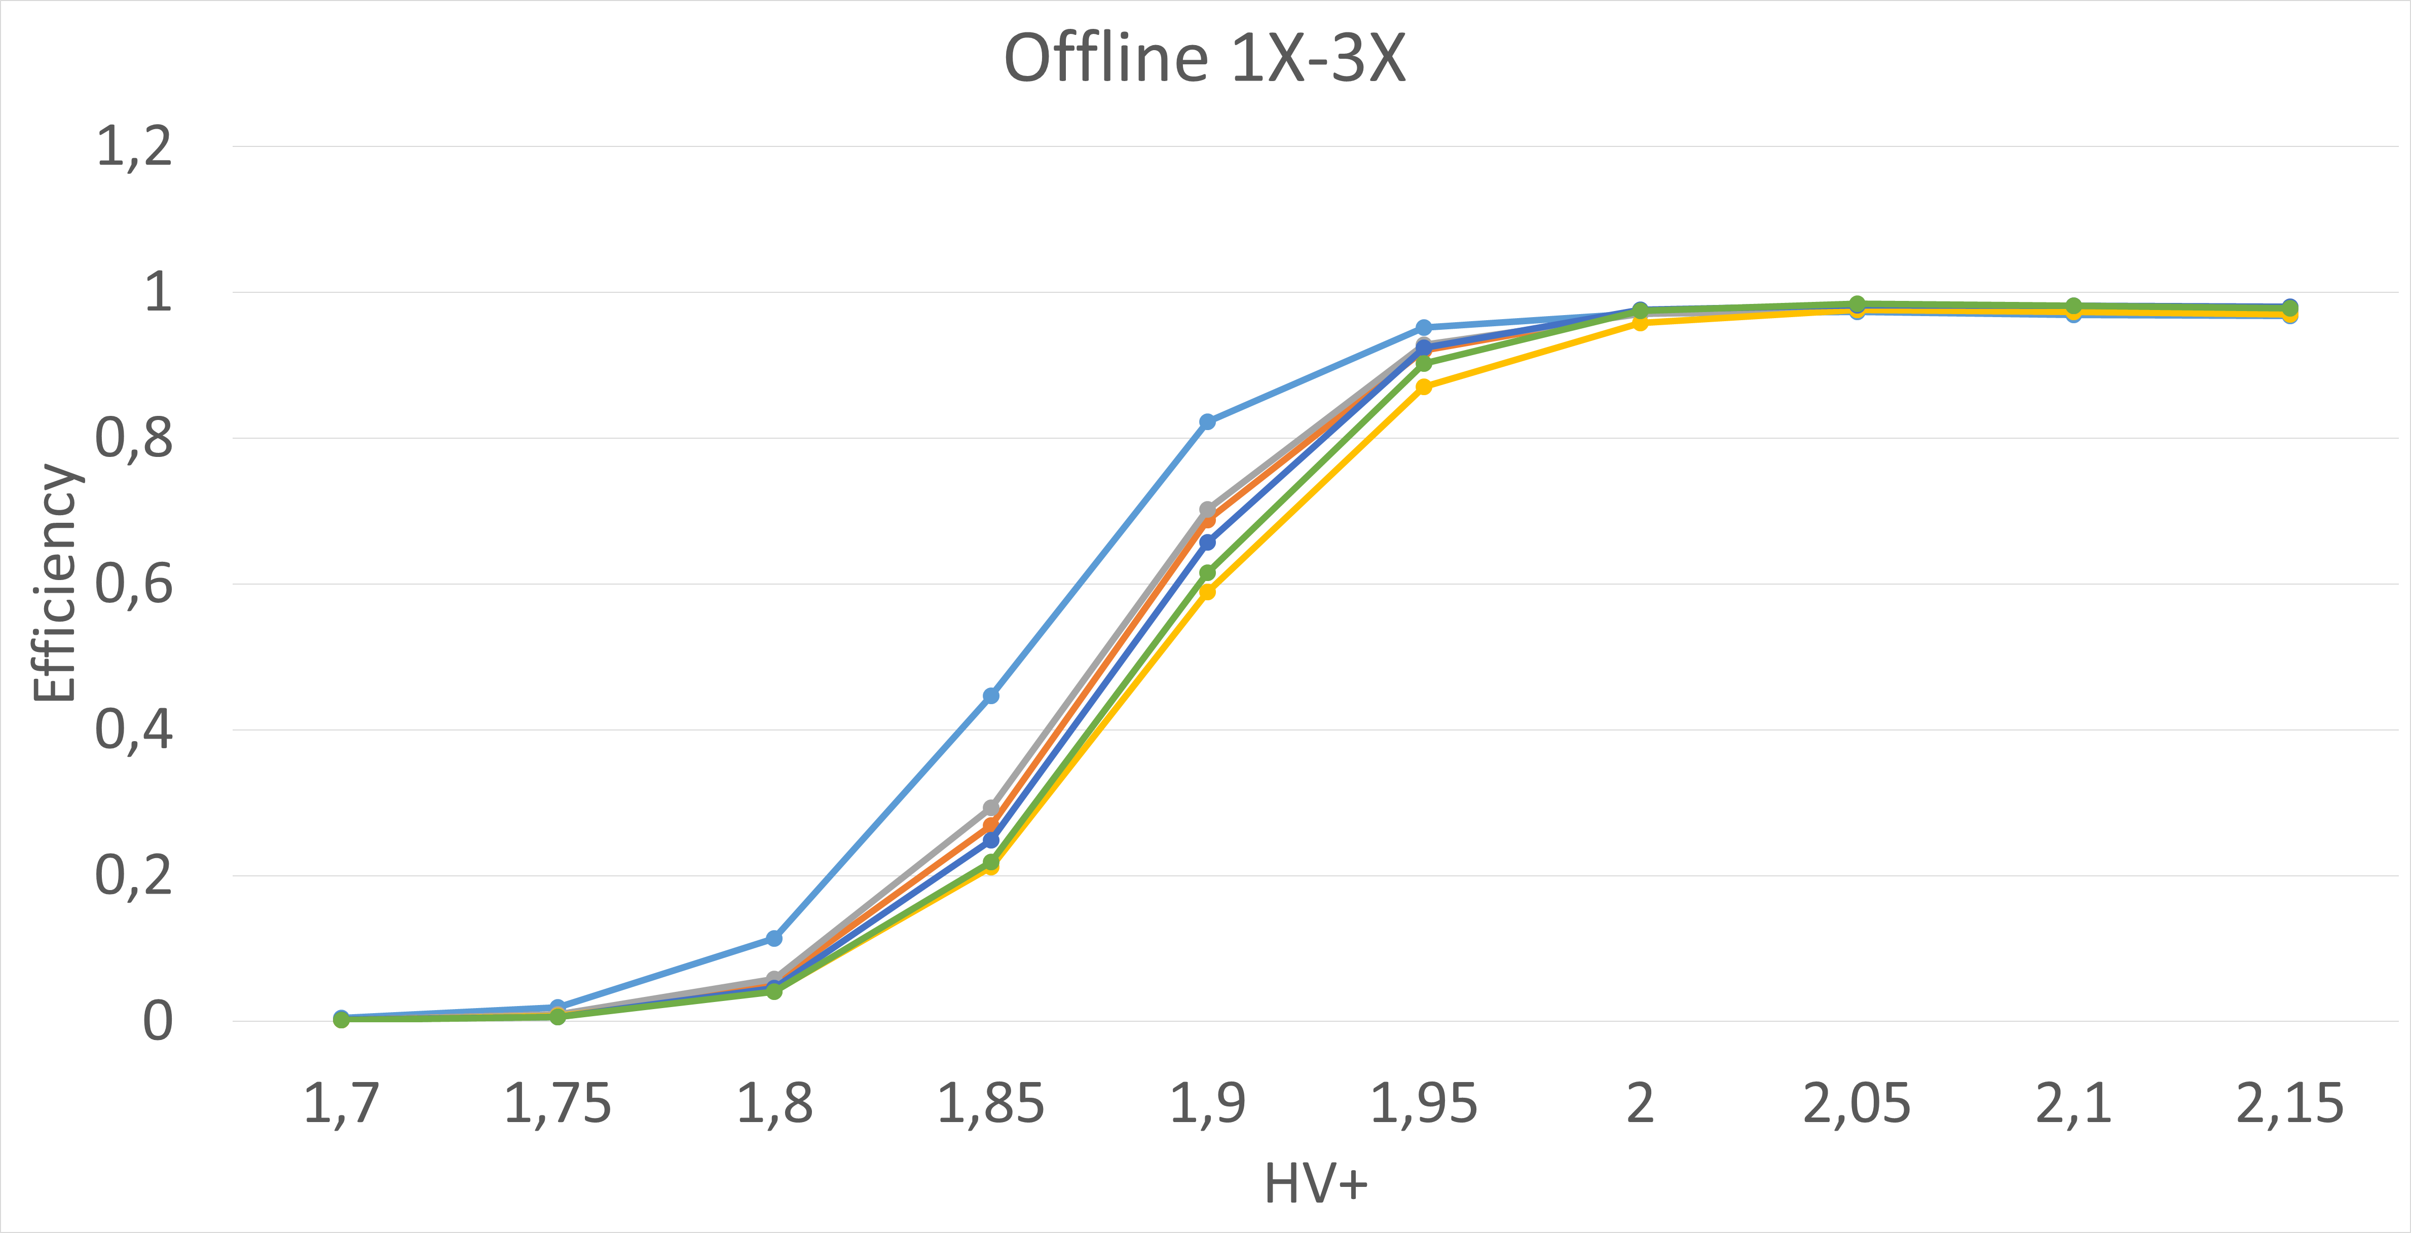
Efficiency HV+
Plato ~200 V

Slide 13
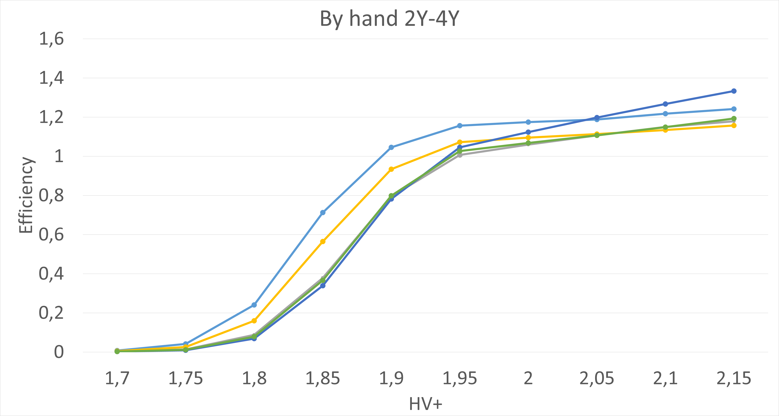
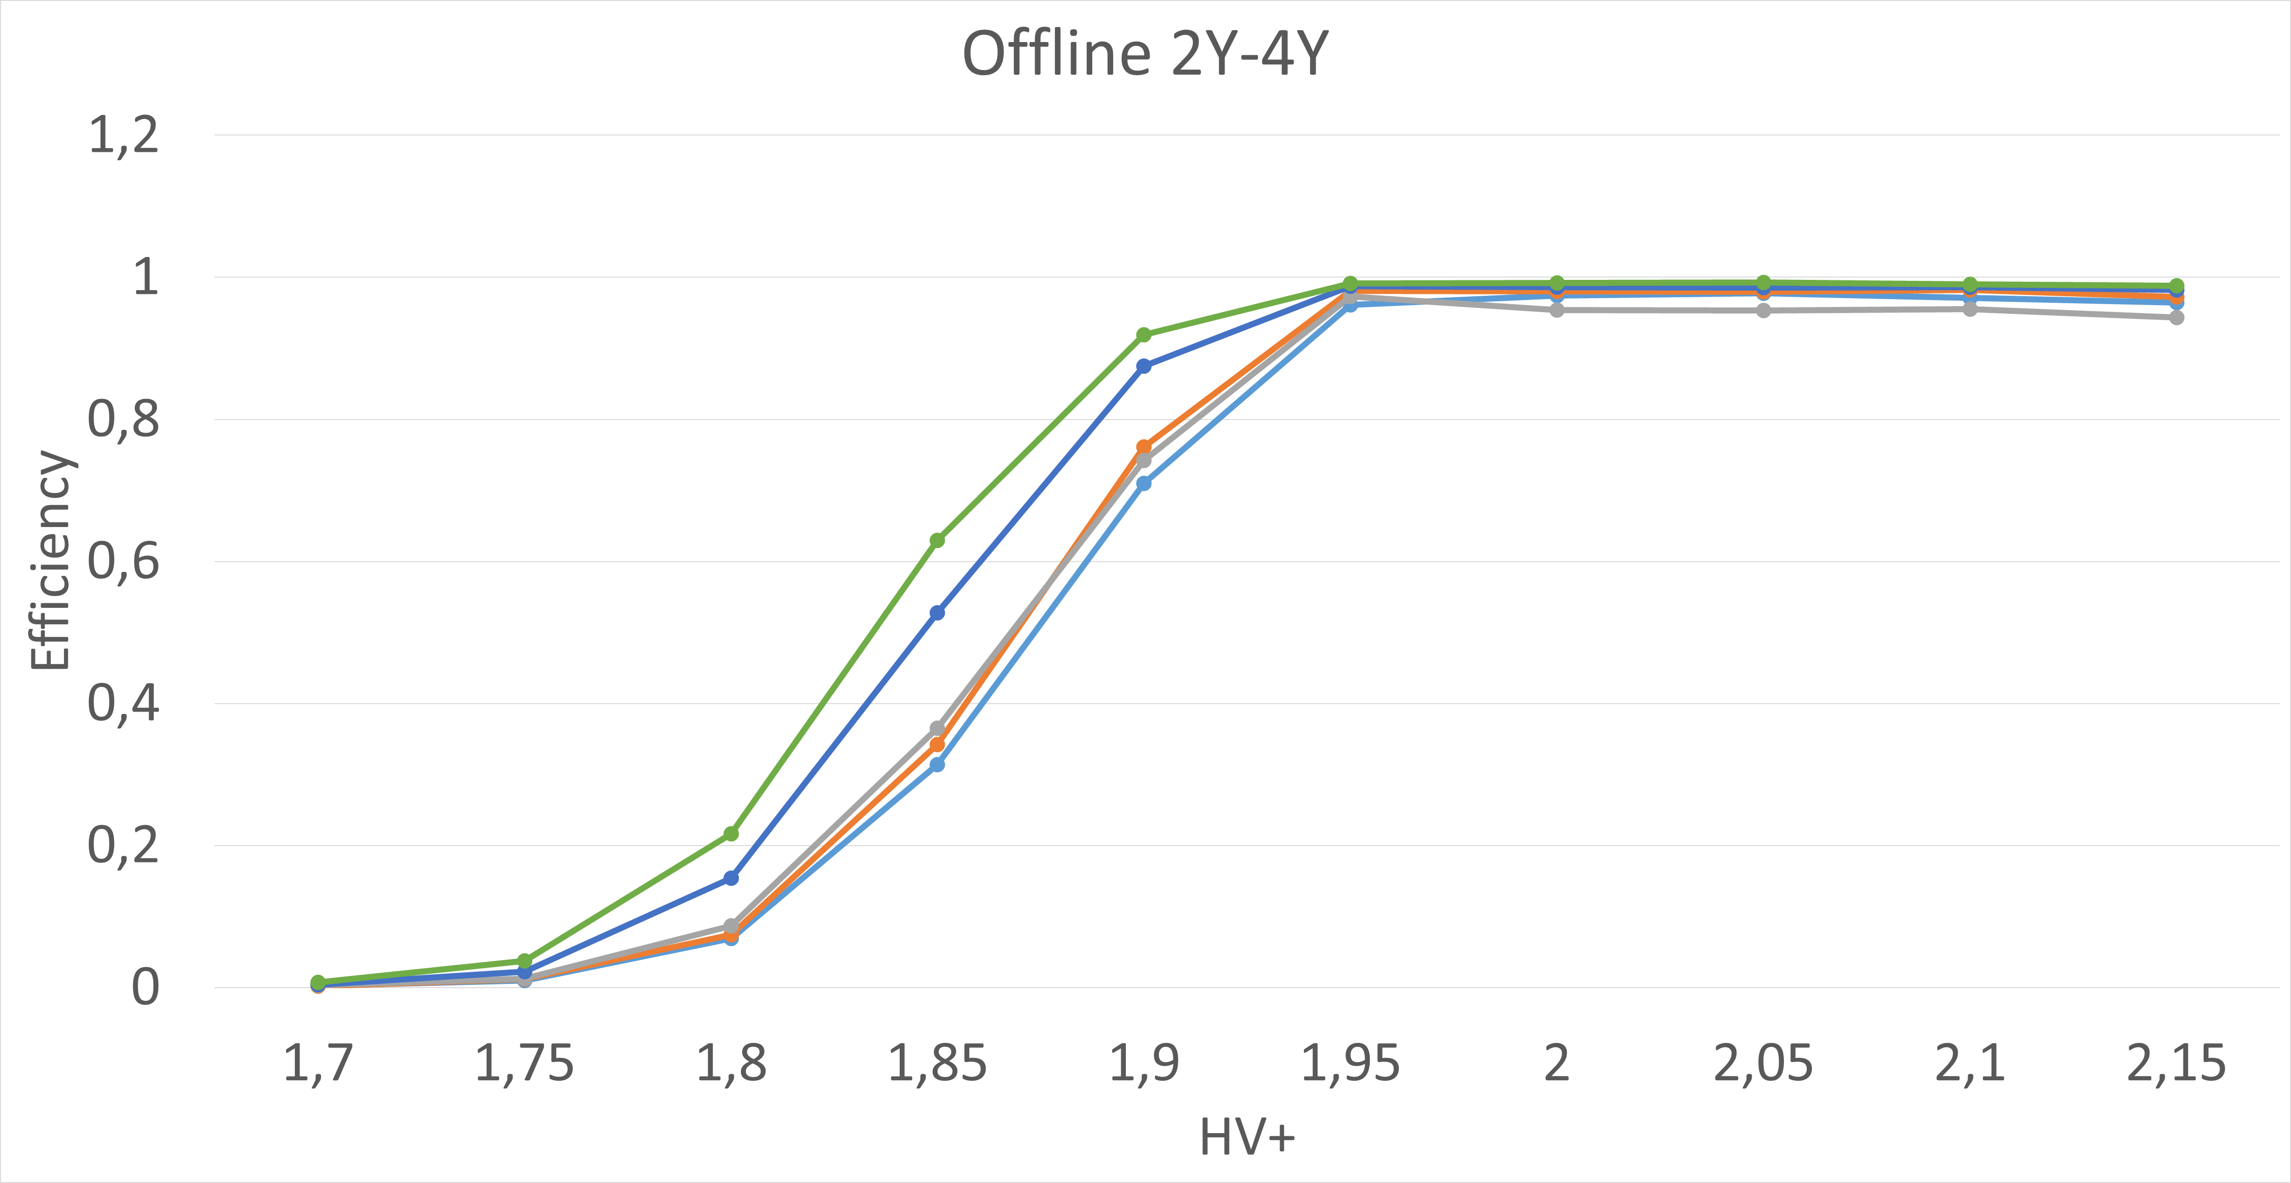
Efficiency HV+
Plato ~200 V

Slide 14
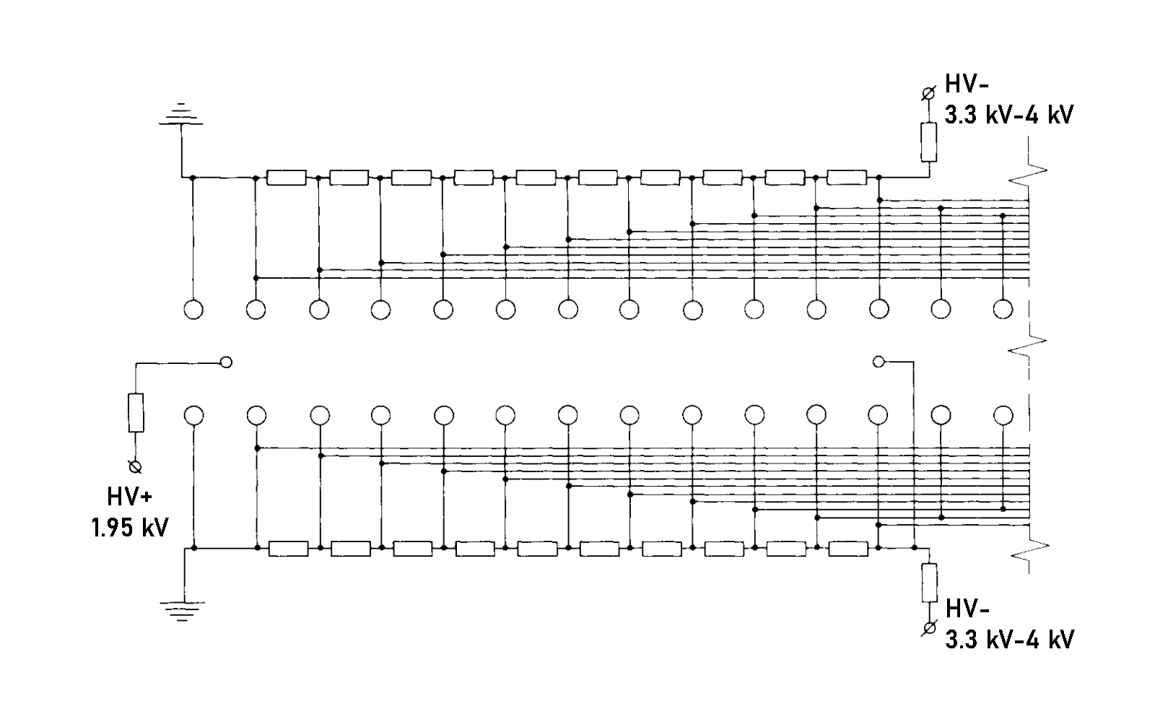
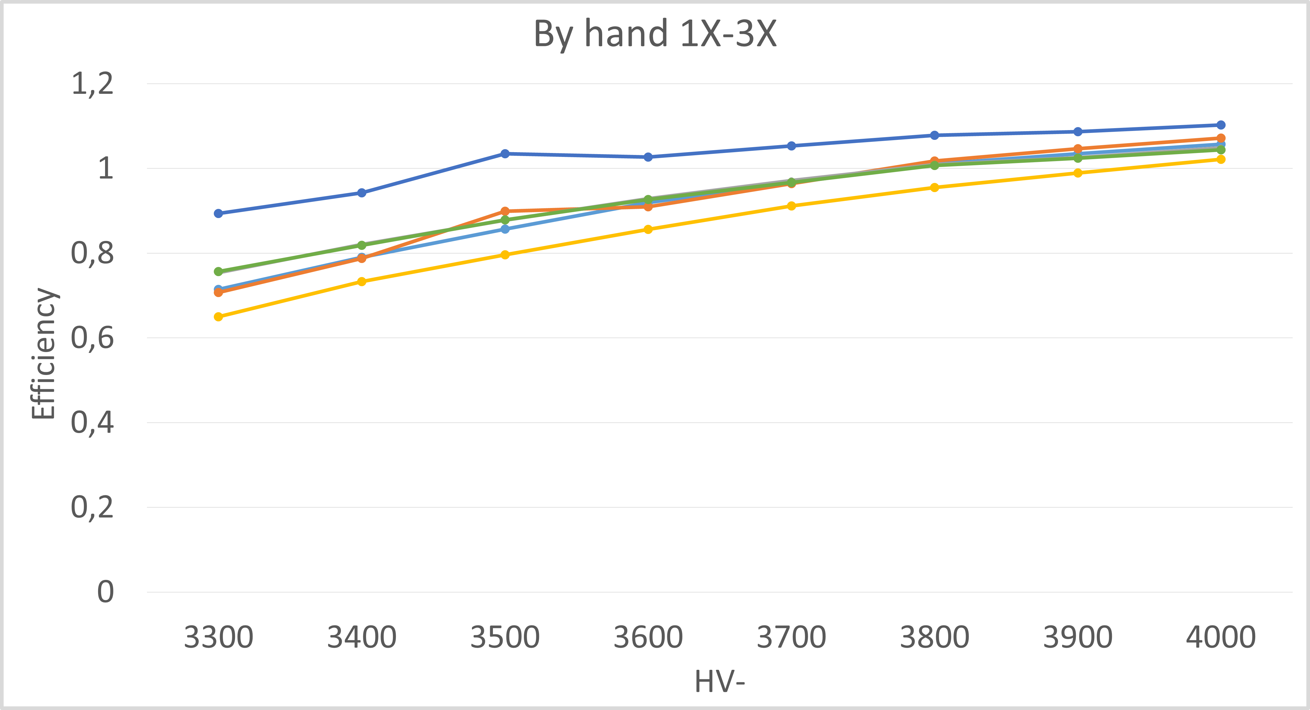
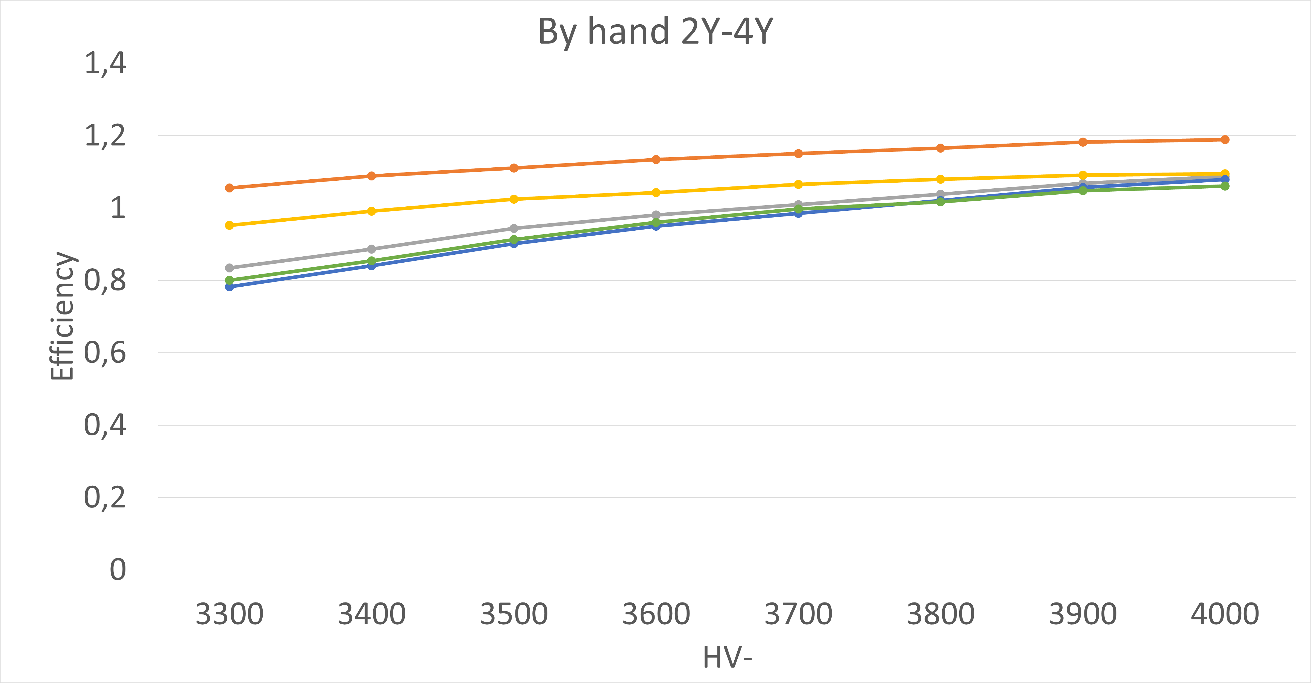
Efficiency HV-

Slide 15
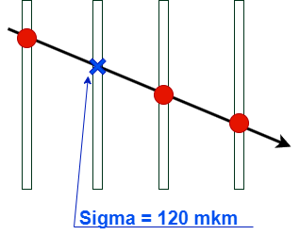
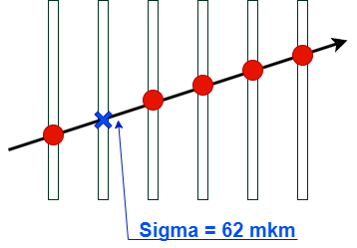
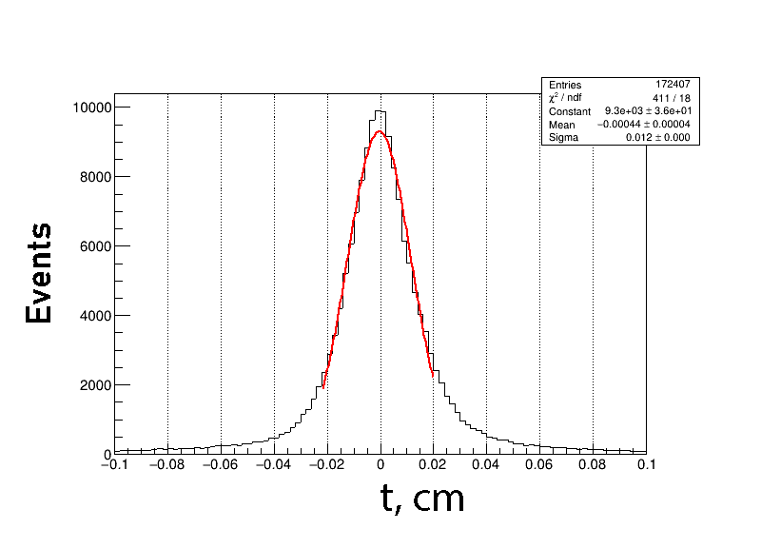
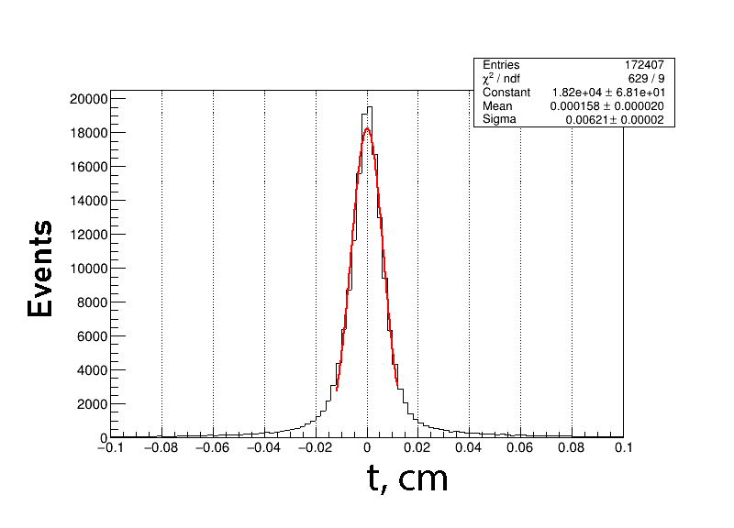
Resolution

Slide 16
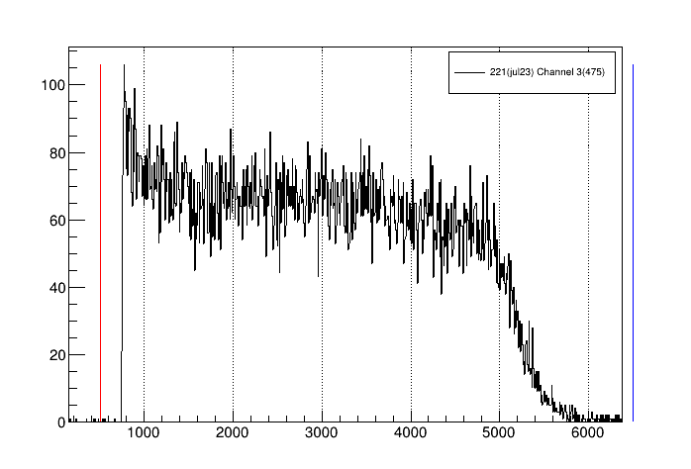
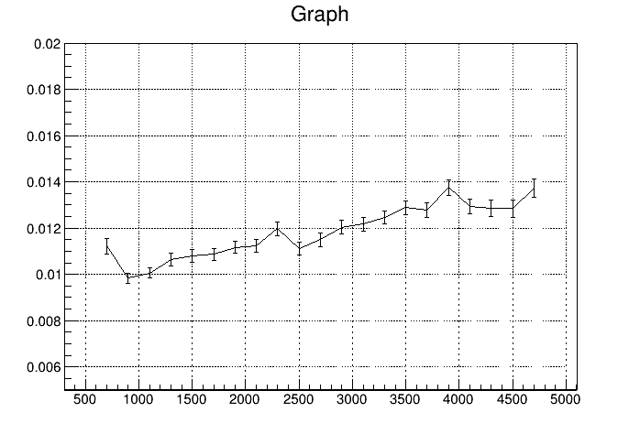
Time spectrums

