Slide 1
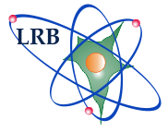
Neurobiological effects after exposure of ionizing radiation with different physical characteristics in rodents experiments
Severiukhin Y. S., Utina D. M., Golikova K. N., Kolesnikova I. A., Pronskikh E. V., Budennaya N. N., Lalcovichova M., Ermolaeva M. E., Gaevsky V. N., Molokanov A. G. , Timoshenko G. N., Ivanov A.A., Komarov D. A., Ostrovsky M. A., Feldman T. B., Krasavin E.A.
JINR Association of Young Scientists and Specialists Conference “Alushta - 2023”

Slide 2
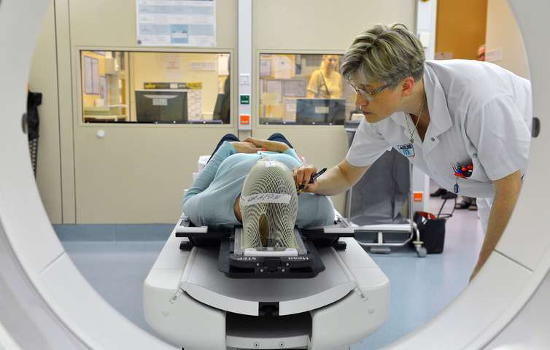
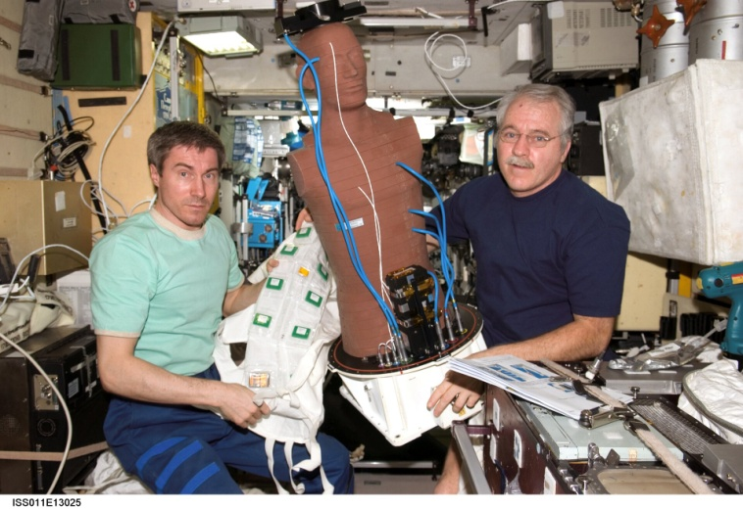
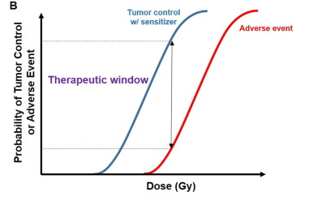
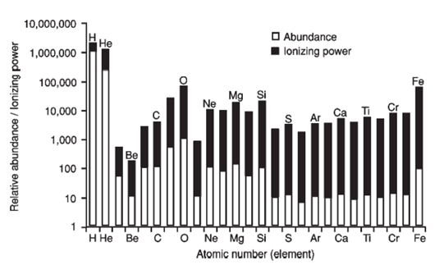
Introduction
Hadron therapy of CNS tumors
Radiation safety of spaceflights
Reda M, Bagley AF, Zaidan HY, Yantasee W. Augmenting the therapeutic window of radiotherapy: A perspective on molecularly targeted therapies and nanomaterials. Radiother Oncol. 2020;150:225-235. doi:10.1016/j.radonc.2020.06.041
Michael R. Barratt, Sam L. Pool Principles of clinical medicine for space flight / 2008.

Slide 3
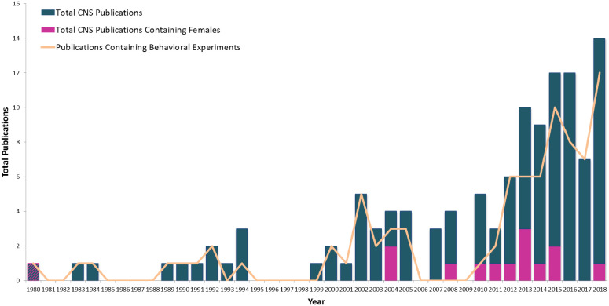
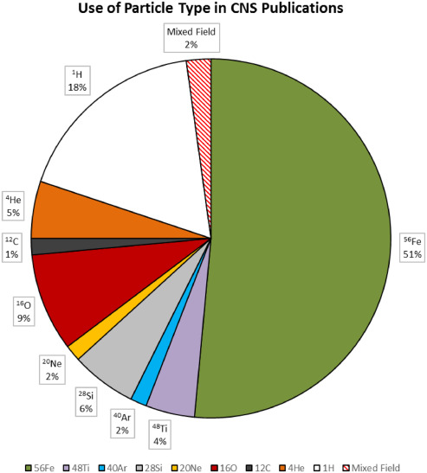
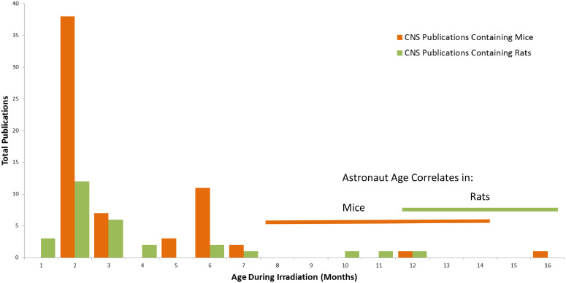
Introduction
Frederico Kiffer, Marjan Boerma, Antiño Allen, Behavioral effects of space radiation: A comprehensive review of animal studies, Life Sciences in Space Research, Volume 21, 2019, Pages 1-21

Slide 4
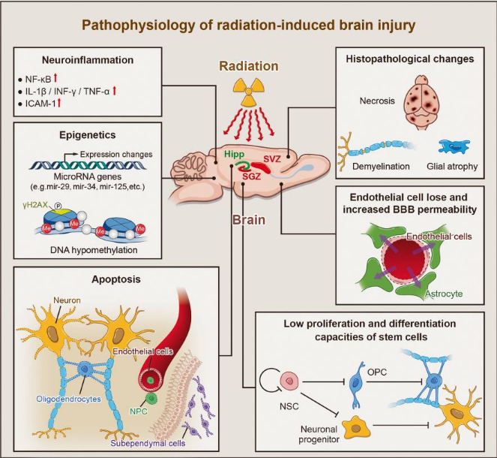
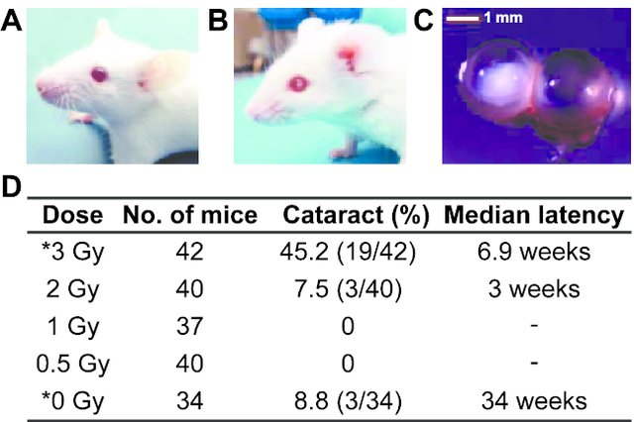
Introduction
De Stefano, I., Giardullo, P., Tanno, B., Leonardi, S., Pasquali, E., Babini, G., Saran, A., & Mancuso, M. (2016). Nonlinear Radiation-Induced Cataract Using the Radiosensitive Ptch1(+/-) Mouse Model. Radiation research, 186(3), 315–321. https://doi.org/10.1667/RR14440.1
Yang L, Yang J, Li G, et al. Pathophysiological Responses in Rat and Mouse Models of Radiation-Induced Brain Injury. Molecular Neurobiology. 2017

Slide 5
Aim and tasks
Aim of study - study of changes in the central nervous system of adult rats after gamma, proton irradiation and exposure to 12C ions in the medium term.
Tasks:
Study of behavioral reactions and optomotor response after exposure to various types of ionizing radiation.
Analysis of morphological changes in different brain area in routine and elective histological staining.

Slide 6
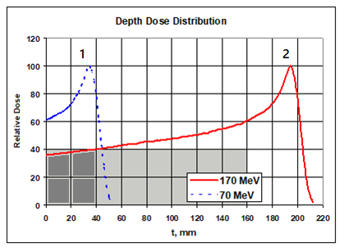
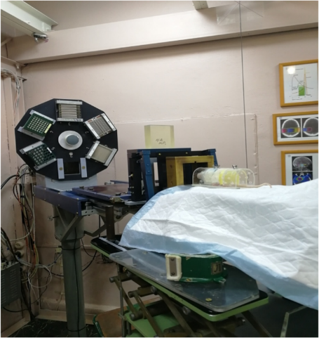
Materials and methods. Irradiation conditions
Rats (female and male) SD – 83 animals.
Group | Type of irradiation | Dose, Gy | Dose rate, Gy/min | Flux, particles/cm² | LET, keV/mkm
Control | - | - | - | - | -
Gamma (SSD=75 cm) | Whole-body | 1 | 0,9 | - | 0,2
Protons 170 MeV | Whole-body | 1 | 0,7 | 1,16*10⁹ | 0,5
Protons 170 MeV | Whole-body | 3 | 0,7 | 1,16*10⁹ | 0,5
Protons 170 MeV | Only head | 5 | 1 | 1,27*10⁹ | 0,5
Protons 70 MeV (Bragg Peak) | Only head | 1 | 1,2 | 1,04*10⁹ | 0,97
Ions ¹²C 500 MeV//nuclon | Whole-body | 1 | 0,03 | 6,1*10⁷ | 10,6

Slide 7
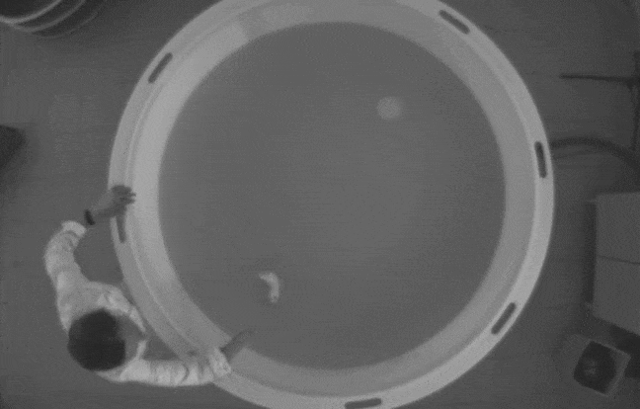
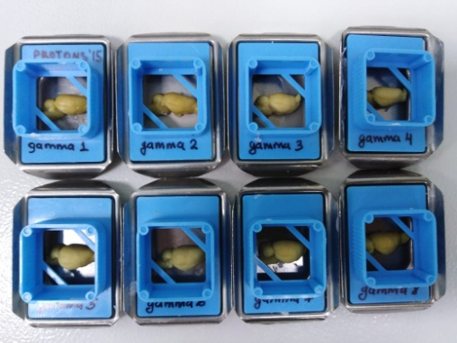
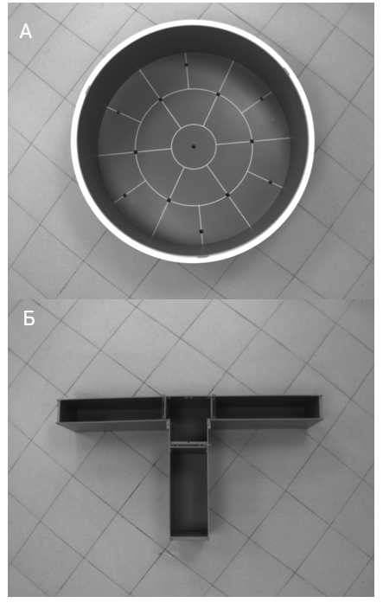
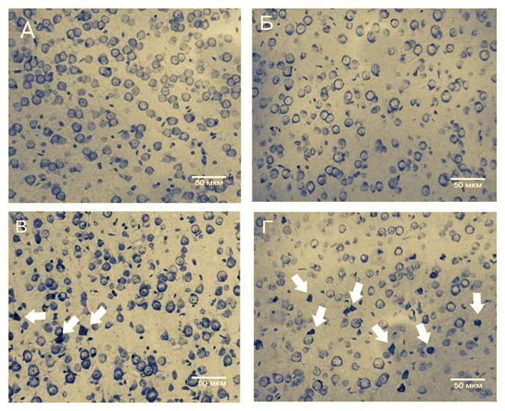
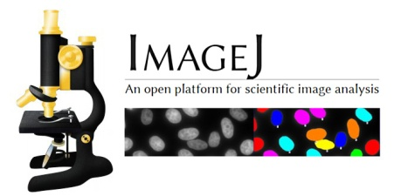
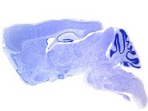
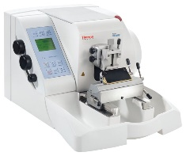
Materials and methods
OFT
T maze
Visual reactions
Nissl
Congo Red
Fluolo Jade B
Cortex
Cerrebelunm
Hippocampus
Ventricular area
ANOVA
Mann-Whitney
Pearson

Slide 8
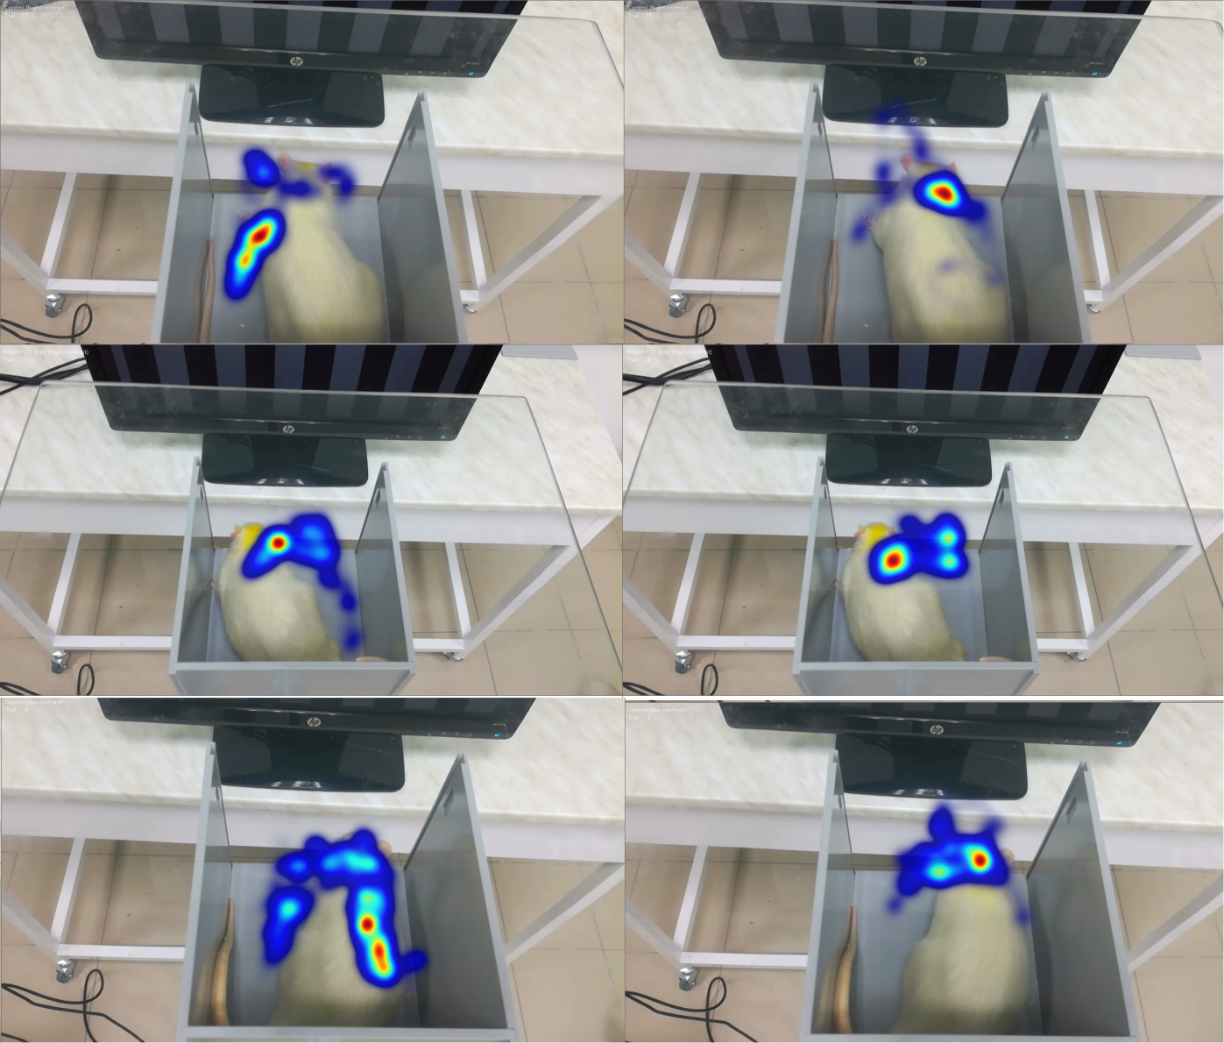
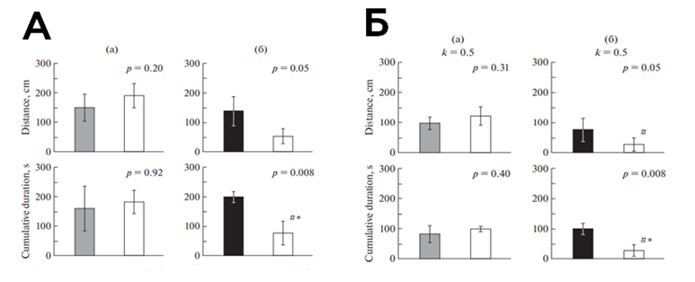
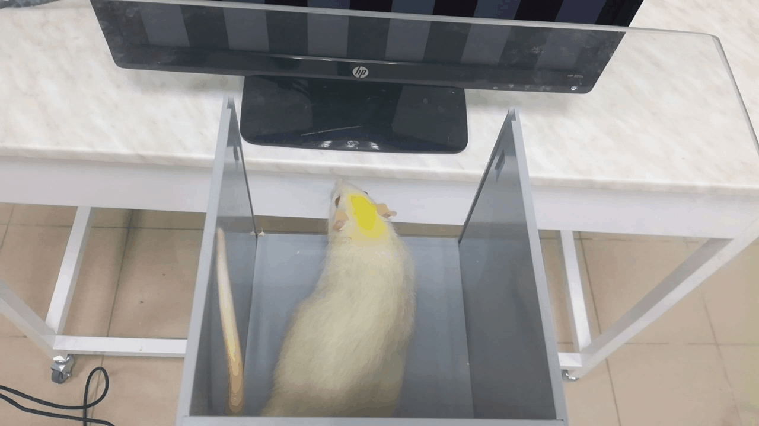
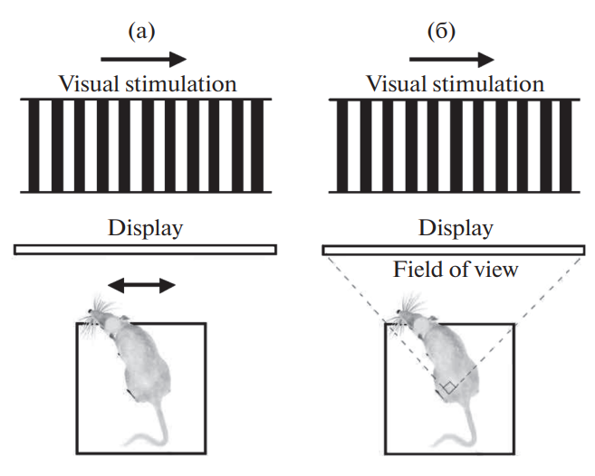
Results
Fig 1. Visual behavioral reactions. A- low contrast, B – high contrast. (a) – 30 days after irradiation, (b) – 90 days after irradiation

Slide 9
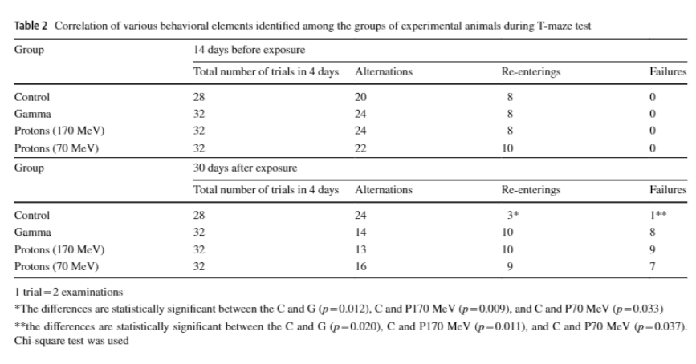
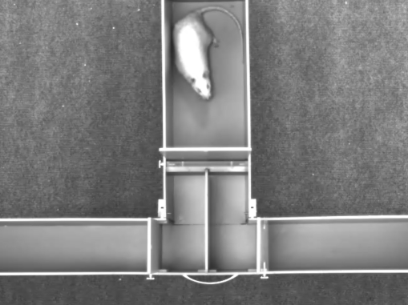
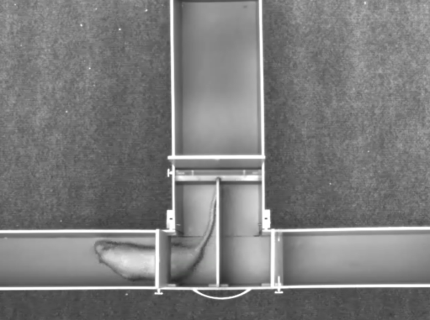
Results

Slide 10
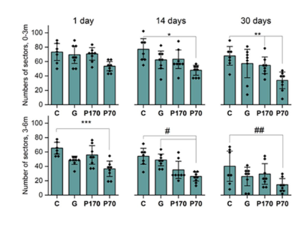
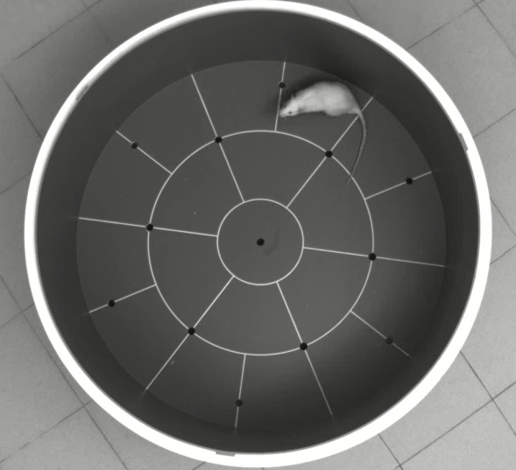
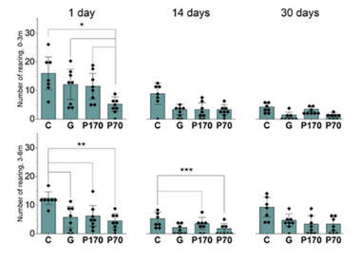
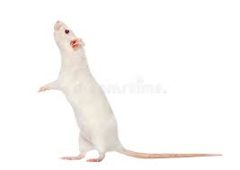
Results
Fig. 2. Locomotion in OFT. 0-3 и 3-6 min. C – control, G – gamma, P170 – protons 170 MeV, P70 – protons 70 MeV
Fig. 3. Rearing. 0-3 и 3-6 min. C – control, G – gamma, P170 – protons 170 MeV, P70 – protons 70 MeV

Slide 11
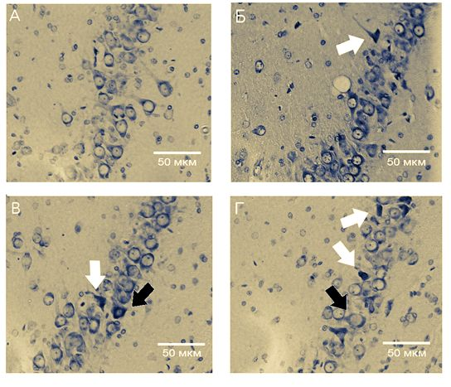
Control
Gamma
Protons 170 Mev
Protons 70 Mev (Bragg Peak)
Fig. 4. Morphological changes of neurons in CA3 layer of hippocampus

Slide 12
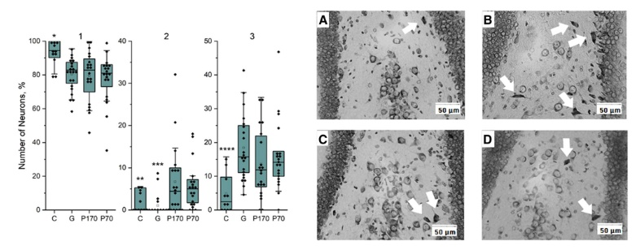
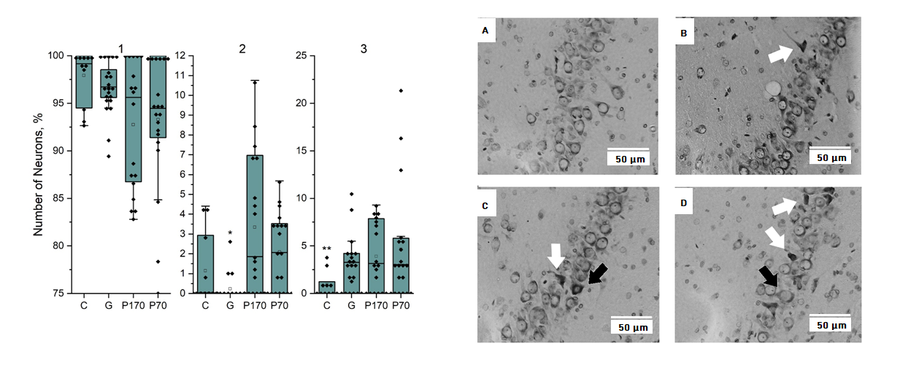
Results
Fig.5 Morphological changes in hilus. C – control, G – gamma, P170 – protons 170 MeV, P70 – protons 70 MeV
Fig. 6. Morphological changes in CA3. C – control, G – gamma, P170 – protons 170 MeV, P70 – protons 70 MeV

Slide 13
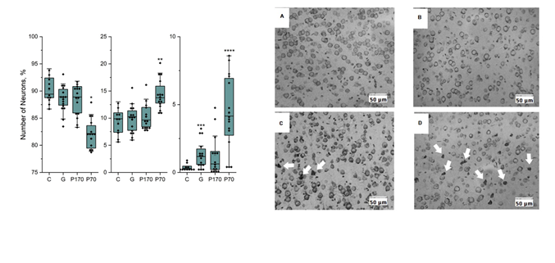
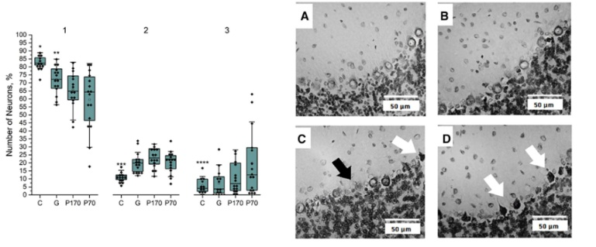
Results
Fig. 7. Morphological changes in cortex. C – control, G – gamma, P170 – protons 170 MeV, P70 – protons 70 MeV
Fig. 8. Morphological changes in cerebellum. C – control, G – gamma, P170 – protons 170 MeV, P70 – protons 70 MeV

Slide 14
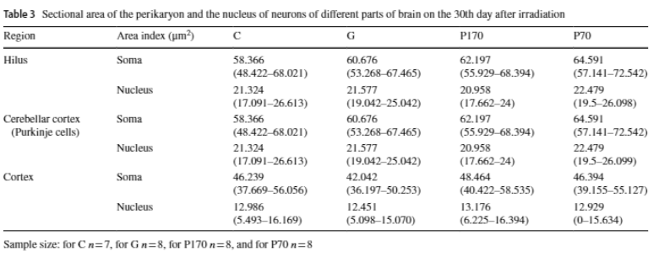
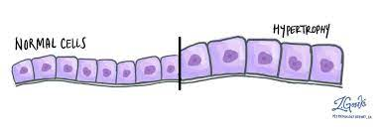
Results

Slide 15
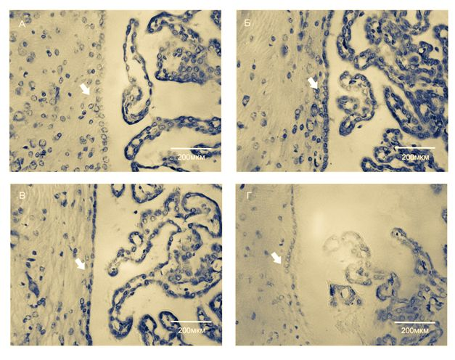
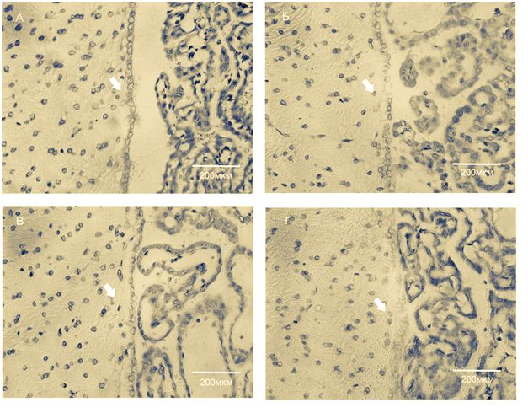
Results
Fig. 9. Morphological changes of ependymal cells in IV ventricular (30 days) C – control, G – gamma, P170 – protons 170 MeV, P70 – protons 70 MeV
Fig. 10. . Morphological changes of ependymal cells in II ventricular (30 days) C – control, G – gamma, P170 – protons 170 MeV, P70 – protons 70 MeV

Slide 16
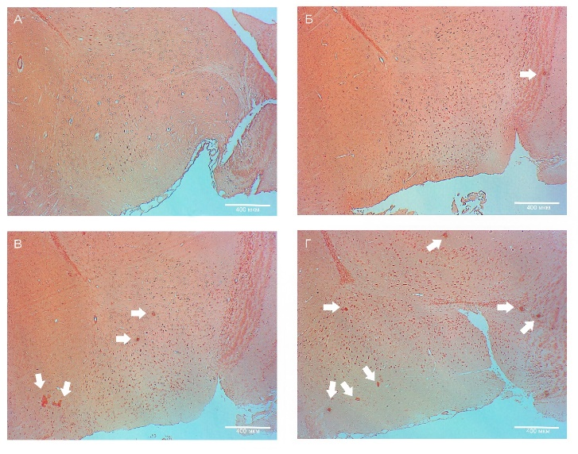
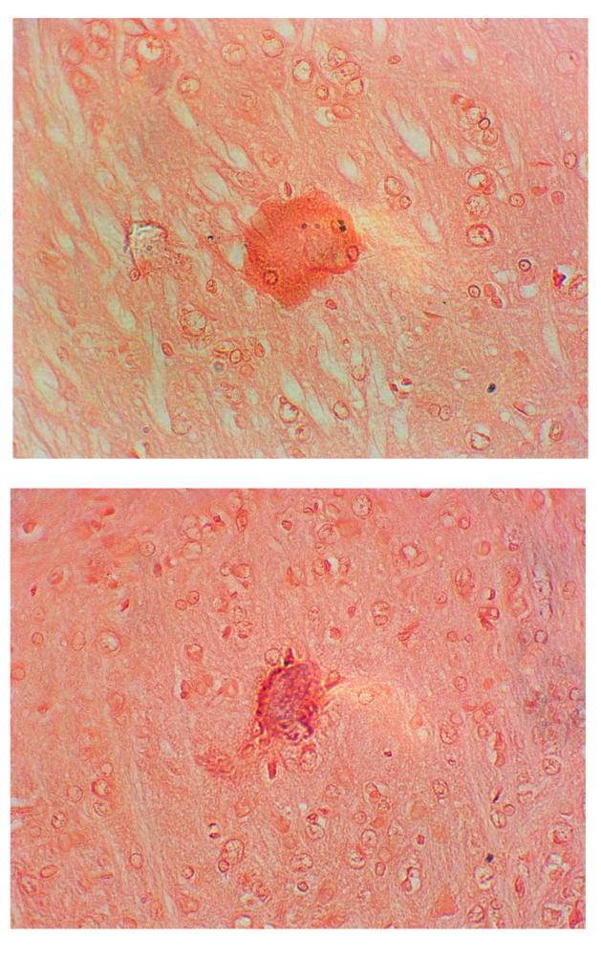
Results
Control
Gamma
Protons 170 Mev
Protons 70 Mev (Bragg Peak)
Fig. 11 Amyloid plaques in forebrain. (30 days after irradiation)

Slide 17
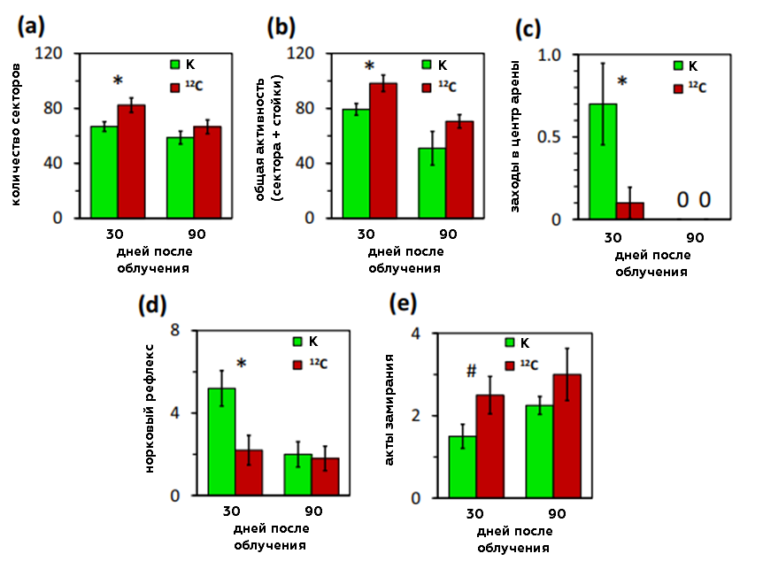
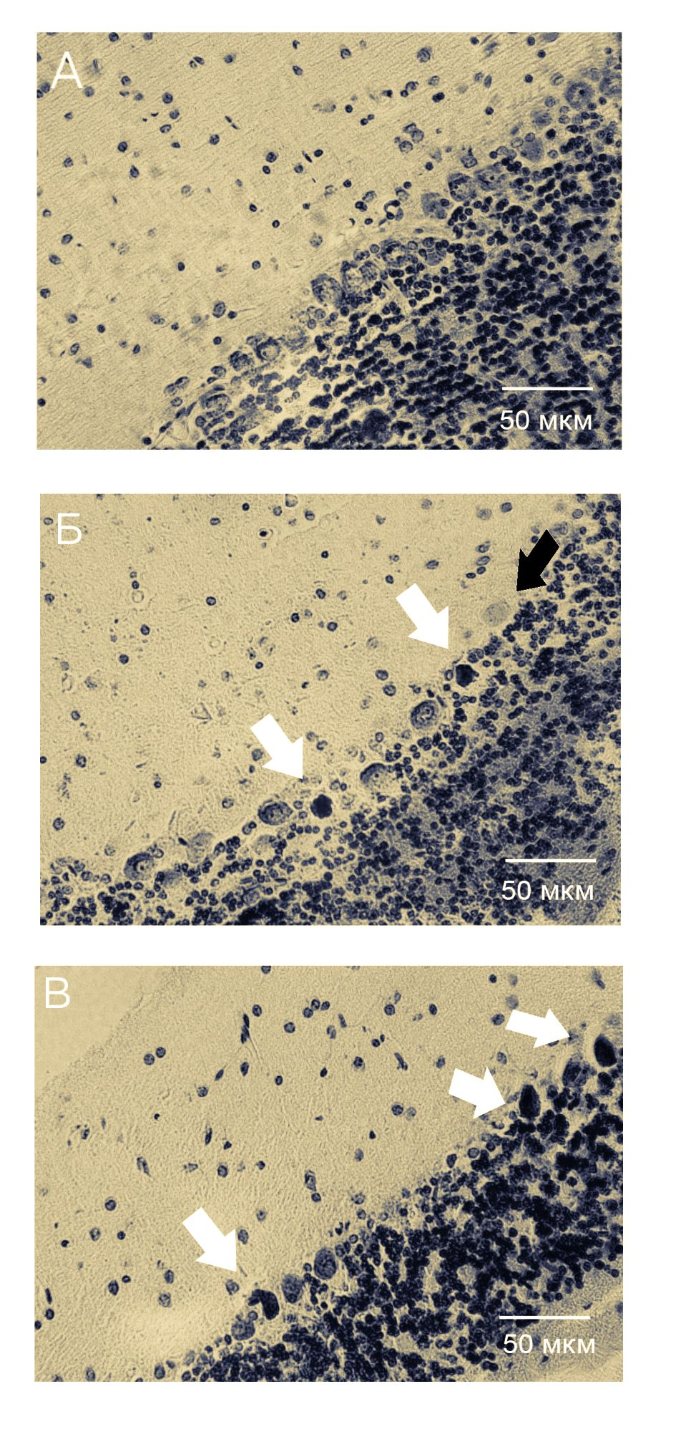
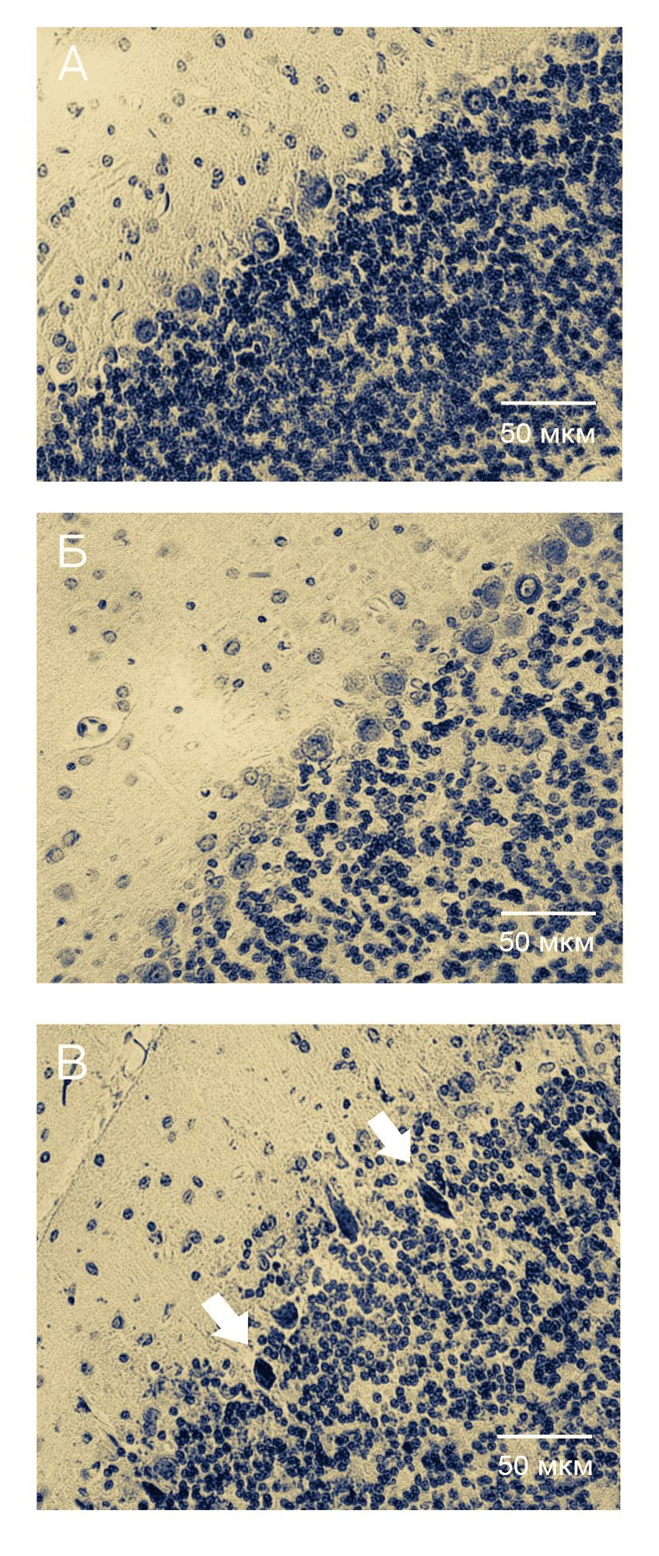
Results
30 days
90 days
Fig. 12. Behavioral reactions of male rats after exposure of carbon-12 ions.

Slide 18
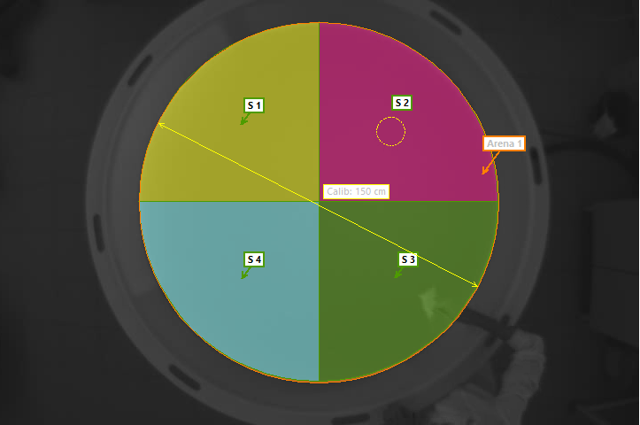
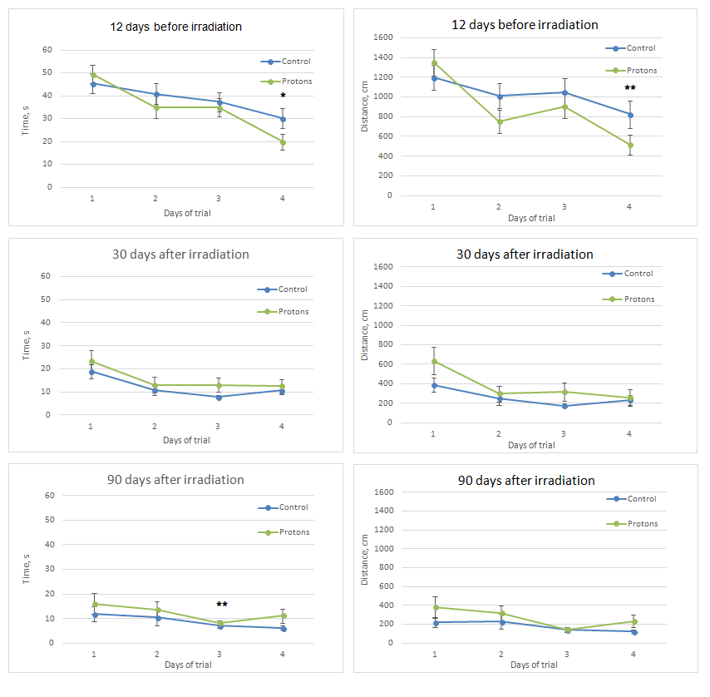
Results
Fig 13. Results of Morris Maze test.

Slide 19
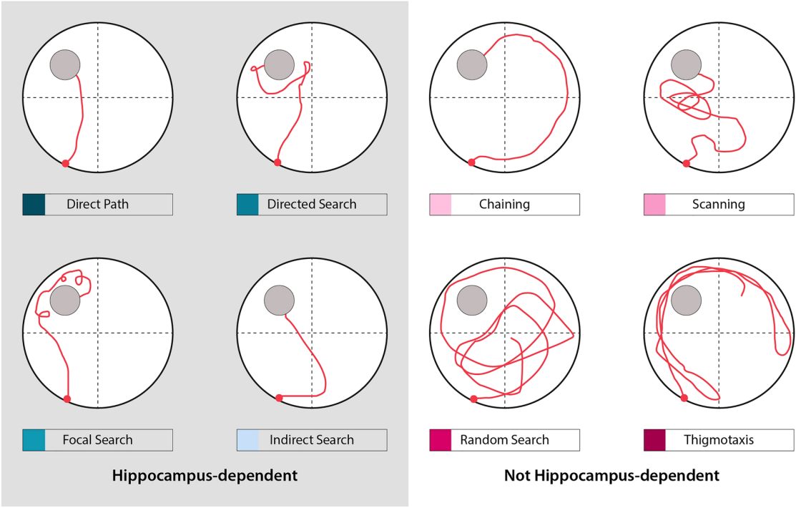
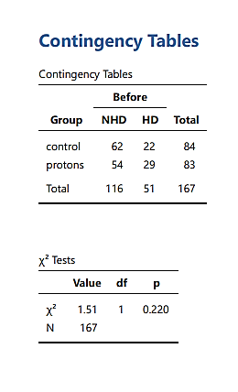
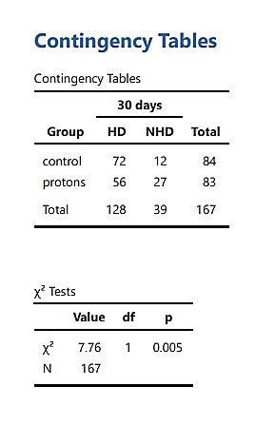
Results
Curdt N. 2022

Slide 20
Conclusions
Exposure to charged particles leads to disruption of stereotypic behavior, short-term memory and research activity, changes in motor activity.
There is an increase in neurons with dystrophic changes at 30 days after irradiation in the group of animals irradiated with protons at the Bragg peak and carbon ions.
An increase in the number of amyloid plaques, disruption of the ependymocyte layer, hypertrophy of cells against the background of no pronounced necrotic death was detected.

Slide 21
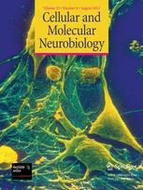
Publications
Северюхин Ю.С. Морфологические изменения клеток Пуркинье коры мозжечка крыс после облучения ионами углерода ¹²C [Текст] / Ю.С. Северюхин, Н. Н. Буденная, Г. Н. Тимошенко, А. А. Иванов, Е. А. Красавин // Авиакосмическая и экологическая медицина.-2017.-Том 51.- №1.-С. 46-50.
Северюхин Ю.С. Влияние краниального облучения протонами 170 МэВ в дозе 5 Гр на зрительное поведение и оптомоторный ответ половозрелых крыс [Текст]/ Ю.С. Северюхин, Т.Б.Фельдман, М.А.Островский, А.Г. Молоканов // Радиационная биология и радиоэкология. - 2019.- Том 59.- №5.-C. 532-537.
Severyukhin Y.S. Effects of Cranial Exposure to 170-MeV Proton Radiation at a Dose of 5 Gy on the Visual Behavior and Optomotor Response of Adults Rats [Текст]/ Y.S. Severyukhin, T.B. Feldman, M.A. Ostrovsky, A. G. Molokanov // Biology Bulletin.- 2019.-46.- P. 1605–1610.
Severyukhin Y. S. Comparative Analysis of Behavioral Reactions and Morphological Changes in the Rat Brain After Exposure to Ionizing Radiation with Different Physical Characteristics [Текст] / Y. S. Severyukhin, M. Lalkovičová, D. M. Utina, K. N. Lyakhova, I. A. Kolesnikova, M. E. Ermolaeva, A. G. Molokanov, V. N. Gaevsky, D. A. Komarov, E. A. Krasavin // Cellular and molecular neurobiology. - 2022.- 43(1). - P. 339–353.
Belov O.V. Exposure to (12) C particles alters the normal dynamics of brain monoamine metabolism and behaviour in rats [Текст] / O.V. Belov, K.V. Belokopytova, A.S. Bazyan, V.S. Kudrin, V.B. Narkevich, A.A. Ivanov, Y.S. Severiukhin, G.N. Timoshenko, E.A. Krasavin // Physica medica : PM : an international journal devoted to the applications of physics to medicine and biology : official journal of the Italian Association of Biomedical Physics (AIFB).-2016.- 32(9).- P. 1088–1094.

Slide 22
Thank you for attention!
http://www.jinr.ru/
http://lrb.jinr.ru/index.php/ru/

