Slide 1
Optimization of the setup for gamma-ray cross-sections measurement in the framework of the TANGRA project
N.A. Fedorov, Y.N. Kopatch, D.N. Grozdanov, V.R. Skoy, P.G. Filonchik and TANGRA collaboration

Slide 2
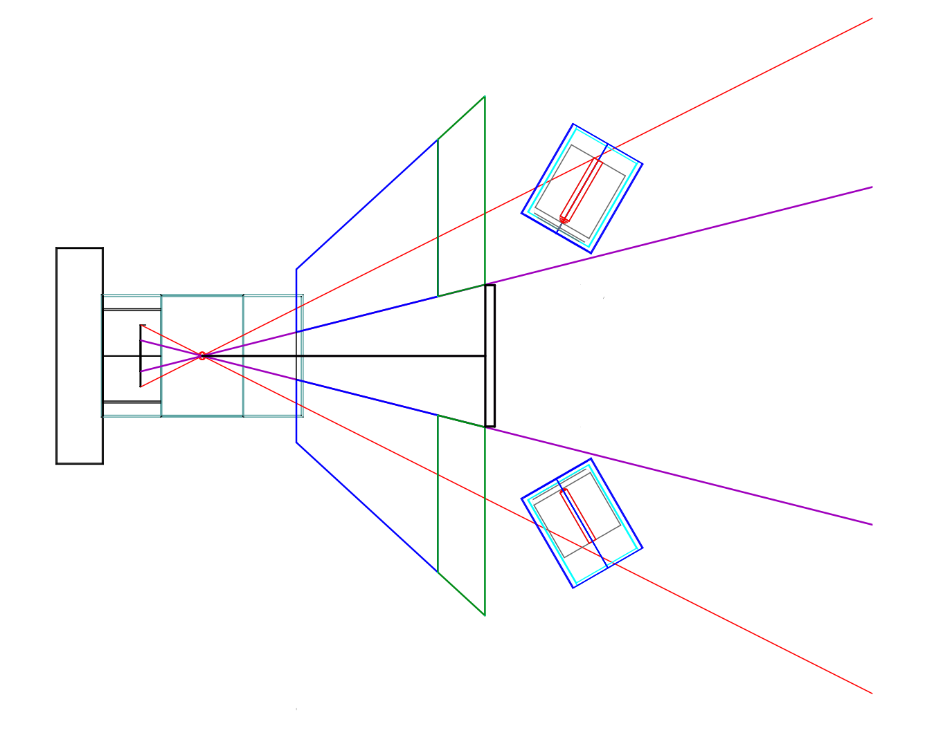
Scheme of the setup
shielding
generator
HPGe
generator
target
Alpha-PSD

Slide 3
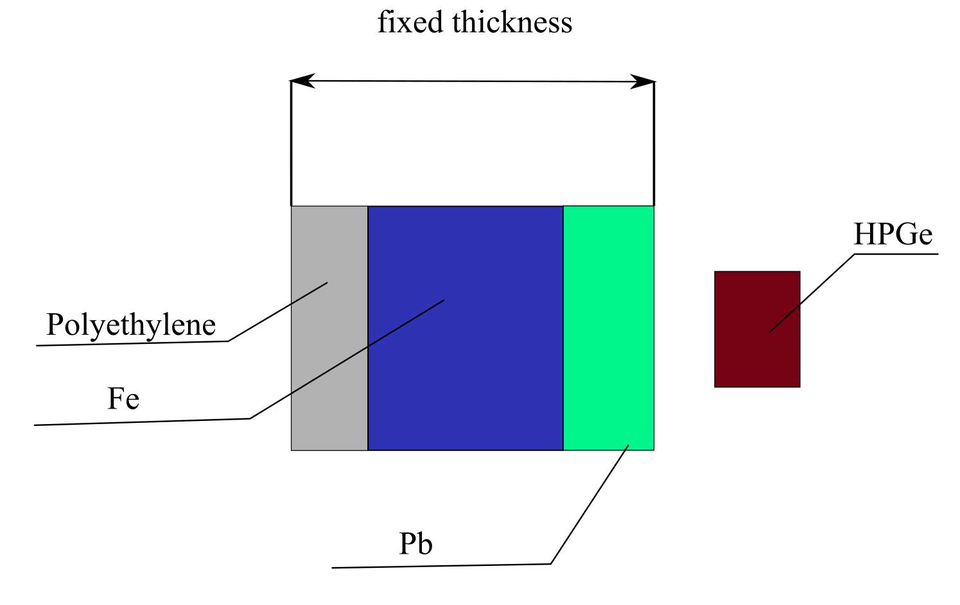
Optimization of shielding
Thickness:
20 cm
30 cm
40 cm

Slide 4
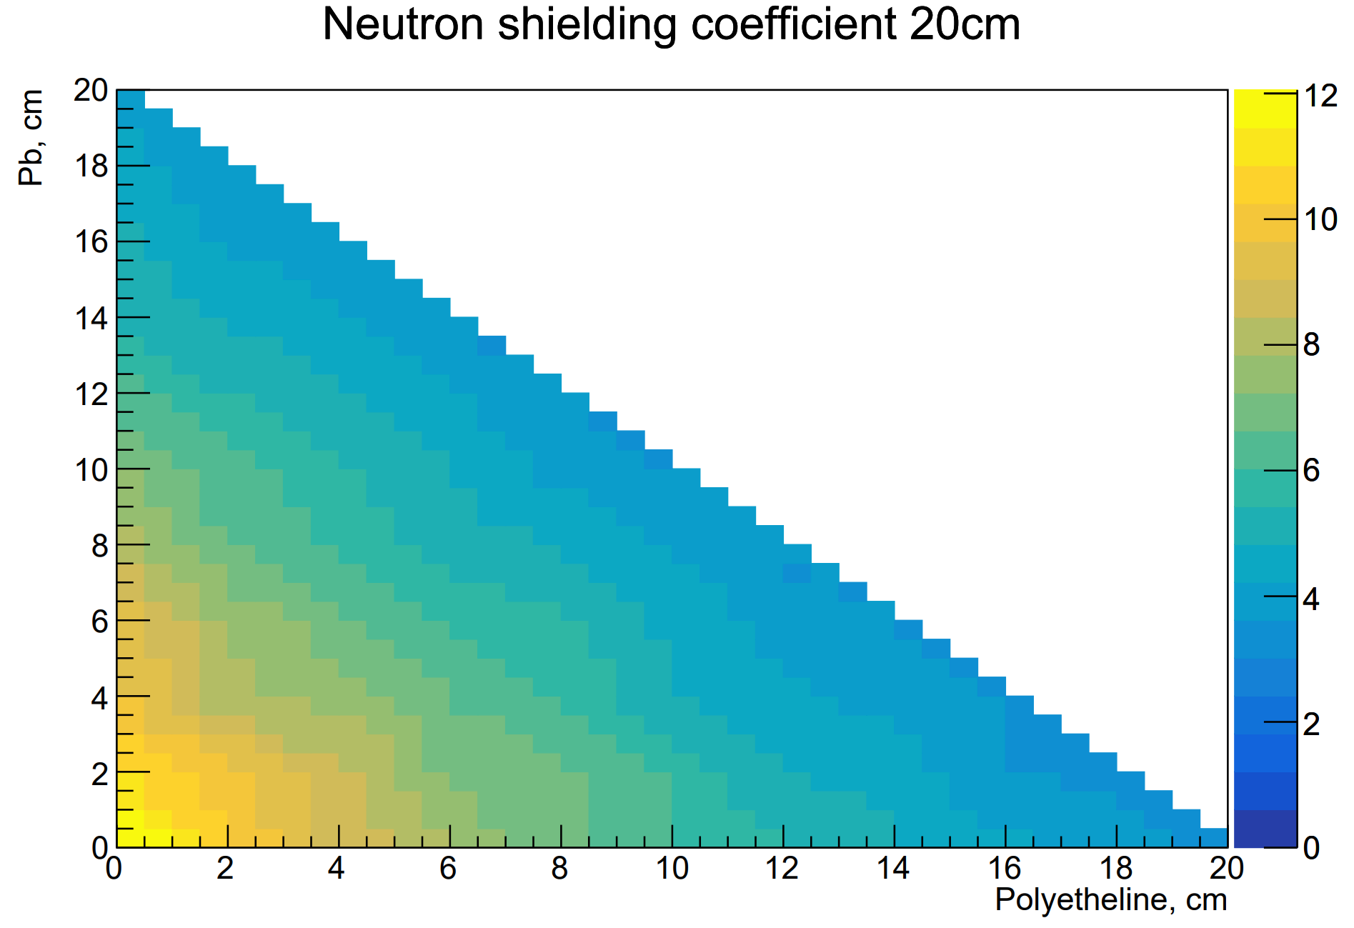
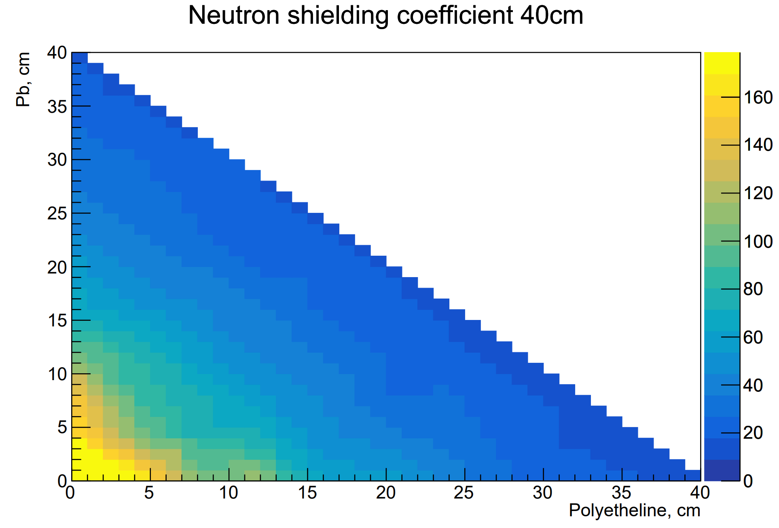
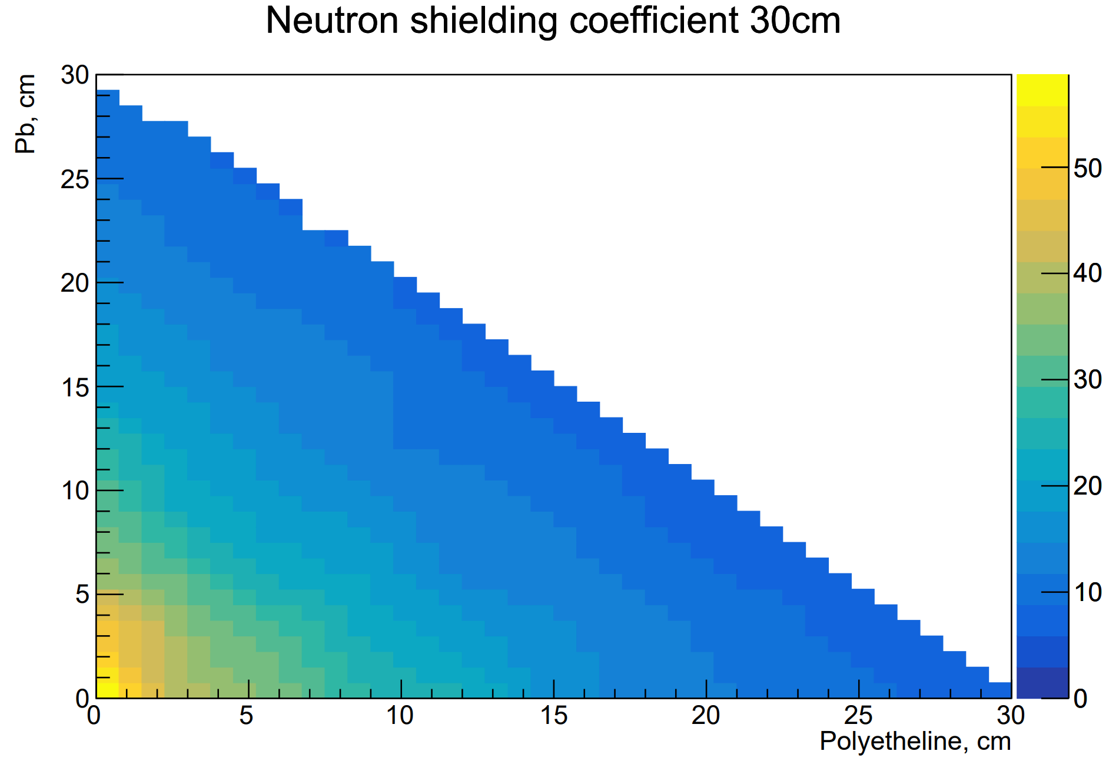
Neutron shielding coefficient
20 cm
Numbers of all particles / numbers of neutrons after schielding
40 cm
30 cm
Polyethylene, cm
Polyethylene, cm
Thickness(Fe) = full thickness – thickness(Pb + Polyethylene)
Polyethylene, cm

Slide 5
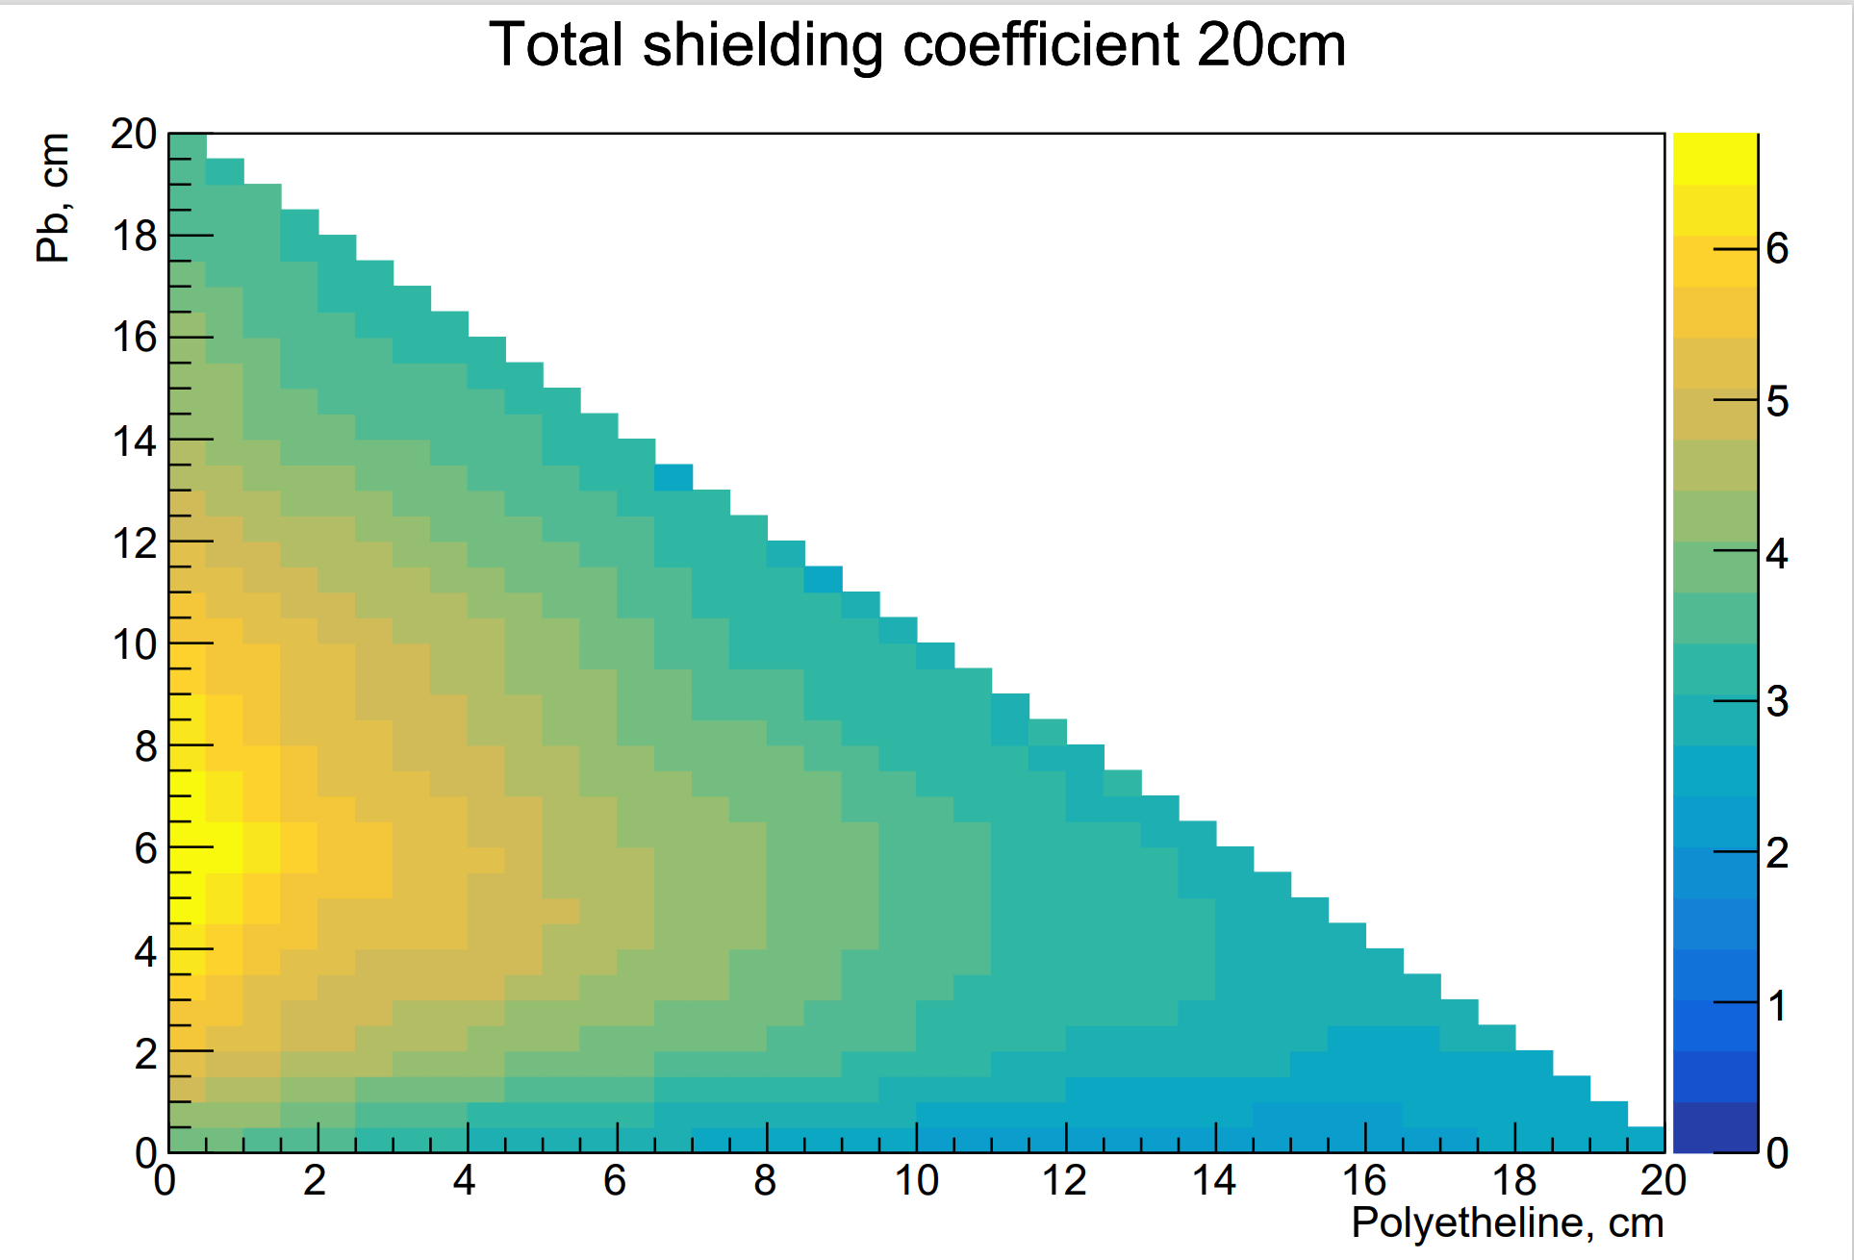
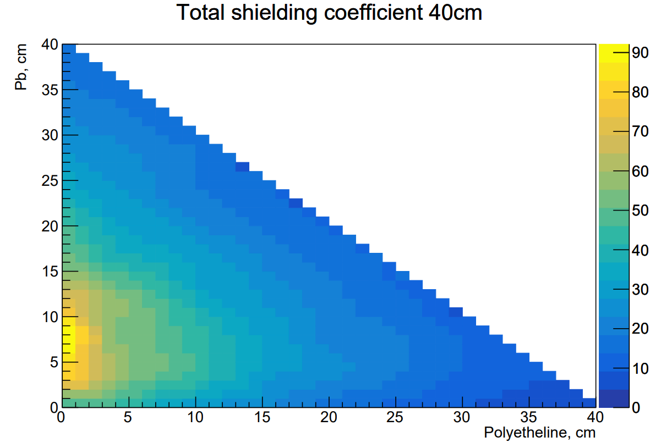
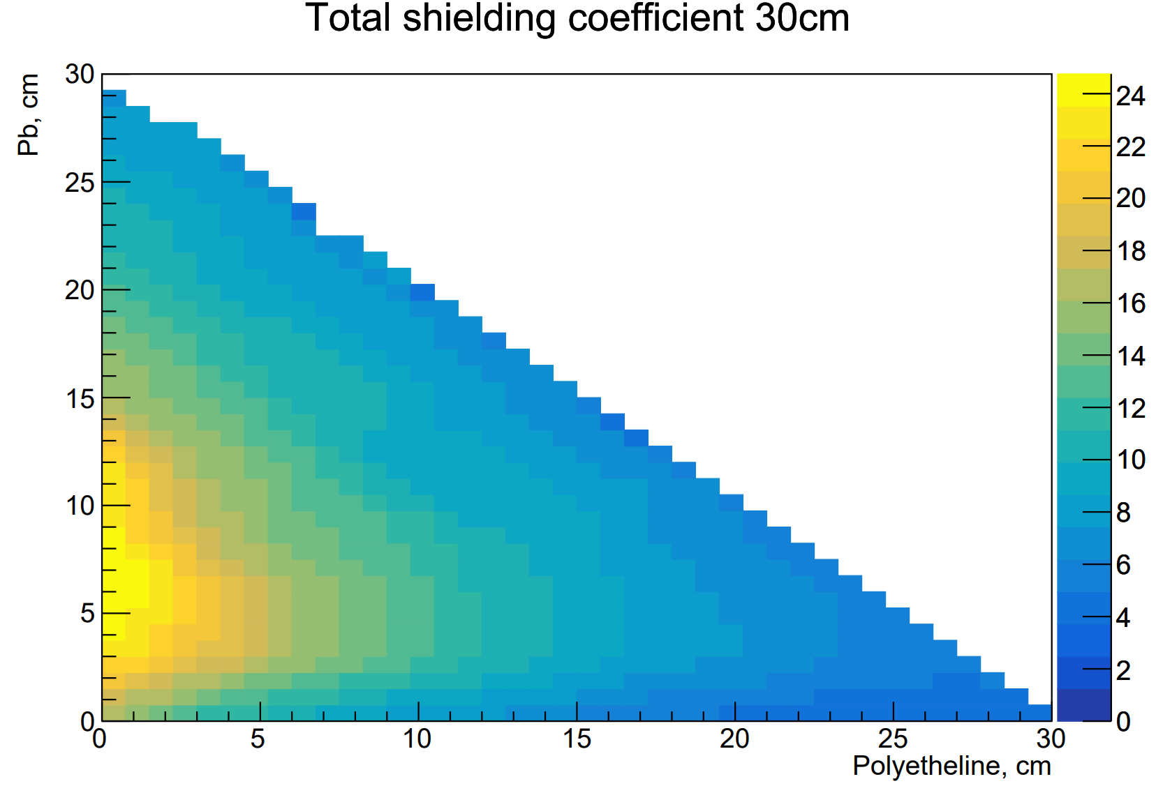
Total shielding coefficient
20 cm
Numbers of all particles / numbers of particles after schielding
40 cm
Polyethylene, cm
30 cm
Polyethylene, cm
Thickness(Fe) = full thickness – thickness(Pb + Polyethylene)
Polyethylene, cm

Slide 6
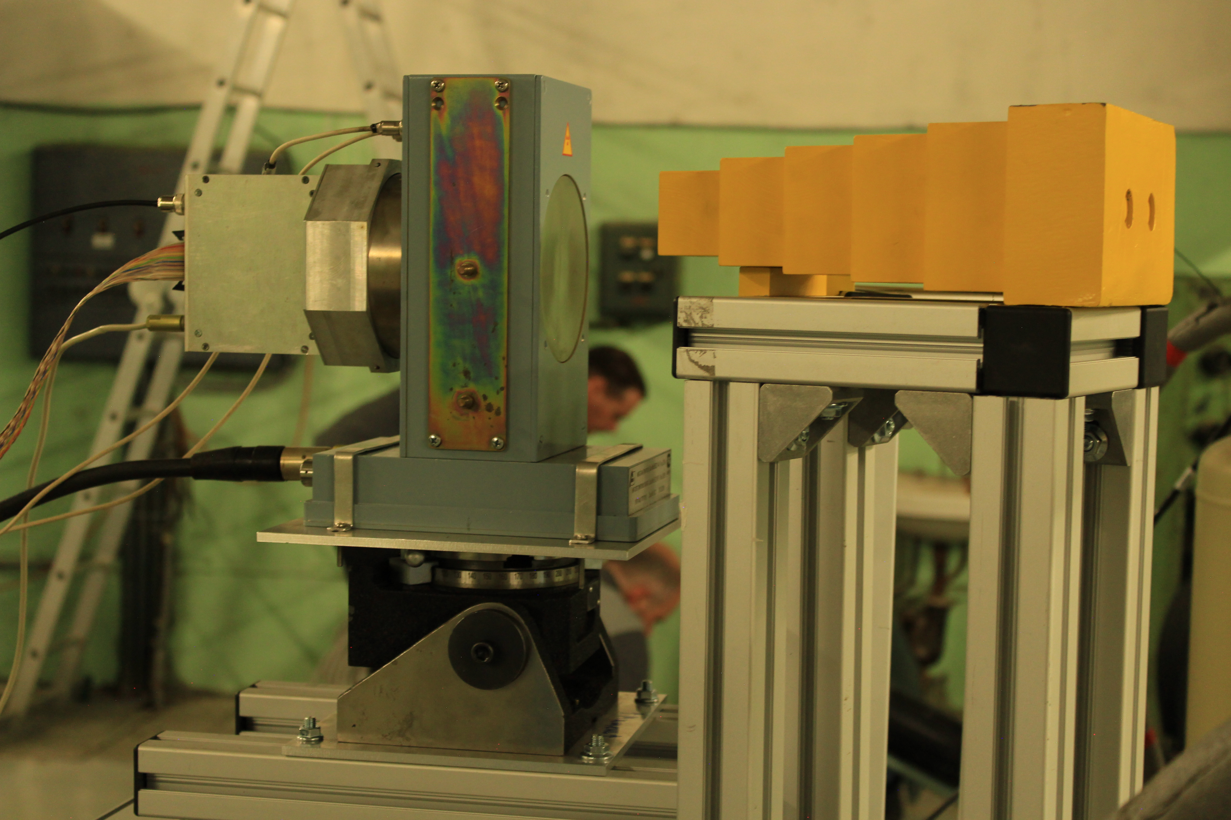
Conclusions
Optimal decision for shield size and materials:
25cm Fe + 5cm Pb without Polyethylene:
Smaller size of the target, but smaller shielding coefficient than for 40cm of shield
This work was supported by RSCF Grant 23-12-00239.
The setup is ready for experiments.

Slide 7
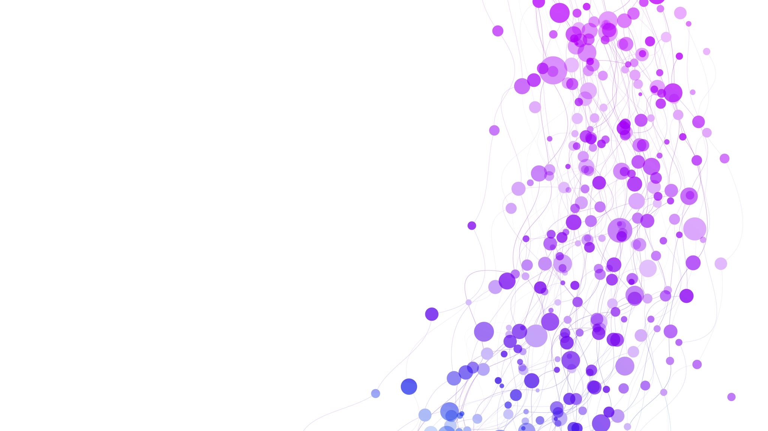
Thank you for your attention!

