Slide 1
Research reactor "NEPTUN" status report
JOINT INSTITUTE FOR NUCLEAR RESEARCH
Ahmed Hassan
AYSS-Alushta-XII
Alushta
2023

Slide 2
Neutron Sources
NEUTRON SOURCES
Denes sources
Weak sources
Spallation neutron sources
Nuclear reactors
Fusion
Fission
Steady state power
Pulsed power
Aperiodic
Periodic
Boosters

Slide 3
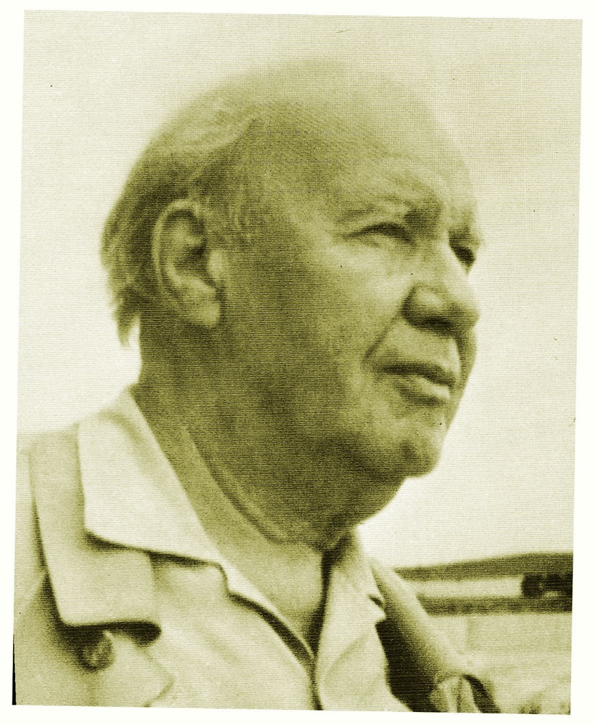
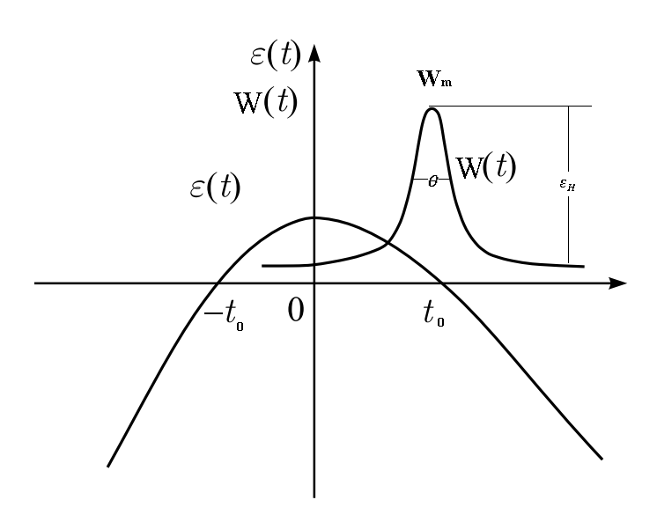
B) Denes sources : 2- Periodic Pulsed power reactors:
Neutron sources
In 1955- in the Obninsk Pysical-Power institute (Russia), D. I. Blokhintsev suggested the idea of a periodic pulsed reactors with mechanically periodically reactivity modulation.
To combines the best features of Aperiodic reactors (pulsed nature without any choppers – time of flight) and steady state power reactors (good enough fluence to neutron spectroscopy).
Dmitry Blokhintsev
(1907-1979)
Reactor Power
Reactor Reactivity
The course of reactivity and power of the reactor during the development of the power pulse

Slide 4
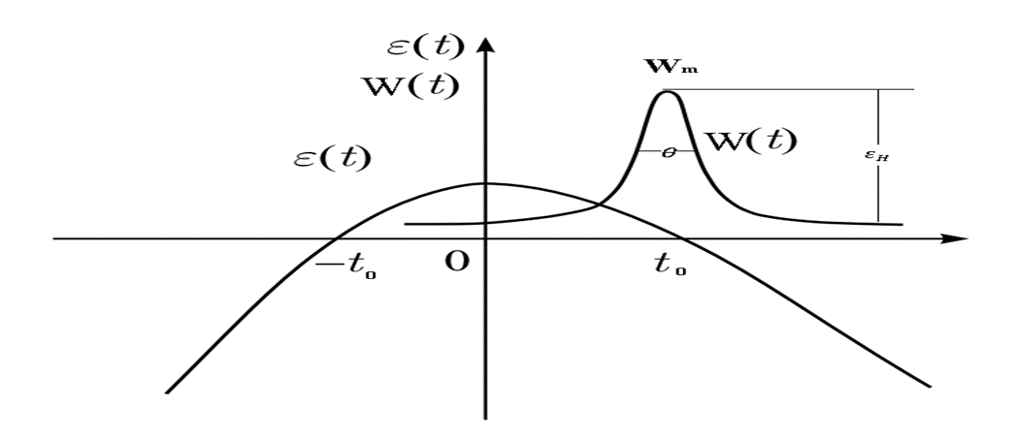
B) Denes sources : 2- Periodic Pulsed power reactors:
Neutron sources
 | IBR-1 1960 -1964 - 1968 | IBR-30 1968-2001 | IBR-2=˃ IBR-2M from 1984 г | Future Goal IBR-3 (NEPTUNE)
Average thermal power / Peak power | 1-3-6 кWт / 25 MWt | 20 кWт / 1000 MWt | 4 МWт / 8300 MWt 2 МWт / 5200 MWt | 12-15 МWт
Working regime | Reactor – Booster (${}_{183}^{74}W$)-Microtron | Reactor – Booster (${}_{183}^{74}W$)-Linear Resonance acc. | Booster – reactor (${}_{183}^{74}W$)- Cf | Reactor
Fissile material | Pu-239 Metal-rods | Pu-239 Metal-rods | PuO2 | NpN
Reactivity modulator, frequency | U-235 5-50 Hz | U-235 0.1 - 100 Hz | Two Moveable reflector from Ni and Al 5-10-25-50 Hz | Neutron Moderator TiH2+and void, 10 Hz
The half width pulse | 30 / 3 μs | 70 / 4 μs | 240 μs | ~200-μs
Average neutron flux at the surface of moderators, см²/ s, | ~10¹⁰ | 10¹¹ | 10¹³ | 10¹⁴

Slide 5
How can this goal (${10}^{14}\frac{n}{{cm}^{2}.s}$) achieve????
To achieve this goal, there were two ways, either continue to use Pu-39 as a nuclear fuel or consider a new fuel cycle (Np-as example).
Booster reactor based on Pu-239
16 neutron channel
Reactor based on Np-237
25 neutron channel

Slide 6
How can this goal (${10}^{14}\frac{n}{{cm}^{2}.s}$) achieve????
CONCLUSTION
1- To obtain the proposed flux using Pu, accelerator must be used. This complicate the operation and raises the cost.
2- High efficiency of MR, allows to get a high pulse height in a very short time ---- very high peak flux.
3- The generation time of fast neutrons (τ) in the neptunium core is 7-10 times shorter than that in the core with plutonium (the task of having a short pulses of neutrons becomes easier).
4- A low value of the delayed neutrons fraction (β-eff) determines a low background power in the intervals between pulses (3-4 times less).
5- Possibility of using neutron moderating materials as a Reactivity Modulator (RM) ( like high-temperature resistance - hydride’s metal Ti$H_{2, }YH2).$
6- There is no reactivity effect from the fuel burnup (it is possible to work without additional fuel loading during the entire reactor cycle):
Np237 (n absorption) Np238 (β-decay, (2.117 days) Pu238 (Fissionable material)
Character | Reactor NEPTUNE | Booster-Reactor Pu-239
Average power, MWt | 15 | 8,5
Control rod efficiency, % | 2,39 (on the basis of n moderation) | 4 (on the basis of neutron absorption)
MR efficiency, % | 4,1 | 0,8
Average ther. flux, n/cm2.s | 1,0 X ${10}^{14}$ | 1,1 x ${10}^{14}$
Β-eff | 0,0011 | 0,0024
Neutron generation time, ns | 10 | 100

Slide 7
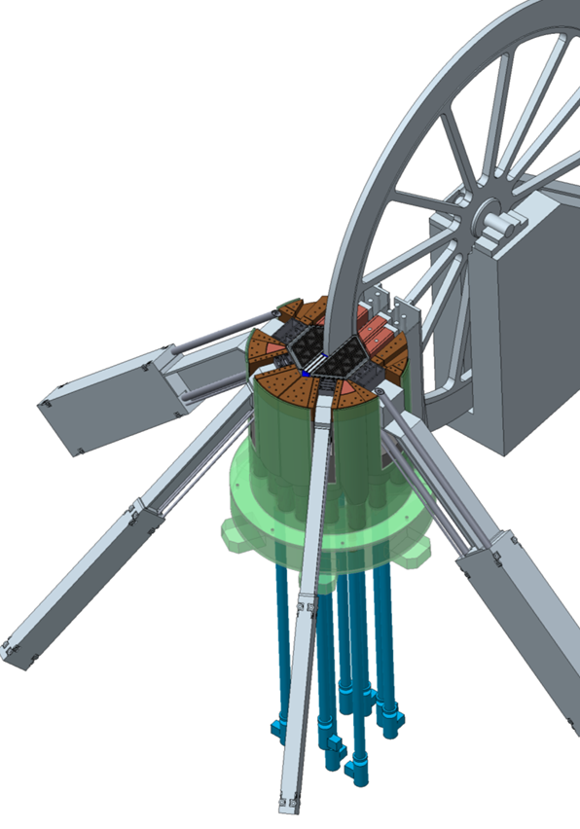
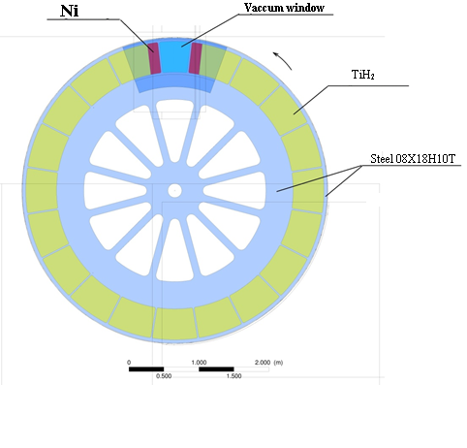
The main parameters of the reactor
Параметр | Значение
AVERAGE THERMAL POWER , MW | 12 - 15
OPERATING MODE | pulsed
PULSE FREQUENCY, Hz | 10
FUEL | NpN
CLADDING MATERIAL OF FUEL RODS | S.Steel ЧС-68
COOLER | Na
REFLECTOR | NICKEL ALLOY + BERYLLIUM
MODERATOR, PREMODERATOR | Hydrides, water, beryllium
COOLANT TEMPERATURE AT THE INLET TO THE CORE AND AT THE OUTLET, ⁰С | 290-390
PRESSURE DROP THROUGH THE CORE, Pa | 0,33·10⁵
FLUENCE ON THE REACTOR SURROUNDING’S FOR 20,000 h, n / СМ² | 4,1·10²²
AVERAGE NEUTRON THERMAL FLUX AT THE SURFACE OF WATER MODERATOR, 2π- equivalent 10¹³ cm⁻²∙sec⁻¹ | 12
EFFECTIVE FRACTION OF DELAYED NEUTRONS | 0,00131
GENERATION TIME OF THE SPONTANEOUS NEUTRONS , n,sec | 10

Slide 8
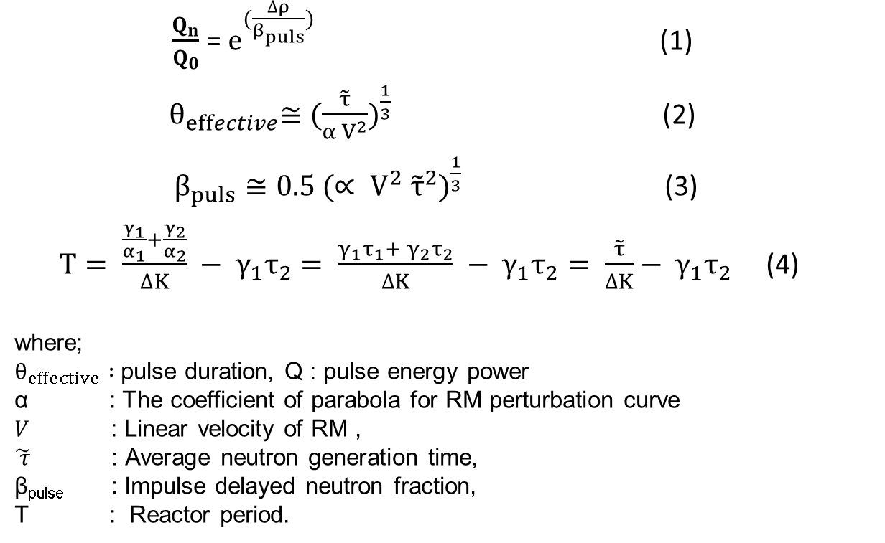
THE MAIN NEUROTIC PROBLEMS THAT FACED REACTOR NEPTUNE, AND THE PROPOSALS TO SOLVE THEM.
1- The problem of non-stationary in reactor’s power: with insertion a very small amount of reactivity to the reactor, the reactor power increases exponentially with time (the reactor is very sensitive to a very small amount of reactivity).
Solution
Increasing the value β-pulsed, through increasing the :
The fast neutron generation time, by insert a high enriched U or Pu in reactor core;
Increasing the linear velocity of MR from 64 to 100 m/s.

Slide 9
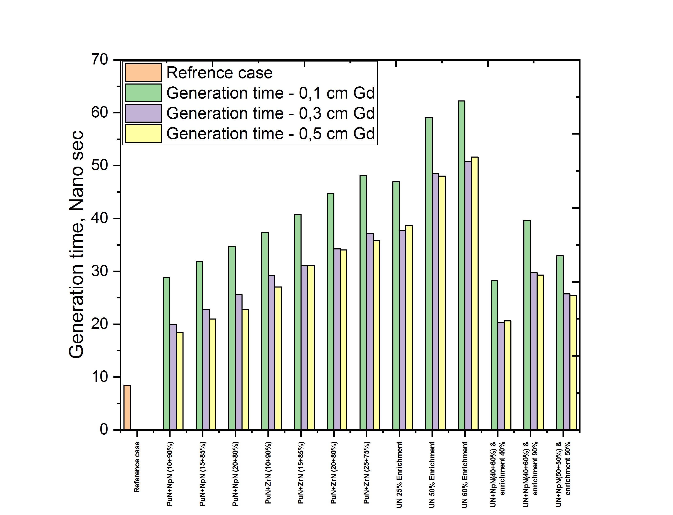
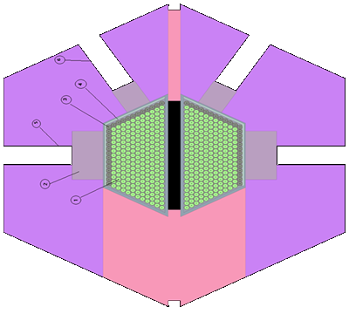
1- The problem of non-stationary in reactor’s power:
THE MAIN NEUROTIC PROBLEMS THAT FACED REACTOR NEPTUNE, AND THE PROPOSALS TO SOLVE THEM.

Slide 10
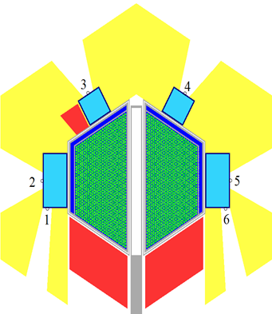
2- The problem of low efficiency of reactor rods:
THE MAIN NEUROTIC PROBLEMS THAT FACED REACTOR NEPTUNE, AND THE PROPOSALS TO SOLVE THEM.
Solution
Insert control rod (CR) inside the reactor (as a result of calculations it was decided to use for the first time moderator material as a CR instead of neutron absorber) to increase there efficiency from 2,39 to 3,7% to maintain a safe reactor operation with company life time.
As a result the power production was increased in each fuel rod, so the height of fuel column increased by 30 mm to reduce the power density production in fuel rods.

Slide 11
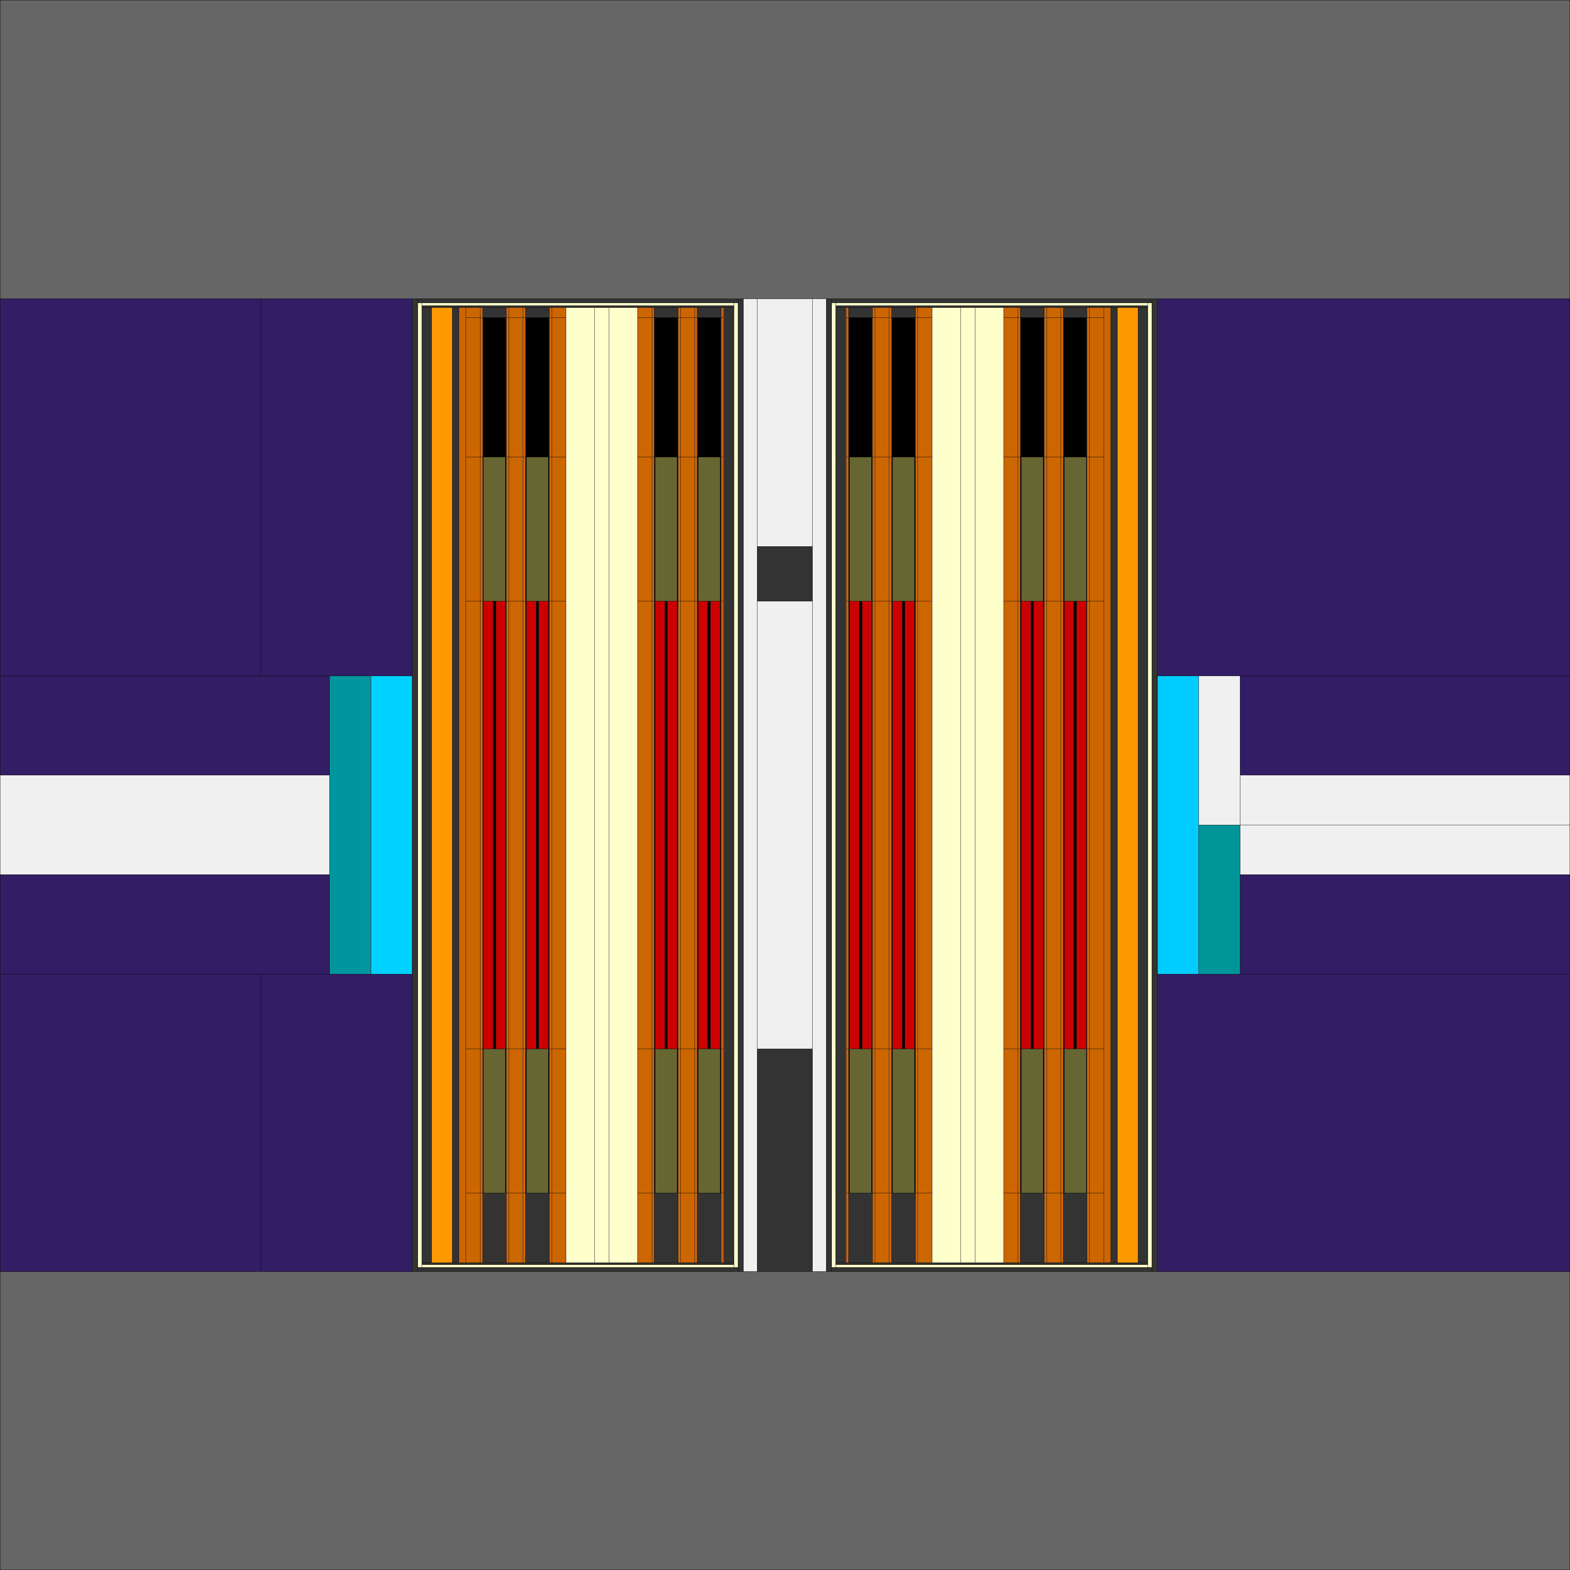
3- The problem of using high enriched U (90%) to increase the generation time: nonproliferation laws prohibit the use of enriched U higher than 20% in research reactors.
THE MAIN NEUROTIC PROBLEMS THAT FACED REACTOR NEPTUNE, AND THE PROPOSALS TO SOLVE THEM.
Solution
Using a new reflector made from Pb-208 instead of Be and Ni.
This will increase the generation time through a deep penetration of neutrons into the reflector and long return to the core with high probability and the other part through the fission in low enriched U.
Reflector --- Ni + Be
Reflector --- Pb-208

Slide 12
THE MAIN NEUROTIC PROBLEMS THAT FACED REACTOR NEPTUNE, AND THE PROPOSALS TO SOLVE THEM.
3- The problem of using high enriched U (90%) to increase the generation time:
 | K-эфф | Max. efficiency of RM | Generation time, ns
1- initial solution | 1,0143 | 1,49% | 9,97154
2- U(5%)N 100% + 0% NpN | 1,00242 | 1,65% | 33,3602
3- U(5%)N 25% + NpN 75% | 1,01631 |  | 13,3972
4- U(5%)N 50% + NpN 50% | 1,01124 |  | 16,6921
5- U(5%)N 75% + NpN 25% | 1,01326 |  | 15,5914
6- U(10%)N 25% + NpN 75% | 1,01669 |  | 15,227
7- U(10%)N 50% + NpN 50% | 1,01239 |  | 20,8807
8- U(10%)N 75% + NpN 25% | 1,00844 |  | 28,7854
9- U(15%)N 25% + NpN 75% | 1,0173 |  | 16,3718
10- U(15%)N 50% + NpN 50% | 1,01368 |  | 23,2121
11- U(15%)N 75% + NpN 25% | 1,01007 |  | 32,2773
12- U(20%)N 25% + NpN 75% | 1.01805 |  | 19.3032
13- U(20%)N 50% + NpN 50% | 1.01491 |  | 26.7414
14- U(20%)N 75% + NpN 25% | 1.01173 |  | 35.7730

Slide 13
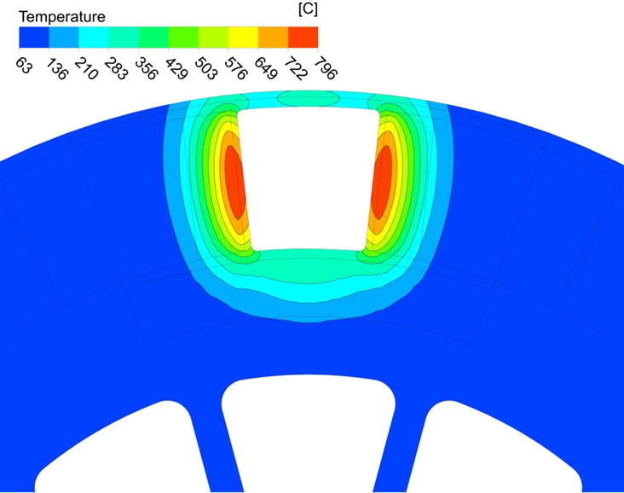
4- Reduced heat load on Ti𝐇𝟐 in the MR: The slide shows that the temperature of titanium TiH2 at the edges of the empty sector reaches 700 degrees, and it is known that the use of TiH2 is limited to a temperature of 500 degrees. After that, the hydrogen content in it decreases. Reducing the thermal load on titanium hydride leads to a significant extension of the service life of the reactivity modulator.
THE MAIN NEUROTIC PROBLEMS THAT FACED REACTOR NEPTUNE, AND THE PROPOSALS TO SOLVE THEM.

Slide 14
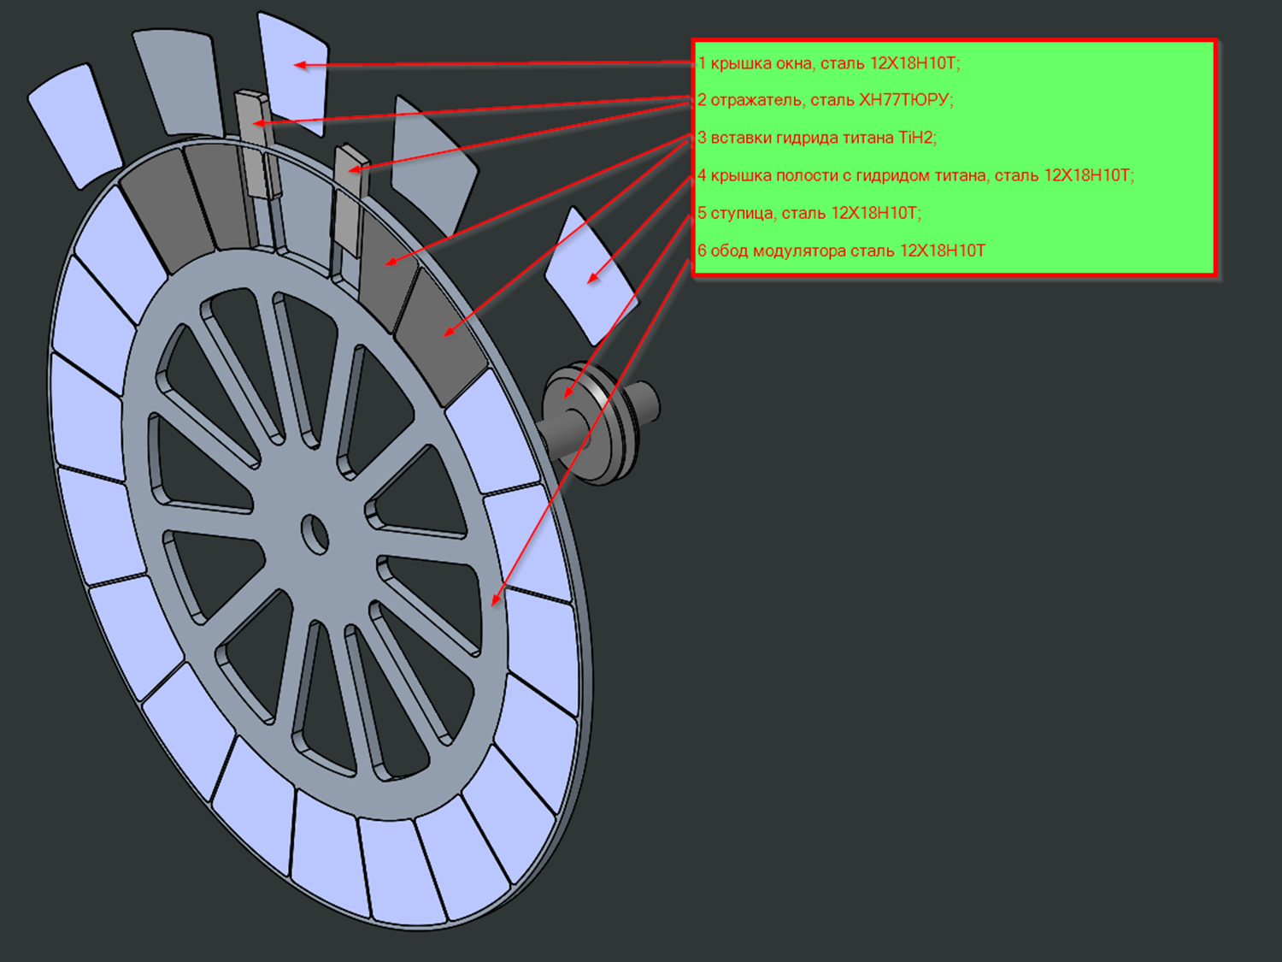
4- Reduced heat load on Ti𝐇𝟐 in the MR: Solution
THE MAIN NEUROTIC PROBLEMS THAT FACED REACTOR NEPTUNE, AND THE PROPOSALS TO SOLVE THEM.
it is proposed to install additional nickel reflectors on the border of the empty sector and the sector with titanium hydride.

Slide 15
Зависимость максимального удельного тепловыделения в диске модулятора (Вт/см3), максимального эффекта смещения модулятора (%) и α – параметра (см-2) от изменения ширины вакуума и толщины Ni
 | Максимальный удельная тепловыделения , Вт/см3
 | 0 cm Ni |  |  | 5 cm Ni |  |  | 10 cm Ni
 | Справа | Слева |  | Справа | Слева |  | Справа | Слева
30 cm вакуум | 9,65634 | 10,5207 |  | 6,66692 | 7,75357 |  | 4,48174 | 5,43119
35 cm вакуум | 8,5089 | 9,52174 |  | 5,55672 | 6,59312 |  | 3,82486 | 4,4615
40 cm вакуум | 7,41187 | 8,45502 |  | 4,71953 | 5,61119 |  | 3,22433 | 3,61275
45 cm вакуум | 6,3444 | 7,32191 |  | 4,00864 | 4,68787 |  | 2,59712 | 2,93969
 | 30 cm Вакуум, 0 см Ni | 30 cm Вакуум, 5 см Ni | 30 cm Вакуум, 10 см Ni |  | 35 cm Вакуум, 0 см Ni | 35 cm Вакуум, 5 см Ni | 35 cm Вакуум, 10 см Ni |  | 40 cm Вакуум, 0 см Ni | 40 cm Вакуум, 5 см Ni | 40 cm Вакуум, 10 см Ni |  | 45 cm Вакуум, 0 см Ni | 45 cm Вакуум, 5 см Ni | 45 cm Вакуум, 10 см Ni
Максимальный эффект смещения модулятора, % | 6,29% | 7,13% | 7,50% |  | 6,73% | 7,37% | 7,59% |  | 7,01% | 7,46% | 7,61% |  | 7,17% | 7,48% | 7,59%
α -параметр, см-2 | 1,37E-04 | 1,24E-04 | 9,82E-05 |  | 1,21E-04 | 9,88E-05 | 6,81E-05 |  | 9,01E-05 | 6,04E-05 | 3,85E-05 |  | 5,40E-05 | 2,92E-05 | 1,28E-05

Slide 16
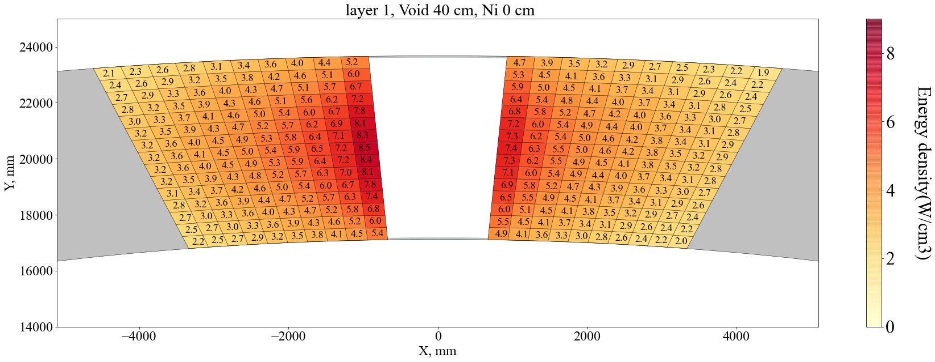
Удельные тепловыделения в диске модулятора без установки дополнительного никелевого отражателя, Вт∙см-3

Slide 17
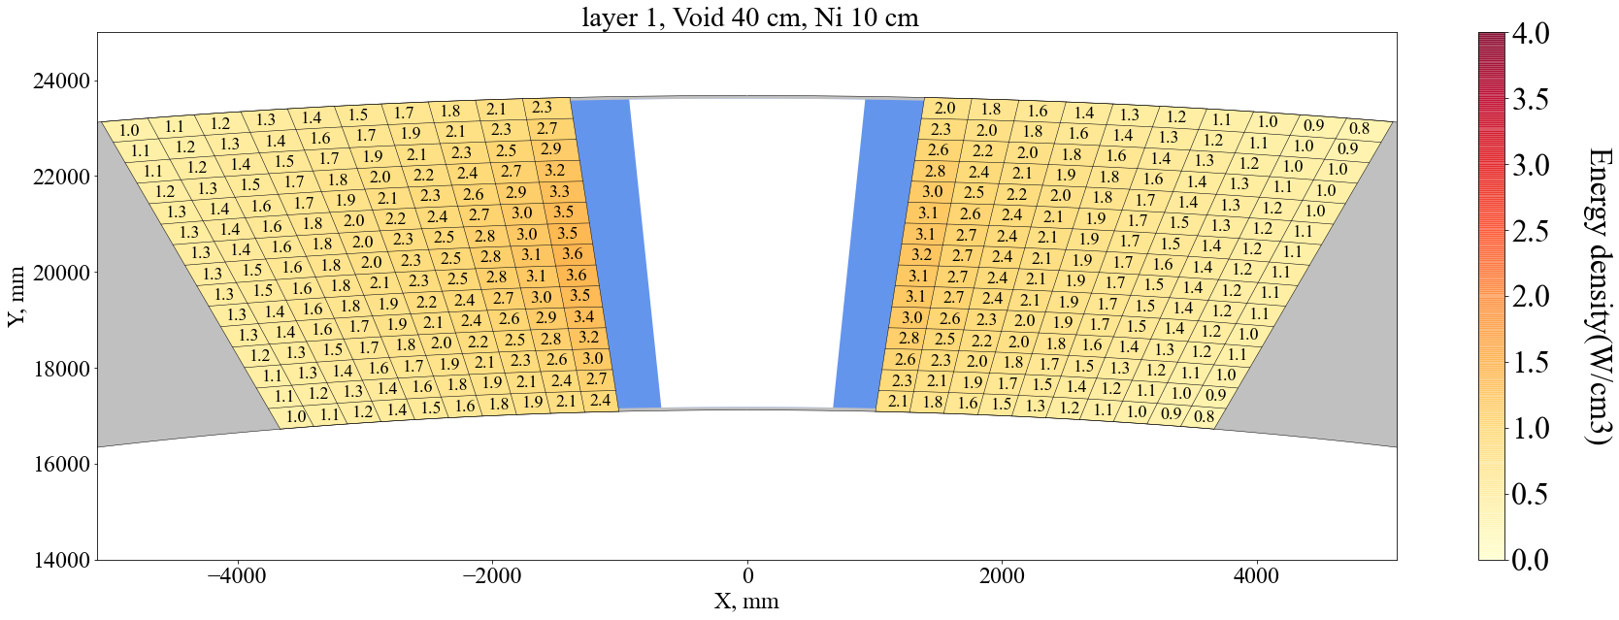
Удельные тепловыделения в диске модулятора с установкой 10 см дополнительного никелевого отражателя, Вт∙см-3

Slide 18
Thank you
Any questions?

Slide 19
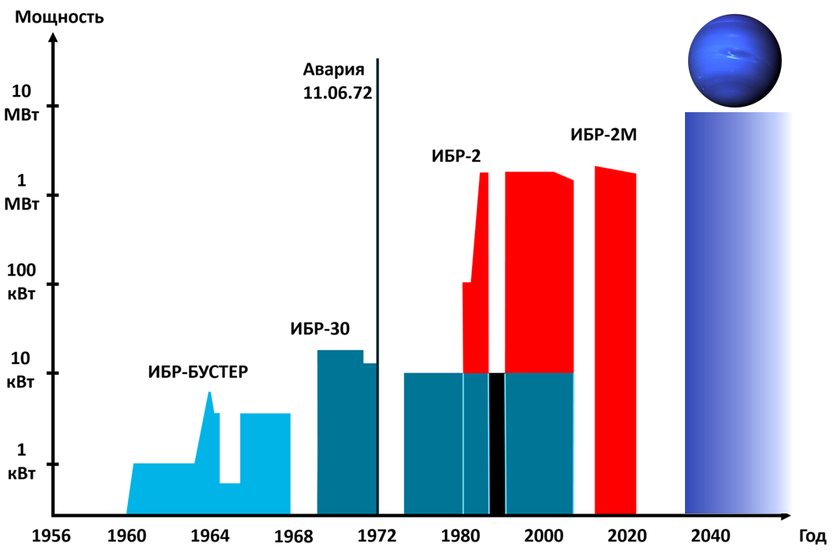

Slide 20
Change of K-eff with reactor company time

