Slide 1
Comparison of two methods for processing signals from neutron counters based on a scintillator 6LiF/ZnS(Ag) and optical fibers
Podlesnyy M. M., Bogdzel А. А., Milkov V. M.
Alushta-2023

Slide 2
Outline
Introduction
Experimental setup
Results
Conclusion

Slide 3
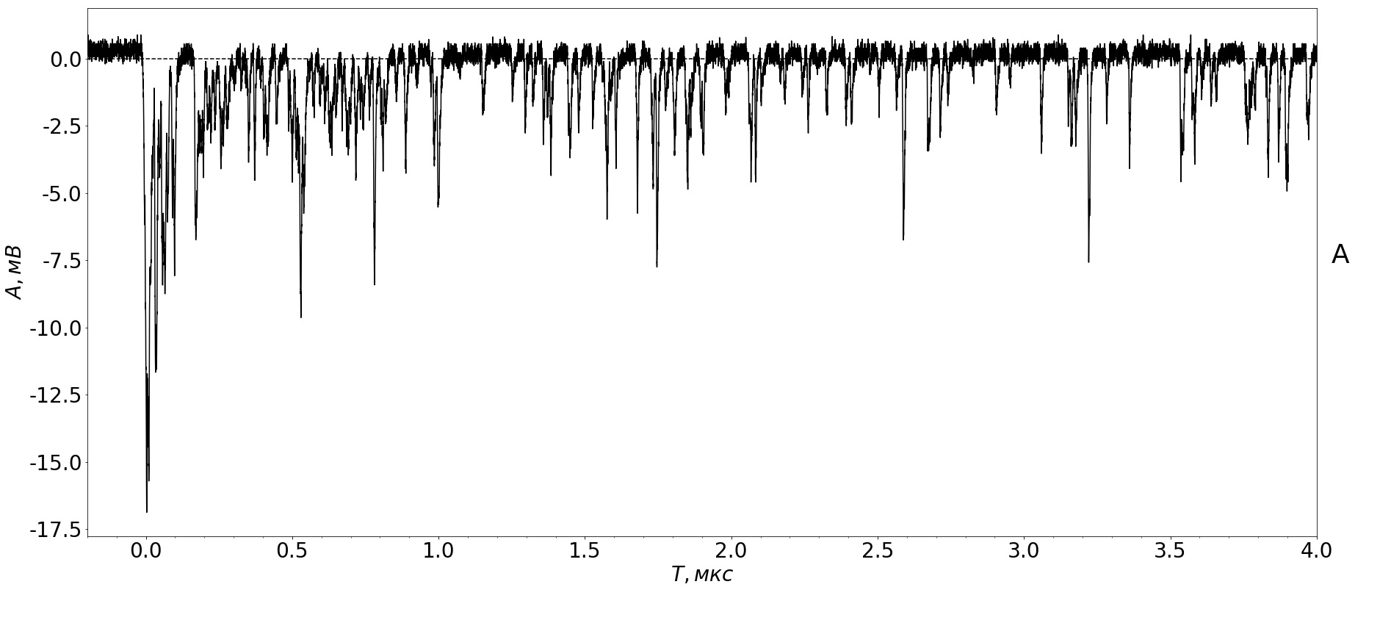
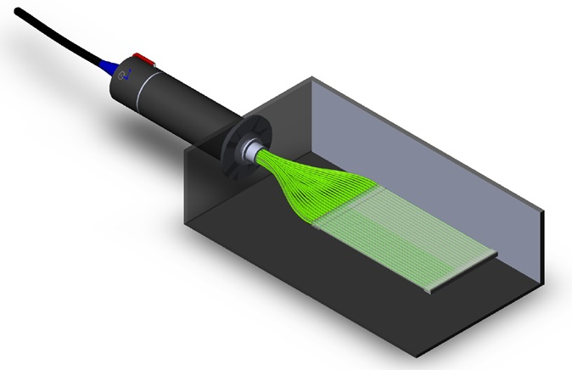
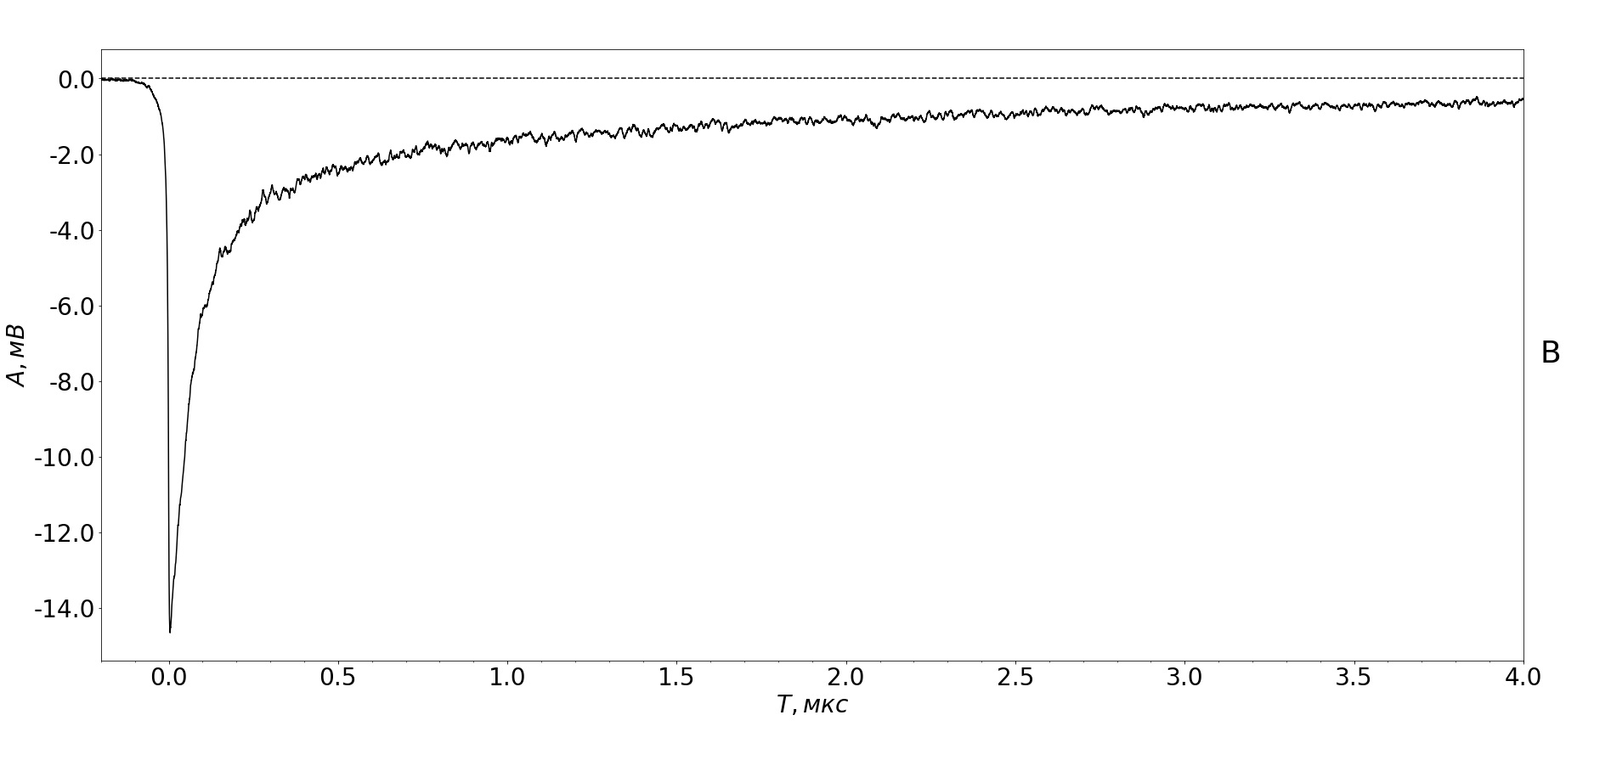
Detector efficiency
1 signal
Efftotal= Effconv * Effsignal
Mean signal (500 avg.)

Slide 4
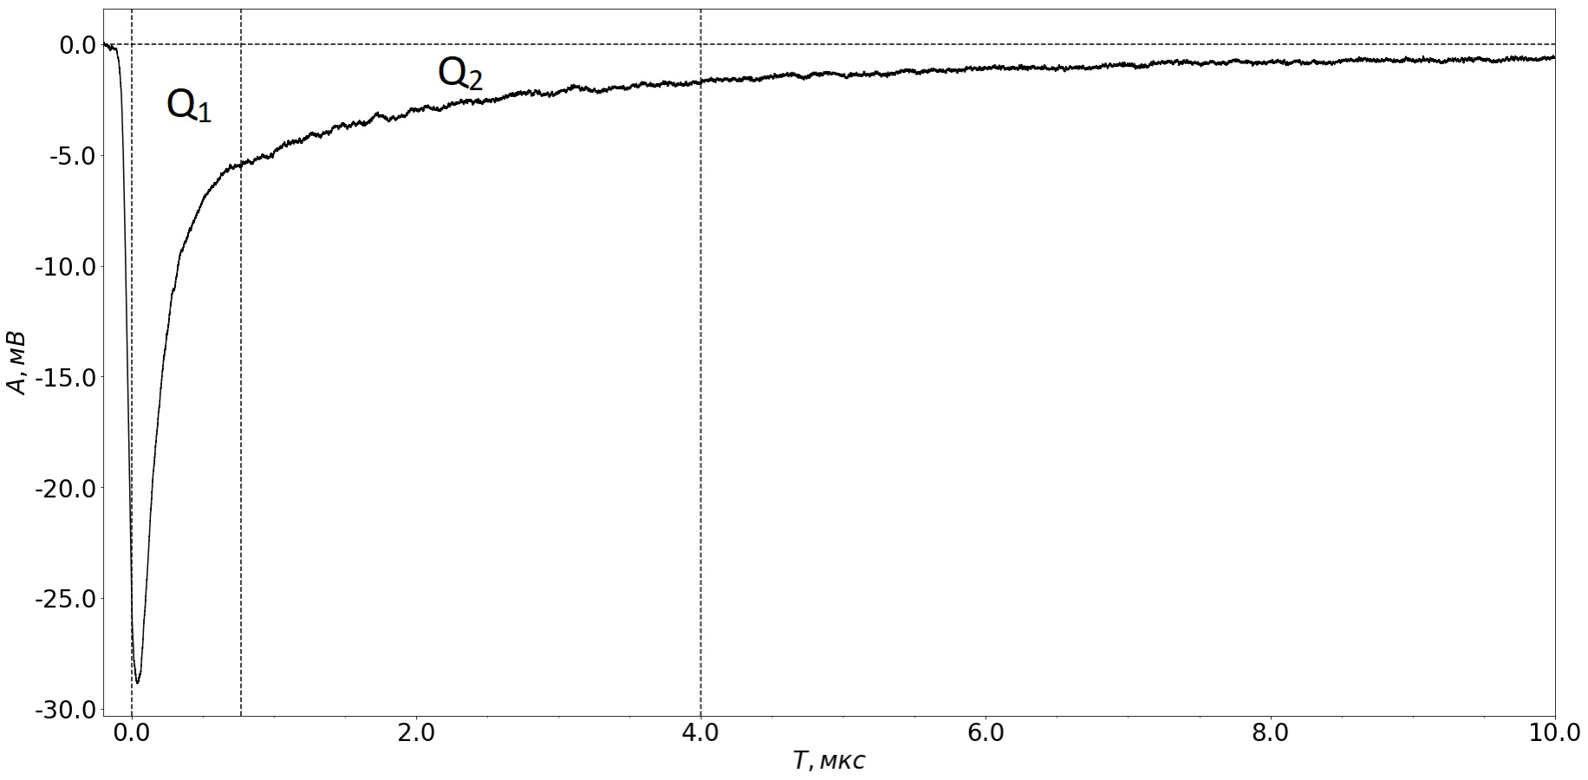
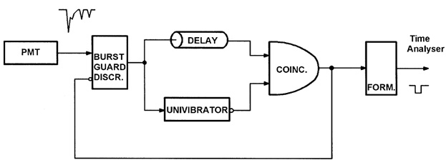
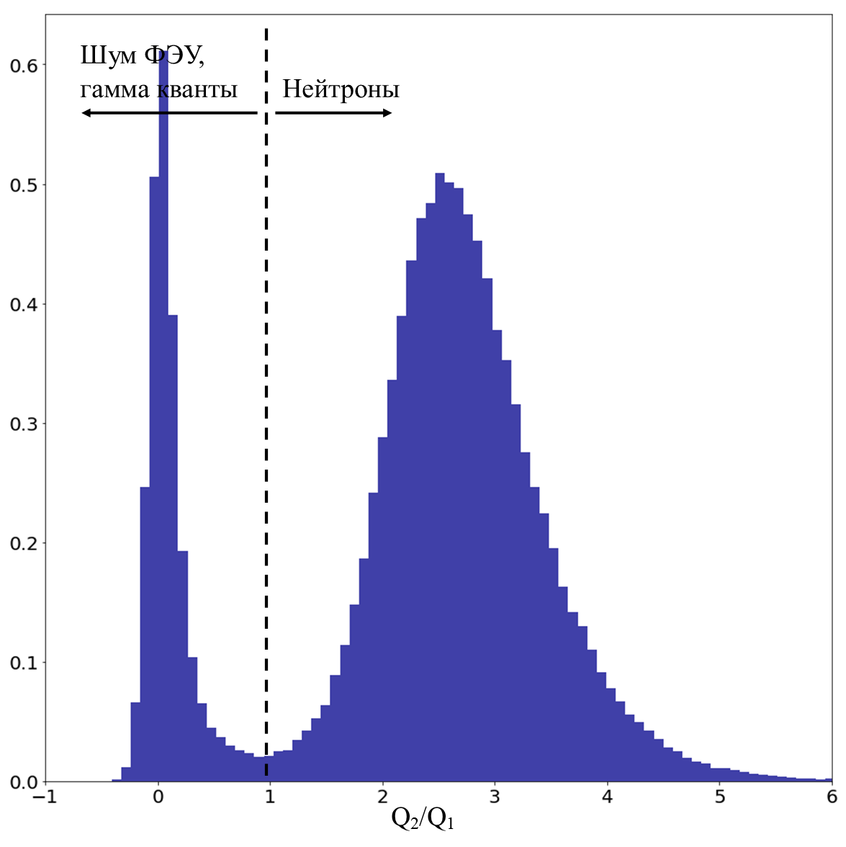
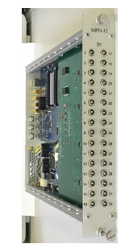
Comparison of 2 methods
Pulse shape discrimination method (PSD)
Timing filter
t > tveto
PSD = Q2/Q1
tdead time
MPD-32
Digitiser
N6730,
Caen

Slide 5
Formulation of the experiment
Goal – comparison of 2 methods at different neutron flux.
Subject – neutron count rate, percentage of false counts.
Variables: Dead time, Analog shaping time.
Input parameters should be the same for both methods.
Criteria for false event identification should be the same for both methods.

Slide 6
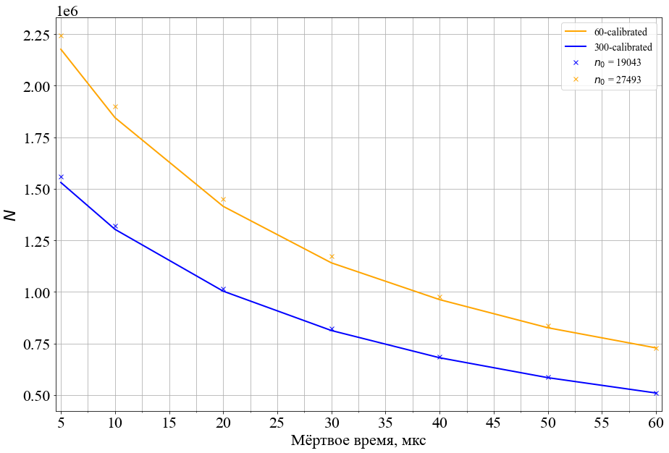
False event criteria
Recording shape of signals (too long and difficult)
Δt between consecutive signals (MPD-32)
Comparison events count rate with «non-paralyzable dead time curve»: N = n*t/(1+n𝜏)
The main problem is to guarantee right identification of neutron events

Slide 7
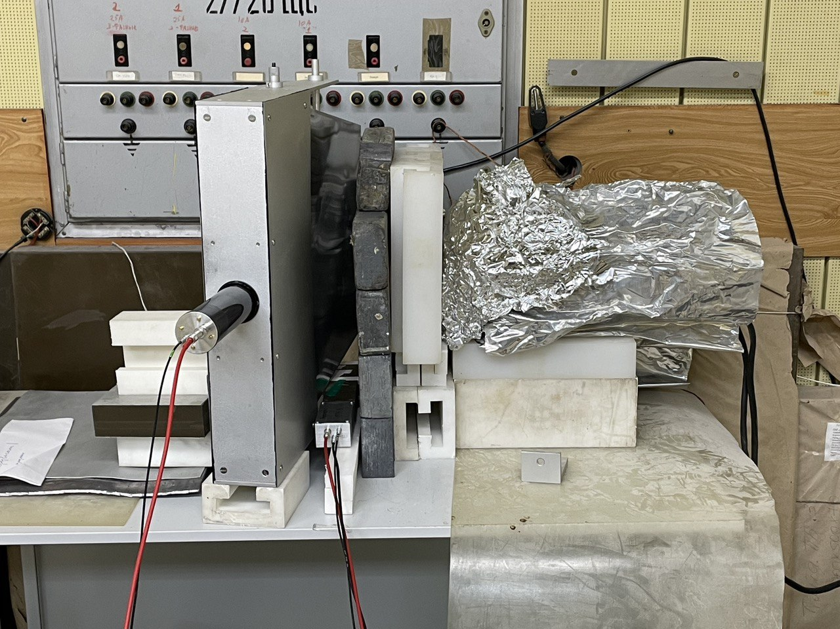
Experimental setup
2 neutron sources (²⁵²Cf incapsulated and neutron generator)
2 neutron counters (50 cm² and 1400 cm²)
PMT signal supplies on amplifier (х50) with implemented RC integrated chain (45, 130, 300 ns), then doubled and supplies on MPD-32 and digitiser N6730, Caen
Neutron generator (~ 2*10⁷ n/s in 4pi)
ASTRA-M detector element (1400 cm²)

Slide 8
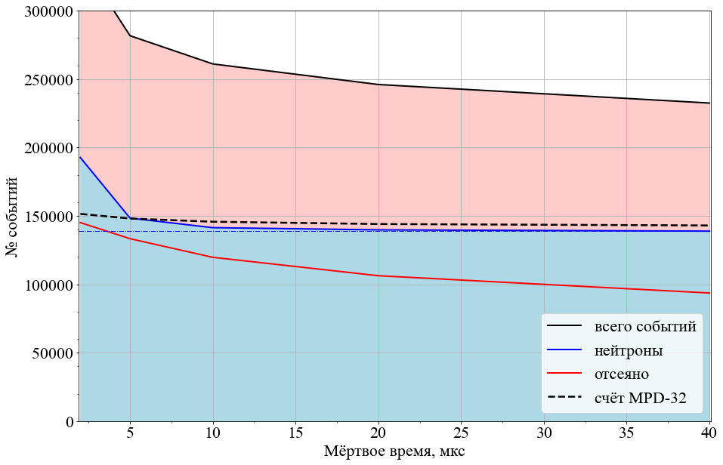
Measurements with ²⁵²Cf and a test counter (~100 n/s)
Tshaping = 45 ns
t of measurement = 1000 s
Threshold = 21 mV
MPD-32
tveto = 96 ns
Дигитайзер
Gates 100 ns и 1000 ns

Slide 9
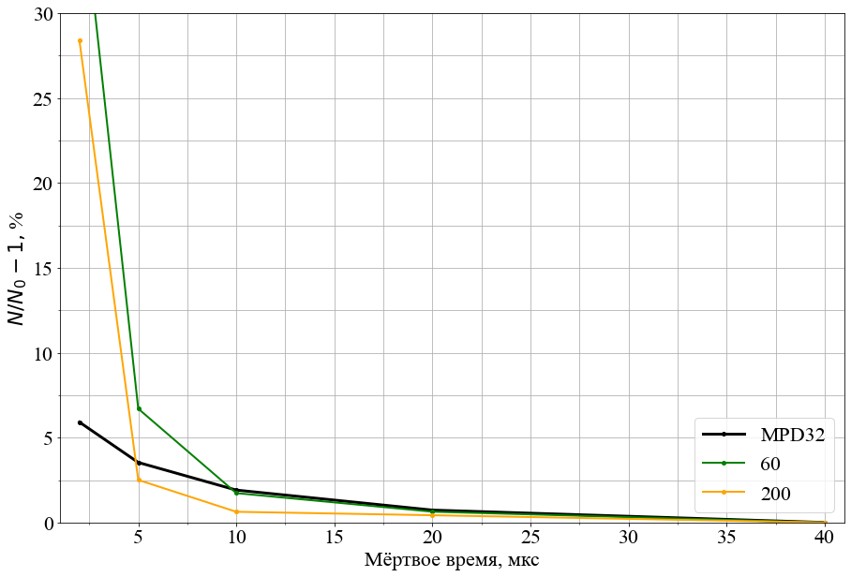
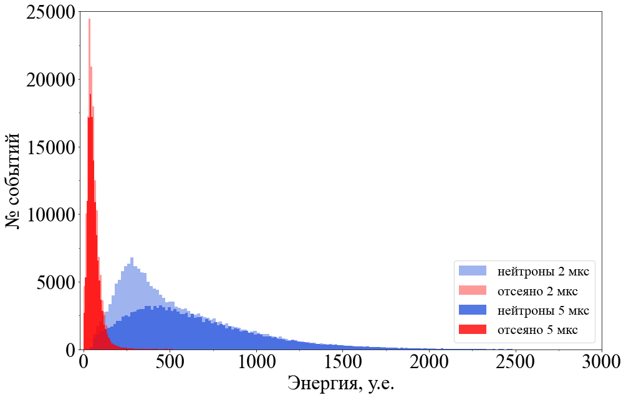
Measurements with ²⁵²Cf and a test counter (~100 n/s)
% of false counts with low sample rate <6% for MPD-32
PSD method work properly for d.t.≥ 5 mks
% of false counts
Amplitude spectrum
Dead time
Additional amplitude filter

Slide 10
Measurements with a neutron generator and ASTRA-M counter
Shaping time 45 ns
t of measurement = 100 s
Threshold = 21 mV
filtered events trigger dead time lasting ~20% of the entire measurement

Slide 11
Measurements with a neutron generator and ASTRA-M counter
Shaping time 300 ns
t of measurement = 100 s
Threshold = 21 mV
an increase in shaping time led to a decrease in the efficiency by 33%

Slide 12
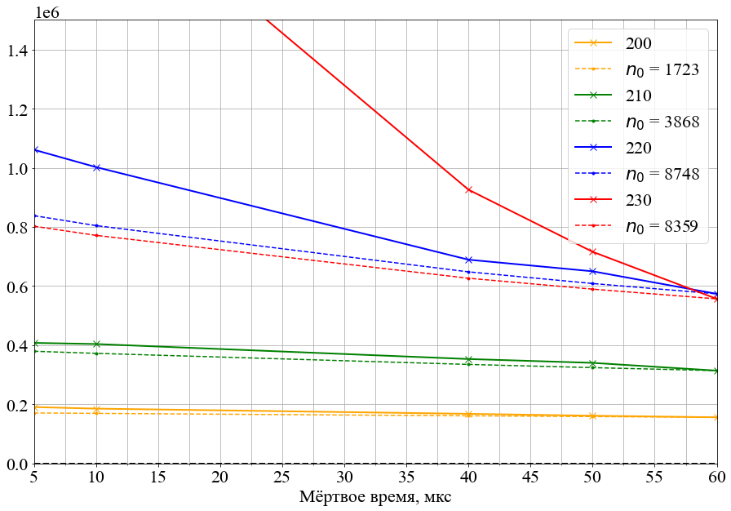
MPD-32 counting curves with different thresholds
Shaping time 45 ns
MPD-32 counts ~9kHz properly, then curve falls (66% loss)
Digitiser counts neutrons properly 2 times more

Slide 13
Conclusion
PSD method work properly at high neutron flux.
PSD method with low threshold requires minimum dead time 5 ≥ mks (~12% loss)
Real efficiency loss due to signal processing is ~20-33%.
MPD-32 is very sensitive to setup and has a high losses at high neutron flux (~66%). Why?

Slide 14
Thanks for your attention!

Slide 15
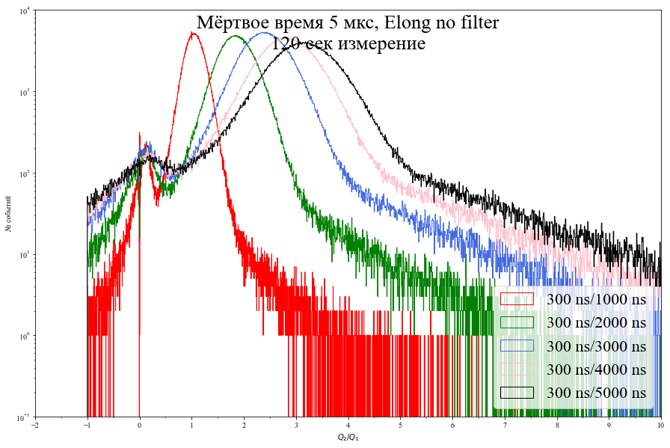
Discussions, discussions, discussions…

Slide 16
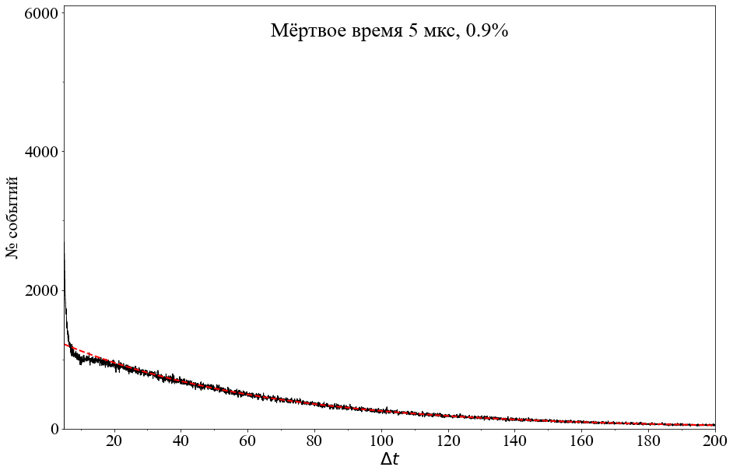
Measurements with neutron generator and a small counter
Shaping time 45 ns

Slide 17
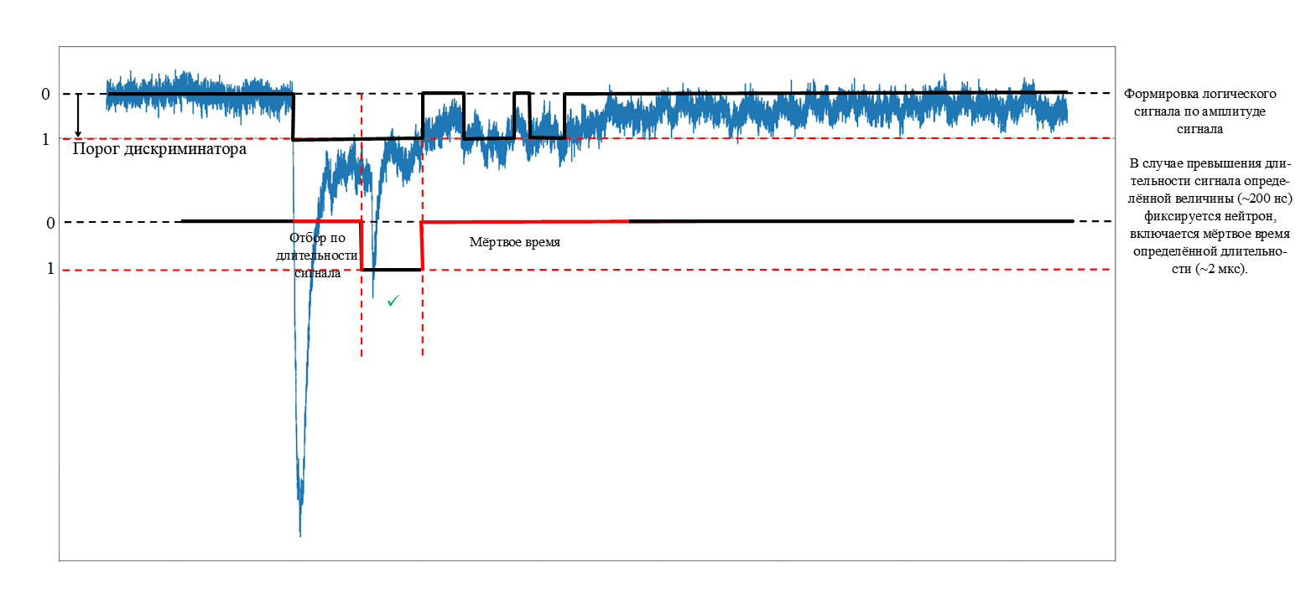
Time filter method

Slide 18
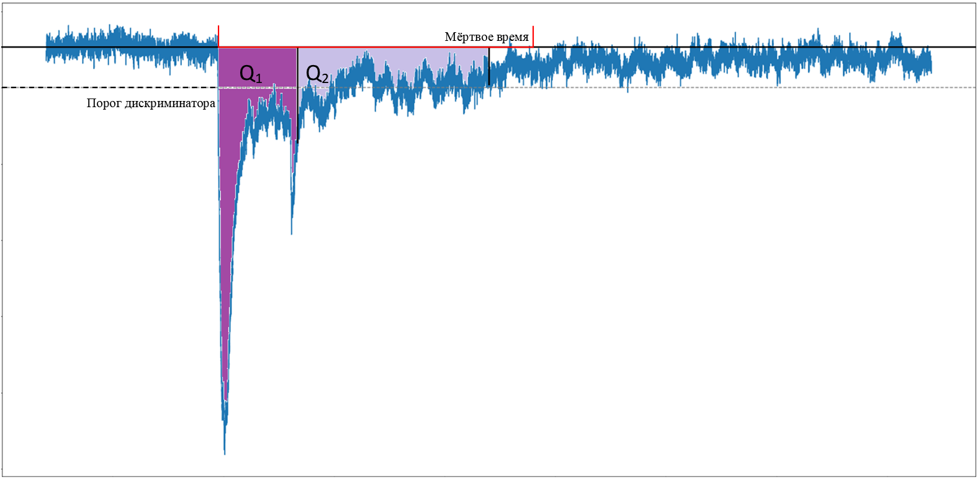
PSD method

