Slide 1
Studying the possibility of hyperon reconstruction in the BM@N experiment at the NICA complex
Made by:
Barak R.
Supervised by:
Merts S.P.
JINR Association of Young Scientists and Specialists Conference "Alushta-2023", 4–11 Jun 2023

Slide 2
Introduction
Collisions of heavy relativistic ions allow us to study nuclear matter at extreme density and temperature.
At sufficiently high temperature and energy density, the so-called Quark-Gluon Plasma (QGP) is formed [1]:
  Hyperon formation.
Theoretical models offer different descriptions [2],[3]:
  New experimental data is needed for clarification.
[1] Kapishin.M, “Studies of baryonic matter at the BM@N experiment (JINR).” Nuclear Physics A 982 (2019) 967–970.
[2] J. A. et al Nucl. Phys., vol. A 757, pp. 102–183, 2005.
[3] K. A. et al Nucl. Phys., vol. A 757, pp. 184–283, 2005.

Slide 3
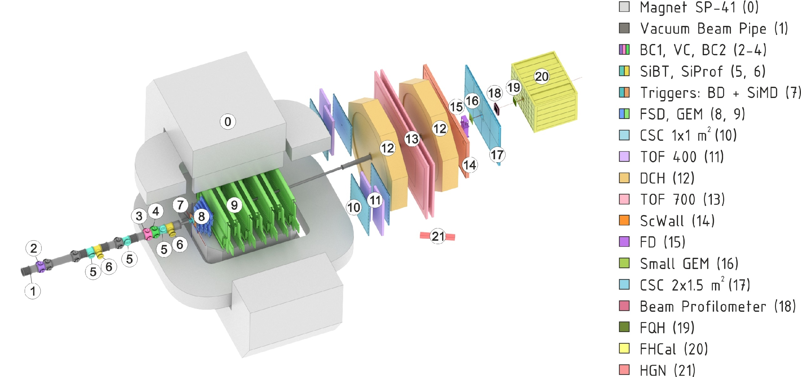
BM@N experiment at the NICA complex
Collisions of elementary particles and ions with a stationary target at energies up to 4 GeV per nucleon.
Experimental setup of BM@N
NICA accelerator complex

Slide 4
Goal of the work
Search for hyperons in the data of the BM@N experiment.
Tasks
Modelling and reconstruction of data for analysis.
Development and implementation of a hyperon reconstruction algorithm in bmnroot.
Determination of the sources of background increment in the mass distribution.
Investigation of the influence of background sources on the quality of reconstruction.

Slide 5
Data
Data obtained from the Monte Carlo generator DCMSMM [4] was used for the analysis. 100,000 events were simulated and reconstructed.
[4] Baznat M., Botvina A., Musulmanbekov G., Toneev V., Zhezher V. Monte-Carlo Generator of Heavy Ion Collisions DCM-SMM, Physics of Particles and Nuclei Letters 17, 3, 303-324 (2020)

Slide 6
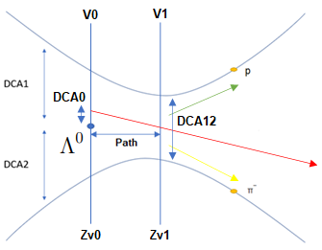
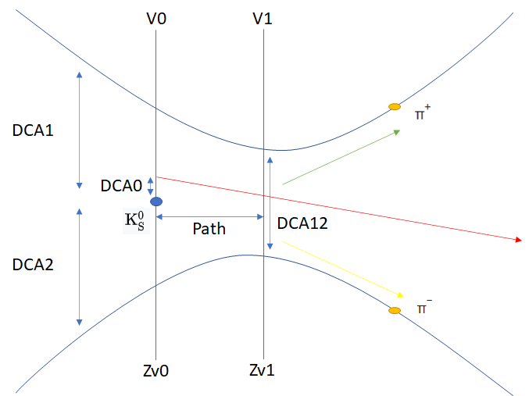
Data processing
Algorithms were developed and implemented to enable the search for the trajectories of lambda hyperons along the decay channel into a proton and negative pi-meson and short-lived neutral kaons along the decay channel into positive and negative pi-mesons:
  Sorting of pairs of particles with different signs.
  Calculating the invariant mass.
  Imposing a number of geometric restrictions on the parameters of each pair.

Slide 7
Sources of background increment
Blurring of the beam
  In the least realistic case, the beam is assumed to be point like. In reality, there is beam blurring in the transverse plane, as well as a small spread in angle.
SiMD, BD
  The production of secondary particles and, as a consequence, an increase in the background in the mass distribution of lambda hyperons, can be affected by the presence of the substance of trigger detectors located after the target and before the track detectors.
Target
  Since the target is an extended object, in addition to the primary interaction of the beam with the target, there will be interactions of secondary particles with the target nuclei. This might also be a source of the background increment in the mass spectra.

Slide 8
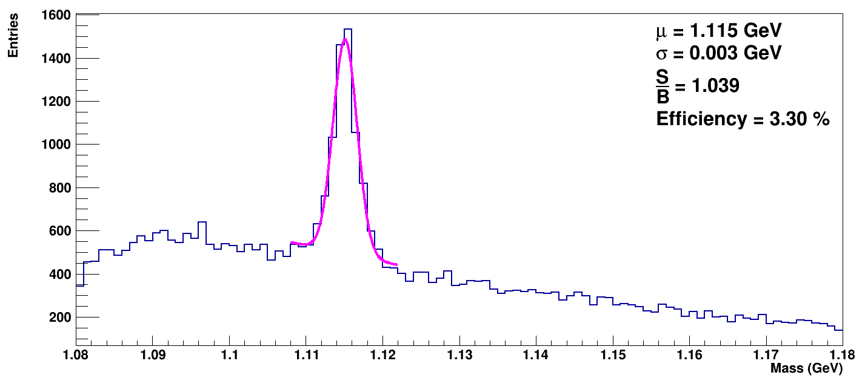
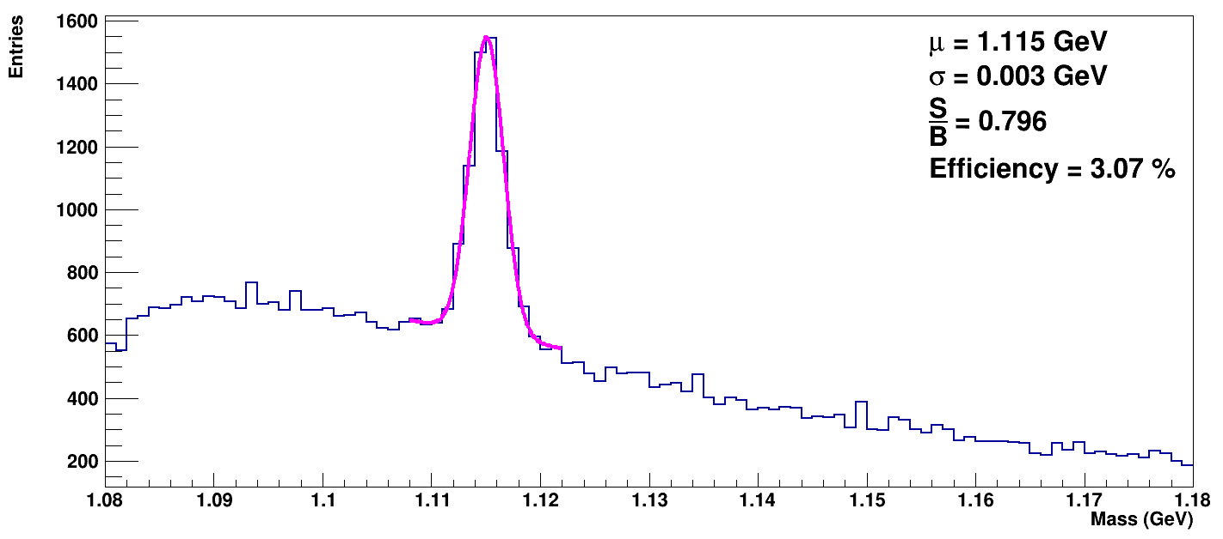
Results
Lambda hyperons
Ideal case
SiMD, BD, target and beam blurring
Cuts
  3.0 < path < 20
  0.0 < DCA12 < 0.4
  0.0 < DCA0 < 0.2
  0.1 < DCA1 < 3.0
  0.3 < DCA2 < 3.0

Slide 9
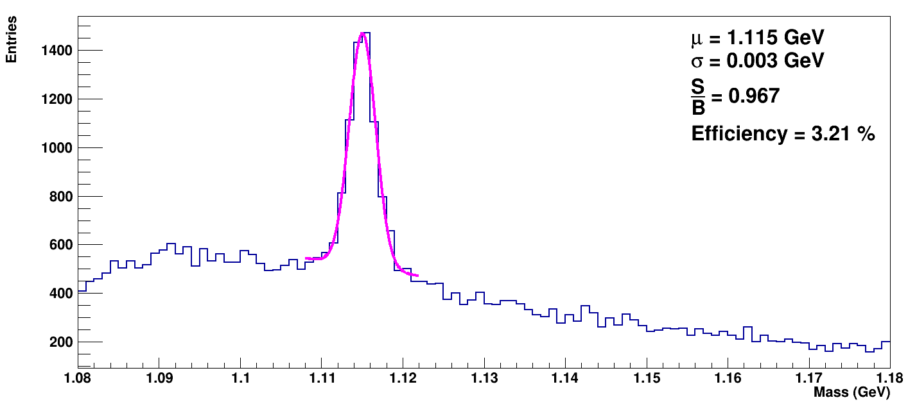
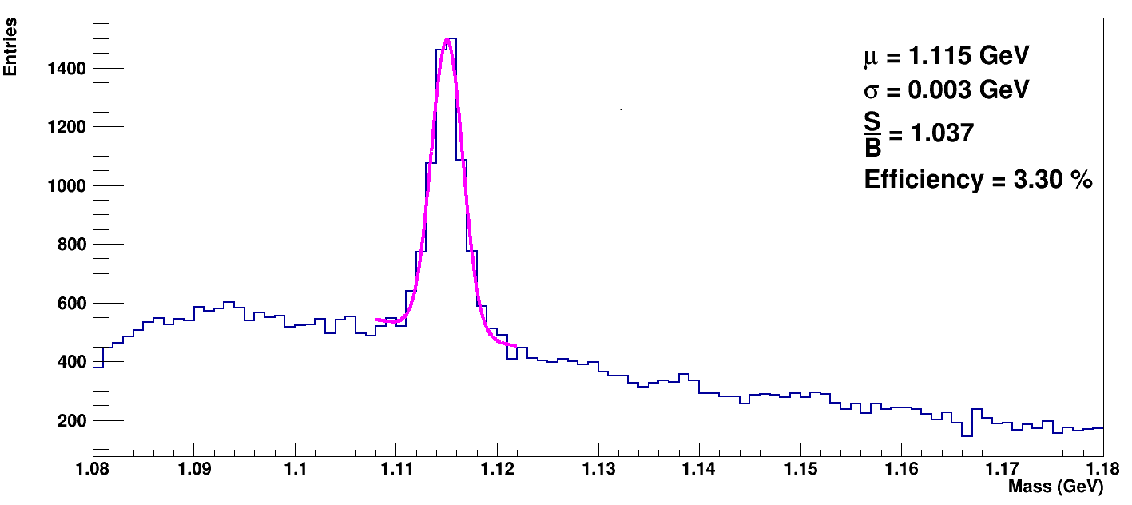
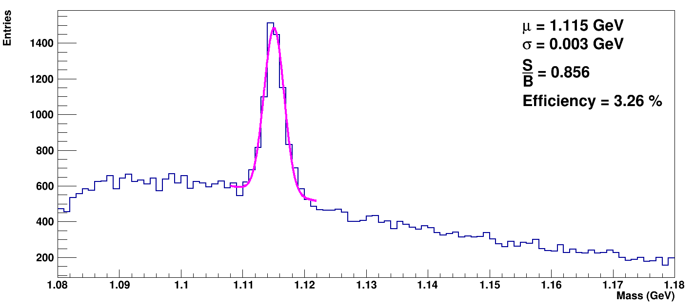
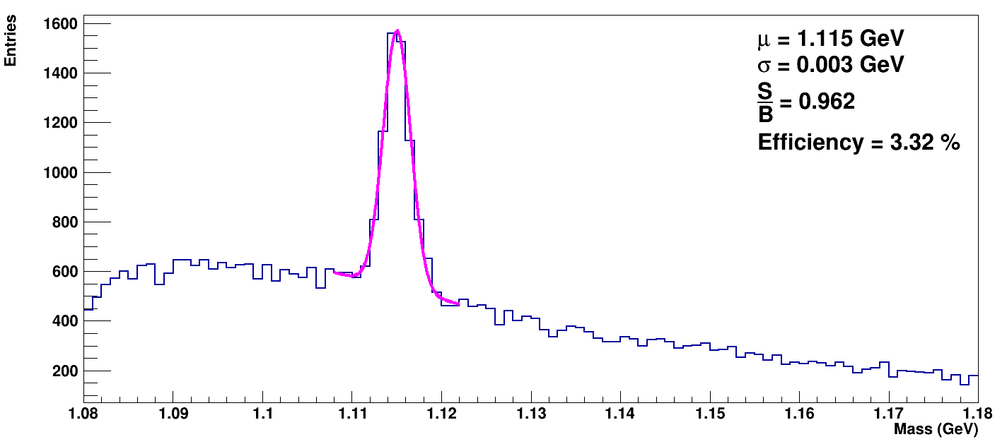
Results
Lambda hyperons
SiMD
BD
Beam blurring
Target

Slide 10
Results
Lambda hyperons
 | Ideal case | SiMD, BD, target и размытие пучка | SiMD | BD | Target | Beam blurring
µ (GeV) | 1.115 | 1.115 | 1.115 | 1.115 | 1.115 | 1.115
σ (GeV) | 0.003 | 0.003 | 0.003 | 0.003 | 0.003 | 0.003
S | 3713 | 3466 | 3606 | 3720 | 3733 | 3480
B | 3574 | 4353 | 3730 | 3588 | 3881 | 4067
S/B | 1.039 | 0.796 | 0.967 | 1.037 | 0.962 | 0.856
Efficiency (%) | 3.30 | 3.07 | 3.21 | 3.30 | 3.32 | 3.26

Slide 11
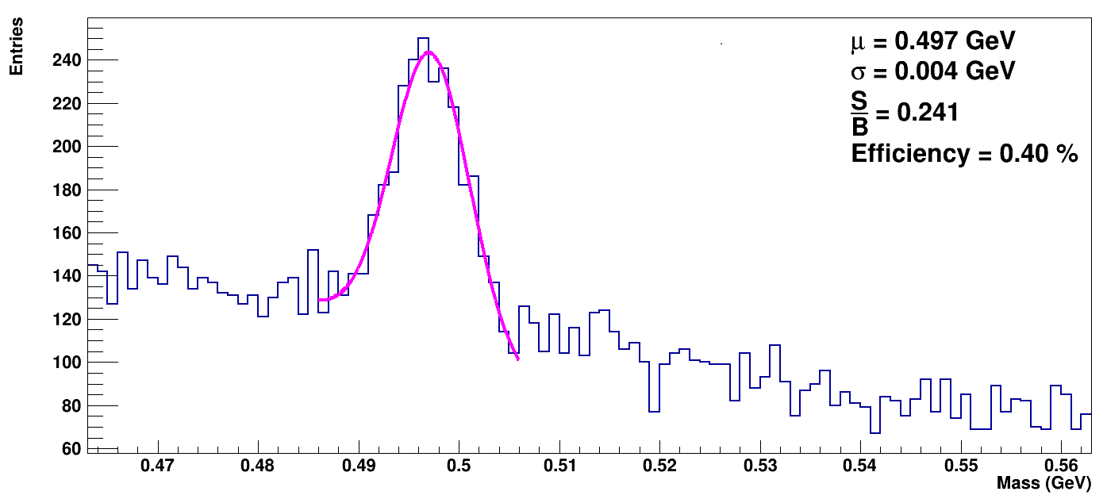
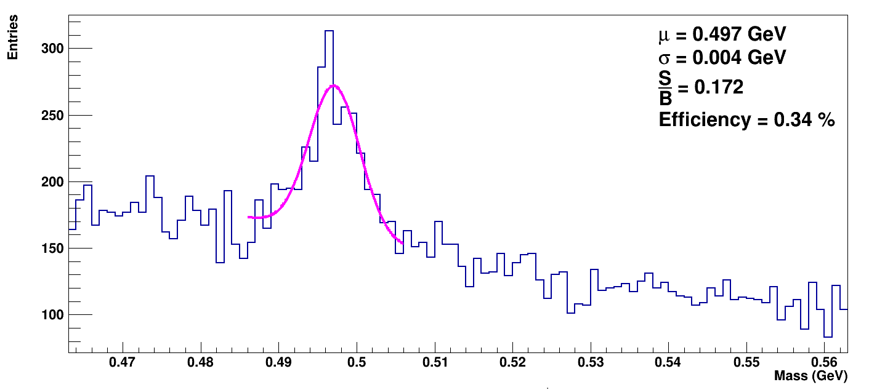

Results
$$K_{S}^{0}$$
Ideal case
SiMD, BD, target and beam blurring
Cuts
  1.0 < path < 20
  0.0 < DCA12 < 0.3
  0.0 < DCA0 < 0.2
  0.2 < DCA1 < 3.0
  0.2 < DCA2 < 3.0

Slide 12
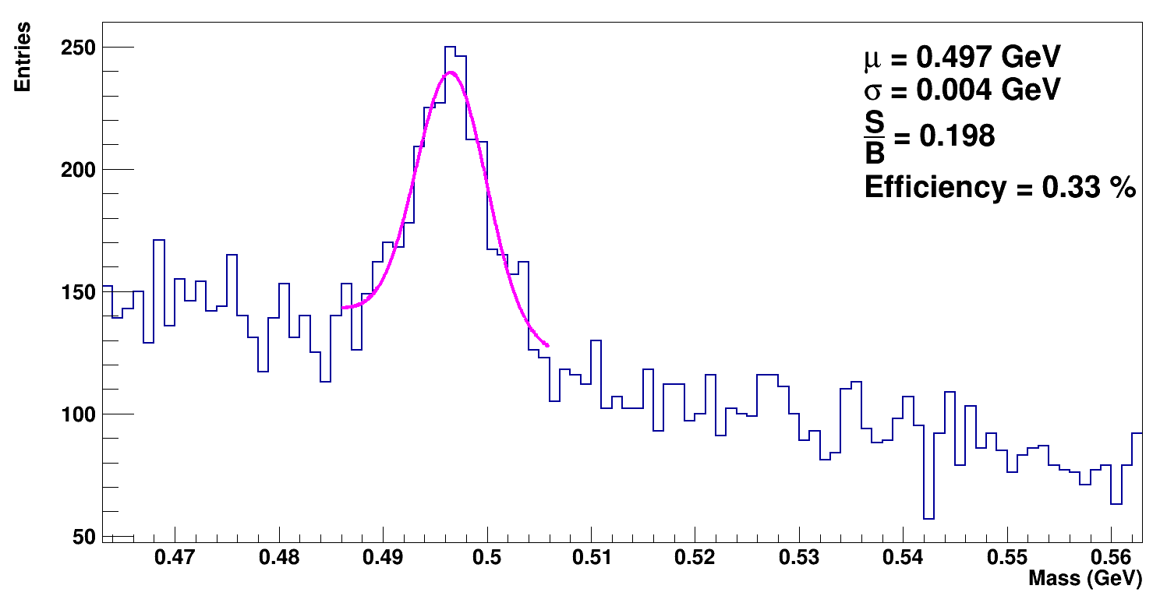
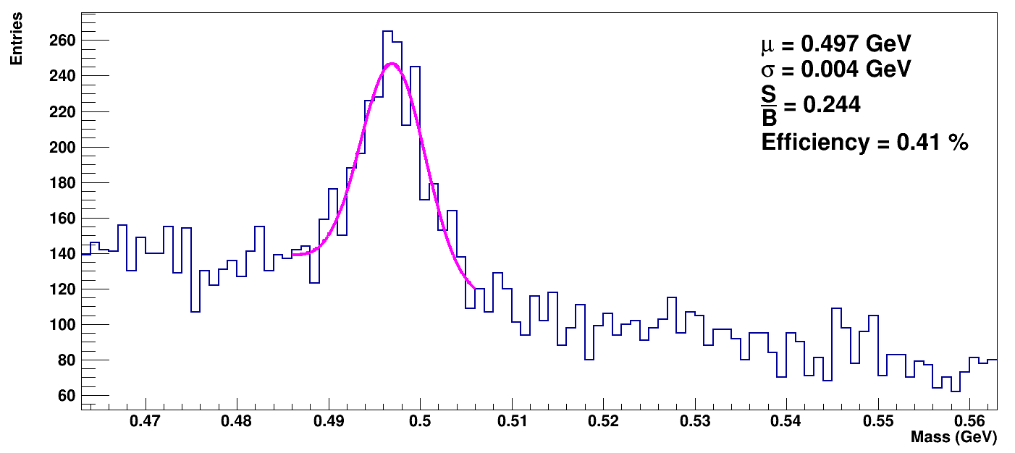
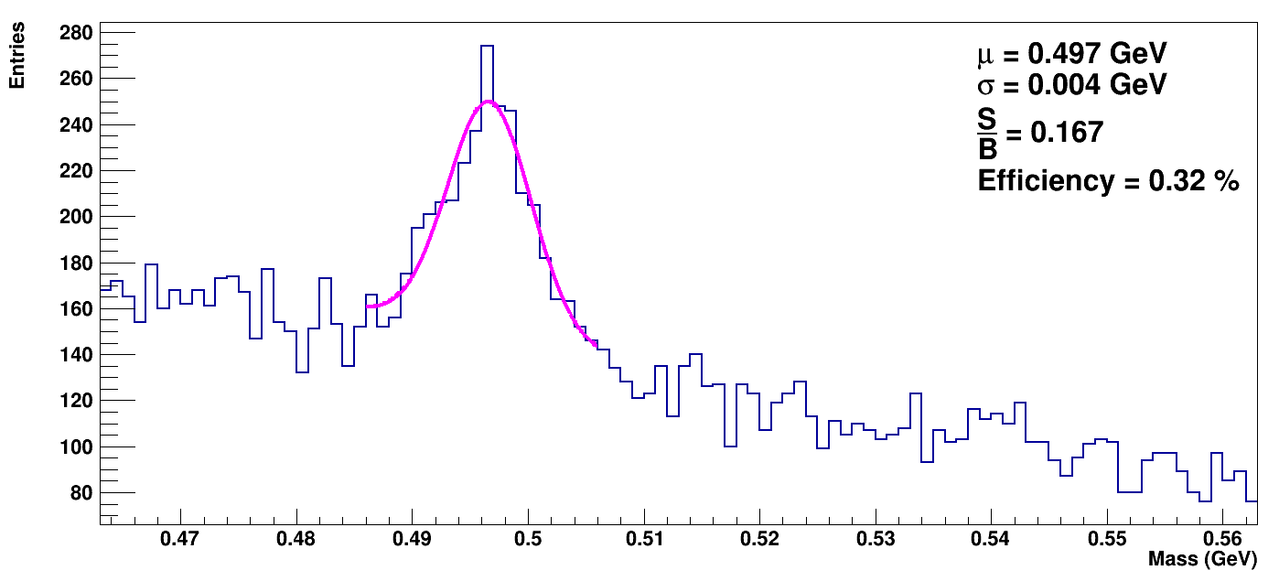
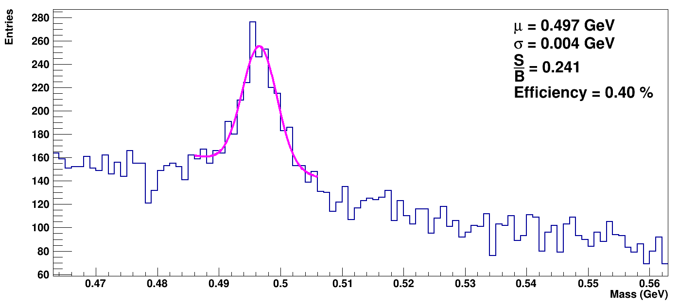
Results
$$K_{S}^{0}$$
SiMD
BD
Beam blurring
Target

Slide 13

Results
$$K_{S}^{0}$$
 | Ideal case | SiMD, BD, target и размытие пучка | SiMD | BD | Target | Beam blurring
µ (GeV) | 0.497 | 0.497 | 0.497 | 0.497 | 0.497 | 0.497
σ (GeV) | 0.004 | 0.004 | 0.004 | 0.004 | 0.004 | 0.004
S | 380 | 323 | 318 | 391 | 389 | 295
B | 1574 | 1882 | 1607 | 1598 | 1617 | 1761
S/B | 0.241 | 0.172 | 0.198 | 0.244 | 0.241 | 0.167
Efficiency (%) | 0.40 | 0.34 | 0.33 | 0.41 | 0.40 | 0.32

Slide 14
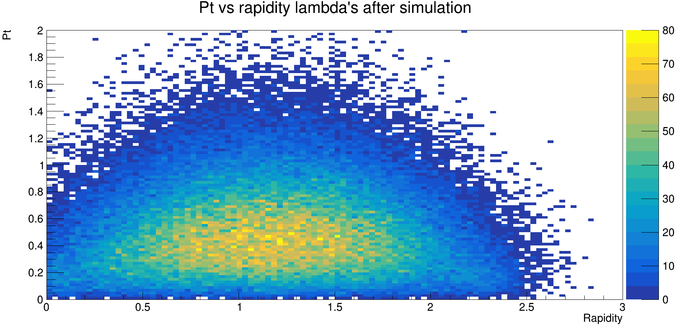
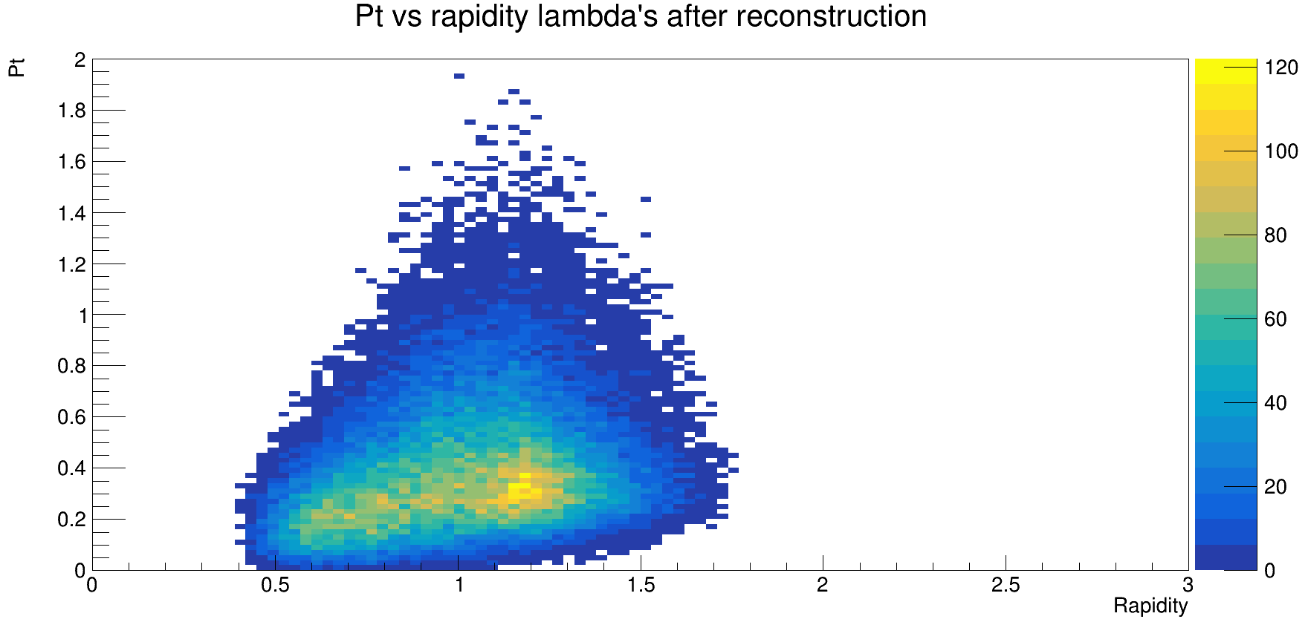
Results
Lambda hyperons

Slide 15
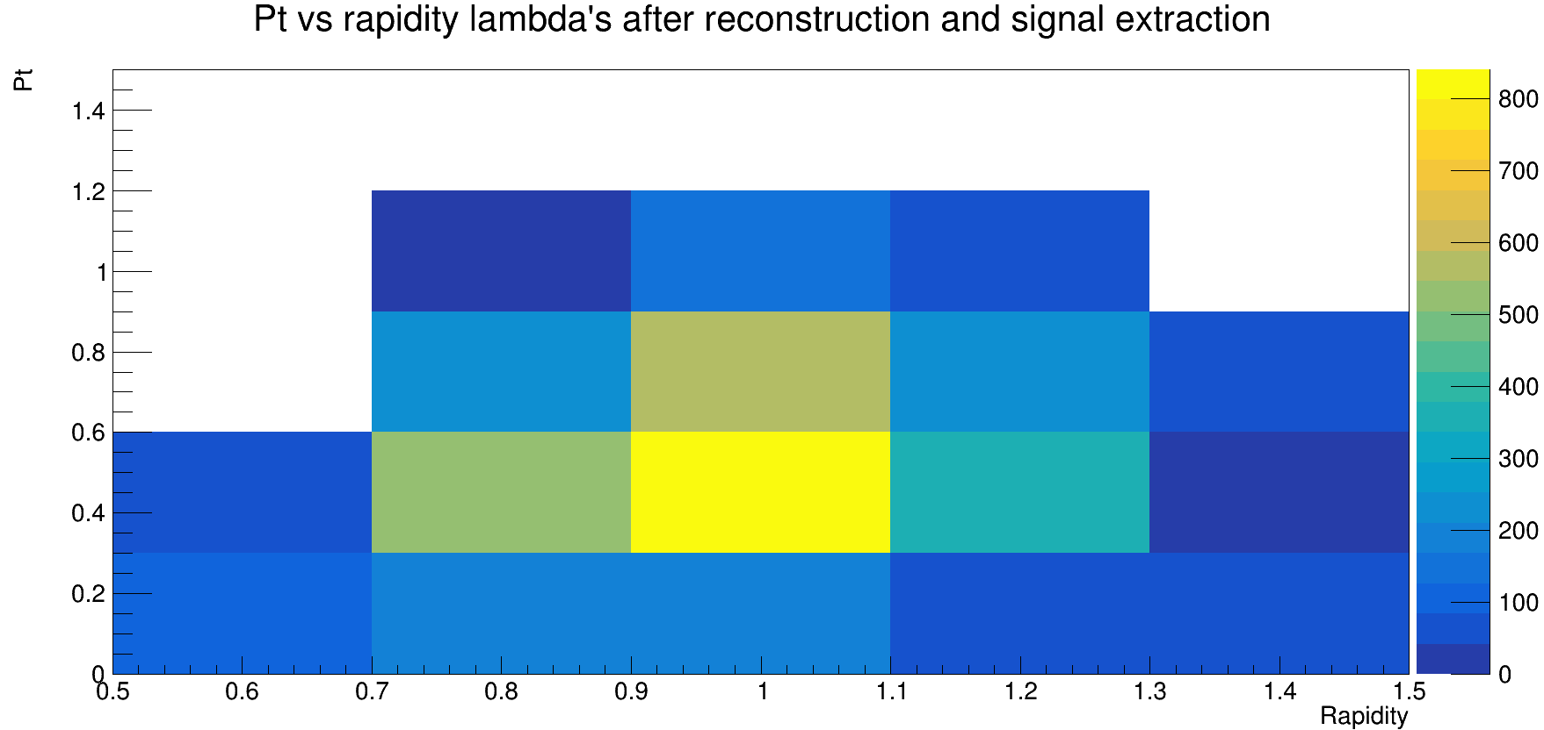
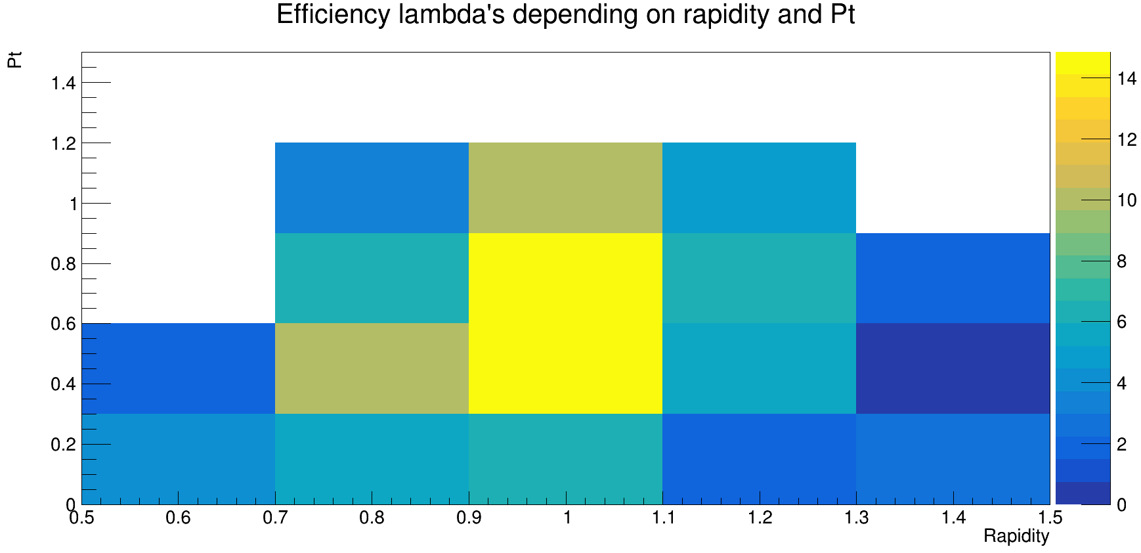
Results
Lambda hyperons

Slide 16
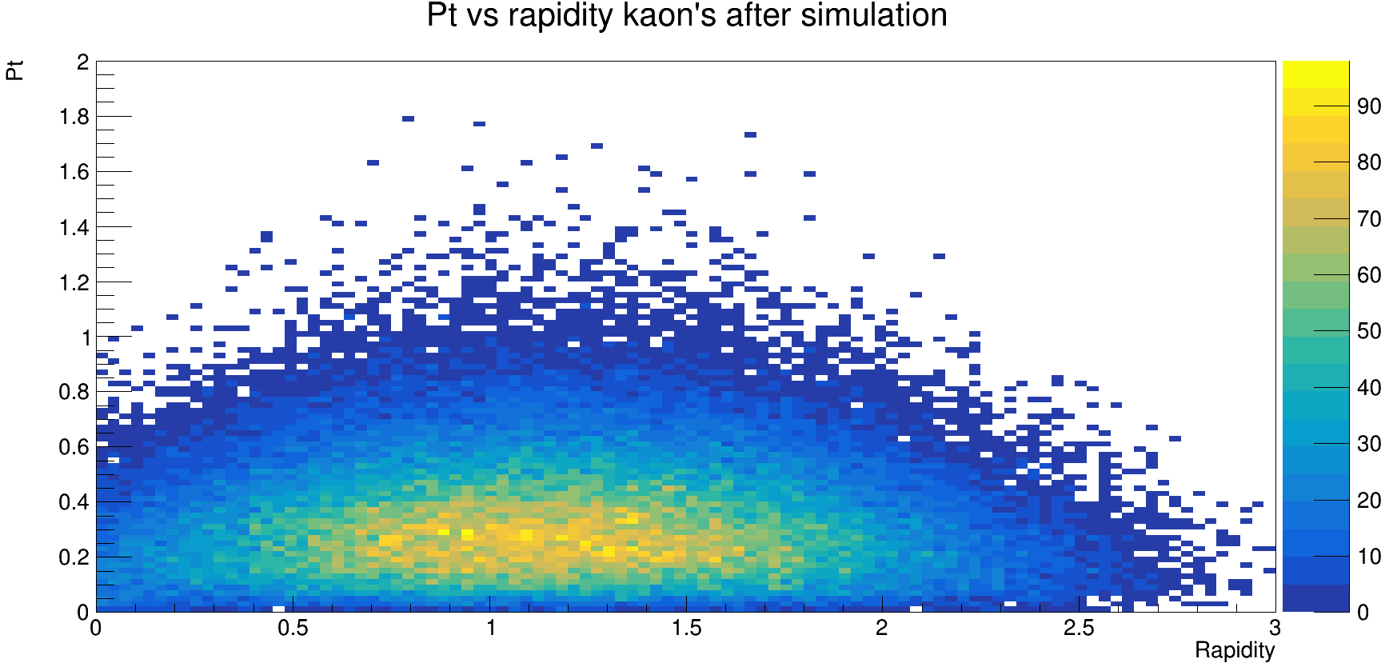
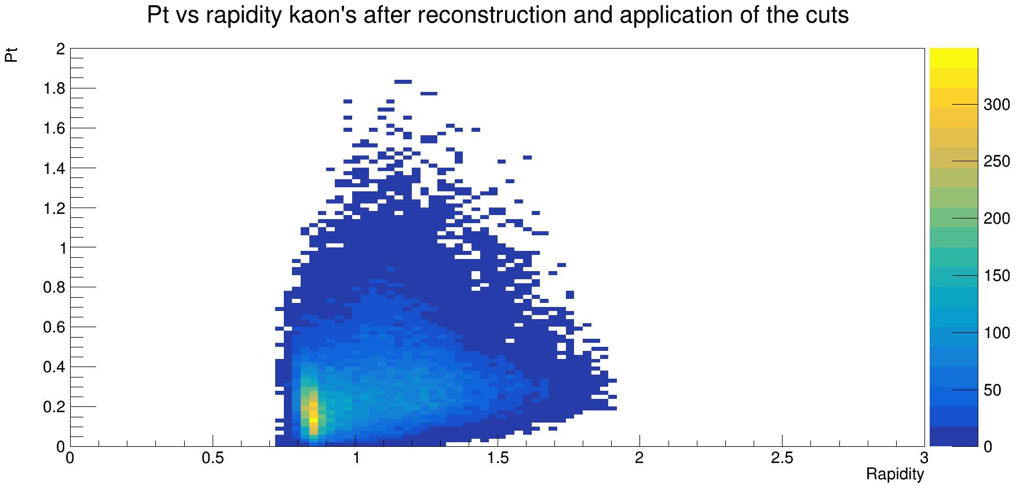

Results
$$K_{S}^{0}$$

Slide 17
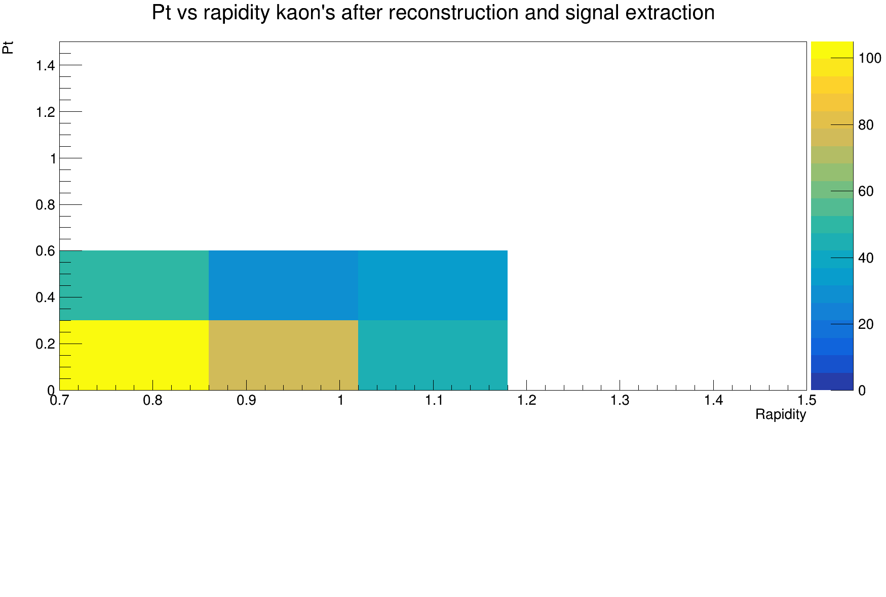
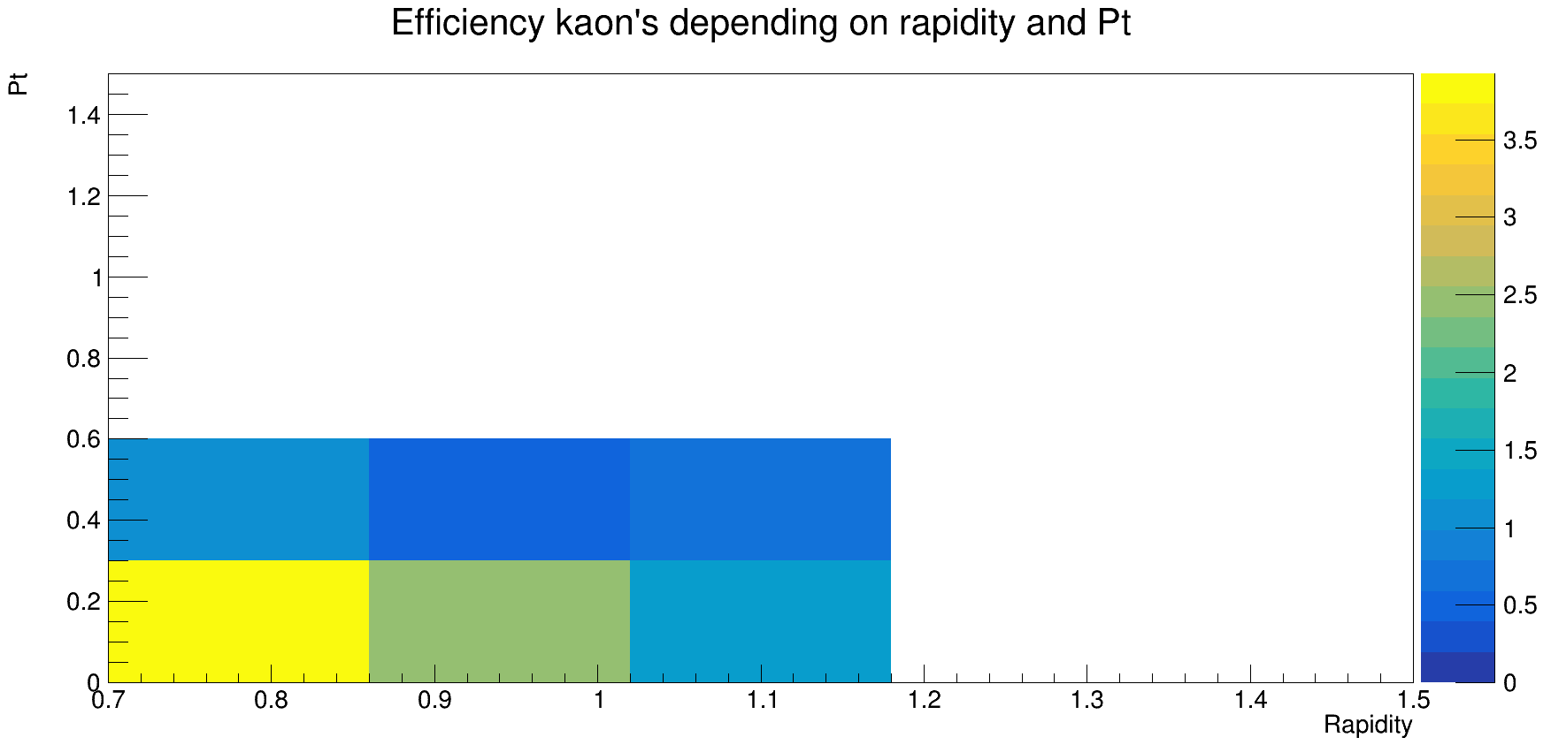
Results
$$K_{S}^{0}$$

Slide 18
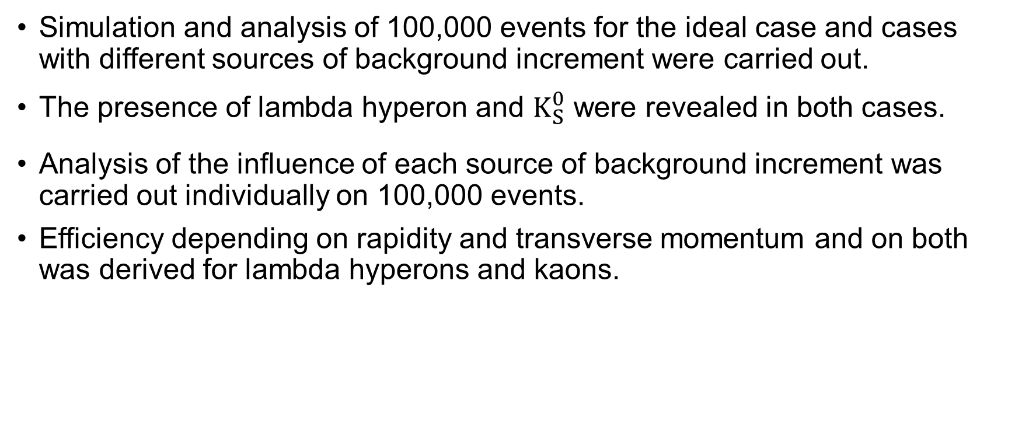
Conclusion
Simulation and analysis of 100,000 events for the ideal case and cases with different sources of background increment were carried out.
The presence of lambda hyperon and $K_{S}^{0}$ were revealed in both cases.
Analysis of the influence of each source of background increment was carried out individually on 100,000 events.
Efficiency depending on rapidity and transverse momentum and on both was derived for lambda hyperons and kaons.

Slide 19
Future work
Study of the effects of rotating the silicon stations by a certain angle on the recovery of strange particles.
Verification of the algorithm on experimental data.

Slide 20
Thank you for your attention!

Slide 21


Slide 22
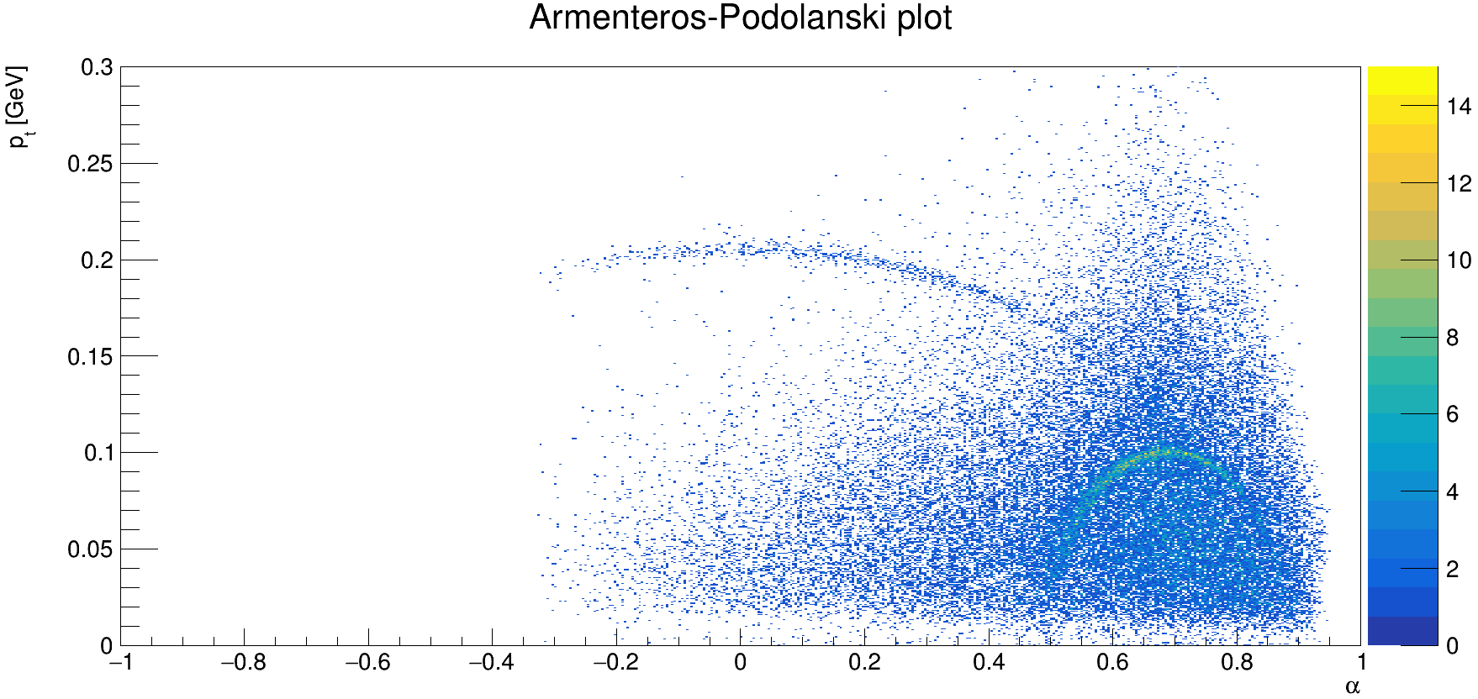
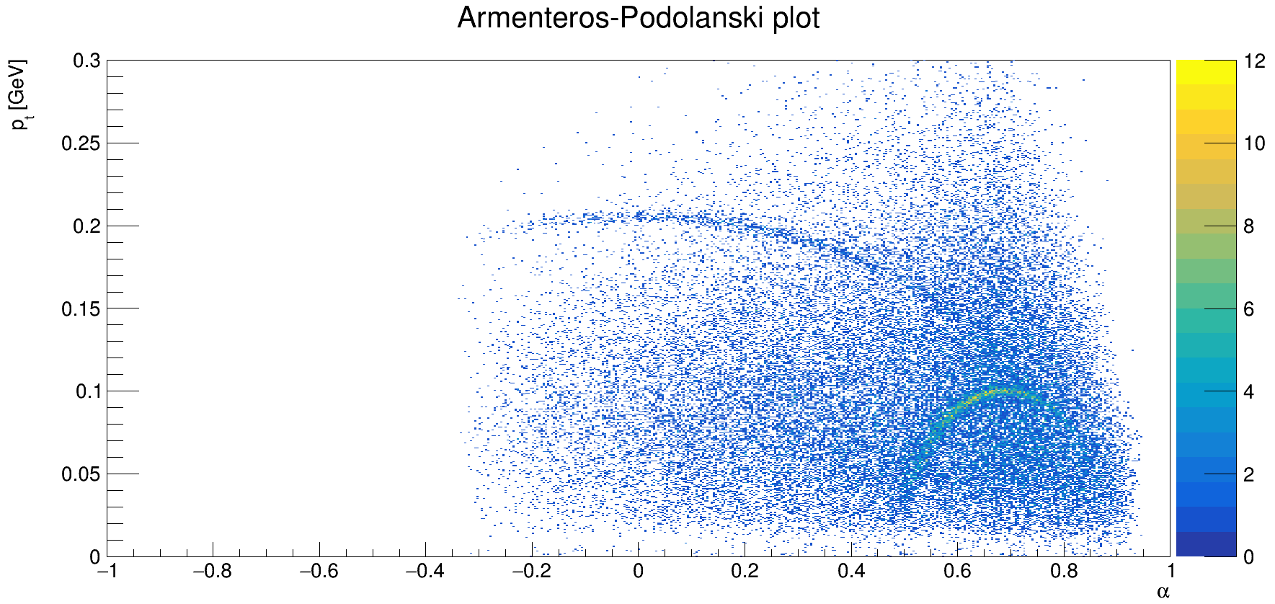

Results
Armenteros-Podolanski plots
Algorithm for lambda hyperon reconstruction
Algorithm for $K_{S}^{0}$ reconstruction

Slide 23
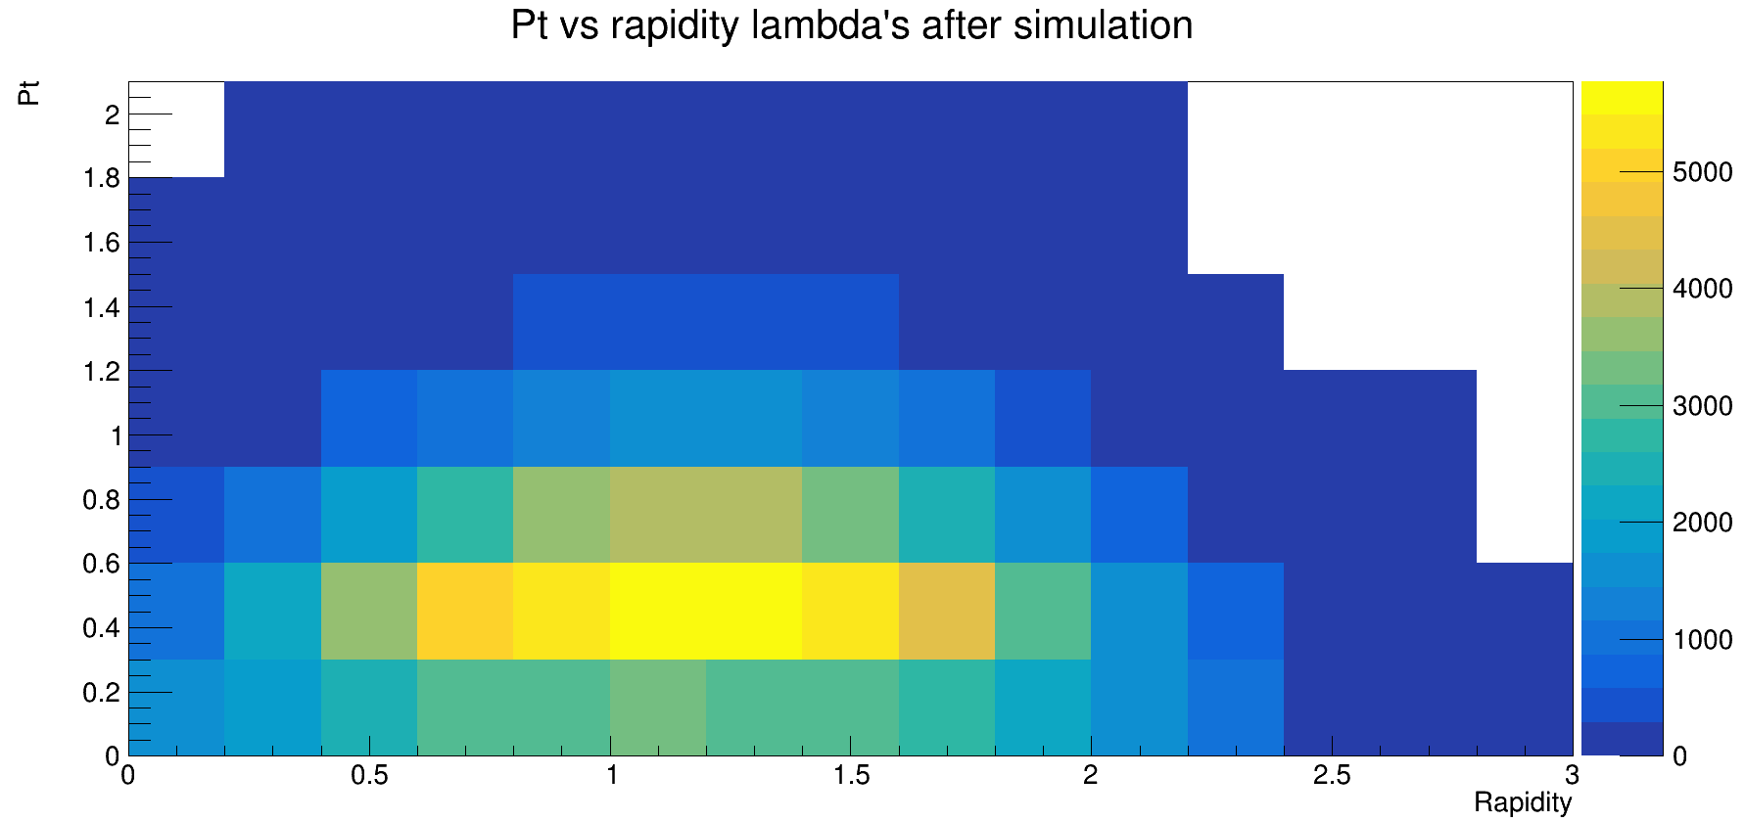
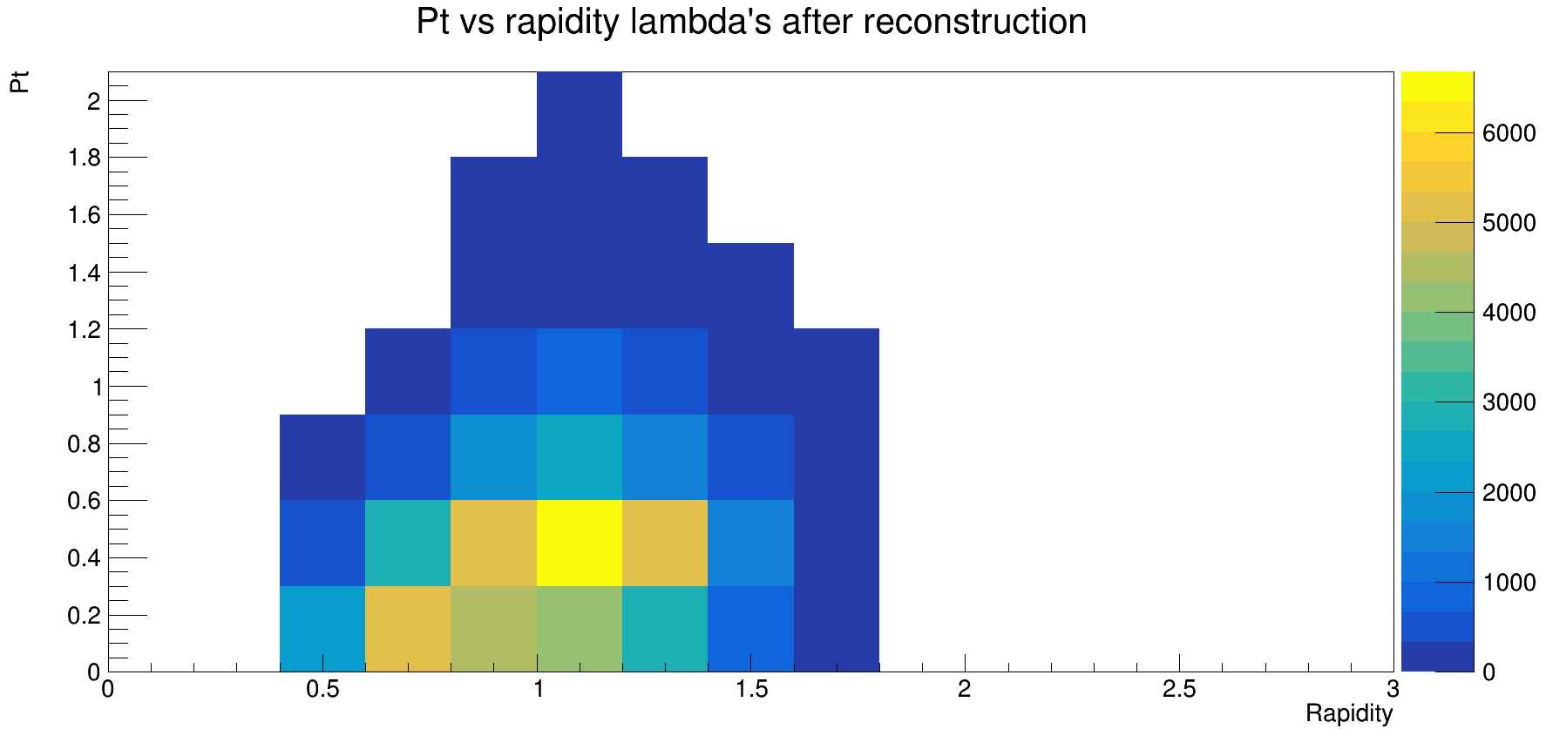
Results
Lambda hyperons

Slide 24
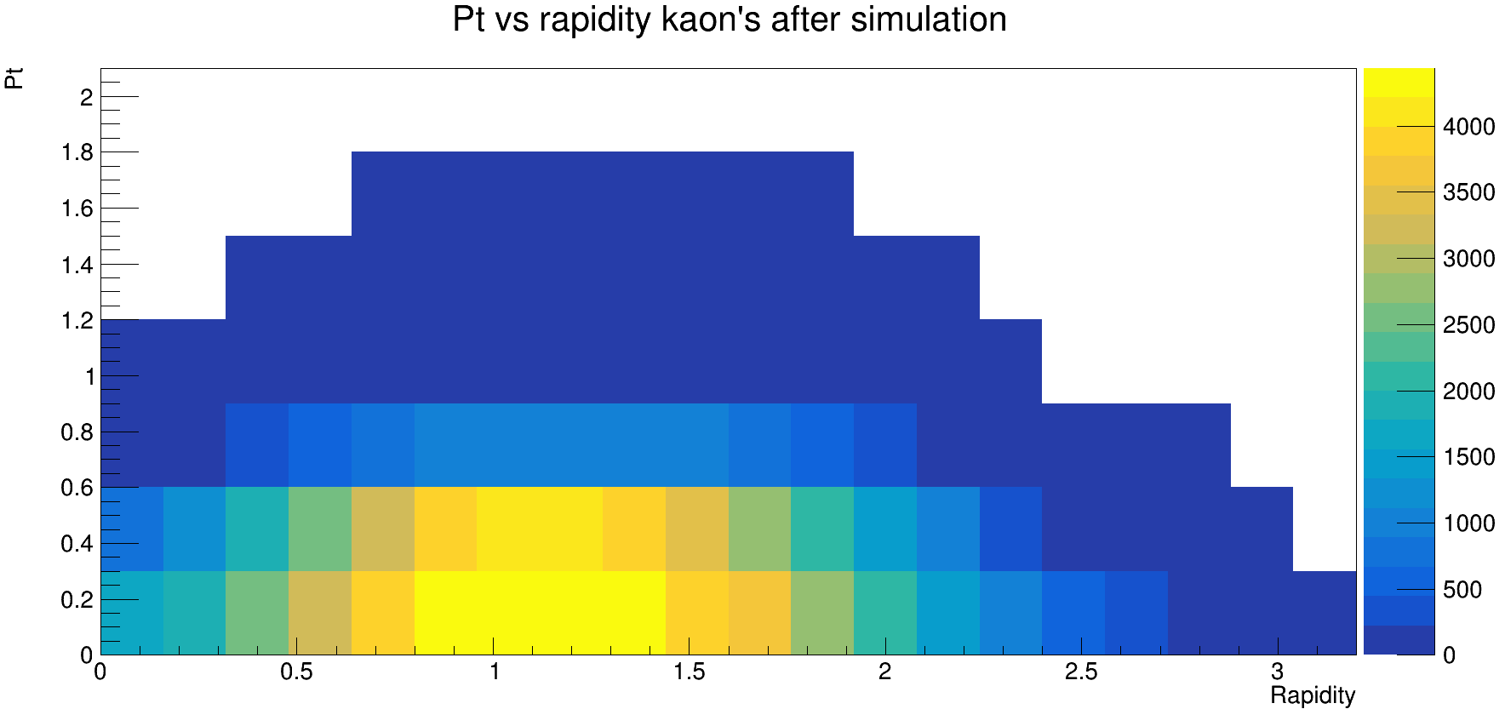
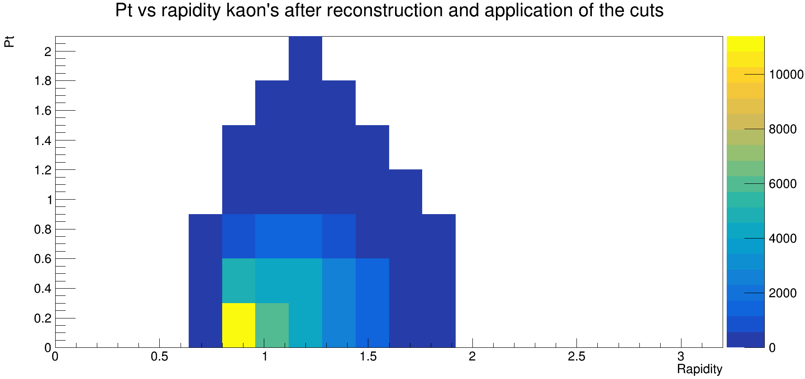
Results
$$K_{S}^{0}$$

Slide 25
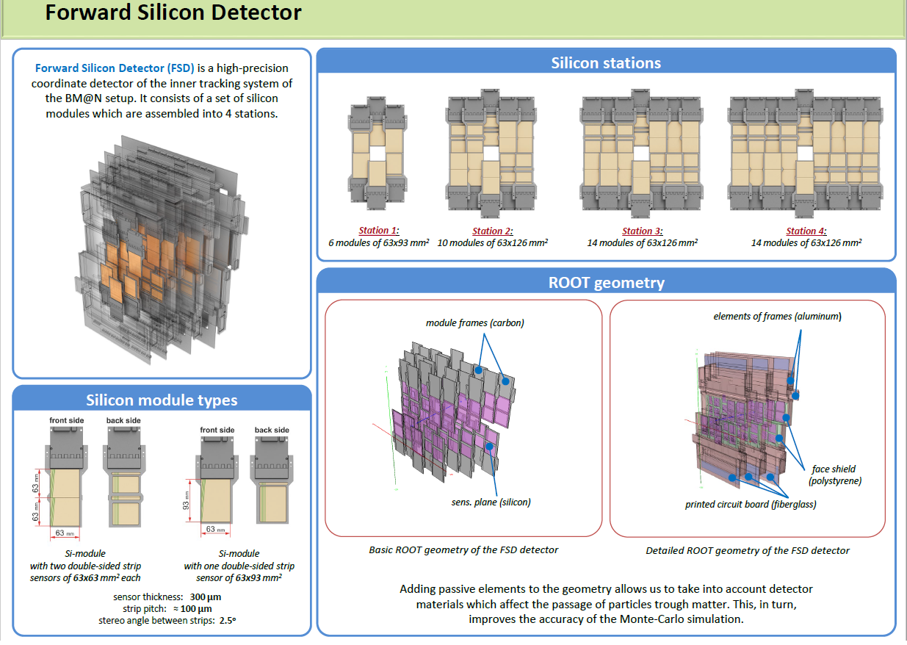

Slide 26
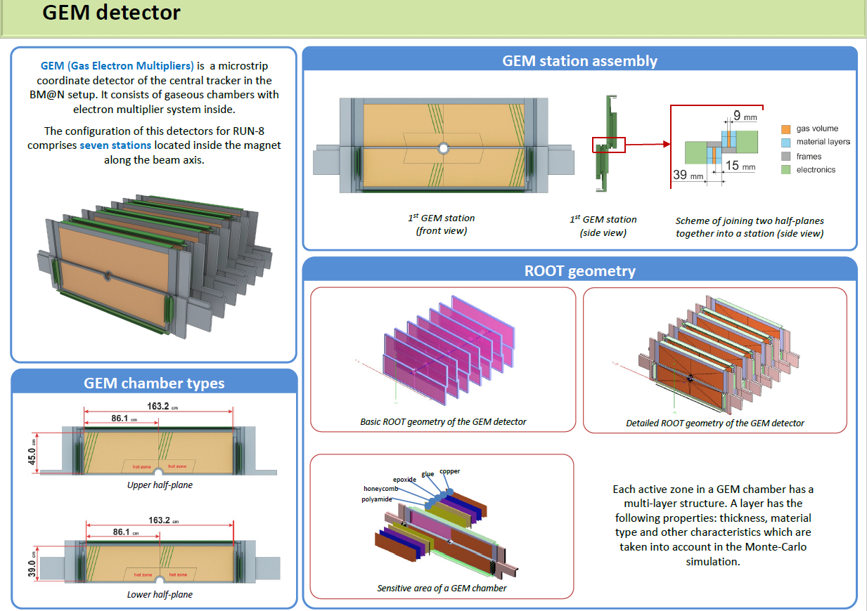

Slide 27
