Slide 1
Web interactive 3D event display for MPD experiment at NICA collider
Alexander Krylov
Dubna/JINR
Email: avkrylov@jinr.ru

Slide 2
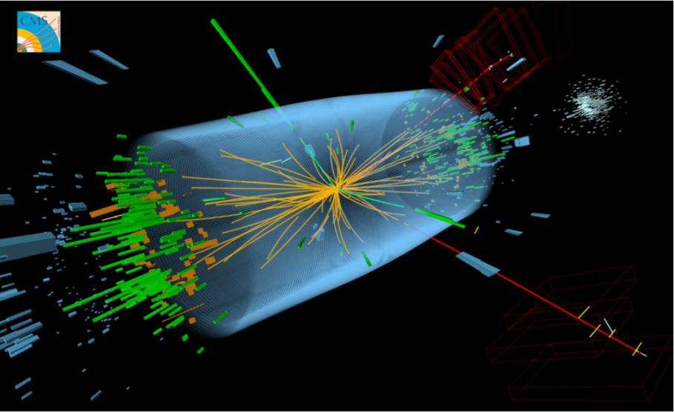
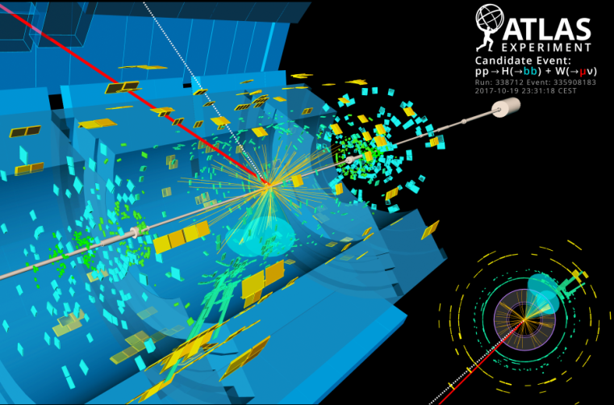
Event display in LHEP experiments
OpenGL based event displays
CMS (Frog)
ATLAS

Slide 3
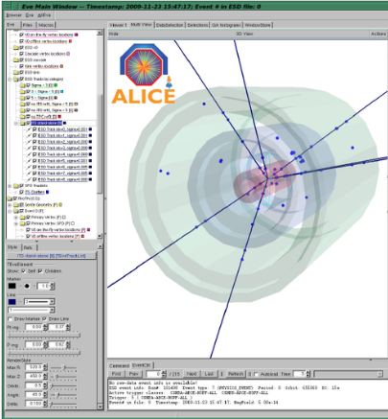
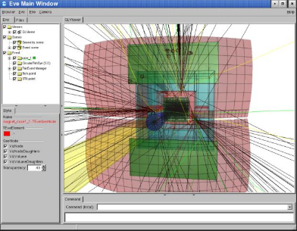
Event display in LHEP experiments
Root EVE (OpenGL) based event displays
CBM
Alice
Notes:
3

Slide 4
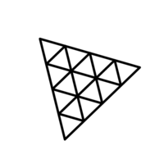
Technologies
JavaScript Engine V8
WebGL
ThreeJS library
NodeJS
React framework + Redux library
Notes:
4

Slide 5
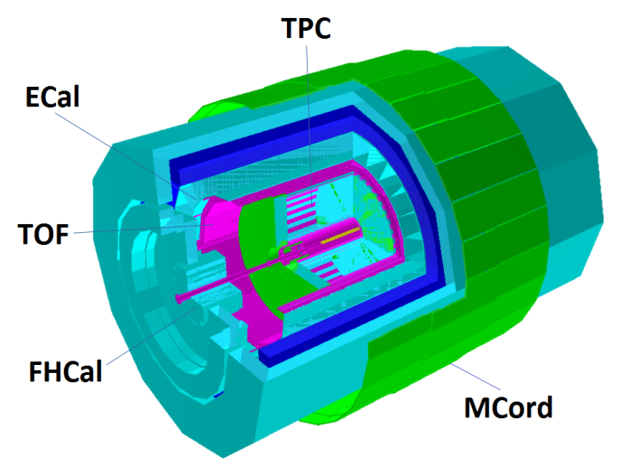
NICA — MPD experiment
First stage of MPD:
Time-Projection Chamber (TPC)
Time-Of-Flight detector (TOF)
Electromagnetic Calorimeter (ECal)
Forward Hadron Calorimeter (FHCal)
Muon detector (MCord)
1-st stage of Multi Purpose Detector (Geant geometry)

Slide 6
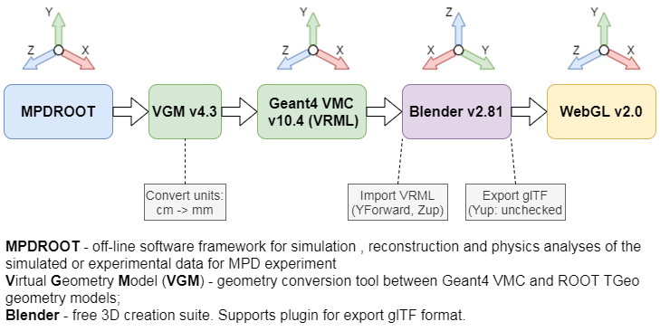
Geometry conversation scheme
VRML - Virtual Reality Modeling Language
glTF – Graphics Library Transmission Format
Notes:
6

Slide 7
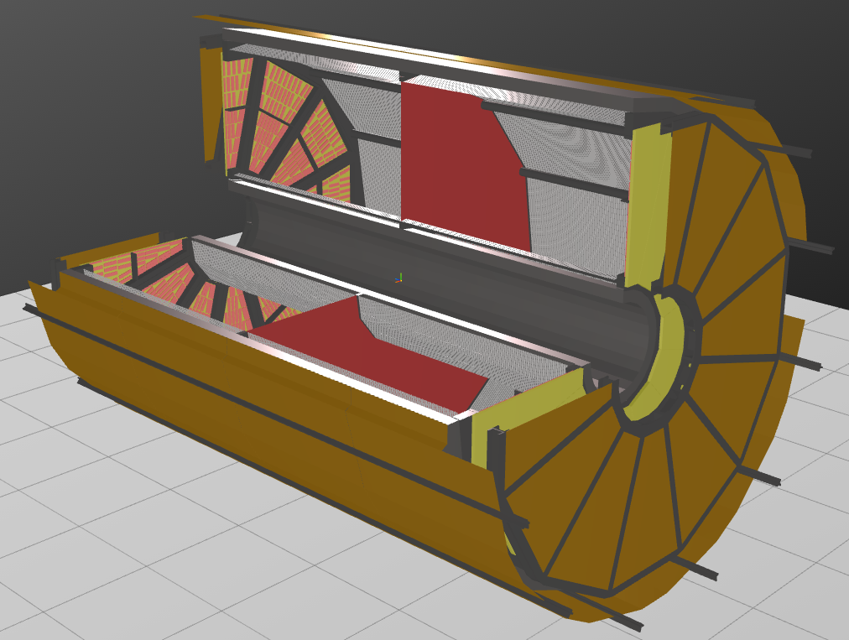
TPC Elements
Notes:
7

Slide 8
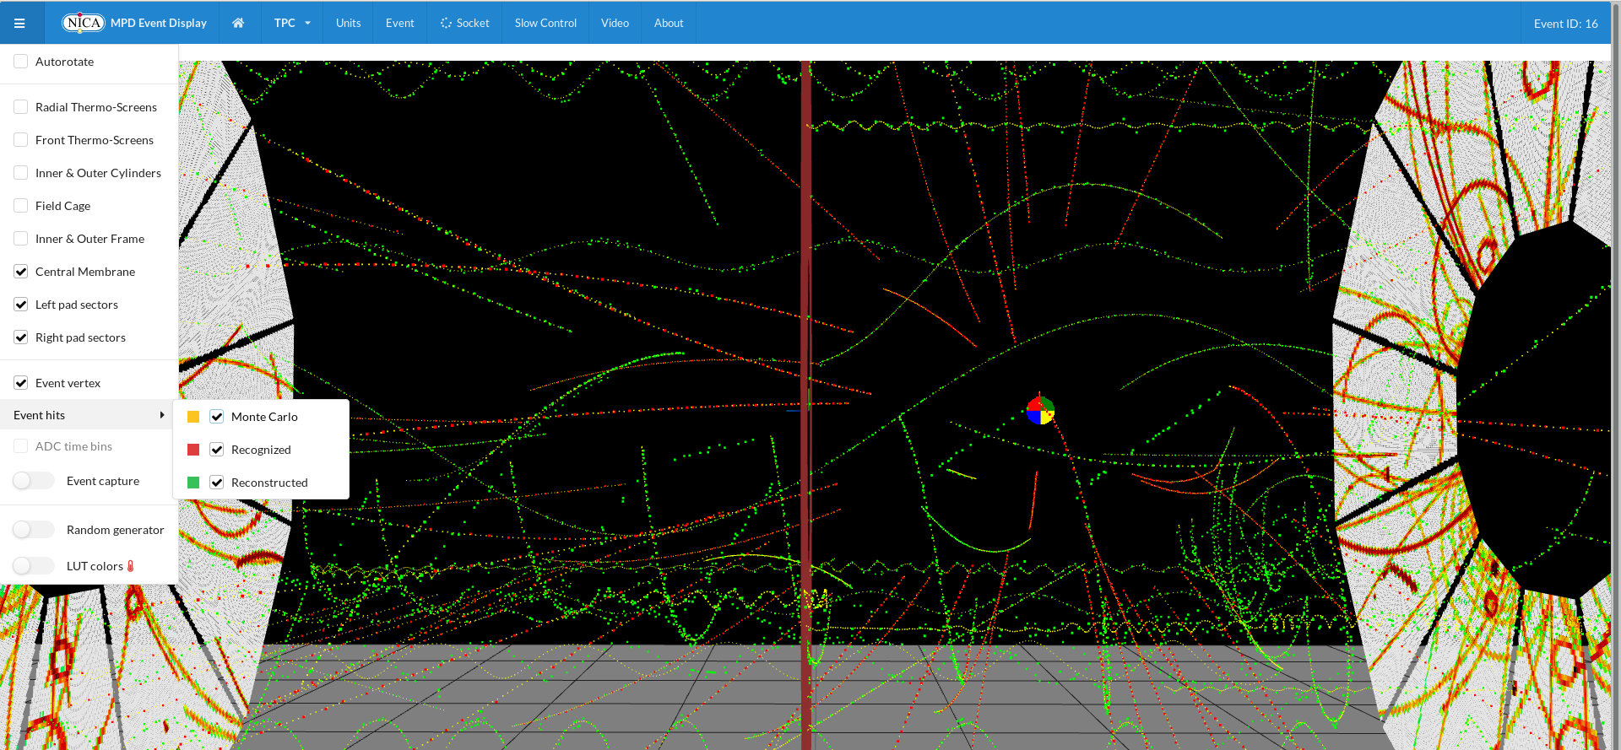
TPC tracking visualization in Event Display

Slide 9
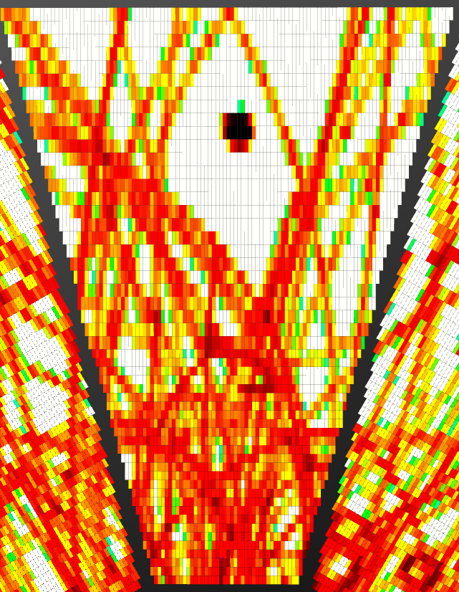
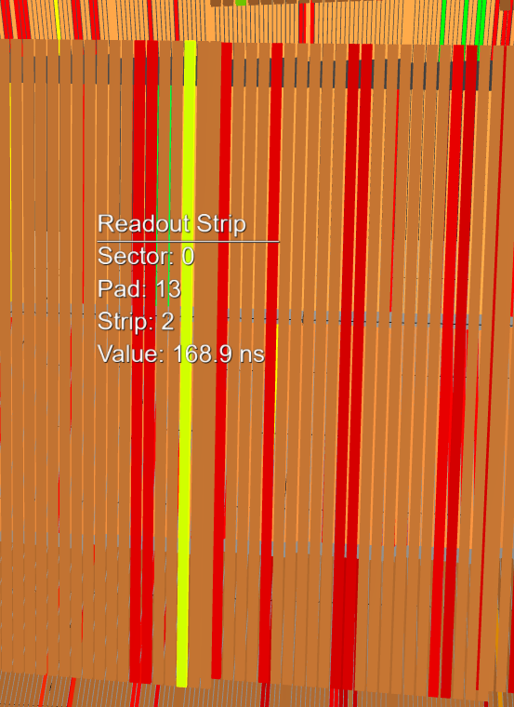
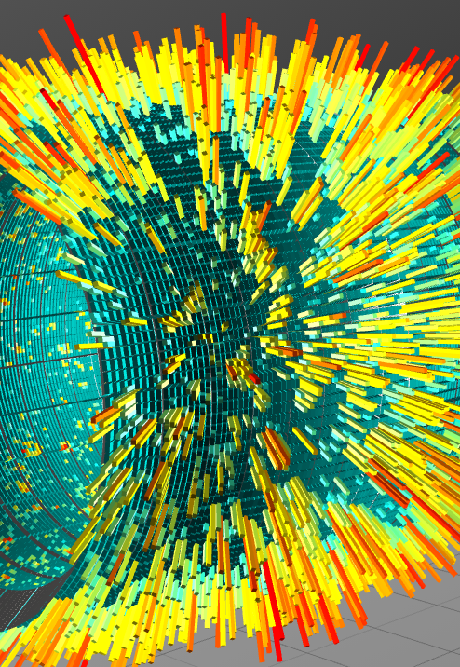
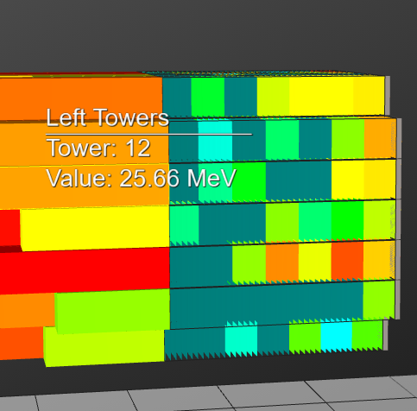
Event Display capabilities
Reconstucted file (LAQGSM_7.7Gev) — active sensors visualization:
TPC Pads
TOF Strips
ECal towers
FHCal towers

Slide 10
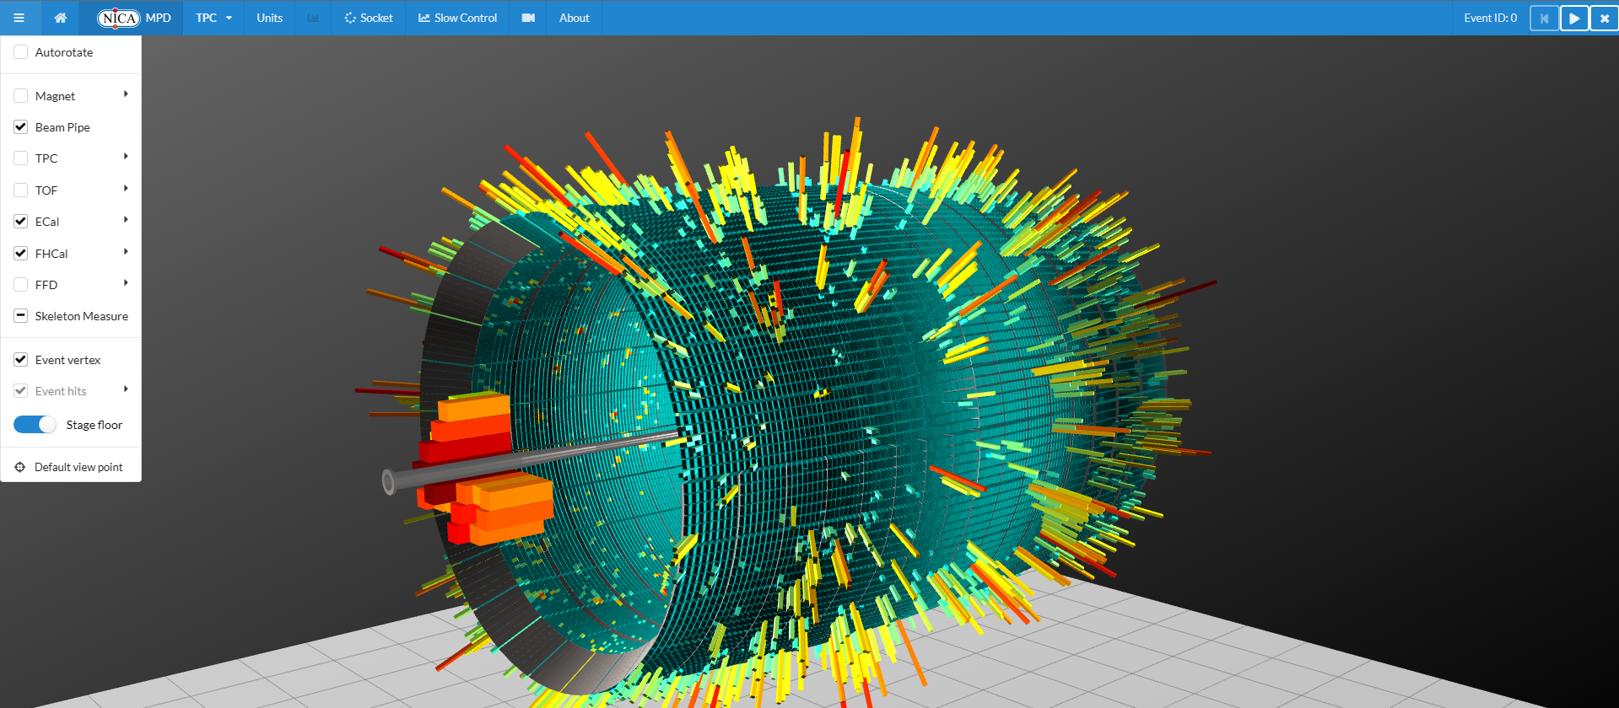
Event Display visualization examples

Slide 11
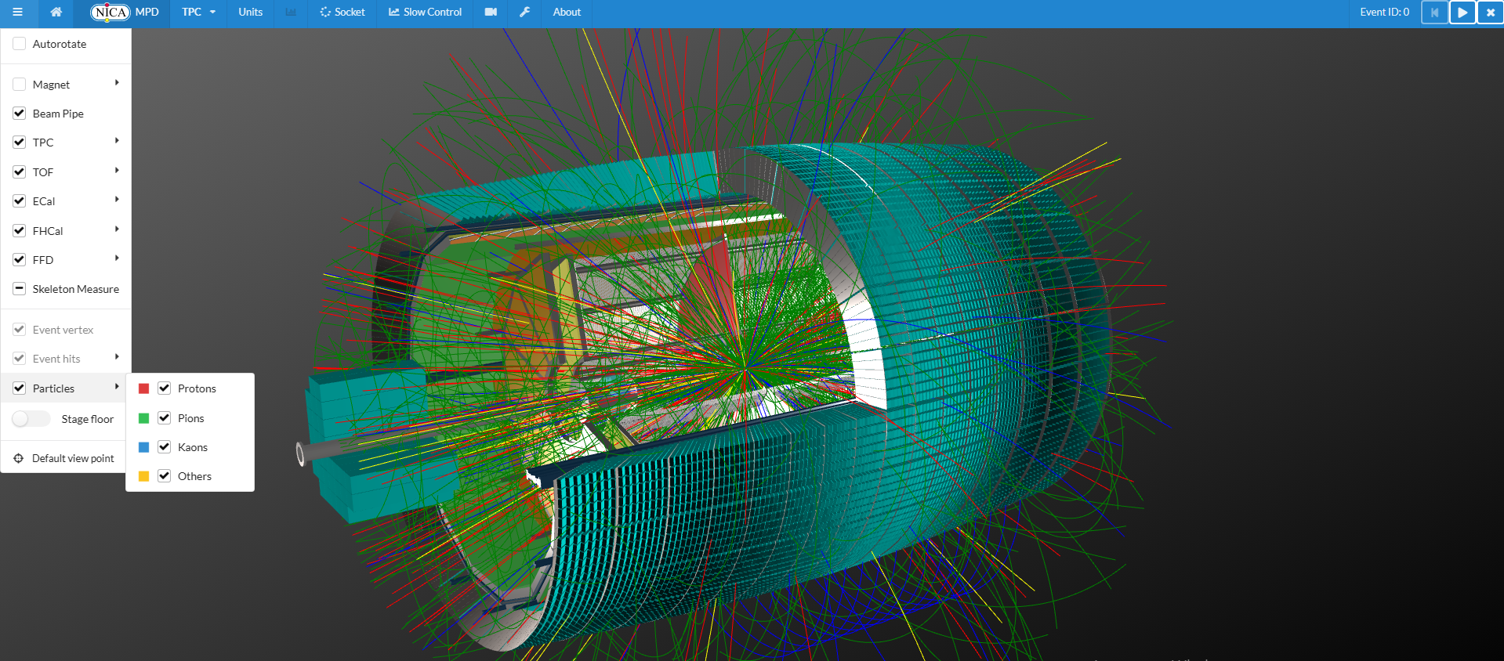
Event Display visualization examples

Slide 12
Conclusion
Interactive web 3D event display is ready to use in offline mode and already was implemented into MPD software.
At the moment only TPC, TOF, ECal and FHCal geometries were added.
For TPC visualization of reconstructed hits, pad signals and tracks (with particles separation) are available.
Other detectors will be added soon.
Notes:
12

Slide 13
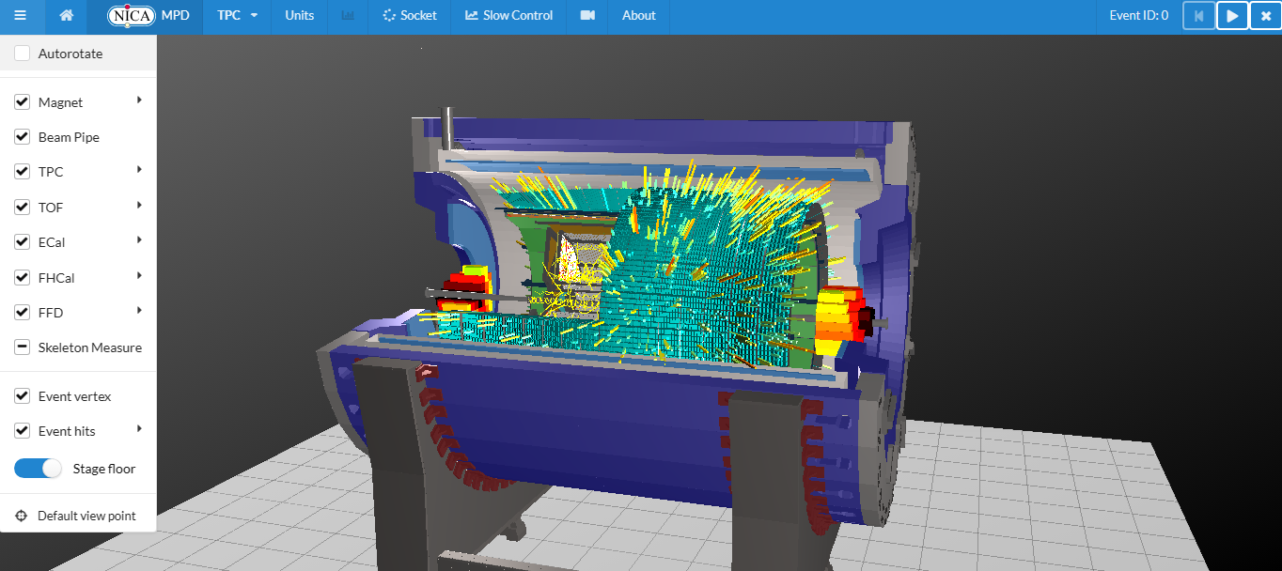
Thank you for your attention!

