Slide 1
Development of hardware solutions for beam capture by Nuclotron accelerated stations
JINR, VBLHEP

Slide 2
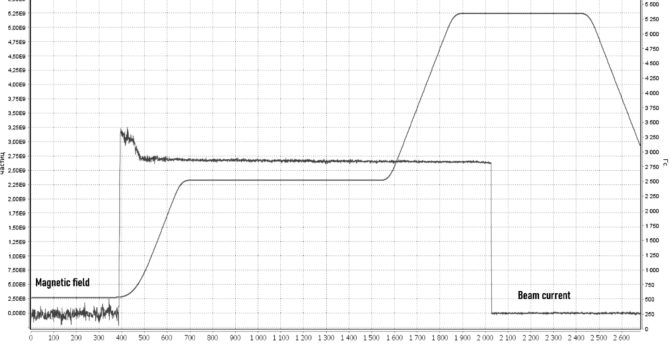
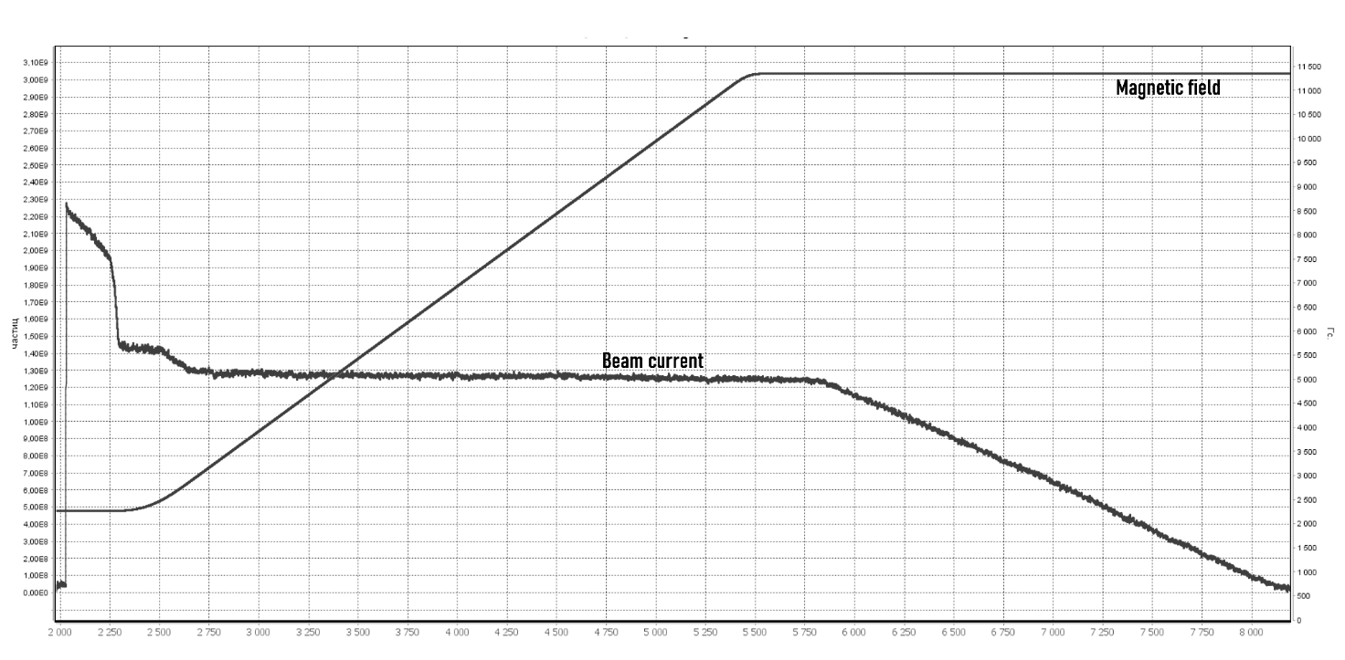
Introduction
Increasing the number of accelerated particles by the booster-Nuclotron chain is the most important task at the time of the completion of the PNR4. In order to increase the efficiency of the Nuclotron accelerating stations, it was decided to develop a number of devices, such as: programmer of accelerating voltage, precision phase detector, bias current source without pulse-width modulation. Such hardware solutions will make it possible to increase the beam current and the speed of setting the RF parameters.
In addition to hardware solutions, it is necessary to understanding the pdysiacal processes at the moment of beam capture and acceleration

Slide 3
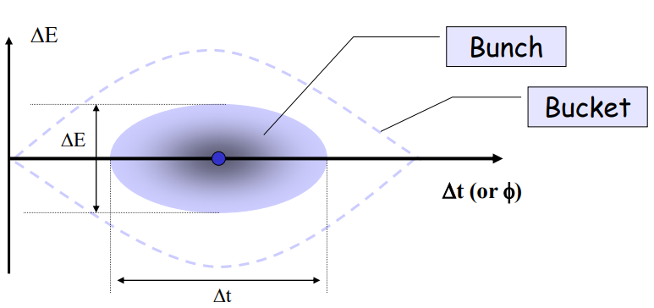
RF acceptance
Fig.1. RF acceptance
$${\left(\frac{∆E}{E_{S}}\right)}_{max}=β\left(\frac{eV_{rf0}}{πqηE_{s}}\right)\left(2\cos\left(φ_{s}\right)−\left(π−{2φ}_{s}\right)sin⁡(φ_{s})\right)$$
$$∆φ_{max}=\frac{qηE_{s}}{p_{s}R_{S}Ω_{s}} {\left(\frac{∆E}{E_{S}}\right)}_{max}$$
$$Ω_{s}=\sqrt{\frac{qZeV_{rf0}ηsin{(φ}_{S})}{A2πR_{s}p_{s}}}$$

Slide 4
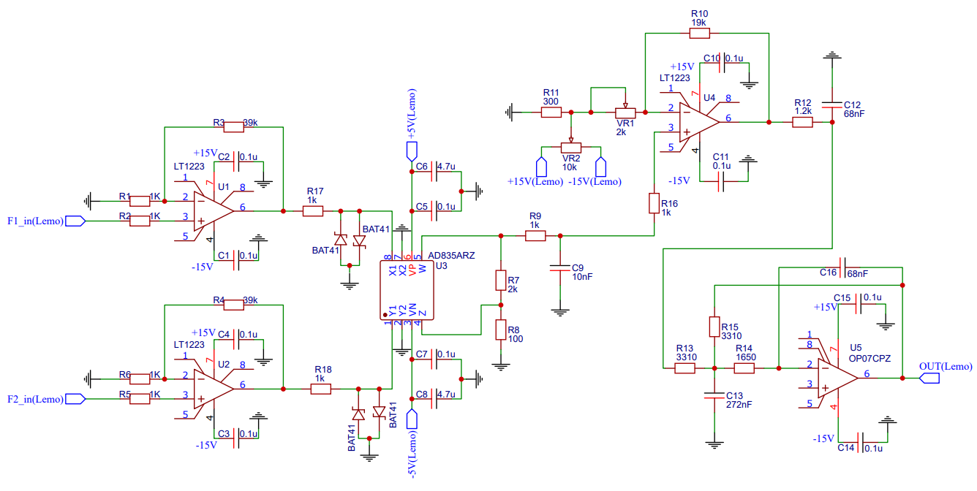
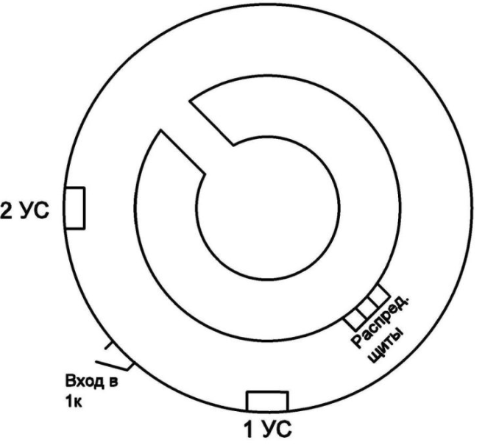
Phase detector
The 90 degree phase detector and ring of Nuclotron are shown in Figure 1 :
RF2
Entry
RF1
Fig.2. Phase detector and ring of Nuclotron

Slide 5
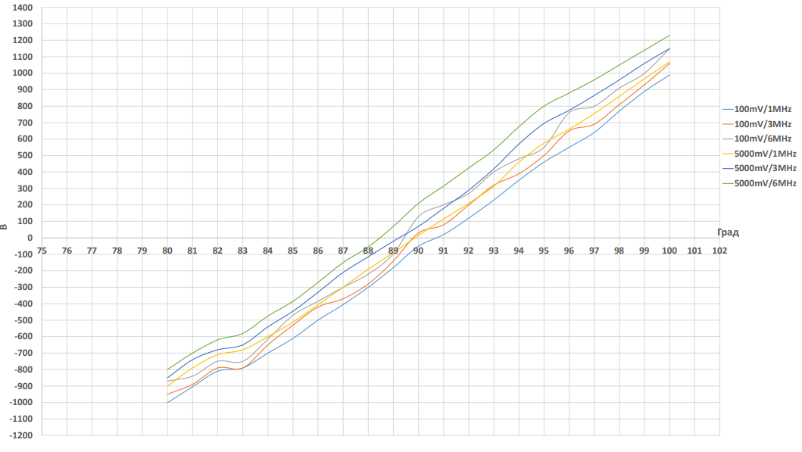
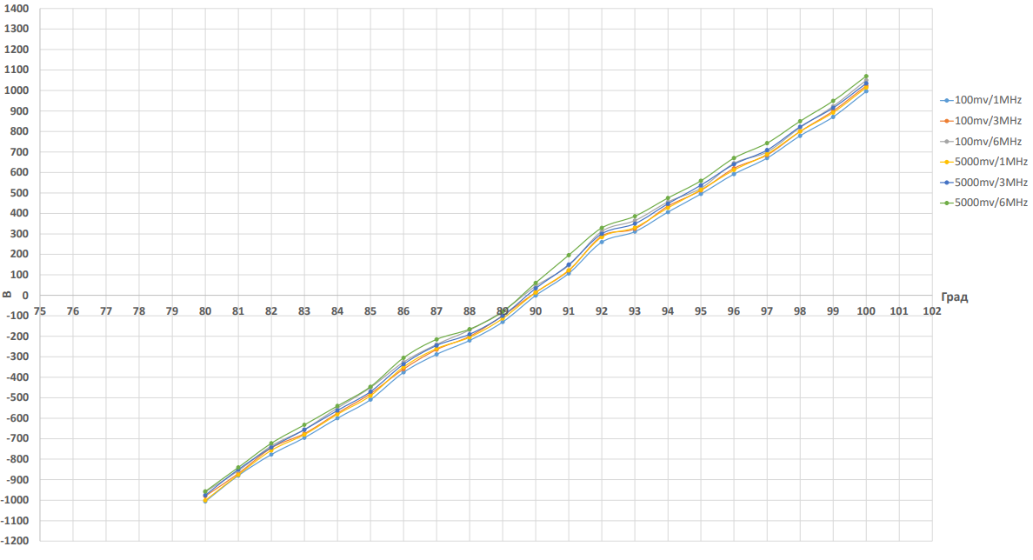
Fig.3а. Phase detector
$$∆E={\frac{Ze}{A}V}_{rf0}=K_{э}{\frac{Ze}{A}V}_{rf}$$
$$V_{rf0}=KV_{rf}$$
Fig.3b. Precision phase detector
$${\frac{Ze}{A}V}_{rf0}\cos\left(φ_{s}\right)=RP\frac{dB}{dt}$$

Slide 6
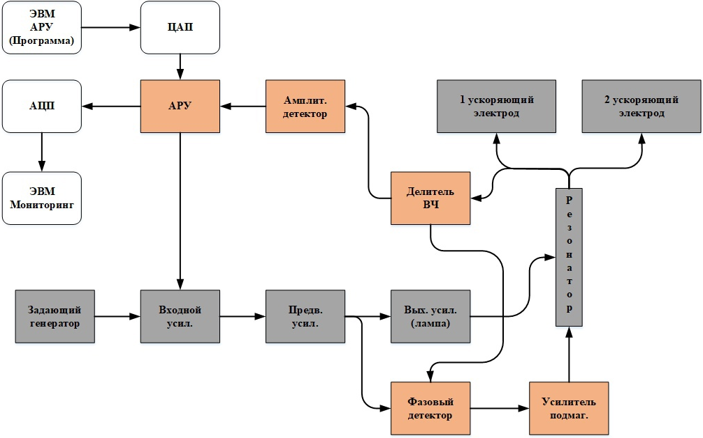
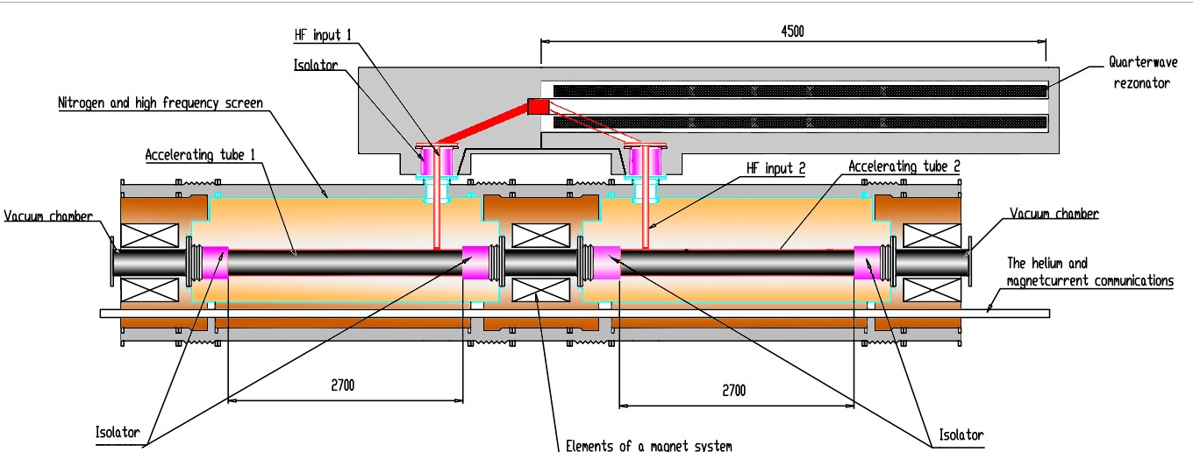
The phase detector can be used as part of a resonator auto-tuning circuit. In figure 3 you can see the functional diagram of the Nuclotron acceleration station.
Fig.4. Functional diagram of the Nuclotron acceleration station
$$K=2\left( sin\left(φ_{4}\right)−sin\left(φ_{3}\right)\right)=0,65$$
$$ωC−\frac{1}{Z_{c}}ctg\frac{ωl}{c}=0$$
$$Z_{c}=\sqrt{\frac{L_{пог}}{C_{пог}}}$$
$$φ_{3}=\frac{l_{мэ}}{2}\frac{2π}{P}q=0,015q$$
$$L=\frac{Ф}{I}=\frac{l}{2π}μμ_{0}\ln{\frac{b}{a}}$$
$$μ \sim \frac{1}{I_{bias}}$$
$$φ_{4}=\left(\frac{l_{мэ}}{2}+l_{э}\right) \frac{2π}{P}q=0,0824q$$

Slide 7
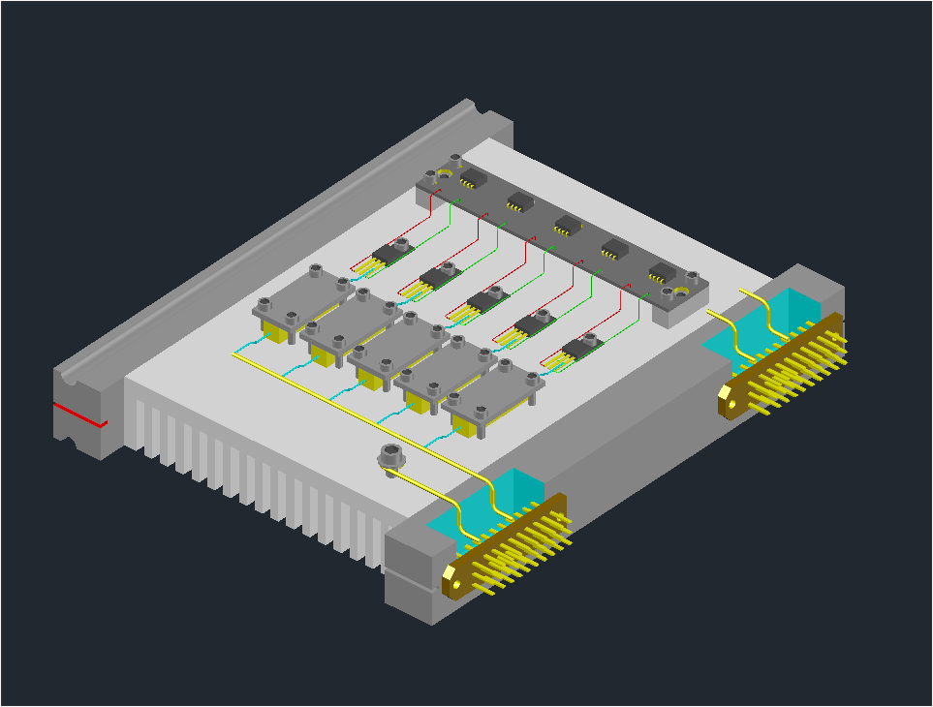
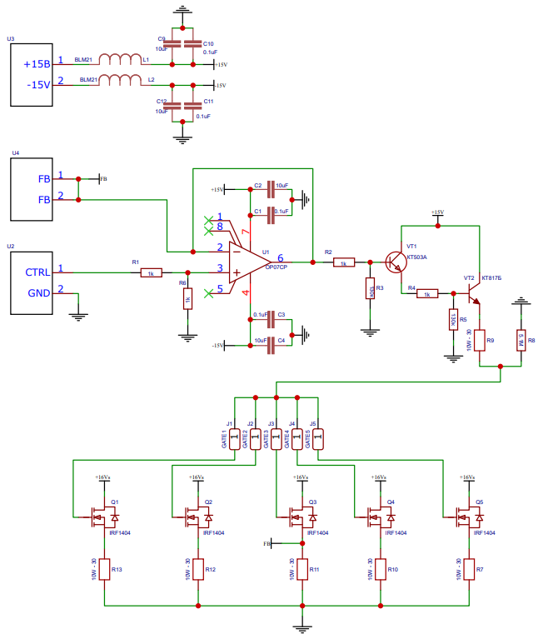
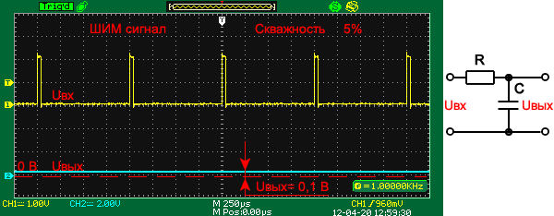
Current source
Fig.5. Сircuit diagram of a biasing amplifier
$${F_{pwm}≫Ω}_{s}=\sqrt{\frac{qZeV_{rf0}ηsin{(φ}_{S})}{A2πR_{s}p_{s}}}$$

Slide 8
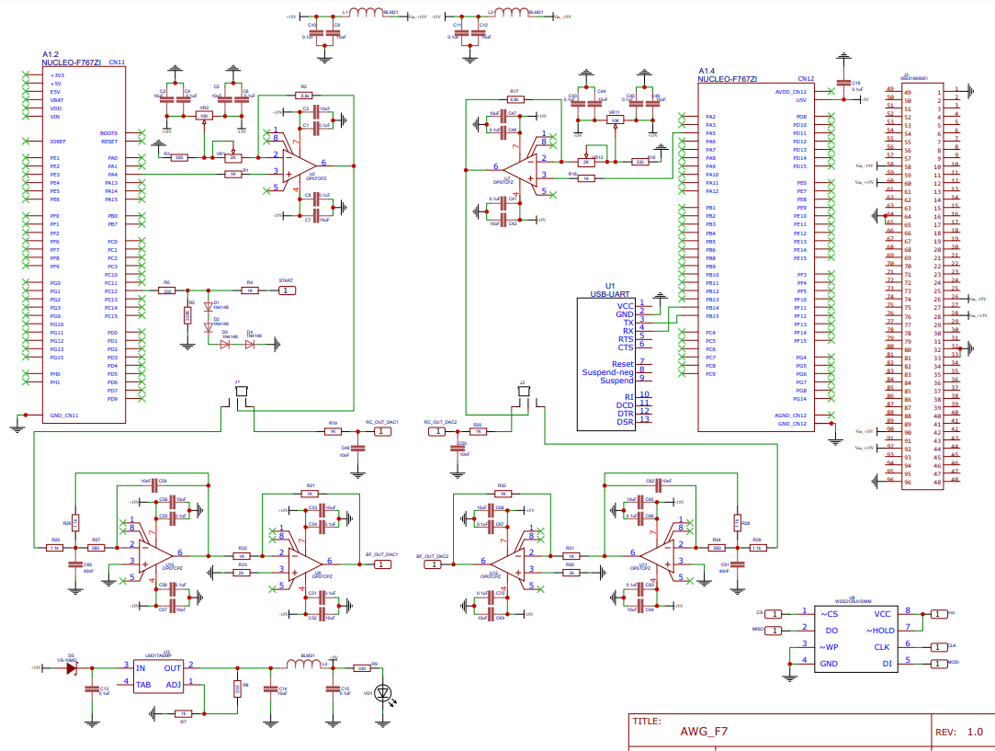
Programmer of accelerating voltage
$${F_{samp}≫Ω}_{s}=\sqrt{\frac{qZeV_{rf0}ηsin{(φ}_{S})}{A2πR_{s}p_{s}}}$$
Fig.6. Arbitrary Function Generator (AWG)

Slide 9
An example of the operating cycle of the accelerating station of the Nuclotron is shown below.
Fig.7. Work cycle example

Slide 10
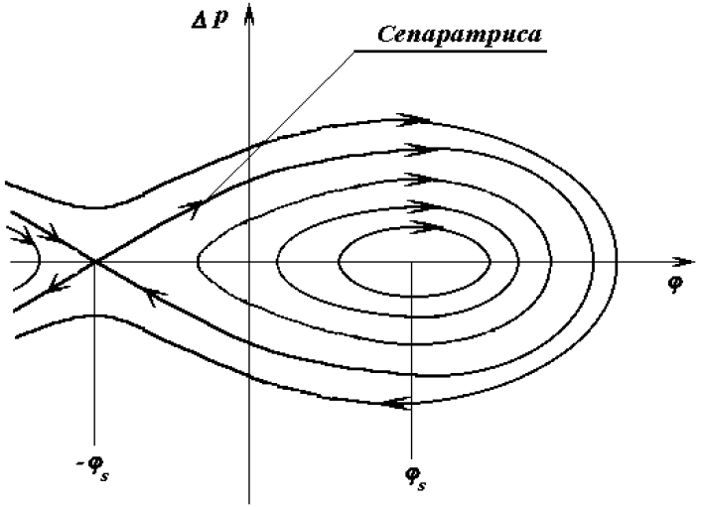
Application
Fig.8. RF acceptance and phase space
$$∆p_{cen.max}=\frac{2Ω_{s}p_{s}}{qηω_{S}}\sqrt{1−φ_{s}ctg⁡(φ_{s})}$$
$$S=\int{\frac{∆p}{m_{0}c}dφ →longitudinal phase space}$$
Then the largest value of the longitudinal phase volume:
$$S_{cen}=16F(cosφ_{s})\sqrt{\frac{γeV_{rf0}}{2πqηm_{0}c^{2}}}$$

Slide 11
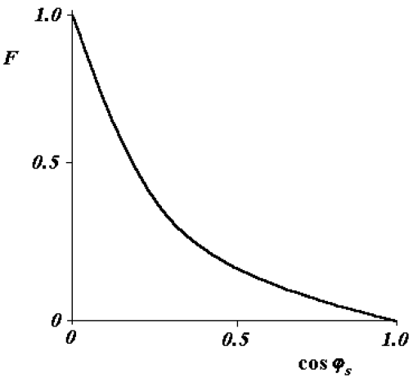
where the function F changes from 0 to 1 and has the form (Figure 2):
$$F=\frac{1}{8\sqrt{2}}\int{\sqrt{sinφ+sinφ_{s}−\left(φ−φ_{s}\right)cosφ_{s}}dφ}$$
Let us consider the change in the longitudinal phase volume when changing the multiplicity in the Nuclotron:
$$K=\frac{∆E_{max}}{\frac{Ze}{A} V_{rf0}}≅0,53 where{ V}_{rf0}=K∗V_{rf}$$
$$cos\left(φ_{s}\right)=\frac{2πρR}{V_{rf0}}\frac{dB}{dt} →\cos_{5}\left(φ_{s}\right)<\cos_{4}\left(φ_{s}\right)$$
Fig.9. $F(cosφ_{s})$
$$F_{4}<F_{5} →S_{4^{∗}cen}>S_{5^{∗}cen}$$

Slide 12
Conclusion
Such hardware solutions will make it possible not only to increase the convenience of working with the Nuclotron RF stations, but also to improve capture and acceleration.

Slide 13
Thank you for your attention

