Slide 1
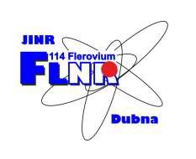
K. Berestov, S. Bogomolov, K. Kuzmenkov
Jinr, Dubna, Moscow Region, Russia
Investigation of characteristics of 2.45 GHz ECR ion source

Slide 2
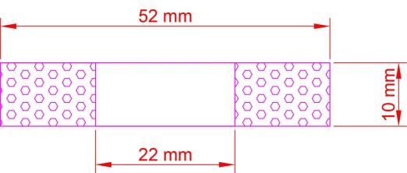
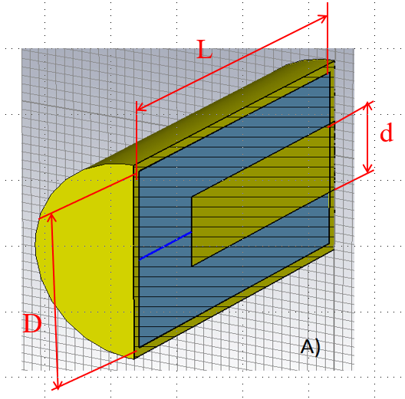
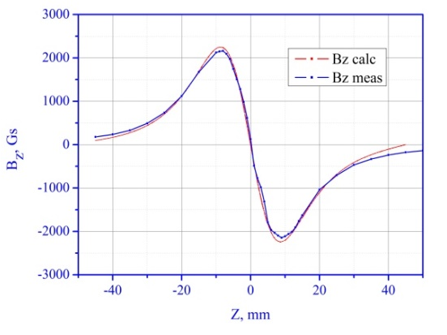
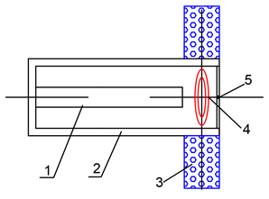
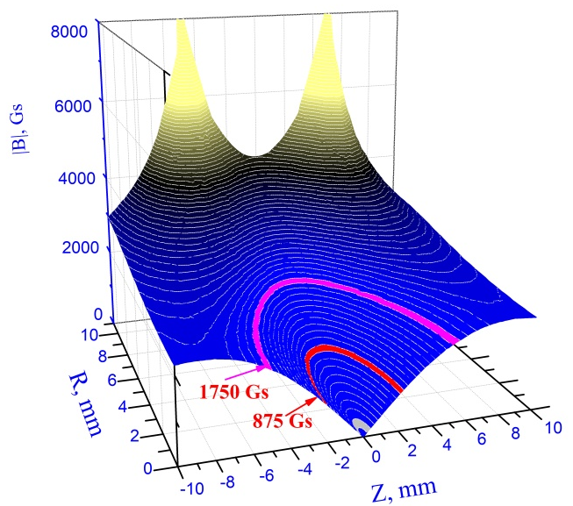
The concept of compact 2.45 GHz ECR ion source based on a coaxial resonator
Permanent magnet ring
Coaxial resonator
1 - central conductor of a coaxial resonator;
2 - resonator casing;
3 - magnetic ring;
4 - closed lines of the magnetic field;
5 - extraction hole.
L = λ/4 (~ 3 cm)
D/d = 2.3 (50 Ω)
Notes:
2.45 GHz ECR ion sources are widely used for production of single charged heavy ions and secondary radioactive ion beams. This slide shows the concept of the ion source. The magnetic system of the source is composed of a radially magnetized ring. The distribution of the magnetic field on the axis of the ring is shown in__ . The lines of an equal field are shown in__. It can be seen that this magnetic system provides creation of pseudo-closed surfaces with a field level from 875 Gs up to 1750 Gs. Schematic structure of the source is shown in __, the closed surfaces of the magnetic field are located in the gap between the electrodes of quarter wave resonator.

Slide 3
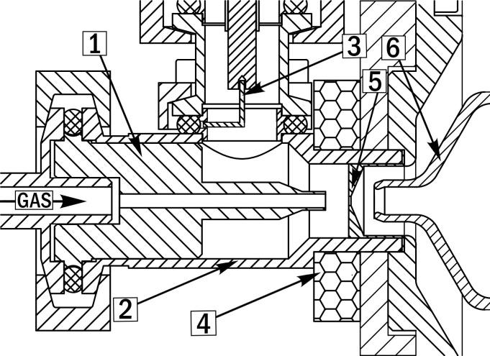
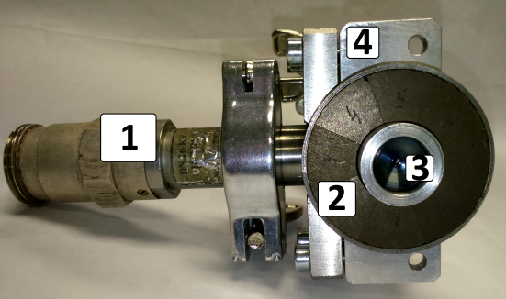
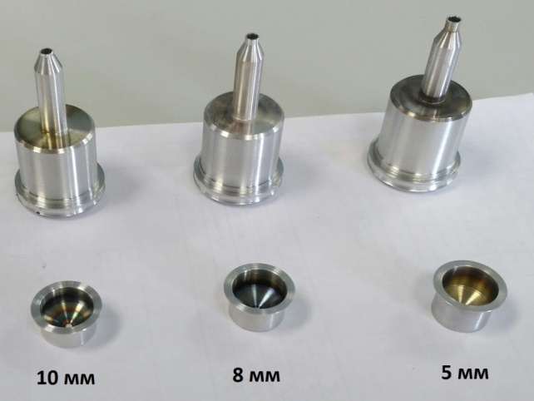
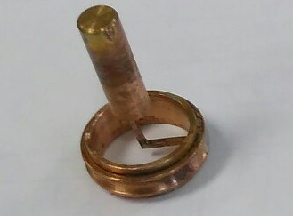
Compact 2.45 ECR development
Design of the source
1 - replaceable internal part of the resonator
2 – resonator casing
3 – coupling loop
4 – permanent magnet ring
5 - replaceable plasma electrode
6 - pulling electrode
Assembled ion source
Replaceable parts providing gap sizes of 5, 8 and 10 mm
View of coupling loop
1 – N-type coaxial feedtrough, 2 – permanent magnet ring,
3 – plasma electrode, 4 – resonator casing
Notes:
This slide shows already manufactured and tested 2.45 GHz ion source in FLNR. In the source design the existing N-type connector with KF16 (16 mm internal diameter and 7 mm diameter of central conductor) flange was used. For the power input the following type of coupling loop was used (Power was connected from the side). By using replaceable resonator parts was observed that for the 5 mm gap was achieved highest electric field value and lowest power required for plasma discharge ignition. So all further experiments were with 5 mm gap.

Slide 4
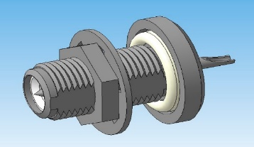
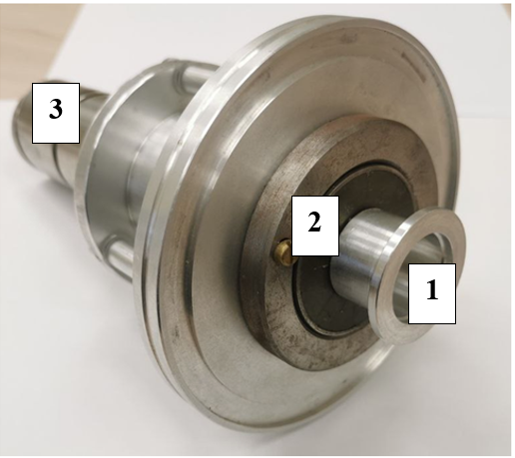
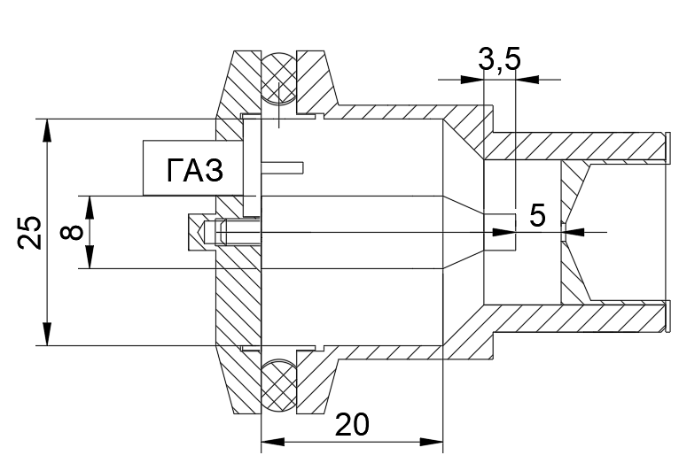
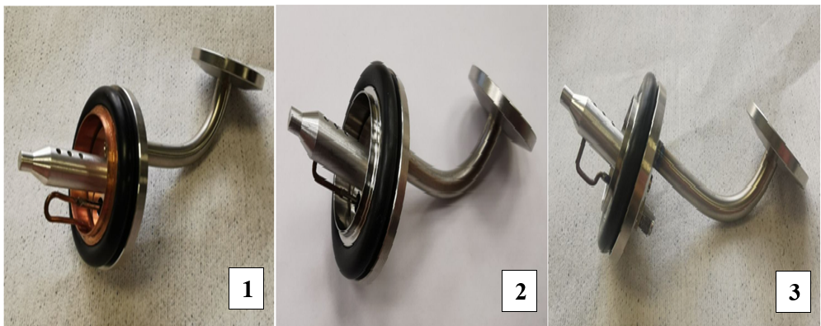

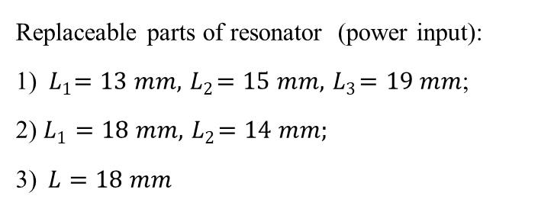

Compact 2.45 GHz ECR ion source
FLNR JINR (Dubna)
ECR-source
SMA-type coaxial feedthrough
1 – resonator casing (plasma cavity);
2 – permanent magnet ring;
3 – pulling electrode
Design of the source
Replaceable parts of resonator (power input):
1) ${ L}_{1}=13 mm, { L}_{2}=15 mm, { L}_{3}=19 mm$;
2) $L_{1}=18 mm, { L}_{2}=14 mm;$
3)$L=18 mm$
$$L$$
$$L$$
$$L$$
$L$ – length of the coupling loop
Notes:
For the production of the short-lived radioactive ions it is necessary to achieve fast transformation from atom to ion . As we already know that the smaller the plasma chamber volume the faster ionization processes occurs, so its reasonable to use compact ion source with small chamber volume. Here on slide you can see our compact ECR ion source (тут про то что 1 – это корпус резонатора, 2 - …, 3 - …). The SMA-Type coaxial feedtrough was used to connect ion source with generator. Power input was carried by using of coupling loop (1 – connect to the casing, 2 and 3 to the coaxial) (Power feedthrough installed at the end plate of resonator). So, the main goal of my work is to test ion source on He gas, measure the ion current at different generator powers and frequencies, (measure the ion current) using different power inputs.

Slide 5
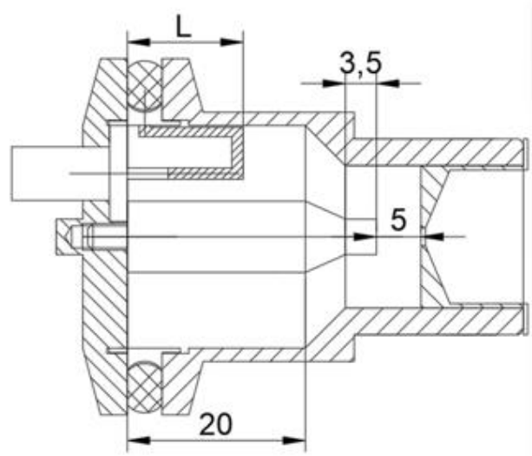
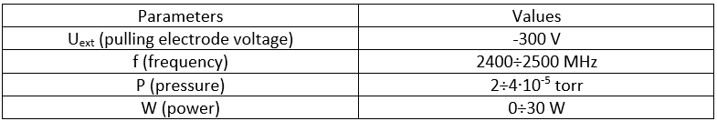
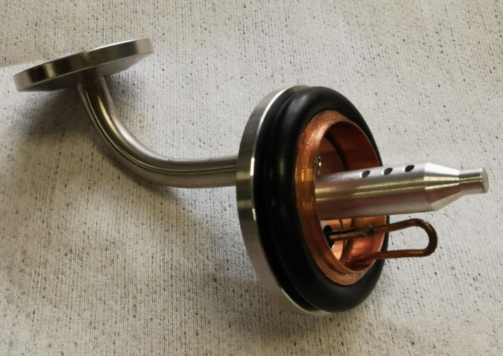
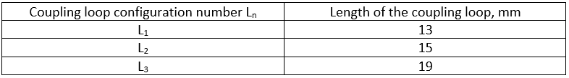
Ion source testing with power input configuration №1
Design of the source with configuration of UHF coupler №1 and photo of power input with coupling loop configuration №1
Notes:
Here on slide shown the ion source with power input configuration №1. For this configuration loop is connected to the resonator casing, were used 3 loop with lengths L=13 L=15 L=19. During the source testing the pressure in chamber was about 10⁻⁵ torr, voltage on pulling electrode was -300 V, frequency was in range from 2400 to 2500 MHz and power from 0-30 W.

Slide 6
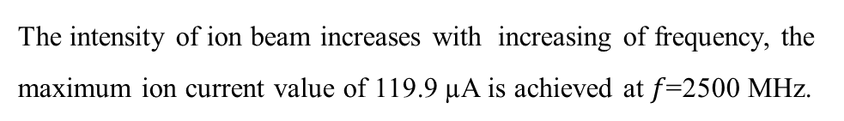
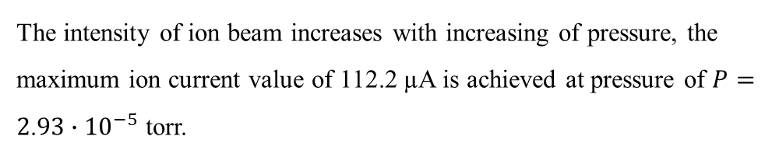
Ion source testing with power input configuration №1 $I\left(P\right)$ $I\left(f\right)$
He⁺ ion current $I$ as a function of pressure P
He⁺ ion current $I$ as a function of UHF $f$
The intensity of ion beam increases with increasing of pressure, the maximum ion current value of 112.2 µA is achieved at pressure of $P=2$.$93∙{10}^{−5}$ torr.
The intensity of ion beam increases with increasing of frequency, the maximum ion current value of 119.9 µA is achieved at $f\text{=2500}$ MHz.
Notes:
This picture shows ion source ion current dependence on pressure and frequency. Firstly we study dependence of ion current as a function of pressure, it has been shown that the intensity of ion current increases with increasing of pressure, maximum ion current value 112 mkA. From the second graph we can that ion current increases with increasing of frequency, maximum value of ion current was achieved at 2500 MHz.

Slide 7
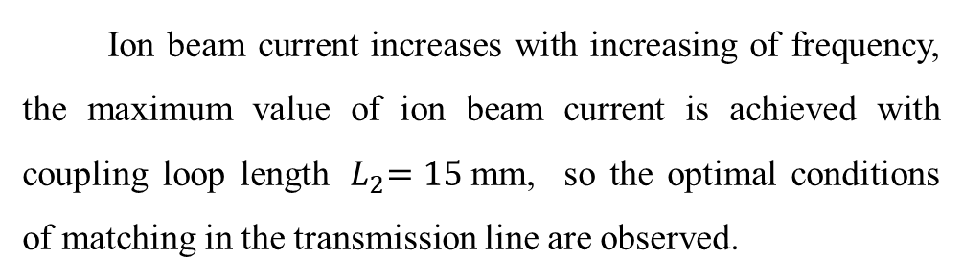
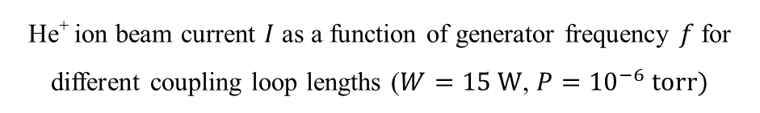
Ion source testing with power input configuration №1 $I\left(f\right)$
$$I_{max}=128.4 \text{µ}\text{A}$$
Ion beam current increases with increasing of frequency, the maximum value of ion beam current is achieved with coupling loop length ${ L}_{2}=15$mm, so the optimal conditions of matching in the transmission line are observed.
He⁺ ion beam current $I$ as a function of generator frequency $f$ for different coupling loop lengths ($W=15 W$, ${P=10}^{−6} torr)$
Notes:
After we checked the dependence of ion current as a function of frequency for power input configuration №1 with different coupling loop lengths. As we see the maximum ion current was achieved with coupling loop length 15 mm, so that means that the optimal matching conditions in the transmission line was observed.

Slide 8
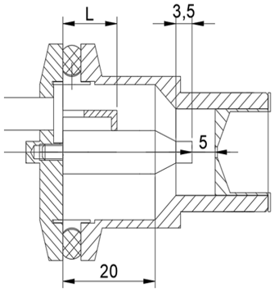
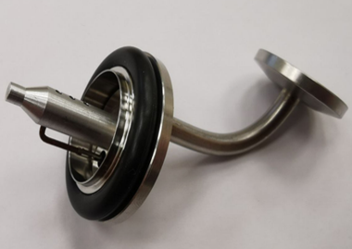

Ion source testing with power input configuration №2
Design of the source with configuration of UHF coupler №2 and photo of power input with coupling loop configuration №2
Notes:
This picture shows ion source with power input configuration №2. For this configuration loop is connected to central conductor of resonator, we used 2 loop lengths L=18 L=14. During the source testing the pressure in chamber was about 10⁻⁵ torr, voltage on pulling electrode was -300 V, frequency was in range from 2400 to 2500 MHz and power from 0-30 W.

Slide 9
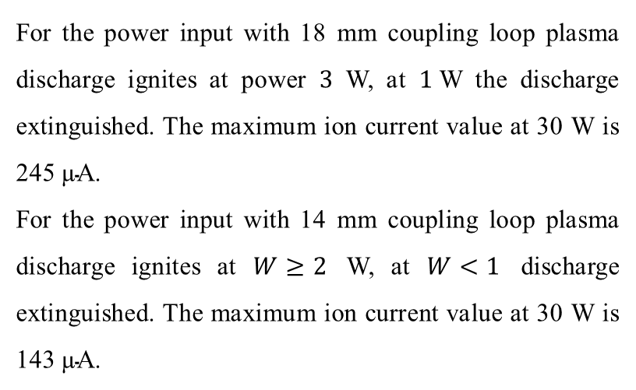
Ion source testing with power input configuration №2 $I\left(W\right)$
For the power input with 18 mm coupling loop plasma discharge ignites at power $3$ W, at $1$W the discharge extinguished. The maximum ion current value at 30 W is 245 $\text{µ}\text{A}$.
For the power input with 14 mm coupling loop plasma discharge ignites at $W≥2$ W, at $W<1$ discharge extinguished. The maximum ion current value at 30 W is 143 $\text{µ}\text{A}$.
He⁺ ion current $I$ as a function of power $W$
Notes:
For 2 loop length firstly we measured ion current as a function of power. Its been observed that for 18 mm loop that when we increase power plasma discharge ignites at 3 W. At power 1 W plasma disappears. Maximum ion current value we achieved at 30 W is 245 mkA. For 14 mm loop plasma discharge ignites when power more or equal 2 W and disappears when power less than 1 W, maximum value of ion current here is 143 mkA.

Slide 10
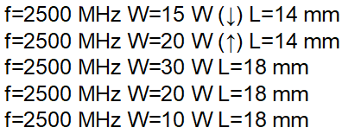


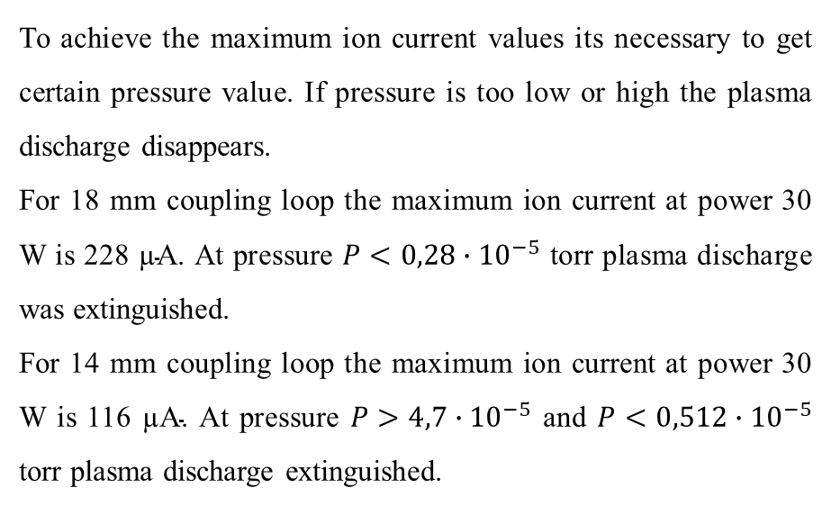
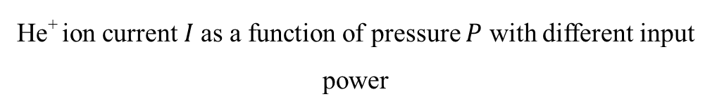
Ion source testing with power input configuration №2 $I\left(P\right)$
To achieve the maximum ion current values its necessary to get certain pressure value. If pressure is too low or high the plasma discharge disappears.
For 18 mm coupling loop the maximum ion current at power 30 W is 228 $\text{µ}\text{A}$. At pressure $P<0,28∙{10}^{−5}$ torr plasma discharge was extinguished.
For 14 mm coupling loop the maximum ion current at power 30 W is 116 $\text{µ}\text{A}\text{.}$ At pressure $P>4,7∙{10}^{−5}$ and $P<0,512∙{10}^{−5}$ torr plasma discharge extinguished.
He⁺ ion current $I$as a function of pressure $P$ with different input power
Notes:
After we checked the dependence of ion current as a function of pressure in chamber. It was observed that to achieve maximum current we must get certain pressure, when pressure to low or to high plasma discharge disappear. If pressure is too low plasma doesn’t ignite or disappear – that means there are a few number of neutral atoms to make plasma. If pressure is too high plasma also doesn’t ignite or disappear because the processes of recharging and recombination prevail over ionization.

Slide 11
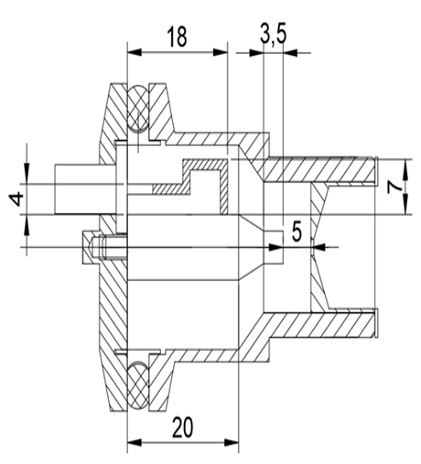
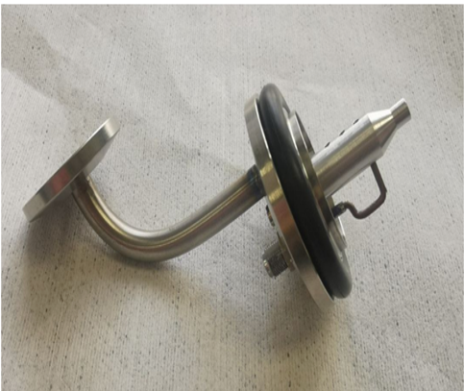
Ion source testing with power input configuration №3
Design of the source with configuration of UHF coupler №3 and photo of power input with coupling loop configuration №3
Notes:
This picture shows ion source with power input configuration №3. For this configuration was used loop with following geometry which was connected to central conductor of resonator, loop length L=18. During the source testing the pressure in chamber was about 10⁻⁵ torr, voltage on pulling electrode was -300 V, frequency was in range from 2400 to 2500 MHz and power from 0-30 W.

Slide 12

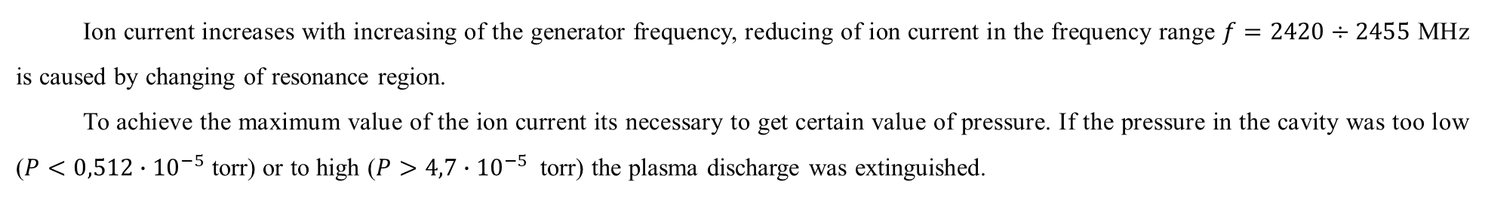
Ion source testing with power input configuration №3 $I\left(f\right)$, $I$(P)
$$I_{max}=103 \text{µ}\text{A}$$
$$I_{max}=118.5 \text{µ}\text{A}$$
He⁺ ion current $I$as a function of the UHF $f$
He⁺ ion current $I$as a function of the cavity pressure $P$
Ion current increases with increasing of the generator frequency, reducing of ion current in the frequency range $f=2420÷2455$ MHz is caused by changing of resonance region.
To achieve the maximum value of the ion current its necessary to get certain value of pressure. If the pressure in the cavity was too low ($P<0,512∙{10}^{−5}$ torr) or to high ($P>4,7∙{10}^{−5}$ torr) the plasma discharge was extinguished.
Notes:
This picture shows ion source ion current dependence on frequency and pressure. Firstly we study ion current increases with increasing of frequency, reducing of ion current if frequency range is caused by changing of resonance region. From the second graph we can that dependence of ion current as a function of pressure, it has been shown that to achieve the maximum value of the ion current its necessary to get certain value of pressure. If the pressure in the cavity was too low ($P<0,512∙{10}^{−5}$ torr) or to high ($P>4,7∙{10}^{−5}$ torr) the plasma discharge was extinguished.

Slide 13
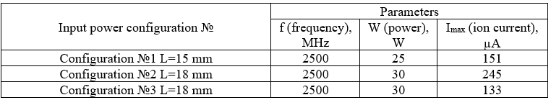
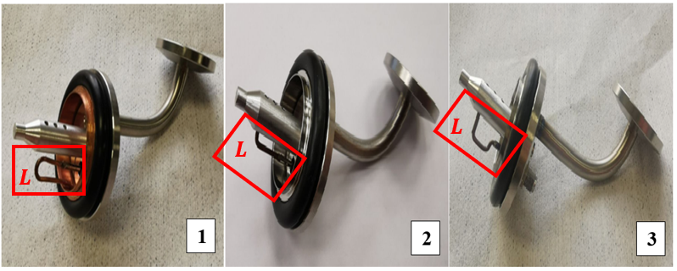
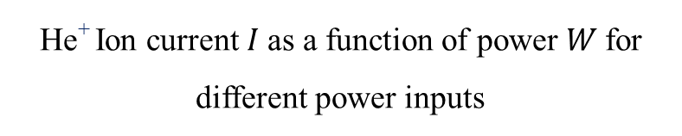
Comparision of different power inputs
He⁺ Ion current $I$as a function of power $W$for different power inputs
Notes:
This slide shows the comparison of all power inputs. The dependence of the He+ ion current on the generator power was measured for different power input configurations. The maximum He⁺ ion current value (245 mkA) is achieved at power 30 W by using power input configuration №2 with length of the coupling loop $L=18$ mm therefore, optimal matching conditions are observed.

Slide 14
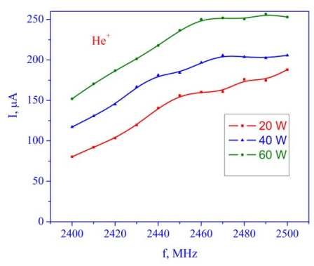

Comparisons with previous results
2019 y.
2022 y.
He⁺ ion current vs frequency at different power level
He⁺ ion current vs frequency
View of coupling loop
$L=13$ mm
View of coupling loop
Notes:
Here are comparisons of previous results with new ones. As we see in 2019 at power 20 W and frequency 2500 MHz the maximum ion current was 175 mkA, in our case at power 20 W and frequency 2500 MHz the maximum ion current value was 222 mkA, that means that using power input with connection from end face of resonator allows not only to minimize size of the ion source but also to increase it’s efficiency.

Slide 15
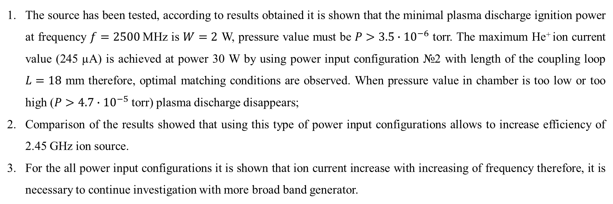
Conclusion
The source has been tested, according to results obtained it is shown that the minimal plasma discharge ignition power at frequency $f=2500$MHz is $W=2$ W, pressure value must be $P>3.5∙{10}^{−6}$ torr. The maximum He⁺ ion current value (245 $\text{µ}\text{A}$) is achieved at power 30 W by using power input configuration №2 with length of the coupling loop $L=18$ mm therefore, optimal matching conditions are observed. When pressure value in chamber is too low or too high ($P>4.7∙{10}^{−5}$ torr) plasma discharge disappears;
Comparison of the results showed that using this type of power input configurations allows to increase efficiency of 2.45 GHz ion source.
For the all power input configurations it is shown that ion current increase with increasing of frequency therefore, it is necessary to continue investigation with more broad band generator.

Slide 16
Thanks for your attention!

