Slide 1

Metallic ion beams
production for SHE at FLNR
Dmitry Pugachev
pugachev@jinr.ru

Slide 2
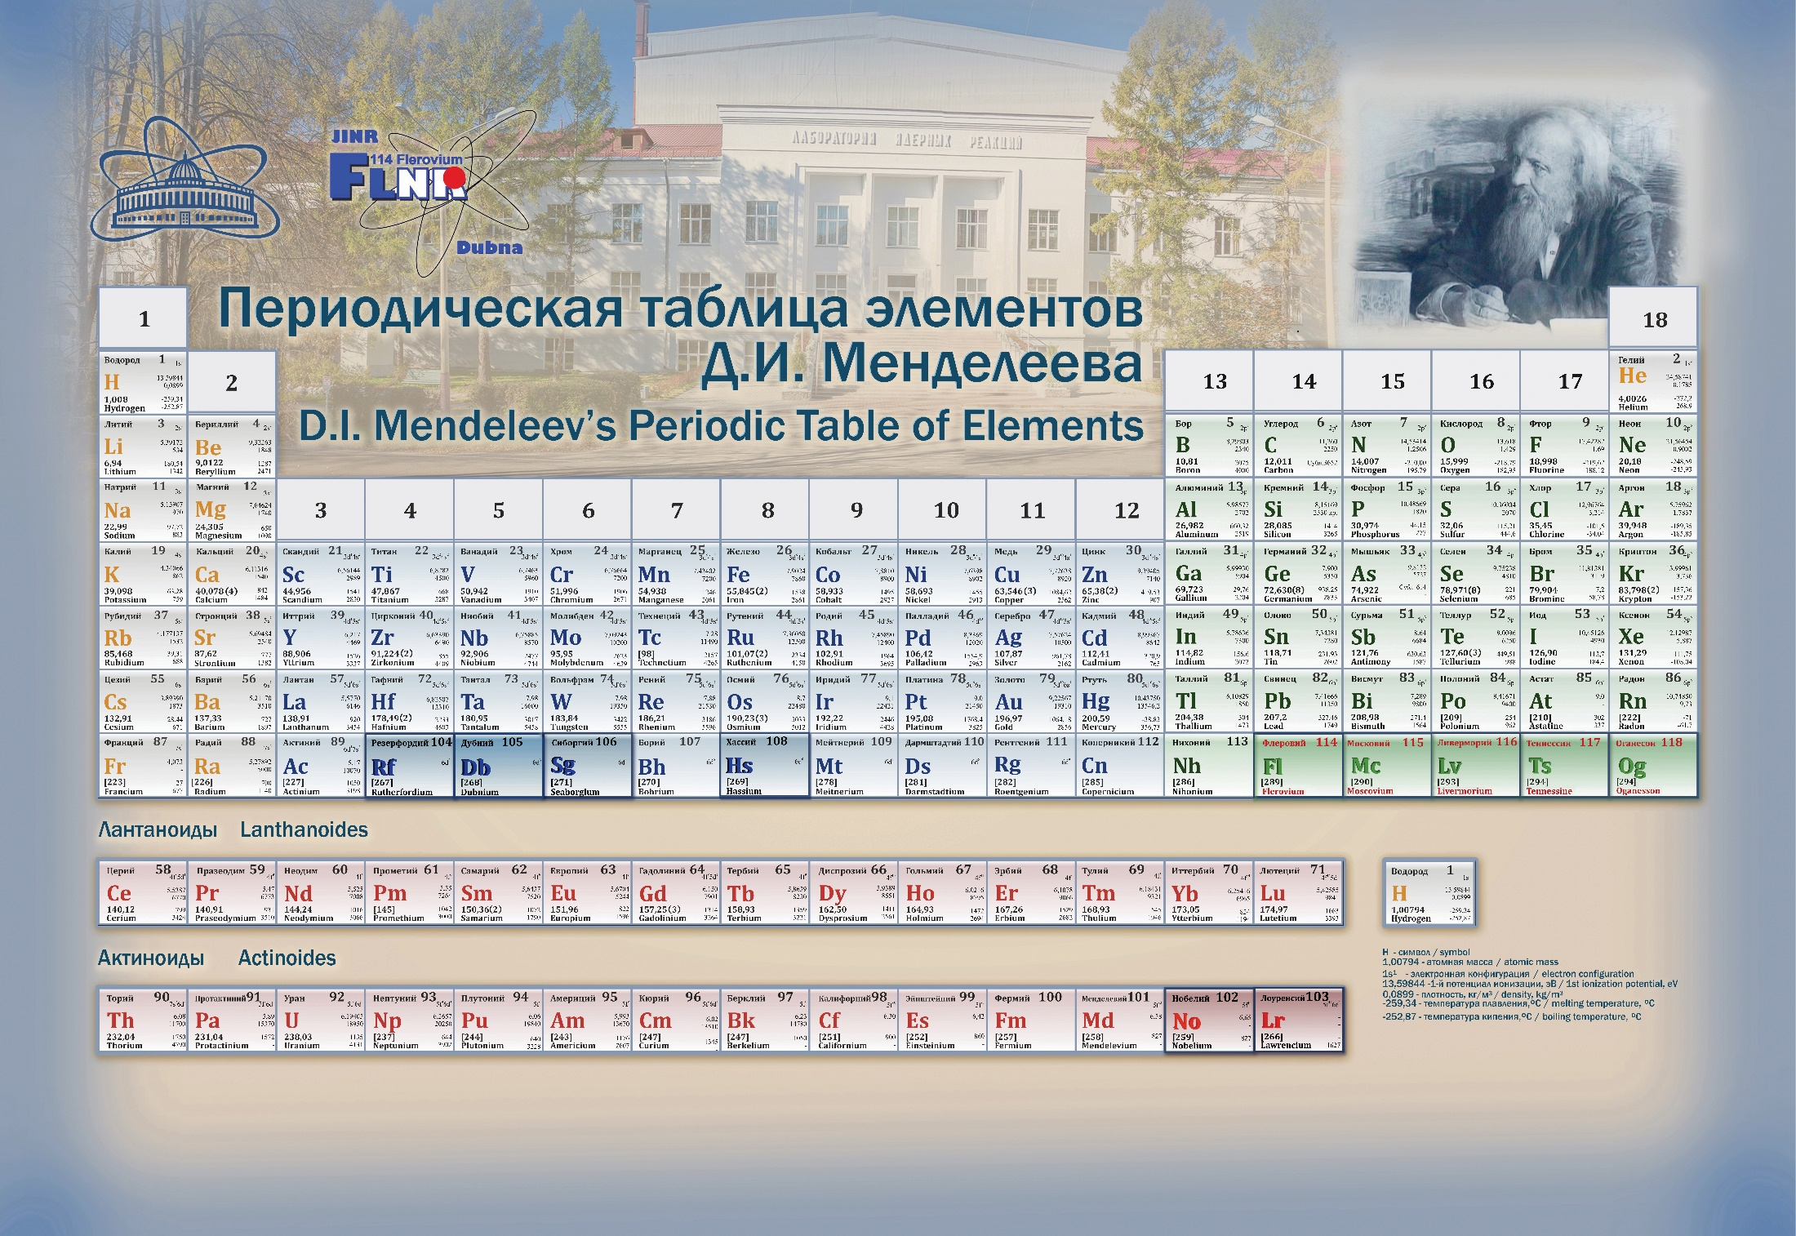
The heaviest target for experiments on synthesis of superheavy elements in heavy-ion reactions is ²⁴⁹Cf, so further progress in the synthesis of elements with Z > 118 requires the production of intense beams of accelerated neutron-enriched isotopes, such as ⁵⁰Ti, ⁵⁴Cr, ⁵⁸Fe, ⁶⁴Ni, etc.
²⁴³Am
²⁴⁹Bk
²⁴⁹⁻²⁵¹Cf
²⁴⁸Cm
¹¹⁹
⁵⁰Ti
⁵⁴Cr
¹²⁰
Up to 5 pmkA
2

Slide 3
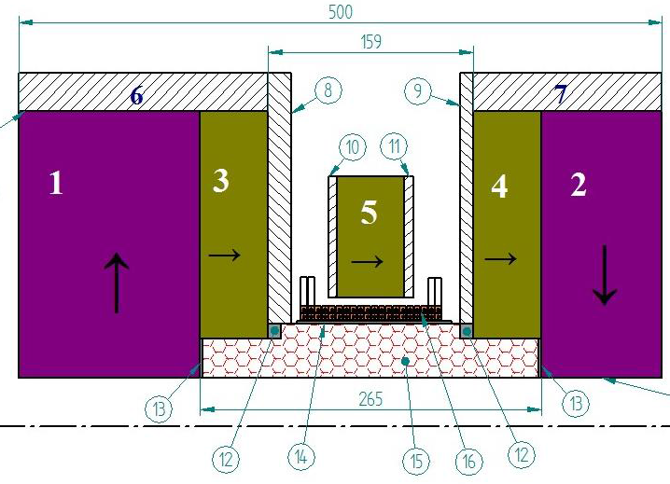
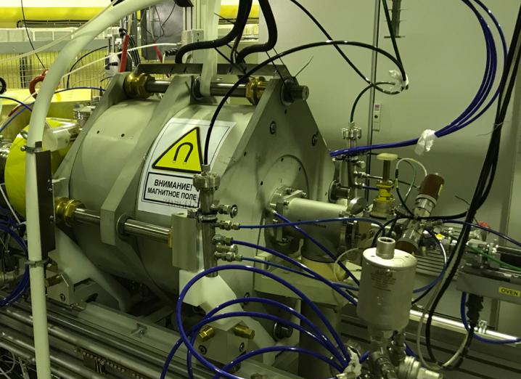
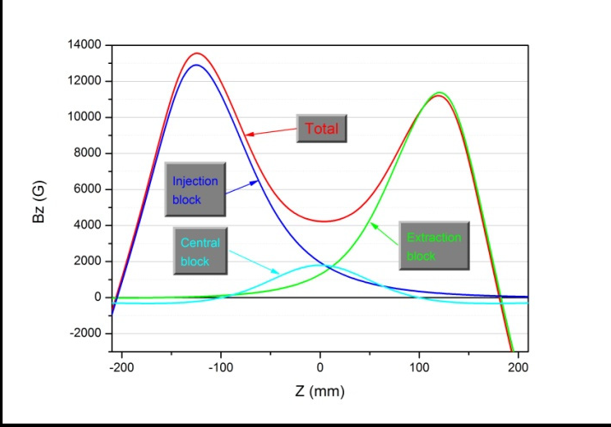
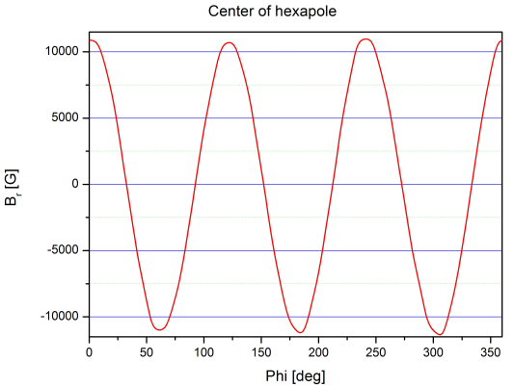
DECRIS-PM
Magnetic structure of DERIS-PM.
1÷5 – PM rings;
6, 7 – soft iron rings;
8÷11 – soft iron plates;
12÷14 - auxiliary elements;
15 – hexapole; 16 – coil.
Parameters of DECRIS-PM
UHF frequency | 14 GHz
Binj | ≥ 1.3 T
Bmin | 0.4 T
Bextr | 1.0 ÷1.1 T
Br | 1.05÷1.15 T
Plasma chamber internal diameter | 70 mm
Axial magnetic field distribution
Radial magnetic field distribution

Slide 4
Metallic ion beams production
Low temperature oven – Ca, Mg, Bi, etc.
Inductive/foil oven - Cr and Ti in near future
MIVOC – Cr, Ti, Al, Zr, Fe, etc.
Insertion into plasma – Al
Sputtering – Al, Ta, Cu
Up to 1000 ºC
More than 1000 ºC
4

Slide 5
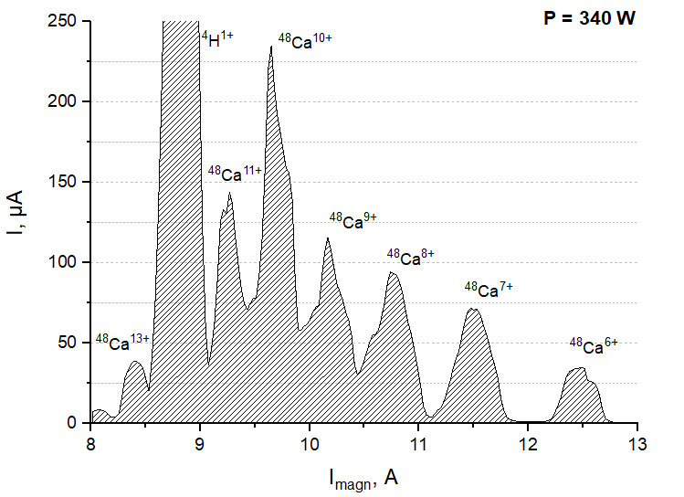
Total working time, h | 12000
Average consumption, mg/h | 0.5
Average operating current of ⁴⁸Ca¹⁰⁺, pµA | 8
Global efficiency of the Ca ionization | 16%
Production of ⁴⁸Ca beam
⁴⁸Ca¹⁰⁺
Faraday Cup | Current, eµA | Efficiency of beam transfer
I_{inj1} | 116.642 | 100.0%
I_{inj2} | 110.131 | 94.42%
I_{inj3} | 100.518 | 86.18%
I_{RP2-1} | 77.161 | 66.15%
I_{RP2-2} | 66.103 | 56.67%
I_{FCI} | 55.1 | 47.24%
The ⁴⁸Ca ion spectrum, optimized for Ca¹⁰⁺
Obtaining high-intensity beams of ⁴⁸Сa, ⁴⁸Ti and ⁵⁴Cr ions on the DC-280 cyclotron
Lukianov A.A.
5

Slide 6

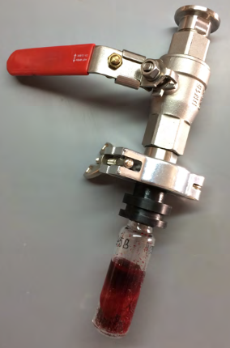
Production of ⁴⁸Ti and ⁵⁴Cr beams (MIVOC)
(CH₃)₅C₅Ti(CH₃)₃
C₁₀H₁₀Cr
The ⁴⁸Ti ion spectrum,
optimized for Ti⁹⁺ (5.5 pµA)
The ⁵⁴Cr ion spectrum,
optimized for Cr¹⁰⁺ (10 pµA)
6

Slide 7
Accelerating of ⁴⁸Ti and ⁵⁴Cr
⁴⁸Ti⁹⁺
⁵⁴Cr¹⁰⁺
Faraday Cup | Current, eµA | Efficiency of beam transfer
I_{inj1} | 47.4 | 100%
I_{inj2} | 45.5 | 95.9%
I_{inj3} | 40.9 | 86.3%
I_{RP2-1} | 30.7 | 64.8%
I_{RP2-2} | 26.4 | 55.7%
I_{FCI} | 21.2 | 44.7%
Faraday Cup | Current, eµA | Efficiency of beam transfer
I_{inj1} | 97.5 | 100%
I_{inj2} | 95.2 | 97.6%
I_{inj3} | 82.2 | 84.3%
I_{RP2-1} | 60.7 | 62.3%
I_{RP2-2} | 54.3 | 55.7%
I_{FCI} | 43.2 | 44.3%
3 pmkA?
5 pmkA?
Obtaining high-intensity beams of ⁴⁸Сa, ⁴⁸Ti and ⁵⁴Cr ions on the DC-280 cyclotron
Lukianov A.A.
7

Slide 8
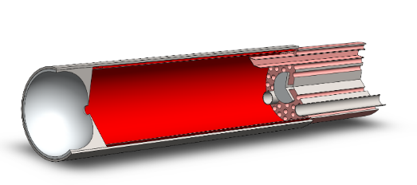
Ti ion production using SF₆ plasma*
ECR ion source plasma chamber
UHF
He + SF₆
Ti foil
Ti + F TiF_{x}
Volatile compounds
*Production of multiply charged metallic ions by compact electron cyclotron
resonance ion source with SF₆ plasma Y. Saitoh et al.
REVIEW OF SCIENTIFIC INSTRUMENTS VOLUME 69, NUMBER 2 FEBRUARY 1998
*Recycling effect of germanium on ECR ion source P. Leherissier et al.
Nuclear Instruments and Methods in Physics Research B 211 (2003) 274–280
8

Slide 9
Ti ion production using SF₆ plasma
Ti foil
MIVOC - (CH₃)₅C₅Ti(CH₃)₃
The ⁴⁸Ti ion spectrum, current of the Ti¹¹⁺ - 65 eµA
The ⁴⁸Ti ion spectrum, current of the Ti¹¹⁺ - 45 eµA
9

Slide 10
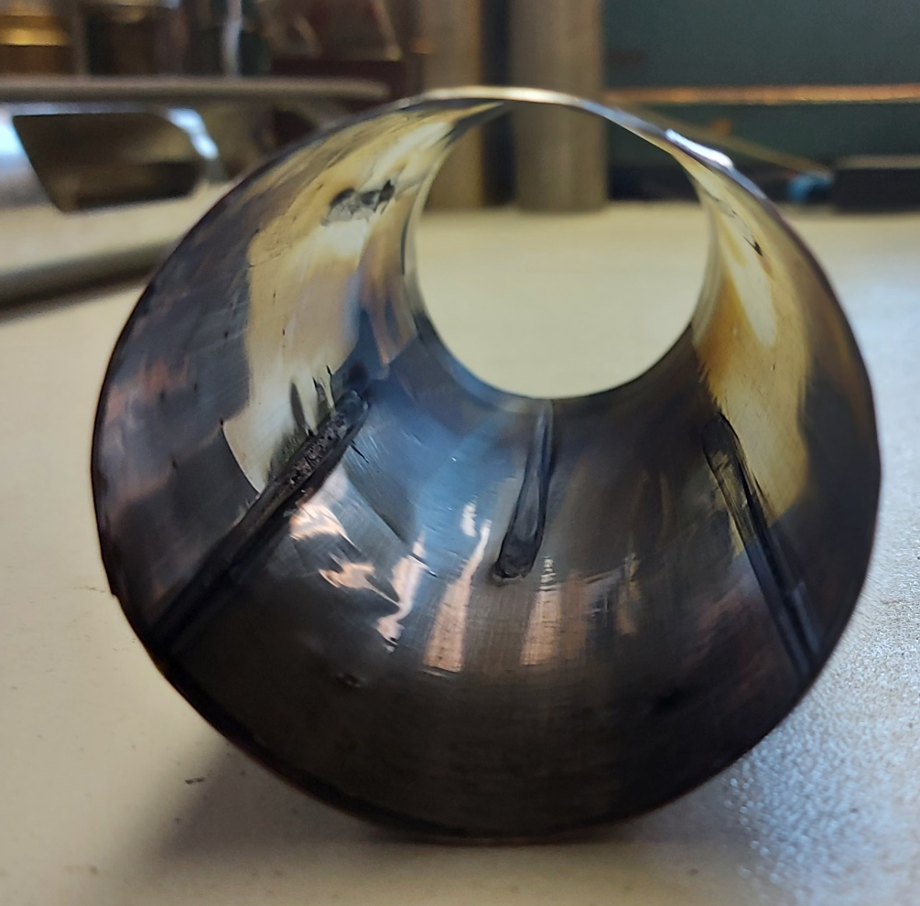
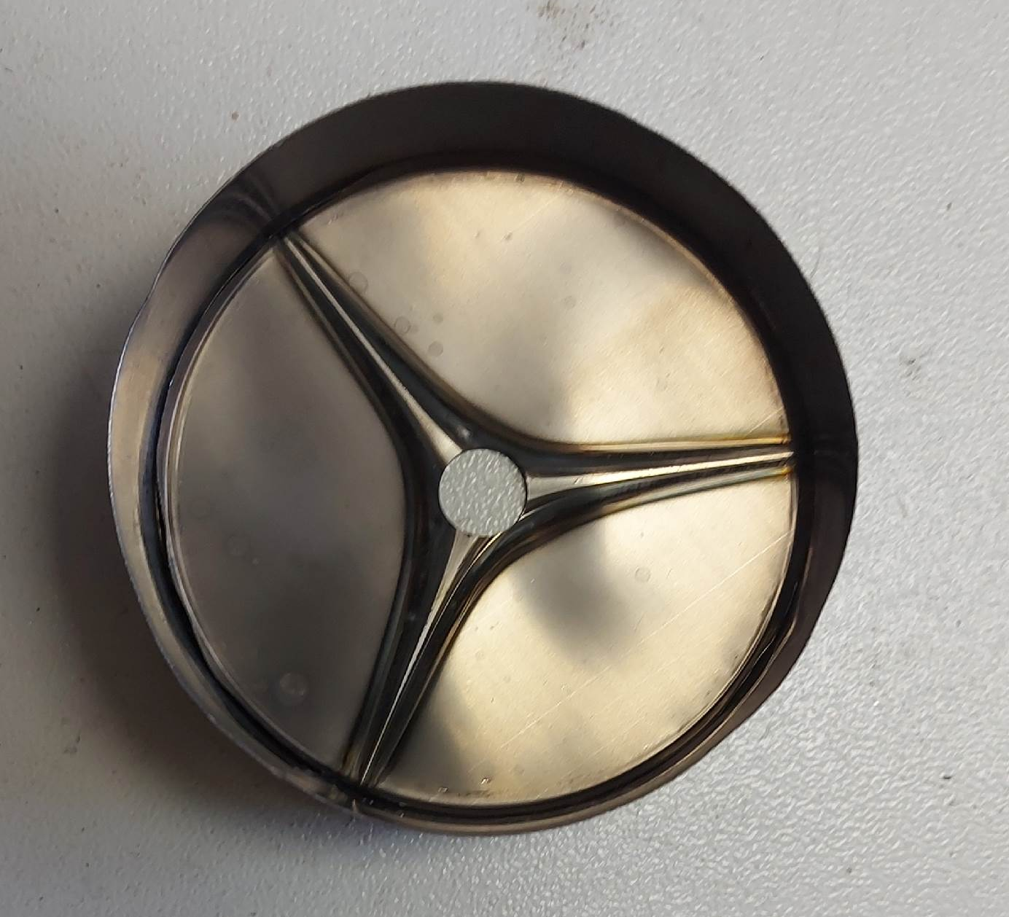
Screen with Ti foil after operation with SF₆ plasma
S_{eff} ≈ 600 mm²
S_{eff} ≈ 4500 mm²
10

Slide 11
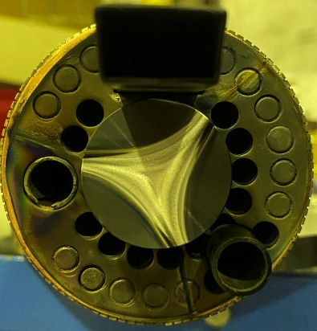
Ti ion production using SF₆ plasma*
ECR ion source plasma chamber
UHF
He + SF₆
Ta screen
Ti biased-electrode
R=15mm
S_{eff screen} ≈ 20 ∙ S_{eff} _{biased-electrode}
S = 707 mm²
S_{eff} ≈ 254 mm²
11

Slide 12
Ti ion production using SF₆ plasma
He
He
S_{eff} ≈ 5100 mm² (Ti screen)
S_{eff} ≈ 250 mm² (Ti biased-electrode)
Ti⁷⁺=80 emkA
Ti¹¹⁺=65 emkA
Ti⁷⁺=40 emkA
Ti¹¹⁺=30 emkA
12

Slide 13
future plans

Slide 14
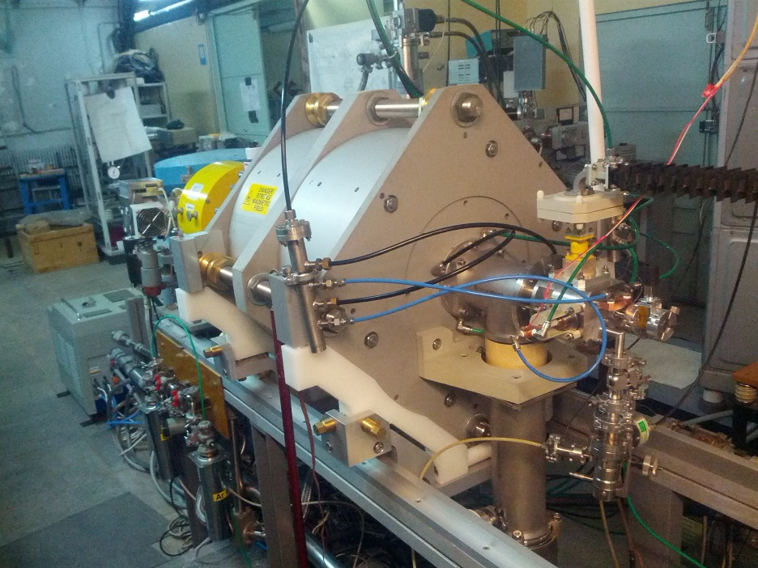
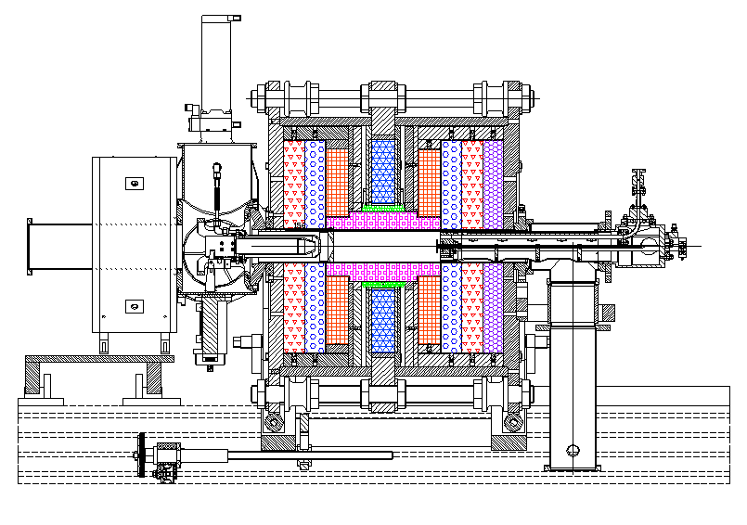
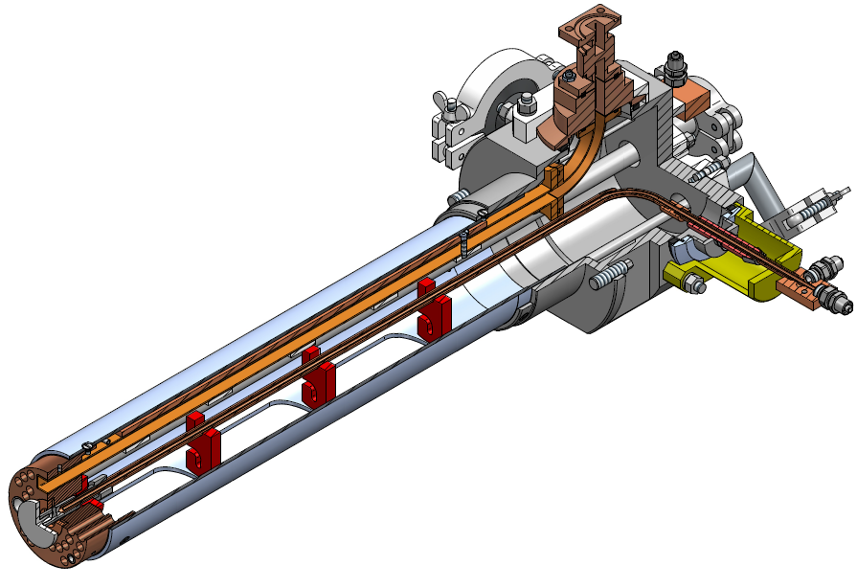
Inductive oven
1700⁰C
Injection plug
UHF injection
Ø 70
14

Slide 15
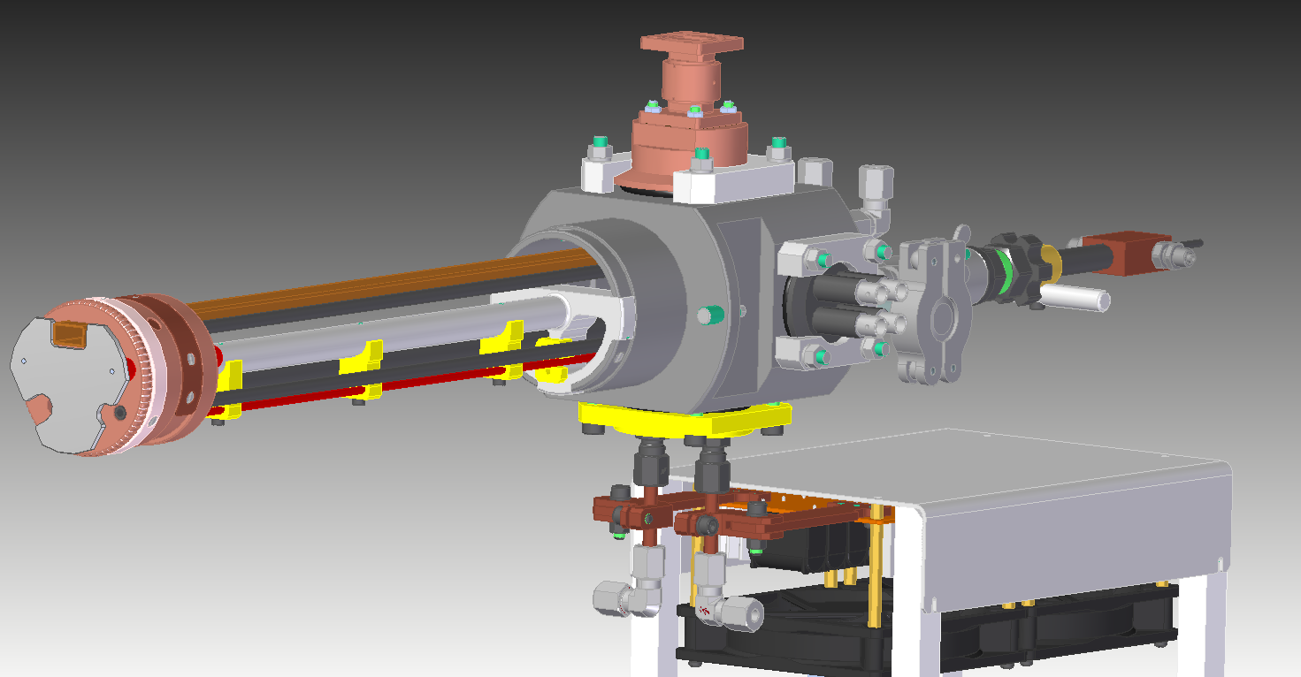
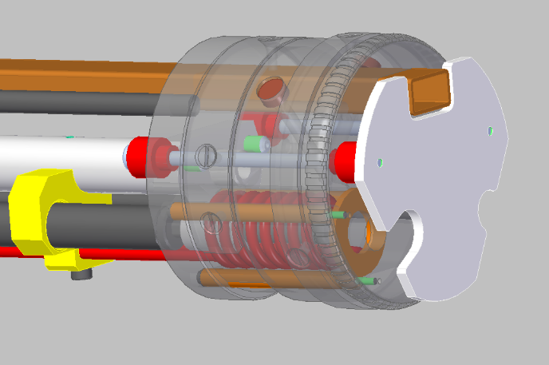
Pre-pumping volume
Waveguide
water cooling of the crucible holder
Water cooling of the cooper plug
Resonance circuit
Inductor
water cooling of the inductor
Power supply:
EA-PSI 9080-60
0÷80 V, 0÷60 A, 0÷1500 W
15

Slide 16
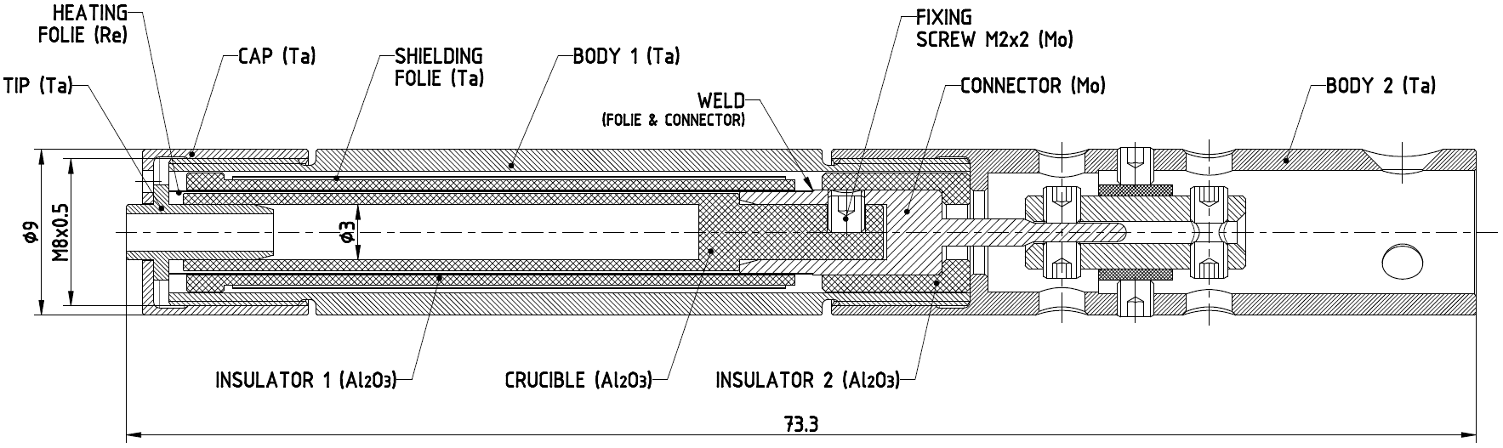
“FOIL” OVEN (GANIL type)
Foil thickness – 0.05 mm
Outer diameter (with screen) – 20 mm
Power consumption – 57 W
T_{crucible,} °C - 1500°C
T_{foil,} °C - 1700°C
T_{outer surface,} °C - 800°C
Technical drawings are developed in collaboration with VINCA (Belgrade)
16

Slide 17
Results and future plans
Calcium consumption was 3.5 mg/h for a high-intensity ion beam (25 pµA ⁴⁸Ca¹⁰⁺) and 0.3 mg/h for a low-intensity beam (4 pµA ⁴⁸Ca¹⁰⁺). Average consumption of calcium 0.5 mg/h. Total working time with a calcium beam around 12000 h.
Titanium and chromium beams were obtained on the DC-280 cyclotron. The issues of modernization of the design of some elements of the ion source, contributing to an increase in the intensity of the ion beam using the MIVOC method, are being solved.
Induction and “foil” ovens will be manufactured and tested in near future. If every tests will be finished successfully we will prepare all equipment to install it on the DECRIS-PM ion source to obtain Ti and Cr ion beams.
17

Slide 18

Thank you for your attention

