Slide 1
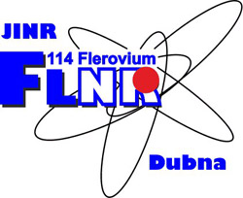

DIAGNOSTICS OF HEAVY ION BEAM LOSSES VIA THE TRANSPORT CHANNEL FROM THE ACCELERATOR TO THE PHYSICAL INSTALLATION
Alushta – 2023
K. Timoshenko

Slide 2
Outline
Introduction
Advantages and Disadvantages of diagnostic methods
Principle of Operation of the Non-destructive method
Used equipment
Software
Research results
Conclusion

Slide 3
Diagnostic methods
In the field of diagnostics of heavy ion beam losses, there are two main methods: contact and non-destructive.
Contact method:
  Requires direct interaction with the beam.
  Provides direct information about the beam profile and parameters.
  Contact diagnostics methods can include measuring the beam's charge, intensity, or energy.
Non-destructive method:
  Allows assessing beam losses without direct interaction with the beam.
  Measures secondary effects caused by the beam's interaction with the environment.
  Enables the estimation of beam losses based on the intensity and distribution of the registered effects.

Slide 4
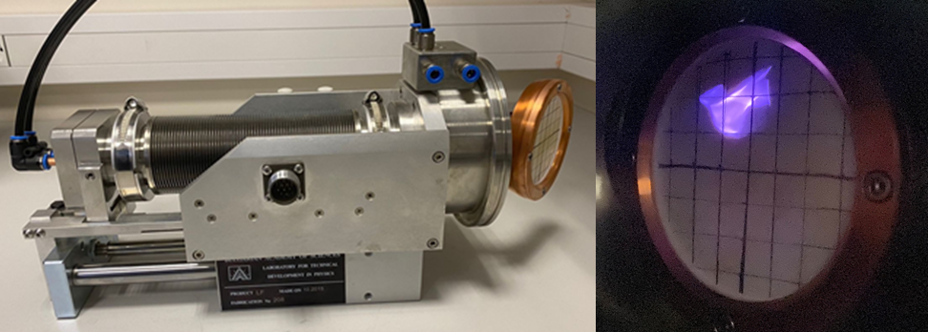
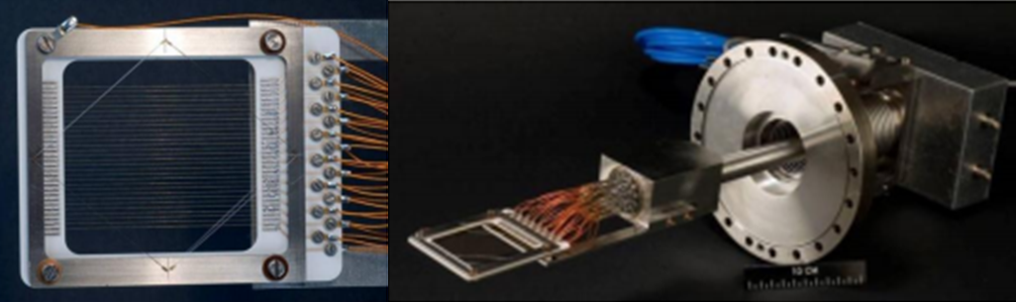
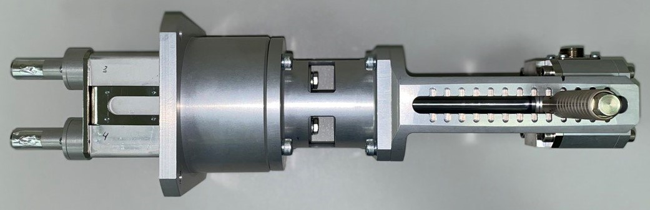
Contact sensors
Depending on the initial parameters of the accelerated heavy ion beam, its profile, intensity, and energy are measured/monitored using various methods. The most common methods include:
Faraday Cup;
Luminescent screen;
Secondary emission grid;
ToF detectors;
Strip detectors;
Ionization chamber;
Scintillation detectors.
Faraday Cup
Luminescent screen, phosphor screen
Secondary emission grid, secondary emission monitor, SEM
Scintillation detector

Slide 5
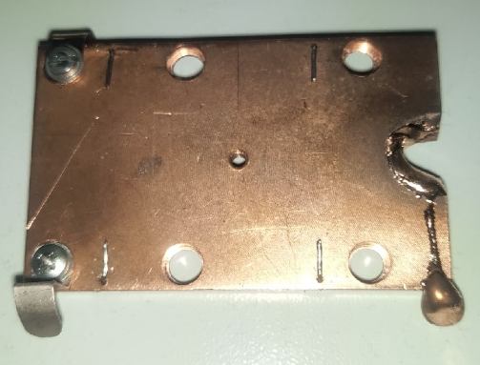
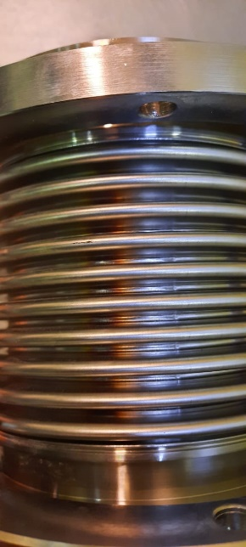
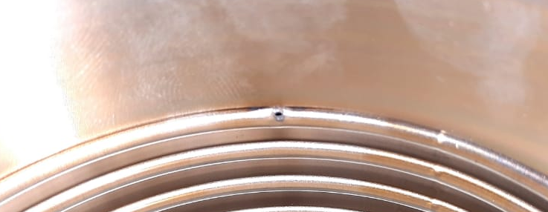
Disadvantages of contact methods
destructive effect on the beam;
Overheating and destruction of equipment.
A high-intensity ion beam hit the bellows

Slide 6
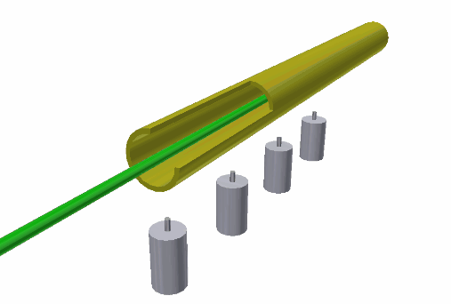
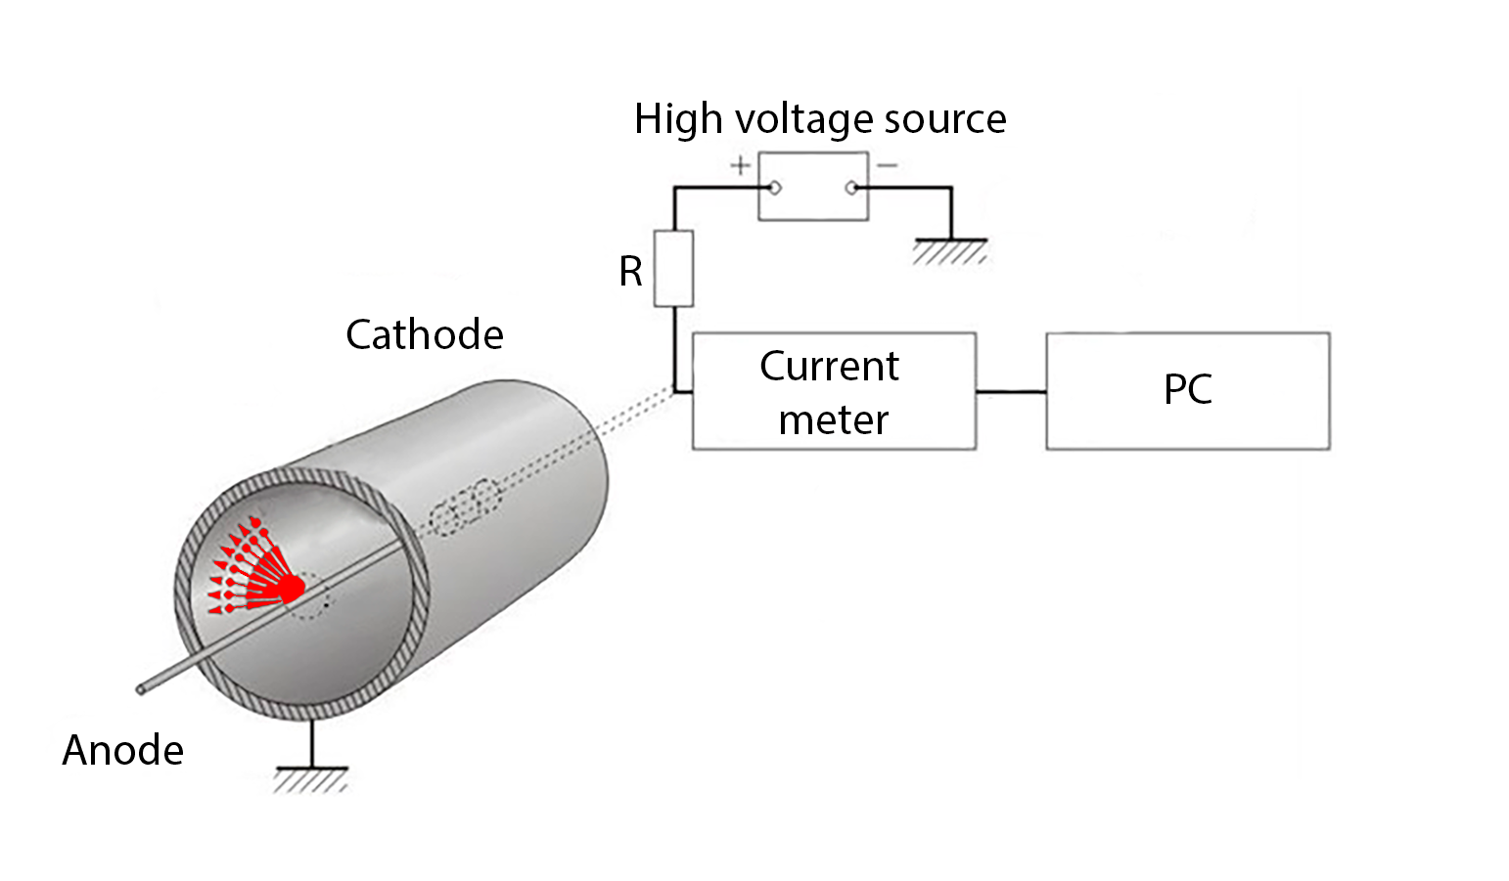
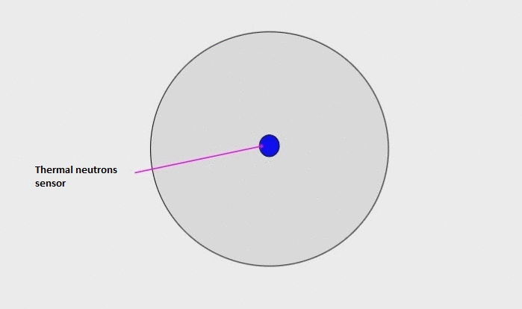
Principle of Operation of the Non-destructive Method
Ion beam channel
Detector 4
Beam
Detector 3
Scheme of operation of
the thermal neutron sensor
Detector 2
Detector 1

Slide 7
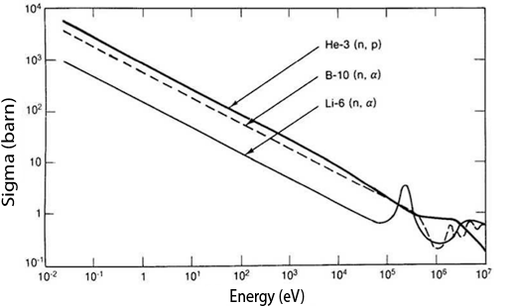
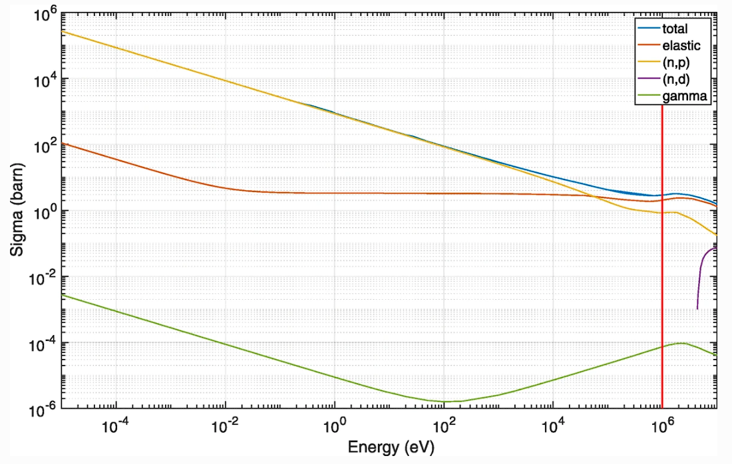
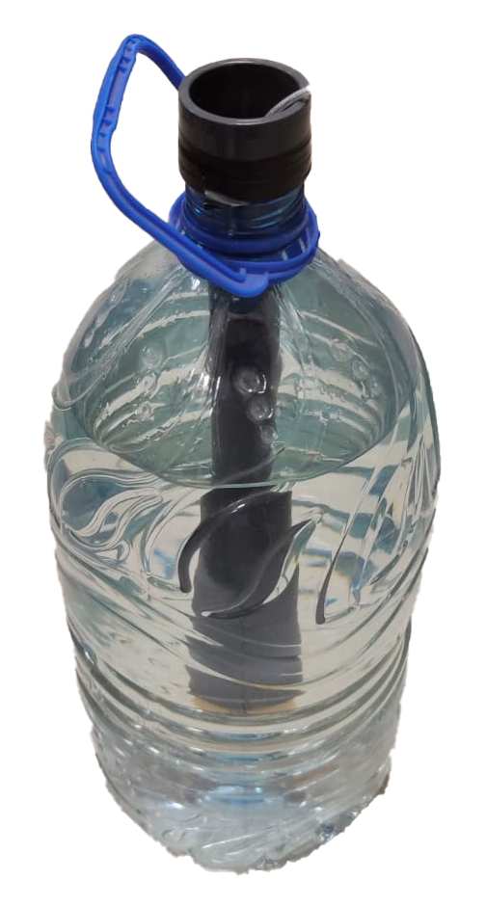
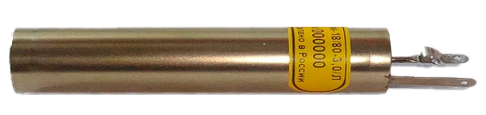
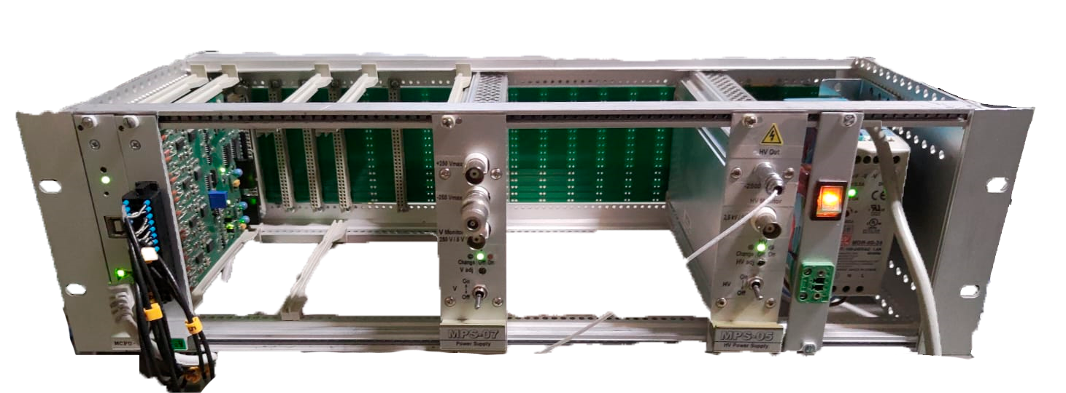
Detector of neutrons
Helium-18/80-3,0/L (proportional counter)
Rated operating voltage range, V | 1150-1450
Effective working length, mm | 55
Thermal neutron detection efficiency,% | 80
Dependence of the Cross Sections of Reactions ³He(n,p), ¹⁰B(n,α), and ⁶Li(n, α) on Neutron Energy
Moderator of neutrons: H₂O

Slide 8
Detector of neutrons
Helium-18/80-3,0/L (proportional counter)
Rated operating voltage range, V | 1150-1450
Effective working length, mm | 55
Thermal neutron detection efficiency,% | 80
Neutron cross section in the energy range 0-10 MeV for the 4 reactions: ³He recoil, (n,p), (n,d) and γ-rays
Moderator of neutrons: H₂O

Slide 9
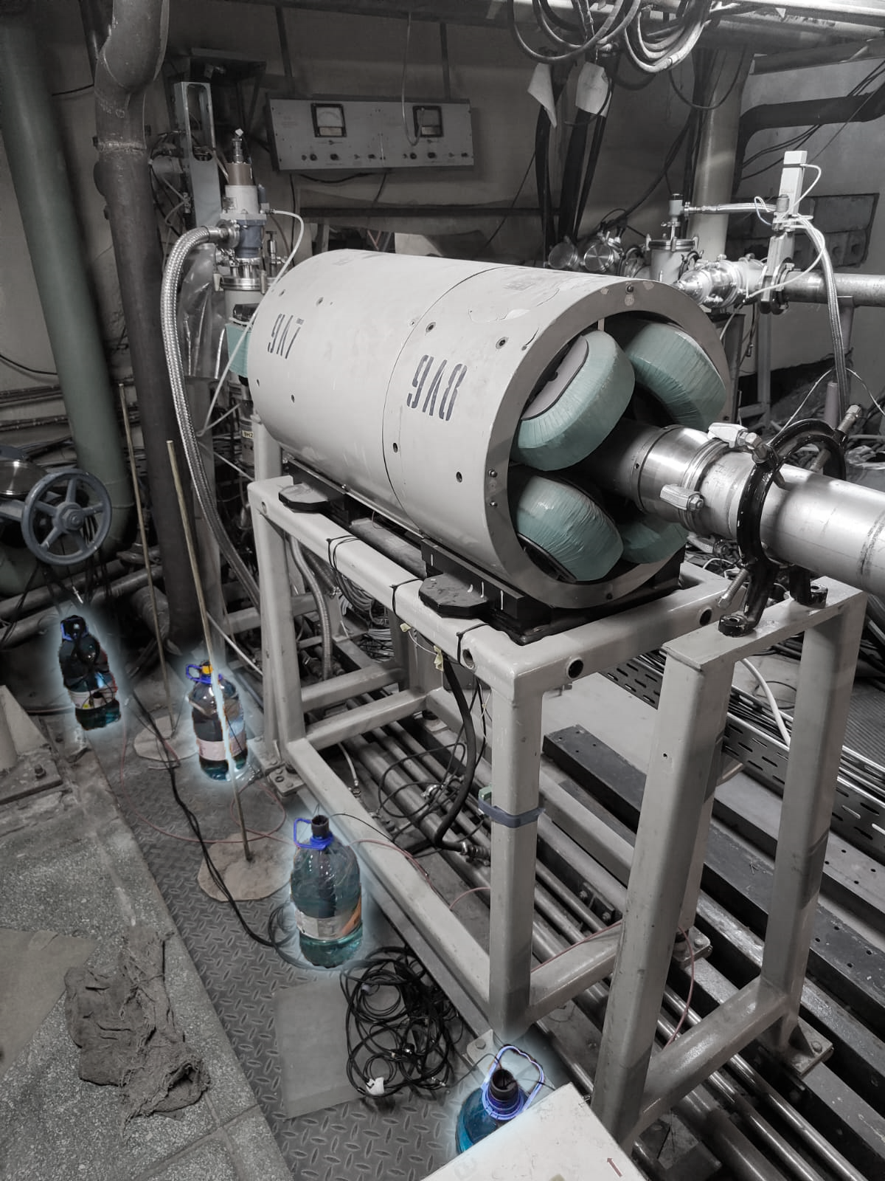
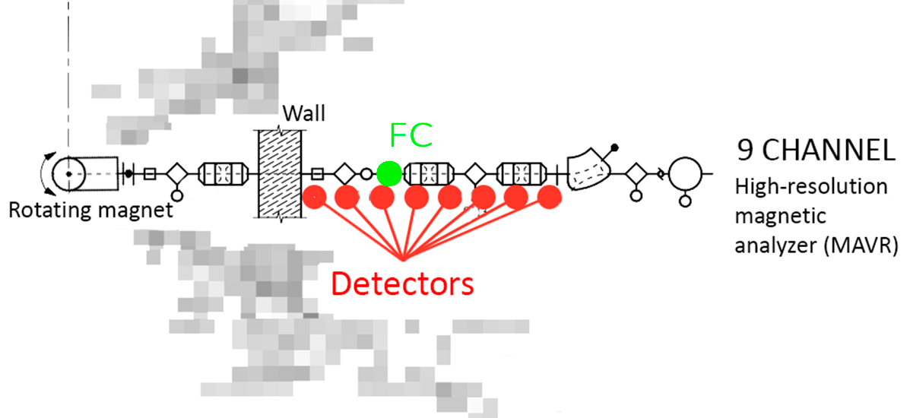
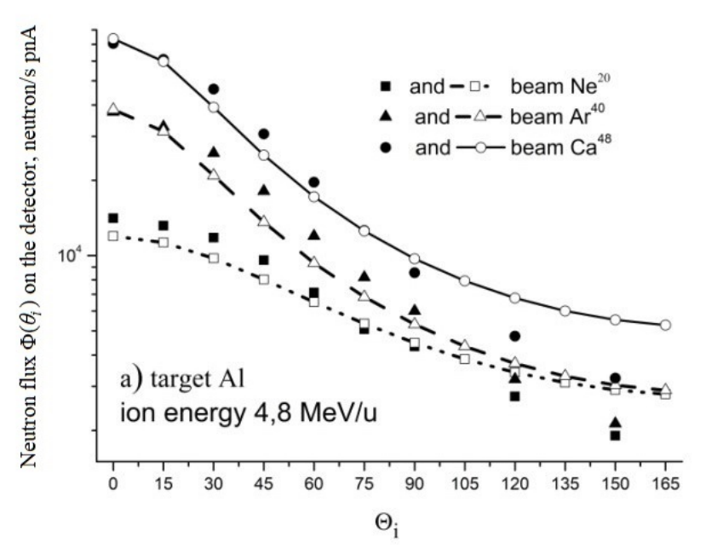
Location on the U-400
Basic parameters of the U-400 accelerator
Parameter | Meaning
Accelerated Particles | From ⁶Li to ¹³²Xe
Ion energy, MeV/nuclei | 25 – 3
Range of accelerated ions | A / Z = 5,0-5,95
Beam parameters | Meaning
Accelerated Particle | ⁴⁸Ca⁷⁺
Beam current | 200 nA
Beam diameter | 15-20 mm
Comparison of the calculation results using formulas (open symbols) and the FLUKA program (closed symbols) for the neutron flux incident on a detector placed at a distance of 1 m at an angle θi when bombarded by ²⁰Ne, ⁴⁰Ar, and ⁴⁸Ca ions on a thick Al target

Slide 10
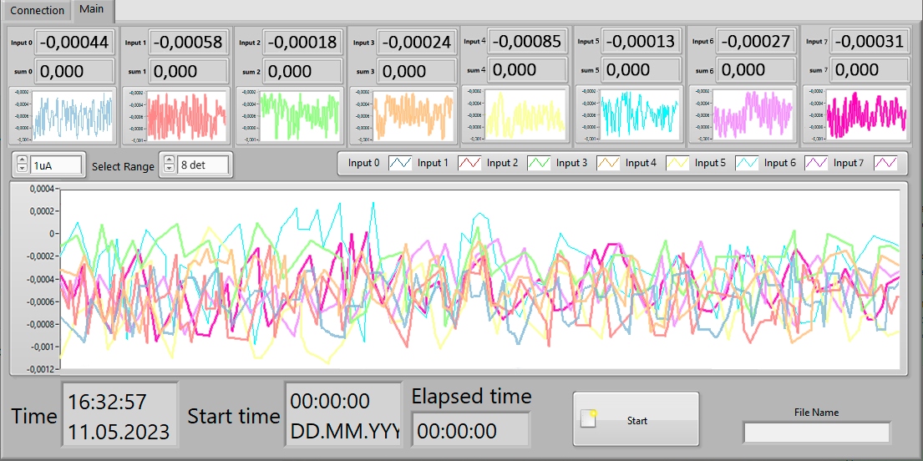
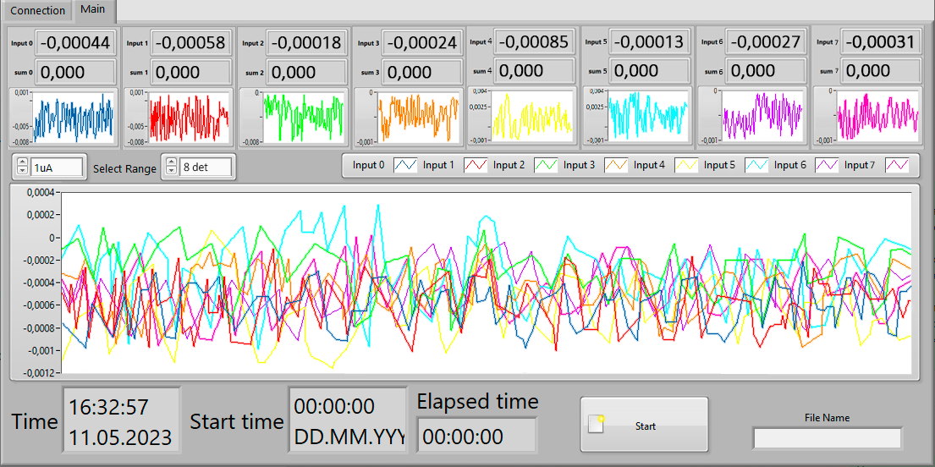

Slide 11
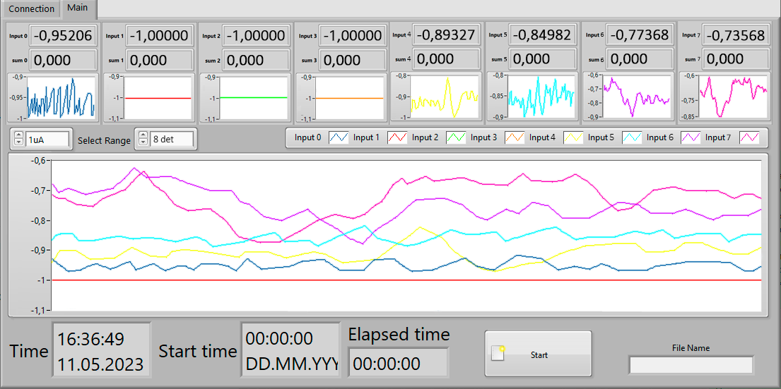

Slide 12
Conclusions
The measurements were conducted at the U-400 accelerator in the Flerov Laboratory of Nuclear Reactions at the Joint Institute for Nuclear Research.
As a result, it was determined that eight Helium-18/80-3.0/L neutron counters, operating in proportional mode, can be used to identify the beam loss locations. For 48Ca7+ ions, the minimum beam currents were determined at which the diagnostic method can be applied.
In the future, it is planned to install and conduct a series of experiments using the system on the U-400 cyclotron and subsequently on all the main facilities at the Flerov Laboratory of Nuclear Reactions at the Joint Institute for Nuclear Research. This system can be installed along the ion beamline to monitor the beam loss locations in the gas-filled separator channel (GASSOL) on the DC-280 accelerator.

Slide 13

DIAGNOSTICS OF HEAVY ION BEAM LOSSES VIA THE TRANSPORT CHANNEL FROM THE ACCELERATOR TO THE PHYSICAL INSTALLATION
Alushta – 2023
K. Timoshenko
Email: timoshenkokd@jinr.ru

