Slide 1
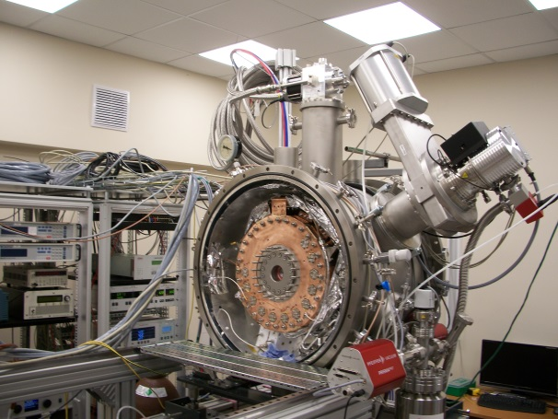
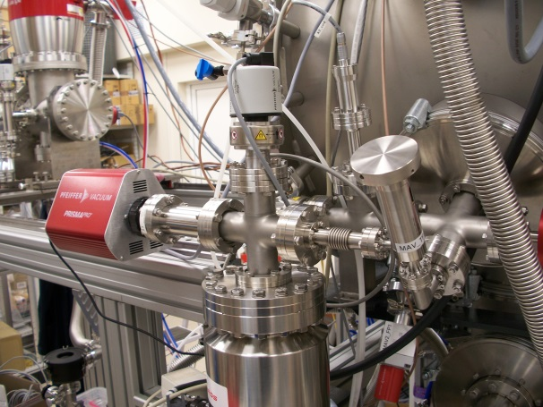
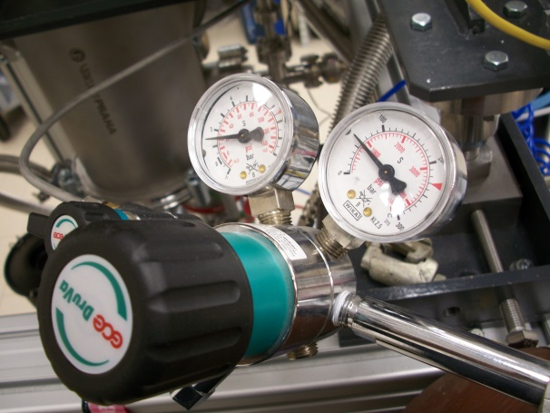
Residual gas analysis in the vacuum at the cryogenic gas stopping cell
Novoselov A.S.
Sector №4 FLNR JINR
Alushta-2023

Slide 2
Plan of the presentation
Introduction
Cryogenic gas stopping cell
Quadrupole mass spectrometer
Residual gas analysis
Summary

Slide 3
Introduction
Modern high precision experiments in nuclear physics are require high quality ion beam parameters. And this is true both for primary and secondary beams. This report contains some information about the cryogenic gas stopping cell for secondary beams also known as “gas catcher”. This setup now is under constuction and testing at the Flerov laboratory of nuclear reactions at the Joint institute for nuclear research. The presentation is dedicated to working gas quality analysis.

Slide 4
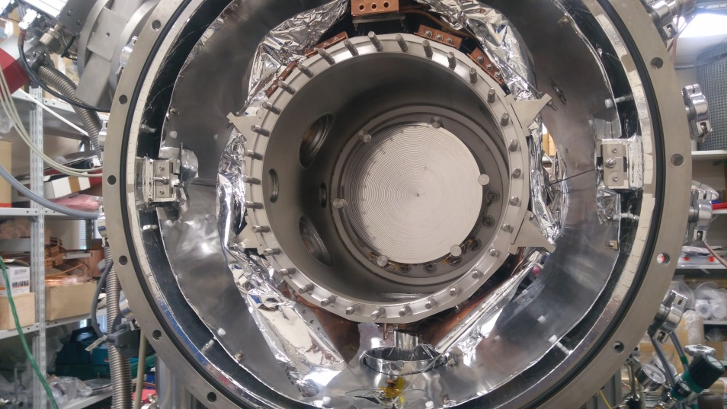
Cryogenic gas stopping cell
Entrance window
DC cage
RF funnel
Extraction nozzle
Extraction RFQ
Fig. 1. Cryogenic gas stopping cell at the FLNR JINR.
The aim of the cryogenic gas stopping cell is the transformation of rare ion beams produced in nuclear reactions from high energy with large emittance into low-energy beams with small emittance and low energy spread. The working temperature of the cold chamber <40K.

Slide 5
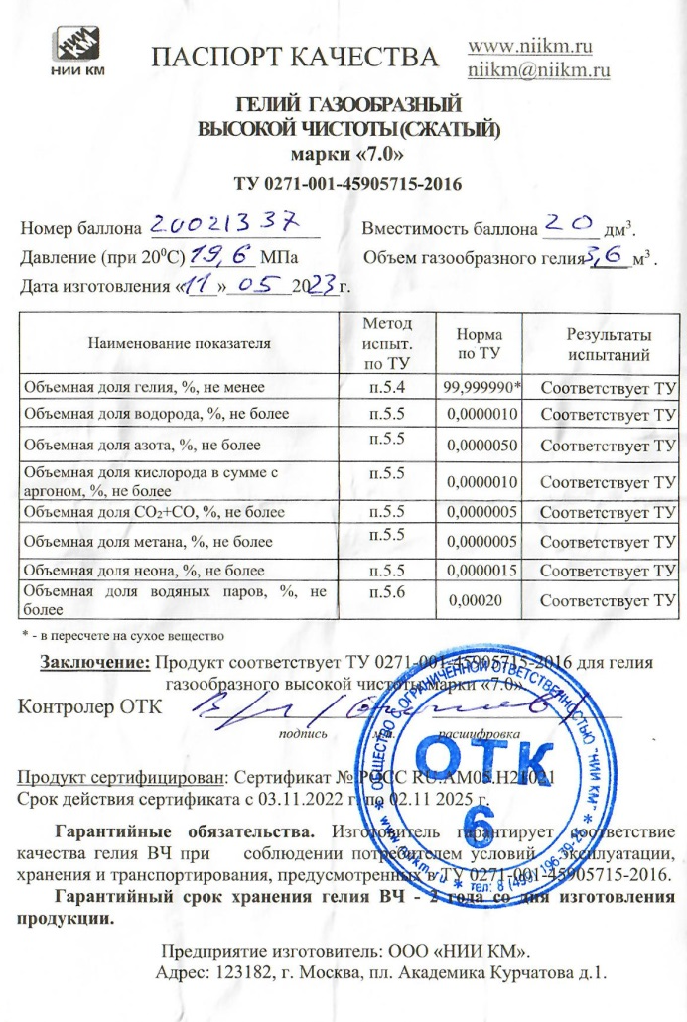
Cryogenic gas stopping cell
Table 1. Atmosphere gases properties
№ |  | T_{m}, K | T_{b}, K | %, atm
1 | Nitogen (N₂) | 63,13 | 77,33 | 78,1
2 | Oxygen (O₂) | 54,35 | 90,17 | 20,9
3 | CO₂ | 216,5 | 194,6 | 0,03
4 | CO | 68,12 | 81,64 | 1E-5
5 | Argon (Ar) | 83,84 | 87,24 | 0,934
6 | Hydrogen (H₂) | 13,95 | 20,37 | 5E-4
7 | Neon (Ne) | 24,62 | 27,21 | 2E-3
8 | Krypton (Kr) | 115,44 | 119,92 | 1E-4
9 | Xenon (Xe) | 161,29 | 165,18 | 9E-6
10 | CH₄ | 90,65 | 111,56 | 2E-4
11 | Helium (He) | 1,74 | 4,206 | 5E-4
Fig. 2. Ultra high purity helium 7.0

Slide 6
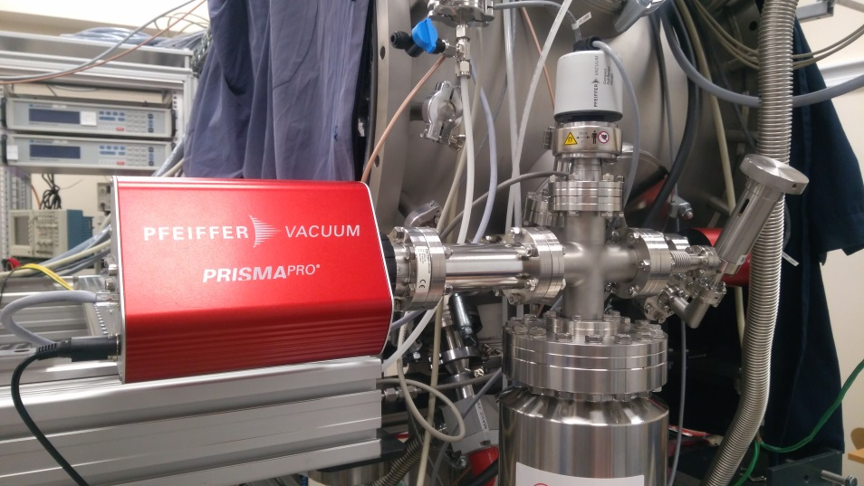
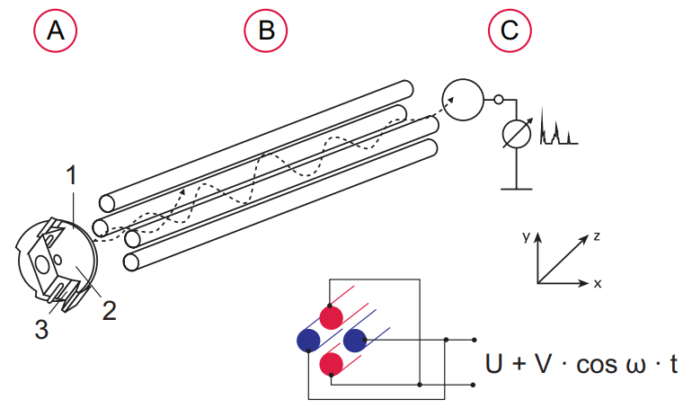
Quadrupole mass spectrometer
Fig. 3. Pfeiffer Vacuum PrismaPro QMG 250 M3 is a quadrupole mass spectrometer for qualitative and quantitative gas analysis.
Ion formation in the ion source from electron impact ionization
  Ion optic
  Formation area
  Filament
Ion separation according to the mass-to-charge ratio
Ion detection
Fig. 4. Principle of the quadrupole mass spectrometer

Slide 7
Quadrupole mass spectrometer
Pfeiffer Vacuum PrismaPro QMG 250 M3 technical parameters:
Detector type: EM/Faraday
Mass range: 1-300 u
Connection flange: DN 40CF
Vacuum required (max pressure): <3,75∙10⁻⁴ Torr
Detection limit (EM): 3,75∙10⁻¹⁵ Torr
Sensitivity (Faraday): >2,25∙10⁻⁴ A/Torr
Operating temperatures:
  Analyzer: ≤150 ⁰C
  QME: 5 to 50 ⁰C
Interfaces:
  Ethernet
  D-Sub (relay output, analog input, digital input, +24V output)
Software: PV MassSpec

Slide 8
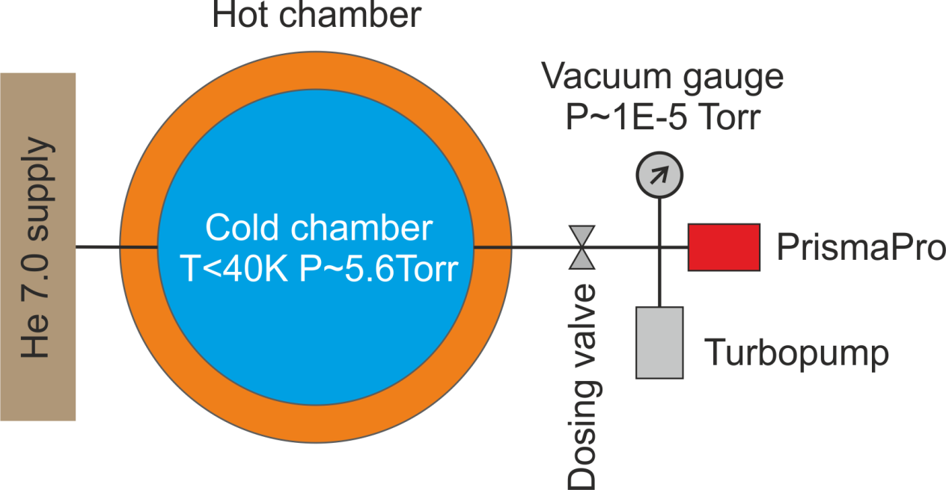
Scheme of the experiment
Obtain UHV conditions at the PrismaPro
Obtain HV conditions at the cold chamber
Obtain temperature below 40K at the cold chamber
Scan m/z spectrum as reference
Open dosing valve to scan m/z spectrum probe from the cold chamber
Compare two scans
Fig. 5. Simplified scheme of the gas analysis using PrismaPro mass spectrometer

Slide 9
Residual gas analysis
Fig. 6. Example of the m/z spectrum from the PrismaPro vacuum volume.
Total pressure ~1,8E-10Torr. Dosing valve from cold chamber closed.

Slide 10
Residual gas analysis
Fig. 7. Example of the m/z spectrum from the PrismaPro
and the cold chamber vacuum volume.
Total pressure ~1,4E-5Torr.

Slide 11
Summary
The working cryogenic temperature and gas pressure at the cold chamber in the standalone mode are reached.
The first results of the residual gas analysis at the cryogenic gas stopping cell are show that helium quality is enough high for the using it as working gas. The quantity of impurities are lower relative to reference m/z spectrum which was done at ultra high vacuum area.
For the future plans concerning to helium it is needed to measure gas parameters at the flow mode.

Slide 12
Thanks for attention

