Slide 1

On the Final Draft of JINR Seven-Year Plan for 2024–2030
Grigory V. Trubnikov
June 2023

Slide 2
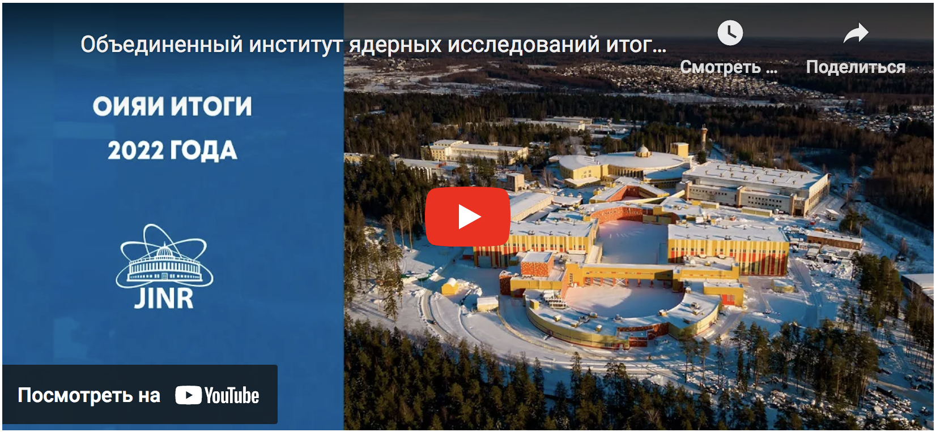
JINR results 2022
https://youtu.be/LabKigVFcog

Slide 3


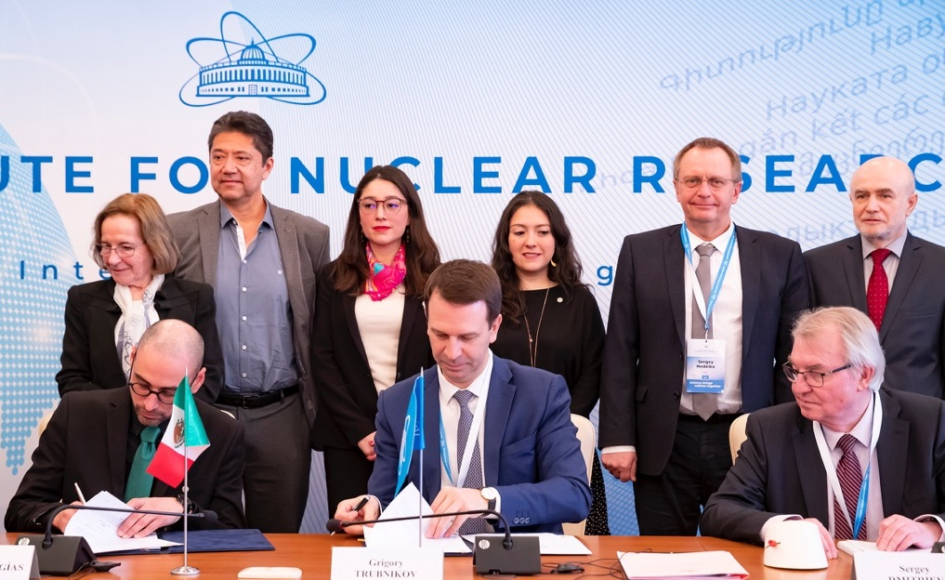
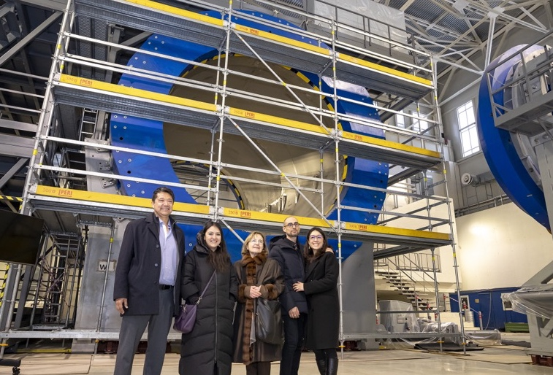
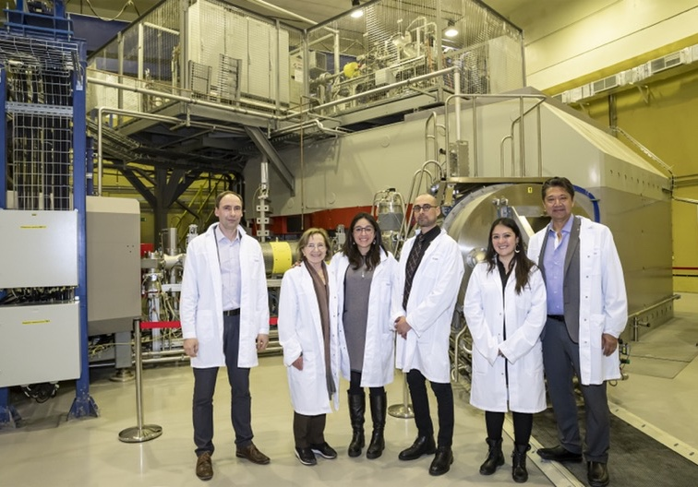
JINR - Mexico: new horizons of cooperation
Joint Declaration
MPD NICA, VBLHEP JINR
February 15-16, 2023, JINR, Dubna
Delegation of Mexico headed by H.E. Eduardo Villegas Megías,
Ambassador Extraordinary and Plenipotentiary of the United Mexican States
Highlights of the visit:
signing of the Joint Declaration of Intent between the National Council for Science and Technology of Mexico (CONACYT) & JINR;
report on JINR-Mexico cooperation by the President of the Mexican Physical Society Ana Maria Cetto at the session of the JINR Scientific Council;
acquaintance with the JINR infrastructure.
DC-280, LNR JINR

Slide 4
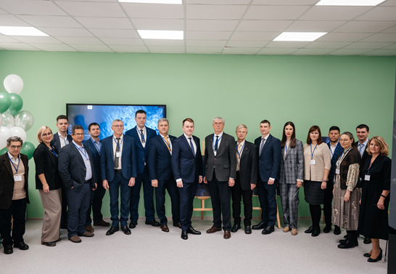
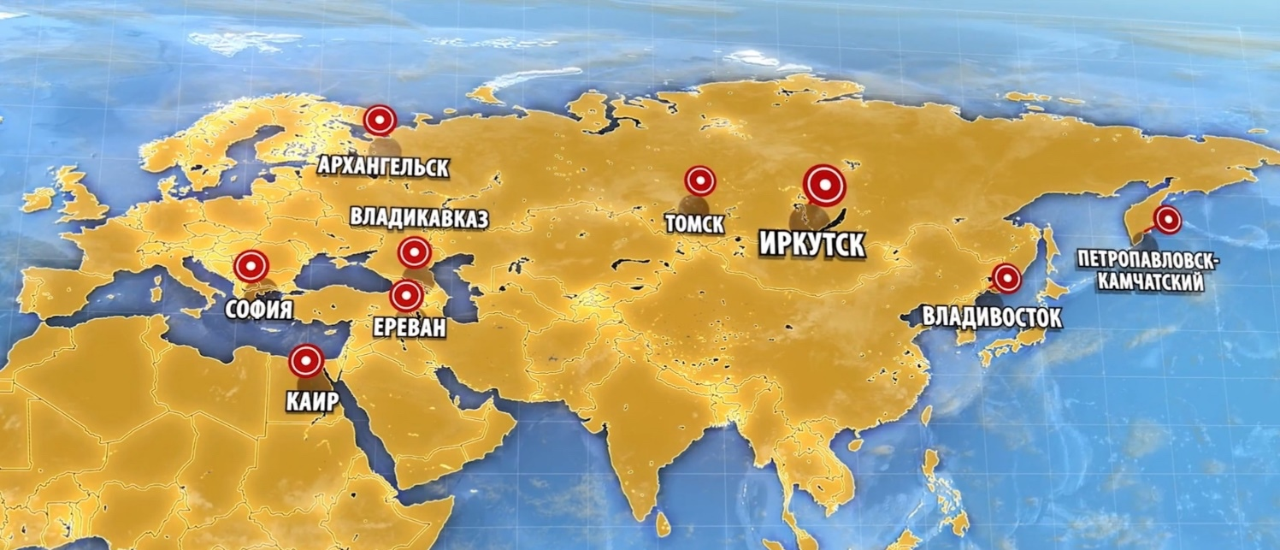
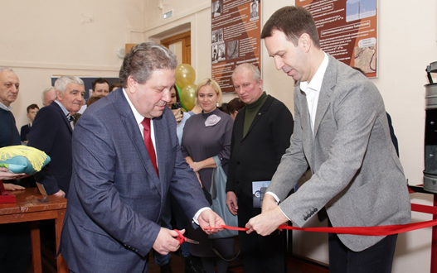
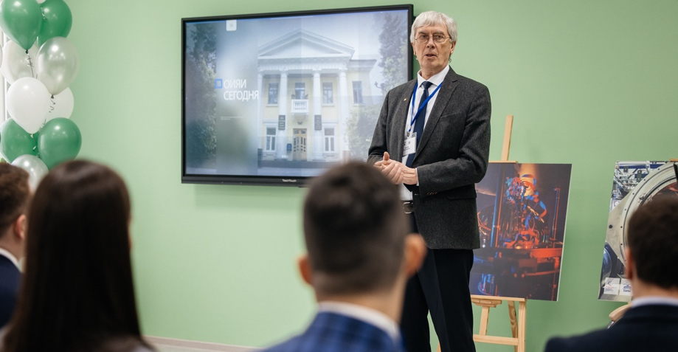
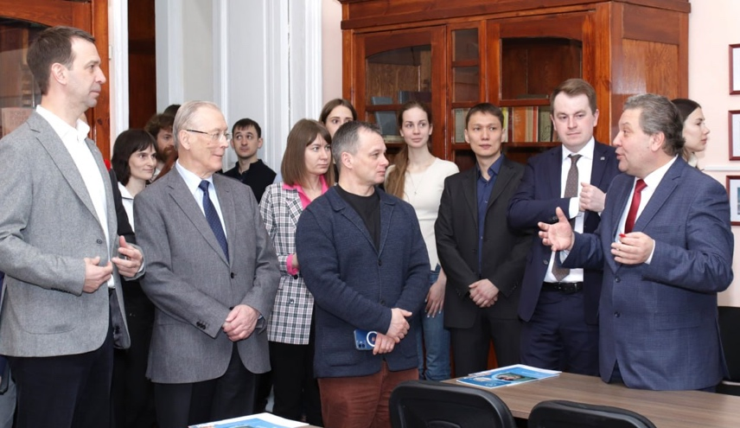
Expansion of the JINR information centers’ network
Arkhangelsk
Vladikavkaz
Tomsk
Irkutsk
Petropavlovsk-
Kamchatsky
Sofia
Yerevan
Vladivostok
Cairo
Tomsk Polytechnic University (TPU)
Tomsk, Russia
Signing of the agreement: April 6, 2022
Opening: December 12, 2022
Irskutsk State University (ISU)
Irkutsk, Russia
Signing of the agreement: March 7, 2023
Opening: March 7, 2023

Slide 5

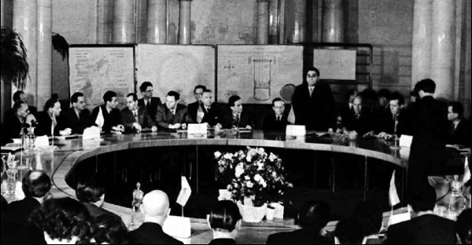
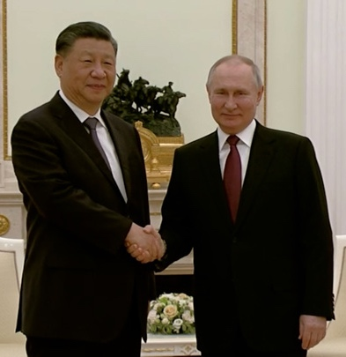
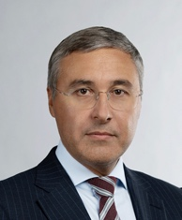


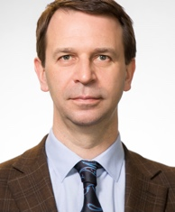

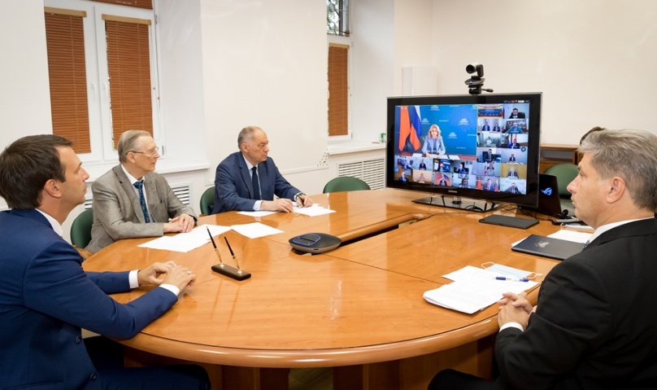

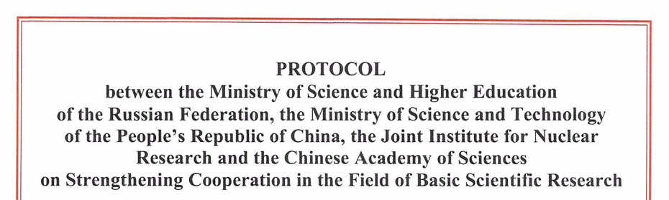
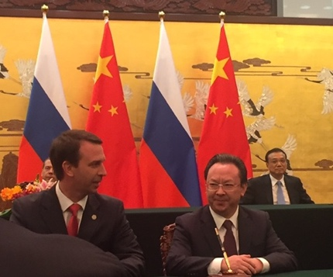
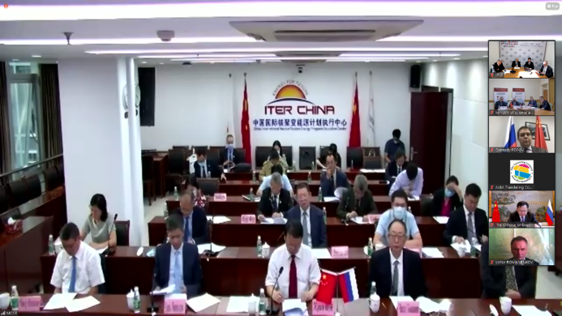
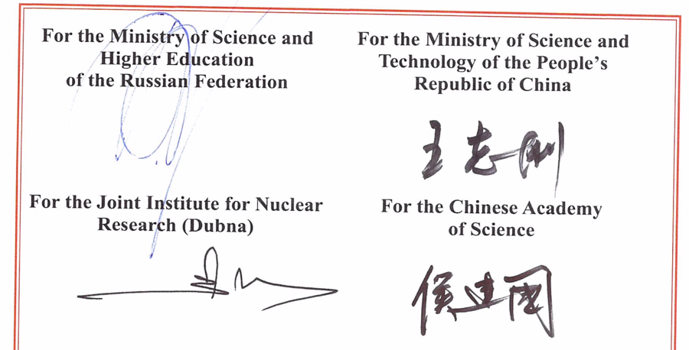
JINR-China: new horizons of cooperation
The People's Republic of China was one of the JINR founding states in 1956.
WANG Ganchang, prominent Chinese scientist and researcher, Academician of the Academy of Sciences of China was Vice-Director of JINR (1958-1960).
CPR was actively and fruitfully involved into JINR from 1956 to 1965.
26.08.2020, Agreement between the Ministry of Science and Technology of the China and the JINR on Participation in the Construction and Operation of the Complex of Superconducting Rings for Heavy Ions Colliding Beams NICA
In January/March 2023, JINR and China held 7 workshops with 24 scientific partner organizations from China: the common wish is to enhance the level of cooperation between JINR and China.
Acknowledging that JINR is currently recognized as one of the leaders in world science, successfully implementing international integration in scientific research,
Intending to enhance the level of participation of the China in JINR,
Reaffirming commitment to the peaceful use of research results,
21.03.2023

Slide 6
Wins of 2017-2023: what we accomplish it with, where expect to be proud of, how JINR enriches Member-States
We are starting to commission the NICA Complex. We already execute NICA Physics Program (BM@N), start the international research Program (MPD Collaboration > 500 researchers);
The Superheavy Element Factory is operating in "cruising mode". Commissioned in 2021. Now exceeds capabilities of the previous FLNR complex and its global competitors by dozens of times;
The underwater gigaton neutrino telescope ”Baikal” becoame a full-fledged element of the global network of large-scale neutrino detectors. The volume was increased by a factor of 6 (from 2 to 12 clusters), > 20 events are candidates for UHE astrophysical neutrinos had been registered.
IT cluster is TOP-1 in Russia and in member-countries in complex terms of data storage volume, transfer speed and data processing efficiency. Among first 25 of global TOP-500;
JINR is one of the world's leading centers (in TOP-5) exploiting intense Neutron source (IBR-2M) and Research program in Condenced matter physics;
The JINR International Life Sciences and Innovative Research Program has fully started working: new LRB basic facilities + NICA applied research channels + new FLNP basic facilities.
Modern and challenging trends in personnel policy, digitalization, environmental friendliness and safety standards of JINR activities, significant/multiple activation

Slide 7

ВЫЗОВЫ / РИСКИ:
Архитектура Стратегии Развития
(ключевые блоки):
Потеря статуса «члена элитарного клуба», реализующего прорывные научные исследования в одном ряду с мировыми лидерами;
«Кризис» восприятия обществом и государством ценности ЯФ и ФЧ, включая создание мега-установок;
Возрастная структура кадров (старение);
Тренд из-за внешние факторов на переход в он-лайн, и на отток персонала (университеты и инновационные компании – «пылесосы» кадров);
Не отвечающая современным вызовам система административного управления (в т.ч. дисбаланс персонала, бюджета, неконкурентность системы оплаты труда, другие барьеры);
Утрата роли и статуса ММО («де-факто», не «де-юре») и риск превращения в мононациональный институт;
Тенденция «Do Science outside of Dubna». Границы - барьеры.
ММО 2030+
Кадровая
политика
Социальная среда
Innovations, PR, Outreach
Научно-организационная деятельность
Админ.
управление
ДНК ОИЯИ: Научная программа (ПТП)
7

Slide 8
Distribution by fields of science
Global trends and JINR today
Large Research Infrastructures:
Large Hadron Collider (CERN)
European Spallation Source (ESS)
Facility for Antiproton and Ion Research (FAIR)
LBNF-DUNE (Neutrino experiment)
Future Circular Collider
SNOLAB (underground neutrino facility)
European Synchrotron Radiation Facility (ESRF)
Cubic Kilometre Neutrino Telescope (KM3NeT)
International Linear Collider
NICA (Nuclotron-based Ion Collider fAсility)
SCT (Super charm-tau factory)
Amundsen arctic research vessel
Extremely Large Telescope (ELT)
Square Kilometer Array (SKA)
…
The statutory for JINR fields of science occupy a priority position in the world scientific agenda and development of a large research infrastructure.
The analysis shows that almost half of modern projects in the field of basic sciences have accompanying programmes of applied research aimed at sustainable development goals (SDG).
Worldwide international dimension, the multi-disciplinary scientific programme and large infrastructure projects of JINR harmoniously complement the global scientific agenda and the worldwide landscape of mega-science infrastructure, assuming, along with the main goals in the field of fundamental research, the achievement of certain SDG.
Distribution by mission
Distribution by international dimension
About 40 LRI in a wide range of scientific fields that meet the criteria for a large research infrastructure (complexity, scale, uniqueness, mission), both operational and those under construction, as well as some planned ones – ICRI, GSF OECD, 2021

Slide 9
IUPAP Report (May 2023)
The key physics issues that have led to the nuclear science facilities existing or being planned:
• The nuclear physics as studied from its beginning; nuclear structure and nuclear reactions, the formation of the elements throughout the universe including the super-heavy elements.
• The structure of the nucleon consisting of quarks and gluons within the Standard Model.
• Fundamental symmetries leading to physics beyond the Standard Model and with the study of neutrino properties through neutrino-less double beta-decay and neutrino oscillations.
• Nuclear energy in the era of climate change and global warming.
• Applications of nuclear physics to the benefit of society, e.g. as in nuclear medicine.

Slide 10
SEVEN-YEAR PLAN FOR THE DEVELOPMENT OF JINR FOR 2024–2030
DEVELOPMENT OF A LARGE RESEARCH INFRASTRUCTURE
NICA,
MPD, SPD
DRIBs-III (SHE, U-400R, DC-140, Radiochemical Lab Class-1)
IBR-2M, NEPTUN
BAIKAL-GVD
DEVELOPMENT OF ENGINEERING INFRASTRUCTURE
INNOVATION ACTIVITIES
STRENGTHENING HUMAN RESOURCES
ORGANIZATION OF SCIENTIFIC ACTIVITY
DEVELOPMENT OF JINR AS INTERNATIONAL ORGANIZATION
SCIENTIFIC PROJECTS,
EQUIPMENT AND MEDIUM-SCALE INFRASTRUCTURE
Elementary paricle physics and high energy heavy ion physics
Nuclear physics
Condensed matter physics
Radiation research in life sciences
Theoretical Physics
Information technology
Physics and technology of charged particle accelerators
STRATEGIC OUTRICH AND COMMUNICATIONS (IC, PR, GR)
DIGITAL JINR
FINANCIAL SUPPORT
MONITORING THE IMPLEMENTATION OF THE
SEVEN-YEAR PLAN AND THE STRATEGY OF DEVELOPMENT

Slide 11
THEORETICAL PHYSICS (BLTP)
Theory of
Fundamental
Interactions
Theory
of Atomic
Nucleus
Theory of
Condensed
Matter
Modern
Mathematical
Physics
Interlaboratory cooperation
Research and
educational project
DIAS-TH
“Dubna International
Advanced School of
Theoretical Physics”
VBLHEP Hot and dense nuclear matter in heavy-ion collisions
FLNP
Condensed Matter,
New materials
DLNP
Neutrino physics
FLNR
Superheavy and exotic nuclei
FLNR
Nanoporous 2D membranes,
Ion irradiation
MLIT
Lattice QCD calculations
DLNP Few-body systems,
Exotic nuclei
MLIT Computational methods for
nuclear physics and quantum chemistry
Human strategy:
Attraction of leading scientists
Attraction of young researchers
Stimulation of scientific activity
Scientific strategy:
Extension of international collaboration
Keeping up with current scientific trends
Interplay of research and education

Slide 12
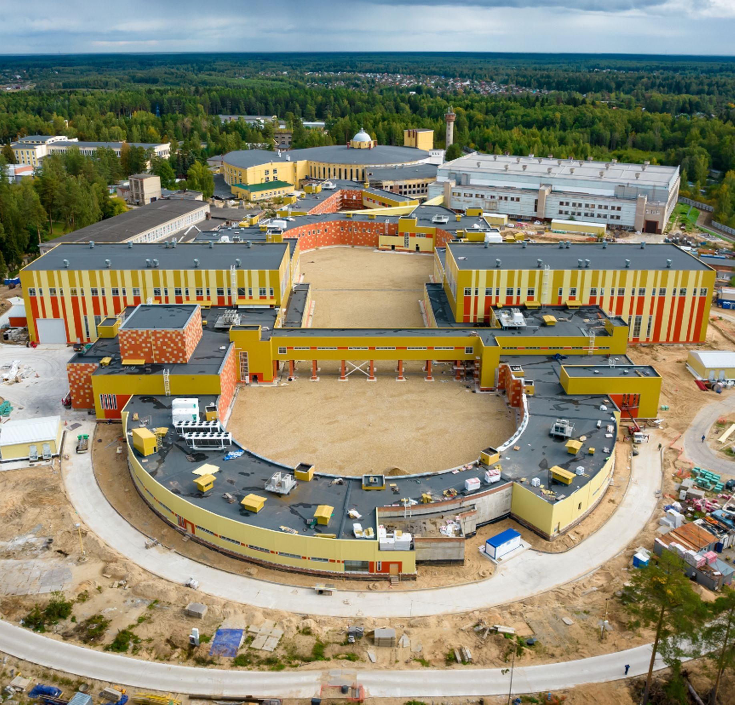
Relativistic Heavy Ion Physics and Study of nucleon structure. Near and Long-Term Future
The timely completion of the NICA project, its commissioning and steady and efficient operation.
Completion of the detectors: BM@N, MPD and SPD at NICA and successful data taking over the decades to come. JINR will make significant contribution to the basic configuration of the SPD detector.
After several years of running of MPD, an Upgrade is foreseen, responding to an increase in luminosity of NICA. Adding detectors in the forward region as planned.
Studies of possible future extension of NICA for acceleration of electrons, opening new physics potential via e-p and e-A collisions.
ARIADNA
BM@N
MPD
SPD
Notes:
For the next two decades, the principal focus in heavy ion physics and spin physics, that will influence to a large extent the JINR strategic development is the timely completion of the JINR flagship facility - NICA. The aim of the NICA project is to create a world-class experimental infrastructure for fundamental research in contemporary High Energy Physics (HEP), applied research, and in development of novel nuclear power technology. The format of close interlaboratory cooperation will contribute to the development of modern detectors and to further achievements in the area of high-temperature superconductivity. This base should be utilized by a global scientific community of users from member and non-member states of JINR.

Slide 13
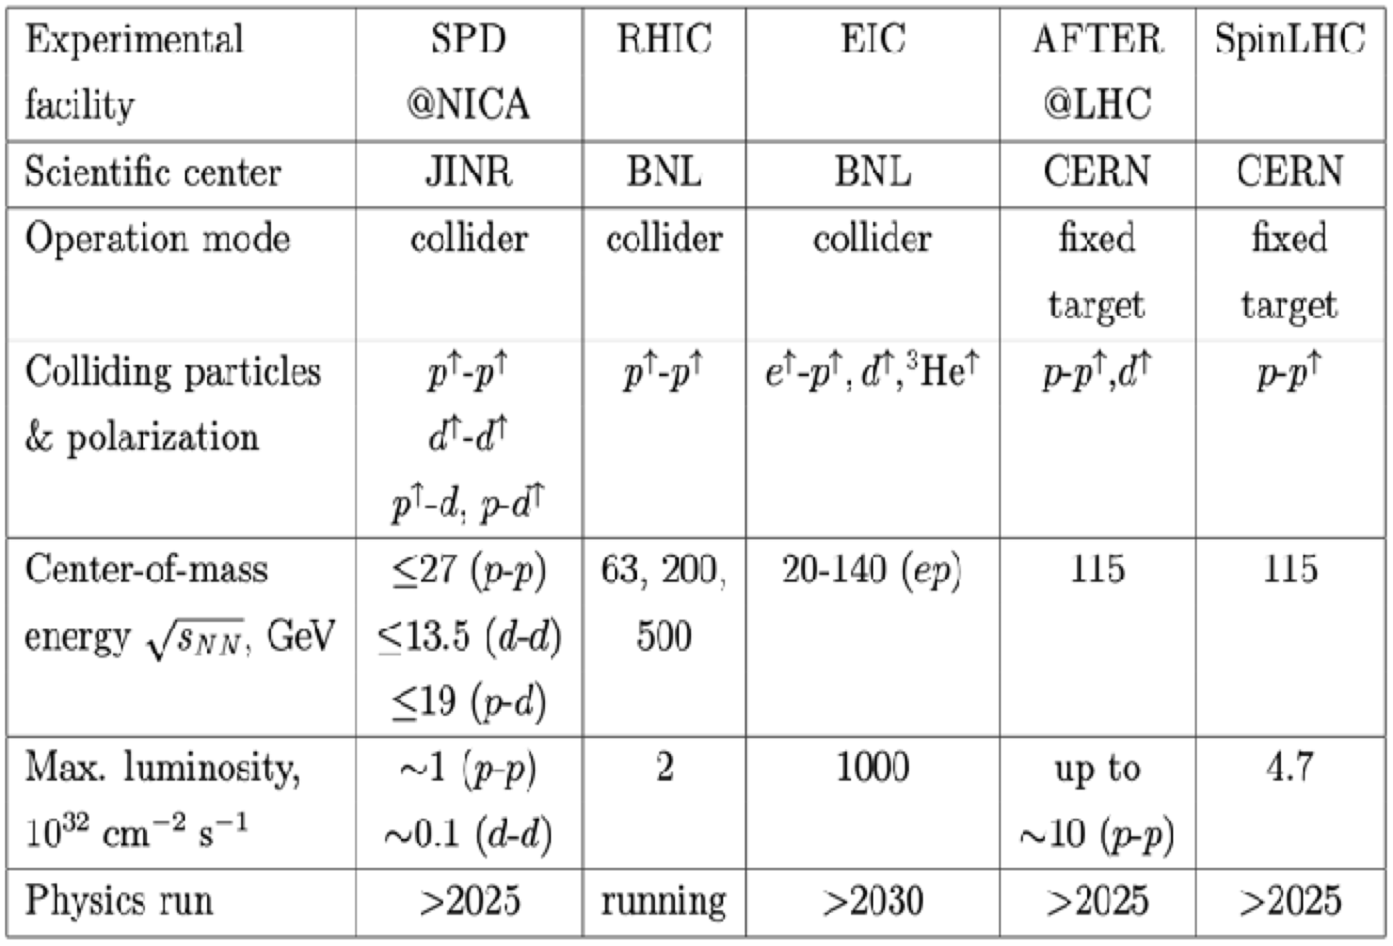

BM@N & MPD NICA project SPD
The SPD experiment is aimed at studying the properties of strong interactions in the nonperturbative region, at measuring the proton and deuteron spin structures, and at the development of a three-dimensional model of the nucleon. It is unique in its methodology, breadth of coverage and variety of tasks.
MPD covers this interesting region providing powerful combination of large luminosity, collision energy and system size scan (including isobars), large and consistent acceptance, full centrality range.
NICA is complementary to existing and planned world facilities (FAIR, SPS), and will be a natural and necessary continuation and significant expansion of studies at RHIC BES.
Notes:
Advantages of the MPD & NICA
NICA covers an energy range where most important an interesting physics appears to take place - transition from hadronic to partonic effect dominance, possible appearance of first order phase transition in QCD phase diagram, transition from baryon to meson dominance in particle production. All of this is also connected to astrophysical studies which are strongly developing now and may pose additional questions for us. In summary there are a lot of interesting open questions and MPD has the capabilities to answer many of them.
MPD covers this interesting region providing powerful combination of large luminosity, collision energy and system size scan (including isobars), large and consistent acceptance, full centrality range.
NICA is complementary to existing and planned world facilities (FAIR, SPS), and will be a natural and necessary continuation and significant expansion of studies at RHIC BES.
Other facilities:
HADES and SIS18 provide energies below 3 GeV;
FAIR is not going to provide data before 2028 - so it will not provide data in timescale comparable to NICA;
SPS operates at higher energies, and is fixed target (and also mostly limited to highest centralities);
STAR BES (Beam Energy Scan) covered the energy range of 3-20, however:
- the data taking is finished,
- data sample of 100M at most energies may be
enough to "pose interesting questions", or
highlight the region of interest, but not provide
"definite answers",
- data below 8 GeV is in fixed-target mode,
- no collision system size scan was done,
- isobar run of RHIC showed new interesting physics
that may be explored at NICA.
BM@N
Baryonic Matter at Nuclotron (BM@N) experiment is focused on measurement of Au+Au collisions up to a kinetic beam energy of 3.8·A GeV in order to investigate the equation-of-state (EOS) and the microscopic degrees-of-freedom of QCD matter at neutron star core densities, as EOS defines relation between density, pressure, temperature, energy and isospin asymmetry of nuclear matter.
The “hot” topics of the experiment are:
Study isospin symmetric matter EOS at densities of ρ=3-5 ρ₀ (saturation density) by the following measurements:
- elliptic and direct flows of protons, mesons and hyperons,
- sub-threshold production of multi-strange hyperons and
anti-hyperons.
Constrain symmetry energy E_{sym} - difference between binding energy of isospin symmetric and asymmetric matter by the following measurements:
- collective flow of neutrons vs protons,
- sub-threshold production of particles with opposite isospin.
Searches for quark degrees-of-freedom and the critical endpoint of the first order phase transition at high baryonic densities.
Role of hyperons in neutron stars (ΛN and ΛNN interactions) by measurements of yields and lifetime of light hyper-nucleus at high baryonic densities.
О возможности изучения на NICA столкновений изобарных ядер, имеющих тот же атомный номер, но разный заряд: в частности - не можем ли мы столкнуть свинец-208 и висмут-208?
RICH закончил набор данных, но на последнем рабочем совещании (закрытом) они говорили об интересных результатах, которые могут быть очень важны для понимания структуры ядра. В этом плане низкие
энергии NICA могут быть дополнительным преимуществом. Если столкновения идут с большим прицельным параметром, то возникают
сильные электромагнитные поля и соответствующая физика - Chiral Magnetic Effect.
Есть давние работы по теме. Например, С.Волошин (Phys.Rev.Lett.105 (2010) 17230) предлагает сталкивать Ru-44 и Zr-40 (A=96).

Slide 14
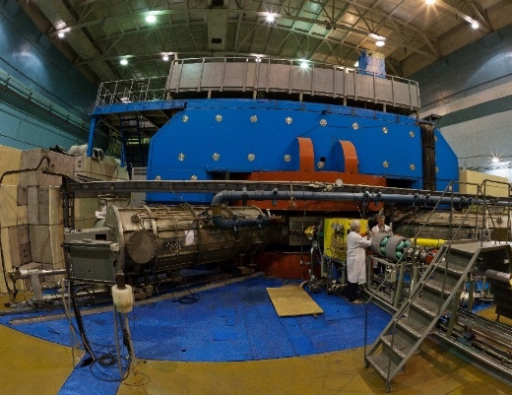
Synthesis of new elements @ SHE Factory
Radioactive Ion-Beam research Basic facility: U-400M
Nuclear reaction studies @ U-400R
Ambitions: up to 2.6 mA (U-beam)
10¹⁰⁻¹¹, smooth energy variation
Ambitions: E up to 80AMeV, I x 2
TARGETS:
Rosatom and ORNL (USA): Isotopically enriched heavy actinide materials;
Radiochemical Lab of class 1
Upgrade in 2023-25. Operation from 2026
Operation from end of 2023
Multinucleon transfer reactions:
Production of new isotopes of heavy,SH nuclei;
Study of properties of new nuclei.
Decay spectroscopy of heavy nuclei: actinides and light transactinides
Study of fusion-fission and quasifission reactions leading to heaviest nuclei
Low-energy and spontaneous fission of heaviest nuclei
Study of nuclei at high excitation energies (several hundred of MeV)
Nucleon halo, neutron skin;
Exotic decays:
b-delayed, 2p,2n radioactivity;
Soft excitation mode;
New magic numbers;
Spectroscopy of exotic nuclei;
Cluster states;
Reactions with RIBs;
Astrophysical applications.
BEAMS:
Production of high-intensity beams of ⁵⁰Ti, ⁵⁴Cr and others
New ECR-28 GHz (2024)
Notes:
Test reactions (2022-2023):
²³⁸U + ⁵⁴Cr → ²⁹²Lv*
²⁴²Pu + ⁵⁰Ti → ²⁹²Lv*
²⁴⁵Cm + ⁴⁸Ca→ ²⁹³Lv*
σ_{3n}= 4pb

Slide 15
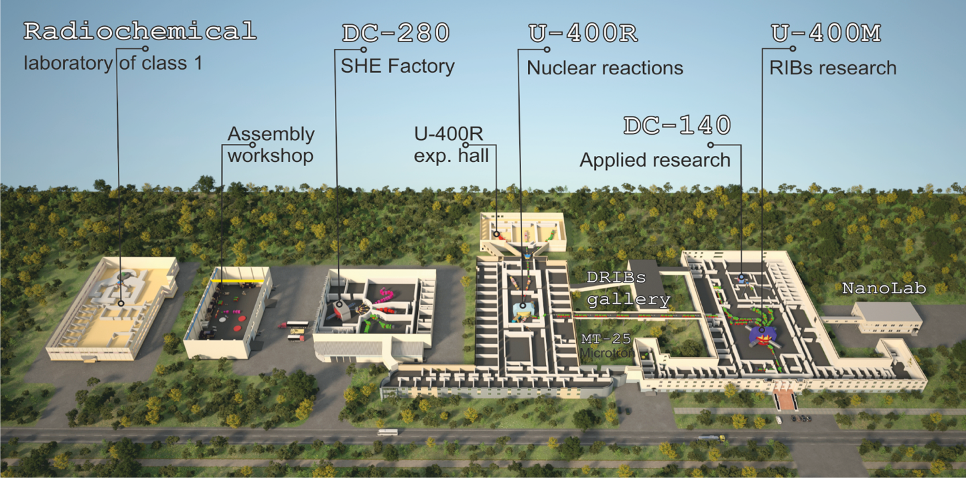
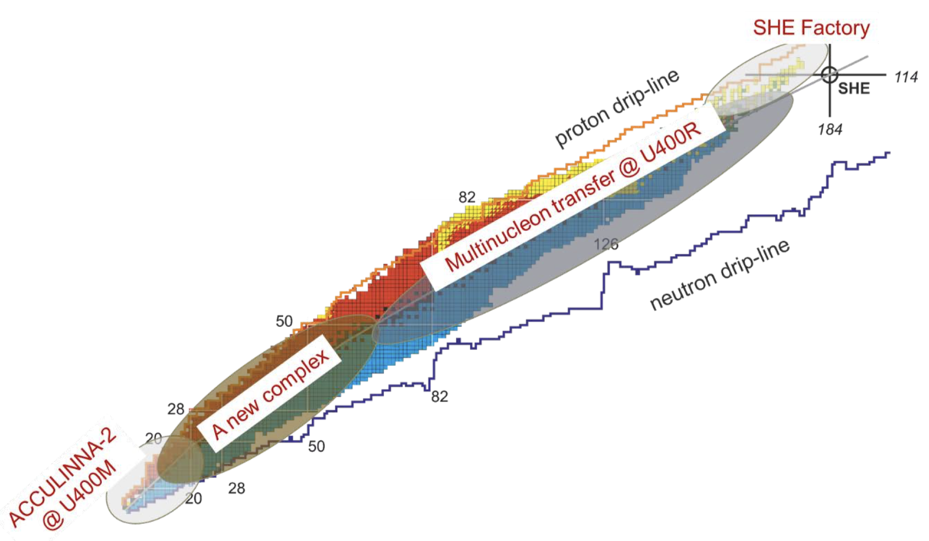
FLNR 2030
Notes:
A: Minimal+ program. RIBs on the base of the operating cyclotrons U400M+U400R
B: Maximal program. RIBs on the base of a tandem of new cyclotrons E1-E2 (100 AMeV), or 100 AMeV LINAC.

Slide 16
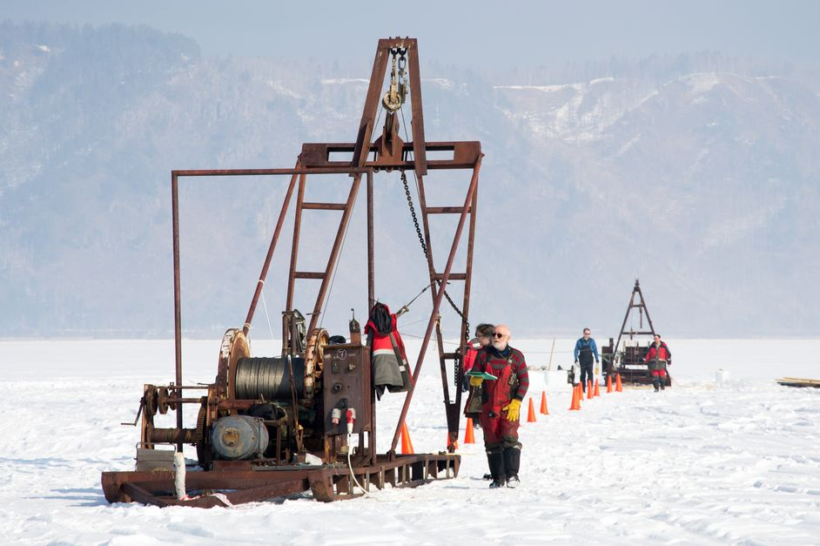
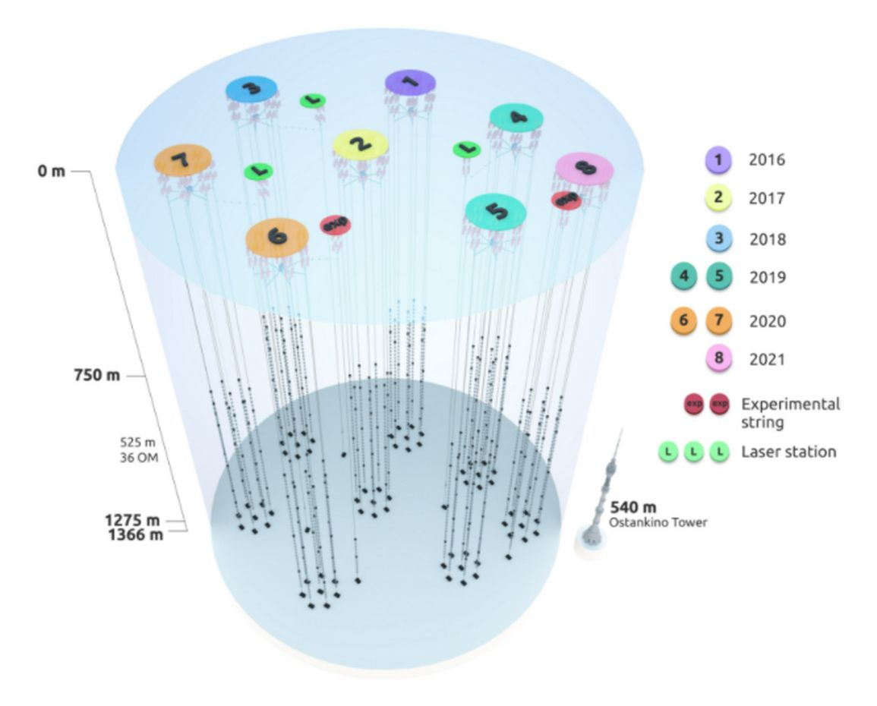
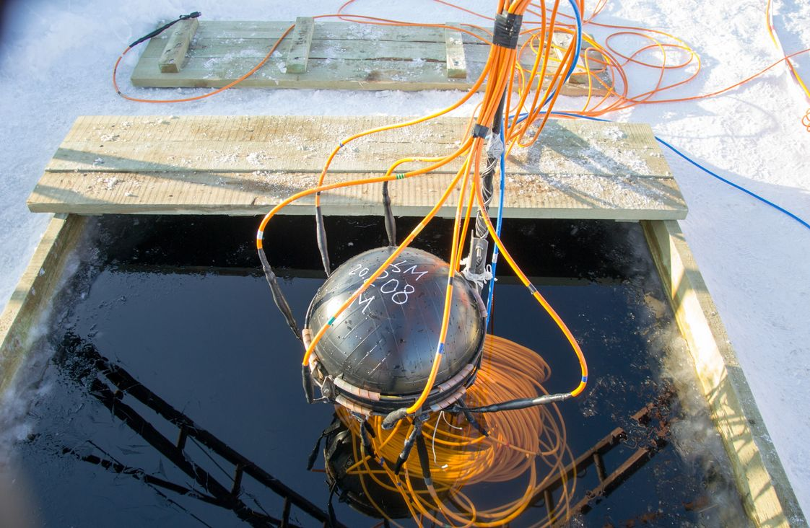
NEUTRINO AND ASTROPARTICLE PHYSICS
PROJECT BAIKAL-GVD
Baikal-GVD: Identification of astrophysical sources of ultra-high energy (exceeding tens of TeV) neutrinos. Actuality: their sources are still unknown. The identification of sources will help to elucidate mechanisms of galaxies creation and evolution.
Main advantage of Baikal-GVD: pure and t-stable water. Angular resolution of muon tracks 0.3-0.5 grad (IceCube: 0.5-1); angular resolution of shower direction 2-3 grad (IceCube: 15);
Northern detectors have better view to the Galaxy center.
Year | Number of clusters | Number of OMs
2016 | 1 | 288
2017 | 2 | 576
2018 | 3 | 864
2019 | 5 | 1440
2020 | 7 | 2016
2021 | 8 | 2304
2022 | 10 | 2880
2023 | 12 | 3456
2024 | 14 | 4032
Baikal-GVD: flagship experiment of JINR with a leading role in the collaboration. Gain new experience in the detector design, construction, deployment, maintenance, simulation and data analysis. Expected breakthrough discoveries.
More dense configuration, + light sensors, fiber vs Cu, smart data transmission, + radio-antennas → New Quality and Efficiency.
Global competence in 2030 horizon: Ice-Cube: 2025-2034 8km³ (w RA 100 km3 => PeV); Km3NET: few km³; Baikal-GVD (Phase II) = new type of OM, trigger-less operation, ML&AI, ~ 10 km³ ? (CDR in 2024).

Slide 17

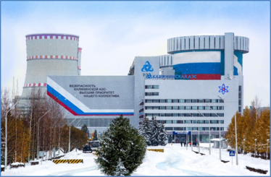
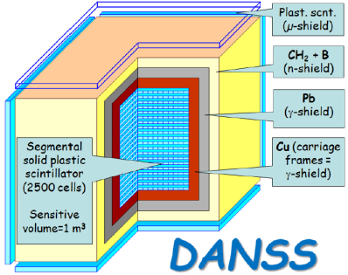


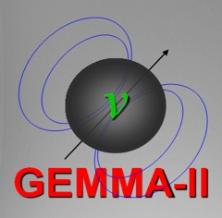



Non-accelerator neutrino physics and astrophysics
Projects: BAIKAL-GVD, SuperNEMO, GERDA (Legend), Monument, EDELWEISS/Ricochet, ΝgeN, DANSS, JUNO
Scientific directions:
– Double beta decay, neutrino nature: Majorana or Dirac; Nuclear matrix elements
– Fundamental neutrino properties (magnetic moment, mixture with a
sterile state, etc)
– Monitoring of nuclear reactors with neutrino detectors
– Direct and indirect search for Dark Matter
– Investigation of galactic and extragalactic neutrino sources
– Atomic processes accompanying radioactive decay
– Applied directions of research
Places: JINR, Underground laboratories, Nuclear reactors, Lake Baikal
Exp. Data Level&Scale | JINR recognition
Human Resources | Finance Resources
The major aims:
– BAIKAL-GVD: Observation of ultra-high energy astrophysical neutrinos; identification of their sources and nature
– DANSS: precision measurement of the spectrum of reactor antineutrinos
– RICOCHET: New physics with precision measurements at reactors.
– νGeN: search for magnetic moment of neutrino
– LEGEND: neutrinoless double-beta decay at 10²⁸ years
– Radiochemistry plus spectroscopy for astrophysics and nuclear medicine
Priorities
1
2
3
SuperNEMO, GERDA-LEGEND, nuGEN,
DANSS
DarkSide, TAIGA, MONUMENT
JUNO,
NOvA-DUNE, EDELWEISS

Slide 18

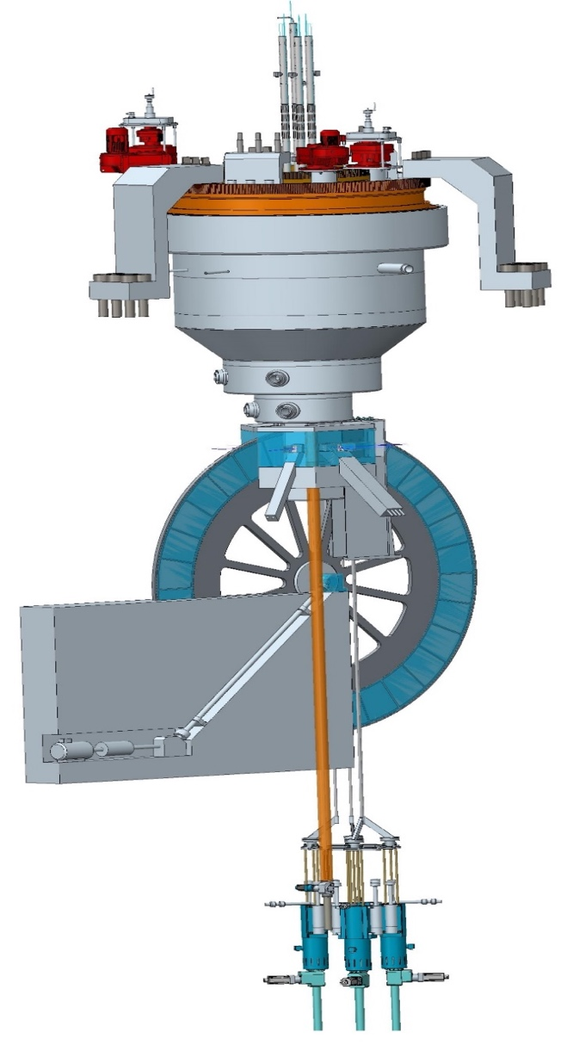
FLNP Long-term plan up to 2030
R&D of neptunium-nitride fuel of NEPTINE reactor (JSC VNIINM, 2022)
R & D for the development of fuel rods includes the following stages:
permit to use of nuclear materials, which is in federal ownership;
development of preliminary design specifications for neptunium nitride fuel;
development a complex of fuel characteristics’ measurement methods;
development a technology of fuel fabrication for experimental fuel rods;
carry out of fuel rods researches before reactor irradiation;
reactor irradiation of fuel rods (with dose of 77 dpa)
post-irradiation researches of fuel rods in hot cells
Notes:
The long-term plan for the development of the main elements of FLNP research infrastructure is presented in the table.

Slide 19
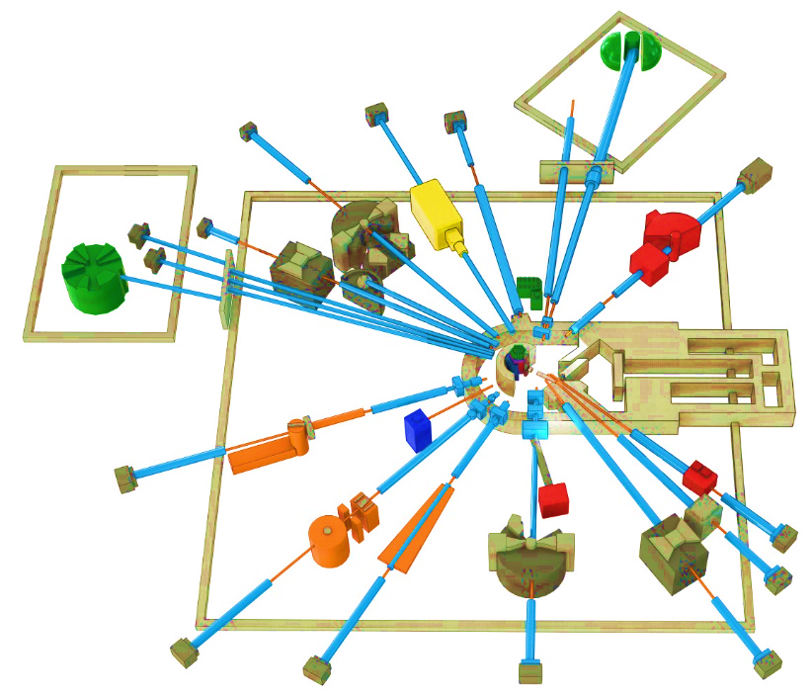
Condensed Matter Physics, Neutron Physics. Priority research in 2024-2030
THE IBR-2 FACILITY
SPECTROMETER COMPLEX
The service life of the core IBR-2 reactor is expected to end in 2032-35. The possibility to extend the operation of the IBR-2 until 2040 is being studied. To extend the reactor core campaign – new fuel (manufacture of FA with FR) around 2025.
Considering the present-day tendency, after 2030 only five sources will be available in Europe: ISIS (Didcot, UK), SINQ (PSI, Villige), FRM II (TU Munich), and two new sources: ESS (Lund, Sweden) and reactor PIK (NRC KI, Gatchina, Russia), both under construction with the start of operations planned for 2023-2024. Oak Ridge (STS SNS) –is planned in 2037.
Development of the basic configuration elements of the inverse geometry inelastic n-scattering spectrometer BJN.
Completion of basic configuration of the small angle n-scattering and imaging spectrometer.
BJN
(project)
HRFD
YuMO
EPSILON
DN-6
SKAT
RTD
KOLKHIDA
NERA
NRT
REMUR
FSS
REFLEX
DN-12
GRAINS
FSD
Modernization and reconstruction of spectrometers HRFD, YuMO, RTD, DN-6, DN-12, FSD, NERA, REMUR, REFLEX, SKAT, EPSILON, FSS, NRT, focused on improvement of technical parameters and extension of research capabilities.
Development of laboratory equipment for samples characterization and physical properties measurements.
Support and modernization of the complex of cryogenic moderators. New operating reliable UCN channel.
JINR provides FS for new neutron source (IBR-3 = “NEPTUNE”). The goal – is to have the best pulsed neutron source in the world by 2037: with brightness of 7*10^15 (for TN), and 9*10^14 (for CN)
Notes:
Эксплуатационный проектный ресурс установки ИБР-2, как одного из лучших нейтронных импульсных источников заканчивается в 2032-35 годах. В настоящее время в ЛНФ изучается возможность продления кампании реактора до 2040 года. Для этого, в частности, необходимо изготовить дополнительную партию свежего топлива с аналогичными характеристиками до 2025 года.
Учитывая существующие тенденции, после 2030 года в Европе для проведения исследований будет доступно 5 источников, включая три действующих: ISIS (Didcot, UK), SINQ (PSI, Villigen, Switzerland), FRM II (TU Munich, FRG), и два новых, начало эксплуатации которых планируется в 2023- 2024 годах: (ESS (Lund, Sweden) and steady-state reactor PIK (PNPI NRC KI, Gatchina, Russia). Ввод в эксплуатацию 2-х мишенной станции на источнике (STS SNS) of Oak Ridge National Laboratory (USA) планируется в 2037 году. Таким образом, потребность в новом поколении высокопоточных источников нейтронов возрастает на фоне общего уменьшения их количества в мире.
Приоритетными задачами развития комплекса спектрометров реактора ИБР-2 будут являться:
Разработка и создание элементов основной конфигурации нового спектрометра неупругого рассеяния нейтронов в обратной геометрии BJN.
Завершение работ по разработке и созданию основной конфигурации спектрометра малоуглового рассеяния и имиджинга.
Модернизация и реконструкция действующих установок HRFD, YuMO, RTD, DN-6, DN-12, FSD, NERA, REMUR, REFLEX, SKAT, EPSILON, FSS, NRT, направленная на улучшение технических параметров и расширение экспериментальных возможностей.
Развитие лабораторного оборудования для характеризации образцов и измерений физических свойств.
Поддержка и модернизация комплекса криогенных замедлителей

Slide 20
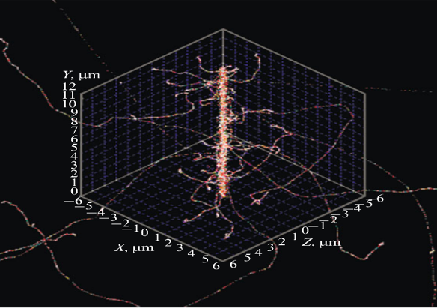
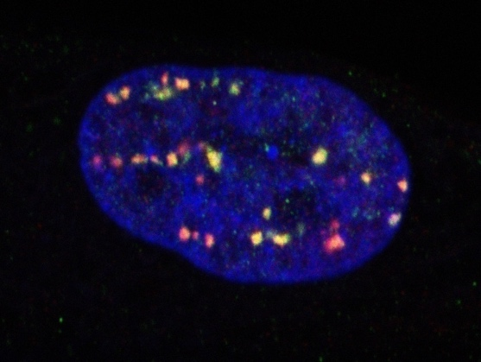
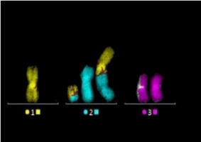
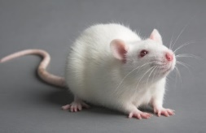
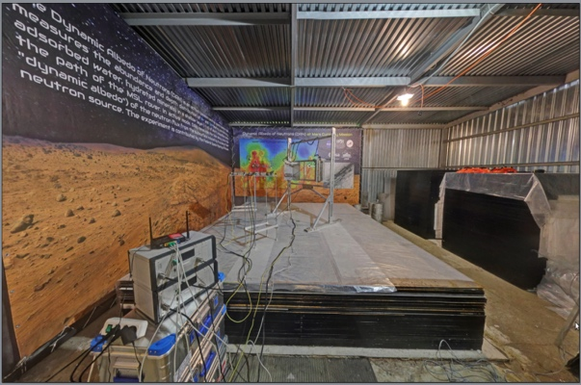
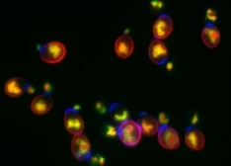
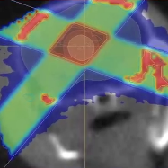
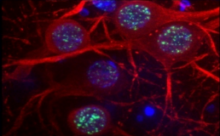
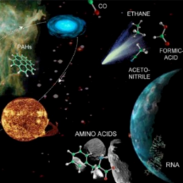
RADIATION RESEARCH IN LIFE SCIENCES
Mathematical Modeling
Main Research Fields:
Molecular Radiobiology
Radiation Cytogenetics
Radiation Physiology
Radiation Research
Radiation Genetics
Clinical Radiobiology
Radiation Neuroscience
Astrobiology

Slide 21
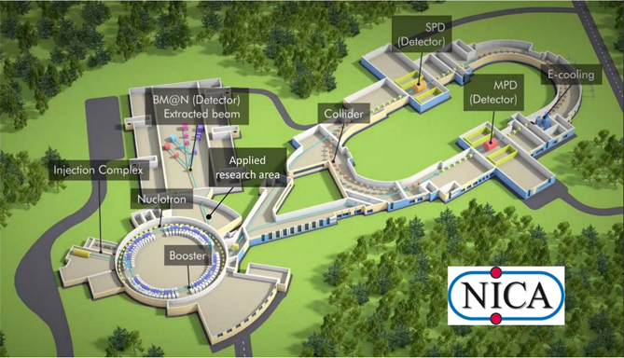
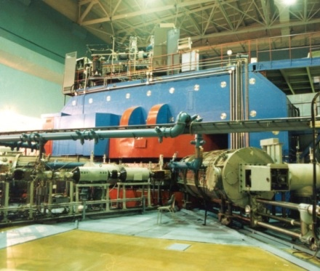
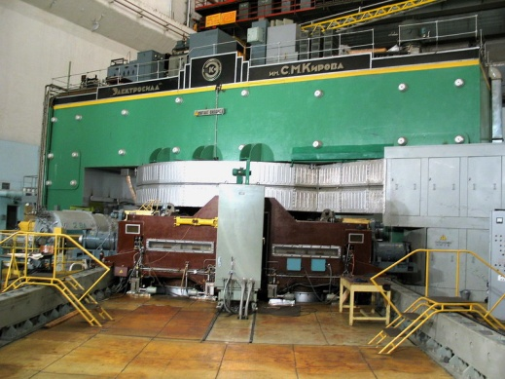
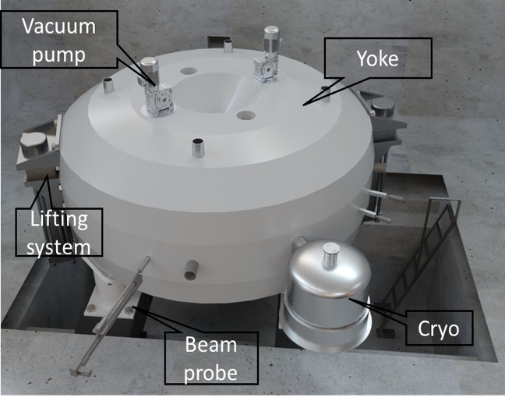
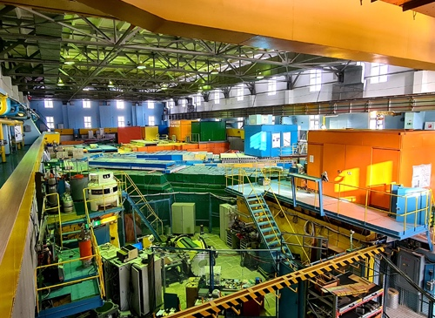
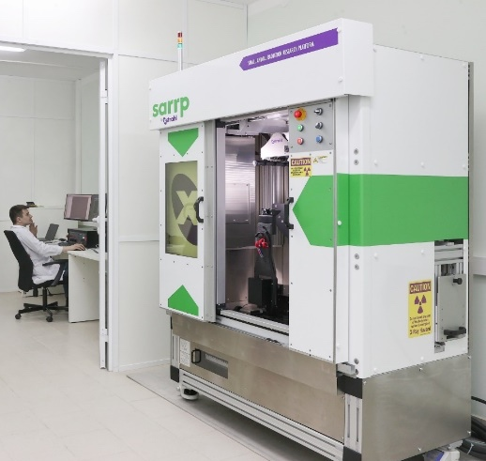
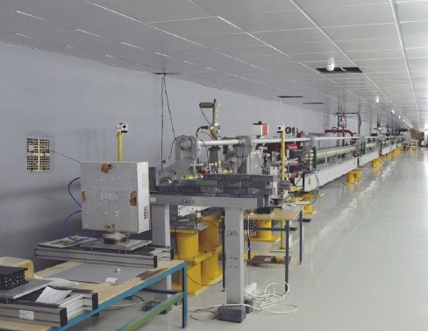
JINR’s radiation sources for radiobiological studies
Phasotron:
protons 170 MeV
U-400M cyclotron:
heavy ions 50 MeV/u (Li-Ne)
Nuclotron: heavy ions 0.3-1 GeV/u (H – Kr)
cyclotron MSC230
(since 2024):
protons up to 230 MeV
IBR-2, IREN: neutrons
SARRP: X-ray
Linac200:
electrons 20-200 MeV

Slide 22

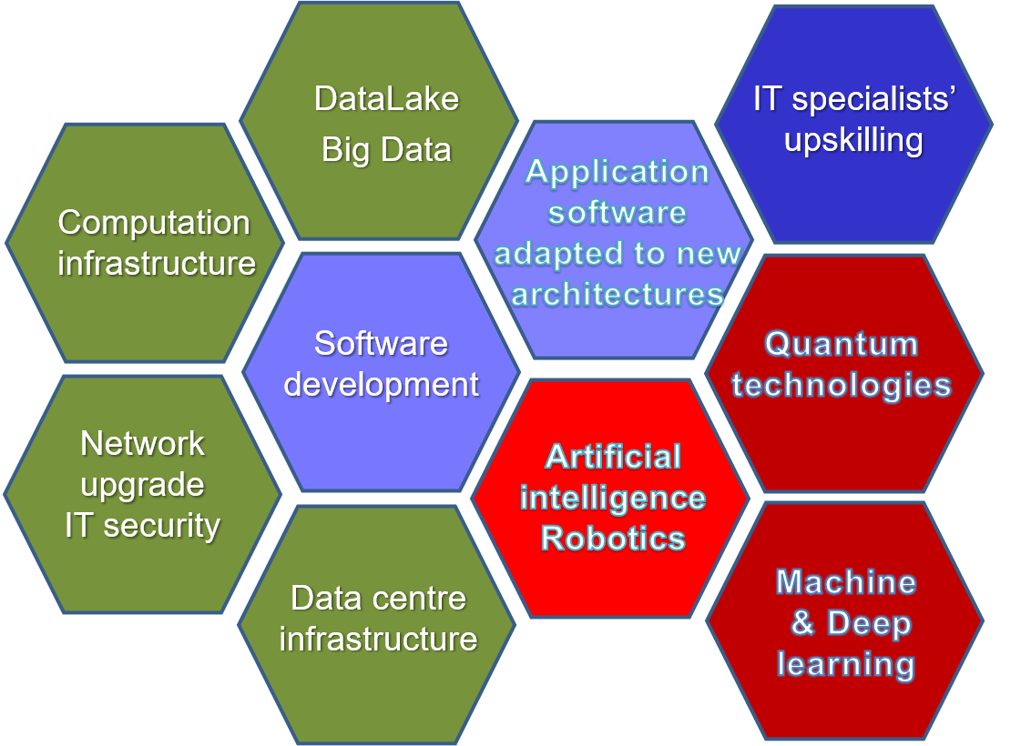
Strategy for Information Technology and Scientific Computing at JINR
Scientific IT ecosystem:
Steady implementation/upgrades of
Networking (Tb/s range)
Computing infrastructure within the Multifunctional Information & Computing Complex (MICC) and
“Govorun” Supercomputer,
NICA Tier0-Tier1-number of Tier2;
Baykal, NOvA, JUNO – all types of resources
LHC@HL-LHC: Tier1 for CMS, Tier 2 for ATLAC, ALICE
Data center infrastructure,
Data Lake & long-term storage for all experiments.
The development of new data processing and analysis algorithms based on
ML/DL,
artificial intelligence,
Big Data
Quantum technologies.
The coordinated development of interconnected IT technologies and computational methods
A variety of means will be used for IT specialists upskilling.

Slide 23
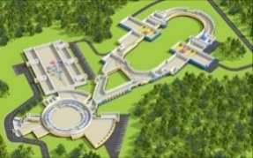
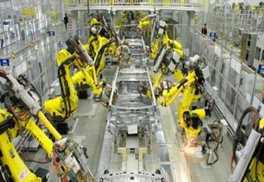






Quantum computing in the quantum robust control design
GOAL: Intelligent control of JINR physical experimental facilities
Robust control in unforeseen and unpredictable situations
USE@DO: Modern software technologies
Design of embedded intelligent controllers
PRODUCE: Intellectualization of innovative products
Communication of knowledge (master-slave system),
adaptation and teaching in industrial complexes
Expected results:
Applied library of quantum algorithms for JINR projects;
Quantum simulators for modeling quantum algorithms on the “Govorun” supercomputer;
Quantum control systems for NICA;
Intelligent cognitive quantum robust controllers for intelligent control systems;

Slide 24
Researchers of JINR are active participants of the of state-of-the-art international accelerator projects: LHC, XFEL, FAIR, RHIC, GANIL, INFN, IMP CAS, HIAF, EIC, ILC, CLIC, FCC, etc. We will focus on R&D in the following areas:
BEAM PHYSICS AND ACCELERATOR TECHNOLOGIES
– highly charged intense ion sources for generating heavy-ion beams with a charge state (Z > 40+);
– superconducting magnetic technologies: high-field magnets with fields up to 14–20 T, fast-cycling high-field magnets (B > 4 T, ramp > 4 T/s), high-current cables and windings (I_cr >30 kA);
– studies in the field of high-temperature superconductivity, development of ”Dubna SC” cable technologies;
– efficient fast cooling systems for intense hadron beams (~ 10 - 100 ms);
– superconducting RF structures (RFQ and DTL) and cryomodules for intense p- and i- beams;
– research in the field of colliding beam accelerators. Problems of future colliders (FCC, ILC, CpeC, etc.);
– technologies of fast cycling synchrotrons for acceleration and accumulation of intense heavy-ion beams;
– R&D on beam therapy (flash, pencil beam, light ions, neutrons);
– development of modeling methods (including using artificial intelligence methods) of beam dynamics with the “real” accelerating and focusing electromagnetic fields in accelerator structures and in-flight beam parameters (emittance, intensity, charge composition, etc.), deep machine learning for operation.
Progress for the implementation of the tasks listed above depends on the coordination of priorities/resources, which must be carried out in close Interlaboratory JINR cooperation and involving centers from Member States. It is feasible within the framework of the dedicated All-Institute theme for the period 2024–2030.

Slide 25



Detector technology in fore-front experiments
ATLAS – calorimeters; muon spectrometer
of high-granularity timing detector,
enlargement of Micromegas technology.
ALICE – upgrade of PHOton Spectrometer.
CMS – muon system, calorimeters,
high-granularity endcap calorimeter.
ATLAS: Large Micromegas module production
COMET, NA62 - ultra-thin (12 µm) straw;
large area of straws in vacuum.
EDELWEISS – low radioactivity materials.
SuperNEMO - scintillator detectors;
low background measurements
with HPGe & BiPo d-etectors.
GERDA - automation of det. movement in gloves box.
PLI - New method to measure surface inclination
with nano-radian accuracy
MPD –TPC, TOF based on MRPC,
ECal with projection geometry.
required in
gravitational waves detect. (LIGO, VIRGO, Einstein),
colliders (LHC, NICA),
early warning of earthquakes.
BM@N, RD-51 – GEM chambers.
JUNO – high resolution liquid scintillators
DUNE – light detection in LAr TPC

Slide 26





INNOVATIONS: International Centre for Nuclear Technologies Research
OMICS@LRB and neuro-RB studies. Radiation neuroscience. Approaches to increase radiosensitivity: pharmaceuticals, transgene systems, targeted delivery and radionuclide;
ARIADNA. Applied beams@NICA: radiobiological studies (400-800 MeV/n); radiation testing of semicond. Electronics (3; 150-350 MeV/n); nuclear physics @ 1-4.5 GeV/n;
DC-140 cyclotron for electronic component testing, radiation material science, track pore membrane research;
MSC-230 cyclotron for beam therapy: treatment planning; radiomodificators for γ− and p- therapy, flash-therapy, pencil beam (10 µA, >5 Grey/l @ 50 ms pulse).
Radiochemical Laboratory Class-I for production of radioisotopes (Ac²²⁵, ^{99m}Tc), nuclear medicine R&D in photonuclear reactions @ 40MeV.
DC-140 (construction phase)
MSC-230 (general view)
Notes:
26

Slide 27
Participation in experimental collaborations worldwide
JINR intends to participate in advanced external experiments in the relativistic heavy-ion physics, particle physics and neutrino physics, provided that the potential for discoveries in these experiments is high, JINR researchers can play a leading role, and partner scientific organizations show mutual interest in strengthening cooperation.
Relativistic heavy ion physics
JINR scientists will continue the study of the properties of nuclear matter under extreme conditions, in the search for quark deconfinement and possible phase transitions within the framework of common research programs in the in the CBM experiment at FAIR (GSI), STAR experiment at RHIC, BNL, NA61 experiment at the SPS accelerator (CERN), ALICE experiment at LHC (CERN). JINR's participation will depend on the progress in implementing the NICA project, as well as on the need to consolidate work at JINR accelerator complex.
The nucleon spin structure and other polarization phenomena in nucleon–nucleon and nucleon–nucleus interactions The SPD research program will extend the ongoing research programs of the COMPASS++/AMBER experiment (at SPS, CERN) on hadron structure and spectroscopy investigations with high-intensity muon and hadron beams, as well as with polarized proton beams at the STAR@RHIC, in which teams of VBLHEP and DLNP scientists of JINR will continue to take part during 2024–2028. JINR's participation in these programs will be coordinated with the JINR's efforts on the creation of the SPD detector and its research program.
Elementary particle physics
The search for physical phenomena beyond the Standard Model will be continued in the CMS and ATLAS experiments at CERN’s LHC. JINR will take part in the 2nd phase of detectors’ upgrade during the LHC shutdown periods in 2026–2028 and will continue analysis of data from the LHC. The JINR group will continue to participate in the NA64 experiment to search for weakly interacting particles of dark matter at the SPS accelerator at CERN. JINR will also take part in a search for charged lepton flavor violation in muon-to-electron conversion in nuclei in the μ2е (FNAL) and COMET (J-PARC) experiments.

Slide 28




Directions of the Personnel Strategy 2024‒2030
Moscow Regional Physics and Mathematics Lyceum named after Academician V. G. Kadyshevsky
- Staff renewal (continuing education)
- Possibility of retirement
- Social support agreement
- Harmonizing age structure
- Significant growth of Associate staff.
Moscow State Univ. Branch in Dubna
Departments of Elementary Particle Physics and
Department of Fundamental Nuclear Interactions
and
Departments at MIPT, MEPhI, SPbSU, Dubna University and several others.

Slide 29
RISKS and MITIGATION
Subject to the principle of reciprocity, the Institute will continue to fulfill all its obligations, will consistently pursue a policy of Open Access to its research infrastructure and scientific data (Open Science), strictly follow internationally recognized standards of scientific expertise and legal support of intellectual property.
The main financial risk for the development of JINR for 2024-2030, associated with the geopolitical situation, is the incomplete and/or untimely fulfillment of the Member-country contributions, the reduction of member states and non-payment of contributions by states where membership was suspended for an indefinite period. Such factors, first of all, will affect the reduction of JINR's human capital, a decrease in the value of its assets and competitiveness, and a significant shift in the timing of achieving scientific results that directly affect the scientific visibility of the Institute's member countries.
Attracting new states with strong and dynamically developing economies to orbit of JINR is the most important area of ​​work to prevent the development of negative scenarios for realization of financial risks.
The Sum of Contributions are to be increased by 5% annually to fully cover the $1,944.6 million cost.
In case of insignificant indexation of the amount of contributions, we have: underfunding of certain stages of work on large scientific projects (NICA-SPD in the first place, about $ 45 million, DRIBs-III Radiochemical Laboratory - class 1 - about 8.5 M$), Life Science and external cooperation up to 10 M$, reduction of experimental time (10-20 M$, as well as cancellation of the involvement of about 200 highly qualified scientists and specialists (36 M$).Even after these cardinal cuts for the JINR Development Program, the budget will have a deficit of about 100 M$.
Notes:
Основные риски и маневры
При соблюдении принципа взаимности Институт продолжит выполнять все взятые на себя обязательства, будет последовательно проводить политику открытого доступа к своей исследовательской инфраструктуре и научным данным (Open Science), неукоснительно следовать международно-признанным стандартам научной экспертизы и правовой поддержки интеллектуальной деятельности. Основным финансовым риском развития ОИЯИ на 2024-2030 гг., связанным с геополитической обстановкой, является неполное и/или несвоевременное выполнение взносов стран-участниц, сокращение числа государств-членов и неуплата взносов государствами. Такие факторы, в первую очередь, повлияют на сокращение человеческого капитала ОИЯИ, снижение стоимости его активов и конкурентоспособности, а также существенное смещение сроков достижения научных результатов, что напрямую влияет на научную значимость самих стран-участниц Института. Привлечение на орбиту ОИЯИ новых государств с динамично развивающейся экономикой является важнейшим направлением работы по предотвращению развития негативных сценариев реализации финансовых рисков.
Сумма взносов должна увеличиваться на 5% ежегодно и ежегодно наполняться, чтобы полностью покрыть расходы в размере 1.944,6 M$. При меньшей индексации суммы взносов будет недофинансирование отдельных этапов работ по крупным научным проектам: NICA-SPD около 45 M$, DRIBS-III Радиохимическая лаборатория - 1 класс - около 8,5 M$, Life Science и внешнее сотрудничество до 10 M$, сокращение времени проведения экспериментов: 10-20 M$, а также отмена привлечения около 200-300 высококвалифицированных ученых и специалистов - 36 M$. Даже после этих кардинальных сокращения на Программу развития ОИЯИ дефицит бюджета составит около 100 M$.

Slide 30
Milestones of the 2024-2030
Reliable, ecosafe, globaly demanded Research Infrastructure (NICA, FLNR, IBR-2M, B-GVD, MICC): annual beam operation_av => +30%, N_users => +30%, N_publ => +20-30%.
JINR Human Capital (Staff) => + 1500 employes. (620 M$ => 820 M$ || 38% => 44%)
New Innovative Facilities: MSC-230 ~15M$, DC140 ~ 7M$, ARIADNA@NICA ~ 13M$
Feasibility Studies for New Large-Scale Projects: RCL, NEIF, NEPTUN, FRIB, others.
Budget (Integral) growth: 1.5 B$ => 2 B$
New quality and significant attractiveness of JINR2030:
Intellectual ECOSYSTEM ”Digital JINR”
New Educational Standards: Higher School in Dubna, Lyceum;
Development of a social environment: medicine, comfortable urban environment (>100 new flats), ”Ratmino” Guest House;
New countries in the orbit of JINR: Full Members,
Associate and Cooperative States. Proactive ISTC and Communications.

Slide 31
JINR regional cooperation approach – cluster programmes
Middle East
and Northern Africa region
JINR country
Egypt – member state
10 partner organizations
Hub organization
AAEA
MoU since 2016
Southwest Balkans
JINR country
Bulgaria – member state,
Serbia – associated member
5 partner organizations
Partners in region
3 Croatia
2 Slovenia
1 Montenegro
1 Northern Macedonia
BulgariaSerbia
Cuba
Egypt
Vietnam
India
ASEAN region
JINR country
Vietnam – member state
10 partner organizations
Partners in region
5 Thailand
1 Indonesia
Latin American region
JINR country
Cuba – member state
4 partner organizations
Partners in region
15 Brazil (2)
6 Mexico (1)
2 Argentina
2 Chile (1)
1 Ecuador
1 Peru
RSA
South African region
JINR country
South Africa – associated member
10 partner organizations
Partners in region
1 Botswana
Area of potential interests: East and Central Africa
Rwanda – East Africa Institute for Fundamental Research (ICTP partner), Centre of Nuclear Science and Technologies
Kenya – headquarter of the African Academy of Sciences
ROSATOM strategic partners: Namibia, Angola, Ghana, Kenya, Uganda
South Asian region
Partners in region
24 India
3 Pakistan
1 Bangladesh
1 Sri Lanka
Notes:
Региональный подход к международному сотрудничеству является эффективным способом развития контактов с новыми партнерами и этот подход уже используется для развития контактов в странах арабского мира. В 2019 году начата работа на пространстве АСЕАН. Также большой объем партнерской сети у ОИЯИ в Латинской Америке. Наряду с перечисленными приоритетными регионами, ОИЯИ имеет определенные наработки в Южной Азии, на Юге Африки и на Юго-Западных Балканах. Как правило, работа с регионом опирается на опыт одной из стран Института, являющейся «точкой притяжения» для региональной научно-исследовательской сети. Наиболее действенным инструментом расширения контактов ОИЯИ в регионах является программа долговременных стажировок на конкурсной основе. Данный подход не является новым, с конца 60х годов он успешно работал под названием «стипендиаты ОИЯИ». Благодаря возможности привлечения кадров из стран-неучастиц, обеспеченной поддержкой КПП, в настоящий момент в Институте работают сотрудники более чем из 30 стран мира. Позвольте мне обратиться к Вам, уважаемые Полномочные представители, за очередным подтверждением мандата дирекции в продолжении зарекомендовавшей себя практики долговременных стажировок для стран-неучастниц.

Slide 32



YET TO BE DONE
The final preparation for the start of the implementation of the Plan should be made in Feb. – Nov. 2023:
Preparation of the final version of the Seven-year Plan for the Development of JINR for 2024–2030.
Completion of the Plan examination - joint Working Group of the Program Advisory Committees.
Scientific expertise of the themes and projects to be included in the JINR Topical Plan for implementation of the first stage of the
Seven-year Plan.
Formation of the JINR Topical Plan for 2024 in accordance with the updated structure of TP and guided by the approved Regulations on the Planning of Scientific Activities at JINR and the updated rules for the preparation of projects.
Decisions of CP on financial resource support of the Plan, budget 2024.

Slide 33
SCIENCE: indicators and indexes
Notes:
В ноябре мы показывали проект системы индикаторов. Сейчас он актуализирован.
Система индикаторов подразделяется на тематические разделы «Наука», «Люди», «Мир». Кратко приведу лишь несколько слайдов о том, как выглядит данная система по её основным разделам.
1) «Наука»,

Slide 34

PEOPLE: indicators and indexes
55-65%

Slide 35

Matrix of JINR Key Projects
2020 | 2023 | 2026 | 2029 | ~ 2032 | ~ 2035 | ~ 2038
DRIBS, SHE-Factory
Operation and development
FRB @ Flerov Lab
R&D
Feasibility Studies + R&D
Decision
Phased construction
Operation
NICA MPD
Construction
Operation
upgrade
Operation
NICA SPD
R&D + Design
Construction and commissioning
Operation
upgrade
NICA - III (EIC, others)
Feasibility Studies + R&D
International Program + R&D
Technical design and prototyping
Operation
DNS-IV
Technical design and prototyping
Decision
Construction
Operation
Baikal - GVD
Construction and data acquisition
upgrade and data acquisition
Operation
ν & AP Physics
International scientific program
Life Science
Formulation of Internati-onal scientific program
International scientific program
FCC, ILC, GWI, …
Participation in Feasibility Studies, advanced R&D
Decision
Participation in construction
Innovation center
R&D + Design
Construction
Operation and regular modernization

Slide 36




Slide 37


