Slide 1
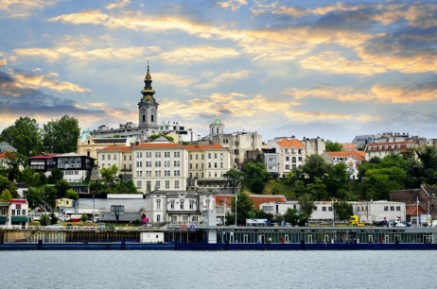
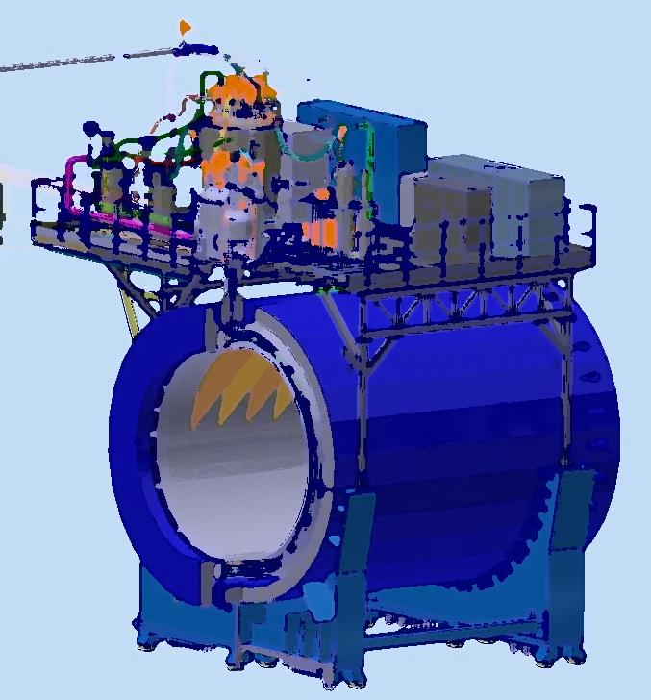
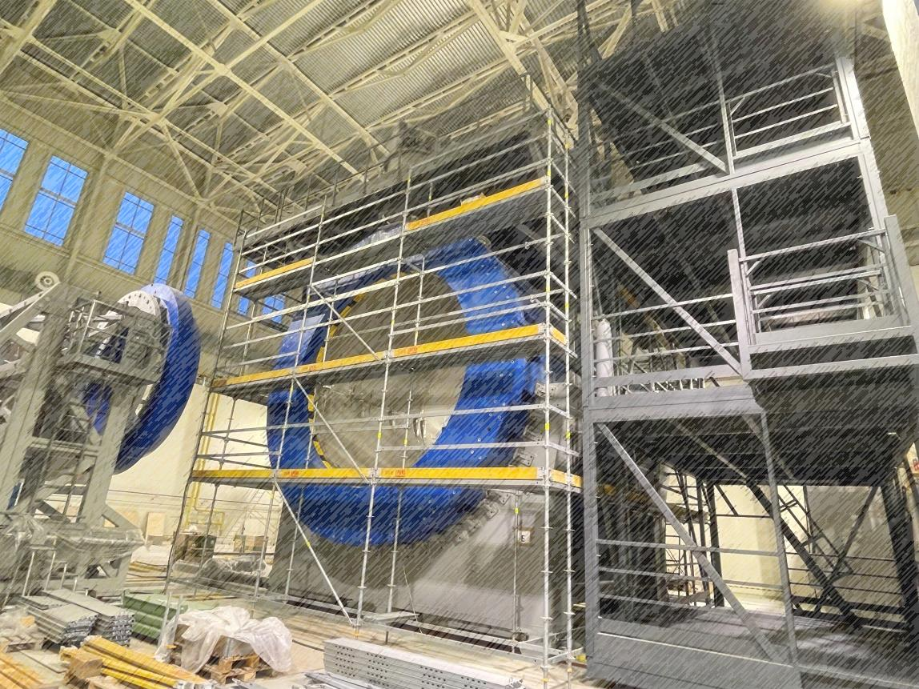
Status of the solenoid assembling
NICA Days and XII Collaboration Meeting of the MPD
02-06/010/2023
Serbia, Belgrade 2023
From drawing
to facility
Speaker: K. Mukhin

Slide 2
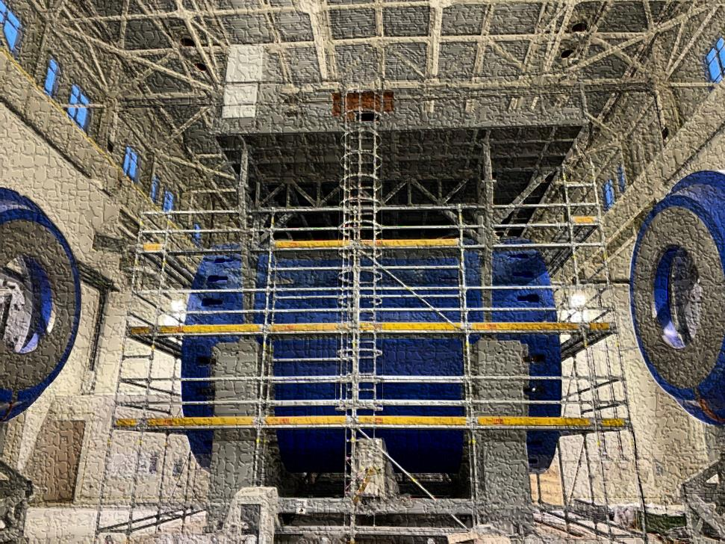
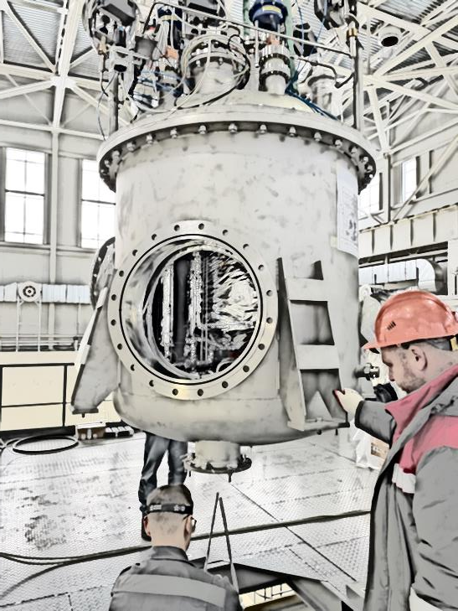
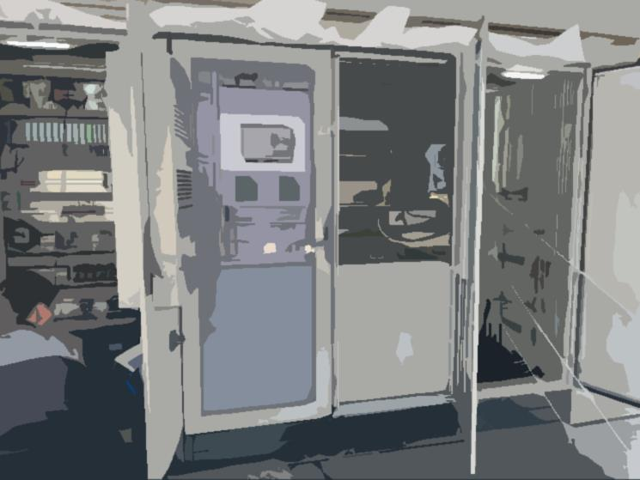
Plan of talk
Magnet construction
Cryogenic infrastructure
Ready to cooling
Control and protection system
Timeline

Slide 3
Chapter 1 Magnet construction

Slide 4
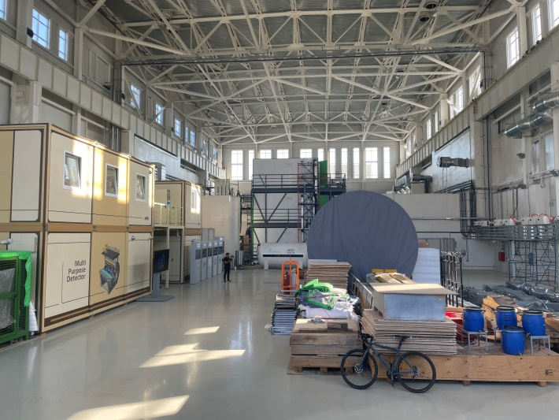
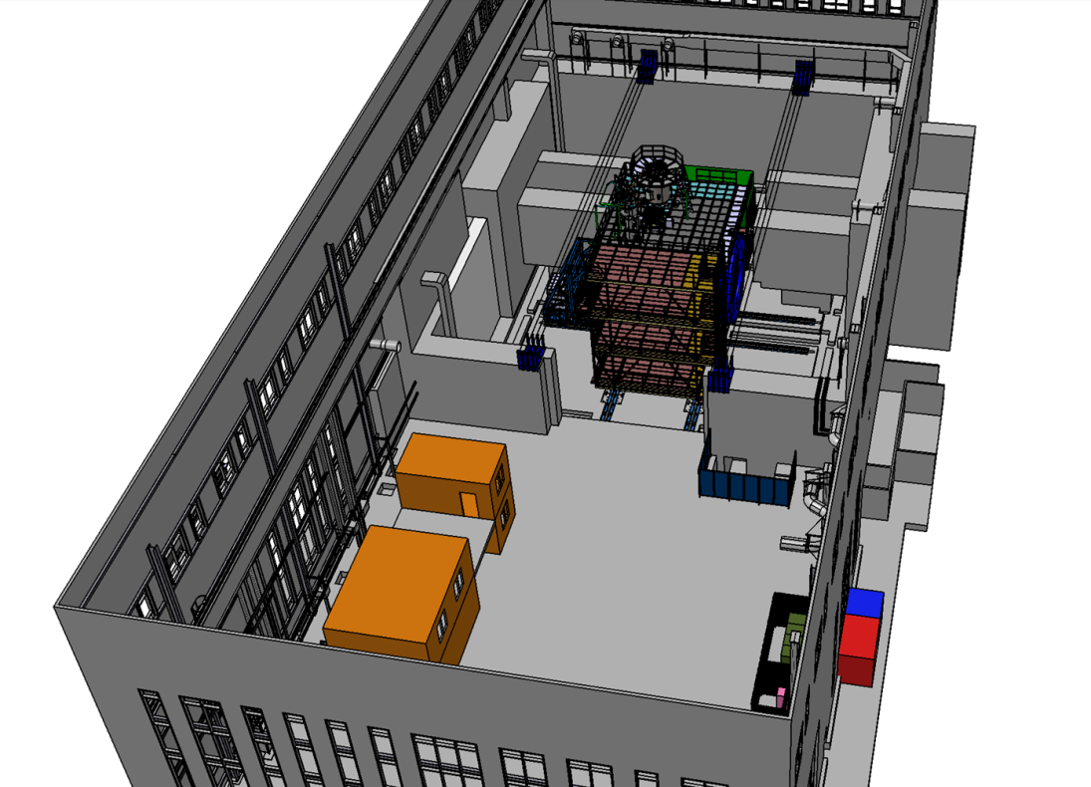
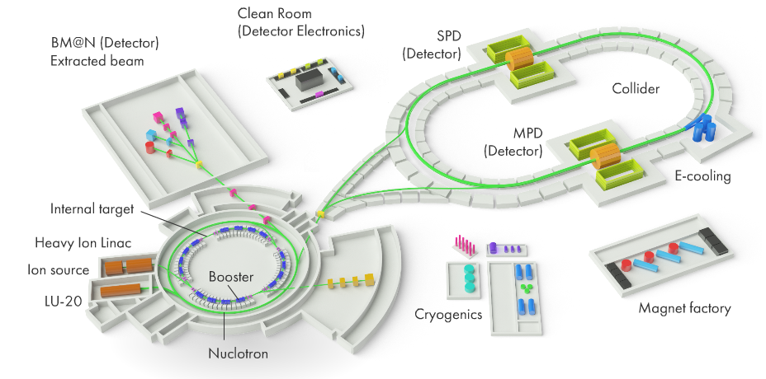
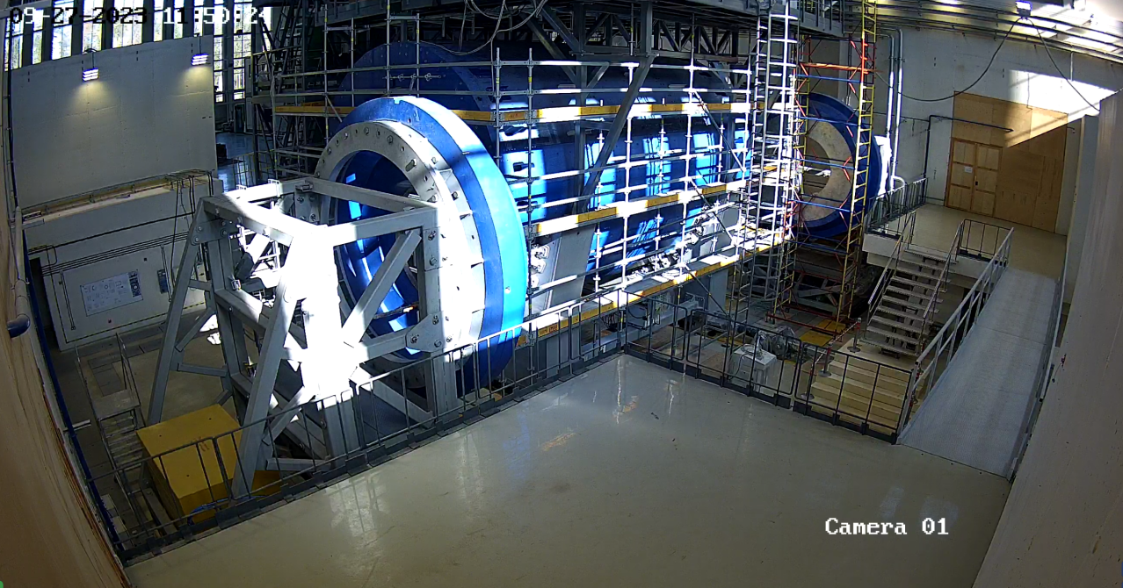
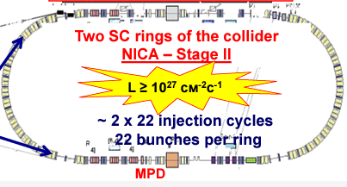
MPD in NICA complex
NICA parameters

Slide 5
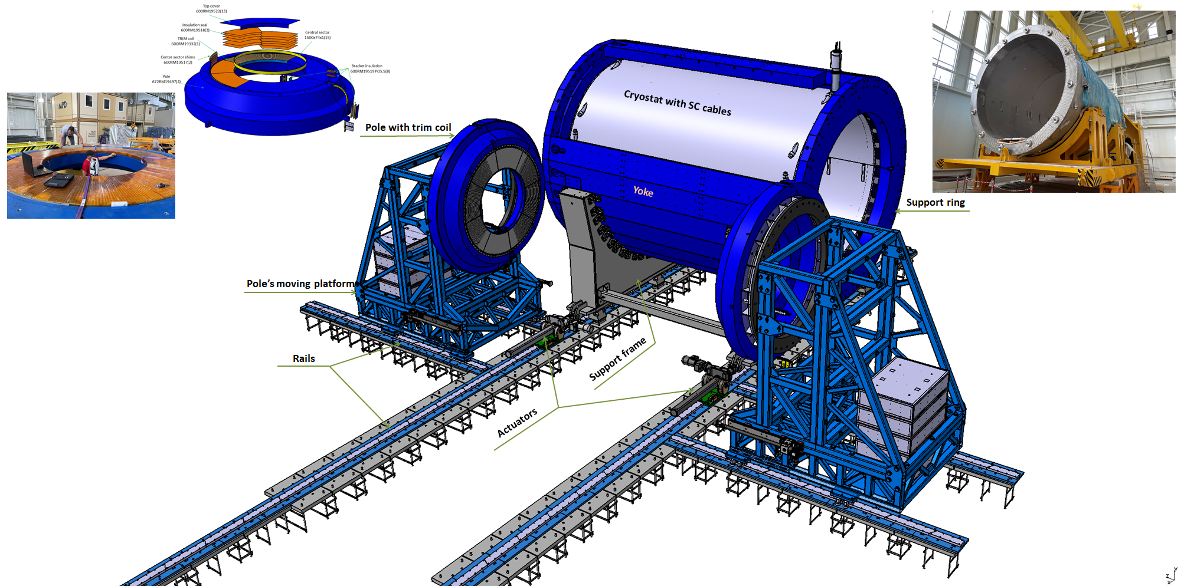
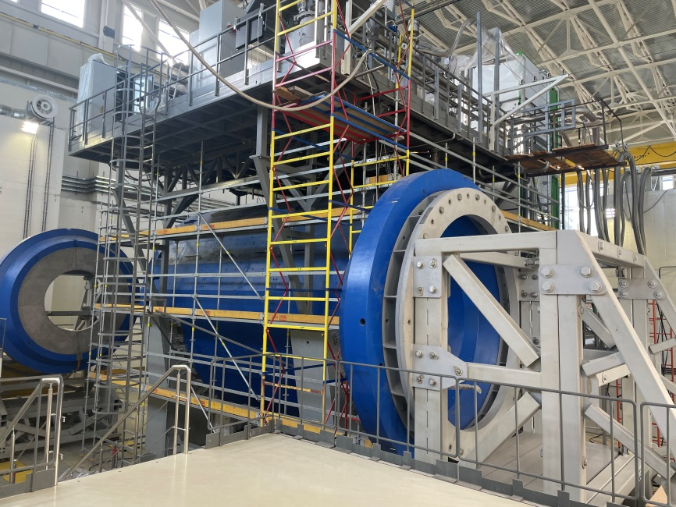
MPD magnet construction
Parameters of the magnet
Magnetic field | 0,57 T
Cryostat weight and size (diameter/length) mm | 66 tons 5443/7910
Yoke weight and size (diameter/length) mm | 630 tons 6583/8970
Current Voltage | 1790 A 10V
Each pole weight | 45 tons
Total weight with support equipment | 800 tons

Slide 6
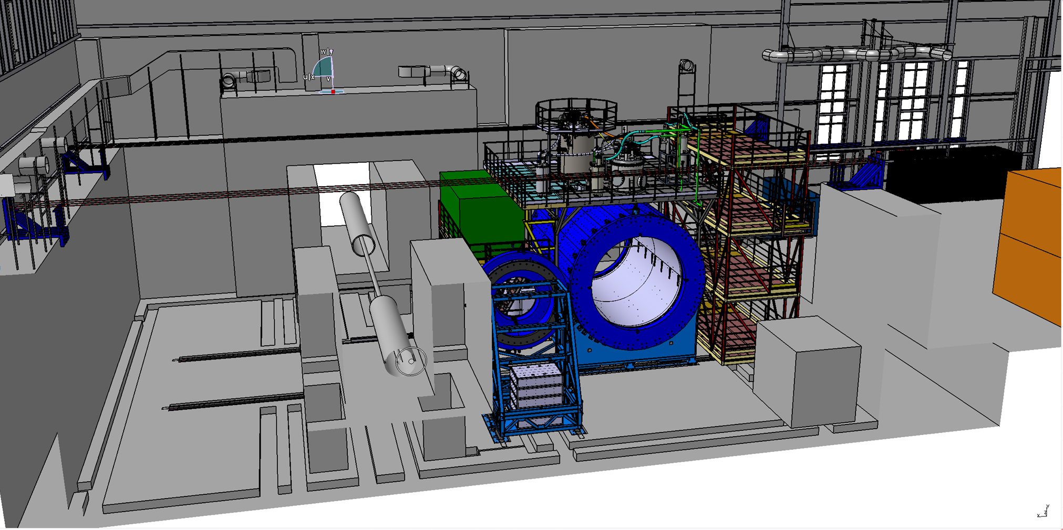
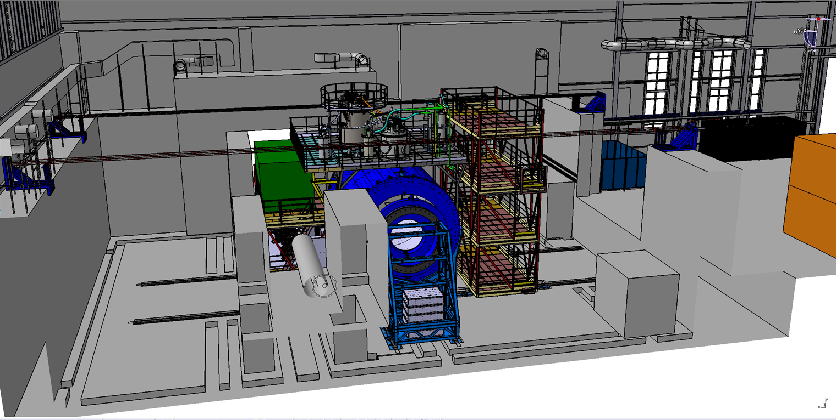
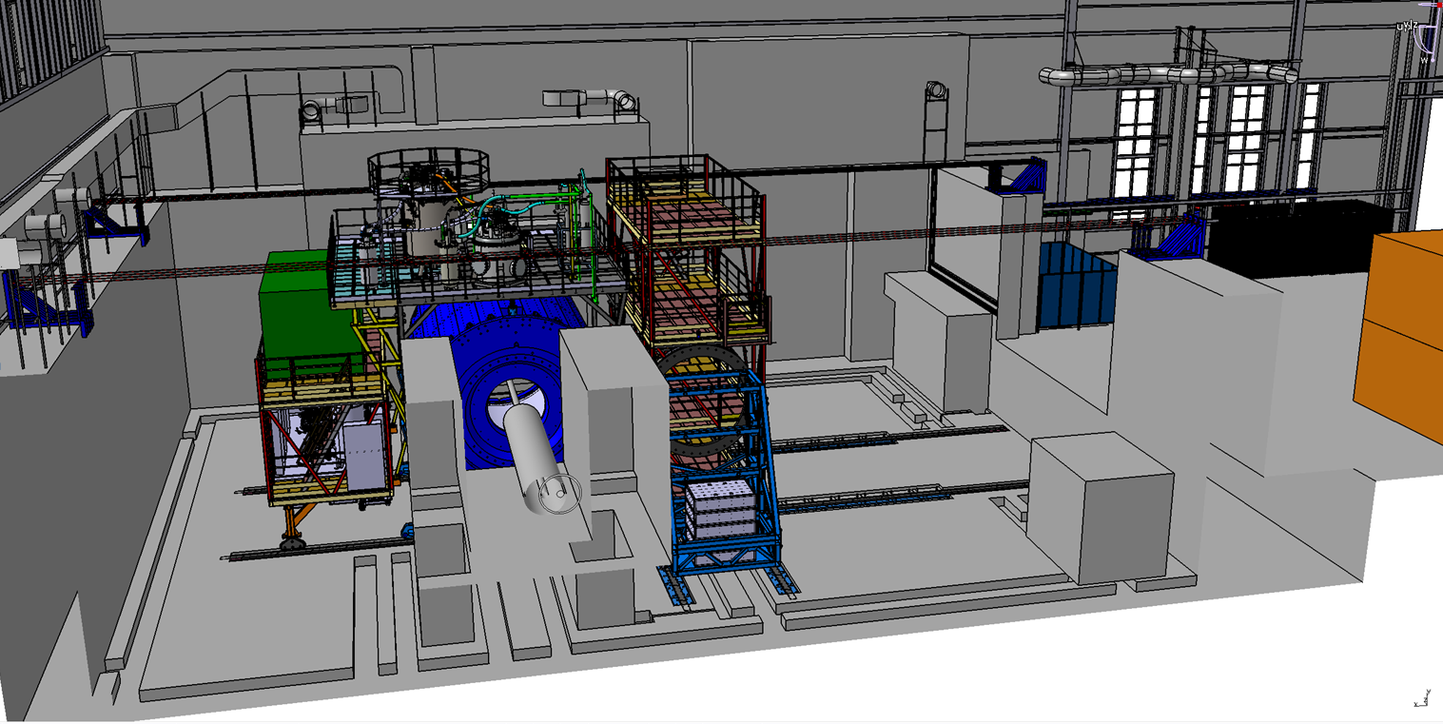
Possibility of magnet moving
Three main position
Assembling position
Trim coils installation position
Beam position
Distance – 12 m
Moving time about 5 hours
Speed 2 – 3 mm/s (for the final step 0,4-0,5 mm/s)

Slide 7
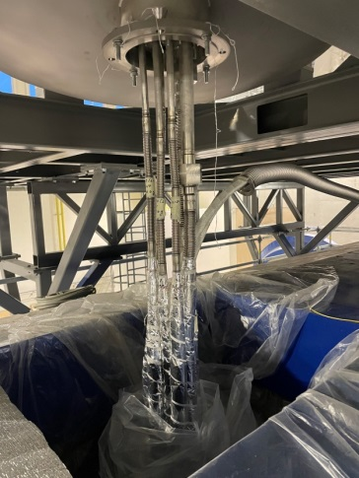
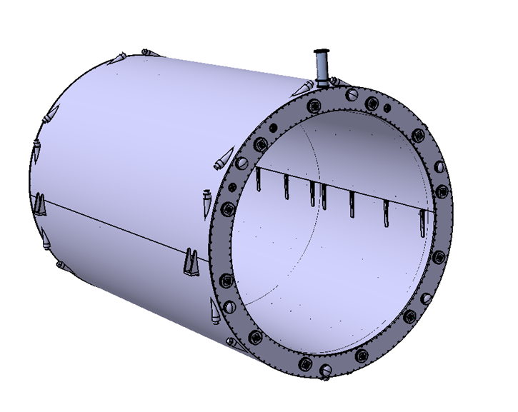
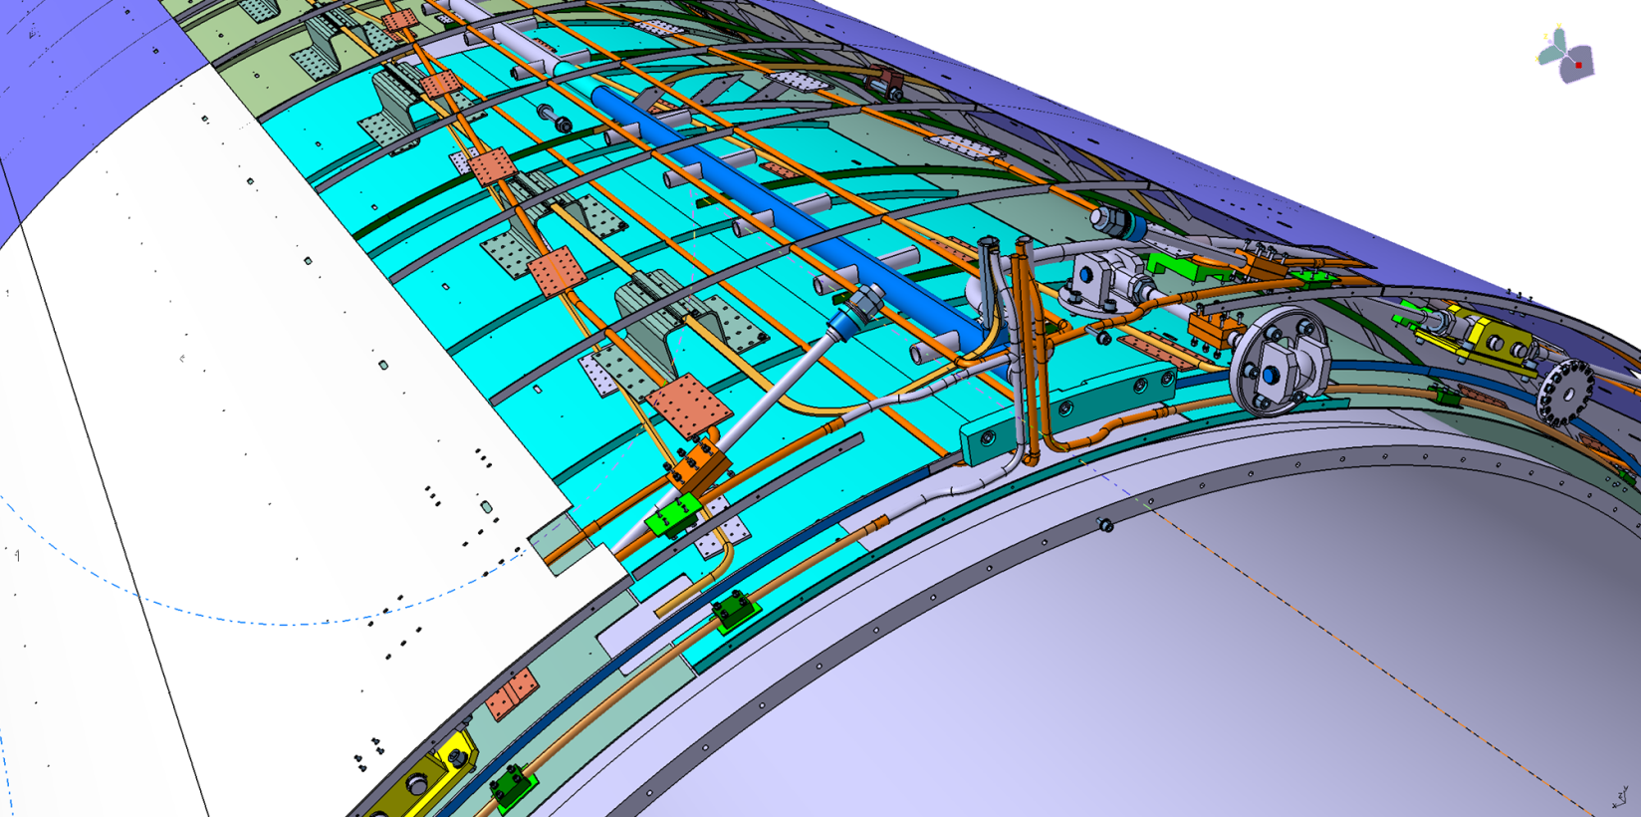
Solenoid construction
Solenoid with vacuum jacket
Solenoid without vacuum jacket
LN2 shield
4, 5
9
3
Vacuum jacket
Parameters of solenoid
Vacuum jacket (10-5 Torr in warm mode)
LN2 thermal shield (80K)
Cold mass (support cylinder for SC cables)
Superconductor cables (3 parts) total length 27 km, NbTi in pure aluminum matrix.
Cooling LN2 and LH pipes (cimmny area)
6. Number of turns – 1674
7. Operation temperature 4,5 – 5,5 K
8. Operation current / Rated induction – 1,79 A / 0,5 T.
9. 12 Radial and 6 axis cold mass suspensions
10. Total heat gain – 1056 W
Inner diameter is 4656 mm
Outer diameter is 5443 mm
Length is 7910 mm

Slide 8
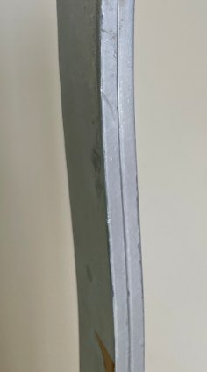
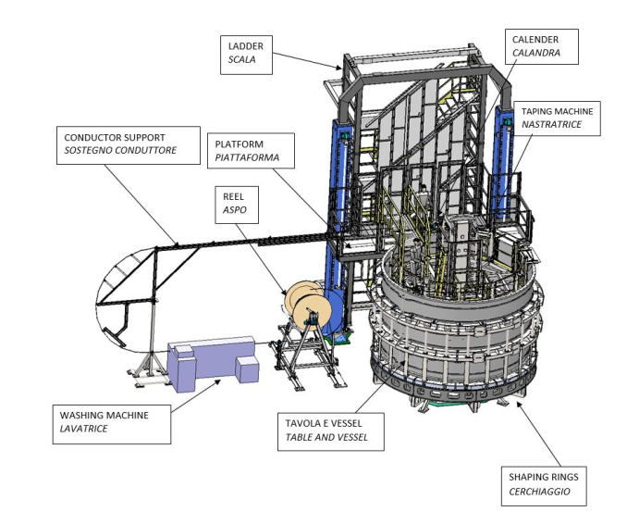
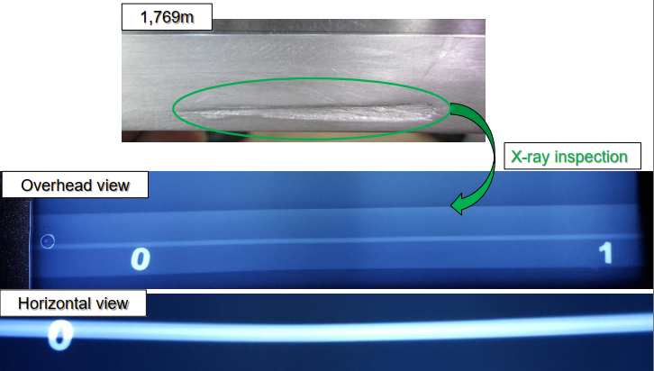
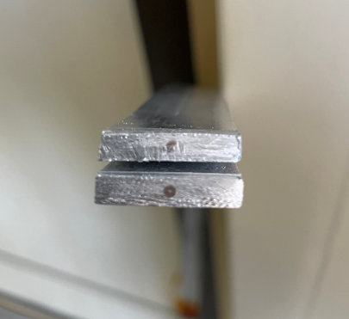
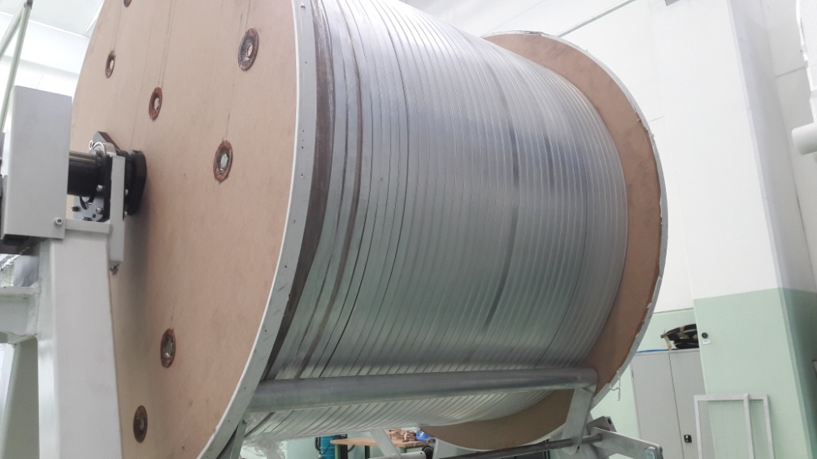
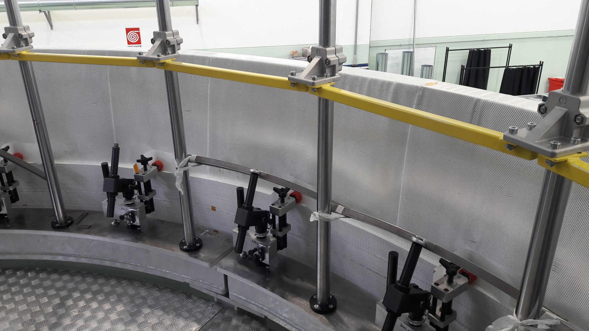
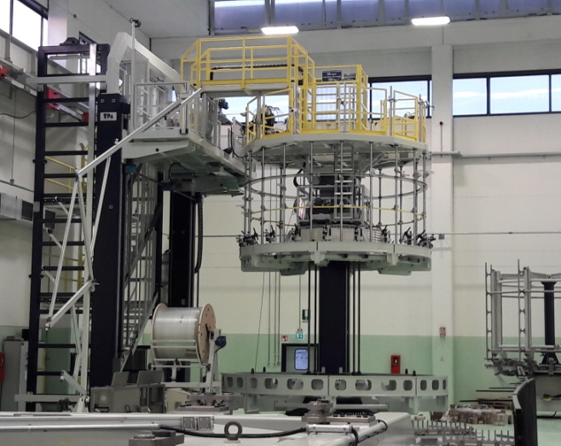
Superconductor cable
Original SC cables for MPD
Winding and tests of SC cable in ASG
SC cables parameters
SC Materials – NbTi/Cu.
Cable composition is pure aluminum matrix (4,1 x 20 mm) and inside string of Cu/SC ratio 0,9/1 (d – 1,5 mm).
Insulation – kapton tape, glass tape and epoxy resin.
Critical current (1,2 T, 4,5 K) – 6,9 kA
Cable length - 27 km.
Cable weight – 6,3 tons

Slide 9
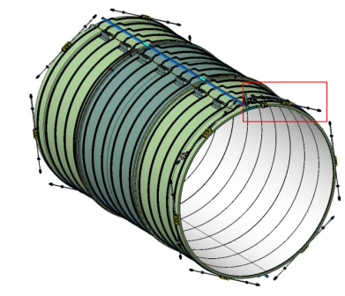
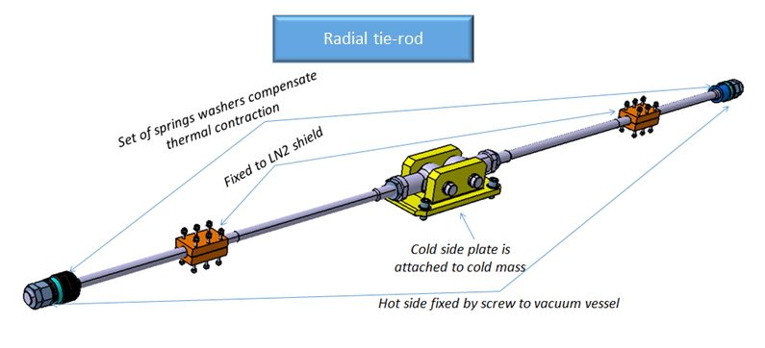
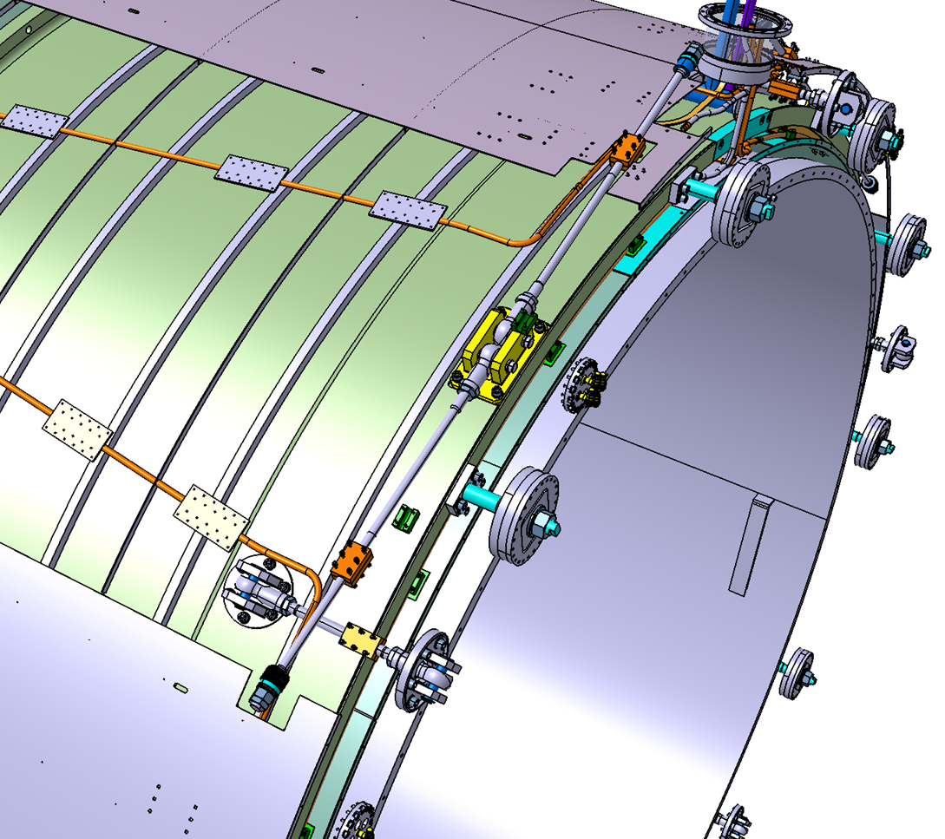
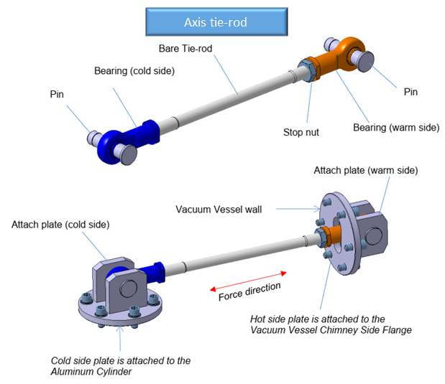
Suspension system of cold mass
Suspension system consist of 6 axils and 12 radial tie-rods.
Axis tie-rods – fixed cold mass from moving in axis direction
Maximum force of tensile/compressive is 240/89 kN. Safety factor is 4,3.
Radial tie-rods – supporting a cold mass inside vacuum vessel.
Safe against shear + bending with the sizing load of 50 kN. Safety factor 1,8.

Slide 10
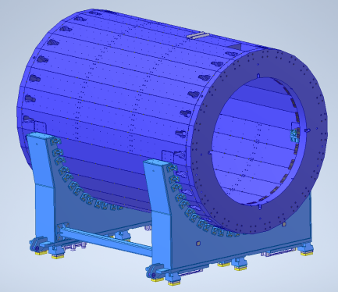
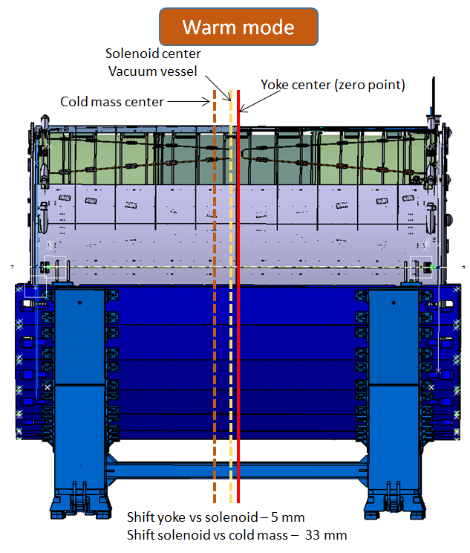
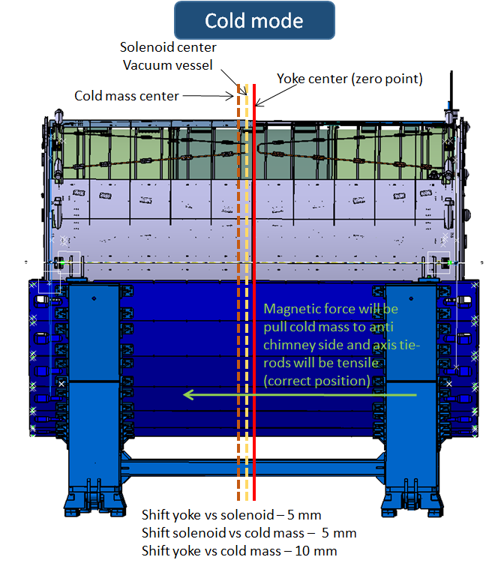
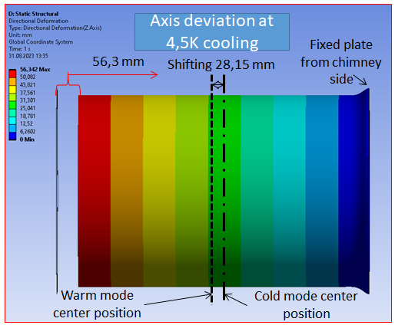
Vertical axis position and verification
Yoke
Solenoid (vacuum vessel)
Cold mass with SC cables
Computing simulation

Slide 11
Chapter 2 Cryogenic infrastructure. Ready to cooling.

Slide 12
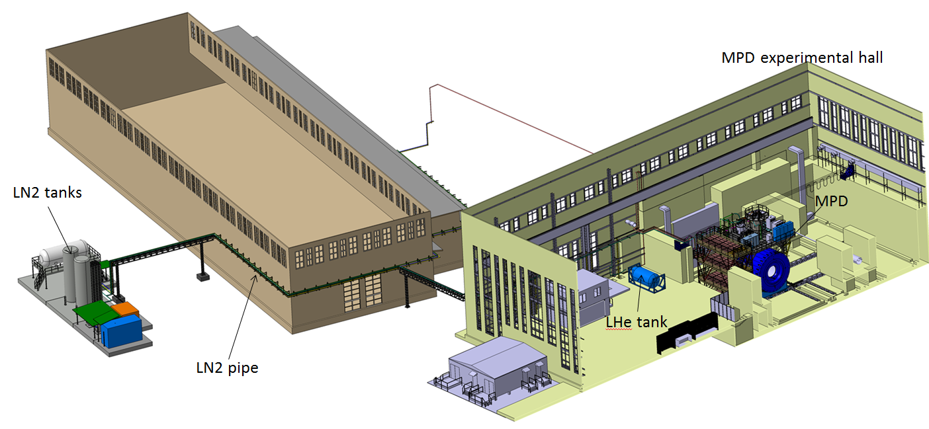
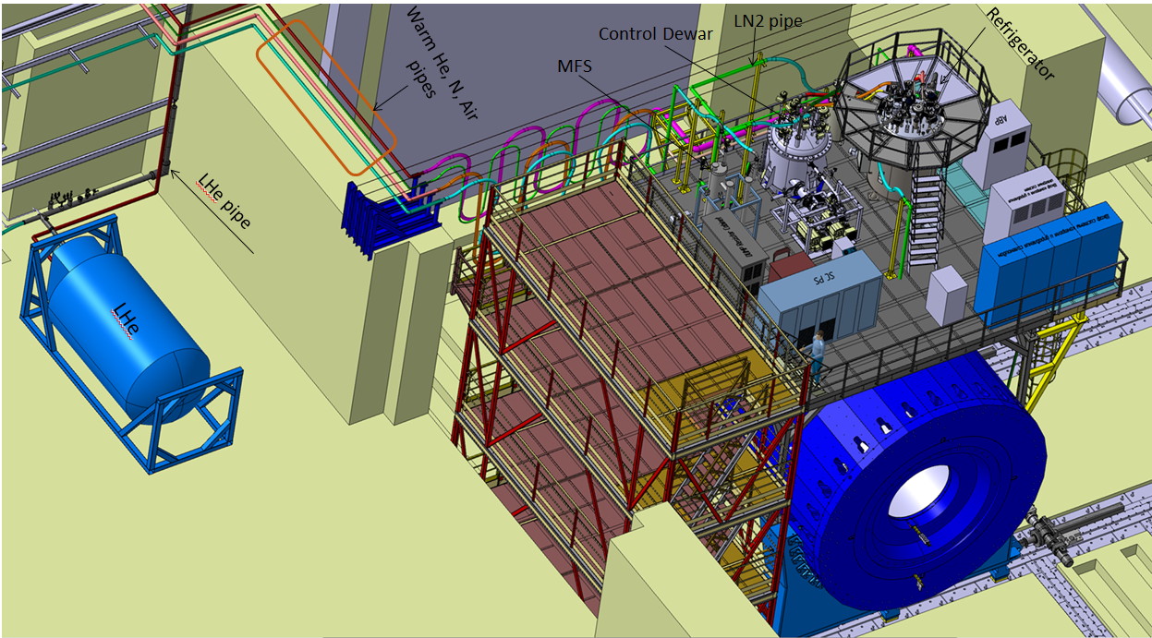
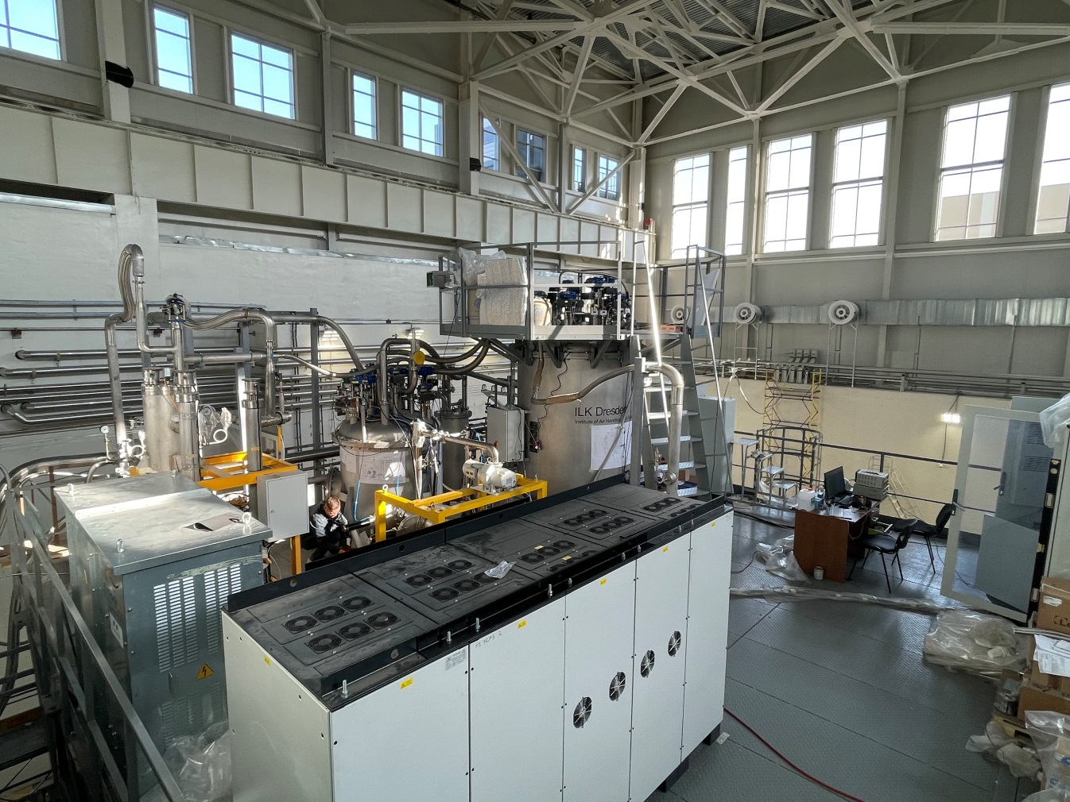
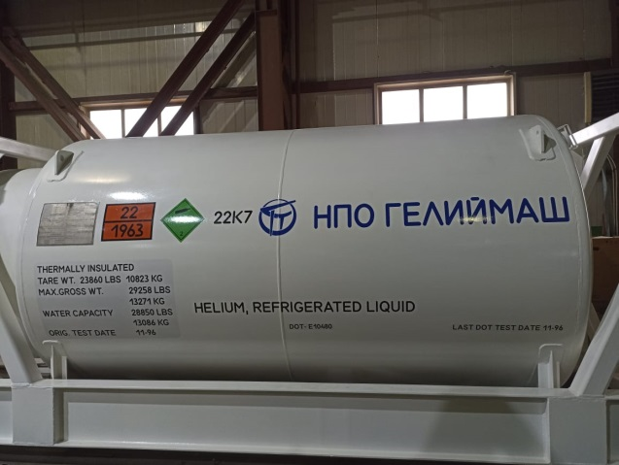
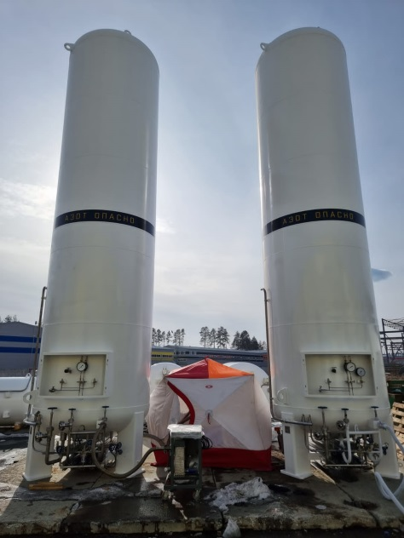
Cryogenic infrastructure at the present time
- Control Dewar (ready to operation)
- Refrigerator (ready to operation)
- MFS (ready to operation)
- LN2 and LHe heaters (was ordered in UK, re-ordered in Russia (Delived))
- LHe pipe (ordered in UK, drawings was ready, delivery not possible, transfer manufacturing in Russia March 2024)
- Cryogenic flexible connection pipes (LHe, LN2 installed)
- LN2 Tanks (2 pc) – can’t be delivery from CR, ordered in Russia (installed)
- LHe Tanks (2 pc) – now in Russia ready to installation
- LN2 transfer pipe 120 m with two support frame (December 2023)
- Warm pipes for He, N2 and Instrumentation Air (installed and ready to operation)
- Flexible warm pipes (installed)
- Support system for flexible pipes (installed)
- Temporary pipes for cooling by temporary scheme (in JINR)

Slide 13
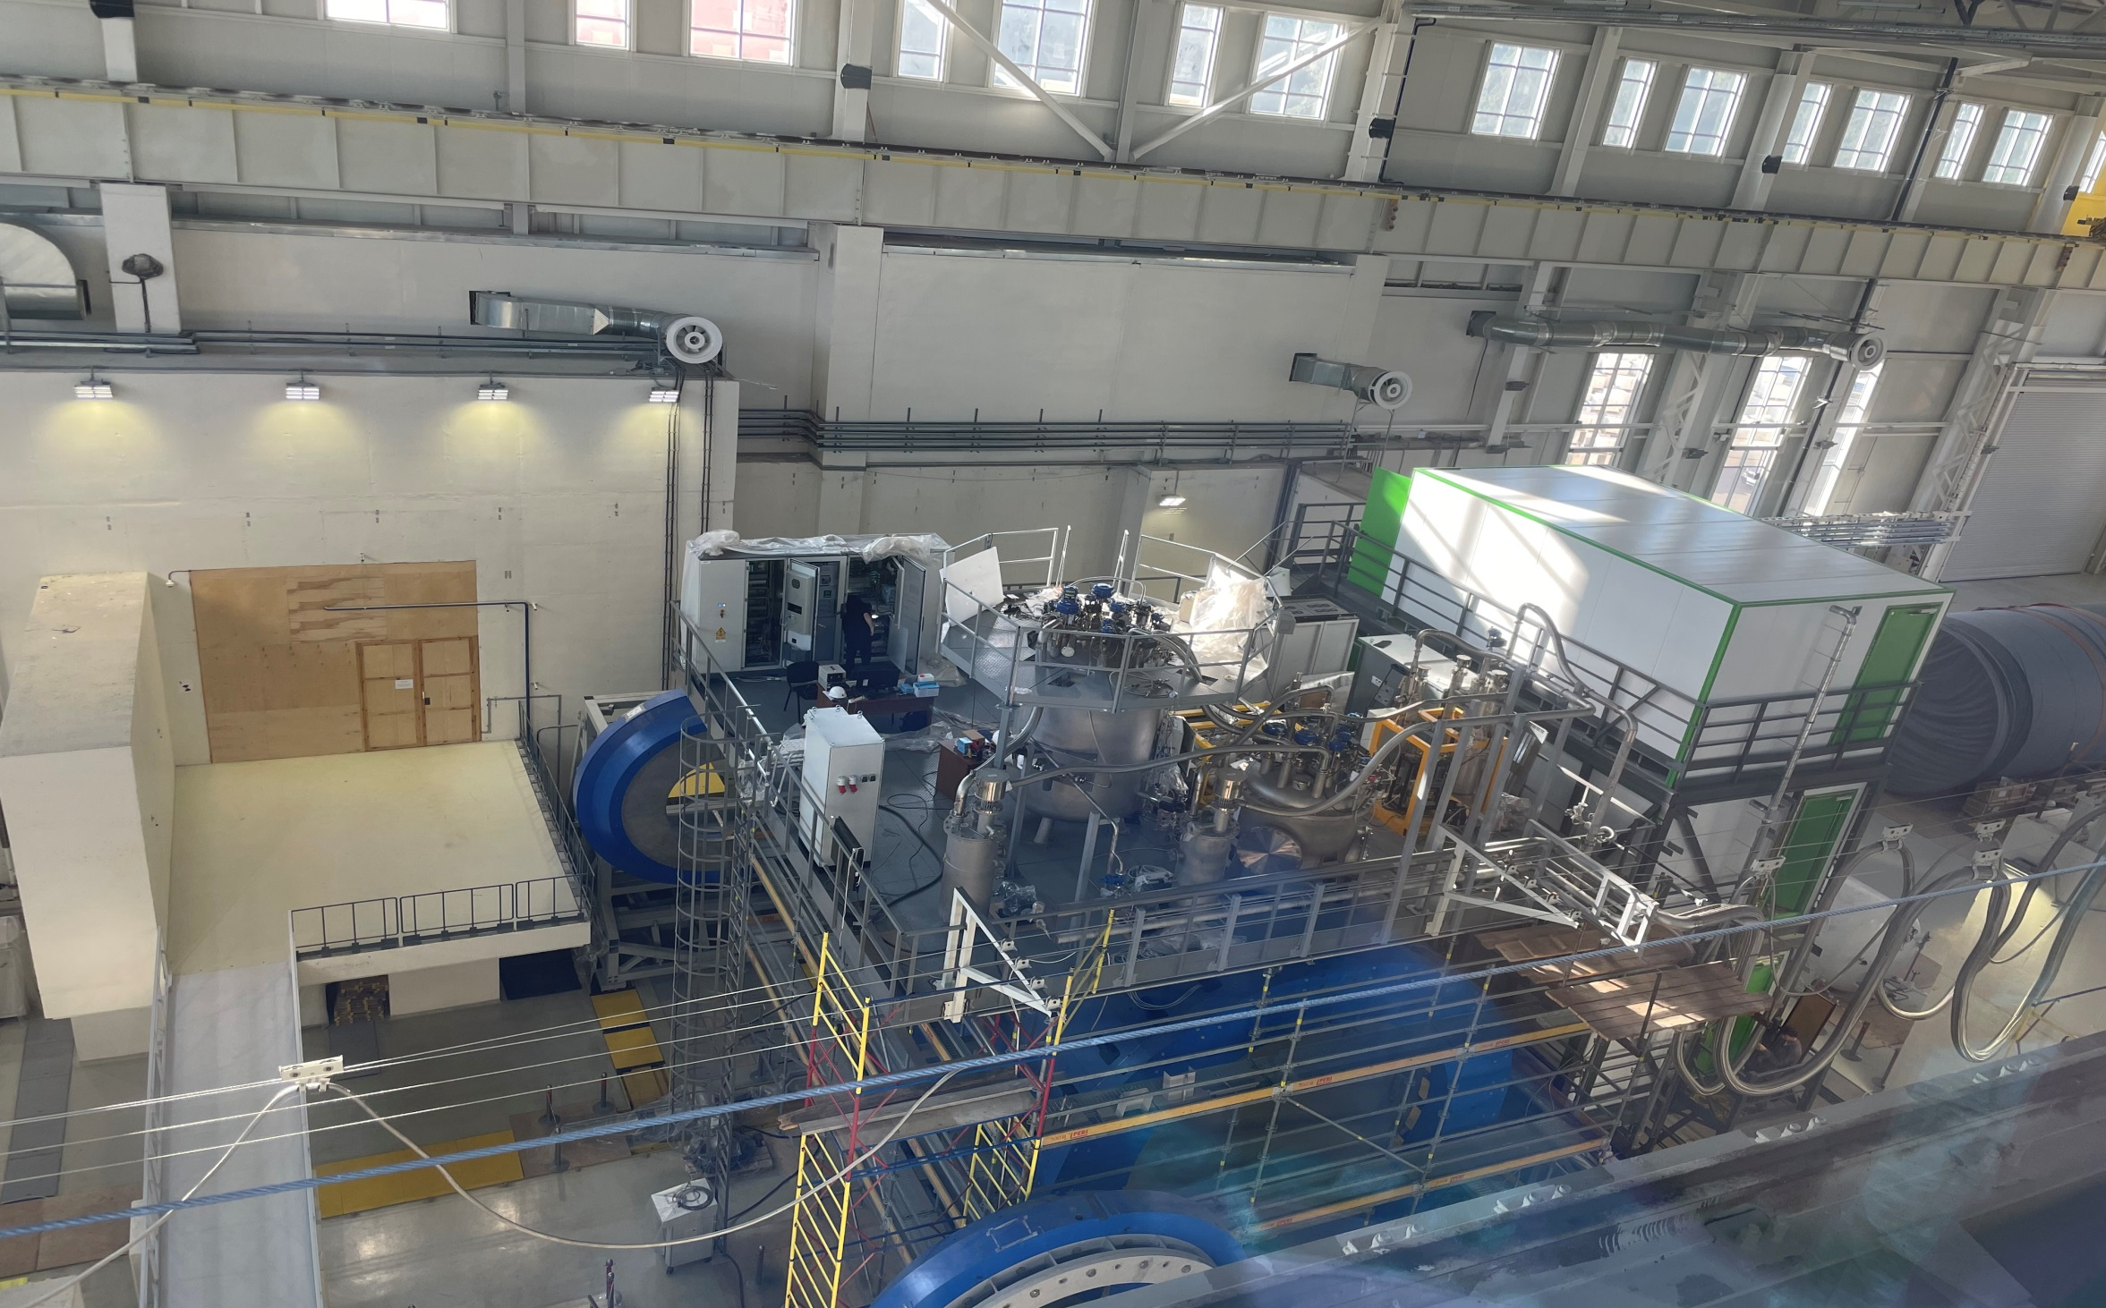
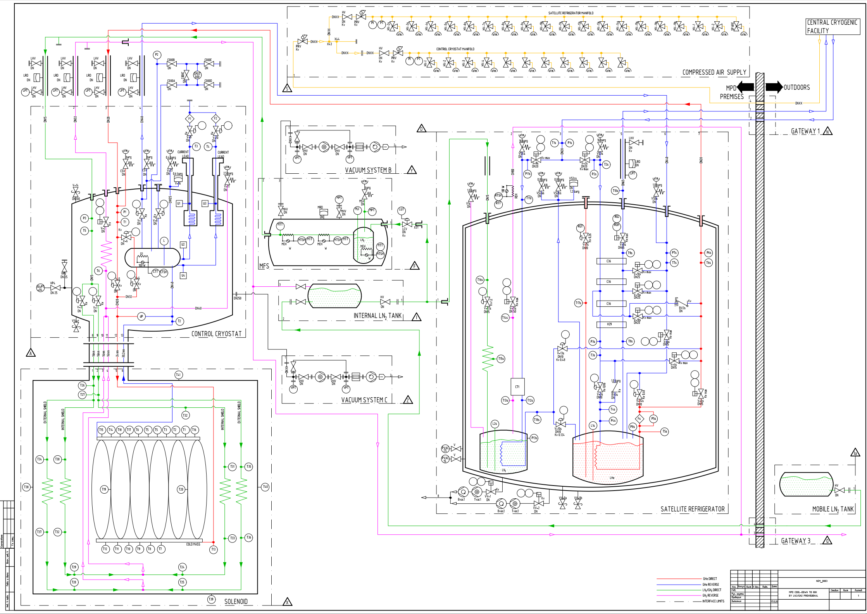
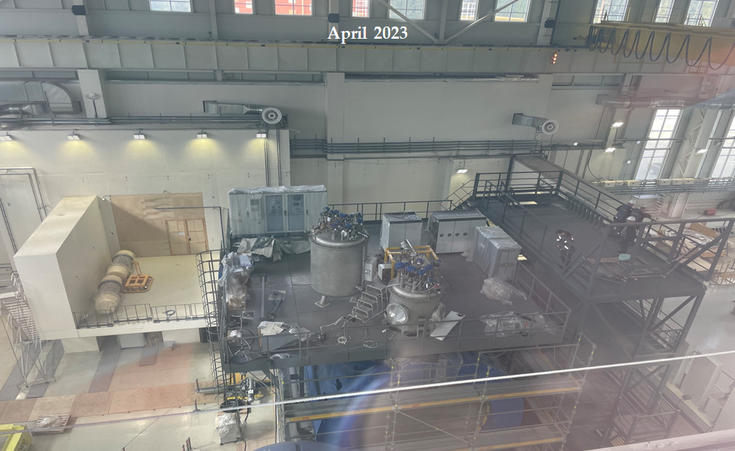
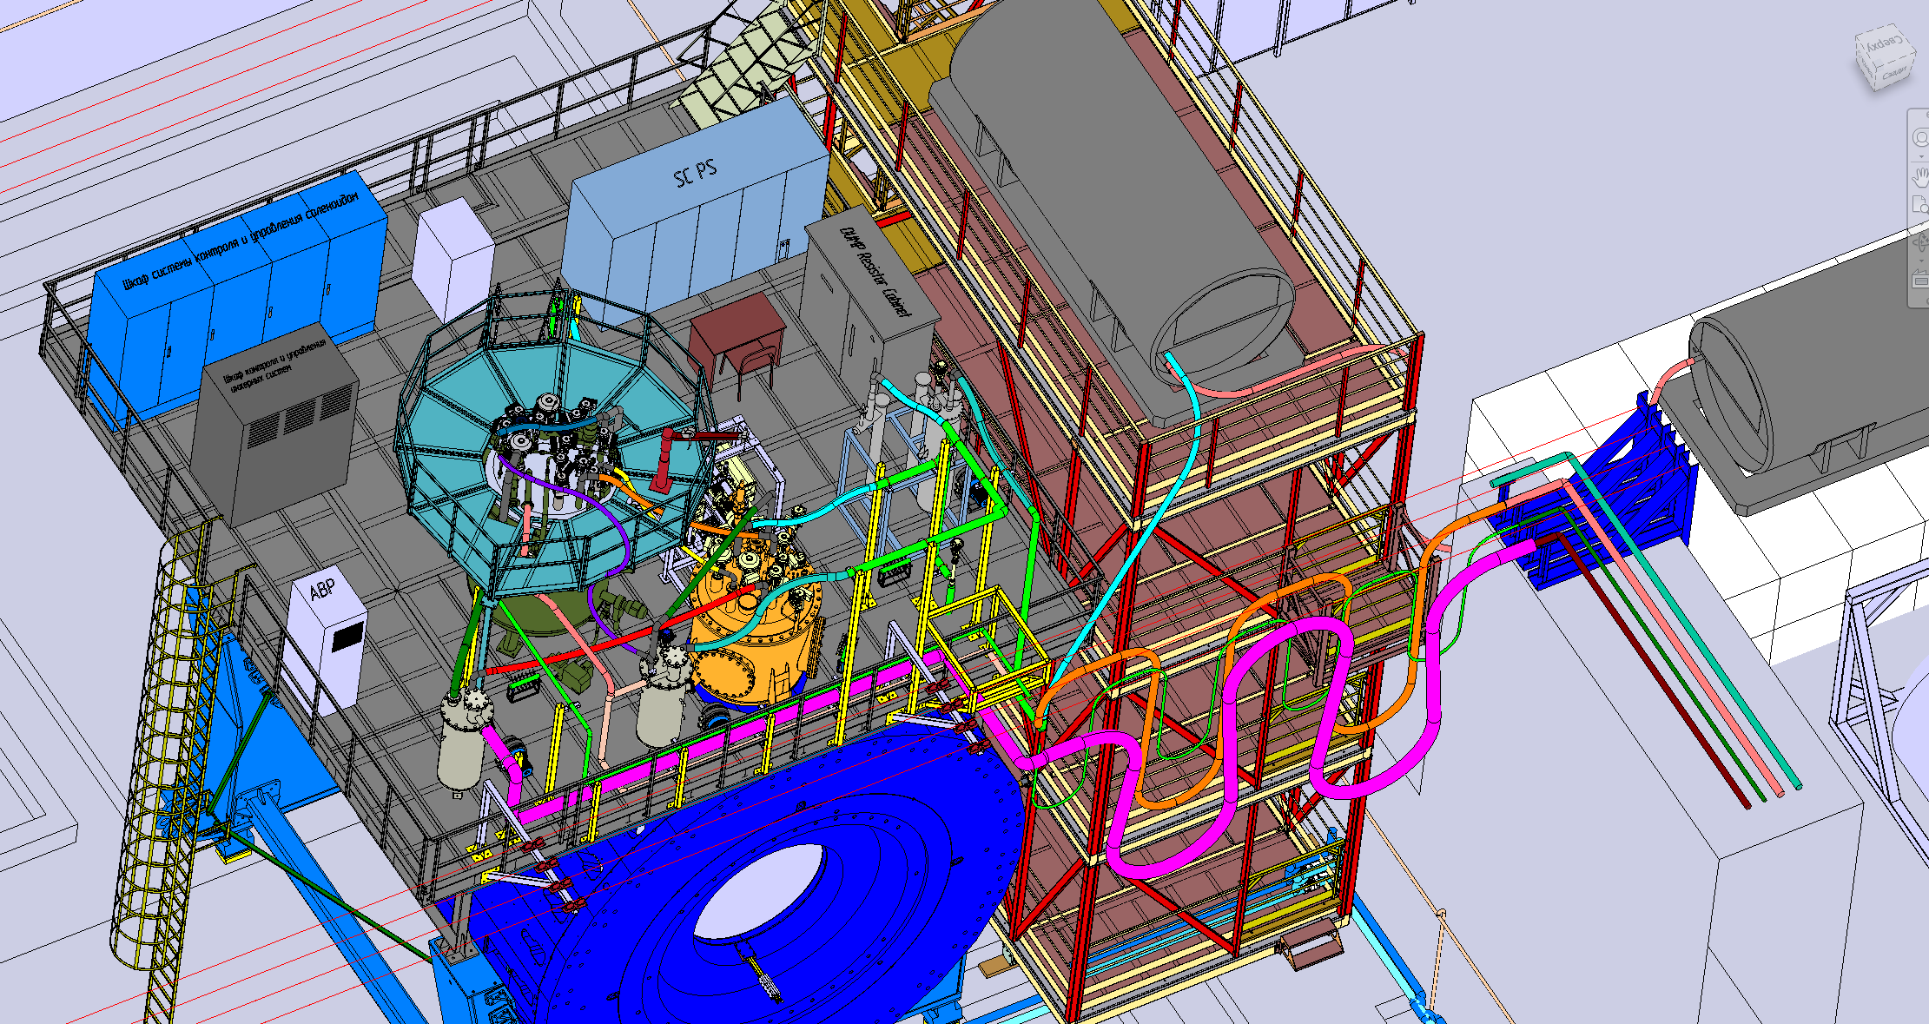
Temporary scheme of cooling at 80 K

Slide 14
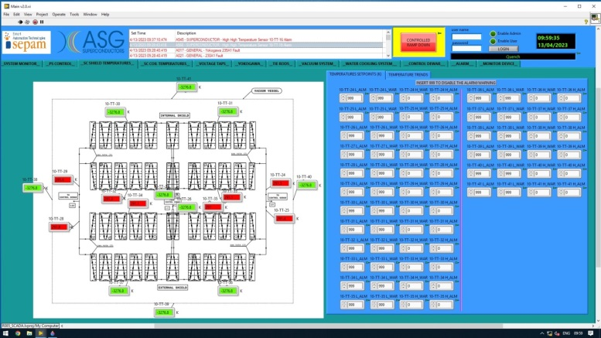
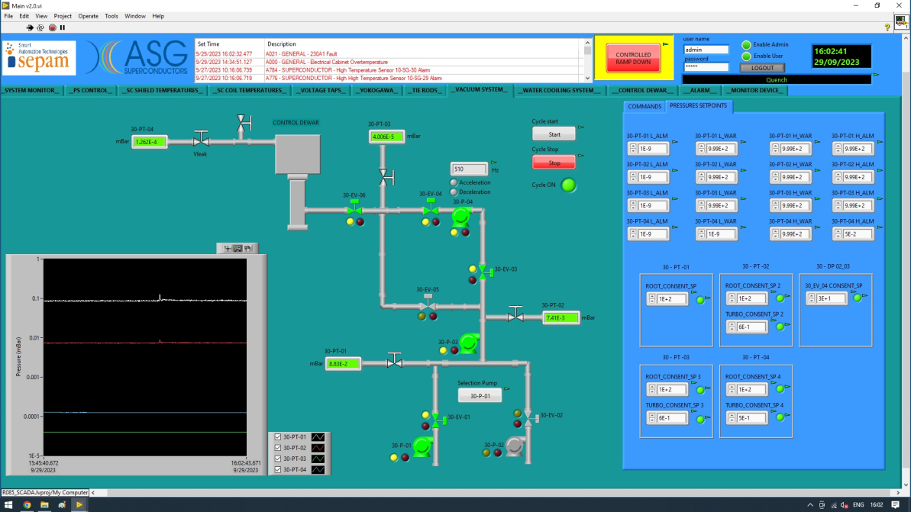
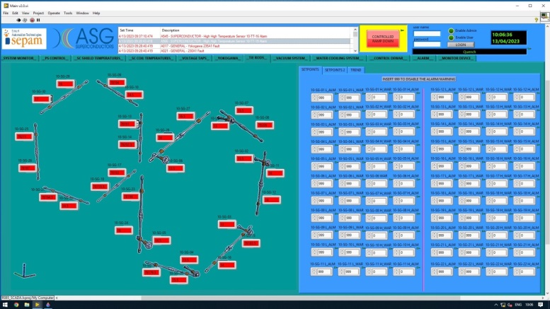
Solenoid is ready to cooling
Main point
For the present day the main equipment (control cabinet of solenoid, refrigerator, control Dewar, heaters, flexible and stationary pipes) was successfully re-ordered, manufactured, tuned, passed test (pump, leak, electrical…), installed to operation position and integrated into a single system.
Control parameters by cooling mode
Vacuum
Temperature
Tie-rods

Slide 15
Chapter 3 Control and protection system.

Slide 16
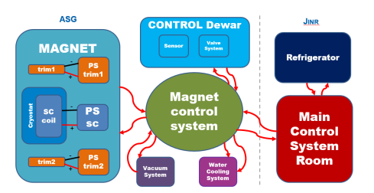
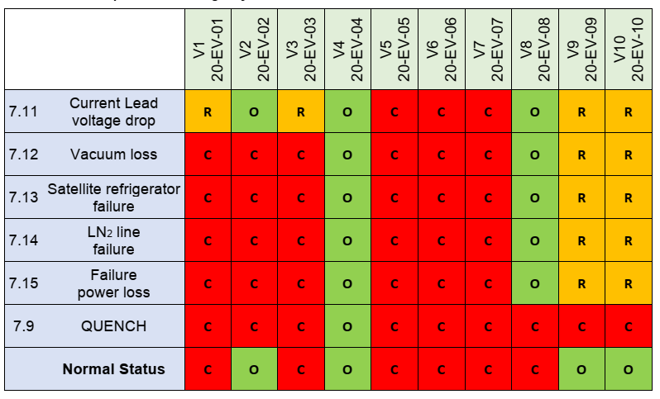
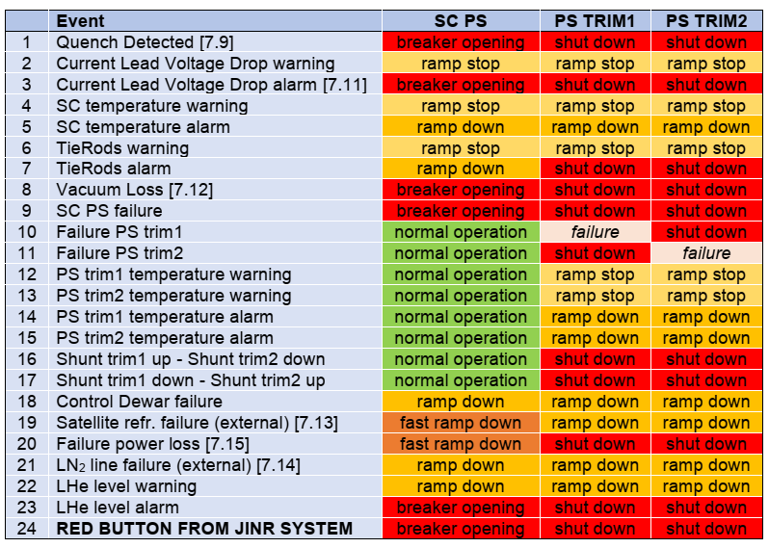
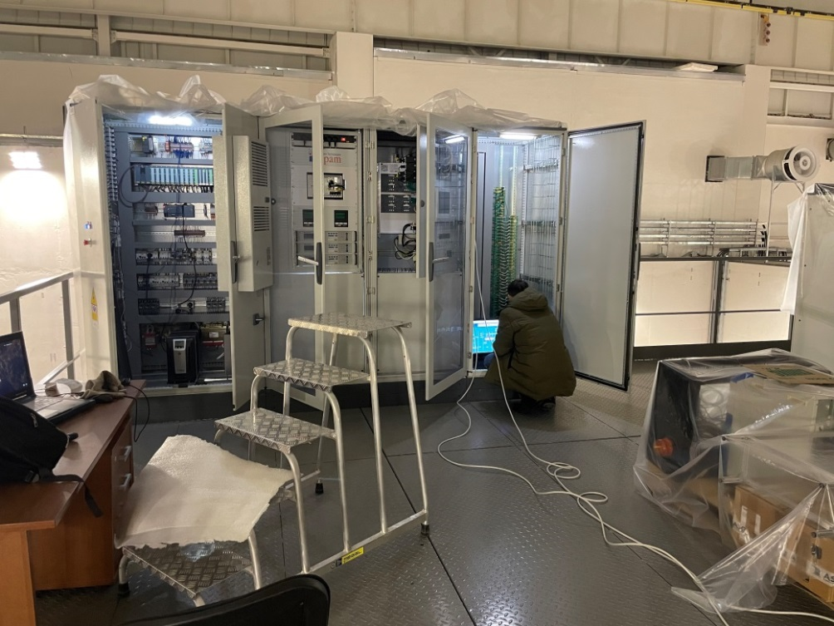
Control system
All signals from solenoid engineering system connect to control system
Valves position in different operation and alarm modes
Failure list and feedback on CS
Main control parameters
Temperature of CS cables (we add 6 sensors to chimney area and current leads)
Temperature of thermal shield
Volume of LHe in control Dewar vessel
Voltage taps (drop current at CS, current leads)
Pressure inside vacuum vessel
Tie rods (stress sensors, position of cold mass)
Water flow and temperature
Refrigerator failure (by LHe level)

Slide 17
Test of solenoid protection system (voltage taps)
Nominal current - 1790 A
Nominal volts - 10 V
Induction – 0,5 T
For the safety of SC cables and previously shout down power system, provide QD and voltage taps.
Voltage taps located in to welding points of SC cables, warm and cold part of current leads.
Signals from voltage taps transfer to Yokogawa, converted and gives a control signal to QD.
Safety parameters is +/- 1 V.
Test parameters 1,2A, 10V
Solenoid MPD felt electricity for the first time!

Slide 18
Timeline
September – October 2023 – preparation all system to cooling (clean, leak test, electricity test, vacuuming main equipment…)
October – December 2023 – cooling of solenoid to 80 K (analyzation process, correction, optimization…)
December 2023 – delivery LH Tank from Geliymash to JINR (preparation temporary line Tank - refrigerator)
January – March – cooling solenoid to 4,5 K
October 2023 – January 2024 – prepare a program and test stand for Power supply system, quench detection system and energy evacuation system.
January – March 2024 – tests power supply and energy evacuation system.
December 2023 – January 2024 – measurement of magnetic field of Earth in INP (Novosibirsk).
February – March 2024 – assembling and measurement Earth field in JINR.
April – May 2024 – installation and measurement magnetic field in MPD magnet.
May –… assembling detectors, correction parameters and development of control system…

Slide 19
Thank you for attention

