Slide 1
Magnetic field measurement of MPD detector magnet
XII Collaboration Meeting of the MPD Experiment at the NICA Facility
E. Antokhin, BINP, Novosibirsk.
4-6 Oct. 2023
Belgrade, Serbia.

Slide 2
Magnet MPD
Magnetic field: 0.2 - 0.56 Т
Superconducting coil: (current 1800 А)
Two trim coil: (current 2800 А).
Good field region 1:
Z=±2.6 м, R=2.2 м.
Good field region 2: (ТРС):
Z=±1.7 м, R=1.2 м.
Field uniformity: ± 2×10⁻⁴.

Slide 3
Specification for mapping system
Using one 3D Hall sensor (HE444).
Covering all area inside TPC region.
Accuracy 0.3 Gauss.
Measuring positions in X, Y, Z with laser tracker.
Measuring inclination angle of carriage respect to solenoid axis with laser tracker.
Measuring time 1 sec for one point.
Possibility to reconstruct the field inside internal volume of cylinder from data measured at cylindrical surface.
.

Slide 4
Magnetic field uniformity

Slide 5
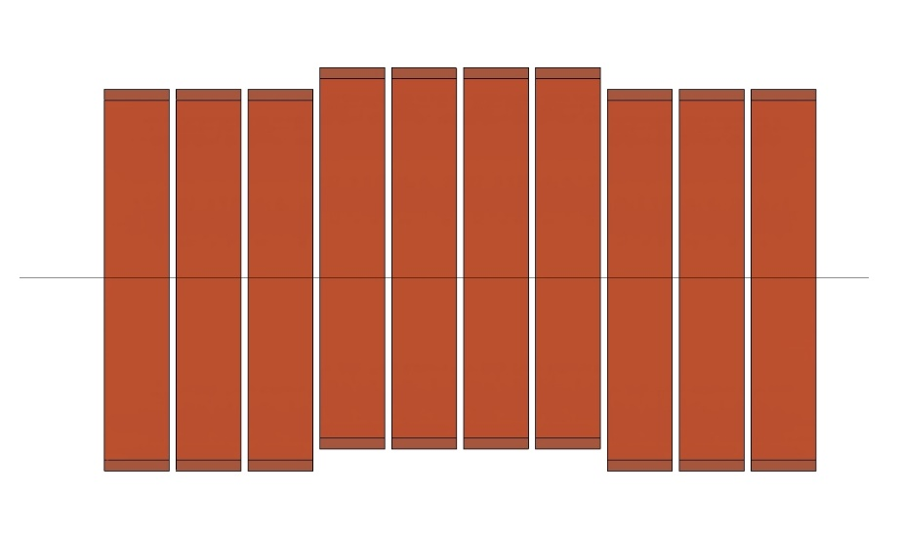
Magnetic field uniformity change due to SC central coil shift 5 mm

Slide 6
Free holes of the magnetic yoke at the time of
magnetic field measurement

Slide 7
Very precise vertical flange.
Accuracy of manufacturing and assembly of the magnetic yoke about 0.2 mm.
We must take advantage of this!

Slide 8
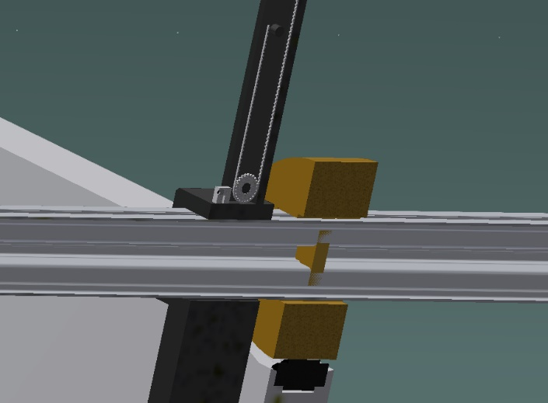
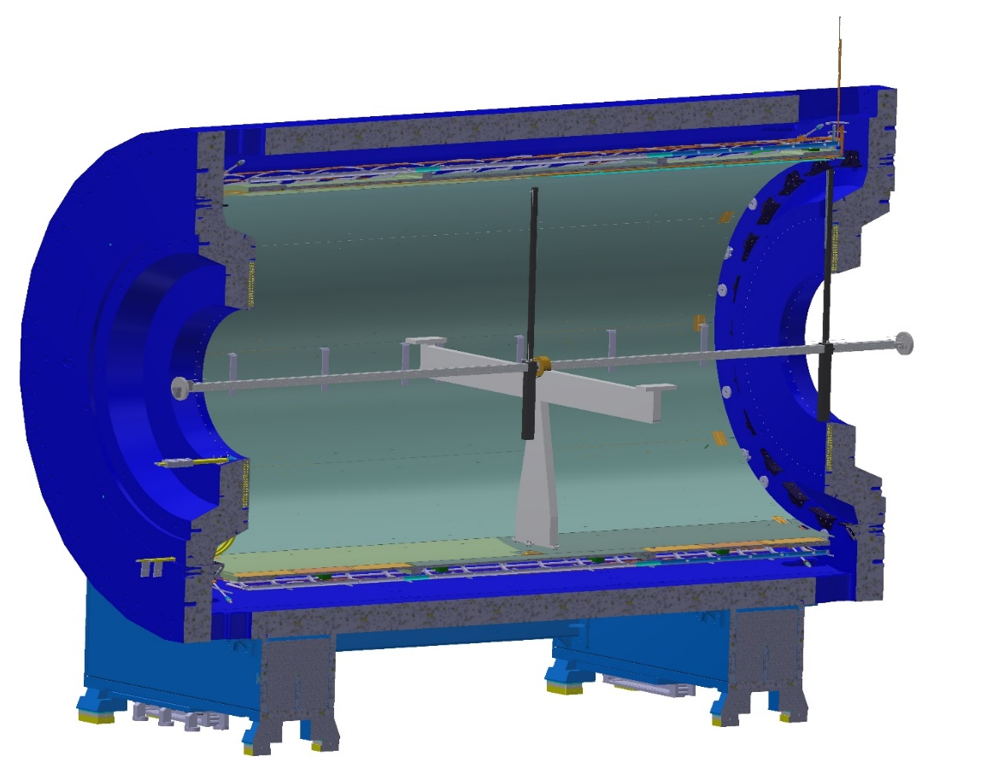
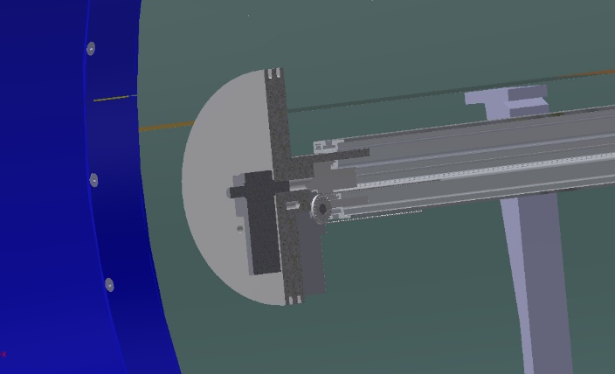
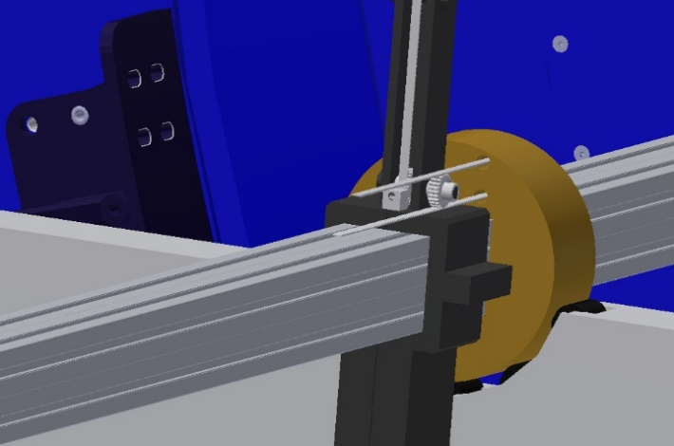
Our proposal for MPD magnet
.

Slide 9
Our proposal for MPD magnet. Measurement procedure.
The field map will be built in a Cartesian system, while the measurement results are issued in cylindrical coordinate system.
The direction of the Z axis of the local system obviously coincides with the Z axis of the laboratory system.
The control code uses a procedure that first moves through all the values ​​of the azimuth angle at the same position in Z at the minimum radius, then rotates back 360°, then steps along the radius, with rotation in azimuth at each radius, and reaching the maximum radius.
It is necessary to determine the coordinates of the 3D Hall sensor at each measurement point. To do this, one need to use a laser tracker with a set of reflectors and mirrors.
It is necessary to measure the inclination of the rod with the measuring block of the Hall sensor as a function of the length of the solenoid Z in advance and make correction table. The output file shall be as: N X Y Z Bx By Bz
.

Slide 10
Our proposal for MPD magnet. Mapper specification.
Parameter | Value
Length of movement for Z | 9 m
Length of movement for R | 0.1 – 2.2 m
Rotation of measurement block | 360 deg.
Accuracy of movement for Z | 50 microns
Accuracy of movement for R | 50 microns
Accuracy of rotation | 0.2 deg.
Hall 3D sensor | НЕ444, HE Hoeben Electronix,
Hall 3D sensor accuracy | 0.1 Gs
Hall 3D sensor accuracy total (with accuracy of laser tracker and temperature correction) | 0.3 Gs
Sag of guide line | 4 mm
Weight of mapper | 60 kg
Reading time per one measurement | 1 sec
.

Slide 11
Carbon plastic carriage
20 kg.
2,1 m
9 m
Carbon plastic guide line
40 kg.
Bearing
Bearing
Servo transmission
Cross section of guide line
□150
The weight of the carriage is symmetrical about the axis of the guide
Young's modulus for carbon plastic 180 Gpa
The servo drive will be a belt drive. On the servo shaft and on the guide. there will be toothed pulleys.
The carriage is in the furthest position from the servo for calculation of torque
Through hole
4

Slide 12
Our proposal for MPD magnet . Carbon plastic beam data.
CFRP based on UMT530 fibers and epoxy binder. The effective modulus of elasticity of the multilayer package in the longitudinal direction Ex = 179 GPa, the effective shear modulus in the plane of the package Gxy = 17.6 GPa.
To get minimal sag at condition of minimal weight dependence of the sag on external dimension of the cross section of the beam was studied for different wall thickness.
It was found that minimal possible sag of carbon plastic beam as 3-4 mm corresponds wall thickness 4 mm and cross section size 150 mm. The beam weight is then within 37 kg.
.

Slide 13
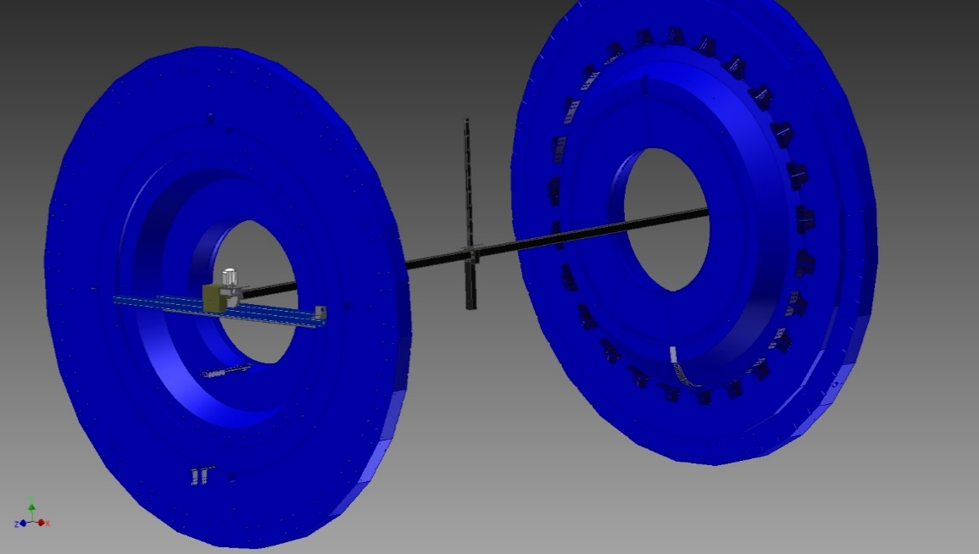
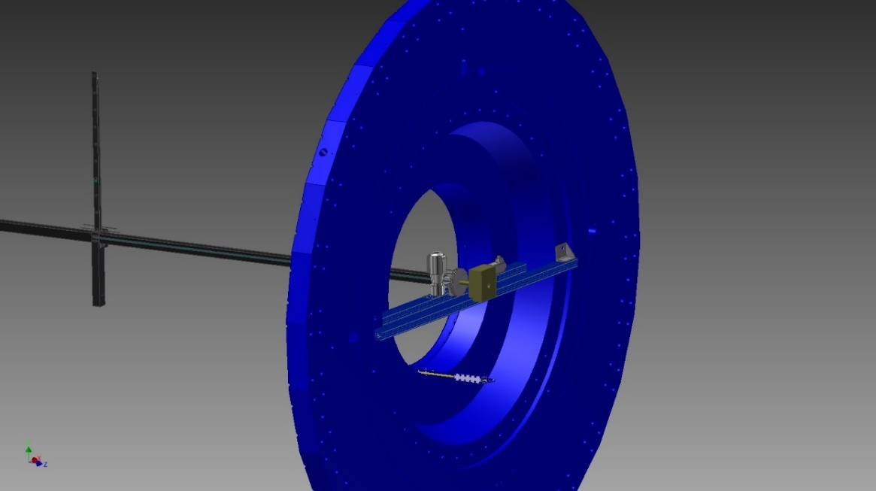
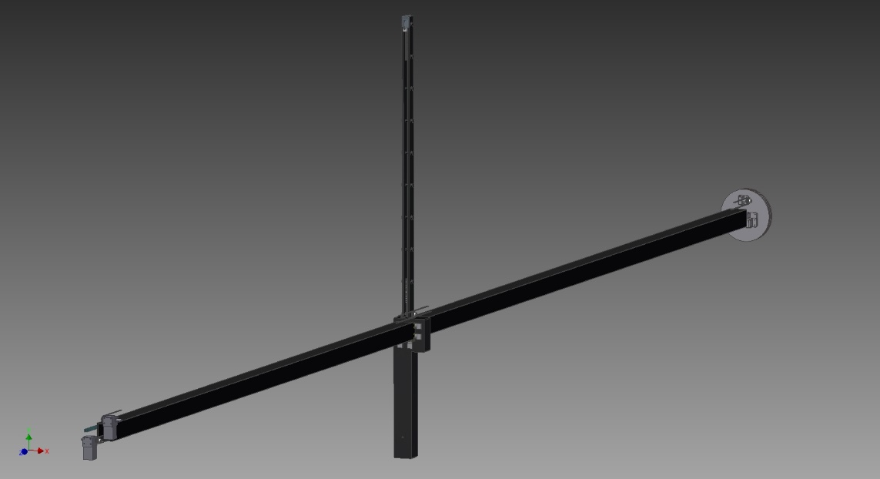
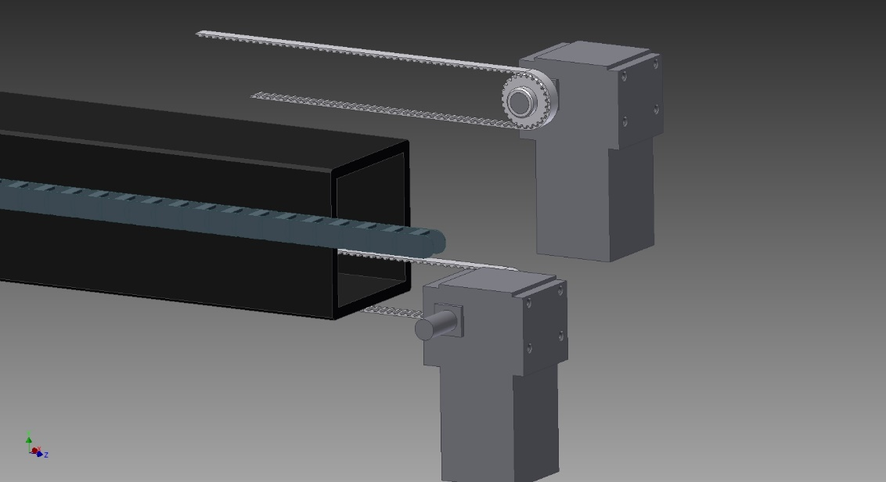
Recent mapper design with 9 m carbon plastic guide line.
.

Slide 14
Status of project.
The 3D STEP model and 2D drawings done.
Servomotors type selection done. Contraсts with supplier concluded.
Preparation of a test facility for simulating the attachment of the mapper to the MPD magnet and testing the mapper on the Earth's field (at the BINP side).
Control software is in process. Basic algorithm is done.
Control unit electronic blocks had been purchased.
Technical specification and drawings for 9 m carbon fiber beam is ready. Contract with manufacturer had been concluded.
Mechanical parts are in process of manufacturing.

Slide 15
Status of project. Example.
Mechanical parts are in process of manufacturing.

Slide 16
Time schedule
Time, month | 1 | 2 | 3 | 4 | 5 | 6 | 7 | 8 | 9
Carbon fiber beam and carriage.
Control code development
Control unit blocks purchasing
Servomotors and related parts (belts, bearings)
Mechanical parts
Production and alignment of testing facility for Earth field measurement (at BINP side).
Assembling of mapper on testing facility at BINP
Test with Earth field at BINP
Assembling of mapper at JINR
Measurements and correction of magnetic field in JINR.
Works

Slide 17
Thank you for attention.

