Slide 1
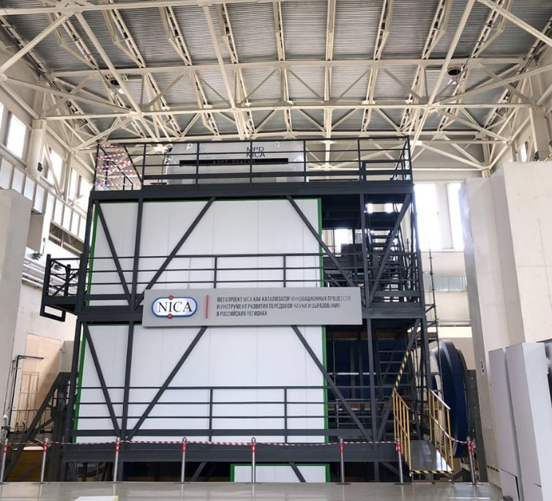
Status of the NICA-MPD PLATFORM
Author:
Alexander Fedunin
Sector No 3; Engineering Support Group
Joint Institute for Nuclear Research
XII MPD Collaboration meeting

Slide 2
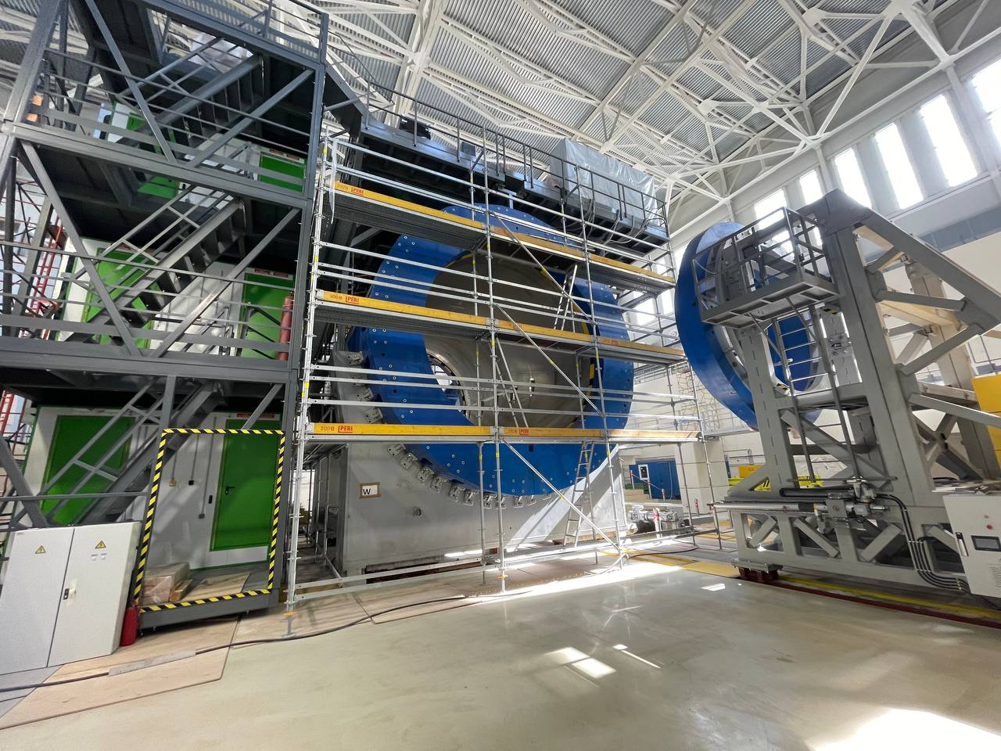
NICA-MPD-Platform (NMP)
The NMP contains the electronics for collecting and processing data from the MPD, power supply(hv,lv) and gas distributors sub detectors.

Slide 3
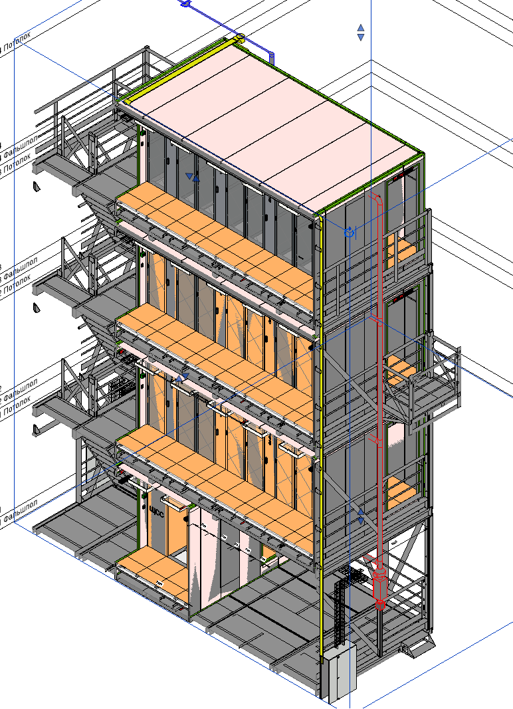
NMP consist of (4 separate modules, which installed vertically).
Each module includes 1 room, which divided by 2 corridors.
Inside module there are racks with electronics, cooling and power supply equipment and other engineering systems.
Three zones: cold corridor, hot corridor, space under the raised floor.
Each floor has ventilation and air conditioning systems.
XII MPD Collaboration meeting

Slide 4
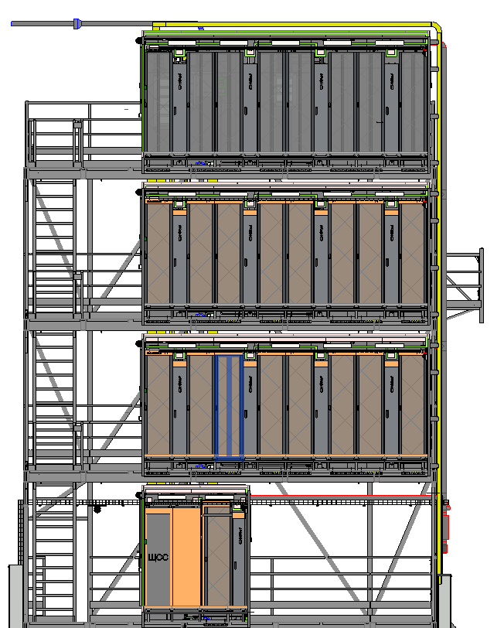
PARTS of NMP:
IT RACKS on the NMP
Cooling System
Main electrical distribution board
Structed Cabling(fiber optic)
Access control and management system
CCTV video surveillance system
Аutonomous fire extinguishing system
Monitoring system
XII MPD Collaboration meeting

Slide 5
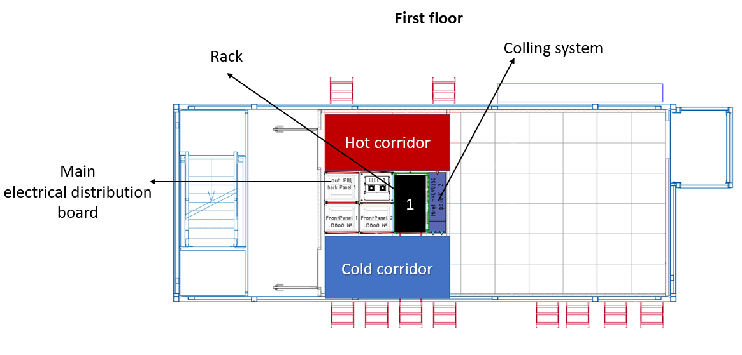
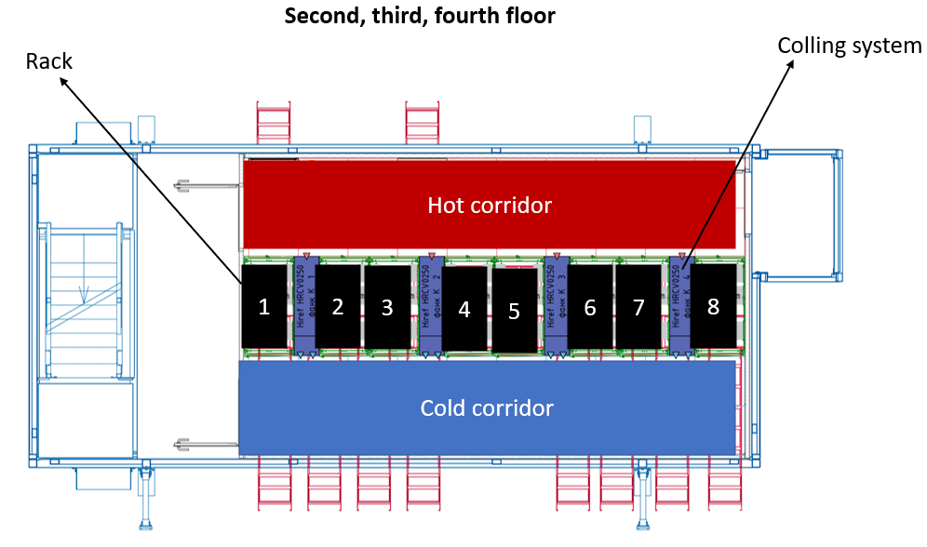
IT RACKS on the NMP
All floors have 2 corridors: hot and cold.
Main power supply equipment is located on the ground floor.
XII MPD Collaboration meeting

Slide 6
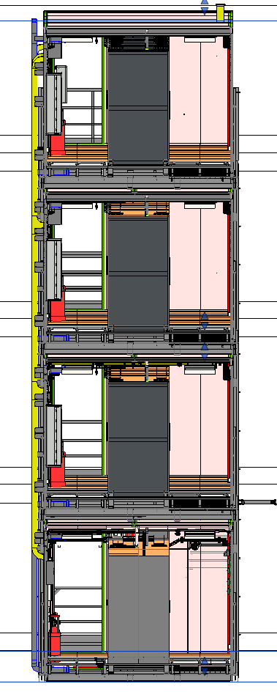
Main electrical distribution board
The platform power supply is isolated on each floor.
Each floor has its own power distribution board, which makes it possible to carry out preventive maintenance of the floor without shutting down the entire NMP.
XII MPD Collaboration meeting

Slide 7
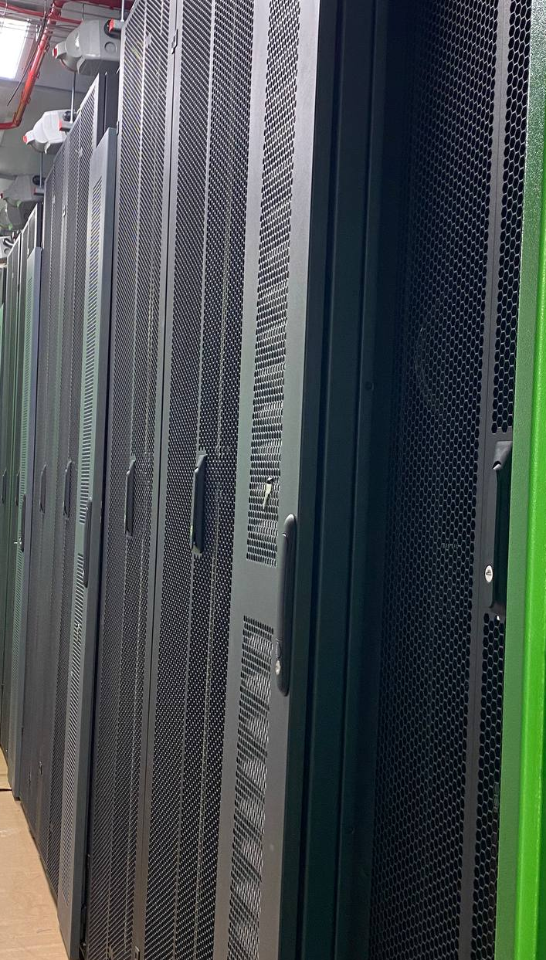
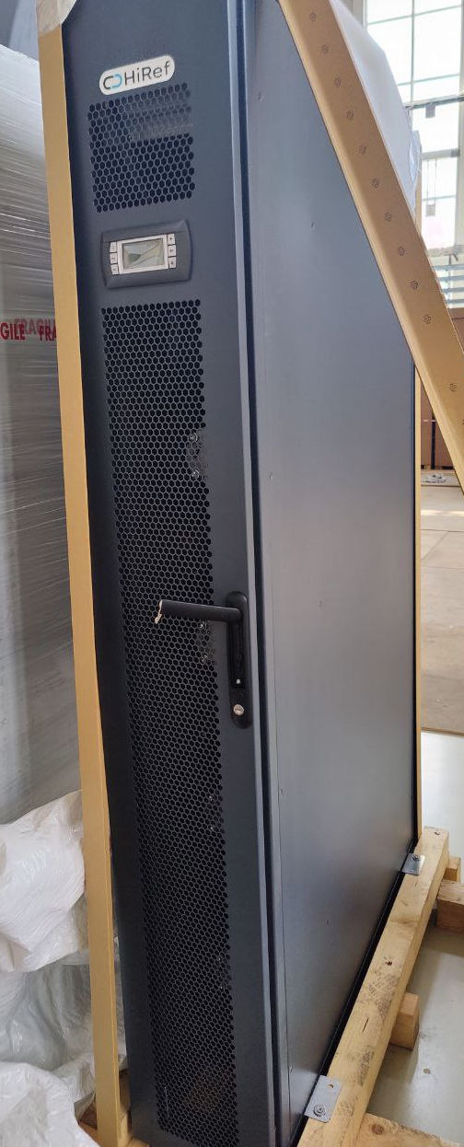
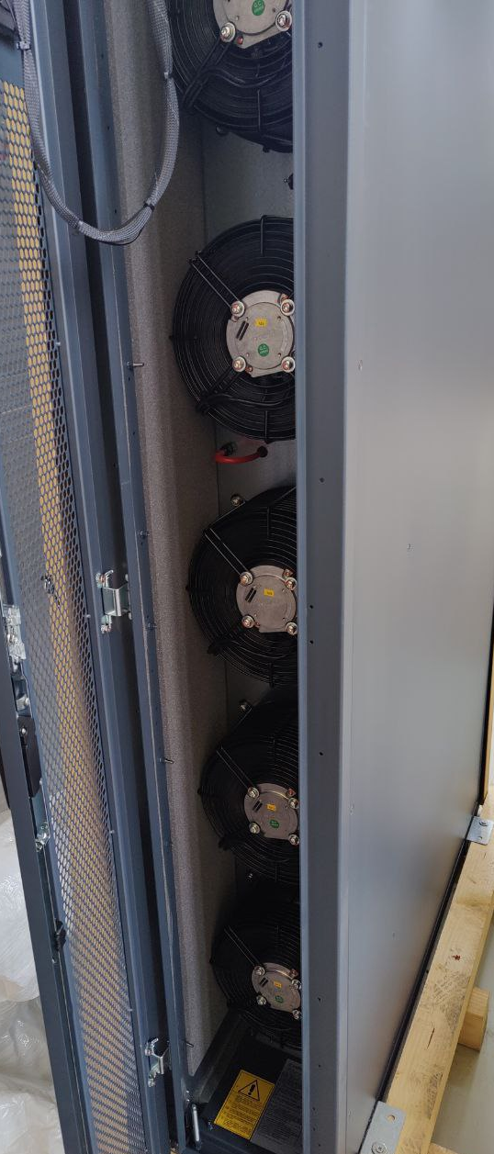
IT RACKS on the NMP
On the second, third and fourth floors there are 8 equipment racks and 4 fan coil units.
XII MPD Collaboration meeting

Slide 8
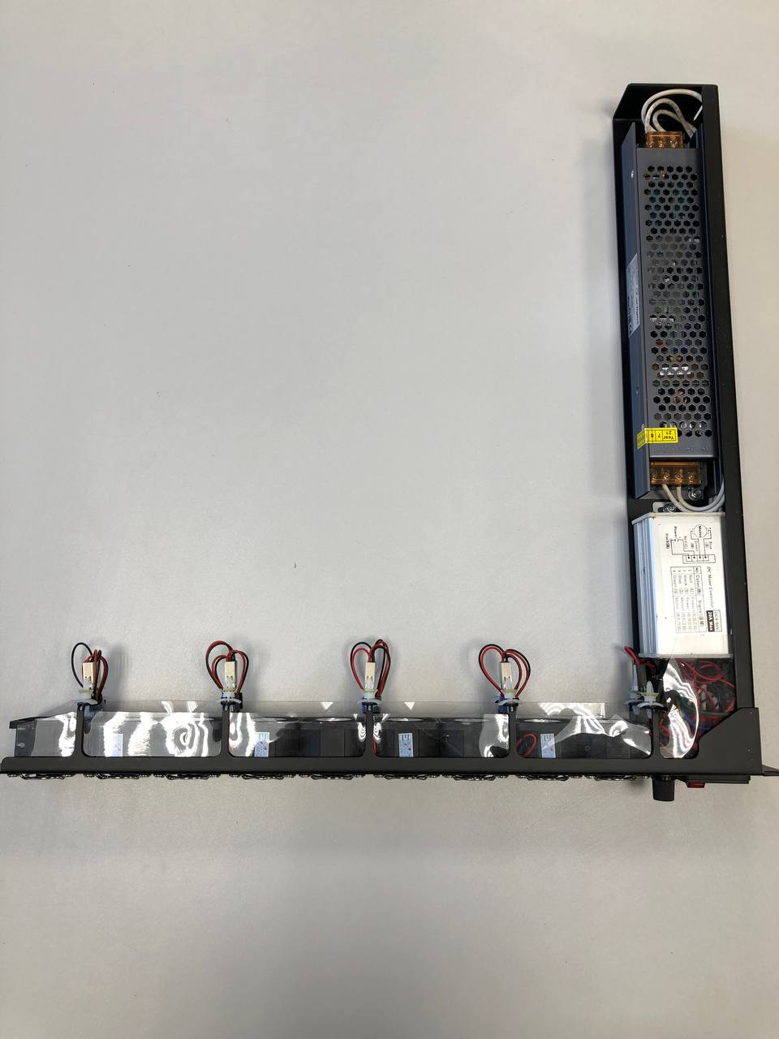
IT RACKS on the NMP
MPD equipment racks
Each Rack C3 ECO 48U 600*1200, black, perforated door has
PDU controlled C3, 3 phases, 32A, C13-24, C19-12.
GreenMDC ventilation panel, active, 1U
XII MPD Collaboration meeting

Slide 9
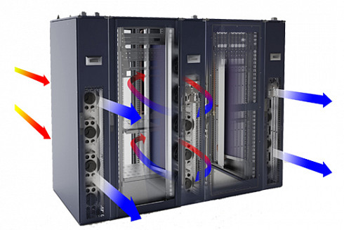
COOLING SYSTEM
The NMP cooling system is an integral part.
It is designed for:
Cooling equipment from overheating
Maintenance and regulation of the set air temperature
Ensuring round-the-clock and year-round temperature conditions.
XII MPD Collaboration meeting

Slide 10
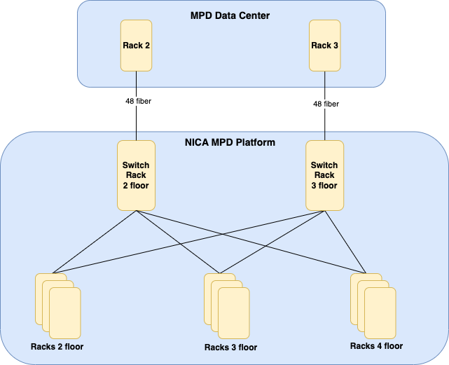
Cable system NMP (fiber optic)
XII MPD Collaboration meeting

Slide 11
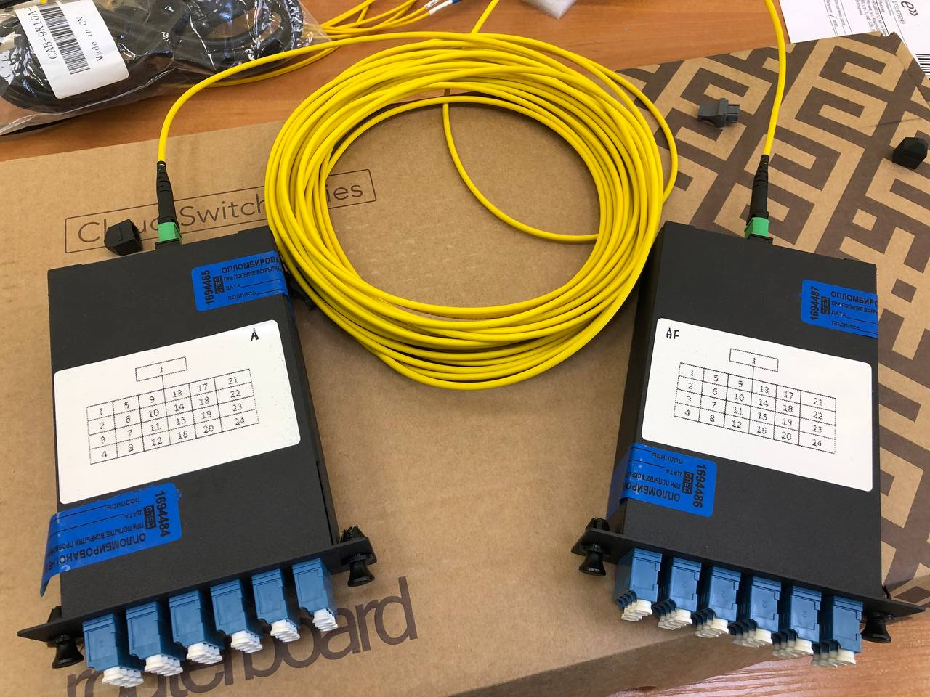
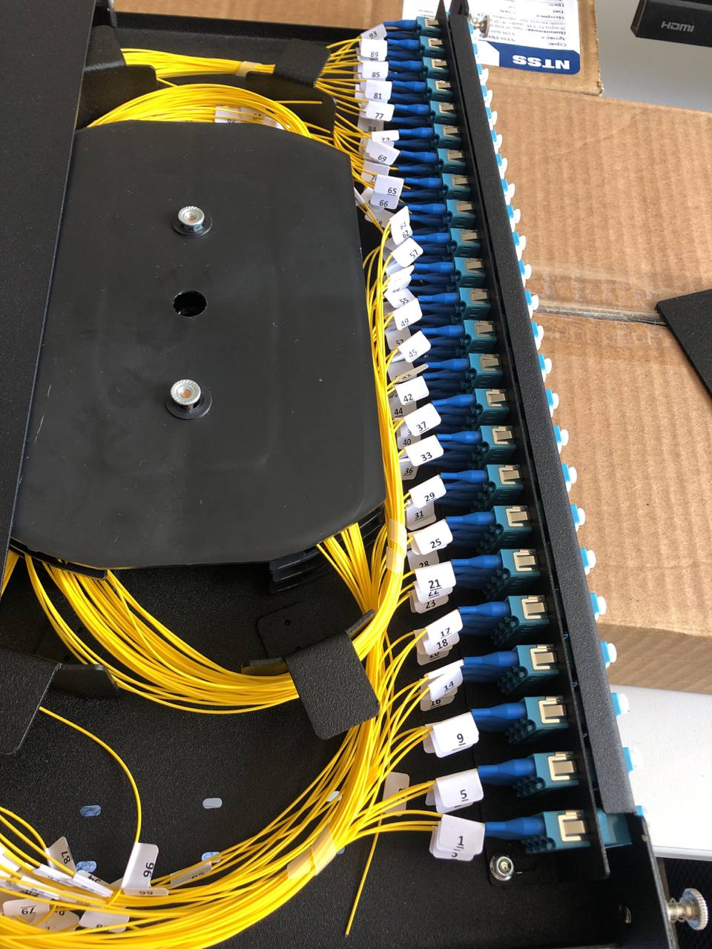
Mechanical Transfer Push-On(MTP) 24 fiber optic line.

Slide 12
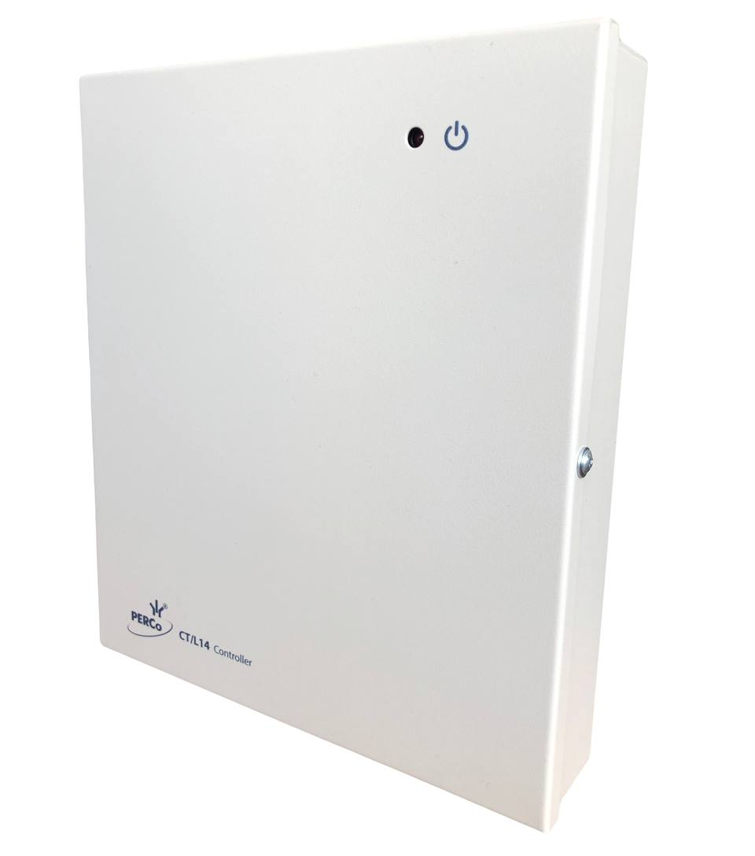
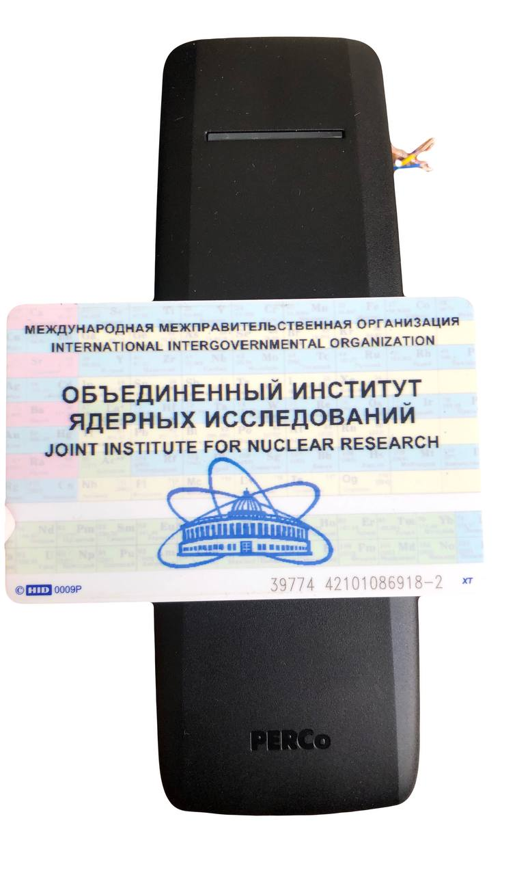
Access control and management system
Lock controller CL211.3
Universal controller CT/L14.1
JINR employees will be able to use their badge for access to all rooms.
XII MPD Collaboration meeting

Slide 13
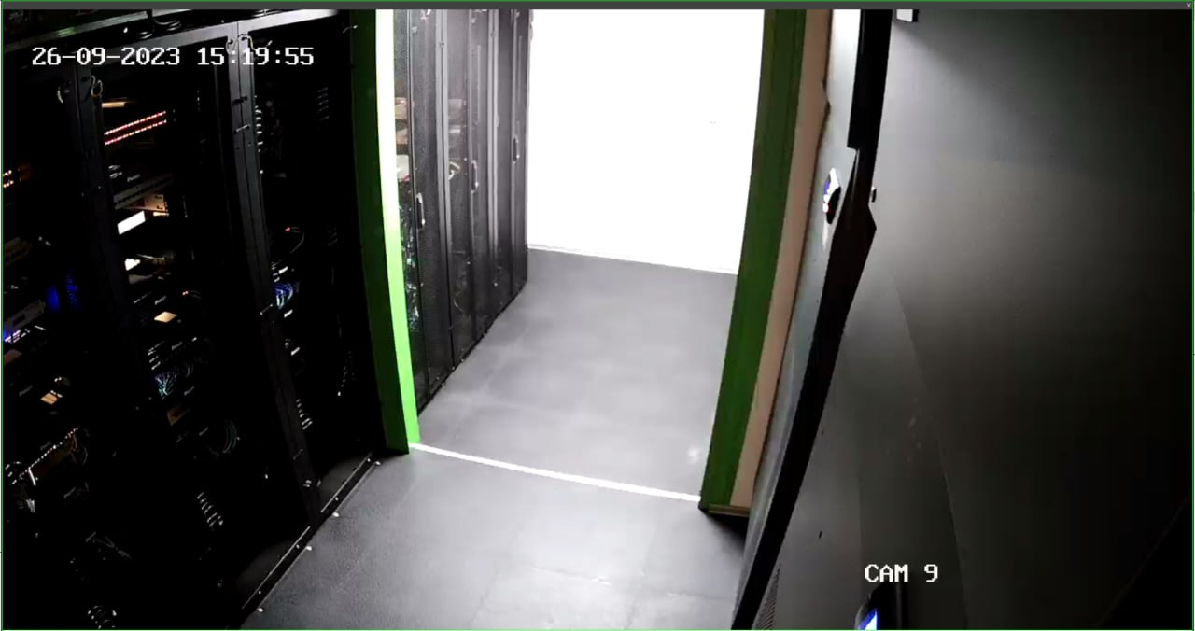
CCTV video surveillance system
Video control will be carried out in the same way as in MPD Data Center. There will be 3 video cameras installed on each floor.
These cameras archive videos and save them for at least 30 days in motion-based recording mode and the ability to remotely connect to the Video Control system through any browser on any OS, and to a mobile application.

Slide 14
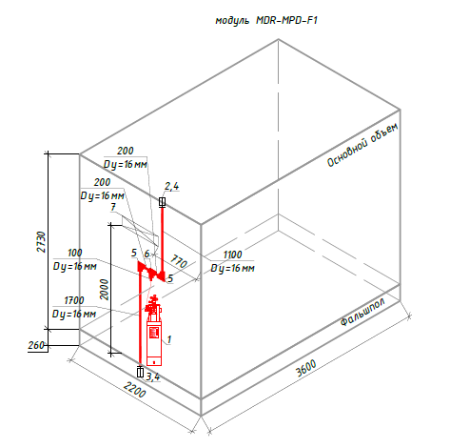
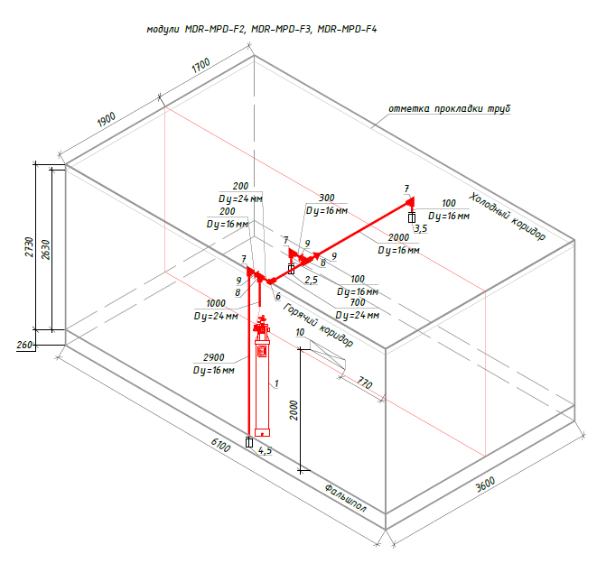
Аutonomous fire extinguishing system
Chladon 125 is used
XII MPD Collaboration meeting

Slide 15
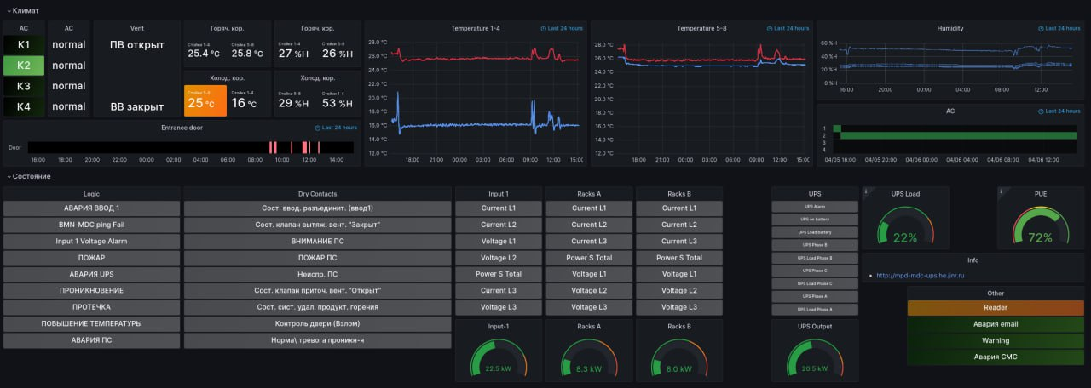
Monitoring system
The system shows:
• Temperature and humidity. There are 4 sensors, which installed on each floor.
• fire alarm signals on each floor.
• power monitoring by floors and in each rack.
• ventilation system signal.
• signals from access control and management system.
All critical signals: fire, power overload, power supply outage, cooling system leakage will be duplicated by SMS to responsible employees.
XII MPD Collaboration meeting

Slide 16
Stages of work
 |  | April 2023 |  |  |  |  |  |  |  |  |  |  |  | May | June-September | September | October
 |  | 19 | 20 | 21 | 22 | 23 | 24 | 25 | 26 | 27 | 28 | 29 | 30 | 1-30 |  | 1-30 | 1-31
№ | Stage
1 | Delivery of all engineering systems to JINR
2 | Installation of metal structures
3 | Installation of structures
4 | Installation of raised floor and engineering networks
5 | Connecting the NMP water cooling system
6 | The closure of Building 17. Work is stopped
7 | Installation of the structure of the 4th floor and engineering systems
8 | Testing of all NMP systems
XII MPD Collaboration meeting

Slide 17
Results
№ | PARTS of NMP | WORK DONE (%)
1 | IT RACKS on the NMP
2 | Cooling System
3 | Main electrical distribution board
4 | Structed Cabling(fiber optic)
5 | Access control and management system
6 | CCTV video surveillance system
7 | Аutonomous fire extinguishing system
8 | Monitoring system
9 | Testing of all NMP systems
100 %
100 %
100 %
100 %
100 %
100 %
100 %
80 %
100 %
0 %
XII MPD Collaboration meeting
XII MPD Collaboration meeting

Slide 18
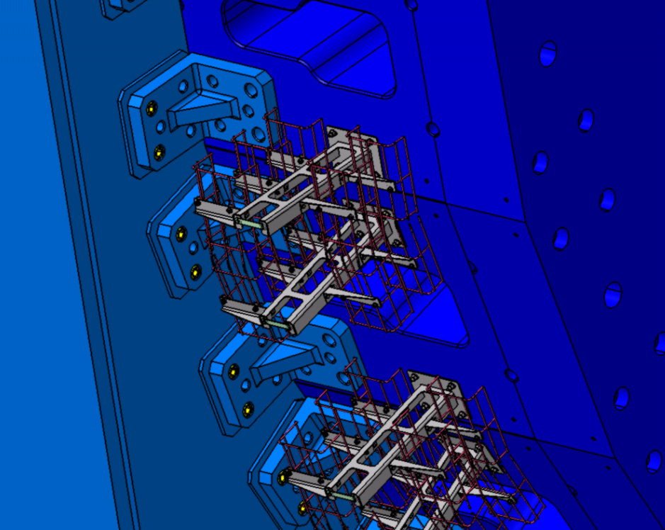
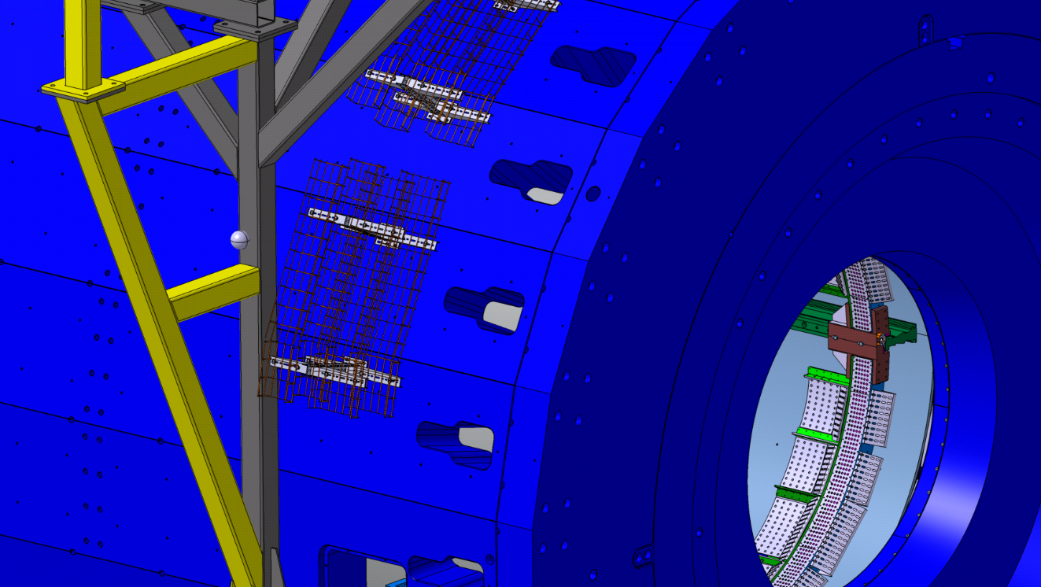
List of cables and pipes
 |  |  | 14 | 12 | 10 | 8 | 6 | 4 | 2 | 1 | 3 | 5 | 7 | 9 | 11 | 13
 | Purpose | Diameter, mm | Qty | Qty | Qty | Qty | Qty | Qty | Qty | Qty | Qty | Qty | Qty | Qty | Qty | Qty
EDTC | Data cable | 3 | 0 | 6 | 12 | 18 | 24 | 30 | 36 | 42 | 48 | 54 | 60 | 66 | 72 | 78
ESNC | Sense cable | 9,4 | 0 | 3 | 6 | 9 | 12 | 15 | 18 | 21 | 24 | 27 | 30 | 33 | 36 | 39
EPWC | Power cable | 14,7 | 0 | 3 | 6 | 9 | 12 | 15 | 18 | 21 | 24 | 27 | 30 | 33 | 36 | 39
ESRL | Service cable(1) | 1х13 | 0 | 3 | 6 | 9 | 12 | 15 | 18 | 21 | 24 | 27 | 30 | 33 | 36 | 39
EWCT | Wotercooling tubes | ~20 | 0 | 2 | 4 | 6 | 8 | 10 | 12 | 14 | 16 | 18 | 20 | 22 | 24 | 26
EACT | Air cooling tubes for FE and BOX | ~20 | 0 | 2 | 4 | 6 | 8 | 10 | 12 | 14 | 16 | 18 | 20 | 22 | 24 | 26
TSGC | Signal | 13 | 10 | 20 | 30 | 40 | 50 | 60 | 70 | 80 | 90 | 100 | 110 | 120 | 130 | 150
THVC | HV | 8,5 | 0 | 4 | 4 | 8 | 8 | 12 | 12 | 16 | 16 | 20 | 20 | 24 | 24 | 28
TLVC | LV Cable | 13 | 1 | 1 | 2 | 2 | 3 | 3 | 4 | 4 | 5 | 5 | 6 | 6 | 7 | 8
TUTC | UTP | 6 | 1 | 1 | 2 | 2 | 3 | 3 | 4 | 4 | 5 | 5 | 6 | 6 | 7 | 8
TTRL | Trigger (OR) | 10 | 2 | 2 | 4 | 4 | 6 | 6 | 8 | 8 | 10 | 10 | 12 | 12 | 14 | 16
TGST | Gas Pipes | 12 | 2 | 2 | 4 | 4 | 6 | 6 | 8 | 8 | 10 | 10 | 12 | 12 | 14 | 16
 | TPC gas system
TGTT | Purge TPC (in/out) | 40 | 0 | 0 | 0 | 0 | 0 | 0 | 0 | 1 | 1 | 1 | 1 | 1 | 1 | 1
 | LV
TLPC | LVDB: low-voltage cable supply | 12 | 0 | 8 | 8 | 16 | 16 | 24 | 32 | 32 | 32 | 32 | 40 | 40 | 48 | 48
TLSC | LVDB: sense wire | 2,5 | 0 | 4 | 4 | 8 | 8 | 12 | 16 | 16 | 16 | 16 | 20 | 20 | 24 | 24
TCPC | Controller: low-voltage cable supply | 12 | 0 | 2 | 2 | 4 | 4 | 6 | 8 | 8 | 8 | 8 | 10 | 10 | 12 | 12
TCSC | Controller: sense wire | 2,5 | 0 | 1 | 1 | 2 | 2 | 3 | 4 | 4 | 4 | 4 | 5 | 5 | 6 | 6
TLCC | LVDB: slow control cable | 9 | 0 | 2 | 2 | 4 | 4 | 6 | 8 | 8 | 8 | 8 | 10 | 10 | 12 | 12
 | DAQ
TDCC | Controller: slow control | 7 | 0 | 2 | 2 | 4 | 4 | 6 | 8 | 8 | 8 | 8 | 10 | 10 | 12 | 12
TDDO | Controller: DATA QSFP | opt. 3.3 | 0 | 1 | 1 | 2 | 2 | 3 | 4 | 4 | 4 | 4 | 5 | 5 | 6 | 6
TDTO | Controller: data and trigger/ sync SFP+ | opt. 3,9x1,8 | 0 | 1 | 1 | 2 | 2 | 3 | 4 | 4 | 4 | 4 | 5 | 5 | 6 | 6
TDTC | Controller: trigger | 6 | 0 | 1 | 1 | 2 | 2 | 3 | 4 | 4 | 4 | 4 | 5 | 5 | 6 | 6
TDRC | Controller: Reset | 6 | 0 | 1 | 1 | 2 | 2 | 3 | 4 | 4 | 4 | 4 | 5 | 5 | 6 | 6
TDSC | Controller: Sync | 6 | 0 | 1 | 1 | 2 | 2 | 3 | 4 | 4 | 4 | 4 | 5 | 5 | 6 | 6
TDQO | Reserve cables QSFP | opt. 3.3 | 0 | 1 | 1 | 1 | 1 | 1 | 2 | 2 | 2 | 2 | 2 | 2 | 2 | 2
TDSO | Reserve cables SFP+ | opt. 3,9x1,8 | 0 | 1 | 1 | 1 | 1 | 1 | 2 | 2 | 2 | 2 | 2 | 2 | 2 | 2
 | ROC chamber
TRAC | for ROC: HV power supply for anode sections | 4,1 | 0 | 0 | 4 | 4 | 8 | 8 | 8 | 8 | 12 | 16 | 16 | 20 | 20 | 24
TREC | for ROC: HV electrode adjusting supply | 4,1 | 0 | 0 | 1 | 1 | 2 | 2 | 2 | 2 | 3 | 4 | 4 | 5 | 5 | 6
TRNC | for ROC: HV locking grid | 4,1 | 0 | 0 | 2 | 2 | 4 | 4 | 4 | 4 | 6 | 8 | 8 | 10 | 10 | 12
TRCC | for ROC: cameras electrode (cathode), test signal | 4,1 | 0 | 0 | 1 | 1 | 2 | 2 | 2 | 2 | 3 | 4 | 4 | 5 | 5 | 6
TRSC | from ROC: signal cable (anode) | 4,1 | 0 | 0 | 4 | 4 | 8 | 8 | 8 | 8 | 12 | 16 | 16 | 20 | 20 | 24
 | Sensors
TSSC | Temperature sensor cable Pt100 | 8 | 0 | 0 | 3 | 3 | 6 | 6 | 6 | 6 | 9 | 12 | 12 | 15 | 15 | 18
TSPC | Cables from pressure sensers on pipes cooling + stabilization | 7,8 | 0 | 0 | 4 | 4 | 8 | 8 | 8 | 8 | 12 | 16 | 16 | 20 | 20 | 24
TSTC | Cables from temperature sensers on pipes cooling + stabilization | 7,8 | 0 | 0 | 4 | 4 | 8 | 8 | 8 | 8 | 12 | 16 | 16 | 20 | 20 | 24
 | HV TPC central membrane
THEC | Central HV electrode TPC | 8 | 0 | 0 | 0 | 0 | 0 | 0 | 0 | 0 | 1 | 1 | 1 | 1 | 1 | 1
THRC | low-voltage cable input for resistors (centr). HV electrode | 10 | 0 | 0 | 0 | 0 | 0 | 0 | 0 | 0 | 1 | 1 | 1 | 1 | 1 | 1
 | Thermostabilization
TTOT | external thermal screen stabilization pipes | 32 | 0 | 0 | 2 | 2 | 2 | 4 | 4 | 6 | 6 | 7 | 8 | 8 | 10 | 10
TTTT | end Thermal Shield Stabilization Pipes | 32 | 0 | 0 | 0 | 0 | 1 | 2 | 2 | 2 | 2 | 2 | 2 | 3 | 4 | 4
TTIT | inner thermal shield stabilization pipes | 32 | 0 | 0 | 2 | 2 | 2 | 2 | 2 | 2 | 2 | 2 | 2 | 2 | 2 | 2
TTRT | Pipes stabilisation ROC chambers housings | 32 | 0 | 0 | 0 | 0 | 0 | 0 | 0 | 0 | 0 | 2 | 2 | 2 | 2 | 2
TTFT | TPC flange stabilisation pipes with spokes | 32 | 0 | 0 | 0 | 0 | 0 | 0 | 1 | 3 | 4 | 4 | 4 | 4 | 4 | 4
TTST | Stabilization pipes FE SAMPA | 32 | 0 | 4 | 4 | 6 | 8 | 9 | 12 | 12 | 15 | 16 | 17 | 20 | 20 | 24
 | Cooling (12 loops)
TCLT | Cooling pipes LVDB, controllers & FE FPGA | 32 | 0 | 0 | 0 | 1 | 2 | 2 | 2 | 2 | 2 | 2 | 3 | 3 | 4 | 4
 | TPC laser system
TLWC | Cable for WEB camera control system floor laser beam | 7 | 0 | 0 | 1 | 1 | 1 | 1 | 1 | 1 | 1 | 2 | 2 | 2 | 2 | 2
 | TPC gas system
TGST | Purge of C1C2 and C3C4 (input/output) | 12 | 0 | 0 | 0 | 0 | 0 | 0 | 0 | 0 | 0 | 0 | 1 | 1 | 1 | 1
 | Hydraulic actuators
TSGC | Position centers hydraulic cylinder | 6 | 0 | 4 | 4 | 4 | 4 | 4 | 4 | 4 | 4 | 4 | 4 | 4 | 4 | 8
XII MPD Collaboration meeting

Slide 19
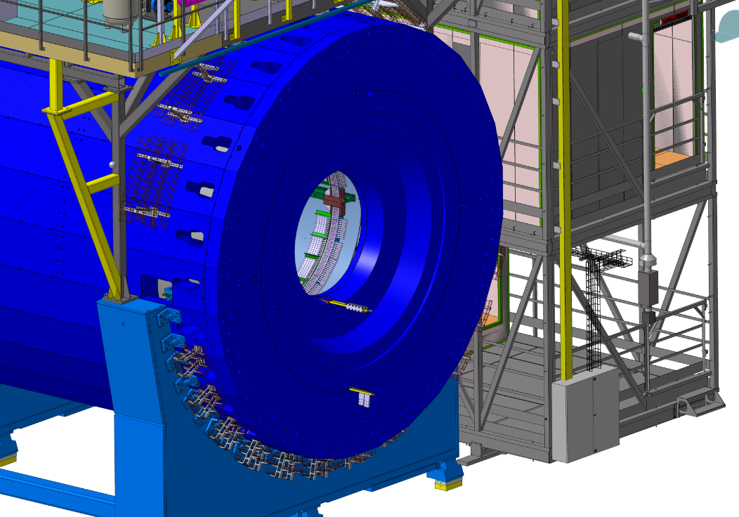
Cable routing
XII MPD Collaboration meeting

Slide 20
Results
№ |  | WORK DONE (%) | Completion of work
1 | Data collection |  | -
2 | Grouping cables into trays |  | -
3 | Design |  | 01.11.2023
4 | Purchase of equipment |  | 29.12.2023
5 | Installation |  | 01.03.2024
6 | Cabling |  | -
100 %
100 %
80 %
100 %
0 %
100 %
0 %
100 %
0 %
100 %
XII MPD Collaboration meeting

Slide 21
Thank you for Attention
Author: Alexander Fedunin
Email: fediunin@lhep.ru
XII MPD Collaboration meeting

