Slide 1
Detector for beams collision monitoring and luminosity measurements in the interaction point
A.Litvinenko ,JINR
(alitvin@jinr.ru)
on behalf of the working group

Slide 2
working group
JINR (Dubna)
S.G.Buzin, M.G.Buryakov, V. M.Golovatyuk, Z.A.Igamkulov, E.I.Litvinenko
JINR (Dubna) + Dubna State University
S.P.Avdeyev, A.I.Malakhov, G.D.Milnov,
A.G. Litvinenko
INR RAS (Moscow)
A.B.Kurepin,
Institute of Physics and Technology, MAS, Ulaanbaatar, 13330 Mongolia
M.Sovd, B.Otgongerel
Anyone wellcome

Slide 3
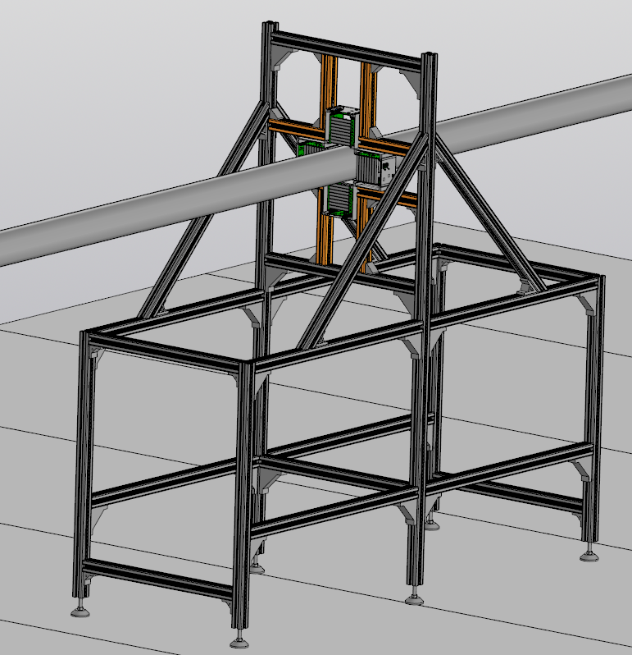
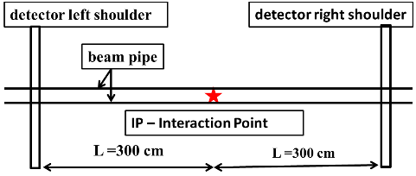
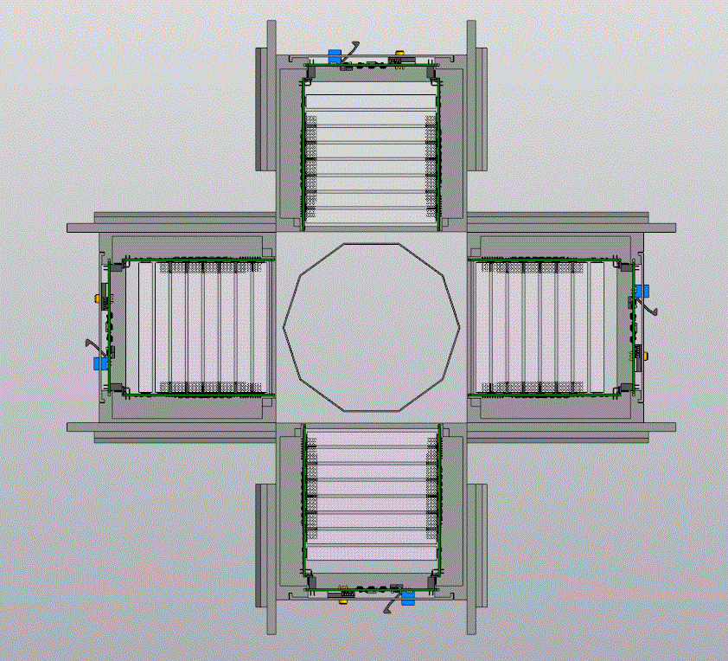
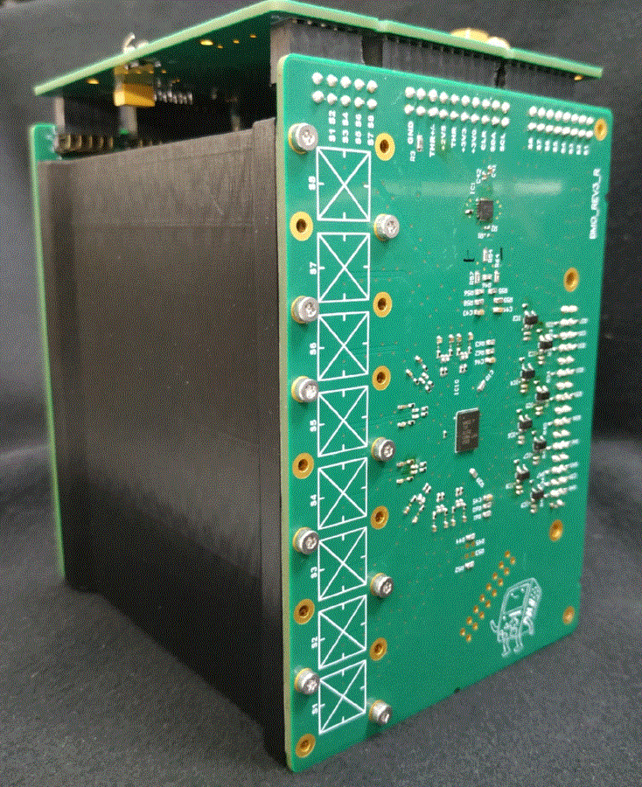
Subject of the report
Setting up the intersection of beams
in the interaction point at MPD/NICA
Luminosity measurements in the interaction point at MPD/NICA
Luminosity detector

Slide 4
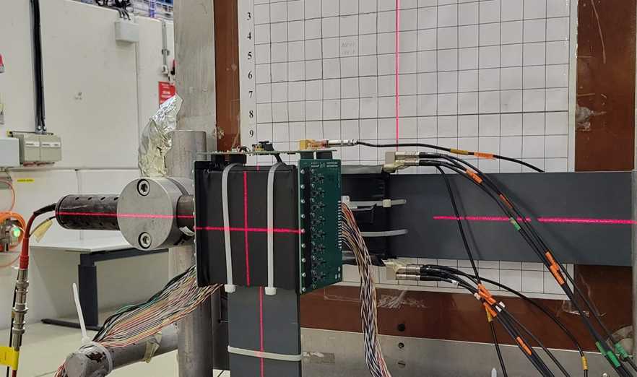
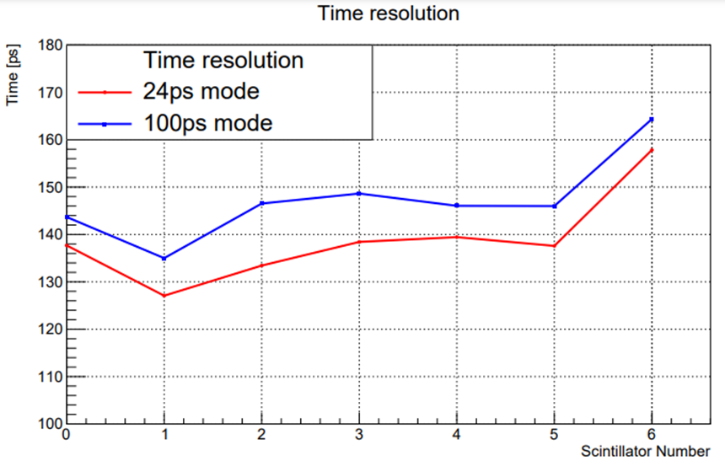
Module of the detector (Beam test)

Slide 5
Vertex position
L
L
RS
LS
z
$$L−z$$
$$L+z$$
$T_{L}=\frac{L−z}{cβ}$ ; $T_{R}=\frac{L+z}{cβ}; τ=T_{R}−T_{L}=\frac{2z}{cβ}$
$$c=3∙{10}^{8}; β=p/{E; \sqrt{S_{NN}}=11→β=0.985≈1}$$
z$=\frac{1}{2}c∙τ→z\left(cm\right)=15∙τ(ns)$
$σ_{τ}=(300 ÷400) ps ; →σ_{z,τ}≈(4.5÷$ 6) cm
$$∆z^{max}\left(cm\right)=\frac{{\tilde{σ}}_{z}}{\sqrt{N_{tr}}}=\frac{\sqrt{σ_{z,V}^{2}+{\left(15∙σ_{τ}\left(ns\right)\right)}^{2}}}{\sqrt{εN_{tot}}}$$

Slide 6
Luminosity
number of events
per second
$$R={N_{tr}}/{T_{run}}=𝓛∙σ$$
cross section
$$\left[𝓛\right]={cm}^{−2}s^{−1}$$
one of the key parameters of the collider

Slide 7
Relative Luminosity ($𝓛_{r}$)
Counting rate for reaction with unknown cross section
or/and unknown detector efficiency
R$=ε_{D }∙\tilde{σ}∙𝓛=σ_{c}𝓛_{r};$
$$𝓛_{r}=k∙𝓛;k={\left(ε_{D }\tilde{σ}\right)}/{σ_{c}}$$
Knowledge of relative luminosity is often enough to calculate physical quantities from measured experimental data. For example, when measuring polarization observables, for a given reaction, it is sufficient to know the relative luminosity.
BUT … SEE NEXT SLIDE
1

Slide 8
Knowledge of absolute luminosity is necessary for the following tasks:
When planning the measurements - to calculate the counting rate.
When planning the experiment - to calculate the overlay of signals from different events (pile-up events).
To calculate the absolute value of cross section from experimental data.
To make differential measurements.
…………

Slide 9
Luminosity for some colliders
Collider | Particles | Luminosity
(LEP) | $$\left(e^{−}e^{+}\right)$$ | $$𝓛={10}^{32}{см}^{−2}с^{−1}$$
SuperKEKB | $$\left(e^{−}e^{+}\right)$$ | $$𝓛={8∙10}^{35}{см}^{−2}с^{−1}$$
RHIC (BNL) | $$\left(pp\right)$$ | $$𝓛={1.6∙10}^{32}{см}^{−2}с^{−1}$$
RHIC (BNL) | $$\left(AuAu\right)$$ | $$𝓛={8.7∙10}^{27}{см}^{−2}с^{−1}$$
RHIC (BNL) | $$\left(CuCu\right)$$ | $$𝓛={6∙10}^{28}{см}^{−2}с^{−1}$$
LHC (CERN) | $$\left(pp\right)$$ | $$𝓛={2∙10}^{34}{см}^{−2}с^{−1}$$
LHC (CERN) | $$\left(PbPb\right)$$ | $$𝓛={3.6∙10}^{27}{см}^{−2}с^{−1}$$

Slide 10
Luminosity for hadron colliders
Luminosity for hadron colliders
Hadron colliders have the highest luminosity for (pp) collisions and several (4-6) orders of magnitude lower luminosity for heavy ion collisions. ‘The large cross section for collisions of heavy ions, compared to proton-proton collisions, does not compensate for the drop in luminosity for ion collisions. So for the interaction cross sections and counting rates on NICA we have:
$$\begin{matrix}σ_{pp}≅45 мб; 𝓛={10}^{32}{см}^{−2}с^{−1};R=4.5∙{10}^{6}1/с \\ σ_{dd}≅70 мб; 𝓛={10}^{31}{см}^{−2}с^{−1};R=7∙{10}^{5}1/с \\ σ_{AuAu}≅6.2 б; 𝓛={10}^{27}{см}^{−2}с^{−1};R=6.2∙{10}^{3}1/с\end{matrix}$$
Hadron colliders have the highest luminosity for (pp) collisions and several (4-6) orders of magnitude lower luminosity for heavy ion collisions. The large cross section for collisions of heavy ions, compared to proton-proton collisions, does not compensate for the drop in luminosity for ion collisions. So for the interaction cross sections and counting rates on NICA we have:
$$\begin{matrix}σ_{pp}≅45 мб; 𝓛={10}^{32}{см}^{−2}с^{−1};R=4.5∙{10}^{6}1/с \\ σ_{dd}≅70 мб; 𝓛={10}^{31}{см}^{−2}с^{−1};R=7∙{10}^{5}1/с \\ σ_{AuAu}≅6.2 б; 𝓛={10}^{27}{см}^{−2}с^{−1};R=6.2∙{10}^{3}1/с\end{matrix}$$

Slide 11
Approaches to luminosity determination
From the experimental data for the counting rate of some reaction
$$N_{tr}=\left(𝓛εσ\right)T_{run}$$
$$𝓛= \frac{N_{tr}}{T_{run}\left(ε∙σ\right)}$$
$$δ𝓛=\frac{∆𝓛}{𝓛} =\sqrt{{{\left(\frac{∆σ}{σ}\right)}^{2}+\left(\frac{∆ε}{ε}\right)}^{2}+\frac{1}{N_{tr}}}$$
This method is widely used to determine the luminosity of electron-electron and electron-positron colliders

Slide 12
absolute luminosity
S. van der Meer, CERN-ISR-PO-68-31, 1968
van der Meer scan
at RHIC and LHC the van der Meer scan is commonly accepted procedure for calibration

Slide 13
Luminosity structure.
$ℒ= \sum_{b=1}^{N_{b}}{f_{r}}\frac{I_{b,L}I_{b,R}}{S_{⊥,b}}$
$ℒ_{b}=f_{r}\frac{I_{b,L}I_{b,R}}{S_{⊥,b}}$
Luminosity is determined by the following three factors:
1. Accelerator constants:
‘’revolution frequency $f_{r}$’’ and ‘’number of bunches $N_{b}$”;
2. Intensity (numbers of particles in banch $I_{b,L/R}$);
3. Parameters of colliding bunches, such as the distribution of particles inside the bunch and focusing conditions.

Slide 14
The distribution of particles inside the bunch
For clarity, it is assumed that the distributions of particles in all bunches are identical and are described by a normal law for all coordinates:
$p_{(L,R)}\left(x,y,z;z_{V}\right)=p_{x,L/R}(x ;z_{V})∙ p_{y,L/R}(y;z_{V})∙p_{z,L/R}(z)$
$$\left\{\begin{aligned}p_{x,L/R}\left(x;z_{V}\right)=\left(1/{(\sqrt{2π}σ_{x}\left(z_{V}\right))}\right)exp⁡(−{x^{2}}/{\left(2σ_{x}^{2}\left(z_{V}\right)\right)}) \\ p_{y,L/R}\left(y;z_{V}\right)=\left(1/{(\sqrt{2π}σ_{y}\left(z_{V}\right))}\right)exp⁡(−{y^{2}}/{(2σ_{y}^{2}\left(z_{V}\right)))} \\ p_{z,L/R}\left(z\right)=\left(1/{(\sqrt{2π}σ_{z})}\right)exp⁡(−{z^{2}}/{\left(2σ_{z}^{2}\right)}) \end{aligned}\right.$$

Slide 15
Effective area $S_{⊥,b}\left(δX,δY\right)$ of beam intersection
$$𝓛_{b}\left(δX,δY\right)=f_{r}\frac{I_{b,L}I_{b,R}}{S_{⊥,b}\left(δX,δY\right)}$$
$$\begin{matrix}\frac{1}{S_{⊥,b}\left(δX,δY\right)}= \\ =2\iint{\iint{dz_{V}dξ dxdy\left(p_{⊥,L}\left(x+{δX}/2,x→y;z_{V}\right)p_{⊥,R}\left(x−{δX}/2,;x→y{;z}_{V}\right)\right)}} \\ \left(p_{z,L}\left(z_{V}−ξ\right){∙p}_{z,R}\left(z_{V}+ξ\right)\right)\end{matrix}$$
key property of $S_{⊥,b}\left(δX,δY\right)$
$$\iint{d\left(δX\right)d\left(δY\right)\left(\frac{1}{S_{⊥,b}\left(δX,δY\right)}\right)}=1$$

Slide 16
vdM scan
Step I
$$\left\{N_{tr}\left({δX}_{i},{δY}_{j}\right),T_{run}\left({δX}_{i},{δY}_{j}\right)\right\}→R\left({δX}_{i},{δY}_{j}\right)={N_{tr}\left({δX}_{i},{δY}_{j}\right)}/{T_{run}\left({δX}_{i},{δY}_{j}\right)}$$
Step II
r$\left({δX}_{i},{δY}_{j}\right)=\frac{R\left({δX}_{i},{δY}_{j}\right)}{\left(f_{r}I_{i,j;L}I_{i,j;R}\right)}=\left(εσ\right)\frac{1}{S_{⊥}\left({δX}_{i},{δY}_{j}\right)}$
reminder
$$𝓛=f_{r}\frac{I_{b,L}I_{b,R}}{S_{⊥,b}};\text{R}=\left(εσ\right)𝓛$$
Step III
approximation
r$\left({δX}_{i},{δY}_{j}\right)=\left(εσ\right)\frac{1}{S_{⊥}\left({δX}_{i},{δY}_{j}\right)}$
r$\left(δX,δY\right)$

Slide 17
vdM scan
Step IV
$$K=\iint{d\left(δX\right)d\left(δY\right)r\left(δX,δY\right)=}\left(εσ\right)\iint{d\left(δX\right)d\left(δY\right)}\frac{1}{S_{⊥,b}\left(δX,δY\right)}=\left(εσ\right)$$
Luminosity from the experimental data: (any run )
$$𝓛= \frac{N_{tr}}{T_{run}\left(ε∙σ\right)}=\frac{N_{tr}}{T_{run}K}$$

Slide 18
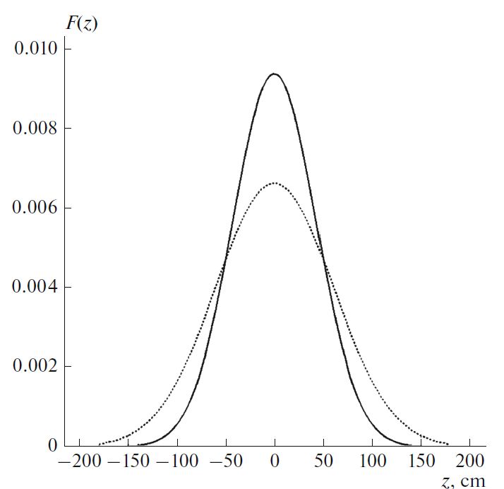
examples with normal distribution
without focusing
$\frac{1}{S_{⊥,b}\left(δX,δY\right)}=\frac{1}{4πσ_{x}σ_{y}}exp⁡(−\frac{{\left(δX\right)}^{2}}{4σ_{x}^{2}})∙exp⁡\left(−\frac{{\left(δY\right)}^{2}}{4σ_{y}^{2}}\right)$
Vertexes
$σ_{z,V}={σ_{z,p}}/{\sqrt{2}}$=$42.3 cm$
particles in bunches
$σ_{z.p}=60 cm$

Slide 19
examples with normal distribution
with focusing
$$\begin{matrix}\frac{1}{S_{⊥,b}}\left(δX,δY\right)=\frac{1}{4πσ_{x}\left(0\right)σ_{y}\left(0\right)} \frac{1}{\sqrt{π}σ_{z}}\int_{−∞}^{∞}{dz_{V}} exp⁡(−\frac{z_{V}^{2}}{σ_{z}^{2}})∙ \\ ∙\left[exp⁡(−\frac{{\left(δX\right)}^{2}}{4σ_{x}^{2}\left(0\right)\left(1+{\left(\frac{z_{V}}{β_{IP}}\right)}^{2}\right)})∙exp⁡(−\frac{{\left(δY\right)}^{2}}{4σ_{y}^{2}\left(0\right)\left(1+{\left(\frac{z_{V}}{β_{IP}}\right)}^{2}\right)})∙\frac{1}{\left(1+{\left(\frac{z_{V}}{β_{IP}}\right)}^{2}\right)}\right]\end{matrix}$$
$β_{IP}=60 cm$ - beta function at the Interaction Point

Slide 20
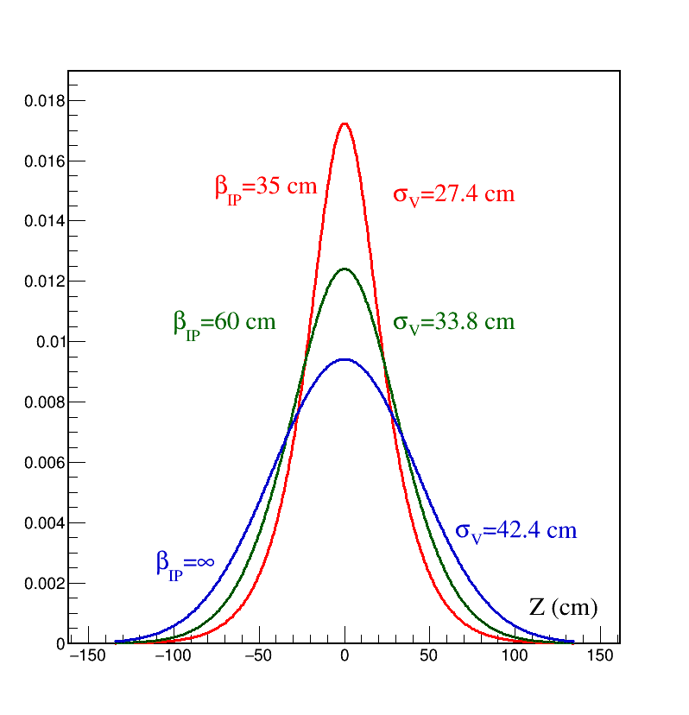
examples with normal distribution
with focusing
Distribution of interaction vertices
$$\left\{\begin{aligned}&P\left(Z_{V}\right)=N\frac{ exp\left(−{Z_{V}^{2}}/{σ_{Z}^{2}}\right)}{\left(1+{\left({Z_{V}}/{β_{IP}}\right)}^{2}\right)} \\ &N=\frac{1}{\int_{−∞}^{∞}{\frac{exp\left(−{Z_{V}^{2}}/{σ_{Z}^{2}}\right)}{\left(1+{\left({Z_{V}}/{β_{IP}}\right)}^{2}\right)} dZ_{V}}}\end{aligned}\right.$$

Slide 21
Сonclusion
The algorithm for obtaining absolute luminosity with “luminosity detector” at MPD/NICA has been presented

Slide 22
FUNDING
The work is partially supported by the Russian Science Foundation, project nos. 23-22-00077 and 23-22-00160.

Slide 23
Backup slides

Slide 24
stage 0
IN THE BEGINNING
$$B\sim N_{b}$$
$$S\sim {\left(N_{b}\right)}^{2}$$
$N_{b}(1/{bunch}$) | $$𝓛 ({cm}^{−2}s^{−1})$$ | $$N_{AuAu}\left(1/s\right)$$ | $$N_{𝓛D }\left(1/s\right)$$ | $$N_{AuAu}\left(1/m\right)$$ | $$N_{𝓛D }\left(1/m\right)$$ | $$B/S$$
$$2∙{10}^{9}$$ | $${10}^{27}$$ | $$6000$$ | $$4900$$ | $$360000$$ | $$294000$$ | $$<{10}^{−5}$$
$$2∙{10}^{8}$$ | $${10}^{25}$$ | $$60$$ | $$49$$ | $$3600$$ | $$2940$$ | $$<{10}^{−4}$$
$$2∙{10}^{7}$$ | $${10}^{23}$$ | $$0.6$$ | $$0.49$$ | $$36$$ | $$29.4$$ | $$<{10}^{−3}$$
$$2∙{10}^{6}$$ | $${10}^{21}$$ | $$0.006$$ | $$0.0049$$ | $$0.36$$ | $$0.29$$ | $$<{10}^{−2}$$

Slide 25
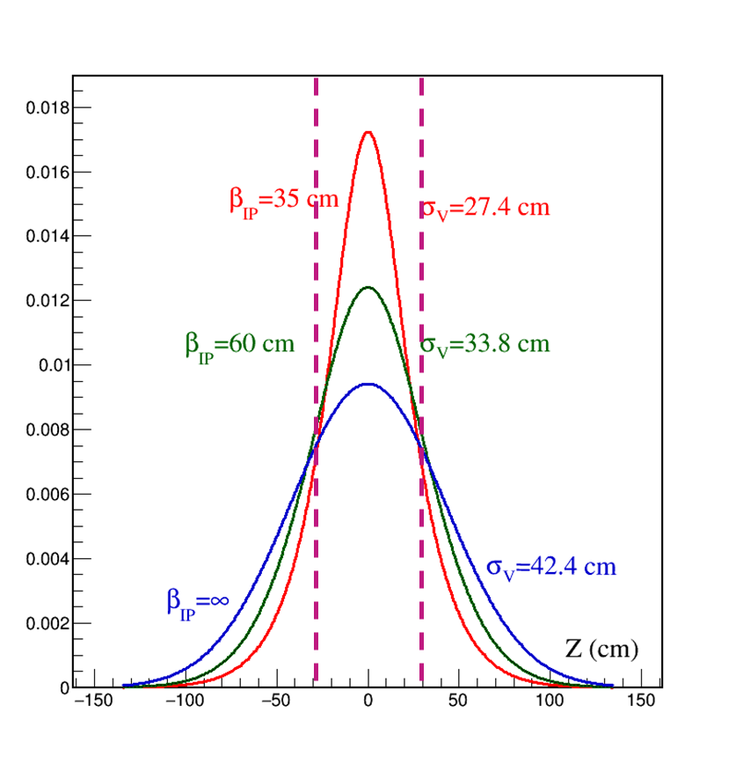
Efficiency, Luminosity and beta function
$$N_{L}=N_{R}=2.8∙{10}^{9}$$
$$σ_{x}=1.1 mm; σ_{y}=0.82 mm$$
$${−30 cm≤Z}_{V}≤30 cm$$
 | $$β_{IP}=35 cm$$ | $$β_{IP}=60 cm$$ | $$β_{IP}={10}^{4} cm$$
$$ℒ ({cm}^{−2}s^{−1})$$ | $$5∙{10}^{26}$$ | $$6.9∙{10}^{26}$$ | $$9.1∙{10}^{26}$$
Eff ($ε$) | 0.756 | 0.635 | 0.517
$$ℒ({cm}^{−2}s^{−1})ε$$ | $$3.8∙{10}^{26}$$ | $$4.4∙{10}^{26}$$ | $$4.7∙{10}^{26}$$

Slide 26
Tasks for the luminosity detector
finding the parameters of the collider, for the most efficient hit of bunches into each other;
finding the parameters of the collider that optimize the transverse profile of colliding beams;
selection of collider parameters that optimize the longitudinal position of the interaction vertex
two observables
the first one is the counting rate
the second one is the distribution of interaction vertices obtained from ToF

Slide 27
Ion guide on MPD
old
$$⊘$$
Ø 10 мм
new

Slide 28
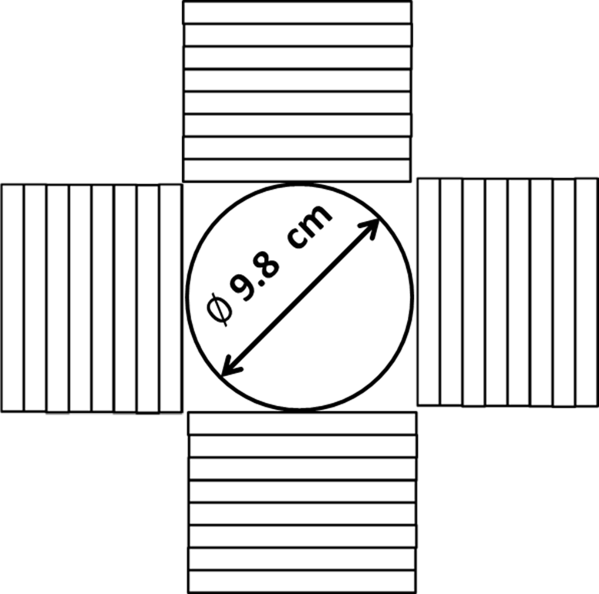
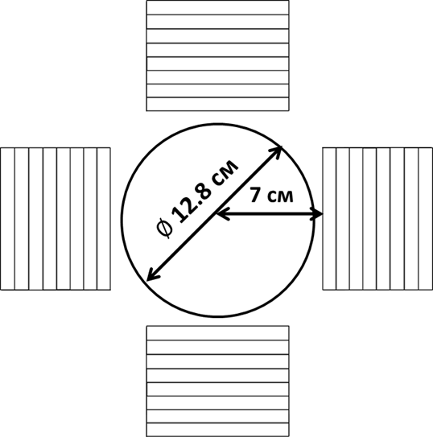
What has changed
since April this year
new

Slide 29
What has changed
since April this year
$$\sqrt{S_{NN}}=11 GeV$$
new
$$ε=82\%$$
$$ε=77\%$$
$$R≈4900 1/{s ;\left(≈1.4 \%\right)}$$
$$R≈4600 1/{s ;\left(≈1,5 \%\right)}$$
Efficiency = Detected/Produced
DCM-SMM (M. Baznat, A. Botvina, G. Musulmanbekov,
V. Toneev, V. Zhezher, //arXiv:1912.09277 [nucl-th], 2019)

Slide 30
Time of Flight for Left and Right Shoulders
$$T_{L/R}=min\left\{T_{L/R, i}\right\}$$
Trigger
$$\left|T_{L}−T_{R}\right|≤10 нс$$
Efficiency
$$ε=82\% →ε=77\%$$
Efficiency = Detected/Produced
DCM-SMM (M. Baznat, A. Botvina, G. Musulmanbekov,
V. Toneev, V. Zhezher, //arXiv:1912.09277 [nucl-th], 2019)

Slide 31
Transverse plane. Luminosity structure. Van der Meer scan.
$$𝓛\left(δX,δY\right)=f_{r}∙N_{b}∙\frac{N_{L}N_{R}}{S_{eff}\left(δX,δY\right)}$$
$N_{L}{, N}_{R}$-number of the beam ions in the left and right bunches
Van der Meer scan.
For normal distribution
$$𝓛\left(δX,δY\right)=f_{r}∙N_{b}∙\frac{N_{L}N_{R}}{4πσ_{x}σ_{y}}exp\left(−\frac{{δX}^{2}}{2σ_{x}^{2}}\right)∙exp\left(−\frac{{δY}^{2}}{2σ_{y}^{2}}\right)$$

Slide 32
Adjustment of beam convergence in the transverse plane
Conclusion I
estimated time to adjust the convergence of beams
in the transverse plane is about three hours
1.5 h – data taking;
1.5 h – setting collider modes;
$$𝓛={10}^{27} {cm}^{−2}s^{−1}$$
$$𝓛={10}^{25} {cm}^{−2}s^{−1}$$
$$δX$$ | $${{ N}_{tr}}/{(10 min)}$$ | Errors
$$0$$ | 2 760 000 | 0.06 %
$$δX=σ_{X}$$ | 1 764 025 | 0.07 %
$$δX=2σ_{X}$$ | 373525 | 0.16%
$$δX=3σ_{X}$$ | 30661 | 0.60%
$$δX$$ | $${{ N}_{tr}}/{(10 min)}$$ | Errors
$$0$$ | 27600 | 0.6 %
$$δX=σ_{X}$$ | 17640 | 0.75 %
$$δX=2σ_{X}$$ | 3735 | 1.6%
$$δX=3σ_{X}$$ | 307 | 5%

Slide 33
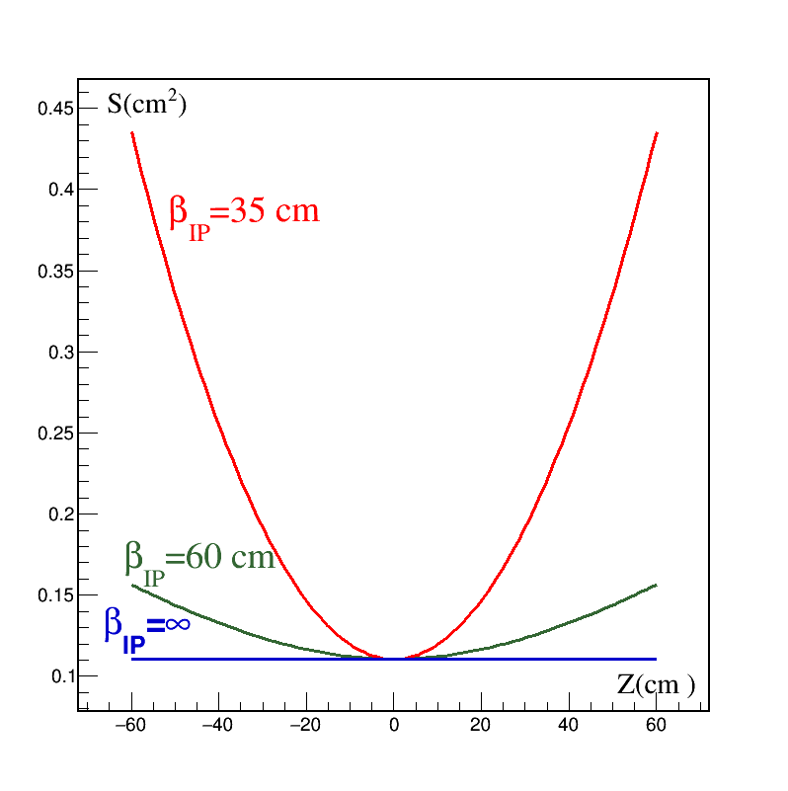
Beta function
Transverse area
$$S_{eff,⊥}\left(Z\right)=S_{eff,⊥}\left(0\right)\left(1+{\left(Z/{β_{IP}}\right)}^{2}\right)$$

Slide 34
Distribution of interaction vertices
$$\left\{\begin{aligned}&P\left(Z_{V}\right)=N\frac{ exp\left(−{Z_{V}^{2}}/{σ_{Z}^{2}}\right)}{\left(1+{\left({Z_{V}}/{β_{IP}}\right)}^{2}\right)} \\ &N=\frac{1}{\int_{−∞}^{∞}{\frac{exp\left(−{Z_{V}^{2}}/{σ_{Z}^{2}}\right)}{\left(1+{\left({Z_{V}}/{β_{IP}}\right)}^{2}\right)} dZ_{V}}}\end{aligned}\right.$$

Slide 35
Efficiency, Luminosity and beta function
$$N_{L}=N_{R}=2.8∙{10}^{9}$$
$$σ_{x}=1.1 mm; σ_{y}=0.82 mm$$
$${−30 cm≤Z}_{V}≤30 cm$$
 | $$β_{IP}=35 cm$$ | $$β_{IP}=60 cm$$ | $$β_{IP}={10}^{4} cm$$
$$ℒ ({cm}^{−2}s^{−1})$$ | $$5∙{10}^{26}$$ | $$6.9∙{10}^{26}$$ | $$9.1∙{10}^{26}$$
Eff ($ε$) | 0.756 | 0.635 | 0.517
$$ℒ({cm}^{−2}s^{−1})ε$$ | $$3.8∙{10}^{26}$$ | $$4.4∙{10}^{26}$$ | $$4.7∙{10}^{26}$$

Slide 36
Vertex position
L
L
RS
LS
z
$$L−z$$
$$L+z$$
$T_{L}=\frac{L−z}{cβ}$ ; $T_{R}=\frac{L+z}{cβ}; τ=T_{R}−T_{L}=\frac{2z}{cβ}$
$$c=3∙{10}^{8}; β=p/{E; \sqrt{S_{NN}}=11→β=0.985≈1}$$
z$=\frac{1}{2}c∙τ→z\left(cm\right)=15∙τ(ns)$
$σ_{τ}=(300 ÷400) ps ; →σ_{z,τ}≈(4.5÷$ 6) cm

Slide 37
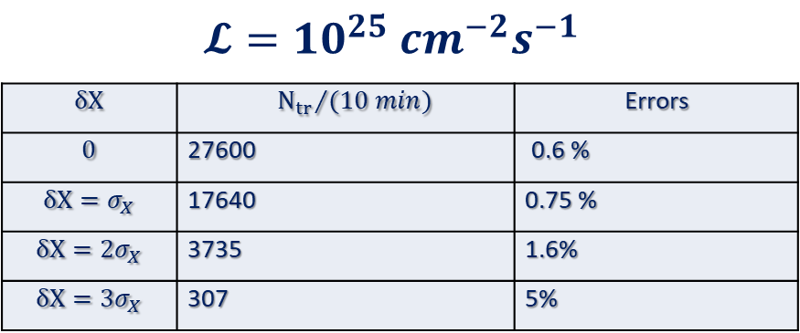
Z coordinate. Maximum of interaction point distribution from ToF
${\tilde{σ}}_{z}=\sqrt{\left(σ_{z,V}^{2}+σ_{z,τ}^{2}\right)}=34∙\left(1+0.016\right)$ cm
$$∆Z\left(cm\right)=\frac{{\tilde{σ}}_{z}}{\sqrt{N_{tot}}}=\frac{34∙\left(1+0.016\right) \text{cm}}{\sqrt{N_{tot}}}$$

Slide 38
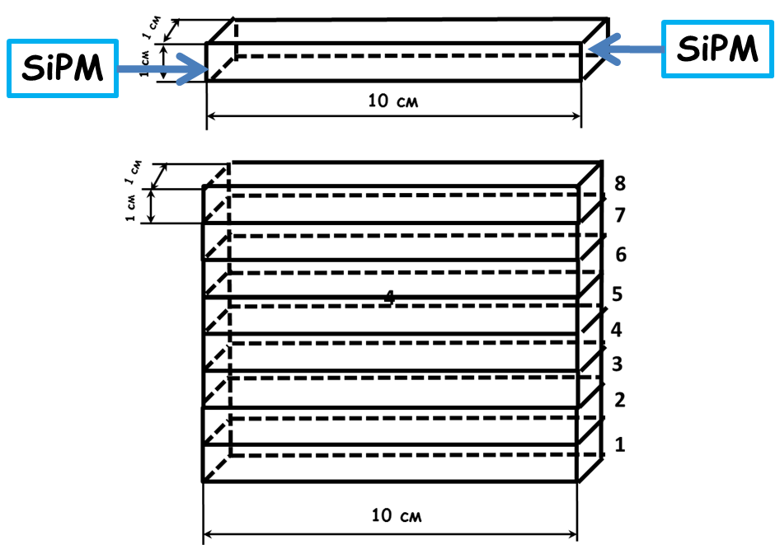
One plane of detector
The plane consists of $100x10x10 {mm}^{3}$ plastic scintillator (organic polystyrene (PS) scintillator with the addition of 1.5% p-terphenyl and 0.05% POPOP) strips viewed from both sides with silicon photomultipliers (SiPM HAMAMATSU S13360-6025CS)

Slide 39
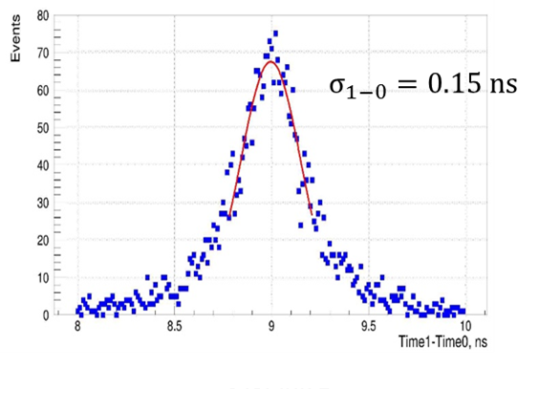
Space muons. ToF of counters
$$σ_{1−0}=\sqrt{2σ^{2}}→σ={σ_{1−0}}/{\sqrt{2}}$$
$$σ≈100 ps$$
G. D. Milnov et al., Physics of Particles and Nuclei Letters, 2022,
Vol. 19, No. 4, pp. 362–367.

Slide 40
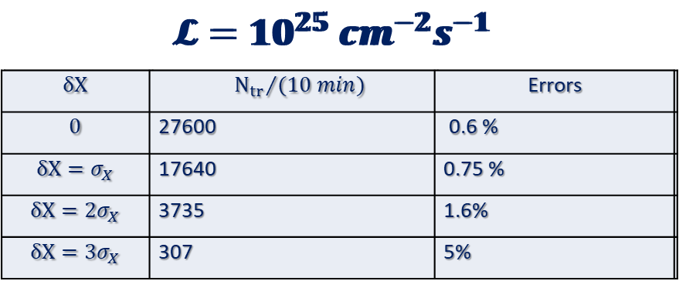
Adjustment of beam convergence along interaction line
Conclusion II
setting beam convergence along the collision axis
does not require record time-of-flight resolutions.
Even 400 picoseconds enough.
$$∆Z\left(cm\right)=\frac{{\tilde{σ}}_{z}}{\sqrt{N_{tot}}}=\frac{34∙\left(1+0.016\right) \text{cm}}{\sqrt{N_{tot}}}$$

Slide 41
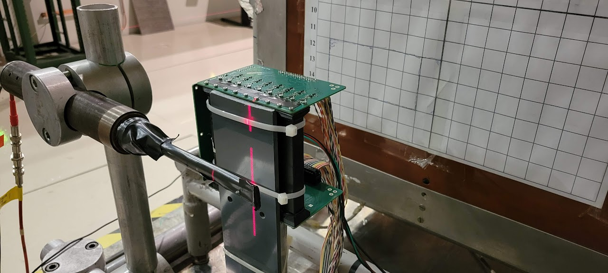
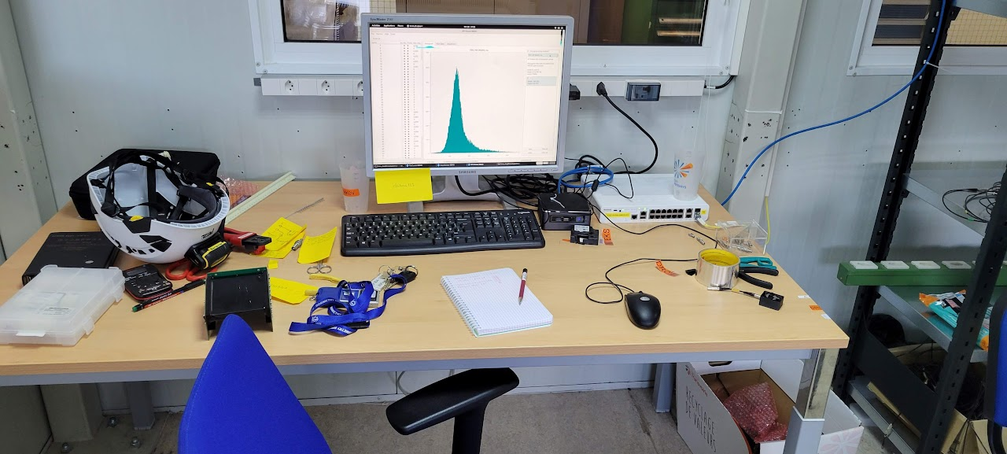
Beam test at CERN
S.G.Buzin, M.G.Buryakov
Two planes

Slide 42
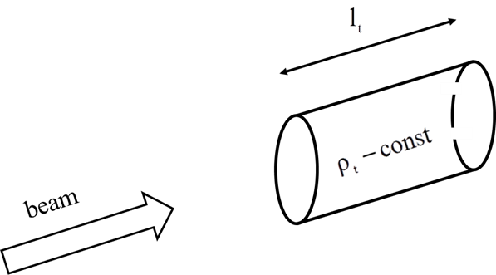
Fixed target luminosity
$$𝓛=\frac{N_{bm}N_{t}f}{S}$$
Nt - the number of target atoms in volume
through which the beam passes
N_{bm} - numbers of particles per burst
f - repetition rate
$S$ - transverse beam area

Slide 43
Fixed target luminosity
$𝓛=N_{bm}N_{A}\frac{{ρ\left(g/{{cm}^{3}}\right)l}_{t}\left(см\right)}{A_{t}}f$
Example
Nuclotron $f=0.1$ 1/s
$A_{t}=208$ (Pb)
$l_{t}$ = 0.1 cm
$N_{bm}$= ${10}^{10}$
$$𝓛=3.3∙{10}^{30} {cm}^{−2}s^{−1}$$

Slide 44
Time structure of AuAu collisions at NICA
Collision parameters (for $\sqrt{S_{NN}}=11 GeV$ )
Cross section for minimum bias event $σ_{AuAu}≈$ $6.2 b$
Max Luminosity $𝓛={10}^{27}{cm}^{−2}s^{−1}$
Counting rate $R=6200 s^{−1}=𝓛∙$ $σ_{AuAu}$
Scattering probability for a single crossing of bunches
$$w_{1}=\frac{R}{{f_{r}N}_{b}}≈5∙{10}^{−4}$$
Admixture of pile up events for $t≤100 ns$
$<{10}^{−4}$ negligible

Slide 45
Favorable conditions for creating
a “luminosity detector"
Topology of Au + Au collisions when in a cone $θ≤4^{0}$ along both beams many spectators are flying ($E_{s}{≈E}_{b}=5.5 GeV$) (${}_{79}^{}{Au )}$). Convenient for trigger.
Long time between neighboring collisions. No overlapping events.
The role of scattering on the residual gas is small.
Low counting rate.
Small energy.
Large asymmetry of events.

Slide 47
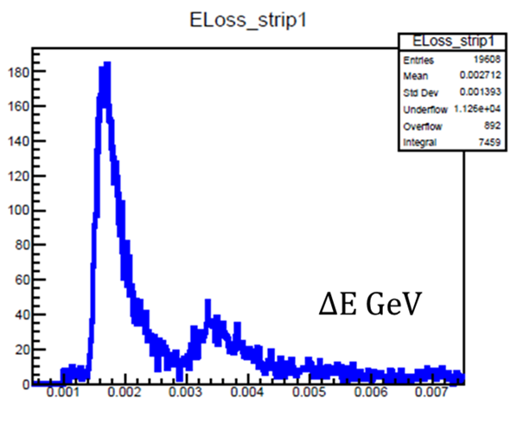
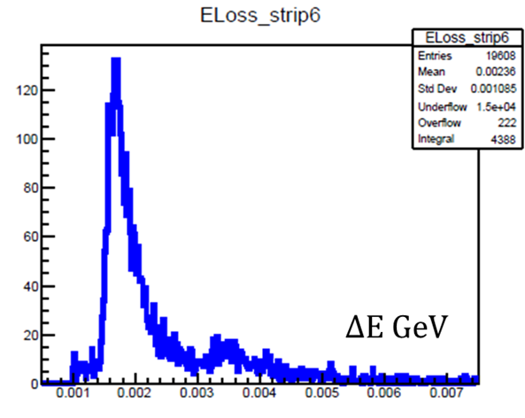
Simulation
Detector operating conditions $\left(\sqrt{S_{NN}}=11 GeV\right)$
Spectator energy $E_{S}≈5.5 {Gev}/c$
Energy loss spectrum in the scintillator

Slide 48
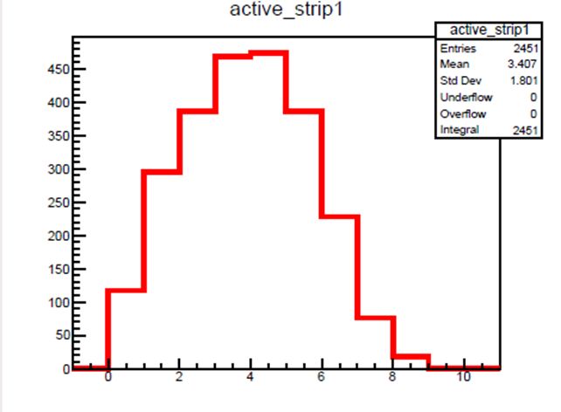
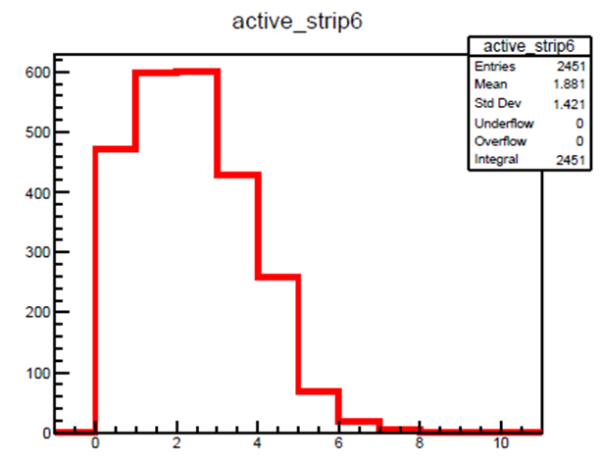
Simulation
Detector operating conditions $\left(\sqrt{S_{NN}}=11 GeV\right)$
strip occupancy (per 4 strips)
$${\left\langle n\right\rangle }_{6}=\frac{1.88}{4}=0.47$$
$${\left\langle n\right\rangle }_{1}=\frac{3.4}{4}=0.85$$

Slide 49
III. absolute luminosity
S. van der Meer, CERN-ISR-PO-68-31, 1968
van der Meer scan
at RHIC and LHC the van der Meer scan is commonly accepted procedure for calibration

Slide 50
Definitions and normalizations
$$𝓛= {\left(N_{L}N_{R}f_{r}N_{b}\right)}/{\left(S_{eff}\right)}$$
$$\frac{1}{S_{eff}\left(δX,δY\right)}=\left(\int_{−∞}^{∞}{dx}p_{┴}\left(x−{δX}/2\right)p_{┴}\left(x+{δX}/2\right)\right)∙\left(\int_{−∞}^{∞}{dy}p_{┴}\left(y−{δY}/2\right)p_{┴}\left(y+{δY}/2\right)\right)$$
$$\int_{−∞}^{∞}{\int_{−∞}^{∞}{d(δX)d(δY)}}\frac{1}{S_{eff}\left(δX,δY\right)}=1$$

Slide 51
III. absolute luminosity
$$𝓛=\frac{\frac{dR_{1,2}\left(0,0\right)}{dt}}{\iint{\frac{dr_{1,2}\left(δX,δY\right)}{dt}dδXdδY}}$$

Slide 52
$\begin{matrix}\int{d(δX)\left(\frac{1}{S_{⊥,x}\left({δX}/2 \right)}\right)}=\int{d(δX)\left(\int{dx\left(p_{⊥,L}\left(x+{δX}/2\right)p_{⊥,R}\left(x−{δX}/2\right)\right)}\right)}= \\ \iint{d(δX)}dx\left(p_{⊥,L}\left(x+{δX}/2\right)p_{⊥,R}\left(x−{δX}/2\right)\right)\end{matrix}$
$\left\{\begin{aligned}u=x+{δX}/2 \\ v=x−{δX}/2\end{aligned}\right.$
$\begin{matrix}\iint{d(δX)}dx\left(p_{⊥,L}\left(x+{δX}/2\right)p_{⊥,R}\left(x−{δX}/2\right)\right)= \\ \left(\int{du{∙p}_{⊥,L}\left(u\right)}\right)∙\left(\int{dv∙p_{⊥,R}\left(v\right)}\right)=\left(1\right)\text{∙}\left(1\right)=1\end{matrix}$

Slide 53
RHIC and NICA
RHIC $\sqrt{S_{NN}}=200 GeV$
NICA $\sqrt{S_{NN}}=11 GeV$
Angular acceptance
$${p_{b,RHIC}}/{p_{b,NICA}≈20;→{θ_{s,NICA}}/{θ_{s,RHIC}≈}20}$$
ZDC at RHIC and NICA
$$L_{NICA}≈20∙L_{RHIC}$$
Energy resolution
RHIC ${∆E_{s}}/{E_{s}≈6\%}$
NICA ${∆E_{s}}/{E_{s}≈25 \%}$
more questions?

