Slide 1
Status of Forward Hadron Calorimeter (FHCal)
A.Ivashkin
Institute for Nuclear Research RAS, Moscow
on behalf of the FHCal group
FHCal overview;
FHCal modules;
FHCal readout;
FHCal in trigger
Installation to MPD
12th MPD collaboration meeting, Oct., 2023.

Slide 2
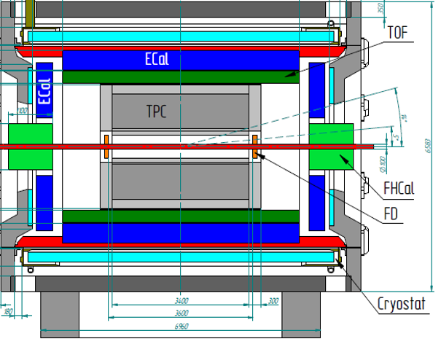

FHCal in MPD
FHCal modules
FHCal
FHCAL consists of 2x44 modules.
~1x1 m² each part.
Beam hole 15x15 cm².
Lead/scintillator sampling calorimeter.
Longitudinal segmentation;
Light readout- WLS-fibers;
7 sections/photodetectors in each module.
Two arms of hadron calorimeter at opposite sides in forward regions.
At the distance 3.2 meters from the interaction point.
Available acceptance corresponds to pseudorapidity 2.0<η <5.0

Slide 3
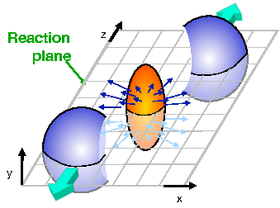

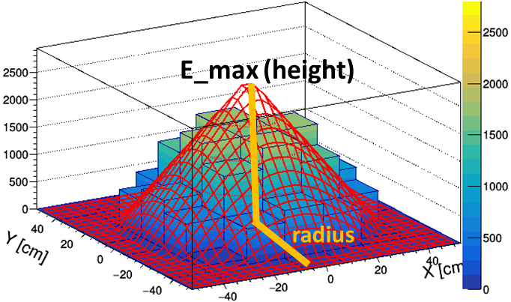
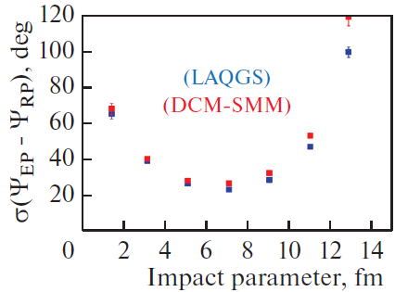
Tasks of FHCal :
The centrality of the collision;
The reaction plane orientation;
Minimum bias trigger;
Physics in forward rapidity?
Centrality:
2D-Fit of energy distributions in FHCal modules
X

Slide 4
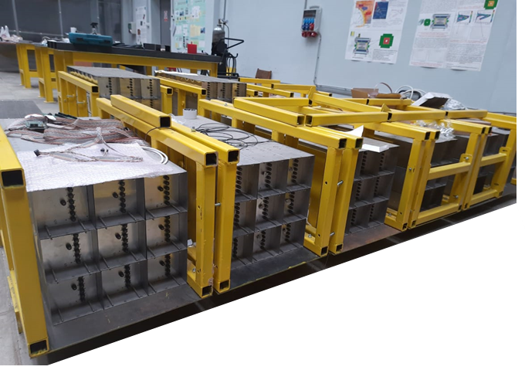
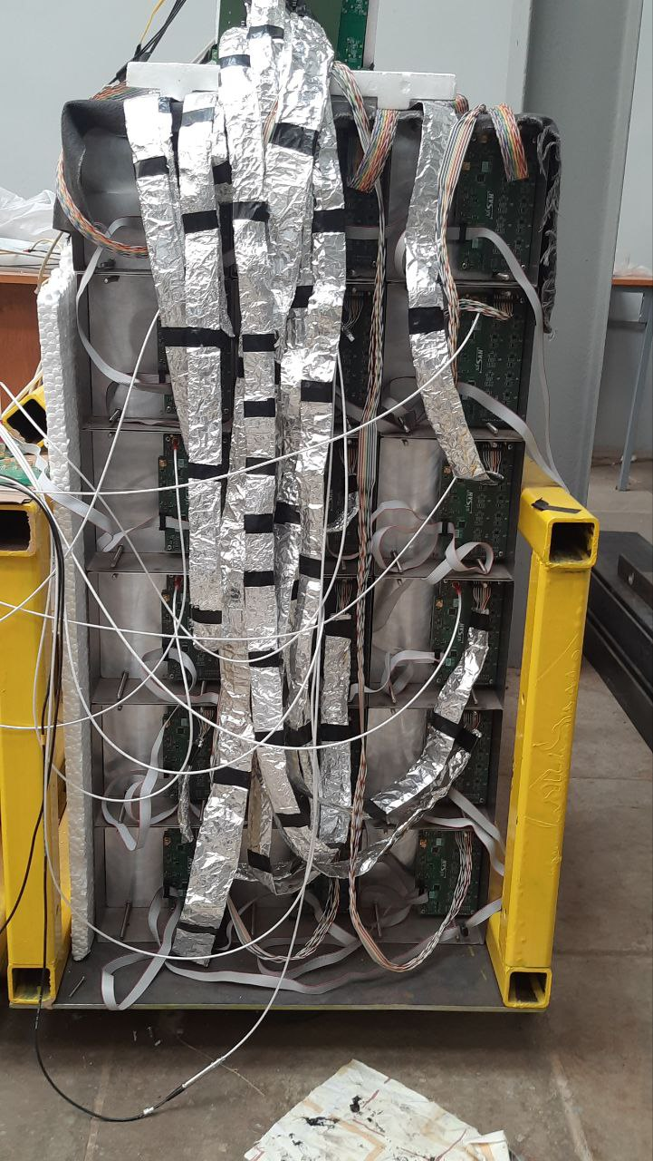
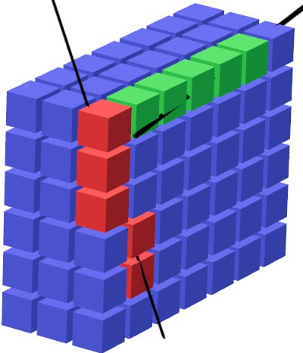
FHCal modules
All (90+spare) FHCal modules are assembled and tested with cosmic rays.
Modules are ready for the delivery at MPD site.
Mini-FHCal is operating now at INR.
Modules in stockroom
The activities with modules:
Calibration with cosmic muons;
Development of readout;
Development of FHCal trigger;
Development of Detector Control System;
Monitoring system.

Slide 5
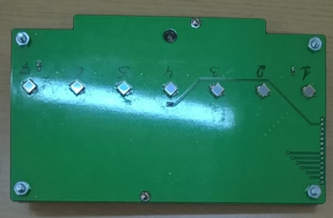
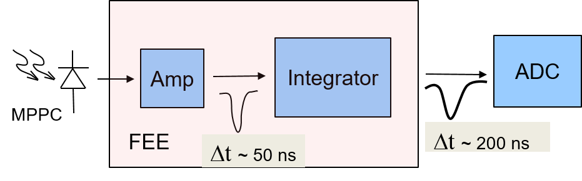
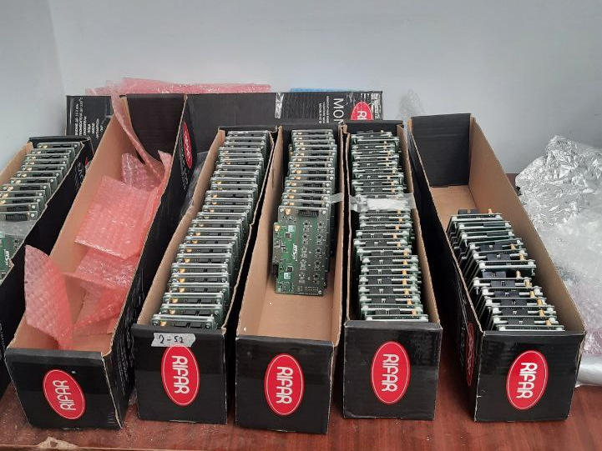
Readout electronics (FEE)
Two PCBs in each module with:
7 photodetectors ;
Photodetectors – MPPCs;
two-stage amplifiers;
HV channels;
LED calibration source.
MPPC: new type
S14160-3010PS
size – 3x3 mm²;
pixel -10x10 µm²;
PDE~18%.
100 units of FEE were produced and tested.

Slide 6
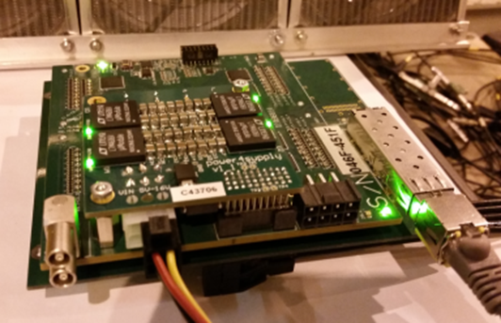
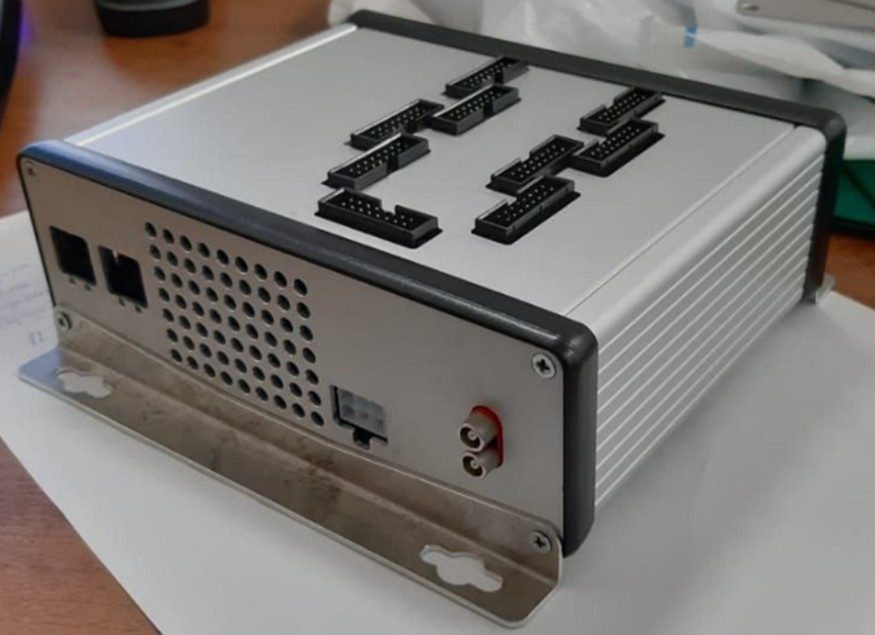
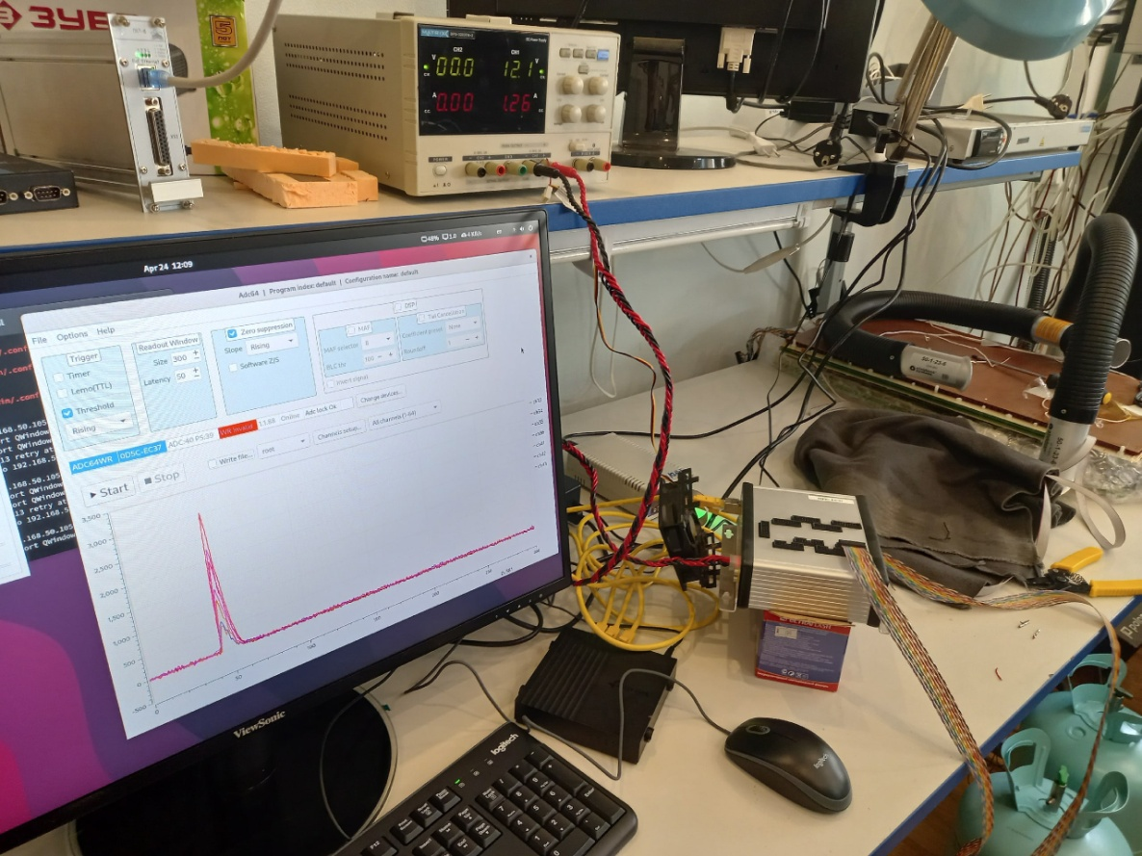
ADCs for FHCal
FPGA based 64 channel ADC64 board, 62.5MS/s (AFI Electronics, JINR, Dubna).
Bench for ADC tests
5 ADCs for each part of FHCal
All 10 ADC boxes were produced last year.
All ADCs were tested this year at JINR.
4 ADCs were repaired during the tests.
All ADCs are ready for installation.

Slide 7
FHCal readout and control
FHCal arm
on detector
signal cables
1
FEE
near detector
~20m cables
DAQ
2
FEE
ADC64 (1)
(9 modules)
…
ADC64 (2)
(9 modules)
44
FEE
power supply
…
ADC64 (5)
(8 modules)
DCS Control box
HVsys
- Ethernet
General Control System (Tango)
Both FHCal arms have the same readout scheme.

Slide 8
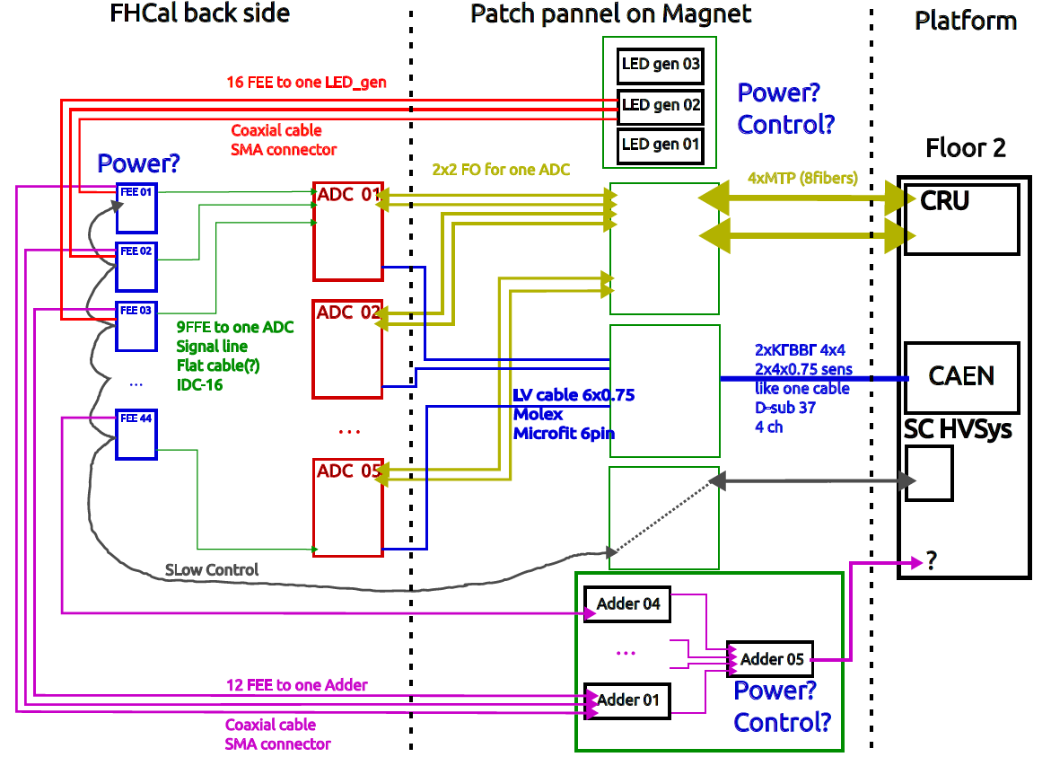
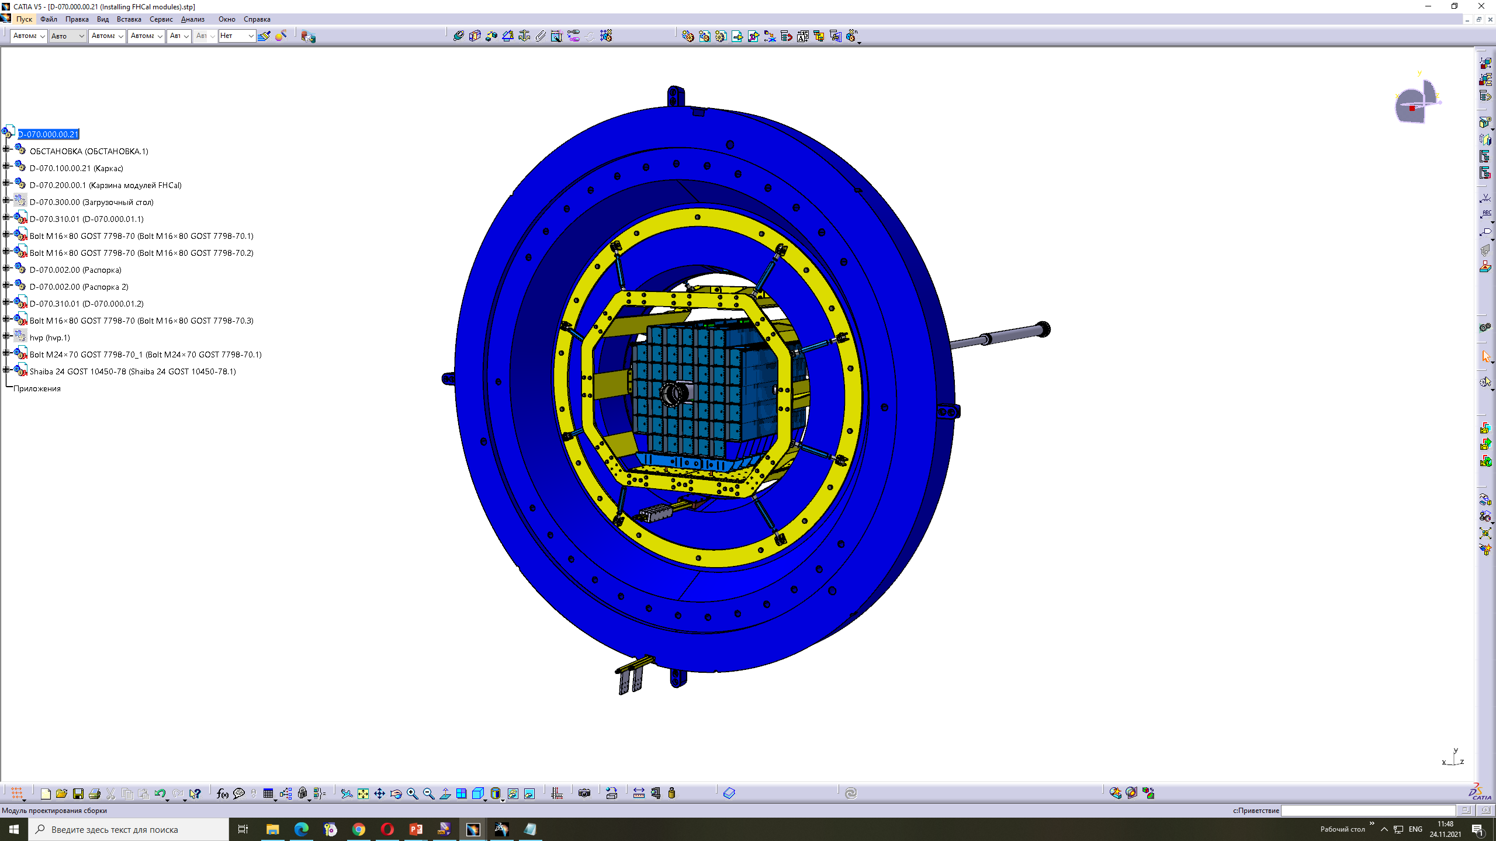
FHCal cabling
Prepared by
M. Rumyantsev
Patch panel is not ready.
Must be constructed in nearest time

Slide 9
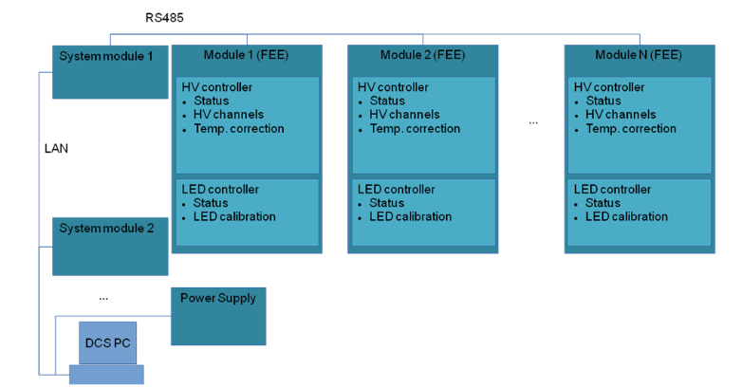
Detector Control System (DCS)
DCS Tasks:
Control of HV at photodetectors (MPPC’s);
Temperature control of photodetectors;
Compensation of temperature drift of MPPC gain;
Monitoring of MPPC gain with stabilized light source.
Status of DCS:
It is practically fully operational;
Further improvements of functionality are going on.
LAN
RS485
General
Slow Control
FHCal New Slow
Control (proxy)
System Module
FEE
FEE
FEE
System Module
FEE
Database
FEE
FEE
Connection diagram

Slide 10
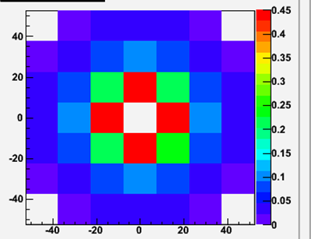
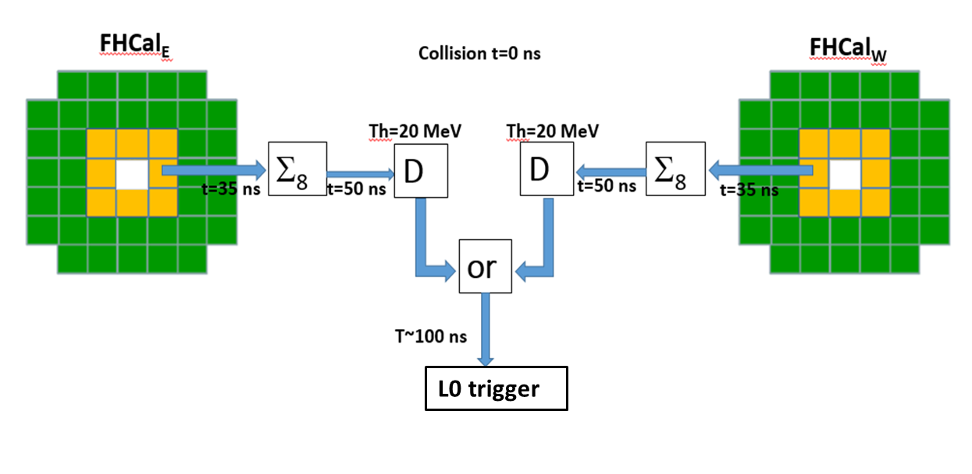
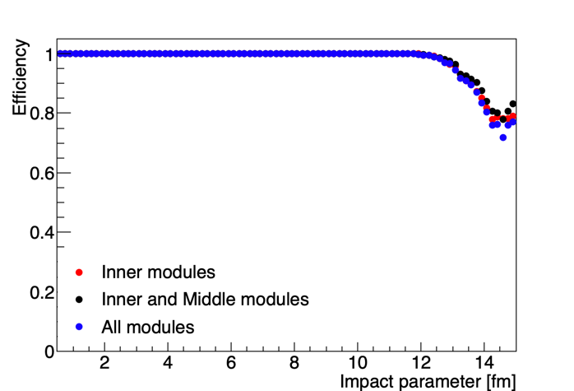
FHCal in trigger
Scheme of FHCal trigger
Threshold 2 MeV/module
Trigger efficiency ~98%
Dependence of trigger efficiency on the configuration of modules (Au-Au 11 GeV).

Slide 11
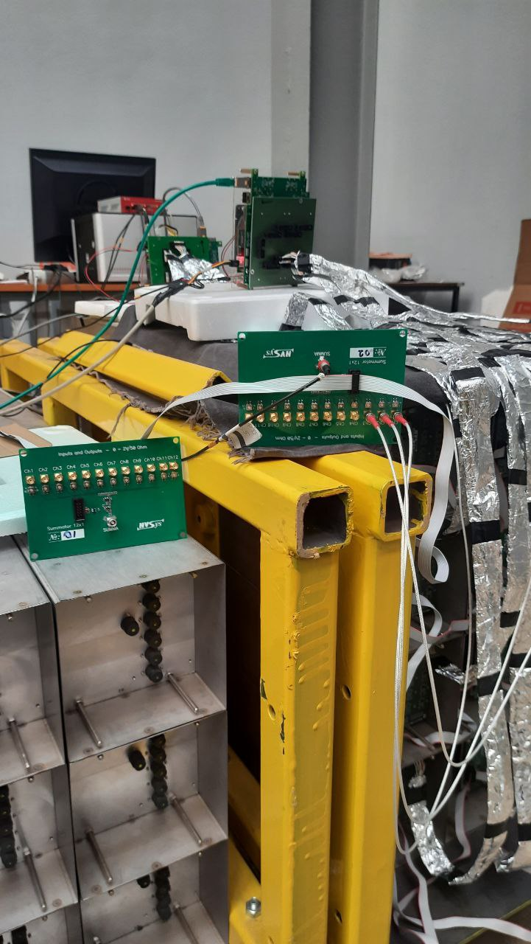
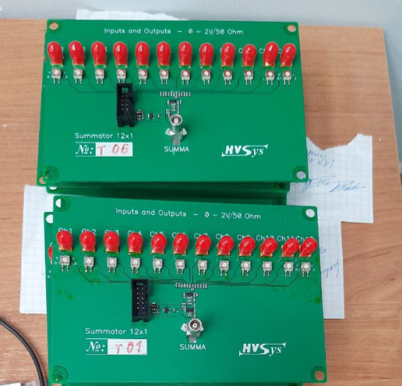
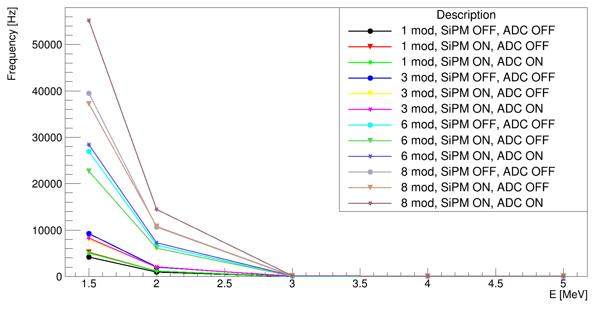
Preparations for FHCal trigger
Adders of analog signals from individual modules were produces for full FHCal.
The configuration of modules in trigger would depend on FEE and correlation noises. Flexible configuration is to be developed.
12-channels signal adders
Dependence of trigger noise on energy threshold
All adders are working.
The noises are under tests.
It seams that 3 MeV threshold is safe for trigger.

Slide 12
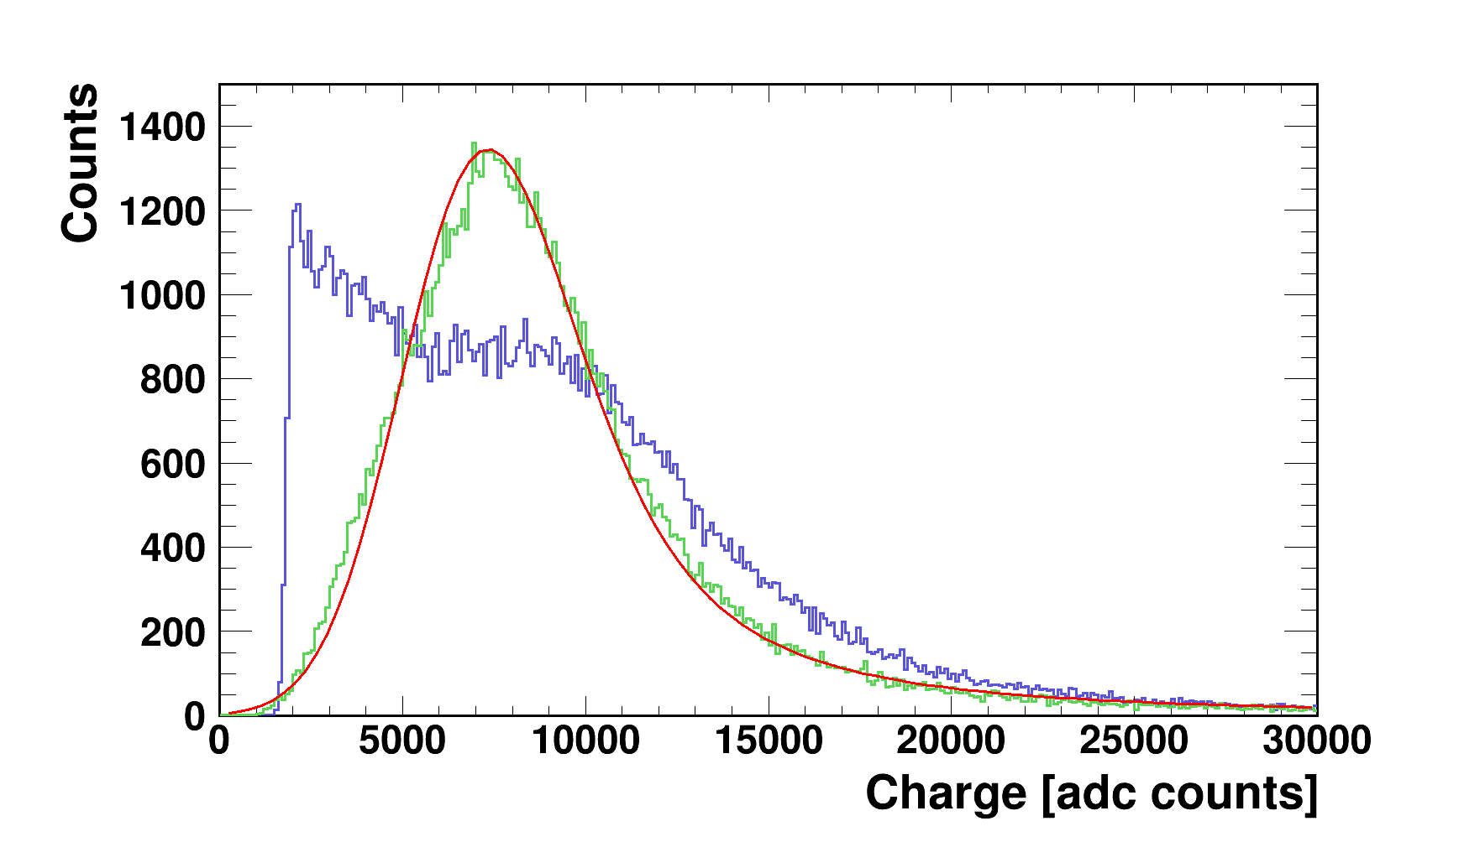
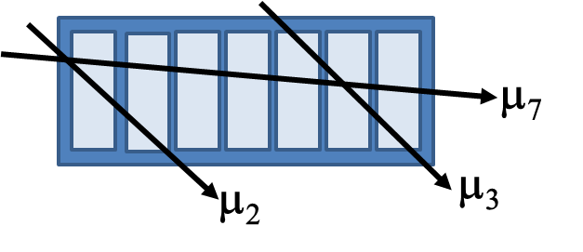
Energy calibration with cosmic nuons
Response of FHCal modules to cosmic muons with different track geometries.
Corrected to pass length in scintillators.
Raw spectrum without selection of tracks
~5 MeV
New MPPC type
The energy calibration is planned in self-triggering mode (without external muon trigger).
The different geometries of muon tracks are to be considered.
The selection of different muon tracks can be done by requiring the coincidence of muon signals in FHCal modules and longitudinal sections.
A few versions of energy calibration is under development (with/without correction to pass length).

Slide 13
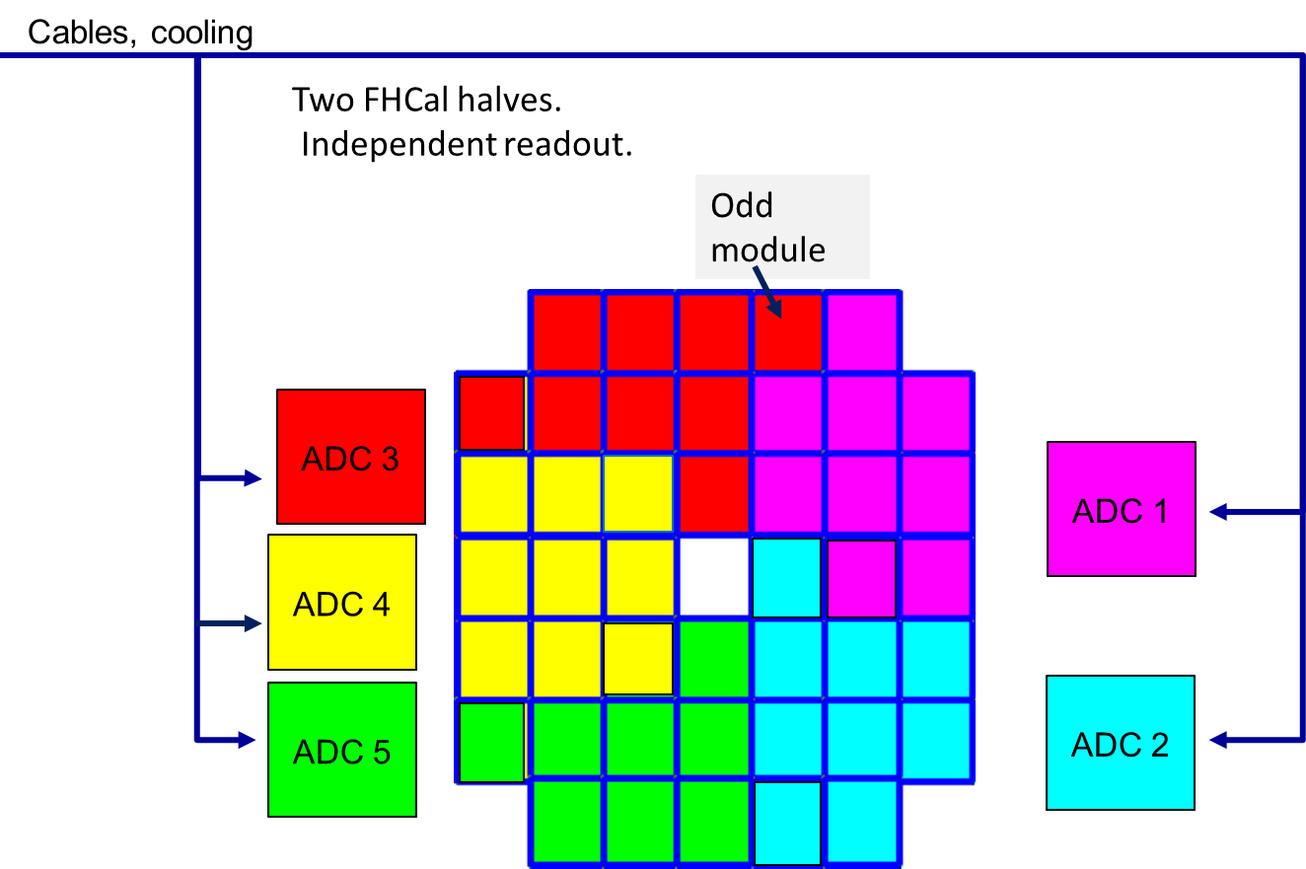
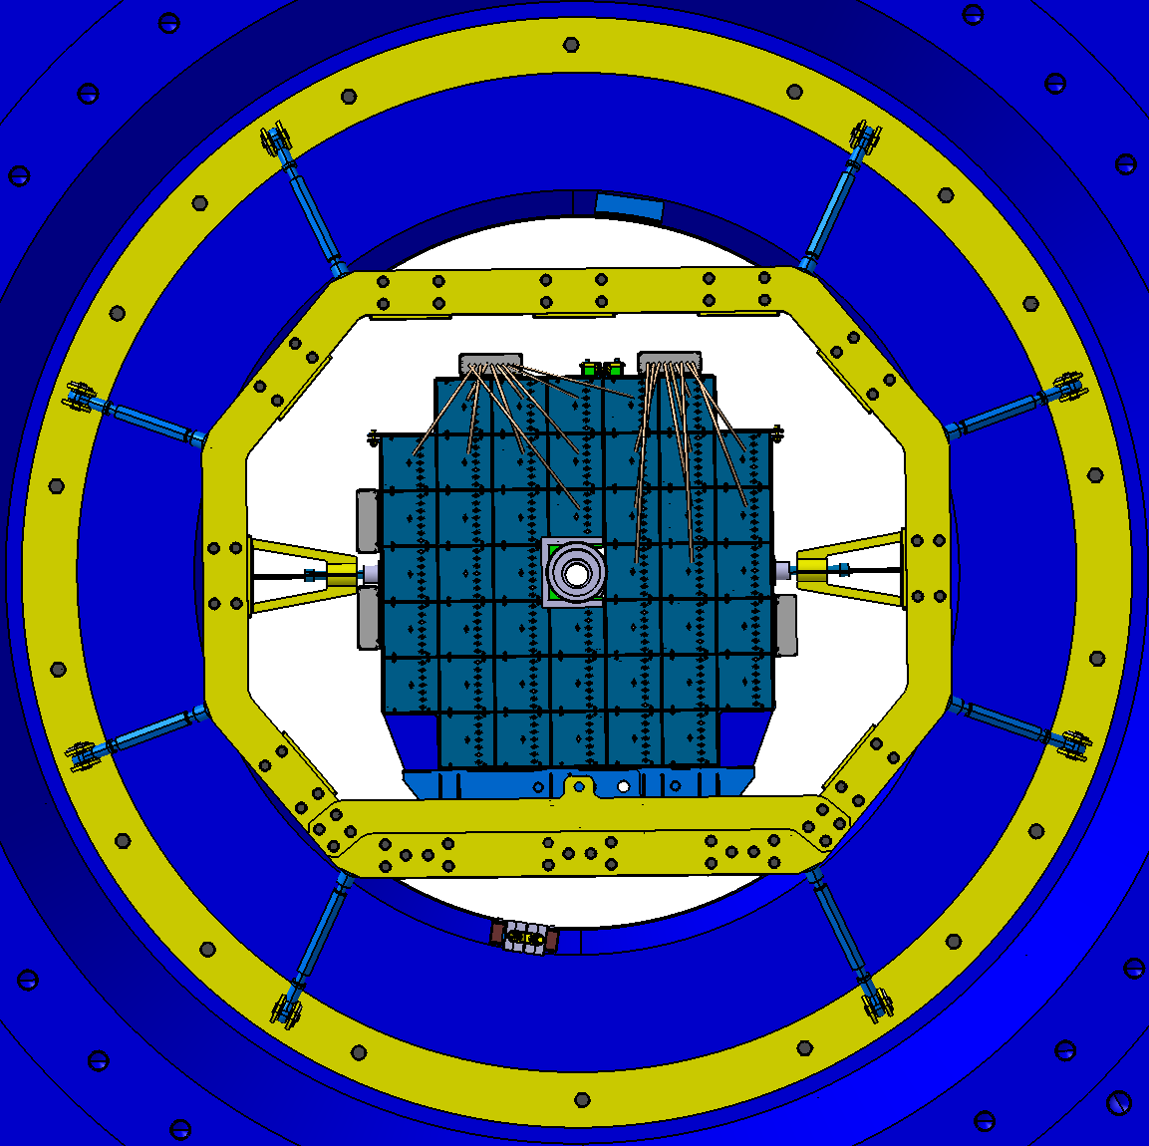
FHCal integration to MPD (ADC readout)
ADC boxes are placed at the lateral sides of FHCal support
Two halves of FHCal.
ADC cooling with compressed air is planned.
5 pipes from each side are to be available!

Slide 14
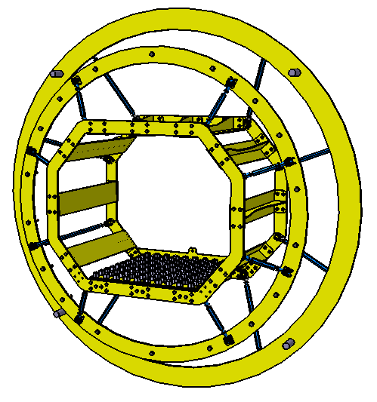
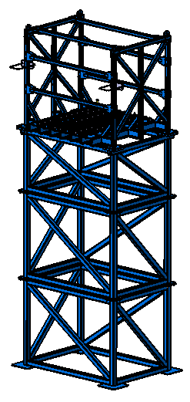
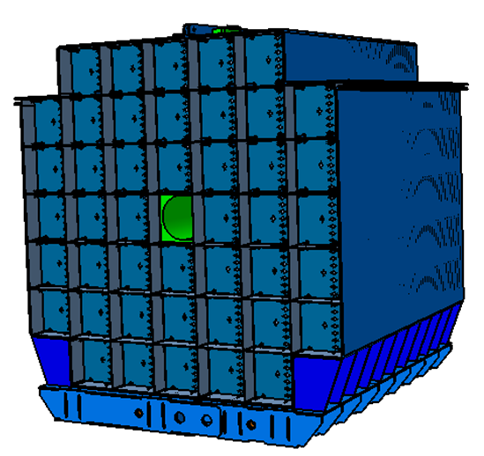
Mechanical support (main elements)
Support frame in magnet pole
Outer table
Basket of FHCal modules
Пластина
Design of all elements was finished!
The production starts now!

Slide 15
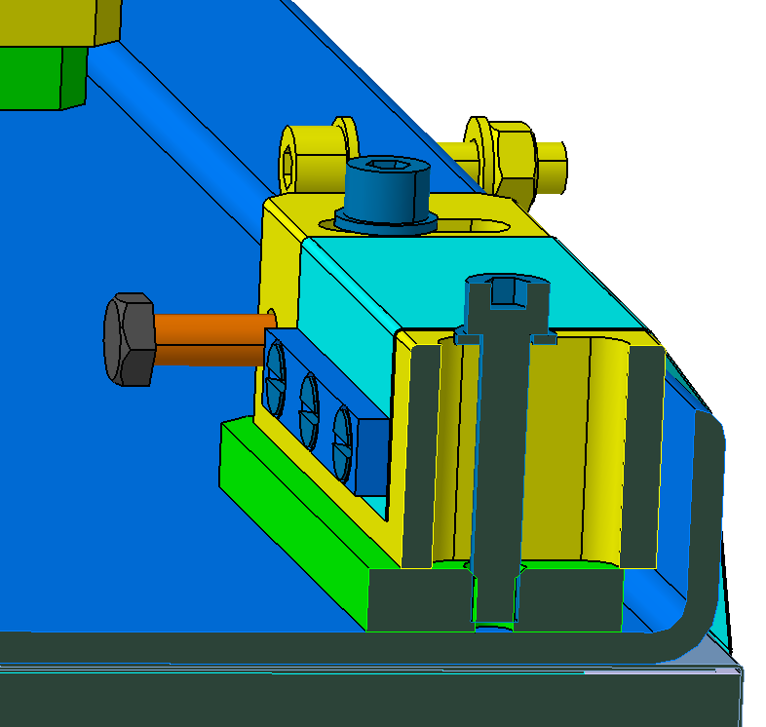
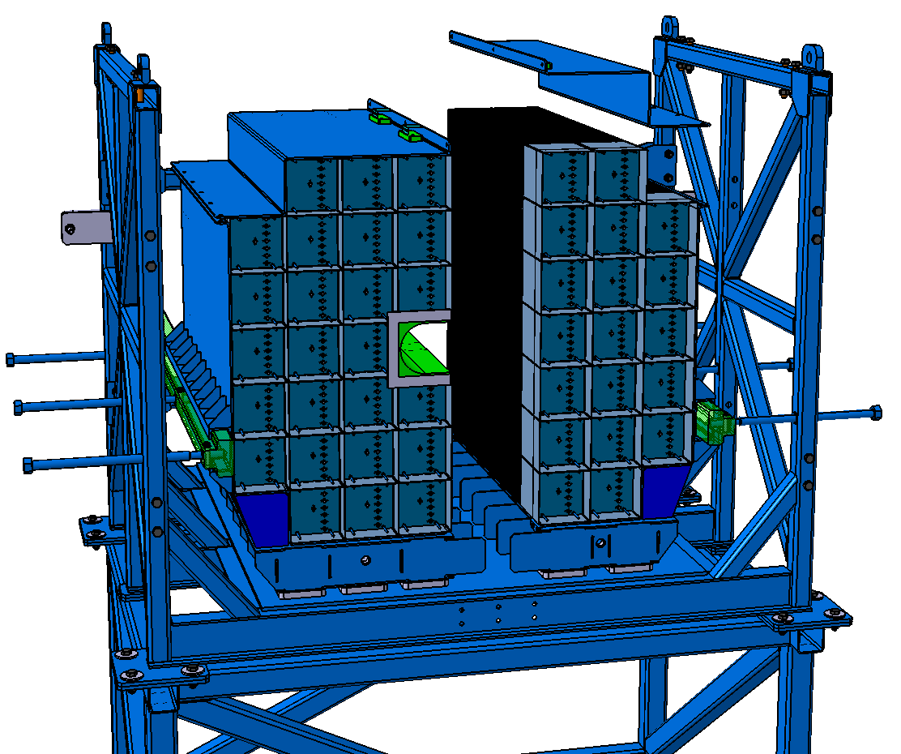
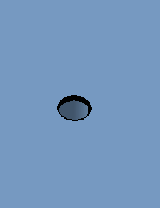
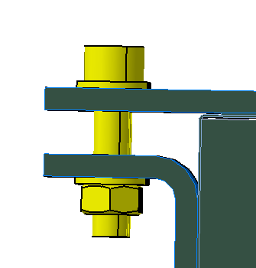
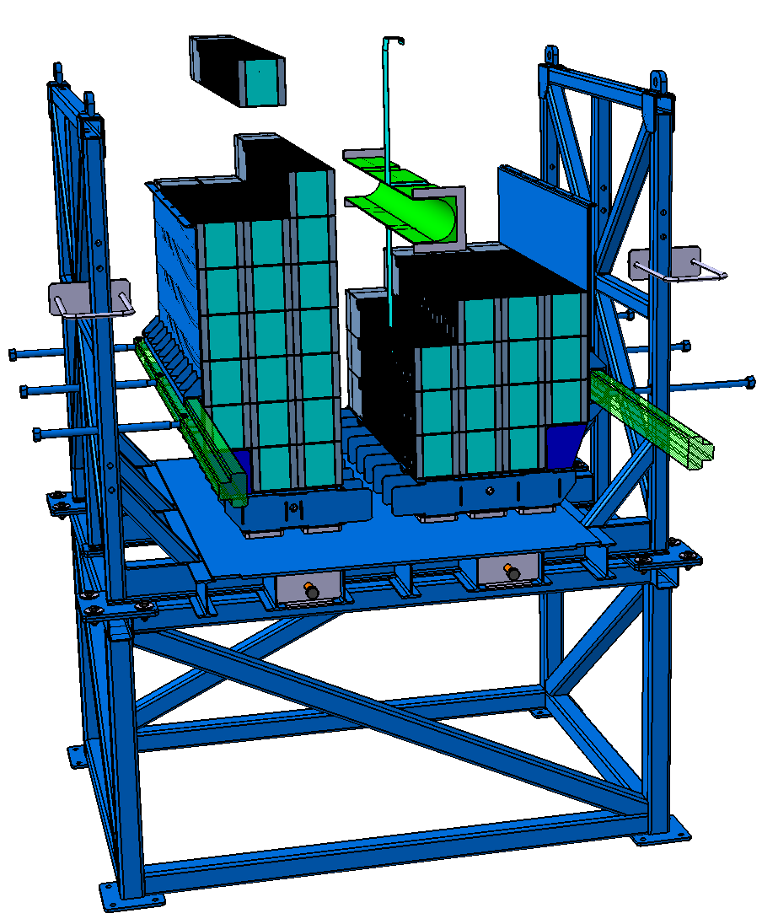
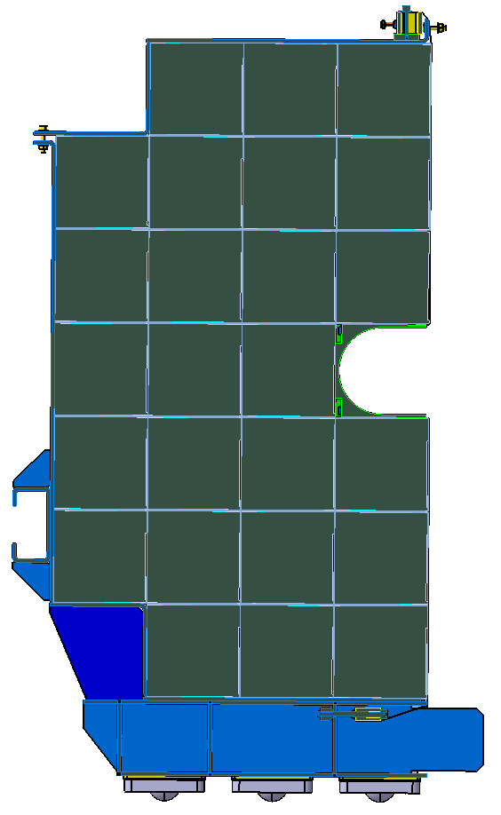
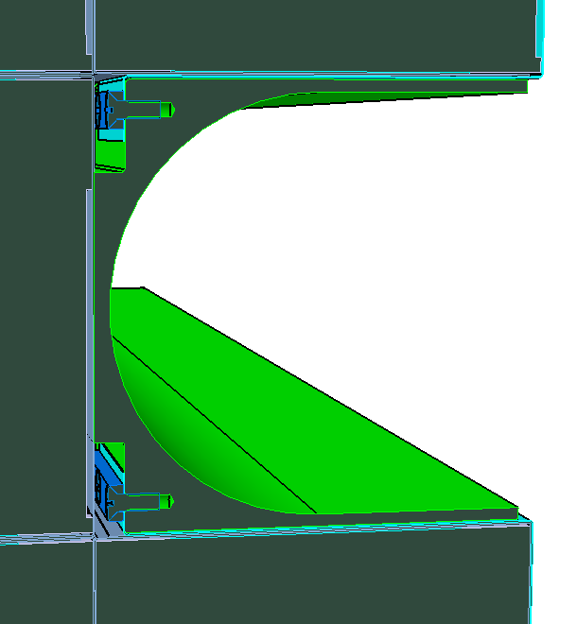
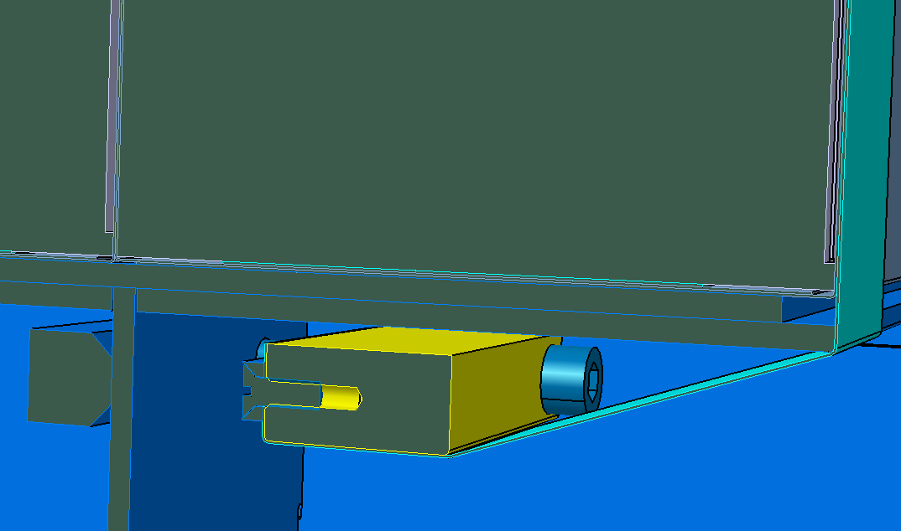
Assembling of FHCal modules in basket
М10 х30
M8
M6

Slide 16
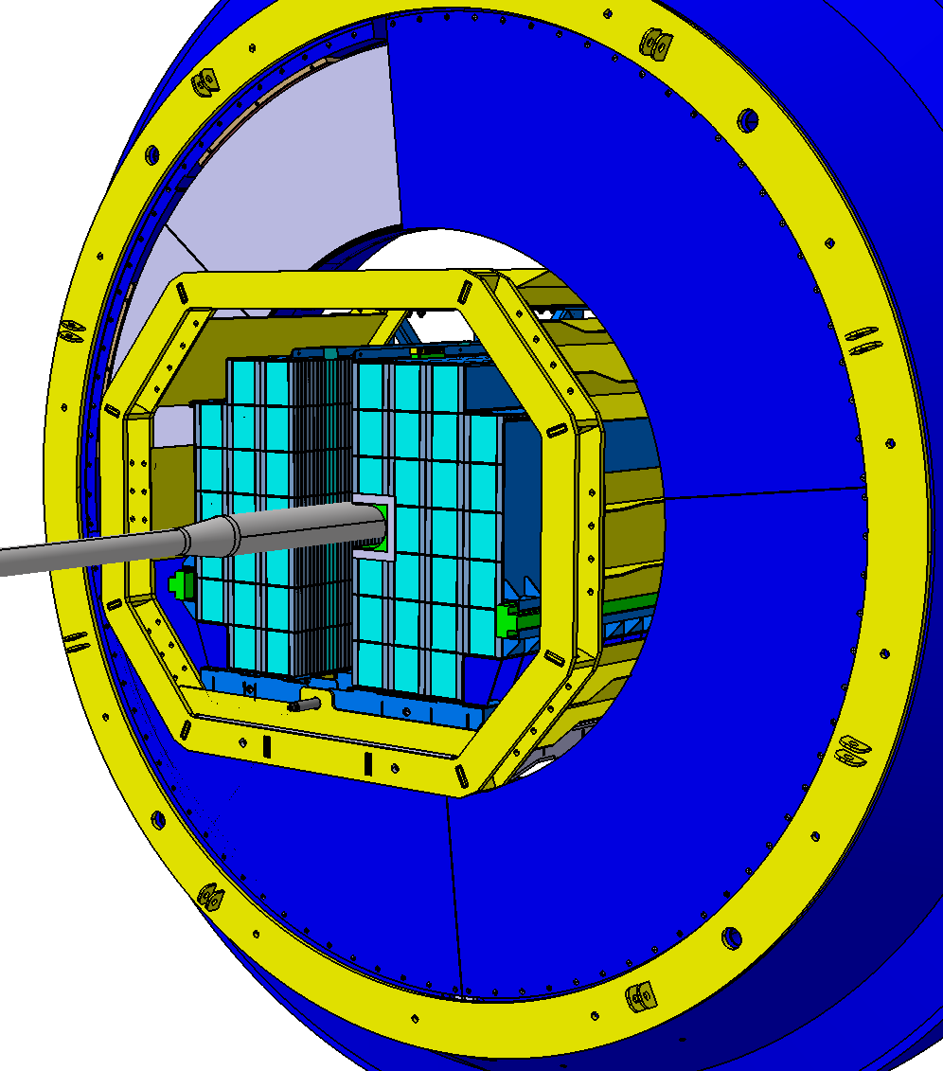
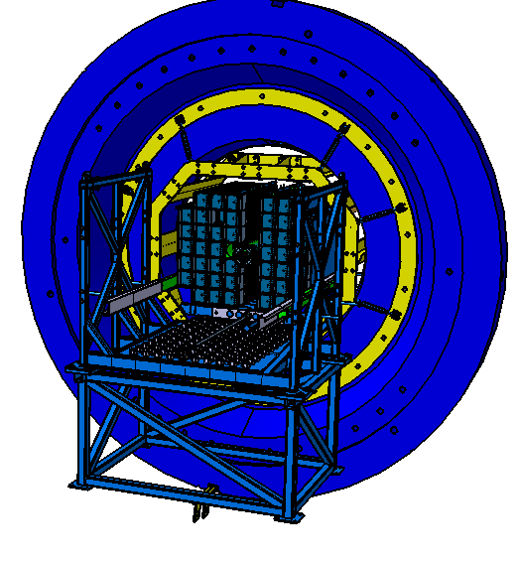
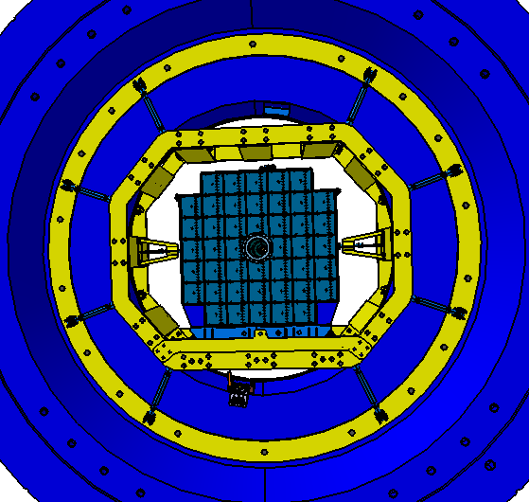
FHCal installation into magnet pole
FHCal inserted into pole from inner side
Main problem: beam pipe between two FHCal halves
Two FHCal halves pressed together

Slide 17
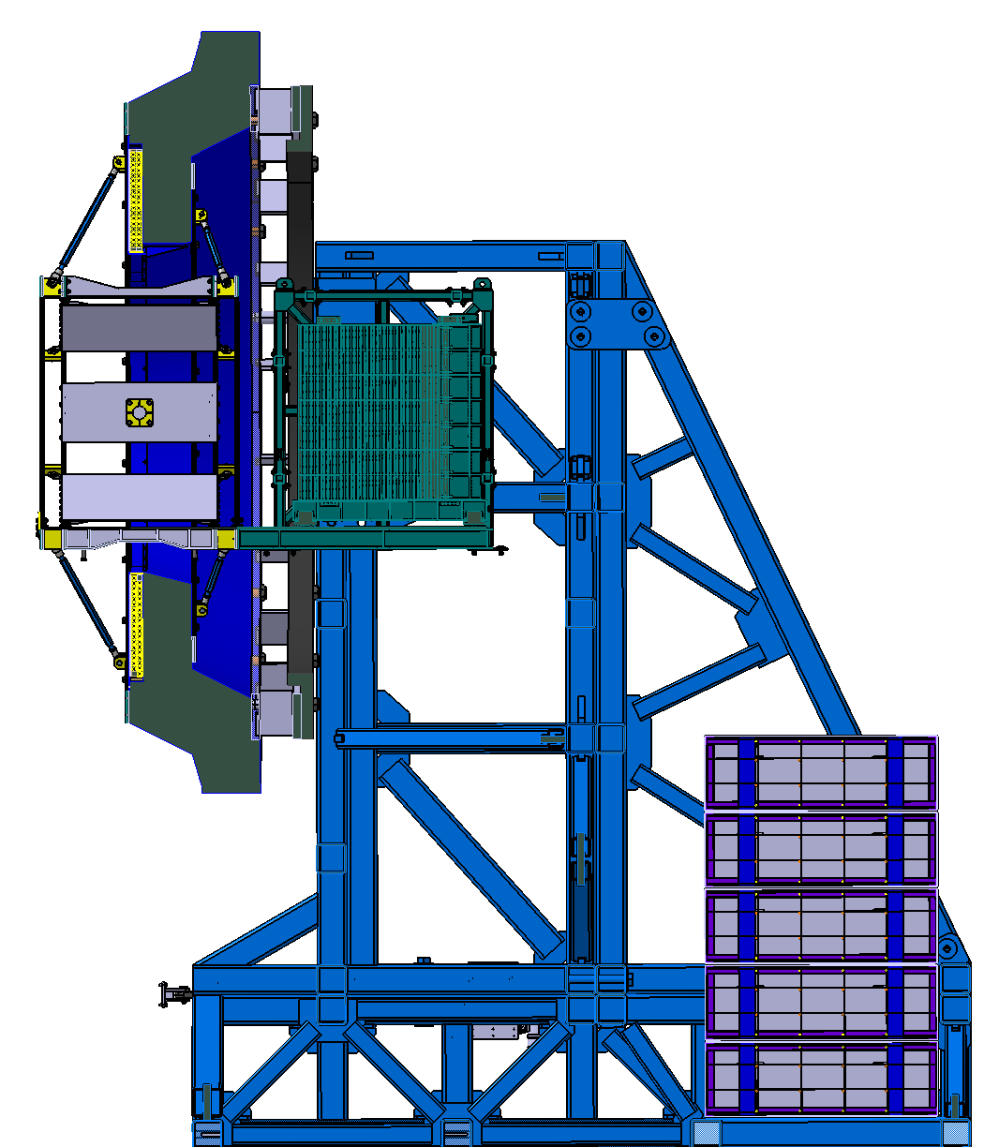
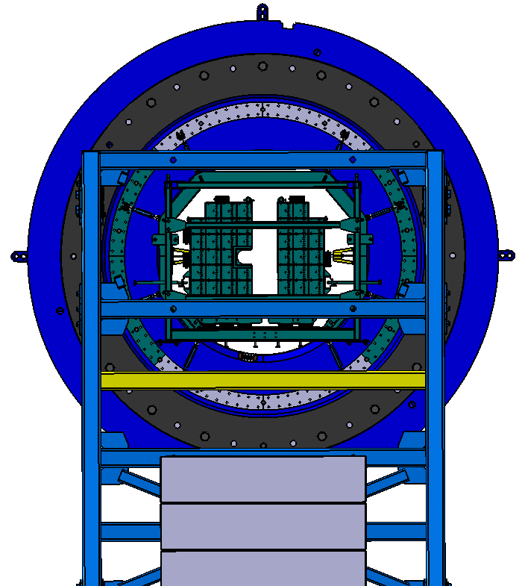
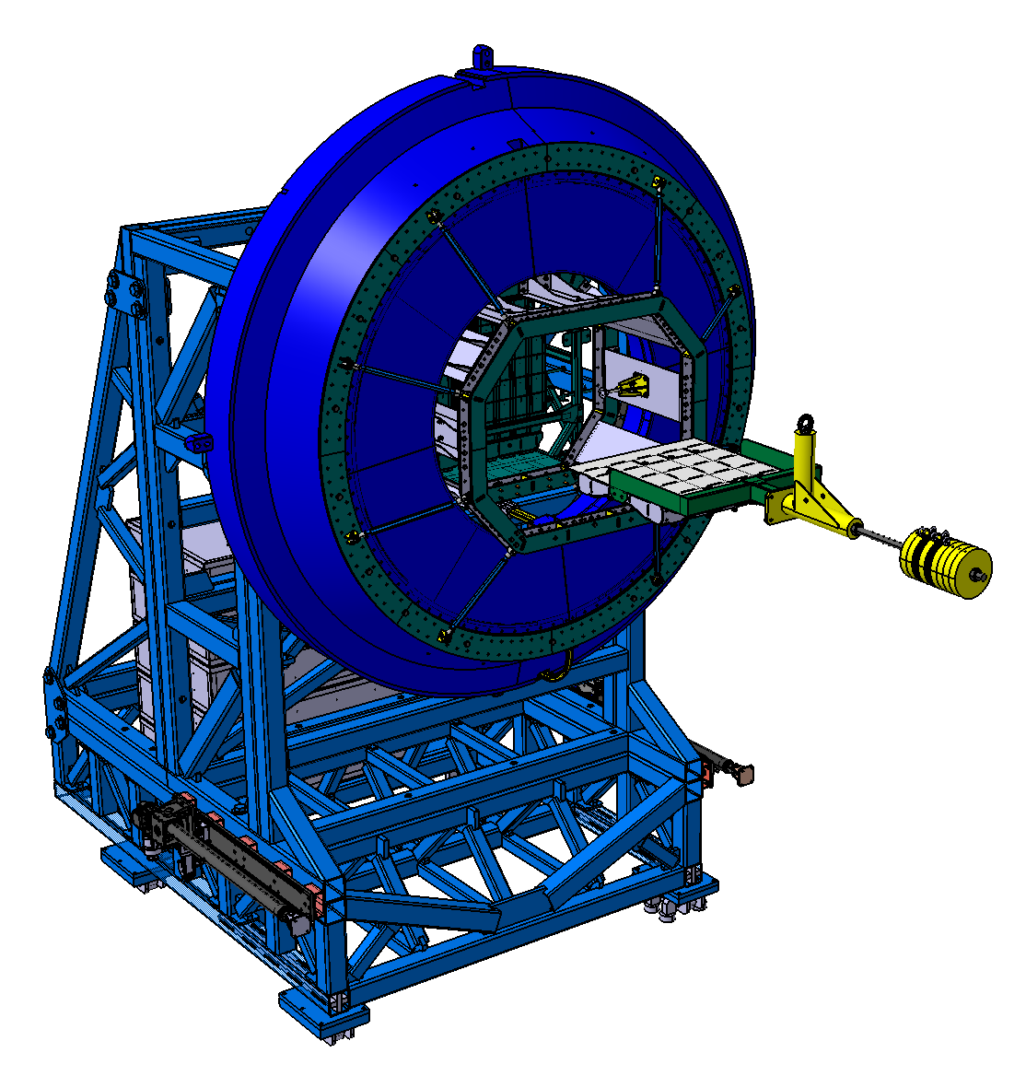
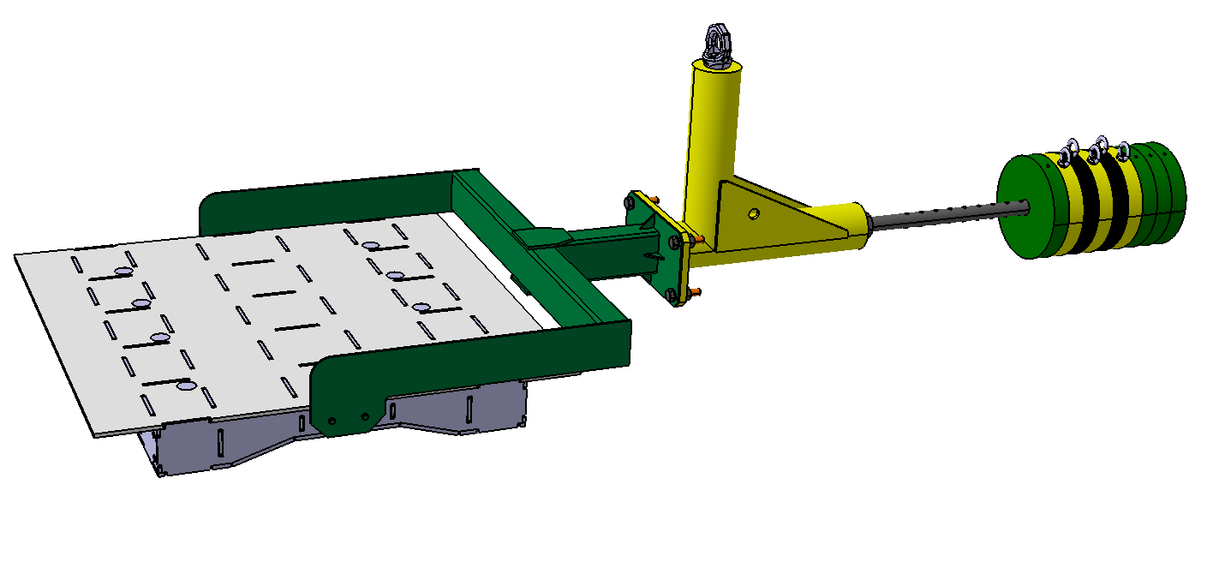
Alternative way of FHCal installation from outer side of magnet pole
300
Additional tool is needed
Modification of support is needed

Slide 18
Summary
All FHCal modules were tested and are ready for delivery at MPD site.
FEE was produced and tested.
Detector Control System is ready and is improved permanently.
Energy calibration procedure is optimized.
FHCal trigger is under development. Flexible configuration of modules is considered.
The design of mechanical platform is finished. The production starts now!
We plan to start the calorimeter assembling at MPD site in the beginning of 2024.
The space an some infrastructure for FHCal assembling must be available!

Slide 19
Thank you!

