Slide 1


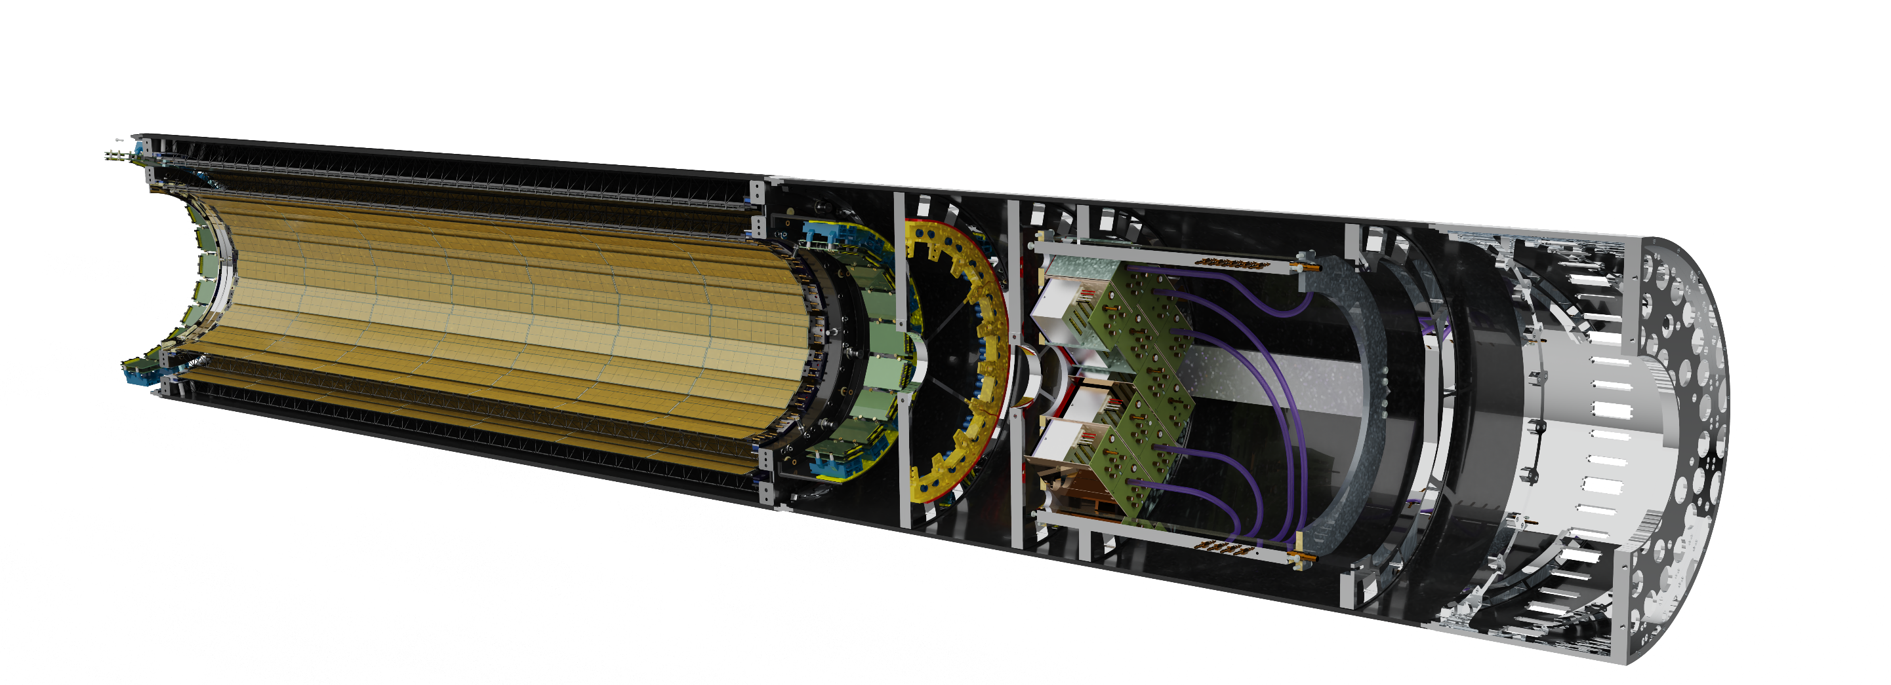
A long and winding road to the MPD ITS
Yuri Murin, JINR for the MPD ITS Team
All credits for illustrations and reference material: MPD ITS Project Team C.Ceballos,A.Sheremetiev,D.Andreev, D.Dementev, V.Kondratiev, S.Igolkin, Xiangming Sun, Yaping Wang, Lei Zhao, Le Xiao, Di Guo et al….

Slide 2
To design and build ITS means….
….to choose between strips and pixels
….. to work out general layout of the tracker
…. to optimize the design through computer simulations
…. to bring up the international team to make components and module assembly centers available
….to answer the challenge of lightweight support mechаnics with in-built cooling elements
….to suggest and realize feasible scenario for integration of the tracker and its readout electronics with the MPD
to perform the planning and get the requested resources to get all things done!
2

Slide 3
Strips or Pixels ? The ALPIDE chip is making the change!
Featers :
Process: 180nm Imaging Sensor process(TowerJazz, Izrael)
Pixel Array: 512 × 1024
Pixel size: 29 µm × 27 µm
Chip Size: 15 mm × 30 mm
NWELL diode 2 µm
Deep PWELL shielding of NWELL allowing use of P-MOS transistors
Peaking time: < 1us
Pulse discrimination time: 5-10 us
Parallel data port: 80 MHz I/O CMOS 3.3 V
High speed serial data port: 1.1 Gb/s, 8B10B encoding
Two readout modes: trigger/continuous
Each pixel can be individually masked; Pixels include built-in testing functions.
Zero suppression (Priority Encoder)
Back
3

Slide 4
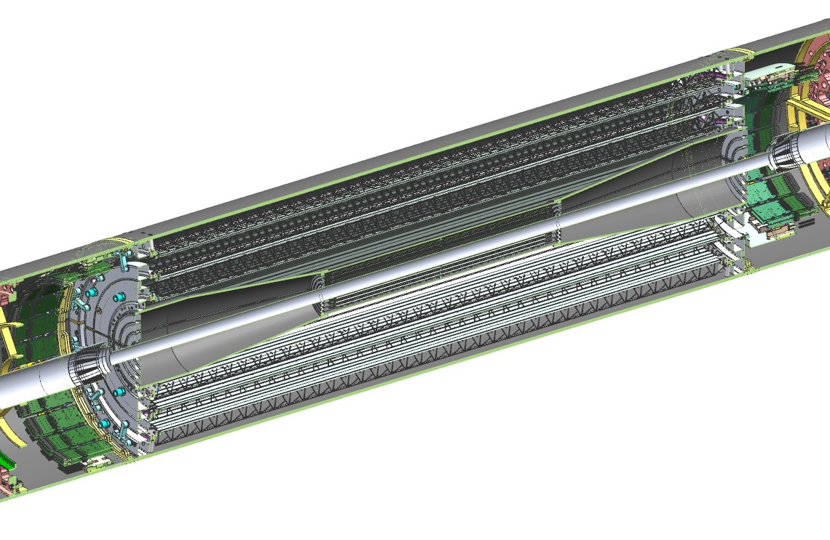
General layout of the tracker ( to be continued )
NB! Third layer of the OB is not yet activated in simulations!
2023
April 2023
March 2021
1. ITS comprised two barrels – IB(3 layers) and 0B (3 layers)
2. OB is built of ALICE ITS2 supermodules
3. IB= ALICE ITS2 IB (EAST)-><-ALICE ITS2 IB (WEST)
2023
IB=2 x 48 x 9 = 864 chips of 50 μm thickness
bB=54 x 196 = 10584 chips of 100 μm thickness
S = 5,2 m2
Number of chips to produce 19’000’000
1919
March 2022
4

Slide 5
Current results of computer simulations
April 2023
March 2021
MPD ITS TDR (draft!) https://disk.jinr.ru./index.php/s/SgscL93JwxKpoDp
(2020) Zinchenko A.I. et al. Physics of Particles and Nuclei, 17 (6), pp. 856-870.
(2021) Kondratiev V.P. et al. Physics of Particles and Nuclei, 52 (4), pp. 737-741.
Acta Physica Polonica B, Proceedings Supplement, 14 (3), pp. 497-501.
(2022) Известия РАН. Сер. Физ. т.86, №8, сс.1212-1216
2023
Meson decay channel | Mass, MeV | Average free length(cτ), μm | Branching ratio, %
D⁺ ->π⁺+ π⁺+K⁻ | 1869.66±0.05 | 312 | 9.13
D⁰ ->π⁺+ K⁻ | 1864.84±0.17 | 123 | 3.89
D⁺_{s}->π⁺+ K⁺+K⁻ | 1968.35±0.07 | 150 | 5.50
March 2022
5

Slide 6






Availability of components and module assembly centers (1/4)
2018
2019
2020
2022
2023
Overcoming barriers
ALPIDE
ALTAI
MICA
6

Slide 7
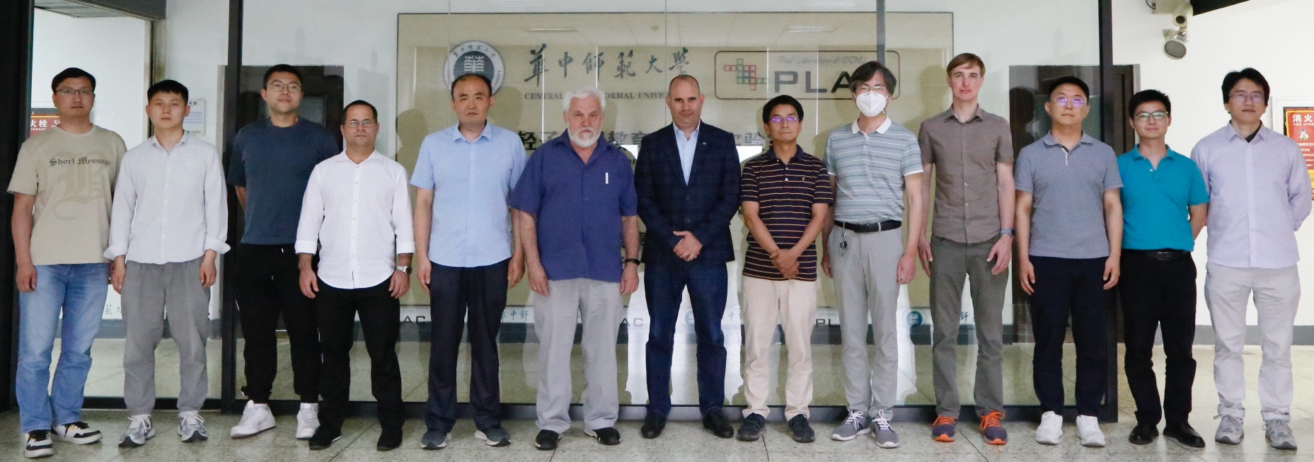
Availability of components and module assembly centers
NICA-MPD/ITS Seminar on China-Russia Cooperation, Wuhan, 2023.06.15-16
The long-term sustainable proposal
Participants: JINR, CCNU, USTC, IHEP and IMP.
Our proposal: A joint development and construction of Monolithic Active Pixel Sensors (MAPS) for fundamental and applied science experiments including front-end electronics to make this technology freely accessible to China and Russia.
Their answer: “是的!” (shì de!)
7

Slide 8
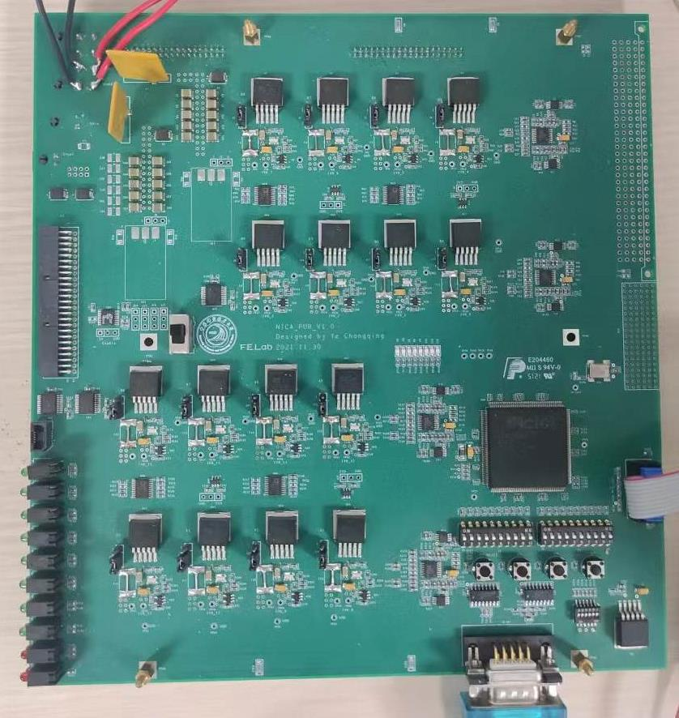
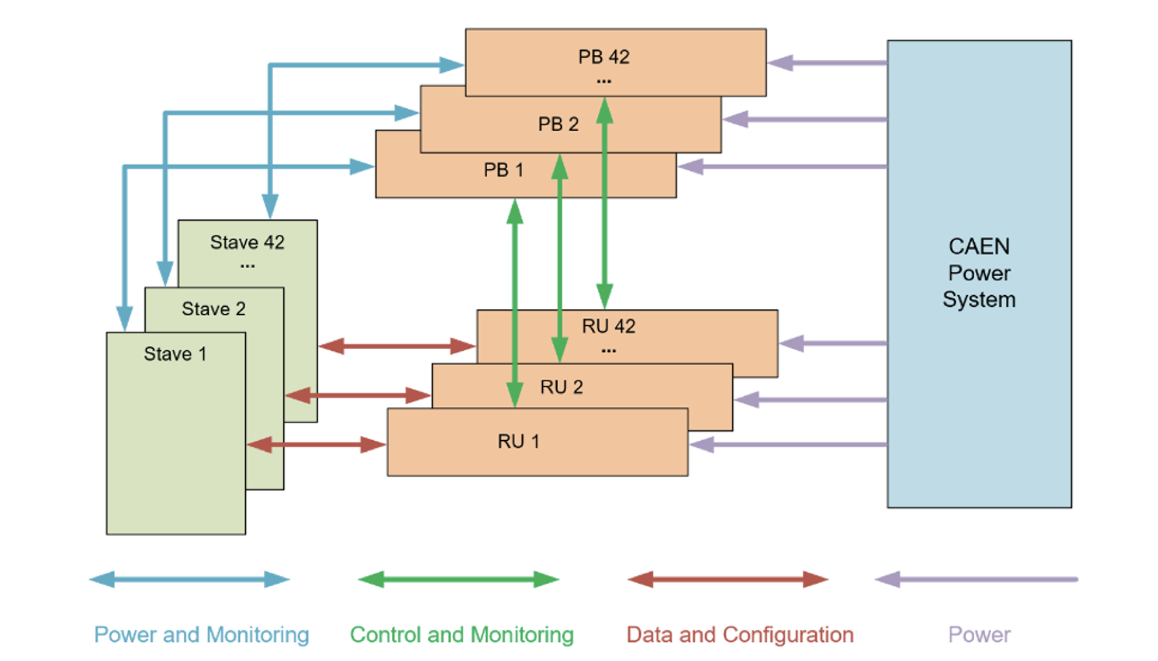
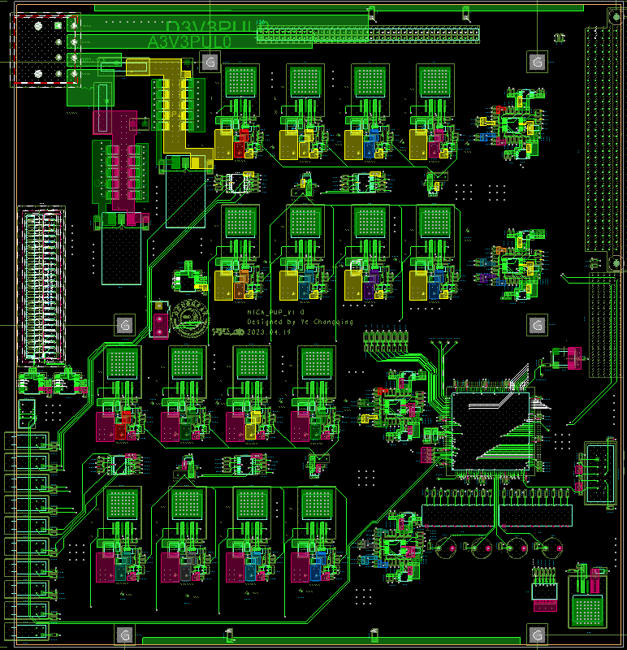
PU_V0
Structure of the power system of MPD-ITS
PU_V1
The PUs are 6U VME board and supply 1.8 V positive power, as well as negative power used as bias for the MAPS.
In addition to supplying power to the staves, the PU is also controlled by RU through the serial interface to implement the following functions:
Monitoring of voltages and currents and over-current protection with adjustable threshold on each supply channel
Monitoring of temperature and over-temperature protection
Individual adjustment of supply voltages
Individual enabling of supply voltages
Communication with RU
Remove electrical connection with VME backplane.
Remove RS422 part (block the installation of PU in crate).
8

Slide 9

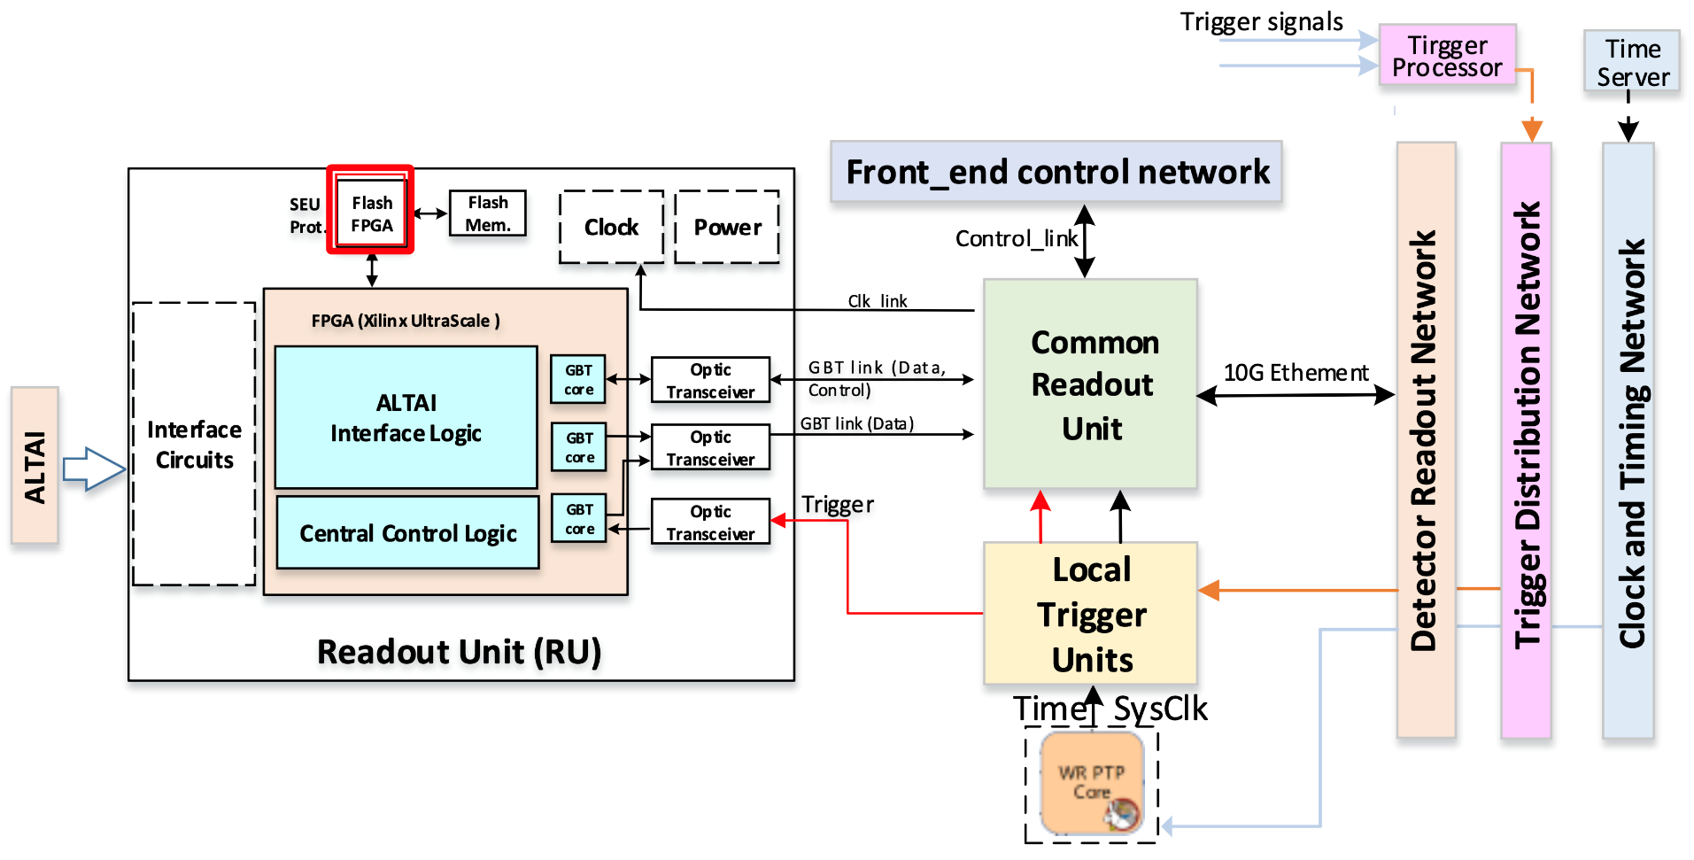
Readout Unit (FPGA-based & ASICs-based)
“Courtesy of Lei Zhao (USTC)”
MICA
MICA
Control and read out the data from 14 modules (7 MICA chips/module)
SRAM-FPGA receives control/trigger signals and delivers packed data to CRU
GBT function integrated into the SRAM-FPGA
A Flash-FPGA to monitor and protect the SRAM-FPGA from SEU based on scrubbing
9

Slide 10
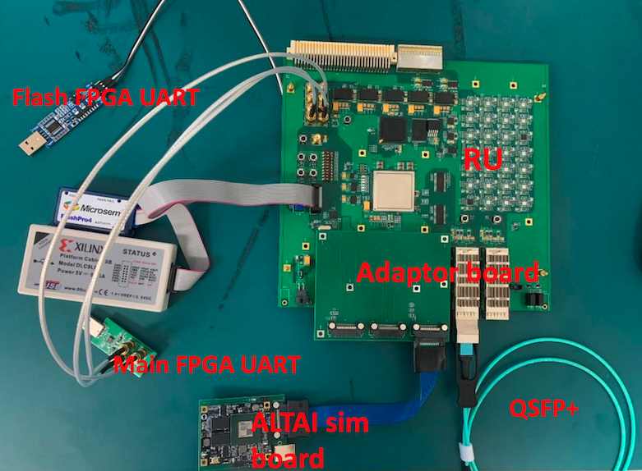
Readout Unit (FPGA-based & ASICs-based)
“Courtesy of Lei Zhao (USTC)”
Bitstream file load test passed
Partial reconfiguration test passed
Error injection test passed
SelectMAP test passed
co-test passed
Finalization of the FPGA-based RU is expected to be done by mid-2024
10

Slide 11

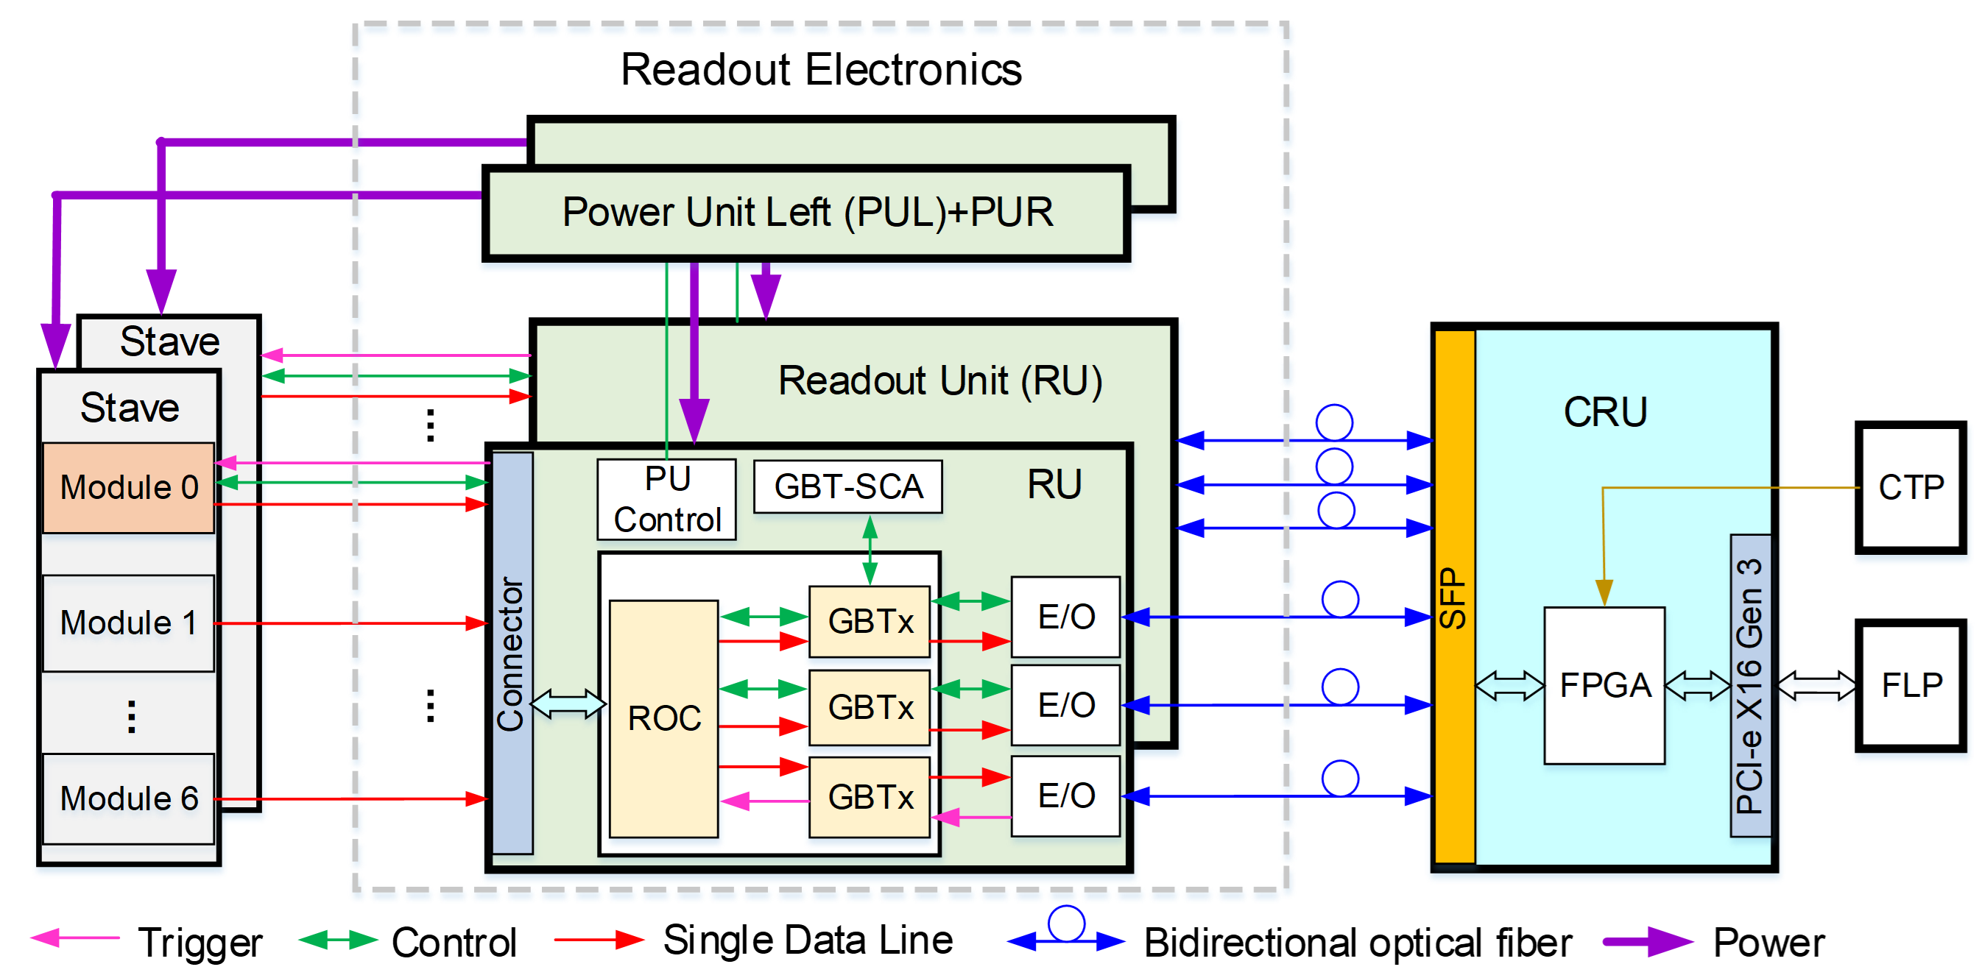
Readout Unit (ASICs-based)
“Courtesy of Di Guo (CCNU)”
Monolithic Active Pixel Sensor (MAPS) ASIC
NICA_ROC:
Data collection and control distribution ASIC
NICA_GBT family (3 chips + optical module)
NICA_ LD : Laser Driver ASIC
NICA_TIA : Transimpedance Amplifier ASIC(Receiver)
NICA_GBTx: Bi-directional data interface ASIC
Note: NICA_LD and NICA_TIA are inside the optical module

Slide 12
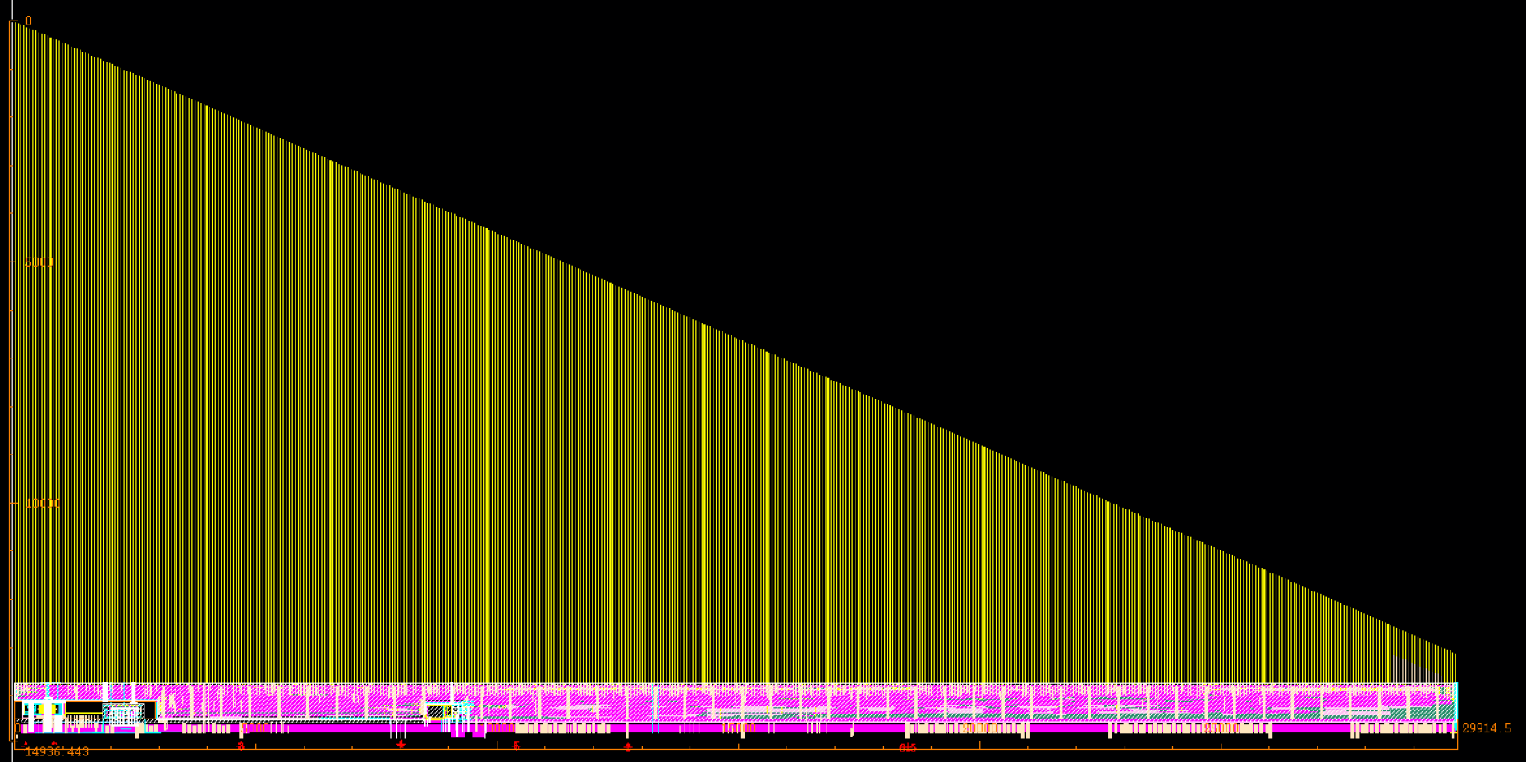

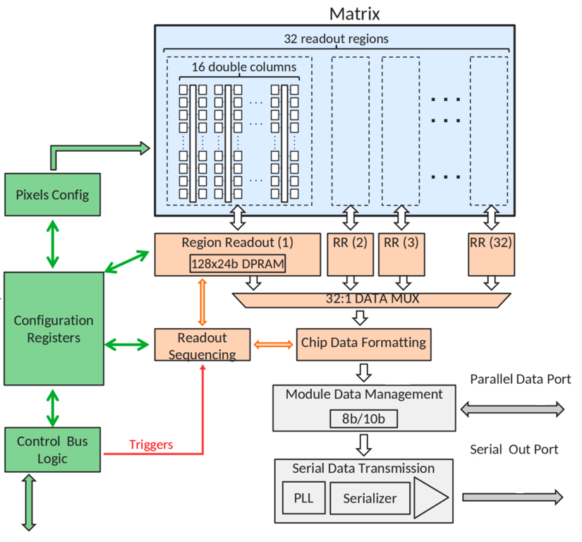
MICA chip design
Courtesy of Le Xiao (CCNU)”
Features:
Process: 130nm
Pixel Array: 512 × 1024
Pixel size: 30.53 µm × 26.8 µm
Chip Size: 15 mm × 30 mm
Peaking time: < 1us
Pulse discrimination time: 5-10 us
Parallel data port: 80 MHz I/O CMOS 3.3 V
High speed serial data port: 1.1 Gb/s, 8B10B encoding
Configuration interface: SPI
Two readout modes: trigger/continuous
Each pixel can be individually masked; Pixels include built-in testing functions.
Layout of MICA chip
Current Status:
DRC clean
LVS clean
Tapeout flow started
Post simulation checks
Block diagram of MICA chip
12

Slide 13
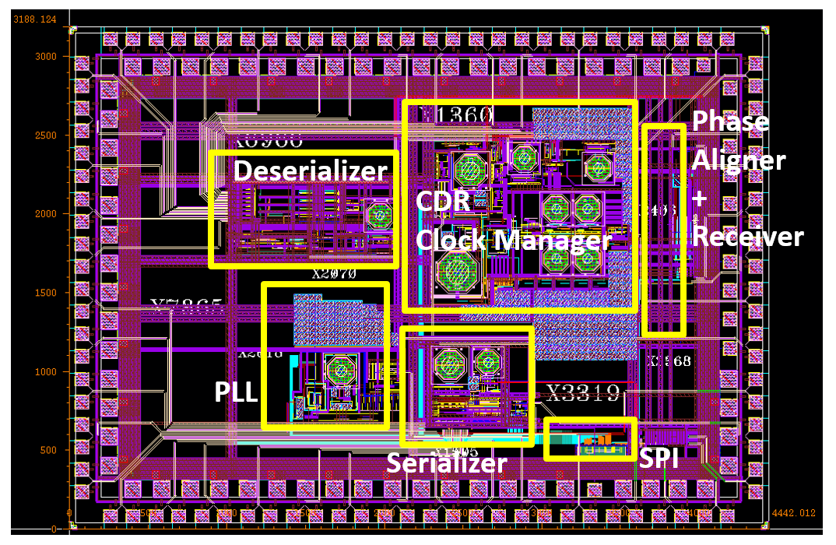
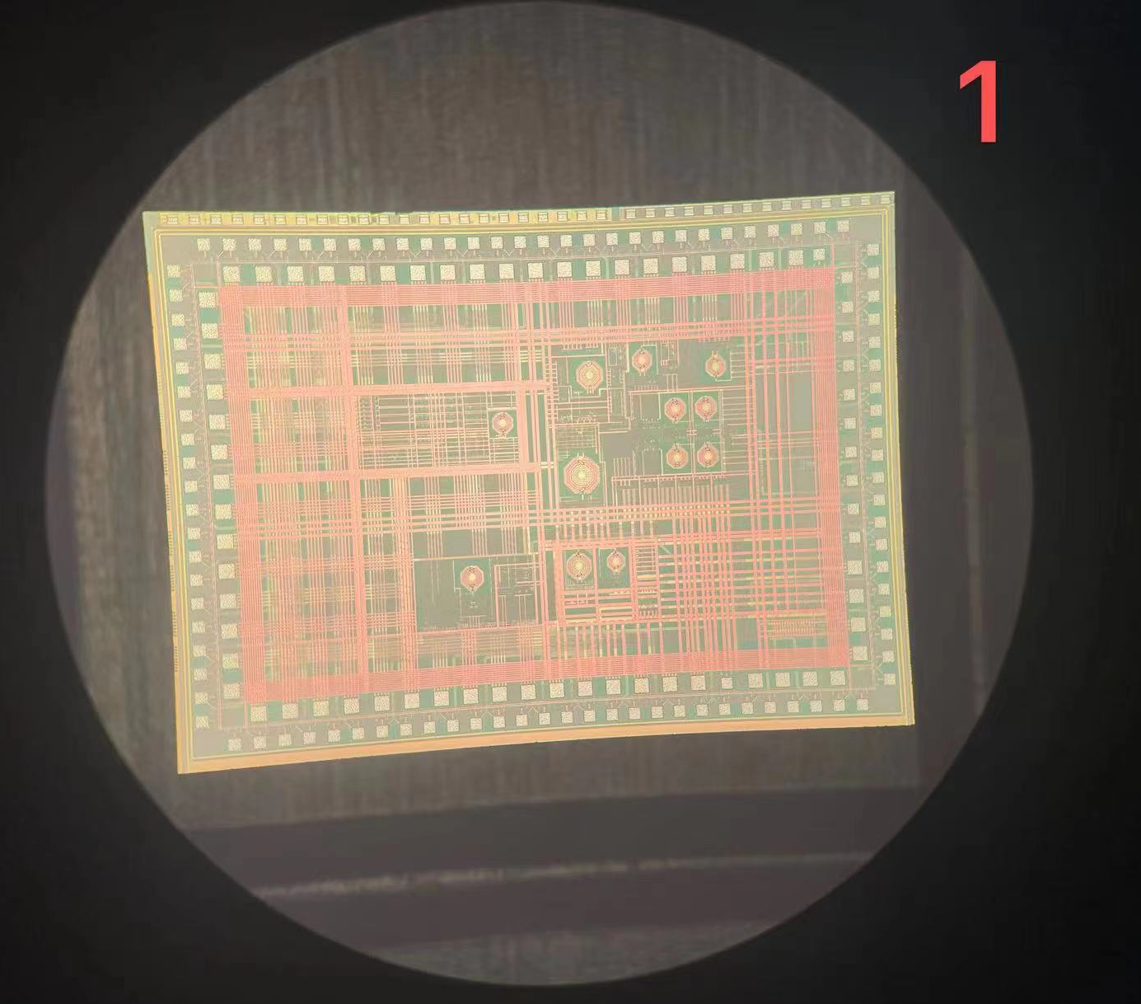
NICA_GBTX chip
Courtesy of Di Guo (CCNU)”
NICA_GBTx layout
Practical NICA_GBTx chip picture
under microscope
Includes complete analog sub-modules:
  2.56 GHz CDR (Rx direction)
  2.56 Gbps De-serializer (Rx direction)
  10.24 Gbps Serializer (Tx direction)
  5.12 GHz PLL (Tx direction)
  Phase Aligner
Total pins: 166
Chip size: 2880 x 4000 μm (Bare die)
9
13

Slide 14
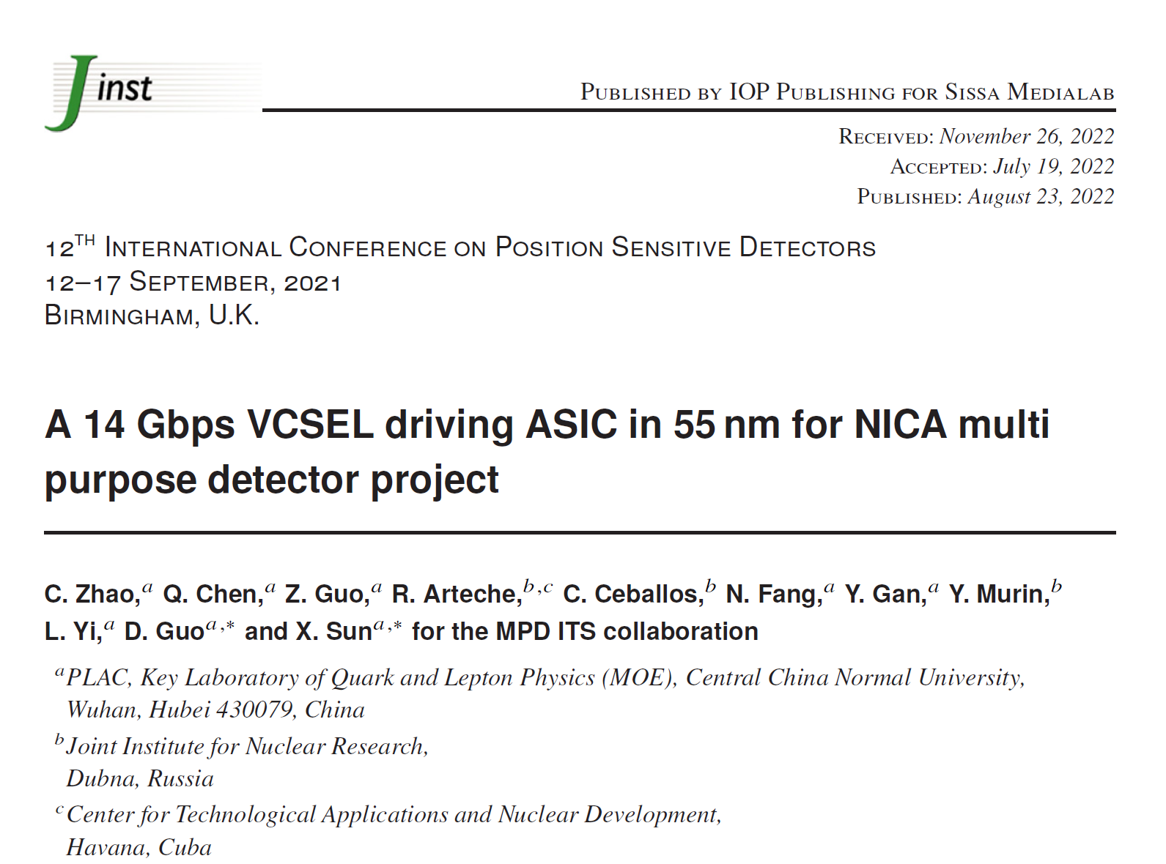
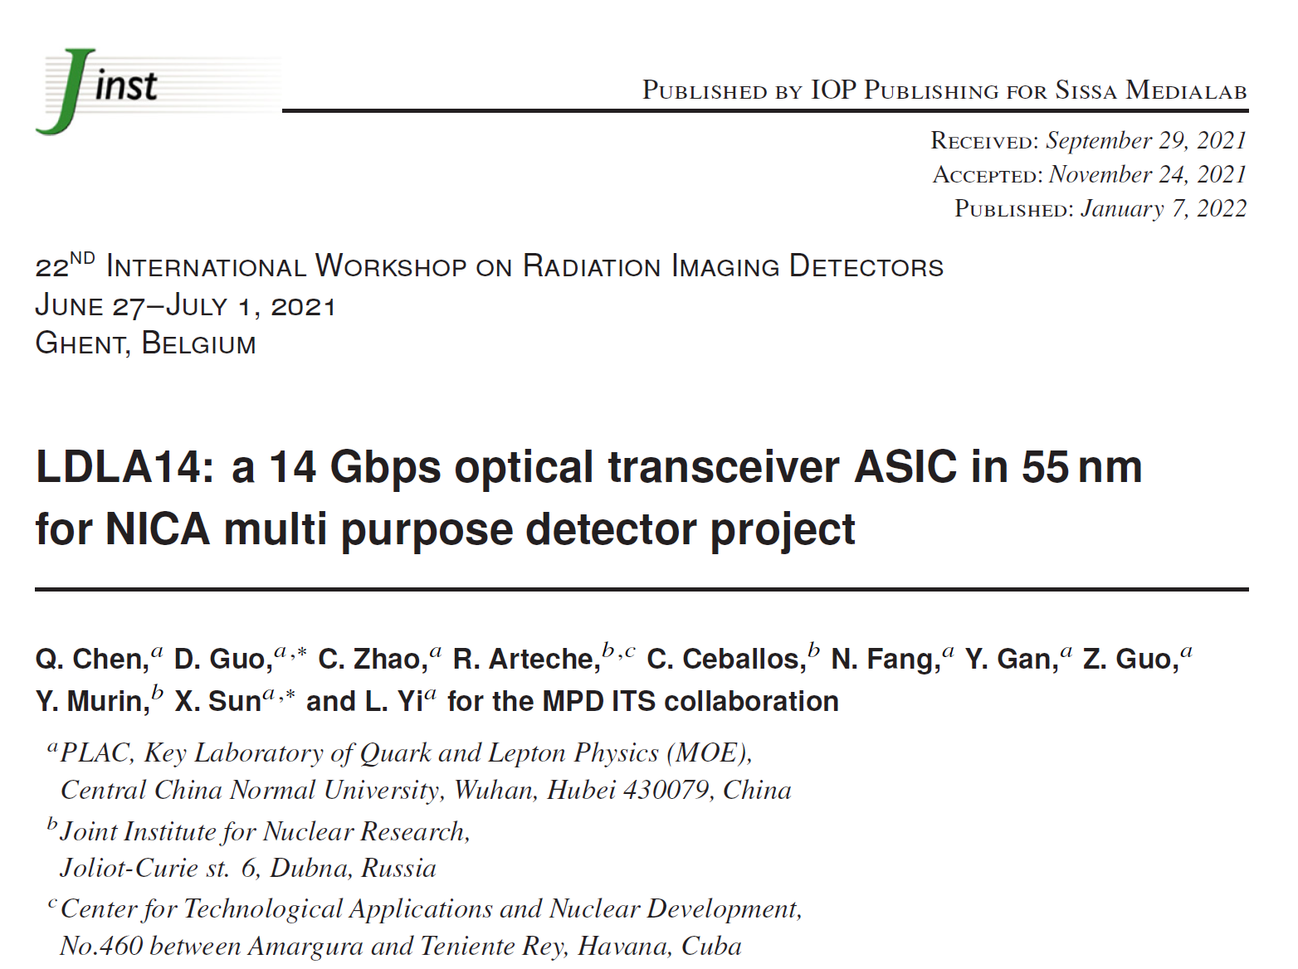
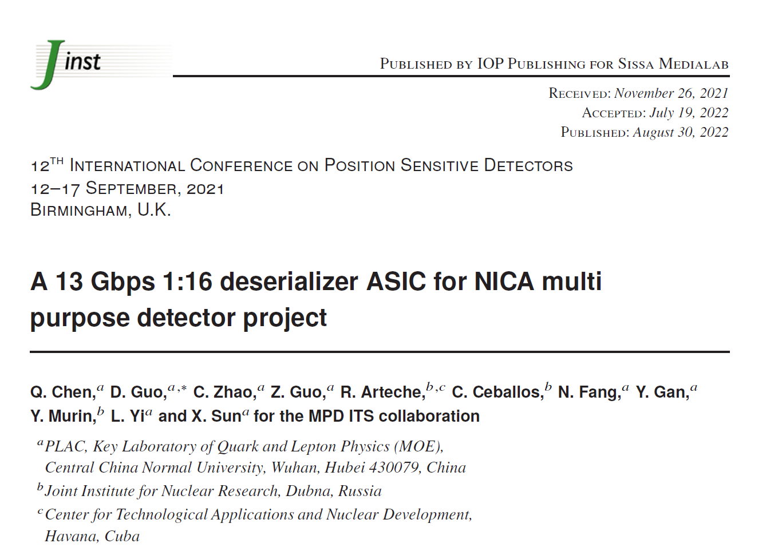
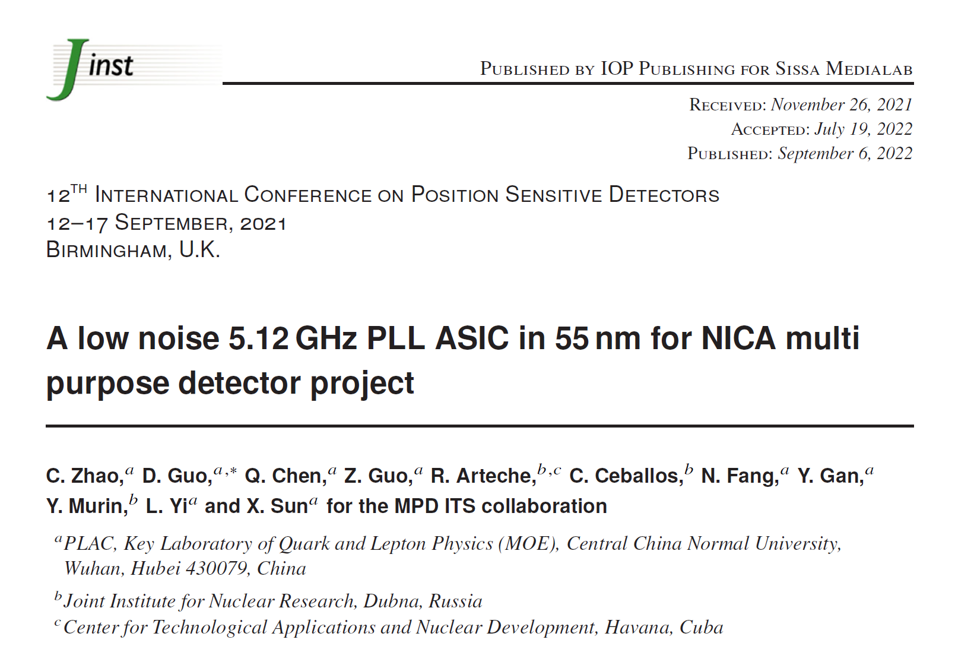
Readout Unit (ASICs-based)
“Courtesy of Di Guo (CCNU)”
NICA_LD_v1
JINST 2022
NICA_LD+TIA_v1
JINST 2022
The design and test results of the NICA_LD_v1, NICA_TIA_v1 and the Deser+PLL have been published in JINST 2022 on behalf of the MPD ITS collaboration.
Deser in NICA_GBTx
JINST 2022
PLL in NICA_GBTx
JINST 2022
14

Slide 15
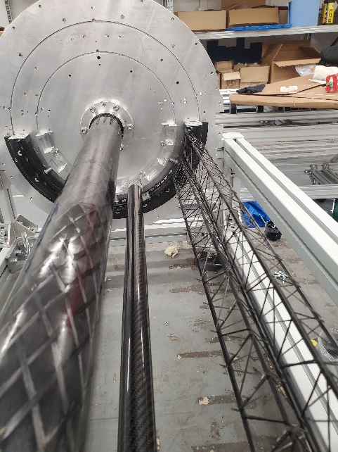
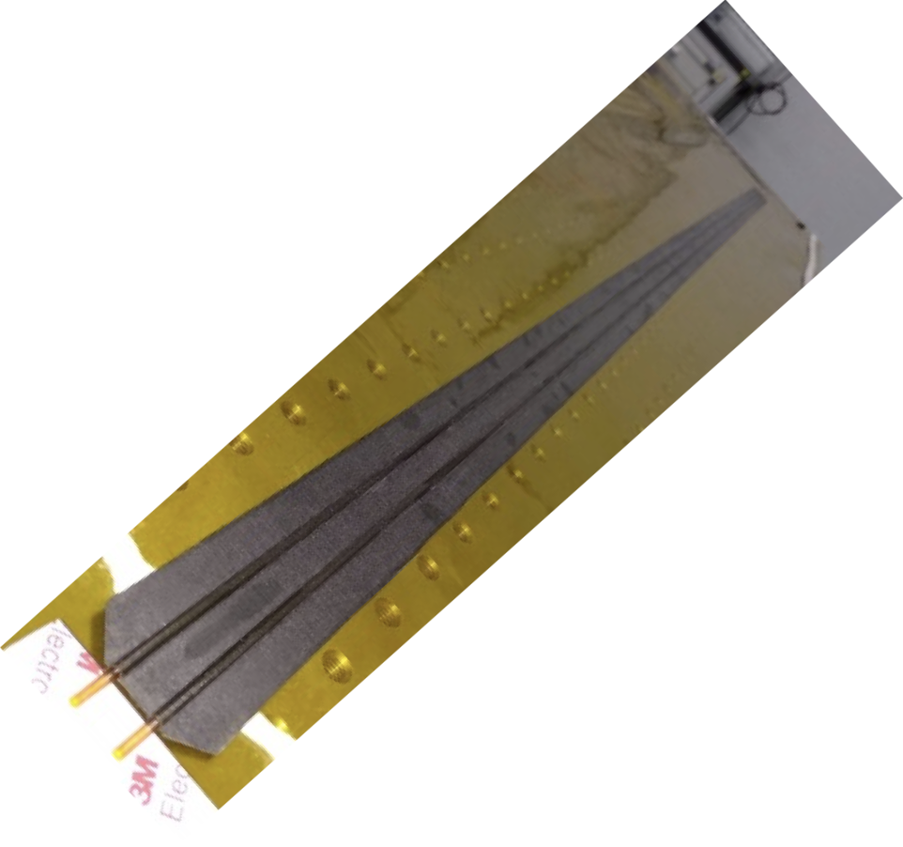
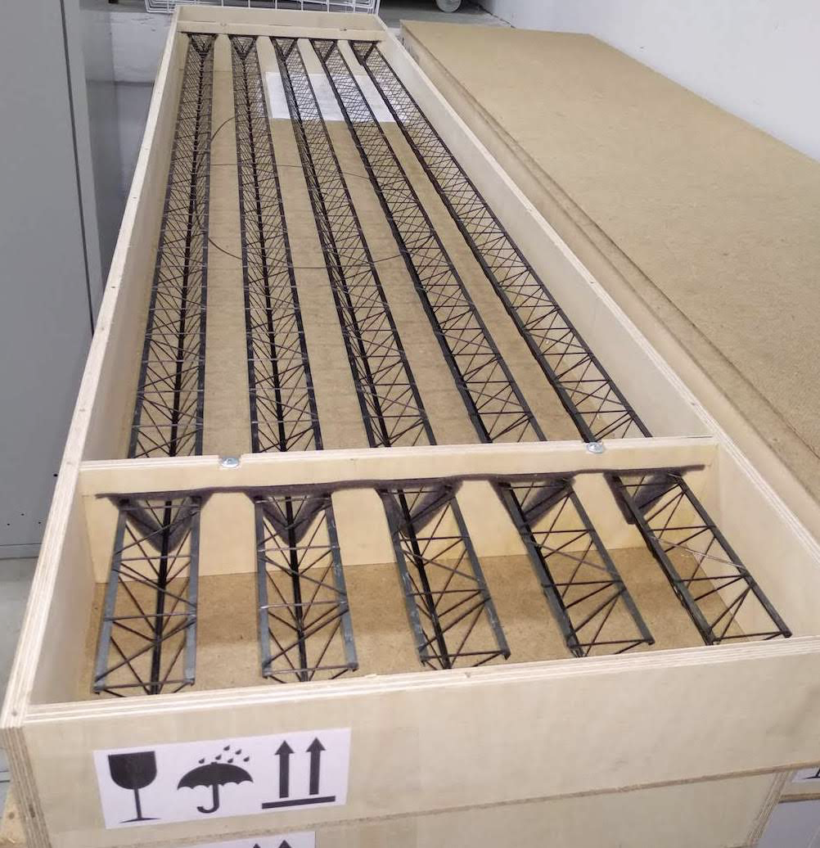
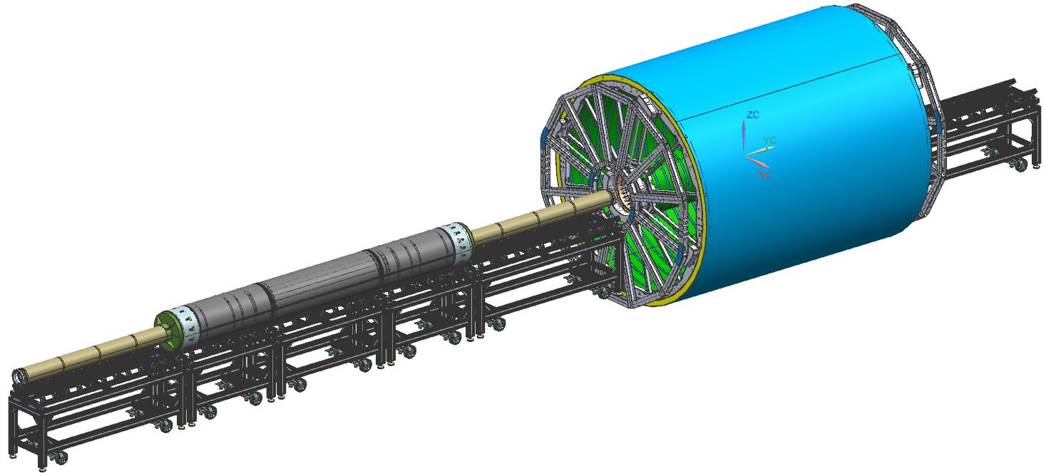
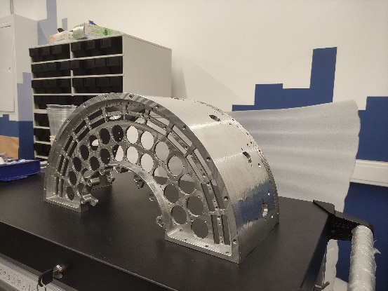
Low weight supporting structure with in-built cooling elements
Central part is almost finished
Integration dry tests scheduled for Q1 20024
Essential parts manufactured
15

Slide 16
Ultimate goals and timelines of the MPD ITS Team
Development of the MICA chip in two years 2026
Establishing series production of MICA chips (2026-2027)
Finalization of the MPD ITS OB, its integration and commissioning ( First stage of MPD ITS project) (2028 )
Approving the design of the IB (curved or straight sensors?) (2023)
Building, integration and commissioning of the IB (2024-2029)
Commissioning of the MPD ITS (2029)
Thank you for the attention
16

Slide 17
April 2023
March 2021
BACKUP SLIDES TO FOLLOW
April,
2023
March 2022

Slide 18
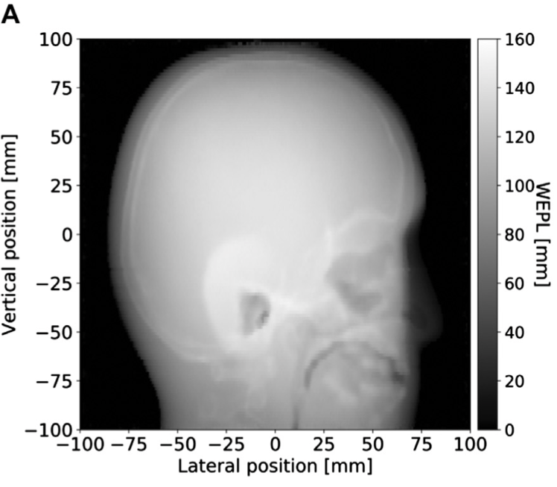
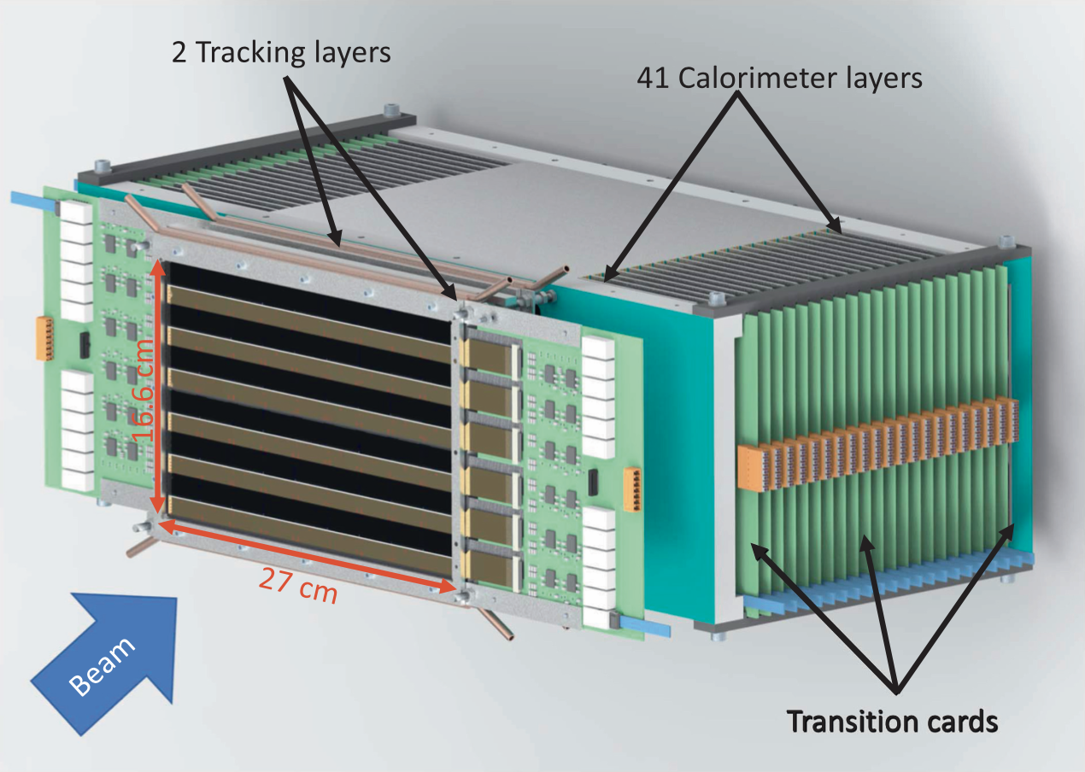
Proposal for the redimension of our current collaboration
China – Russia MAPS Consortium
Participants: JINR, SPbU, CCNU, USTC, IMP
MICA chips
Prototyping
Series production
Fundamental Research
Life Science Applications
MPD-ITS
pCT clinical prototype
"A High-Granularity Digital Tracking Calorimeter Optimized for Proton CT", Frontiers in Physics | 1 October 2020 | Volume 8 | Article 568243| www.frontiersin.org
Notes:
Series Production

Slide 19
Backup
NICA_ROC: Concentrates the output data of front-end MICA chips and transfer the packaged data to the following NICA_GBTx ASIC. It also receives control commands, clocks, and trigger signals from the backend and distributes them to MICA chips.
NICA_GBTx: A high-speed bidirectional data interface ASIC for optical links.
It receives multichannel data from the front-end (NICA_ROC), performs scrambling, encoding, frame building and serializing as the main function for the up-link direction.
It receives high-speed serial data from the back-end, performs CDR (Clock and Data Recovery), deserializing, decoding and distributing to the front-end as the main function for the down-link direction.
NICA_LD (Laser Driver) and NICA_TIA (Transimpedance Amplifier): Are two analog ASICs that would be integrated together with the laser and PD (Pin Diode) in the customized optical transceiver module.
NICA_LD receives the high-speed up-link serial data from NICA_GBTx and amplifies the signal to driver the laser.
NICA_TIA receives the down-link serial signal from the pin diode, and amplifies the signal to NICA_GBTx, so that the data can be furthered processed in NICA_GBTx. These four ASICs will be introduced in the following sections.

Slide 20
The BM@N detector
Projectile fragments with A/Z=2
Xenon beam of 3.9 GeV/n in injection chain including ion source Kryon-6T, HILAC, Booster stored 500*10^6 events in December 2022 to February 2023 experiment
Xenon beam of 3.9 GeV/n in injection chain including ion source Kryon-6T, HILAC, Booster stored 500*10^6 events in December 2022 to February 2023 experiment

