Slide 1
Cluster finder acceleration for TPC detector
Alexander Krylov (LHEP)
Email: avkrylov@jinr.ru
O. Rogachevsky (LHEP)
V. Krylov (LNP)

Slide 2
TPC reconstruction workflow

Slide 3
TPC reconstruction workflow

Slide 4
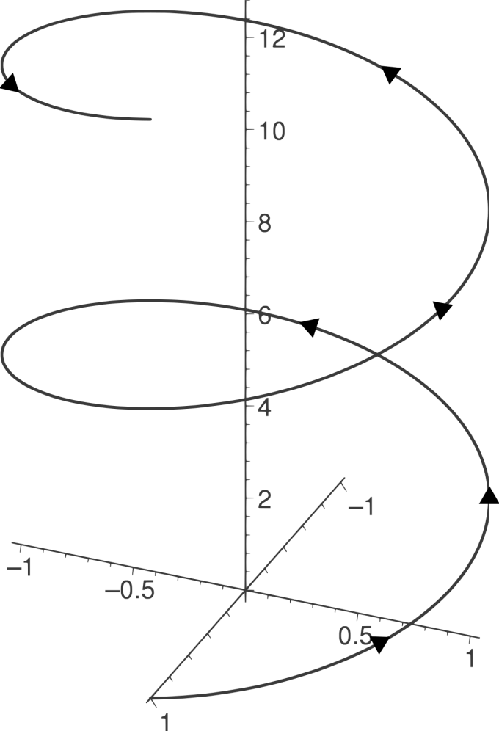
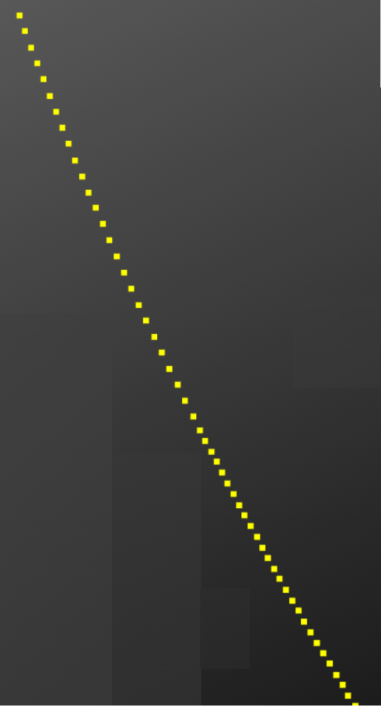
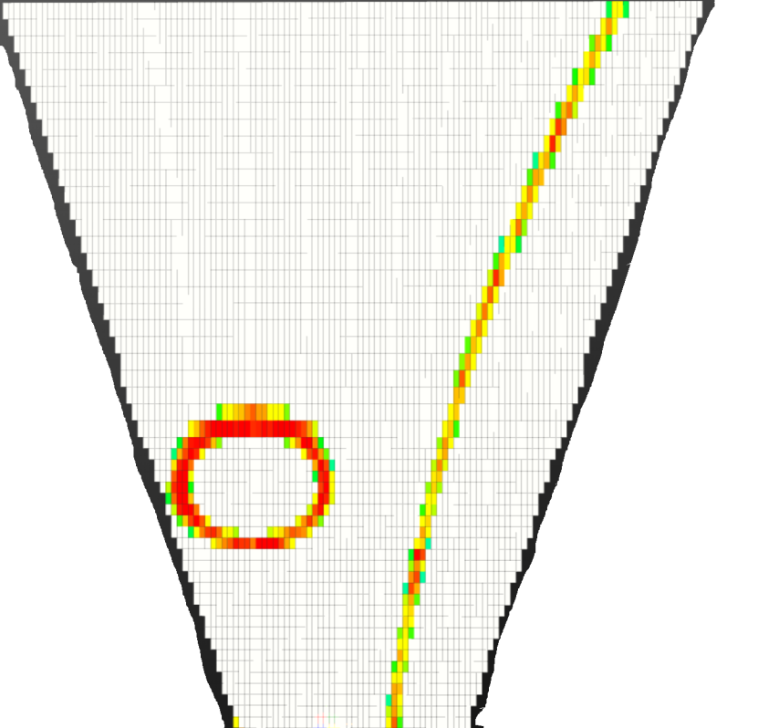
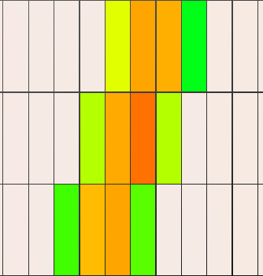
Clustering in TPC
Clustering
Digits on PadPlane
TPC hits
Helix

Slide 5
Fast Clustering workflow

Slide 6
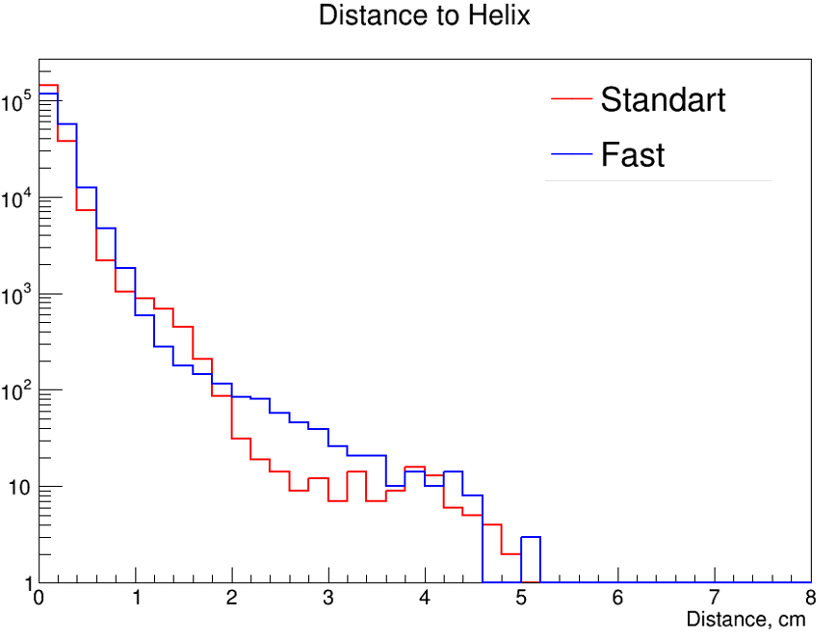
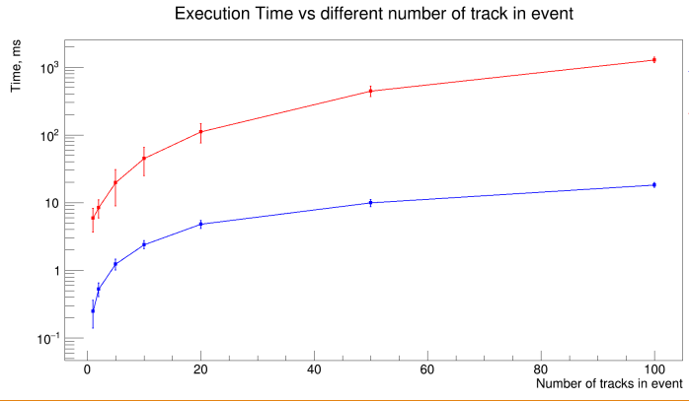
Fast vs Standard
BOX generator (0.25 - 2.5 GeV/c), 100 muons with magnetic field
Notes:
Scale on left

Slide 7
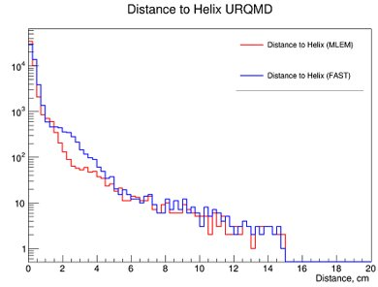
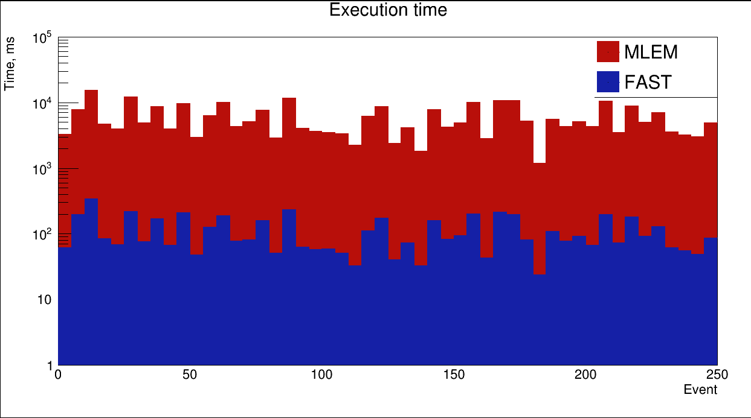
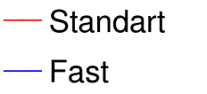
Fast vs Standard
URQMD generator, √s= 7.0 GeV, mb, 250 events

Slide 8
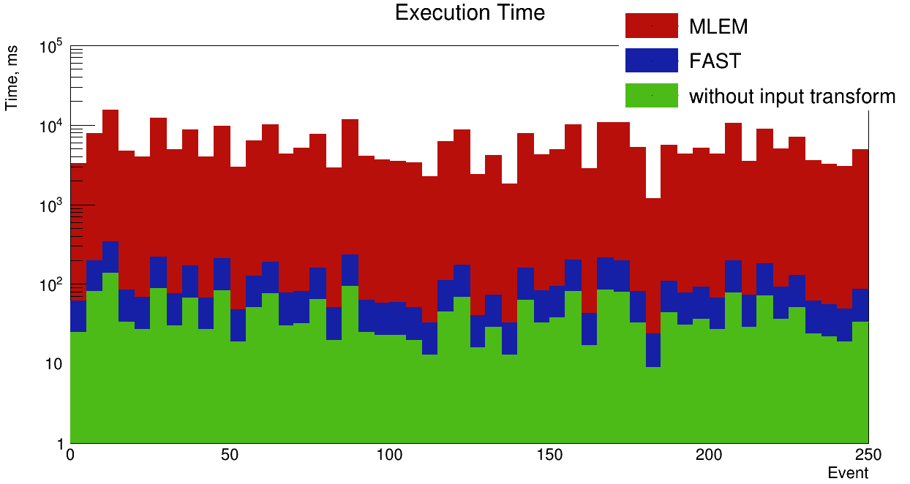
Fast vs Standard
URQMD generator, √s= 7.0 GeV, mb, 250 events

Slide 9
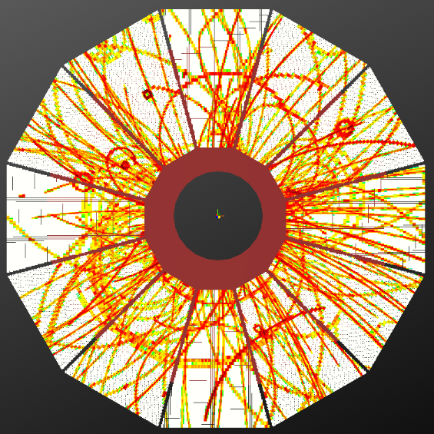
Parallel processing
Parallel processing is performed for each of the 24 TPC sectors independently (one thread for each sector).
For that task POSIX Threads library was used.

Slide 10
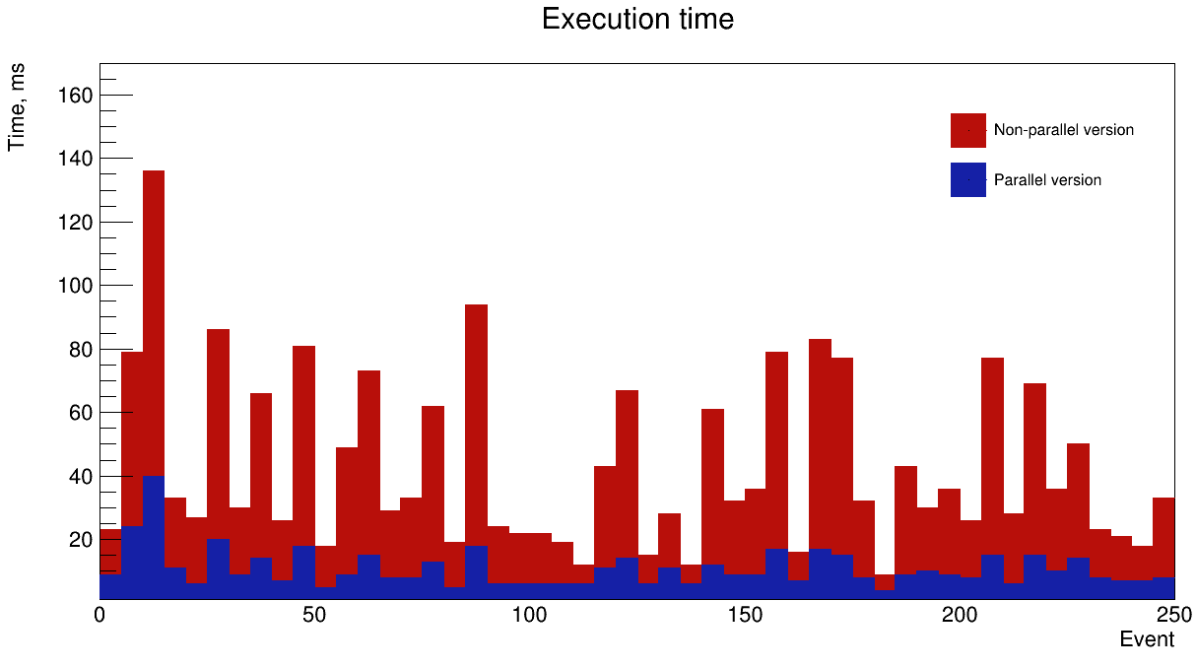
Parallel processing results
URQMD generator, 7.0GeV, mb, 250 events

Slide 11
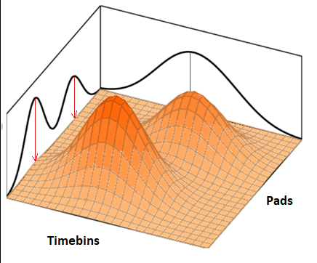
Complex cluster disentanglement
A discrete wavelet transform (DWT) is a transform that decomposes a given signal into a number of sets, where each set is a series of coefficients describing the signal on a different scale.
This allows to "filter" the signal, cutting out the smal space structures. [G.A.Ososkov “The growing neural gas and clustering of large amounts of data”]
Signal with the translated wavelet

Slide 12
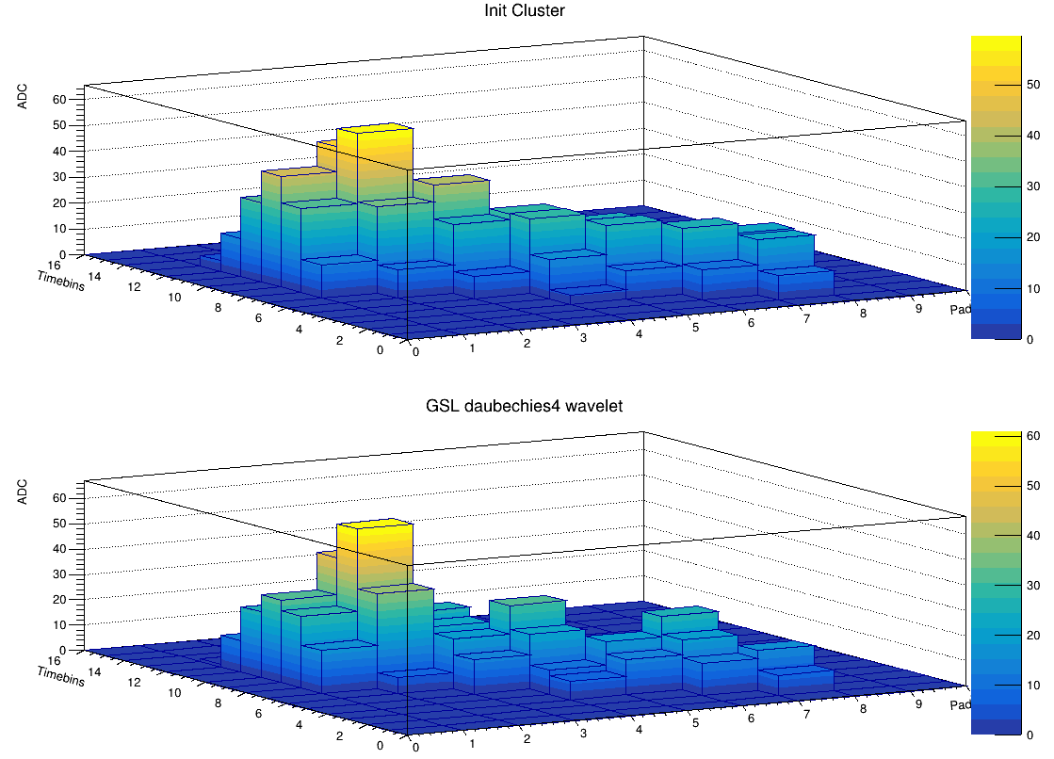
ClusterFinder with wavelet transform
The library provides functions to perform two-dimensional discrete wavelet transforms on square matrices.
Transform performs a complete discrete wavelet transform on the rows of the matrix, followed by a separate complete discrete wavelet transform on the columns.
Daubechie(4) wavelet transform

Slide 13
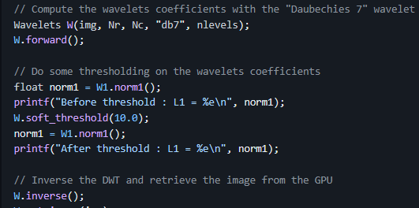
Wavelet transform on GPU
PDWT library is a parallel implementation of the Discrete Wavelet Transform (DWT). This implementation in CUDA targets Nvidia GPUs.
PDWT primarily aims at being fast, simple and versatile for an easy integration in a bigger project.
Git repository: https://github.com/pierrepaleo/PDWT
Notes:
It is possible to accelerate the same task using PDWT library for GPU

Slide 14
TODO
Apply different wavelet transform algorithms on GPU
Use GPU for other processes
Apply different types of parallelization
Using of FPGA cards for clustering (Alice)?

Slide 15
Conclusions
Improvements:
Increased task execution speed
Added hits clusters proportional split
Added parallelization by 24 sector
Fixed some bugs

Slide 16
Thank you for your attention!

Slide 17
Introduction
One of the tasks during the reconstruction of an event in the TPC detector is the task of combining digits into clusters, followed by finding their most probable center. This task is called ClusterFinder and it is already present in the reconstruction chain.
To work with real data from MPD detector the task of finding clusters must be completed in a minimum amount of time, but at the same time have satisfactory accuracy. This is why a library for quickly searching for clusters was written. For this task, methods to improve the speed and accuracy of cluster determination, such as the use of GPU computing and wavelet transform will be proposed

Slide 18
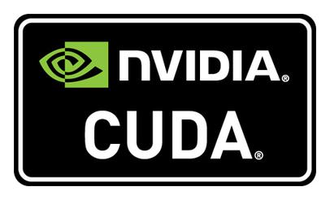
CUDA
CUDA is an architecture that allows the use of a graphics processing unit (GPU).
It is a set of tools and libraries for working with the GPU, based on GPGPU technology.
CUDA cores are better suited for tasks that require massive parallelism, such as matrix operations, machine learning and scientific simulations.

Slide 19
GPU computing
GPU computing enables applications to run with extreme efficiency by offloading series of computational scientific and technical tasks from the CPU.
GPUs process thousands of tasks in seconds through their hundreds of cores via parallel processing.

Slide 20
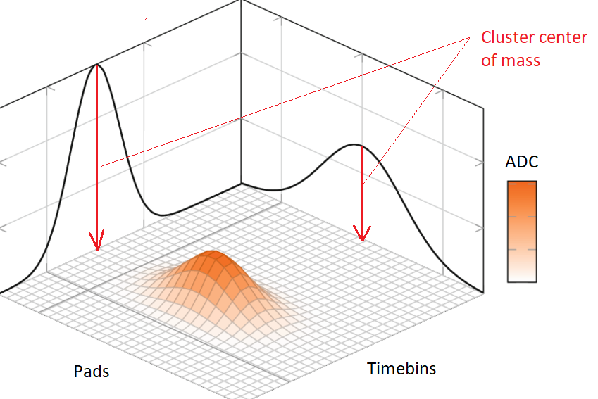
Operations for GPU
There are a number of processes for which processing using graphics cores is suitable.
For example, matrix calculations are used to search for the most probable cluster center.
Also GPU can be used to calculate wavelet transform for complex clusters.

