Slide 2
DIRAC based MPD mass production and its automatization
Andrey Moshkin, Igor Pelevanyuk, Oleg Rogachevskiy
12th MPD Collaboration meeting

Slide 3
MPD: Victor Riabov, Arkadiy Taranenko Andrey Moshkin, Oleg Rogachevskiy, DIRAC: Igor Pelevanyk, Andrey Tsaregorodtzev Responsibles for resources: Tier-1,Tier-2, EOS: Valery Mitsyn Govorun: Dmitry Podgainy LHEP cluster: Ivan Slepov
Participants

Slide 4
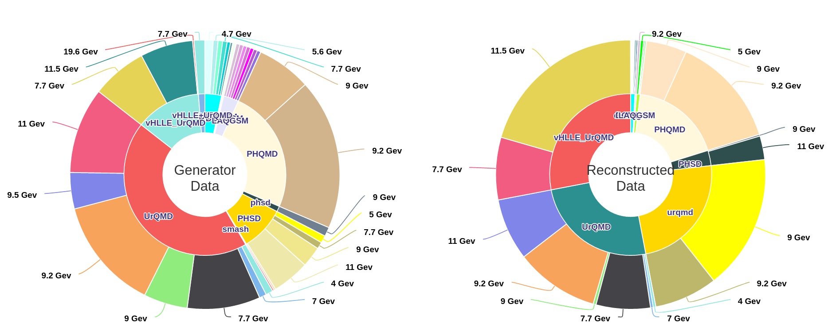
MPD MC generation
The MPD(Multi Purpose Detector) apparatus has been designed as a 4π spectrometer capable of detecting of charged hadrons, electrons and photons in heavy-ion collisions at high luminosity in the energy range of the NICA collider. To reach this goal, the detector will comprise a precise 3-D tracking system and a high-performance particle identification (PID) system based on the time-of-flight measurements and calorimetry.
http://db-nica.jinr.ru/mpdmc/stat.php

Slide 5
MPD MC generation
Generator | PWG | Coll. | $$\sqrt{s}$$ | # of events(${10}^{6}$) | Reco
UrQMD | PWG4 | AuAu | 11 | 15 | +
 |  | BiBi | 9 | 10 | +
 |  |  | 9.46 | 10 | +
 |  |  | 9.2 | 95 | +
 | PWG2 | AuAu | 11 | 10 | +
 | PWG3 | AuAu | 7.7 | 10 | +
 |  | BiBi | 7.7 | 10 | +
 |  |  | 9 | 15 | +
 |  | pp | 9 | 10 | +
 |  | BiBi fix target | 2.5 | 12 | +
 |  | BiBi fix target | 3.0 | (12 underway) | +
 |  | BiBi fix target | 3.5 | (12 underway) | +
 | PWG1 | BiBi | 9.2 | 11(50 underway) | +
DCM-SMM | PWG1 | BiBi | 9.2 | 1 | +
PHQMD | PWG2 | BiBi | 8.8 | 15 | +
 |  |  | 9.2 | 61 | +
 |  |  | 2.4/3.0/4.5 | 10/10/2 | -
vHLLE-UrQMD | PWG3 | BiBi | 11.5 | 15 | +
 |  | AuAu | 11.5 | 15 | +
 |  | AuAu | 7.7 | 20 | +
 |  | BiBi | 9.2 | 48 | +
Smash | PWG1 | BiBi | 9.46 | 10 | +
 |  | ArAr | 4/7/9/11 | 20/20/20/20 | -
 |  | AuAu | 4/7/9/11 | 20/20/20/22 | -
 |  | XeXe | 4/7/9/11 | 20/20/20/20 | -
 |  | CC | 4/7/9/11 | 20/20/20/20 | -
 |  | pp | 4/7/9/11 | 50/50/50/50 | -
JAM | PWG3 | AuAu | 3/3.3/3.5/3.8/4.0/4.2/4.5/5 | 40/40/40/40/40/40/40/40
DCM-QGSM-SMM | PWG3 | AuAu | 4/9.2 | 5/5 | +
 |  | AgAg | 4/9.2 | 5/5 | +
 |  | BiBi | 4/9.2 | 5/6 | +
PHSD |  | BiBi | 9/9.2 | 25 | +
Total |  |  |  | 1293(74 underway) | 449(74 underway)

Slide 6
MICC Resources
EOS
dCache
Storage
Disk, Tape
Protocol
local, root
GridFTP, root
local
local
Auth Storage
Kerb. , x509
x509
ceph key
HybriLIT
Auth Jobs
x509
x509
SSO
HybriLIT
Job Submit.
Grid
Grid
OpenNebula
Slurm
Component
Tier-2/CICC
Tier-1
Cloud
Govorun/HybriLIT
* This is a simplified schema to demonstrate complexity and variability of protocols and accesses approaches

Slide 7
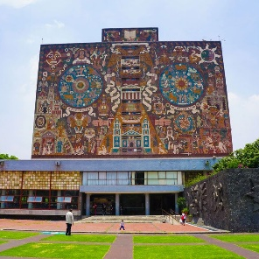
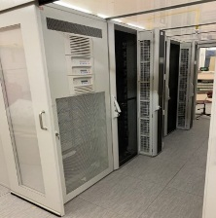
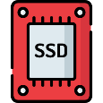
DIRAC in JINR
UNAM
MICC basic facility
NICA cluster
MLIT EOS
Clouds
Tier-1
Tier-2
Govorun
Lustre
Ultra-fast storage
Major Resources | Amount
NICA cluster | 200 cores
Govorun | up to 3260 cores
Tier1 | 1500 cores
Tier2 | 1000 cores
EOS | 2 PB (~1.2 PB used) (total 5 PB)
Polytech
MSC

Slide 8
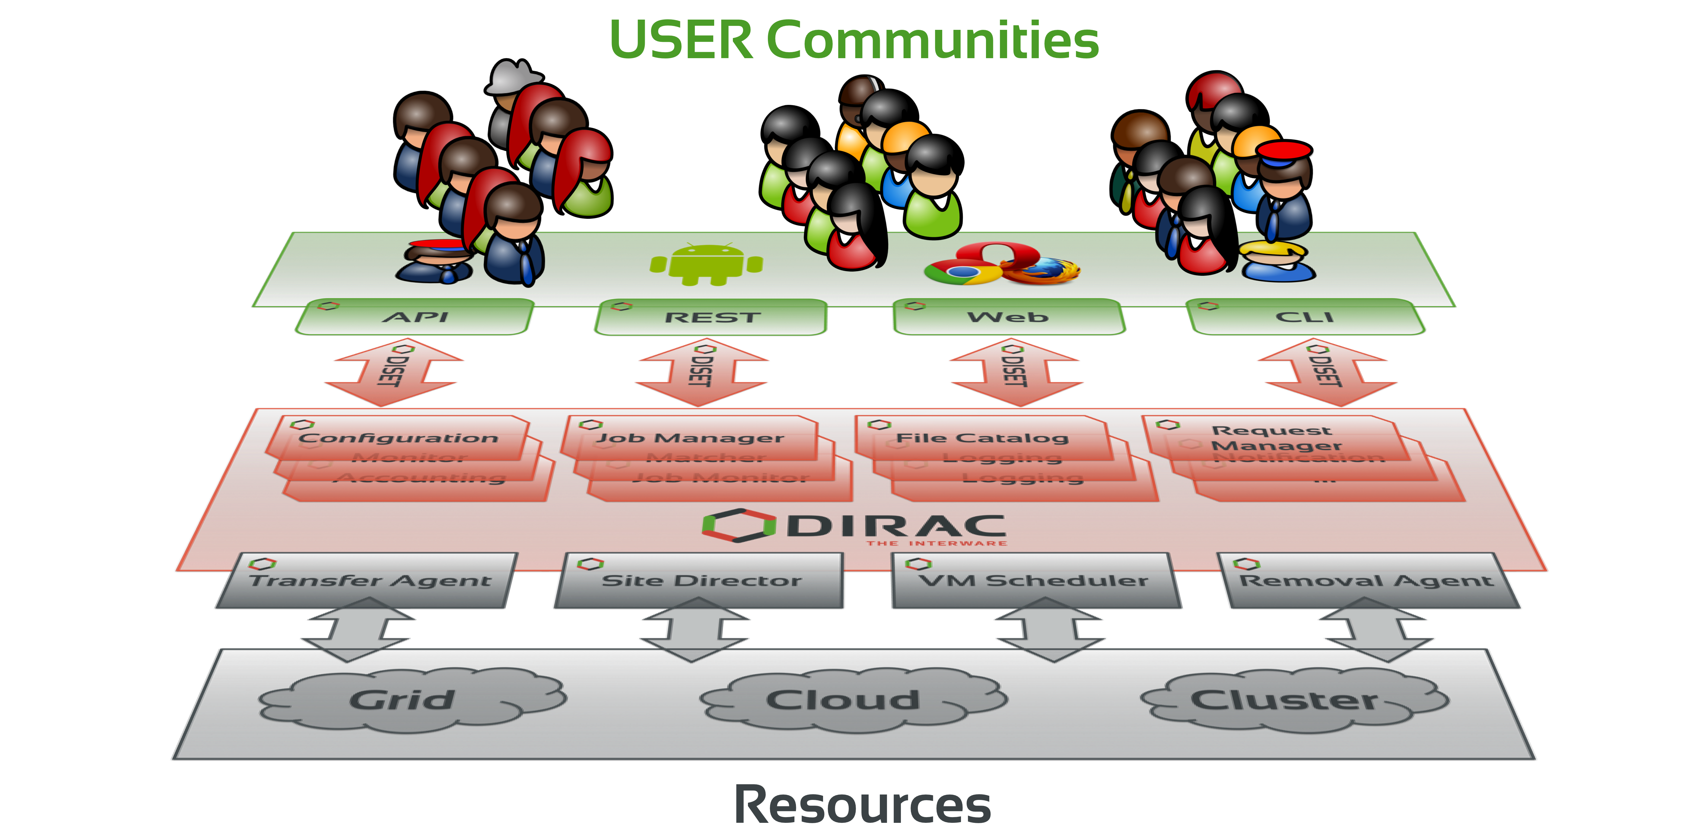
What is DIRAC?
DIRAC provides all the necessary components to build ad-hoc grid infrastructures interconnecting computing resources of different types, allowing interoperability and simplifying interfaces. This allows to speak about the DIRAC interware.
Web
CLI
API
REST

Slide 9
Ratio: between experiments

Slide 10
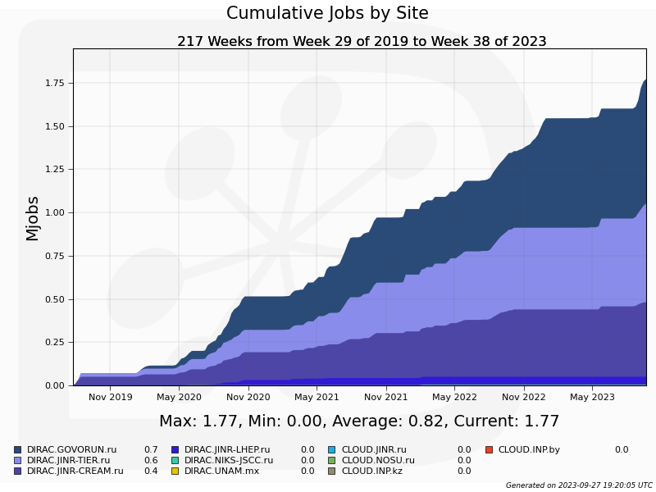
MPD Jobs Total
1,75 million jobs
Govorun
LHEP
Tier1
Tier2

Slide 11
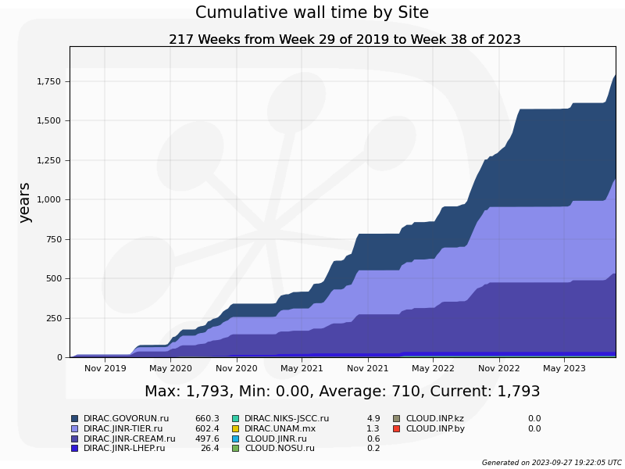
MPD Wall time
1.750 M jobs
Each lasts ~9 hours
Govorun
LHEP cluster
Tier1
Tier2

Slide 12
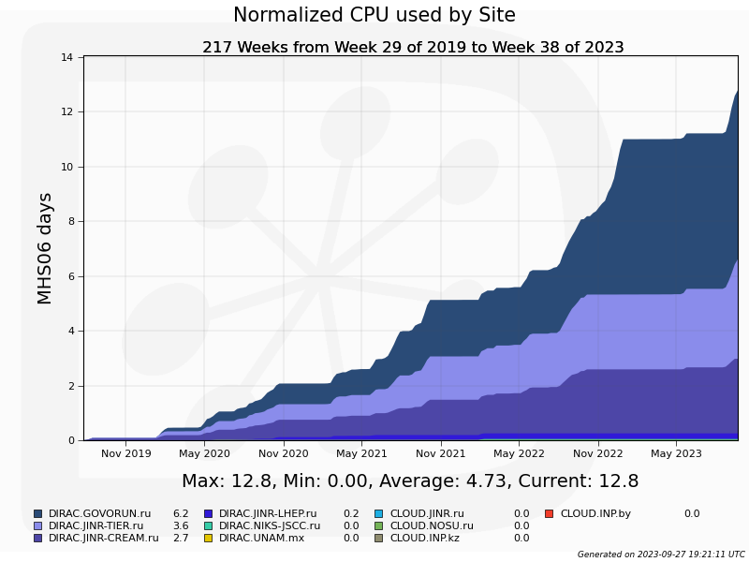
MPD Normalized time
Govorun
LHEP cluster
Tier1
Tier2

Slide 13
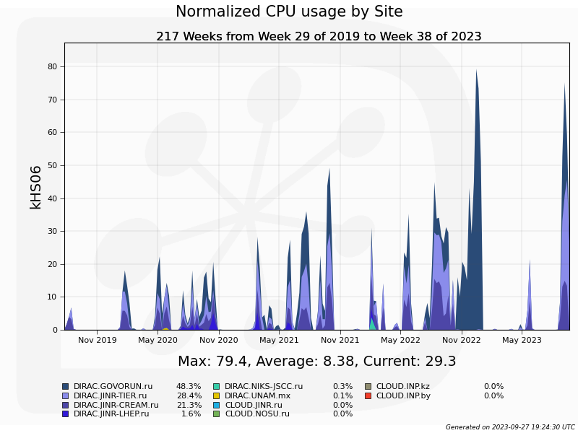
Computing power in DIRAC
Govorun may calculate jobs with extremely high RAM and disk space requirements.
At that time all jobs were “hard”.

Slide 14
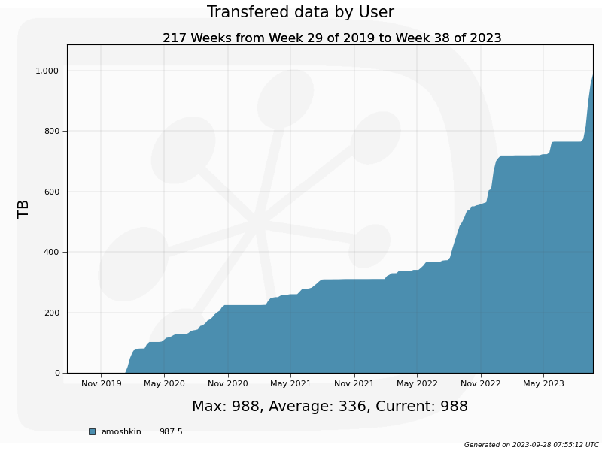
Computing power in DIRAC
Almost 1 PB of data successfully generated and stored for MPD

Slide 15
Automatization

Slide 16
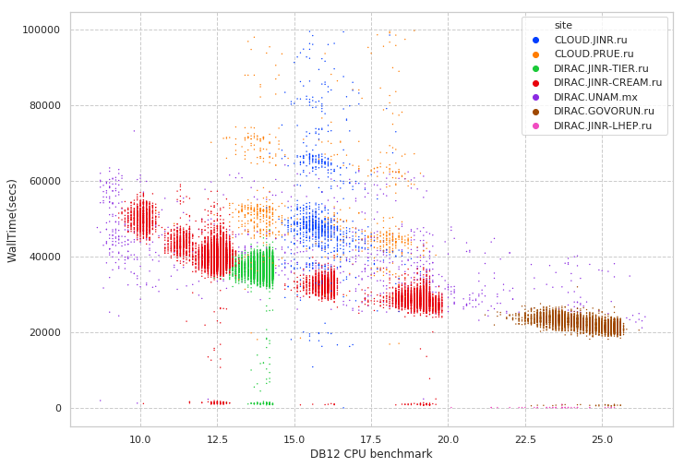
Performance evaluation in distributed infrastructures
Folding@Home
Job execution time
MPD MC
Errors during execution
Immediate errors or short jobs
DB12 Benchmark of a core on which jobs was executed

Slide 17
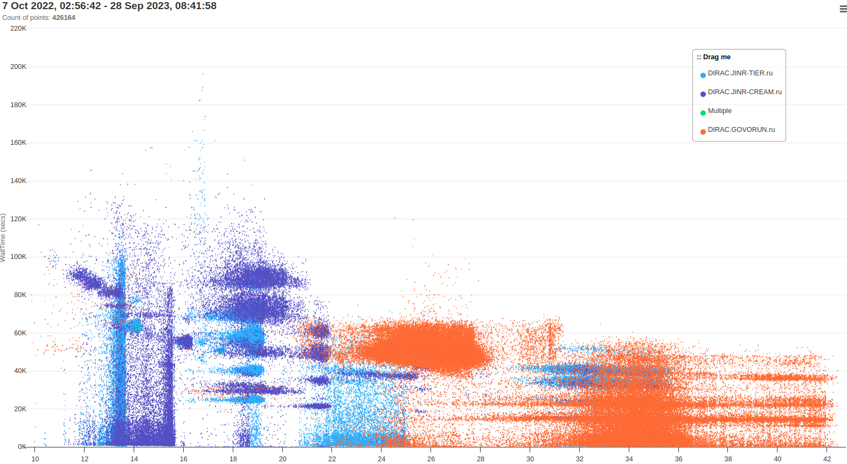
MPD real job distribution for last year

Slide 18
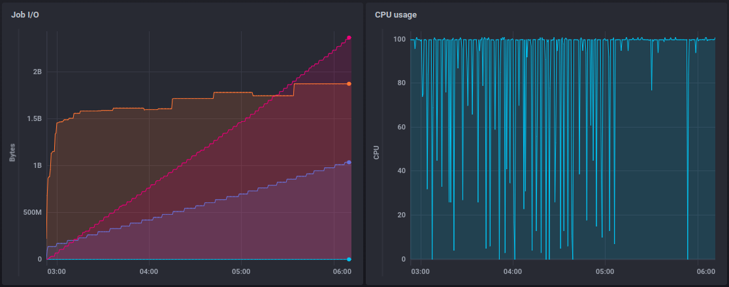
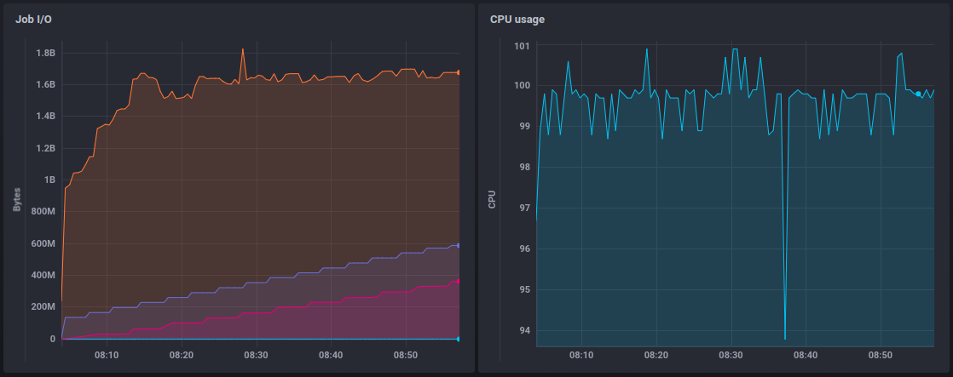
MC jobs monitoring
Write
RAM usage
Read
Write
RAM usage
Read

Slide 19
MPD Monte-Carlo launchpad
Main issue is that in many cases it is necessary to have possibility to provide root commands which should be executed.
Especially for trains.
And it is still necessary to obtain user’s certificate in order to use that application
So, the whole concept was rethought.

Slide 20
MPD mass production launcher
Production launcher
Access Control List
Parameters
MPD Collaboration Web site *
General Production Certificate
Parameters
Token
Jobs
JINR SSO*
UNAM
MICC basic facility
Login
NICA cluster
MLIT EOS
User
Clouds
Tier-1
Tier-2
Govorun
parameters
Lustre
Ultra-fast storage
Results(DST files)
EOS
* Needs to be deployed

Slide 21
Server side is ready
User defined metadata
Submission parameters
"prod_info": "reg31-mb-femto",
"beam": "Bi",
"target": "Bi",
"energy": "09.2GeV",
"centrality": "mb",
"generator": "UrQMD",
"reco_info": "req31-g4-zin",
"prod_number": 46,
"tasks_to_submit": 2,
"events_per_file": 500,
Automaticly calculated parameters
"username": "amoshkin",(from SSO)
"sites": ["DIRAC.GOVORUN.ru"],
"se": ["JINR-EOS-MPD"],
Input/Output files
"input_file_path" : "/mpd.nica.jinr/models/UrQMD/BiBi/09.2GeV-mp/BiBi-mp10-22-1k-req31",
"input_file_suffix": ".mcDst.root",
"filename_template": "urqmd-BiBi-09.2GeV-mb-eos0-1kev-*job_id*",
"output_file_base_path": "/mpd.nica.jinr/vo/mpd/data",
"outputs": { "output1": ["models", "mod.root"],
"output2": ["exp", "reco.root"],
"output3": ["MiniDst", "MiniDst.root"]}

Slide 22
Server side is ready
Input/Output files
"input_file_path" : "/mpd.nica.jinr/models/UrQMD/BiBi/09.2GeV-mp/BiBi-mp10-22-1k-req31",
"input_file_suffix": ".mcDst.root",
"filename_template": "urqmd-BiBi-09.2GeV-mb-eos0-1kev-*job_id*",
"output_file_base_path": "/mpd.nica.jinr/vo/mpd/data",
"outputs": { "output1": ["models", "mod.root"],
"output2": ["exp", "reco.root"],
"output3": ["MiniDst", "MiniDst.root"]}
Payload
root -l -q -b runMC.C\(EGenerators::MCDST,EVMCType::GEANT4,0,\"$FILENAME_TEMPLATE/$INPUT_FILE_SUFFIX\",\"temp.dst.root\",0,$EVENTS_PER_FILE,kFALSE,0\)
root -l -q -b runReco.C\(\"temp.dst.root\",\"$FILENAME_TEMPLATE/$OUTPUT1_EXT\",0,$EVENTS_PER_FILE\)

Slide 23
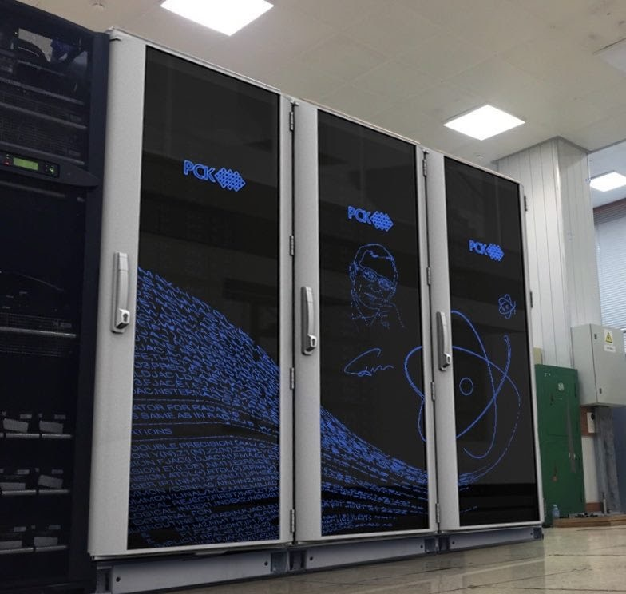
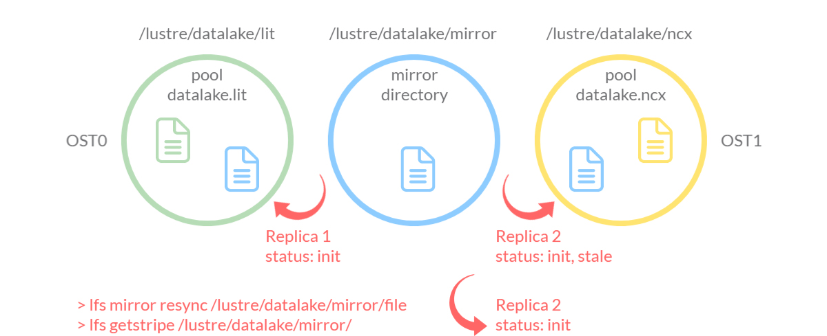
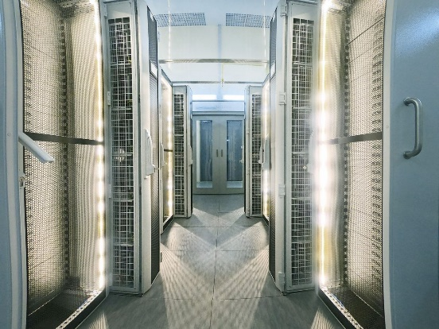
Distributed system for processing and data storage for experiments at the Complex NICA
MLIT Team
Belyakov D.V., Dolbilov A.G., Kokorev A.A., Lyubimova M.A., Pelevanuk I.S.,
Podgainy D.V.
LHEP Team
Moshkin A.A., Rogachevsky O.V., Slepov I.P.
Data flow rates 100 Gbps

Slide 24
Conclusion on MPD+DIRAC
It was 4 years of fruitful cooperation between MPD physicists, engineers, developers and administrators:
1.75M jobs successfully completed, 1PB generated
These jobs would took ~9 years to complete with the basic 200 job slots with 100% load.
But still, some jobs can be completed only on Govorun!
Additional services greatly improve our understanding of computing load, requirements and efficiency.
MPD trains is the next big challenge for us. We are working on providing simple and transparent tool to execute them on MPD distributed infrastructure.

Slide 26
Why DIRAC?
1. Single system for all aspects of computing
User Interface
API
Central configuration
Workload management
Data management
Integration tools
File Catalog
Workflow management
Metadata management
Accounting
Management

Slide 27
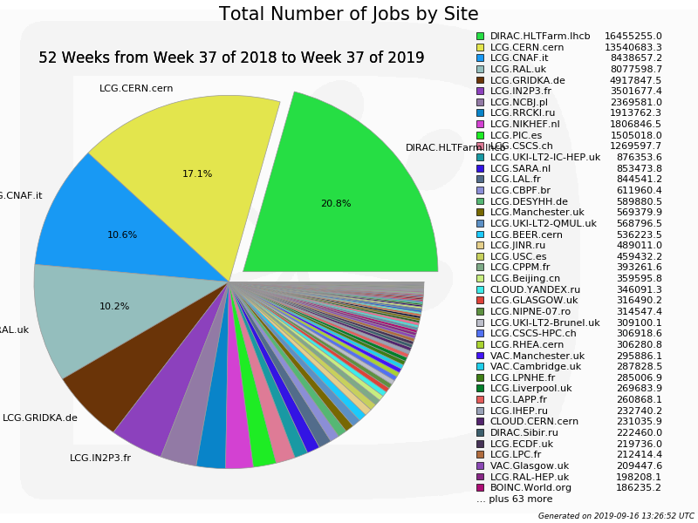
Why DIRAC?
2. Good performance

Slide 28
Why DIRAC?
3. Active users and developers community

Slide 29
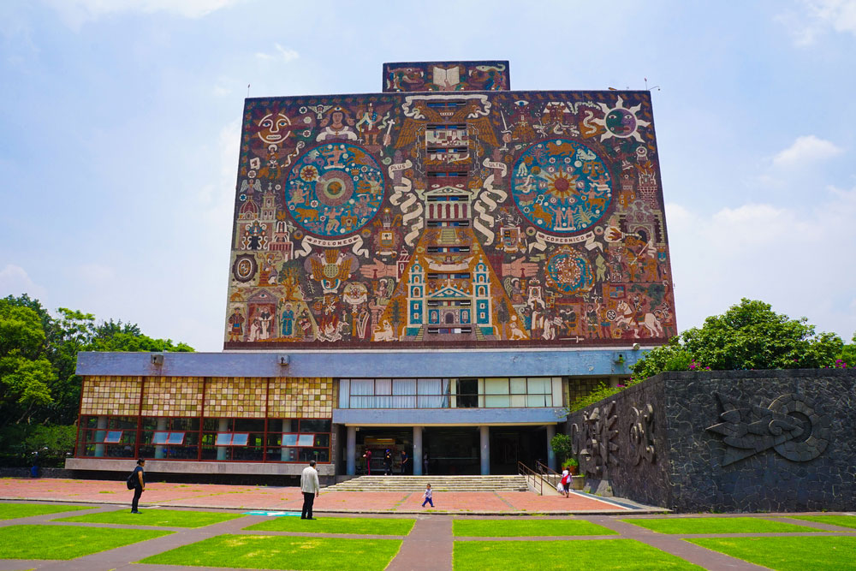
Workload management
Submit thousand of jobs to DIRAC Job Queue
Tier-1
CICC/Tier-2
Clouds
Govorun
NICA Cluster
UNAM

Slide 30
Workload management
Submit thousand of jobs to DIRAC Job Queue
User Job
User Job
User Job
User Job
User Job
User Job
User Job
User Job
User Job
Tier-1
CICC/Tier-2
Clouds
Govorun
NICA Cluster
UNAM

Slide 31
Workload management
Submit thousand of jobs to DIRAC Job Queue
User Job
User Job
User Job
User Job
User Job
User Job
User Job
User Job
User Job
Pilot job
Pilot job
Pilot job
Pilot job
Pilot job
Pilot job
Tier-1
CICC/Tier-2
Clouds
Govorun
NICA Cluster
UNAM

Slide 32
Workload management
Submit thousand of jobs to DIRAC Job Queue
User Job
User Job
User Job
User Job
User Job
User Job
Pilot job
Pilot job
Pilot job
Pilot job
Pilot job
Pilot job
User Job
User Job
User Job
User Job
User Job
User Job
Tier-1
CICC/Tier-2
Clouds
Govorun
NICA Cluster
UNAM

Slide 33
Workload management
Submit thousand of jobs to DIRAC Job Queue
User Job
User Job
User Job
User Job
User Job
User Job
Pilot job
Pilot job
Pilot job
Pilot job
Pilot job
Pilot job
User Job
User Job
User Job
User Job
User Job
User Job
Tier-1
CICC/Tier-2
Clouds
Govorun
NICA Cluster
UNAM

