Slide 1




Рабочее совещание
"Прикладные исследования на комплексе NICA: перспективы сотрудничества РСО-Алания – ОИЯИ"
17–19 июн. 2023 г.
СОГУ им. К.Л. Хетагурова, г. Владикавказ
Исследования в области электроядерных систем в ОИЯИ.
Настоящее и будущее
С.Тютюнников
ОИЯИ, Дубна

Slide 2
J.Adam, A.Baldin, A.Berlev, W.Furman, N.Gundorin, B.Gus’kov, Zh.Hushvaktov, Yu.Kopatch, E.Kostyuhov, I.Kudashkin, A.Makan’kin, I.Mar’in, M. Paraipan, A.Polansky, V.Pronskikh, A.Rogov, V.Schegolev, A.Solnyshkin, V.Tsupko-Sitnikov, S.Tyutyunnikov, A.Vishnevsky, N.Vladimirova, A.Wojciechowski, L.Zavorka
Joint Institute for Nuclear Research, Dubna, Russia
V.Chilap, A.Chinenov, A.Bogomolov, B.Dubinkin, B.Fonarev, M.Galanin, V.Kolesnikov, S.Solodchenkova
CPTP «Atomenergomash», Moscow, Russia
M.Artyushenko, V.Sotnikov, V.Voronko, Yu. Petrusenko
KIPT, Kharkov, Ukraine
A.Khilmanovich, B.Marcynkevich
Stepanov IP, Minsk, Belarus
K. Husak, S.Korneev, A.Potapenko, A.Safronova, I.Zhuk
JIENR Sosny near Minsk, Belarus
M.Suchopar, O.Svoboda, J.Vrzalova, V.Wagner
INP, Rez near Praha, Czech Republic
L. Kostov, Ch. Stoyanov, P.Zhivkov
Institute of Nuclear Research and Nuclear Energy, Sofia, Bulgaria
M.Shuta, E.Strugalska-Gola, S.Kilim, M.Bielevicz
National Centre for Nuclear Research, Otwock-Swerk, Poland
W.Westmeier
Gesellschaft for Kernspektrometrie, Germany
R.S.Hashemi-Nezhad
School of Physics, University of Sydney, Australia

Slide 3
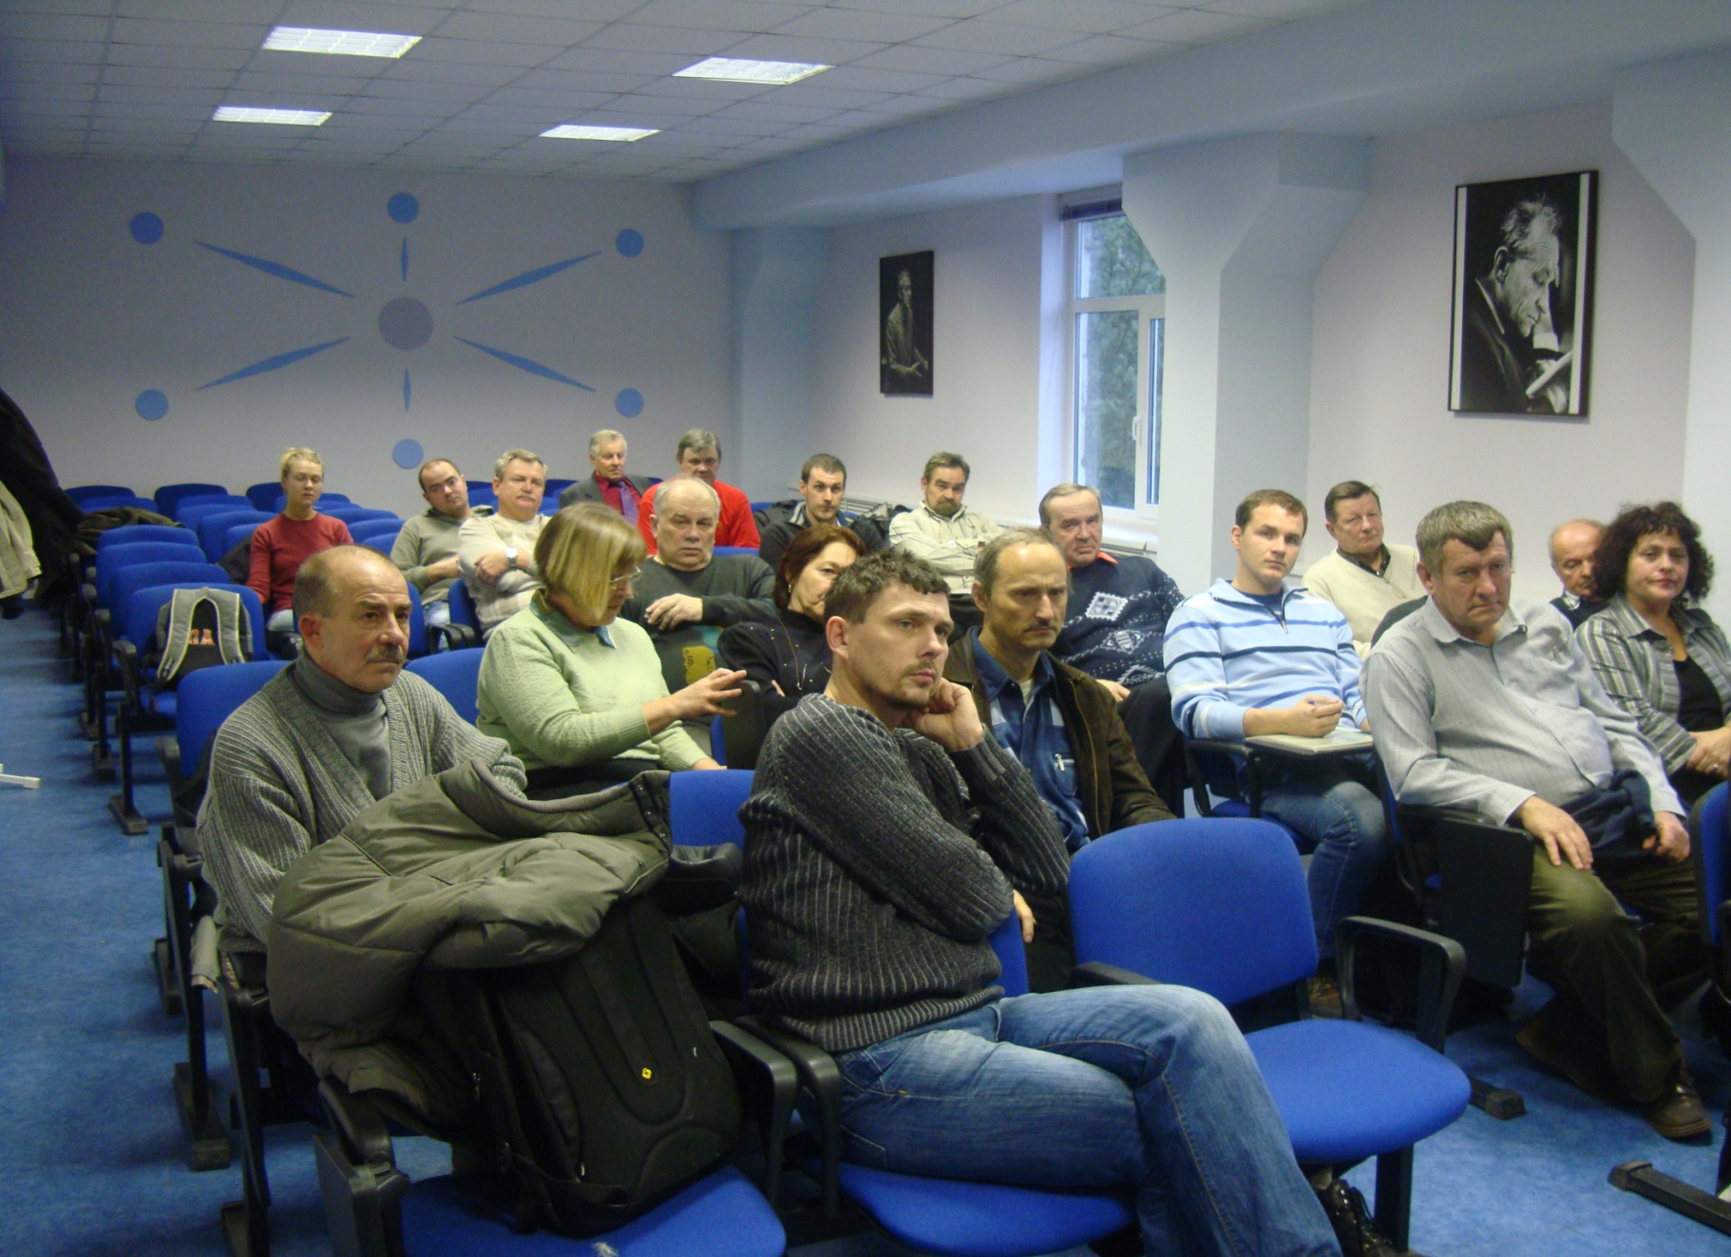

Slide 4
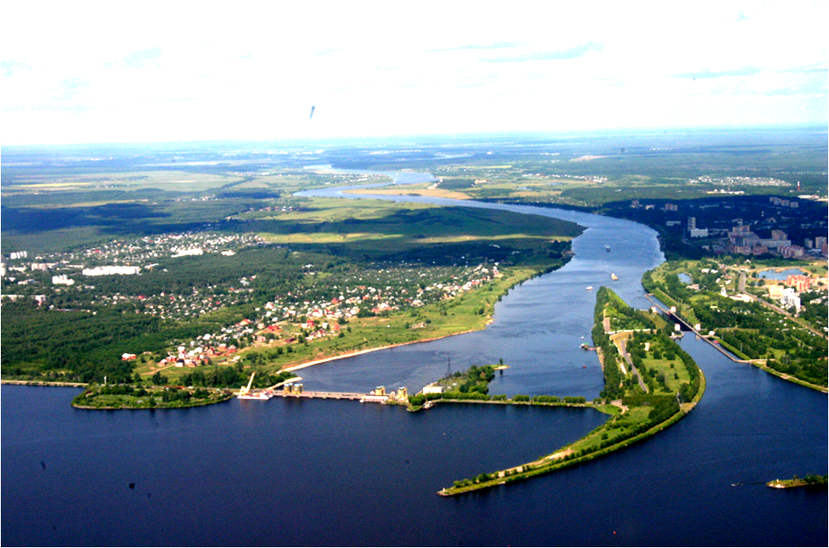
JINR is situated on the right side of the Volga river
120 km north from Moscow
NICA
Volga River
Sluice
12 meters Dam
Volga-Moscow Channel
Water Power Station
“Ivan’kovskoe” Water Storage

Slide 5
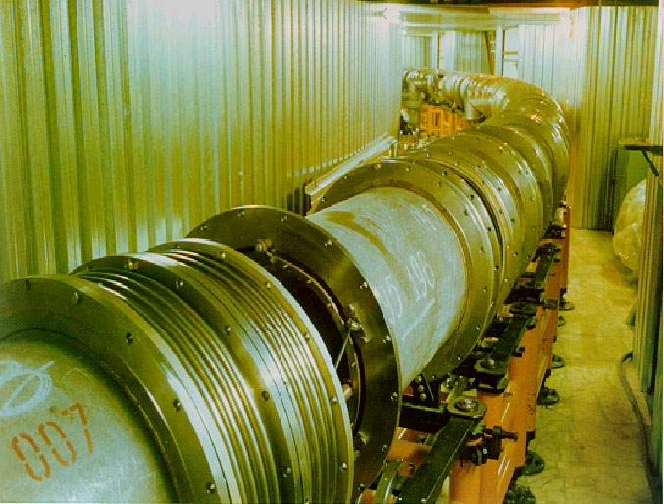

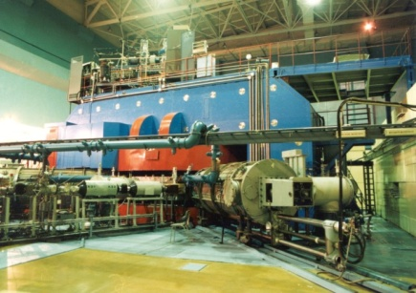
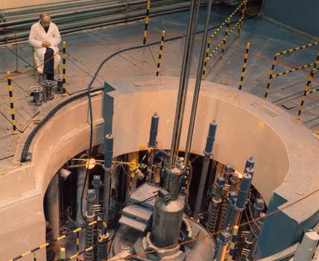
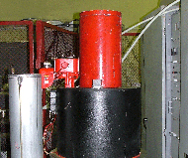
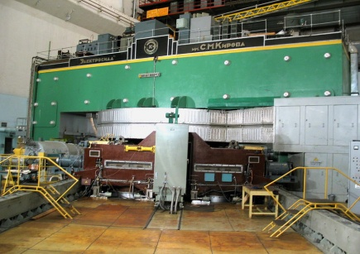
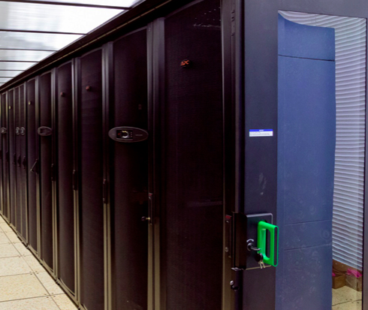
JINR basic facilities
Nuclotron-М – NICA/MPD /SPD
Superconducting ion and polarized particle accelerator and ion collider
Physics of ultrarelativistic heavy ions, high energy spin physics
Applied research
Cyclotron complex U400M, U400MR
Acceleration of heavy ions up to 50 МeV/u
Synthesis of supe-heavy elements
Applied research
Impulse reactor IBR-2М and Source of resonance neutrons IREN
5 Hz pulses with 1,5 GW power and 10¹⁶ neutrons/cm²sec
Accelerator driven neutron beam of 50 GHz up to10¹³ neutrons/sec
Nuclear physics with neutrons, Condense matter physics
Applied research
JINR’s Phasotron
2 μА proton beam with the energy 660 МeV
Complex for Hadron Therapy
Applied research
The Multifunctional Information and Computing Complex (MICC)
Notes:
Этот слайд показывает парк наших базовых установок. За последние годы практически все ускорители и импульсный реактор были существенно модернизированы.
В области физики тяжелых ионов высоких энергий нашей домашней базовой установкой являетса Нуклотрон – сверхпроводящий ускоритель ядер вплоть до атомного номера A~200 с максимальной энергией 5 ГэВ/нуклон. Основные работы по его модернизации закончились в этом году. Предстоит еще введение в строй новых интенсивных источников тяжелых ионов и поляризованных частиц и бустера. Параллельно готовится проект нового ускорительного комплекса – NICA/MPD/SPD (Nuclotron-Based Ion Collider Facility, MultiPurpose Detector и Spin Physics Detector) с энергией 11 ГэВ в сцм нуклон-нуклон.
В области физики тяжелых ионов низких и промежуточных энергий (от 5 до 100 МэВ/нуклон) мы имеем комплекс двух изохронных циклотронов – U400M and U400MR. Их модернизация позволила реализовать 2-ую стадию проекта DRIBs (Dubna Radioactive Ion Beams), целью которого является создание пучков экзотических ядер с нехваткой или избытком нейтронов. 3-я стадия предполагает строительство нового сильноточного циклотрона.
Основной базовой установкой для физики конденсированного состояния вещества и ядерной физики с нейтронами является модернизированный импульсный реактор IBR-2M, запущенного в этом году. С 2009 года в ОИЯИ работает импульсный источник нейтронов до энергий сотен кэВ - Intense REsonance Neutron Source (IREN), управляемый от ускорителя.
Еще одной базовой установкой ОИЯИ является Фазотрон (модернизированный синхроциклотрон), используемый в основном для адронной терапии и прикладных исследований.

Slide 6
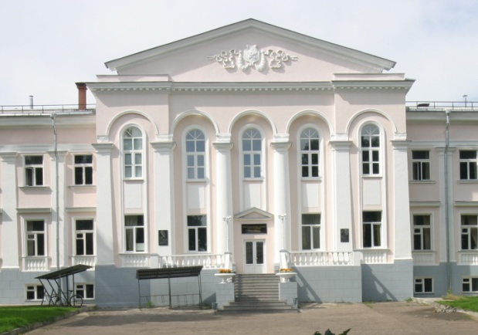
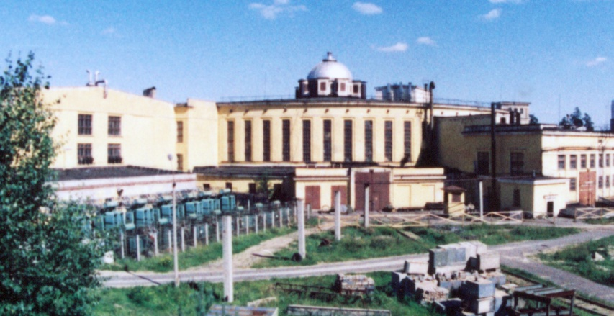
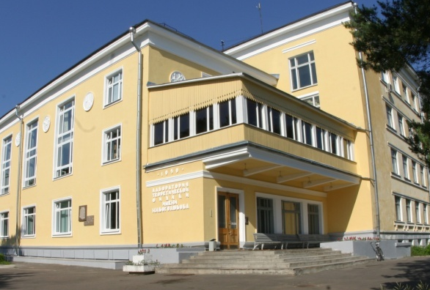
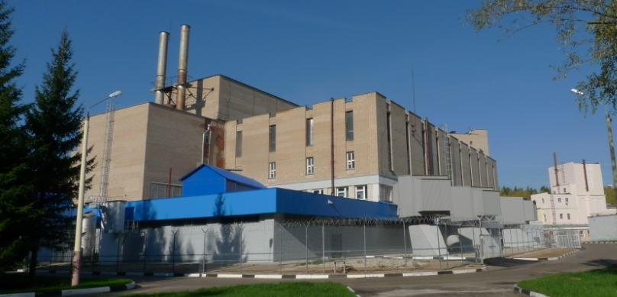
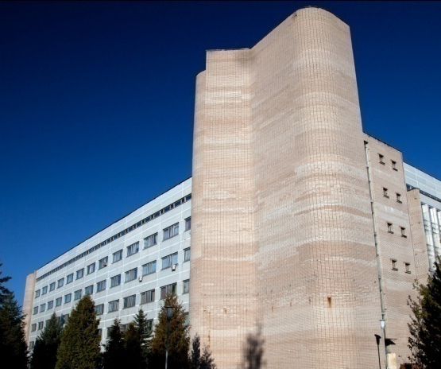
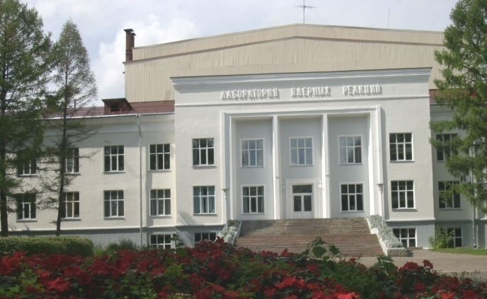
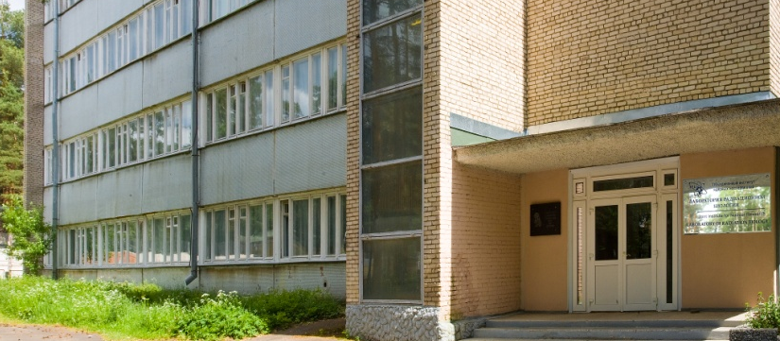
JINR comprises 7 Laboratories, each being comparable with a large institute in the scale and scope of investigations performed
Veksler and Baldin
Laboratory of High Energy Physics
Dzhelepov
Laboratory of Nuclear Problems
Bogoliubov
Laboratory of Theoretical Physics
Frank Laboratory of Neutron Physics
Laboratory of
Information Technologies
Flerov
Laboratory of Nuclear Reactions
Laboratory of Radiation Biology

Slide 7
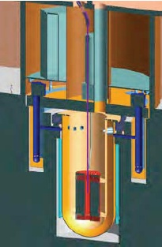

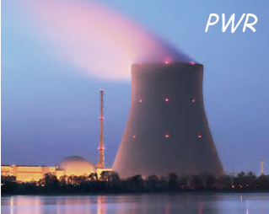
Comparing alternatives
To continuously generate a power output of 1GW for a year requires:
3,500,000 tones of coal
Significant impact upon
the Environment
especially CO₂ emissions
200 tones of Uranium
Low CO₂ impact but challenges with reprocessing and very long-term storage of hazardous wastes
Proliferation
1 tone of Thorium Low CO₂ impact Can consume Plutonium and radioactive waste Reduced quantity and much shorter duration for storage of hazardous wastes
No proliferation

Slide 8
Introduction
Stocks explored oil and gas provide energy fuel for 30-50 years.
Explored reserves of coal - for 200-300 years.
The share of nuclear energy in overall energy balance of the Earth - 6%.
Classical nuclear power, founded on the division of U²³⁵, Pb²³⁹ has several problems:
Limited stocks of fissile material - at 20-50 years.
Continuous operating time of nuclear waste.

Slide 9
Nuclear fission in traditional thermal reactor
Today’s nuclear energy is based on U-235, 0.71 % of the natural Uranium, fissionable both with thermal and with fast neutrons
²³⁵U + n ²³⁵U + 2.42n , fission
²³⁶U + α , capture

Slide 10
Nuclear fission in fast reactor
● It seems to be reasonable to use ²³⁸U and ²³²Th as nuclear fuel because the content of ²³⁸U in rock is much more (99.28%) than ²³⁵U (0.72%) and stock of thorium several times as much than that of uranium U
²³²Th+n ²³³U; ²³³U +n X+ 2.3 n (Th cycle)
²³⁸U+n ²³⁹Pu; ²³⁹Pu +n X+ 2.5 n (²³⁸U cycle)
● The main advantage of these reactions without U-235 is that they may offer an essentially unlimited energy supply, during millennia at the present primary energy level, quite comparable to the one of Lithium driven D-T Nuclear Fusion.
● However, they require substantial developments since :
➩two neutrons (rather than one) are necessary to close the main cycle
➩the daughter elements (U-233 and/or Pu-239) do not exist in nature but they can be generated after initiation

Slide 11
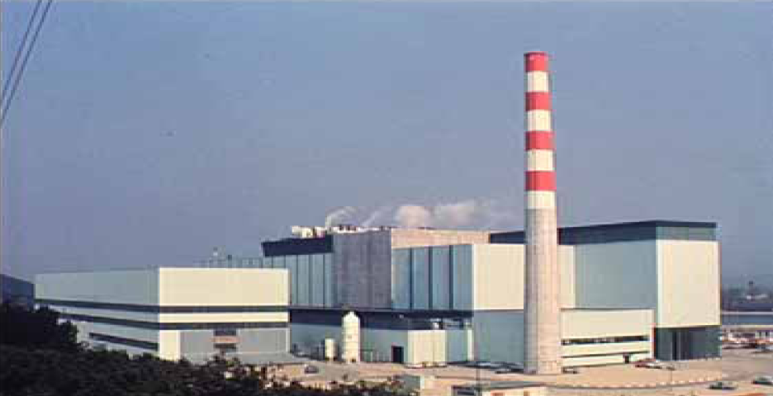
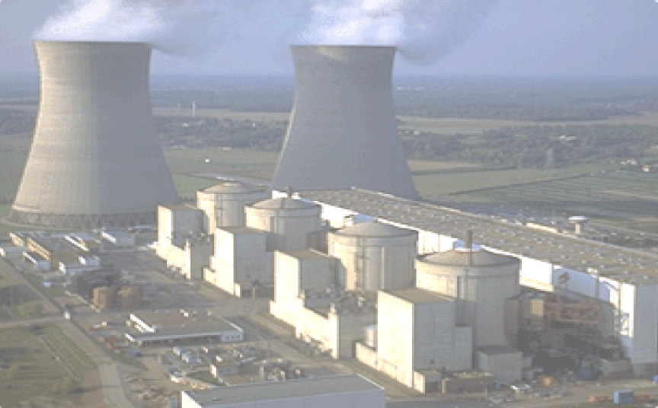
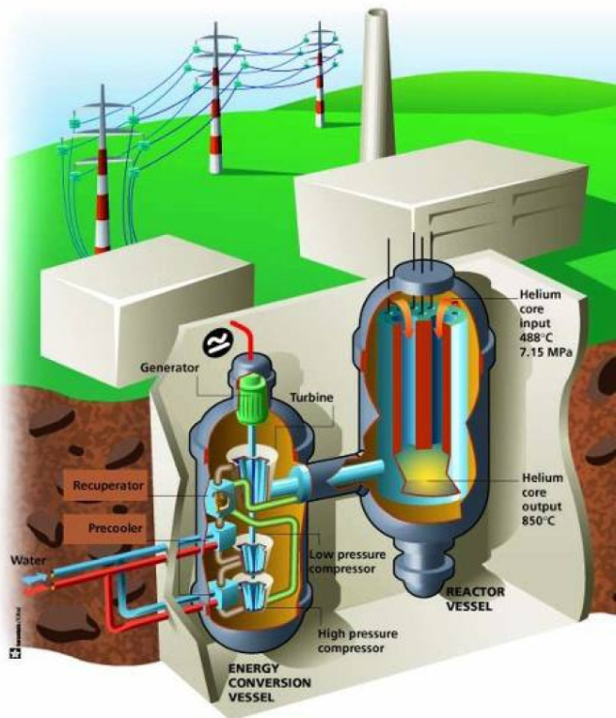
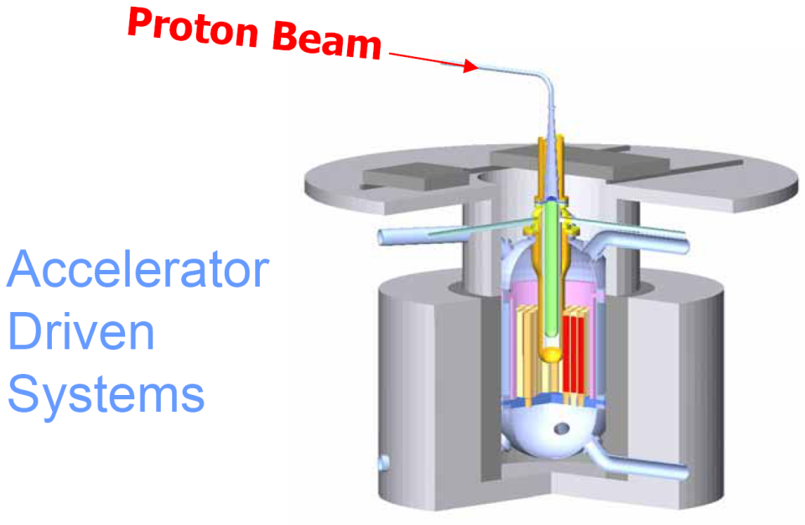
Transmutation with present technology
Fast Reactors
LWR Reactors
Innovative Concepts
Innovative
Gene IV
Reactors

Slide 12
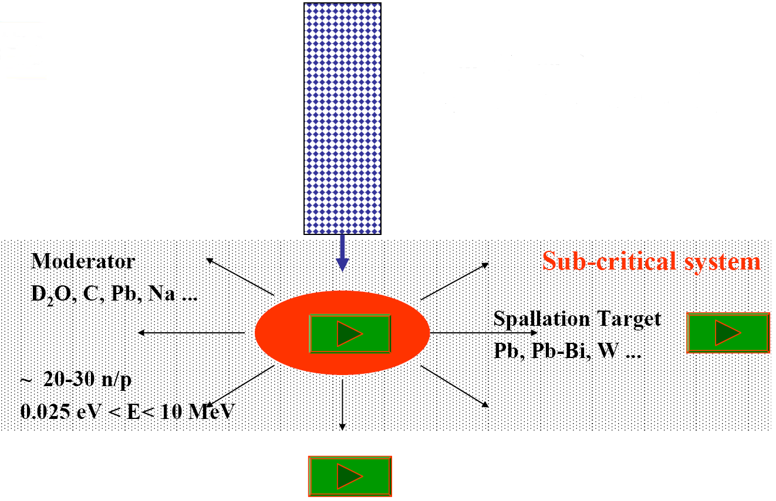
Accelerator Driven Systems
Proton (Linear) Accelerator
E ~ 1 GeV, I ~ 15-100 mA

Slide 13
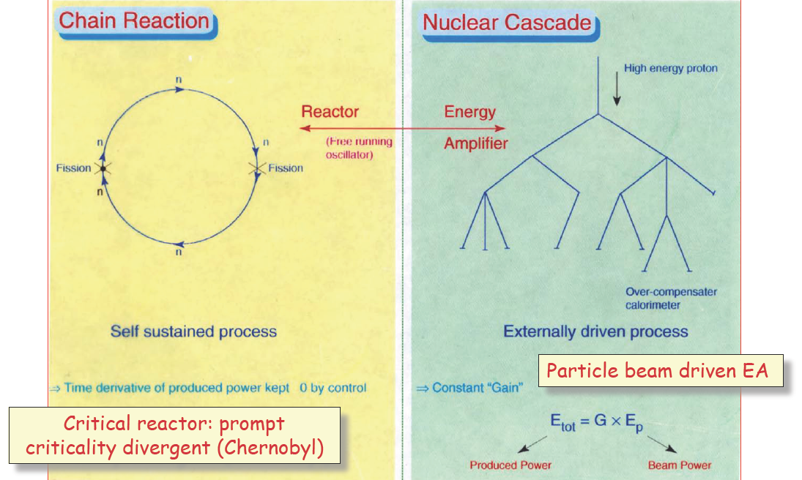
Critical (reactor) and sub-critical (energy amplifier) operation

Slide 14
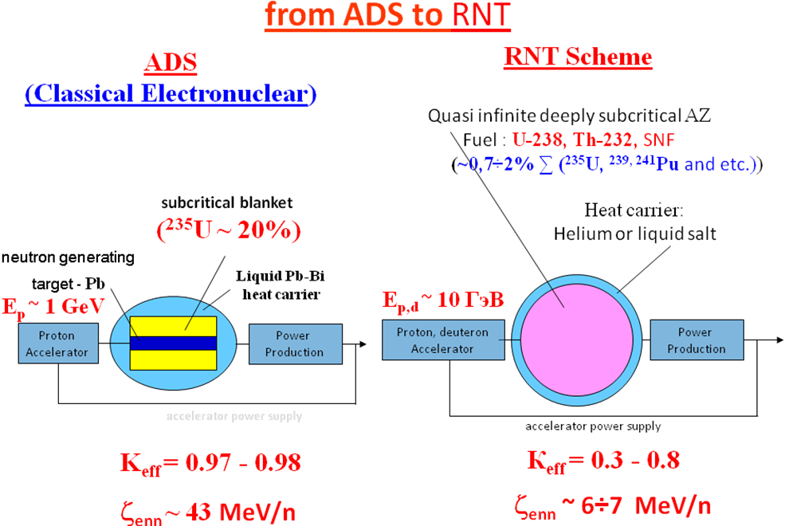
Scheme of obtaining nuclear energy with the use of charged particles beams.
It should be noted that all the programmes and projects are focused on classic electronuclear (ADS - Accelerator Driven Systems) scheme, which is, in fact, a subcritical fast reactor with an external (electronuclear) source of neutrons.
A lead or lead-bismuth neutron-producing target of limited size (usually, in calculations and experiments Ø20×60 cm targets are considered), placed in the center of subcritical active zone, in which narrow proton beam with an energy of ~1 GeV is delivered from the accelerator, serves as an external source of neutrons.
In the basis of the RNT (relativistic nuclear technology) scheme lies an idea of using the extremely hard neutron spectrum formed by beams of relativistic particles inside deeply subcritical, quasi infinite (at negligible leakage of neutrons) active zone (AZ) of natural (depleted) uranium and thorium for disposal of SNF of nuclear power plants with simultaneous energy production. To implement the idea in the NRT scheme there is provided, in particular, increase in energy of relativistic particle beam from traditional value of ~ 1 GeV to ~ 10 GeV.

Slide 15
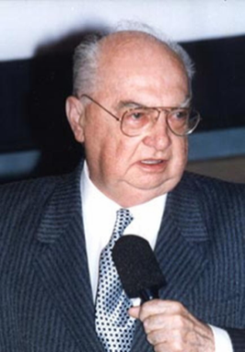
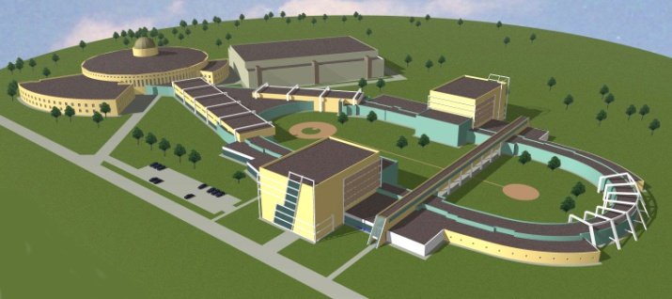
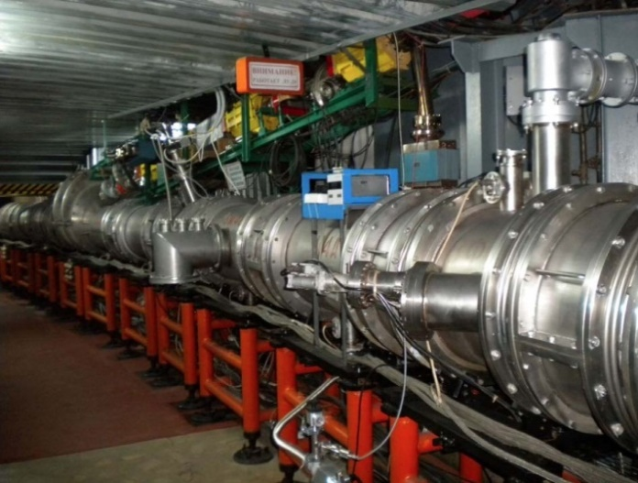
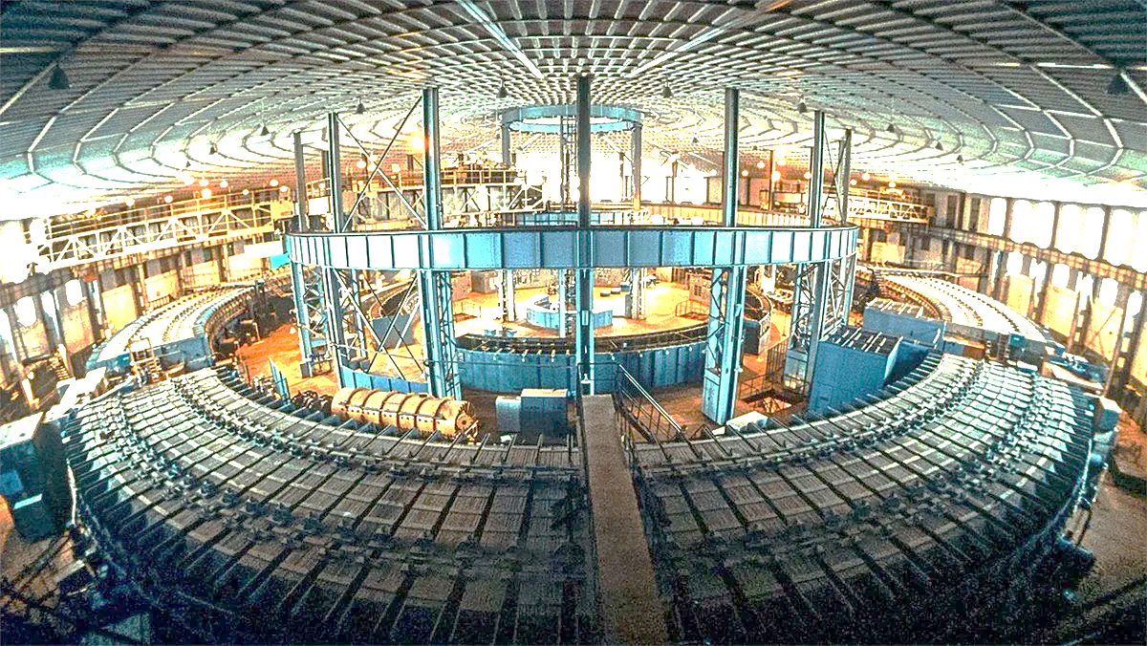
From the Synchrophasotron to the NICA collider
1957
Synchrophasotron
1993
Nuclotron
2019
NICA
10 GeV proton synchrotron – then the world leader in energy
Start up of the
high energy era
the first superconducting
accelerator of heavy ions
based on
Dubna type
SC magnets
Superconducting
collider of heavy ions
A.M. Baldin
– pioneer
of relativistic
nuclear physics
V.I.Veksler – discovery of
the Phase Stability Principle
(1944)
Study of nuclear matter under extreme conditions
and spin physics

Slide 16
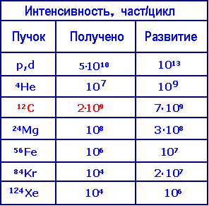
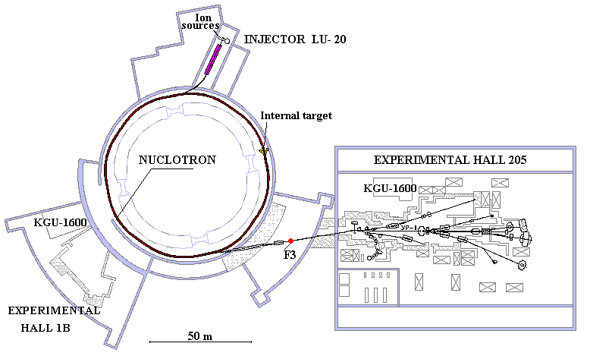
Accelerator complex Nuclotron
Intensity, particle/second
Beam
Get
Future

Slide 17
Basic experimental problem for setup "Quinta"
Determination of the energy spectrum of the neutrons generated in the uranium target with a beam of relativistic particles, a comparison of the experimental data with calculations based on different methods.
Determination of the spatial distribution of neutron leakage, their dependence on the energy of incident particles.
Measuring the energy yield from deeply subcritical assembly, its dependence on the energy of incident particles.
The study of transmutation of minor actinides by neutron spectrum generated in a deeply subcritical assembly.
Investigation of the effect on the radioactive decay of high-power pulsed microwave radiation FEL VBLHEP.

Slide 18
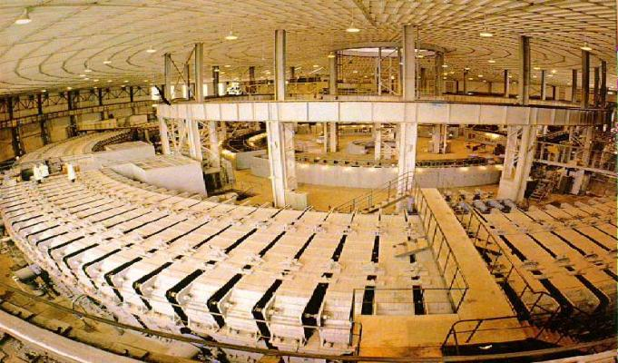

Slide 19
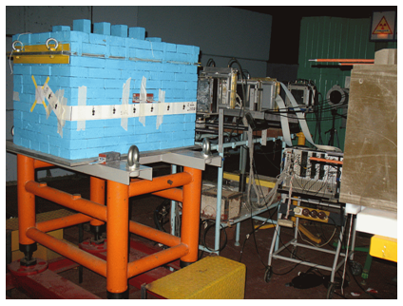
The “Quinta” target setup with the lead reflector on the irradiation position

Slide 20
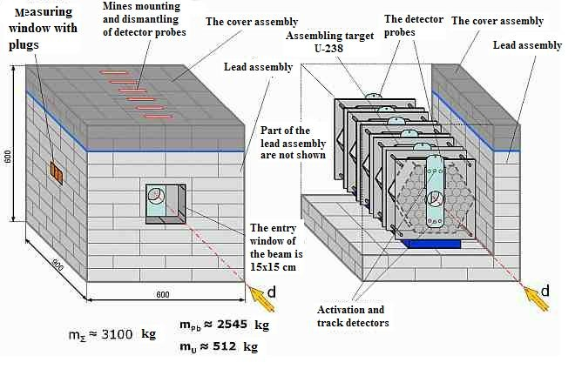
The “Quinta” target setup with the lead reflector

Slide 21
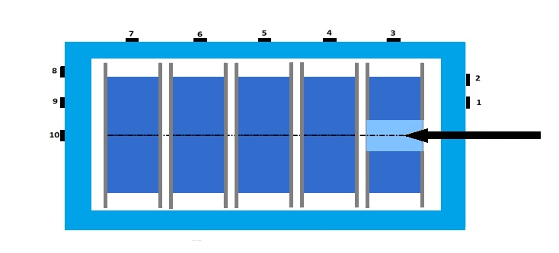
Neutron fluence measurements with passive silicon detectors outside Quinta
Run 48 and 49
The hardness factor relates the fluence of a given beam with the equivalent fluence of a 1 MeV neutron beam which produces the same effect
The hardness factor has values between 0.7 and 0.96
Fig. 2 Displacement damage cross section as a function of energy for various particles in silicon (from [9]).
Scheme of the experiment - detector positions

Slide 22
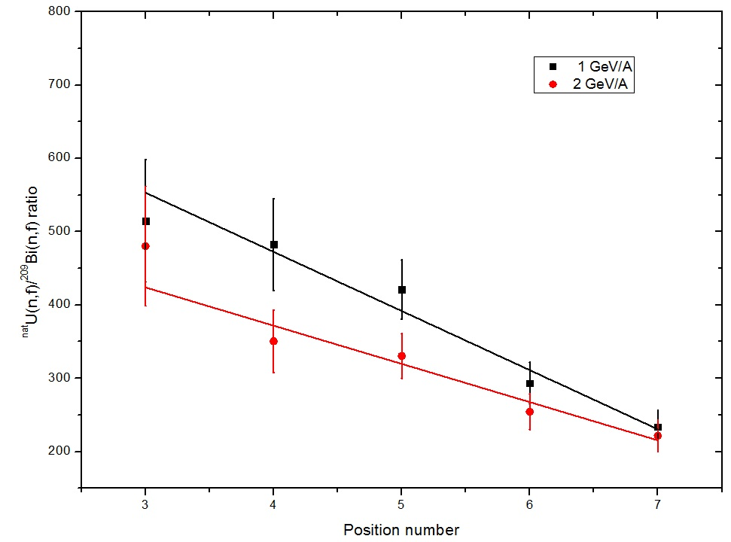
The ratio of number of fission ^{nat}U(n.f) / ²⁰⁹Bi(n,f)
along the side of Quinta
(data for 0.66 GeV/A and 4 GeV/A is not displayed, but the trend - the same)
^{nat}U (nf) / 209Bi (n, f)
Group A. Smirnov (Radium Institute)

Slide 23
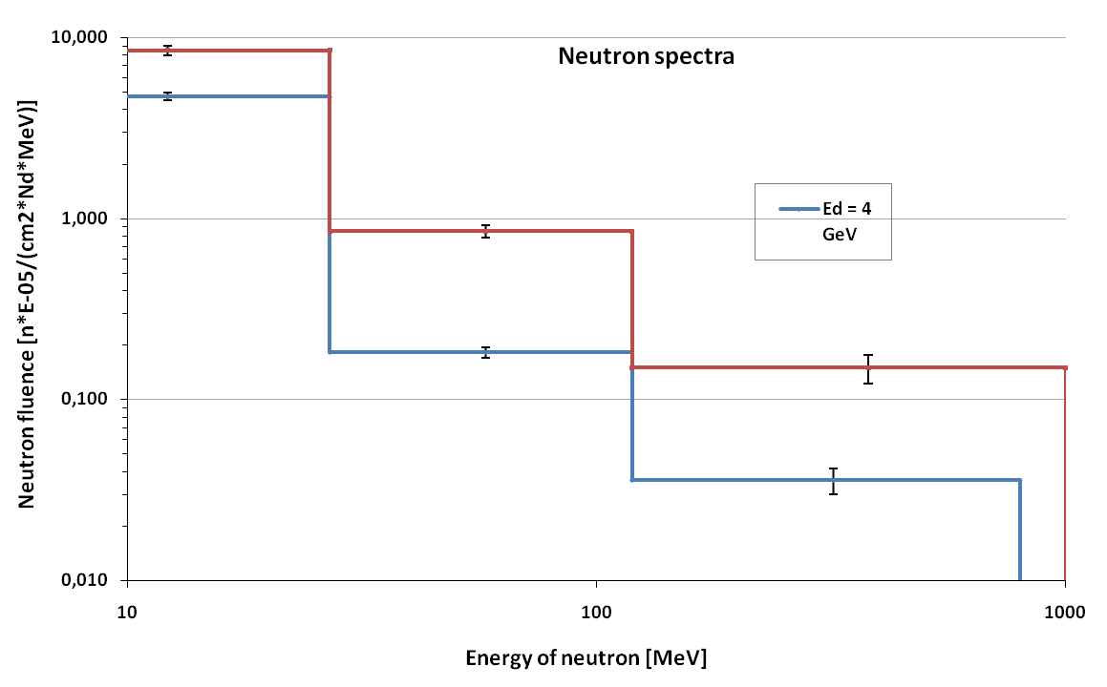
Average of high energy neutron spectra on the surface of QUINTA

Slide 24
N*R for different Z (¹²C - 2 AGeV and protons of 660 MeV)
Notes:
Хорошо видно, что по сравнению с протонами гораздо больше делений происходит на периферии мишени (и по радиусу и по Z).
Эксперименты на КВИНТе с пучками С12 и более тяжелых ядер представляют очень большой интерес в связи отсутствием подобных исследований на массивных мишенях.
Точки на графиках для протонов и С12 при разных радиусах, т.к. пучок падал на мишень по разному, а R мы считаем от оси пучка

Slide 25
The dependence of the power gain from the energy (in units of fission numbers on 1 deuteron and for 1 GeV). Sessions in 2012-2015

Slide 26
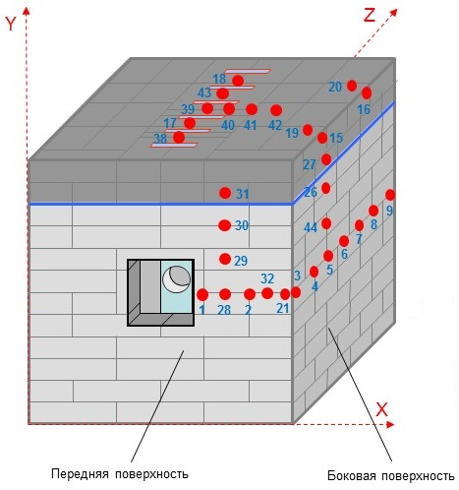
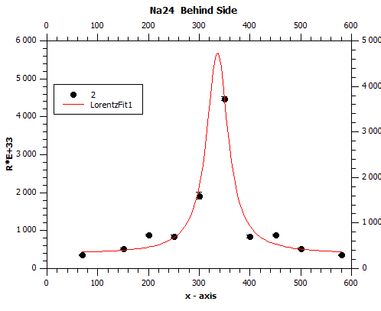
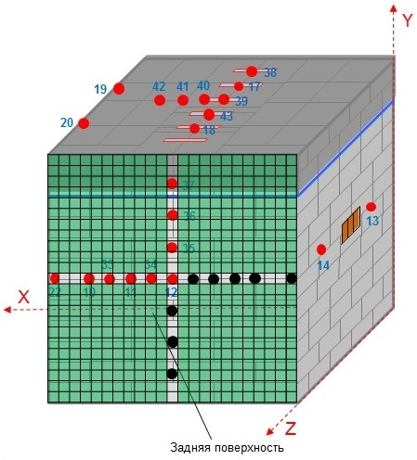
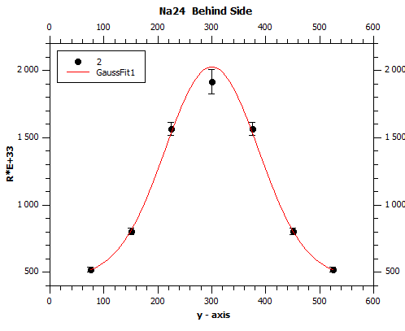
The formation of ²⁴Na isotope from the aluminum target under the irradiation of protons with an energy of 660 MeV (spatial distribution)
Front surface
Lateral surface
φ(x,y) = φ(y)f(x)/f(x0)
f(x,y) = f(x) φ(y)/φ(y0)
φ(x0,y0) = f(x0,y0)
➔ φ(y0) = f(x0)
➔ φ(x,y) = f(x,y)
Behind surface

Slide 27
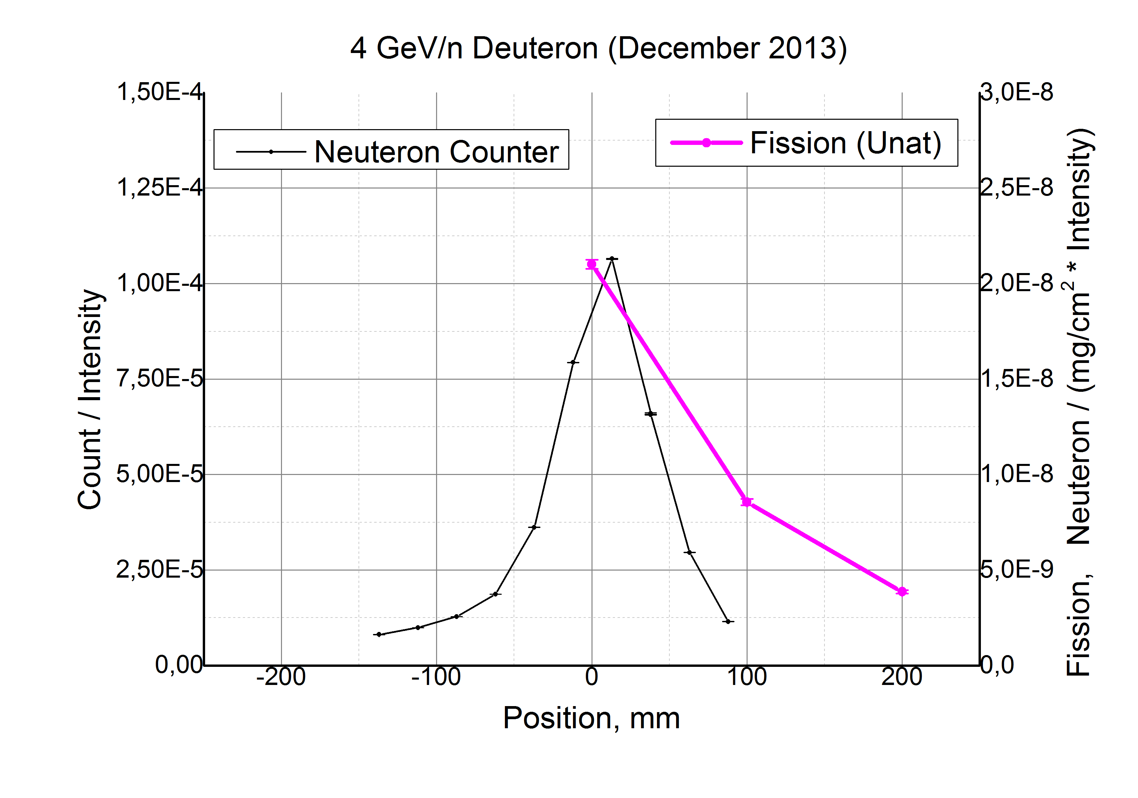
Profile of the neutron flux at the output of the setup "Quinta" under irradiation deuteron beam with an energy of 4 GeV / nucleon

Slide 28
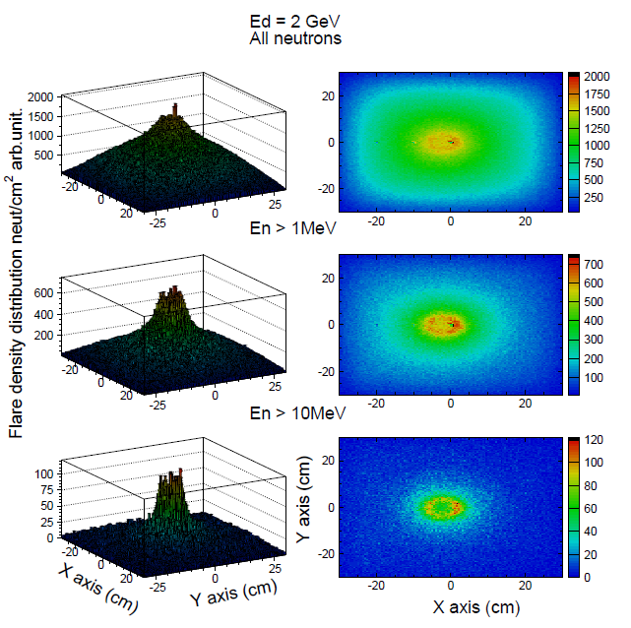
The results of neutron torch calculation on the "Quinta" under irradiation deuteron beam with an energy of 2 GeV/nucleon

Slide 29
Recovered spectra of neutrons
29

Slide 30
The main results of the project "E&T - RW“ for 2014 ÷ 2021
The processes of neutron formation and spatial distribution of neutron spectra are studied.
Determined the spatial distribution of accumulation and destruction (fission) ²³⁹Pu, depending on its concentration
Determined the dependence of beam power gain from energy of incident protons, deuterons and heavy ions.
Determined the optimum energy types of particles (protons- deuterons) and dimensions AZ NRT-reactor
Defines the rates of reactions of processing the most relevant isotopes from the spent fuel.
Received a set of experimental data for the modification of existing models and transportation codes.
Discovered effects influence of the powerful MICROWAVE radiation on radioactive decay Eu¹⁵².
Experimentally determined neutron leakage levels from assembly "Quinta" under irradiation with protons, deuterons and heavy ions.
Discovered the effect of the torch formation of “high-energy neutron leakage" along the axis of the "Quinta".

Slide 31
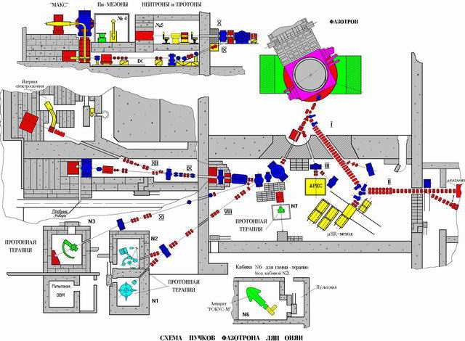
БУРАН
Scheme of LNP Phasotron beam

Slide 32
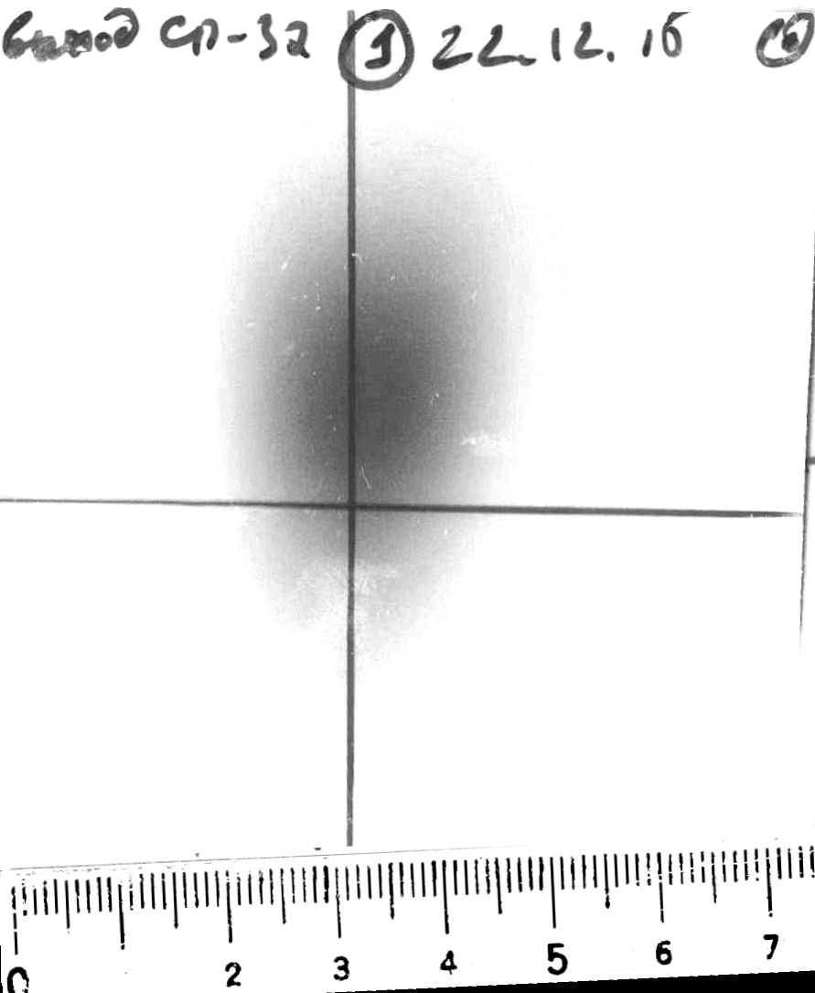
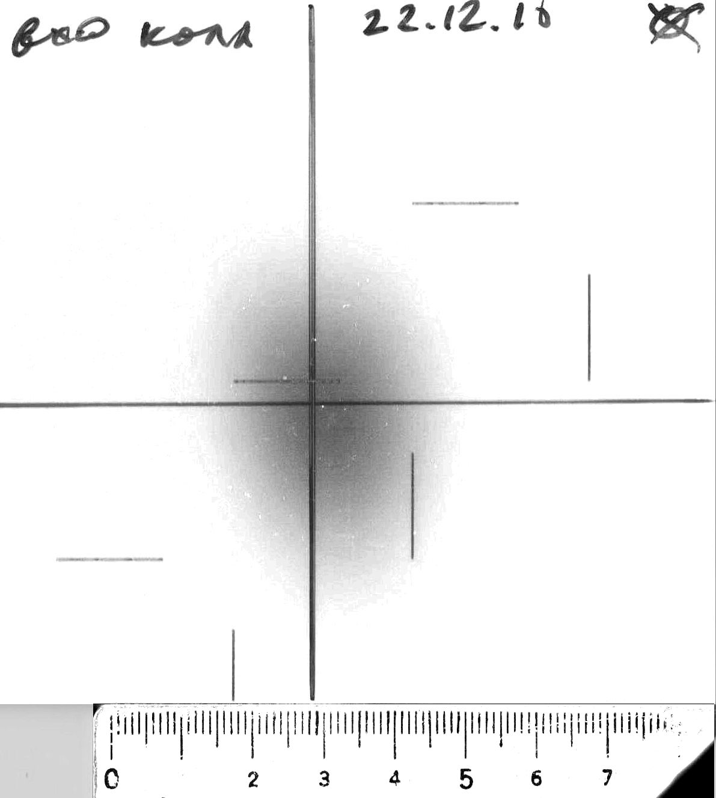
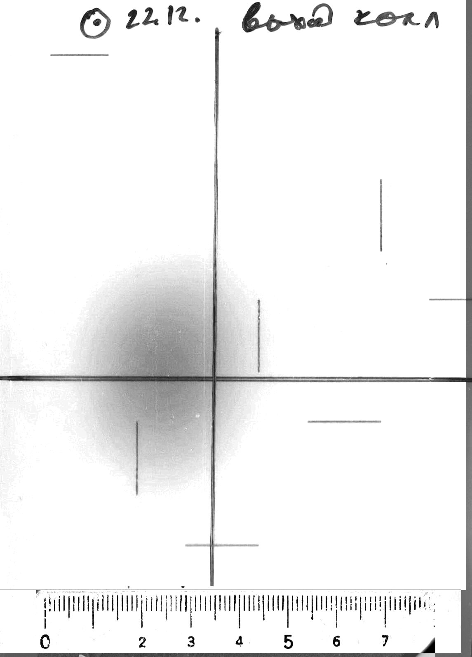
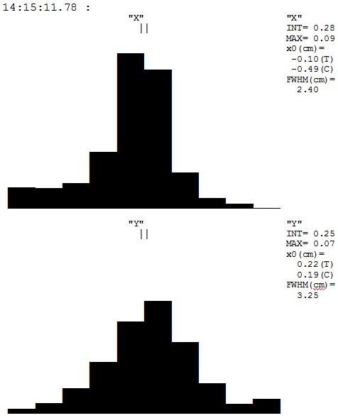
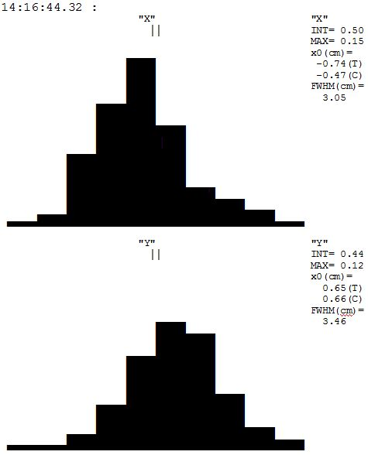
LNP Phasotron Session 22 December 2015
1
2
3
output beam SP-37
Input beam of collimator
output beam of collimator

Slide 33
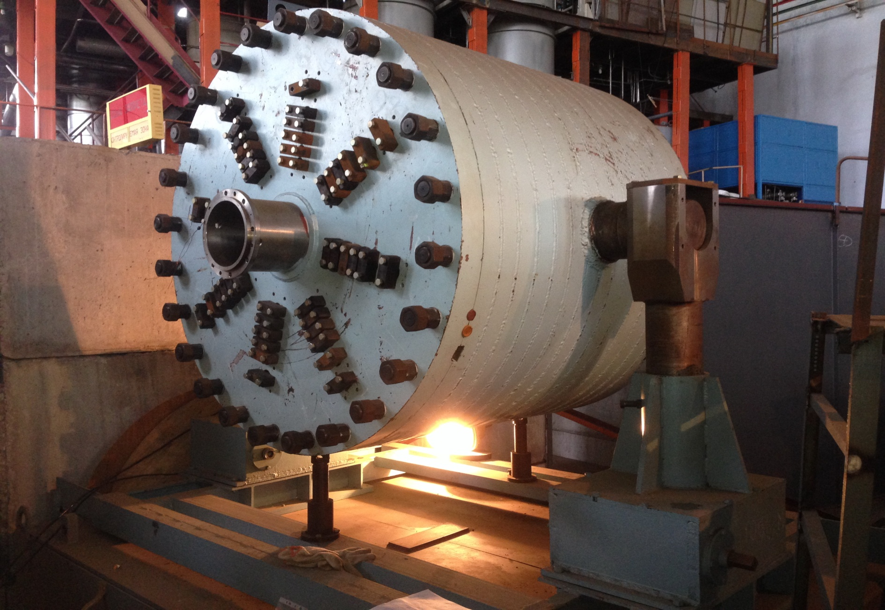
Big uranium target

Slide 34
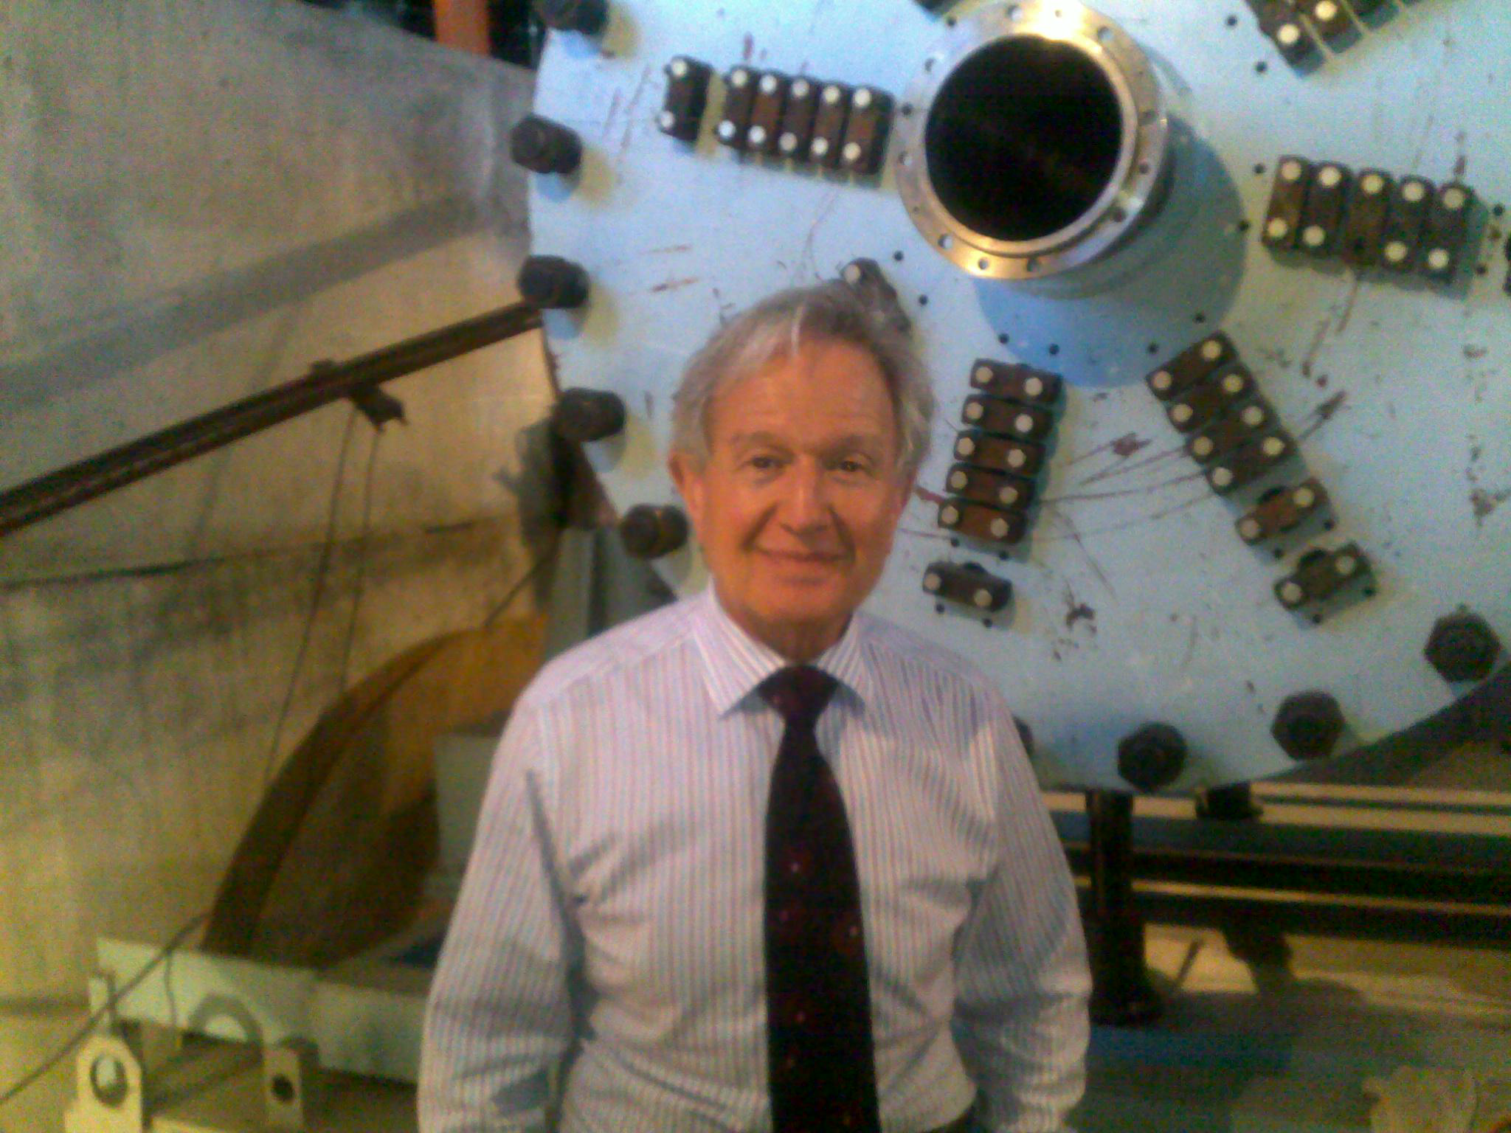
IAEA spokesman Pablo Adelfang near setup "Buran"

Slide 35


Mass of uranium – 19.5 т. Materials of central zone – U, Th, Pb.
Diameter – 1,2 м. Diameter of central zone – 0,2 м.
Length – 1 м.
General view of the target setup BURAN at the transport-fixing platform.
The scheme of longitudinal section of the TS BURAN with the mounted central zone (top-left) and general view photo (right).

Slide 36



ENERGY PRODUCTION DEMONSTRATOR FOR MEGAWATT PROTON BEAMS
Leakage from the uranium target surface.
Number of neutrons released per one proton per GeV in the target.

Slide 37

Energy multiplication in the target

Slide 38
J-PARC: Japan Proton Accelerator Research Complex

Slide 39


Slide 40
СПАСИБО ЗА ВНИМАНИЕ!

