Slide 1
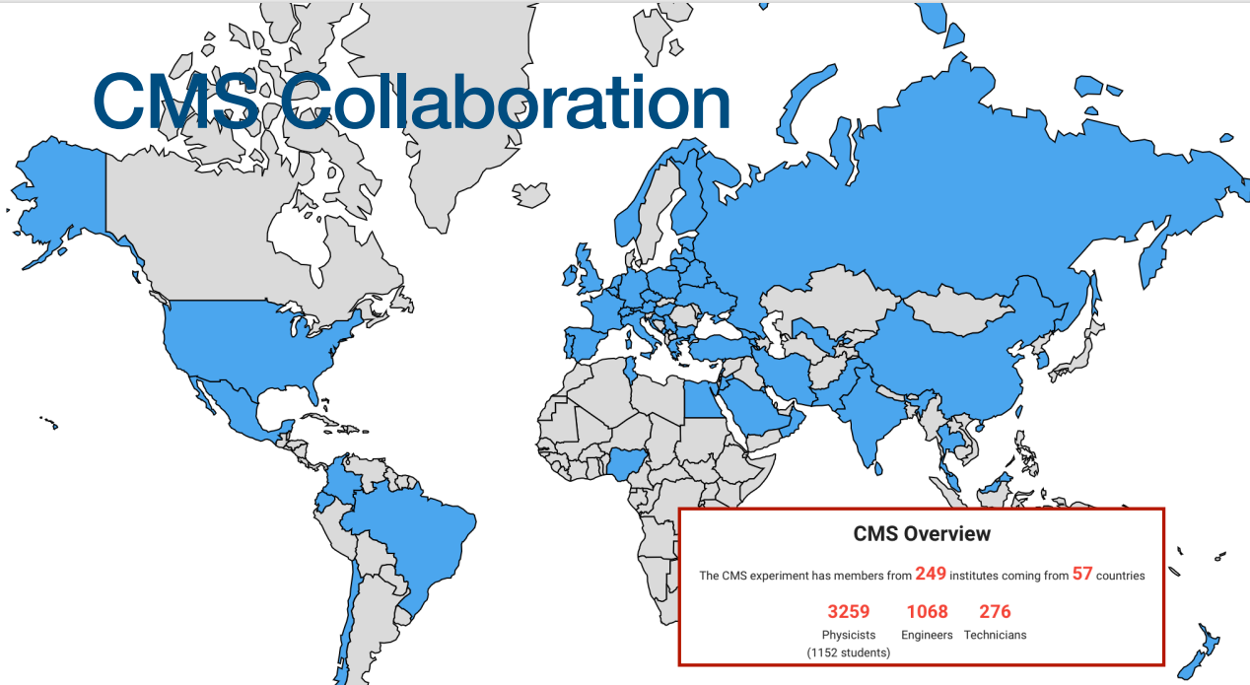
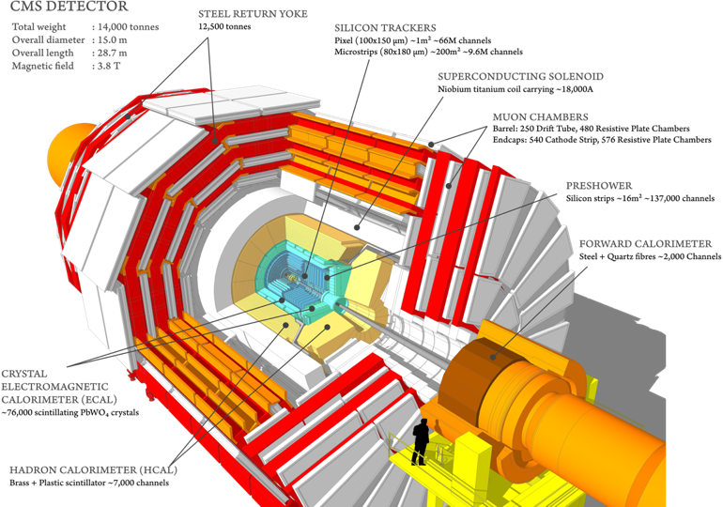
Report on the scientific results obtained
by the JINR group in the CMS experiment
JINR Topic 02-0-1083-2009/2023
Vladimir Karjavine
for JINR CMS group
58th Meeting of the Programme Advisory Committee. 21.06.2023.

Slide 2
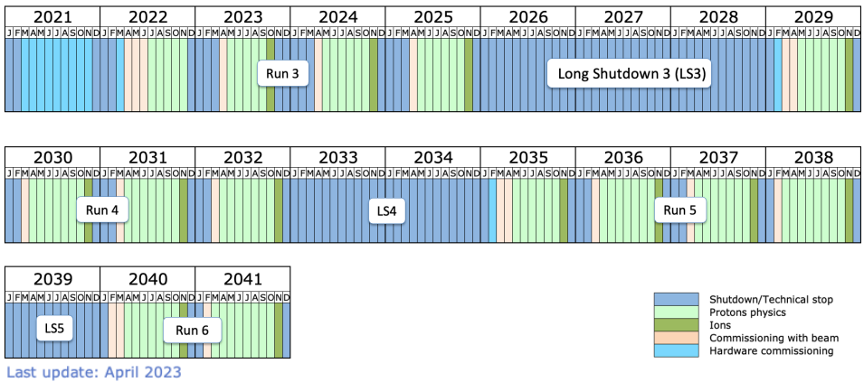
LHC Schedule
CMS Operation plan in 2023
First beam on March 28
First Stable beams @900 GeV on April 6
First stable beams @ 13.6 TeV on April 19-22
Start of physics run on May 15th
▪ Last day of pp physics: September 12
▪ Start of pp reference run on September 21
▪ Start of ion physics on October 2
▪ Last day of beam in 2023: October 30
2

Slide 3
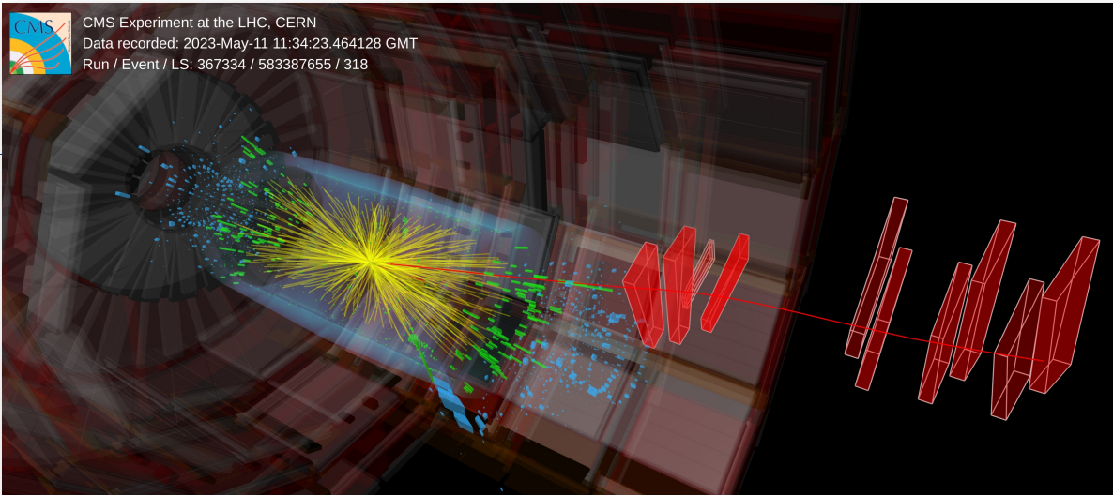
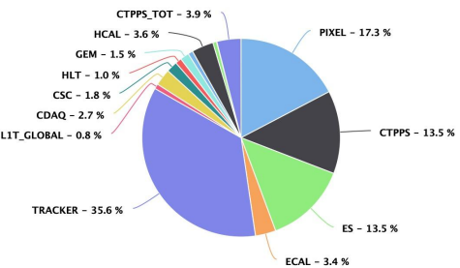
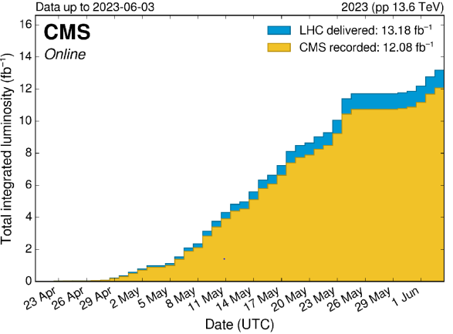
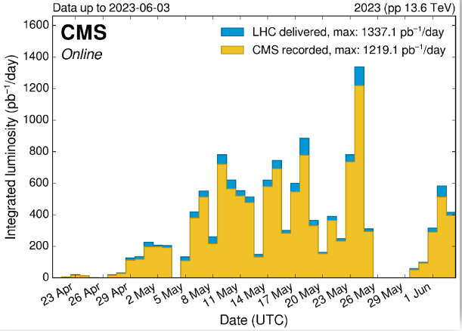
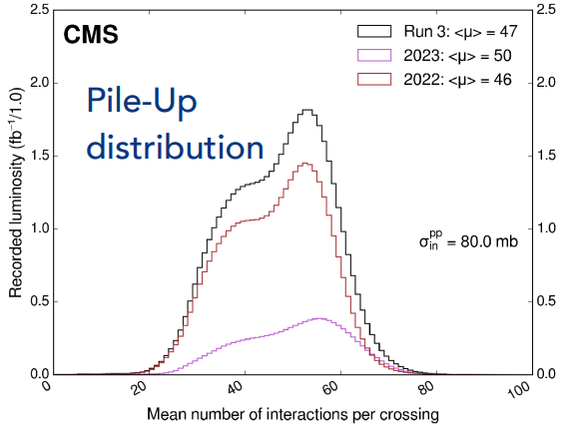
CMS Data taking performance in RUN 3
Downtimes are mainly due to automatic procedures to recover blocked channels caused by high lumi and/or high pileup
Data taking efficiency: 91.6%
3

Slide 4
JINR Group Activities in 2023
In accordance with the M&O category B the JINR team is responsible for commissioning after Phase-1 Upgrade, maintenance and operation of detector systems in RUN3, computing, software development
Under the MoUs concerning JINR participation in CMS Phase-2 JINR contributes in HGCal project and Muon system upgrade
Total number of CMS participants from JINR: 70
JINR authors in CMS: 21 (17 paid and 4 unpaid PhD St.)
11 young researchers: 1 MS from JINR, 5 PhD Students from JINR, 5 PhD Students from DMS
JINR team full time equivalent (FTE): 105.32 FTE-months*
In 2023 JINR physicists plan to take 62 central shifts
*) According to Experimental Physics Responsibilities (EPR) each author (paid and unpaid) is required to work on operational, maintenance, upgrade duties, including participation in shifts, at least 4 months
JINR physicists are responsible for 8 physics analysis based on RUN2 data and RUN3 data
Activity in CMS Physics working groups
Exotica, Higgs, and Standard Model Analysis.
Muon and Jet/MET Physics Object Groups.
Muon and HCAL Detector Performance Group.
CMS duties executed by JINR physicists:
HCAL Technical Coordination
Muon DQM Coordination
CMS data managers of Tier-1 and Tier-2 sites
Participation in Analysis Review Committee (ARC) and Institutional publication review (IR)
4

Slide 5
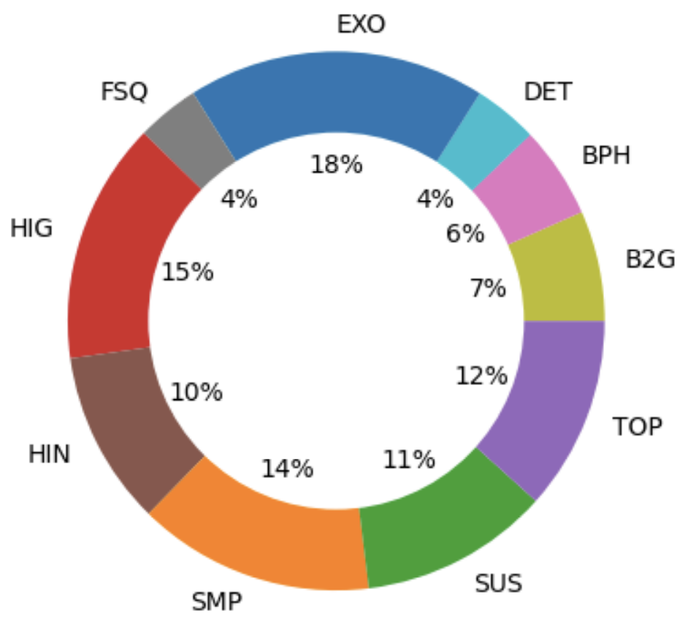
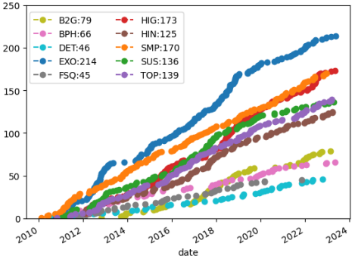
Publications
JINR Group publication status
24 scientific papers and one patent were prepared in 2022 – 2023 by JINR group
The results of the scientific research were presented in 38 reports at various conferences (at least half of them is given by the young scientists).
CMS publication status
1197 papers based on collision data
▪ 1117 published as of 22/05/2023
By research areas
CMS titles
❖ 600 “Search”
❖ 52 “Observation”
❖ 21 “Evidence”
❖ 336 “Measurement”
❖ 42 “Study”
5

Slide 6
JINR Activity in the CMS Physics Analysis and SW
6

Slide 7
The list of JINR Physics and SW Tasks
We focus on analysis that can be completed before the end of 2024
Physics beyond the Standard Model and Higgs Physics
Search for physics beyond the standard model in dilepton mass spectra in pp collision search for new gauge bosons, extra dimensions, new higgs states, dark matter candidates.
2 PhD (0.9 FTE), 1 PhD Student (1 FTE). Analysis of RUN3 data is started.
Searches for signals of dark matter and new scalar bosons beyond SM (extra Higgs bosons)
produced pairs of leptons/b-quarks and missing ET.
5 PhD (3.5 FTE), 4 PhD Student (3 FTE). Analysis of RUN3 data is started.
Search for a mu+mu-+b-jet event excess at the dimuon mass of 28 GeV in pp collisions at 13 TeV.
2 PhD (0.5 FTE), 1 PhD Student (0.2 FTE). Analysis of RUN2 data is ongoing.
4. Search for physics beyond the standard model in processes with fermion flavor violation (microscopic black holes, dark matter candidates, new higgs states).
1 PhD (0.5 FTE), 1 PhD Student (1 FTE). Simulation for RUN3 data analysis is started.
Studies of Higgs bosons with bbar-decays in Vector-Boson-Fusion Higgs production process.
1 PhD (0.5 FTE), 1 PhD Student (1 FTE). Analysis of RUN2 data is preapproved.
7

Slide 8
The list of JINR Physics and SW Tasks
Standard Model
6. Measurement of the differential Drell-Yan cross section in p-p collisions. Drell-Yan Radiative Corrections.
2 PhD (1.3 FTE), 1 MS Student (0.5 FTE). Analysis of RUN2 data is finished.
Angular coefficients of Z bosons produced in pp collisions as a function of transverse momentum and rapidity.
1 PhD (0.4 FTE), 1 PhD Student (1 FTE). Analysis of RUN2 data continues (going to be preapproved).
8. Measurements of the multiplicity in quark and gluon jets and fractions of gluon jets.
1 PhD (1 FTE), 1 PhD Student (1 FTE). Analysis of RUN2 data completed. The results are under discussions.
Algorithms and Software
9. Development of algorithms for high-momentum muons reconstruction.
Muon hit reconstruction and segment builder. Work in progress.
3 PhD (0.8 FTE), 1 PhD Student (0.5 FTE).
10. Data Certification (DC) software development with machine learning (ML) algorithms.
1 PhD (0.5 FTE), 1 MS Student (0.5 FTE). Work in progress.
8

Slide 9
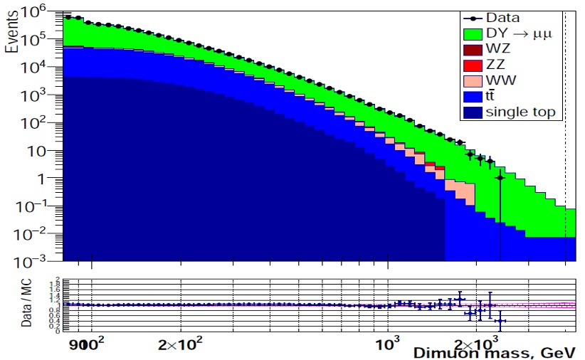
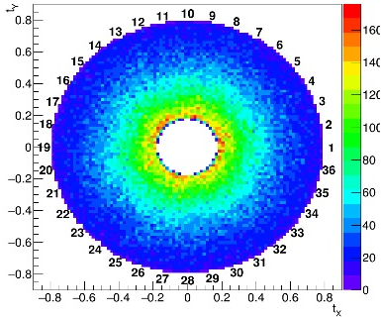
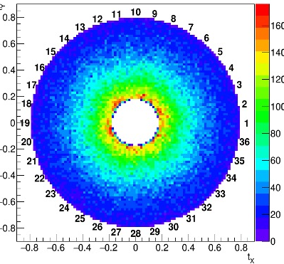
The first check of muon reconstruction
and dimuon Data/MC comparison on Run3 data
Analysis focused on search for new physics beyond the SM
(new gauge bosons, graviton exited states, dark matter mediators)
preliminary
Reconstructed muons used in physics
analyses were checked for:
distributions of muon angles from dimuons
slopes (tangents on X-Y) of muon angles in CSC
No obvious problems seen
Data/MC plots of various kinematical quantities were studied
MC samples simulated with √s = 13 TeV were used
(13.6 TeV MC samples are in production)
Scrutiny of events with heavy dimuons is done
ME1/1-
ME1/1+
Detector redundancy makes the muon reconstruction not concerned by rare problems in some individual chambers
Nice agreement with the expected behavior
9

Slide 10
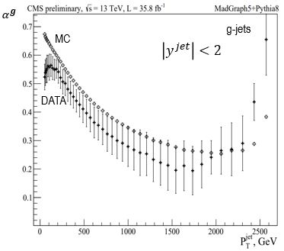
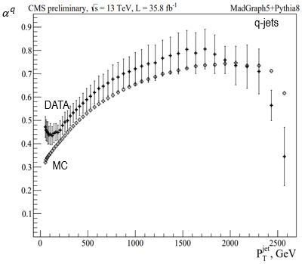
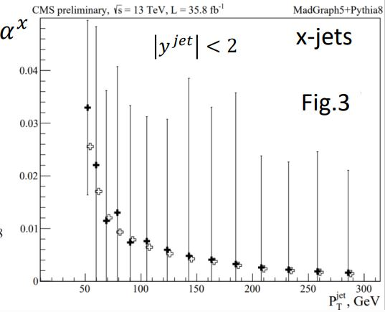
Measurement of q/g-jet fractions with CMS
preliminary
It was shown that q/g-jet Likelihood discriminator (QGL) used in previous measurements needs to be reworked. New QGL was obtained
q/g-jet fractions with new QGL in data analysis and MC simulation are in a good agreement within uncertainties except jet P_{T} < 90 GeV
New measurement method that includes model uncertainty has been proposed and implemented
First measurement of fraction of jets with undefined flavour
10

Slide 11
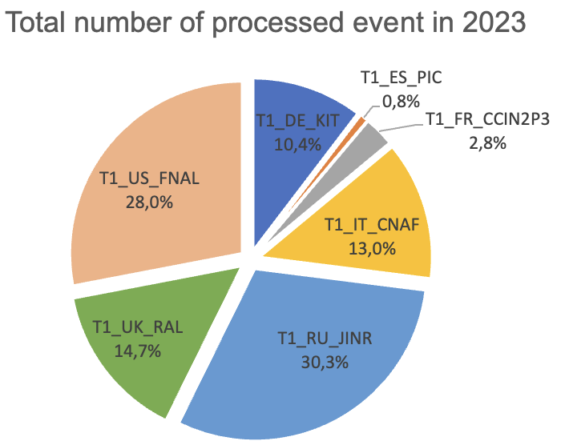
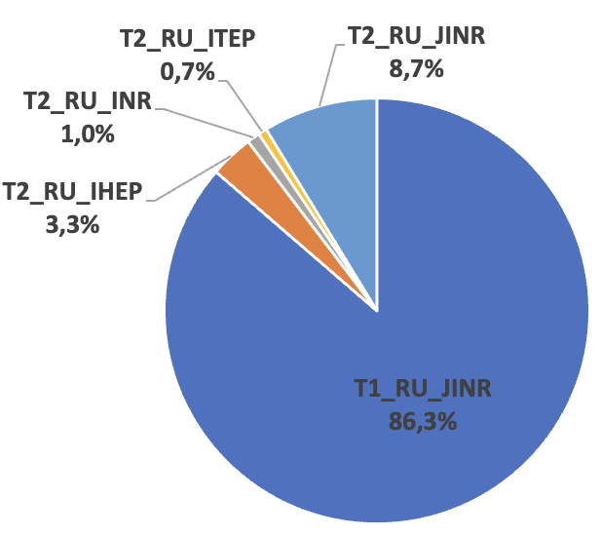
JINR contribution in CMS Computing
The JINR Tier-1 site holds the first place in the list of CMS sites
JINR Contribution in RDMS
Computing is crucial
Total number of completed jobs by Russian sites in 2023
20096 cores
324 kHS06
14 PB disks
50.6 PB tapes
100% reliability and availability
JINR Tier2 is the most productive in the Russian Data Intensive Grid (RDIG)
11

Slide 12
CMS Detector Commissioning and Operation
Completion of Phase1 upgrade, commissioning
and launch experimental data taking Run3
12

Slide 13
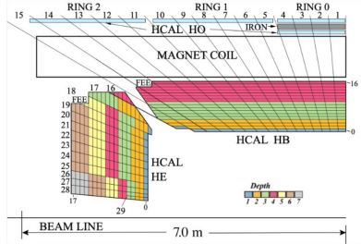
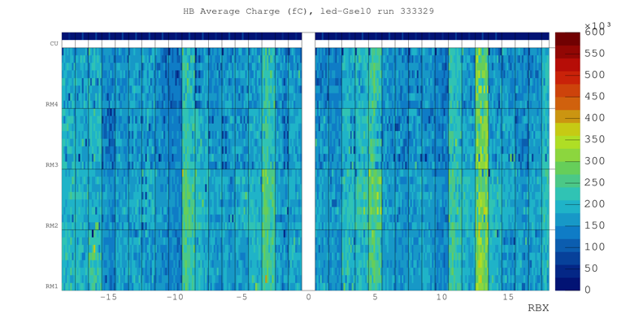
JINR participation in HCAL Upgrade
Upgrade of the HCAL on detector electronics
Hybrid photodetectors(HPD) replaced with new silicon multipliers (SiPM)
JINR group has created a test-stand for long-term burn-in tests of readout electronics and participate in assembling, installation and commissioning of new readout system
Mitigate radiation damage to the scintillator (monitoring of pedestal evolution and updates of the zero-suppression thresholds)
HF LV power supplies moved from high radiation area to reduce the SEU
Eliminate a source of high-amplitude noise (voltage-spike protection circuits)
New segmentation of HCAL
Distribution of average signal amplitudes from HB SiPMs
(from LED)
Benefit of the upgrade - reduce noise and improve energy measurement
Three times higher photon detection efficiency, 200 times higher gain
Finer depth segmentation: 4 in barrel, up to 7 in endcap
350% increase in the number of readout channels
Added timing information (0.5ns resolution)
Enable new triggers (for instance long lived particles)
13

Slide 14
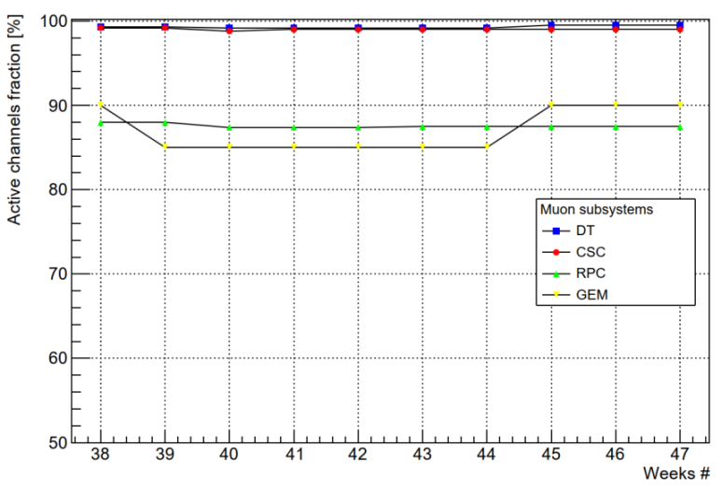
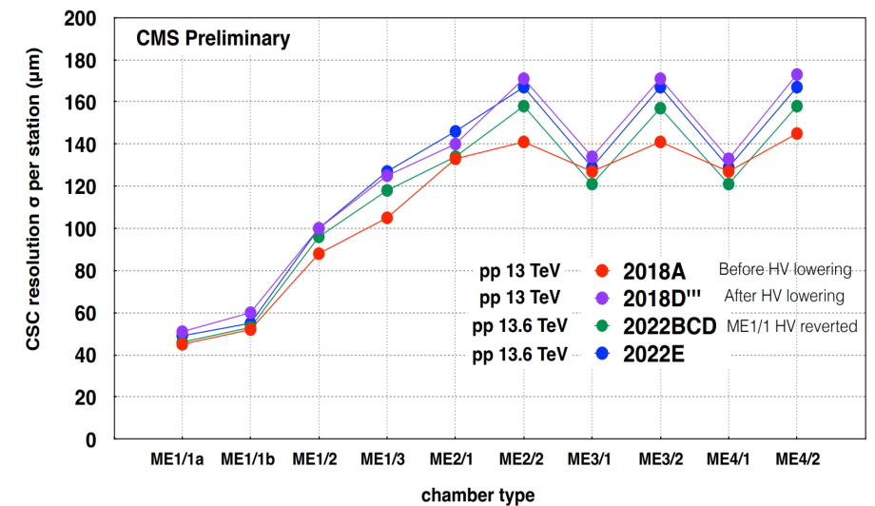
JINR participation in the Endcap Muon system upgrade
Upgrade of the CSC electronics on the inner rings of CMS Muon Endcap stations MEx/1
JINR group developed 120 Low Voltage Distribution boards (LVDB7) and test stand for commissioning.
180 chambers were refurbished with the new electronics reinstalled to CMS and commissioned.
72 ME1/1 CSCs were equipped with the new on-chamber cooling systems.
CSC parameters study base on Run3 experimental data
CMS muon system active channel fraction in 2022 p-p collisions data taking (99% for CSC)
CSC spatial resolution for different muon Stations
(consistent with 2018 data)
14

Slide 15
JINR group contribution to CMS Phase 2 Upgrade
Participation in HGCal Project.
Cooling plate of HGCal cassettes design and construction.
Design and construction of the HGCAL silicon and scintillator cassettes test facility.
Participation in the Endcap Muon system upgrade.
Cathode Strip Chambers maintenance during LS3 long shutdown period.
Cathode Strip Chamber longevity study R&D.
Upgrade of the ME1/1 CSCs cables and services layout for the new CMS Endcap detectors configuration.
Design and construction of the new ME1/1 Patch Panel.
Design and construction of new tooling for ME1/1 CSC assembly and installation.
15

Slide 16
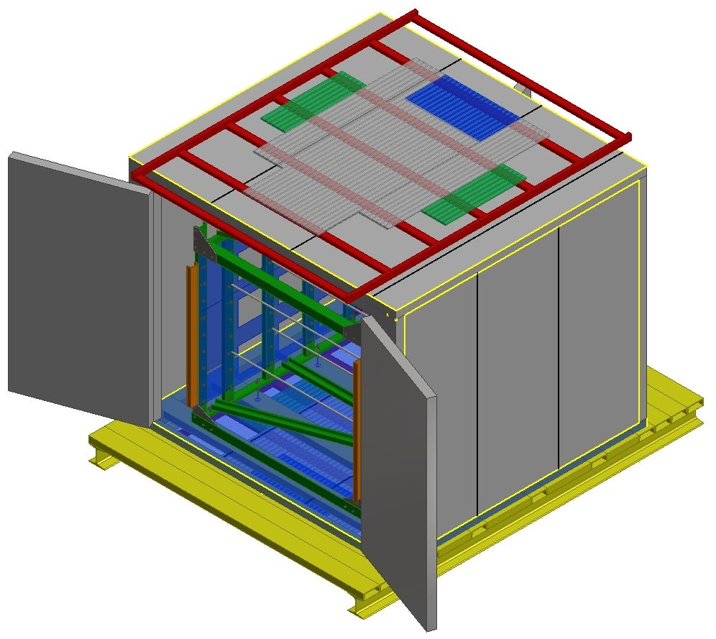
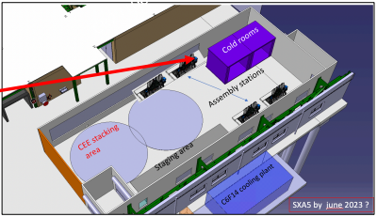
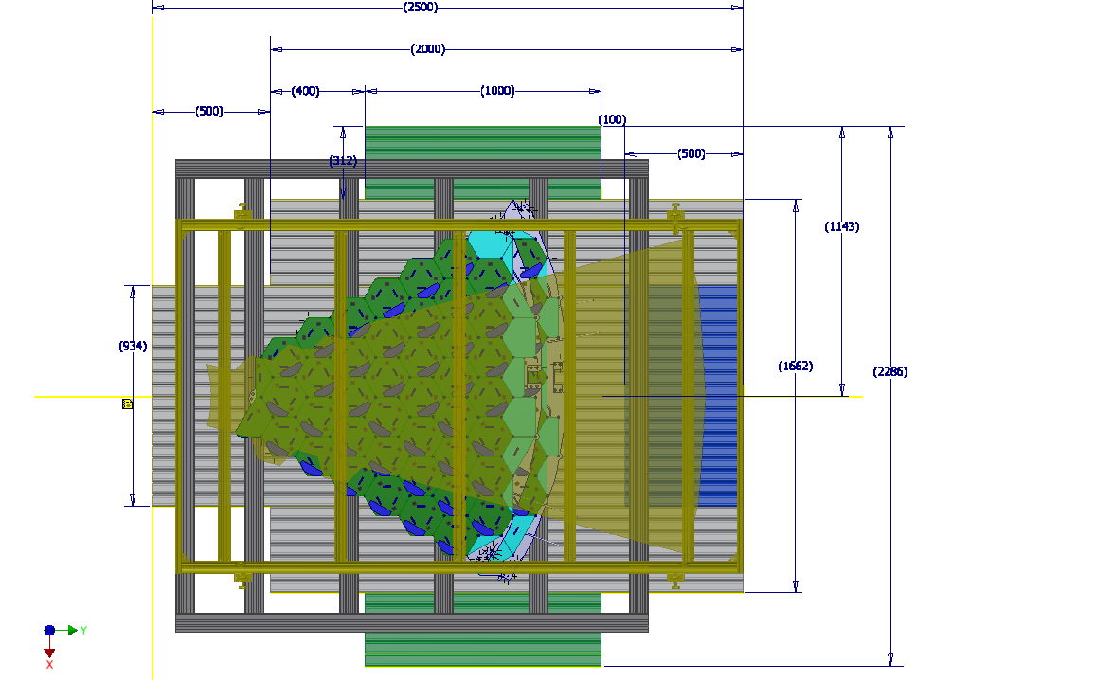
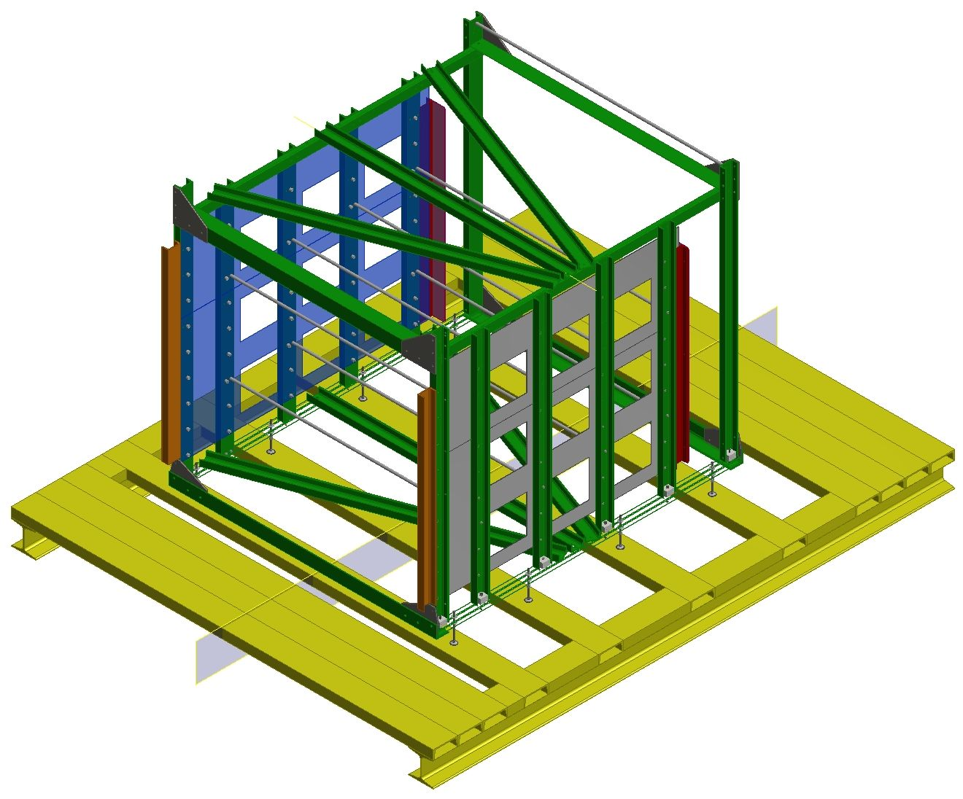
Test Setup for HGCal Silicon and Scintillator Cassettes
Cold room
3.1x2.9x2.5 m
CE-E Cassette assembly site at CERN (Clean room CR1)
Trigger
scintillator plates
top and bottom
Phase-2 Project
Cold rooms
Supporting frame for cassettes
Rack
Cold rooms delivered to CERN in May 2023
Assembling planned in Sep. – Oct. 2023
Rack for cassettes designed - construction
in Sep. – Oct. 2023
Design and construction of patch panels for cables and services Oct. 2023
Trigger for test setup simulation
- Performance estimations, detector
evaluation algorithms tests.
- Scintillator trigger planes of cosmic
test setup optimization.
Goal is to complete test setup construction this year
16

Slide 17
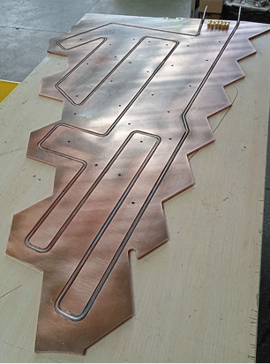
Cooling Plate of HGCal Cassettes
Phase-2 Project
4 prototypes of cooling plates of different sizes were produced in
Minsk for development of the production technology
Production technologies were tested during prototypes construction:
Automatic soldering using a heating table.
Copper sheet straightening before and after machining.
Raw vs. annealed steel tube bending.
Heat dissipation with press-fitted tube.
Copper spray coating technique.
Special tooling for plates production was produced:
Press fit + glue tube binding technique.
Soldering the spray-coated tube.
Press-fit + glue
Comprehensive test of these prototypes will be done at Minsk this year.
17

Slide 18
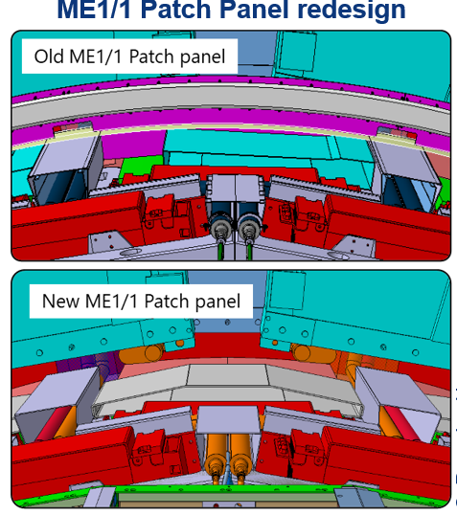
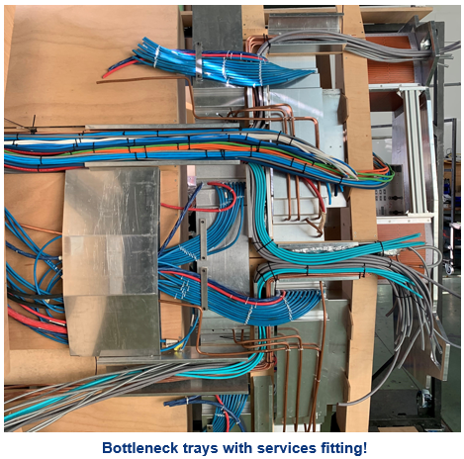
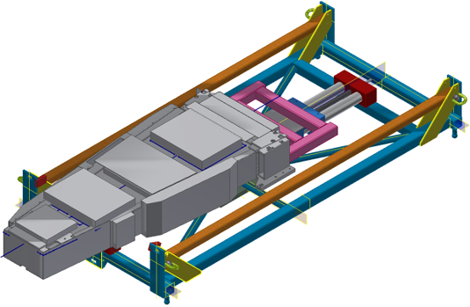
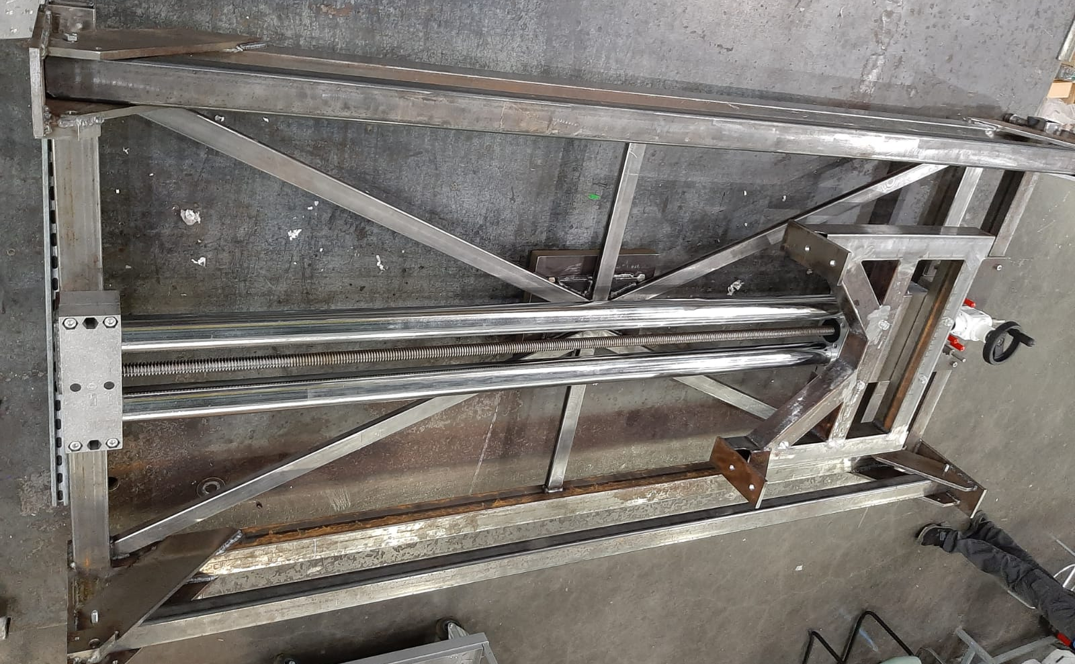
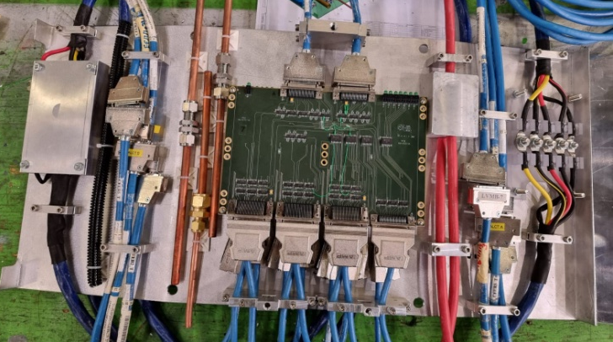
ME1/1 CSC Phase 2 Upgrade
Integration and Tooling
Phase-2 upgrade
ME1/1 Patch Panel redesign upon HGCAL request to avoid bottlenecks for services routing
New ME1/1 Loading Machine
For extraction/installation ME1/1 CSC detectors
Frame
DLRE Table
ME1/1 chamber
ME1/1 PP
New ME1/1 PP – thinner and wider
Mockup built to validate design:
off-detector services and cables
36 new ME1/1 PP should be constructed before LS3
ME1/1 Loading Machine designed and constructed
18

Slide 19
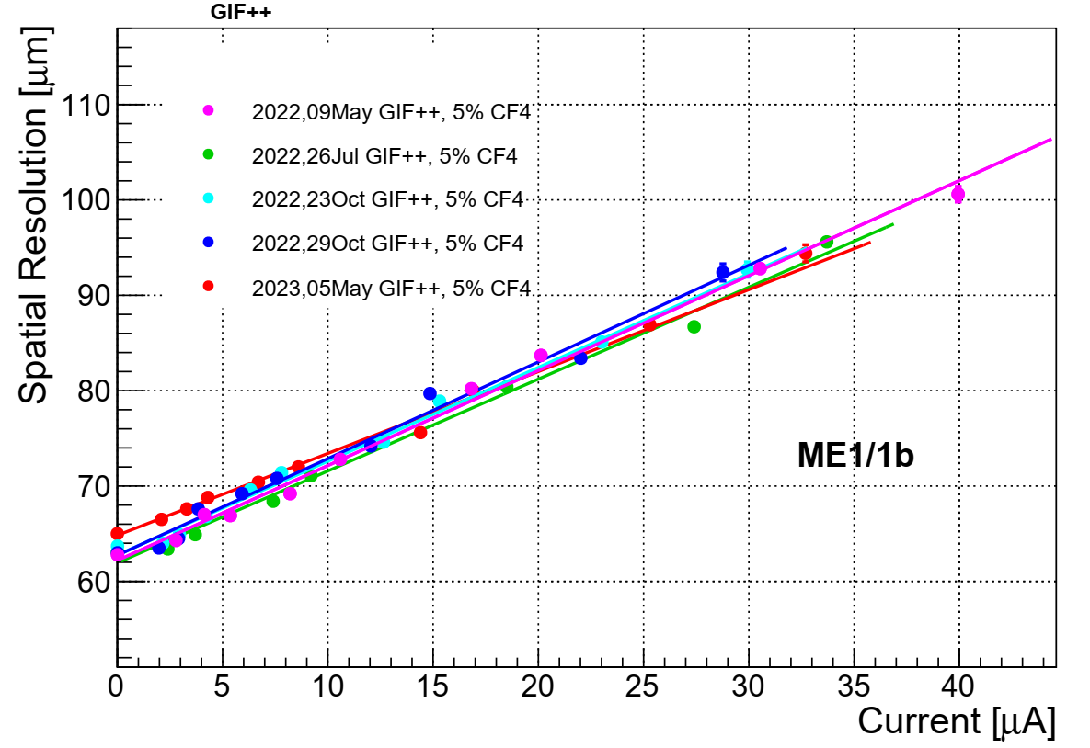
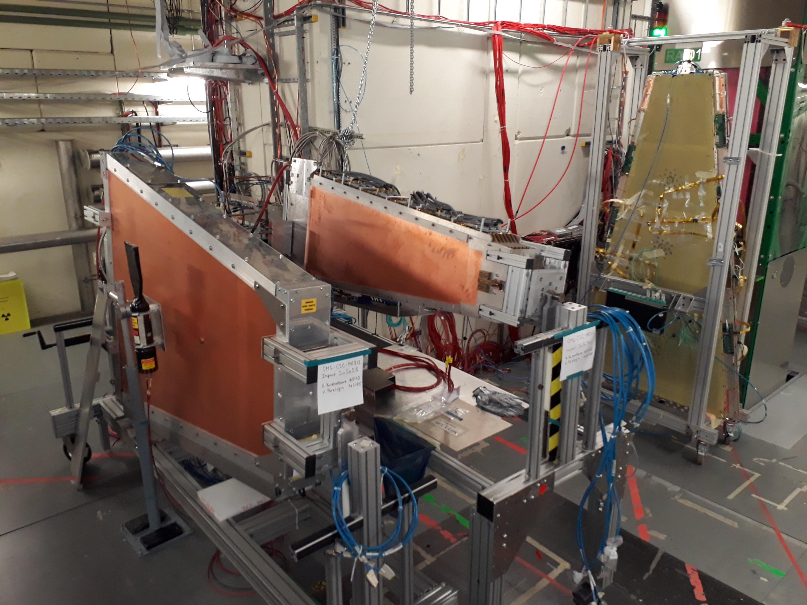
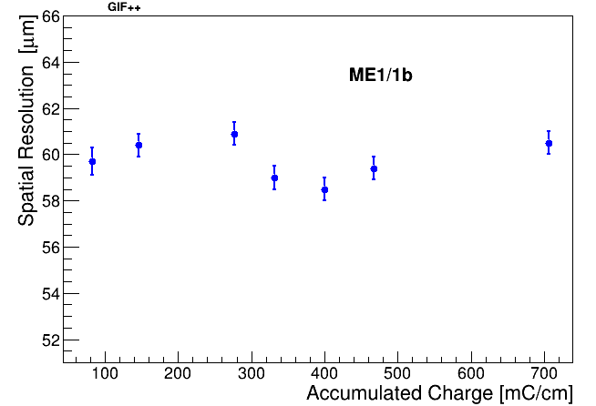
Cathode Strip Chamber Longevity Study
CSC detectors exposed with the 12TBq Cs-137 gamma source at CERN GIF++ Facility
Filter scan.
ME1/1b CSC spatial resolution vs mean CSC layer current.
Spatial resolution is stable up
to I=40 uA
- Value of current at HL-LHC
operation mode: I _{HL-LHC}~20 uA
ME1/1
ME2/1
Spatial resolution is stable up to accumulated charge of 706 mC per the centimeter of anode wire length - 3 times higher than expected in the HL-LHC operation period.
Cathode Strip Chambers in 2023 Test Beam
at GIF++ (SPS, CERN)
19

Slide 20
Plans for 2023
Continue RUN2 and RUN3 data analysis
Dimuons, dimuons + MET, Z + MET, bbar + MET to search for
new physics and to test the SM.
Participation in RUN3 within JINR responsibilities
(CMS operation, maintenance of detector systems, shifts).
Participation in Phase-2 HGCAL project
- Assembly of the 2 cold rooms at CERN ~ October.
Racks for cassettes construction - November.
Construction of trigger system and patch panels – October.
Test of the HGCal cooling plate prototypes this year.
Participation in Phase-2 upgrade of Muon Endcap System
Studying the ageing effects of the CMS muon endcap detectors (CSC) at GIF ++ facility.
Participation in the new gas mixture studies (different CF4 contamination).
Development and test of algorithms for reconstruction of muon track segments.
20

Slide 21
Summary
JINR group actively participate in the development of physics research
The first checks of RUN3 data were done for muon reconstruction and dimuon Data/MC comparison within analysis focused on search for new physics beyond the SM (new gauge bosons, graviton exited states, dark matter mediators)
The significant progress in analyses with RUN2 data for measurement of q/g-jet fractions and Drell-Yan angular distributions
In total, three physics analyses based on RUN3 data are in progress, five physics analyses based on RUN2 data are going to be completed.
The considerable contribution was done by JINR group to the upgrade, commissioning and launching of CMS detectors for the RUN3 data taking period.
CMS Endcap Muon System (ME) and Hadron Calorimeter (HCAL) shows a good performance in RUN3
JINR group is actively involved in the CMS Phase-2 upgrade to maintain HL-LHC operation mode.
Participation in high-granularity calorimeter (HGCal) project.
Cold room delivered to CERN. Rack for HGCal cassettes designed.
HGCal cassettes test setup assembling will start in September 2023.
Forward muon station (ME1/1) upgrade and R&D
CSC patch panel redesigned. ME1/1 loading machine constructed.
CSC longevity and performance study in presence of gamma background.
Study of CSC operation with the new gas mixtures.
JINR group, including young researchers made a significant contribution to CMS publications.
21

Slide 22
Thank you for your attention!!!
22

Slide 23
Backup slides
23

Slide 24
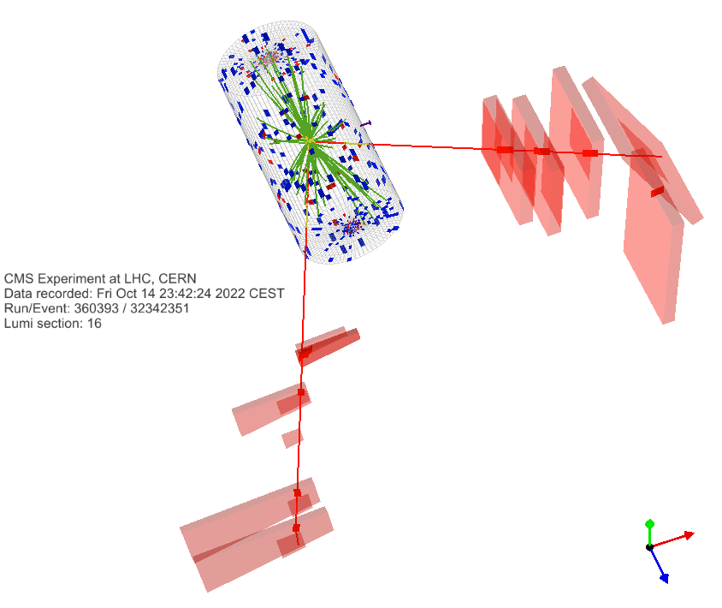
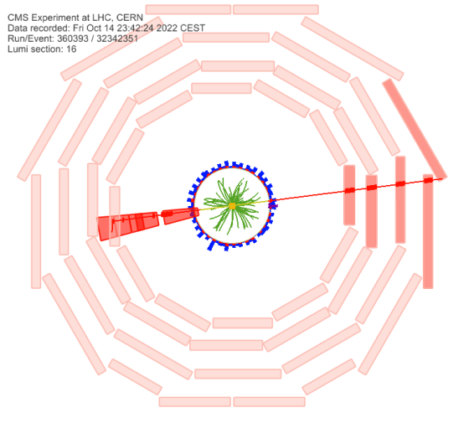
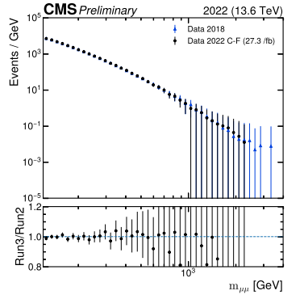
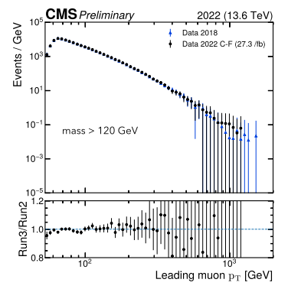
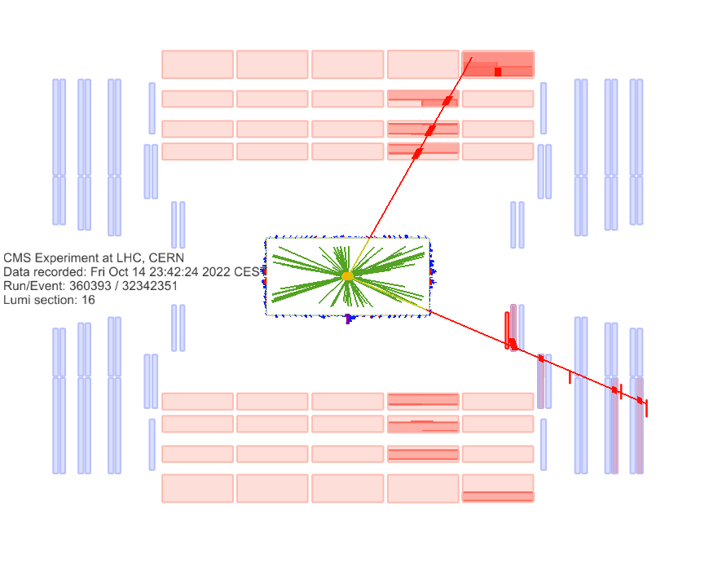
The First Look on RUN3 Data (Dimuons)
Data-to-data comparison of dimuon events between 2018 and RUN3.
Event 360393:16:32342351 taken on 14-Oct-2022.
RUN3 data: 27.3 fb⁻¹ (normalized to 2018 integrated luminosity for the comparison).
Two muons passing high-p_{T} ID and loose tracker isolation with opposite charge (same as Run 2 analysis).
To search for:
New resonances (dark matter, extra gauge bosons, graviton states, etc).
Non-resonant signals (extra dimensions, compositeness, etc.).
Lepton-flavor violated processes.
Good event, passes all the cuts, the run was certified by the data quality as good. M = 2407 GeV.
Muon1: p_{T} = 1161 GeV eta = 1.589 phi = -3.014 (hits CSC including ME1/1).
Muon2: p_{T} = 935 GeV eta = 0.538 phi = 0.131 (hits DT chambers).
24

Slide 25
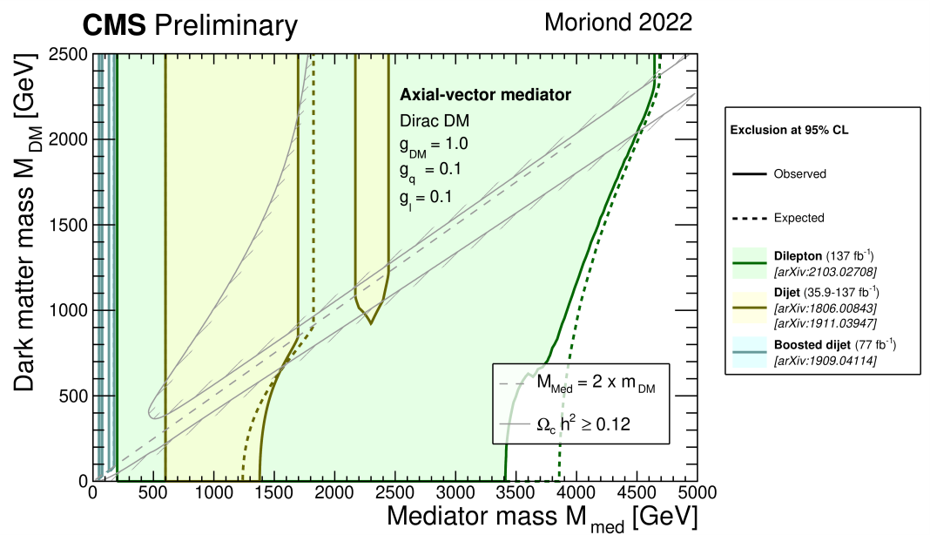
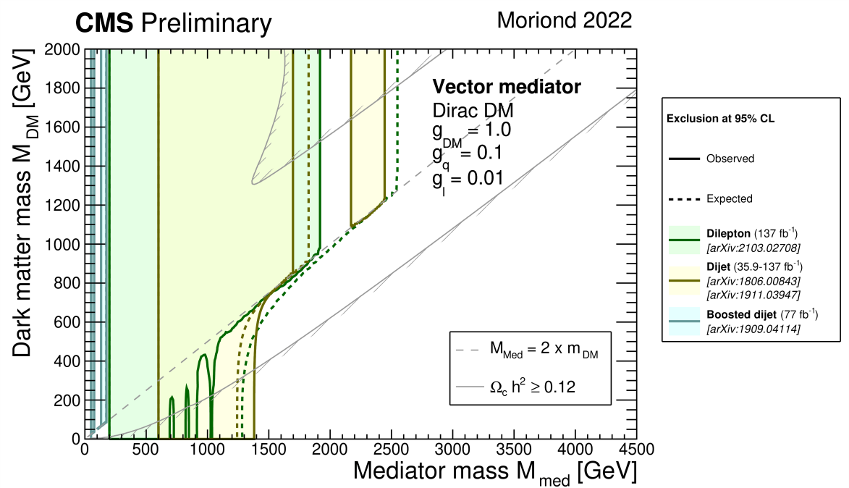
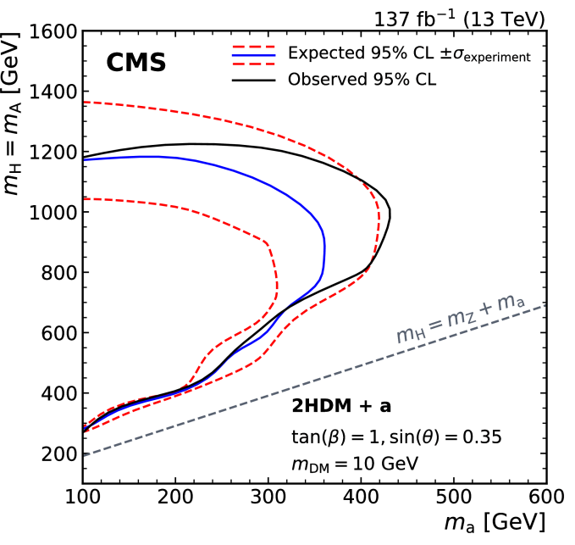
Search for New Physics: Dark Matter Candidates with RUN2/3 Data
95% confidence level (CL) observed and expected exclusions have been set for combined di-jet and di-lepton searches in the simplified dark matter (DM) scenario. The mass limits are presented in the plane of the Dirac DM particle m_{DM} and mediator m_{med}.
The exclusions are computed for:
Leptophilic scenarios with the axial-vector mediator (a universal
quark coupling of g_{q} = 0.1, lepton coupling g_{l} = 0.1, and for a DM
coupling of g_{DM} = 1.0).
And for leptophobic scenarios with the vector mediator
(a universal quark coupling of g_{q} = 0.1, lepton coupling g_{l} = 0.01, and for a DM coupling of g_{DM} = 1.0).
The analysis of the RUN3 data within the framework of the extended two-Higgs-doublet models (2HDM+a/2HDM+S).
The cross sections are calculated for the processes of production of dark matter particles associated with Higgs or Z boson at an energy of 13.8 TeV.
The analysis parameters were tuned, and the simulation of the CMS setup response was started.
RUN3 area
RUN2 exclusions
25

Slide 26
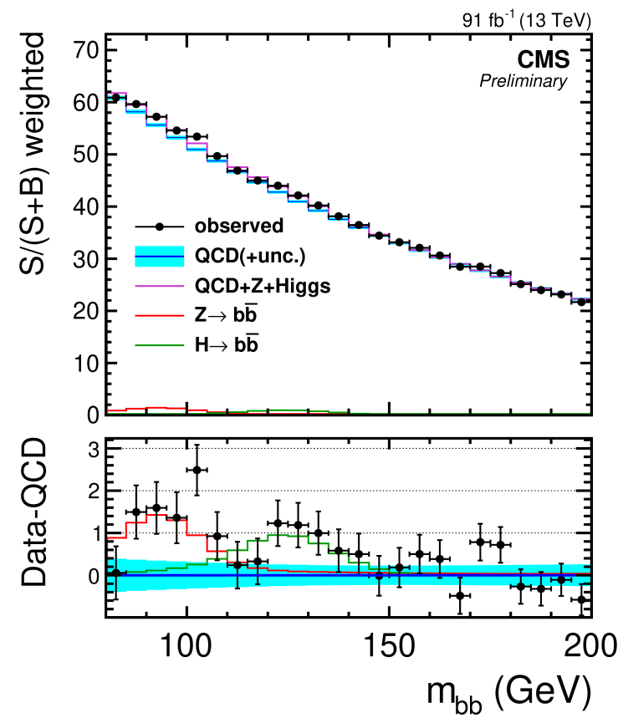
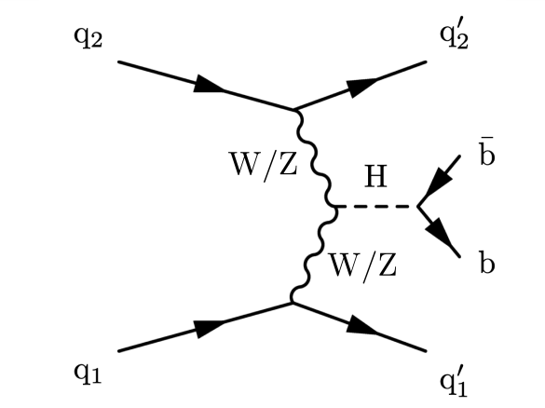
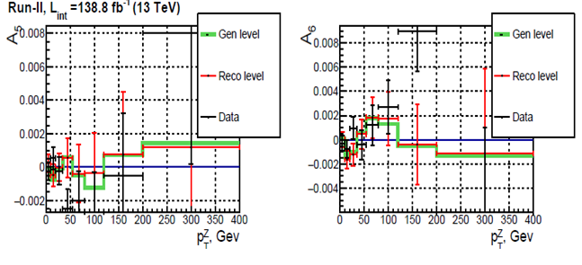
Higgs Physics and Standard Model
Analysis of VBF Higgs boson in bb decay is pre-approved
Drell-Yan angular polarization coefficients
The vector boson fusion (VBF) signal is measured with
a significance of 2.5 (2.9 expected).
Deep neutral network (DNN) is used for VBF selection.
Coefficients $A_{5}, A_{6}$, $A_{7}$ were measured for the first time at the CMS experiment. Full Run 2 statistic at $\sqrt{s}=13$ TeV was used. $A_{5}, A_{6}$,$A_{7}$ are small as expected in the standard model.
The measured inclusive signal strength
Drell-Yan Radiative Corrections
Search for additional Higgs bosons μ+μ− + b–jet events
Detailed numerical analysis of electromagnetic radiative effects is performed for differential cross sections in wide kinematical region including the CMS experiment in Run3 HL-LHC operation mode corresponding ultra-high energies and dilepton invariant masses.
The blind analysis @ 13 TeV is continued with the full Run2 dataset. CMS AN-21-089, the last release 2023/01/07.
The SINP MSU, Moscow and JINR, Dubna groups have performed the synchronization running independent codes and using AOD.
26

