Slide 1
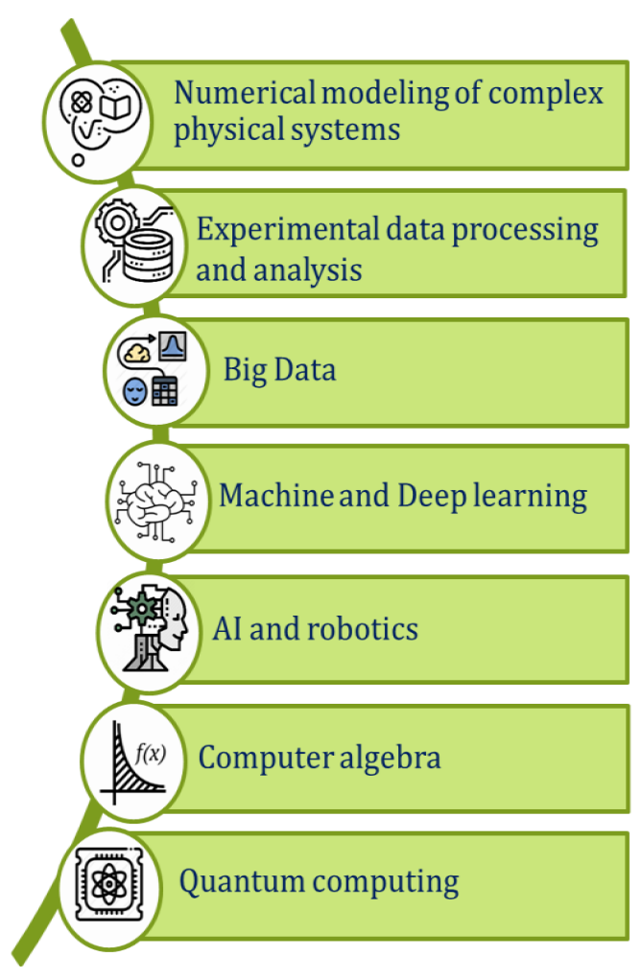
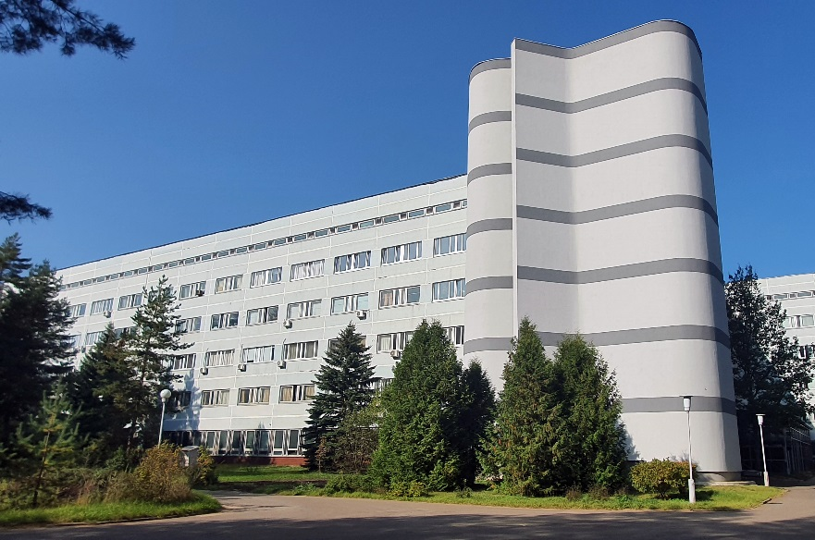
Mathematical methods, algorithms and software for modeling physical processes and experimental facilities, processing and analyzing experimental data
The proposal of the new project under the theme 05-6-1119-2014/…
Leader: Sergei Shmatov
Deputy Leaders: Alexander Ayriyan,
Nikolay Voytishin
Sergei Shmatov, shmatov@jinr.ru
58th meeting of the PAC for Particle Physics, 21 June 2023

Slide 2
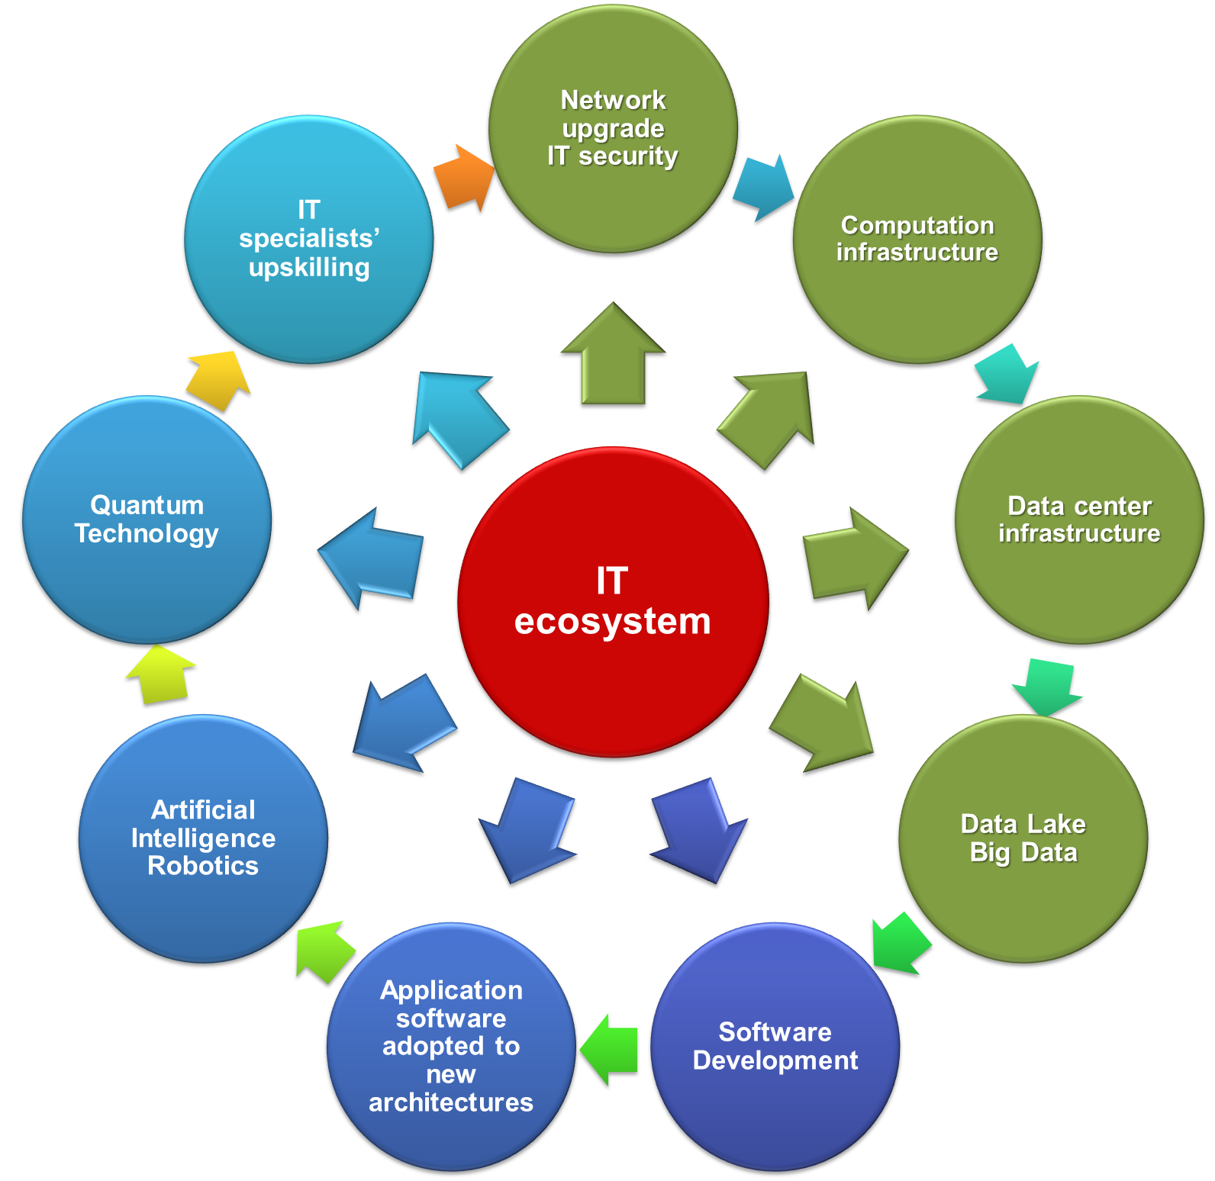
The Main Tasks for MLIT
The concept of the development of information technologies and scientific computing aimed at solving the strategic tasks of JINR, in the JINR Seven-Year Plan for 2024-2030, provides for
Further development of the computing systems and resources of the JINR Multifunctional Information and Computing Complex (MICC)
  distributed multilevel heterogeneous computing environments (Tier-N)
  “Govorun” supercomputer and JINR Cloud Infrastructure
  data lake (entre-wide data storage system dCache/EOS/…)
  support and further development of the JINR network infrastructure
  development of middleware applications
Mathematical, algorithmic and software support for experimental and theoretical researches performed at JINR; development of new data processing and analysis algorithms based on
  deep and machine learning, including artificial intelligence
  Big Data analytics and quantum computing
Development of the platform “JINR Digital Ecosystem”
Development of the system for teaching and training IT specialists (IT-school)
Dynamically evolving IT-ecosystem
AI, Quantum Technologies and Big Data Analytics.
flexible and open to new computing methods such as quantum calculations, machine learning methods and data mining, as well as to any developments of new algorithmic bases.

Slide 3
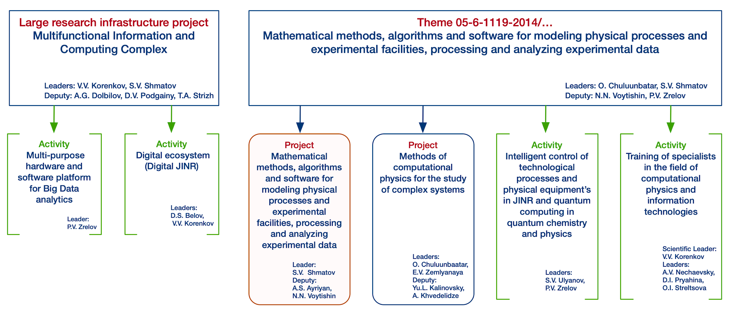
JINR Topical Plan for MLIT
The written report on the Theme 05-6-1119-2014/2023 is available on https://indico.jinr.ru/event/3750/attachments/15350/25946/Written_report_1119_eng.pdf
in my report
this proposal was considered at the 57th meeting of the PAC for Condensed Matter Physics, 15 June 2023
58th meeting of the PAC for Particle Physics
15.06.2023

Slide 4
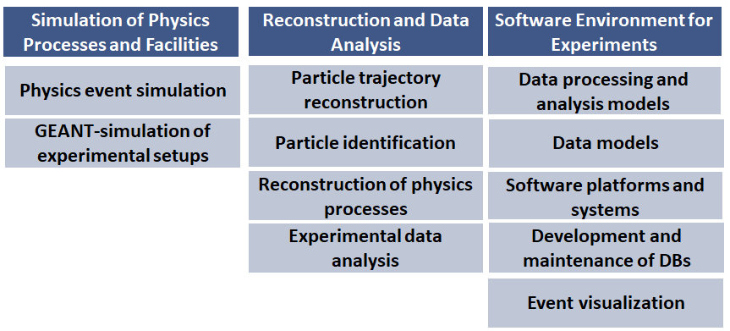
The Goals and Objectives of the Project
The project is aimed at
the development of mathematical methods and software for modeling physical processes and experimental facilities, processing and analyzing experimental data in the field of elementary particle physics, nuclear physics, neutrino physics, condensed matter, radiobiology, etc.
development, support and operation of software complexes for the distributed processing and analysis of experimental data as well as information systems to support research at JINR and other world centers.
The Project Structure
The main strategy is to use common solutions and methods for different experiments
The priorities are mathematical and computational physics to support the JINR large research infrastructure projects, and first of all the experiments at the NICA accelerator complex and the Baikal-GVD neutrino telescope.
Further cooperation will also be continued with the experiments at the largest world accelerator centers (CERN, BNL, etc.), experiments in the field of neutrino physics and astrophysics, radiobiological research programs.
The possibility of using the developed methods and algorithms within other fundamental science and applied projects is being considered.

Slide 5
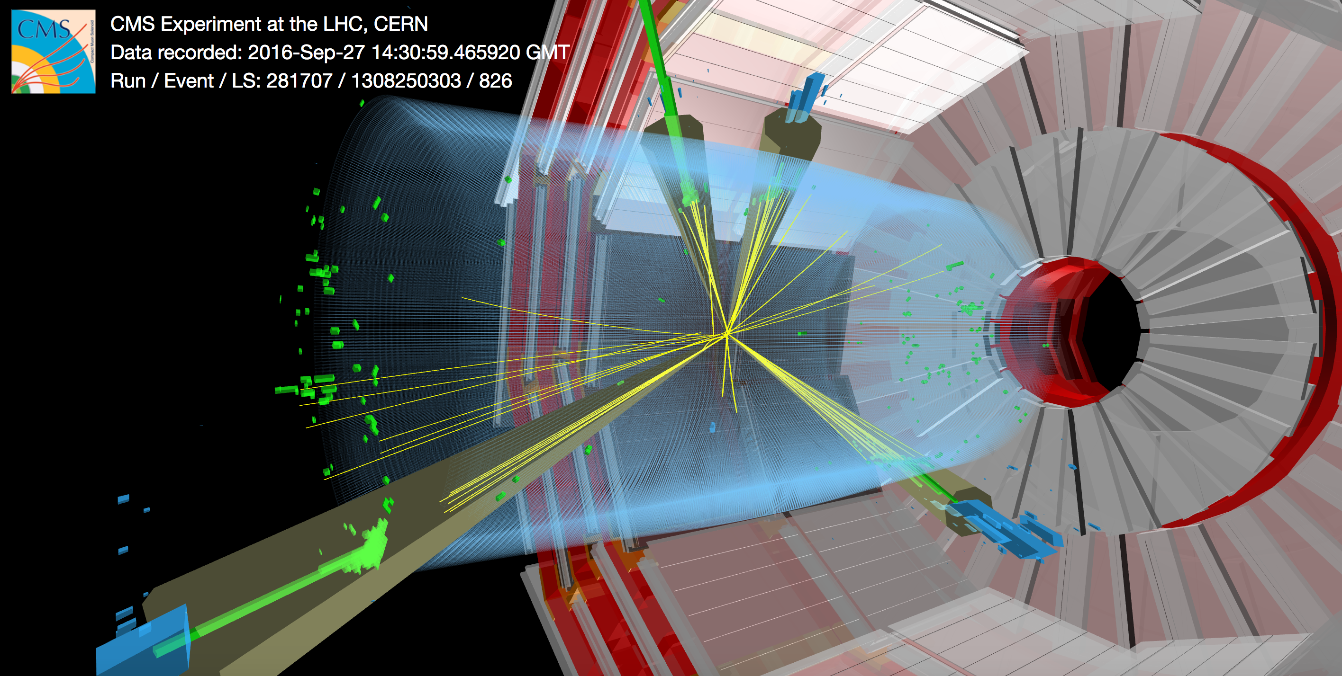
Simulation of physical processes and experimental facilities
analytical and numerical calculations of physical processes, software optimization, including tuning and adaptation of physics event generators;
MC event production, development and support of information systems for event catalogues;
participation in the creation of computer models of experimental facilities and simulation of elementary particles passing through them based on GEANT4 (and others) and fast simulation of the response of the detectors.

Slide 6
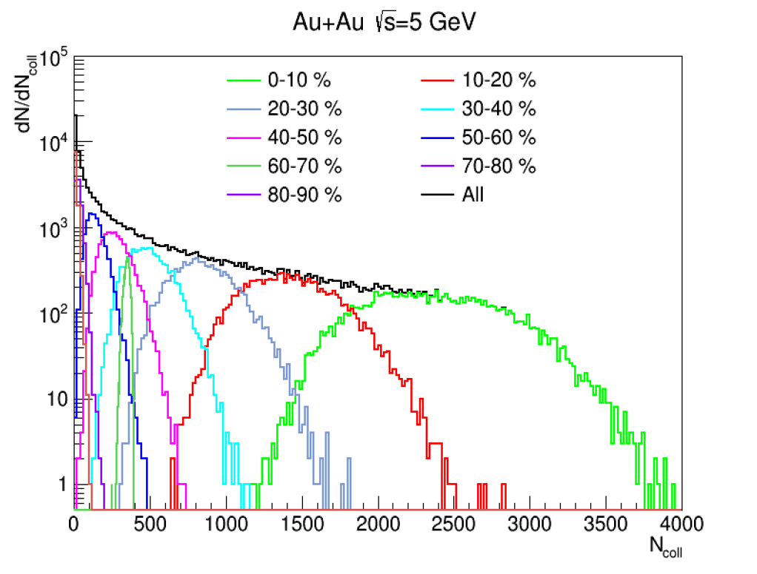
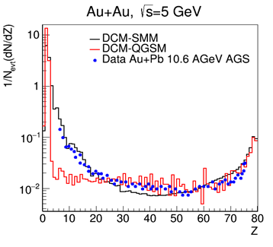
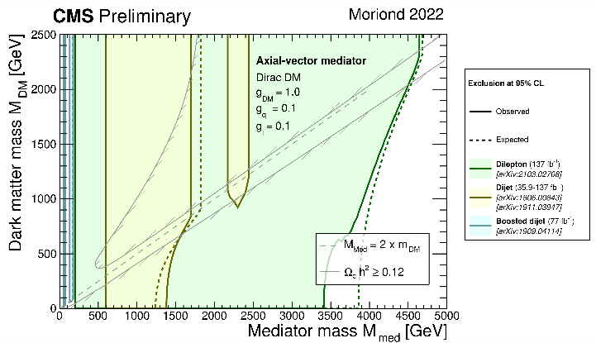
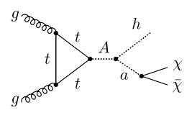
MC Generators for the NICA and LHC Experiments
Development of the heavy ion collision generators
  Dubna Cascade Model, Quark-Gluon-String Model, Statistical Multifragmentation Model for the NICA Experiments
  tuning the HIJING generator with data of NA49 and NA61/SHINE @ CERN, STAR@RHIC (can be used in MPD and SPD experiments)
Analytical and numerical methods for calculating neutron-proton systems under strong compression at the NICA
The priority tasks of the JINR Groups in LHC physics program (ATLAS and CMS) include searches for candidates for dark matter particles, tests of predictions of TeV-energy scenarios
h (→ bbar) + a (→ χχ) = bbar + MET
Fine tuning the generators for searches for new physics
  revision of model parameters for 2HDM+a, 2HDM+s, etc.
  simulation with Pythia8, QBH, MadGraph5_aMC@NLO + FeynRules (simplified DMM, HDM+a, 2HDM+s, etc.)
  mass production + Geant4 response
Ex., Dark Matter can be probed with two fermions/two fermions + MET/higgs + MET/Z + MET in the final states
MLIT + BLTP + VBLHEP

Slide 7

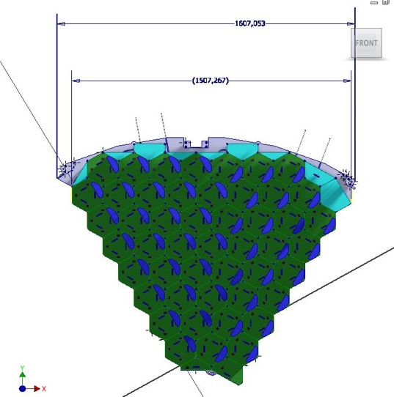
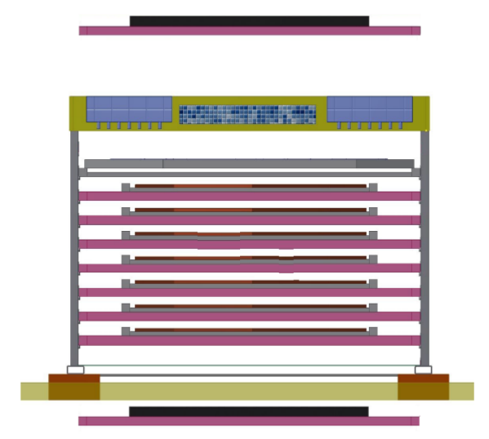

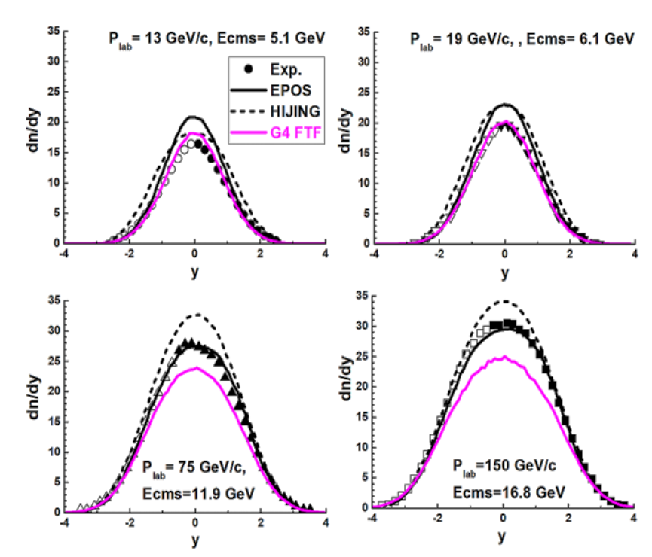
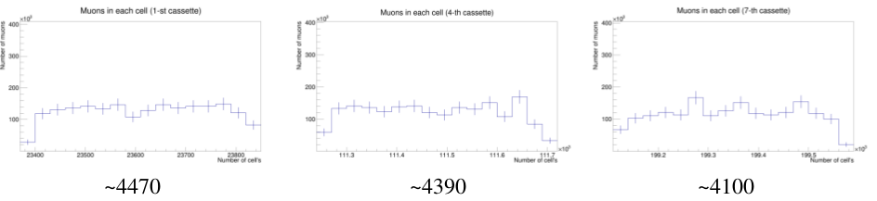
Modeling Experimental Facilities for the NICA and LHC
Development, verification, validation and application of FTF (Fritiof) and QGSM (Quark-Gluon-String-Model) hadronic models
Simulation of the HGCal cassettes test stand for the CMS Experiment @ LHC with cosmic muons in Cold room
Most wide area less statistics
Cold room trigger planes position options
Rapidity distributions of π⁻ mesons in
⁴⁰Ar + ⁴⁵Sc interactions (EPJ , C82 (2022)
modeling and optimization the test stand geometry
scintillator trigger planes optimization
performance estimations, detector evaluation algorithms tests
~1400 muons/cell in 2 weeks for outside option
Exp. conclusion: “There is no model (EPOS, UrQMD, HIJING …) able to describe the data!” from NA61/SHINE Collab. on PP, ⁴⁰Ar + ⁴⁵Sc and ⁷Be + ⁹Be

Slide 8
Reconstruction of physical objects and analysis of experimental data
development of algorithms, including those based on recurrent and convolutional neural networks for machine and deep learning tasks, and creation of corresponding software for the reconstruction of physical objects (tracks, particles, clusters, etc.) and physical processes;
development of methods and algorithms for data analysis, including statistical analysis;
adaptation of existing software for specific experiments, reconstruction and analysis of experimental data;
analysis of Open Data of experiments, in particular, experiments at the LHC;
conducting a global analysis of data from various experiments (in particular, a combined analysis of data from accelerator and astrophysical experiments in search for candidates for the role of dark matter).

Slide 9
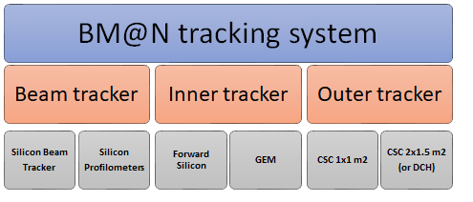
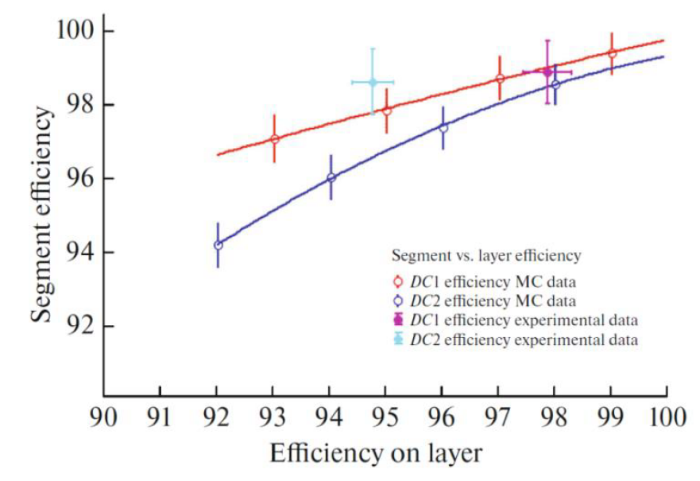
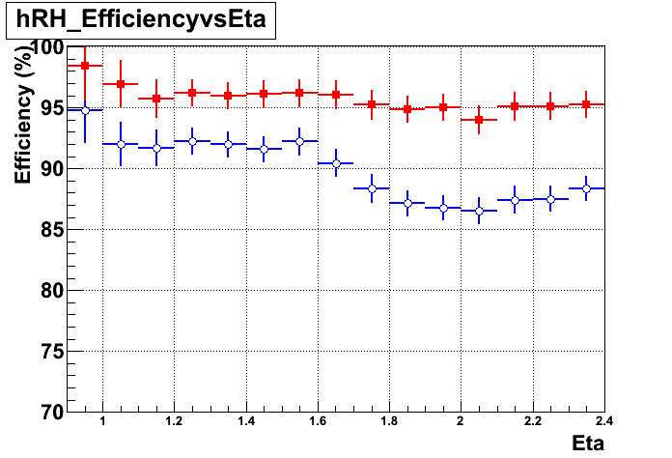
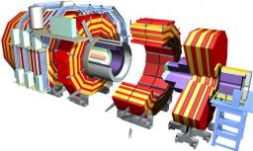
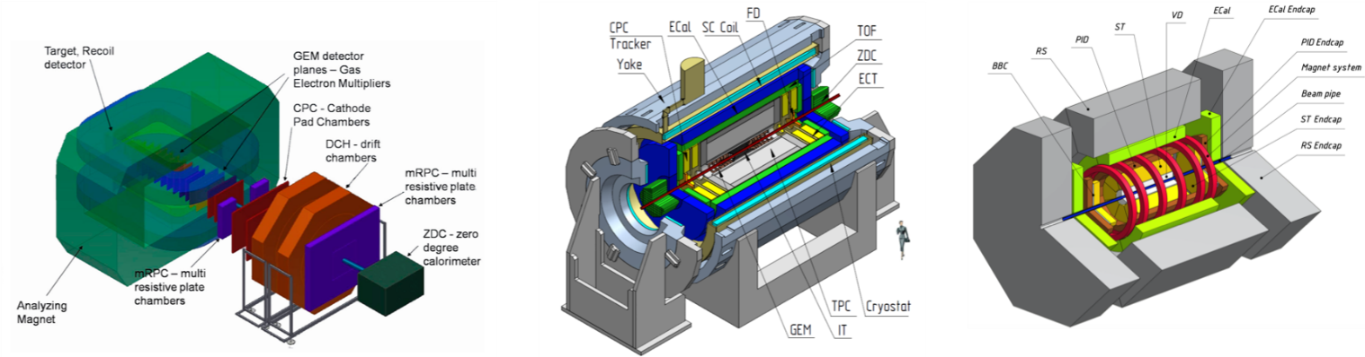
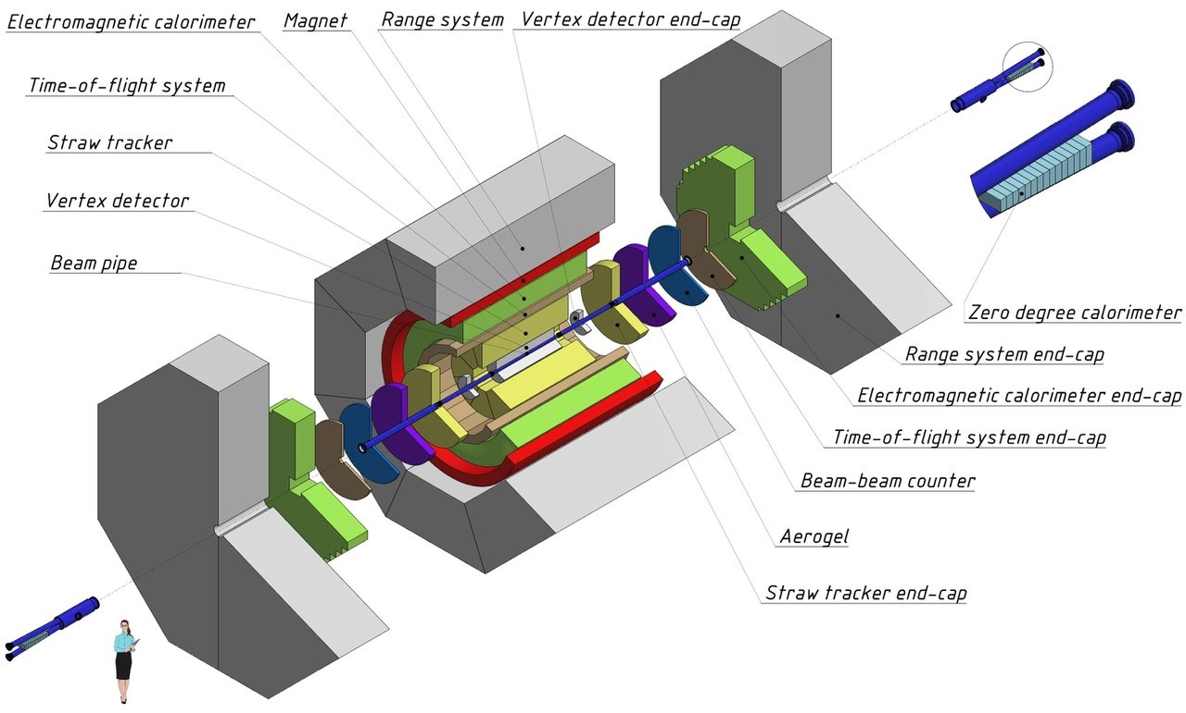
Tracking Algorithms for HEP Experiments
Mathematical methods and software for processing and analyzing data from the experiments @ NICA
  software for alignment and calibration of the BM@N STS (silicon chambers) and GEM (gas electron multipliers) track detectors
  development and application of methods and algorithms for processing and analyzing experimental data for the coordinate detectors
Mathematical methods and software for muon reconstruction and the estimation of operation parameters of CMS detectors @ LHC
  reconstruction of the cosmic muon trajectory in the setup for testing active elements of the CMS HGCal, as well as evaluation of the efficiency of HGCal modules;
  usage of discrete wavelet analysis to recognize the coordinates of close-flying particles from over-lapping signals in the Cathode Strip Chambers (CSC). Evaluation of the operation parameters of CSC detectors and of the rate of background particles for different types of experimental data.
Blue – old algorithm
Red – new algorithm

Slide 10
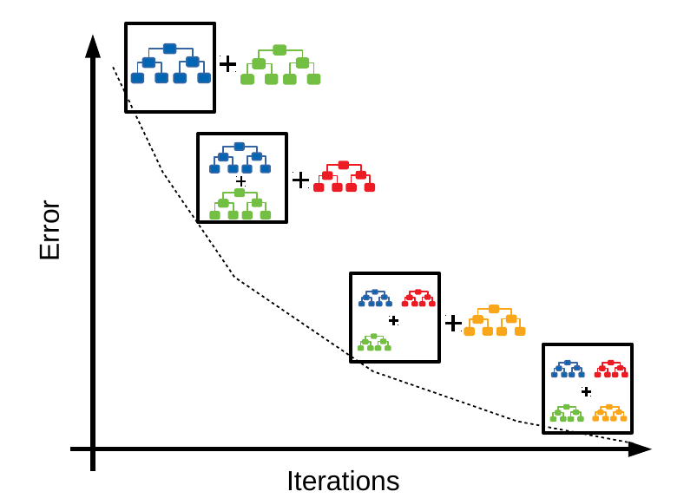
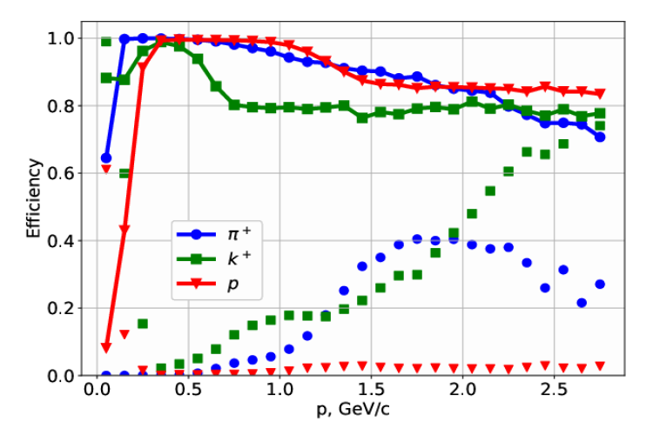
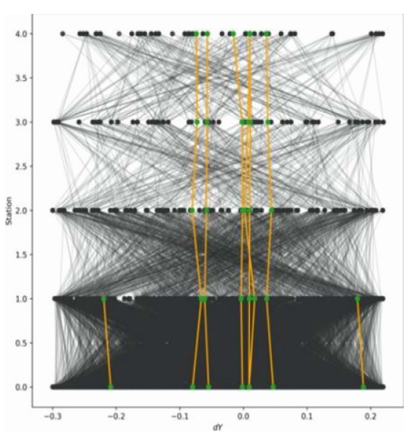
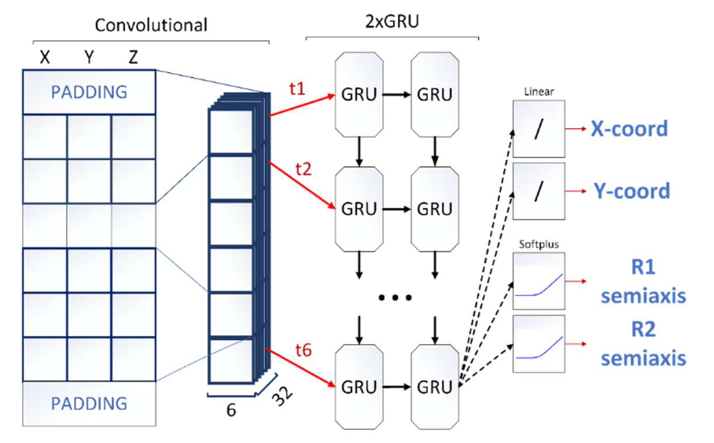
Machine Learning Methods for the Track Reconstruction and PID
particle identification based on the gradient boosting of decision trees with MPD Time-Projection Chamber (TPC) and Time-of-Flight (TOF)
new approaches to track recognition in SPD strip and pixel detectors based on a recurrent neural network and a graph network (already used for track recognition in the BM@N experiment at JINR and in the BESIII experiment in China)
MPD
BM@N
Efficiency and contamination of the identification of positively charged particles in the MPD model data, obtained by the method of decision trees with gradient boosting
Preliminary results: accuracy of about 99% for testing data на (18% of true segments are lost)

Slide 11
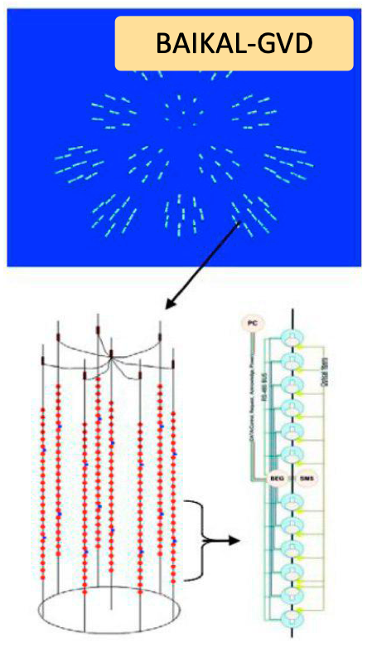
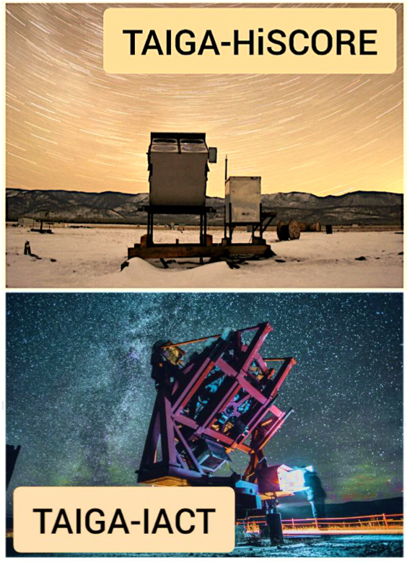
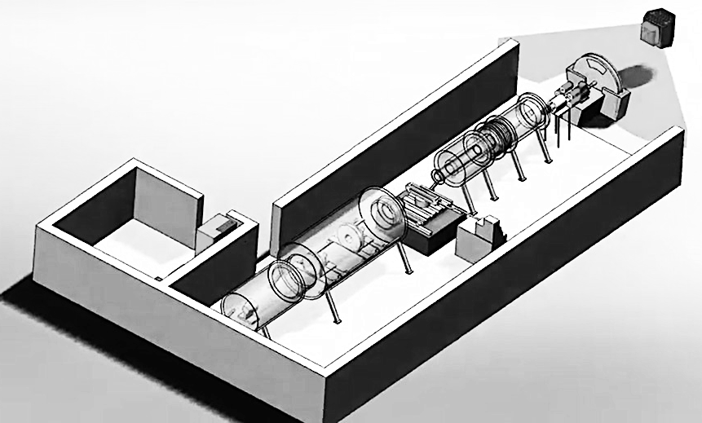
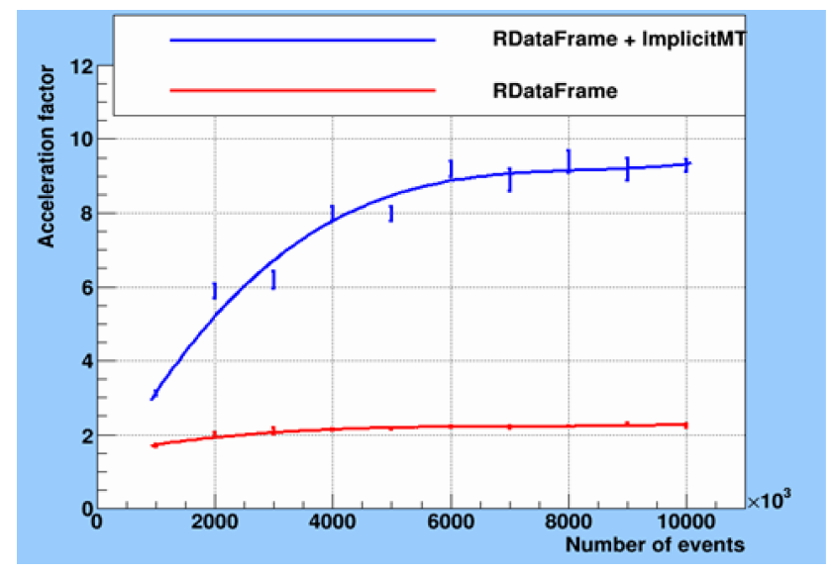
… and other fields
reconstruction of cosmic rays at the TAIGA gamma-ray observatory
  several atmospheric Cherenkov telescopes (IACT) with a network of TAIGA-HiSCORE wide-aperture Cherenkov optical detectors
data processing of the Baikal Neutrino Telescope
  estimate of the positions of the underwater detector components
  substantial acceleration of the main code of the Cascade Recovery Collaboration, which is important for tracking transient astrophysical neutrino sources
software complex for data processing of the YuMO small-angle neutron scattering spectrometer at IBR-2
  data fitting (increase the speed of the data processing with a factor up to 5.5)
  parallel ROOT (PROOT) tools, also ca be used for experimental data analysis the Baikal-GVD
  processing and analysis of neutron noise of the IBR-2M reactor
  track reconstruction in the proton digital calorimeter for proton therapy
YuMO

Slide 12
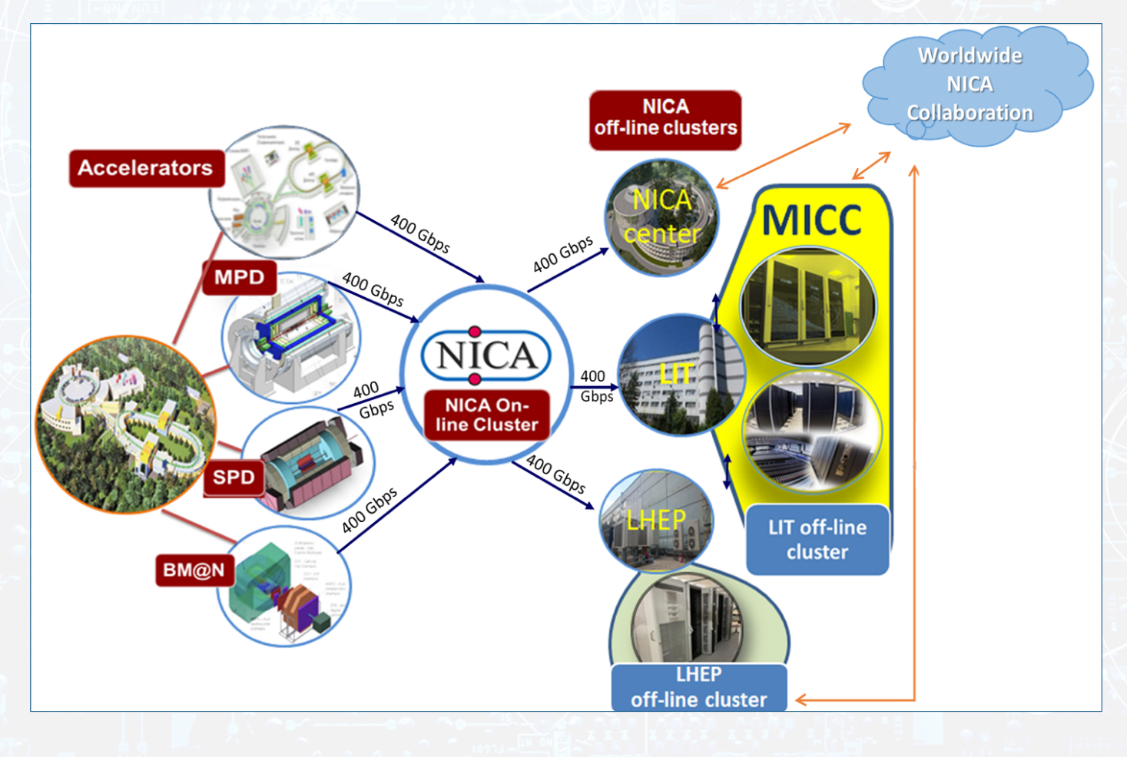
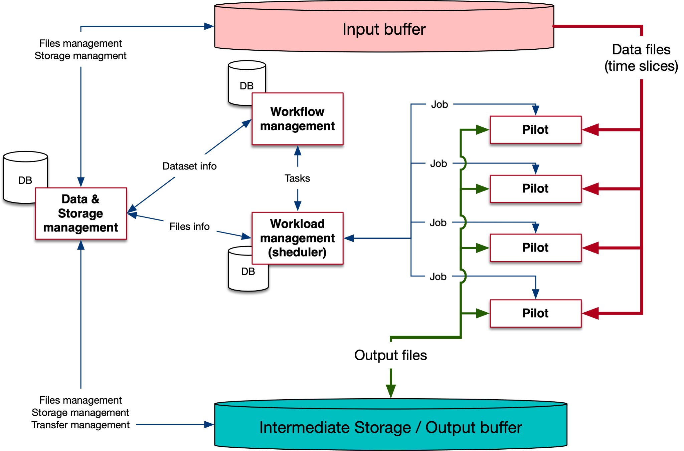
Support and development of the software environment for JINR research
Development of the software environment for processing and analyzing data from the NICA experiments
Creation, implementation and development of an information and computing complex for processing, analyzing and storing data for the SPD experiment
Creation of specialized databases and information systems for the Collaborations @ NICA and LHC (ATLAS, BM@N, MPD)
Development and creation of an information and computing system for
  automating the processing of data from radiobiological studies
  intelligent determining the state of agricultural and decorative plants
  monitoring and predicting the state of the environment

Slide 13
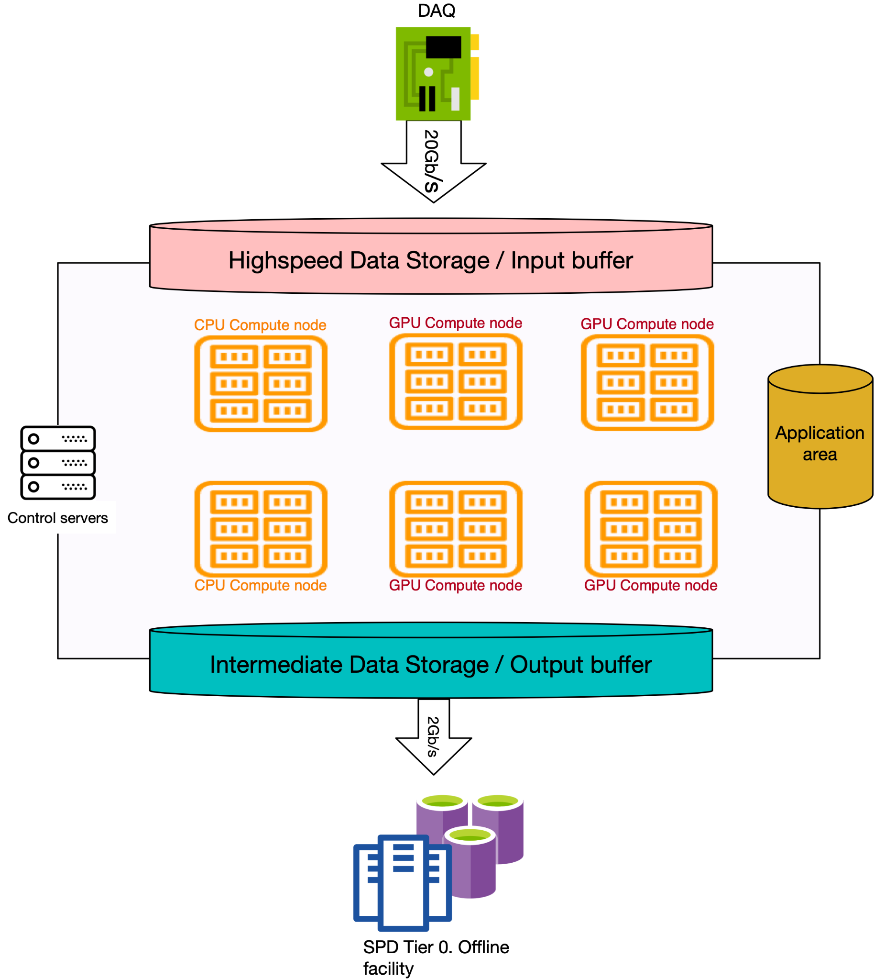
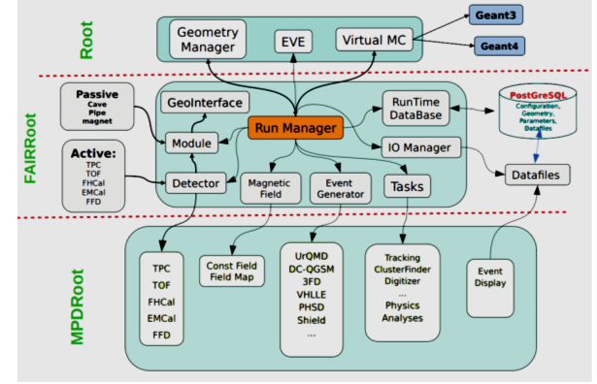
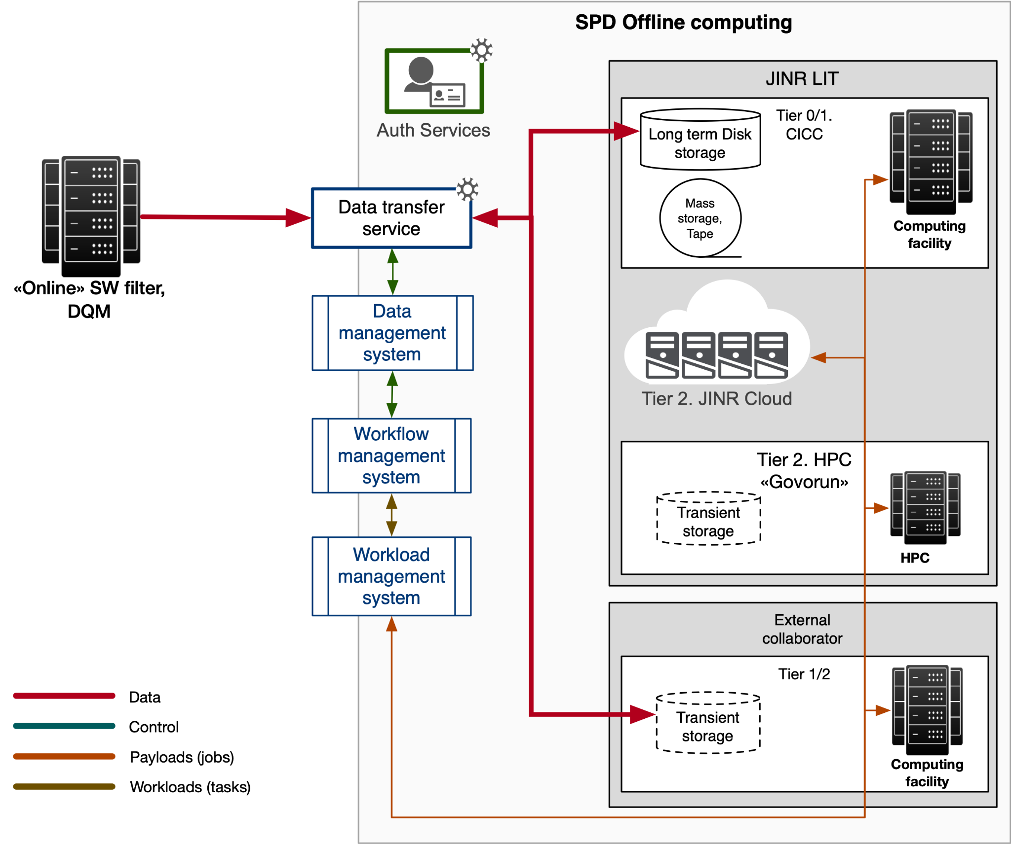
Software Environment for the NICA Experiments
Collaboration SW for MPD
SPD OnLine Filter for SPD
refactoring of the MPDroot architecture; its adaptation to the latest changes in the FairRoot package
development and support of the NICAdist system for building modules;
improving the performance of MPDroot algorithms
design and creation of a software complex for organizing the high-throughput processing of data received from the SPD DAQ
data flow ~3М ev./s. (~20 GB/s)
no trigger
middleware complex for dedicated computing farm
methods and approaches to filtering data in real time using artificial intelligence technologies
development of a model for distributed data processing and analyses
Middleware SW for MPD
to run MPD tasks through the DIRAC Interware
MPD distributed computing model

Slide 14
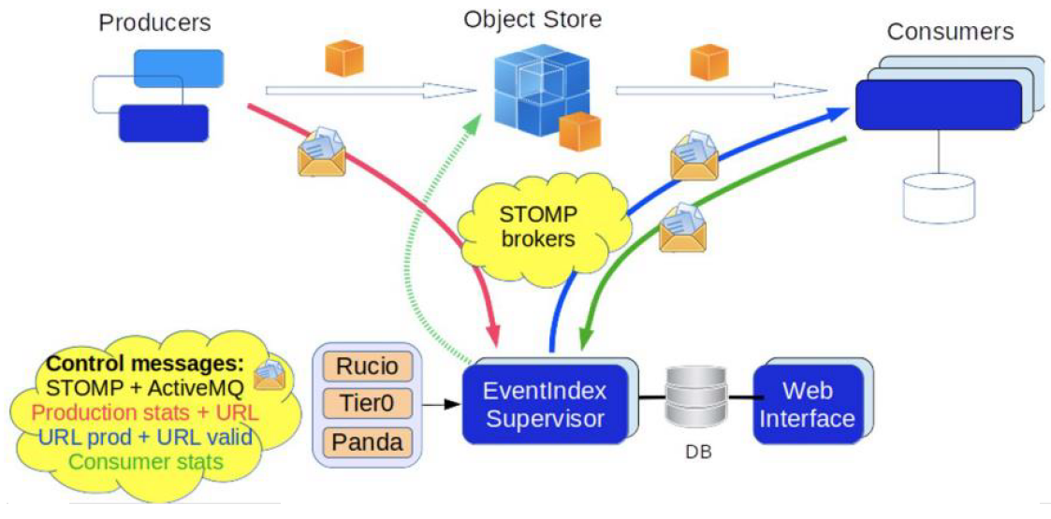
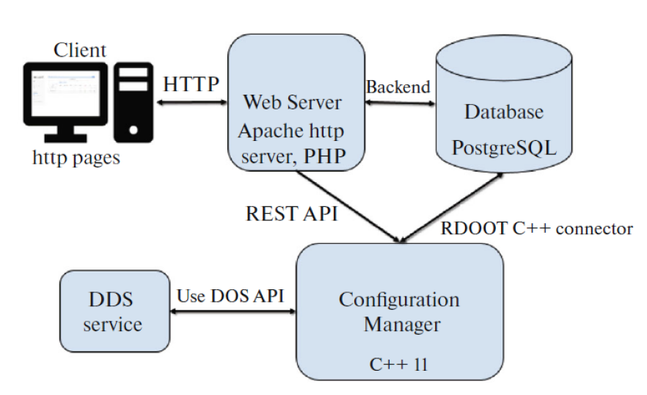
Data Bases for HEP Computing
ATLAS EventPickingService
    the first version for automated event collection has been created.
    the service was used for the second stage oа the «γγ→WW» analysis (136 K events)
    further modernization of the service is ongoing according to the received results
ATLAS CREST (Condition DB)
    C++ API for CREST (implemented into Athena software package)
    COOL2CREST converter (developed, but not yet implemented)
    both parts require constant improvement for compatibility with the updated CREST server
Event metadata system for the experiments at NICA (BM@N, MPD and SPD)
    has been designed to index events of the NICA experiments and store their metadata
    quick search by required conditions and parameters used in various physics analyses for a set of physics events to use in further event data processing
Geometry DB
    The geometry database is the main element of the information system designed to store, process and manage information about the geometric models of detectors. It is implemented into BMNROOT software
Configuration DB (Configuration Information System, CIS)
    Configuration database for managing online applications for collecting and processing high energy physics events. It was created for process launching in BM@N environment.

Slide 15
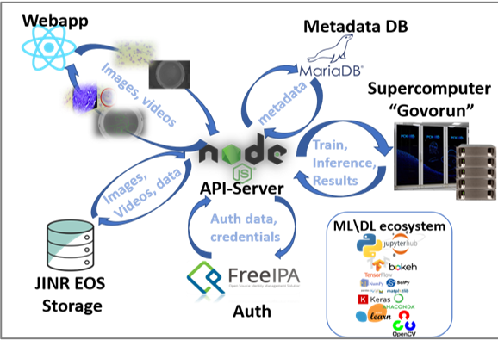
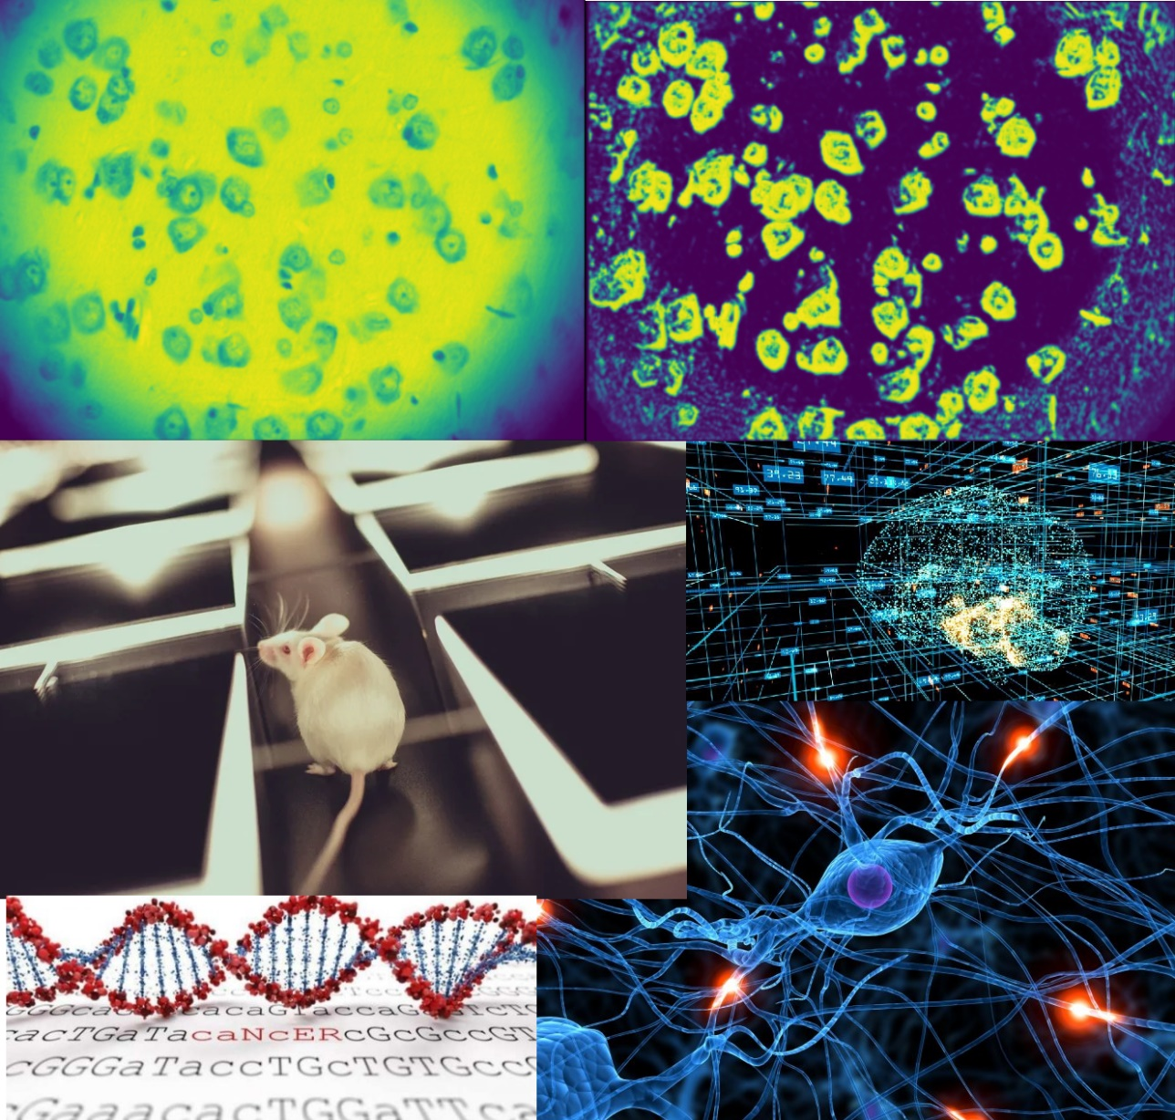
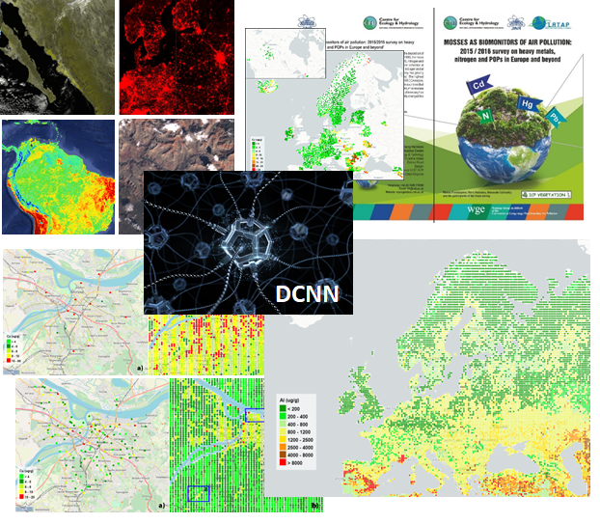
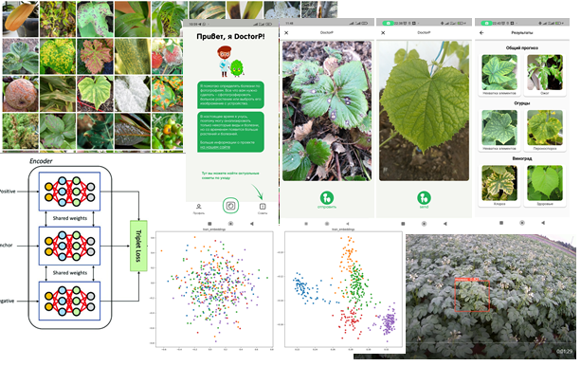
Radiobiology and Life Science
The ML/DL/HPC ecosystem
Application of accumulated experience to various classes of
problems!
top of ML/DL technologies
modern IT solutions for data storage, processing and visualization
statistical analysis
Information System (IS) for Radiation Biology Tasks
to store, quickly access and process data from experiments at LRB
using a stack of neural network and classical algorithms of computer vision, providing a wide range of possibilities for automating routine tasks.
Development of the intelligent platform for determining the state of agricultural and decorative plants.
Intelligent Environmental Monitoring Platform

Slide 16
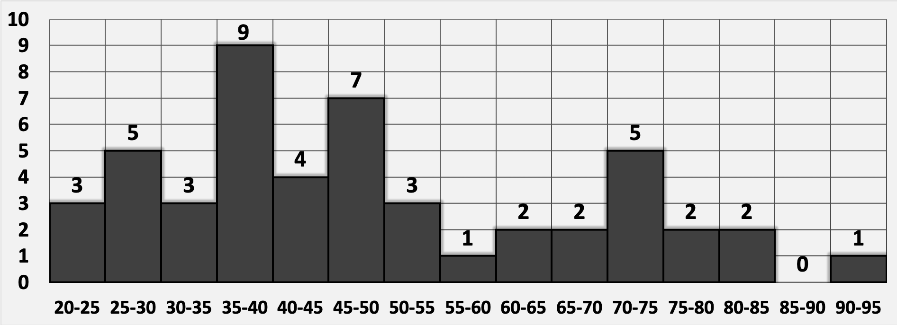
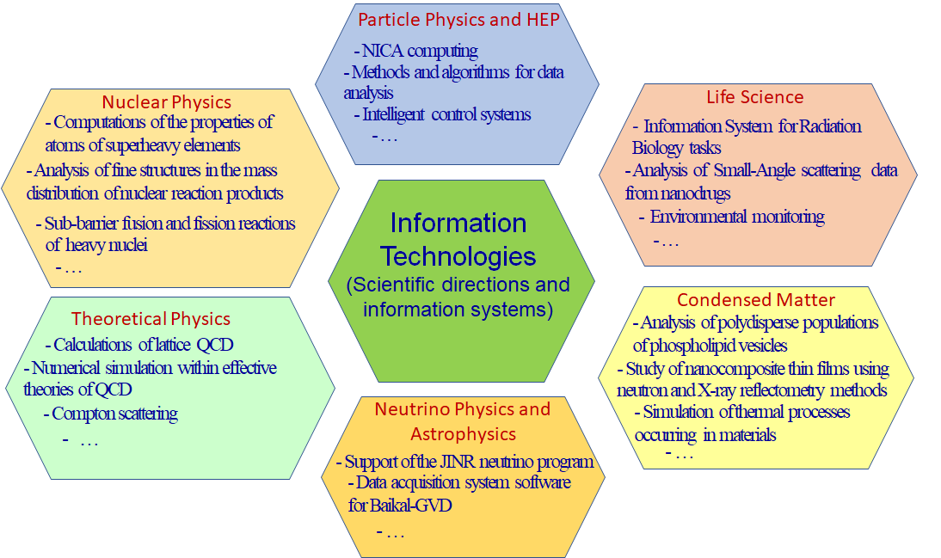
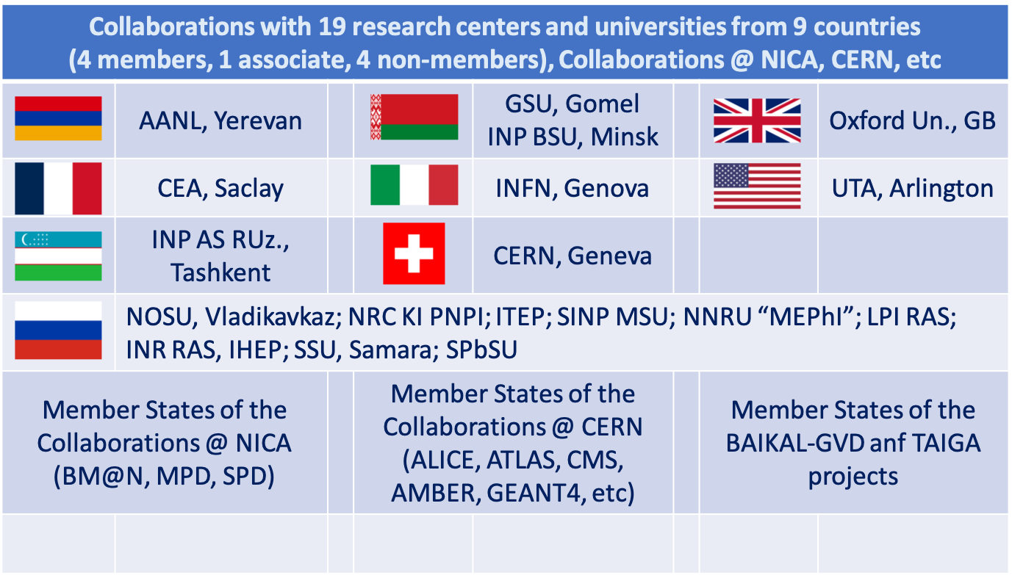
Personnel
Available manpower in FTE
Category | JINR staff
researchers | 23,95
engineers | 6,75
Total: | 30,7
49 participants, 8 DSc, 17 CSc
> 90 publications since 2020
5 PhD Thesis were submitted

Slide 17
Strengths, Weaknesses, Opportunities and Threats
 | Helpful | Harmful
Internal | Strengths − wide approbation of research; − participants are experts in various fields; − rich experience in the project tasks; − participation in the major collaborations; − balanced researcher group (49 participants, 8 DSc, 17 CSc) | Weaknesses − possible partial revision of project priorities; − partial shortage of personnel in a number of areas of the project; − international restrictions for Russian participants;
External | Opportunities − development of new methods; − emergence of new experimental data; − development of the JINR MICC and other world data processing centers; − increase in the availability of quantum computers | Threats − possible changes in timing of the projects at JINR and elsewhere; − uncertainty in cooperation with CERN; − possible suspension of cooperation with the scientific centers abroad

Slide 18
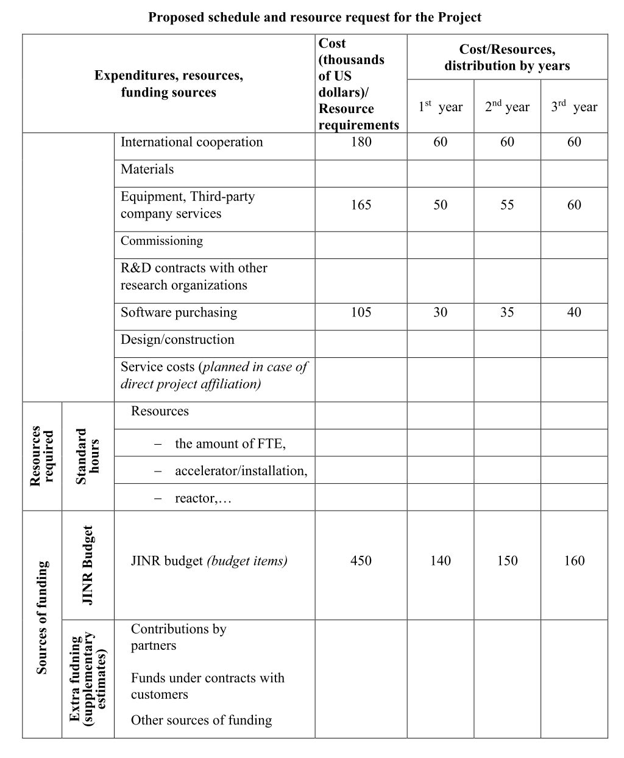
Requested Funding

Slide 19
We ask PAC
to give recommendation to open a new project “Mathematical methods, algorithms and software for modeling physical processes and experimental facilities, processing and analyzing experimental data”
for the period of 2024-2026.
Thank you for your attention!!!

Slide 20
The Project Structure
Simulation of Physics Processes and Facilities
Reconstruction and Data Analysis
Software Environment for Experiments
Physics event simulation
Particle trajectory reconstruction
Data processing and analysis models
GEANT-simulation of experimental setups
Particle identification
Data models
Reconstruction of physics processes
Software platforms and systems
Experimental data analysis
Development and maintenance of DBs
Event visualization
The main strategy is to use common solutions and methods for different experiments to develop software for physics simulation, data processing and analysis, as well as computing systems.

